Slide 1



FELIX read-out with ITkPix
Wael Alkakhi
In consultation with Prof. Arnulf Quadt
II. Physikalisches Institut, Georg-August-Universität Göttingen
ATLAS-D Annual meeting 2023, Bonn
Parallel Sessions I: Detector Physics 2

Slide 2
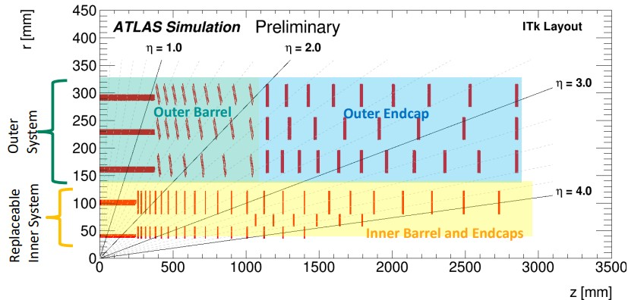
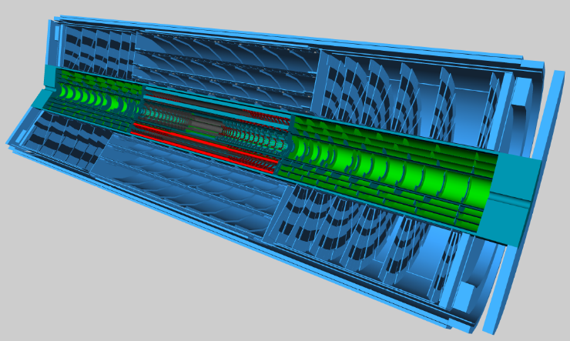
Introduction: HL-LHC & ITk detector
HL-LHC target is to perform at high energies collisions, luminosity ~ 7x10³⁴ cm⁻²s⁻¹
Current inner detector system will be replaced with a new all-silicon tracking system ITk (Inner TracKer).
Properties: High range cover (|η| < 4), High trigger rate (1 MHz), High pile up events (200), High resolution (50µm x 50µm pixel size)
Consists of pixel sub-detector surrounded by strips sub-detector.
Pixel subdetector consists of Inner Barrel and Endcap, Outer Barrel and Outer Endcap.

Slide 3
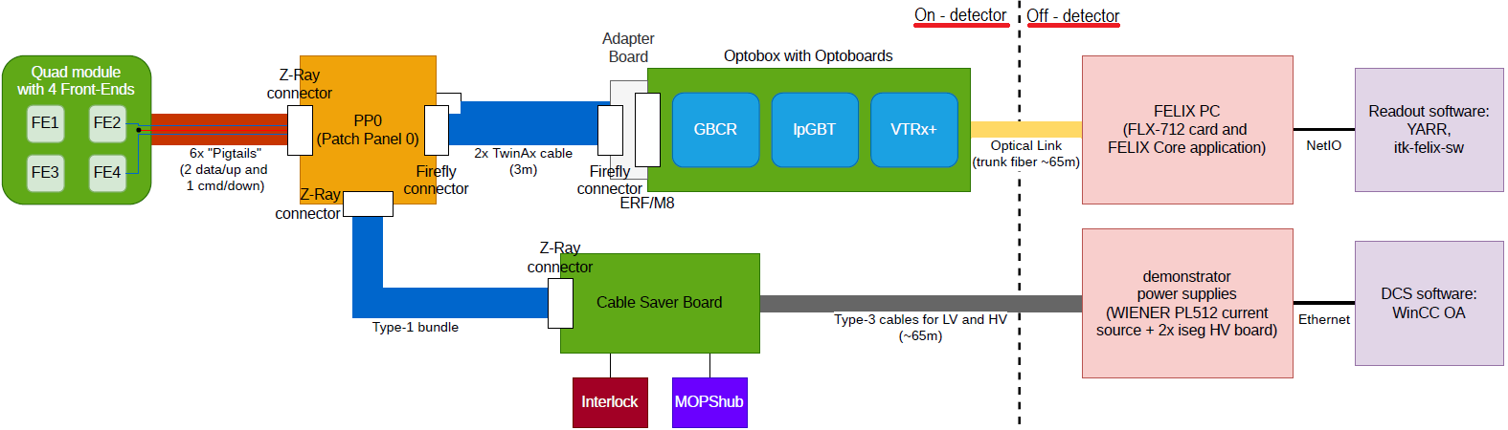
ITK Pixel Readout
FELIX-STAR application
NetIO-Next
RD53A chips -> ITkPix chips
Current Read-out chain is RD53A-Optoboard-Felix-YARR.
Felixcore application and Netio protocol in the read-out chain.
Target: Switching to Felix-star and NetioNext for better performance and reading out ITkPix front-ends (Yarr(NetioNext-felixstar)/ Felix/ Optoboard/ ITkpix).

Slide 4
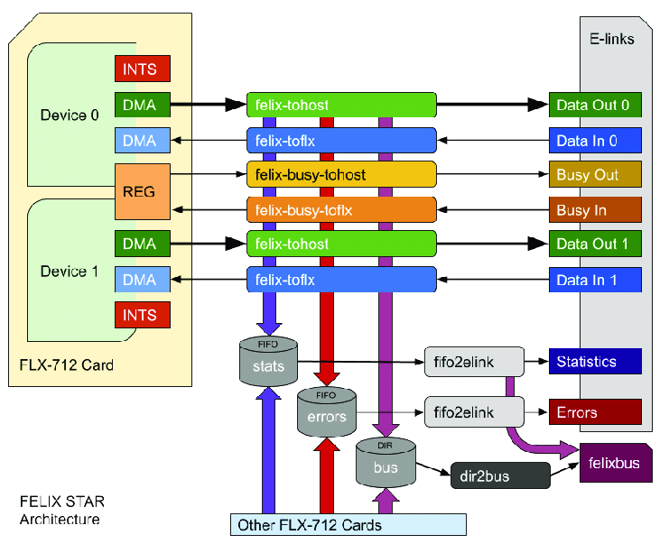
Felix Read-out Chain Data Handling
Felix-star application is the central process of a Felix system and replaces Felixcore.
It handles all its tasks in a single thread.
It handles the communication between one or more FELIX Cards on one side and a set of Netio-next clients on the other side.
Netio-next is A fast communication protocol for data messaging between Felix-Star and Felix clients.

Slide 5
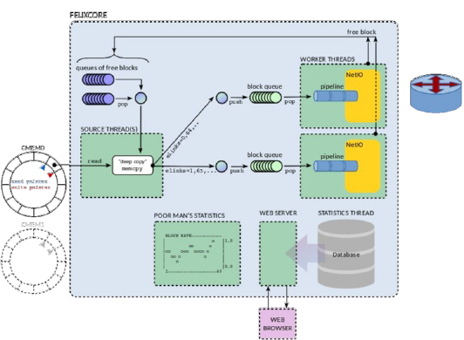
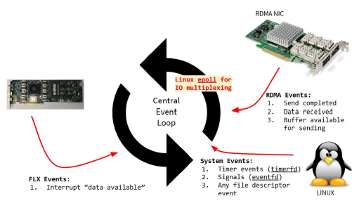
Netio/Felixcore vs Felix-star/Netio-Next
Mutlipule thread
Uses Netio
Single thread
Uses Netio-Next
Felixcore
Felix-star

Slide 6
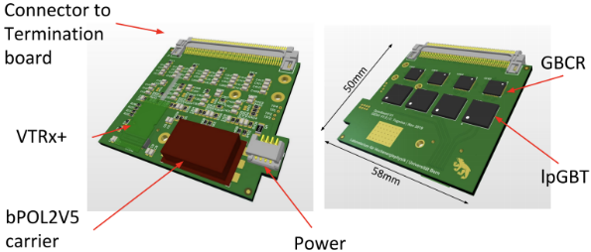
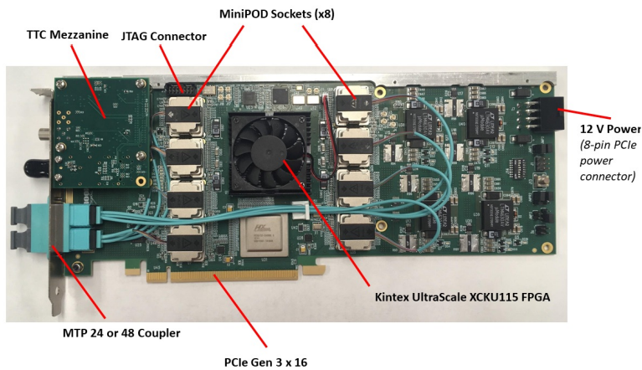
ITk Read-out system building blocks
FELIX is a “data router”. Sends commands and triggers to detector front-end (FE) electronics and receives data packets from them. Hosts a FPGA supporting 48 high speed optical links.
Optoboard is an interface between FELIX and front-ends
  4 GBCRs (recovers the signal after twinax cables).
  4 lpGBTs (multiplexes/de-multiplexes the high-speed uplinks/downlinks).
  1 VTRx+ (coverts highspeed signals from electrical to optical and vice-versa).

Slide 7
Motivation & Work Plan
Aim: Validate YARR-Felix-Optoboard-ITkPix Read-out chain using Netio-Next and Felix-star.
Start point(RD53A read-out):
  Yarr Branch: devel_rd53a_felixNetioNext, using Vldb (GBT) and Felix VC709 board through felix-star/Netio-Next.
  Yarr Branch: devel_rd53a_felixNetio, using Vldb+ (lpGBT) and Felix-712 Card through felixcore/Netio.
Intermediate step :
  Validate YARR-Felix-Optoboard-RD53A Read-out chain using Netio-Next and Felix-star.

Slide 8
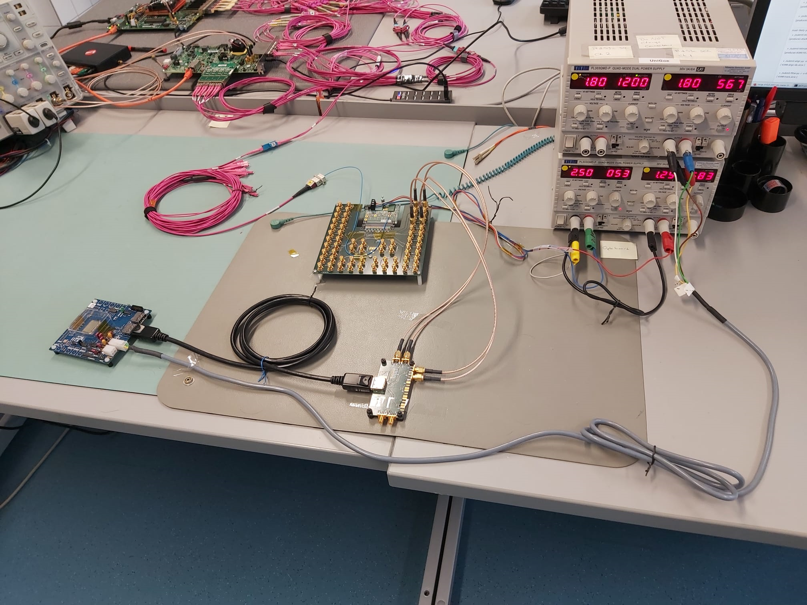
Yarr/Felix/Optoboard/RD53A Lab Setup
To FELIX PC
Power
Optoboard
Rd53A SCC

Slide 9
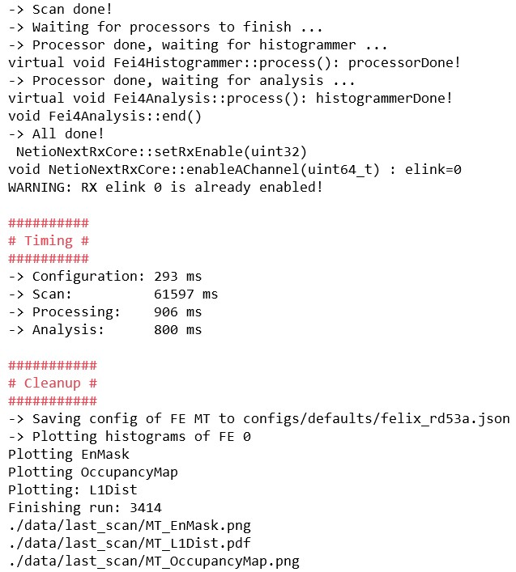
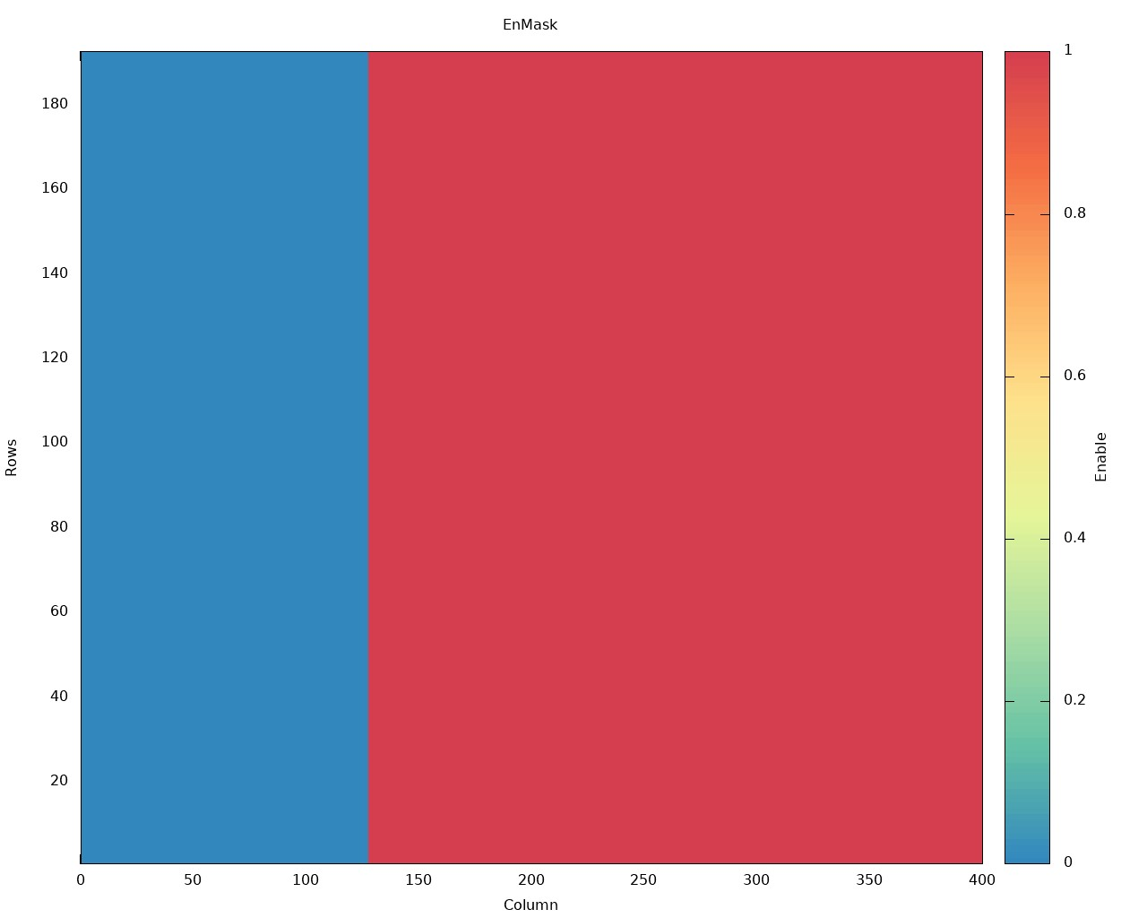
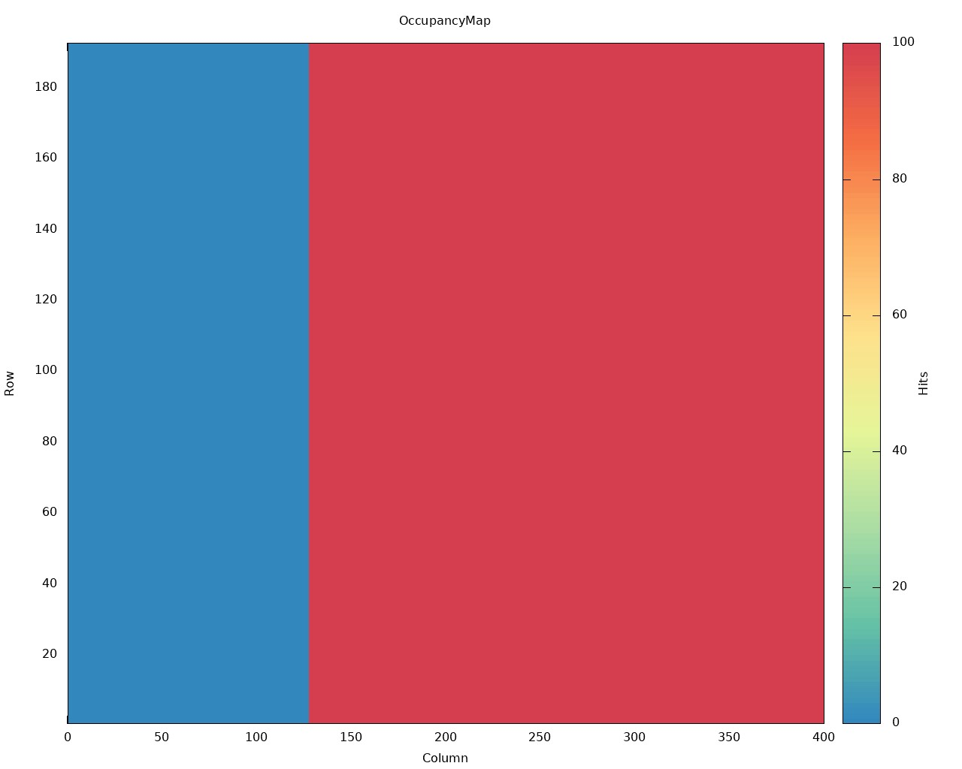
Example of Achieved Results
YARR-Felix-Optoboard-RD53A Read-out chain using Netio-Next and Felix-star works.

Slide 10
Conclusion & Outlook
Towards achieving the YARR/Felix/Itkpix readout system:
  First: YARR/Felix/Optoboard/RD53A read-out validated.
    New branch created on YARR gitlab repo devel_rd53a_felixNetioNext-lpGBT-debugging .
    Merging to Master branch is undergoing.
  Next: Move to ITkPix, (different in encoding/decoding scheme → need a new Firmware for Felix).
Future plans: Integrate the achieved developments in the final Atlas read-out system including the ITk software (YARR) and the new Felix application FelixClient.
Thank you for your Attention

Slide 11
Back up

Slide 12
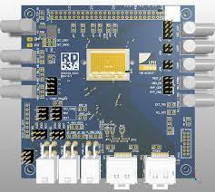
RD53A SCC
RD53A Chip
The width is 20mm and 400 pixels, the height is 11.6mm and 192 pixels
Pixel size is 50 µm × 50 µm
3 types of pixel readouts in chip (linear, differential, Synchronous)
Power
Display port (Output data)

Slide 13
Issues & Solutions
Building Yarr SW was not working because of recent initializations in Netio-Next:
=> solved through re-initialization some variables in Yarr
During scans, connection was refused during loading configs stage:
=> solved by updating libfabric.
Wrong representation of link fid discovered in Felix-star Felix-toflx application
=> Representation was corrected.
Truncation error in libfabric,
  =>Fixed by increasing used buffers size in YARR.
Added headers by Netio-Next in data messages
=> Extract headers in readData function before forwarding data to YARR dataprocesser (avoiding doing so in callback function).
Lost data packages addresses
=> Retrieve correct related rx from extracted headers, use it as data package address .

