Slide 1




HL-LHC MCBRD CCT Magnets: Review and Latest Progress in China
Qingjin XU
IHEP-CAS
For the CCT Magnet Team
20 Sep 2023

Slide 2
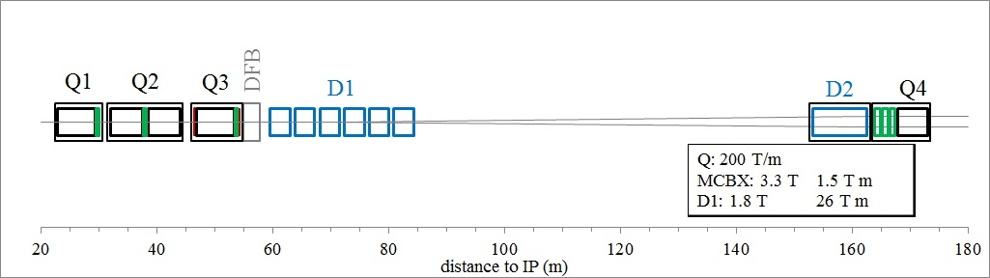
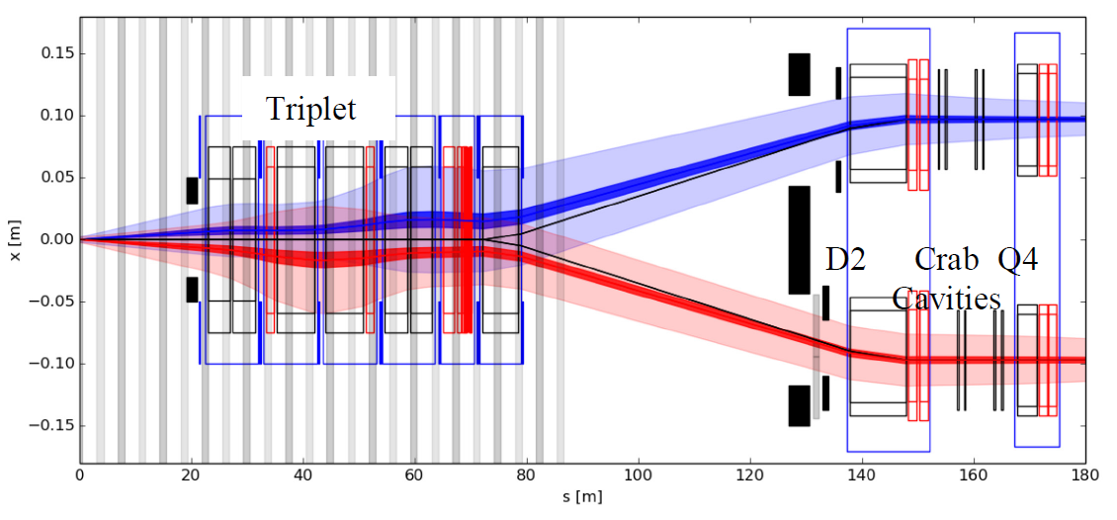
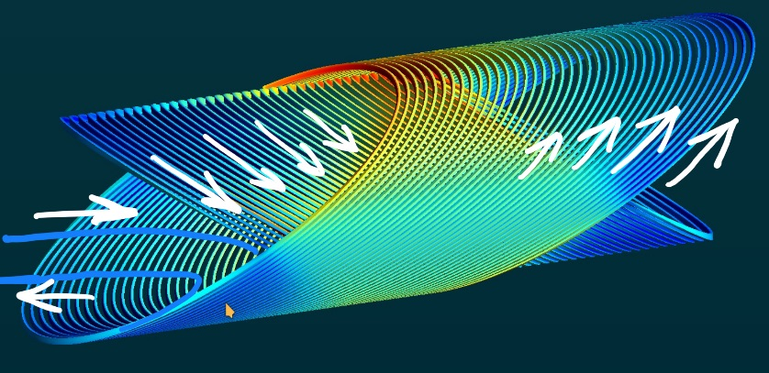
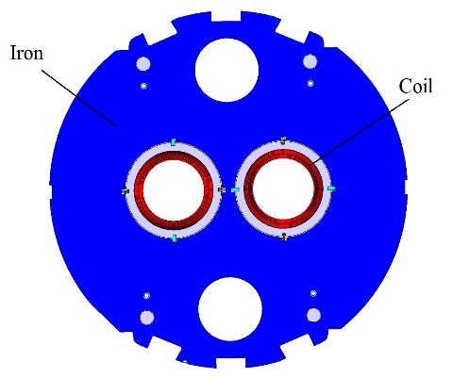
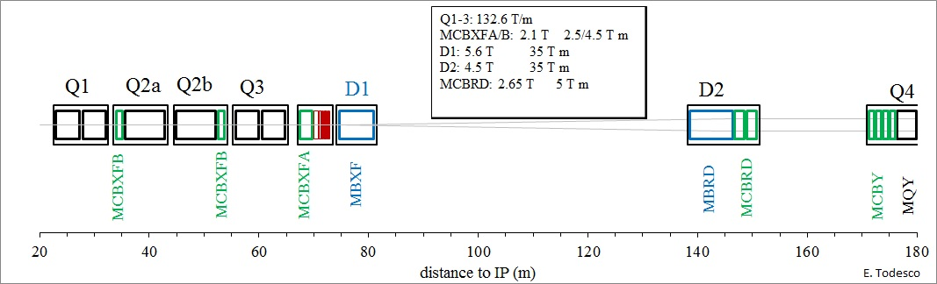
MCBRD: the HL-LHC D2 orbit correctors, 12+1 units, providing a 5 Tm integrated field in two apertures, vertical in one and horizontal in the other.
LHC 2008-2022
E. Todesco
HL-LHC 2026-2035

Slide 3


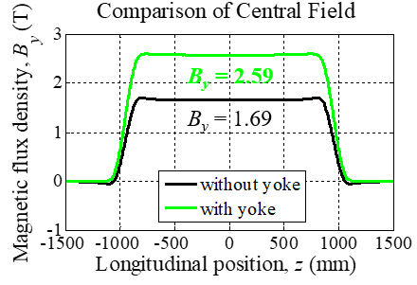
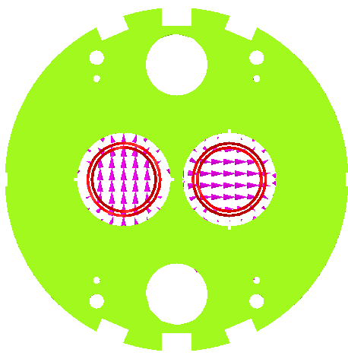

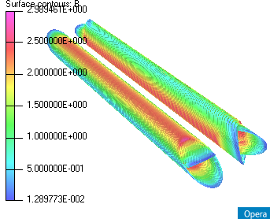
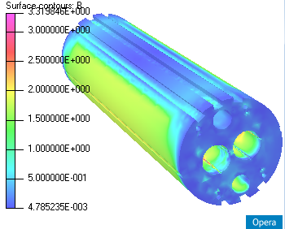
Main design parameters of the magnet
Items | Values
CCT skew angle | 30°
No. of turns per layer | 365
Slot size in former (mm) | 2×5
Spacing per turn | 5.222
Inside/Outside diameter of the former (mm) | Inner former:105.35/119.35 Inner former:120.80/134.85
Inside diameter of the groove/slot(mm) | 1st layer: 109.15/119.15 2nd layer: 124.65/134.65
Reference radius (mm) | 35
Diameter of aperture (mm) | 105
Current (A) | 395
Cooling hole
Hole for tie rod
Hole for fixing pin
Aperture
Yoke alignment
CCT Coils
Ø 614 mm
Items | Values
Diameter of yoke (mm) | 614
Thickness of yoke lamination (mm) | 5.8
Diameter of aperture (mm) | 167
Position of aperture (mm) | 94.19
Yoke key slot(mm) | 8(3.01) ×6
Diameter of cooling hole (mm) | 110
Position of cooling hole (mm) | 205

Slide 4

Progress of series production
 | Coil name | Winding method | Location | Coil stand-alone performance (4.2 K) | Magnet performance at 4.2 K
Magnet 1 | MCBRD_CB01 | Wet wind | CERN | 530 A | Both apertures reached ultimate current 422 A, and passed 4-hour stability test
 | MCBRD_CB03 | Direct wind |  | 410 A (training stopped due to the availability of the test station)
 | MCBRD_CB02 | Direct wind | CERN | Failed to reach the design current
Magnet 2 | MCBRD_CB04 | Wet wind | CERN | 422 A(training stopped due to the availability of the test station) | Both apertures reached ultimate current 422 A, and passed 4*1 hour stability test
 | MCBRD_CB06 | Wet wind |  | 530 A
Magnet 3 | MCBRD_CB09 | Direct wind with new channel size | Shipped to CERN | 530 A | Both apertures reached ultimate current 422 A, and passed stability test
 | MCBRD_CB12 | Direct wind with new channel size |  | 526 A (25 quenches)
Magnet 4 | MCBRD_CB13 | Direct wind with new channel size | IMP | 530 A (20+33 quenches) | -
 | MCBRD_CB14 | Direct wind with new channel size | BAMA | 530 A (30+34 quenches), put in quarantine | -
 | MCBRD_CB17 | Direct wind with new channel size | IMP | 524 A (47 quenches) | -
MCBRD_CB18-19 |  | Direct wind with new channel size | IHEP | Waiting for stand-alone test | -
MCBRD_CB20 |  | Direct wind with new channel size | BAMA | Under fabricaiton
MCBRD_CB10, 11, 15, 16 |  | Shipped to CERN for fabrication

Slide 5
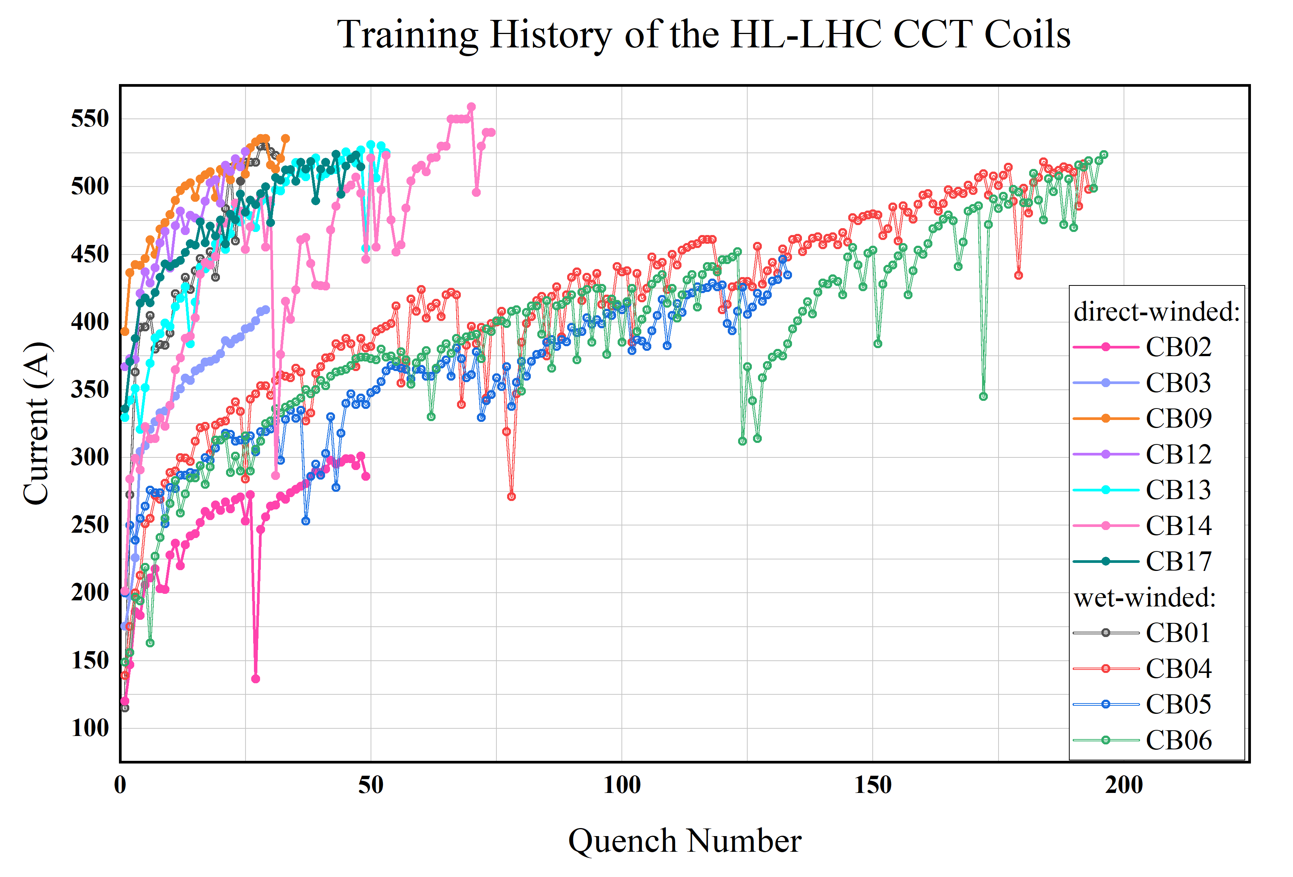
Stand-alone training of the CCT coils

Slide 6



Stand-alone training of CB17
524A

Slide 7
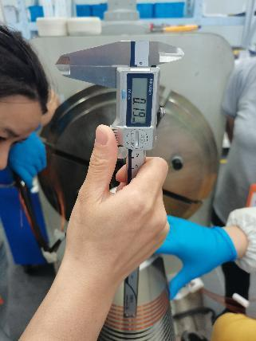
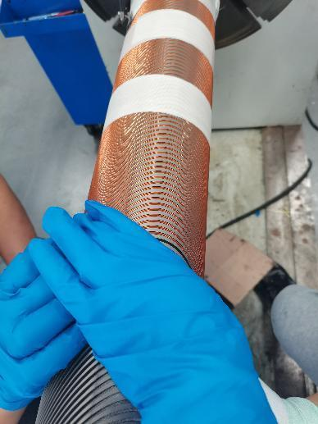
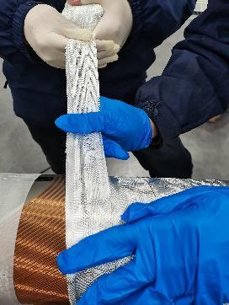
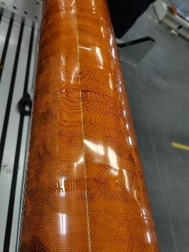
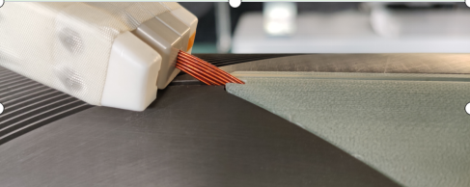
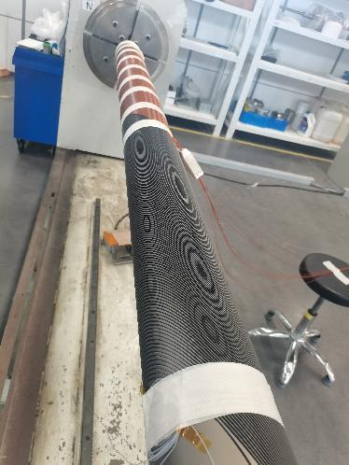
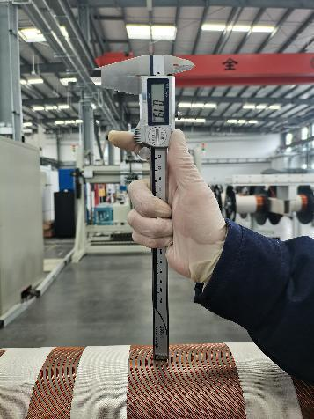
Manufacture of CB14

Slide 8
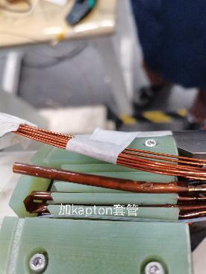
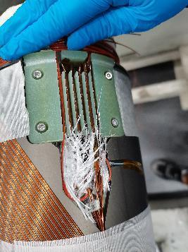
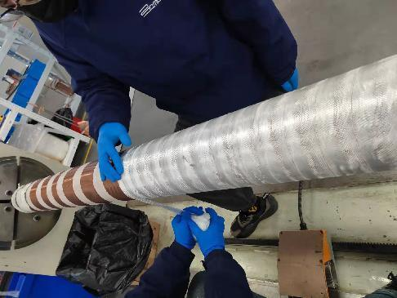
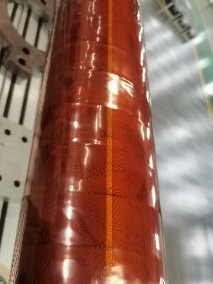
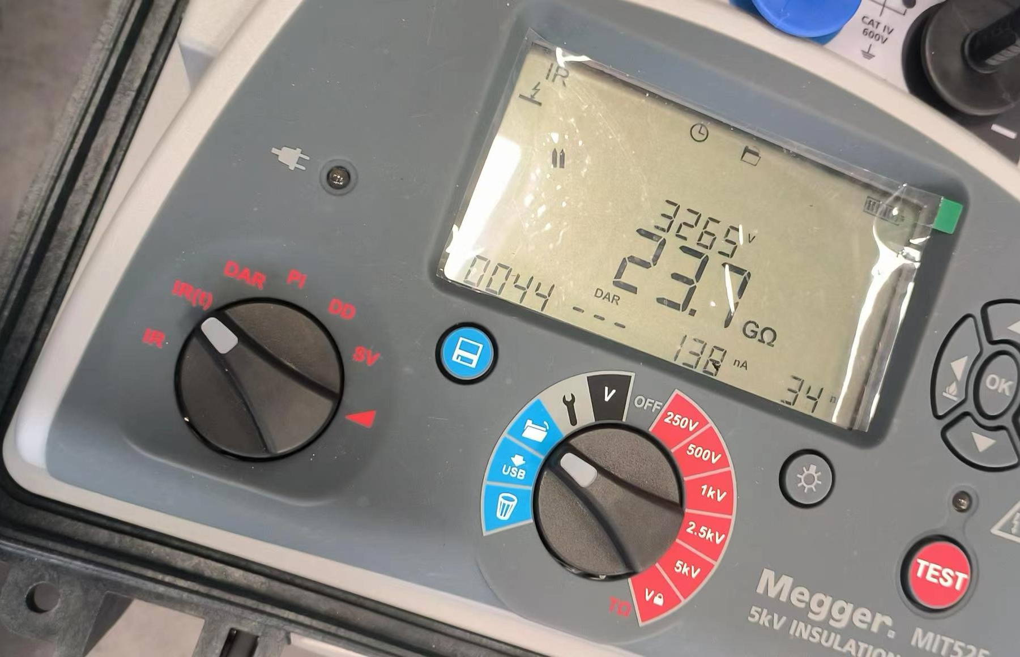
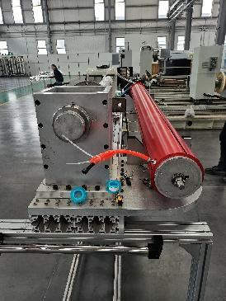
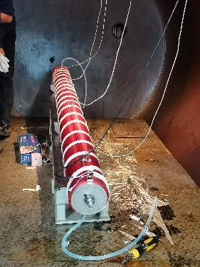
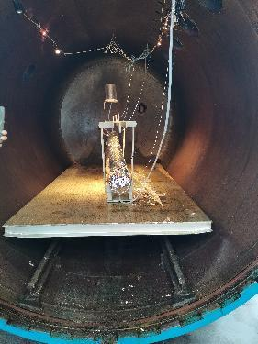
Manufacture of CB14

Slide 9
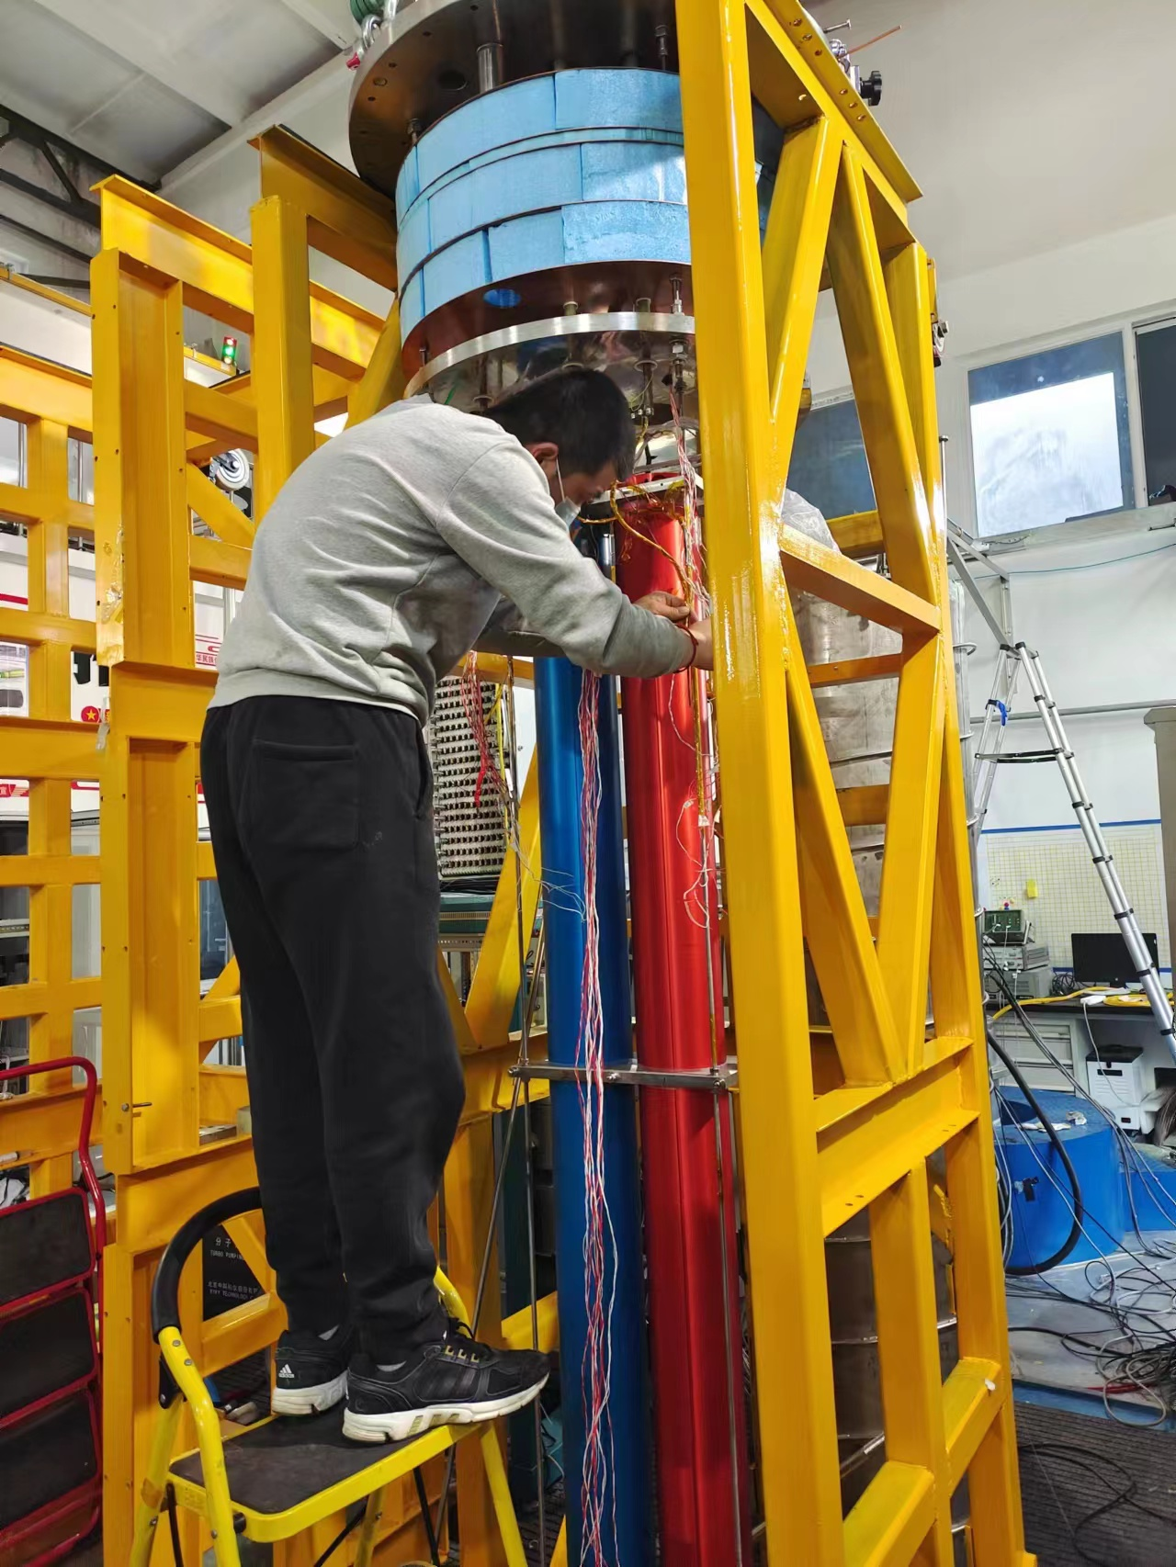
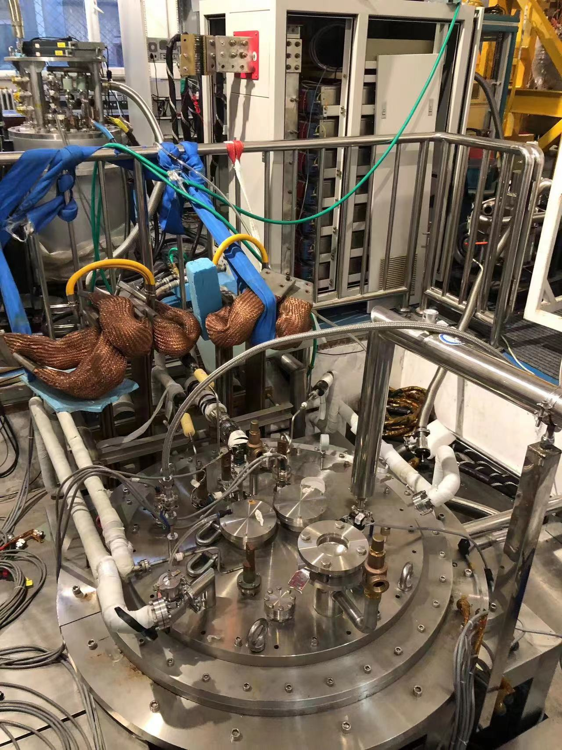
Stand-alone test of CB14 at IHEP

Slide 10
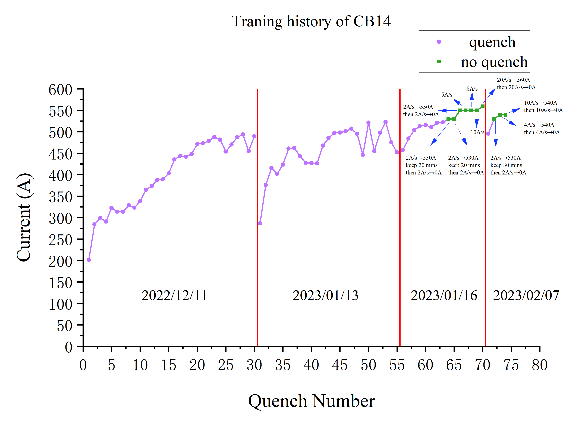
Stand-alone test of CB14
Changes:
Changes of the operators.
The inlet pipeline between mix tank and impregnation furnace (exposed in the air ~10℃) didn’t use any thermal insulation.
It takes a longer time (6~7h) of injection compared with CB09 ~ CB13 (3~4h).
Detraining

Slide 11
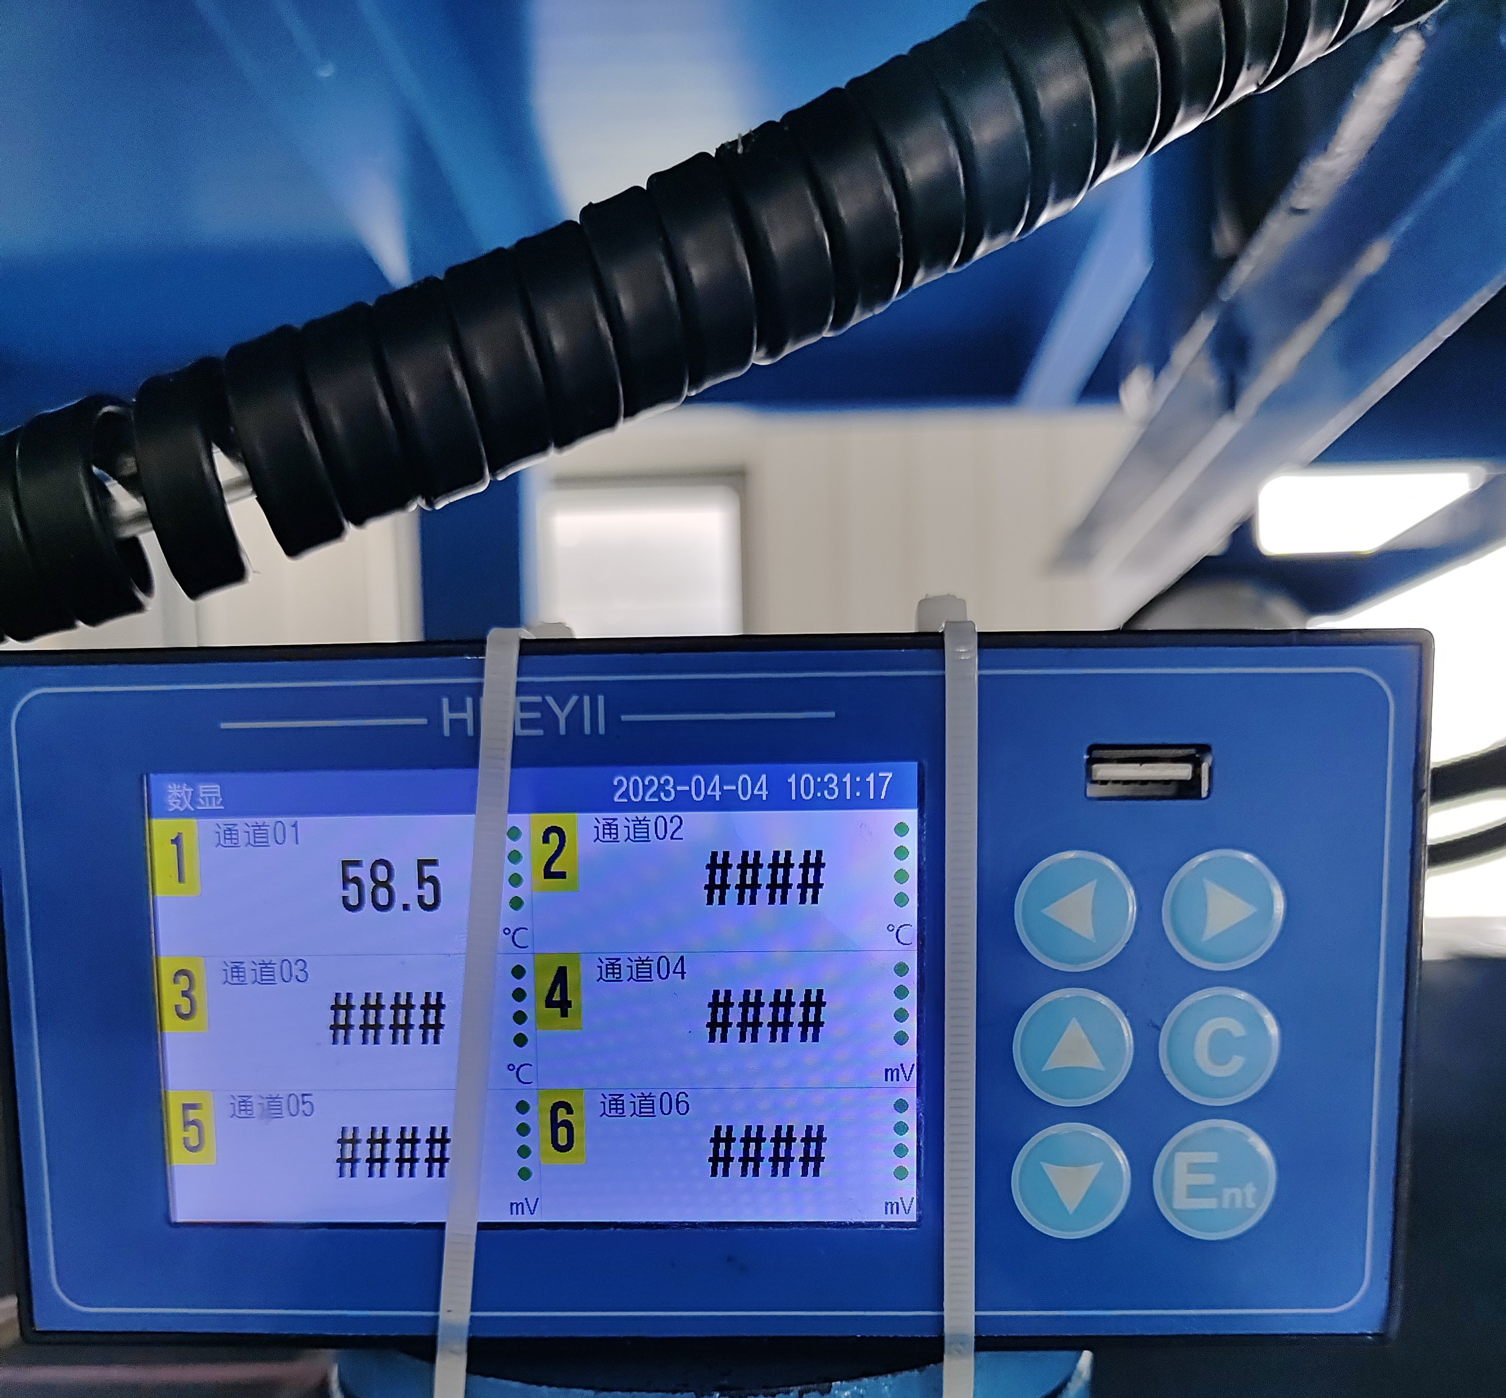
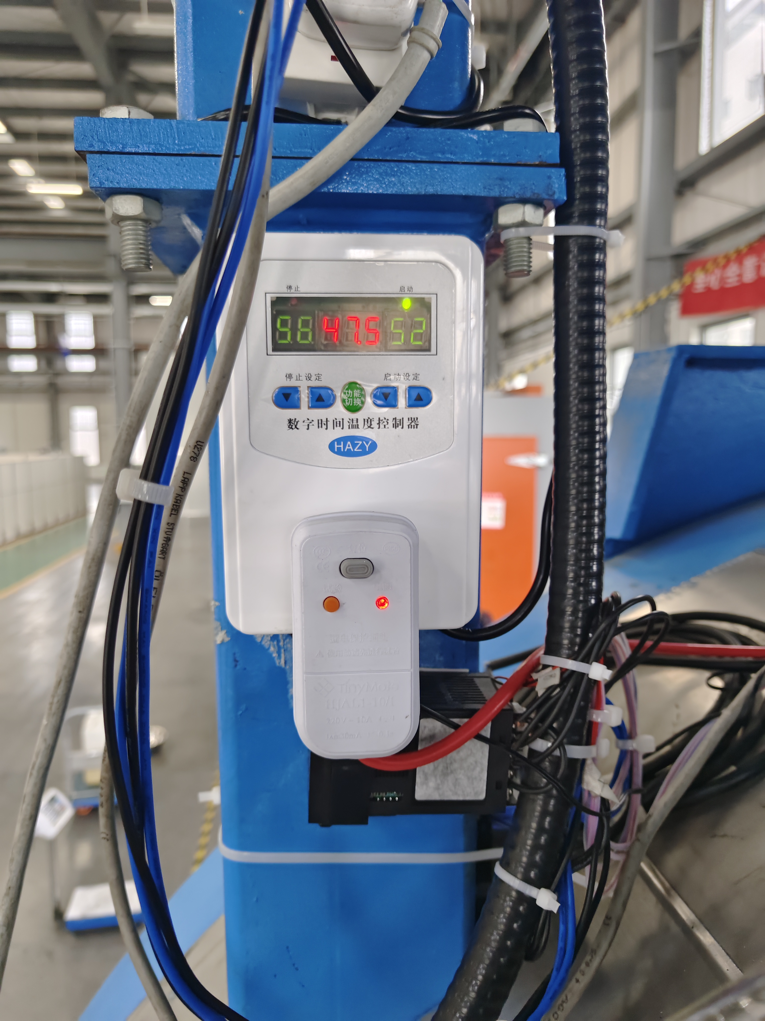
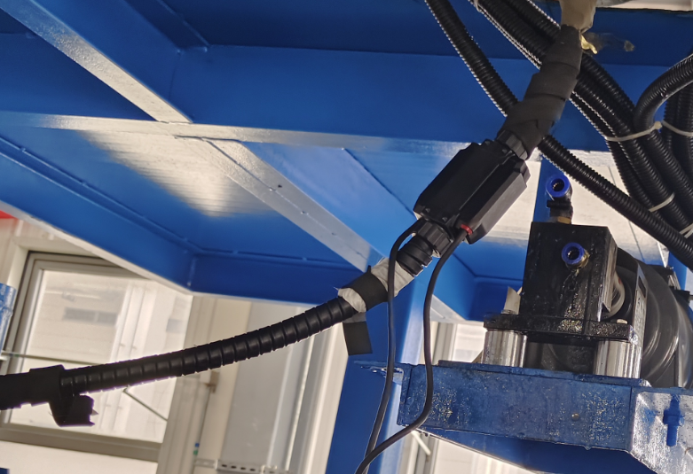
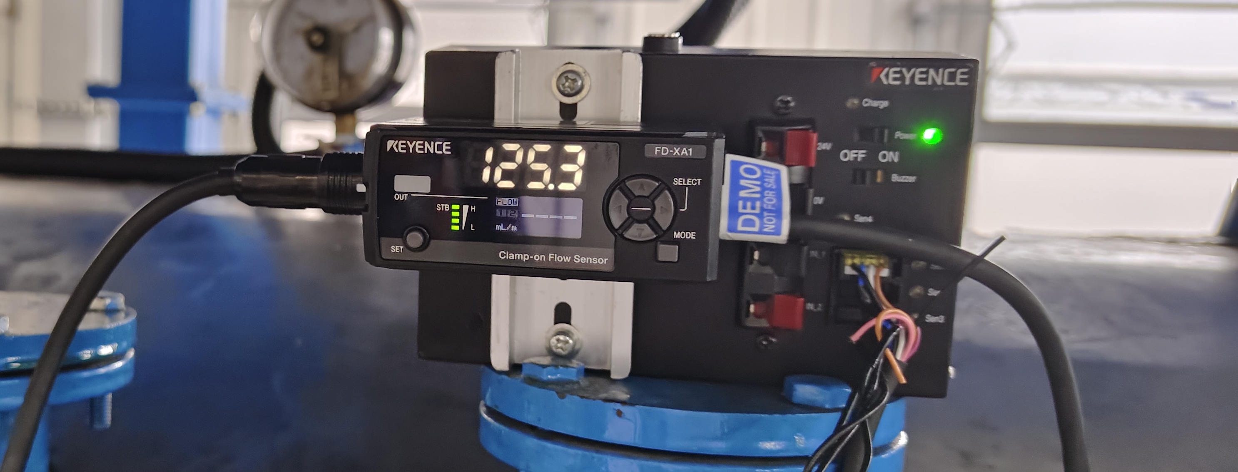
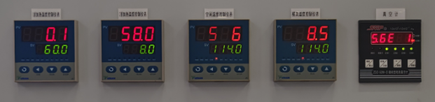
Corrective action of the VPI station
Inlet pipeline
Thermal insulation
Heating belt
Ultrasonic flow meter
T controller for the inletpipeline:52-58
T controller for the mold
60.1 - 58.0 - 58.6 - 58.5

Slide 12
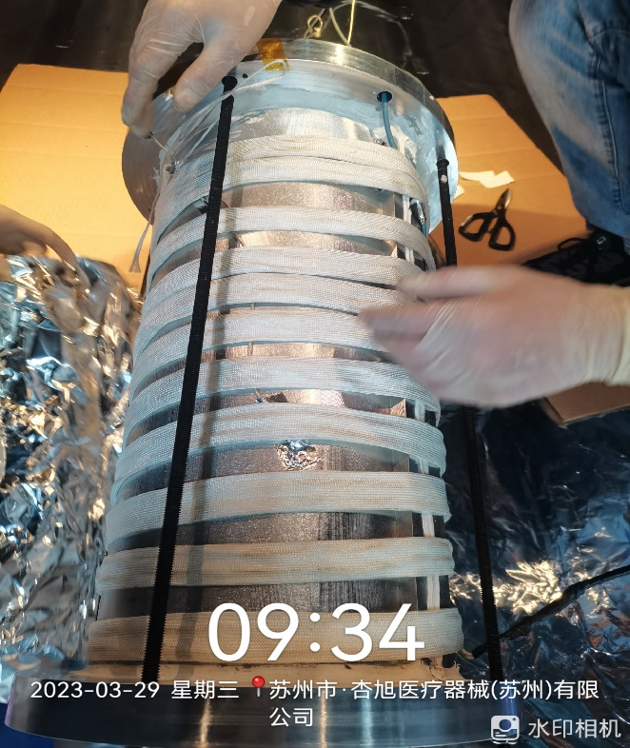
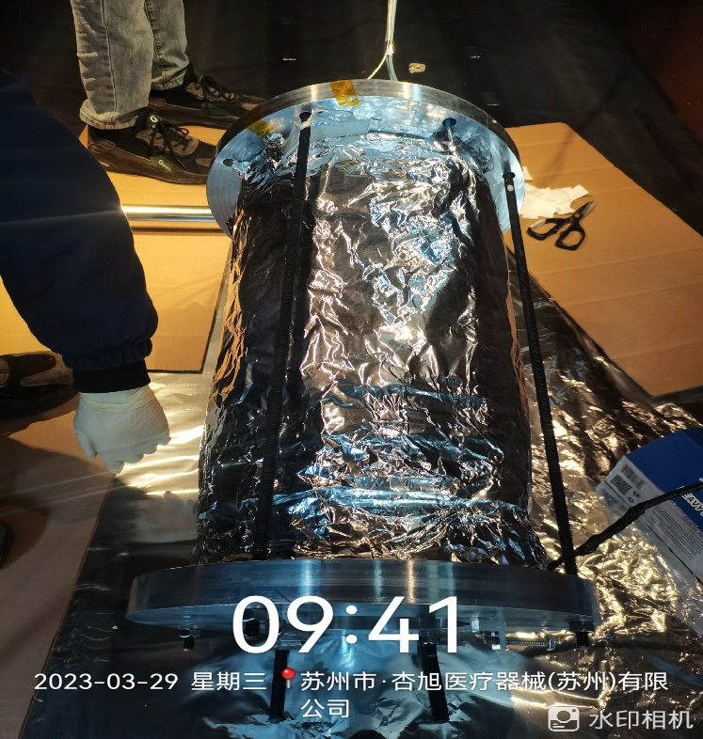
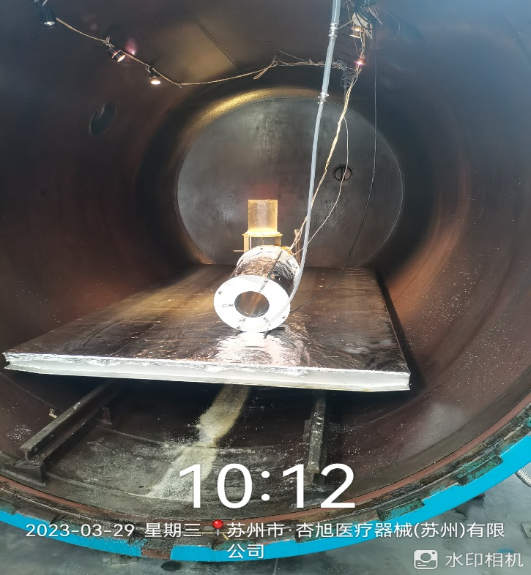
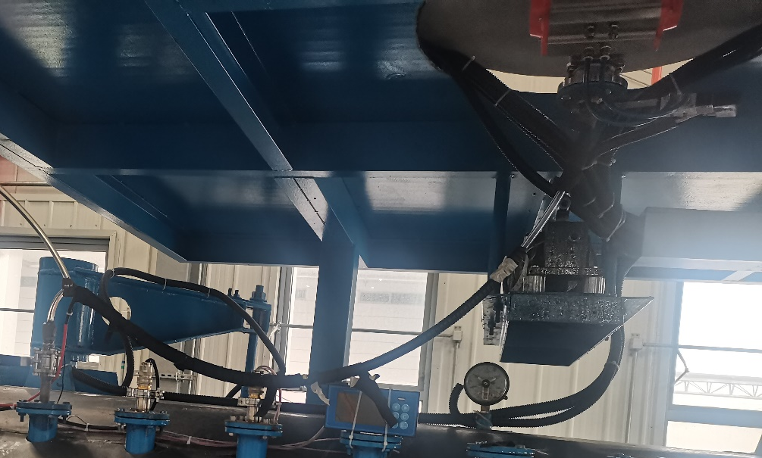
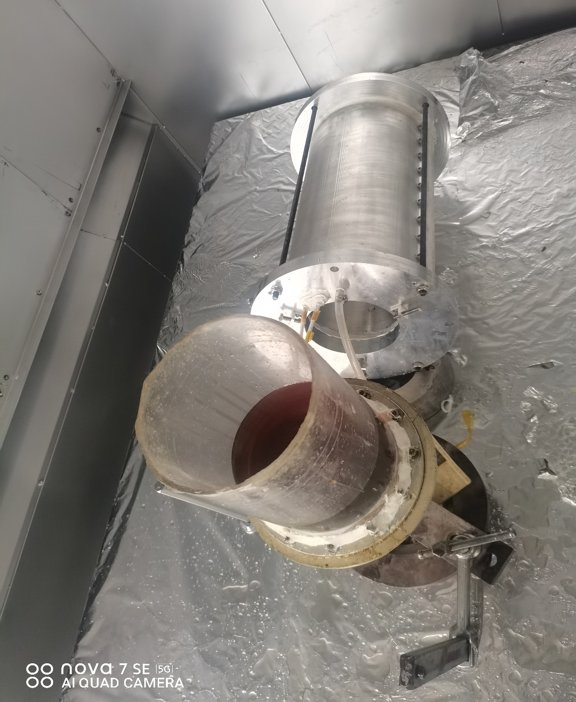
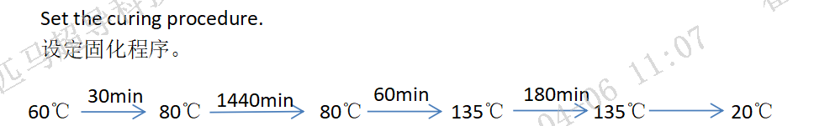
Qualification of the VPI system
Thermal insulation for the inlet pipeline
We use a 0.5m quadrupole CCT magnet as a qualification of the VPI system after applying the corrective actions.
This magnet will be tested this week.

Slide 13
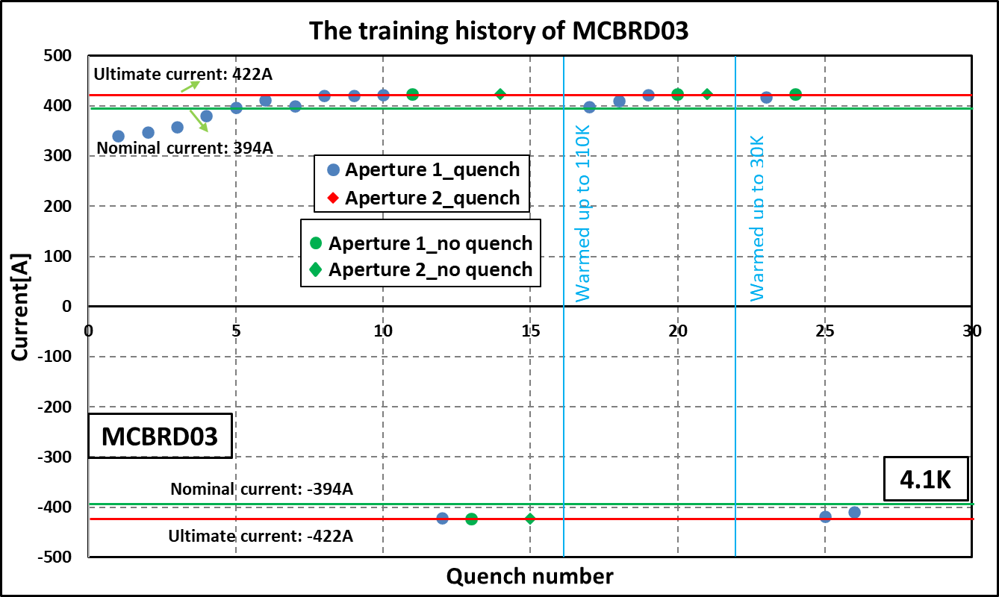
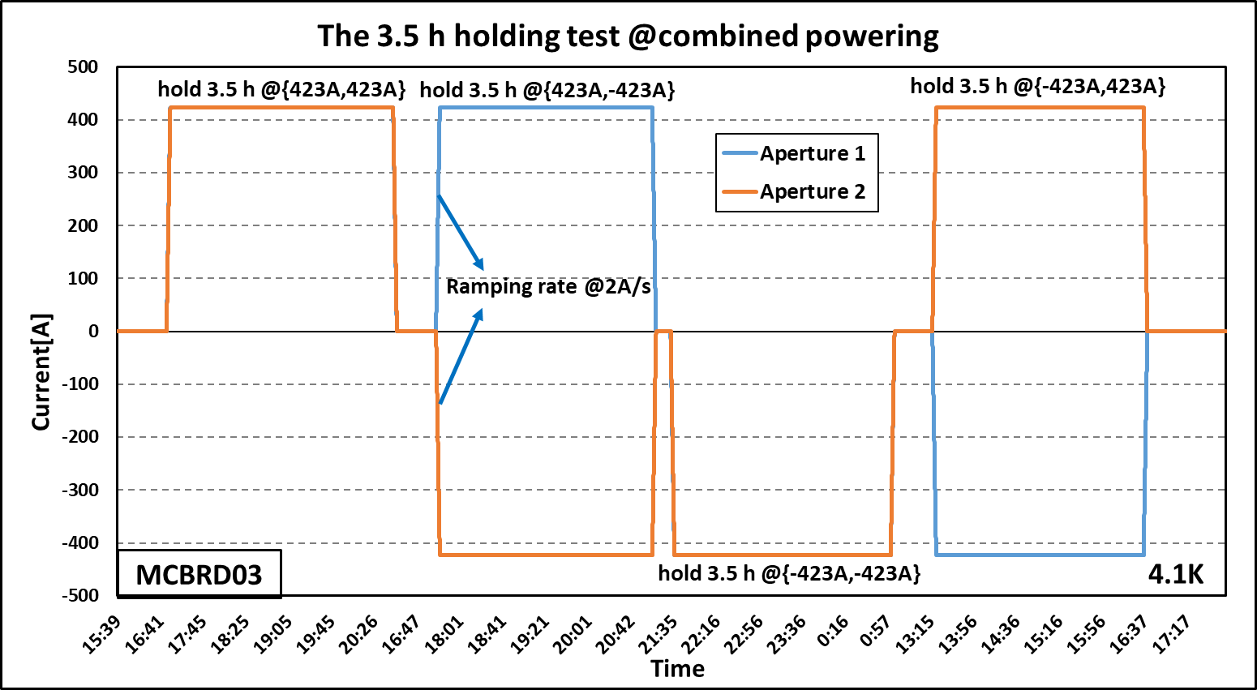
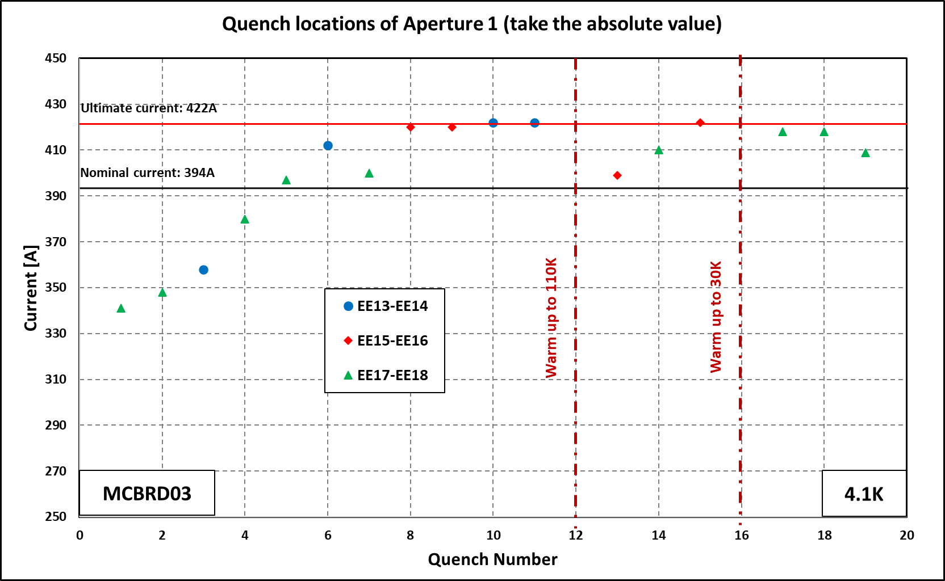
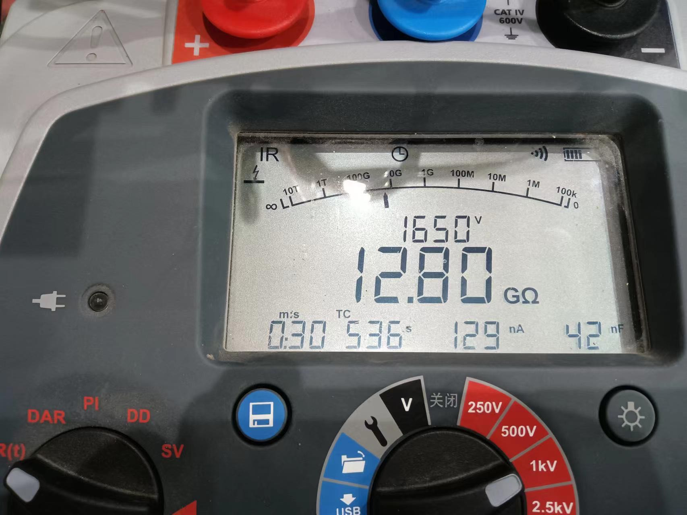
Training history of MCBRD03 (1st test)
AP1(CB12，25 quenches 526A) reached ±422A after 11 quenches.
AP2(CB09, 33 quenches 530A; after thermal cycle ＞500A) reached ±422A without any quenches.

Slide 14
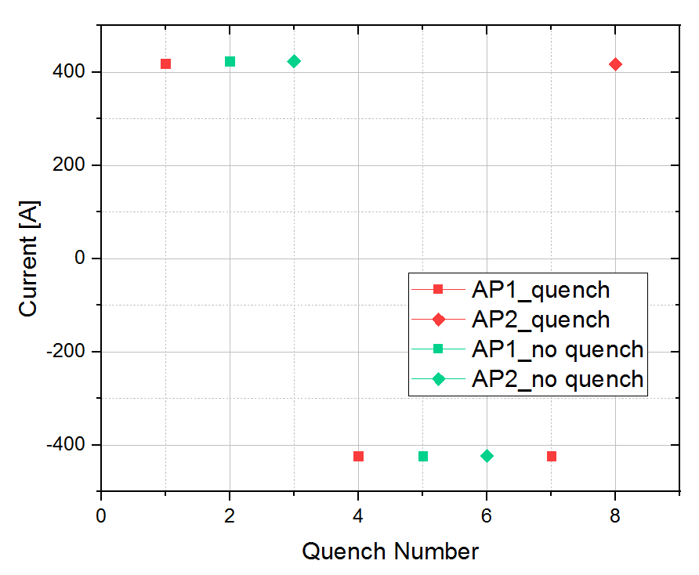
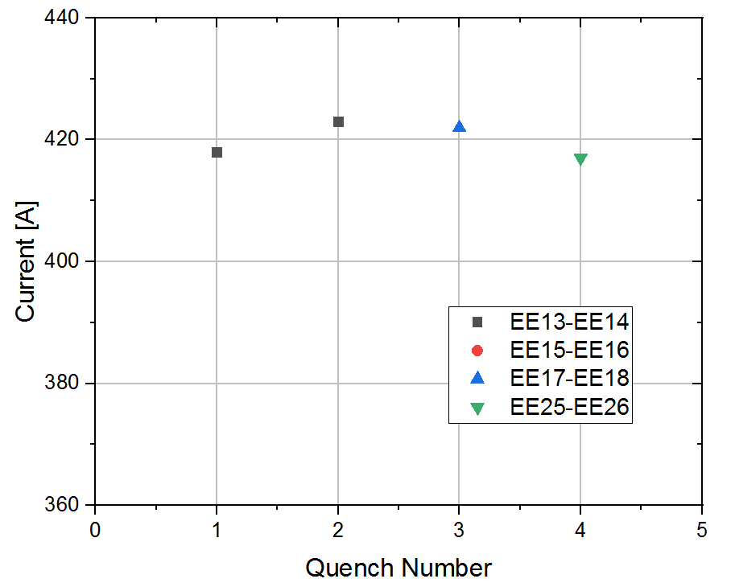
Training history of MCBRD03 (2nd test)
Both Apertures reached the nominal current without any quenches after thermal cycle.
Ultimate current : 422 A
Nominal current : 394 A
4.1 K
Nominal current : -394 A
Ultimate current : -422 A
Training history and quench location of the 2nd test

Slide 15
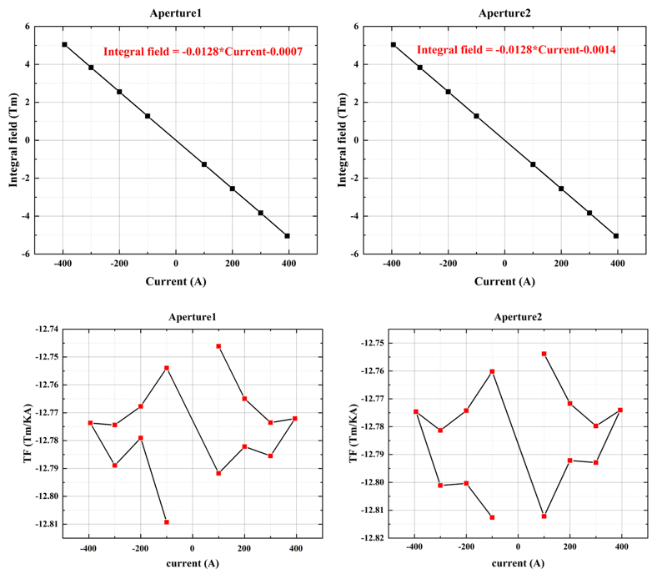
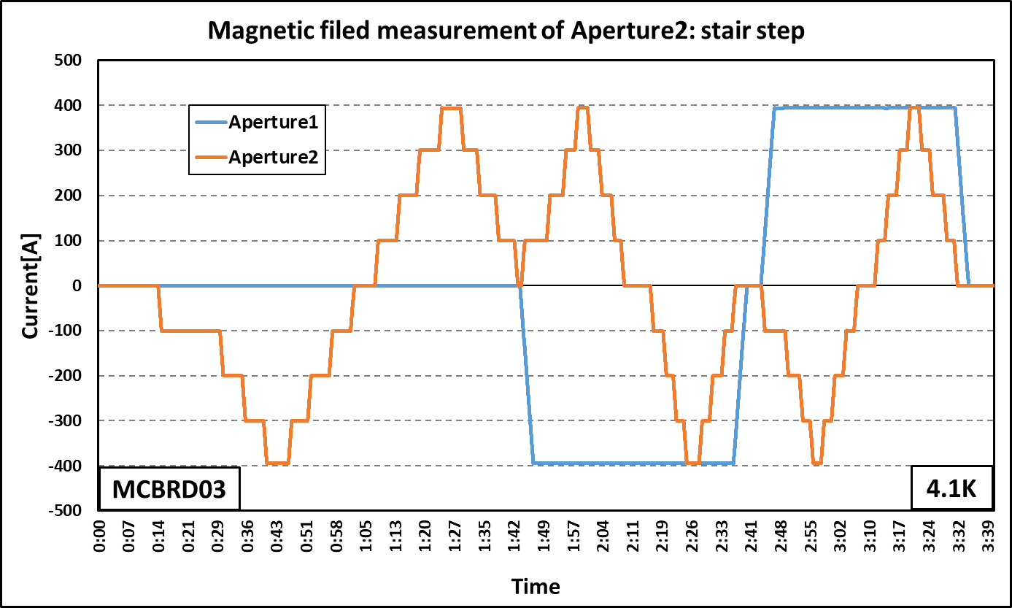
Field Quality of MCBRD03
Stair steps & magnet filed measurement of Aperture 2 (MCBRD_CB09)
Integral Field and Transfer Function

Slide 16
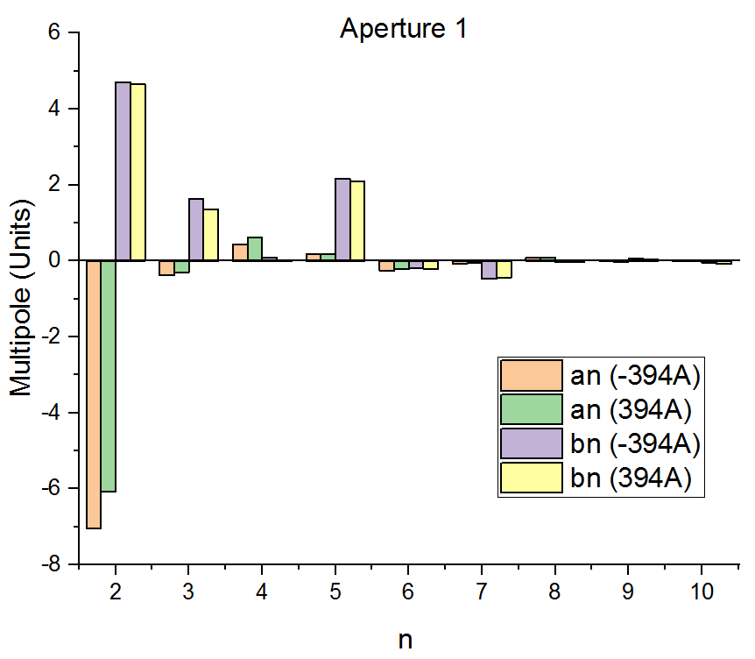
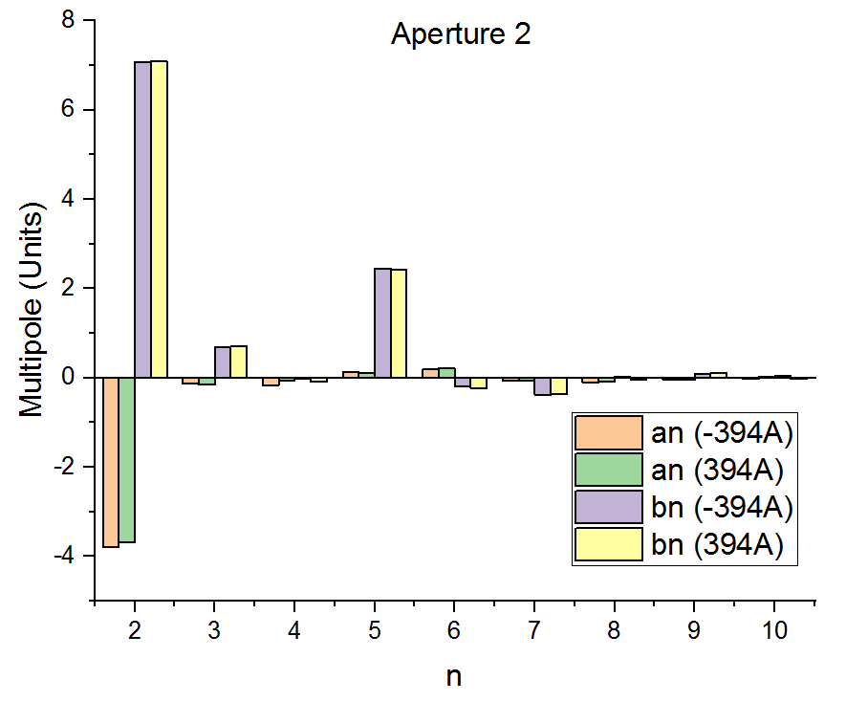
Field Quality of MCBRD03
Multipoles (individual powering)

Slide 17
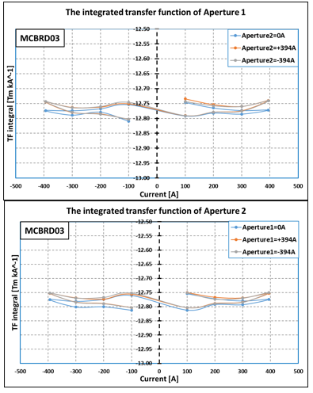

Field Quality of MCBRD03
Crosstalk-transfer function (combined powering)
Crosstalk- Multipoles (combined powering)

Slide 18
AP1(CB17，47 quenches 524A) reached ±422A after 15 quenches.
AP2(CB13, 53 quenches 530A) reached ±422A with 10 quenches.

Slide 19



Performance of SCQ-CCT coils
SCQ-1
Well impregnated magnet SCQ-1 experienced long training
With the modified channel size, the training performance of SCQ-2 significantly improved.

Slide 20
Summary
4 sets of series CCT magnets have been fabricated. All of them reached the ultimate current at 4 K. The 5th magnet is under fabrication
The 4th magnet to be delivered in late Oct or early Nov. The 5th magnet to be assembled in Nov, tested and delivered in late Dec 2023 or early Jan 2024
Production rate for the rest of series magnets: every 3 month per magnet
Components for 2 CCT magnets have been shipped to CERN from IHEP, to verify the performance with components from China and CERN fabrication process.

Slide 21
Thanks for your attention

