Slide 1

Drupal Beginners
Robin Ashford | Cath Noble | Dan Noyes
ENTICE, 8 April 2011

Slide 2

Current situation
Expectations
  “Drupal is awesome! It’s the future of all websites!”
  Great! So when do I get Drupal training?
Reality
  No official or linked-up training plan
  Large time investment in getting up to speed
  Many future site creators reluctant to try Drupal before being trained
    Understandable attitude!
    Building your first-ever Drupal site without initial guidance = painful experience

Slide 3
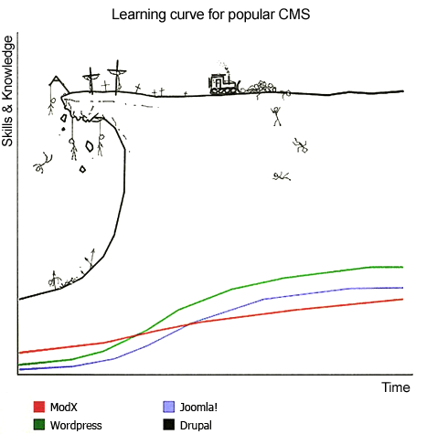

Slide 4
Drupal users (present + future)
Drupalistas at various levels of experience
  Beginners:
    Minimal technical background eg. admin staff, non-technical departments (Finance, HR etc)
  Intermediates:
    Creating sites, experimenting with modules
  Advanced:
    Programmers; writing modules, delving into code

Slide 5
The Plan
We are going to initially target BEGINNERS
  Beginner training sessions provided by a external company
    Ensure a proper ‘abc’ of getting started in Drupal,
    No previous Drupal knowledge assumed
  Sessions backed up by CERN-Drupal community:
    Drupal Starter site
    Drupal Champions

Slide 6
Beginner training sessions
Delivered by professional training company in a dedicated training facility (pref. at CERN)
We define the content
  CERN-specific needs
  Take on-board feedback from December course
  Guided by Zivtech training material structure
Justify a course in the Training Catalogue?
  Or ‘go solo’ per department/CERN community?
    What training requirements do you have?
    To discuss

Slide 7
CERN Drupal community support
Drupal Starter site
  To supplement the training
  Substitute for people with basic requirements
  Ideally integrated with content on the training course.
  www.cern.ch/drupal-starter

Slide 8
CERN Drupal community support
Drupal Champions?
  Provide a bit of help/direction/support/shoulder to cry on
  Max 1 hour per “consultation”
  High level basics
    Structuring content, how to display etc
    Potential ongoing feedback on people’s sites?
  Need to be careful re time commitment and what work is undertaken by the Champion.
http://drupal-starter.web.cern.ch/drupal-champions

Slide 9
Discussion
Training
  What do you need?
  How do you want to proceed?
    Via CERN Technical Training
    Individually arranged per community/department?
Drupal Champions
  Your thoughts?

