Slide 1
Collider Ring
Parameters
C. Carli on behalf of many contributors Accelerator Design Meeting, 25th September 2023
Luminosity
Collider Ring Parameters
Not (yet) in List of Collider Parameters or in other Presentations

Slide 2
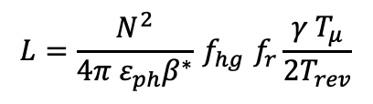
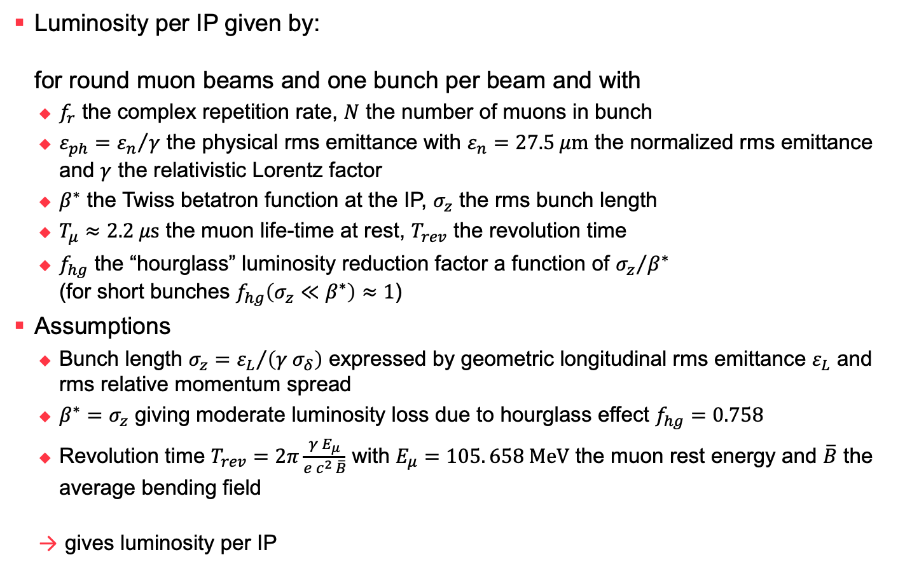
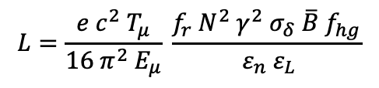
Luminosity
$$L=\frac{N^{2}}{4π ε_{ph}β^{∗}}{ f}_{hg} f_{r}\frac{γ{ T}_{μ}}{{2T}_{rev}}$$
Luminosity per IP given by:
for round muon beams and one bunch per beam and with
  $f_{r}$ the complex repetition rate, $N$ the number of muons in bunch
  $ε_{ph}={ε_{n}}/γ$ the physical rms emittance with $ε_{n}=27.5 μ\text{m}$ the normalized rms emittance and $γ$ the relativistic Lorentz factor
  $β^{∗}$ the Twiss betatron function at the IP, $σ_{z}$ the rms bunch length
  $T_{μ}≈2.2 μ\text{s}$ the muon life-time at rest, $T_{rev}$ the revolution time
  $f_{hg}$ the “hourglass” luminosity reduction factor a function of ${σ_{z}}/{β^{∗}}$
  (for short bunches $f_{hg}\left(σ_{z}≪β^{∗}\right)≈1$)
Assumptions
  Bunch length $σ_{z}={ε_{L}}/{\left(γ σ_{δ}\right)}$ expressed by geometric longitudinal rms emittance $ε_{L}$ and rms relative momentum spread
  $β^{∗}=σ_{z}$ giving moderate luminosity loss due to hourglass effect $f_{hg}=0.758$
  Revolution time $T_{rev}=2π\frac{γ E_{μ}}{e c^{2 }\overline{B}}$ with $E_{μ}=105. 658 \text{MeV}$ the muon rest energy and $\overline{B}$ the average bending field
  gives luminosity per IP
$$L=\frac{e c^{2} T_{μ}}{16 π^{2} E_{μ}} \frac{f_{r}{ N}^{2}{ γ^{2} σ_{δ} \overline{B} f}_{hg}}{ ε_{n} ε_{L}}$$

Slide 3

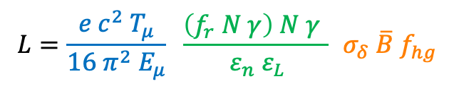
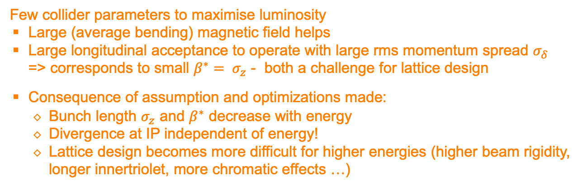
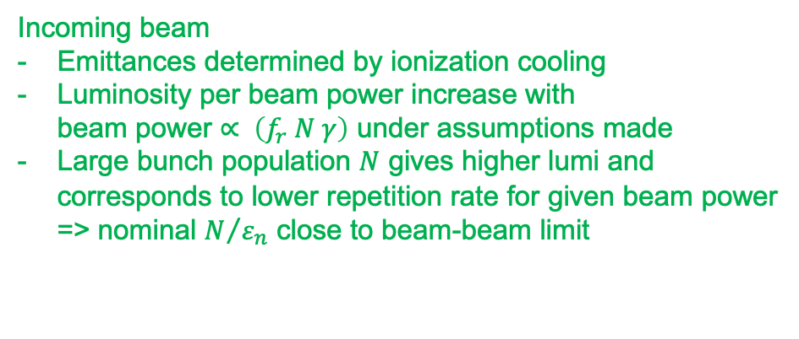
Luminosity
Incoming beam
Emittances determined by ionization cooling
Luminosity per beam power increase with
beam power $∝ \left(f_{r} N γ\right)$ under assumptions made
Large bunch population $N$ gives higher lumi and
corresponds to lower repetition rate for given beam power
=> nominal $N/{ε_{n}}$ close to beam-beam limit
Constant $11.83 {\text{T}}^{−1}$
$$L=\frac{e c^{2} T_{μ}}{16 π^{2} E_{μ}} \frac{\left(f_{r} N γ\right) N γ }{ ε_{n} ε_{L}}{{ σ}_{δ} \overline{B} f}_{hg}$$
Few collider parameters to maximise luminosity
Large (average bending) magnetic field helps
Large longitudinal acceptance to operate with large rms momentum spread $σ_{δ}$
=> corresponds to small ${β^{∗}= σ}_{z}$ - both a challenge for lattice design
Consequence of assumption and optimizations made:
  Bunch length $σ_{z}$ and $β^{∗}$ decrease with energy
  Divergence at IP independent of energy!
  Lattice design becomes more difficult for higher energies (higher beam rigidity,
  longer innertriolet, more chromatic effects …)

Slide 4
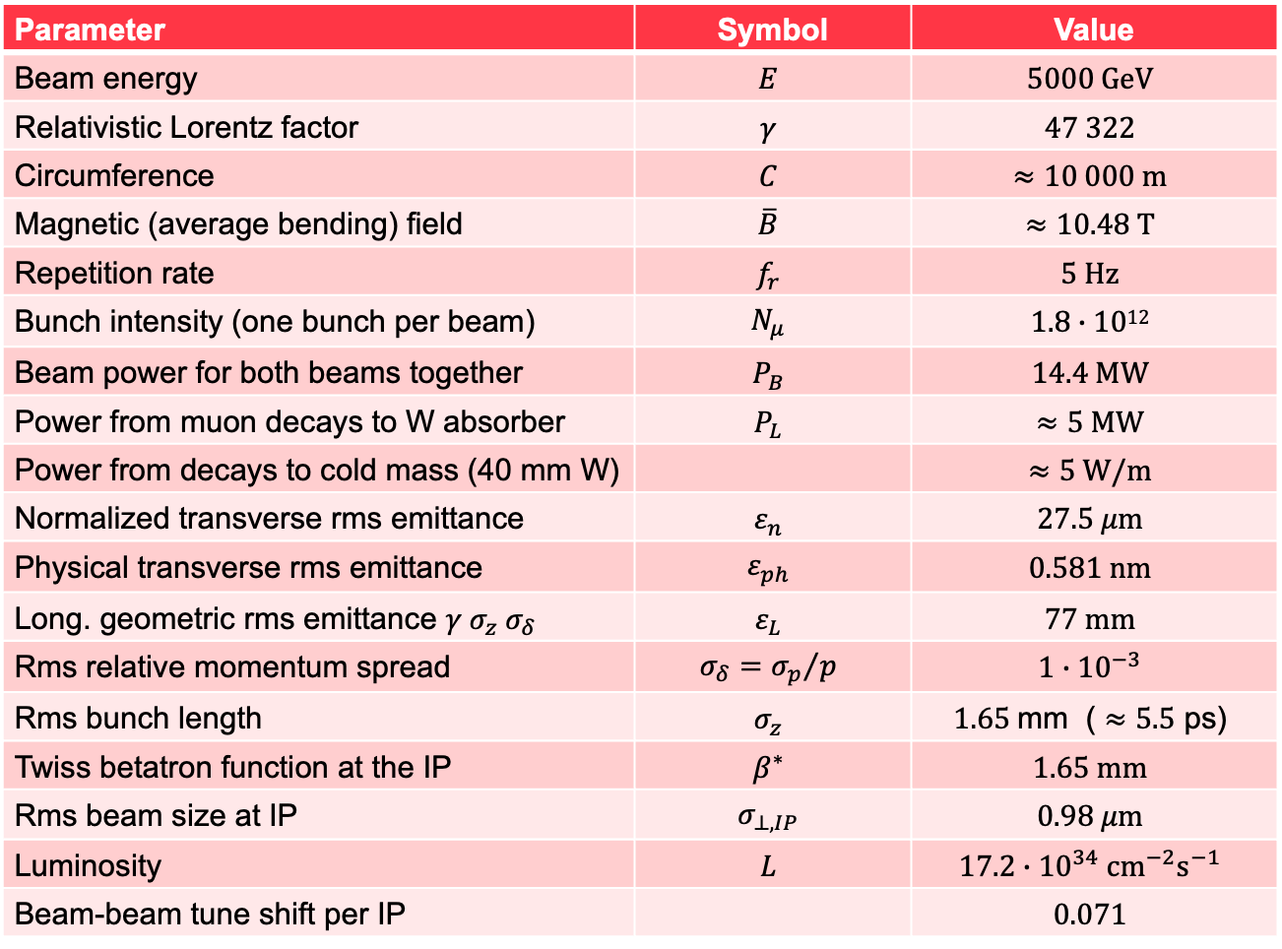
Nominal 10 TeV com
Collider Parameters
Parameter | Symbol | Value
Beam energy | $$E$$ | $$5000 \text{GeV}$$
Relativistic Lorentz factor | $$γ$$ | $$47 322$$
Circumference | $$C$$ | $$≈10 000 \text{m}$$
Magnetic (average bending) field | $$\overline{B}$$ | $$≈10.48 \text{T}$$
Repetition rate | $$f_{r}$$ | $$5 \text{Hz}$$
Bunch intensity (one bunch per beam) | $$N_{μ}$$ | $$1.8∙1012$$
Beam power for both beams together | $$P_{B}$$ | $$14.4 \text{MW}$$
Power from muon decays to W absorber | $$P_{L}$$ | $$≈5 \text{MW}$$
Power from decays to cold mass (40 mm W) |  | $$≈5 \text{W}\text{/}\text{m}$$
Normalized transverse rms emittance | $$ε_{n}$$ | $$27.5 μ\text{m}$$
Physical transverse rms emittance | $$ε_{ph}$$ | $$0.581 \text{nm}$$
Long. geometric rms emittance $γ σ_{z} σ_{δ}$ | $$ε_{L}$$ | $$77 \text{mm}$$
Rms relative momentum spread | $$σ_{δ}={σ_{p}}/p$$ | $${1∙10}^{−3}$$
Rms bunch length | $$σ_{z}$$ | $$1.65 \text{mm}\text{ (}≈5.5 \text{ps}\text{)}$$
Twiss betatron function at the IP | $$β^{∗}$$ | $$1.65 \text{mm}$$
Rms beam size at IP | $$σ_{⊥,IP}$$ | $$0.98 μ\text{m}$$
Luminosity | $$L$$ | $$17.2∙{10}^{34} {\text{cm}}^{−2}{\text{s}}^{−1}$$
Beam-beam tune shift per IP |  | $$0.071$$

Slide 5
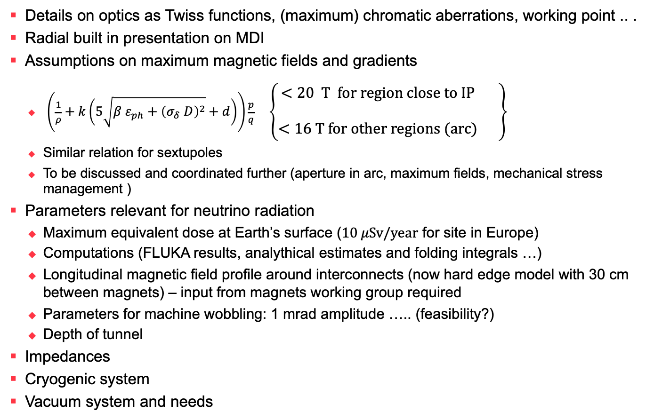
Not (yet?) in List of Collider Parameters or covered in other Presentations
Details on optics as Twiss functions, (maximum) chromatic aberrations, working point .. .
Radial built in presentation on MDI
Assumptions on maximum magnetic fields and gradients
  $\left(\frac{1}{ρ}+k\left(5\sqrt{β ε_{ph}+{\left(σ_{δ} D\right)}^{2}}+d\right)\right)\frac{p}{q} \left\{\begin{matrix}\begin{aligned}<20 \text{T} \text{for} \text{region} \text{close} \text{to} \text{IP} \\ \end{aligned} \\ <16 \text{T} \text{for} \text{other} \text{regions}\text{ (}\text{arc}\text{)}\end{matrix} \right\}$
  Similar relation for sextupoles
  To be discussed and coordinated further (aperture in arc, maximum fields, mechanical stress management )
Parameters relevant for neutrino radiation
  Maximum equivalent dose at Earth’s surface ($10 μ\text{Sv}\text{/}\text{year}$ for site in Europe)
  Computations (FLUKA results, analythical estimates and folding integrals …)
  Longitudinal magnetic field profile around interconnects (now hard edge model with 30 cm between magnets) – input from magnets working group required
  Parameters for machine wobbling: 1 mrad amplitude ….. (feasibility?)
  Depth of tunnel
Impedances
Cryogenic system
Vacuum system and needs

