Slide 1

HTS for pulsed applications: frame of the study
Fulvio Boattini
5/10/2023

Slide 2
Scope of the study: part of Task 7.3
Provide a possible realization for the dipoles and quadrupoles magnets for the RCS4 using High Temperature Superconductors;
It is a scooping study based on latest experimental advances on high dB/dt super ferric realizations;
It is interesting to try and reduce losses in pulsed magnets on the largest RCS stage;
It doesn’t radically change the powering problem as the energy is most probably the same.

Slide 3
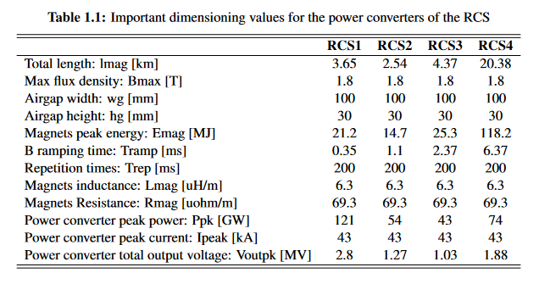
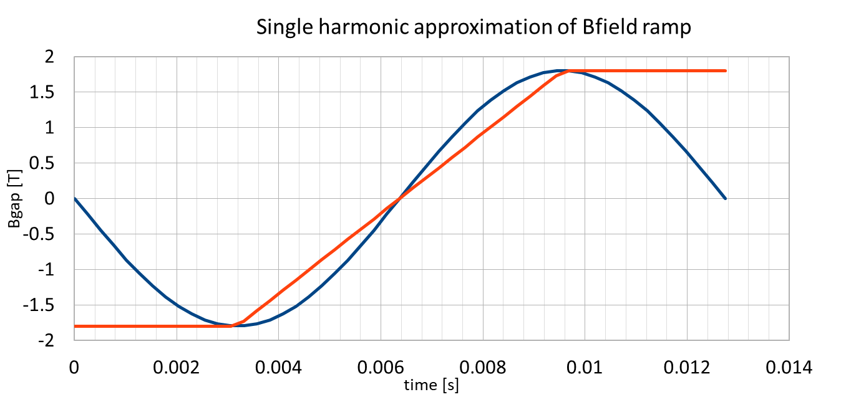
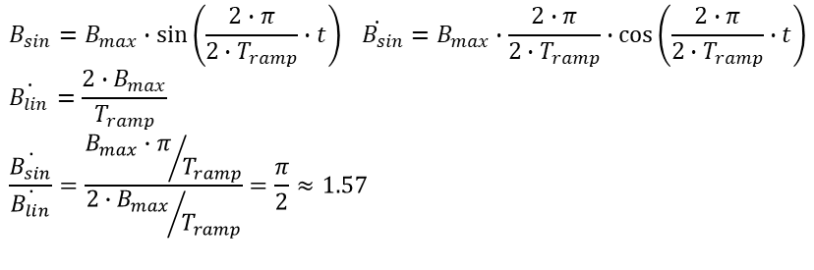
Introduction: General required Data
Main targets:
airgap dimensions: 100m x 30mm;
max B in airgap: 1.8T
Gap field quality value: k1*10^-4 (k1=6?? More??)
flux density B ramping from -1.8T to +1.8T in 6.37ms. This would mean 565 T/s ;
Minimum possible (overall) losses (Target is 95% efficiency);
keep the Bdotmax during acceleration at less than k2* average linear Bdot (k2=1.2 ?? Less ?) ;
Tramp
$$B_{sin}=B_{max}∙\sin\left(\frac{2∙π}{2∙T_{ramp}}∙t\right) \dot{{ B}_{sin}}=B_{max}∙\frac{2∙π}{2∙T_{ramp}}∙\cos\left(\frac{2∙π}{2∙T_{ramp}}∙t\right)$$
$$\dot{B_{lin}}=\frac{2∙B_{max}}{T_{ramp}}$$
$$\frac{\dot{B_{sin}}}{\dot{B_{lin}}}=\frac{{B_{max}∙π}/{T_{ramp}}}{{{2∙B}_{max}}/{T_{ramp}}}=\frac{π}{2}≈1.57$$
The Bdot max in case of pure sinus is almost 60% higher than the ideal ramp

Slide 4
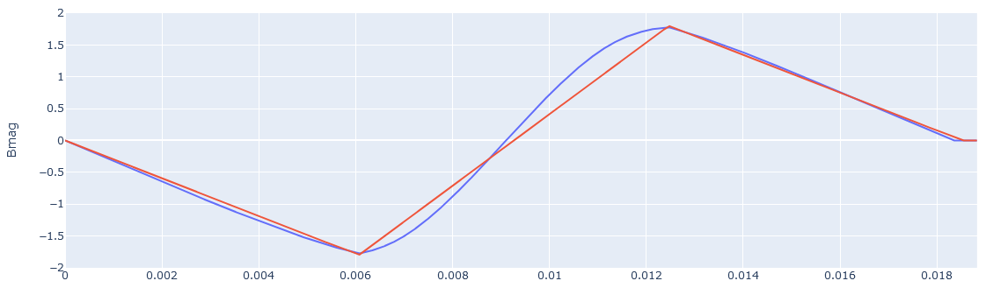
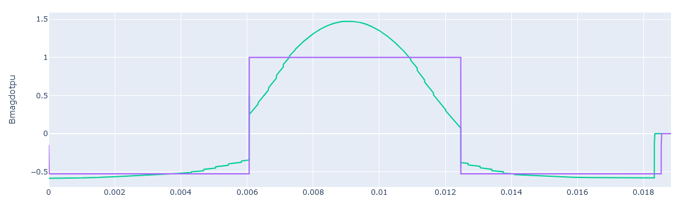
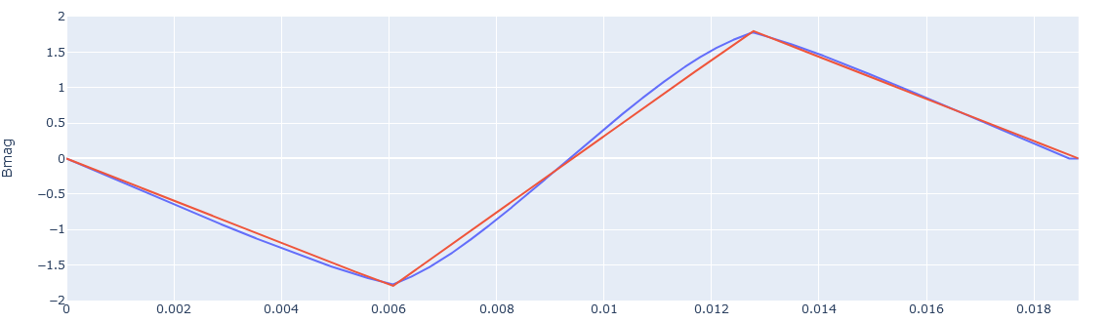
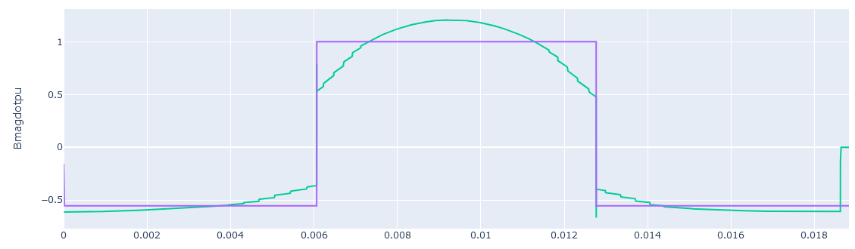
Introduction: General required Data
Main targets:
airgap dimensions: 100m x 30mm;
max B in airgap: 1.8T
Gap field quality value: k1*10^-4 (k1=6?? More??)
flux density B ramping from -1.8T to +1.8T in 6.37ms. This would mean 565 T/s ;
Minimum possible (overall) losses (Target is 95% efficiency);
keep the Bdotmax during acceleration at less than k2* average linear Bdot (k2=1.2 ?? Less ?) ;
Does it make any difference for HTS?
Cboost energy = 1.03 Mag energy
Bdotpu=1.5
Cboost energy = 1.44 Mag energy
Bdotpu=1.2

Slide 5
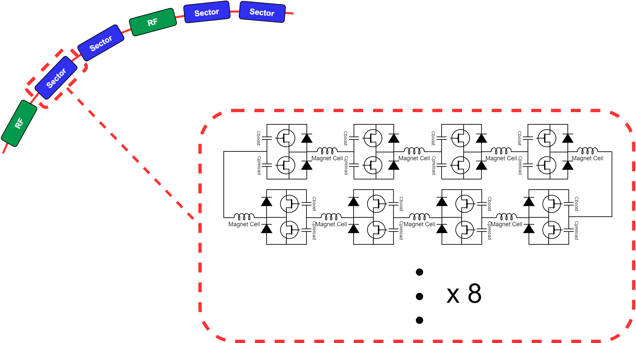
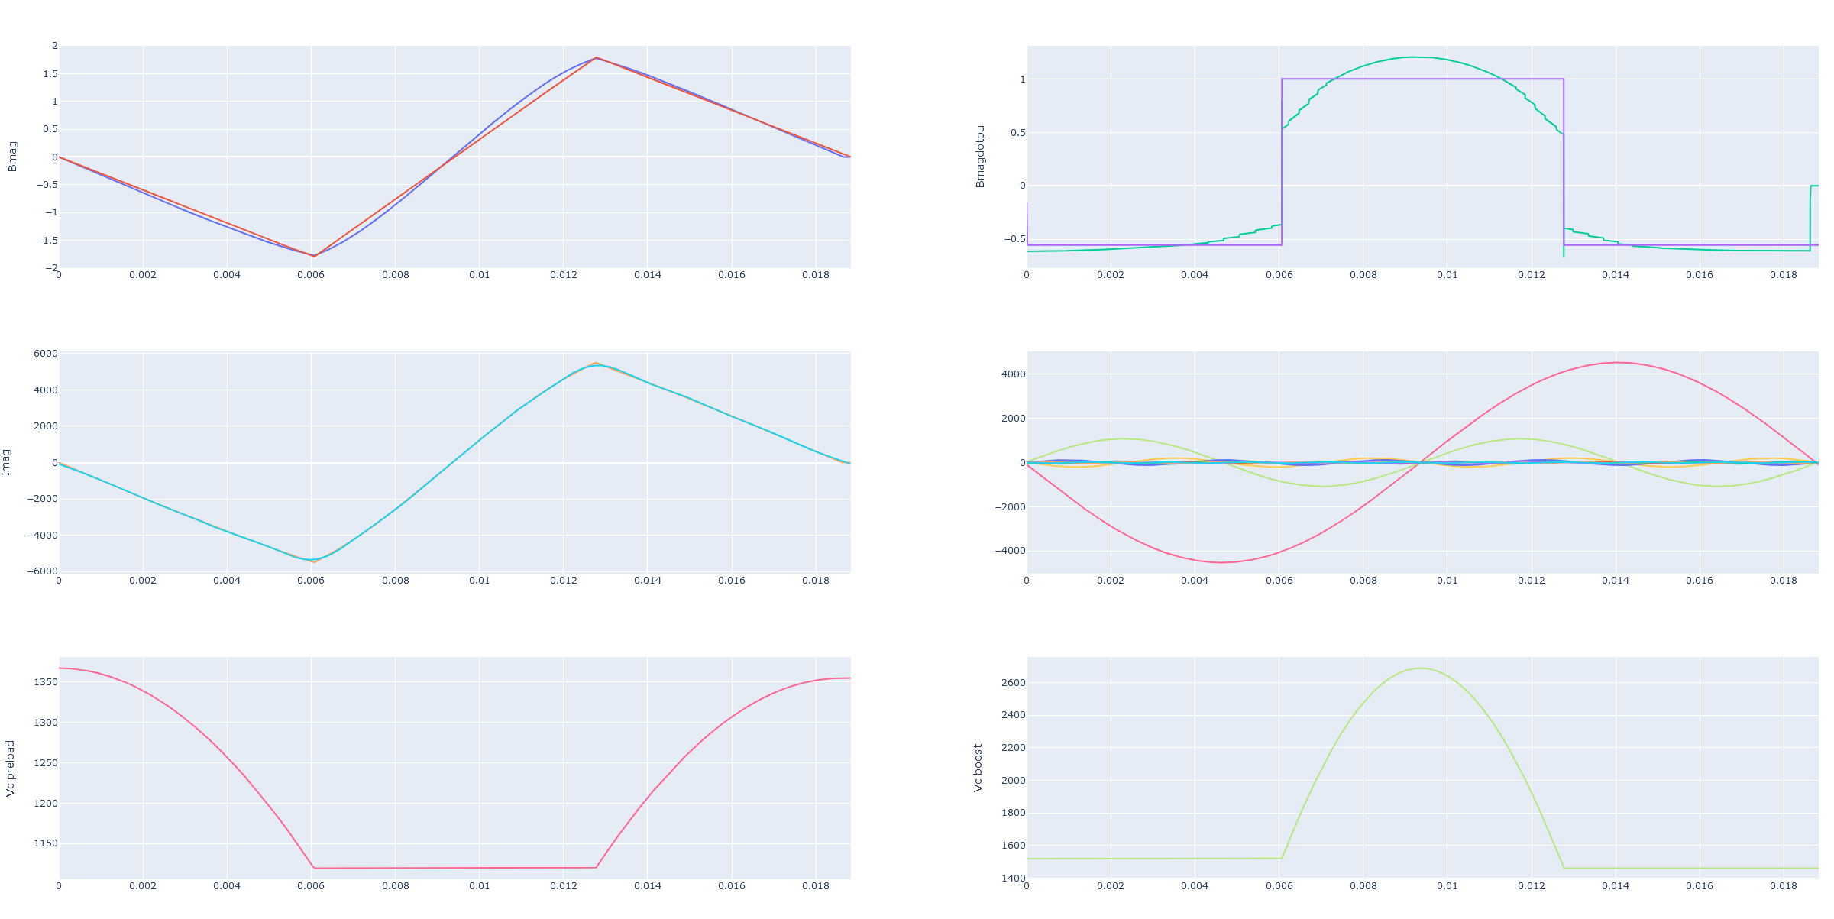
Introduction: The power converters
100 sectors
cell
Installed capacitor Energy (x cell):
Cboost: 30kJ
Cpreload: 65kJ

Slide 6
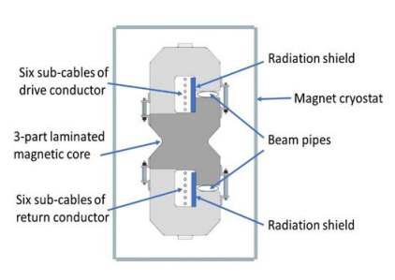
HTS for the RCS4
Present performances from FNAL:
dB/dt = 300T/s with Bmax=0.5T with two gaps of 100mm x 10mm
2111.06459.pdf (arxiv.org)
How do we get to here?
airgap dimensions: 100m x 30mm;
max B in airgap: 1.8T
Gap field quality value: k1*10^-4 (k1=6?? More??)
swap the flux density B from -1.8T to +1.8T in 6.37ms. This would mean 565 T/s ;
Minimum possible (overall) losses (Target is 95% efficiency);
keep the Bdotmax during acceleration at less than k2* average linear Bdot (k2=1.2 ?? Less ?) ;
POINTS to consider:
Feasibility evaluation
Overall losses (crio included?)
Peak total dipole energy of the design
Cost evaluation
More from Henryk

