Slide 1
Integration issues, QA and in-kinds managing
HL-LHC Project Kick-off Meeting
Friday 15th April 2011
Sylvain Weisz DG-DI-DAT
on the behalf of the A&T Sector Projects Support Office
Notes:
This talk will give an insight on the organization that is in place to provide project management support to the projects that are on going in the Accelerators and Technology Sector.

Slide 2
Projects Support Office – Mandate
Affiliated to the Office of the Director for Accelerators and Technology (DG-DI-DAT)
Provide PM support to the studies and projects of the A&T sector: HL-LHC, LIU incl. Linac4, Consolidation and CLIC, but also HIE-ISOLDE
No formal mandate yet
Formal mandate to be released soon

Slide 3
Projects Support Office – Who’s who
A very small unit:
  Pierre Bonnal
      50% CERN Risk Management Project
  Tadeusz Kurtyka
      Chairperson of the A&T Sector Specification Committee
      Chairperson of the QA Working Group
      CERN Linkperson with Eastern Europe States
  Cécile Noels: Linac4 Webmaster & EDMS administration; Specification Com. follow-up; Collaboration agreement
  Sylvain Weisz
      Deputy Chairperson of the Specification Committee
      50% Linac4 Project Technical Co-ordinator
  Nadine Andrey (Nov. 2011 – June 2011):QA WG; Event org.

Slide 4
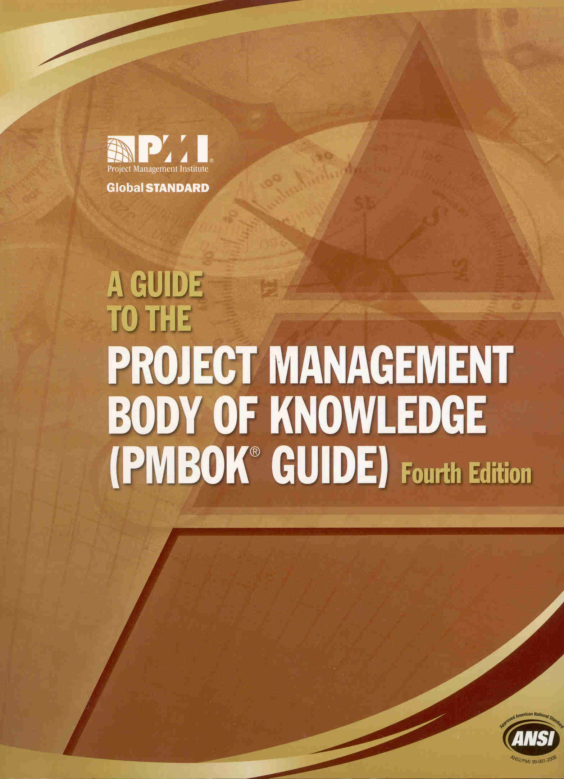
Projects Support Office – Our approach
Pragmatic approach:
  Project Management Institute’s PMBoK = best practices in matter of PM
  Framework and lessons learned from LHC Project
      LHC QAP + Organization
      PPTEVM, EDMS, MTF…

Slide 5
Support along the 9 areas of the PMBoK

Slide 6
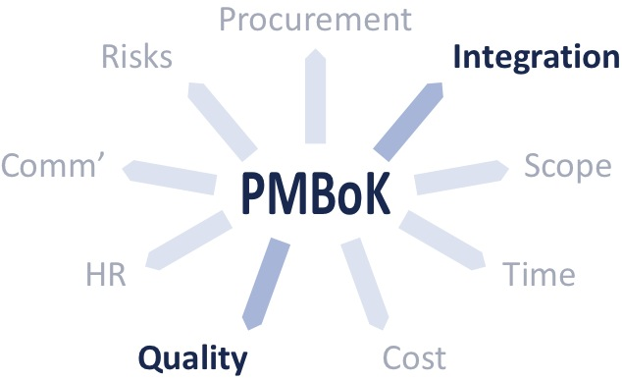
Integration & Quality
Project Integration Management includes the activities needed to identify, define, combine, unify and coordinate the various project management activities.
Project Quality Management includes the activities that determine quality policies, objectives and responsibilities so that the project will satisfy the needs for which it was undertaken.
Providing support to release Project Management Plans, a.k.a. Project QAP and Organization at CERN

Slide 7
Integration & Quality
Providing support to release
Project QAP and Organization
Providing a scheme for handling
Changes (Engineering Change Requests / Orders)
With other support services (EN, BE & GS Depts), providing scheme for Integration and Configuration Management
With other support services (HSE), providing scheme for Safety Documentation

Slide 8
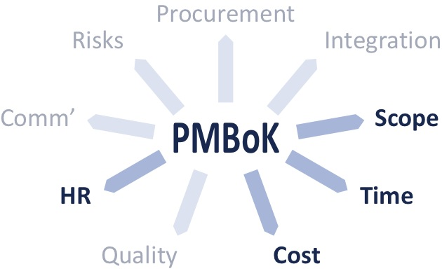
Scope, time, cost and HR
Project Scope Management includes
the activities needed to identify the
work required, and only the work
required to complete the project.
Project Time Management includes the activities needed
to manage timely completion of the project.
Project Cost Management includes the activities involved
in estimating, budgeting and controlling costs so that the project can be completed within the approved budget.
Project Human Resource Management includes the processes that organize, manage, and lead the project team. The project team is comprised of the people with assigned roles and responsibilities for completing the project.

Slide 9
Scope, time, cost and HR
Providing support
to feed PPTEVM:
    Work Breakdown Structure
    Definition of Activities
Providing support to release Master Schedules
With other support services (EN Dept.), providing support to release Co-ordination Schedules

Slide 10
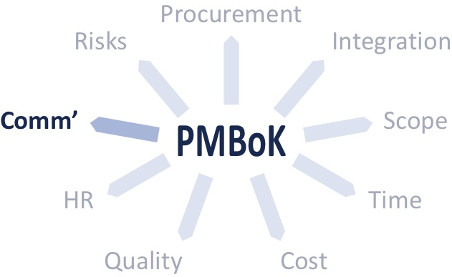
Communication
Project Communication Management
includes the processes required to
ensure timely and appropriate generation, collection, distribution, storage, retrieval,
and ultimate disposition of project information.
Providing a scheme for handling Documents:
  Document templates
  Document lifecycles in EDMS
Limited document handling support!
Providing support to design and develop Project Web Sites

Slide 11
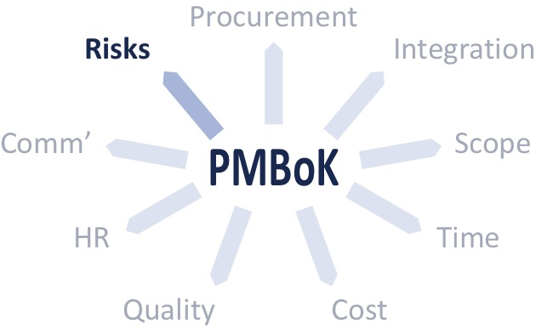
Risks
Project Risk Management includes the processes of conducting risk manage-ment planning, identification, analysis, response planning, and monitoring and control on a project.
In co-ordination with the CERN Risk Manage-ment Project, providing a scheme and support for managing project risks
On-going with Linac4 and HIE-ISOLDE

Slide 12
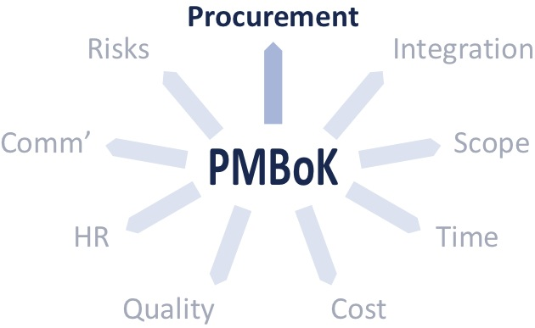
Procurement
Project Procurement Management includes the processes necessary to purchase or acquire products, services, or results needed from outside the project team.
In support to other services (FP Dept.), providing support to release Market Survey and Invitation for Tender Technical Documents
In support to other services, providing support to release Technical Documents to be appended to Collaboration Agreements
In-kind Contributions

Slide 13
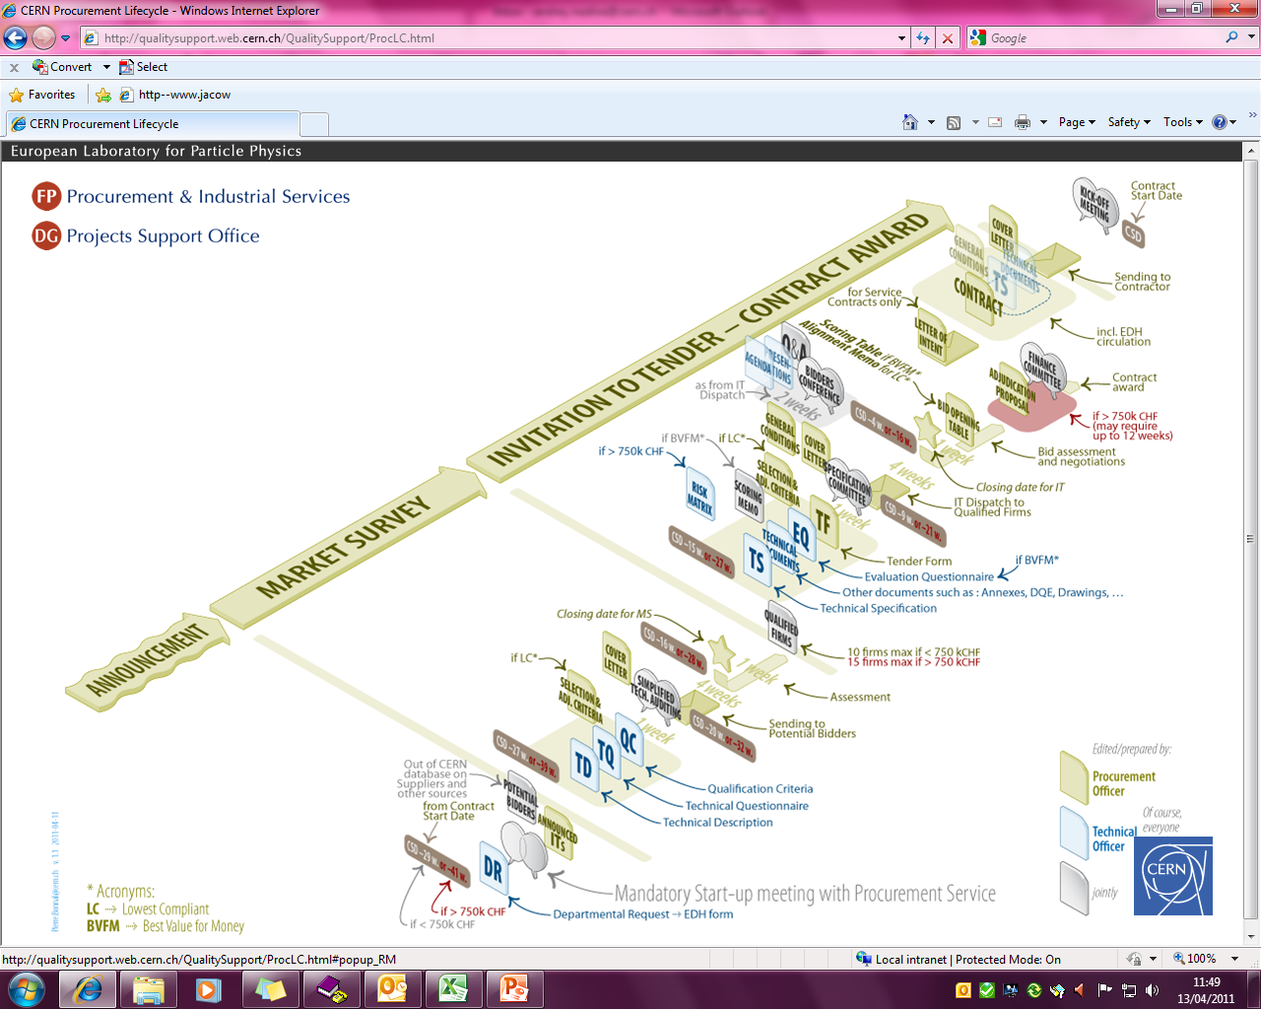
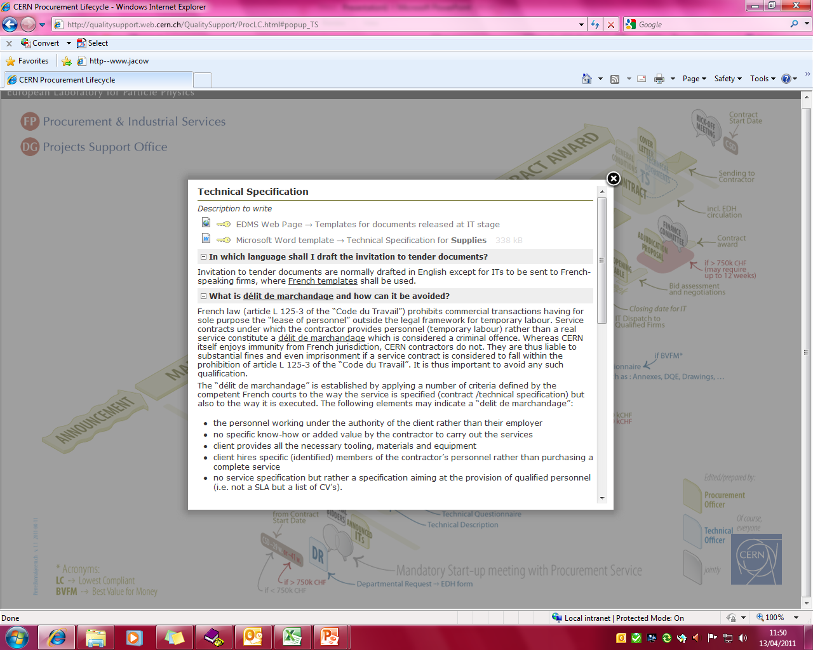
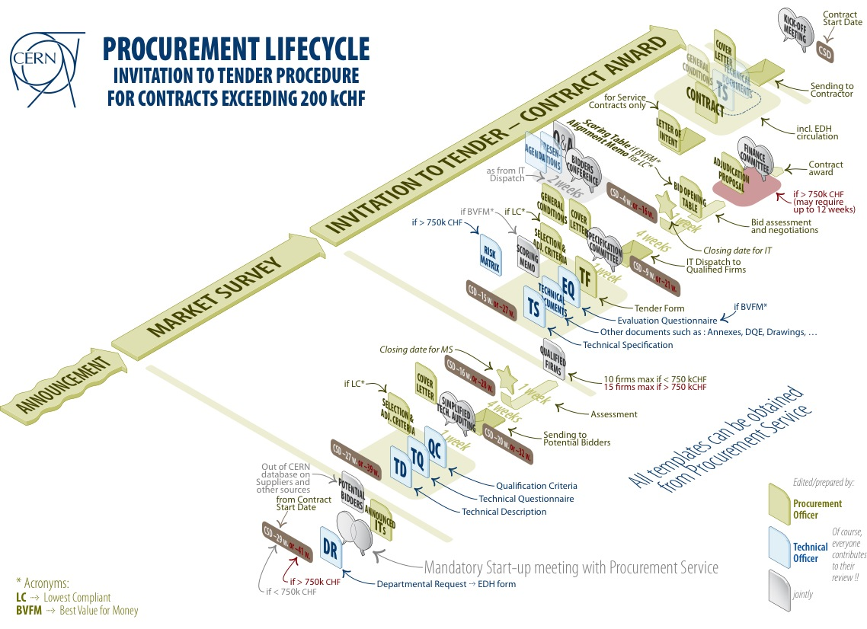
Procurement
https://qualitysupport.web.cern.ch/QualitySupport
Notes:
3 messages with this slide
The supply procurement process has been clarified within QAWG and Spec Committee for A&T sector together with the Purchasing Service FP/IP,
Based on LHC experience, the various documents have been harmonized both on their content and on their form to rationalise technical descriptions and technical specifications,
A web site is now available to access directly to the up-to-date templates and FAQs.

Slide 14
Conclusion
We will do our best with limited means
Systematization of “visual web guidelines”
    https://qualitysupport.web.cern.ch/QualitySupport
    In-kind contributions
    Safety File / Folder / Documentation
    Document and Product Lifecycle Management
    Project Planning, Costing and Scheduling
    Project Risk Management
Thank you. Questions?

