Slide 1
HL-LHC: scope, structure and management
HL-LHC internal kick-off day
15 April 2011

Slide 2
Content
Scope
Structure
Management
Situation of CERN budget
Situation of HiLumi FP7 DS

Slide 3
How the luminosity might evolve optimistic to 2012, then prudent: nominal
Based on 15 months LS1 now under change
Data from M. Lamont
Graph E. Todesco
NOT yet validated in LMC

Slide 4
How the luminosity might evolve optimistic to 2012, then nominal -cont
Based on 15 months LS1 now under change
Data from M. Lamont
Graph E. Todesco
NOT yet validated in LMC
220 inv fb by
end of 2020

Slide 5
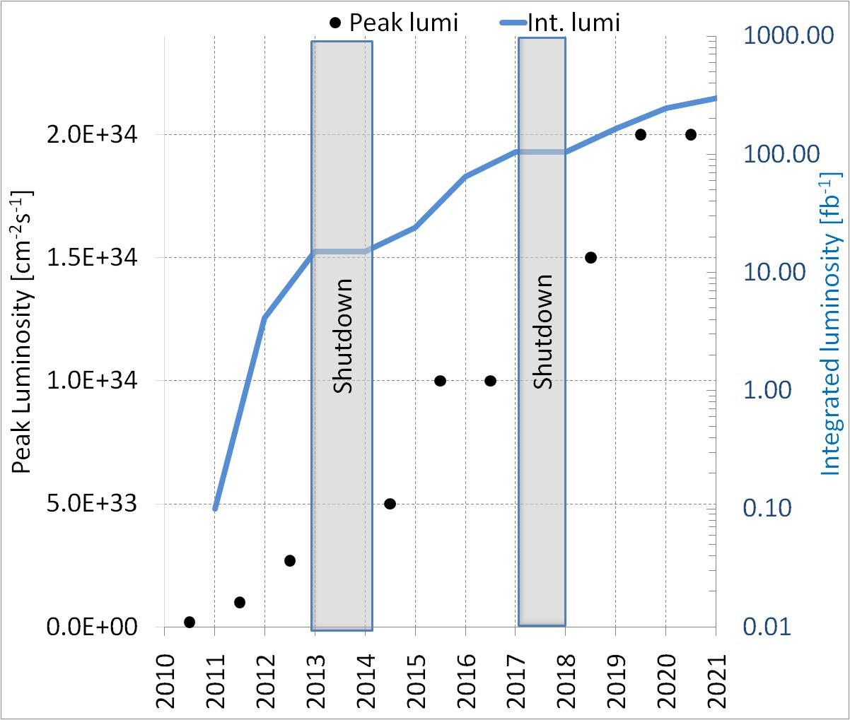
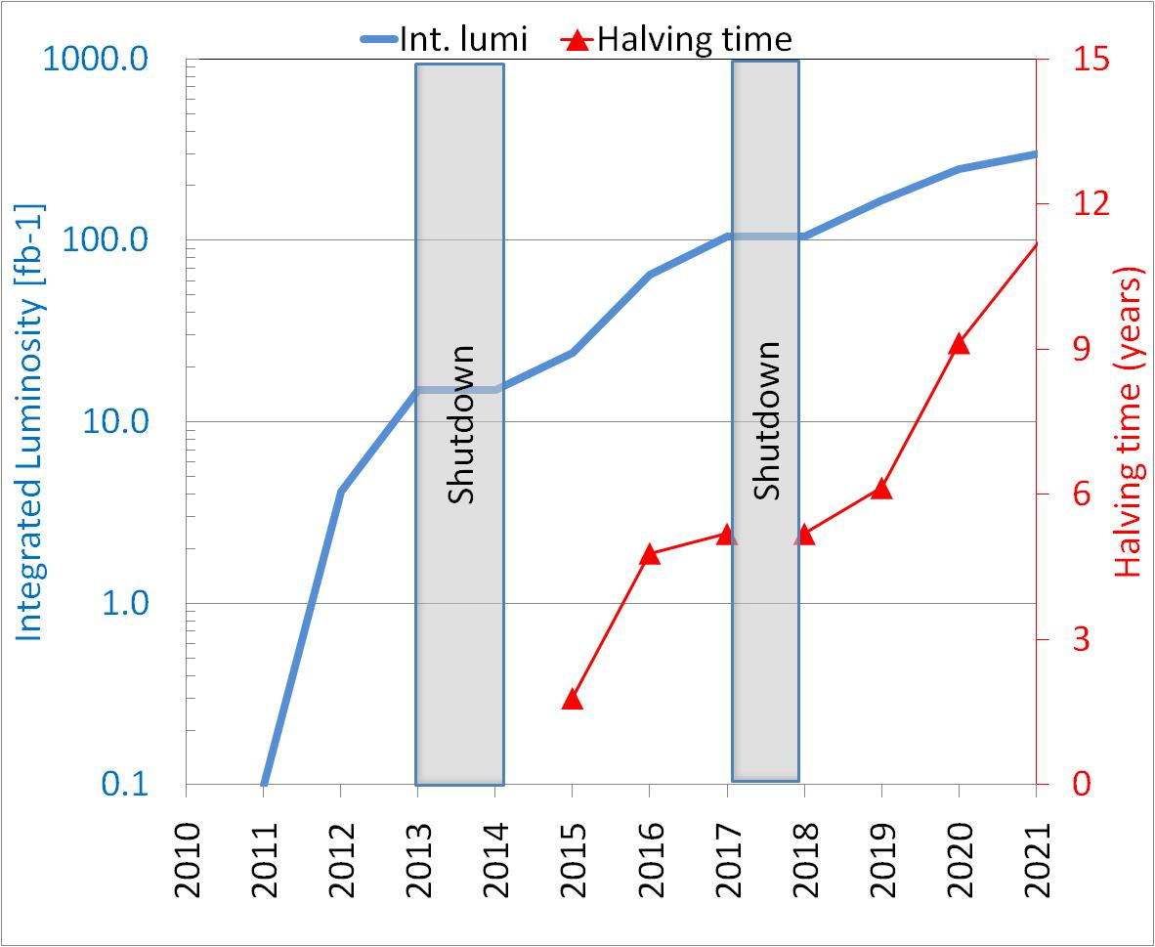
Lumi evolution: more otpimistic
(ultimate=2xnominal) is reached
Based on 15 months LS1 now under change
Data from M. Lamont
Graph E. Todesco
NOT yet validated in LMC
In such case we may reach 320 inv. fb for end of 2020.
If LHC performs « nominal »: the upgrade is required by the saturation
If LHC performs better, saturation is 2 years later, but radiation limits may come in earlier

Slide 6
The goal
The main objective of HL-LHC is to implement a hardware configuration and a set of beam parameters that will allow the LHC to reach the following targets:
A peak luminosity of 5×10³⁴ cm⁻²s⁻¹ with levelling, allowing:
An integrated luminosity of 250 fb⁻¹ per year, enabling the goal of 3000 fb⁻¹ twelve years after the upgrade. This luminosity is more than ten times the luminosity reach of the first 10 years of the LHC lifetime.

Slide 7
Goal – cont.
Levelled lumi of LL_{p} =5⋅10³⁴ s⁻¹ cm⁻² (not Hz cm⁻²)
Annual integrated luminosty: IL =250 fb-1
  More than 1 fb⁻¹ a day
Which is more important? I guess IL . We take L_{p} as guideline, not a barrier, however it is understood that this is the nominal limit.
These goals are already questioning parameter space of Linear Collider: we need to be correct, optimist but not overoptimist

Slide 8
We need to have potential for L_{p} =10-15⋅10³⁴ (before levelling)
  Today the preferred baseline is to reach 5 10³⁴ and then « crabbing ». But may be we put crab at max immediately and then use another parameters.
  We cannot rely only on one scheme: we need to have scheme with very low β and not small β, we need to explore very high beam curent and moderate beam current, and having more than on leveling methods.
  Many actions will be needed in addition to the most visible being discussed today to reach integrated :
    Turn around time: will allow « releasing » beam current (protection)
    Stops, Shutdowns, etc…
      Advanced robotics and monitoring?
      Remove on surface of sensible equipments.
    To be worked out with experiments
    The upgrade is « ultimate consolidation », too. I see these actions as a « continuum » with some spike activities , the biggest being

Slide 9
Structure
By deliverable
  Study and R&D (big part in FP7 HiLumi Design Study and Eucard(2))
  Construction
    tooling&infrastructure, if needed,
    components ,
    Assembly
    Test (on surface)
  Installation, commissioning
This way external contribution are easy to evidence and to account
Also is easy to do a cost-to-completion and decision making by line management
My view is to agree at Management level the cost (M+P) and time profile, then transfer resources (with clear control) to Department/Groups. It is their job to efficiently manage it and our job to check, to see sufferance or excess and propose transfers/integrations. Contingency at CERN level (or Project with full transparency toward management, but see US project: in this way contingency is always used)
The cost-structure should be based on CORE-cost. This will easy in-kind contribution and make them visible.
Next slides: quick overview, details and substructure to be discussed with various leaders of projects and systems.

Slide 10
HL-LHC composition
Matching section and correctors
Collimation
Project
High Field Magnets R&D
Beam Diagnostics
HE-LHC Studies
Hardware Commissioning

Slide 11
HL-LHC management

Slide 21
Long term R&D aimed at SC R&D and validation via FRESCA2 (13 T 100 mm)
Preparation of EU Sc cable, tooling technologies (help from US-LRP)

Slide 22
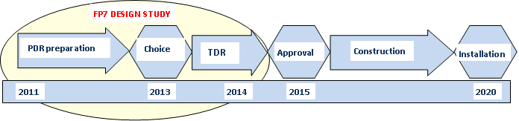
HiLumi FP7 Design Study
End of year

Slide 23
Large participation application 25 Nov 2010

Slide 24
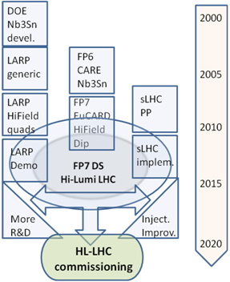
HiLumi is the focal point of 20 years of converging International collaboration
The collaboration wiht US on LHC upgrafe started during the cosntruction of LHC
EU programs have been instruemntal in federatin all EU efforts
With Hi-Lumi the coordination makes a step further: from coordinated R&D to a common project
CERN is not anymore the unique owner, rather is the motor and cathalizer of a wider effort.
Manged like a large detector collaboration (with CERN in special position as operator of LHC)

Slide 25
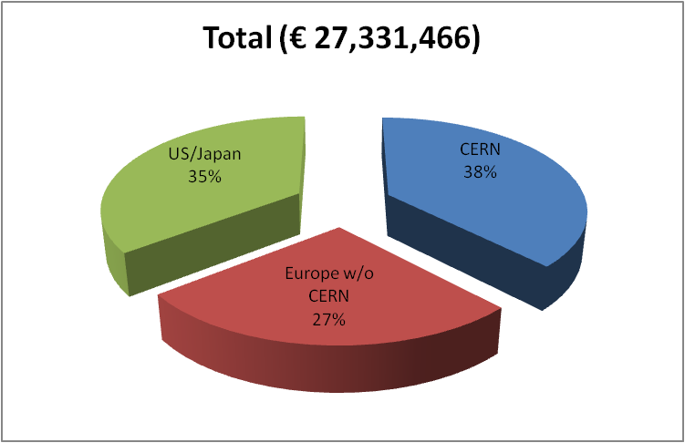
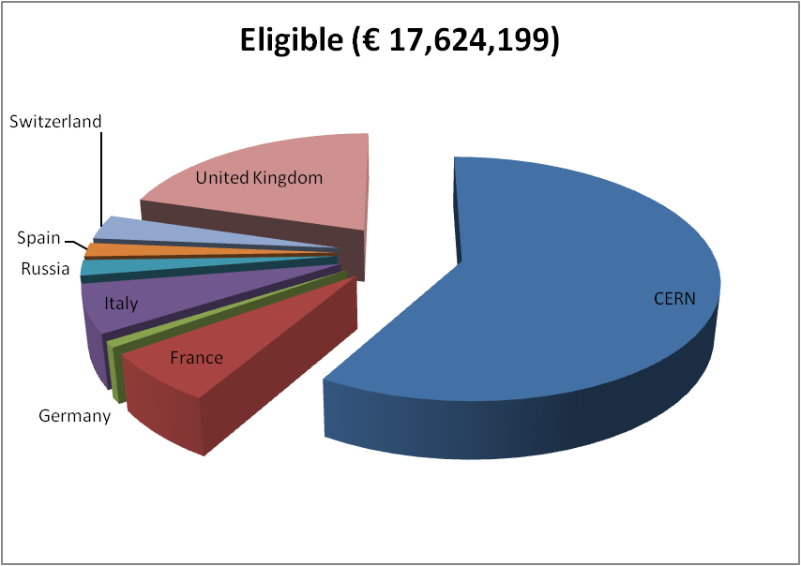
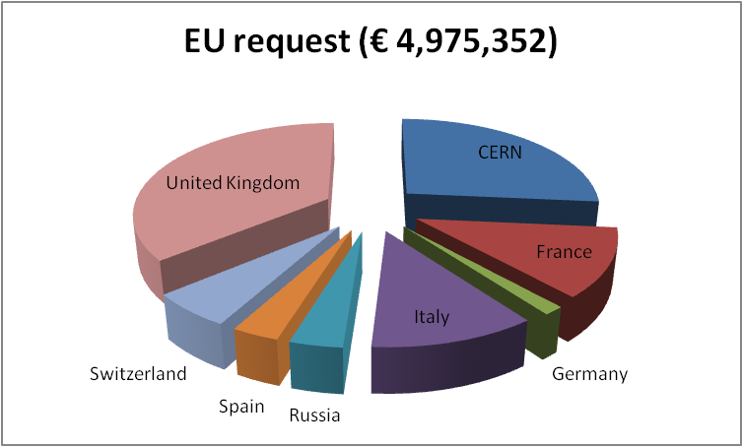
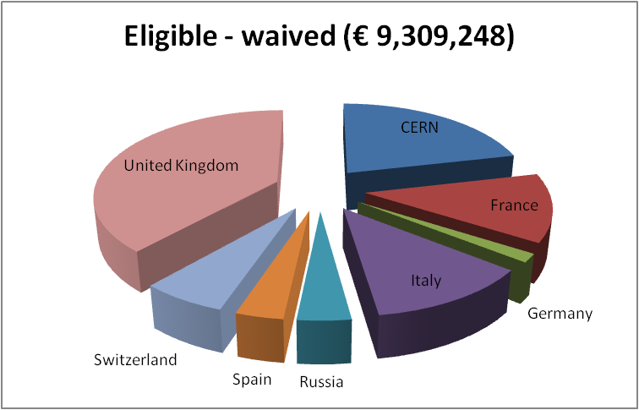
Budget FP7 HiLumi
CERN waives all technical works:
LHC is core program.
Only kept the CERN cost for managem.
Only EU research area
Waiving effect
N.1/67
Score 15/15
4.9 M€
50%
85% of CERN gen. mngt

Slide 26
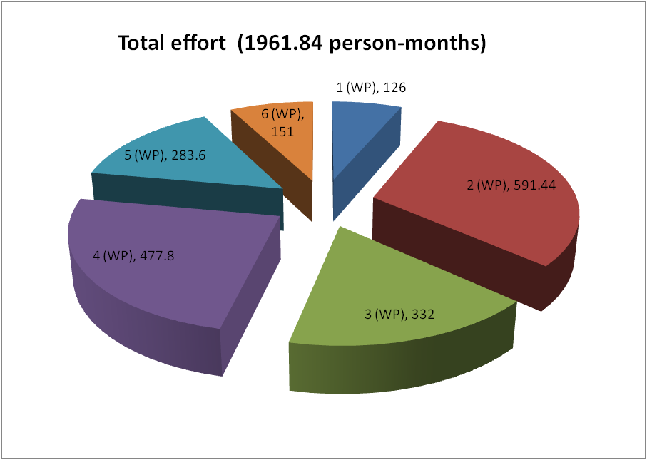
Budget cont.
Personnel for HiLumi by WP
Manag and Tech. Coord. (6%)
Acc. Physics and beam
Magnets for IR
Crab Cavities
Collimators
Sc links
Estimated cost for the the whole HL-LHC over 10 years in M€
Precise cost evaluation by end 2011

Slide 27
In-Kind contributions: targets
Profiting of LARP
  200 M$ from USA (US accounting)
5 G¥ (50 MCHF) from Japan
Others?
  Member states? Difficult or impossible?
    CH and FR are theobvious candidates
    Othr MSs (or Labs) with specific interest or exchange of help we give them
  Non MSs: we need to think wide…

Slide 28
conclusions
A luminous future
in front of us!!!
(Lucio: from Lucius = lux)

