Slide 1


KT Forum - Introduction
G. Anelli, CERN
03.10.2023

Slide 2
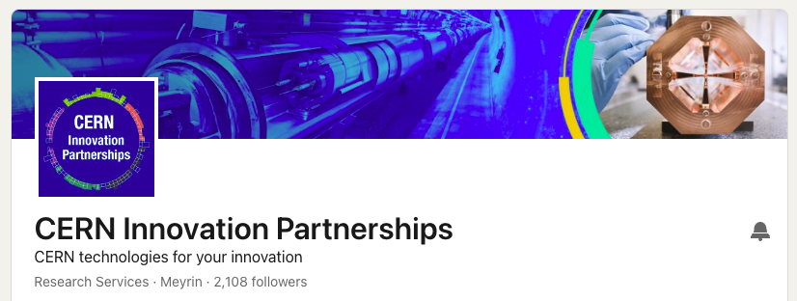
https://www.linkedin.com/showcase/cern-innovation-partnerships/
New channel: Follow us and share our posts

Slide 3

New brochure
https://cds.cern.ch/record/2861714/files/CERN-Brochure-2023-004-Eng.pdf

Slide 4
Internal
External
Hybrid
KT communication channels
See slides from Manuela/Marzena for a complete list of KT comms channels

Slide 5

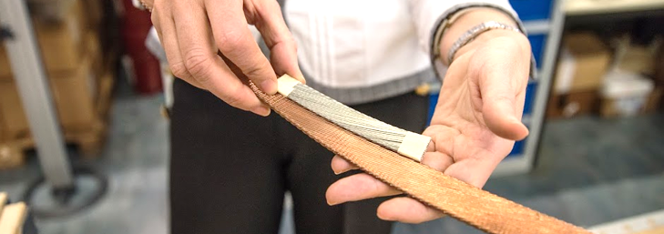
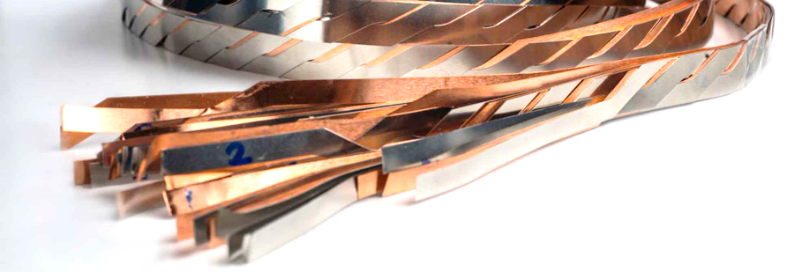
CERN competences on Superconducting Materials
what
apps
CERN uses a wide range of superconducting materials in the construction of its accelerators and experiments. Niobium titanium has been the workhorse for the LHC. Nb₃Sn is required to produce the high-field magnets needed for the high luminosity upgrade. A wide range of materials are being explored to enable the cables, magnets and devices required for the future.
Medical imaging devices (for example MRI)
Nuclear Magnetic Resonance (NMR) analysis magnets
Energy generation, storage and grid management
Supercomputing and data transmission
Transportation (for example maglev)
Knowhow and experience with various SC materials like
Niobium titanium (magnets and bus-bars)
Magnesium diboride (superconducting link for high luminosity upgrade)
Niobium tin (magnets for high luminosity upgrade)
HTS cuprates, YBCO and BSCCO (current leads and future magnets)
Knowhow and experience with various techniques and forms
Specification, analysis and collaborative development of wires and tapes
Production and testing of Nb-Ti, Nb₃Sn and HTS cables
Deposition of coatings and manufacturing of cavities
tech specs
Two new patents filed in 2023, we will share them as soon as they become available.

Slide 6
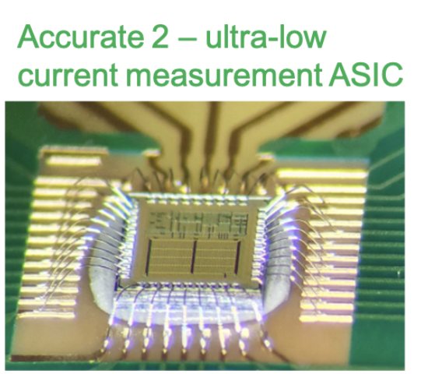
Development boards ready in Feb 2023.
New technology in the CVC portfolio:
ACCURATE 2 Integrated Circuit
ASIC capable of measuring femto amperes to Atto amperes.
Developed by Radio protection team at CERN to measure smallest possible currents.
Documentation and dossier will be available at the end of year.
Accurate 3 chip in development. Will be ready in 2024.

