Slide 1


KT Forum Working Group on KT Strategy Review
Summary of discussions and main conclusions
John Millard (PSI, CH) and Katharine Robertson (STFC, UK), on behalf of the WG
03.10.2023

Slide 2
CERN KT strategy review
Slide from G. Anelli presentation to the KT Forum in March 2023
This year we would like to review our strategy and policies, and your inputs are important to us
We propose to make a relatively small WG with some of you, and will report the outcome to the KT Forum
Any volunteers?
Expected workload: 3 or 4 half days in 2023

Slide 3
Composition of the Working Group
KT Forum Members:
  Mariangela Cestelli Guidi, INFN, IT
  Hakan Kiziltoprak, TOBB, TR
  John Millard, PSI, CH
  Katharine Robertson, STFC, UK
  Martin Uhlig, DESY, DE
  Jan Visser, NIKHEF, NL
From the CERN Knowledge Transfer Group: Giovanni Anelli, Manuela Cirilli, Han Dols, Anais Rassat

Slide 4
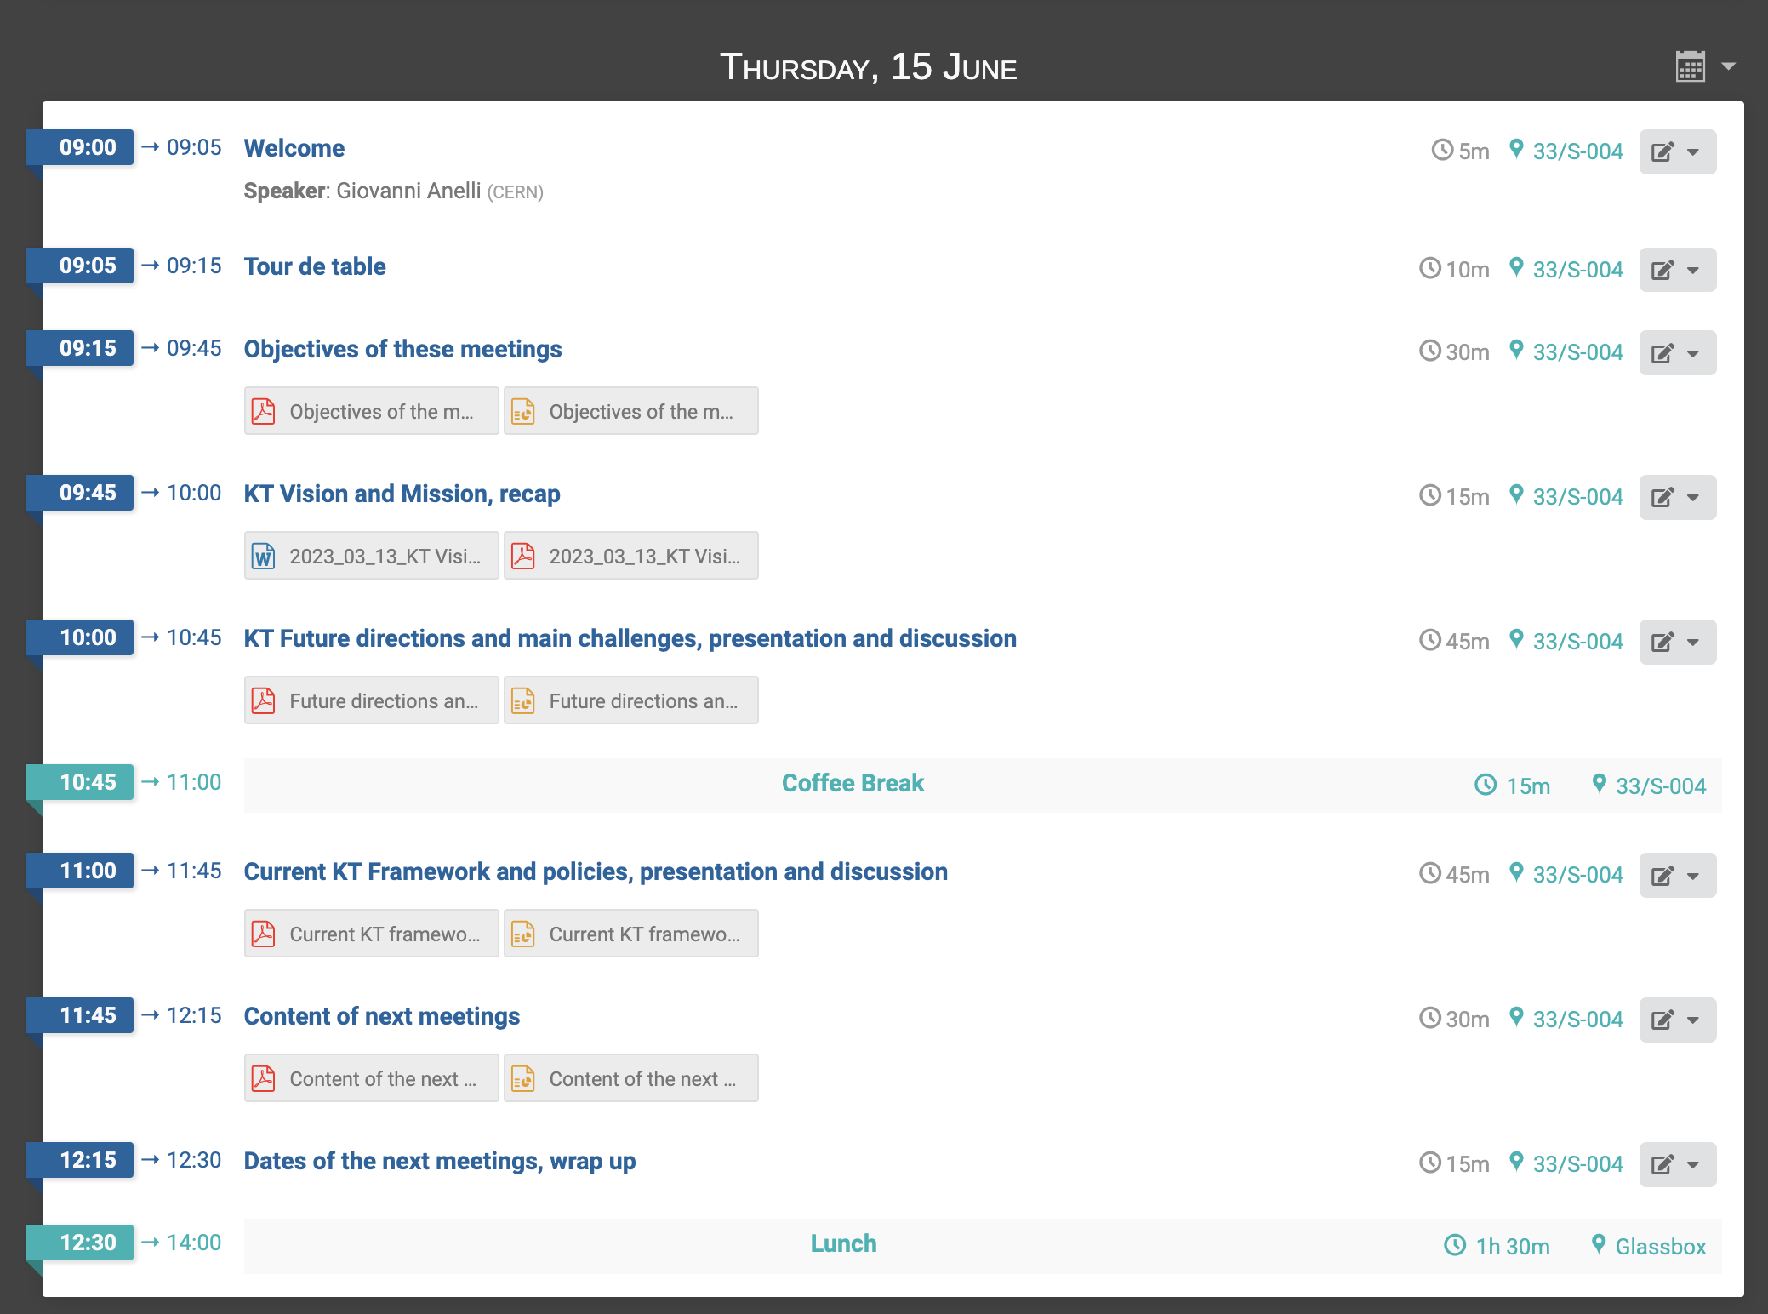
First meeting
15.06.2023
https://indico.cern.ch/event/1281458/
PWD: KTstrategy

Slide 5
Objectives of the meetings
Knowledge Transfer is part of the mission of CERN
Time to review the KT strategy. Is it still adapted to the future needs of the Organization (e.g. FCC)?
In this process the KT group wants to collect inputs from the KT Forum (through this WG), such as, for example:
  How are the current CERN KT activities perceived in the MS? Is the amount of KT projects and activities perceived as too little / adequate / too much?
  When talking about KT to your country, what are the most important aspects for you?
  Do you agree with the main principles adopted by CERN for its KT activities?
  Is there anything obviously missing? Or things you would do very differently?
  Do you feel engaged enough and if not, how could CERN KT do better?

Slide 6
During the first meeting, we:
Agreed on the objectives of the meetings
Discussed CERN KT Vision and Mission statements
Discussed KT’s future directions and main challenges
Reviewed the current KT framework
Decided on the topics to be discussed at the following meeting(s)

Slide 7
Main conclusions of the first meeting:
The policy framework presented is currently appropriate, but:
  It will probably need to be adapted to the increasing ambitions of CERN in terms of KT
  It’s implementation still has barriers (industry interest, availability of CERN experts) difficult to overcome
There needs to be more examples of successful KT in the member states
There is an issue related to the visibility of KT activities and the KT group in the member states
Is there clarity about the role of the KT Forum? Delegates should review the mandate (available at kt.cern)
Main challenges:
  Internal support from CERN personnel
  Visibility within and outside CERN
Future directions: campus development?

Slide 8
Topics for the next meeting:
Based on the conclusions of the first meeting it was decided to focus the following meeting on:
  A “CERN innovation campus”: would it make sense and which shape should it take?
  Visibility and communication: What do we do today and what should we change for the future?

Slide 9
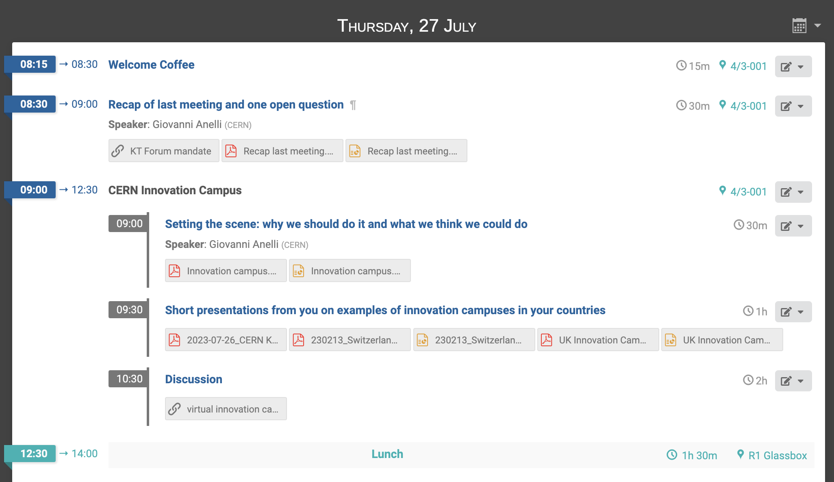
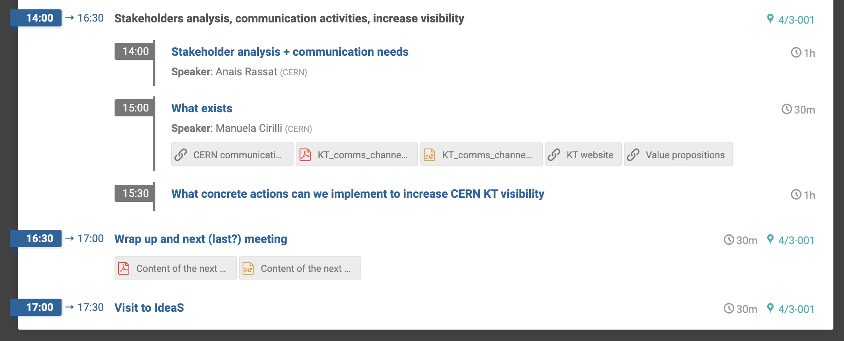
Second meeting
27.07.2023
https://indico.cern.ch/event/1297667/
PWD: KTstrategy

Slide 10
Main conclusions of the second meeting
Visibility and Communications
A quick refresher – the KT forum mandate:
  https://kt.cern/sites/default/files/resource/other/ktforummandate/ktforummandate_2.pdf
  Please review!
Are you aware of all the communication activities of the KT group? If not, please have a look at M. Cirilli’s presentation and… take part! In particular:
  CERN KT Linkedin channel: sign up and share with your contacts!
  Ease the communications to key stakeholders in the Member States (Council delegates, decision makers, ministers, companies – including start-ups) (KT to share material with you)
  Events in the member states: interested? Contact KT!

Slide 11
CERN Innovation Campus
Innovation Campus: what is it?
  A dedicated facility that fosters innovation, collaboration and entrepreneurship. It is a physical space designed to bring together various stakeholders, such as universities, research institutions, technology companies, startups and government agencies, to collaborate on research, development, and commercialization of new technologies, products and services. (ChatGPT inspired)
Should we at CERN?
  Why should we / shouldn’t we have something like this at CERN
  Who are the potential partners (companies, VCs, other academic partners, …) and what’s in it for them
  What (which activities) should be covered by the CERN Innovation campus
  How would we measure success

Slide 12
Main conclusions of the second meeting
CERN Innovation Campus
A CERN innovation campus could be hugely valuable in:
  demonstrating the value of the CERN model - unique globally - international cooperation on big innovation challenges
  demonstrating the value of Big Science: a centre for international collaboration on core internationally significant technologies
Key learnings from the presented initiatives in some MS (see indico):
  It is a long journey, it will take time to develop it
  There is a risk of doing nothing: “start small” and grow it organically over time
Important aspects to be considered:
  proportionate participation and benefits of / for all MS
  complementarity with existing initiatives in the MS
  prefer network approach: expand cooperation with existing technology transfer center or hubs in MS
  prefer decentralised initiatives over local ones (e.g. a purely local innovation campus @CERN)
CERN KT to work on a sensible plan, which takes into account our inputs, and will presented to us in the future

