Slide 1
i2Planet
Welcome and Introduction
1st Nov 2023

Slide 2
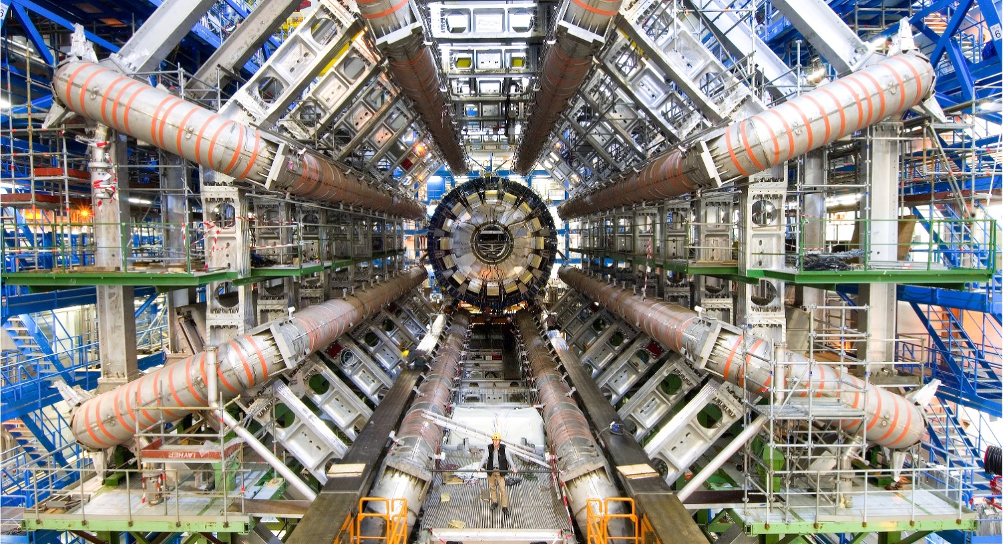
CERN is the world’s biggest laboratory for particle physics.
What is the universe made of?
How did the universe begin?

Slide 3
Why IdeaSquare?
We believe that for fundamental change to be made, we need more than traditional innovation methods and mindsets.
We enable students and innovators to imagine a future worth fighting for, and we give them the tools and confidence to start building that future.

Slide 4
Intersecting societal challenges with deep tech
Societal needs (UN SDGs)
i2
Futures thinking
Exponential thinking
Speculative design
Behavioral design
Deep tech
(detection & imaging, criogenics…)

Slide 5
Our specialties
Order of magnitude thinking
(+ estimations!)
    - Ideas should be disruptive enough to generate excitement,
    - While also having a substantial basis behind - “Do the math”
Design-, Systemic- and Exponential thinking
    Going for exponential ideas
    Thinking in planetary levels
    Nothing is so great that there is nothing bad: what are the implications of your solution?
  10⁻¹²s
  10³¹
  10⁻⁴³s

Slide 6
Full-fledged accredited program in 2025
Teaching Readiness Level
?? Pilots in 2024
2,5-day development in Nov workshop with current and future collaborators
1,5-day pilot with CBI A3
2-week pilot with CDM, ESADE, Lahti University
Holodeck
The idea was born
Master level
Design, engineering, computer science
DE, US, PL, AUS
Space-time continuum
PhD, bachelor, master
Design, engineering, computer science, physics.

Slide 7
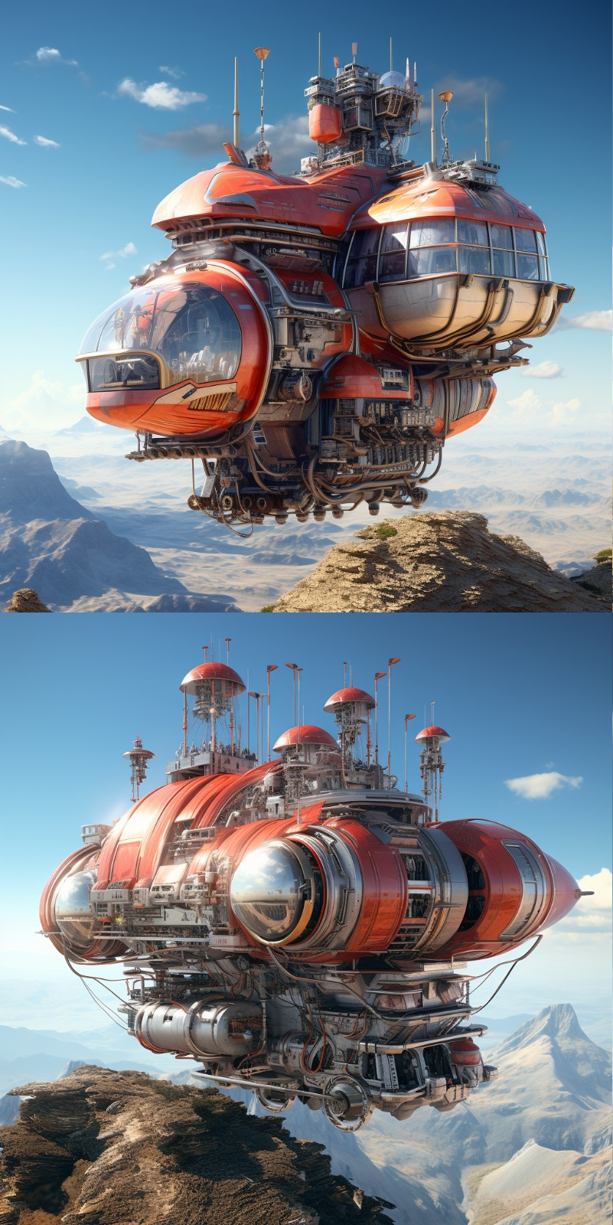
Exploring the i2P concept for design, sustainability, collaboration and creativity in higher education.
Seeking best practices, sharing experiences, and experiencing the method.
Aspiring to create a comprehensive curriculum with specific learning outcomes and flexible formats.
Balancing technical and societal aspects while engaging diverse student backgrounds.
Industry-focused workshops for future thinking, team/leadership skills, and innovation.
Expanding our networks for collaboration and co-teaching, while also staying connected with CERN.

Slide 8


The philosophy for the next two days
Imagining and co-creating the best program experience we could offer together, our ideal vision
Bringing it back to our current setting and planning a pathway for implementation on the short and medium term
Planet icons created by Victoruler - Flaticon
Notes:
Add explanation to intro on Thursday that this day we work on the ideal vision, that may be so amazing that it would never be attainable in real, and on Friday we will translate what that could mean in practice in the short and mid term

Slide 9

Our goals
co-create a prototype of a modular curriculum that can be adapted to different contexts and partners.
transition timeline towards a full-fledged program in 2025.

