Slide 1
I.FAST
9th Steering Committee Meeting
Coordinator Report
M. Vretenar, CERN, Project Coordinator
29 September 2023

Slide 2
Agenda for this Meeting
Introduction, amendment, status of milestones and deliverables
Planning for Periodic Report 2 (April 2024)
Location and structure of next Annual Meeting
Discussion on the SAC Report of April
Information on recent contacts with DG-RTD
Quick “tour de table” on open questions and issues.
Meetings for 2023/24
29 September: Steering Committee meeting for WP Coordinators: general progress, organisational issues.
December 2023: Open Steering Committee meeting for Task Leaders: technical progress, deliverables, milestones.
February 2024: Steering Committee meeting for WP Coordinators: general progress, organisational issues.
April 2024: Annual Meeting (technical progress, SAC, Governing Board, etc.).
June 2024: Steering Committee meeting for WP Coordinators: general progress, organisational issues.

Slide 3
General points
End of October we will be at M30, 62% of the project.
Good progress visible in the (delayed…) Deliverables, and a bit less in the Milestones.
We (still) have a good reputation in Brussels, as you will see in my report from a visit to Brussels in July.
It is time to start preparation for the 2nd periodic Report (deadline: June 2024) and for the Annual Meeting of April 2024.
Change in the I.FAST Coordination: R. Assmann, WP Coordinator for WP6 (Novel accelerators), has moved from DESY to GSI. Since GSI is not active in the WP, his Deputy M. Ferrario (INFN) becomes Coordinator

Slide 4
Delayed Deliverables and extended Tasks
D2.3 Industrial Training Scheme to M36.
D7.5 Construction of the XLS Accelerating Structure Pre-prototype to M32.
D12.3 Prototype of Internal RF Ion Source for Cyclotrons to M31.
D13.1 Strategy for the development of AMICI and Del13.2 Report on the development and promotion of services to Industry, to M30.
D13.3 GaN RF Amplifier Module at KW level, to M33.
Extended Tasks:
Task 2.3 Challenge Based Innovation (to M48)
Task 2.4 Industrial Training associated with Knowledge Transfer (to M36)
Task 10.4 Development of AM-manufactured SC RF cavities (to M36)
Task 12.3 Design of internal RF Ion Source for Cyclotrons (to M36)
Task 13.1 Strategy for development of AMICI TI (to M30)
Task 13.2 Developing and promoting services to industry (to M30)
Task 13.3 New RF amplifiers based on GaN (to M36)
Letter sent to REA Officer on 8 May (and accepted on 10.5):

Slide 5
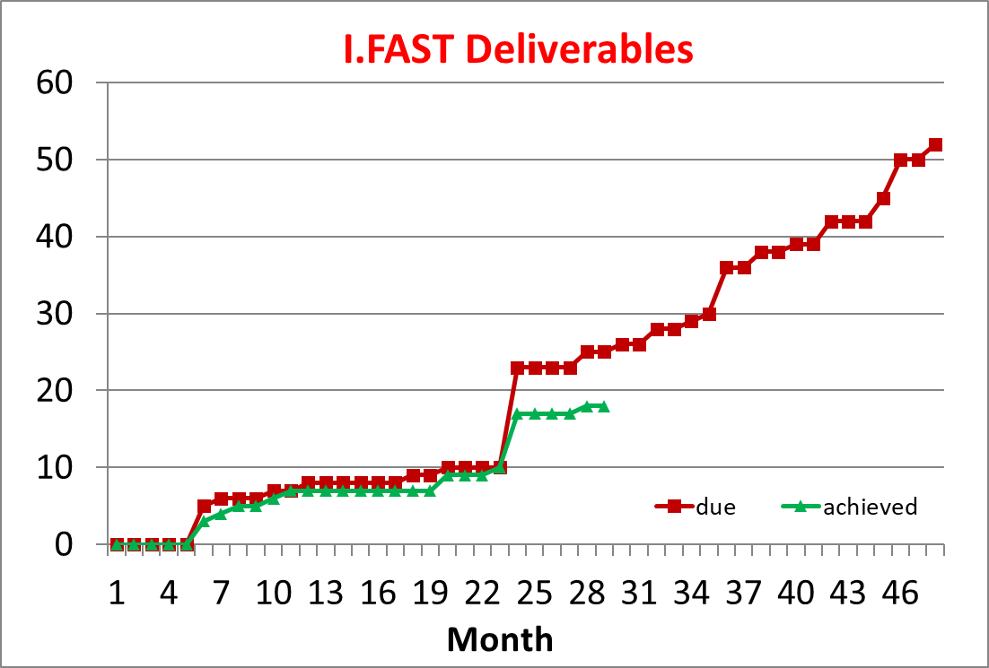
Status of Deliverables
On paper, we are missing 7 Deliverables, but 6 delays were authorised by the EC.
D11.3 (Prototype PM quad) due in August (M28) to M34 no news
3 Deliverables are due for M30 (end October): D13.1, D13.2 (AMICI) and D10.1 (AM applications).
1 Deliverable is due for M31 (end November): D12.3 (prototype source for cyclotrons).
3 Deliverables are due for M32 (end December): D7.5 (XLS), D4.3 (beam windows – no news), D8.6 (nuclotron cable).
Task11.3 (B. Shepherd) extended to M40 in PR1. D11.3 to be delayed (M34)?

Slide 6
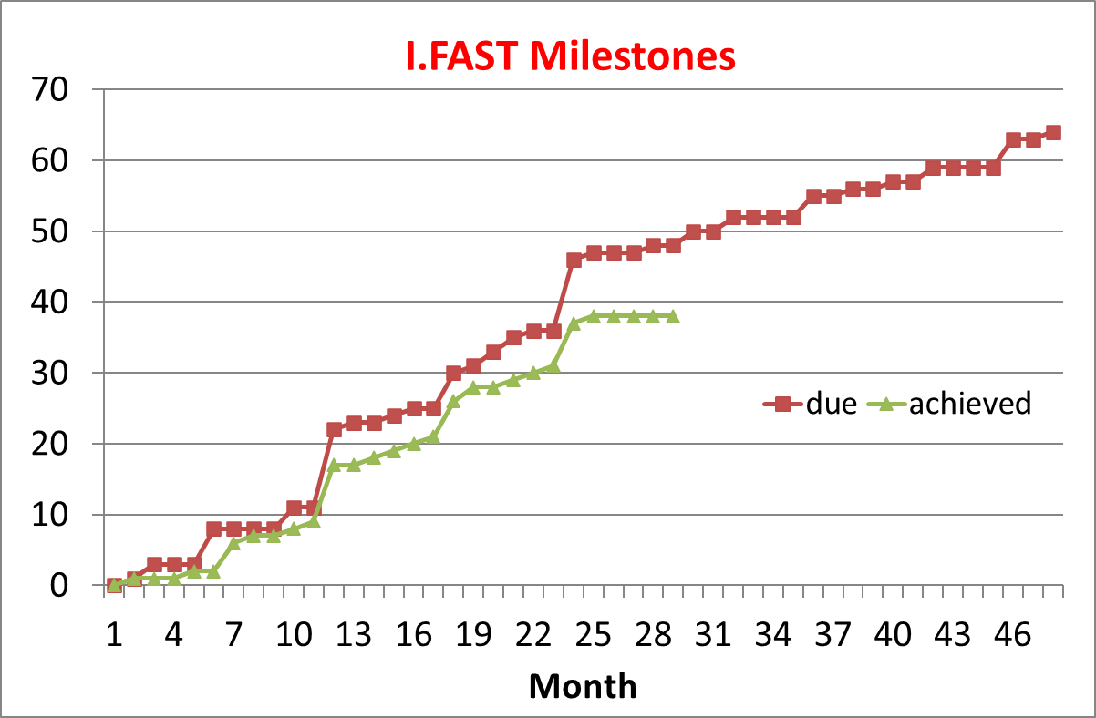
Status of Milestones
We are late by 10 Milestones (/48)!
MS46 (SC/AM, Pepato) delayed to M30 no news.
MS5 (ACO Workshop) no news.
MS60: delay related to D12.3.
MS31 (CCT demonstrator): promised now.
MS30 (CompactLight) delayed to M48.
MS61 (12.1): after Deliverable.
MS52 (Workshop efficient magnets): to M34.
MS26 (optics for ELETTRA): coming…
MS56 late, related to D11.3 (PM magnets)
MS37 (thin film Workshop), delayed to November 23.

Slide 7
Amendment to the GA (Grant Agreement)
Slides from Cloé Levointurier-Vajda
Final signature achieved in August 2023. See email Cloé sent on 18.08.2023.
Include the addition of Ecole Polytechnique (EP) as linked third party (LTP) to CNRS (Art. 14), acting in WP4, task 4.2 IIF (KAIO Accelerator project)
Welcome!
As agreed between I.FAST Management Team and our REA Project Officer, not all budget changes voted by the GB since the beginning of the project have been included in this amendment. However, the GB votes prevails. This means the Annex 2 (Estimated budget of the action) of the amended GA is not up-to-date.

Slide 8
Amendment to the GA (Grant Agreement)
Slides from Cloé Levointurier-Vajda
Final signature achieved in August 2023. See email Cloé sent on 18.08.2023.
Latest version of the budget have been shared in the 18.08.2023 email from Cloé.
If a beneficiary wishes to receive their detailed budget (per WP, and with LTP or Partner Organisations if relevant), please ask Cloé
cloe.levointurier-vajda@cern.ch
A Consortium Amendment is being prepared to include latest changes, incl. latest version of the budget summary tables for all Beneficiaries and Partner Organisations.

Slide 9
Latest version of budget table (prevails on Annex 2)
Slides from Cloé Levointurier-Vajda

Slide 10
Latest version of budget table (prevails on Annex 2)
Slides from Cloé Levointurier-Vajda

Slide 11
Example of detailed budget table that can be sent upon request for Requested EU contribution [GSI]
Slides from Cloé Levointurier-Vajda

Slide 12
Example of detailed budget table that can be sent upon request for Full costs [GSI]
Slides from Cloé Levointurier-Vajda

Slide 13

Periodic Report 2

Slide 14
Periodic report 2 – technical part
Covers the second 18-month period (October 2022 – April 2024)
Must be submitted 2 months after end of period (30 June 2024)
March 2024: templates are sent to all Task Leaders, with copy to WP Leaders.
End of April 2024: deadline for sending the contributions to Valérie, who assembles the WP Sections and sends them to the WP Coordinators for validation.
15 May 2024: deadline for the WP Coordinators to send WP chapters to Valérie.
End of May: complete document sent to WP Coordinators for approval.
15 June: Report ready for submission.

Slide 15
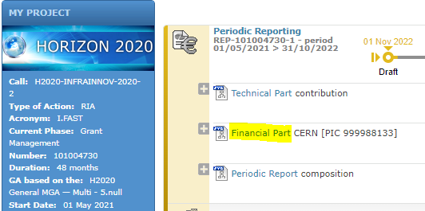
Financial reporting - What is needed, why and when
Slides from Cloé Levointurier-Vajda
IRUS
  IRUS template (Excel file) will be sent in April 2024
  IRUS file to be sent back by email, by 20.05.2024 (J+20)
  Including technical/scientific explanation
  on deviation WP if <55% or >95%
FS and associated Use of Resources [PaCo + FSIGN]
For beneficiaries only
  On the Portal, Periodic Reporting module, Financial part
  Usually done by Financial Officer / Accounting Team
  As soon as possible and no later than 15.06.2024

Slide 16
Financial reporting - What is needed, why and when
Slides from Cloé Levointurier-Vajda
Additional information needed by 15.06.2024 at the latest
  If you are requesting <55% or >95% of your maximum grant amount
  If you are significantly deviating from your estimated funding rate
  If you are significantly deviating from your estimated average personnel cost
  Please justify, or expect me to ask you questions and/or I send you back your IRUS and/or FS for revision

Slide 17
Financial reporting - What is needed, why and when
Slides from Cloé Levointurier-Vajda
Adjustment to P1 data is possible during P2 reporting
In case you did not report eligible costs incurred between May 2021 and November 2022 (P1) during P1 reporting exercise [positive adjustment]
or did report ineligible costs [negative adjustment]
  You can send a revised IRUS file for P1 in the same time as your P2 IRUS file
  You can submit a Financial Statement (positive or negative) for P1 in the same time as your P2 Financial Statement - For beneficiaries only
  Please justify reason for adjustment, or expect me to ask you questions and/or I send you back your IRUS and/or FS for revision

Slide 18
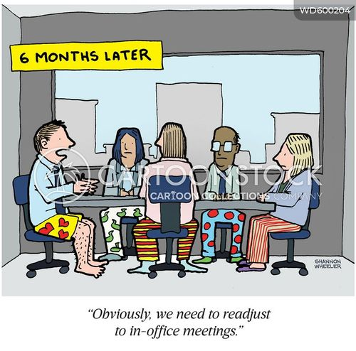
2024 Annual Meeting

Slide 19
Tentative Agenda (based on feedback from 2023)
 | Morning | Afternoon | Evening
Tuesday 16/04 | Parallel meetings | Parallel meetings
Wednesday 19/04 | Industry Workshop? | Plenary meeting | Welcome Drink
Thursday 20/04 | Plenary meeting + Mini-Workshop | Plenary meeting + IFF projects | Banquet
Friday 21/04 | Plenary meeting | SAC Report Governing Board Steering Committee
w.r.t. Trieste, half a day more for Plenary Meeting (including mini-workshop and IIF)
Friday: Governing Board at the end (14:00-16:00). Steering committee 16:00-17:00
Foreseen more time for questions and coffee-breaks.
Task presentations must be centred on last year progress (better: last 18 months)

Slide 20

What we need from you
Number of parallel meetings on Tuesday and We morning
Industry Workshop to be confirmed
Topic for interdisciplinary Workshop (we had AM and AI …)
Options for professional visits (e.g. Orsay lab)?
Annual Meeting Location
PARIS!
With my thanks to S. Leray, A.L. Pelle (CEA), M. Baylac, N. Delerue (CNRS) for their kind support with the organisation.
Paris is big, we are considering 2 options:

Slide 21
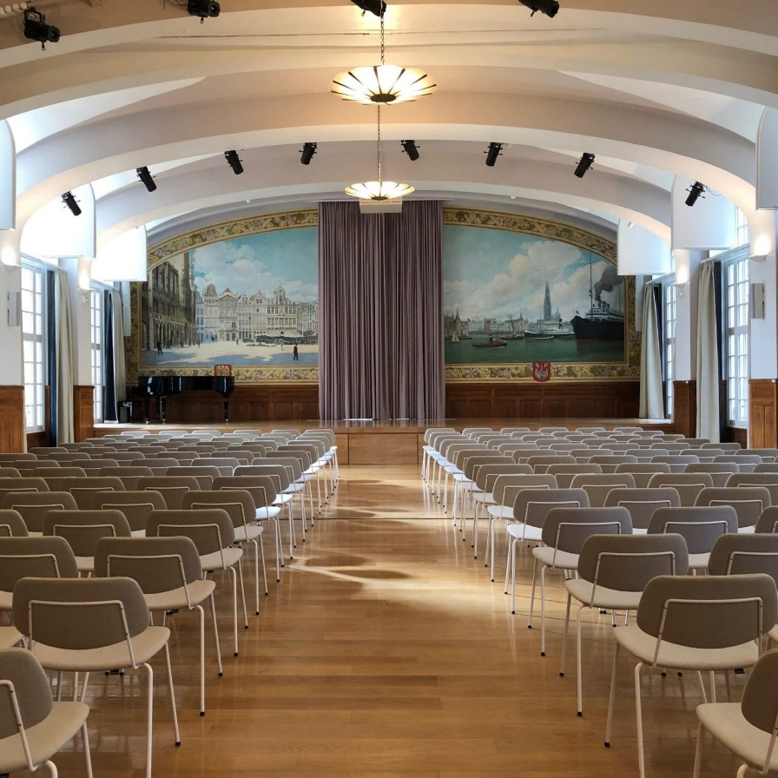
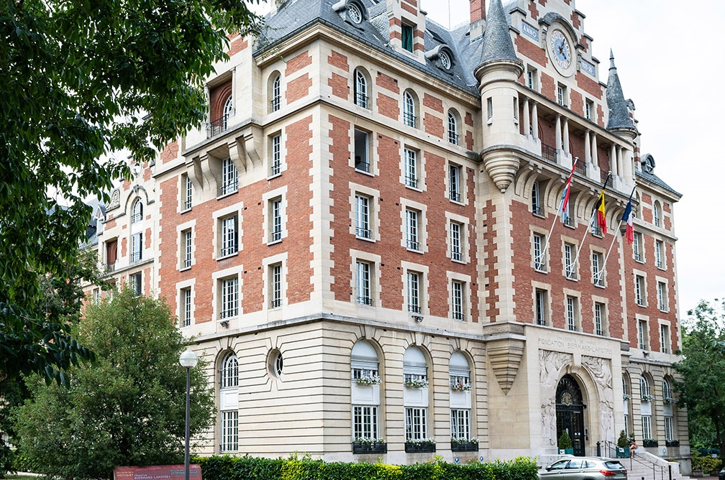
Option 1: Cité Internationale Universitaire
Large campus with unique Art Deco buildings and park, south of Paris near Parc Montsouris, RER stop in front of campus.
Salle des Fêtes of the Biermans Foundation (Belgian college), 400 m2, up to 300 people, can be divided in 3 rooms, wifi.
Lunches in nearby cafeteria (5’ walk).
Accomodation on campus (TDC), 2 hotels at < 1 km, or anywhere in Paris.
Cost: 24,600 € for 4 days (Tue – Fri).

Slide 22
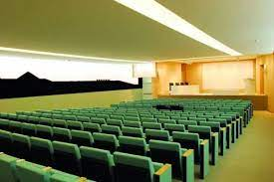
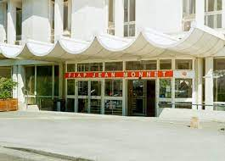
Option 2: FIAP Centre Jean Monnet
Campus in Paris South (14éme). Metro stop nearby.
Auditorium 198 places, 193 m2. Smaller rooms available.
Lunches in campus restaurant.
Accomodation: on campus (student hostel) or nearby hotels.
Cost: 34,340 € for 4 days (Tue – Fri) including lunches and coffee-breaks.

Slide 23
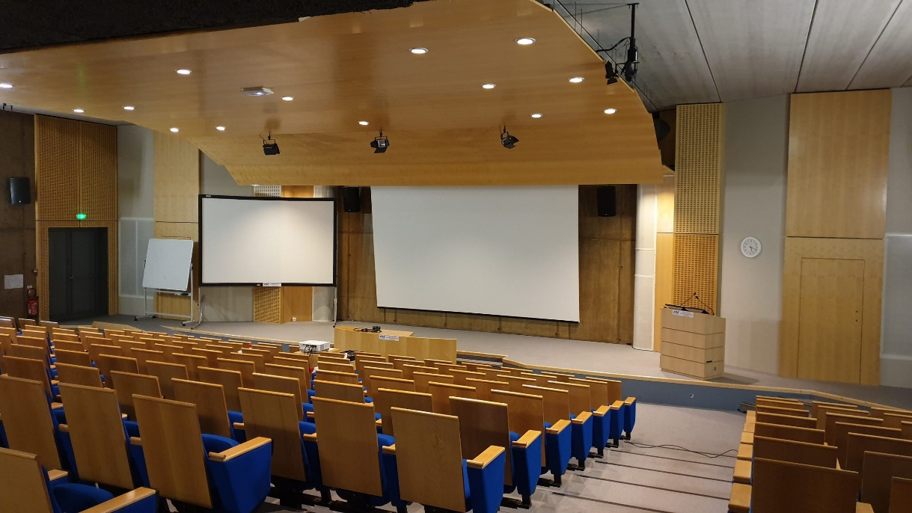
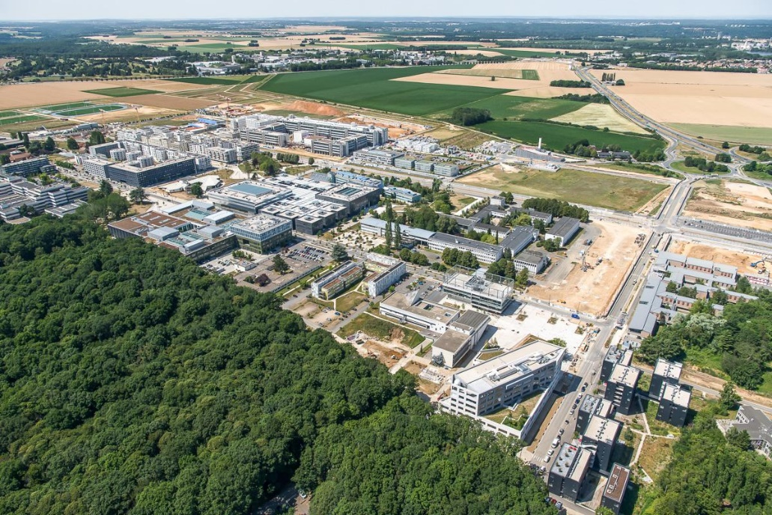
Option 3: Orsay Campus, IJCLab (ex-LAL)
Université de Paris Campus d’Orsay, 400 m from Orsay RER station.
IJCLab Auditorium reserved, up to 250 people. Difficult to find rooms for parallel sessions.
Limited space for buffet lunches and coffee breaks.
Accomodation options: a) one (small) hotel at walking distance, b) Paris South (we can organise a shuttle bus), c) Paris downtown(38 minutes RER to Saint-Michel).
Low cost: few 1,000 €’s (plus shuttles ).

Slide 24
Altrnative Locations
Is it worth exploring other options ?
Other conference centres in Paris (but prices are quite standard)?
Other locations in the Saclay area?
For information: we have about 70,000 € left for the last 2 meetings (2024 and 2025).
The Trieste conference rooms and coffee breaks-lunches costed about 15,000 €.

Slide 25
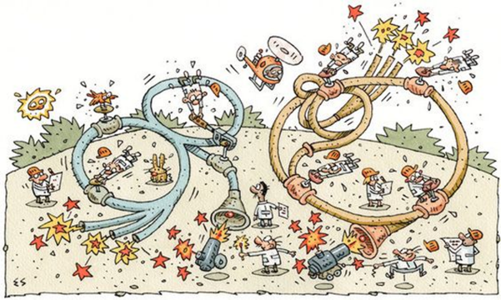
Thank you for your attention!
Image credit: Elwood H. Smith, The New York Times

