Slide 1
password
Tsp@2023

Slide 2

LabVIEW FPGA @ CERN 2023
Unofficial
For fun
Share knowledge

Slide 3
About the workshops
Minimize theory
Maximize practice
Some fun examples

Slide 4
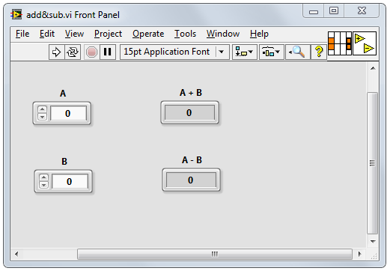
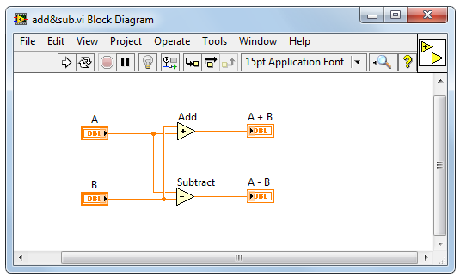
LabVIEW
Intuitive
Data driven
Hardware integration

Slide 5
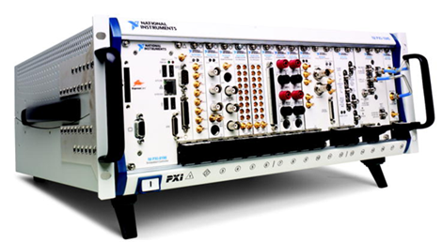
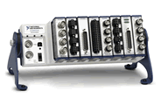
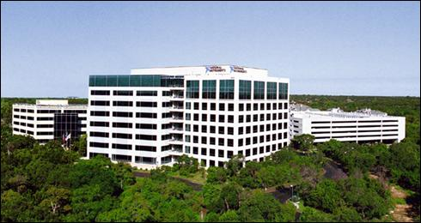


NI : part of Emerson
Corporate headquarters in Austin, TX
Offices in nearly 50 countries
35,000+ companies served annually
More than 1,000 products
Approx. 7,100 employees
600 Alliance Partners
Part of Emerson Electric Co. this year
Leader in data acquisition technology with innovative modular instruments and LabVIEW graphical programming software
Ritu Favre / CEO
Notes:
Founded in 1976
© National Instruments Corporation 3 Introduction to LabVIEW Hands-On

Slide 6

Diversity of applications
Notes:
Those are just a few examples. NI works with engineers in virtually every industry. NI customers have brought hundreds of thousands of products to market, overcome innumerable technological roadblocks, and engineered a better life for us all. If you can turn it on, connect it, drive it, or launch it, chances are that NI technology helped make it happen.
Because we work with engineers in so many industries and application areas, NI is in a unique position to closely monitor trends across industries and develop solutions that integrate the ever-increasing power of available technology to leverage these trends. This is another way NI achieves its mission of equipping engineers and scientists with systems that accelerate productivity, innovation, and discovery.

Slide 7

SpaceX
Falcon rocket launch pad software
Notes:
Those are just a few examples. NI works with engineers in virtually every industry. NI customers have brought hundreds of thousands of products to market, overcome innumerable technological roadblocks, and engineered a better life for us all. If you can turn it on, connect it, drive it, or launch it, chances are that NI technology helped make it happen.
Because we work with engineers in so many industries and application areas, NI is in a unique position to closely monitor trends across industries and develop solutions that integrate the ever-increasing power of available technology to leverage these trends. This is another way NI achieves its mission of equipping engineers and scientists with systems that accelerate productivity, innovation, and discovery.

Slide 8
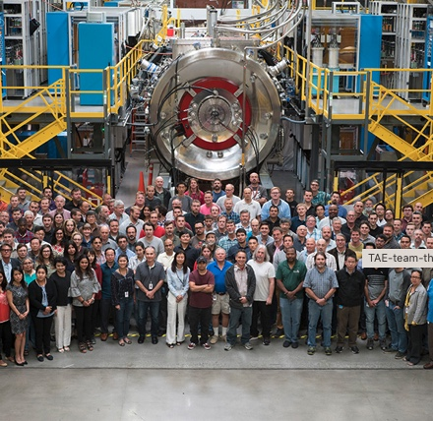
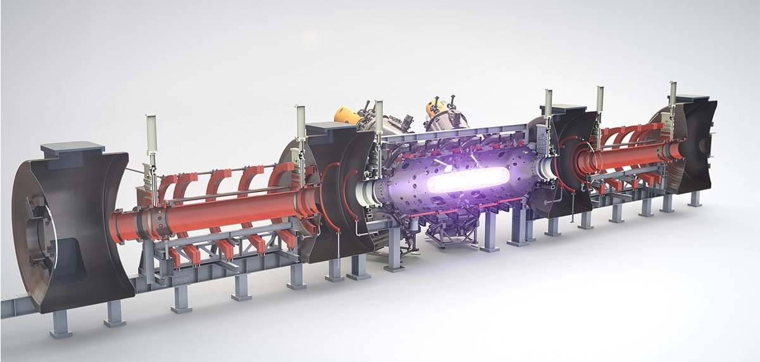
TAE
Commercial nuclear fusion power
Notes:
Those are just a few examples. NI works with engineers in virtually every industry. NI customers have brought hundreds of thousands of products to market, overcome innumerable technological roadblocks, and engineered a better life for us all. If you can turn it on, connect it, drive it, or launch it, chances are that NI technology helped make it happen.
Because we work with engineers in so many industries and application areas, NI is in a unique position to closely monitor trends across industries and develop solutions that integrate the ever-increasing power of available technology to leverage these trends. This is another way NI achieves its mission of equipping engineers and scientists with systems that accelerate productivity, innovation, and discovery.

Slide 9
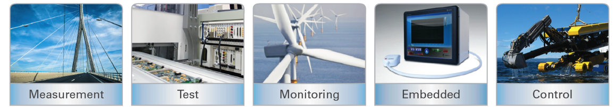

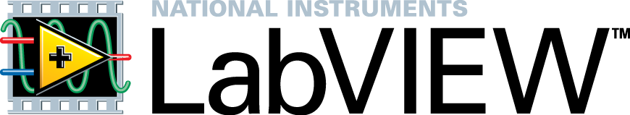
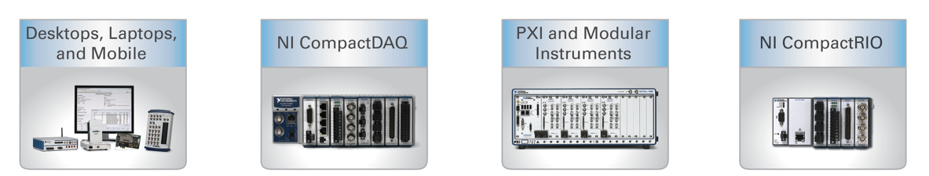
LabVIEW on different hardware
Applications
Hardware
Notes:
Those are just a few examples. NI works with engineers in virtually every industry. NI customers have brought hundreds of thousands of products to market, overcome innumerable technological roadblocks, and engineered a better life for us all. If you can turn it on, connect it, drive it, or launch it, chances are that NI technology helped make it happen.
Because we work with engineers in so many industries and application areas, NI is in a unique position to closely monitor trends across industries and develop solutions that integrate the ever-increasing power of available technology to leverage these trends. This is another way NI achieves its mission of equipping engineers and scientists with systems that accelerate productivity, innovation, and discovery.

Slide 10
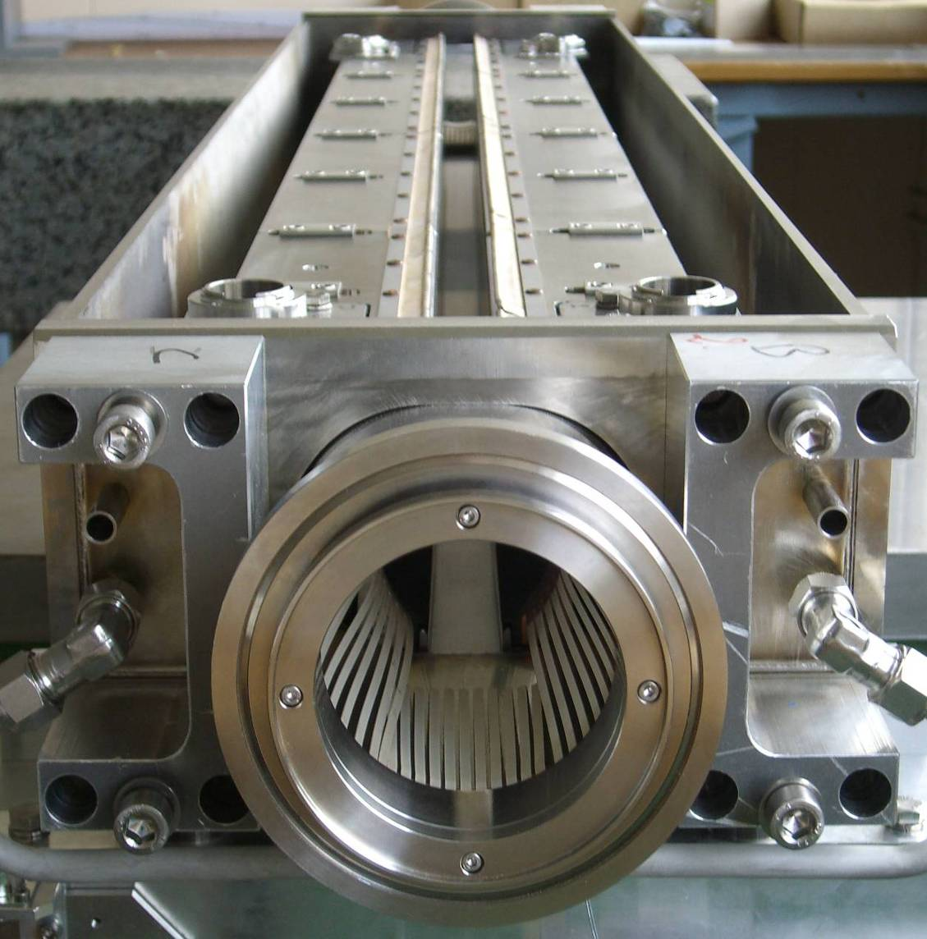
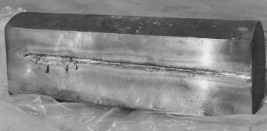
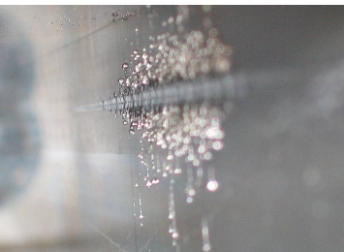
Projects based on NI @ CERN
LHC collimators real-time control system
Control system requirements
Axes positioning accuracy | few µm
Axes motion synchronization | below 1 ms
Response delay to a digital start trigger | 100 µs
Position sensors RT survey frequency | 100 Hz
Reliability | Very high
Notes:
120 kJ / bunch * 2808 bunches = 362 MJ / beam
- One beam melts 0.5 tone of copper
1.8 tone car going 2280 km / h
77.5 t of TNT

Slide 11
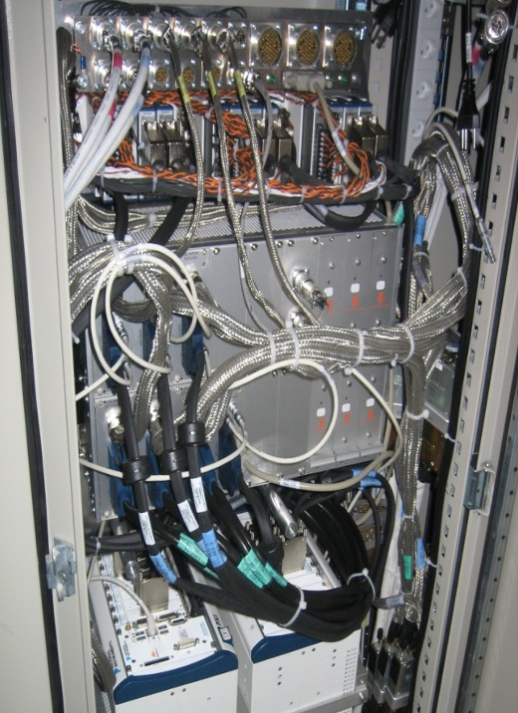
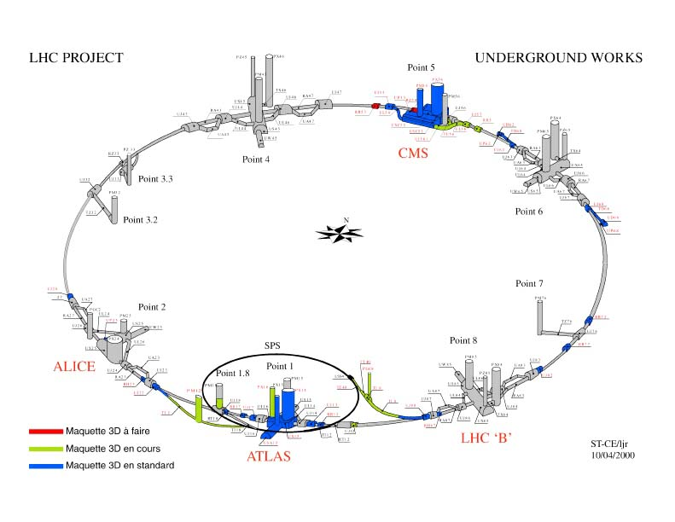
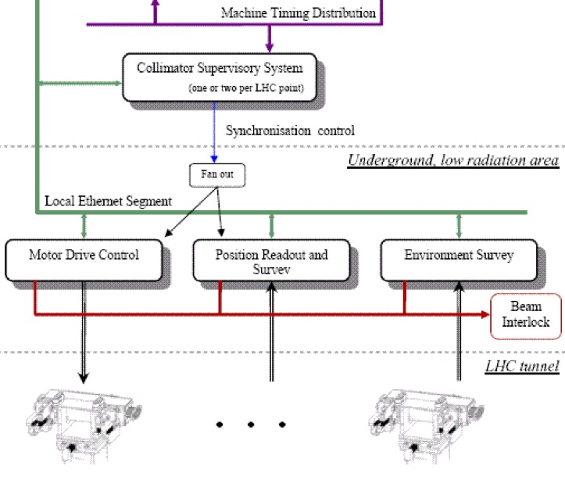
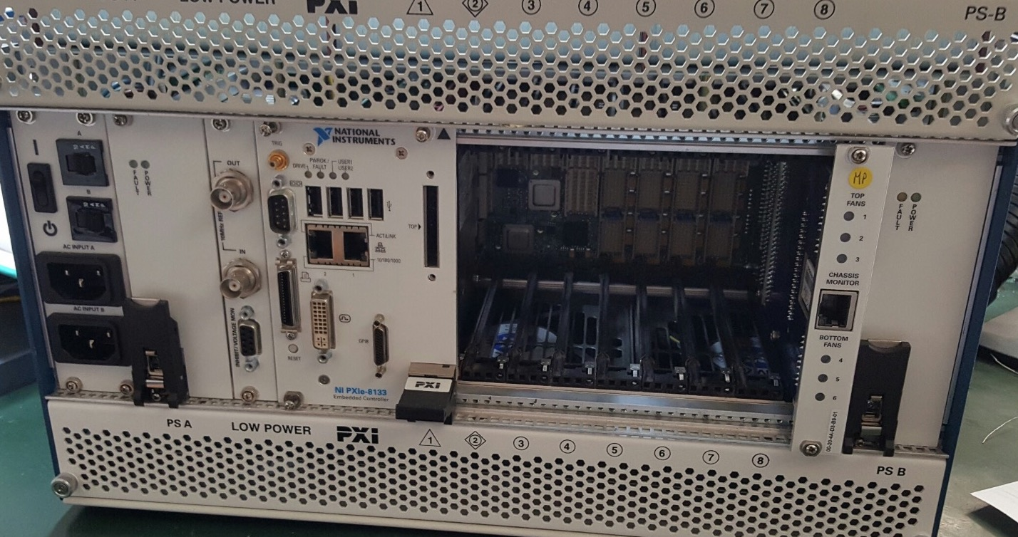
LHC collimators real-time control system
Layout
120 systems
Architecture

Slide 12
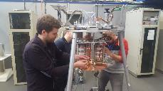
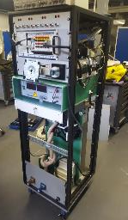
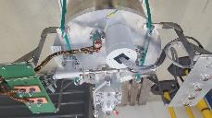

Projects based on NI @ CERN
Measurement setup for characterization of the radiation hardness of cryogenic bypass diodes for the LHC-HL
Power supplies for heaters
PXI system components:
- 7 x DMM 4081
- DAQ M-series 6251
- GPIB
- Ethernet
LHC by-pass diodes
HV power supply – 3kV max
Mu-metal shield (against magnetic field)
Discharge circuit
Capacitor bank 13,3 mF, 1500V
Feedthrough 18kA
Cryostat
$$≈30m$$
Measurement rack
Measurement setup assembly and closed cryostat

Slide 13

CERN LabVIEW support
Website: cern.ch/labview
E-mail: labview.support@cern.ch

Slide 14
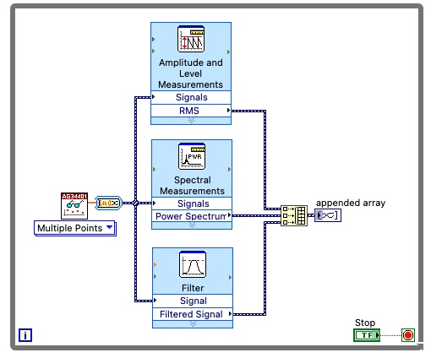
Why LabVIEW?
  Same concepts as in traditional languages (data types, loops, event handling, recursion and OOP)
  Data flow (execution is data-driven, not determined by sequential lines of text)
    Automatic parallelism
    Automatic data synchronisation
  Intuitive
  Easy to debug
  NI hardware integration
  Combines with other languages

Slide 15
B. Project Explorer
Project Explorer Window
Files Types
Project Folders

Slide 16
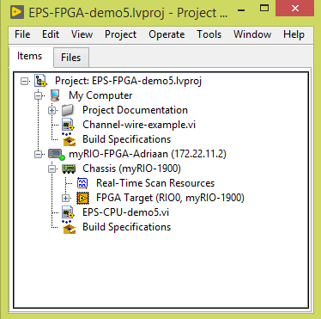
Project Explorer
  See the hierarchy
  Organise project files
  Deploy files to targets
  Manage code for build options
    Executables, installers, and zip files
  Integrate with source code control providers
PC
ARM
FPGA
Notes:
In this course we will use the LabVIEW project for accessing and organizing project files. You view project files in the Project Explorer window. Project files can include LabVIEW and non-LabVIEW files.
In future courses, you will use LabVIEW projects in other ways. For example, in LabVIEW Core 2 you will use LabVIEW to build an executable and installer. Various hardware courses will use the project explorer to configure and deploy applications to a target. In advanced LabVIEW courses, such as Managing Software Engineering in LabVIEW, you learn how to integrate with a source code control provider.

Slide 17

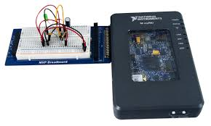
Project Explorer
PC
PC
ARM
Xilinx Zynq 7010
FPGA
Notes:
In this course we will use the LabVIEW project for accessing and organizing project files. You view project files in the Project Explorer window. Project files can include LabVIEW and non-LabVIEW files.
In future courses, you will use LabVIEW projects in other ways. For example, in LabVIEW Core 2 you will use LabVIEW to build an executable and installer. Various hardware courses will use the project explorer to configure and deploy applications to a target. In advanced LabVIEW courses, such as Managing Software Engineering in LabVIEW, you learn how to integrate with a source code control provider.

Slide 18
Connect to myRIO
Don’t have the myRIO connected yet
Power up the myRIO
Wait until the Status LED is off
Connect the myRIO to your PC
PC
myRIO
Notes:
In this course we will use the LabVIEW project for accessing and organizing project files. You view project files in the Project Explorer window. Project files can include LabVIEW and non-LabVIEW files.
In future courses, you will use LabVIEW projects in other ways. For example, in LabVIEW Core 2 you will use LabVIEW to build an executable and installer. Various hardware courses will use the project explorer to configure and deploy applications to a target. In advanced LabVIEW courses, such as Managing Software Engineering in LabVIEW, you learn how to integrate with a source code control provider.

Slide 19
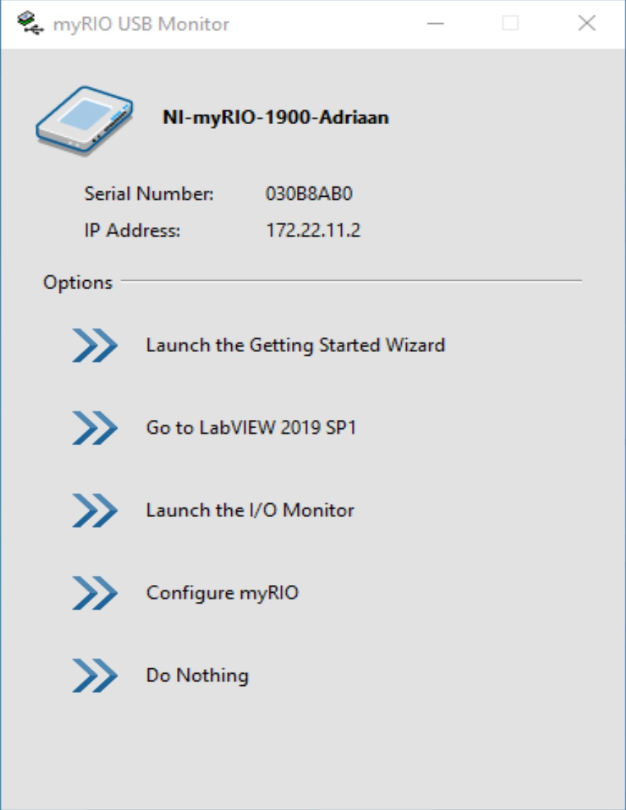
Start LabVIEW
PC
myRIO
Go to LabVIEW
Notes:
In this course we will use the LabVIEW project for accessing and organizing project files. You view project files in the Project Explorer window. Project files can include LabVIEW and non-LabVIEW files.
In future courses, you will use LabVIEW projects in other ways. For example, in LabVIEW Core 2 you will use LabVIEW to build an executable and installer. Various hardware courses will use the project explorer to configure and deploy applications to a target. In advanced LabVIEW courses, such as Managing Software Engineering in LabVIEW, you learn how to integrate with a source code control provider.

Slide 20
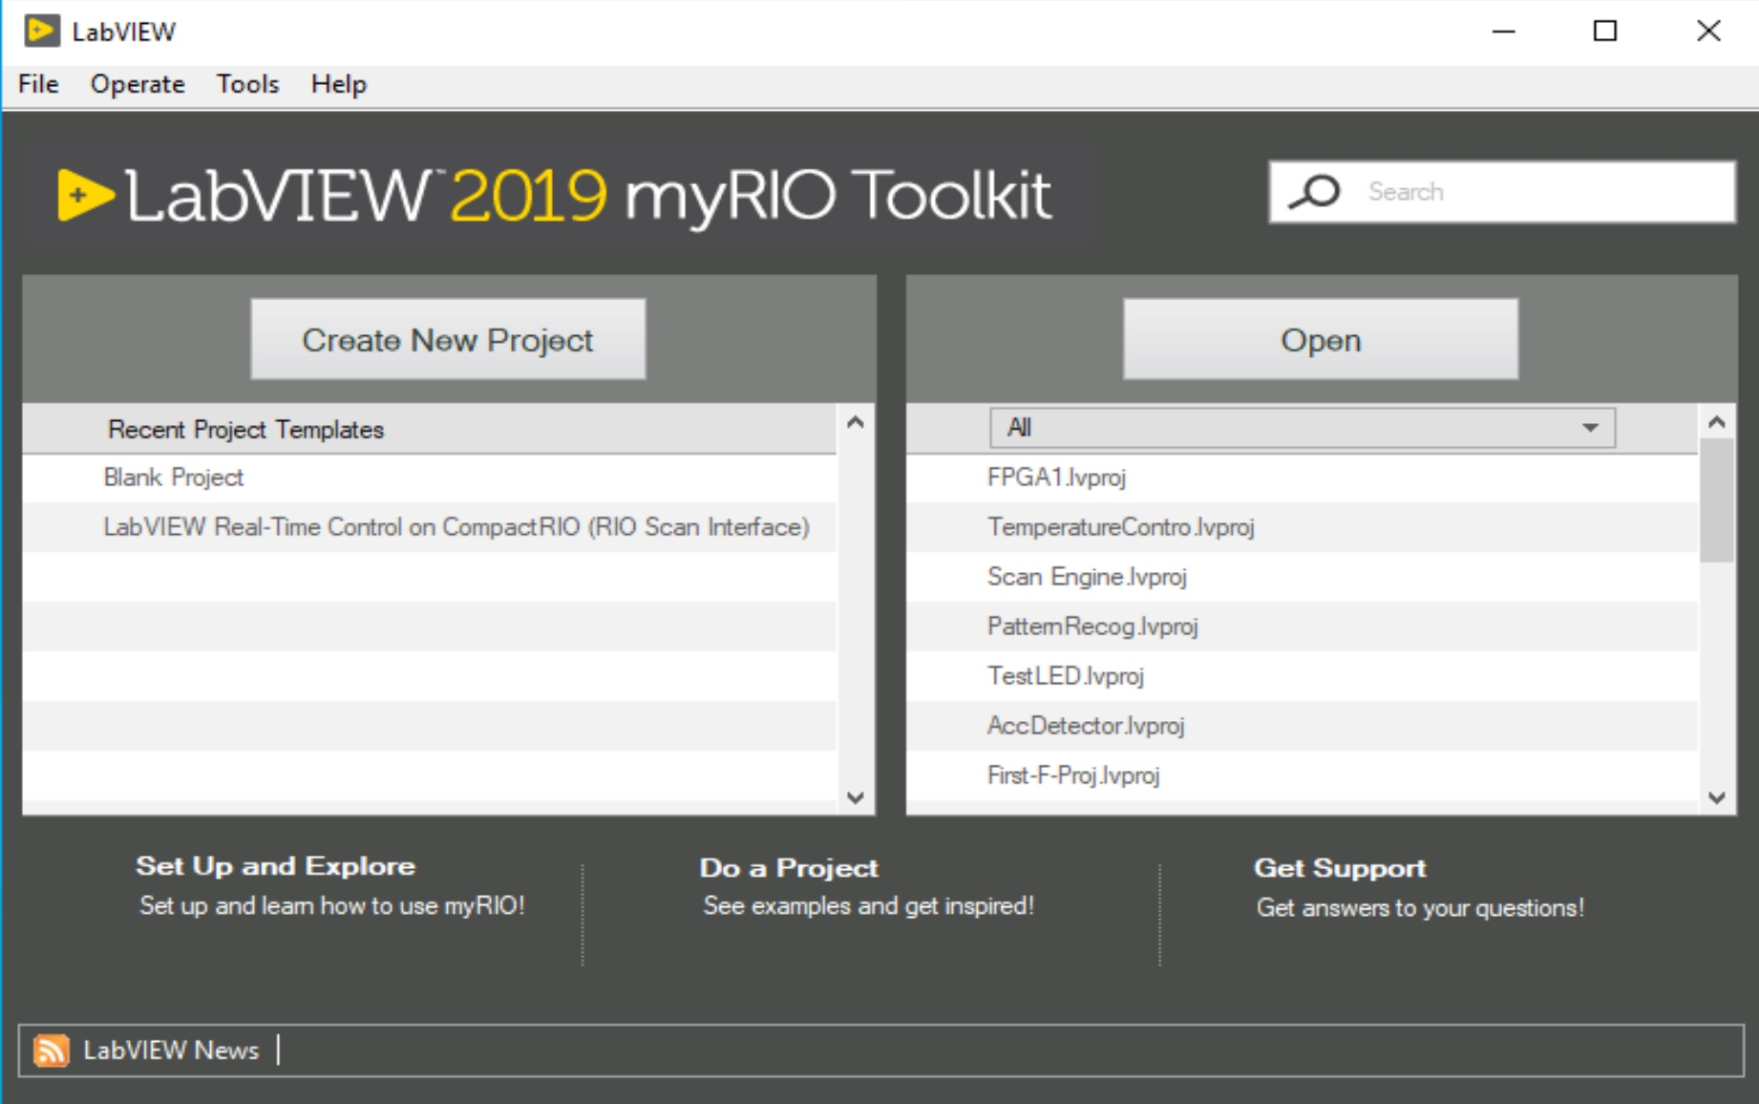
Project
Blank Project
PC
myRIO
Notes:
In this course we will use the LabVIEW project for accessing and organizing project files. You view project files in the Project Explorer window. Project files can include LabVIEW and non-LabVIEW files.
In future courses, you will use LabVIEW projects in other ways. For example, in LabVIEW Core 2 you will use LabVIEW to build an executable and installer. Various hardware courses will use the project explorer to configure and deploy applications to a target. In advanced LabVIEW courses, such as Managing Software Engineering in LabVIEW, you learn how to integrate with a source code control provider.

Slide 21
New target
Right click Project
Choose: New -> targets and devices
PC
myRIO
Notes:
In this course we will use the LabVIEW project for accessing and organizing project files. You view project files in the Project Explorer window. Project files can include LabVIEW and non-LabVIEW files.
In future courses, you will use LabVIEW projects in other ways. For example, in LabVIEW Core 2 you will use LabVIEW to build an executable and installer. Various hardware courses will use the project explorer to configure and deploy applications to a target. In advanced LabVIEW courses, such as Managing Software Engineering in LabVIEW, you learn how to integrate with a source code control provider.

Slide 22
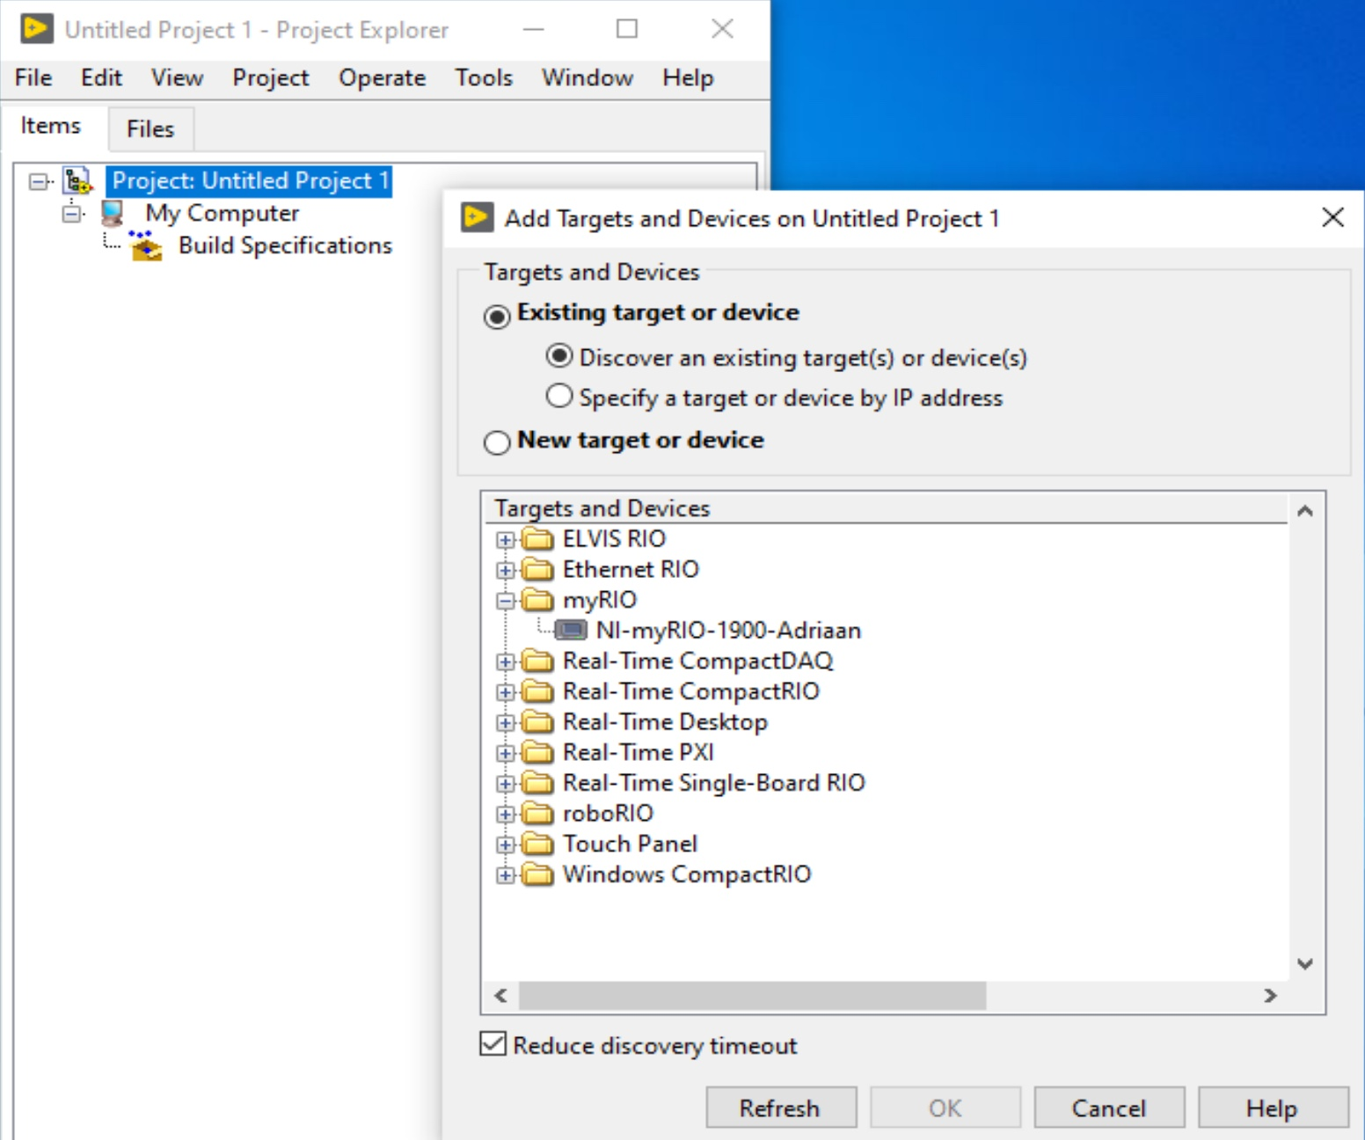
Select myRIO
PC
Open myRIO with +
Select NI myRIO
OK
myRIO
Notes:
In this course we will use the LabVIEW project for accessing and organizing project files. You view project files in the Project Explorer window. Project files can include LabVIEW and non-LabVIEW files.
In future courses, you will use LabVIEW projects in other ways. For example, in LabVIEW Core 2 you will use LabVIEW to build an executable and installer. Various hardware courses will use the project explorer to configure and deploy applications to a target. In advanced LabVIEW courses, such as Managing Software Engineering in LabVIEW, you learn how to integrate with a source code control provider.

Slide 23
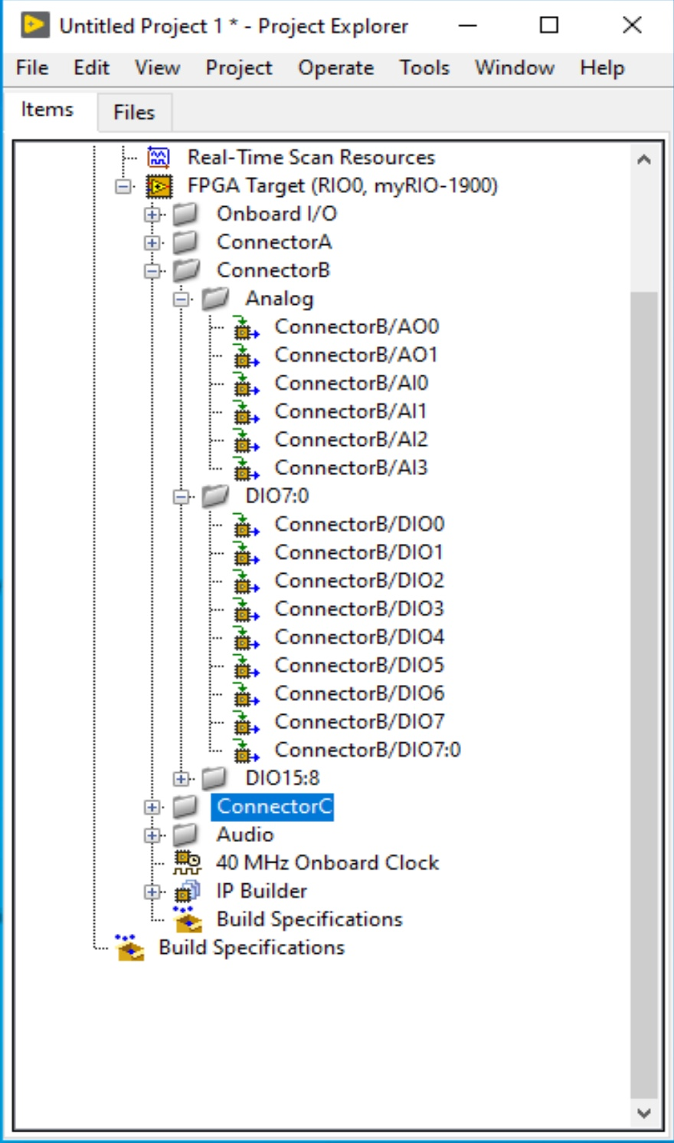
Prepare myRIO
Close tabs:
Onboard I/O
Connector A
Connector B DIO15:8
Connector C
Audio
PC
myRIO
Notes:
In this course we will use the LabVIEW project for accessing and organizing project files. You view project files in the Project Explorer window. Project files can include LabVIEW and non-LabVIEW files.
In future courses, you will use LabVIEW projects in other ways. For example, in LabVIEW Core 2 you will use LabVIEW to build an executable and installer. Various hardware courses will use the project explorer to configure and deploy applications to a target. In advanced LabVIEW courses, such as Managing Software Engineering in LabVIEW, you learn how to integrate with a source code control provider.

Slide 24
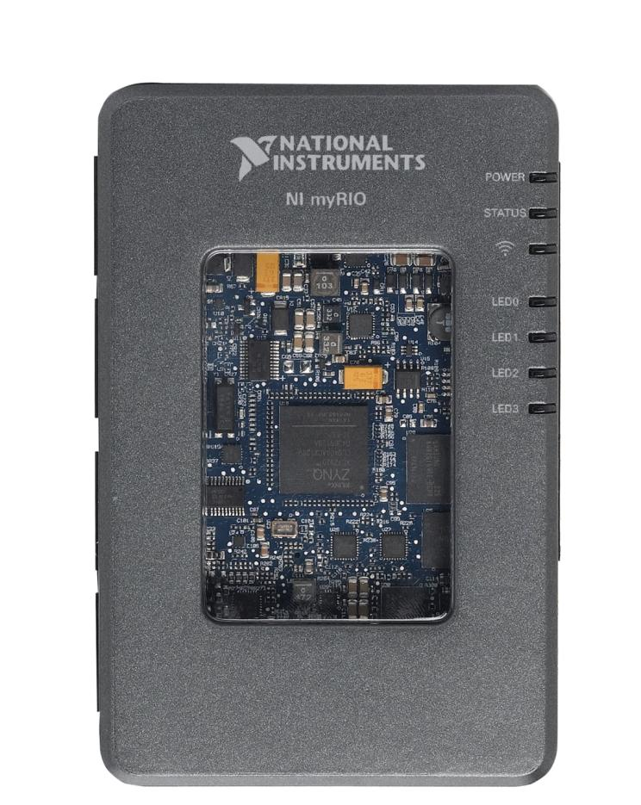
NI myRIO Product Overview: Front View
XILINX Zynq SoC
Notes:
The first thing that you will notice is the Xilinx Zynq chip right in the middle of the myRIO window. National Instruments is very excited to be partnering with Xilinx to bring this cutting edge technology to students. Let’s take a closer look at this chip.

Slide 25

What is Zynq?
Traditional Implementation
Processor
FPGA
Analogue Input
AXI Bus
Analogue Output
PCI Bus
Digital I/O
Custom I/O
Single System on Chip
Notes:
To appreciate what Zynq has to offer, let’s take a look at how the industry has traditionally implemented processors and FPGAs on embedded devices.
Traditionally the processor and FPGA have been two separate, desperate chips… connected with a generic computing bus
<animate>
NI has been working closely with technology leaders like Xilinx and ARM to help bring a new category of system on chip to market… the new Zynq all programmable SOC.
Zynq is revolutionary because it combines both a powerful dual-core processor and the power efficient 7 Series FPGA… and puts then onto a single chip

Slide 26
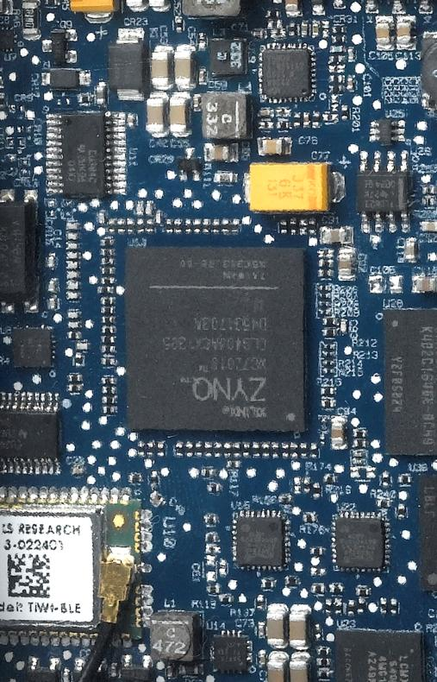
Why Zynq Matters in Education
Smaller Size, Lower Power
667 MHz Dual-Core ARM Cortex-A9 Processor
Artix-7 FPGA, 28k logic cells
16 DMA Channels
92 Billion calculations per second
Notes:
Why Zynq matters in education… Zynq allows us to create smaller, cheaper targets with faster communication between RT and FPGA. Effectively allowing us to develop an affordable student focused device.
However… why does Zynq REALLY matter in education?

Slide 27
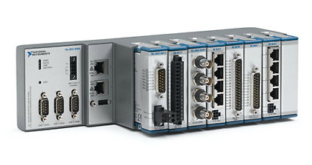
Why Zynq Really Matters in Education
Leading Industry Grade Technology
The same technology is used in the modular I/O Compact RIO systems
Notes:
Ultimately, we are excited to be featuring Zynq because it means that students are learning on the latest industry grade technology which will assure that they are prepared to enter industry having already learned on the tools they will see when they graduate.
<animate>
For instance… the same underlying RIO architecture used in myRIO is used in the NI Compact RIO platform.

Slide 28
C. Parts of a VI
Front Panel
Block Diagram
Icon
Connector Pane

Slide 29
Parts of a VI
VIs have 3 main components:
Icon/Connector pane
Front panel
Block diagram

Slide 30
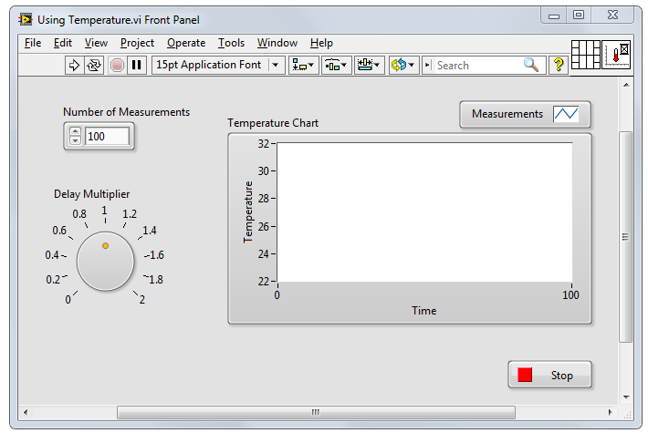
Parts of a VI – Front Panel
Front Panel – User interface for the VI
  You build the front panel with
  controls (inputs) and indicators (outputs).
Notes:
The best way to explain that is to imagine an old, analog osciloscope.
Front panel is how the device interacts with an user.

Slide 31
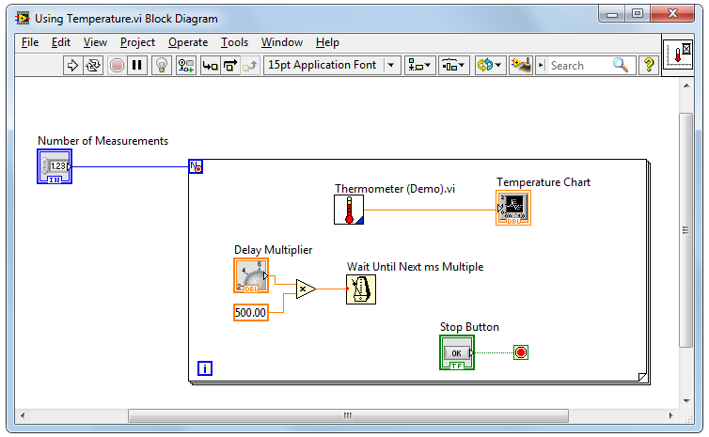
Parts of a VI – Block Diagram
Block Diagram – Contains the graphical source code
  Front panel objects appear as terminals on the block diagram.

Slide 32


Parts of a VI – Icon/Connector Pane
Icon – Graphical representation
of a VI
Connector Pane – Map of the inputs and outputs of a VI
  Icons and connector panes are necessary to use
  a VI as a subVI.
    A subVI is a VI that appears on the block diagram of another VI.
    A subVI is similar to a subroutine or function in a text-based programming language.
Notes:
Connector Pane- similar way as a Function+ Vi Inception

Slide 33
Show – off (2)
Figures

Slide 34
D. Front Panel
Controls and Indicators
Object Styles
Object Types
Boolean
Numeric
String

Slide 35
Front Panel
Notes:
The items on the toolbar:
Run, Run Continuously, Abort Execution, Pause, Text Settings, Align Objects, Distribute Objects, Resize Objects, Reorder, Search, Help
Click the Run button to run the VI. LabVIEW compiles the VI, if necessary. You can run a VI if the Run button appears as a solid white arrow. Note that the Run button appears broken when the VI contains edit-time errors. Students will learn about fixing edit-time errors in the next lesson.

Slide 36
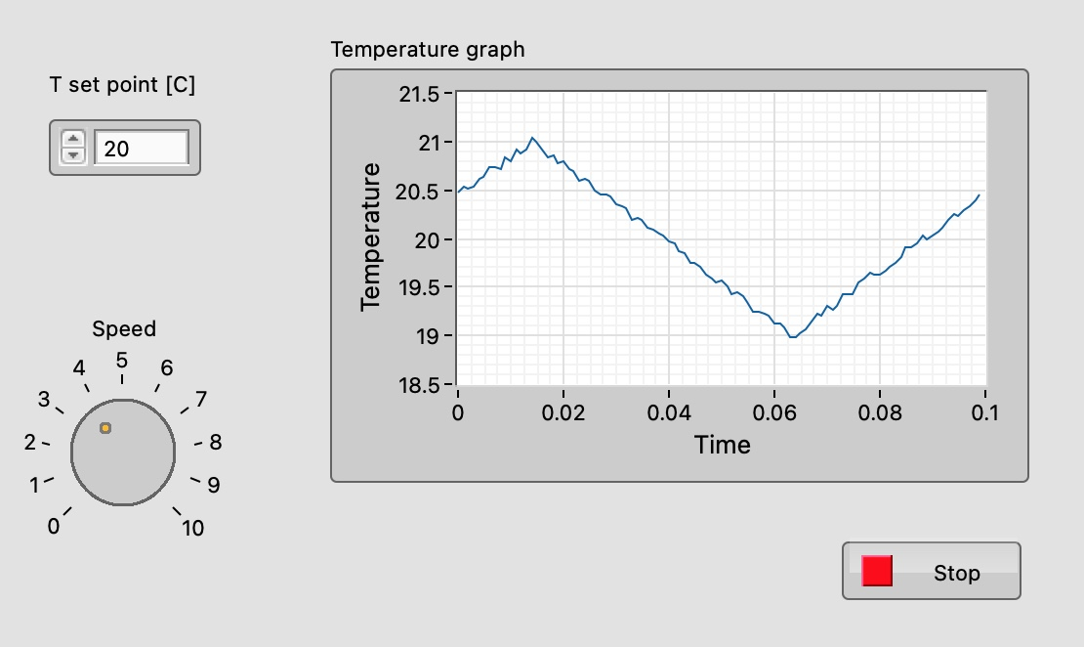
Controls and Indicators
  Controls
    Input devices
    Knobs, buttons, slides
    Supply data to the block diagram
  Indicators
    Output devices
    Graphs, LEDs
    Display data the block diagram acquires or generates
Notes:
Identify controls and indicators on this front panel.
In the next few slides, we discuss basic data types: numerics, strings and Booleans.
We discuss representation, mechanical action, and string display types in the next lesson.

Slide 37
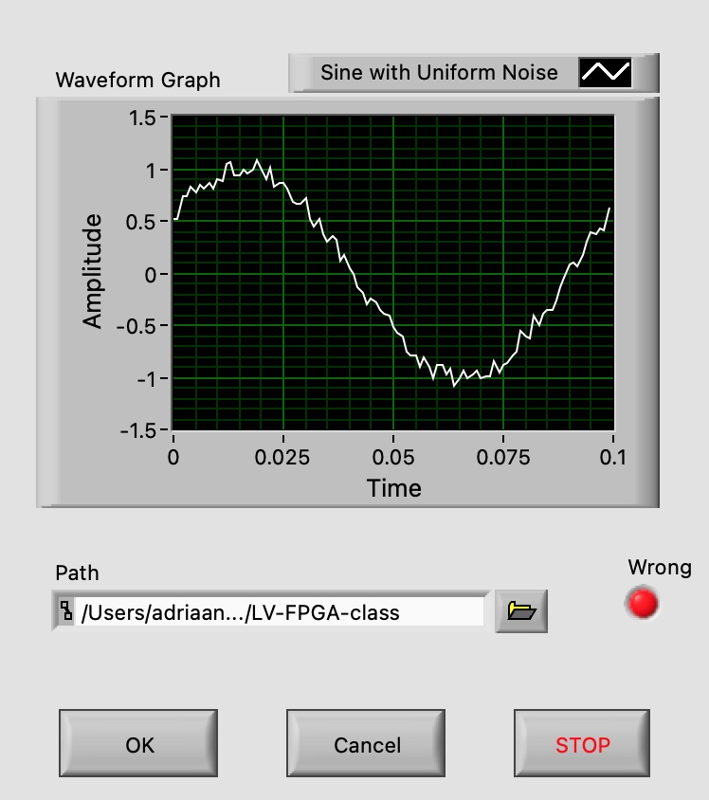
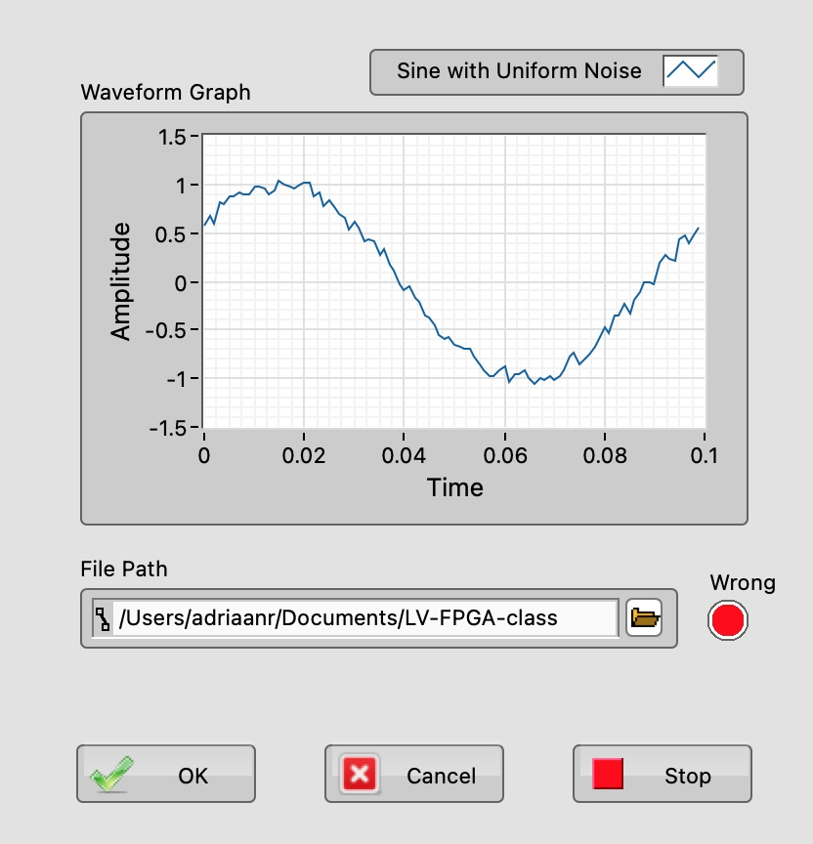
Front Panel Object Styles
Modern
Silver
Notes:
LabVIEW has different control palettes with objects for building user interface, including the Modern, Silver, Classic, and System palettes.
The controls and indicators on the Silver palette are the newest to LabVIEW. They provide a rich user interface. Because of the added glyphs, the Silver objects tend to be a little larger than other styles.
Use objects from the System palette when you want a dialog that matches your operating system. The System controls (also known as dialog controls) change appearance depending on which platform you run the VI. For example, when running on a Mac OS, the controls adapt a different color and appearance than they have on a Windows OS so that they match the appearance of the Mac OS system.
Not all palettes have the same options. For example, the System palette does not have a LED.
Similarly, if you use Quick Drop, you will notice multiple options. The new Silver controls will have “Silver” in the parentheses.

Slide 38
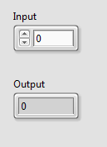
Numeric Controls and Indicators
The numeric data in a control or indicator can represent numbers of various types, such as integer or floating-point.
Numeric
control
Increment/Decrement
buttons
Numeric
indicator
Notes:
Make out , discriminate << rozróżnić

Slide 39

Boolean Controls and Indicators
  The Boolean data type represents data that has only two options, such as True/False or On/Off.
  Use Boolean controls and indicators to enter and display Boolean (TRUE/FALSE) values.
  Boolean objects simulate switches, push buttons and LEDs.
Boolean
control
Boolean
indicator

Slide 40
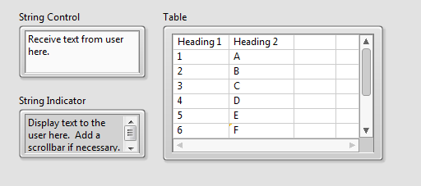
Strings
  The string data type is a sequence of ASCII characters.
  Use string controls to receive text from the user.
  Use string indicators to display text to the user.

Slide 41
E. Block Diagram
Terminals
Nodes
Wires
Help

Slide 42
Block Diagram
Notes:
The items on the toolbar:
Run, Run Continuously, Abort Execution, Pause, Highlight Execution, Retain Wire Values, Step Into, Step over, Step Out, Text Settings, Align Objects, Distribute Objects, Reorder, Clean Up Diagram
Students learn about debugging tools in the next lesson. Use next slide to discuss different objects on block diagram.
Click the Run button to run the VI. LabVIEW compiles the VI, if necessary. You can run a VI if the Run button appears as a solid white arrow. If the Run button appears broken, the VI contains edit-time errors. Students learn about fixing edit-time errors in the next lesson.

Slide 43
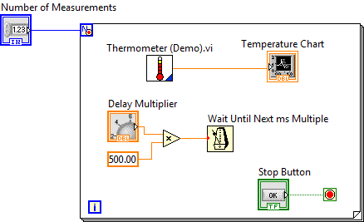
Block Diagram
Block diagram items:
  Terminals
  Constants
  Nodes
    Functions
    SubVIs
    Structures
  Wires
  Free labels
Notes:
Objects on the block diagram include terminals and nodes. You build block diagrams by connecting the objects with wires. The color and symbol of each terminal indicate the data type of the corresponding control or indicator. Constants are terminals on the block diagram that supply fixed data values to the block diagram.
Nodes are objects on the block diagram that have inputs and/or outputs and perform operations when a VI runs.

Slide 44
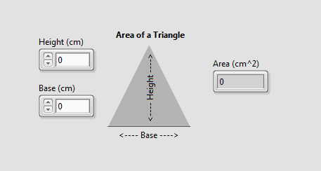
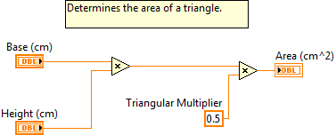
Terminals
Same label name
Notes:
Data values you enter on the front panel controls enter the block diagram through the control terminals on the block diagram.
During execution, the output data values from the block diagram pass from indicator terminals to the front panel indicators.
Front panel items share the same label name as the block diagram terminal.
You can notice visual difference between controls and indicators on the block diagram. There are differences in operation between controls, constants, and indicators. Note that constants are available only on the block diagram.
You can right-click a terminal to change it between a control or indicator.

Slide 45


Terminals for Front Panel Objects
  Terminals are:
    Entry and exit ports that exchange information between the front panel and block diagram
    Analogous to parameters in text-based programming languages
  Double-click a terminal to locate the corresponding front panel object
Notes:
Front panel objects appear as terminals on the block diagram.
Double-click a block diagram terminal to highlight the corresponding control or indicator on the front panel.
On the next slide, you can see the two formats for block diagram terminals: Icon view and standard (compact) view.

Slide 46
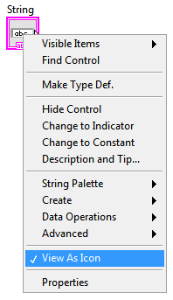
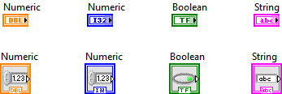
View Terminals as Icons
  By default, View as Icon option enabled.
  Deselect View as Icon for a more compact view.
Notes:
This slide also shows a shortcut menu. In LabVIEW, many options are found in shortcut menus. If you are not sure how to do something, right-click the object. Chances are good that the option you need is in the shortcut menu.

Slide 47
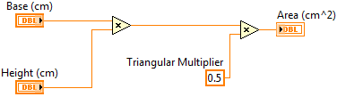
Nodes
  Nodes are objects on the block diagram that have inputs and/or outputs and perform operations when a VI runs.
Nodes
Notes:
Nodes are analogous to statements, operators, functions, and subroutines in text-based programming languages.
Nodes can be functions, subVIs, or structures.

Slide 48
Function Nodes
  Functions are:
    Fundamental operating elements of LabVIEW.
    Do not have front panels or block diagrams, but do have connector panes.
    Has a pale yellow background on its icon.
  Double-clicking a function only selects the function.
  Functions do not open like VIs and subVIs.

Slide 49

SubVI Nodes
  SubVIs :
    Are VIs that you use on the block diagram of another VI.
    Have front panels and block diagrams.
    Use the icon from the upper-right corner of the front panel as the icon that appears when you place the subVI on a block diagram.
  When you double-click a subVI, the front panel and block diagram open.
  Any VI has the potential to be used as a subVI.
Notes:
In lesson 4, the student will learn how to build a subVI.

Slide 50
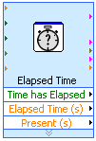
Express VIs
  Express VIs:
    Are a special type of subVI.
    Require minimal wiring because you configure them with GUI dialog boxes.
    Save each configuration as a subVI.
  Icons for Express VIs appear on the block diagram as icons surrounded by a blue field.

Slide 51
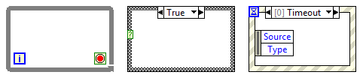
Structures
  Structures in LabVIEW have the form of frames.
  Other nodes (functions, subVIs, more structures) can be inserted into the frames.

Slide 52
Wires
  Wires transfer data between block diagram objects.
  Wires are different colors, styles, and thicknesses, depending on their data types.
  A broken wire appears as a dashed
  black line with a red X in the middle.
Floating-point
Integer
String
Boolean
Scalar
1-D Array
2-D Array

Slide 53

Constants
  Constants are the source of values just as control terminals, but their value is fixed in the code.
  You can create a constant of each data type.
Notes:
What are constants and when should you use them?
Constants are terminals on the block diagram that supply fixed data values to the block diagram. Use constants when your VI needs to use the same value every time the VI runs.
Can you recognize which data types these constants are?
Answer (from left to right):
integer, floating-point numeric, Boolean, string.

Slide 54


Free labels
  A free label is a label (a text box) not attached to any object.
  Free labels can be put on the front panel or block diagram. They are created by double-clicking on empty space in the window.
  They can serve as comments or instructions to the user of the application.
Notes:
What are free labels and when should you use them?
Free labels are not attached to any object. You can create, move, rotate, or delete them independently.
Free labels are useful for documenting code on the block diagram and for listing user instructions on the front panel. Double-click an open space or use the Labeling tool to create free labels or to edit labels.

Slide 55
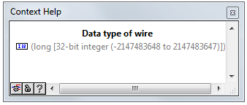
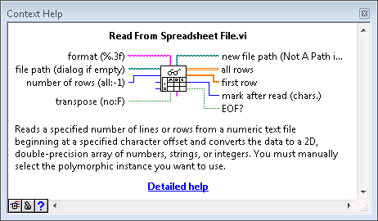
Context Help
  Displays basic information about wires and nodes when you move the cursor over an object.
  Can be shown or hidden in the following ways:
    Select Help»Show Context Help from the LabVIEW menu.
    Press <Ctrl-H>.
    Click the following button on the toolbar:
Notes:
I’d like to point at..
Hold down mouse for a second

Slide 56
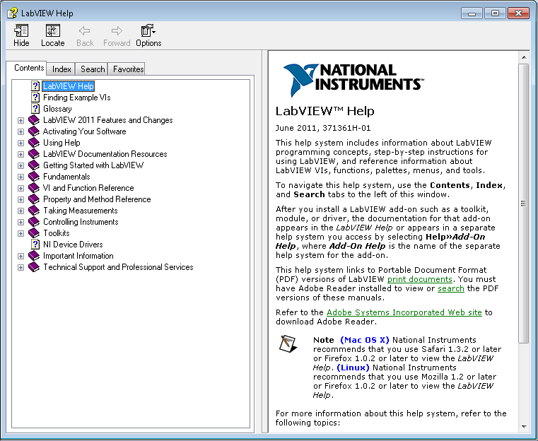
LabVIEW Help
  Contains detailed descriptions and instructions for most palettes, menus, tools, VIs, and functions.
  Can be accessed by:
    Selecting Help»
    LabVIEW Help from the menu.
    Clicking the Detailed help
    link in the
    Context Help window.
    Right-clicking an object
    and selecting Help from
    the shortcut menu.

Slide 57
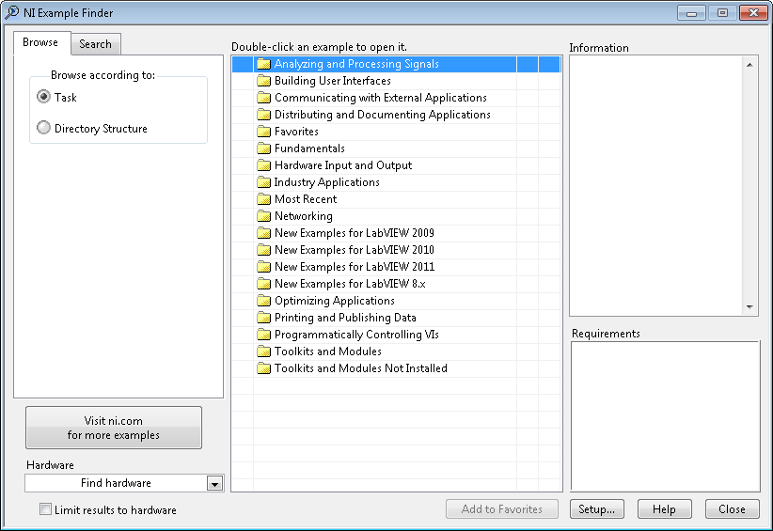

Examples
  LabVIEW includes hundreds of example VIs.
  Use NI Example Finder to browse and search installed examples.
    Select Help»Find Examples in the menu.
  Click the example buttons in LabVIEW Help topics.
Notes:
Use the NI Example Finder to search all installed examples and examples located in the NI Developer Zone on the web.
Modify any example VI to fit an application, or copy and paste from an example into a VI that you create.
Methods of accessing the NI Example Finder:
Select Help»Find Examples
Click the Find Examples link in the Getting Started window
You can access examples using the Open example and Find related examples buttons located at the bottom of certain VI and function reference topics in the LabVIEW Help. Click the Open example button to open the example VI to which the topic refers. Click the Find related examples button to open the NI Example Finder and display related example VIs.

Slide 58
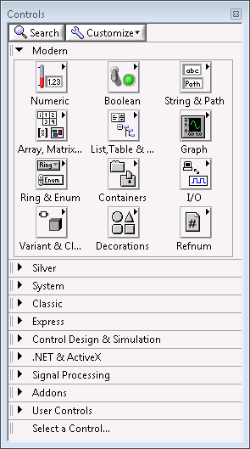
Controls Palette
  Contains the controls and indicators you use to create the front panel.
  Navigate the subpalettes or use the Search button to search the Controls palette.
Notes:
Controls palette is available only when the front panel window is the active window.

Slide 59

Functions Palette
  Contains the VIs, functions, and constants you use to create the block diagram.
  Navigate the subpalettes or use the Search button to search the Functions palette.
Notes:
Functions palette is available only when the block diagram window is the active window.

Slide 60

Searching with Quick Drop
  Lets you quickly find controls, functions, VIs, and other items by name.
  Press the <Ctrl-Space> keys to display the Quick Drop dialog box.

Slide 61


Global Search
Use the Search bar in the top right of the front panel and block diagram windows to search palettes, LabVIEW Help, and ni.com.
Notes:
Searches the local help files and palettes as you type. If you press <Enter>, the Search bar also searches ni.com.

Slide 62
G. Selecting a Tool
Selecting a Tool
Block Diagram Clean-Up

Slide 63

Selecting a Tool
  A tool is a special operating mode of the mouse cursor.
  Create, modify, and debug VIs using the tools provided by LabVIEW.
  By default, LabVIEW automatically selects tools based on the context of the cursor.
  If you need more control, use the Tools palette to select a specific tool.
    Select View»Tools Palette to open the Tools palette.
Notes:
By default, LabVIEW selects tools for you based on the context of your cursor. If you need more control over which tool is selected, use the Tools palette to select a specific tool to operate or to modify front panel and block diagram objects. Select View»Tools Palette (or right-click on empty space in the window while pressing <Shift>) to display the Tools palette.

Slide 64


Wiring Tips
  Press <Ctrl-B> to delete broken wires.
  Right-click and select Clean Up Wire to reroute the wire.
Notes:
If you make a selection first and then press <Ctrl-B>, broken wires are deleted only in the selection and not on the whole block diagram.

Slide 65


Wiring Tips – Clean Up Diagram
  Use the Clean Up Diagram tool to reroute multiple wires and objects and to improve readability.
    Select a section of your block diagram.
    Click the Clean Up Diagram button on the block diagram toolbar (or press <Ctrl-U>).

Slide 66
Cloning Items
  Clone an object in Windows using the following steps:
    Select the Positioning tool.
    Press the <Ctrl> key while clicking an object.
    Drag the copy to new location.
Note: Avoid cutting and pasting objects as this can impact related items. For example, cutting and pasting a block diagram terminal also moves the front panel object.

Slide 67
Setting options for the environment
In Tools»Options… dialog box you can customize settings for the LabVIEW environment.
Suggested changes:
  Front Panel page
    Set Control Style for New VIs to Silver style
  Block Diagram page
    Uncheck Place front panel terminals as icons
    Configure Block Diagram Cleanup to customize your block diagram
Notes:
- If you would like to change the default control and terminal style:
Exercises can be completed with any control style and terminal style. However, if you would like to, select Silver (or other) style for controls.
You may also want to uncheck Place front panel terminals as icons option in the Block Diagram page.
While in the Tools»Options dialog box, you can view, examine and customize other common settings.

Slide 68
H. Dataflow

Slide 69

Dataflow
  LabVIEW follows a dataflow model for running VIs.
  A node executes only when data are available at all of its required input terminals.
  A node supplies data to the output terminals only when the node finishes execution.
Notes:
When a node executes, it produces output data and passes the data to the next node in the dataflow path.
The movement of data through the nodes determines the execution order of the VIs and functions on the block diagram.
LabVIEW does NOT use a control flow program execution model like Visual Basic, C++, JAVA, and most other text-based programming languages. In a control flow model, the sequential order of program elements determines the execution order of a program.

Slide 70

Dataflow – Quiz
What are the nodes in this fragment of code?
Which node executes first?
Notes:
This quiz is intended to encourage students to think about dataflow and its implications. The answers are on the next slide.

Slide 71
Dataflow – Quiz Answer
There are two nodes: „square” and „greater than?” functions.
Square executes first.
71
Notes:
Nodes are functions, subVIs and structures – so in this slide there are two nodes: „square” function and „greater than?” function.
Square function executes first because the comparison function has to wait for the output of square function before it can run.

Slide 72

Dataflow – Quiz
Which node executes first?
Add
Subtract
Random Number
Divide
Sine
72
Notes:
This quiz is intended to encourage students to think about dataflow and its implications. The answers are on the next slide.

Slide 73
Dataflow – Quiz Answer
No single correct answer.
Which node executes first?
Add – Possibly
Subtract –
Definitely not
Random Number –
Possibly
Divide – Possibly
Sine – Definitely not
73
Notes:
In LabVIEW, the flow of data rather than the sequential order of commands determines the execution order of block diagram elements. Therefore, you can create block diagrams that have simultaneous operations.

Slide 74
I. Building a Simple VI

Slide 75


Building a Simple VI
Notes:
Most LabVIEW VIs have three main tasks:
Acquiring data.
Analyzing the acquired data.
Presenting the result.
Express VIs are designed specifically for completing common, frequently used operations in each of these three task areas.

Slide 76




Acquire Express VIs
  DAQ Assistant Express VI
  Instrument I/O Assistant Express VI
  Simulate Signal Express VI
  Read from Measurement File Express VI

Slide 77





Analyze Express VIs
  Amplitude and Level
  Measurements Express VI
  Statistics Express VI
  Spectral Measurements Express VI
  Tone Measurements Express VI
  Filter Express VI

Slide 78







Present Express VIs and Indicators
  Display Message Express VI
  Play Waveform Express VI
  Report Express VI
  Write to Measurement
  File Express VI
  DIAdem Report Express VI
Notes:
Indicators include the Waveform Chart, the Waveform Graph, and the XY Graph.
Express VIs include the Write to Measurement File Express VI, Display Message to User Express VI.
DIAdem is another NI product for reporting. If you have DIAdem, it includes an express VI to assist with report creation.

Slide 79
Building and Running a VI
Place Express VI on the block diagram.
Configure the dialog box that opens.
Wire Express VIs together.
Save and run the VI.
The Run button appears broken when the VI you are creating or editing contains errors.

