Slide 1
The search for Neutrinoless double beta decay in Ge
Nafis Fuad
PIKIMO 15 - Fall 2023
November 11, 2023
INDIANA UNIVERSITY

Slide 2
Outline
Neutrinos: Known and Unknown
Neutrinoless double beta decay, in
LEGEND - a neutrinoless double beta decay (in Ge) experiment
Work of IU group: investigating a small part of the detectors called ‘passivated surface’

Slide 3
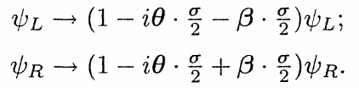

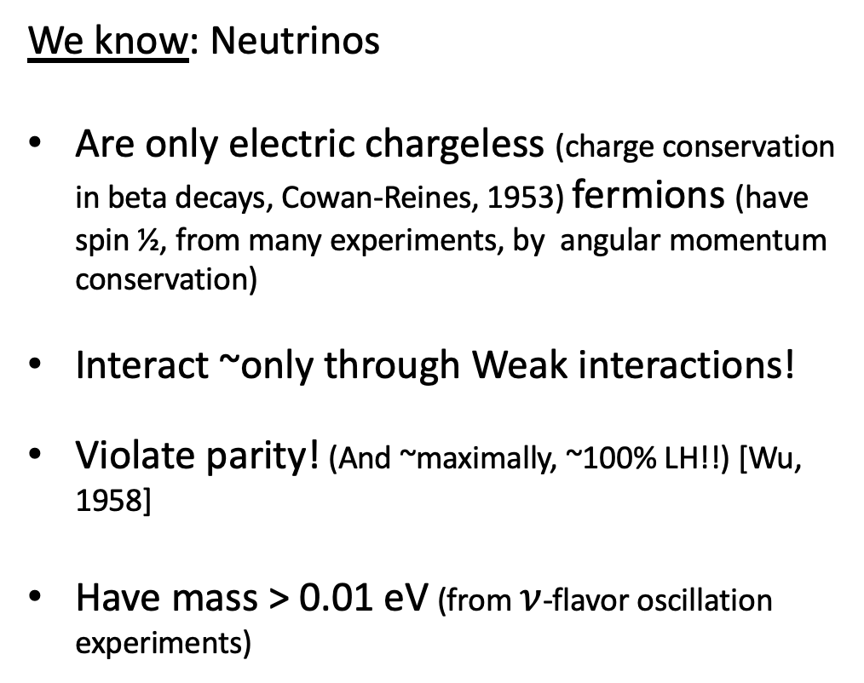
What we know & don’t know about Neutrinos
(so far, among other things)
We know: Neutrinos
Are only electric chargeless (charge conservation in beta decays, Cowan-Reines, 1953) fermions (have spin ½, from many experiments, by angular momentum conservation)
Interact ~only through Weak interactions!
Violate parity! (And ~maximally, ~100% LH!!) [Wu, 1958]
Have mass > 0.01 eV (from $ν$-flavor oscillation experiments)
At least, very tiny, since so many of them can escape the Sun
\/
X

Slide 4
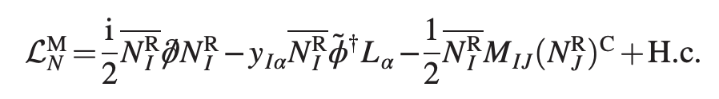


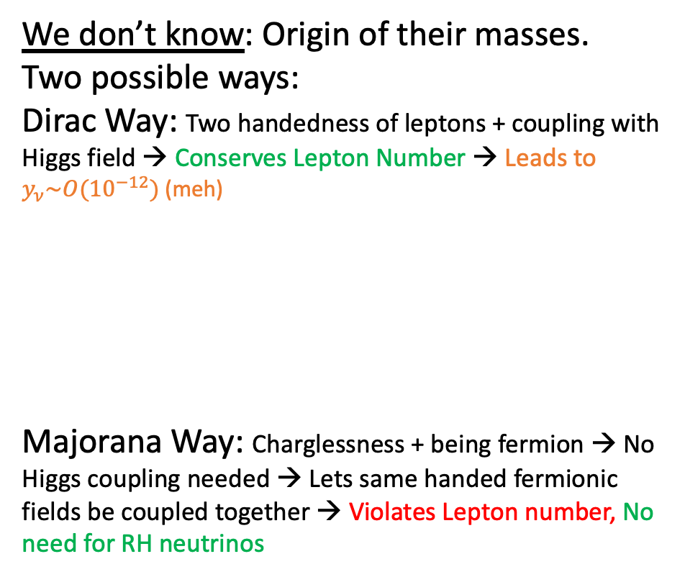
What we know & don’t know about Neutrinos
(so far, among other things)
We know: Neutrinos
Are only electric chargeless (charge conservation in beta decays, Cowan-Reines, 1953) fermions (have spin ½, from many experiments, by angular momentum conservation)
Interact ~only through Weak interactions!
Violate parity! (And ~maximally, ~100% LH!!) [Wu, 1958]
Have mass > 0.01 eV (from $ν$-flavor oscillation experiments)
We don’t know: Origin of their masses.
Two possible ways:
Dirac Way: Two handedness of leptons + coupling with Higgs field → Conserves Lepton Number → Leads to $y_{ν}\sim O({10}^{−12})$ (meh)
Majorana Way: Charglessness + being fermion → No Higgs coupling needed → Lets same handed fermionic fields be coupled together → Violates Lepton number, No need for RH neutrinos
At least, very tiny, since so many of them can escape the Sun
Left handed lepton
Both same handed,
No Higgs field needed.
Higgs
Right handed neutrino
Dirac-like term
Majorana-like term
\/
X
: Particle = Anti-particle

Slide 5
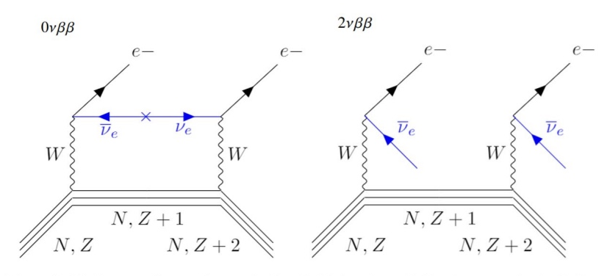
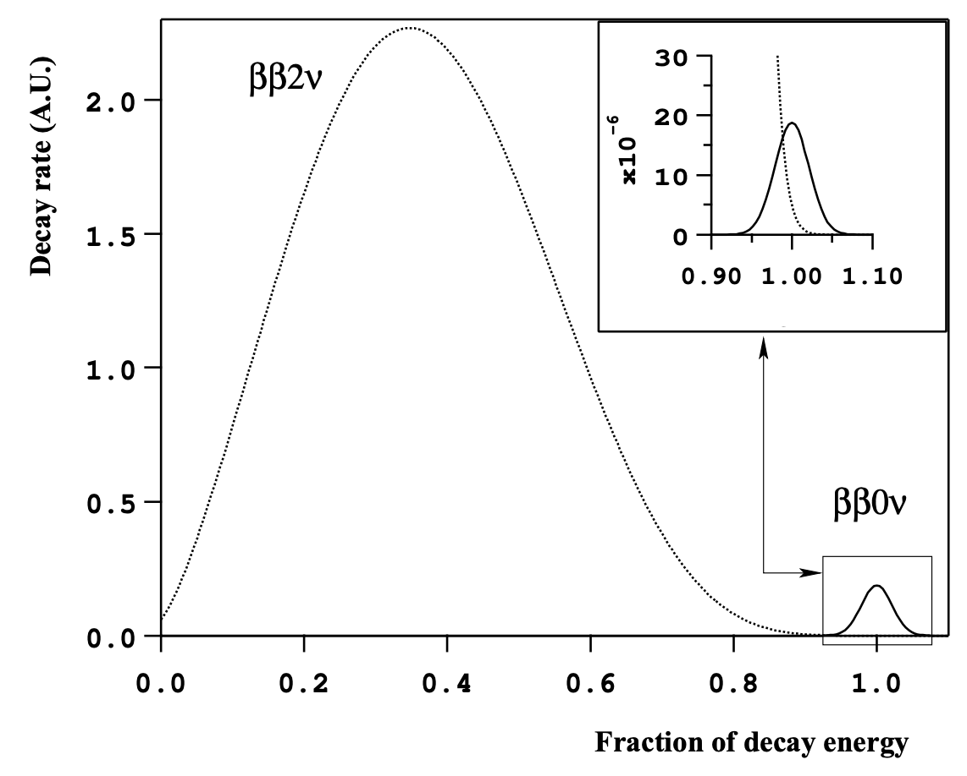

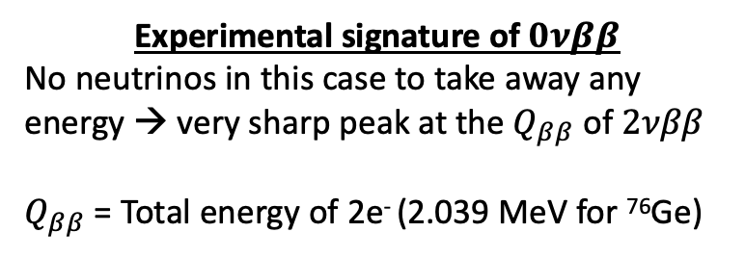
Neutrinoless double beta decay
$β^{−}$ decay: $n →p^{+}+e^{−}+{\overline{ν}}_{e}$
$2νββ$ decay: $2n →{2p}^{+}+2e^{−}+2{\overline{ν}}_{e}$ ($T_{\frac{1}{2}}$ (⁷⁶$Ge$) $={10}^{21}$yr)
$0νββ$ decay: $2n →{2p}^{+}+2e^{−}+0{\overline{ν}}_{e}$ ($T_{\frac{1}{2}}$ $=??$, Current: >10²⁵yr)
Experimental signature of $0νββ$
No neutrinos in this case to take away any energy → very sharp peak at the $Q_{ββ}$ of $2νββ$
$Q_{ββ}$ = Total energy of 2e⁻ (2.039 MeV for ⁷⁶Ge)
2039 keV for Ge
Notes:
Beta decay usually means B- decay
Picture source: https://www.particlebites.com/?p=1002
Talk about

Slide 6
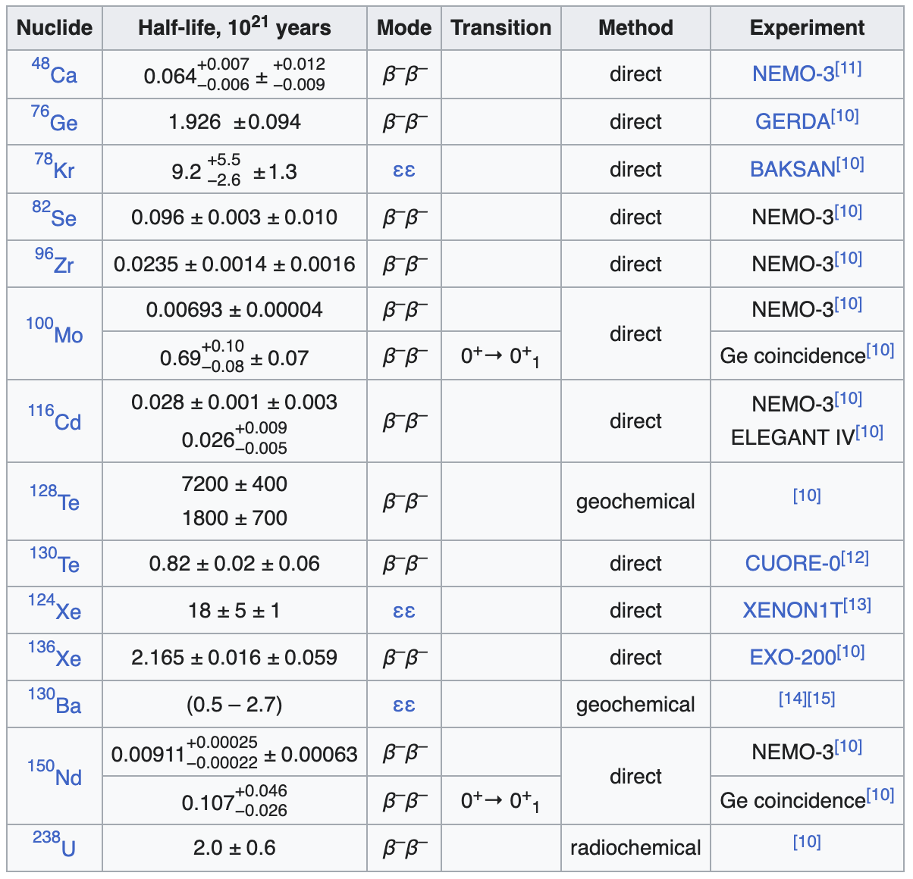
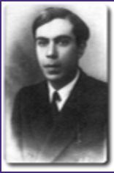

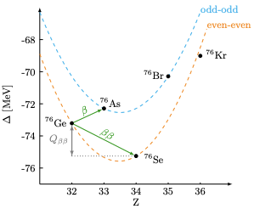

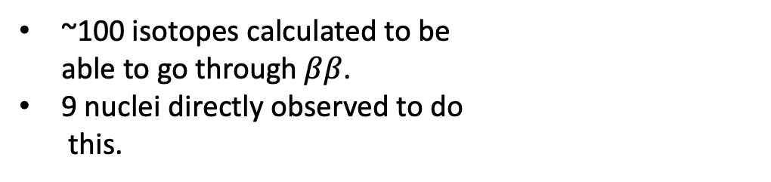


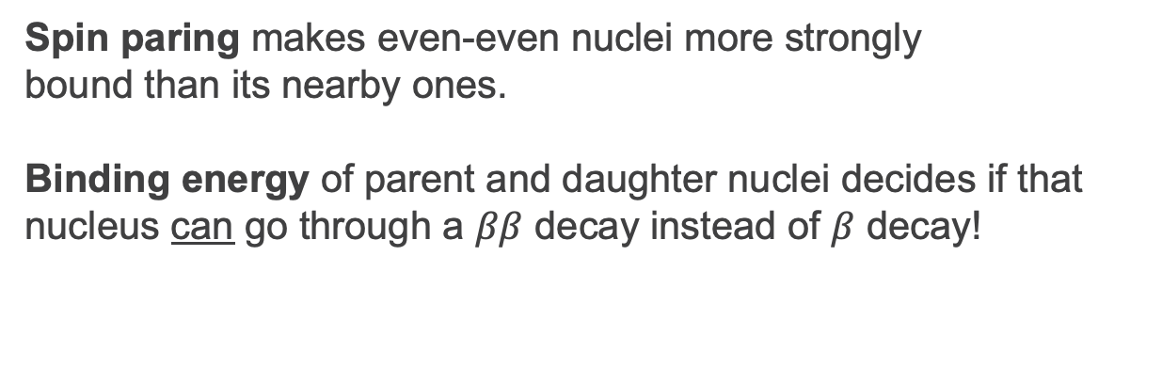
What isotopes can actually go through $ββ$?
Spin paring makes even-even nuclei more strongly
bound than its nearby ones.
Binding energy of parent and daughter nuclei decides if that nucleus can go through a $ββ$ decay instead of $β$ decay!
~100 isotopes calculated to be
able to go through $ββ$.
9 nuclei directly observed to do
this.
$$._{34}^{76}Se:(42n,34p)$$
$$ΔZ=2$$
Notes:
Start with: Not all nuclei can go through a double beta decay. It depends on how stable nearby nuclei are.
Image courtesy: https://www.hindawi.com/journals/ahep/2012/857016/

Slide 7
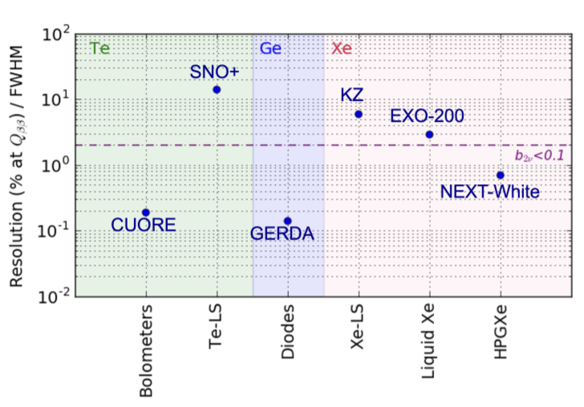
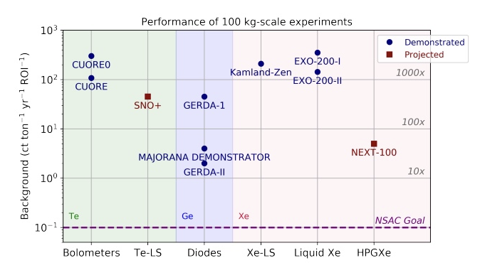
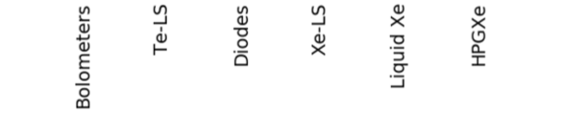
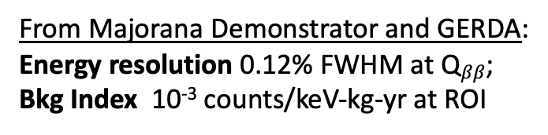
Why Ge?
Ge detectors are semiconductors
Big number of electron-hole pairs for even small amount of energy deposition
Greater energy resolution
Makes it possible to remove more background
From Majorana Demonstrator and GERDA:
Energy resolution 0.12% FWHM at Q$ββ$;
Bkg Index 10⁻³ counts/keV-kg-yr at ROI
Resolution (%FWHM) at Q_BB
Background Index

Slide 8
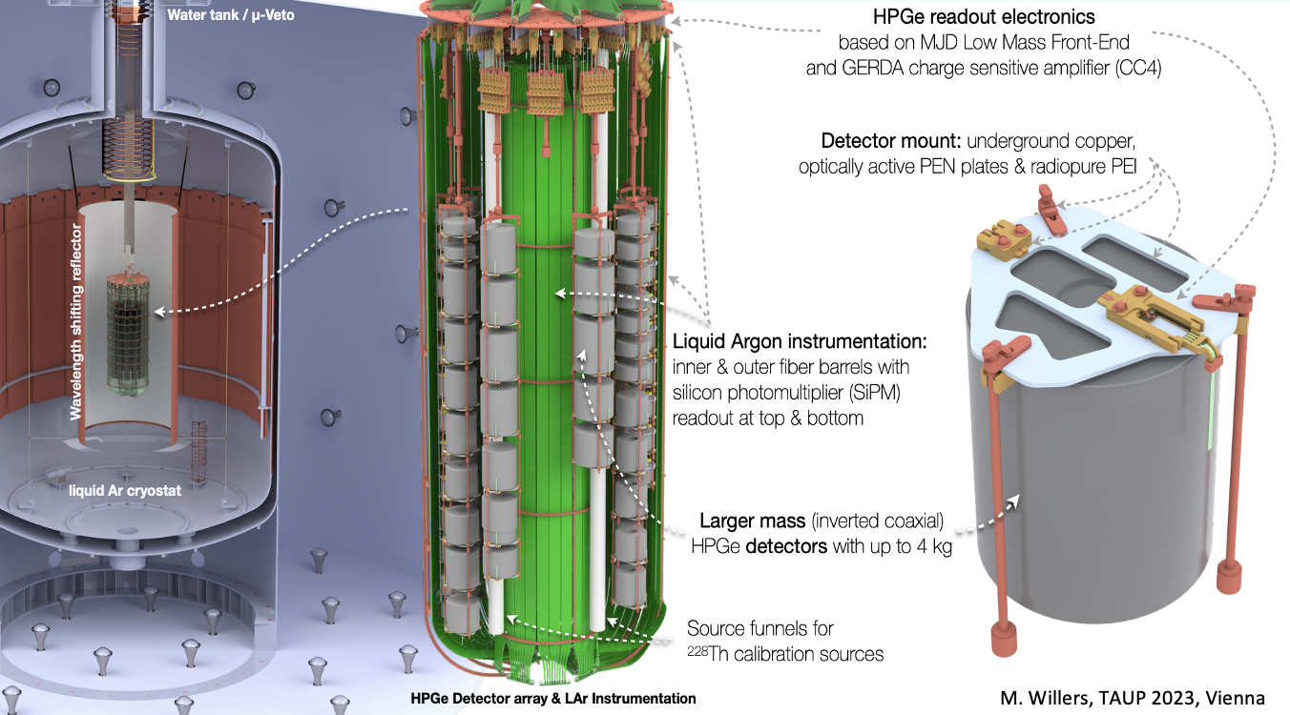
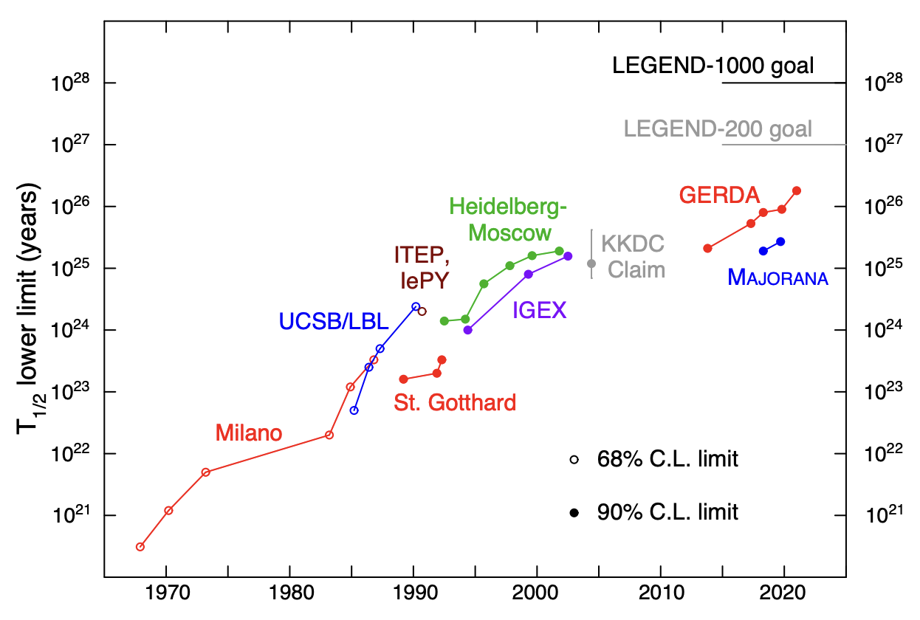
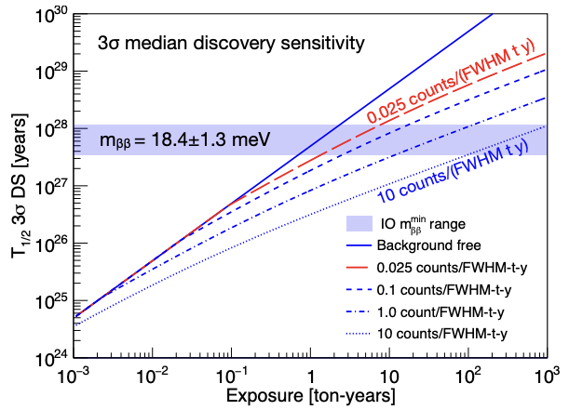
LEGEND (Large Enriched Ge Experiment for Neutrinoless $ββ$ Decay)
~300 members, 55 institutions, 12 countries
~1 mile underground in Gran Sasso, Italy.
Modular form, arrays of ~10 detectors hung on strings.
LAr in the cryostat below detector strings. SiPMs basically make it an ‘active detector for backgrounds’.
Current
meas.
Notes:
[* LEGEND detectors are fully depleted.]
PPC (+ve PC): Inherited from
GERDA & MJD
ICPC(Inverted Co-axial PC):
Can be twice as massive than PPC
Advantages of point-contact detectors:
1. Has ~pF capacitance
→ which reduces ‘pickup’ noise.(?)
→ better energy resolution
2. Also has long drift times + fast charge collection (will explain soon) →excellent Pulse Shape Analysis → Rejecting backgrounds (e.g. multi-site events)

Slide 9
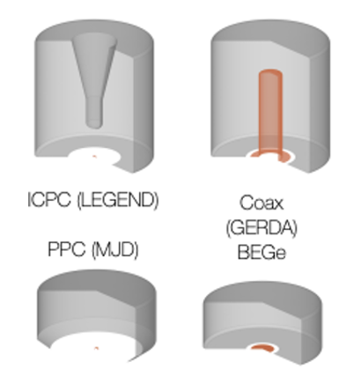
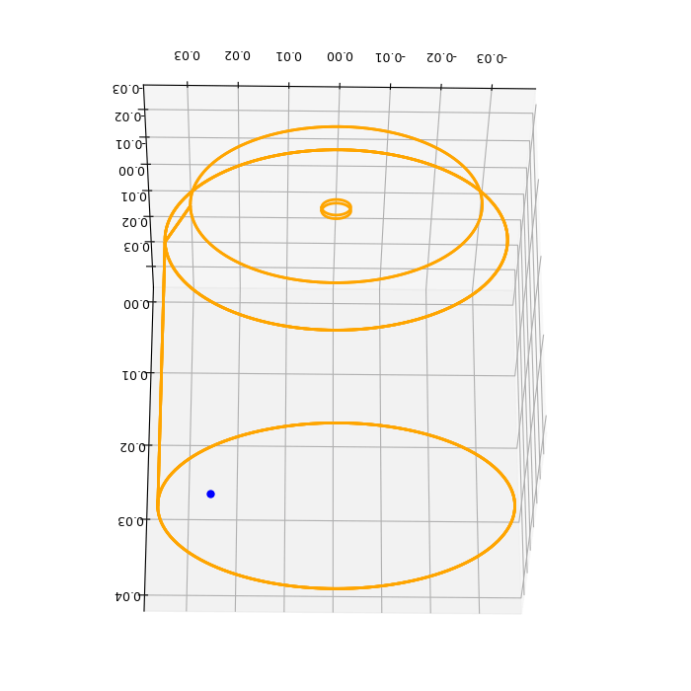
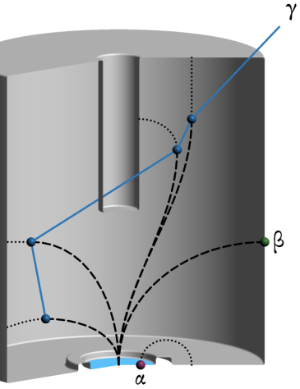
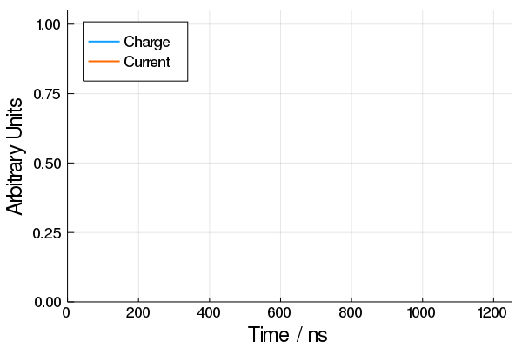
Detectors of LEGEND
Chunks of highly pure Ge. Connected in reverse bias of 2-5 kV.
Broadly two types:
- The ones that collect charge through a point (good for analysis later): PPC (repurposed from MJD), BEGe (from GERDA) , ICPC.
- The ones with larger contact for charge collection: Coaxial.
pulse
Notes:
[* LEGEND detectors are fully depleted.]
PPC (+ve PC): Inherited from
GERDA & MJD
ICPC(Inverted Co-axial PC):
Can be twice as massive than PPC
Advantages of point-contact detectors:
1. Has ~pF capacitance
→ which reduces ‘pickup’ noise.(?)
→ better energy resolution
2. Also has long drift times + fast charge collection (will explain soon) →excellent Pulse Shape Analysis → Rejecting backgrounds (e.g. multi-site events)

Slide 10
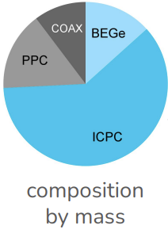

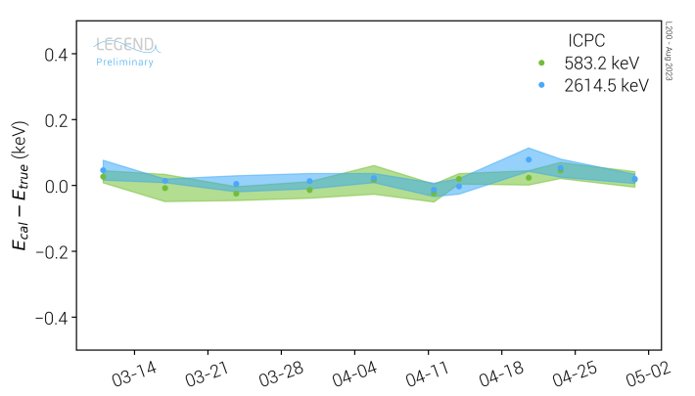
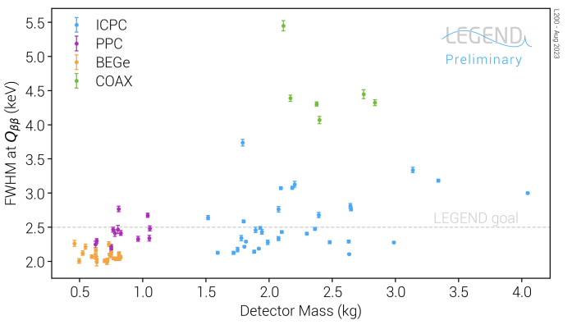
LEGEND-200 : Detector performances
101 detectors = ~140 kg (14% of total goal)
Mostly ICPC. PPC and BEGe from MJD and GERDA repurposed
Weekly energy calibration using ²²⁸Th sources.
Currently collecting data. Recent result on 10.1 kg-yr.
L-200 Detector composition (By mass)
Energy calibration stable over months
FWHM ~ 0.1% of Q$ββ$, even better than expected!
Notes:
[* LEGEND detectors are fully depleted.]
PPC (+ve PC): Inherited from
GERDA & MJD
ICPC(Inverted Co-axial PC):
Can be twice as massive than PPC
Advantages of point-contact detectors:
1. Has ~pF capacitance
→ which reduces ‘pickup’ noise.(?)
→ better energy resolution
2. Also has long drift times + fast charge collection (will explain soon) →excellent Pulse Shape Analysis → Rejecting backgrounds (e.g. multi-site events)

Slide 11
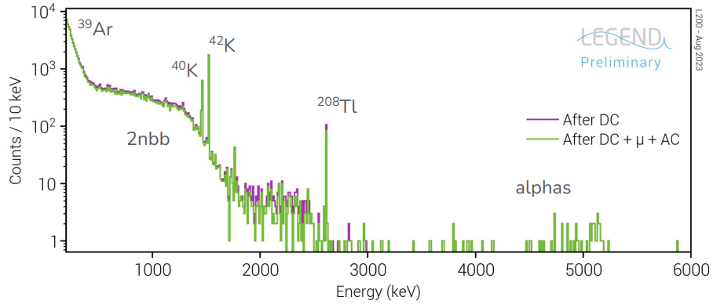
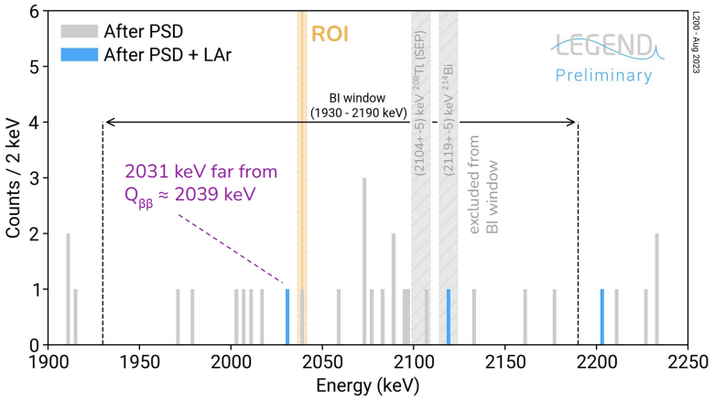
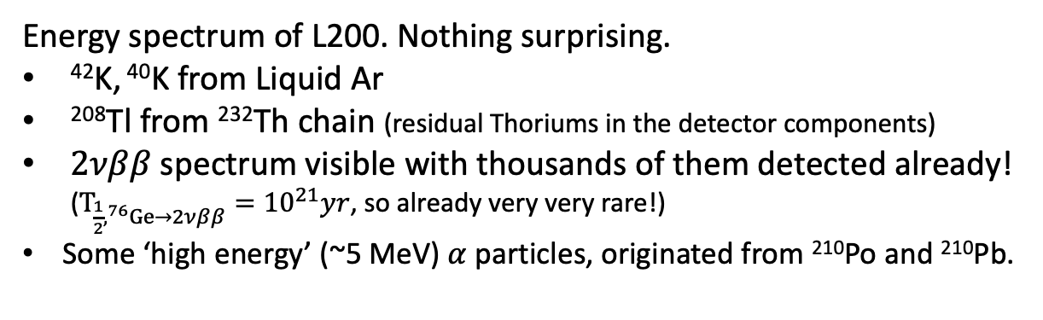
LEGEND-200 : Energy spectrum and background index
Energy spectrum of L200. Nothing surprising.
⁴²K, ⁴⁰K from Liquid Ar
²⁰⁸Tl from ²³²Th chain (residual Thoriums in the detector components)
$2νββ$ spectrum visible with thousands of them detected already! ($T_{\frac{1}{2},^{76}Ge→2νββ}={10}^{21}yr$, so already very very rare!)
Some ‘high energy’ (~5 MeV) $α$ particles, originated from ²¹⁰Po and ²¹⁰Pb.
Bkg Index = 2x10⁻⁴ cts/keV-kg-yr
(< 10⁻³ of previous best)
Background subtracted spectrum of L200 in ROI
Notes:
39Ar is most radioactive Ar, but 99.9% of natural Ar is 40Ar
Alpha particles are from 210Po (T1/2 = 138d) or 210Pb (T1/2 =

Slide 12
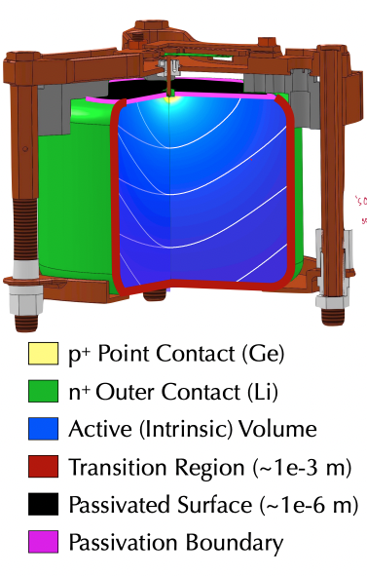
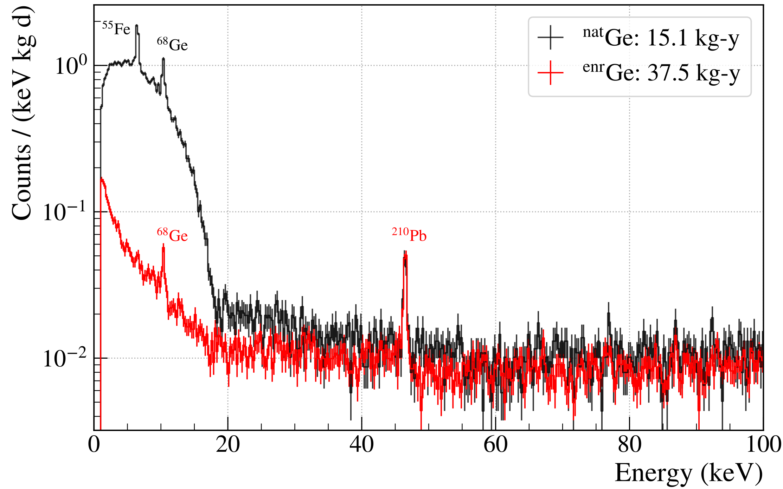
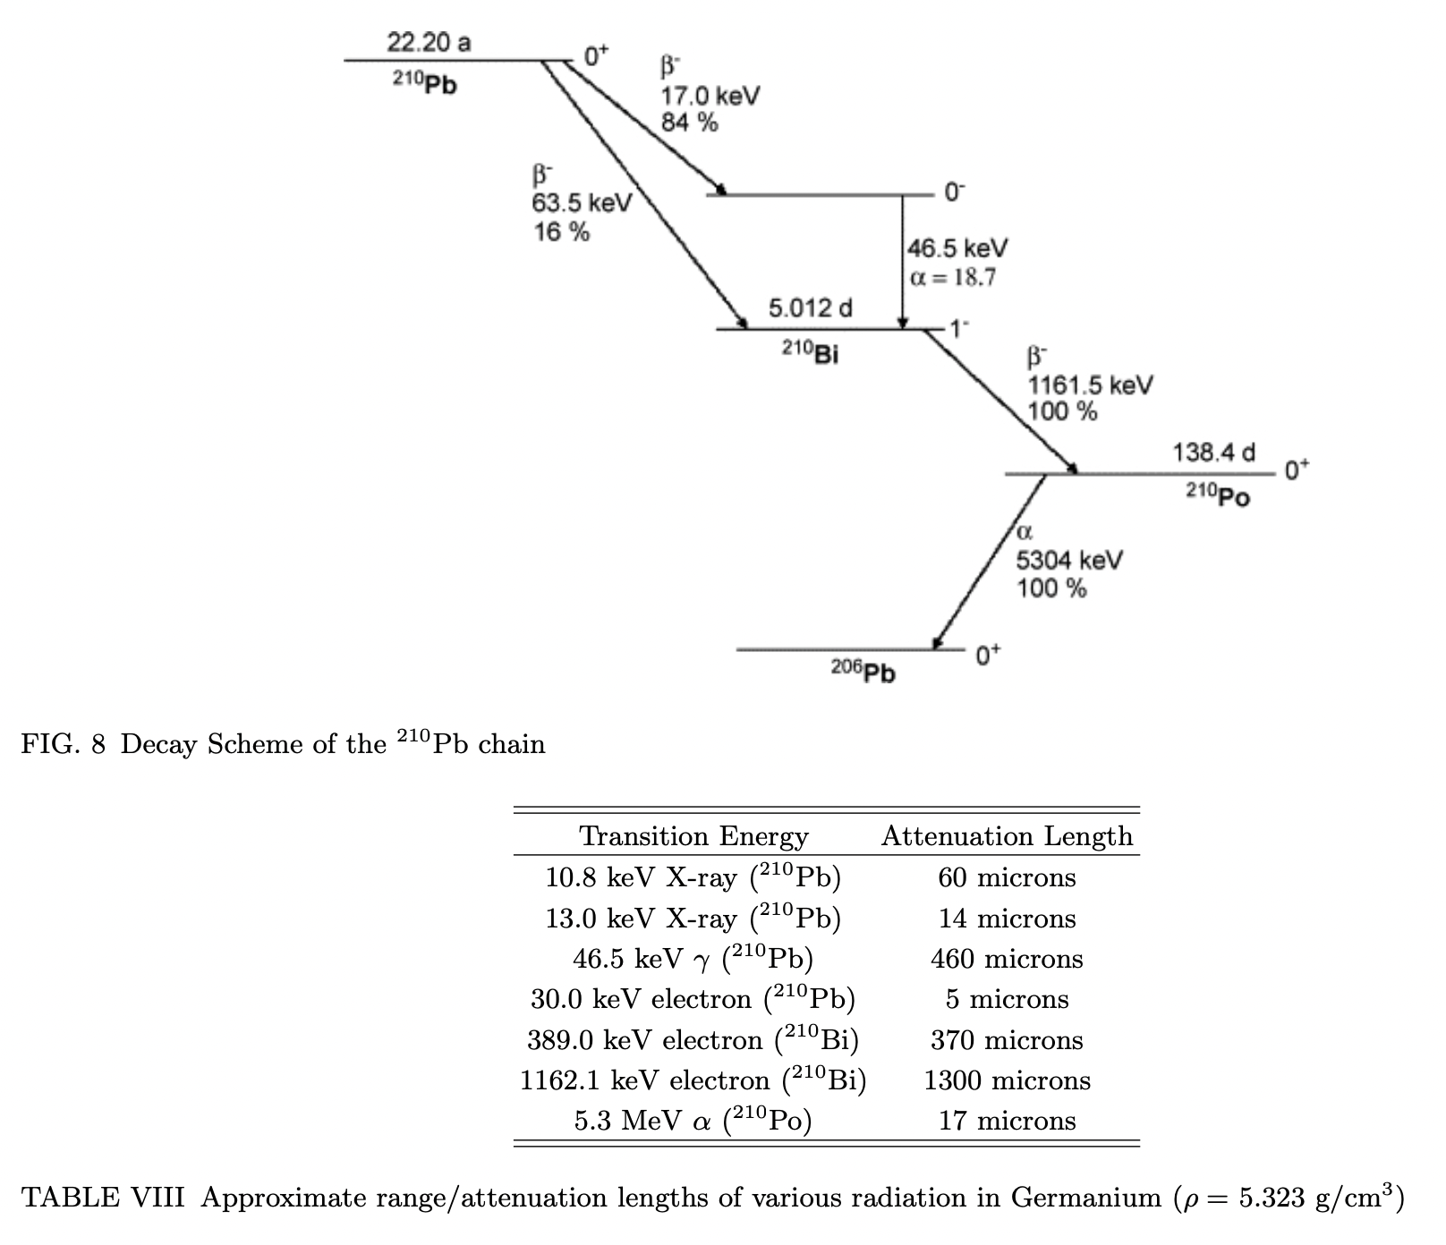
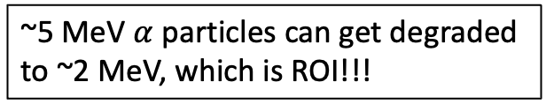
Can those alphas be problematic? Possibly!
Majorana Demonstrator’s low energy spectrum reveals some missing peaks from ²¹⁰Pb → Energy degraded in the passivated surface of the detectors?
~5 MeV $α$ particles can get degraded to ~2 MeV, which is ROI!!!
in
crystal Ge
x
x
\/
x
* this is not a comprehensive list, just a quick copy-paste
Notes:
[* LEGEND detectors are fully depleted.]
PPC (+ve PC): Inherited from
GERDA & MJD
ICPC(Inverted Co-axial PC):
Can be twice as massive than PPC
Advantages of point-contact detectors:
1. Has ~pF capacitance
→ which reduces ‘pickup’ noise.(?)
→ better energy resolution
2. Also has long drift times + fast charge collection (will explain soon) →excellent Pulse Shape Analysis → Rejecting backgrounds (e.g. multi-site events)

Slide 13
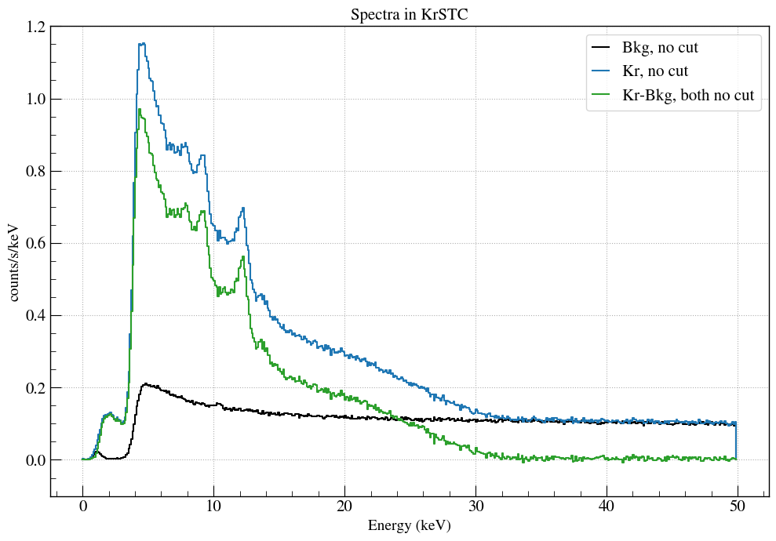
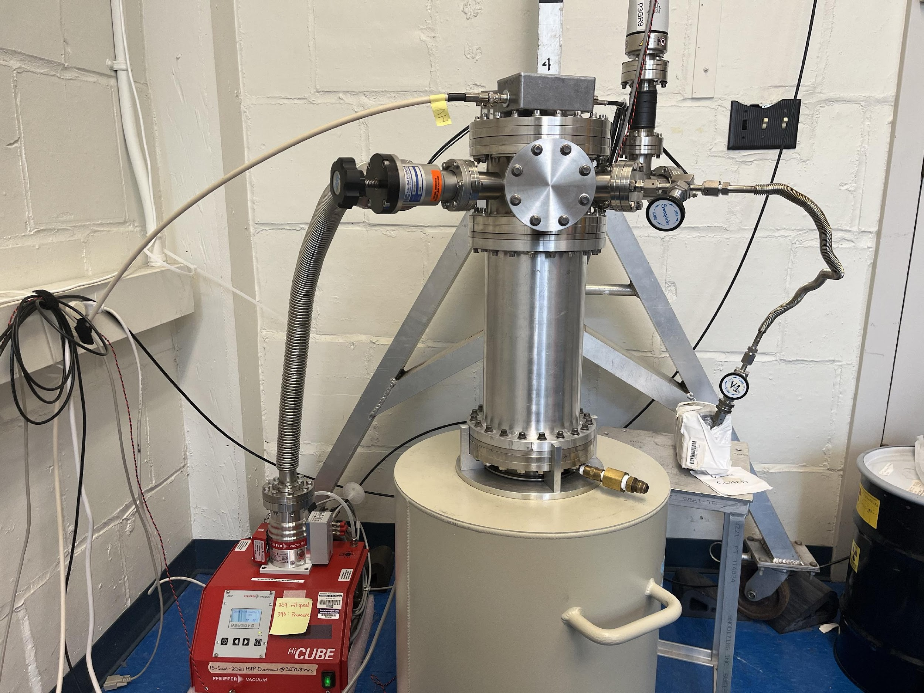
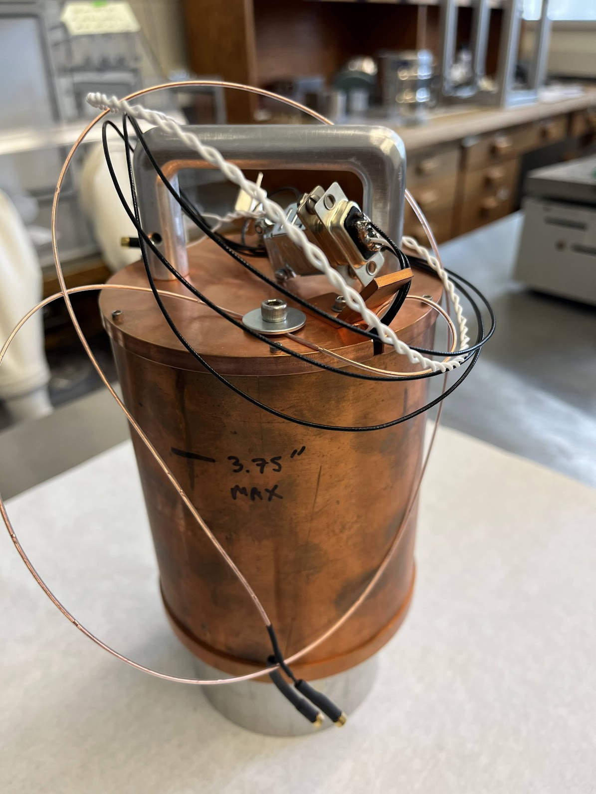
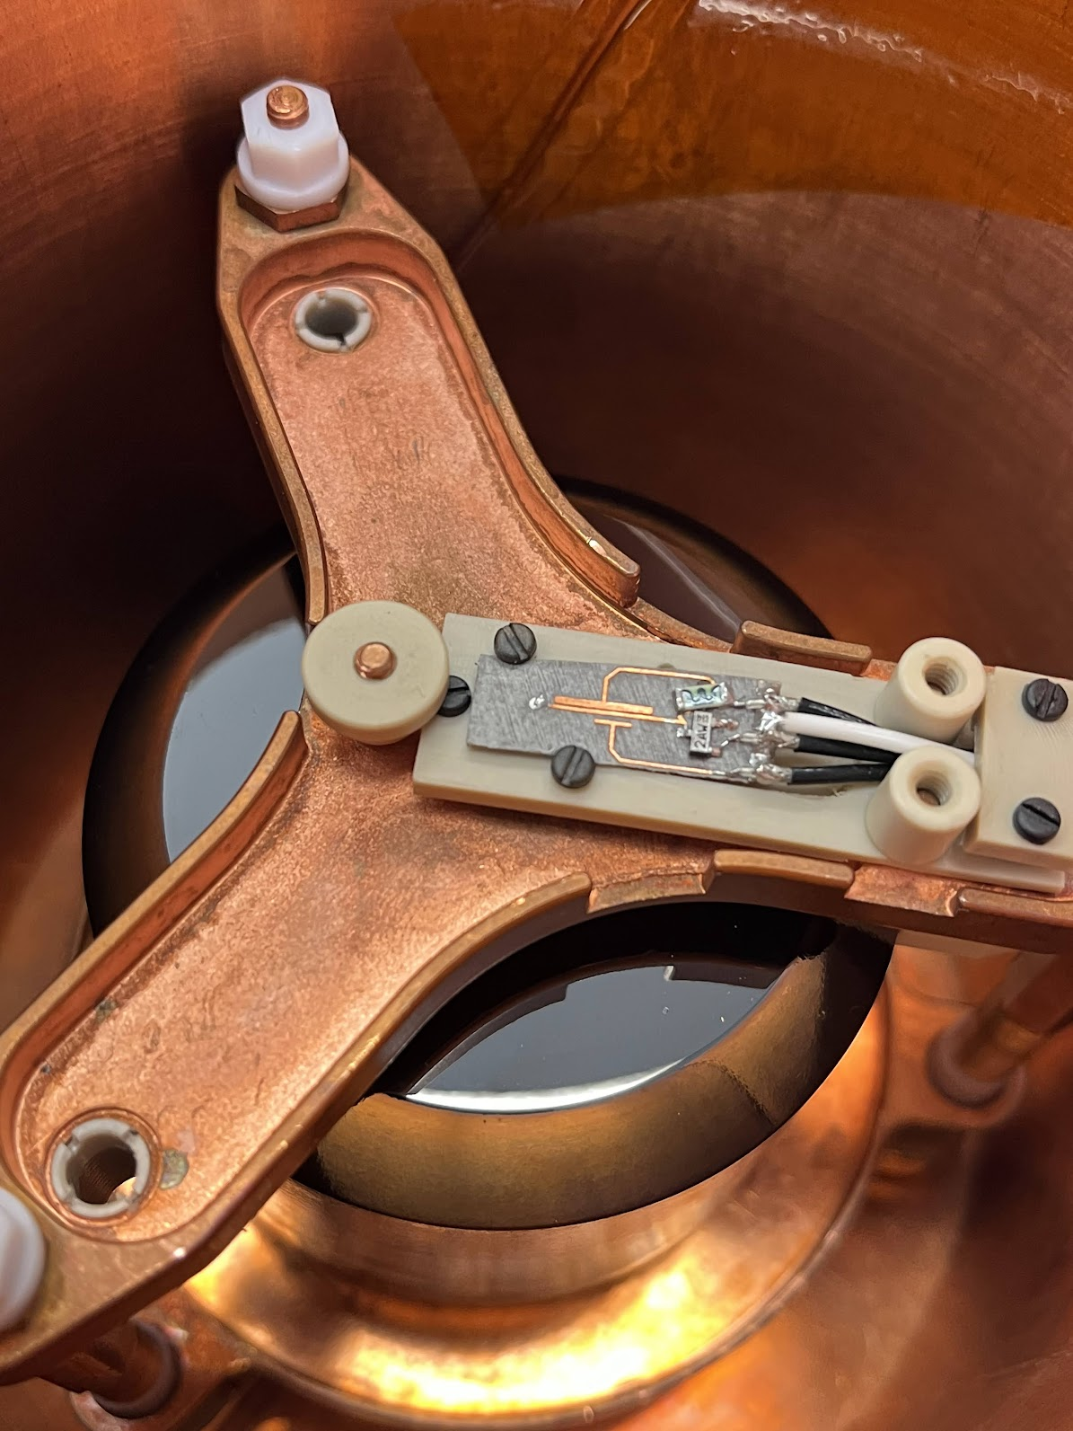

IU+UW joint effort to solve the issue!
A PPC detector from Majorana Demonstrator
Shoot Kr towards it
Look for 32 keV electron peak
Typical energy spectra for the Kr source
Expected signals:
Conversion electrons*
17-18 keV (25%)
30-31 keV (63%)
Gammas
9.4 keV (5.5%),
32.15 keV (< 0.1%)
X-rays
(requires atomic excitation)
12 keV (~13%)
9.4 keV gamma
12.6 keV x-ray
Pump valve
Amplifier
Inside the copper can
Source valve
cryostat
30—32 keV e⁻ line degraded
Source
Turbo pump
Dewar
*monoenergetic
Copper can inside cryostat
32 keV line of Kr is clearly degraded, and possibly in the passivated surface.
How do we quantify it?
Notes:
[* LEGEND detectors are fully depleted.]
PPC (+ve PC): Inherited from
GERDA & MJD
ICPC(Inverted Co-axial PC):
Can be twice as massive than PPC
Advantages of point-contact detectors:
1. Has ~pF capacitance
→ which reduces ‘pickup’ noise.(?)
→ better energy resolution
2. Also has long drift times + fast charge collection (will explain soon) →excellent Pulse Shape Analysis → Rejecting backgrounds (e.g. multi-site events)

Slide 14
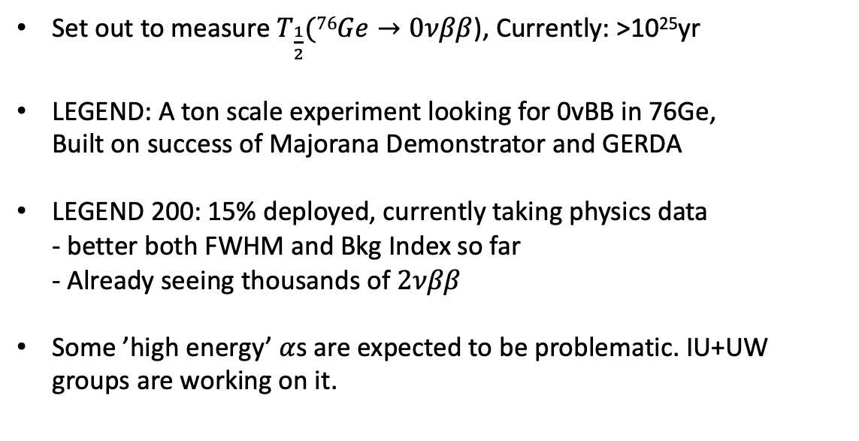

Summary
Set out to measure $T_{\frac{1}{2}}(76Ge→0νββ$), Currently: >10²⁵yr
LEGEND: A ton scale experiment looking for 0vBB in 76Ge,
Built on success of Majorana Demonstrator and GERDA
LEGEND 200: 15% deployed, currently taking physics data
- better both FWHM and Bkg Index so far
- Already seeing thousands of $2νββ$
Some ’high energy’ $α$s are expected to be problematic. IU+UW groups are working on it.
$T_{\frac{1}{2}}$ (⁷⁶$Ge$)= ??
Notes:
[* LEGEND detectors are fully depleted.]
PPC (+ve PC): Inherited from
GERDA & MJD
ICPC(Inverted Co-axial PC):
Can be twice as massive than PPC
Advantages of point-contact detectors:
1. Has ~pF capacitance
→ which reduces ‘pickup’ noise.(?)
→ better energy resolution
2. Also has long drift times + fast charge collection (will explain soon) →excellent Pulse Shape Analysis → Rejecting backgrounds (e.g. multi-site events)

Slide 15
Summary
Set out to measure $T_{\frac{1}{2}}(76Ge→0νββ$), Currently: >10²⁵yr
LEGEND: A ton scale experiment looking for 0vBB in 76Ge,
Built on success of Majorana Demonstrator and GERDA
LEGEND 200: 15% deployed, currently taking physics data
- better both FWHM and Bkg Index so far
- Already seeing thousands of $2νββ$
Some ’high energy’ $α$s are expected to be problematic. IU+UW groups are working on it.
$T_{\frac{1}{2}}$ (⁷⁶$Ge$)= ??
Thanks everyone for listening!
Questions?
Notes:
[* LEGEND detectors are fully depleted.]
PPC (+ve PC): Inherited from
GERDA & MJD
ICPC(Inverted Co-axial PC):
Can be twice as massive than PPC
Advantages of point-contact detectors:
1. Has ~pF capacitance
→ which reduces ‘pickup’ noise.(?)
→ better energy resolution
2. Also has long drift times + fast charge collection (will explain soon) →excellent Pulse Shape Analysis → Rejecting backgrounds (e.g. multi-site events)

Slide 16
Backup slides

Slide 17
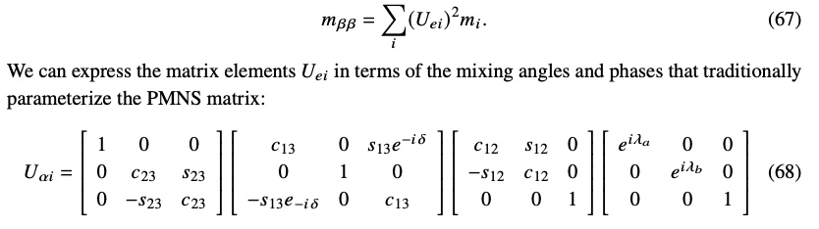
Backup slides
Inverted and normal order hierarchy comes into
play when calculating m_BB from T_1/2, not before that.
Majorana phases

Slide 18
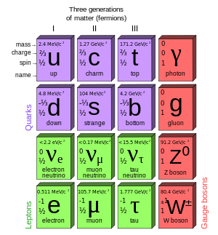
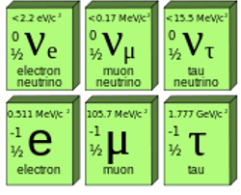


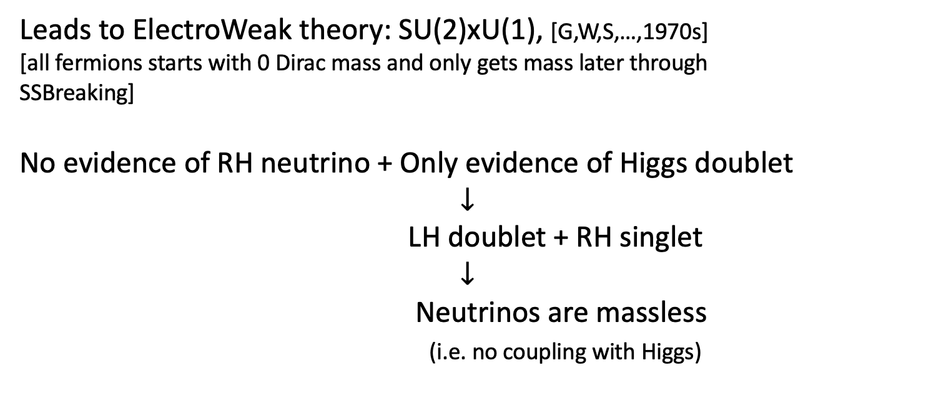
But Standard Model tries to understand them
Leads to ElectroWeak theory: SU(2)xU(1), [G,W,S,…,1970s]
[all fermions starts with 0 Dirac mass and only gets mass later through
SSBreaking]
No evidence of RH neutrino + Only evidence of Higgs doublet
$$↓$$
LH doublet + RH singlet
$$↓$$
Neutrinos are massless
(i.e. no coupling with Higgs)
()
()
()
L L L
()
()
()
LH
doublets
X. X. X
RH
singlets
1998: Neutrinos have mass! (=all mass eigenvalues can’t be 0), but very tiny!(~0.1 eV) [Super-Kamiokande]
R R R
Notes:
Mention: parity violation -> generic to weak interactions → but also neutrino always involved in weak interaction.
No evidence of RH neutrino == neutrinos are massless : complement each other

Slide 19
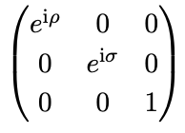
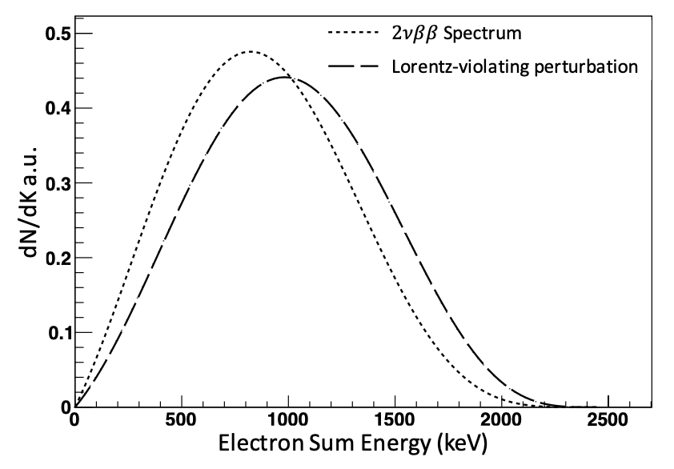
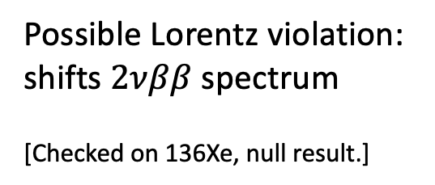


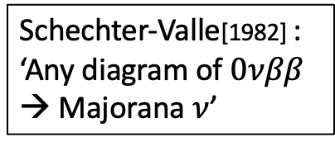
Worth to look for $0νββ$?
* ~‘Anything that can happen,
should happen.’(Good enough?)
Majorana nature of neutrino → ‘Tunable’ origin of $ν$ masses → Leptogenesis
All the good stuff…
Only 3 phases can be absorbed in
leptonic fields
(i.e. only charged lepton fields can do that now)
Schechter-Valle[1982] : ‘Any diagram of $0νββ$ → Majorana $ν$’
$$U_{PMNS}=U_{CKM}(δ)$$
Possible Lorentz violation: shifts $2νββ$ spectrum
[Checked on 136Xe, null result.]
[Just two more ways to explain the
observed ‘big’ amount of CP violation]
Notes:
RH neutrinos can be used as possible explanation of dark matter. Is it still true?
Neutrinos can’t gain masses like other leptons thorugh higgs mechanism because we have to incorporate the fact that weak interactions prefers left handedness.

Slide 20
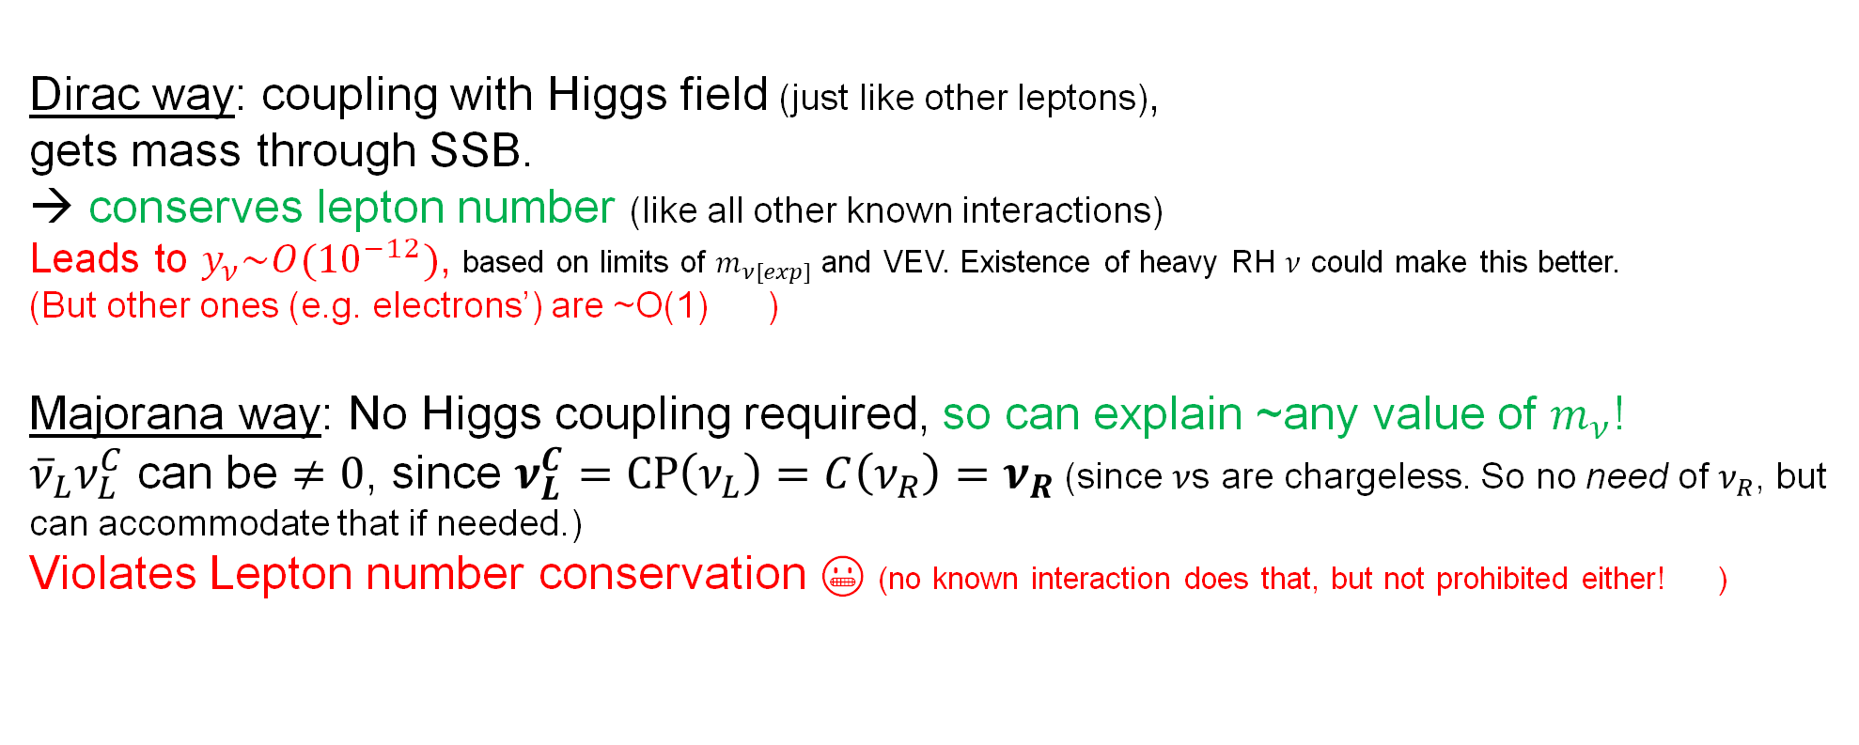
Where could neutrinos gain masses from?
Left handed lepton
Both same handed,
No Higgs field needed.
Dirac way: coupling with Higgs field (just like other leptons),
gets mass through SSB.
→ conserves lepton number (like all other known interactions)
Leads to $y_{ν}\sim O({10}^{−12})$, based on limits of $m_{ν[exp]}$ and VEV. Existence of heavy RH $ν$ could make this better.
(But other ones (e.g. electrons’) are ~O(1) 🤔)
Majorana way: No Higgs coupling required, so can explain ~any value of $m_{ν}$!
${\overline{ν}}_{L}ν_{L}^{C}$ can be $≠0$, since $ν_{L}^{C}=CP\left(ν_{L}\right)=C\left(ν_{R}\right)=ν_{R}$ (since $ν$s are chargeless. So no need of $ν_{R}$, but can accommodate that if needed.)
Violates Lepton number conservation 😬 (no known interaction does that, but not prohibited either! 🤔)
Higgs
Right handed neutrino
Dirac term
Majorana term
Majorana →. → particle = anti-particle
Notes:
M_nu ~ 0.1 eV, VEV~246 GeV

Slide 21
