Slide 1
Field model for MCBXF magnets
A. Chmielińska
P. Rogacki
L. Fiscarelli
WP3 meeting 08.11.2023

Slide 2
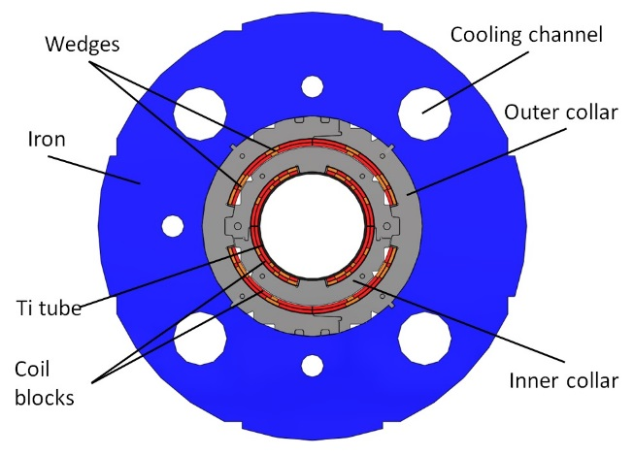
MCBXFB / A
Parameter | Value (B / A)
Aperture (mm) | 150
Magnetic length (m) | 1.2 / 2.2
Int. field (Tm) | 2.5 / 4.5
Current inner (A) | 1740 / 1593
Current outer (A) | 1430 / 1340
  Inner coils produce a vertical field (main field B1, normal).
  Outer coils provide horizontal field (main field A1, skew).

Slide 3
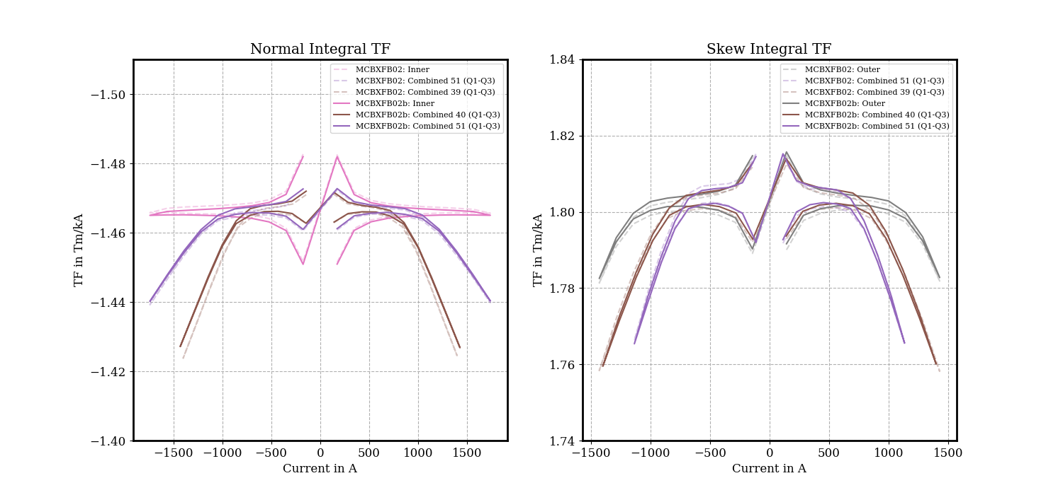
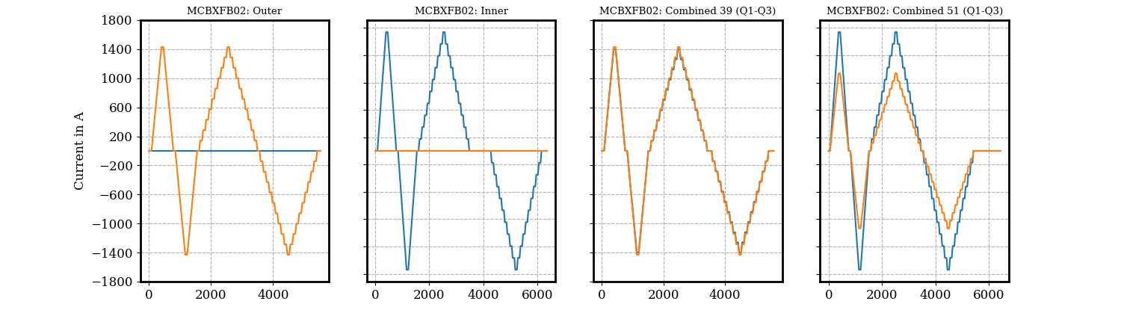
TF from magnetic measurements
2.4 %
2.2 %

Slide 4
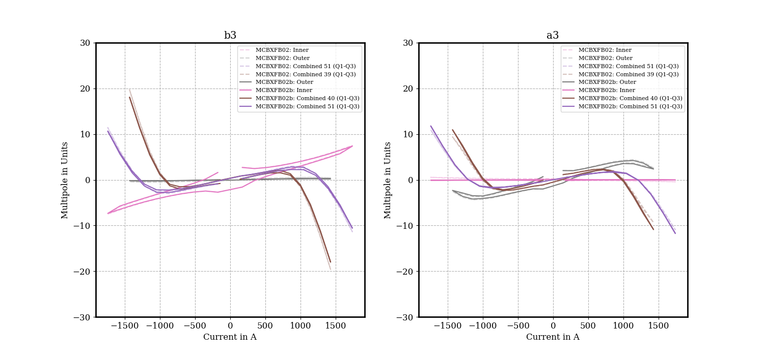
b₃ and a₃ from magnetic measurements
b_{n} and a_{n} normalized to 2.5 Tm
(nominal field)

Slide 5
Coupling of saturation
The MCBXF magnets show a saturation that depends on the field level of both planes (coupling).
The coupling impacts the field up to:
  2.2 % for the B1, 28 units for the b₃
  1.2 % for the A1, 12 units for the a₃
A model able to predict such effect is required.

Slide 6

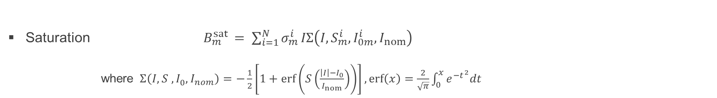
FiDeL field model - static components
Geometric $B_{m}^{geo }= γ_{m}^{ }I$
$$m_{ }^{ }−multipole order$$
Saturation $B_{m}^{sat }= \sum_{i=1}^{N}{σ_{m}^{i}}IΣ\left(I, S_{m}^{i},I_{0m}^{i},I_{nom}\right)$
where$Σ\left(I, S_{ }^{ },I_{0}^{ },I_{nom}\right)=−\frac{1}{2}\left[1+\operatorname{erf}\left(S\left(\frac{\left|I\right|−I_{0}}{I_{nom}}\right)\right)\right], \operatorname{erf}\left(x\right)=\frac{2}{\sqrt{π}}\int_{0}^{x}{e^{−t^{2}}dt}$
DC magnetization and residual magnetization are not considered
FiDeL website, https://lhc-div-mms.web.cern.ch/tests/MAG/Fidel/

Slide 7
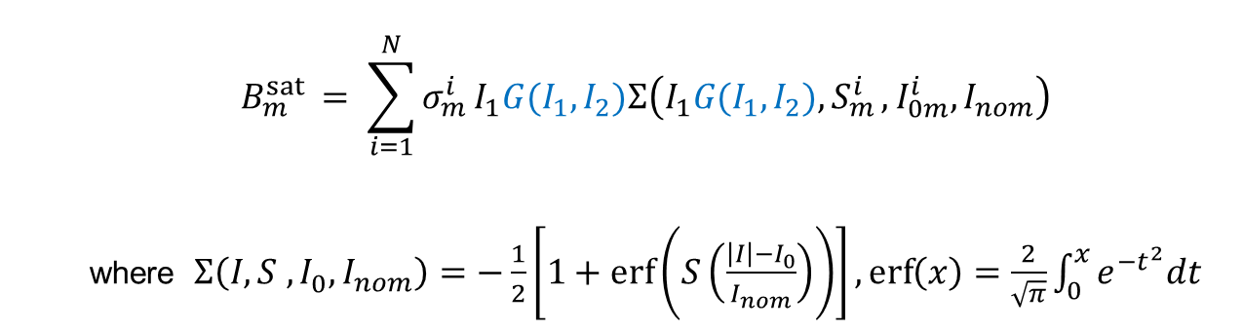
New model for the saturation of MCBXF
$$B_{m}^{sat }= \sum_{i=1}^{N}{σ_{m}^{i}}I_{1}G(I_{1},I_{2})Σ\left(I_{1}G(I_{1},I_{2}){,S}_{m}^{i},I_{0m}^{i},I_{nom}\right)$$
where$Σ\left(I, S_{ }^{ },I_{0}^{ },I_{nom}\right)=−\frac{1}{2}\left[1+\operatorname{erf}\left(S\left(\frac{\left|I\right|−I_{0}}{I_{nom}}\right)\right)\right], \operatorname{erf}\left(x\right)=\frac{2}{\sqrt{π}}\int_{0}^{x}{e^{−t^{2}}dt}$
A multiplication factor G, function of the two currents, is added to modulates the saturation effect.

Slide 8
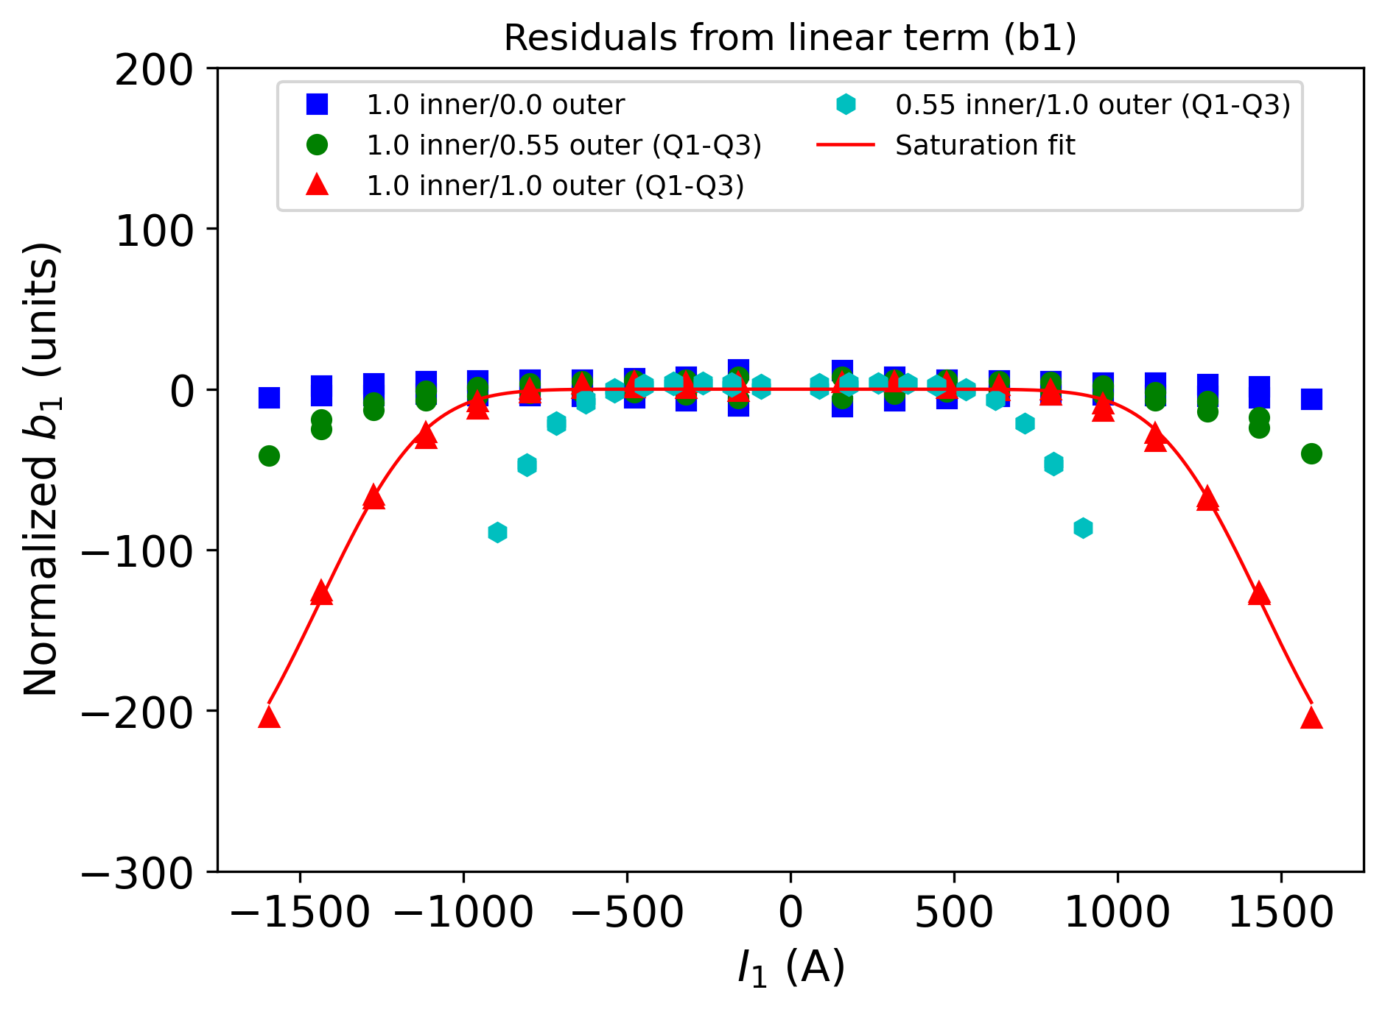
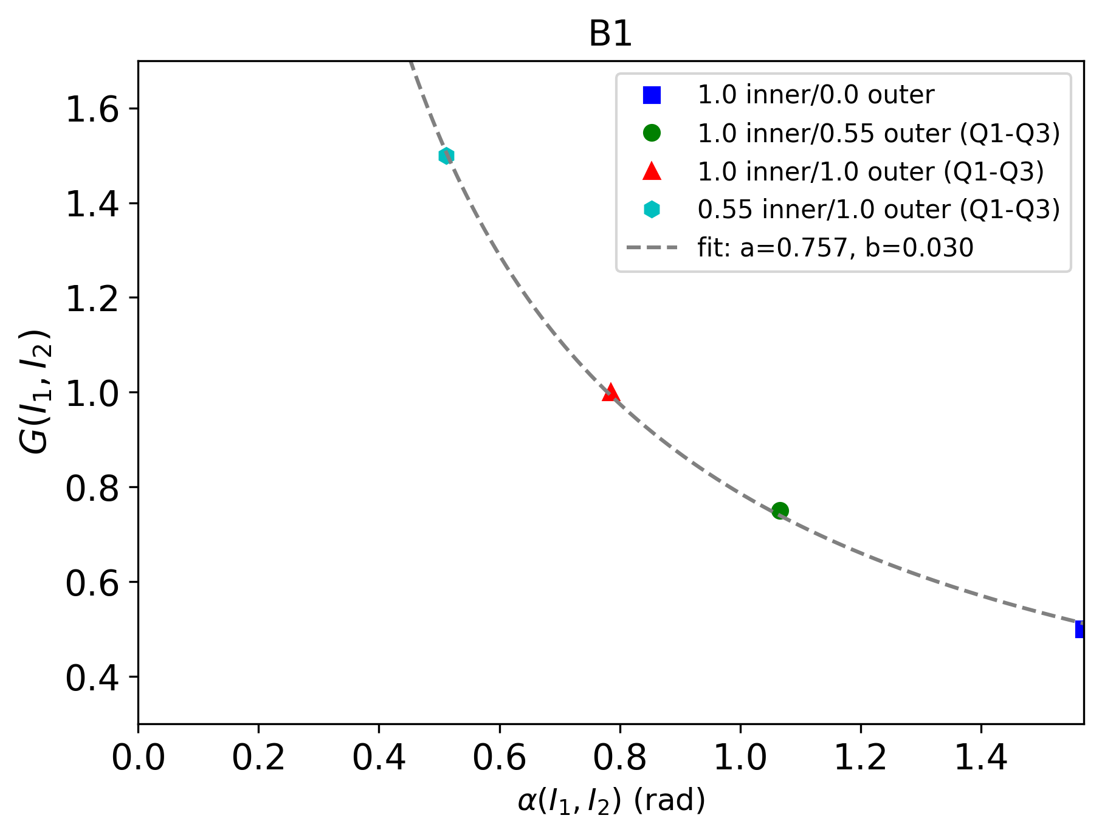
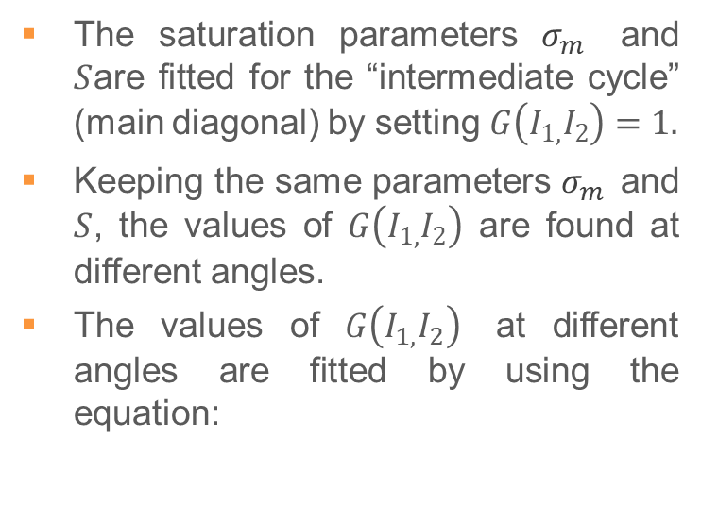



The coupling factor “G(I₁,I₂)”
The saturation parameters $σ_{m}^{}$ and $S$are fitted for the “intermediate cycle” (main diagonal) by setting $G\left(I_{1,}I_{2}\right)=1.$
Keeping the same parameters $σ_{m}^{}$ and $S$, the values of $G\left(I_{1,}I_{2}\right)$ are found at different angles.
The values of $G\left(I_{1,}I_{2}\right)$ at different angles are fitted by using the equation:
  $$G\left(I_{1,}I_{2}\right)=\frac{a}{α\left(I_{1},I_{2}\right)}+b$$
$α\left(I_{1},I_{2}\right)=arctan\left(\frac{|I_{1}|/I_{nom1}}{{|I}_{2}|/I_{nom2}}\right)$
$$a=\text{0.}\text{757}$$
$$b=\text{0.0}\text{30}$$

Slide 9
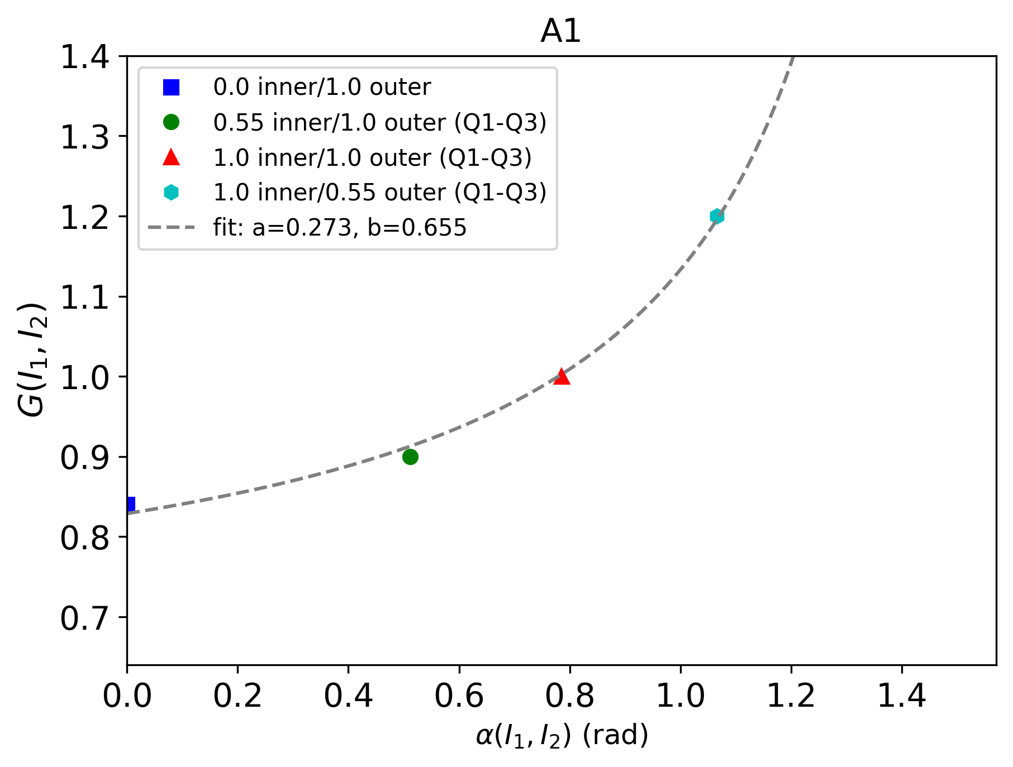

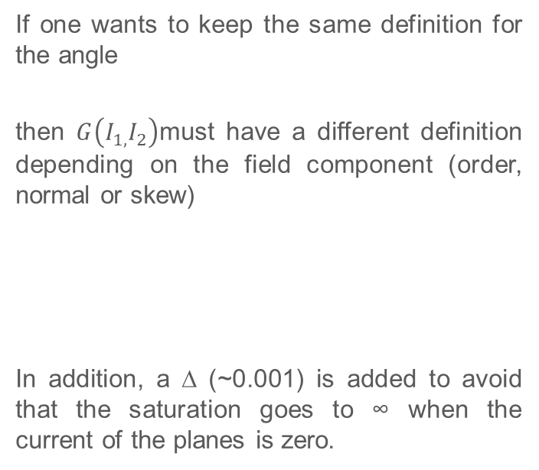


The coupling factor “G(I₁,I₂)”
If one wants to keep the same definition for the angle
then $G\left(I_{1,}I_{2}\right)$must have a different definition depending on the field component (order, normal or skew)
In addition, a ∆ (~0.001) is added to avoid that the saturation goes to ∞ when the current of the planes is zero.
$α\left(I_{1},I_{2}\right)=arctan\left(\frac{|I_{1}|/I_{nom1}}{{|I}_{2}|/I_{nom2}}\right)$
  $$G_{m}^{B}\left(I_{1,}I_{2}\right)=\frac{a}{α\left(I_{1},I_{2}\right)+ ∆}+b$$
  $$G_{m}^{A}(I_{1},I_{2})=\frac{a}{\frac{π}{2} − α\left(I_{1},I_{2}\right)+∆}+b$$

Slide 10
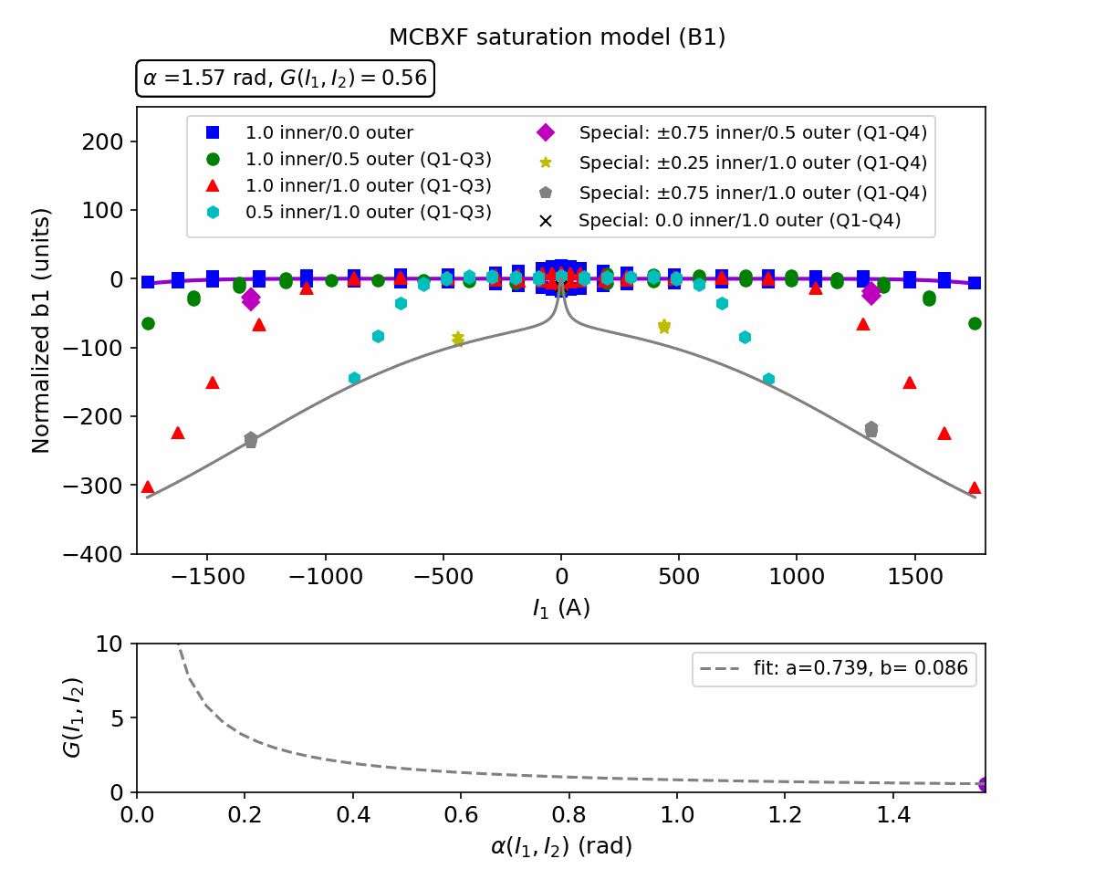
Prediction of B1

Slide 11
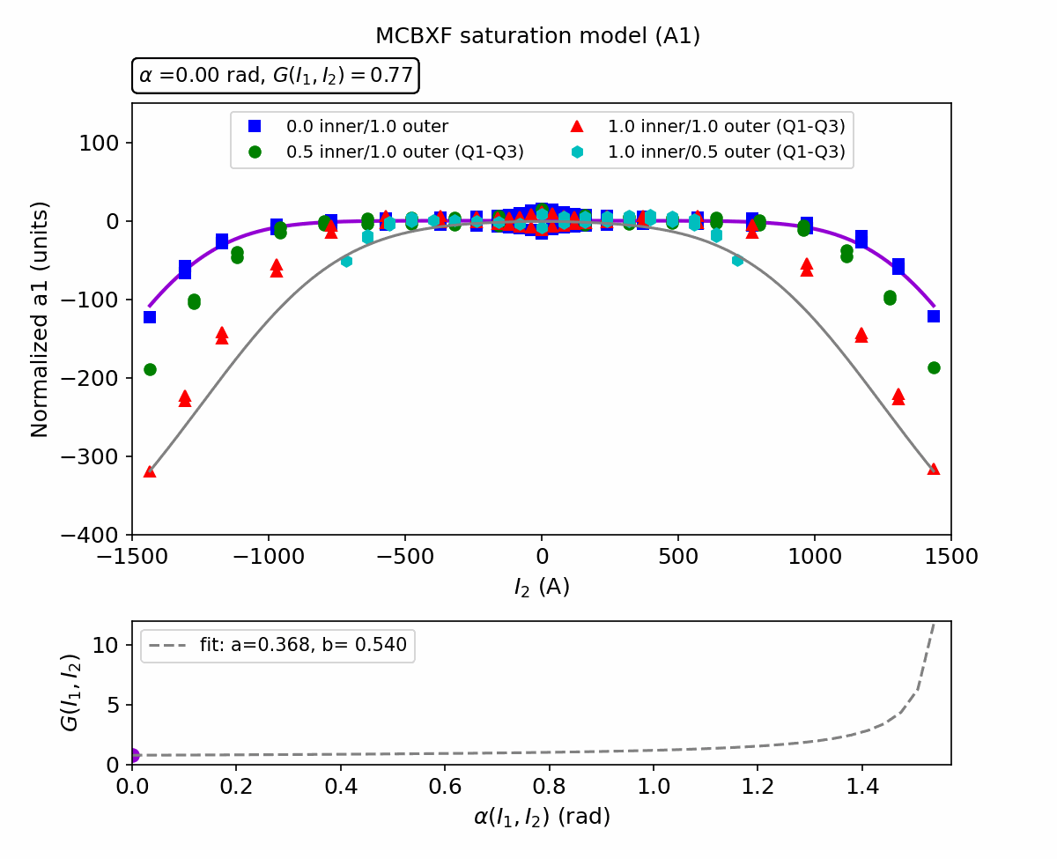
Prediction of A1

Slide 12
Evaluation of the model error
The new model has been already evaluated on individual magnets
  https://indico.cern.ch/event/1192527/
  https://indico.cern.ch/event/1296834/
At present we have measured
  4 MCBXFB
  1 MCBXFA
We can check if one set of parameters can be used for all magnets of the same type
  First comparison
    Same saturation parameters for all magnets
    Magnet-specific versus family-average geometric component
 | MCBXFB | MCBXFA
Multipole | Error [units] | Error [units]
b1 | ±30 | ±15
a1 | ±28 | ±17
b3 | ±4 | ±3
a3 | ±4 | ±3

Slide 13
Fit of B₁ and A₁
Family-average parameters
B1
Component | Parameter | Average value
Geometric | γ | 1.4648 E-3
Saturation | 𝜎 | 0.0485 E-3
Saturation | I₀ | 1445
Saturation | S | 4.7
 | a | 0.728
 | b | 0.091
A1
Component | Parameter | Average value
Geometric | γ | 1.8052 E-3
Saturation | 𝜎 | 0.0665 E-3
Saturation | I₀ | 1200
Saturation | S | 3.9
 | a | 0.368
 | b | 0.540
Magnet-specific geometric component γ
Multipole | MCBXF01 | MCBXF02b | MCBXF03 | MCBXFBP2c | AVERAGE
B1 | 1.4647 E-3 | 1.4660 E-3 | 1.4642 E-3 | 1.4644 E-3 | 1.4648 E-3
A1 | 1.8030 E-3 | 1.8037 E-3 | 1.8008 E-3 | 1.8133 E-3 | 1.8052 E-3

Slide 14
Fit of B₃ and A₃
Family-average parameters
B3
Component | Parameter | Average value
Geometric | γ | -1.2 E-6
Saturation | 𝜎 | -4.5 E-6
Saturation | I₀ | 1445
Saturation | S | 4.7
 | a | 0.737
 | b | 0.089
A3
Component | Parameter | Average value
Geometric | γ | 1.8 E-6
Saturation | 𝜎 | 5.2 E-6
Saturation | I₀ | 1023
Saturation | S | 3.7
 | a | 0.430
 | b | 0.380
Magnet-specific geometric component γ
Multipole | MCBXF01 | MCBXF02b | MCBXF03 | MCBXFBP2c | AVERAGE
B3 | -1.5 E-6 | -1.0 E-6 | -1.1 E-6 | -1.1 E-6 | -1.2 E-6
A3 | 1.6 E-6 | 1.6 E-6 | 1.9 E-6 | 2.1 E-6 | 1.8 E-6

Slide 15
Modeling errors
Max normalized errors for |I| > 500A (units normalized to 2.5 Tm)
Magnet-specific geometric component / Family-average geometric component
Multipole | MCBXF01 |  | MCBXF02b |  | MCBXF03 |  | MCBXFBP2c
b1 | 27 | 27 | 29 | 37 | 30 | 33 | 28 | 29
a1 | 23 | 36 | 15 | 24 | 15 | 40 | 27 | 70*
b3 | 2.9 | 4.9 | 3 | 3.8 | 2.6 | 2.6 | 2.6 | 4.0
a3 | 3.0 | 3.0 | 1.9 | 2.5 | 2.4 | 3.0 | 2.7 | 4.4
* MCBXFBP2c has a different coil length

Slide 16
Conclusions
The MCBXF magnets show a non-negligible coupling of the two planes that affects the saturation.
This effect can be modelled by using a modified “FiDeL” saturation model.
The model works for both MCBXFB and MCBXFA magnet types.
By analysing the measurements taken so far on 3 MCBXFB series magnets, we see that:
  Family-average parameters can be used for both geometric and saturation components;
  The residual errors are:
    <40 units for b1/a1;
    <5 units for b3/a3.
Discussion on-going on how to use the model for beam simulations and operations.

Slide 17
Annex

Slide 18
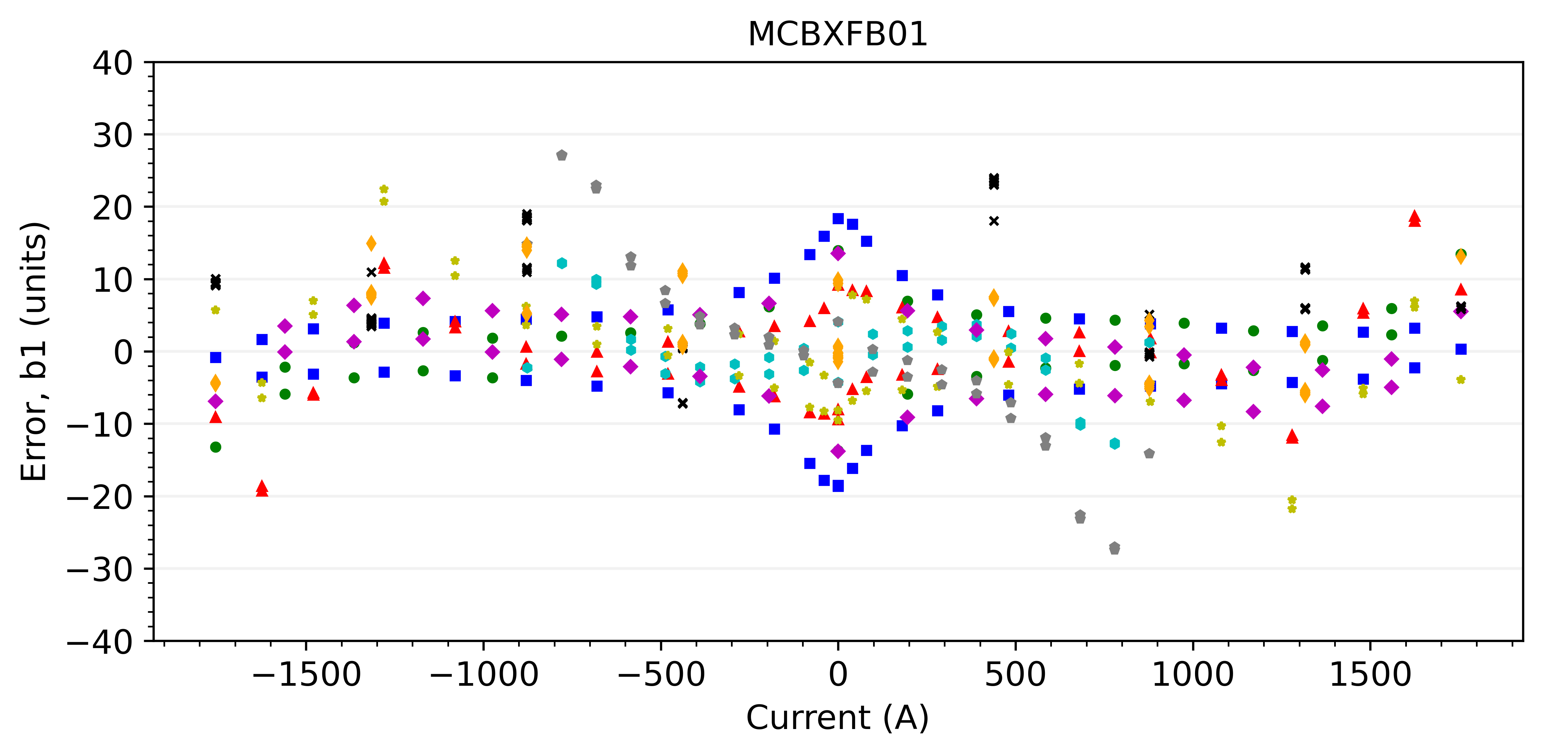
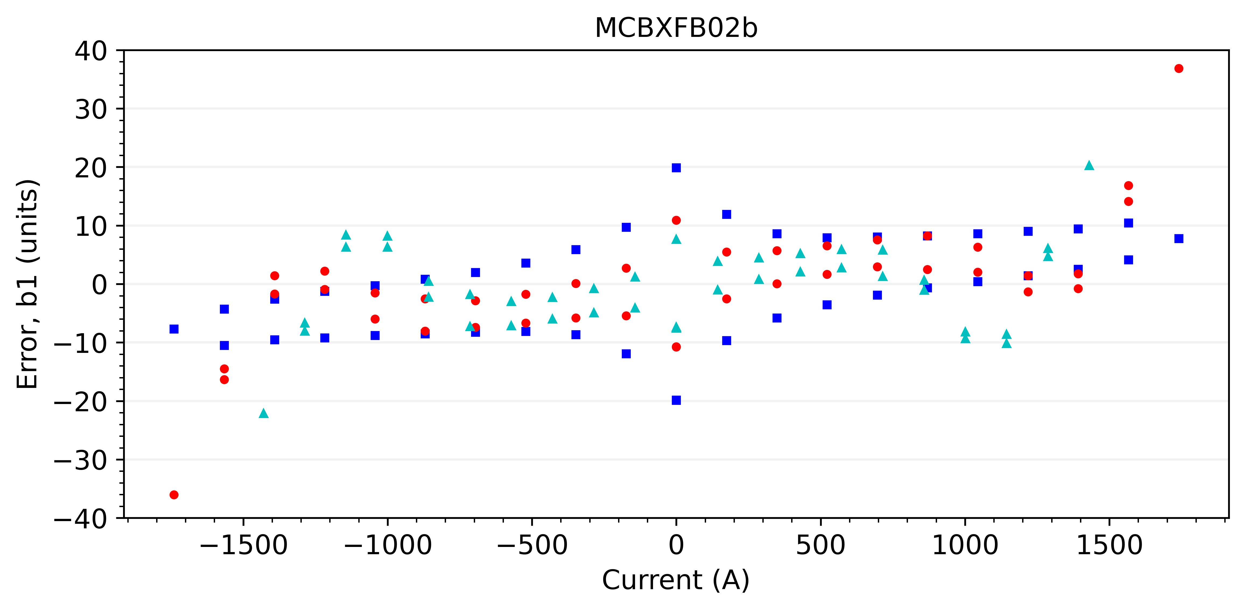
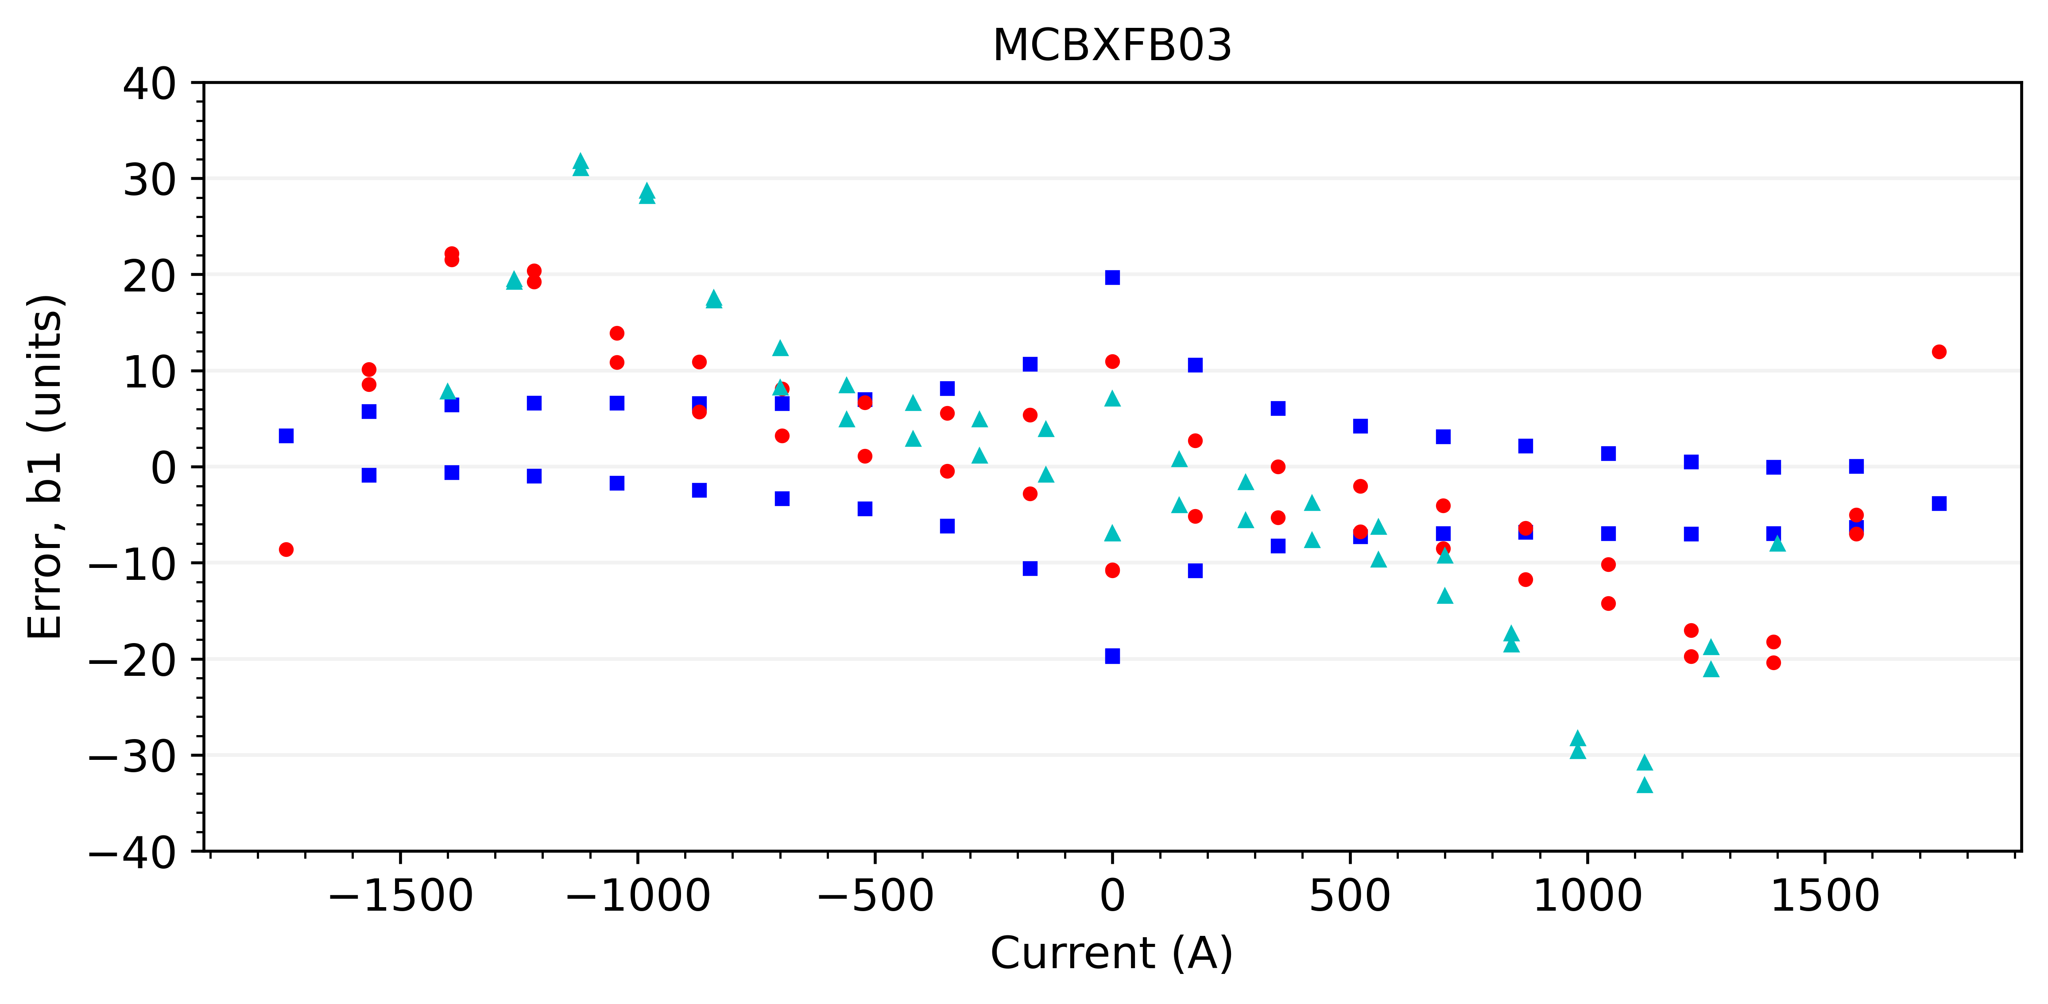
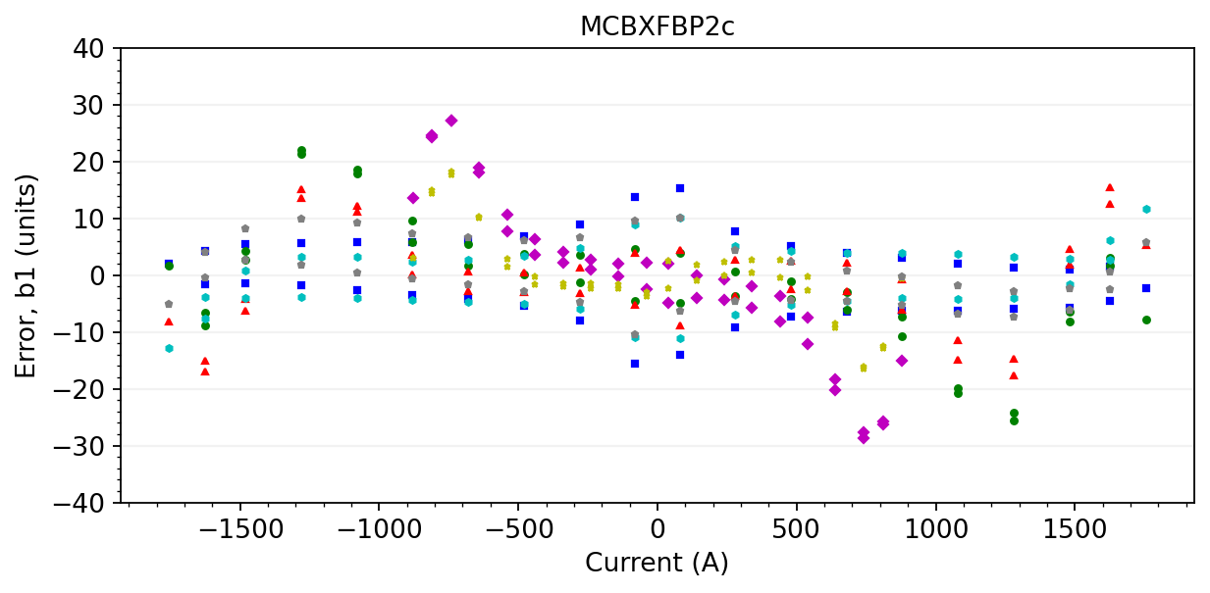
B1 with average geometric component

Slide 19

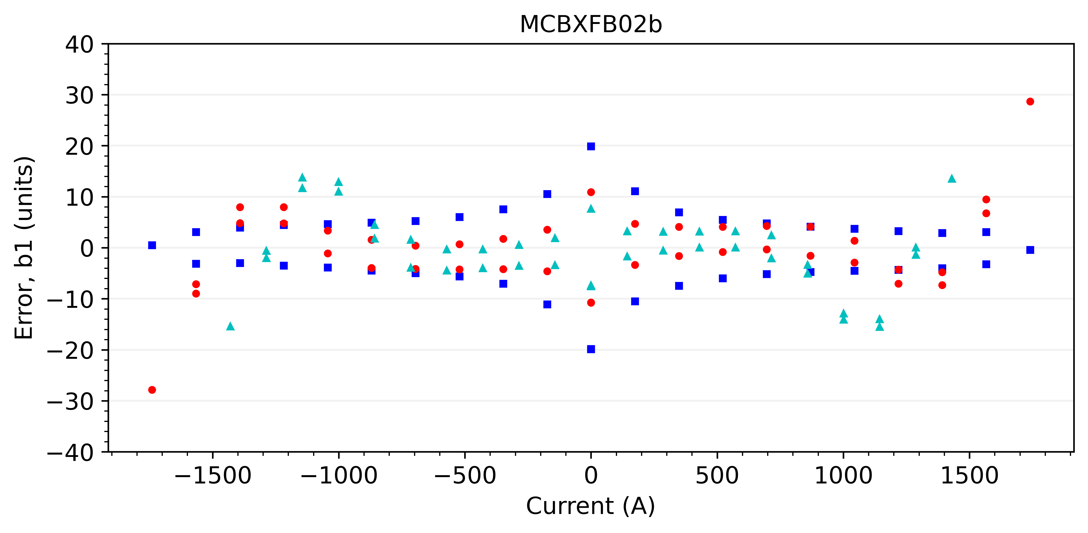
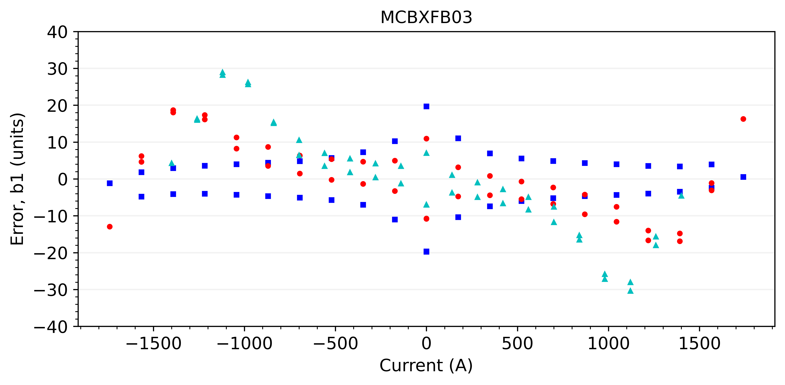
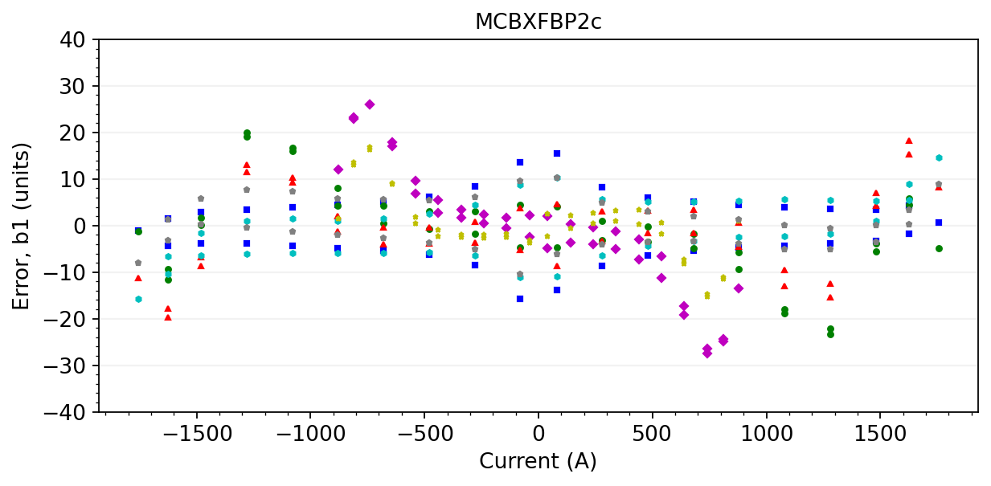




B1 with magnet-specific geometric component
$$y_{1}=0.0014647$$
$$y_{1}=0.0014660$$
$$y_{1}=0.0014642$$
$$y_{1}=0.0014644$$

Slide 20
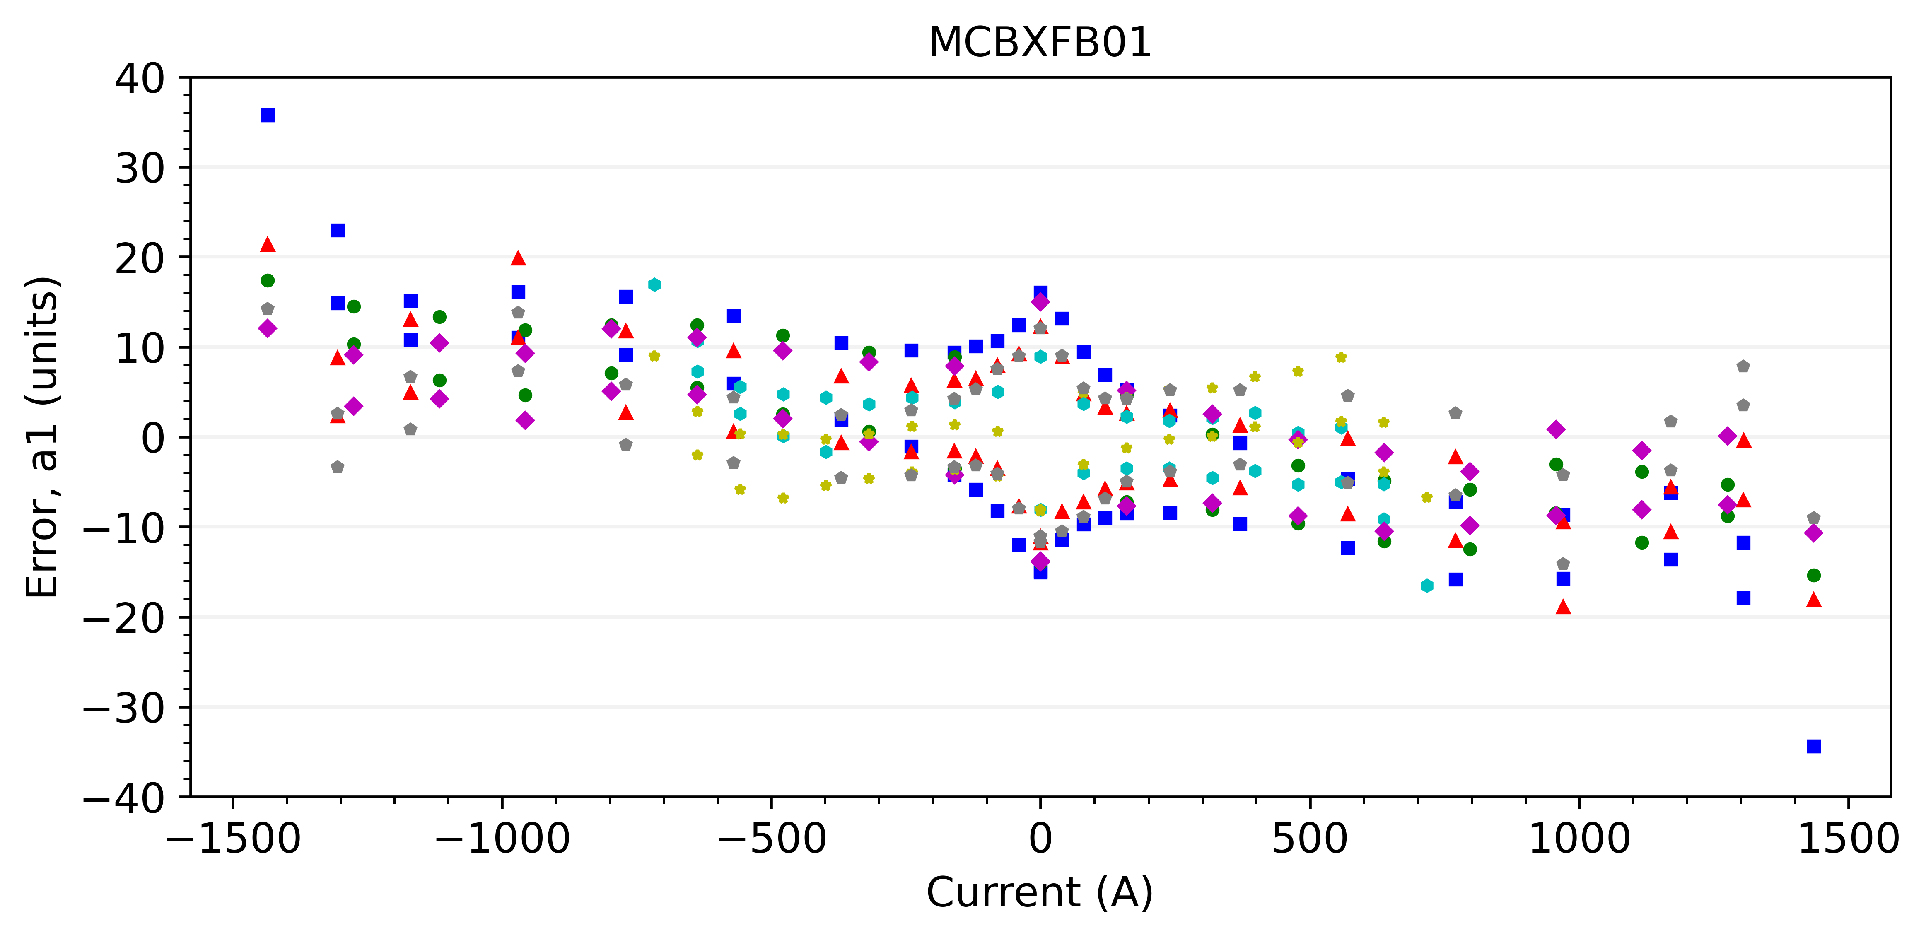
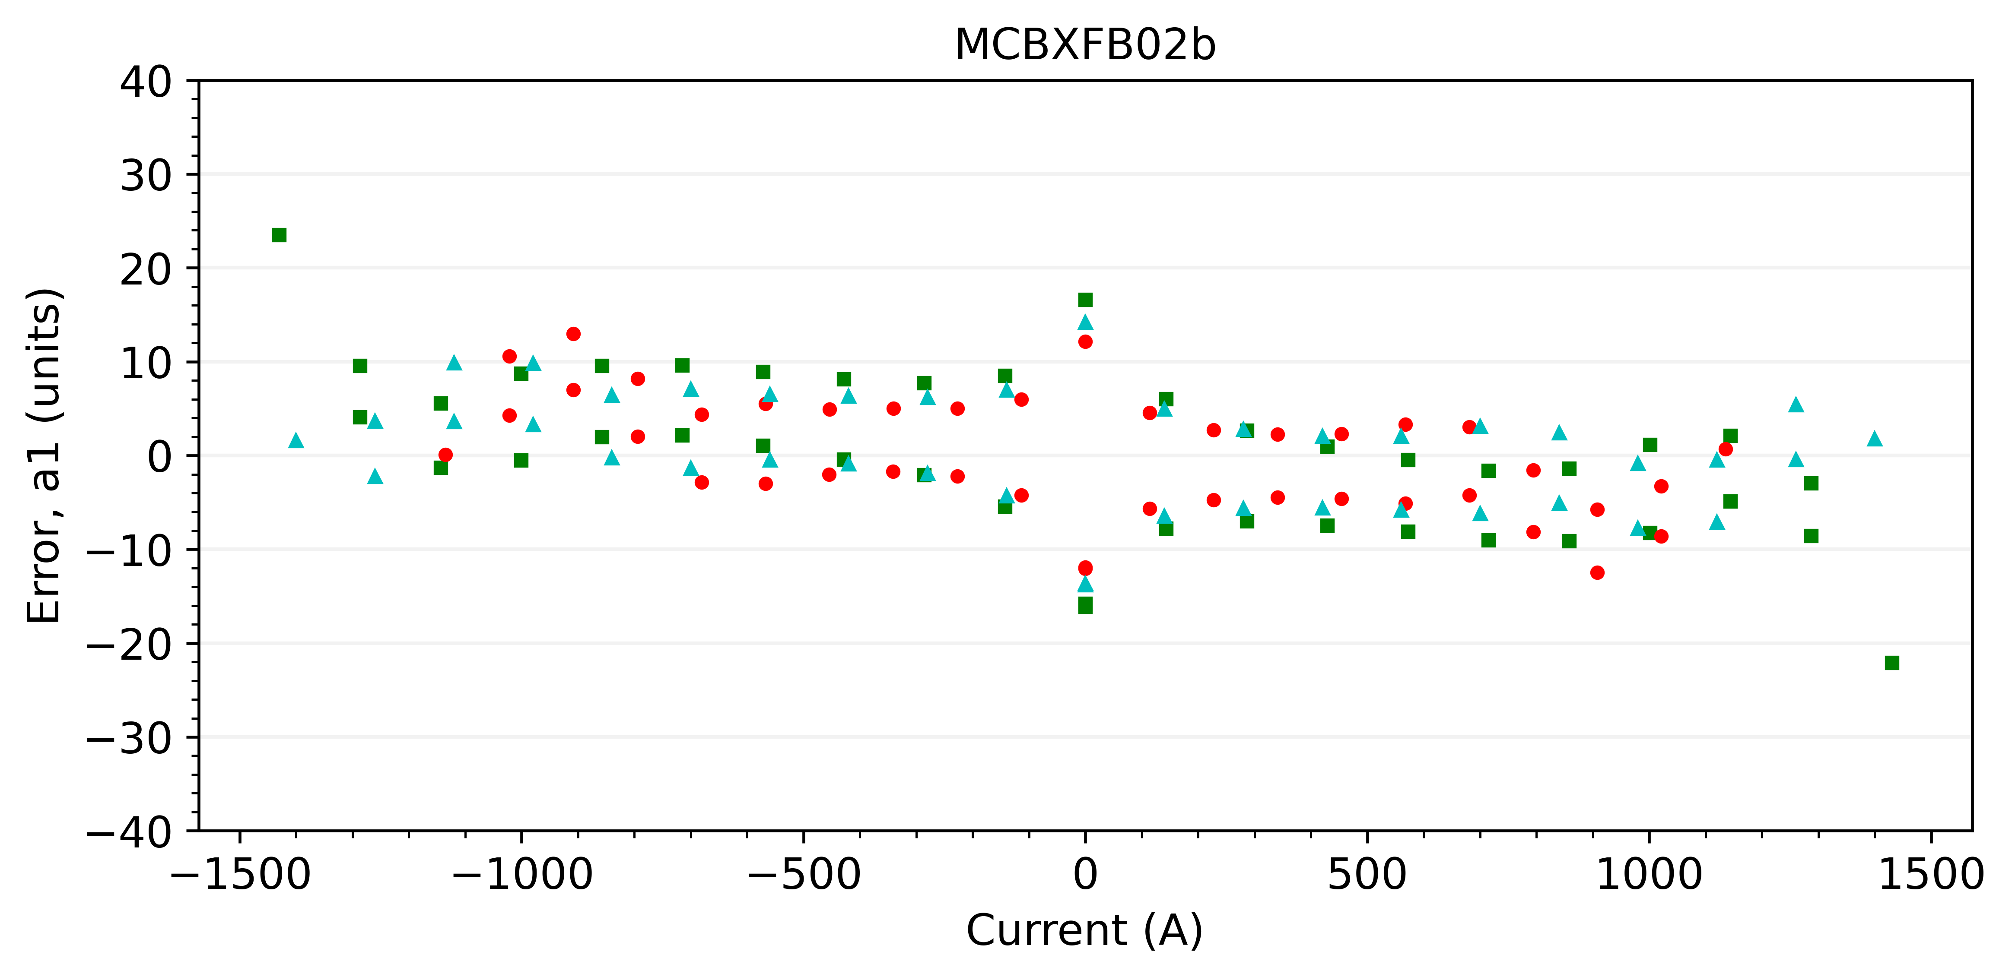
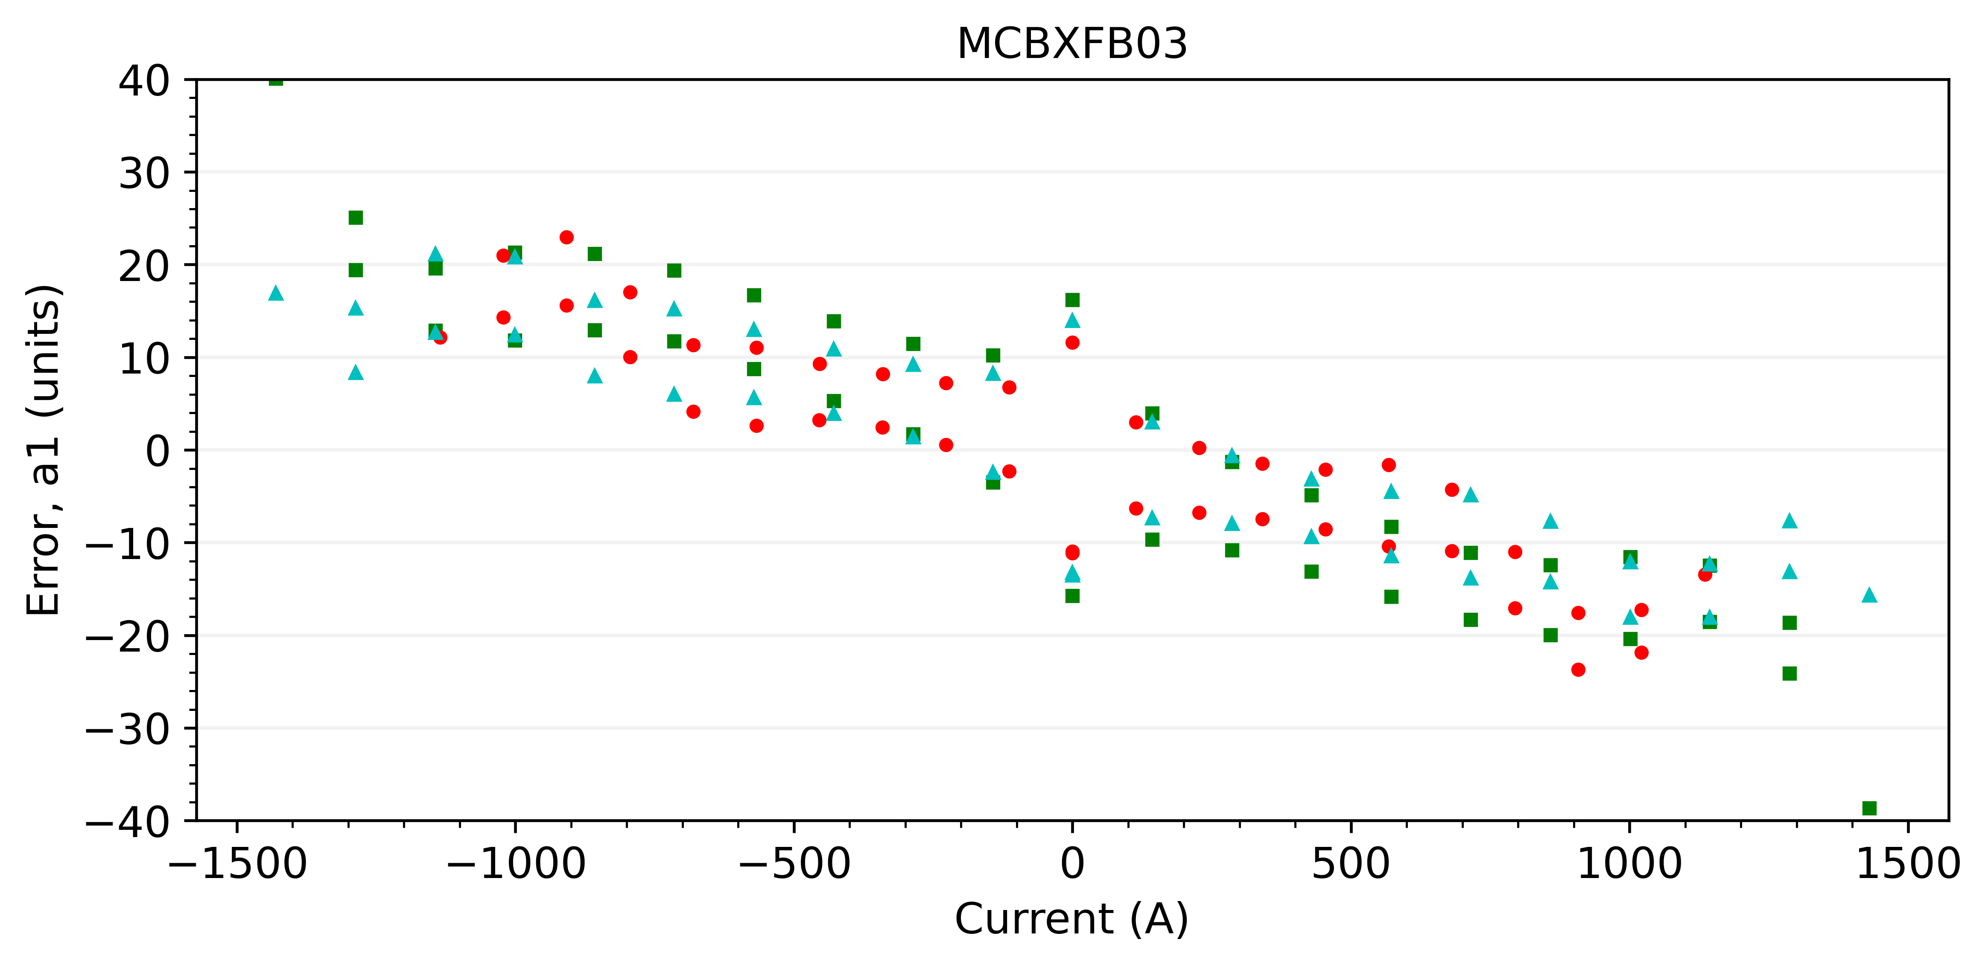
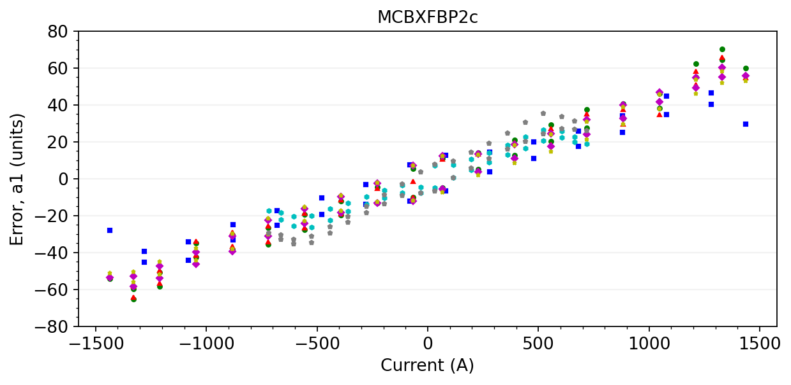
A1 with average geometric component

Slide 21
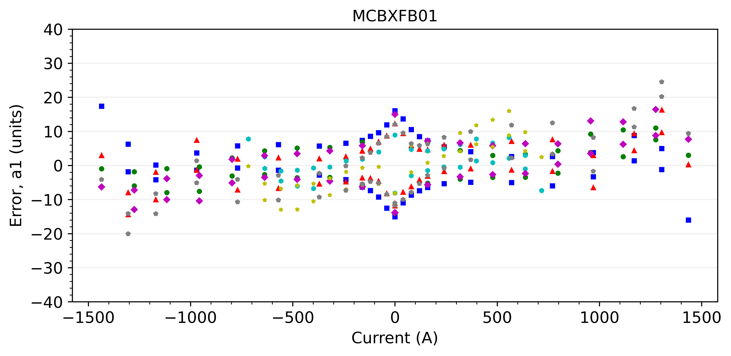
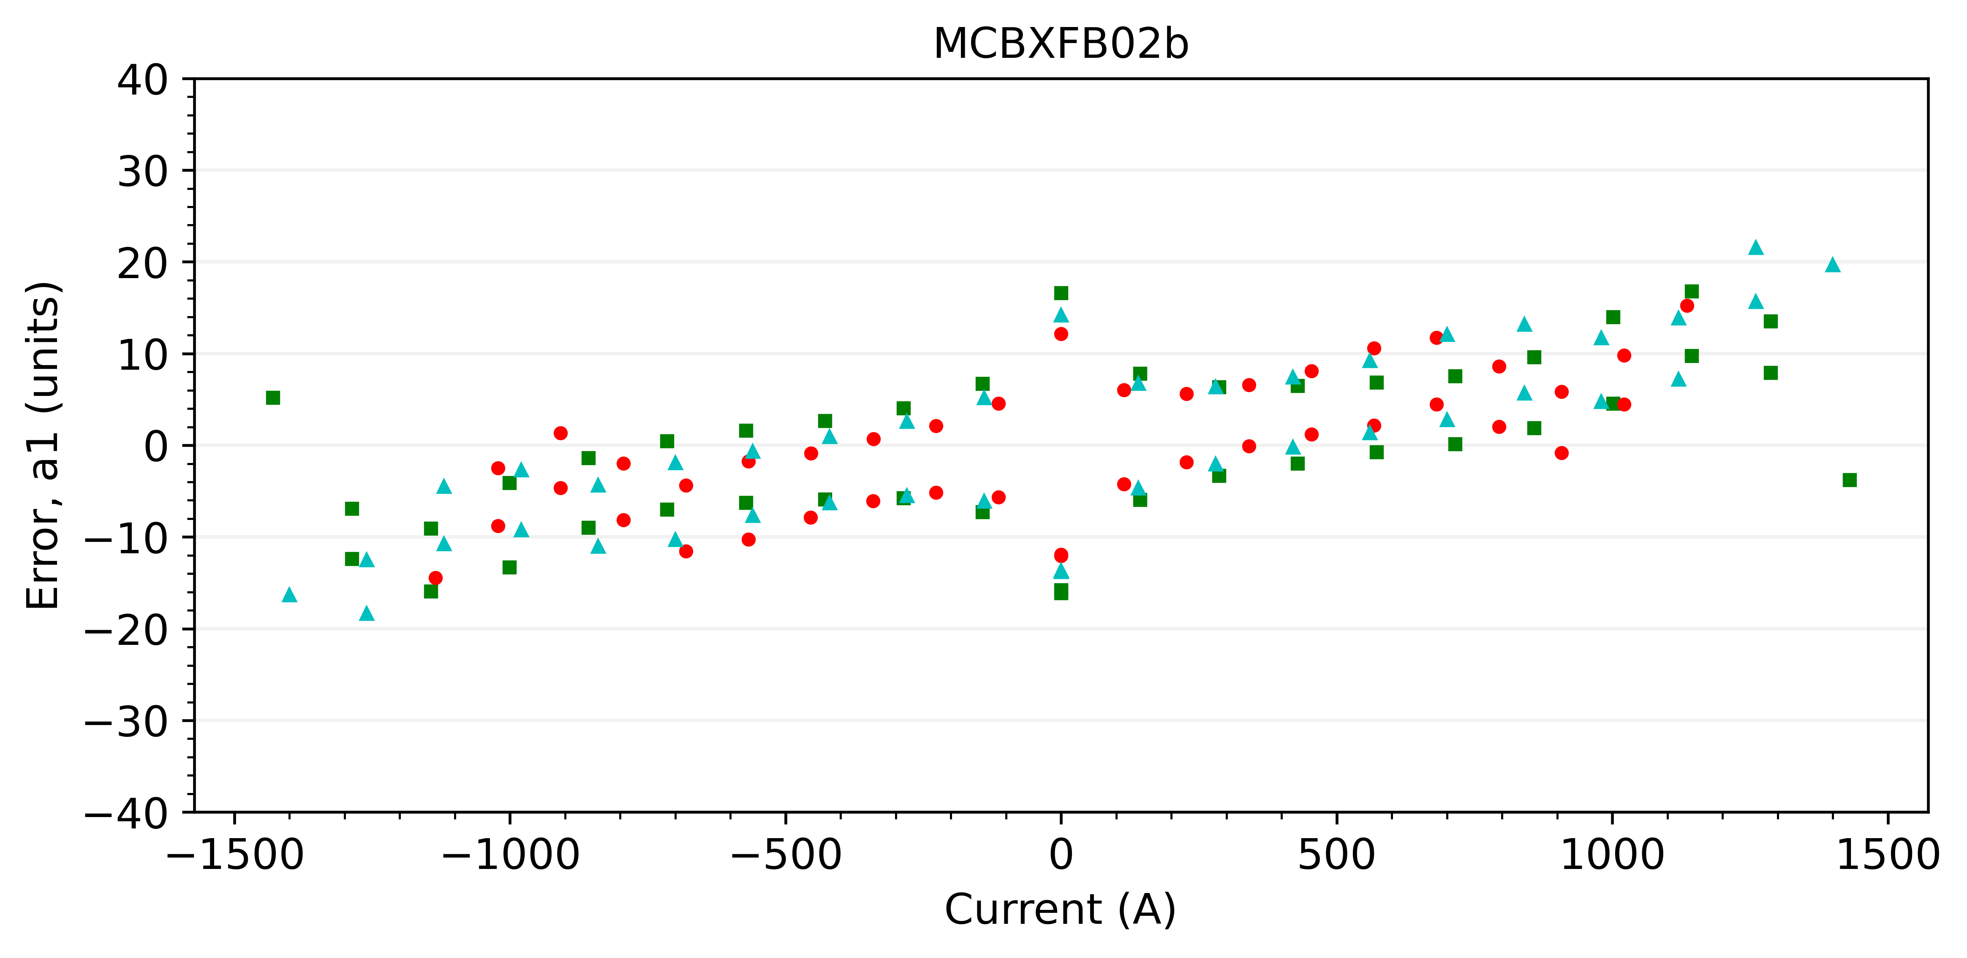
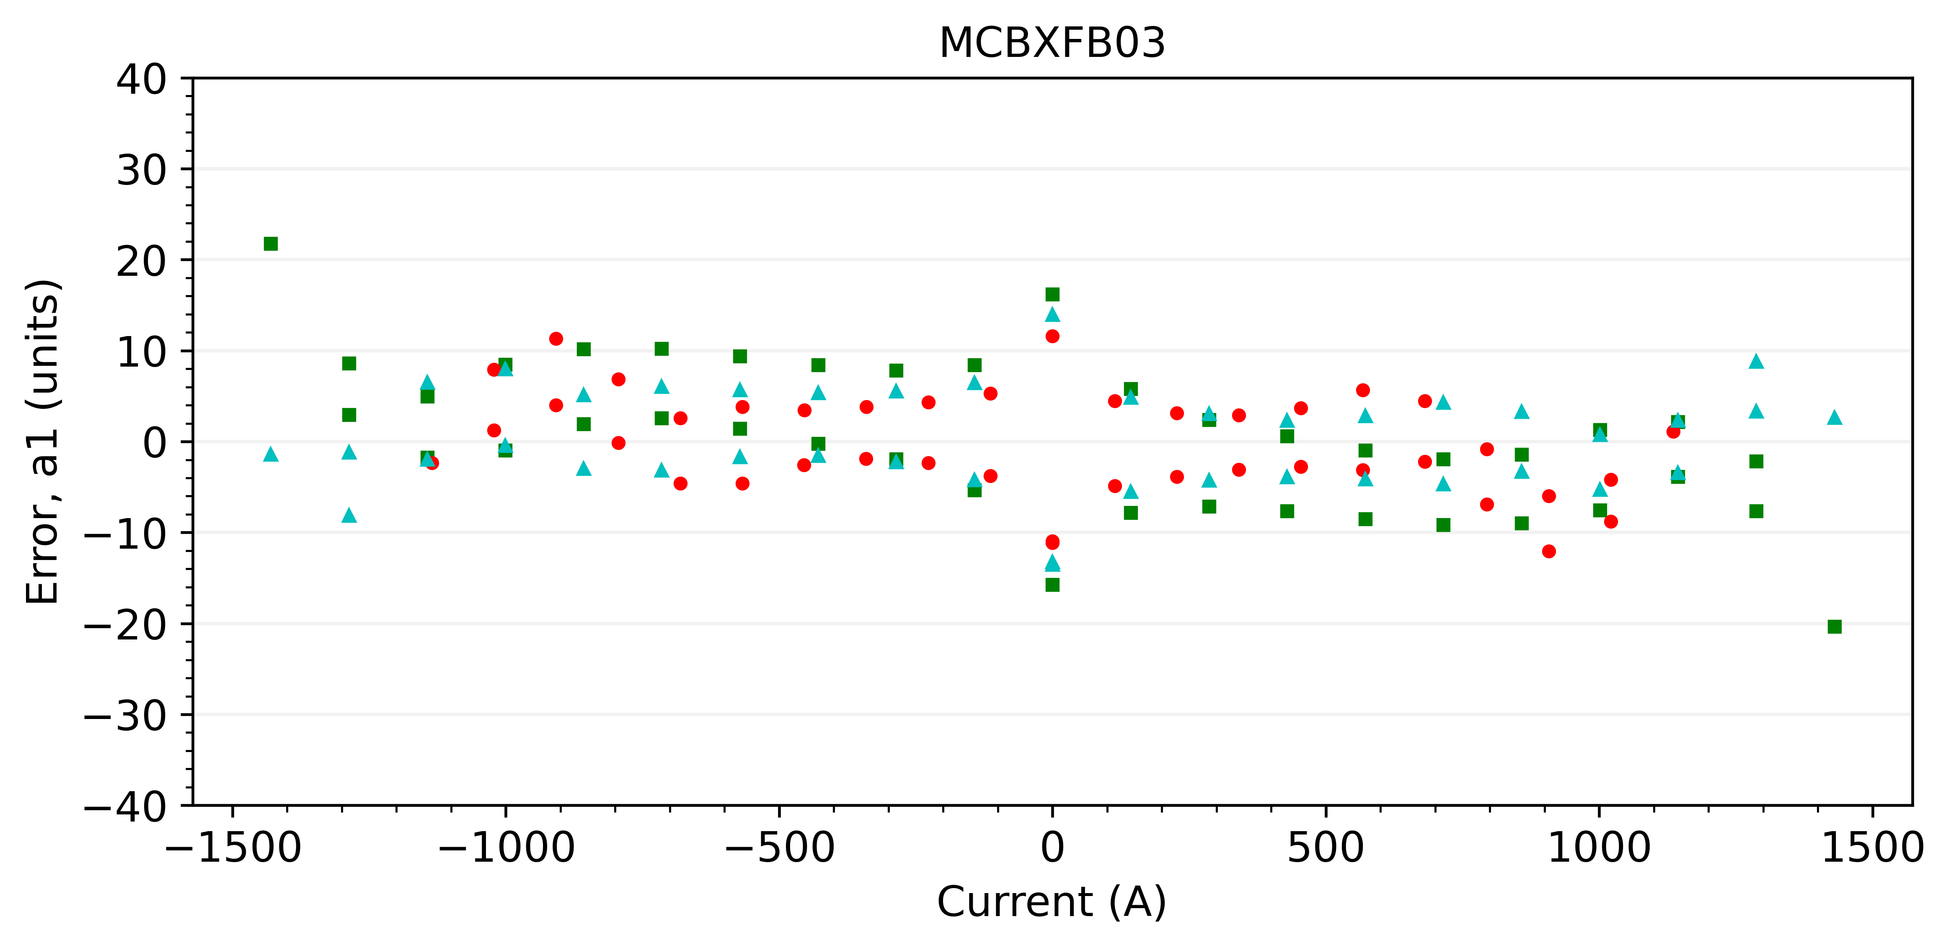
A1 with average geometric component
Based only on series magnets

Slide 22
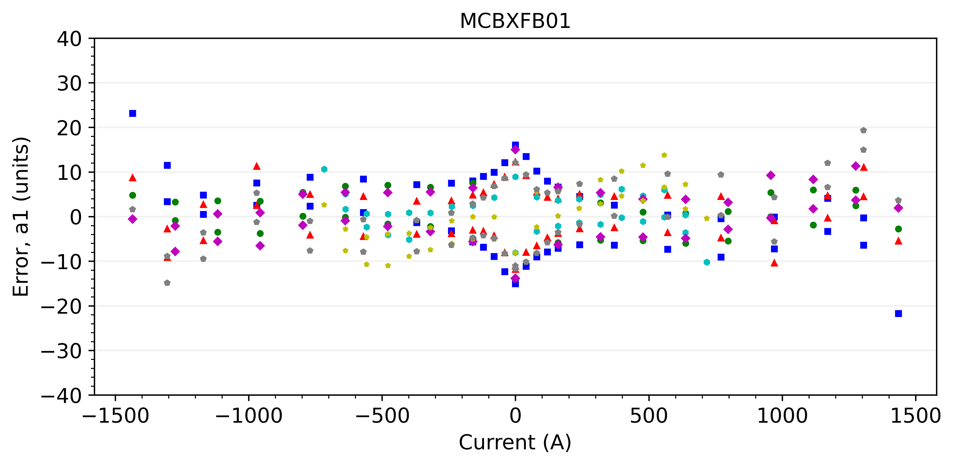
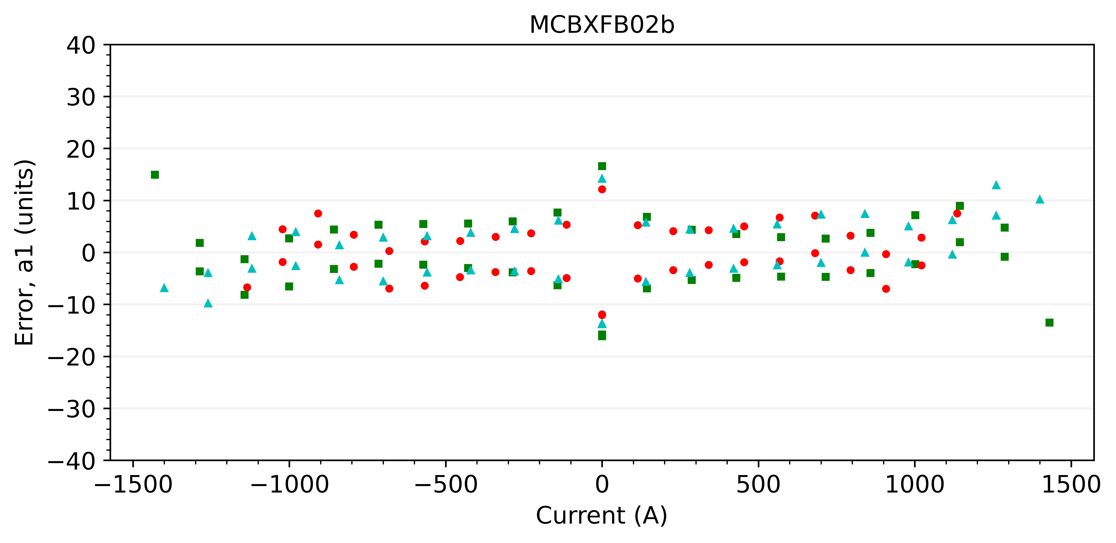
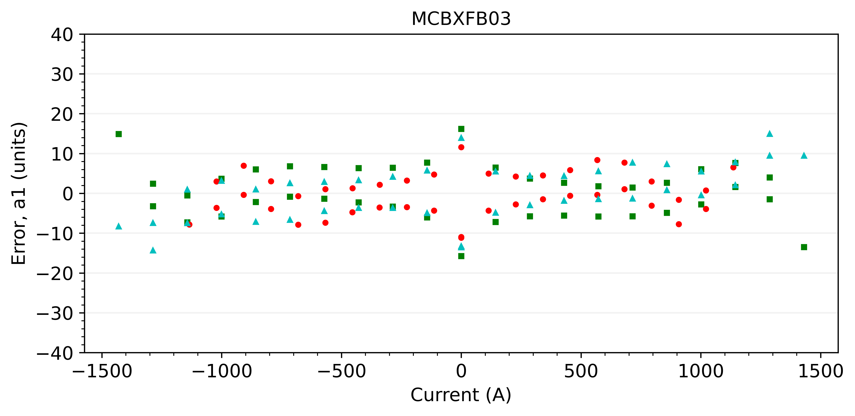
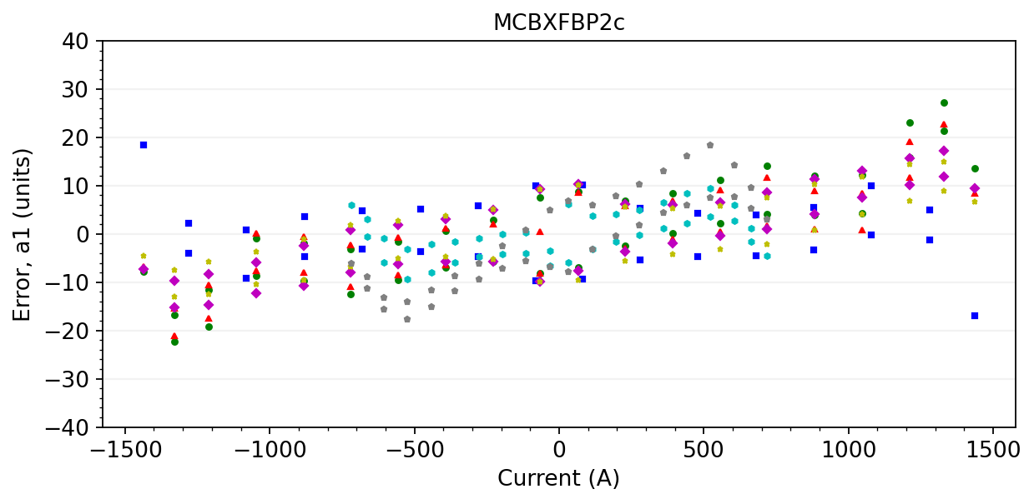




A1 with magnet-specific geometric component
$$y_{1}=0.0018031$$
$$y_{1}=0.0018037$$
$$y_{1}=0.0018008$$
$$y_{1}=0.0018133$$

Slide 23
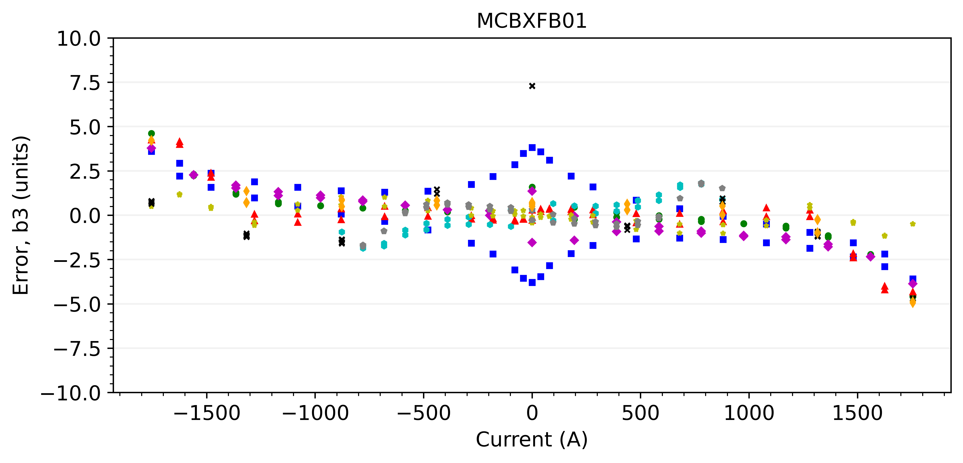
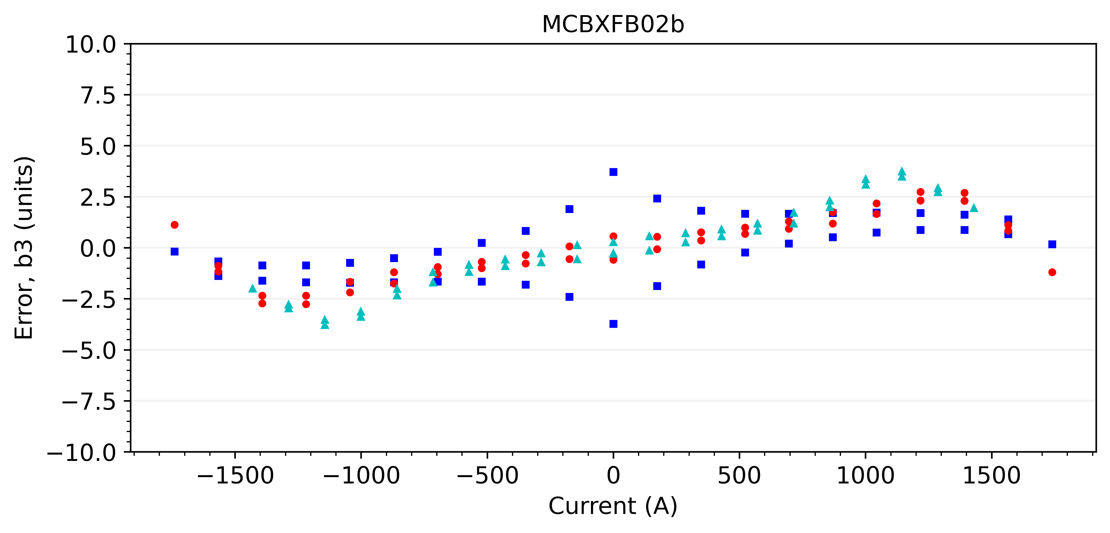
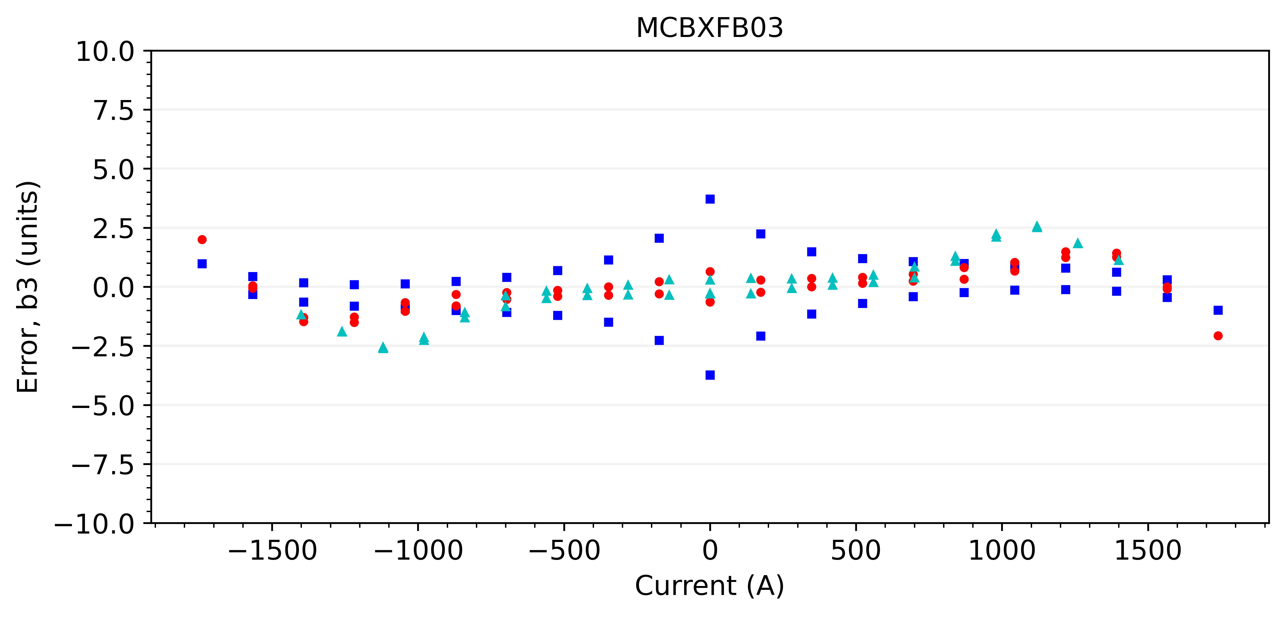
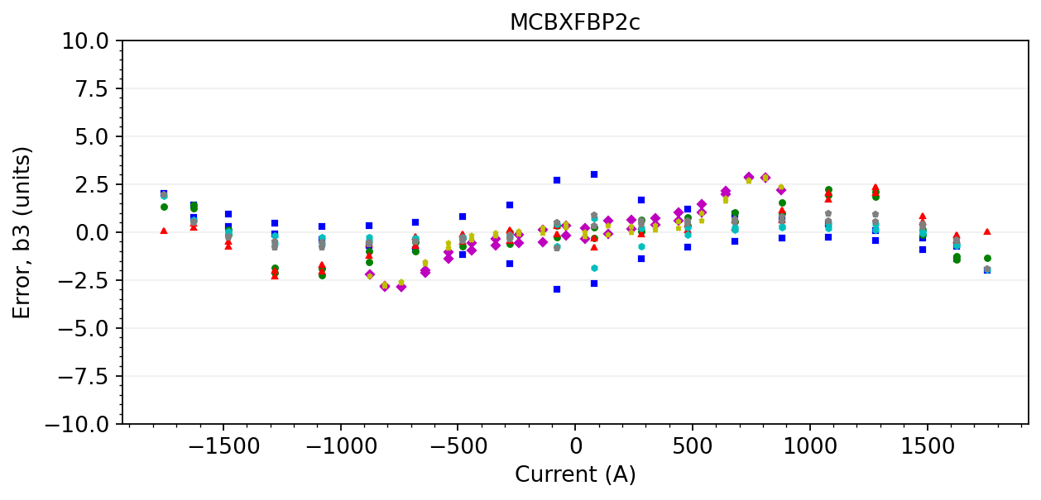
B3 with average geometric component

Slide 24
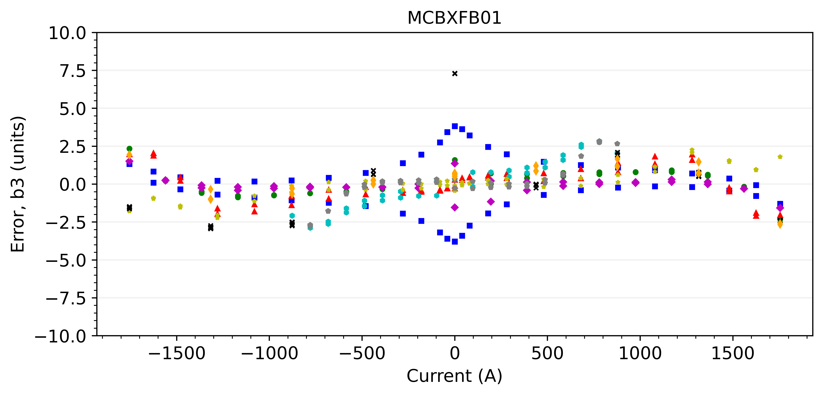
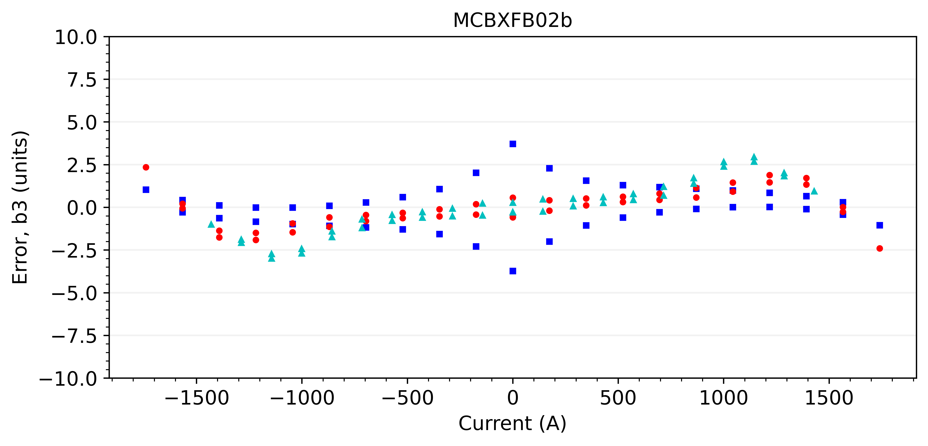
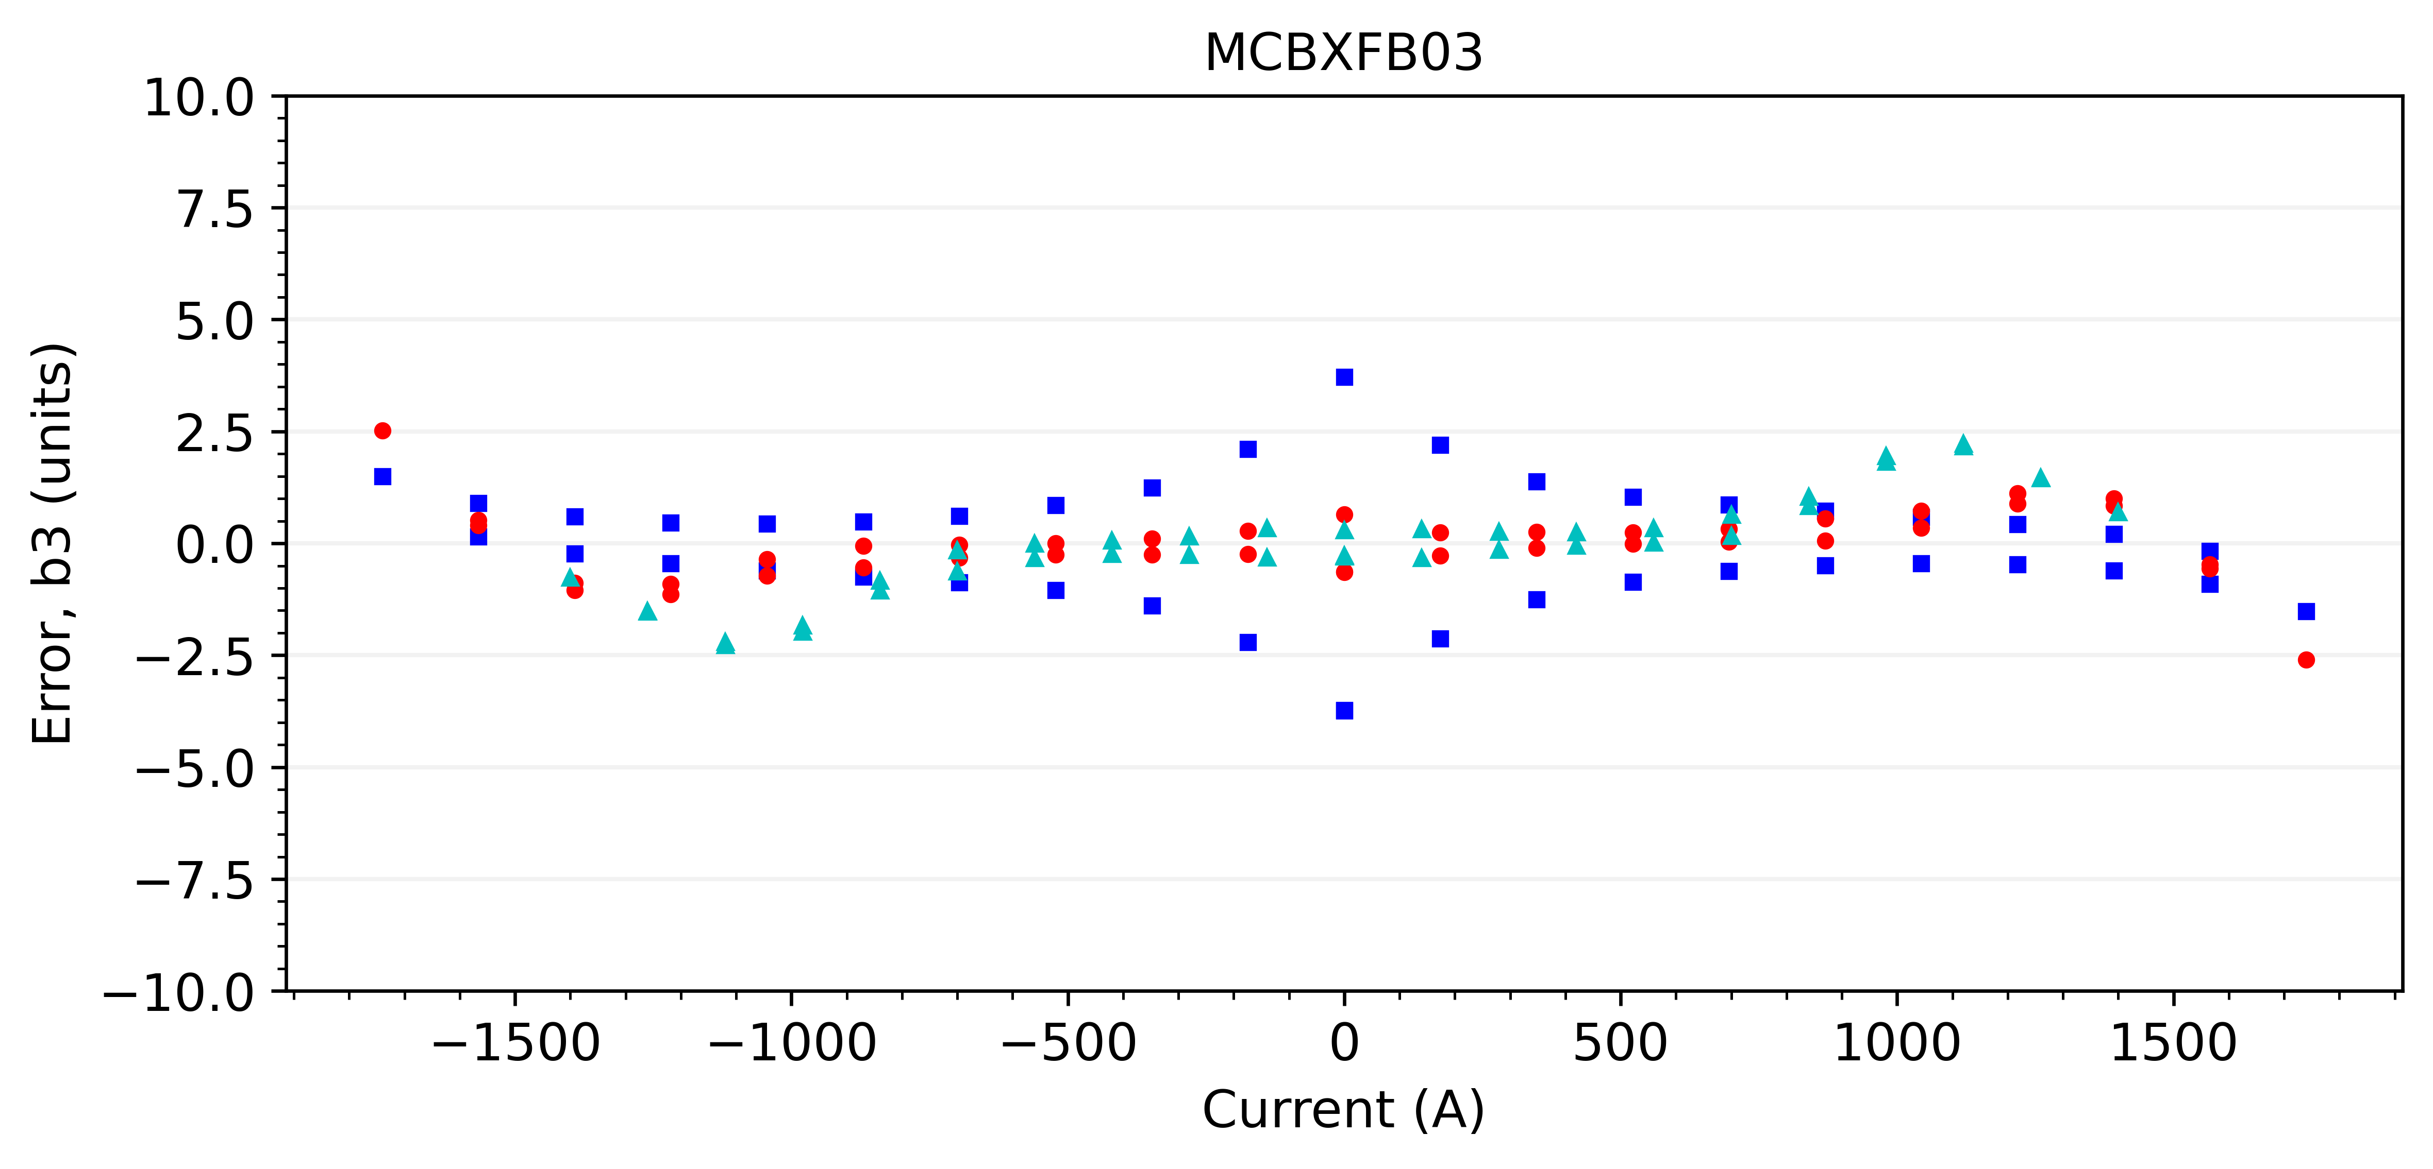
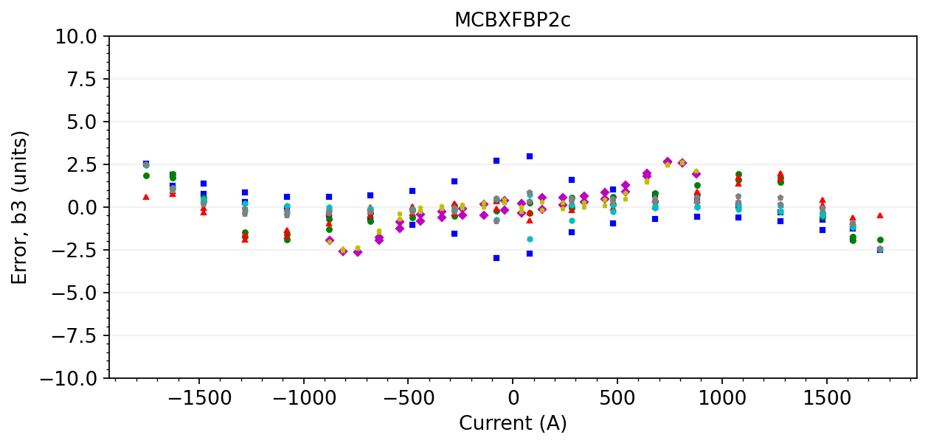



B3 with magnet-specific geometric component
$$y_{3}=−0.0000015$$
$$y_{3}=−0.0000010$$
$$y_{3}=−0.0000011$$
$$y_{3}=−0.0000011$$

Slide 25
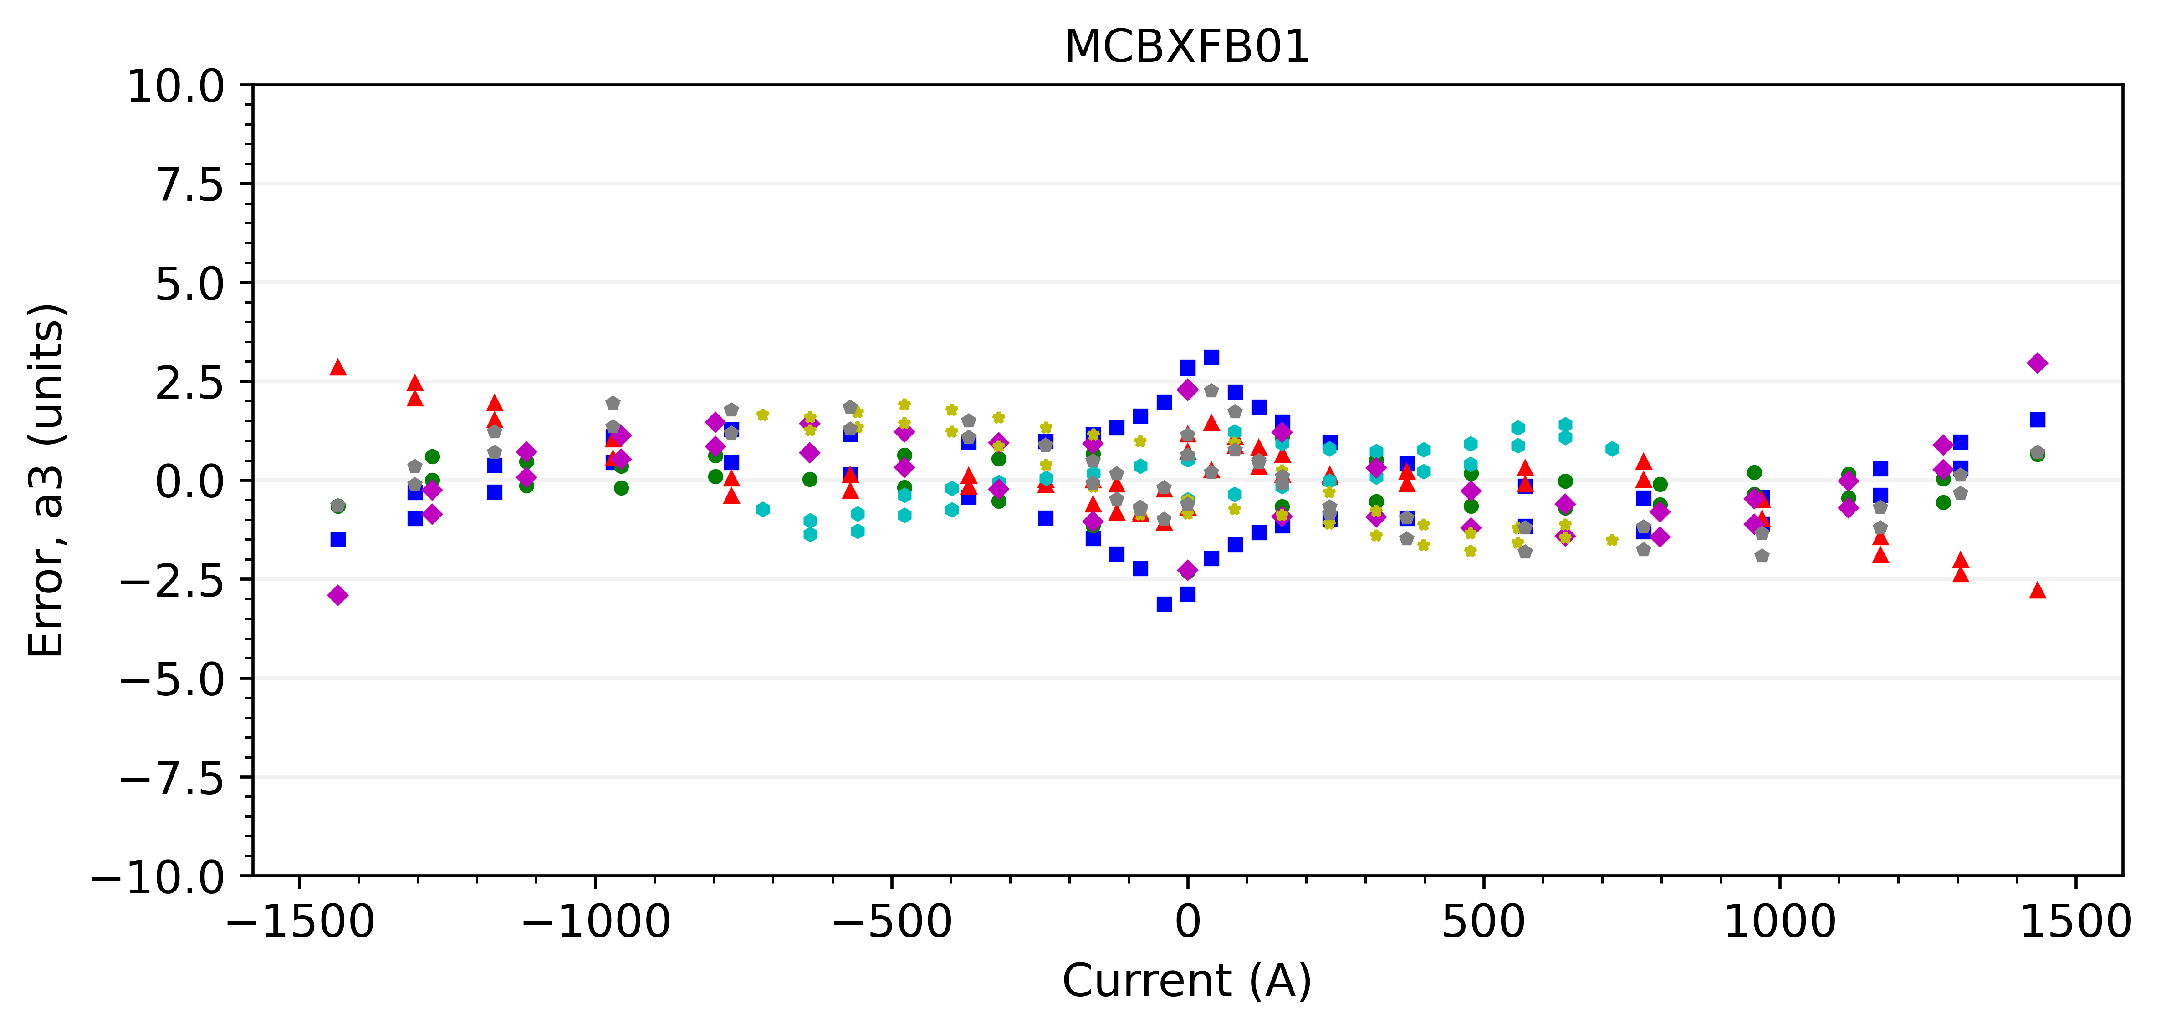
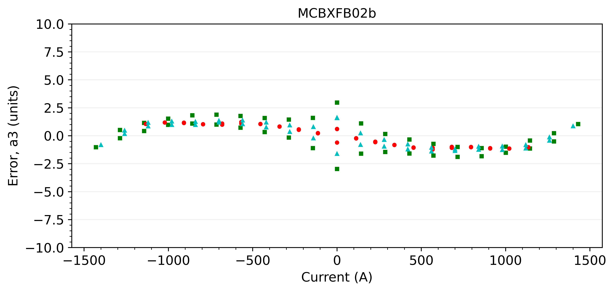
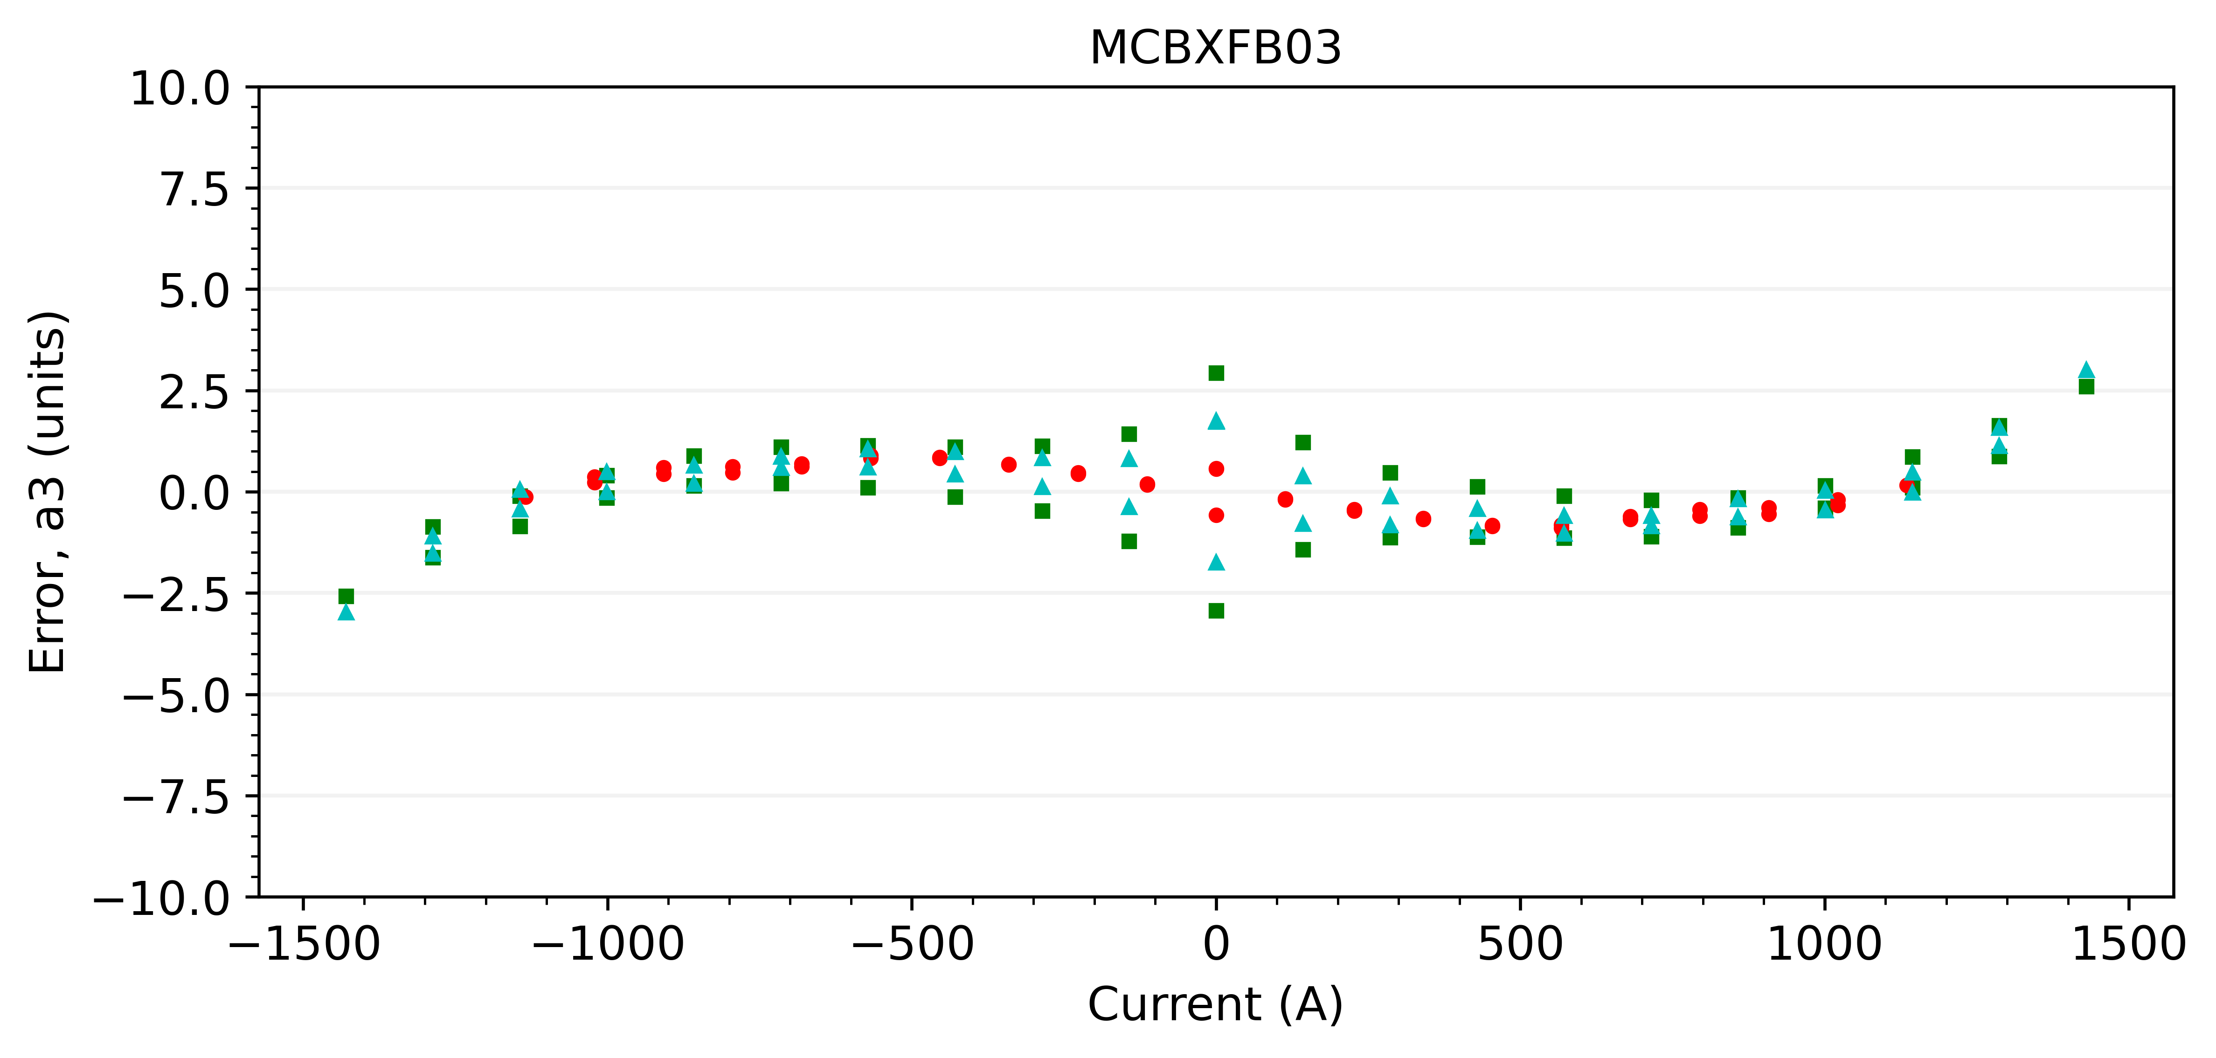
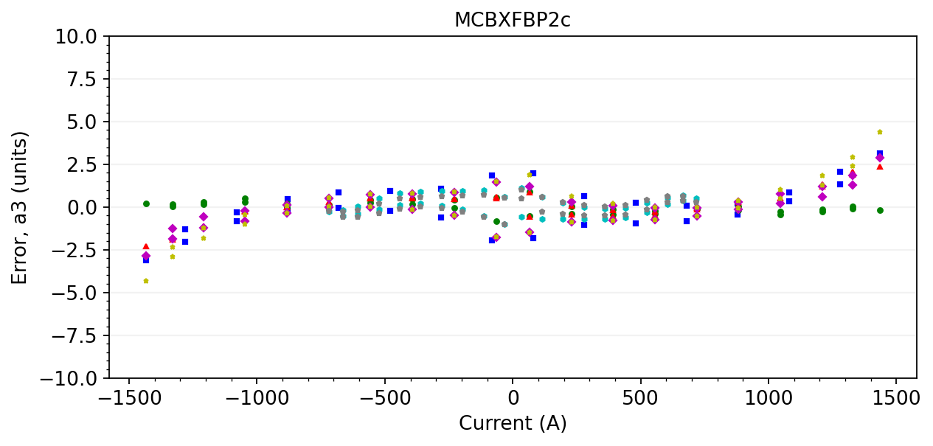
A3 with average geometric component

Slide 26
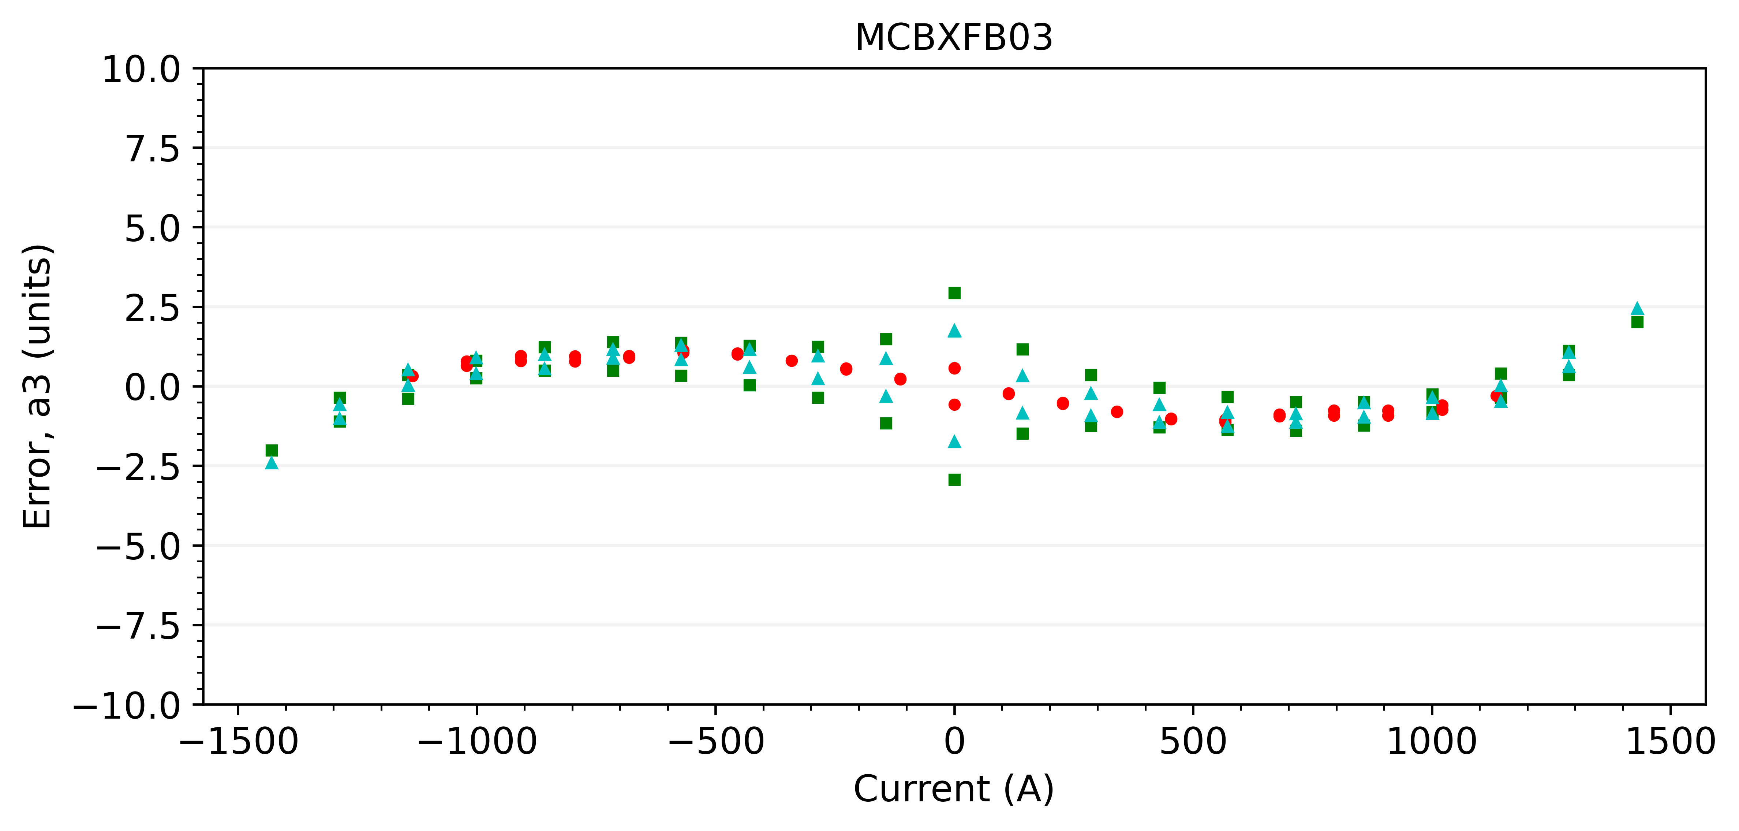
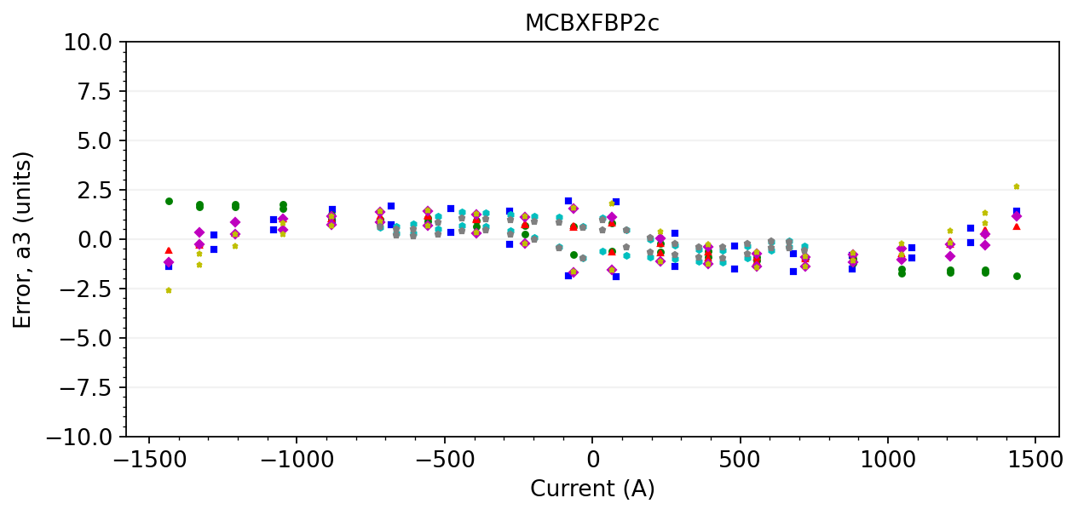



A3 with magnet-specific geometric component
$$y_{3}=0.0000016$$
$$y_{3}=0.0000016$$
$$y_{3}=0.0000019$$
$$y_{3}=0.0000021$$

