Slide 1
Field quality of MBXF2 /
Power test results of MBXF5 in the 1st TC
Kento Suzuki
WP3meeting 2023.11.08

Slide 2
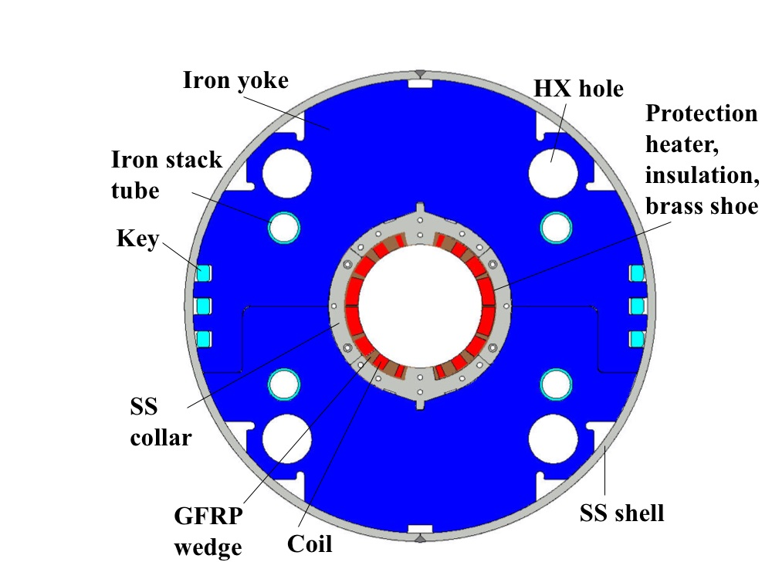
Japanese Contribution to HL-LHC: D1 magnets
Beam separation dipole (D1) by KEK
  Design study of D1 for HL-LHC within the framework of the CERN-KEK collaboration since 2011.
  150 mm single aperture, 35 Tm (5.6 T x 6.3 m), Nb-Ti technology.
  Development 2-m long model magnets (3 units) at KEK
Deliverables for HL-LHC
  1 full-scale prototype cold mass (LMBXFP)
  6 series cold masses (LMBXF1-6)
7 units x 7-m long cold masses

Slide 3
Brief review of production status
MBXF5
  Under the power test at KEK (This talk)
MBXF1
  Cold mass assembly is ongoing at Hitachi
  Final reception test (SSW) at the KEK is planned in Mar.-Apr. 2024
MBXF2
  Warm magnetic measurement of Yoked magnet was completed (This talk)
  Arrival at KEK for the power test is foreseen in Feb. 2024
MBXF3
  Coil winding is ongoing

Slide 4
Contents of the talk
MBXF2:
  Magnetic measurement at the Hitachi premise (5th - 6th Oct)
MBXF5:
  The power test results from the 1st thermal cycle (9th Oct-2nd Nov.)

Slide 5
Magnetic measurement of MBXF2
EDMS:1966491

Slide 6
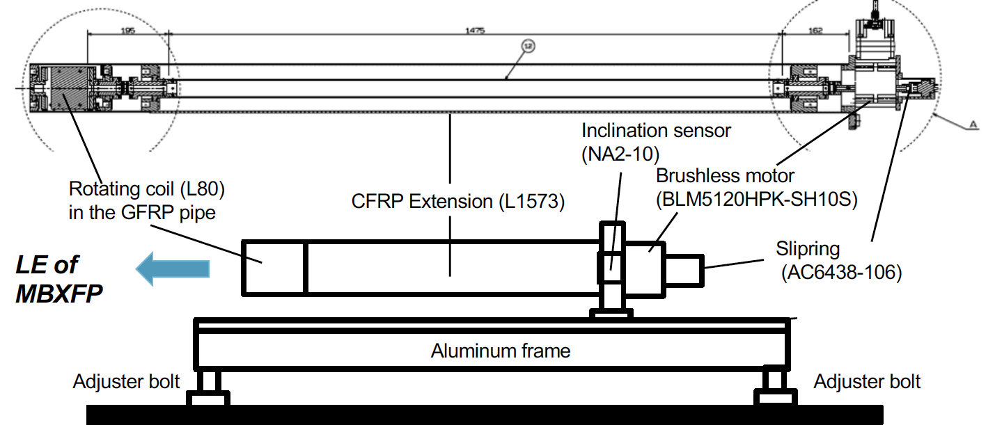
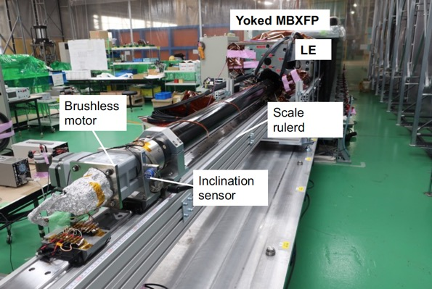
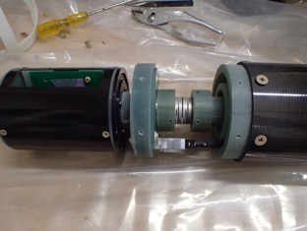
MM after yoking, at Hitachi
Place: The Hitachi Rinkai Factory
Yoked magnet
Radial coil (L=80)
NOTE: This was taken during
the prototype measurement
Encoder disk

Slide 7
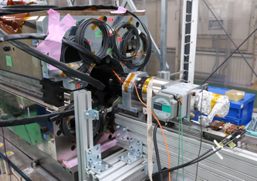
Measurement / data coverage
Coverage by portable system
RE
LE
Used for
field quality evaluation
Lamination yoke
Measured b₁ profile is fitted to the 3D calculation “OPERA”
Probe coverage : Z_{magnet}= 1940 – 3620 mm, where Z_{magnet}=0 corresponds to the longitudinal magnet center
Field quality is evaluated by averaging the data over the straight section (z=1940-2260 mm)
Rotating coil
SS
End section (LE)

Slide 8
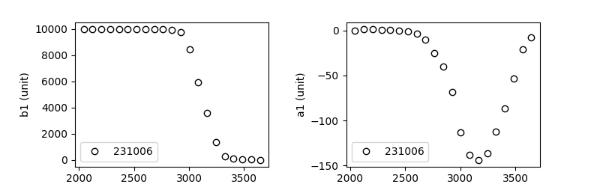
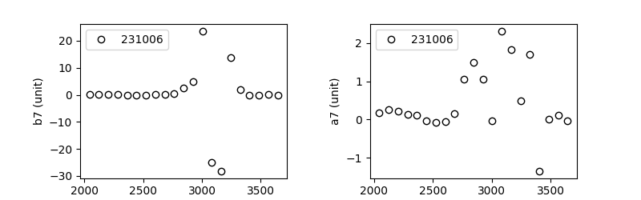
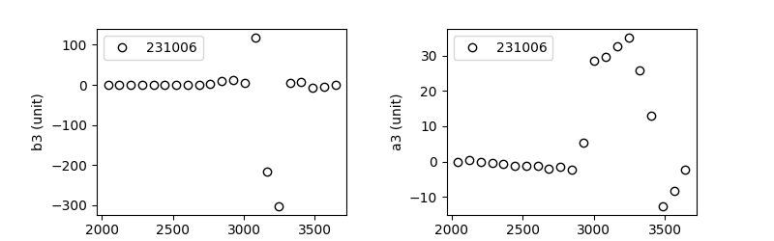
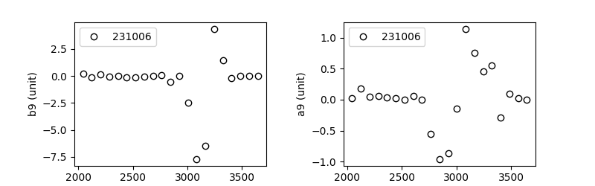
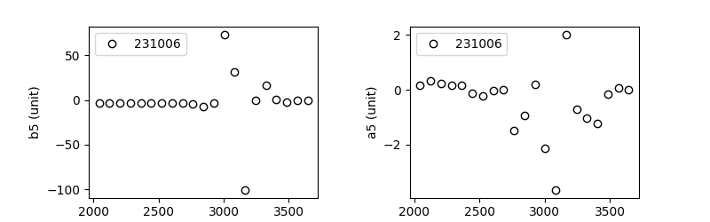
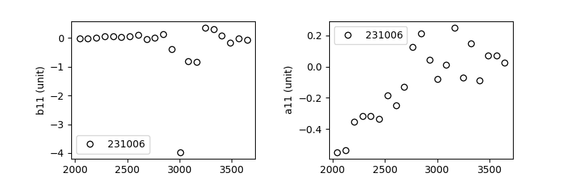
Example) Measured field profile of MBXF2
→LE
→LE
Warm, Yoked magnet

Slide 9
SS-averaged field quality of MBXF2 – comparison with calc.

Slide 10
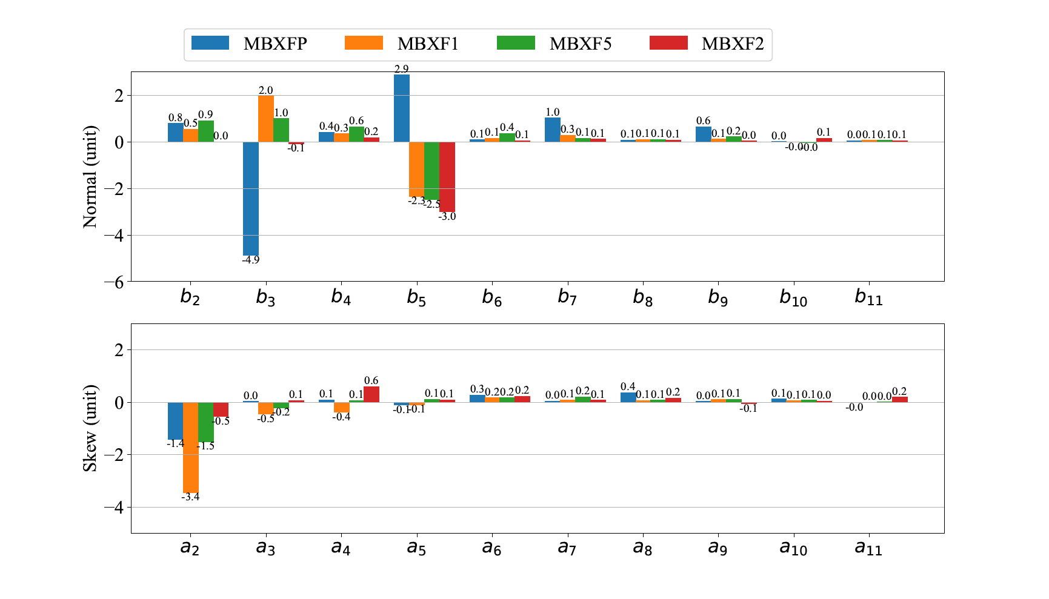
Summary of the field quality (portable) so far
Prototype
Series
＊
Warm, Yoked mag. Hitachi premise
Warm, Yoked mag. Hitachi premise
＊) MBXFP’s cross-section design differs from the series
For the series magnet, variation in b₃ and a₂ is ~3 units

Slide 11
Power test of MBXF5
- Quench training

Slide 12
Test summary of MBXF5
22nd Aug. : Cryostat installation
  Warm magnetic measurement by the vertical MM system
  Test had been suspended due to a malfunction of the cold-box turbine monitoring system
9th Oct. – 2nd Nov. : The 1st thermal cycle
  13th : Hipot test at 1.9 K
  16th - 18th : System check / magnetic measurement at 3 kA
  19th - 25th : Quench training up to the ultimate current
  26th : 4-hours current holding at 12.31 kA (=Nominal + 200A)
  27th - 31st : Magnetic / joint-resistance measurement
Current holding test at the ultimate current, 13.23kA,
is postponed until the 2nd thermal cycle (13th Nov.-)

Slide 13
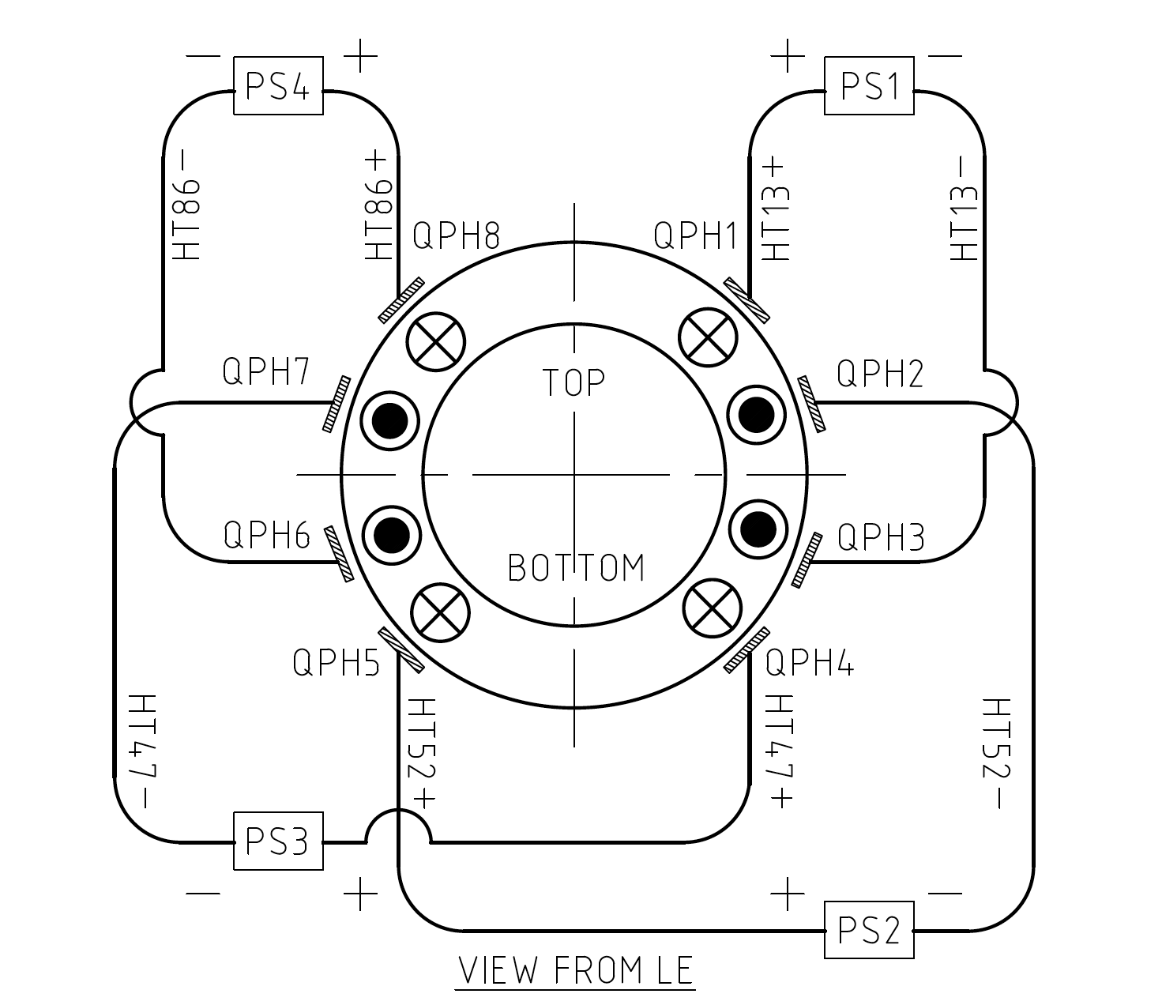
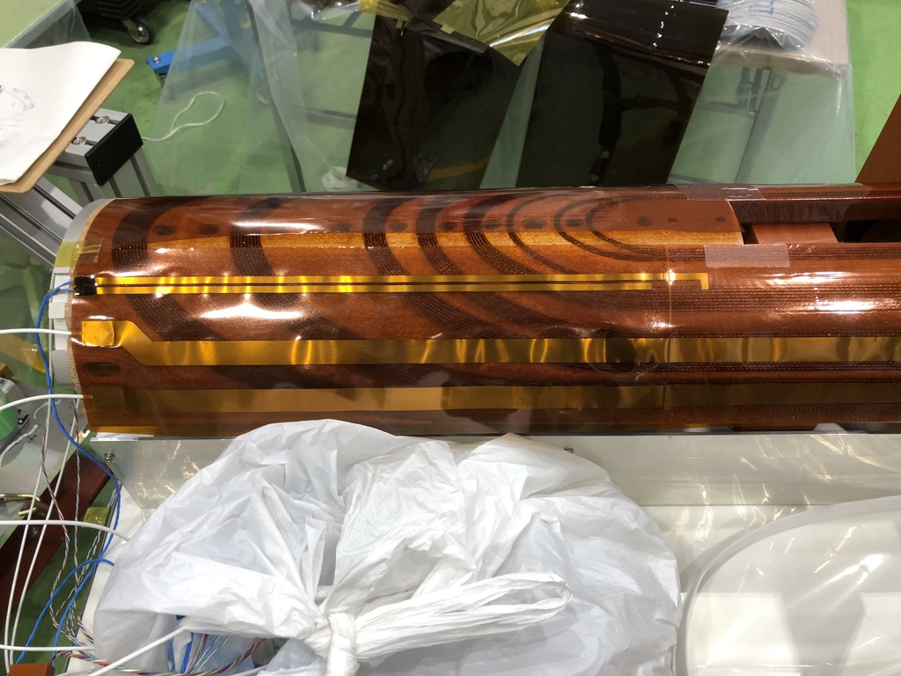
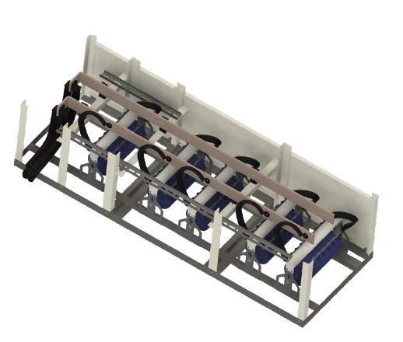
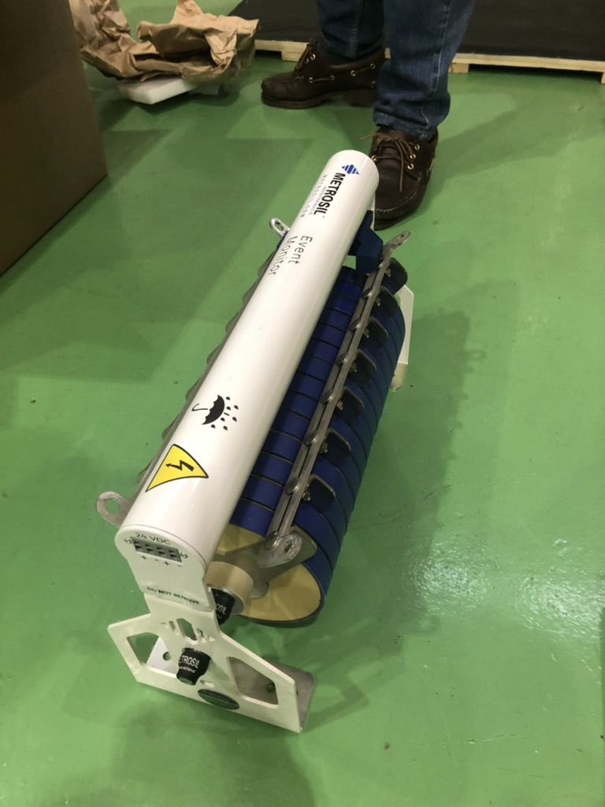
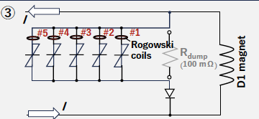
Quench protection
Quench protection heater
  2 strips x 4 circuits
5-units varistor (Metrosil®)
  Validated in the MBXF1 test
  Healthiness is monitored by the Rogowski coils
Once the magnet current is shut off at the current above 3 kA, we perform a ‘3kA-check’ run to inspect healthiness of the varistors

Slide 14
Run history
Reach the ultimate
System check
(current shutoff)
Training
4-hours holding at 12.31 kA

Slide 15
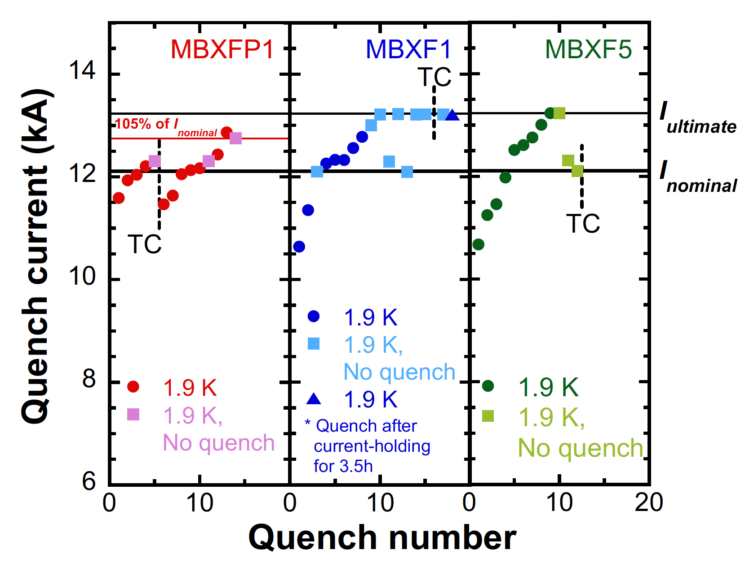
Training summary
Quench# | Iq (A) | Top or Bottom | LE or RE
1 | 10673.4 | Bottom | LE
2 | 11246.0 | Bottom | LE
3 | 11460.5 | Top | LE
4 | 11978.1 | Top | RE
5 | 12513.8 | Top | RE
6 | 12610.5 | Bottom | RE
7 | 12778.3 | Bottom | RE
8 | 13004.3 | Top | N.A.
9 | 13231 | Bottom | LE

Slide 16
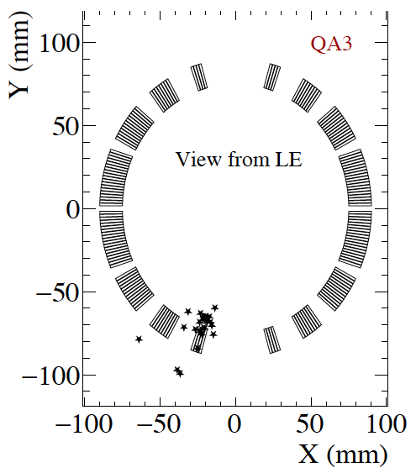
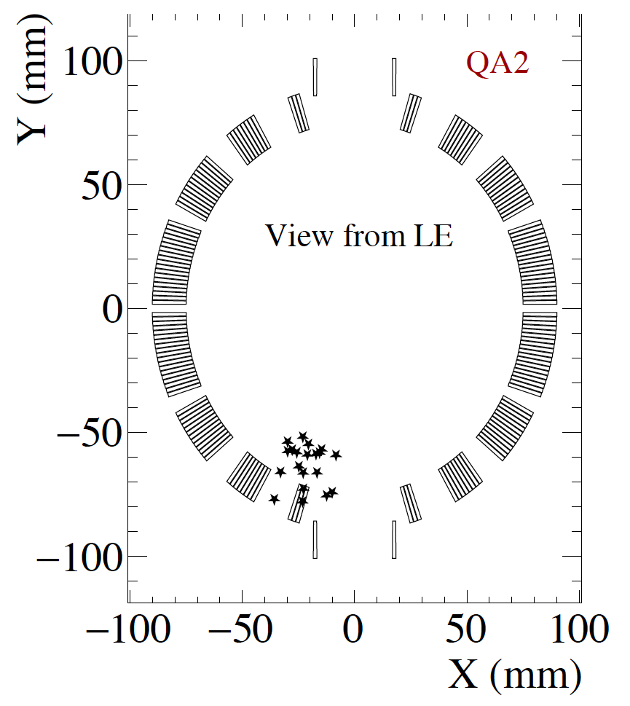
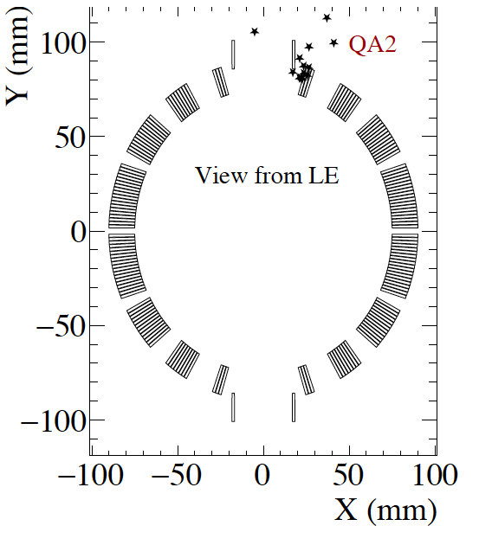
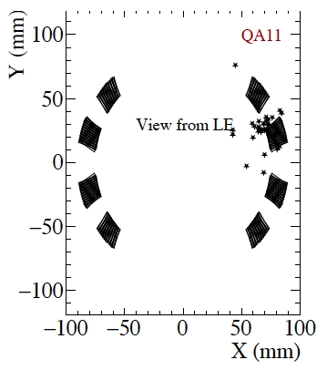
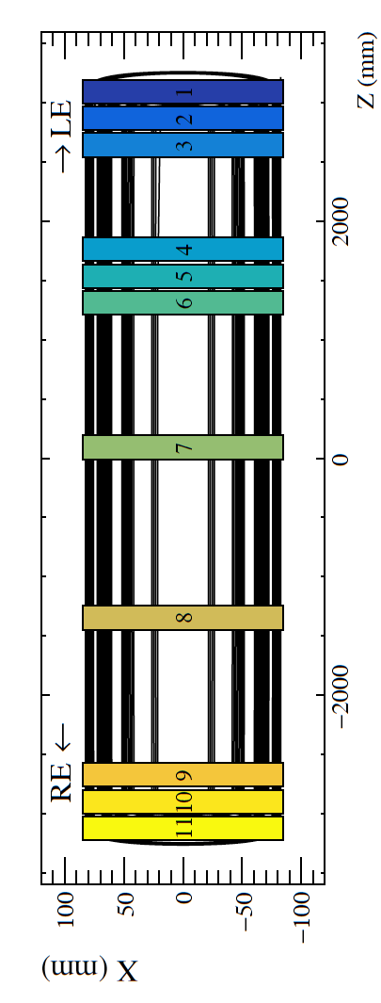
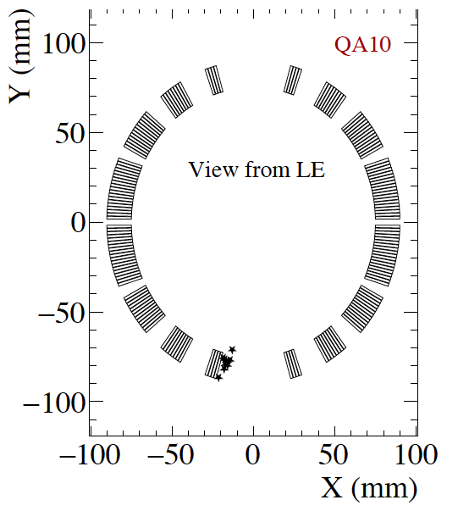
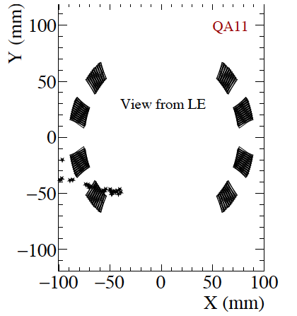
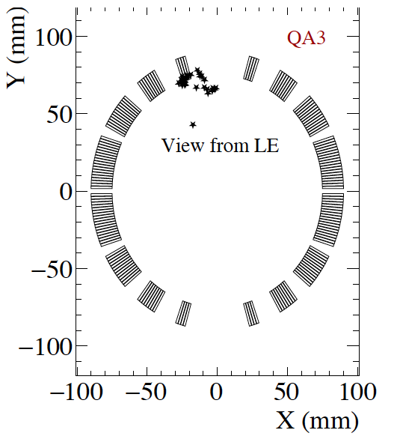
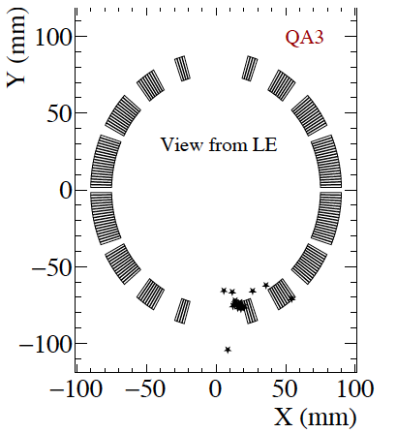
Quench antenna results
Quench#1
#2
#3
#4
#2,#3
#1,#7,#9
#5
#6
#7
#8
#9
No signal
#5
#4,#6
No quench concentration is observed

Slide 17
Power test of MBXF5
- Vertical magnetic measurement

Slide 18
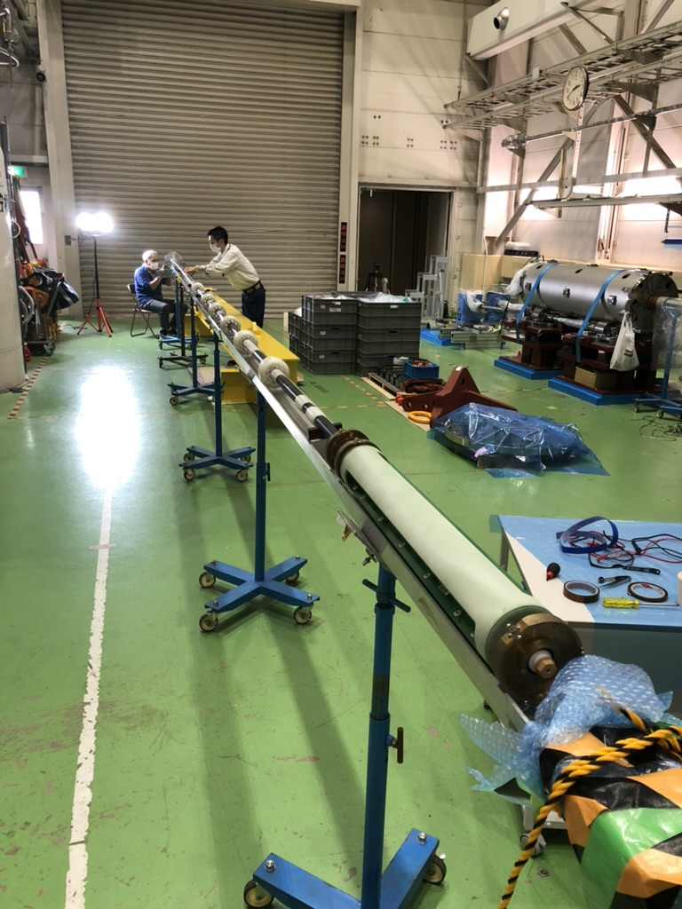
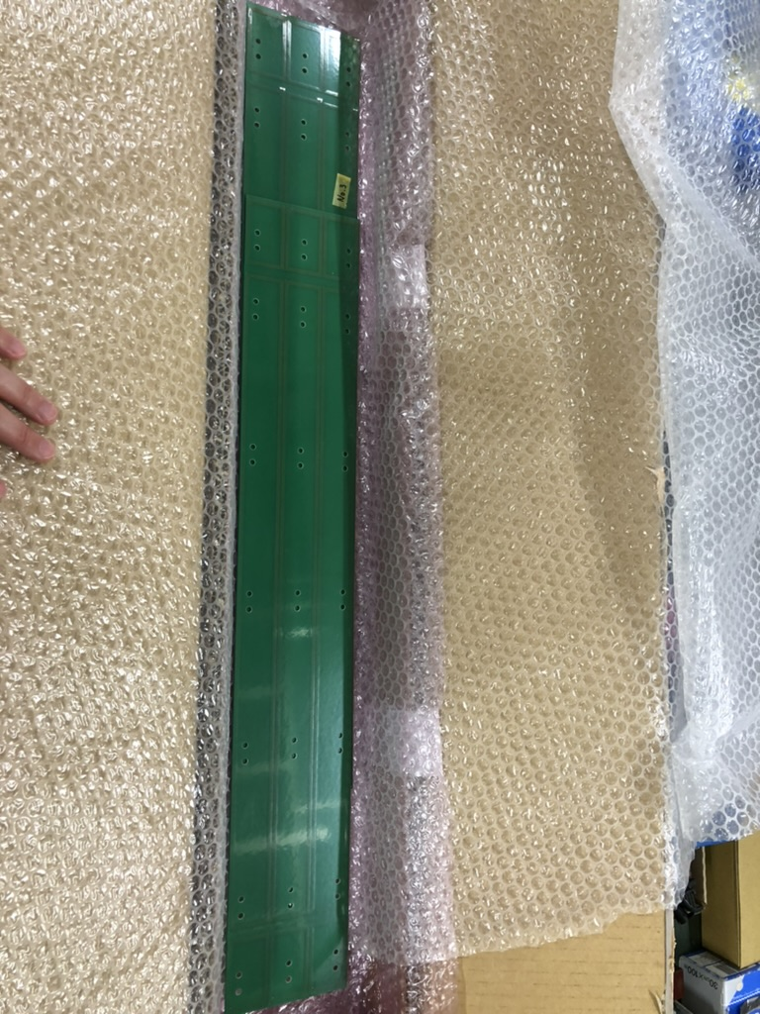
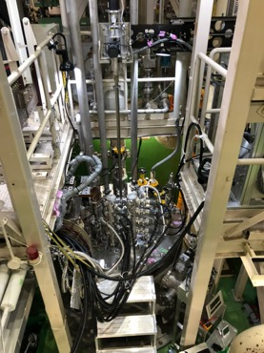
Measurement system
10-m shaft
Field quality of MBXF5 at room temperature / 1.9 K using the KEK’s vertical measurement system
  Rotating coil (PCB):
    3 sets of radial coils
    Long coils (500) for integral measurement
    Short coils (50) for fine search
  Scanning capability
    Stepping motor and Magnescale®
    10-m-shaft to cover the full-length of the magnet
50
500
50

Slide 19
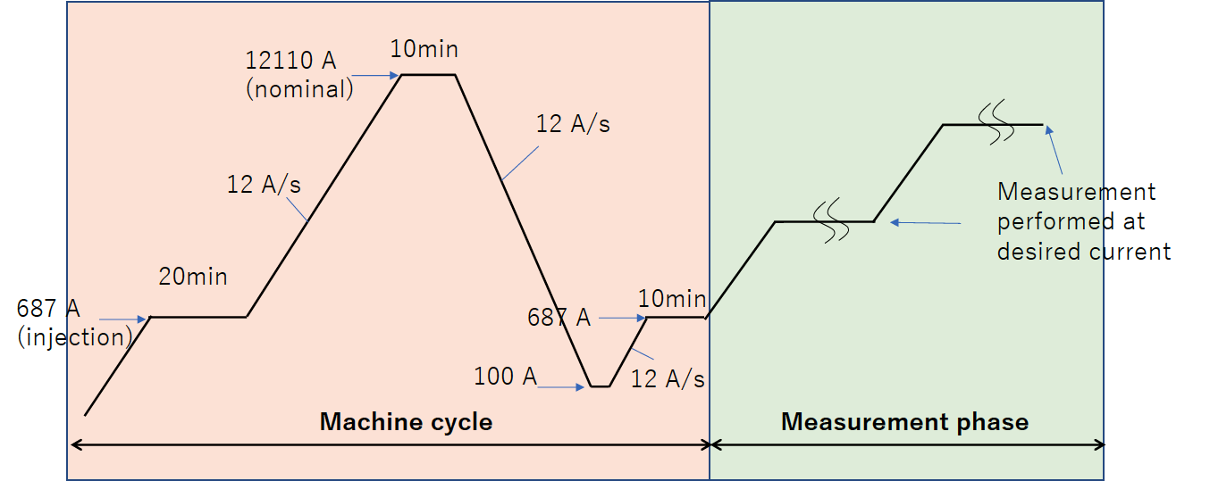
Measured items
Z-scan
  Warm, before cooling
  I =3 kA, before training
  I = [687, 3k, 7k, 10k, 11k, 12.11k, 11k, 10k, 7k, 3k, 687] A, after training and machine cycle (see below)
DC loop at 1.9 K
  Rotating coil position is fixed at the magnet center (z=0)

Slide 20
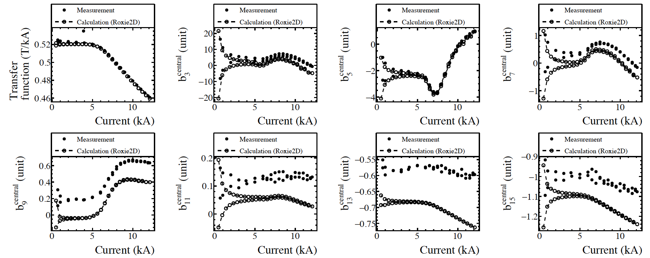
DC loop – comparison with calc.
due to current
monitoring issue
Central field quality was evaluated by the long coil (L=500) brought to the longitudinal magnet center (z=0)
Measured curves are reproducible by the calc. (Roxie2D)

Slide 21
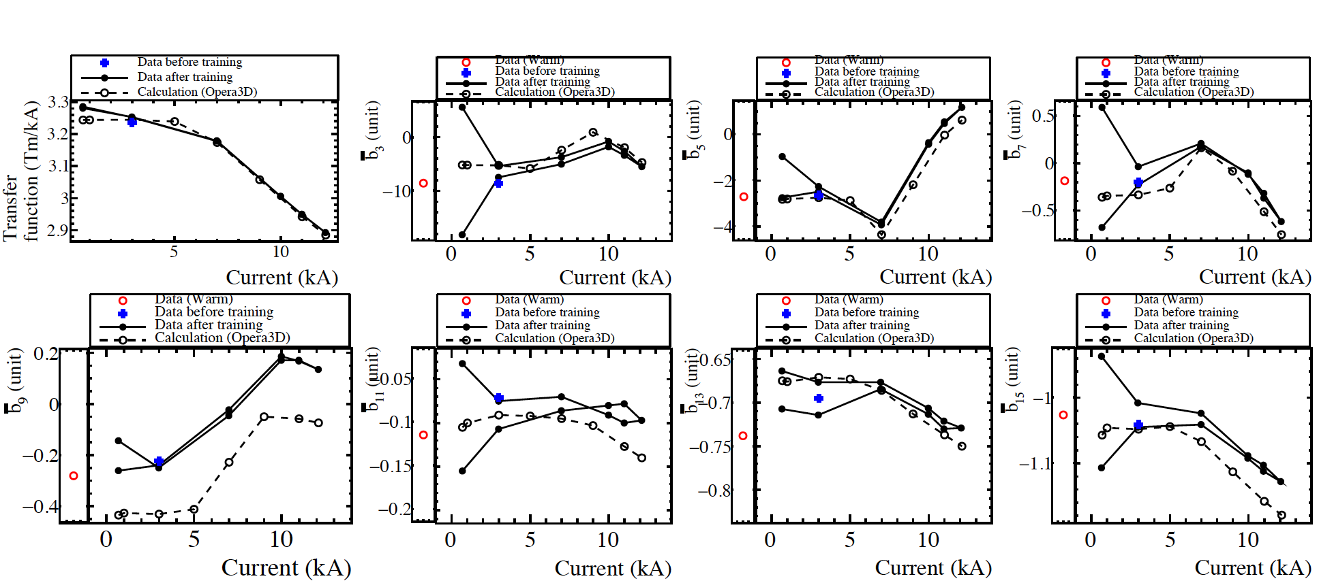
Integral measurement – comparison with calc.
Warm <-> Cold : good reproducibility
Good agreement with the calculation

Slide 22
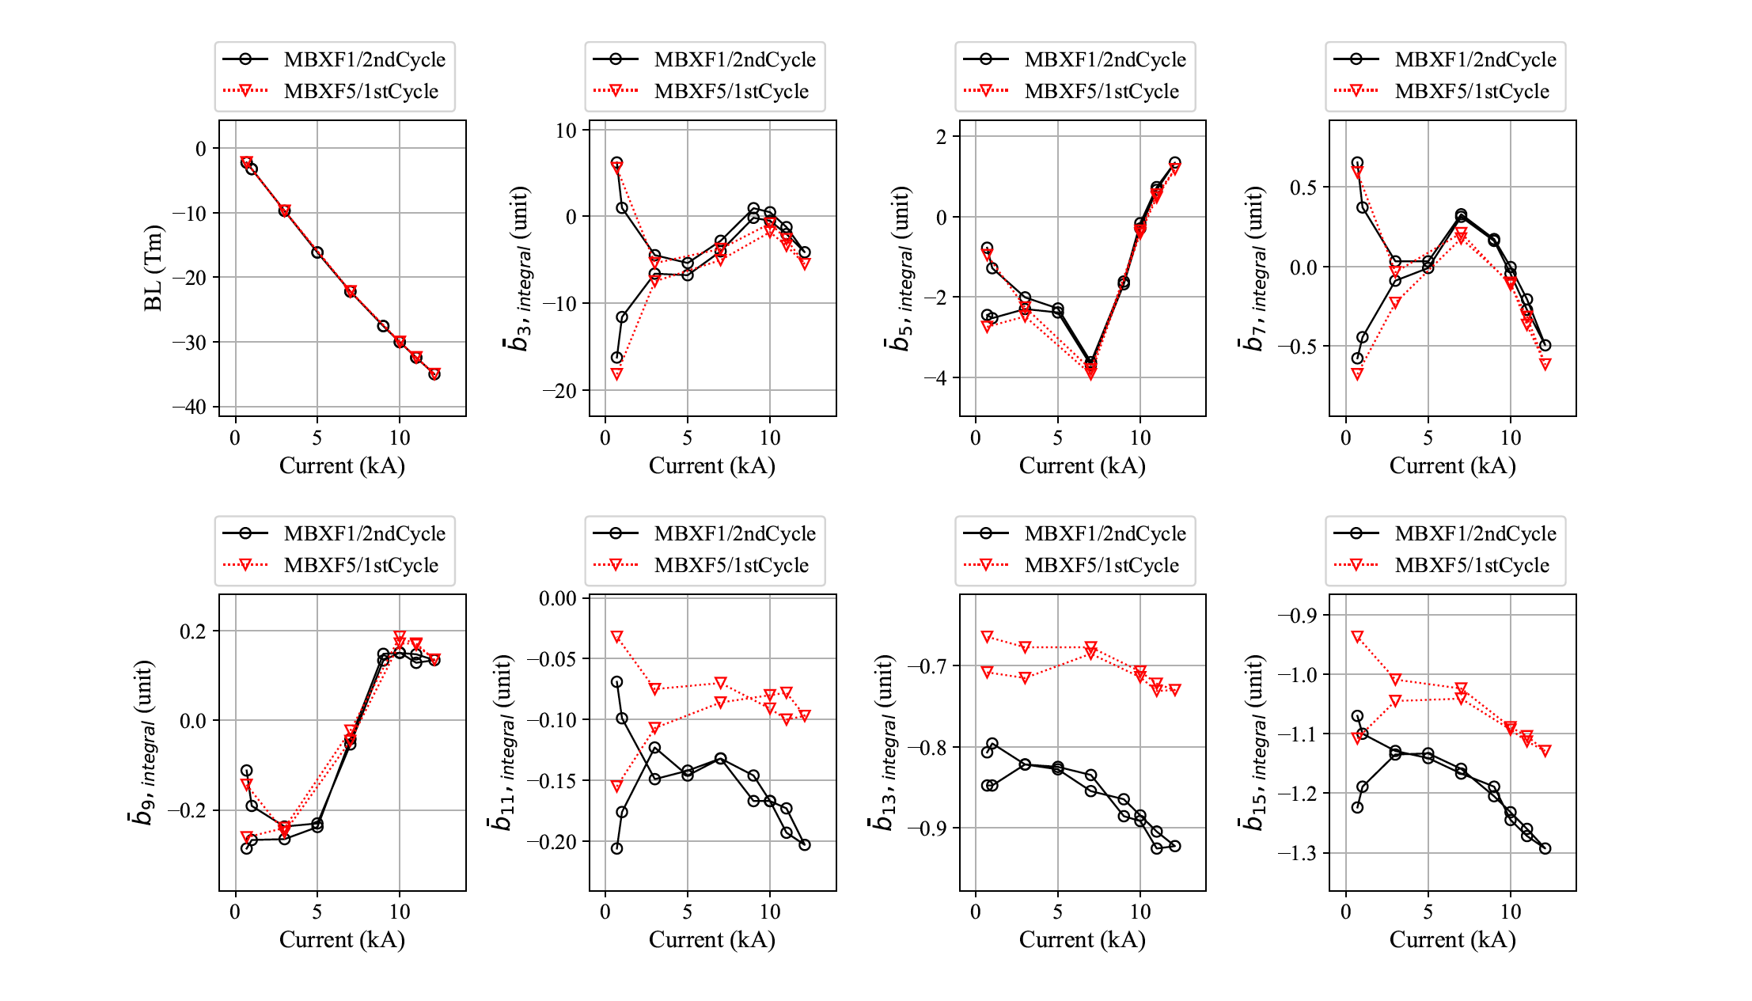
Integral measurement – comparison with MBXF1
Very good reproducibility
Other harmonics data are also plotted in the backup slides

Slide 23
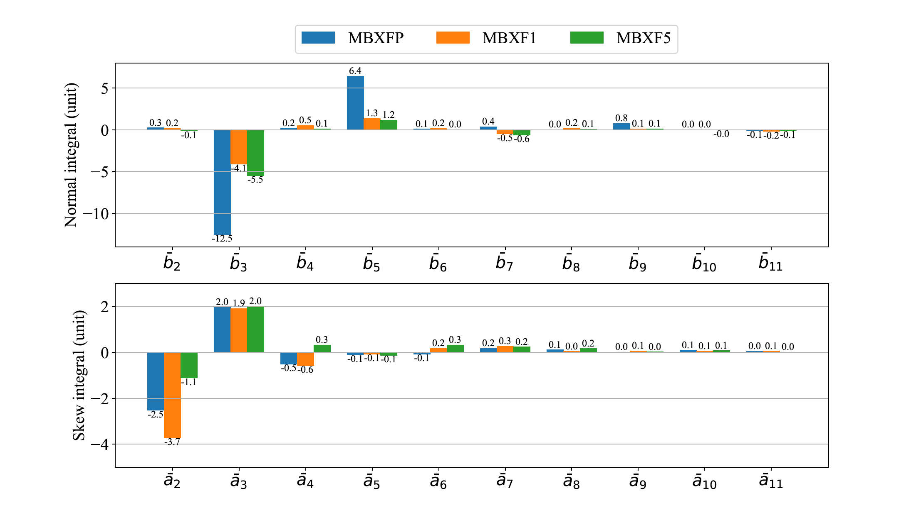
Summary of the field quality (integral) so far
Prototype
Series
＊
I=12.11 kA, KEK cryostat
I=12.11 kA, KEK cryostat
＊) MBXFP’s cross-section design is different from the series

Slide 24
Ref) Summary table : SS averaged & Integral
Warm
T=1.9 K, I=12.11kA

Slide 25
Summary
Warm magnetic measurement of MBXF2 at the Hitachi premise
  Measured field quality agrees with the design value to within ~1 units.
  Series statistics so far : 3
    Good reproducibility
    Variation in b₃ and a₂ : ~3 units
Power test of MBXF5 (1st TC) in the KEK cryostat
  Reached the nominal current after 4 quenches
  Reached the ultimate current after 9 quenches
  No quench concentration
  4-hours holding at the nominal+200A was successful
  4-hours holding at the ultimate current is pending until the 2nd TC
  Field quality
    Good reproducibility and well reproduced by calculation
  The 2nd TC will be started from 13th Nov.

Slide 26
Thank you !

Slide 27
Supplement

Slide 28
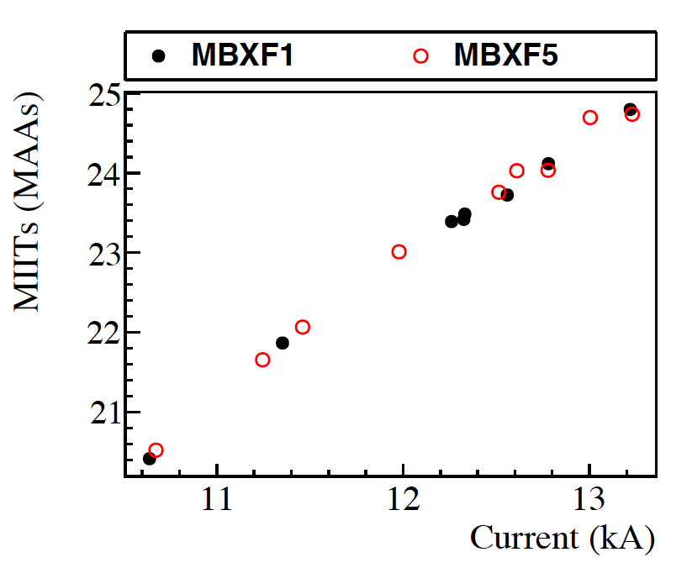
MIITs

Slide 29
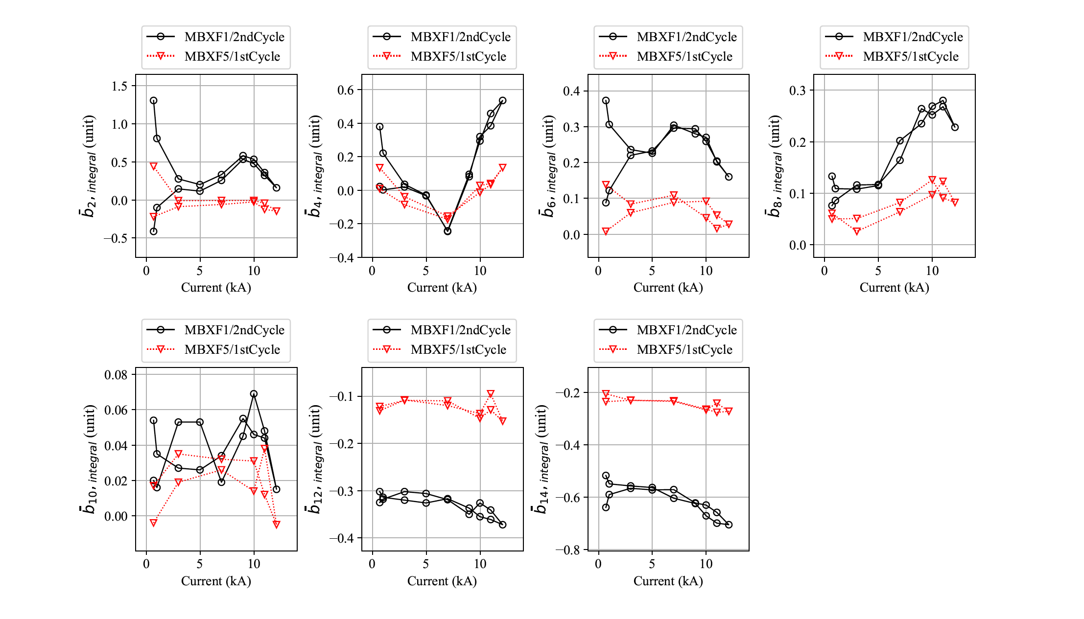
Integral – comparison with MBXF1

Slide 30
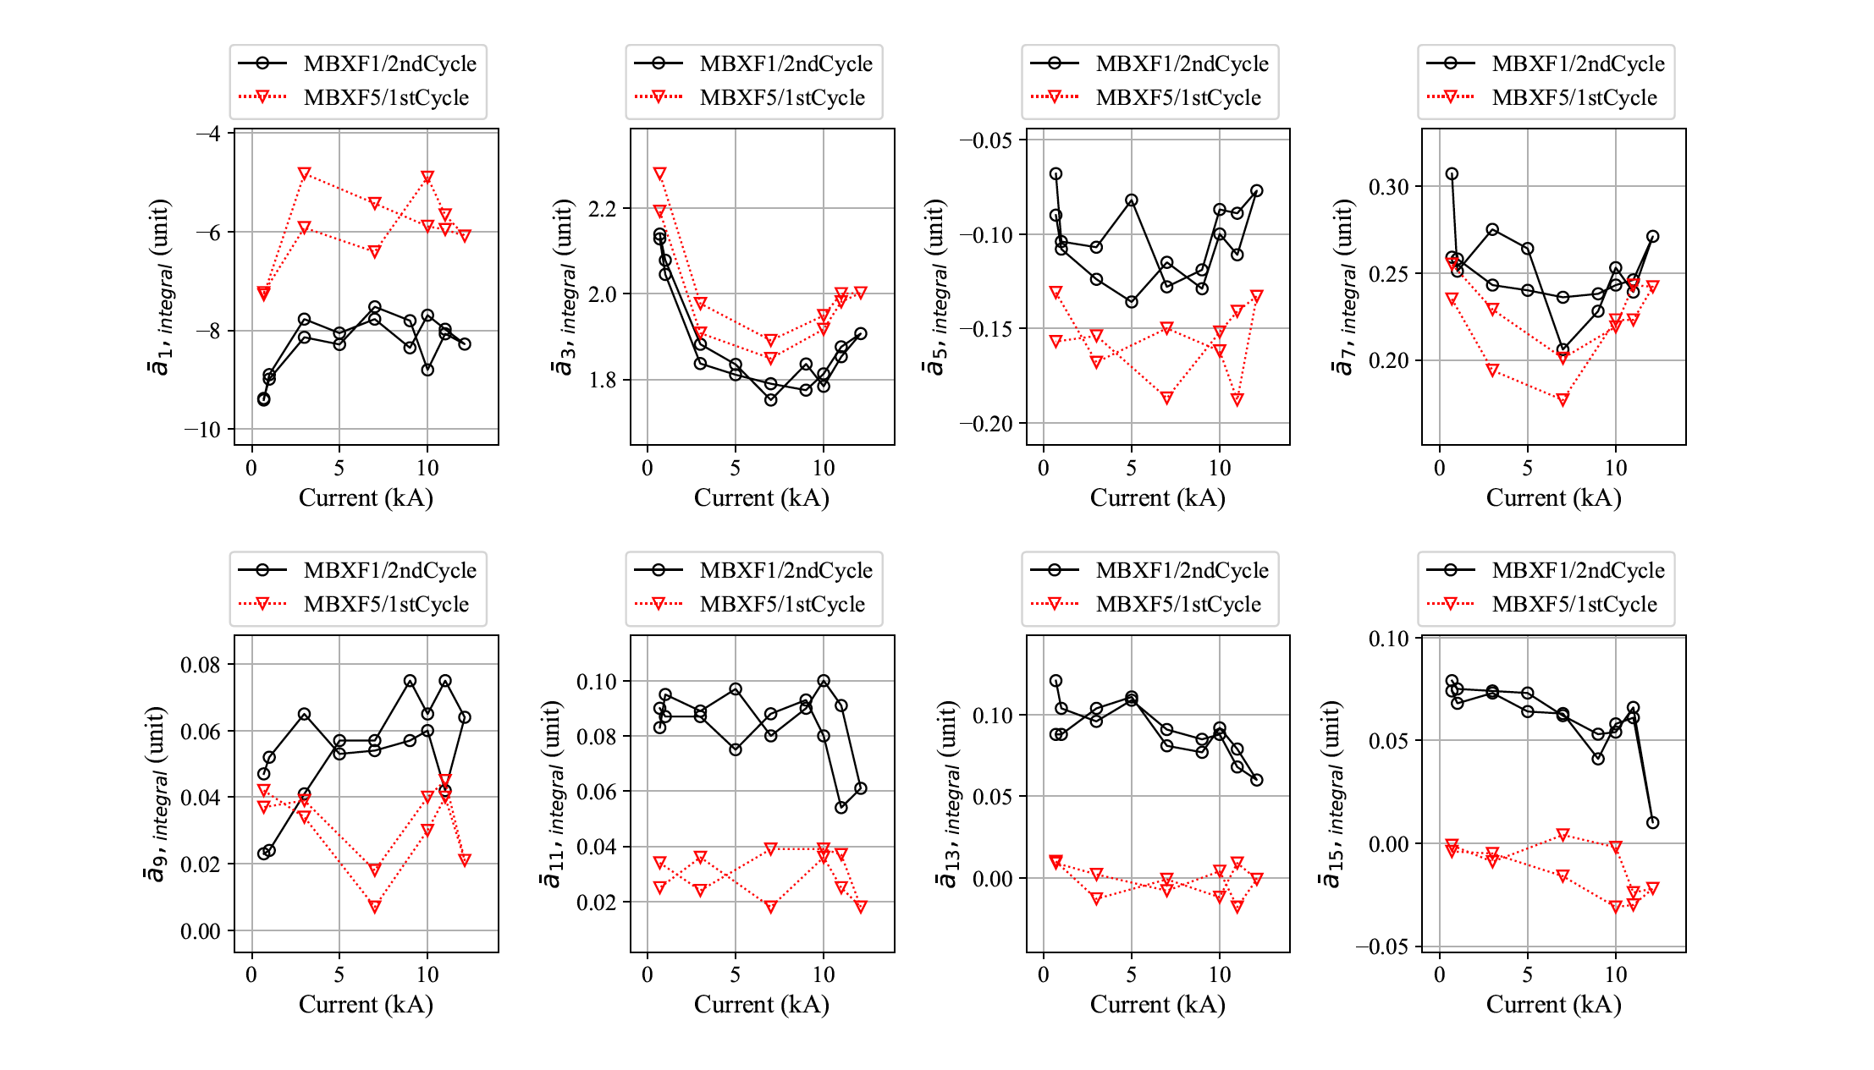
Integral – comparison with MBXF1

Slide 31
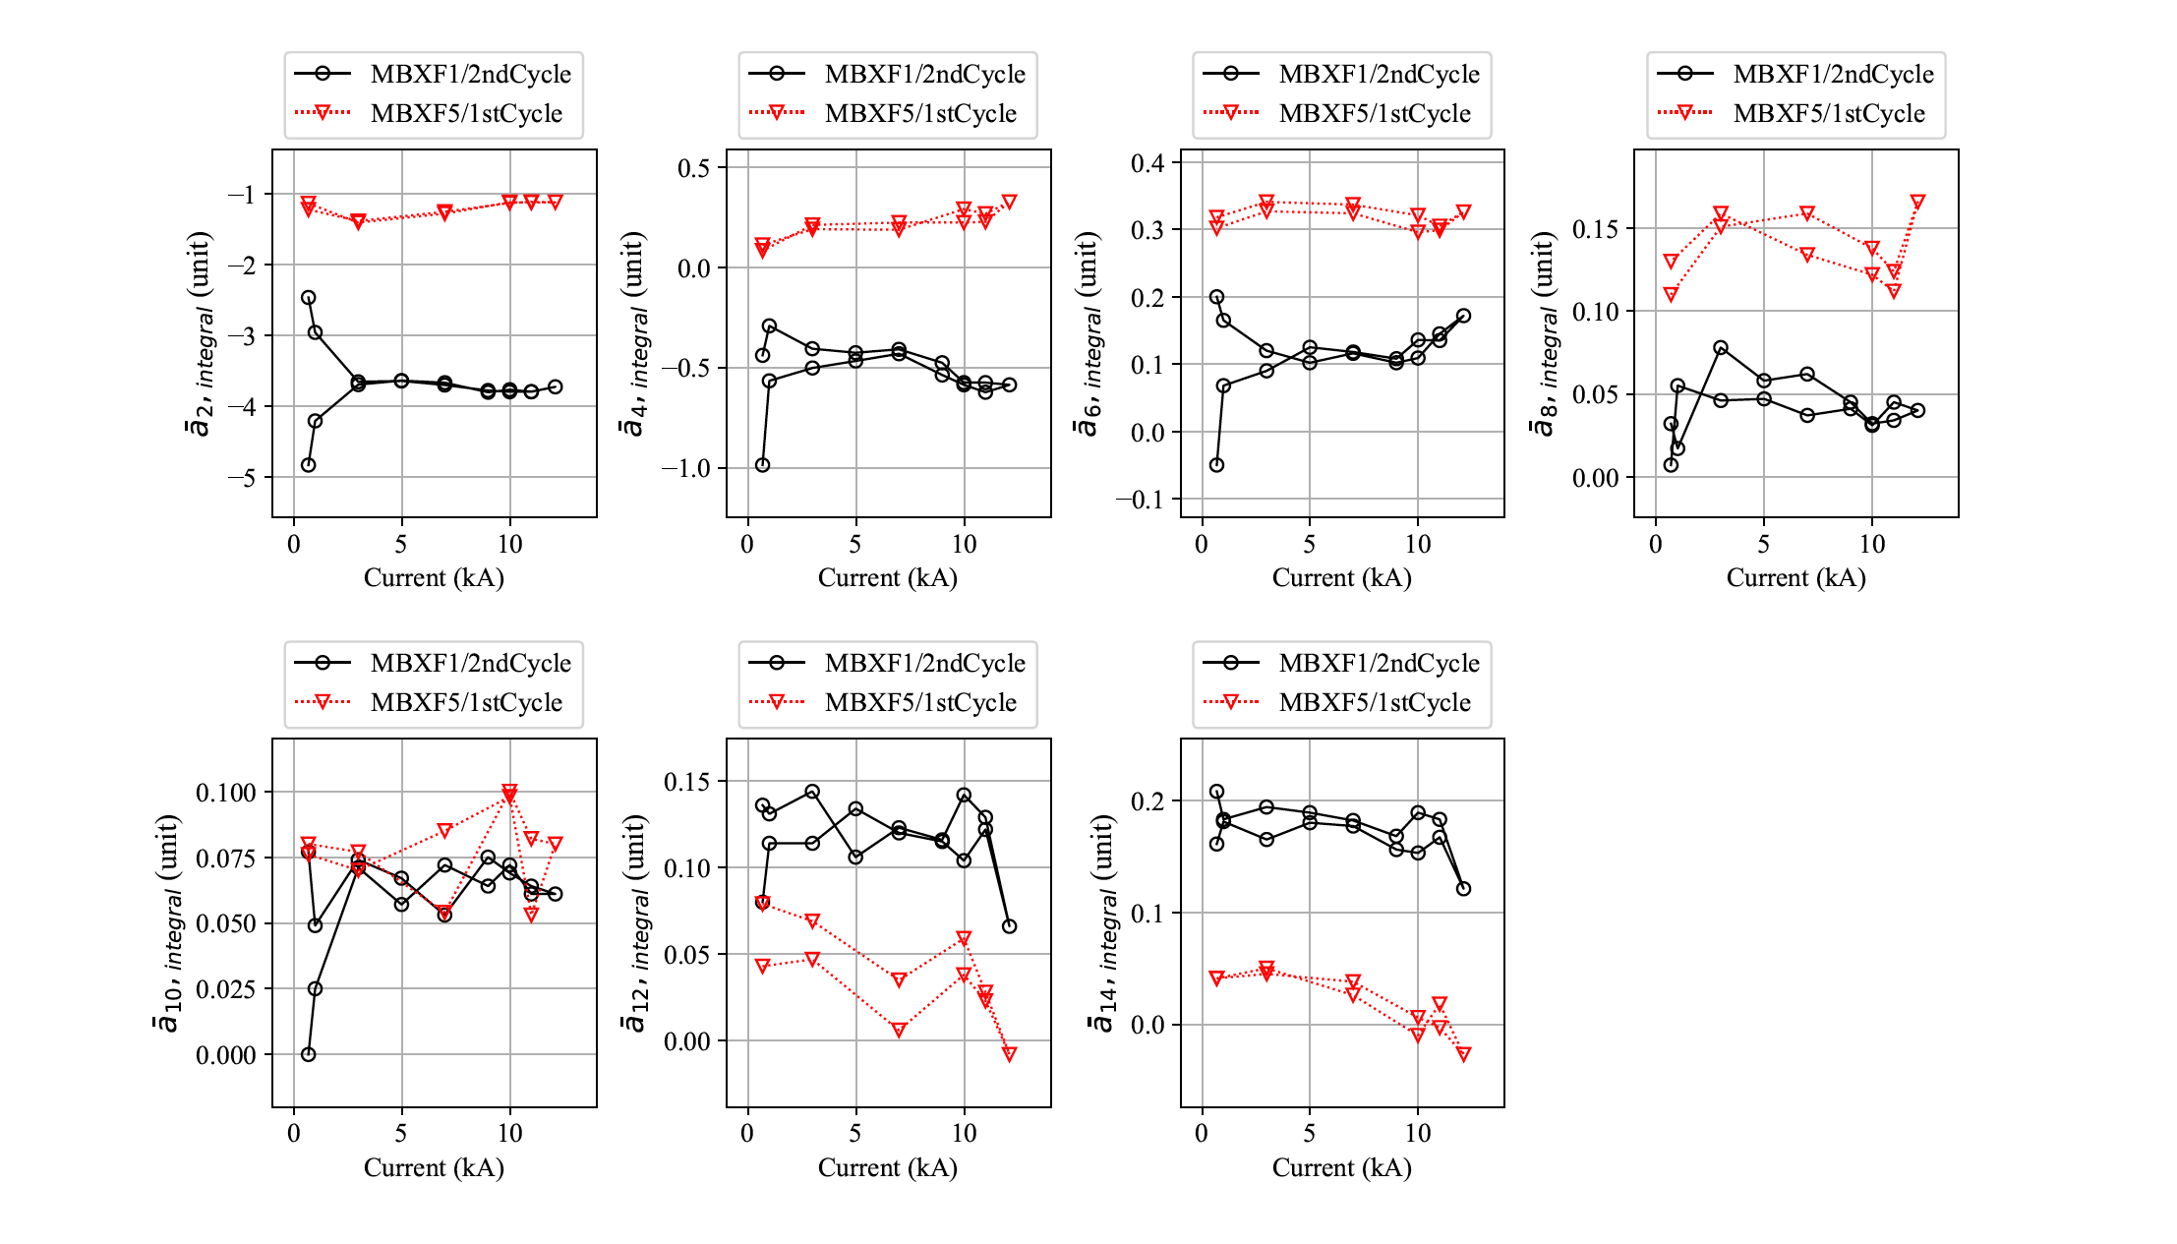
Integral – comparison with MBXF1
a₂：MBXF1の時ほどの顕著な大きさはみられない。
ヒステリシスにも違いが現れている

