Slide 1

D2 cryogenic power extraction constraints wrt beam-optics operation
Cryogenic requirements, WP3
R. van Weelderen,
with major contributions/discussions from Andrew John Lees
08/11/2023

Slide 2
Outline
D2 – cooling system layout
  D2 Magnet Configuration (A. Lees)
  Sources of Static Heat Loads (A. Lees)
Specifications
  Dynamic Heat Loads (A. Lees)
  Combined Heat Loads (A. Lees)
Coupling to other HL-LHC cryogenic systems
Beam – optics request
Conditional margins & Discussion for future investigations

Slide 3
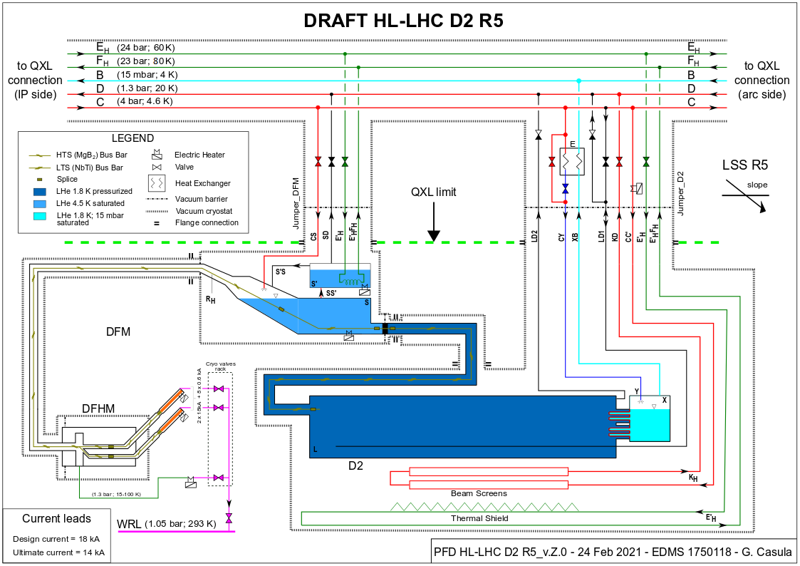
D2 Magnet Configuration
Cooling During Operation
Coldmass and HX:
1.9 K
Interface to QXL Jumper
Beam Screen:
4.5 K in / 20 K out
Calculation:
  IP side 20 K
  Non-IP side 4.5 K
  Radiation at 20 K
Interface to DFM Plug
Thermal Shield:
60 K in / 80 K out
Calculation at 70 K

Slide 4
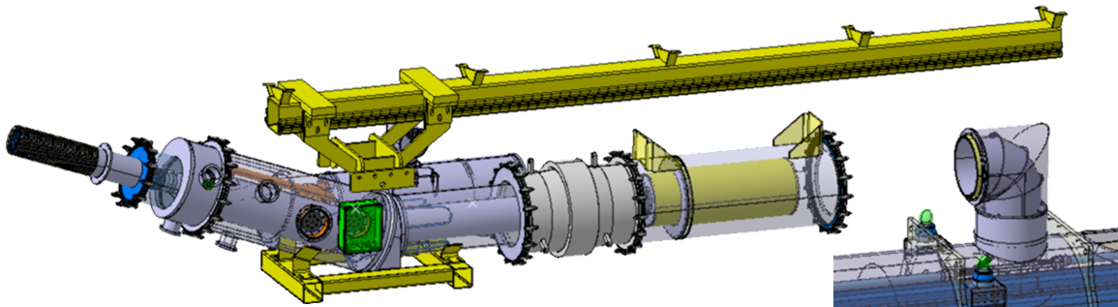
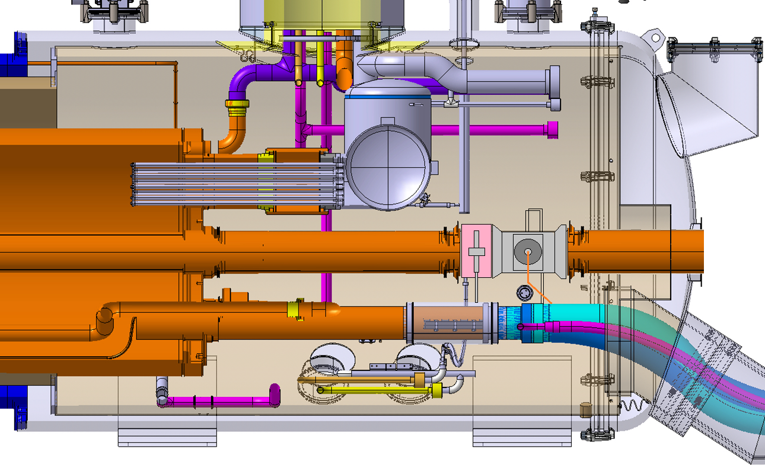
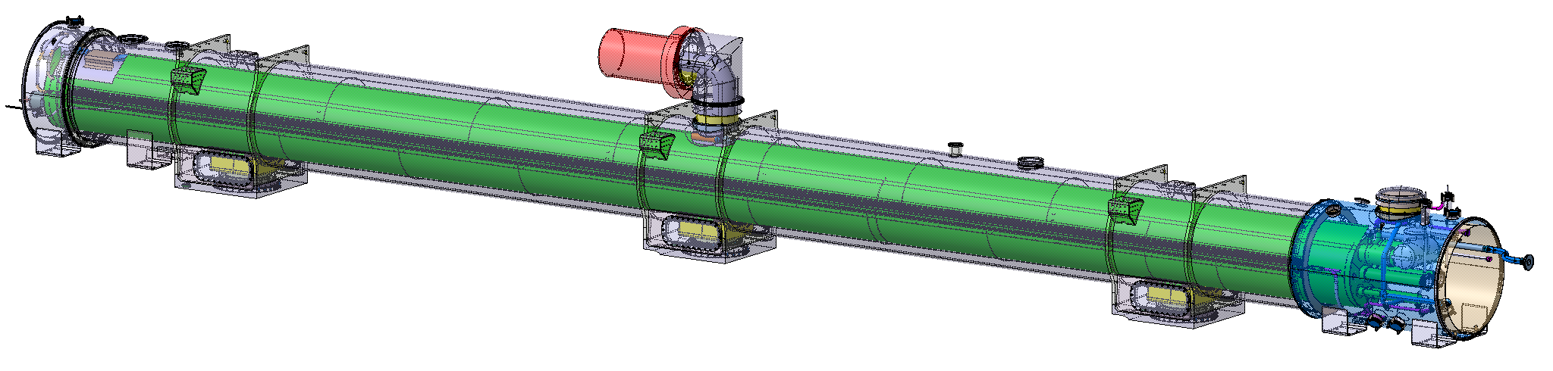
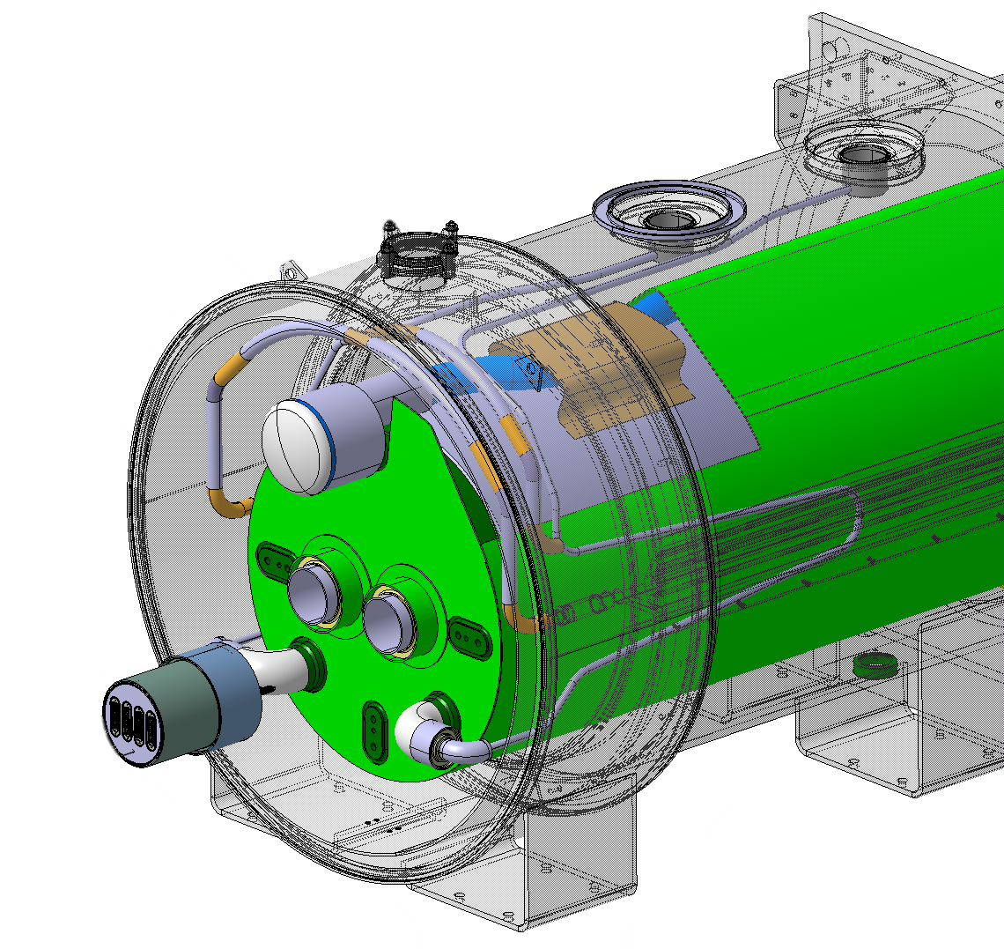
Sources of Static Heat Loads
He-II Heat Exchanger
DFM Interlink
BPM
CWT non-IP-Side
Cold Foot
Previous static heat load estimate by Marco Spitoni (EDMS 1610730, 05/2020) Compiled by scaling from LHC or Inner HL-LHC Triplets.
New study to find most recent and accurate reference, then verify with hand calculation (Reference CAD model for estimations - ST1371245 / ST1237123).
Cold Warm Transition (CWT) – IP-Side
IFS

Slide 5
Dynamic Heat Loads
Source | Nominal Value (W) | Ultimate Value (W) | Temperature Level | Reference
Resistive | 1 | 1.5 x Nominal | 1.9 K (Coldmass) | Nominal Current = 12.33 kA, Ultimate Current = 13.34 kA Splice resistance = 1 nohm per splice Number of splices: 600 A Circuit = 16 / 13 kA Circuit = 5
Beam Induced | 50 | 1.5 x Nominal | 20 K (Beam Screen) | CERN-ACC-2016-0112, G. Iadarola, E. Metral, G. Rumolo, Beam induced heat loads on the beam-screens of the twin-bore magnets in the IRs of the HL-LHC, September 2016.
Collision | 25 | 43.7 | 1.9 K (Coldmass) | HL-LHC heat Loads Review, M. Sabaté-Gilarte, F. Cerutti, Heat loads induced by collision debris, April 2021 (Horizontal crossing in IP1, for 1,9 K → 35 W for D2 and 3 W for D2 correctors). Ultimate values calculated at 7 TeV and 7.5x10³⁴ cm⁻² s⁻¹ instantaneous luminosity, then adjusted for 7.5 TeV by adding 15%.
 | 2 | 2.9 | 20 K (Beam Screen)

Slide 6
Conclusion: Combined Heat Loads on D2
Temp. Level | Source |  | Total Heat Load (W) | Design Value (W) |  |  |  | Installed Local Capacity
 |  |  | Nominal |  |  | Ultimate
 |  |  | Inc. F_{UN} | Nominal | x F_{OV}
1.9 K | Static |  | 30 | 56 | 84.1 | 30 | 75.3 | Cooling at 1.9 K designed for 70 W: He-II HX – Verified OK for 80 W. D2 Coldmass – He-II X-sect at design limit! Significant increase in static heat load, main contributors: Lambda plate 27% Radiation 23% Cold foot 12%
 | Dynamic | Collision | 25 |  |  | 43.7
 |  | Resistive | 1 |  |  | 1.5
20 K | Static |  | 34 | 86 | 129 | 34 | 112 | To be met by LHe supply - OK
20 K | Dynamic | Beam | 50 | 82 | 123 | 75 |  | To be met by LHe supply
 |  | Collision | 2 |  |  | 3
70 K | Static |  | 187 |  | 280 | 187 |  | To be met by GHe supply - OK

Slide 7
Coupling to other HL-LHC cryogenic systems
The D2 & D1 + Inner triplet cooling are indirectly coupled via Header-B of the cryogenic service lines (QXL), that provides the very low-pressure pumping for their respective superfluid helium cold-sources.
The D2 cooling relies on a as low as possible pumping pressure. The lower the pressure (and thus temperature) the more power we can extract from D2. (In D2, the extracted power limit is conditioned by maintaining the superfluid helium conduction along the magnet length. This conductivity is lost at high powers.)
The Inner Triplet’s cooling is enhanced (when pushing HL-LHC to Ultimate) when operating at higher pumping pressure. (In the IT & D1, the extracted power limit is dominated by the vapour pressure drop of the two-phase superfluid helium. Higher densities, and thus higher temperatures are more favourable.)
The compromise of cryogenic services with maximum heat loads (i.e. with colliding beams) is found to be around 23 mbar (1.90 K).
→ When beams are not (yet) in collision we can have lowest pumping pressure conditions and thus maximize the extracted power in D2 (values to be determined in-situ).

Slide 8
Beam – optics request
De : Rogelio Tomas Garcia <rogelio.tomas@cern.ch>
Envoyé : mardi 5 septembre 2023 16:41
…
today we had a joint WP2/5 meeting to study new HL conﬁgurations that could require larger collimator gaps (indico.cern.ch/event/1320306/)
There is one conﬁguration where the deposited power in D2 goes from
28.3 W in the ref. baseline scenario to 54 W
…
Q: What will be the timing of the extra power deposition?
A1: → (Rogelio): “towards the end of the physics ﬁll where power deposited in the IR from impedance and e-cloud is reduced”
A2: → (Rogelio): power sustained for about 1 hour.

Slide 9
Conditional margins & Discussion for future investigations
Under the condition that the “as built & installed” D2-magnet cryostat respects the budgeted static heat-loads
At low enough header-B pumping pressure to optimize heat-extraction capacity.
We see that (slide 6) ~ 50 W provisionally can be taken (under condition [1], as for Ultimate no margins have been taken! Superfluid helium conditions are already being lost inside the DFM current link!).
Seeing the latest emails, clarification about the nominal and ultimate collision power deposits (which are different from the heat-load working group baseline) are needed!
The condition no. 1 can only be verified once the system has been built and tested!
Maximum power extraction beyond 50 W is not guaranteed.

