Slide 1
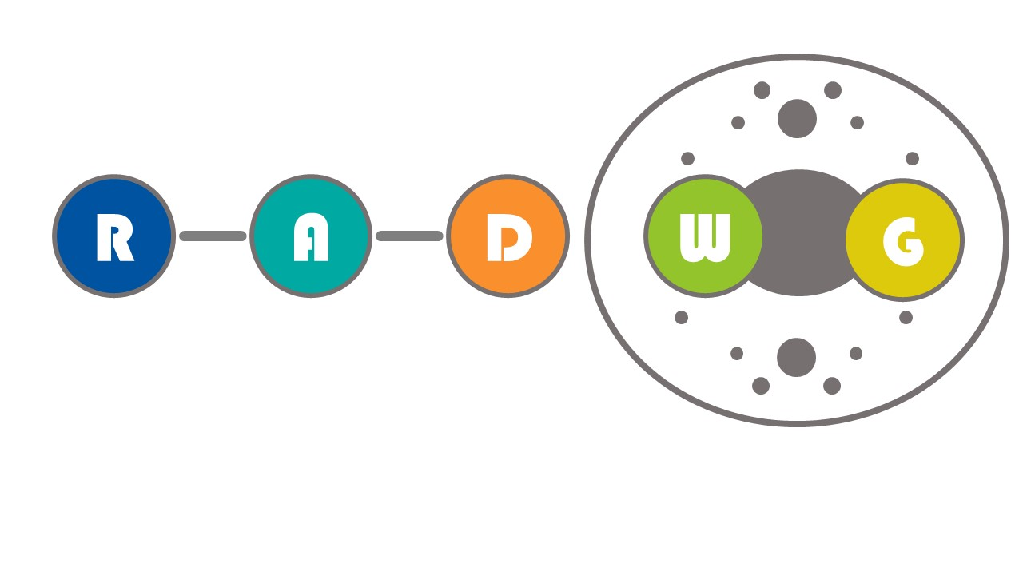
RADWG Meeting
Project Contactors for 600A EE Systems + Controls electronics
Gert Coelingh, David Carrillo, Stephen Pemberton
Thanks to the TE-MPE-MP section and the Radiation Team

Slide 2
Outline
Project description and production plans
Location and expected radiation levels
Component level testing
System level tests
Strategy

Slide 3
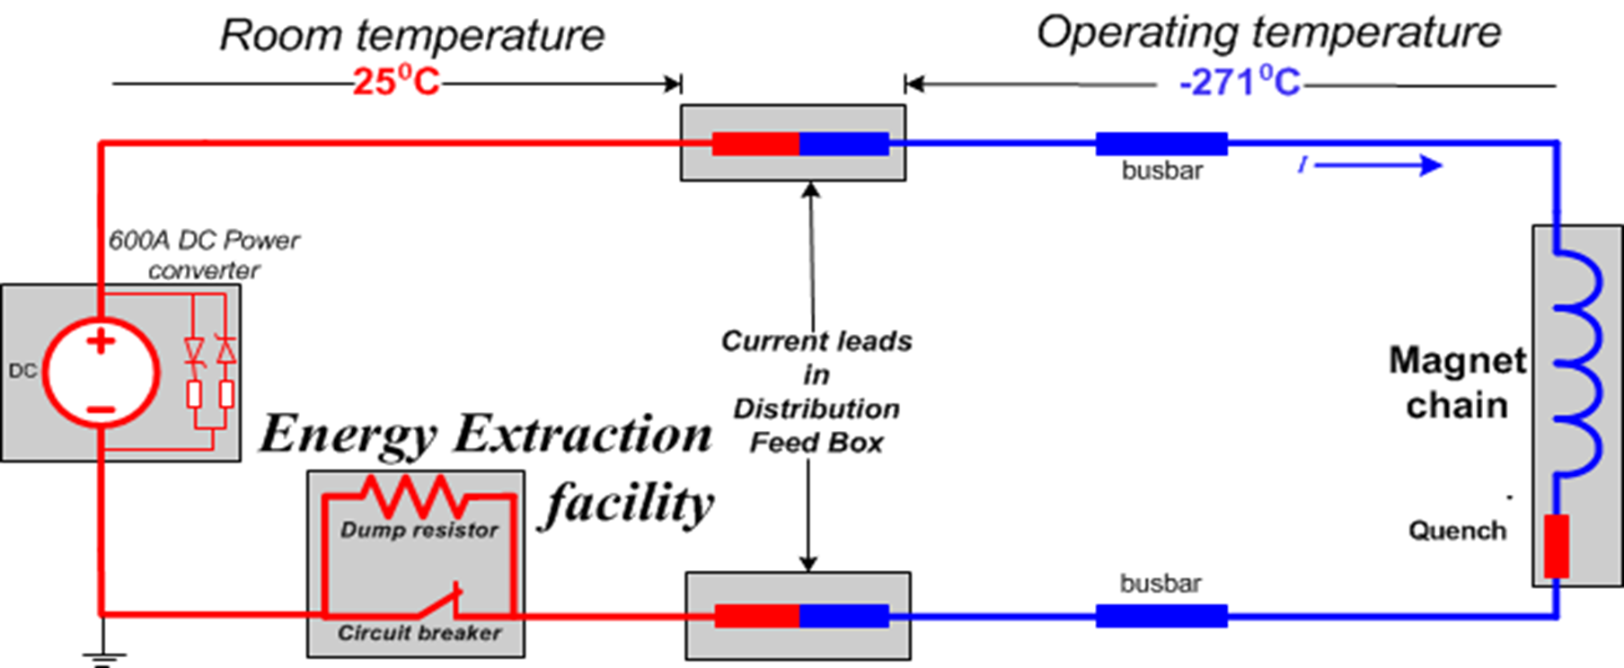
General Description EE protection systems

Slide 4
General Description EE protection systems
Control Electronics & Power Electronics to be replaced for RR1x and RR5x :
Control Electronics: Design/Update Phase; (identical as 13 kA EE)
8 different PCBs - Versatile Electronics on going focussing on RAD-TOL components
1 - DQAMS ( TE-MPE-EP )
2 - Controller Card (redundant – FPGA – Microchip/Microsemi IGLOO2 radtol FPGA)
3 - Interlock Card
4 - Driver electronics
5 - Analog readout/conditioning card
6 - Storage Capacitor Card (Hold-up time)
7 - LV PS Card
8 - FPA Card
9 - Motherboard (passive)

Slide 5
Components procurement and production plans
Electronics
  Power electronics still to be designed – analogue and rad-tol approach
    750 identical PCBs
    prototype expected by Q1 2024
  Control electronics design on-going – rad-tol approach
    250 identical chassis – each with 8-10 pcbs
    prototype expected by Q2 2024
Contactors - Price Enquiry out for 1000 units.
  Two brands tested in CHARM? Excellent results ok > 1 kGy

Slide 6
Location and expected radiation levels
13 kA EE: P3, RR13/17, RR53/57, RR73/77
600A EE: RR13/17, RR53/57, RR73/77
  25% of systems (75% of systems in UA areas)
RR13/17: according to document:
RADIATION LEVEL SPECIFICATIONS FOR HL-LHC - EDMS NO. 2302154
TID: RR1x – RR5x 15 Gy/yr (L0), 25 Gy/yr (L1)

Slide 7
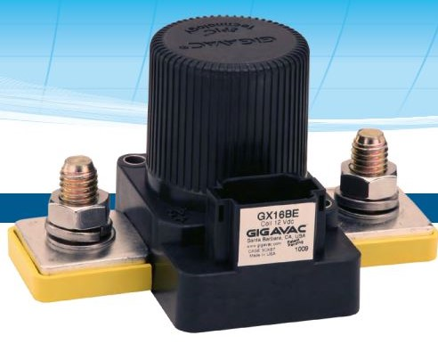
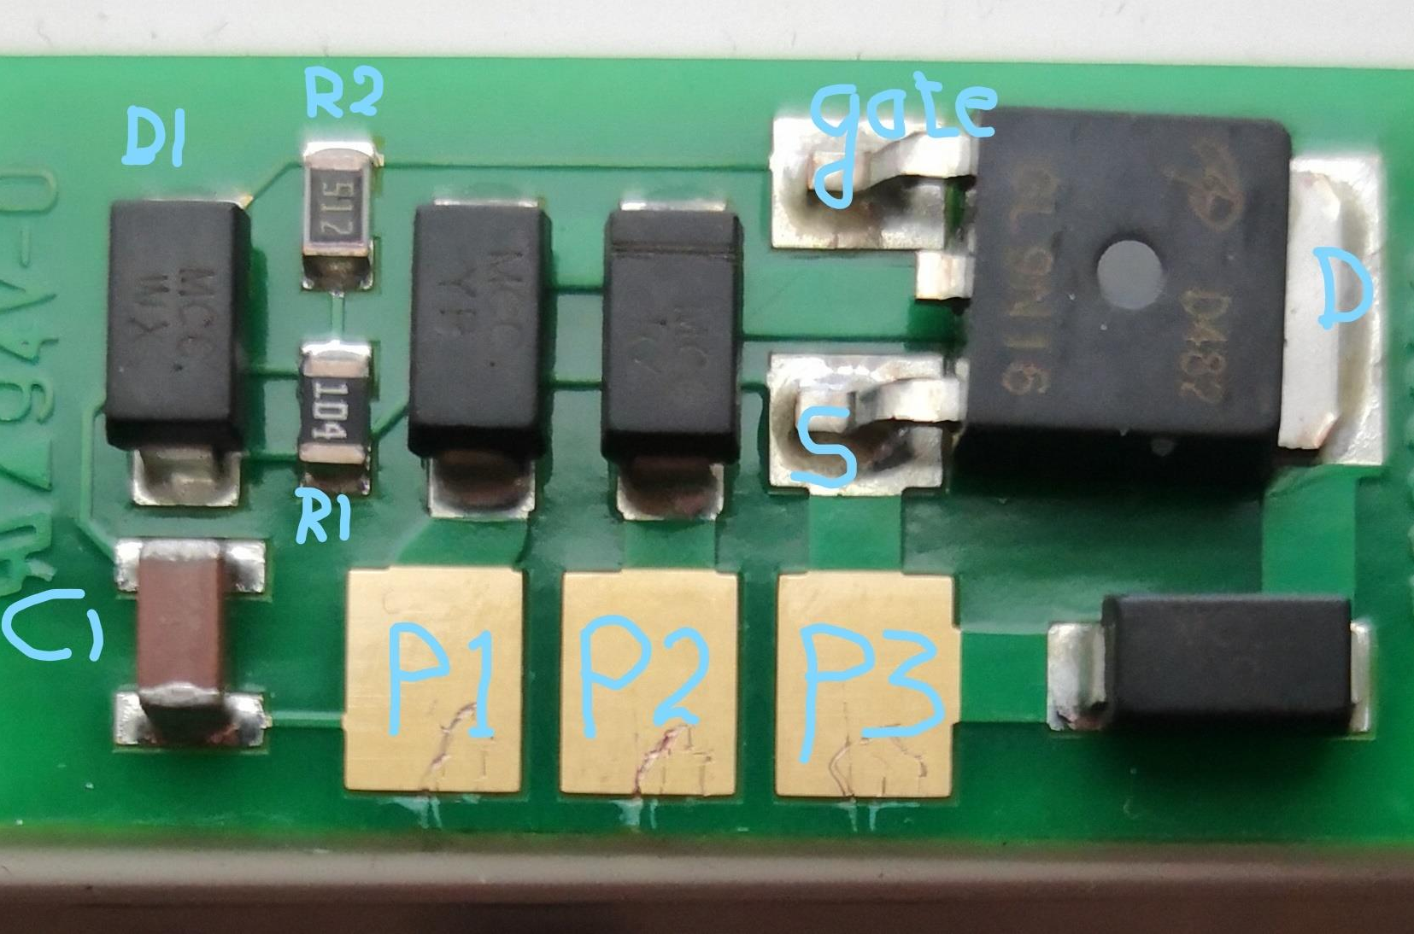
Component Level Testing Contactors GX16
2021/2022: communication with the radiation team to discuss the components susceptible to fail.
  GX16 contactor: The test was performed at a dose rate of 70 Gy/h for 16 hours. The relay absorbed a total of 1140 Gy during the irradiation
    an active test of the relay was performed under gamma radiation provided by a Co-60 source, measuring whether the relay still switched correctly every 20Gy of TID received.

Slide 8
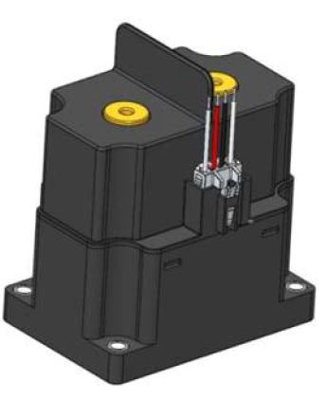
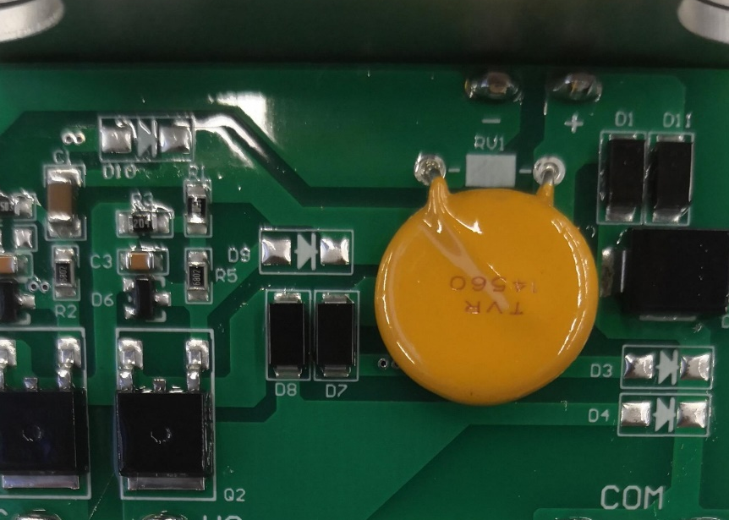
Component Level Testing Contactors DHC600P
2021/2022: communication with the radiation team to discuss the components susceptible to fail.
  DHC600P contactor : The devices were tested up to 2 kGy at a dose rate of about 300 Gy/h at the CERN CC60 facility by means of a Cobalt 60 source.
    an active test was performed under gamma radiation provided by a Co-60 source, measuring whether the relay still switched correctly every 50Gy of TID received

Slide 9
Component Level Testing - results
GX16CEC: In conclusion, no significant effects were observed after 1139 Gy of TID.
DHC600P : In conclusion, three pristine relays were irradiated up to 2 kGy at the CC60 facility. The relays could be switched ON and OFF without problem up to the end of the test.
Further tests planned to be done in CHARM with samples from the series

Slide 10
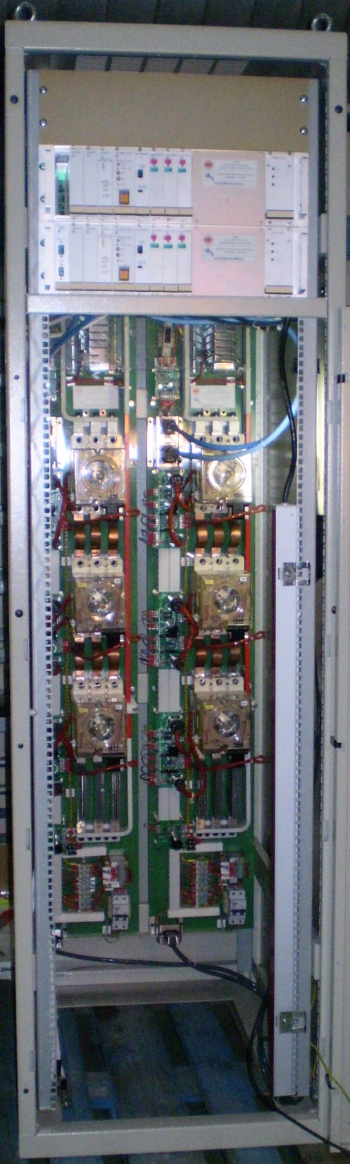
System Level Testing
Not Foreseen
43U Euro-rack 60 x 90 cm – including 2 systems
19 inch electronics chassis – to be tested
  Each system including 19 inch 3U chassis
All “items” to be tested individually

Slide 11
Mitigations strategies
Designed so faults are fail-safe (availability affected, not reliability)
For functional reasons, it is foreseen to replace the switching units in the A position in LS4 (~10 years of )
Additionally, to Slide 5: two more types of power-electronics PCBs will be tested (in CHARM?) to characterize in detail their failure modes

Slide 12
THANK YOU

