Slide 1
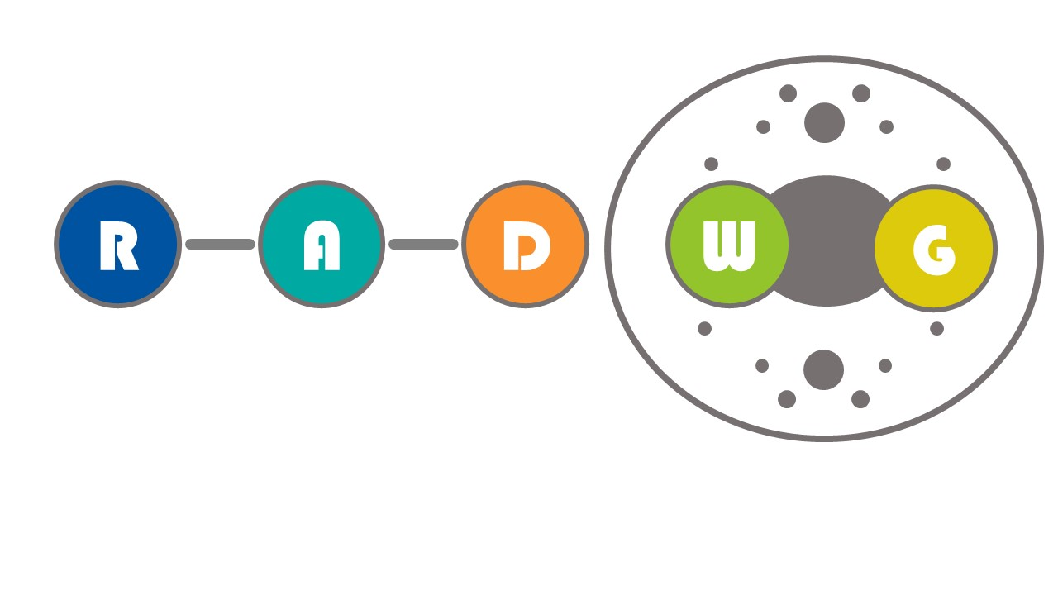
RADWG Workshop (21/09/23)
Salvatore Danzeca BE-CEM-EPR
Manoel Barros Marin SY-BI-BP
on behalf of the RADWG

Slide 2
AGENDA
Introduction
Activities Overview by Rudy Ferraro
EE Radiation Tolerant systems status from TE-MPE (Gert-Jan Coelingh TE-MPE)
BE-GM Radiation Tolerant project Status (BE-GM) (Mateusz Sosin and Roberto Fernandez Bautista)
Open Questions

Slide 3
ATS Common order for rad-hard Bpolxx devices
  bPOL12 and bPOL48
  RADWG organised a common order
  ATS Order Status
    26700 devices ordered
    2000 ATS spares have been ordered
    The quantities written below have been ordered
    TID will be received soon by the requestors
    Devices will be delivered to the requestors in 2024
Requestor | ATS Group | Component Type | Number fo components | Budget Availability | Project Name | Cost
Manoel Barros | SY-BI | BPol48 | 1500 | 2023 | BPM project
Christos Zamantzas | SY-BI | BPol12 | 6000 | 2023 | BLM PSU (BLEPSU) | 54000
Andrea Boccardi | SY-BI | BPol12 | 7500 | 2023 | BPM project PSU | 67500
Nikolaos Trikoupis | TE-CRG | BPol12 | 6000 | 2023 | HL-LHC and future needs | 54000
Salvatore Danzeca | BE-CEM | BPol12 | 1000 | 2023 | RadMON | 9000
Mirko Pojer | TE-MPE | BPol12 | 1500 | 2023 | 600 A CONS | 13500
Mirko Pojer | TE-MPE | BPol12 | 350 | 2023 | Energy extraction system for HL | 3150
Mirko Pojer | TE-MPE | BPol12 | 250 | 2023 | 13 kA CONS | 2250
Greg Daniluk | BE-CEM | BPol12 | 600 | 2023 | DI/OT | 5400
Salvatore Danzeca | ATS | BPol12 | 2000 |  | ATS spares | 18000
Total |  |  | 26700 |  |  | 226800

Slide 4
THANK YOU

