Slide 1



Lecture 22
Beam Instrumentation &
Diagnostics
Professor Emmanuel Tsesmelis
Principal Physicist, CERN
Department of Physics, University of Oxford
Graduate Accelerator Physics Course
John Adams Institute for Accelerator Science
22 November 2023

Slide 2
Introduction
Beam circulating inside closed vacuum chamber is not visible from outside.
Access close to accelerator prohibited during operation.
Equip accelerator with wide range of measuring instruments - monitors
  Establish whether there is beam in machine.
  Measure physical parameters of machine.
  An accelerator is only as good
  as its diagnostic equipment.

Slide 3
What are Beam Diagnostics?
Diagnostics are the ‘eyes and ears’ of accelerator:
  Measure physical properties of the beam, like charge, position, transverse and temporal profile.
  Consist of devices to sense these properties (pick-ups) and associated processing electronics and software (amplifiers, filters, converters, calculations).
  Essential in the commissioning phase to establish operating conditions and tune parameters for optimum performance (beam optics, timing, accelerating field amplitudes and phases).
  Essential in the operation to ensure stable conditions (stable orbit, tune, timing). Thus, diagnostics are required to be reliable and stable in their own right.

Slide 4
Observation of Beam & Measurement of Beam Current

Slide 5
Screens (Phosphor or Scintillator)
Full 2D transverse profile in one shot.
Generally destructive to the beam (energy absorbed, scattering of particles as they pass through screen).
Actuator required to remove screen from beam path.
Camera shutter should be synchronised to beam arrival for best results.
Actuator
Screen
Vacuum
Window
Lens
CCD camera

Slide 6
Fluorescent Screen
Applications
  Measurement of beam position
  Beam profile
  Beam intensity
ZnS is effective fluorescent material
  Mixed with sodium silicate, it is applied in thin layers onto glass, ceramic or metal.
  Screens emit green light with high light yield.
  Disadvantages
    Limited use in high-vacuum environments.
    Limited lifetime & burn out at beam spot after extended exposure.

Slide 7
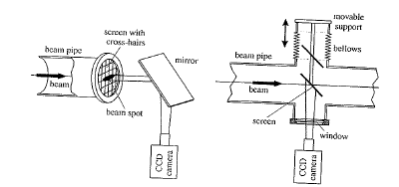
Fluorescent Screen
Thicker screens made of Al₂O₃ doped with chrome.
  Predominantly red light.
  High tolerance to beam exposure.
  Low degassing rate and may be used in UHV.
Left – fixed version at the end of linac.
Right – movable screen which may be
moved in/out of beam line.

Slide 8
Fluorescent Screen
Read-out
  Emitted light viewed using television (CCD) camera in control room.
  CCDs are susceptible to radiation damage.
    Protect by lead shielding and install at low radiation level locations.
Limitations
  Non-linear relationship between light yield and beam intensity
  Long afterglow
    Several ms to seconds
      Not possible to resolve time structure of beam (ns. range).

Slide 9
Optical Transition Radiation (OTR)
Transition Radiation is created when relativistic charged particles cross a dielectric boundary.
Typically, metal targets are used, as metals have large negative dielectric constant at optical frequencies.
A part of the emitted photons (OTR) is in the visible spectrum and can be used to image the particle distribution.
Forward OTR is emitted in a cone around the particle trajectory.
Backward OTR is emitted in a cone around the ‘reflected’ particle trajectory.
Forward OTR
Backward OTR

Slide 10
Properties of OTR
Intensity scales with:
Maximum at 1/γ
Number of (visible) photons per electron:
Practically: 1-3%

Slide 11
OTR Advantages/Disadvantages
Advantages
  Like a phosphor screen, but without resolution limits (resolution possible down to optical wavelength).
  No saturation, linear intensity to destruction threshold (>10¹²e⁻/mm²).
Disadvantages
  Few photons per electron, which are emitted in a large angle at low particle energies.
  Practically only feasible for strongly relativistic particles (γ>100).

Slide 12
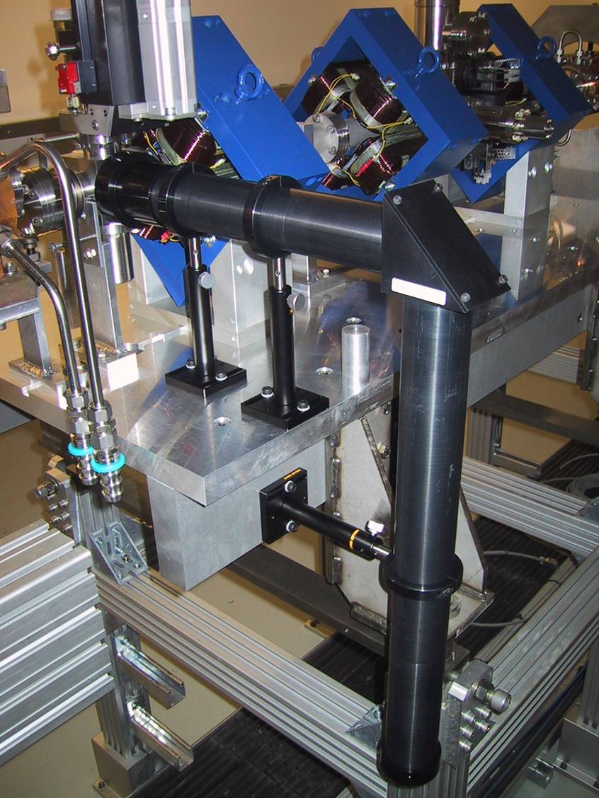
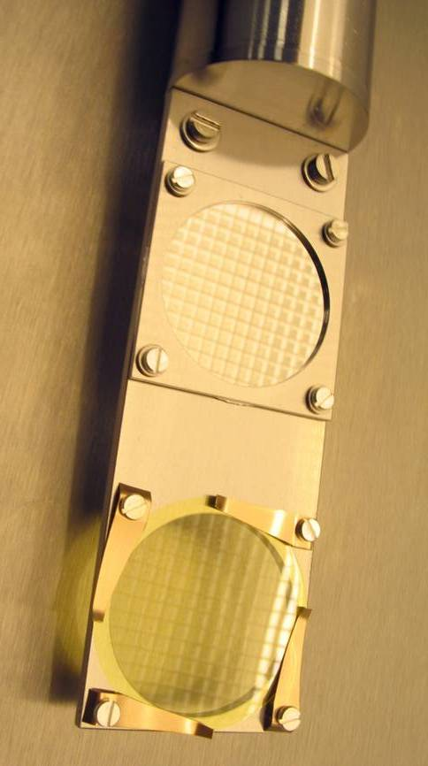
Screens and Optics
Pneumatic Actuator
e⁻ beam
Mirror
OTR
CCD-Camera
YAG:Ce

Slide 13
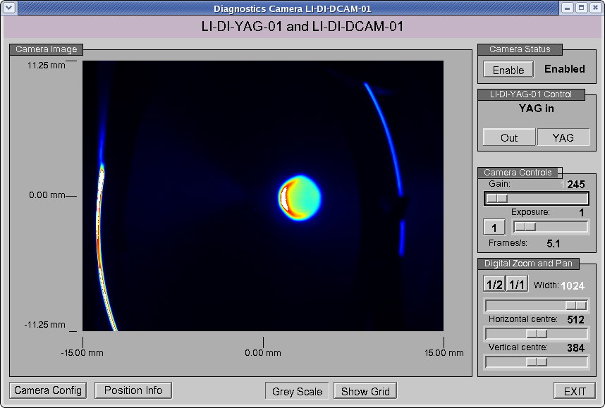
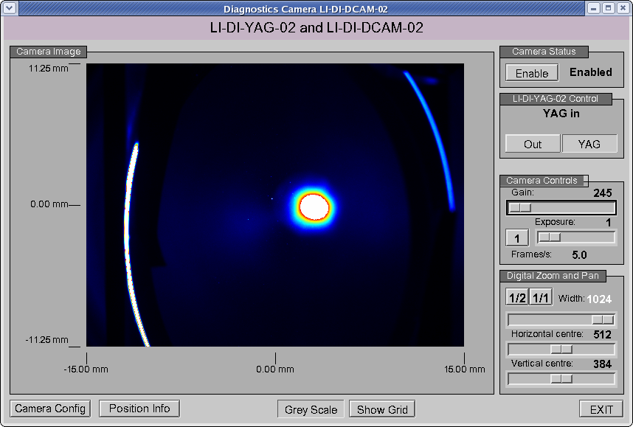
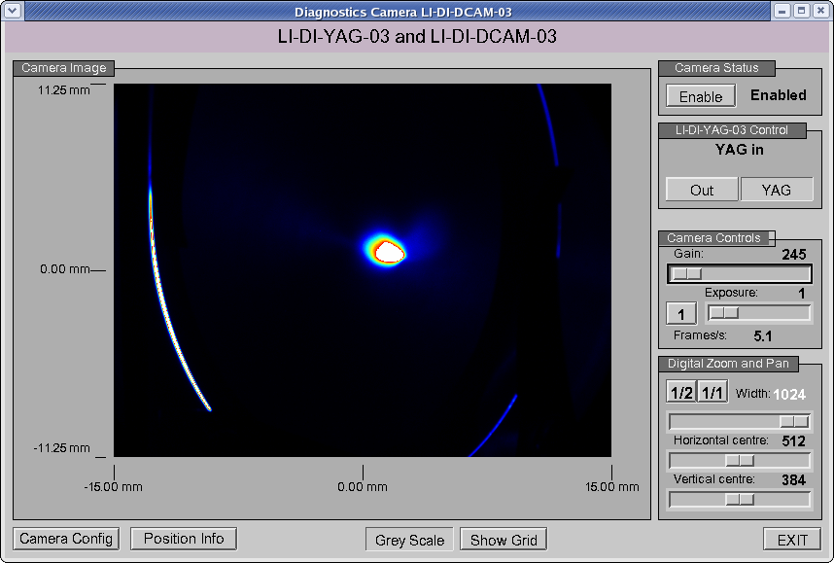
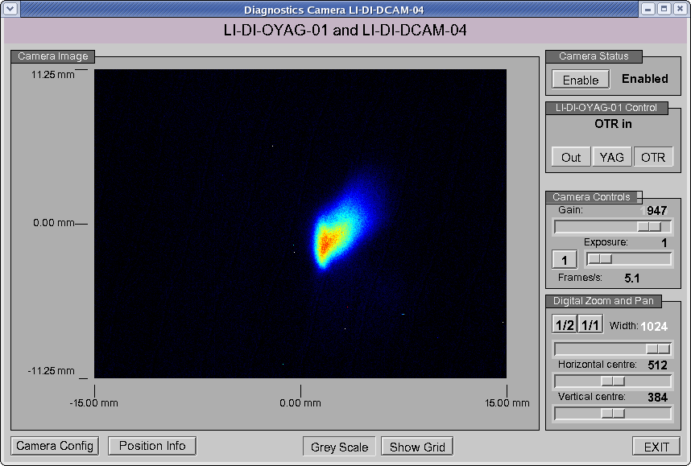
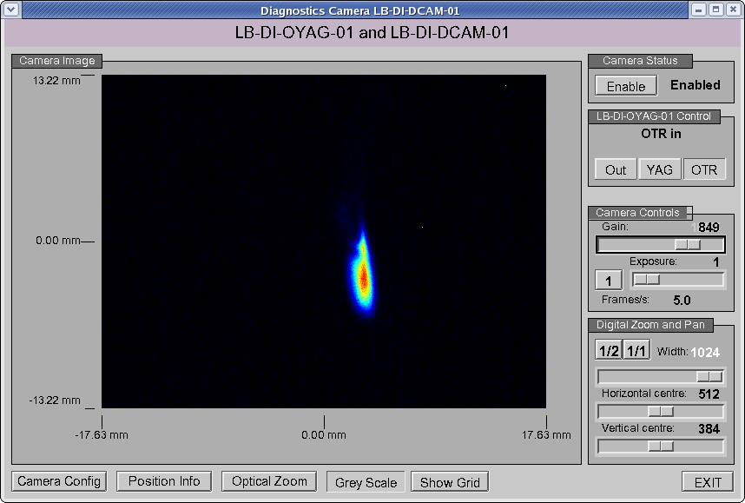
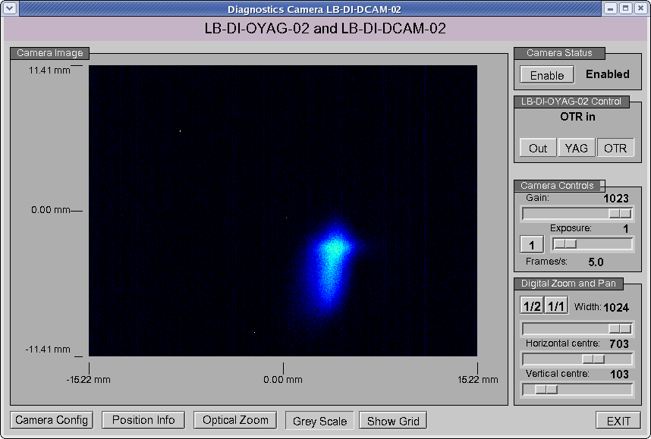
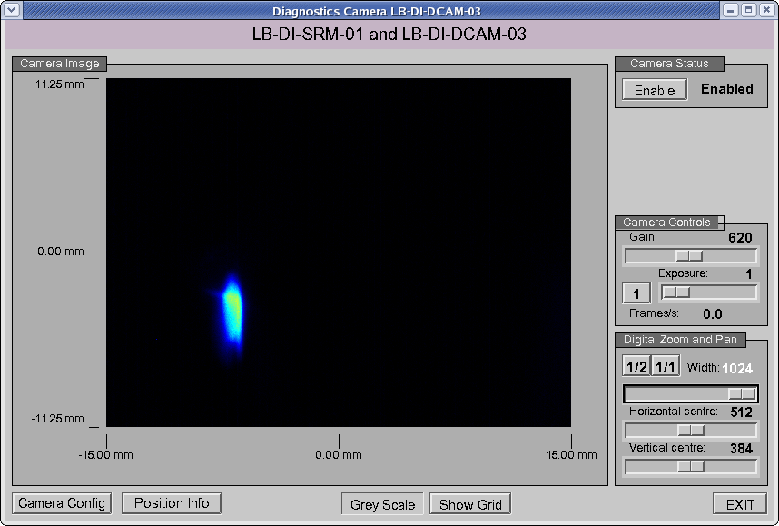
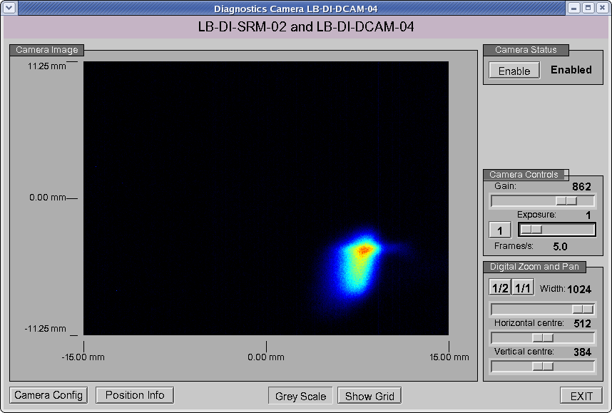
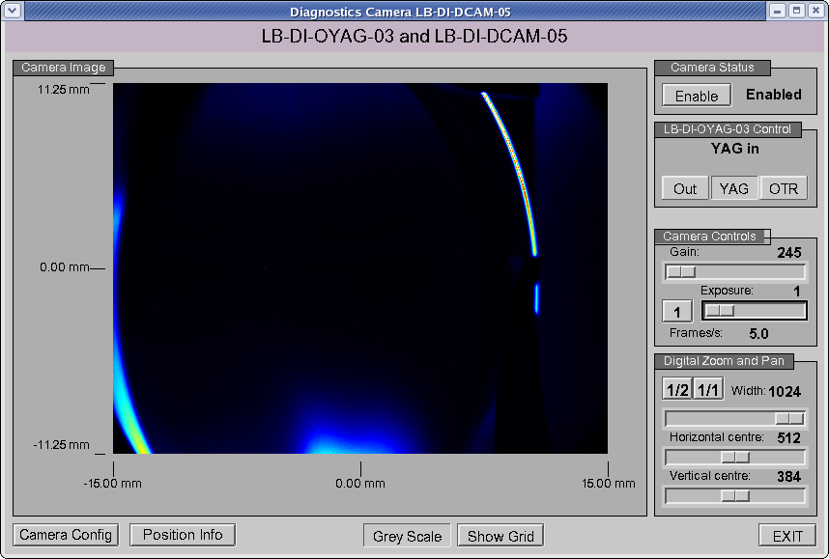
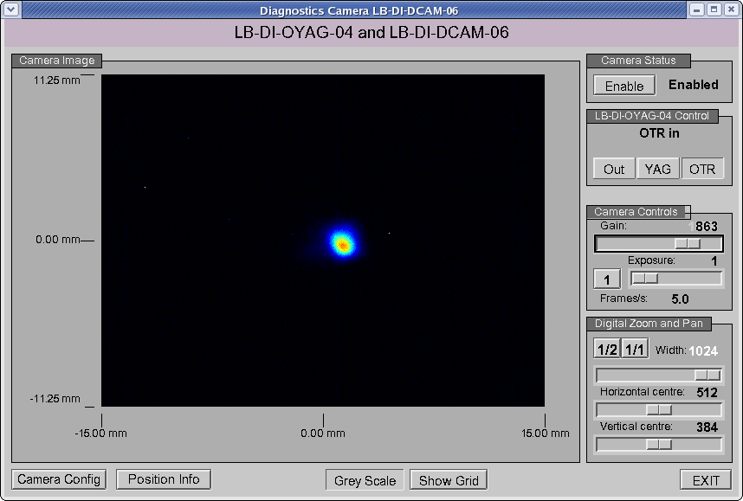
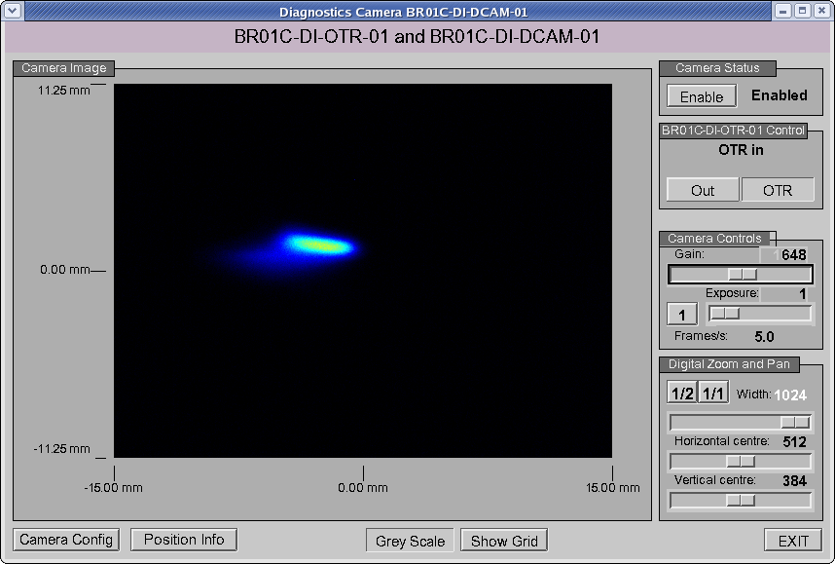
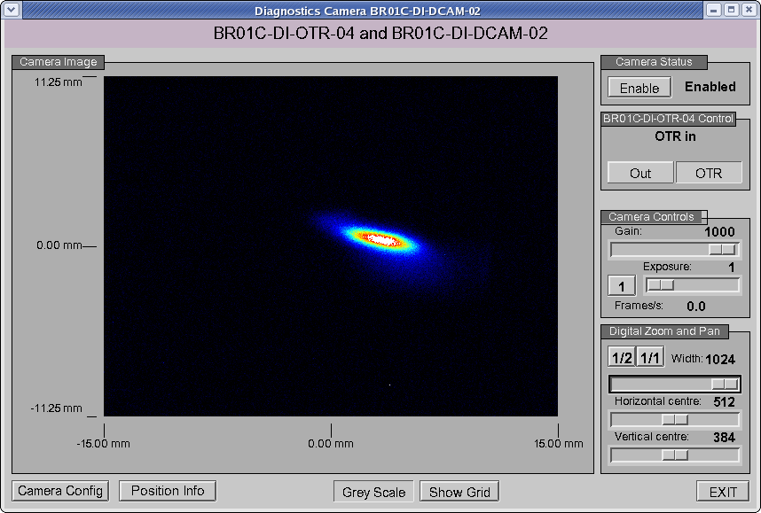
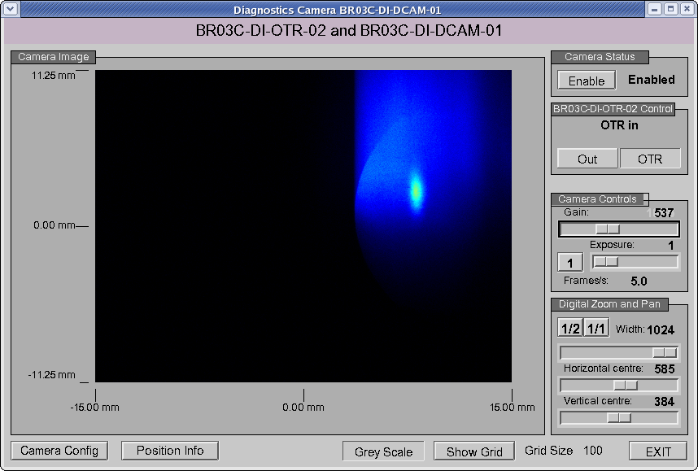
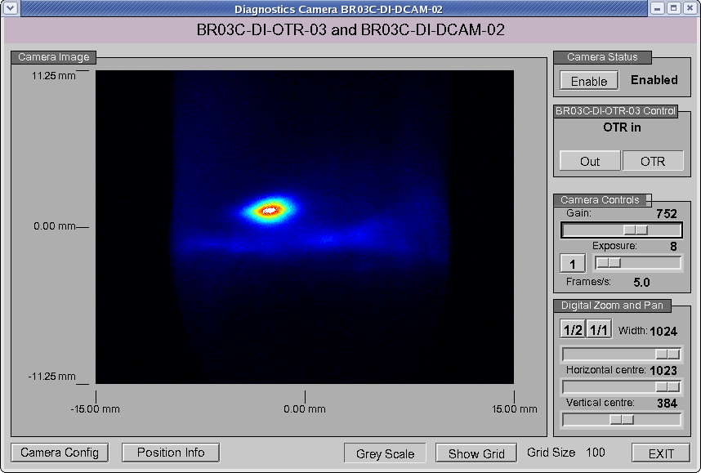
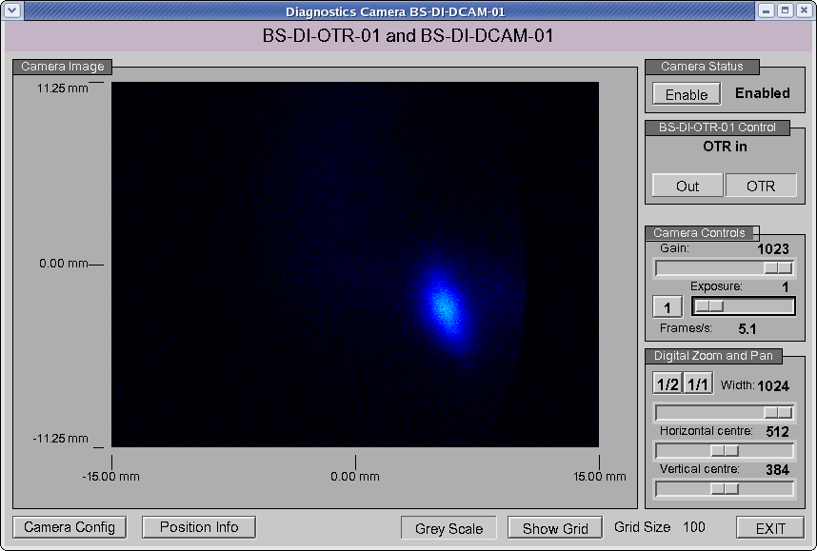
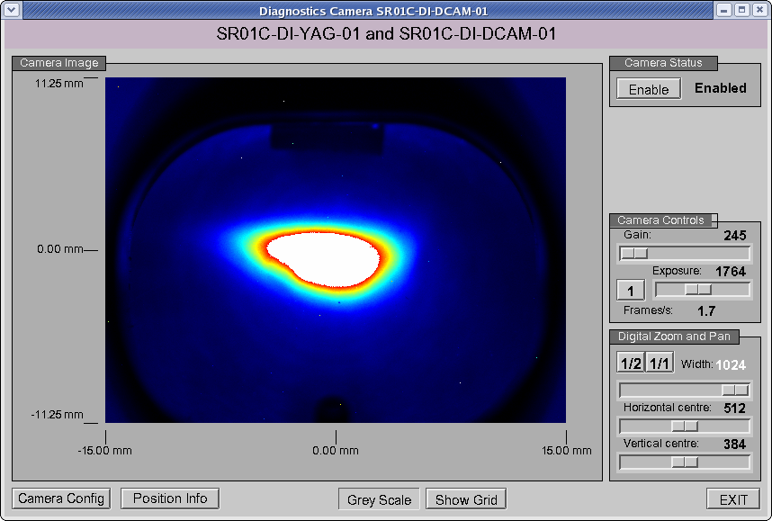
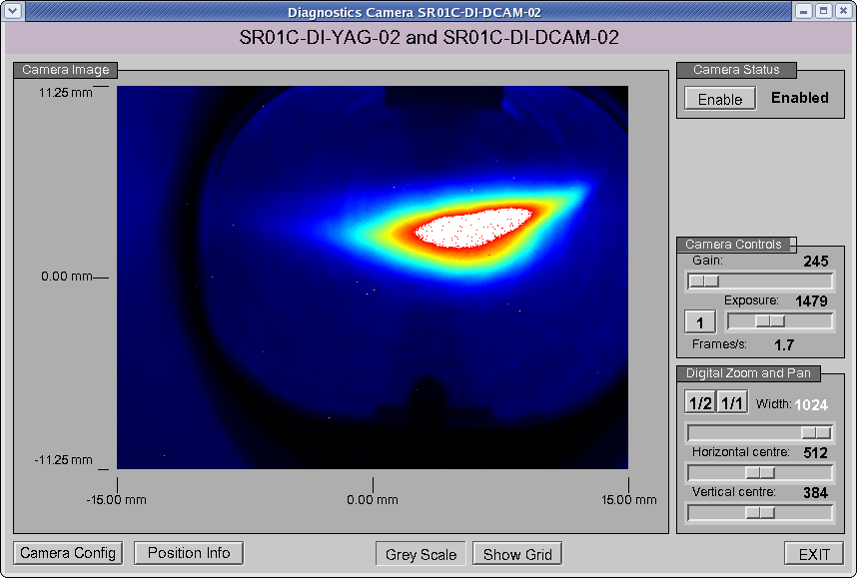
Beam Profiles in the Diamond Injector

Slide 14
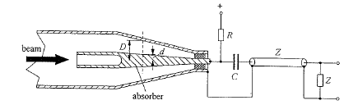
Faraday Cup
Applications
  Simplest method to measure beam current/intensity is to completely absorb beam in block of conducting material.
    Measure captured charge by measuring resulting current.
Faraday cup with coaxial structure
At high energies, penetration depth
is large – material block must be
very thick.
Large energy transfer to absorber –
strong heating.
Multiple scattering – transverse
broadening of beam -> particle losses
Secondary particle production by pair
production.
Therefore, Faraday cup restricted to
low-energy beam applications.

Slide 15
Faraday Cup Principle
Charged particles are absorbed.
Charge is transferred to FC.
FC is discharged through current measurement.
Integral of current over time equals charge.
I
t

Slide 16
Interaction of Particles with Matter
Need to consider ionisation losses (dominant up to a few MeV), bremsstrahlung and e⁺e⁻ pair production.
Higher energy particles will need more length or higher density material to be stopped.
At lower energies (up to a few 10MeV) calculations of absorption length and Moliere radius etc. using empirical formulae will be sufficient.
At higher energies, simulation of scattering, pair-production and energy deposition is required (e.g. Electron Gamma Shower)
γ
γ
e⁺
e⁻
γ
e⁻
e⁺
e⁻

Slide 17
Backscatter
Angular distribution depends on energy of particles and on density of material.
Generally least in direct reverse direction.
Backscattered (or secondary) particles have less energy.
Low Z material, side walls or biased grid to reduce.

Slide 18
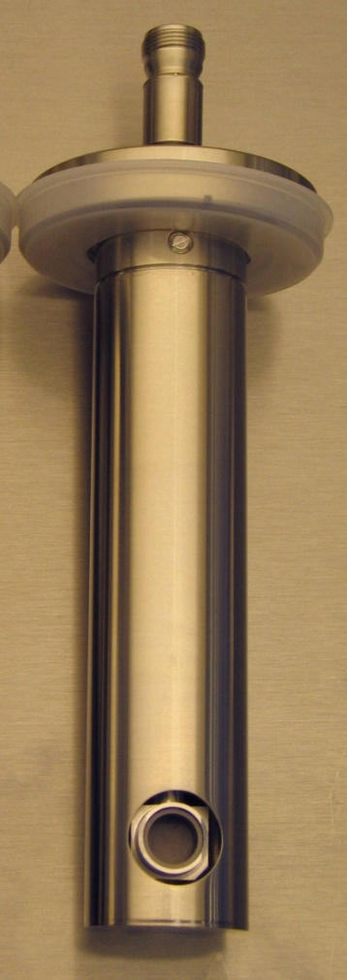
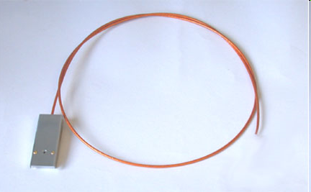
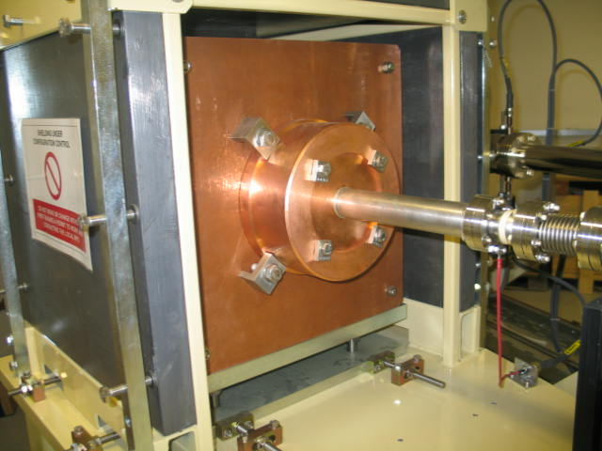
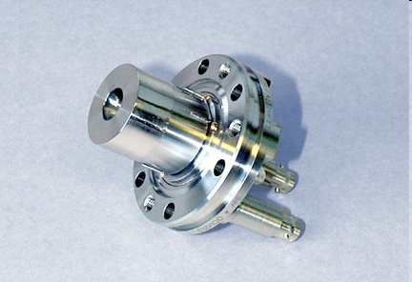
Some Faraday Cups
0.5m*0.5m*0.5m Copper
1.6mm aperture
Kimball Physics
Ceramic break
for insulation
Recess and Graphite
inside to reduce
backscatter
Graphite insert
Flange mounted, 4W beam power
3 GeV FC at the exit
of the Diamond Booster
Actuator mounted coaxial FC
Diamond LINAC @ 90 keV and 4 MeV

Slide 19
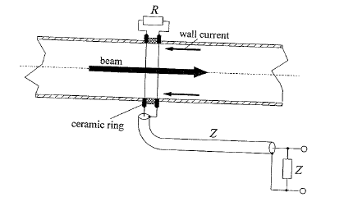


Wall Current Monitor (WCM)
Cyclic Accelerator
  Need to measure the current without disturbing the beam.
Current
  Outside vacuum tube
  Within vacuum tube
  There is a wall current I_{wall} flowing in vacuum chamber
Lay-out of wall current monitor
I_{beam} = -I_{wall}

Slide 20
Wall Current Monitor (WCM)
Beam current determined by measuring current in vacuum chamber wall.
Measure voltage V developed over ohmic resistance R (~ 1 Ω) across a ceramic gap.
Large number of resistors are used, connected in parallel around the vacuum chamber
  Wall current monitor can achieve very high bandwidths (several GHz).

Slide 21
Fields and Currents of a Charged Particle at Relativistic Speed
r
E = Electric Field
+
B = Flux Density
J = Current Density
At ultra-relativistic energies, wall current distribution is an image of beam current distribution.
No field outside tube (only DC magnetic field)

Slide 22
Wall Current Monitor (WCM)
E = Electric Field
+
B = Flux Density
J = Current Density
Typical resolution 100ps RMS
I
t

Slide 23
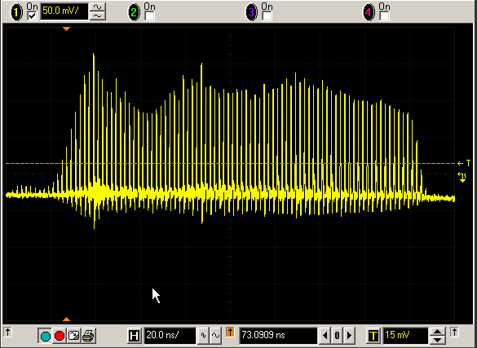
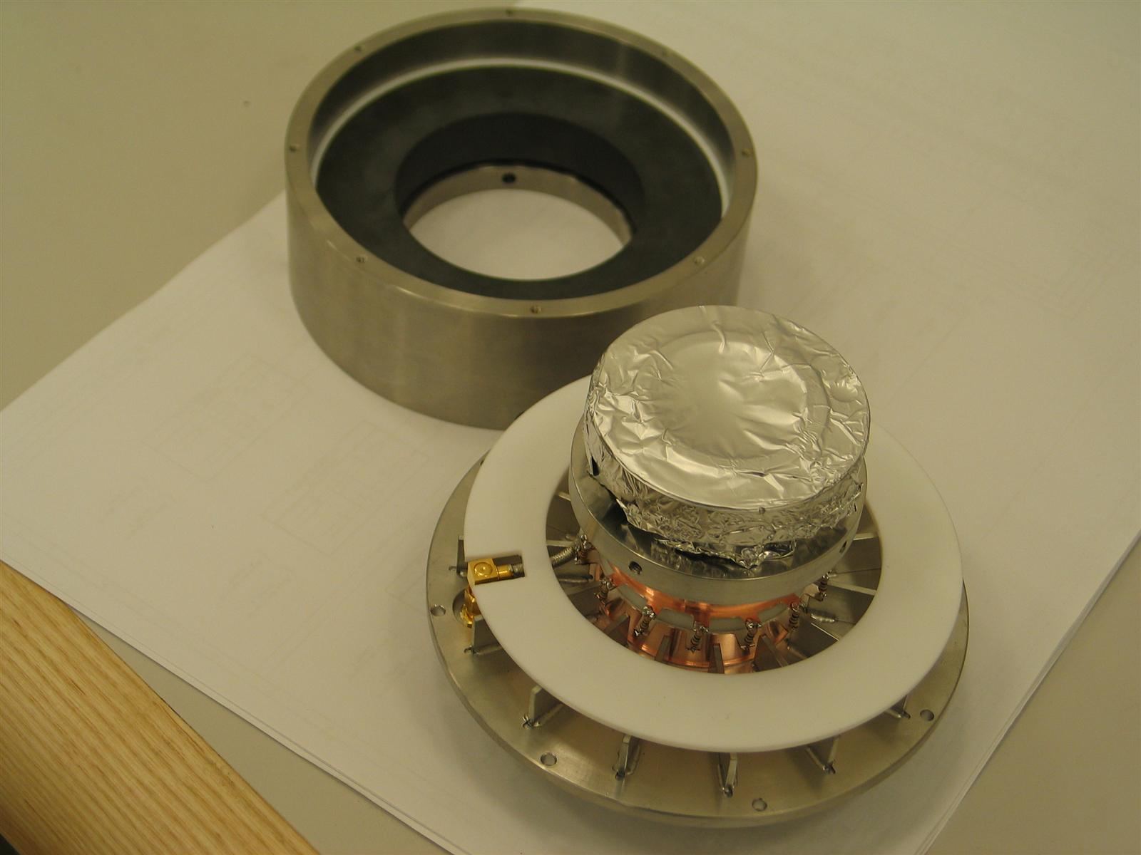
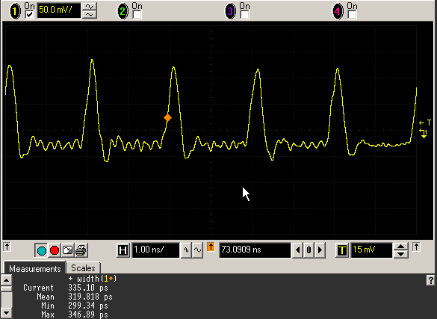
WCM Example Measurements
Bunch train from LINAC
Mechanical Assembly
Individual bunches in train

Slide 24
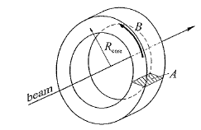

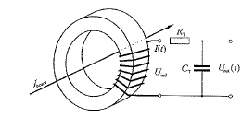
Beam Current Transformer
Ideal iron core around
particle beam
This arrangement acts like a transformer:
Primary winding – particle beam
Secondary winding – inductive coil
→ Beam Transformer
Equivalent circuit of
beam transformer

Slide 25
Beam Current Transformer Principle
Ferrite Core
I
t
Charged particles act as ‘single turn’ in a transformer.
Proportional current is induced into windings.
Integral of current over time equals charge.

Slide 26



Beam Current Transformer
Beam transformer output (secondary) voltage U_{out}
C_{T}R_{T} long compared to duration of bunch pulses →
Secondary voltage becomes:
Time dependence of output voltage U_{out} is only roughly proportional to beam current I_{beam}(t).
True for relatively long bunches with limited frequency components
  For short bunches U_{out} is considerably longer than the current pulse.
  Area under voltage pulse can be used as good approximation of number of particles.

Slide 27
Beam lifetime in storage ring

Slide 28
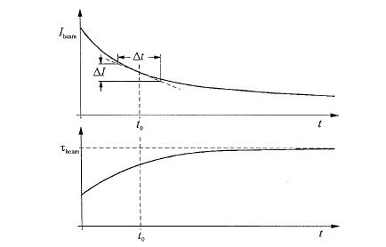
Beam Lifetime in Storage Ring
Beam circulating in storage ring decays in intensity due to:
  Collisions with residual gas molecules.
  Occasional large energy losses through synchrotron radiation (for electrons).
  Non-linear resonances
Time dependence of beam current
and lifetime

Slide 29
Beam Lifetime in Storage Ring
Decline in intensity has exponential form with τ_{beam} being the beam lifetime:
Lifetime is not constant during machine operation.
  Lifetime relatively short at beginning (when intensity is high) because intense synchrotron radiation (for electron beams) causes high level of gas desorption on vacuum chamber surface increasing vacuum pressure.
  As beam current decreases, vacuum improves and lifetime increases.
dI(t)/dt = - I₀/τ_{beam} exp(-t/τ_{beam}) = I(t)/τ_{beam}

Slide 30
Beam Lifetime in Storage Ring
Using a beam current monitor, the current is continuously monitored, with measurements repeated at frequent intervals.
Since beam lifetime can vary from few seconds to many hours (depending on operating conditions), it is useful to vary the time interval between measurements.
  Short lifetimes – beam current varies rapidly & only few measurements required for reliable lifetime measurement → short time interval.
  Long lifetimes – individual current measurements must last sufficiently long for statistical fluctuations not to cause large errors in lifetime measurement.

Slide 31
Measurement of momentum & energy of particle beam

Slide 32
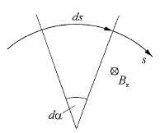

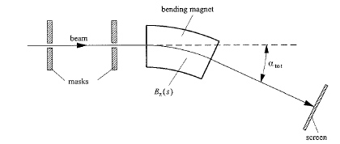

Measurement of Momentum & Energy
Measure angle of deflection in known B-field.
Deflection of a charged particle
in a magnetic field.
Magnetic spectrometer to measure
particle momentum & energy

Slide 33
Measurement of Momentum & Energy
Measurement Parameters
  Incoming beam angle must be precisely defined.
    Fix beam position using precisely aligned screens.
    Measure bending angle after deflection using fluorescent screen.
  ∫B_{z} required, which is obtained by measurement of the B-field as a function of coil current.
    Watch out for hysteresis of iron magnets!
Cyclic Accelerators
  Total bending angle of all dipole magnets must be 2π.
  Connect additional dipole in series with accelerator dipoles and install precise field gauge within it – e.g. NMR probe.
    Field and energy continuously monitored.
    ΔE/E ~ 2 10⁻⁴.

Slide 34
Measurement of transverse beam position

Slide 35
Transverse Space v Phase Space
Transverse profile is distribution of particle positions in the x/y plane at a fixed s location.
Transverse phase space are the distributions of particle positions and directions at a fixed s location.
Transverse emittances equal ‘areas’ of phase space distributions.
y
x
x’
y’
x
y
Horizontal
Profile
Vertical
Profile

Slide 36
Transverse Beam Position
Require centre of beam to always lie as close as possible to ideal orbit.
  Defined by quadrupole axes.
  Transverse deviation of circulating beam from orbit must be less than 100-150 μm.
Measure transverse position of beam at as many points around the accelerator and implement corrective measures.

Slide 37
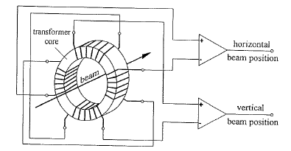
Magnetic Beam Position Monitor
Measure induced B-field due to beam.
The difference in signals from the two opposite coils within each pair provides measure of beam position in that plane.
In order to measure position in both planes simultaneously, install 4 coils arranged at 90º intervals around transformer coil.
Magnetic beam position monitor

Slide 38
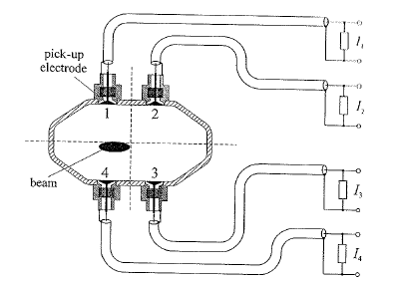
Electrode Beam Position Monitor
Consists of 4 electrodes (electrical pick-ups) arranged symmetrically around beam axis coupling to E-field.
Electrodes tilted away from beam axis by 45º in order to reduce amount of synchrotron radiation hitting them directly.
Beam position monitor with four electrodes

Slide 39
Monitor with Four Electrodes
If beam lies exactly in middle of monitors, ideally all signals will have same intensity.
But there are variations in signal sizes –
  Electrode tolerance
  Vacuum chamber geometry
  Cables and electronics which follow for read-out
If signal has intensity I_{o} + ΔI, will then have position error of
For a = 35 mm and want Δx_{error} < 0.1 mm then the relative error in an electrode signal may not be larger than

Slide 40
Monitor with Four Electrodes
Fundamentally, it is not possible to define with arbitrary precision the point relative to which the beam position is being measured.
  Monitor connected to vacuum chamber, which is generally fixed to magnets.
    Magnets positioned with tolerance of ±0.2 mm.
    Alignment errors of quadrupoles also create orbit distortions.
Even if beam position adjusted so that it has no offset in any of the monitors, this will not necessarily correspond to real ideal orbit.

Slide 41
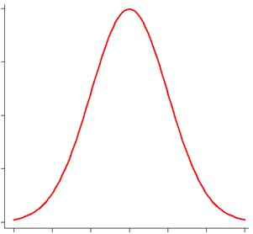
Principle of Wire Scanner
Intensity
Radiation
detector
Position
1D-Profile is measured either as intensity of radiation (Bremsstrahlung) or as secondary emitted electron current over position of wire.
Resolution down to wire diameter (5-6 μm).
Instead of movement, many wires can be used in a ‘harp’.

Slide 42
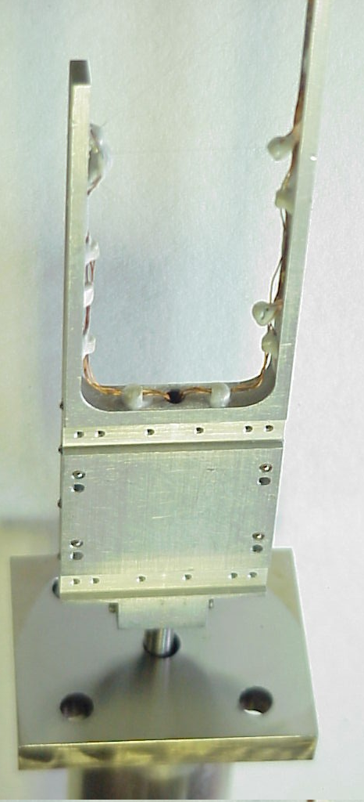
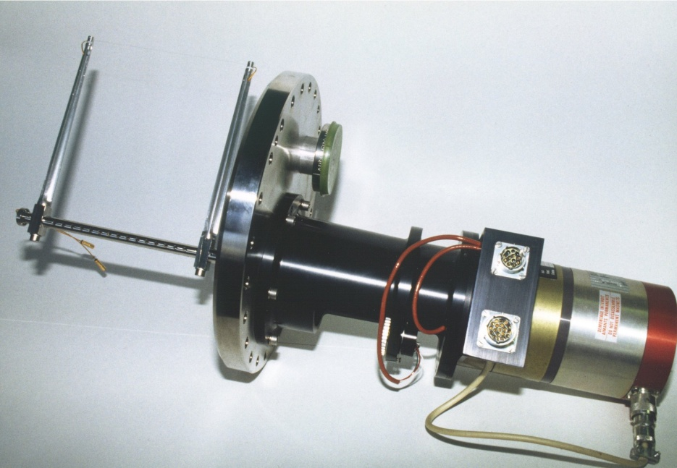
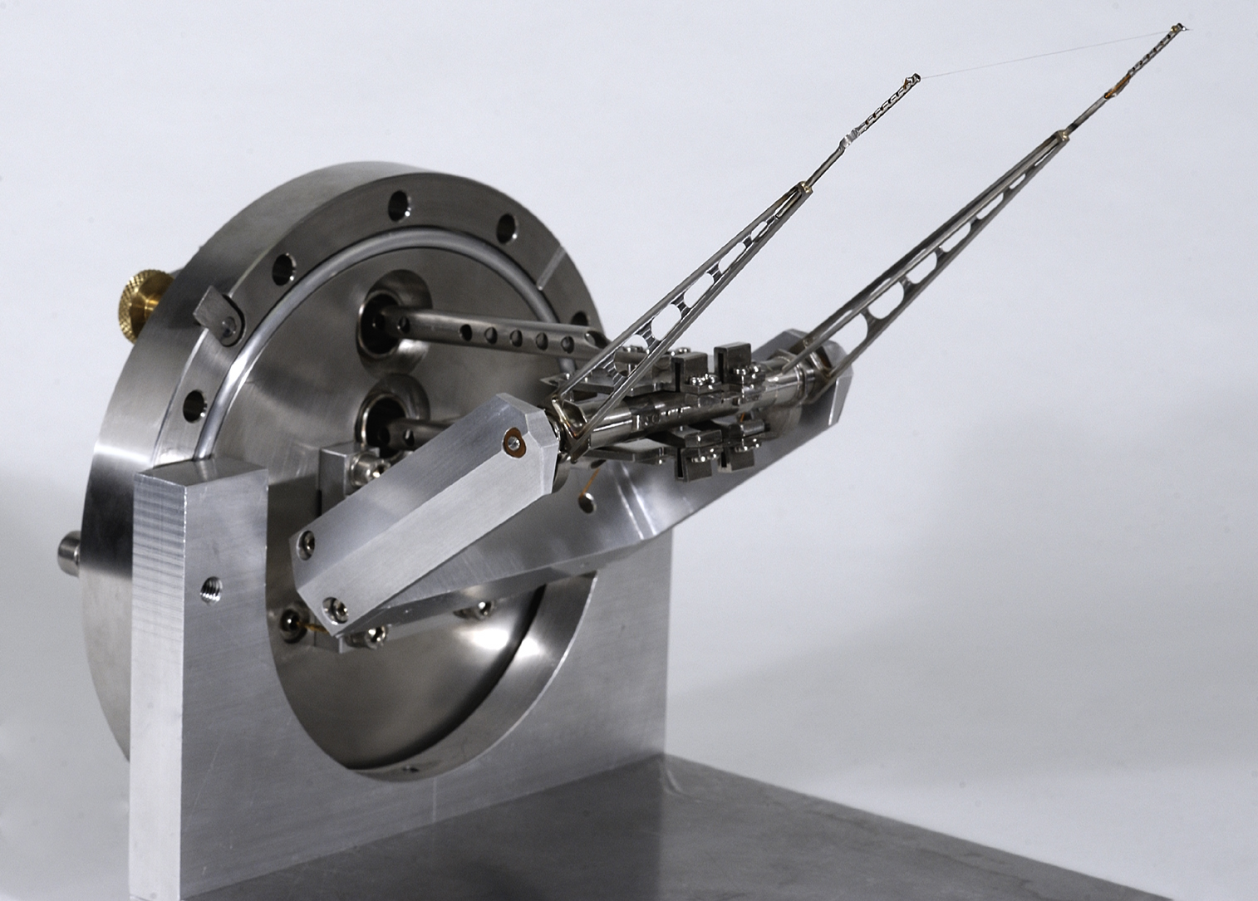
Wire Scanner Designs
CERN AB/BI
SNS ORNL

Slide 43
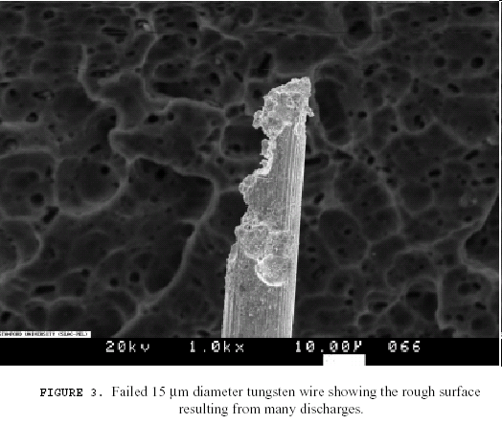
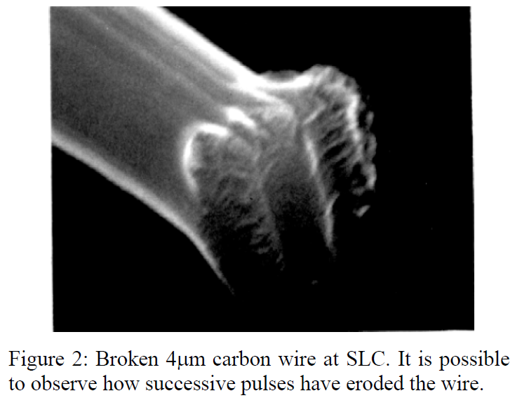
Limitations of Wire Scanners
The smallest measurable beam size is limited by the finite wire diameter of a few microns.
Higher Order Modes may couple to conductive wires and can destroy them.
High beam intensities combined with small beam sizes will destroy the wire due to the high heat load, thus scan as fast as possible.
Emittance blow up.

Slide 44
Measurement of betatron frequency & tune

Slide 45
Betatron Frequency & Tune
Once set of beam optics has been installed, the working point – tune Q – must be measured to check that it lies far enough away from strong optical resonances.
  Tune Q = q + a
    q = integer
    0 ≤ a ≤ 1
Measuring tune also allows detection of changes in focusing.
  B-field imperfection
  Space charge effect
Use the tune to monitor stability of the beam focusing during machine operation.
Amounts to measuring frequency of transverse beam oscillations.

Slide 46


Betatron Frequency and Tune
Measurement
  Fractional tune a
    If beam undergoes betatron oscillations, measure Ω with fast position monitor since revolution frequency is fixed.
  Integer tune q
    Difference between reference orbit and standing betatron oscillation about reference orbit caused by altering steering coil strength.
The solution of the oscillation equation
(assuming very weak damping from synchrotron radiation)

Slide 47
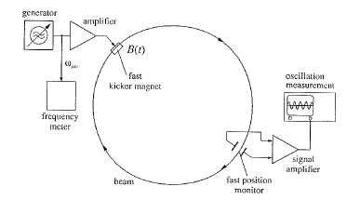

Betatron Frequency & Tune
Excite beam into coherent transverse oscillations.
  Fast bending magnet (10⁻⁴ Tm)
  which produces periodic field
  B(t) = B₀ sin ω_{gen} t
Equation of forced motion
As damping is very weak, resonance occurs if ω_{gen} = Ω
A fast kicker magnet stimulates beam at
frequency ω_{gen}, which is varied until
resonance is found.
Amplitude of induced betatron oscillation
measured using fast position monitor

Slide 48
Measurement of beam optical parameters

Slide 49

Beam Optical Parameters - Dispersion
Determined from position measurements at several points around the orbit.
Vary momentum p of particles by Δp while keeping magnet strengths constant.
Beam position shifts distance
  Δx(s) = D(s) Δp/p
  onto dispersive trajectory.
Dispersion is

Slide 50

Beam Optical Parameters - Dispersion
Change frequency ν_{RF} of accelerating voltage by Δν.
Since phase focusing means the harmonic number remains constant, circumference of particle trajectory changes and hence no longer matches orbit.
Stable particle path shifts onto dispersive trajectory → corresponding change of momentum Δp

Slide 51



Beam Optical Parameters – β Function
If strength of quadrupole changes by amount Δk, tune of cyclic machine shifts by
  The size of shift is proportional to value of β function in quadrupole.
Assuming k is constant along quadrupole axis and variation of β function is small in quadrupole
Start from particular set-up of beam optics and impose well-defined change in quadrupole strength Δk.
By measuring tune Q before & after change the average β function in quadrupole is

Slide 52
Beam Optical Parameters - Chromaticity
Chromaticity measurement essential for correct tuning of sextupoles.
Vary the momentum of circulating particles and measure tune Q before and after change.
Momentum varied by changing RF frequency.
Relationship between change in momentum and tune is far from linear.
  Measure function ΔQ(Δp/p) whose value in the region around nominal value yields chromaticity.

Slide 53
Acknowledgements and References
Guenther Rehm, Diagnostics, Cockcroft Institute Academic Training Programme 2008-2009
Klaus Wille, The Physics of Particle Accelerators, Oxford University Press, 2005
Edmund Wilson, An Introduction to Particle Accelerators, Oxford University Press, 2006
With special thanks!

