Slide 1




JAI Design Project: LhARA
Ken Long
William Shields
Jaroslaw Pasternak
22nd November 2023

Slide 2

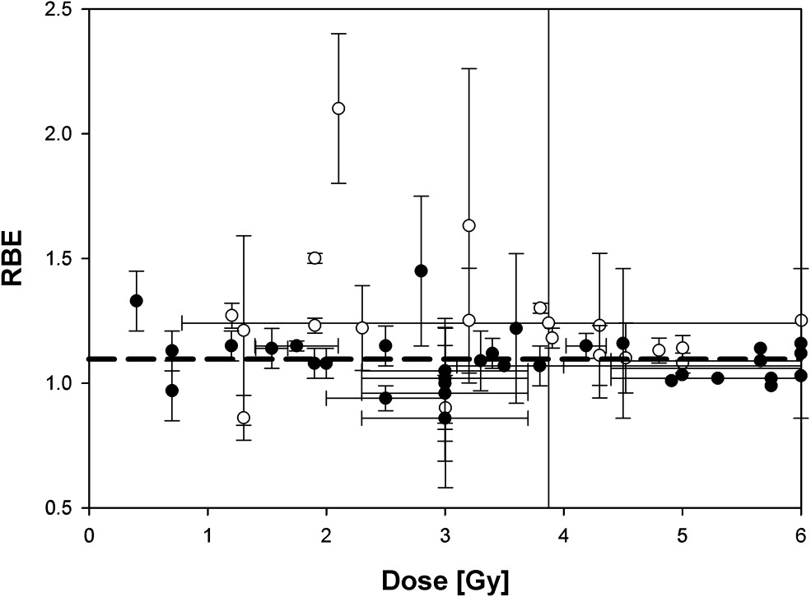
The Case for LhARA
Growing particle therapy demand
  Improve availability & accessibility with new & cost-effective technologies
Systematic study of the radiobiology of proton & ion beams
  Uncertainties due to:
    Energy, ion species, dose, spatial distribution, dose rate, tissue type, biological endpoint
  RBE variation
    Proton treatment planning RBE = 1.1
    Ion RBE even higher
Paganetti,
van Luijk
(2013)
SemRadOncol
Novel treatment modalities
  Ultra-high dose rates: FLASH
  Spatially fractionated – mini-beams
  …
LhARA: a dedicated radiobiology research facility
DATA
MACHINE

Slide 3
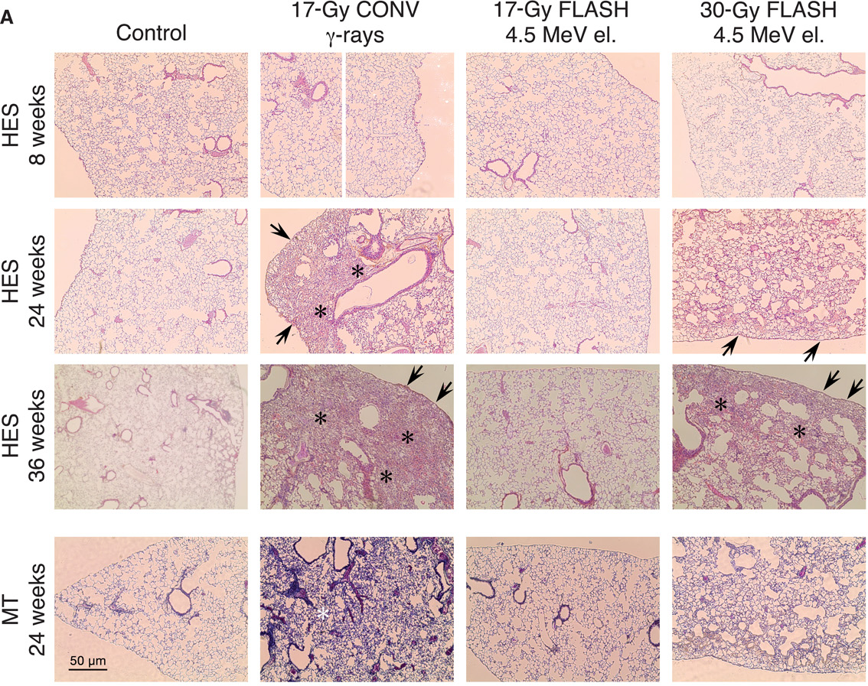
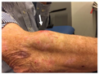
Potential benefit of new regimens
FLASH
Conventional regime : ~2 Gy/min
FLASH regime (p) : >40 Gy/s
Evidence of normal-tissue sparing while tumour-kill probability is maintained:
i.e. enhanced therapeutic window
Time line:
Reports: 2014 (e.g. Flauvadon et al, STM Jul 2014)
Confirmation in mini-pig & cat: 2018 (Clin. Cancer Research 2018)
First treatment 2019 (Bourhis et al, Rad.Onc. Oct 2019)

Slide 4
Potential benefit of new regimens
Worked example: micro beams
Conventional regime : > 1 cm diameter; homogenous
Microbeam regime : < 1 mm diameter; no dose between ‘doselets’
Remarkable increase of normal rat brain resistance.
[Dilmanian et al. 2006, Prezado et al., Rad. Research 2015]
Dose escalation in the tumour possible – larger tumor control probability

Slide 5
LhARA: Stage 1
Laser-target acceleration via TNSA mechanism
  15 MeV protons, ~ 4 MeV/u ¹²C ions
  10⁹ protons / pulse, 10⁸ ions / pulse
Gabor lens focusing & capture
  Confined electron cloud – solenoid-like focusing from radial electric field
Beam transport & delivery to an end station for in-vitro radiobiology studies
  Spot-size flexibility

Slide 6
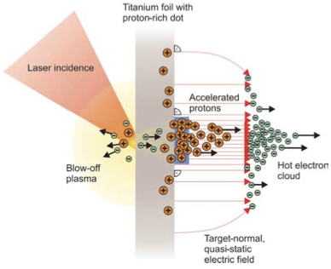
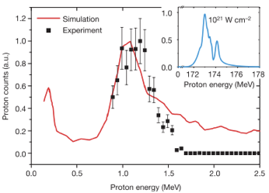
Sheath acceleration
Source [1]
Laser incident on foil target:
  Drives electrons from material
  Creates enormous electric field
Field accelerates protons/ions
  Dependent on nature of target
Active development:
  Laser: power and rep. rate
  Target material, transport
Schwoerer, H. et al., 2006; Nature, 439(7075).

Slide 7
Phase space at source
Source [2]
https://doi.org/10.1038/s41598-021-03897-2
PhysRevLett.90.185002
PhysRevLett.90.185002

Slide 8
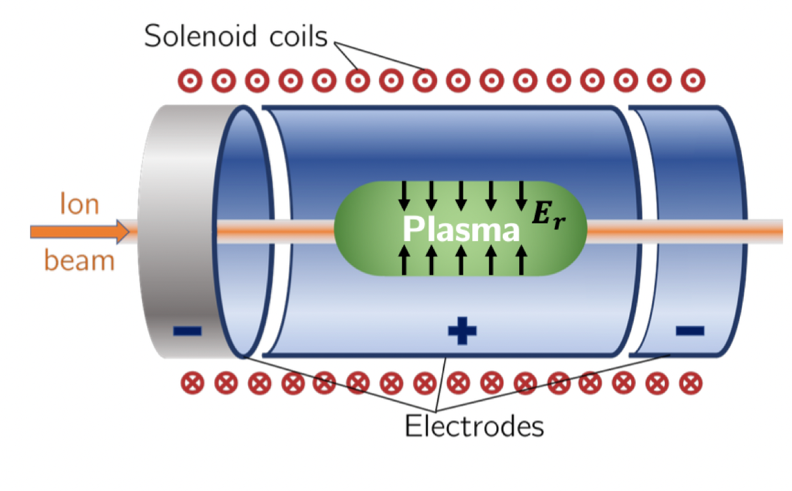
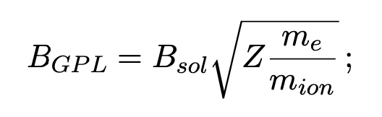
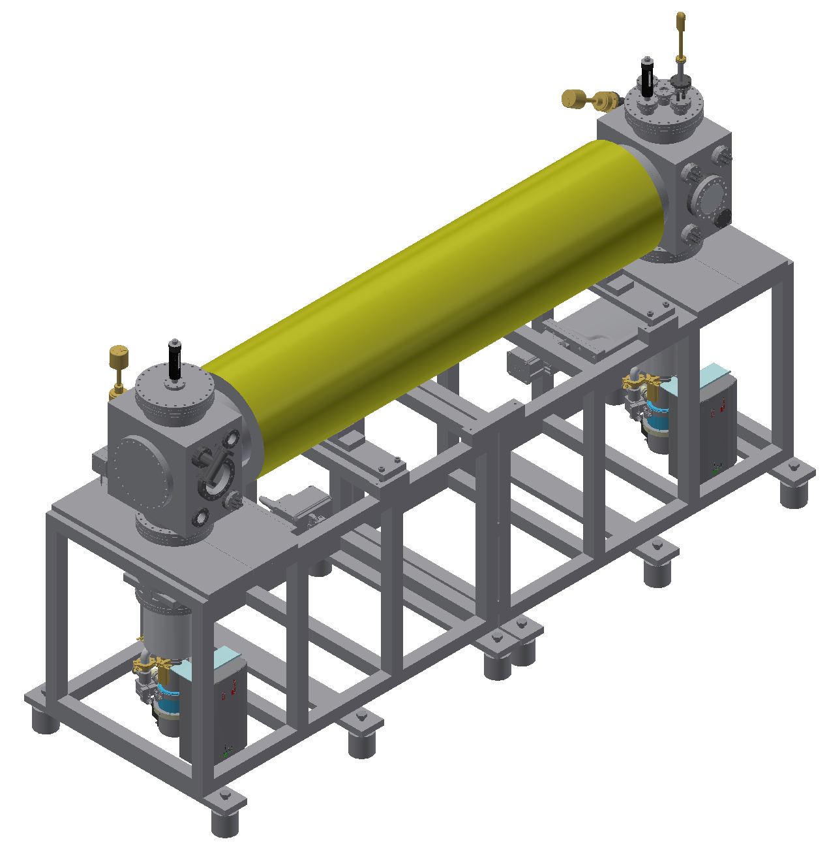


Proton & Ion Capture
Novel Gabor electron-plasma-lens
  Penning-Malmberg trap
  Solenoid field for radial confinement, electric field for longitudinal confinement
LhARA capture & focusing
  Solenoid-like strong focusing without high power, high-field magnet
  Radial focussing in both planes simultaneously
  Energy-dependent focusing strength
$e^{−}$ source
B~0.1T
P-screen
~2m
Electrodes

Slide 9
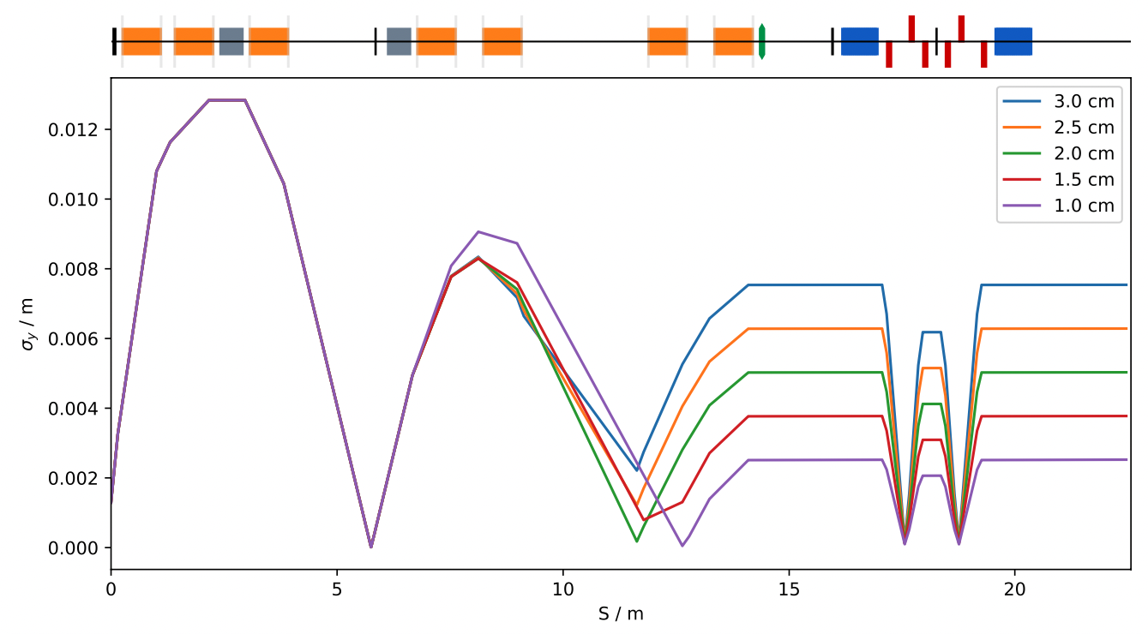
LhARA: Stage 1 Beam Transport
5 optics configuration for 1-3 cm spot sizes (2σ diameter)
  ⍺ = 0, D = 0 m, σ_{x}= σ_{y} at the end station – pencil beam
Additional configuration known of β = 50m, ⍺=0 after 7th Gabor lens
  LhARA stage 2 – FFA injection line
Beam parameters exiting the laser-target housing (15 cm upstream of 1st Gabor lens):
Beam Parameter | Value (RMS)
Mean RMS emittance [m] | 8.25x10⁻⁸
Mean beta [m] | 20.24
Mean alpha | -204.99

Slide 10
LhARA: Design Project Objectives
Meet end station beam requirements + flexibility
  Maintain:
    Variety of spot sizes – full well plate irradiation
    > 95% spatial distribution uniformity with octupolar focusing
Demonstrate:
  Optimised source/capture/transport efficiency
  Mini-beam spot sizes
  Painting / spot-scanning schemes
  Longitudinal phase space manipulation
    <= 2% energy spread - control
    Bunch length ~ 10 ns – control
    RF cavity design
  Vertical arc magnet design

