Slide 1



Lecture 3
Live Feed – CERN Control Centre
Professor Emmanuel Tsesmelis
Principal Physicist, CERN
Visiting Professor, University of Oxford
Graduate Accelerator Physics Course
John Adams Institute for Accelerator Science
11 October 2023

Slide 2
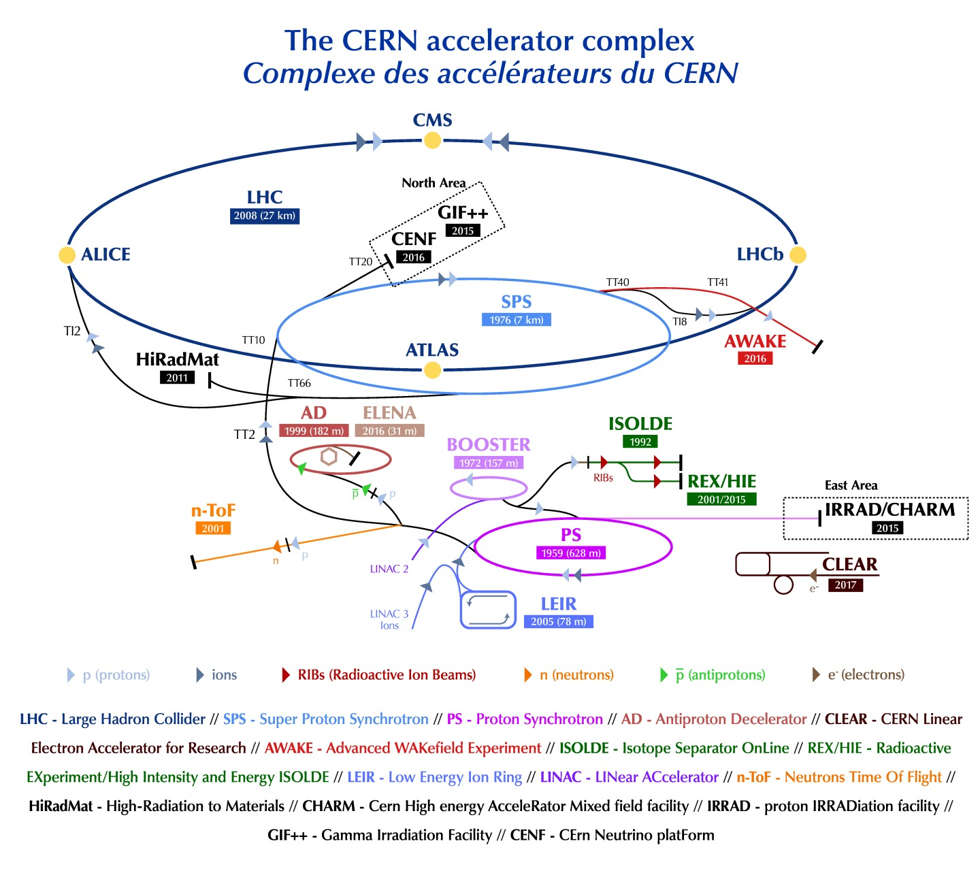
CERN Accelerator Complex

Slide 3

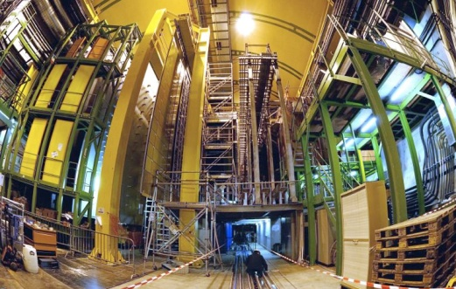


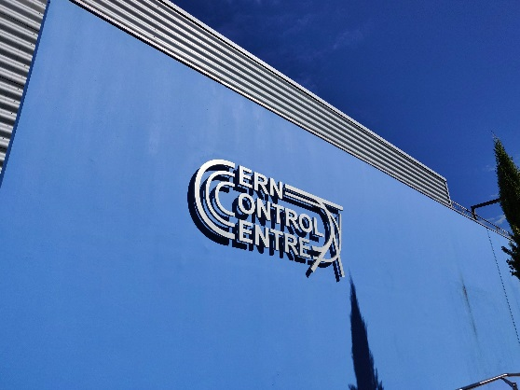
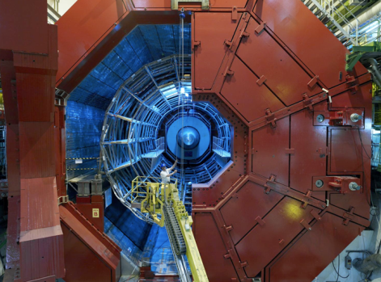

A New Era in Fundamental Science
LHCb
CMS
ATLAS
Exploration of a new energy frontier
in p-p and Pb-Pb collisions
ALICE
LHC ring:
27 km circumference
Notes:
3

Slide 4


Nobel Prize in Physics 2013
The Nobel Prize in Physics 2013 was awarded jointly to François Englert and Peter W. Higgs "for the theoretical discovery of a mechanism that contributes to our understanding of the origin of mass of subatomic particles, and which recently was confirmed through the discovery of the predicted fundamental particle, by the ATLAS and CMS experiments at CERN's Large Hadron Collider”.

Slide 5
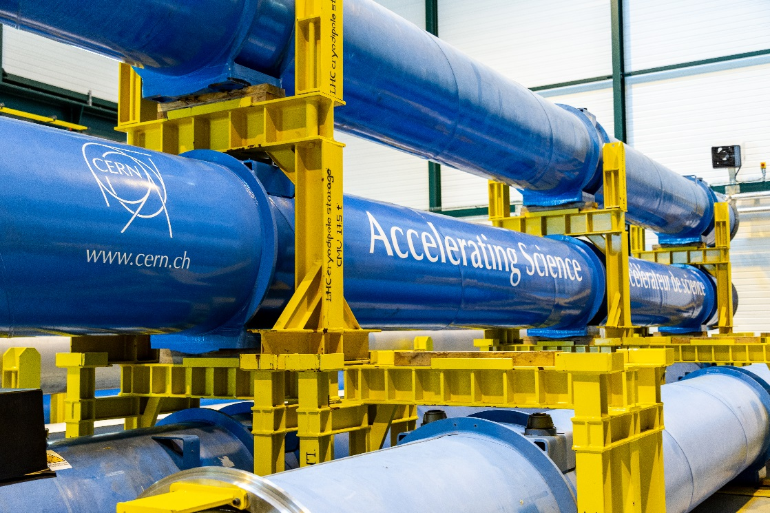
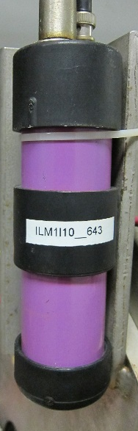
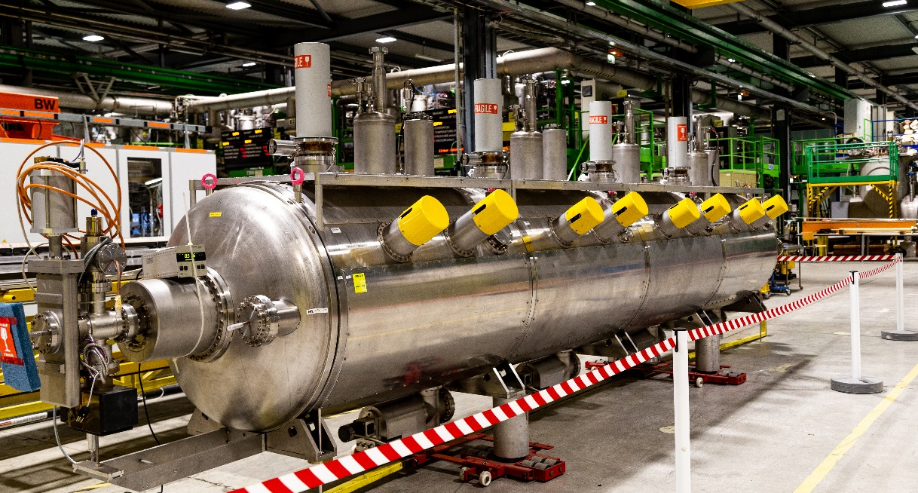
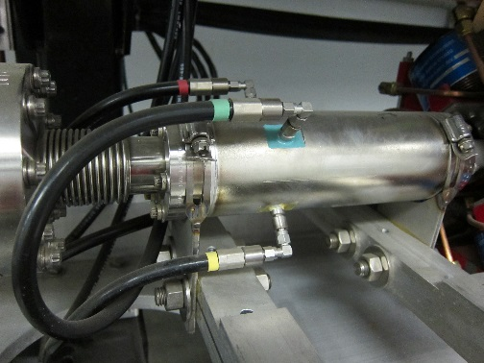
What is in the LHC?
Thousands of magnets: dipoles, quadrupoles, sextupoles, octupoles, and decapoles.
16 Superconducting Radio Frequency (SCRF) Cavities housed in 4 cryomodules.
Diagnostic equipment, such as beam position monitors, wire scanners, and beam loss monitors.
Other equipment, such as vacuum pumps, radiation shielding, safety equipment, etc…

Slide 6
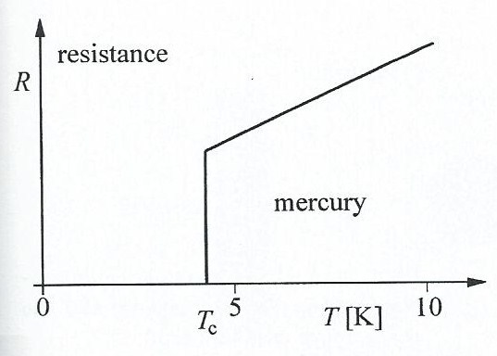
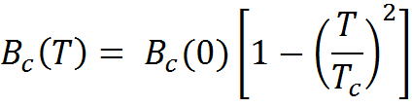
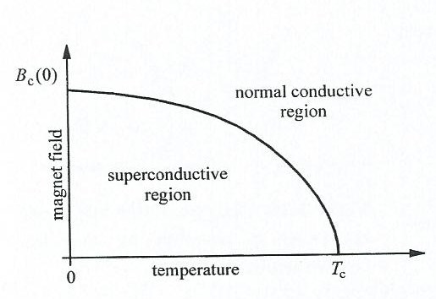
Superconductivity – Enabling Technology
Disappearance of ohmic resistance in Hg at very low T.
Dependence of superconductivity on the T and surrounding B-field.

Slide 7
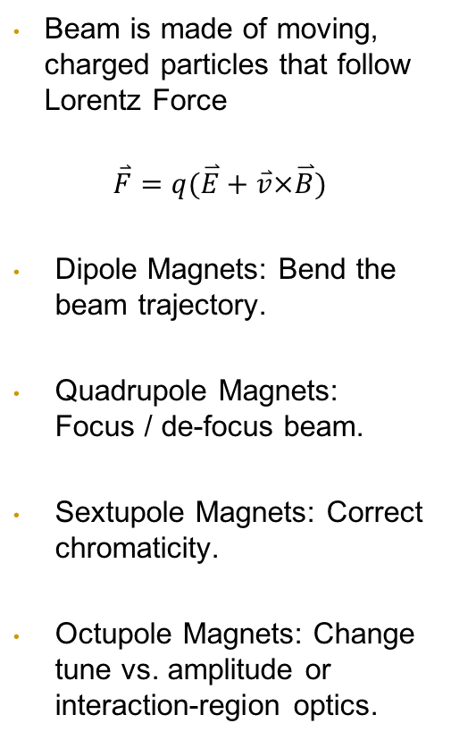
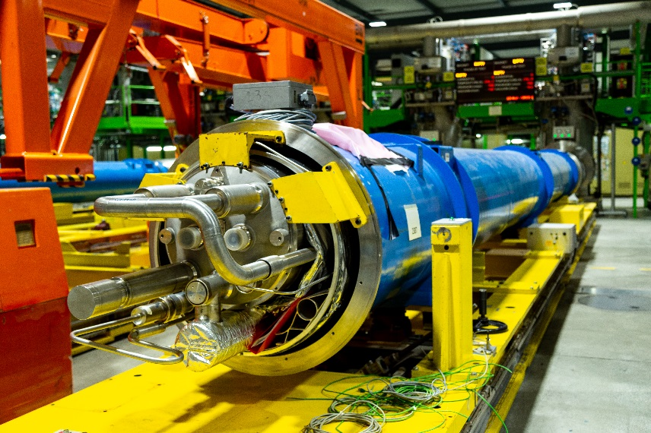
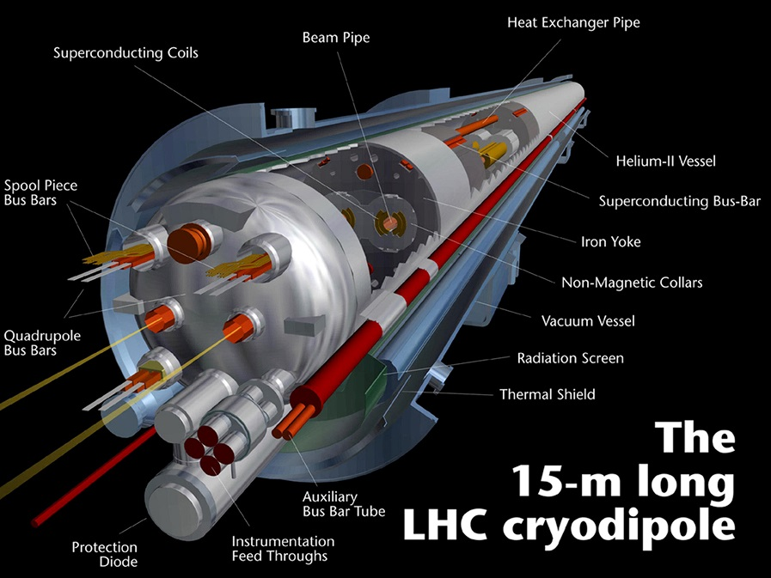
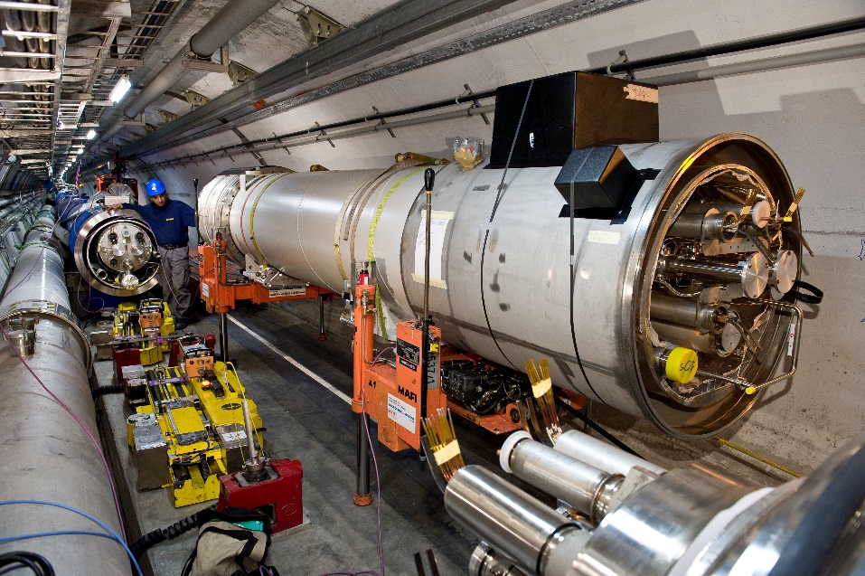
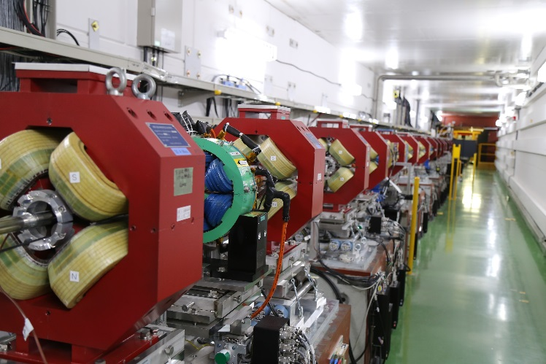
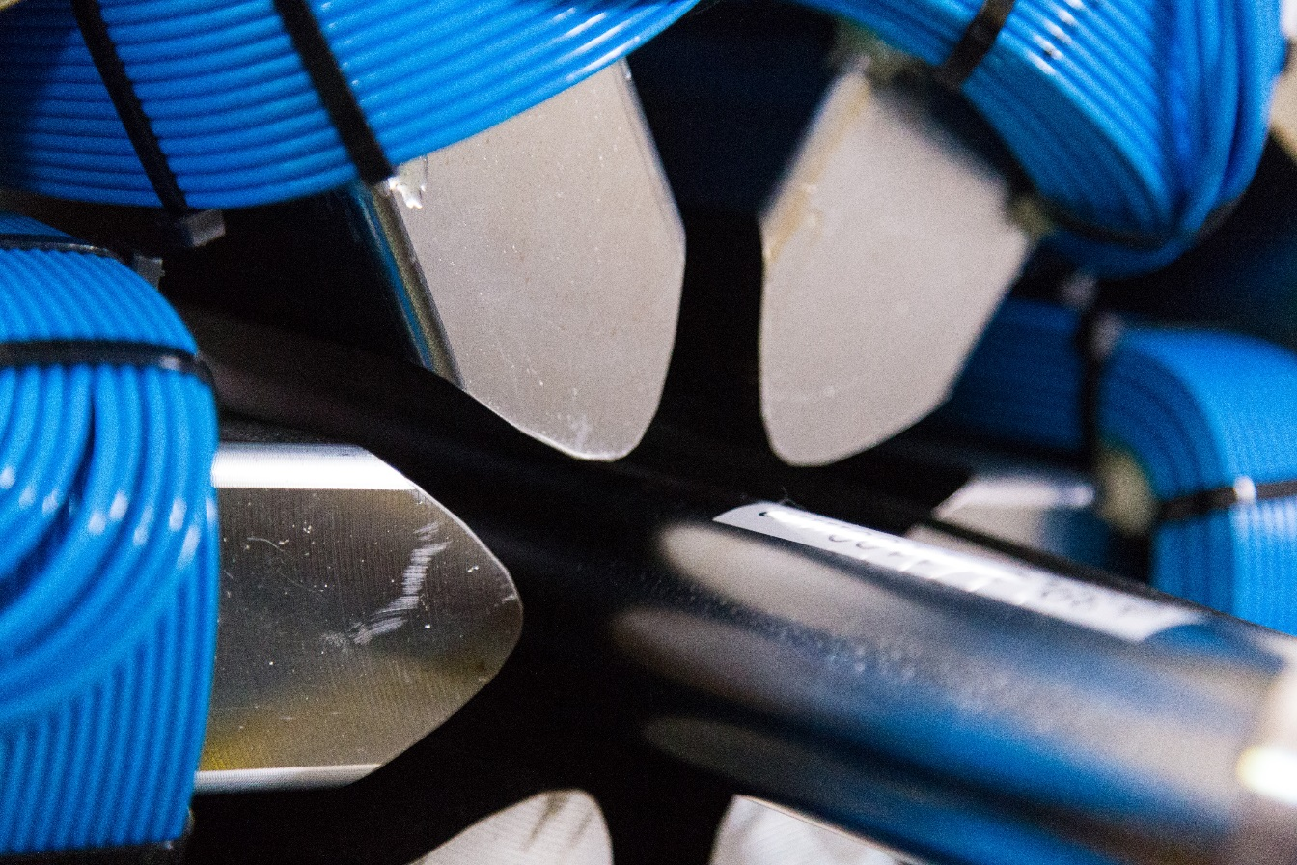
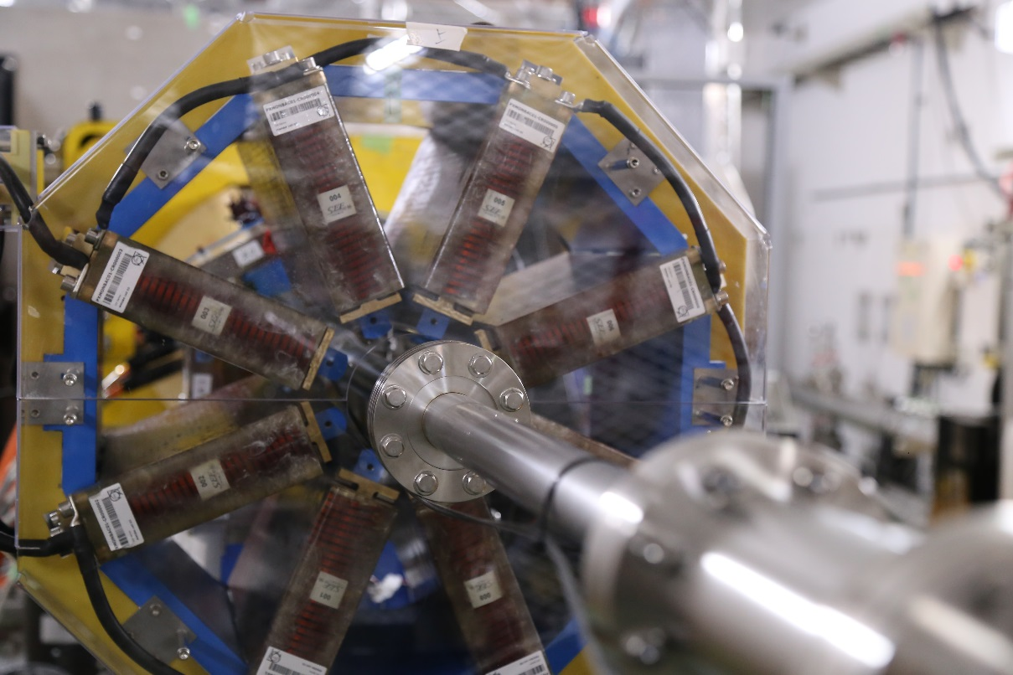
Magnet Systems

Slide 8

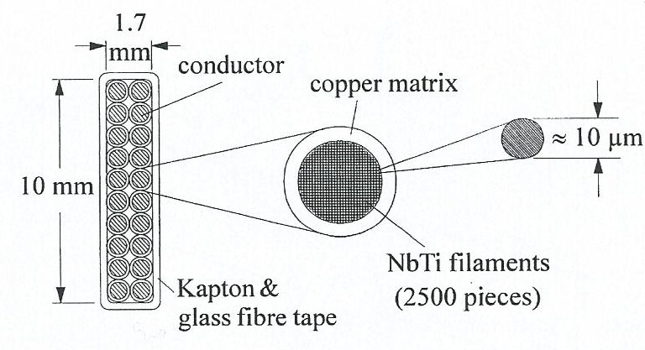
Superconducting Magnets
Construction of superconductor from niobium-titanium (NbTi)

Slide 9
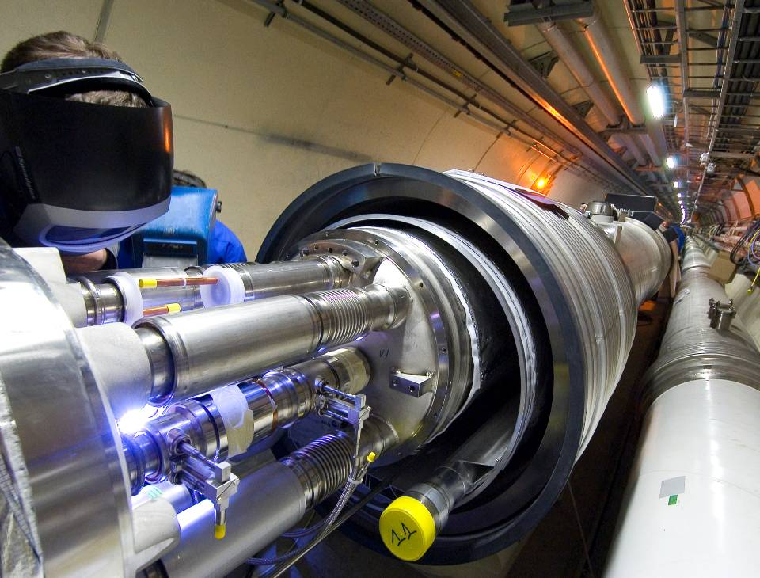
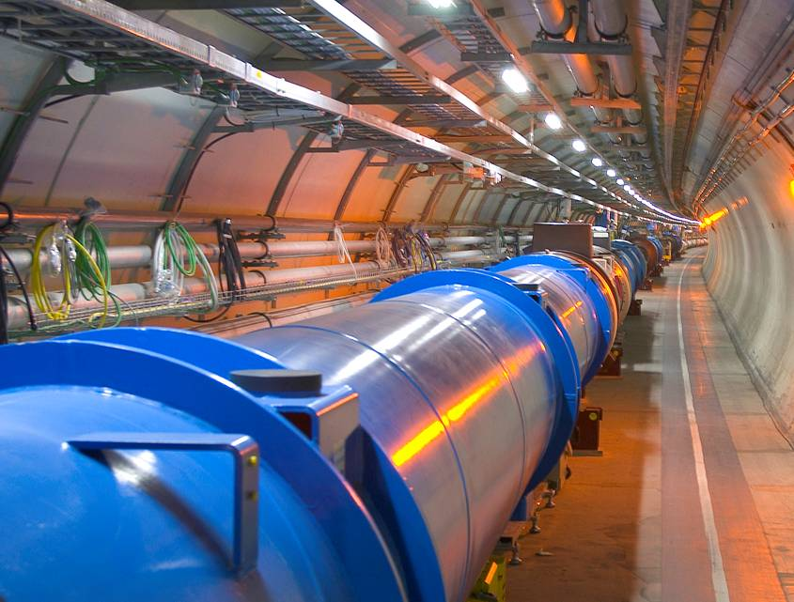
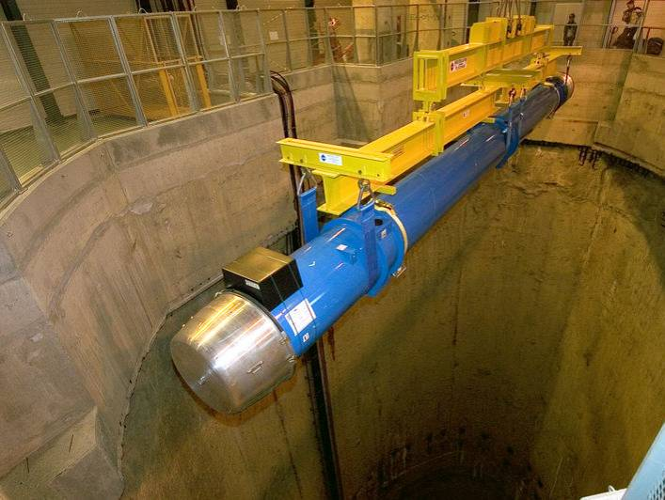
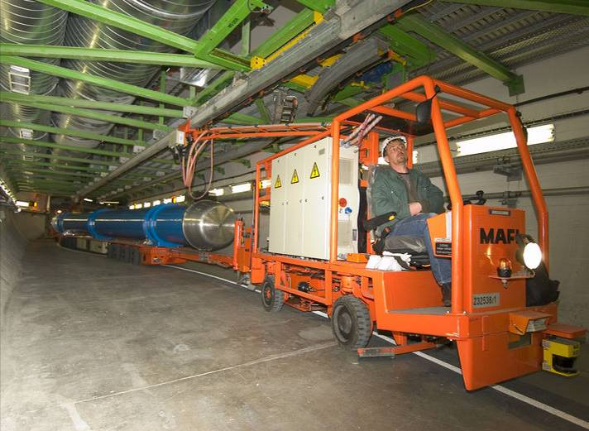
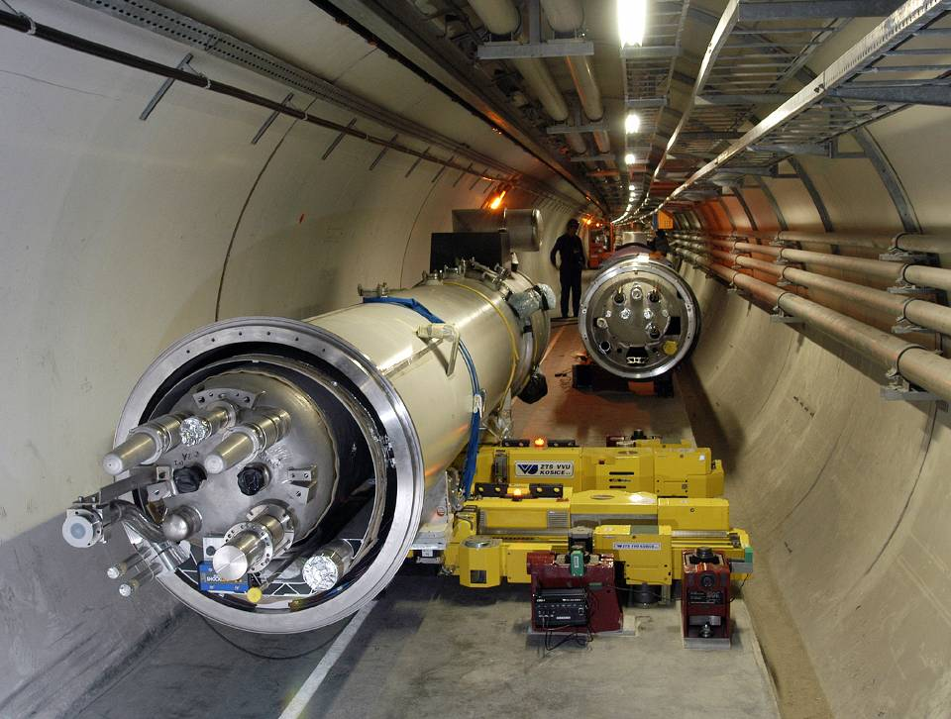
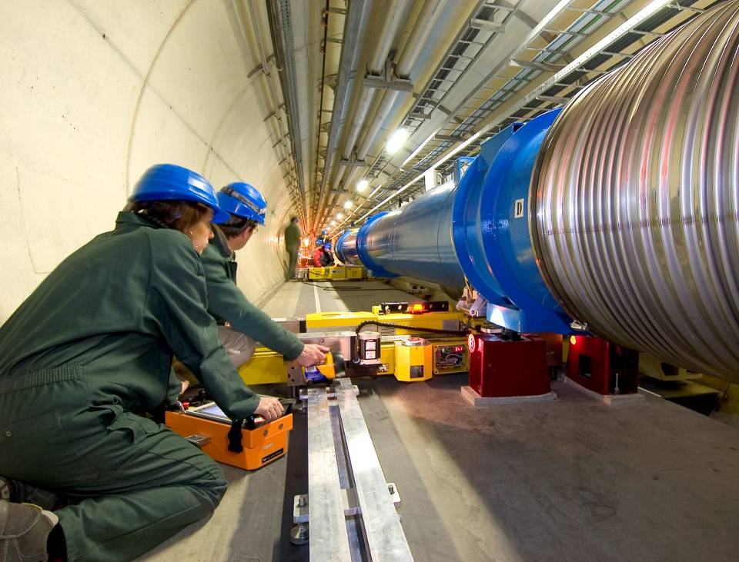
The LHC Arcs

Slide 10
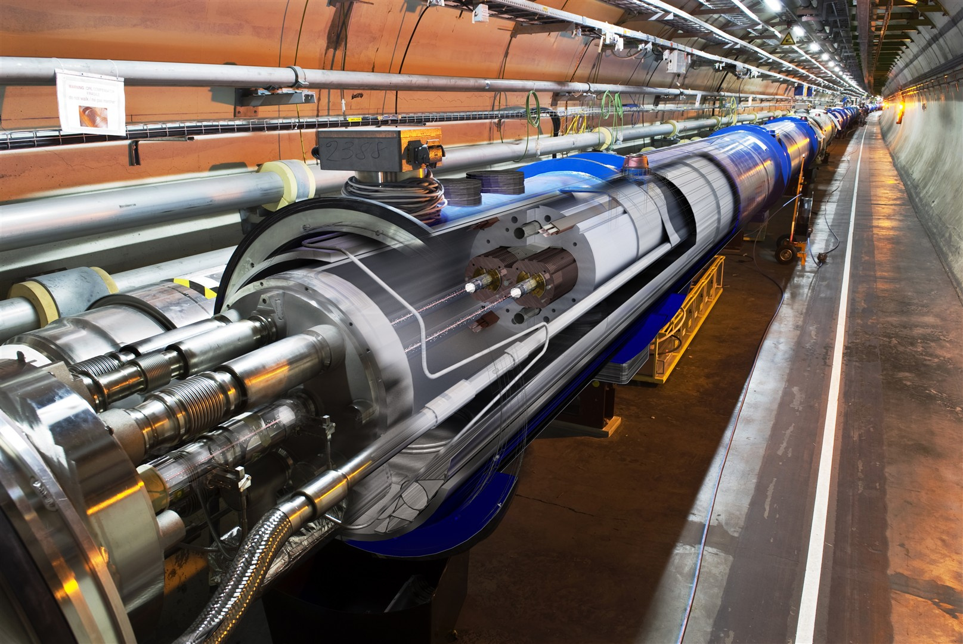

Slide 11
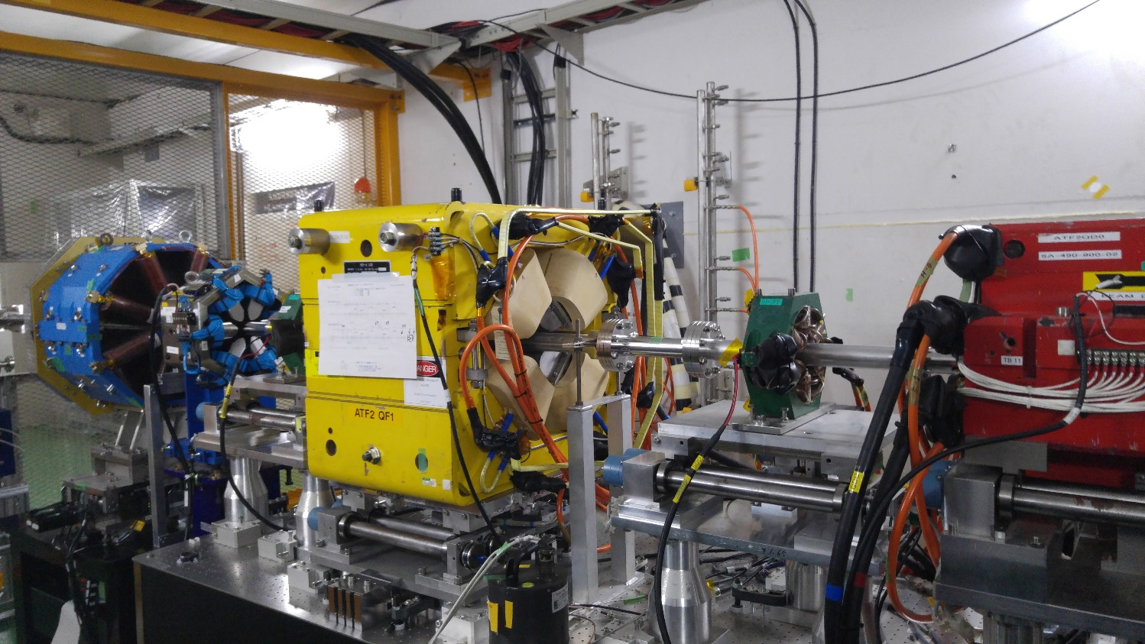

The Lattice
Magnets are arranged onto a lattice to control the beam.
The most fundamental lattice is the F0D0 or FODO lattice
  F = focusing (in one plane)
  D = defocusing (in same plane)
  0/O = drift

Slide 12
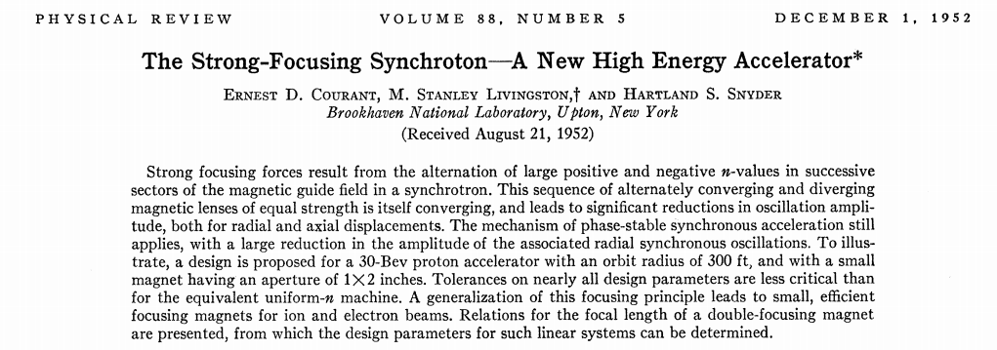
F0D0 Lattice from Strong Focusing

Slide 13
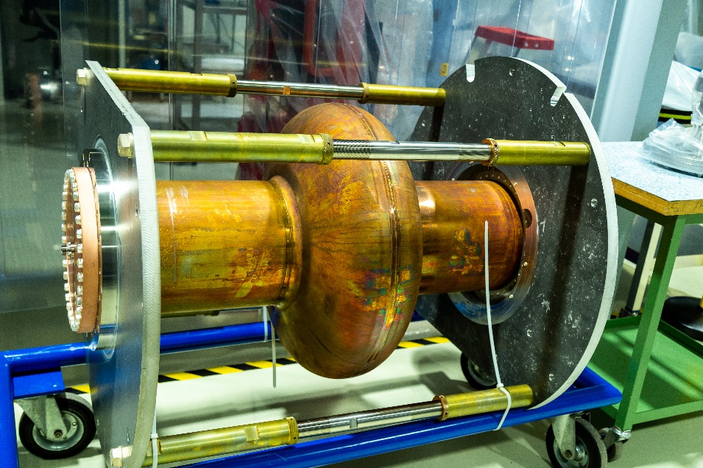
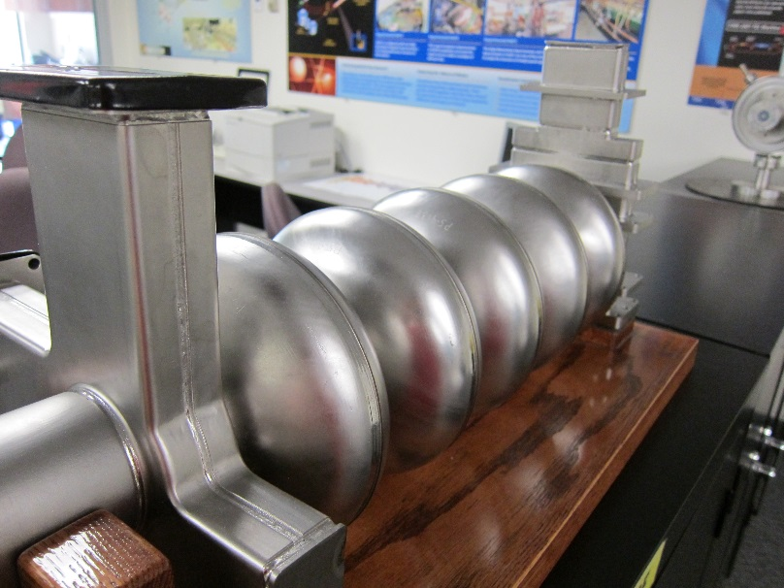
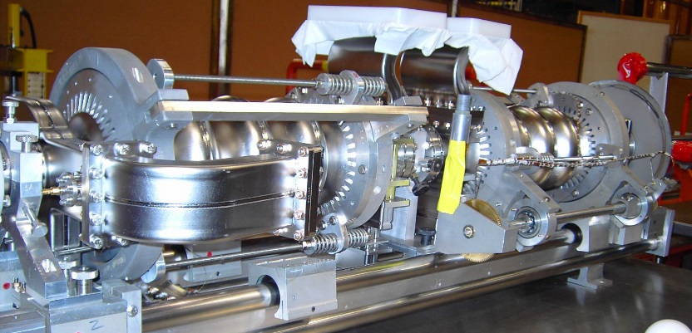
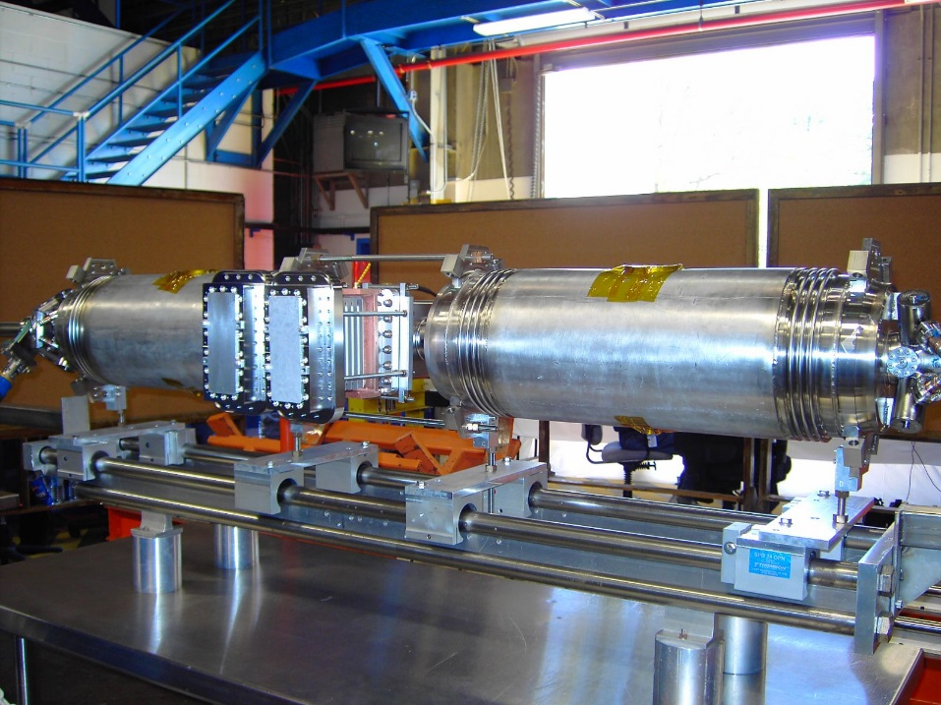

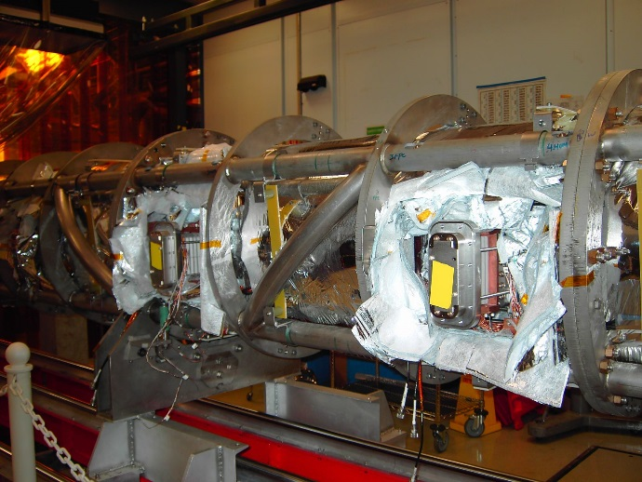
RF Cavities
Both superconducting & normal-conducting radio frequency cavities.
Used in most modern accelerators.
Particles “surf” along RF waves that travel in cavity.
SLAC – normal-conducting, copper.
JLAB – first SRF accelerator.
LHC – superconducting.

Slide 14
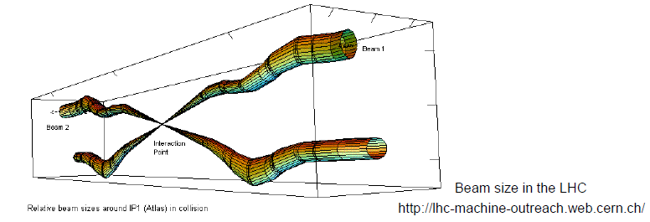
Beam Size
At the interaction points of the LHC, the beam size is compressed to 64 micrometres wide (~human hair)
The ISIS beam gets up to 100 mm.
At Diamond, the beam is a few hundred micrometers.
The possible future linear colliders (ILC and CLIC) will have flat beams on the order of a nanometer high by tens of nanometers wide.

Slide 15
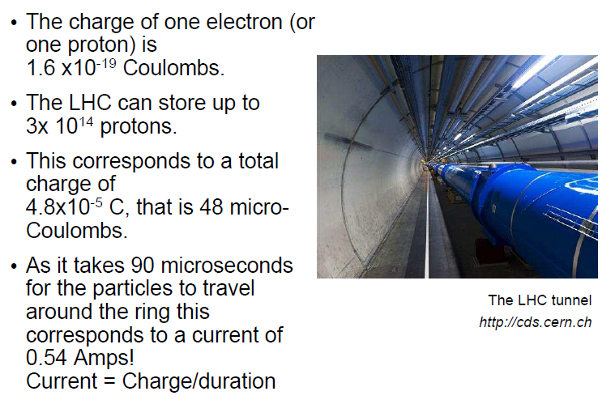
Charge and Current

Slide 16
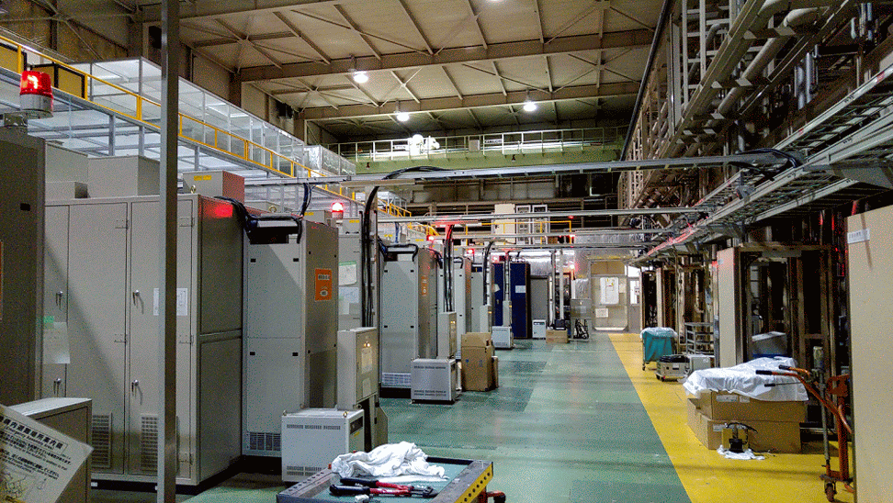
Power and Stored Energy
1 eV = 1.6E-19 J, therefore 7 TeV = 1120 nJ
Since 3E14 protons, get 340 MJ
  Similar to Airbus 380 flying at 100kph
Power = Energy / Time
  340 MJ / 90 microseconds = 4 Petawatts

Slide 17
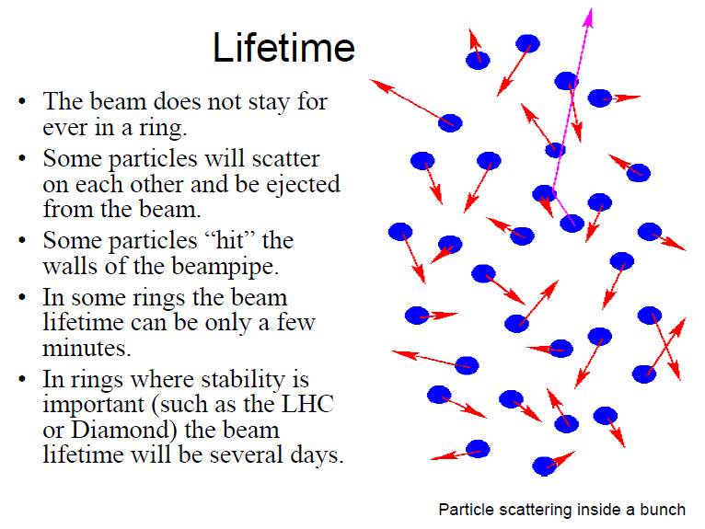
Beam Lifetime

Slide 18
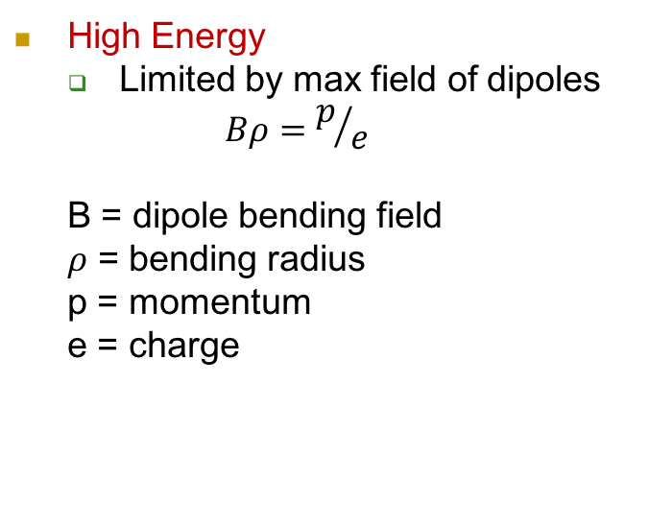
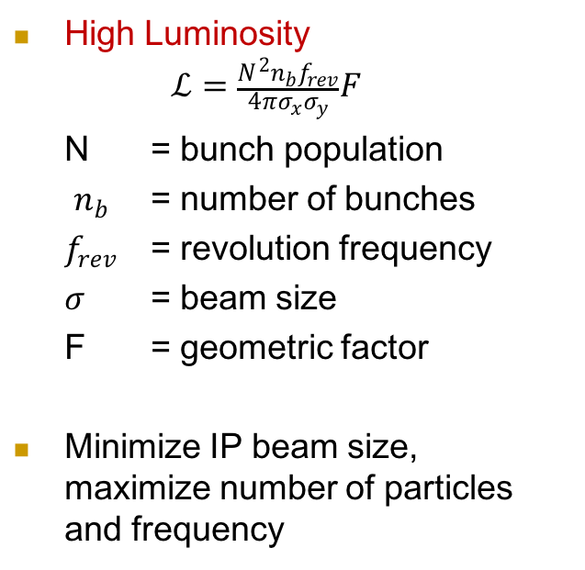
LHC Experiment Needs
Nominal LHC parameters
Beam injection energy (TeV) | 0.45
Beam energy (TeV) | 7.0
Number of particles per bunch | 1.15 x 10¹¹
Number of bunches per beam | 2808
Max stored beam energy (MJ) | 362
Norm transverse emittance (μm rad) | 3.75
Colliding beam size (μm) | 16
Bunch length at 7 TeV (cm) | 7.55

Slide 19
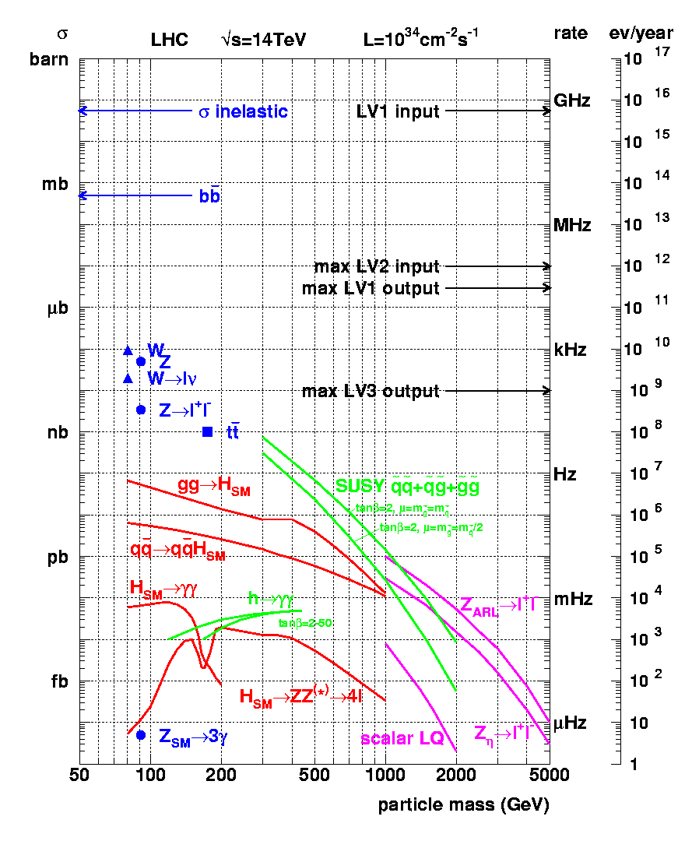
Cross-sections at the LHC
“Well known” processes. Don’t need to keep all of them …
New Physics!!
We want to keep!!

Slide 20
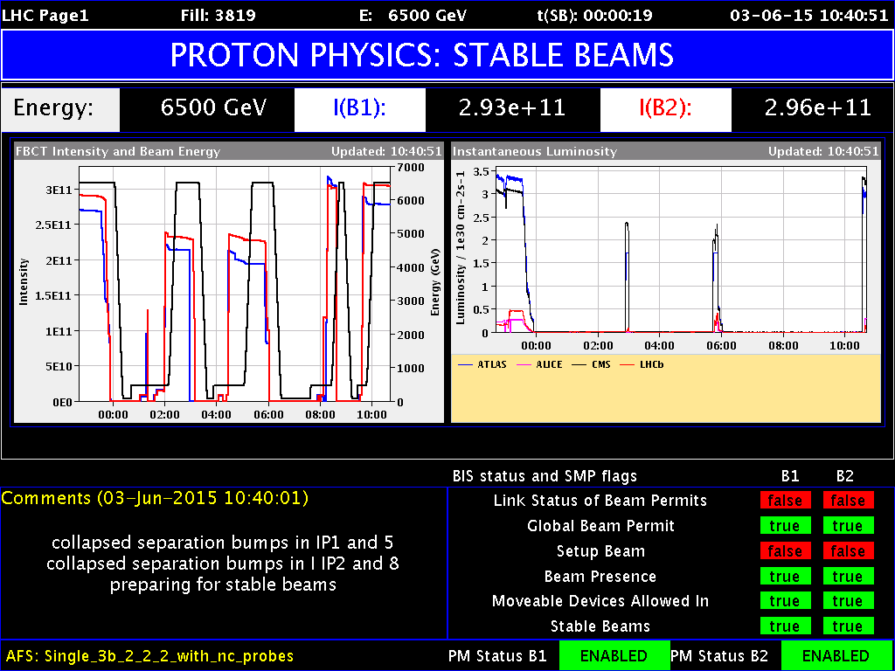
Keeping Track of Accelerator Performance
Operations in the CCC track the various aspects of the beam to make sure that the needs of the experiments are being met.
Here, tracking beam intensity, energy, and luminosity.

Slide 21
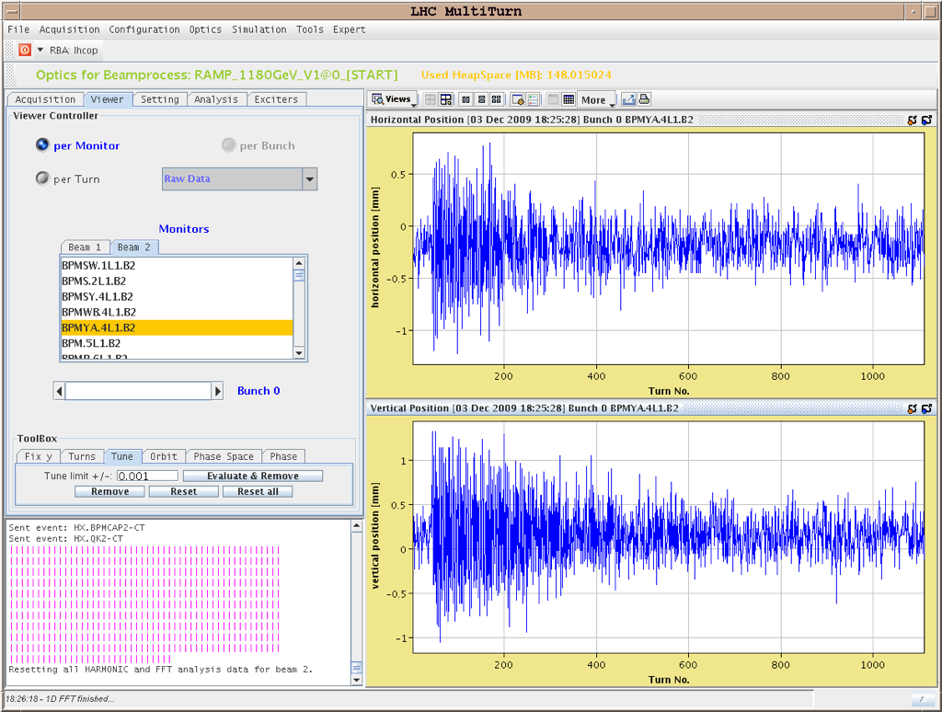
Keeping Track of Performance
Operations in the CCC track the various aspects of the beam to make sure that the needs of the experiments are being met.
Here, beam positions are monitored in each plane by using Beam Position Monitors.

Slide 22
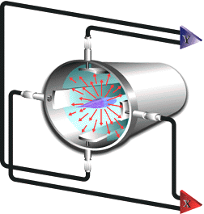
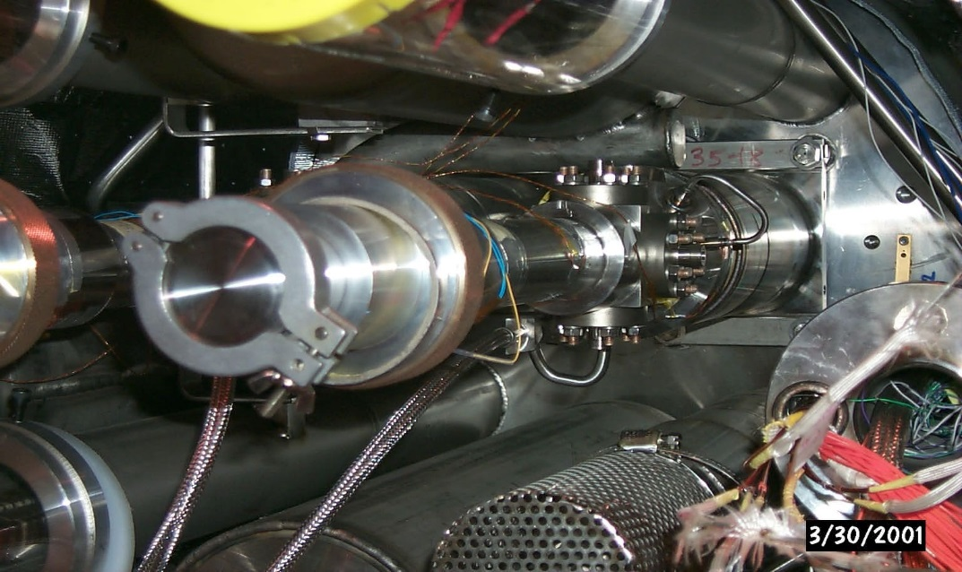
Beam Position Monitor (BPM)
The electric field from the beam induces a charge on the antennas
The charges on each antenna are measured, and one can then calculate the position of the beam inside the beamline
4 buttons pick-up the EM signal induced by the beam.
One can infer the transverse position in both planes.

Slide 23
Beam Position Monitor (BPM)
Different sizes & styles, but most behave in similar manner.
Sizes and lengths carefully designed.
Here, we have two views of one of the BPM types used at Jefferson Lab (notice the antennas along the inside.)

Slide 24
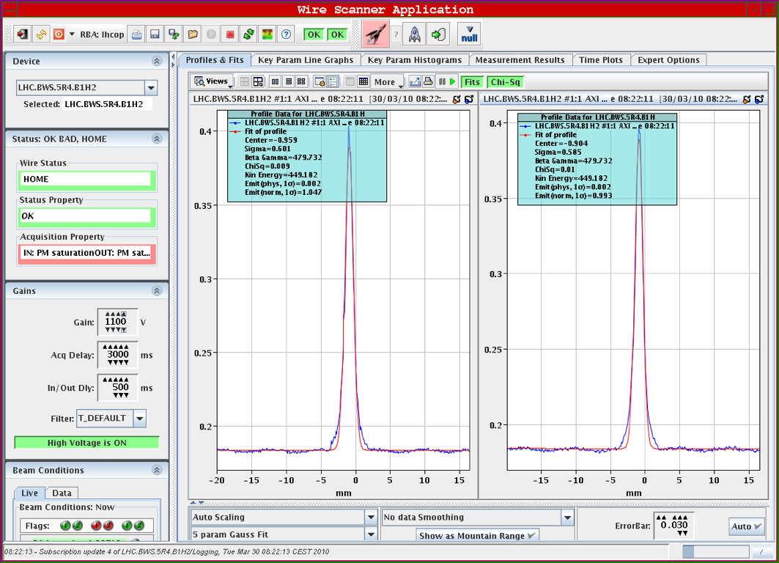
Beam Profile
To find beam size and distribution, measure profile.

Slide 25
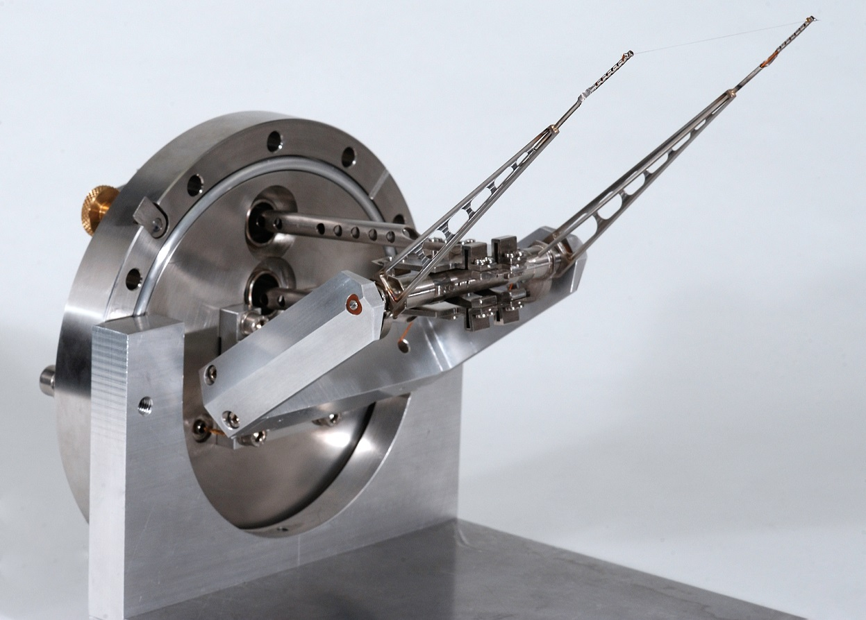
Beam Profile
This is commonly done using a wire scanner.
The wire will move through the beam twice (in and out), giving information about the size and distribution of particles.
CERN-EX-0205022-01 cds.cern.ch

Slide 26
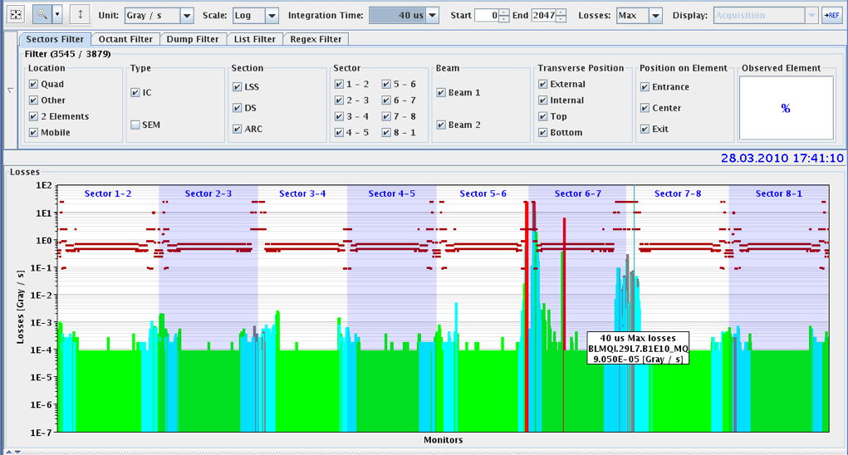
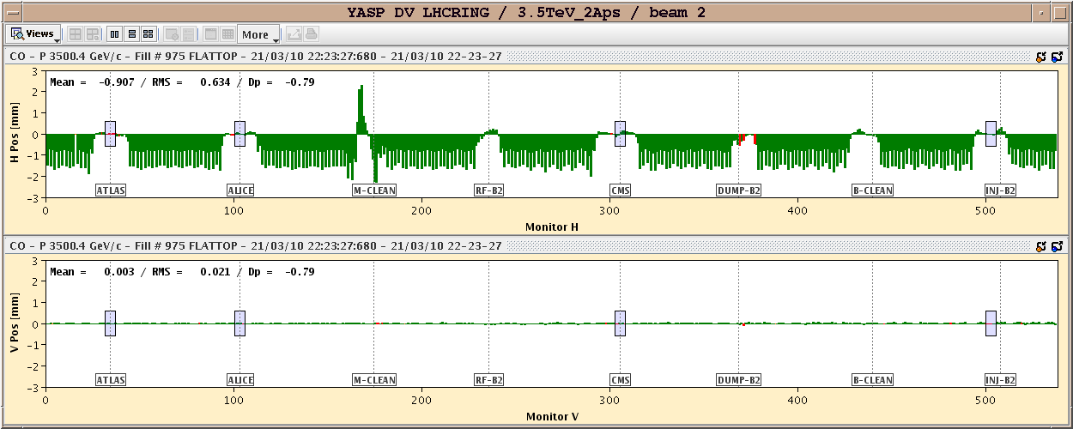
Keeping Track of Performance
Beam loss monitoring
Dispersion measurements

Slide 27
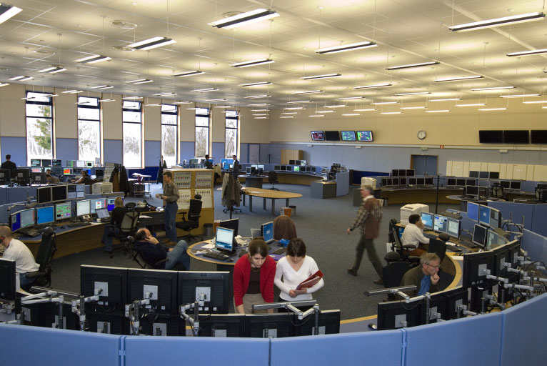
CERN Control Centre - Layout

