Slide 1



Lecture 1
Introduction to Particle Accelerators
Professor Emmanuel Tsesmelis
Principal Physicist, CERN
Visiting Professor, University of Oxford
Graduate Accelerator Physics Course
John Adams Institute for Accelerator Science
11 October 2023

Slide 2
JAI Graduate Accelerator Physics Course
Delivered over two Academic Terms
  Term I (Michaelmas Term 2023)
    24 lectures and 6 tutorials
    First three lectures and first tutorial includes Oxford PP students.
  Term II (Hilary Term 2024)
    Lectures, tutorials and design project
Course site is https://indico.cern.ch/category/5869/
  Includes all lecture / tutorial material, videoconference connection, student handbook etc.
Videoconference facility for remote connection
Contact Sue Geddes (sue.geddes@physics.ox.ac.uk) for accommodation in Oxford college
  Contact e-mail: Emmanuel.Tsesmelis@cern.ch

Slide 3
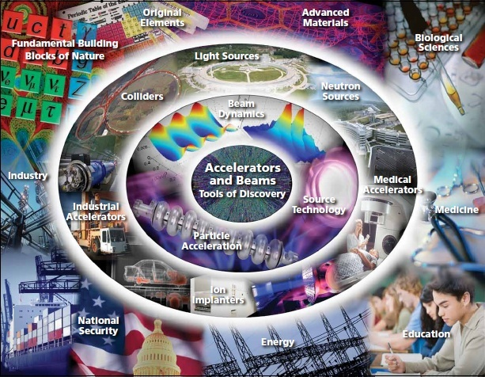
Introduction

Slide 4
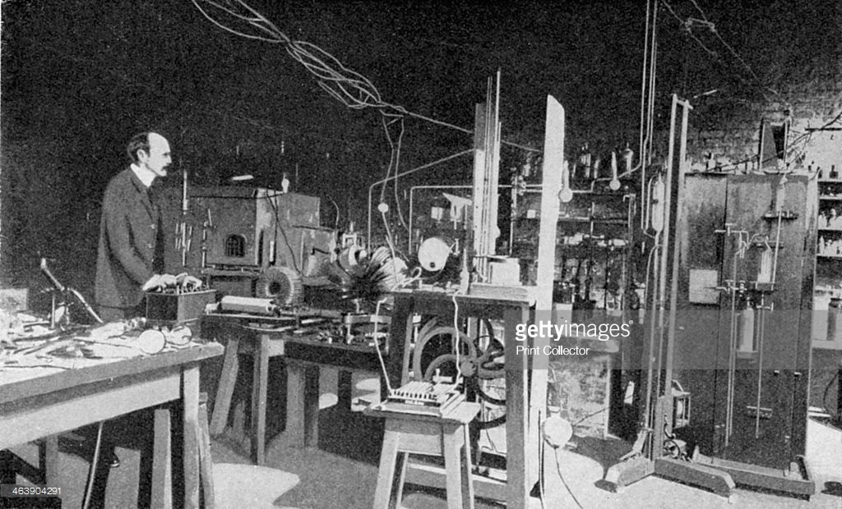
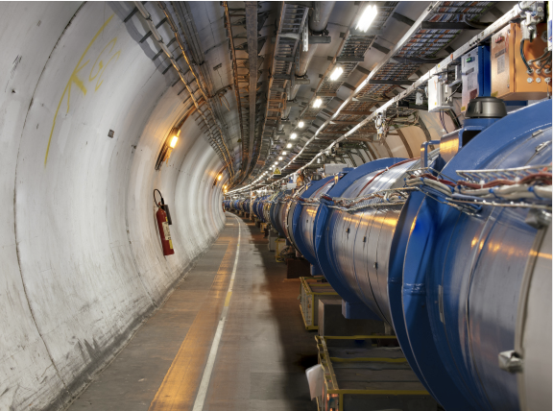
Accelerator Development
Characterised by rapid progress for over a century.
  From cathode-ray tubes to the LHC.
  From the discovery of the electron to the discovery of the Higgs boson.
Advances in accelerators require corresponding advances in accelerator technologies
  Magnets, vacuum systems, RF systems, diagnostics,...
But timelines becoming long, requiring:
  Long-term planning.
  Long-term resources.
  Global collaboration.

Slide 5
24 (+1) Nobel Prizes in Physics that had direct contribution from accelerators
A.Chao and E. Haussecker "Impact of Accelerator Science on Physics Research", published in ICFA Newsletter, Dec 2010; & submitted to the Physics in Perspective Journal, Dec 2010.

Slide 6

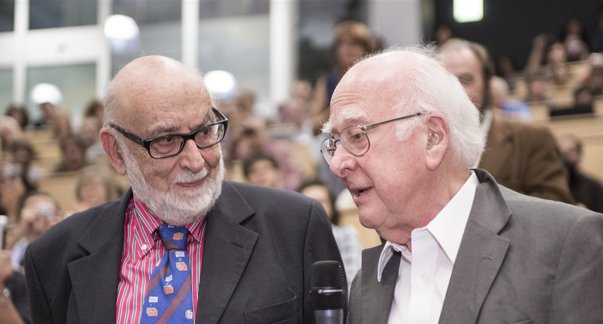
Nobel Prize in Physics 2013
The Nobel Prize in Physics 2013 was awarded jointly to François Englert and Peter W. Higgs "for the theoretical discovery of a mechanism that contributes to our understanding of the origin of mass of subatomic particles, and which recently was confirmed through the discovery of the predicted fundamental particle, by the ATLAS and CMS experiments at CERN's Large Hadron Collider”.

Slide 7
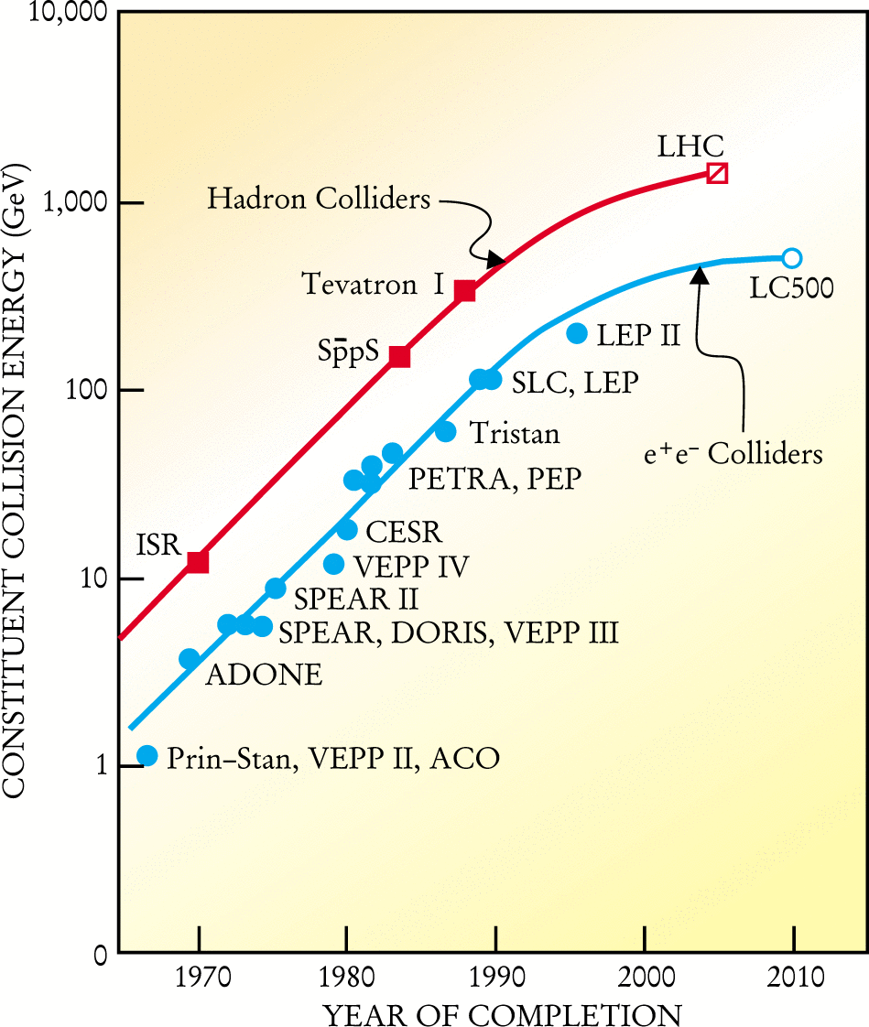
Livingston Plot
Around 1950, Livingston made following observation:
  Plotting energy of accelerator as a function of year of commissioning, on semi-log scale, the energy gain had linear dependence.
Observations today:
    Exhibition of saturation effect:
    New technologies needed.
  Overall project cost increased
    Project cost increased by factor of 200 over last 40 years.
  Cost per proton-proton E_{CM} energy decreased by factor of 10 over last 40 years.

Slide 8
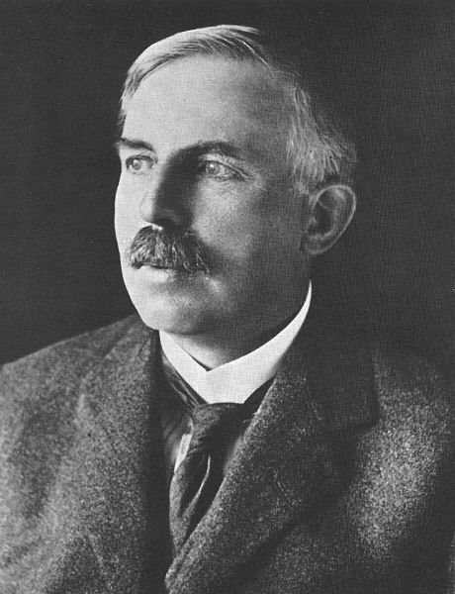
Rutherford fired the starting pistol
At the Royal Society in 1928 he said:
“I have long hoped for a source of positive particles more energetic than those emitted from natural radioactive substances”.

Slide 9
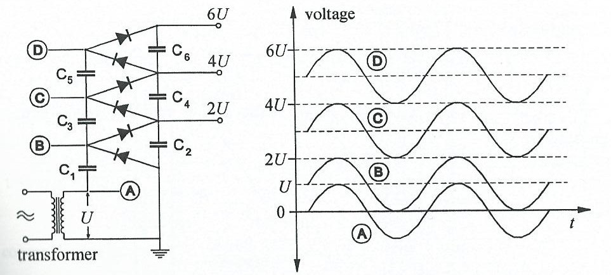

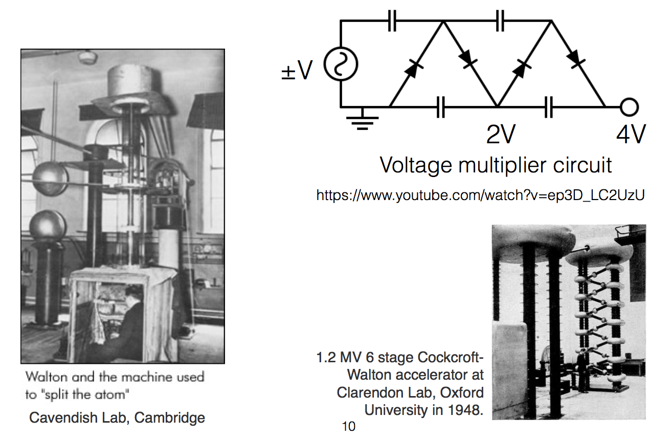
Electrostatic Accelerators
The Cockcroft-Walton
Based on system of multiple rectifiers.
Voltage generated by cascade circuit
Modern CWs
  Voltages up to ~4 MV.
  Beam currents of several hundred mA with pulsed particle beams of few μs pulse length.

Slide 10
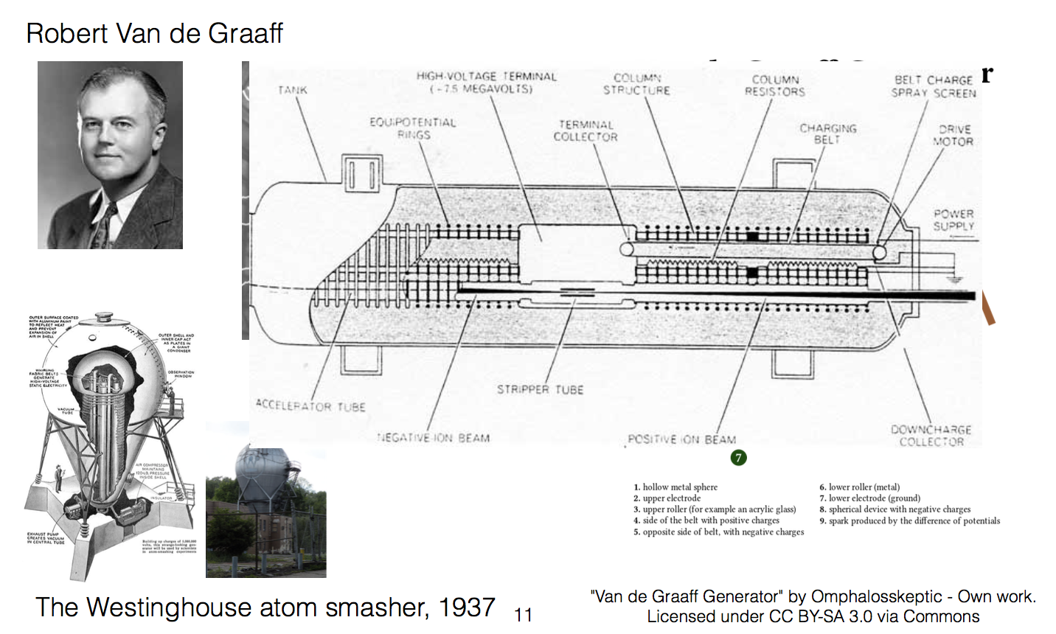
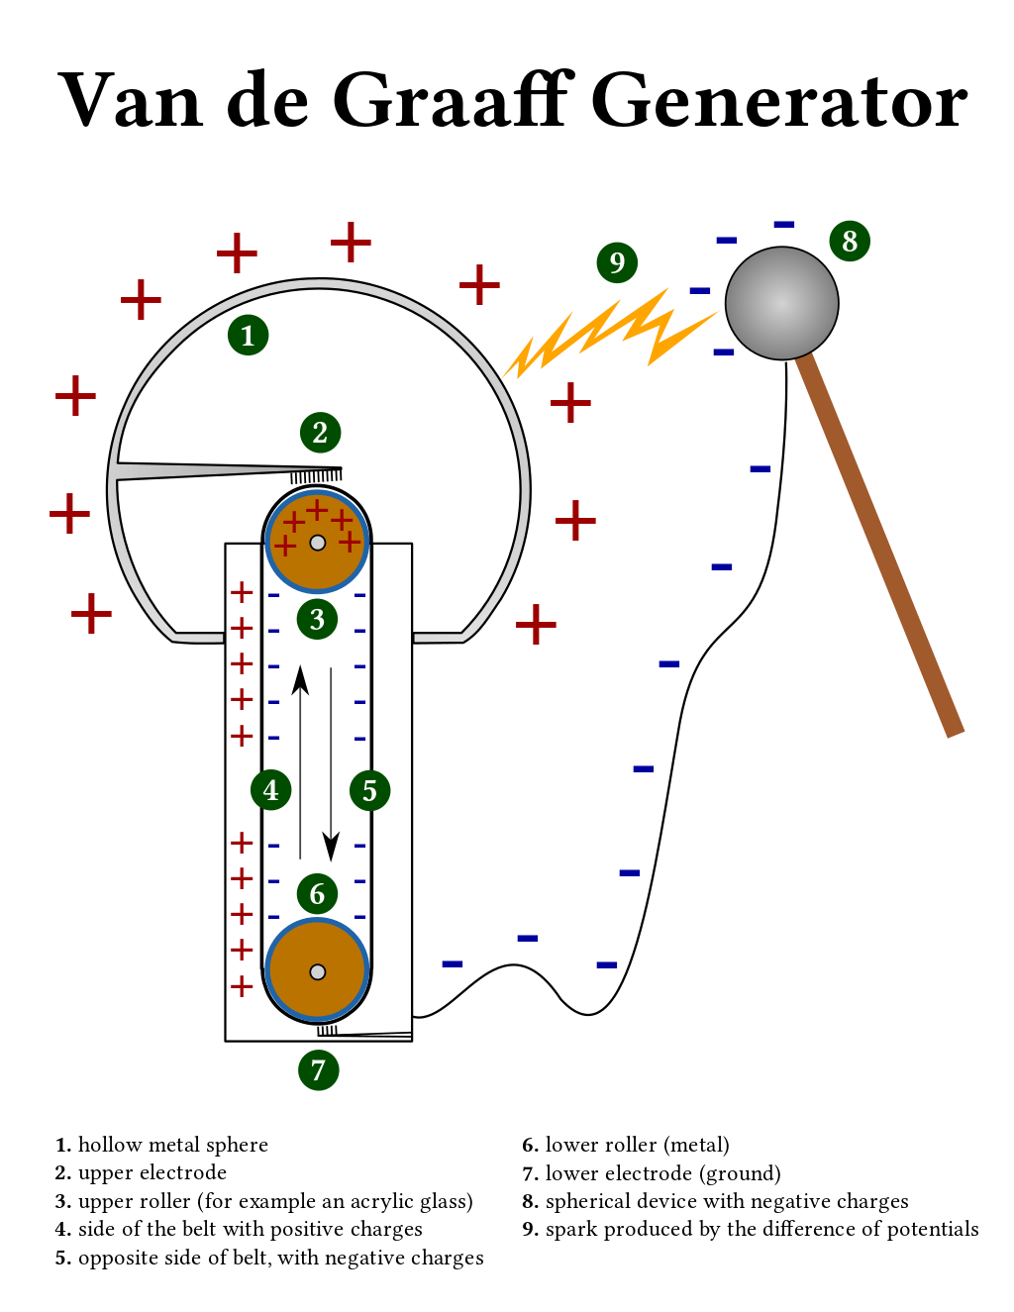
Electrostatic Accelerators – The Van de Graaff
With any electrostatic accelerator, it is difficult to achieve energy higher than ~20 MeV (e.g. due to practical limitations of the size of the vessels).
1929

Slide 11
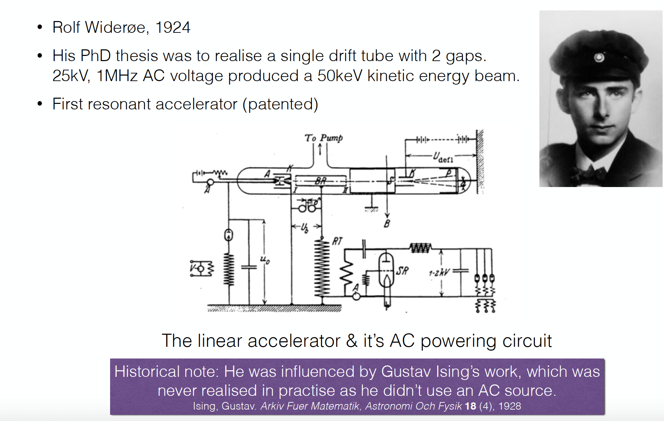
Linear Accelerators

Slide 12
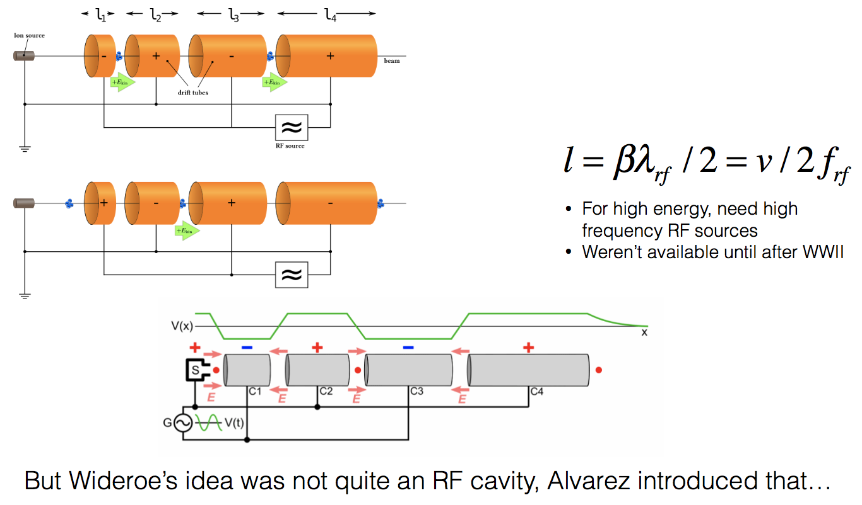
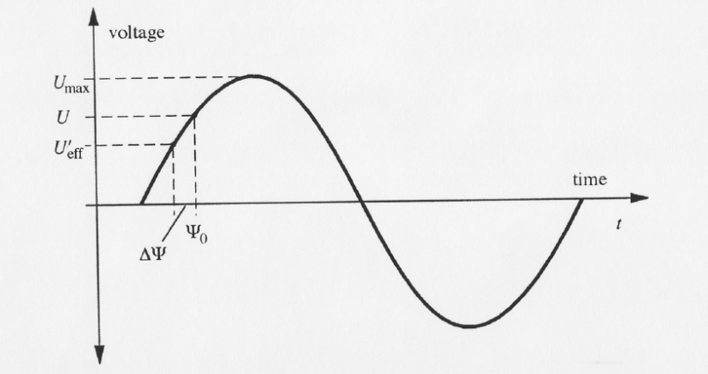
Linear Accelerators
Principle
  Use rapidly-changing high frequency voltages instead of direct voltages (Ising)
  Energy is proportional to number of stages i traversed by particle.
  The largest voltage in entire system is never greater than V_{max}
    Arbitrary high energies without voltage discharge.
Phase focusing in linacs

Slide 13
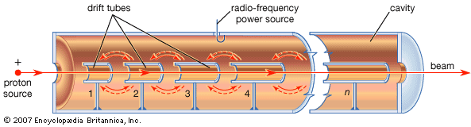
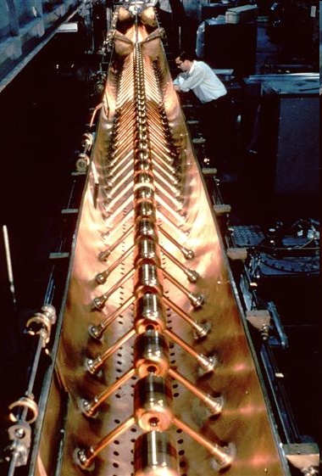
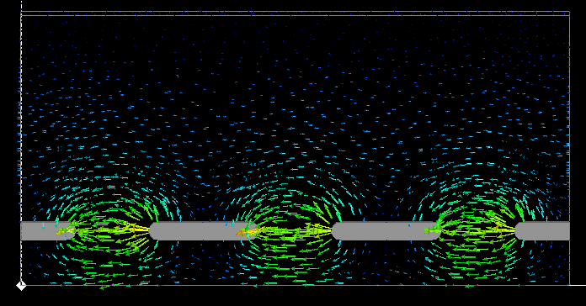
Drift Tube Linac: Higher Integrated Field
CERN LINAC1
© CERN CDS 6808042
Notes:
13
13

Slide 14
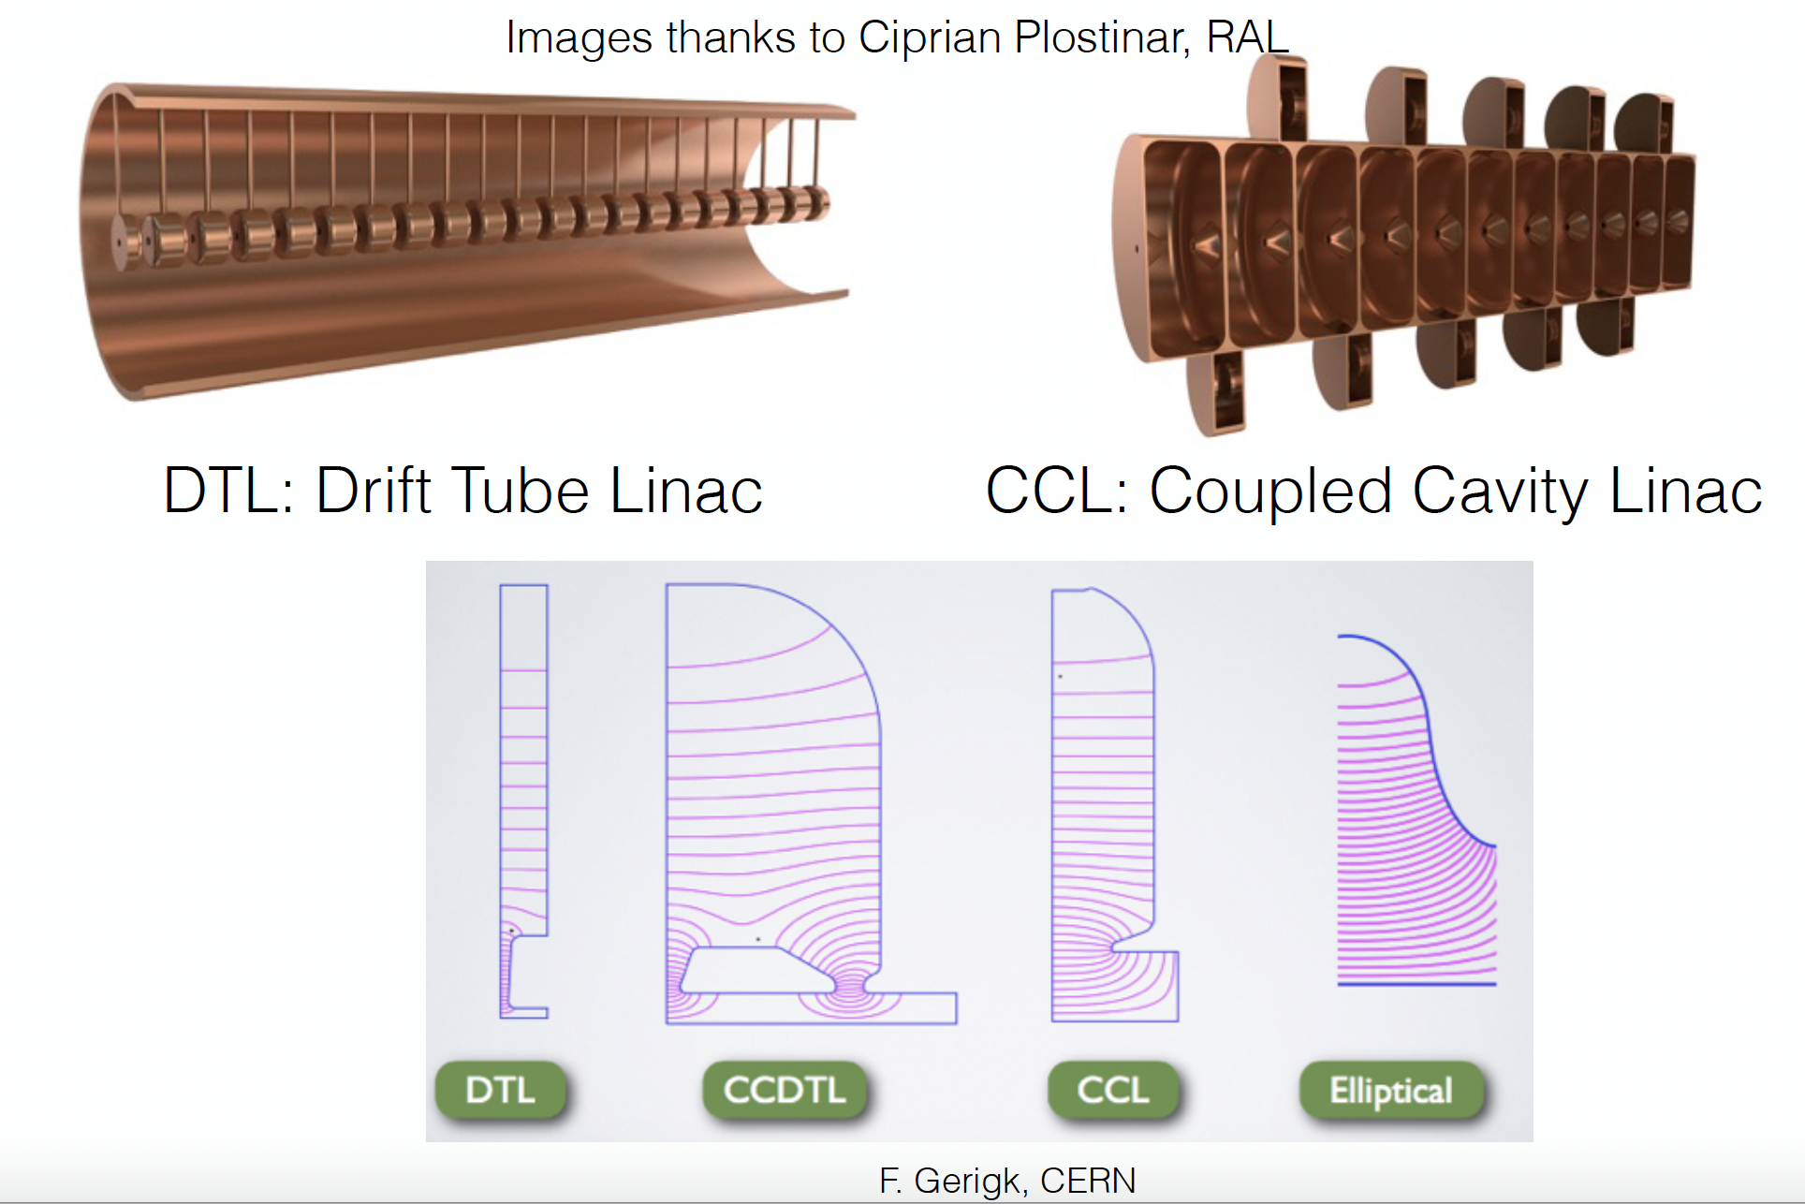
Linac Structures

Slide 15
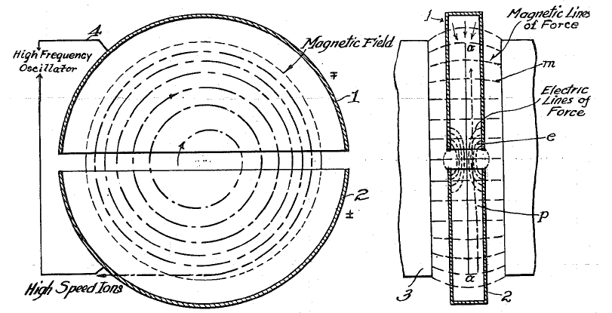
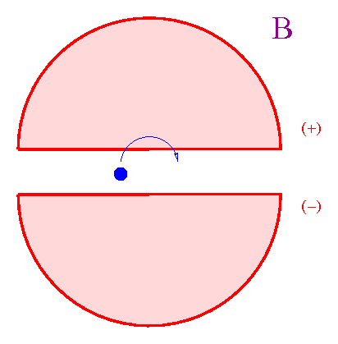
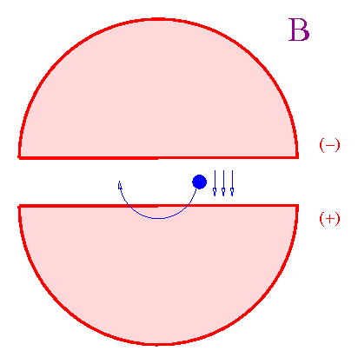
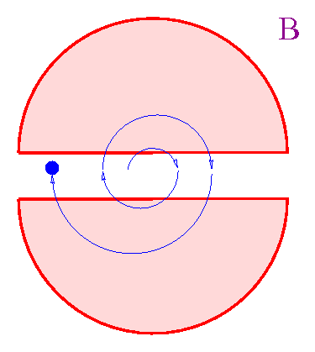
The Cyclotron (1/3)
In 1929-1930 Lawrence designed a “cyclotron”, a circular device made of two electrodes placed in a magnetic field.
Cyclotrons can accelerate (e.g.) protons up to hundreds of MeV.
Cyclotrons cannot accelerate to higher energies due to relativistic effects

Slide 16
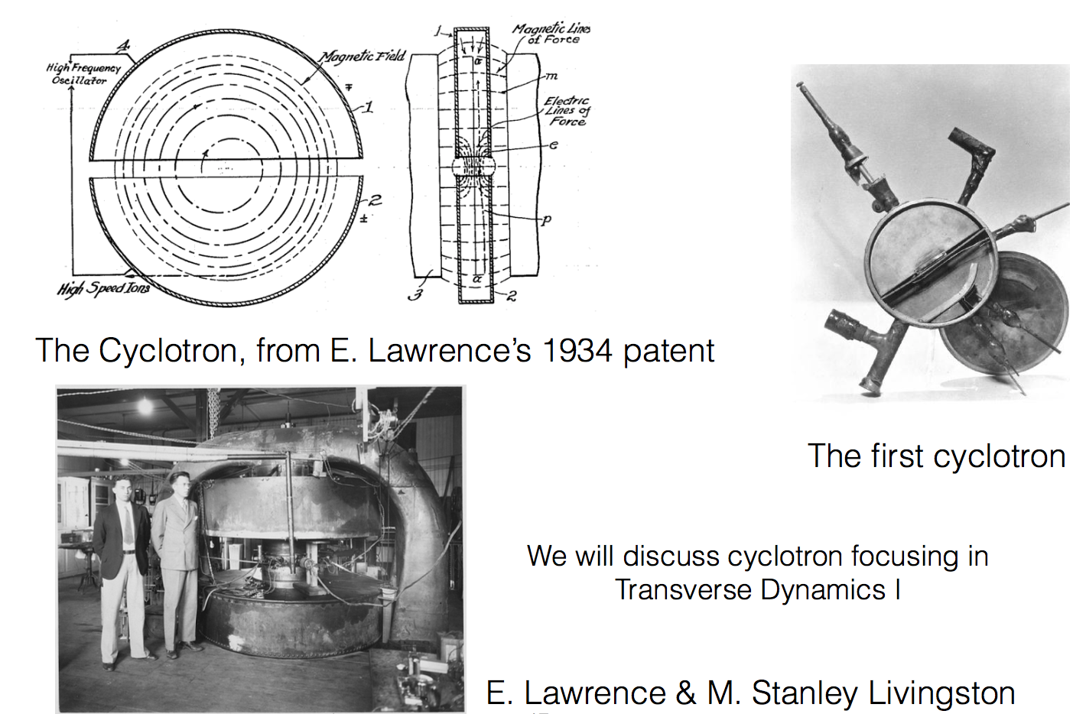
The Cyclotron (2/3)

Slide 17
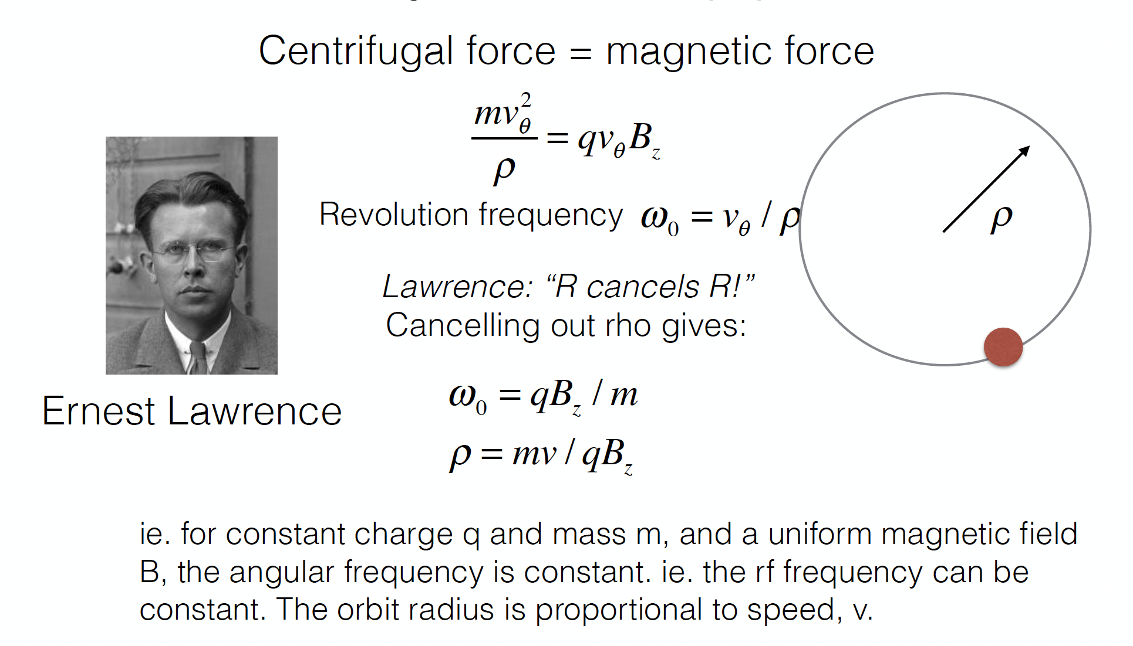
Cyclotron (3/3)

Slide 18
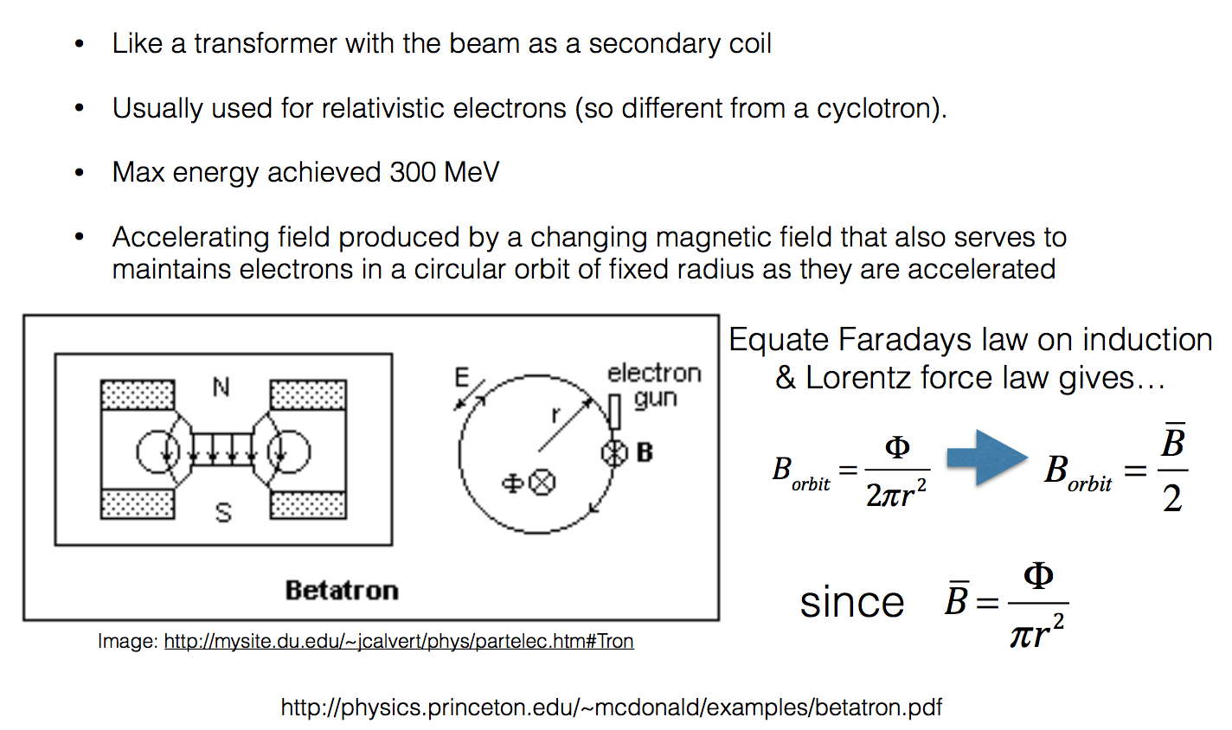
The Betatron
Wideroe Condition
Centripetal force provided by Lorentz force

Slide 19
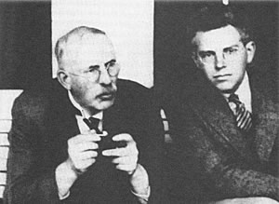
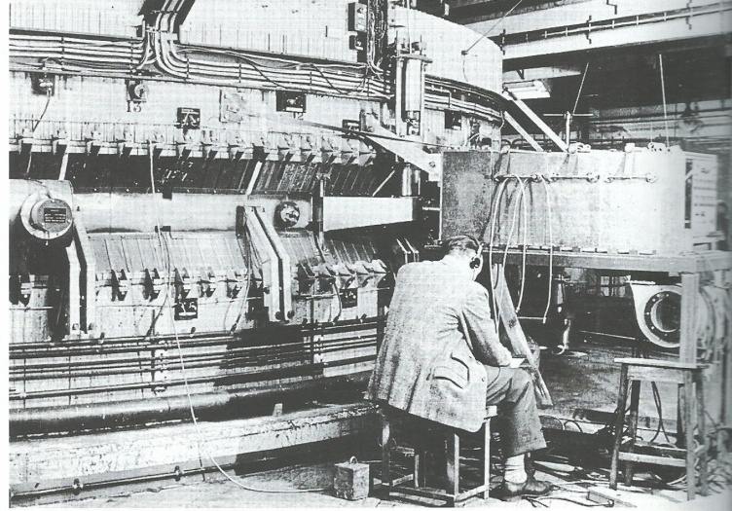
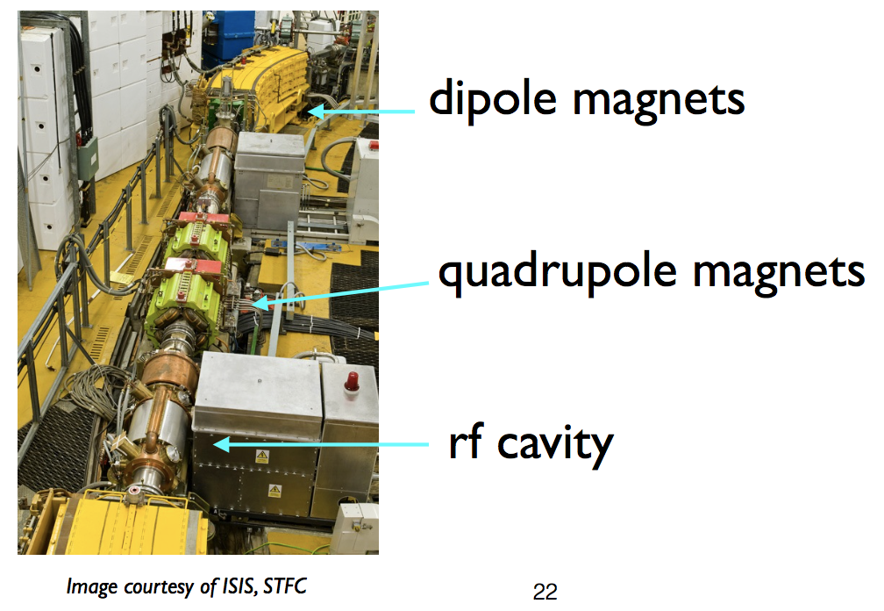
The Synchrotron - Origins
“Particles should be constrained to move in a circle of constant radius thus enabling the use of an annular ring of magnetic field...which would be varied in such a way that the radius of curvature remains constant as the particle gains energy through successive accelerations by an alternating electric field applied between coaxial hollow electrodes.”
Mark Oliphant, Oak Ridge, 1943
With Ernest Rutherford in 1932
1 GeV machine at Birmingham University

Slide 20
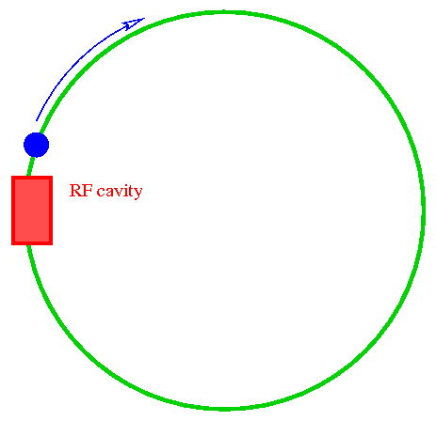
Synchrotrons - Principles
From
  R = E / (ecB)
  E/B kept constant since R is fixed.
  B increases synchronously with rising E
Synchrotrons, such as LHC, can accelerate to much higher energies.
Limitation of synchrotrons (especially for electrons) is due to “synchrotron radiation”.
R = radius of curvature
E = particle energy
B = magnetic field

Slide 21




Beam Optics
Physical fundamentals for beam steering & focusing.
Fix particle trajectory and then repeatedly steer diverging particles back onto ideal trajectory.
Performed by EM fields (E and B) satisfying Lorentz Force
Lorentz force = centrifugal force

Slide 22
Magnetic Rigidity
The force evB on a charged particle moving with velocity v in a dipole field of strength B is equal to its mass multiplied by its acceleration towards the centre of its circular path.
This is:
=
=
mv
2
Radius of curvature
F
evB
ρ
Like for a stone attached to a rotating rope
ρ
=
mv
=
p
Which can be written as:
B
Momentum
P=mv
e
e
Bρ is called the magnetic rigidity, and in the correct units obtain:
Bρ = 33.356·p [KG·m] = 3.3356·p [T·m] (if p is in [GeV/c])

Slide 23
Energy & Momentum
Total energy:
kinetic + rest mass
Einstein’s relativity formula:
Rest mass
For a mass at rest this will be:
Rest energy
as being the ratio between the total energy and the rest energy.
Define:
Then the mass of a moving particle is:
Define:
, then can write:
, which is always true and gives:

Slide 24
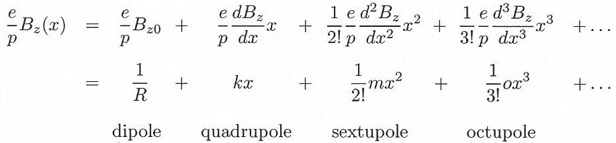
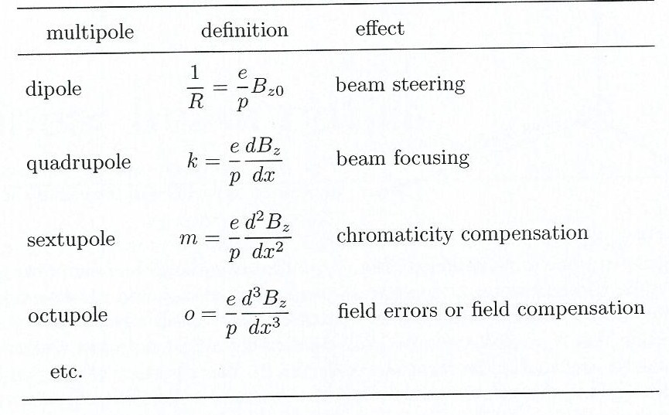
Multipoles in Beam Steering
Magnetic field around beam is sum of multipoles.
  Each has different effect on particle path.
Linear beam optics refers to use of only dipoles and quadrupoles for beam steering.

Slide 25
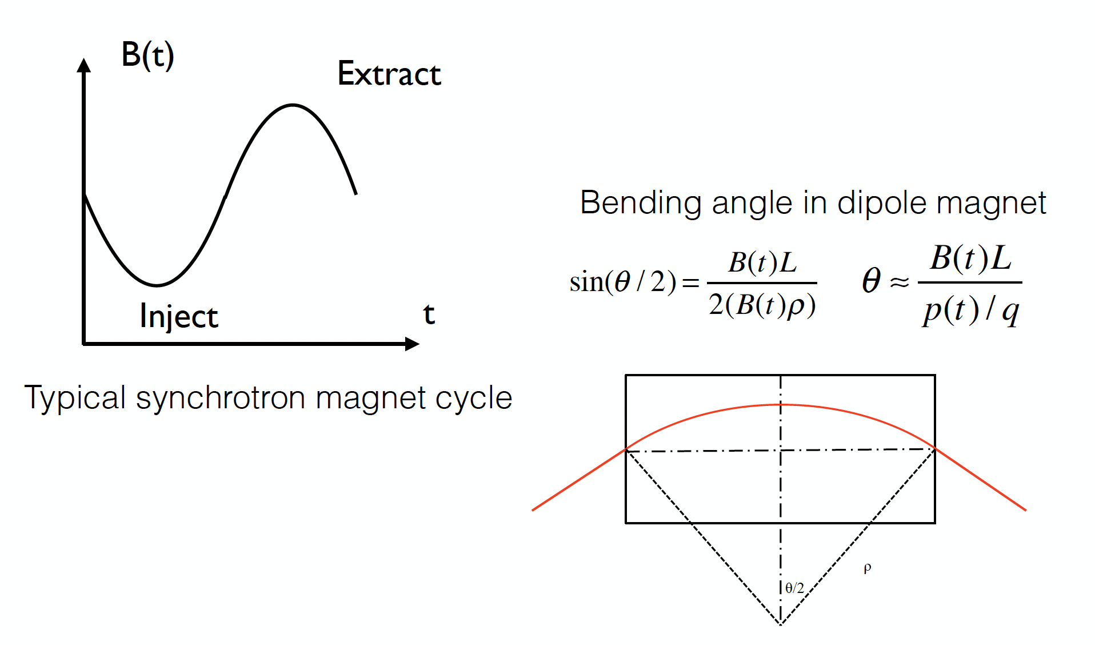
Synchrotrons- Bending Magnets

Slide 26
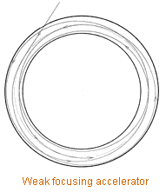
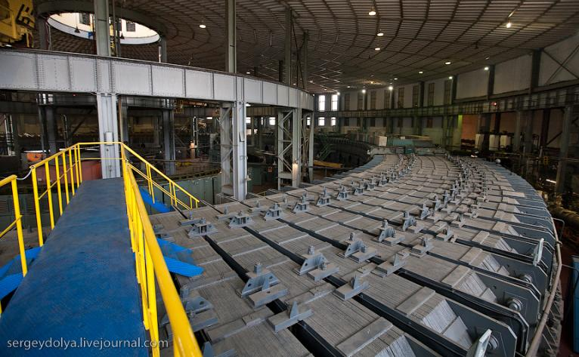
Synchrotrons - Focusing
Focusing is needed to confine the orbits.
First accelerators had “weak focusing” – focusing period is larger than the perimeter.
  Vertical focusing comes from the curvature of the field lines when the field falls off with radius.
  Horizontal focusing from the curvature of the path.
  Negative field gradient defocuses horizontally & must not be so strong as to cancel path curvature effect
10 GeV weak-focusing Synchrophasotron built in Dubna in 1957, the biggest and the most powerful of its time. Its magnets weigh 36,000 tons and it was registered in the Guinness Book of Records as the heaviest in the world.

Slide 27
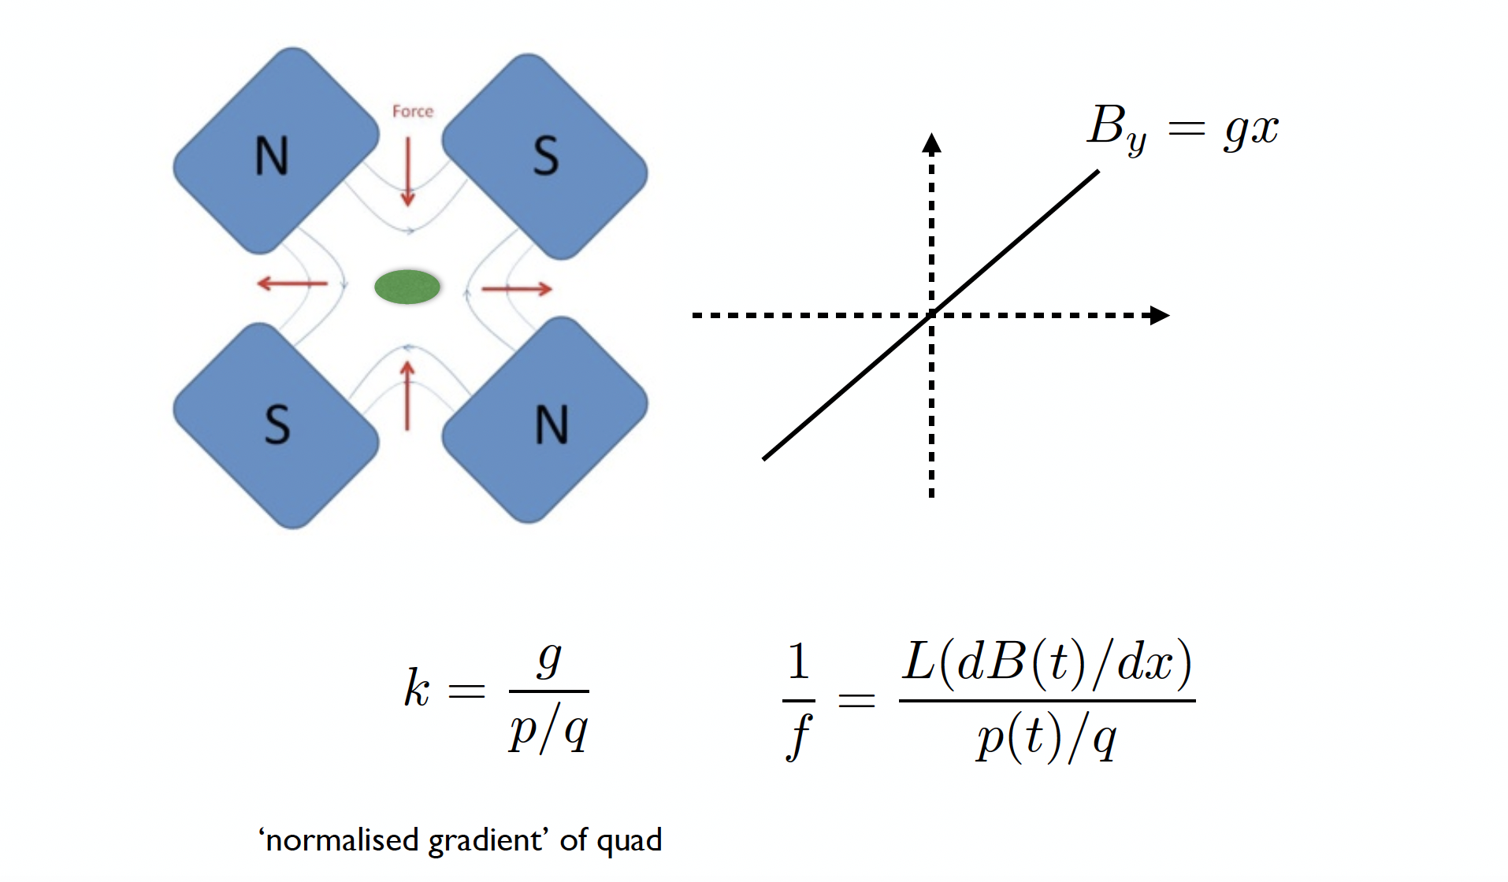
Synchrotron – Focusing Magnets

Slide 28
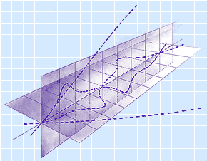
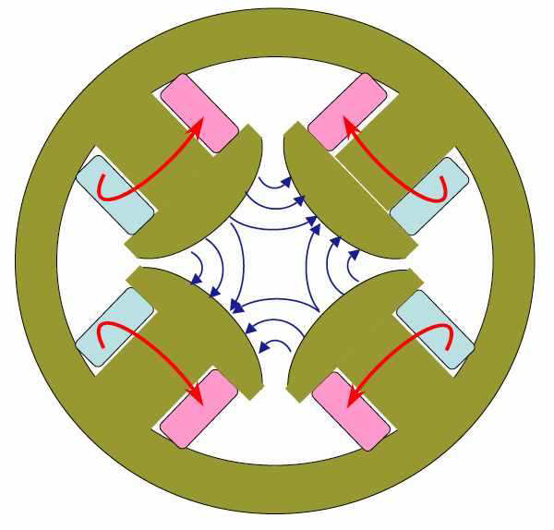
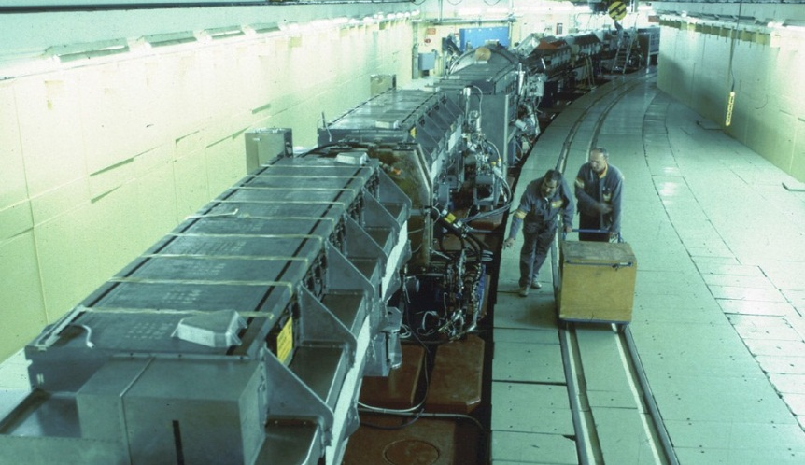
“Strong focusing” alternates focusing-defocusing forces (provided by quadrupoles) to give overall focusing in both X & Y planes.
Transverse trajectories
Strong focusing
Weak focusing
Strong focusing allows use of more compact magnets, thus achieving many times larger energy with the same cost.
CERN's Proton Synchrotron, was the first operating strong-focusing accelerator.
200-m diameter ring, weight of magnets 3,800 tons

Slide 29
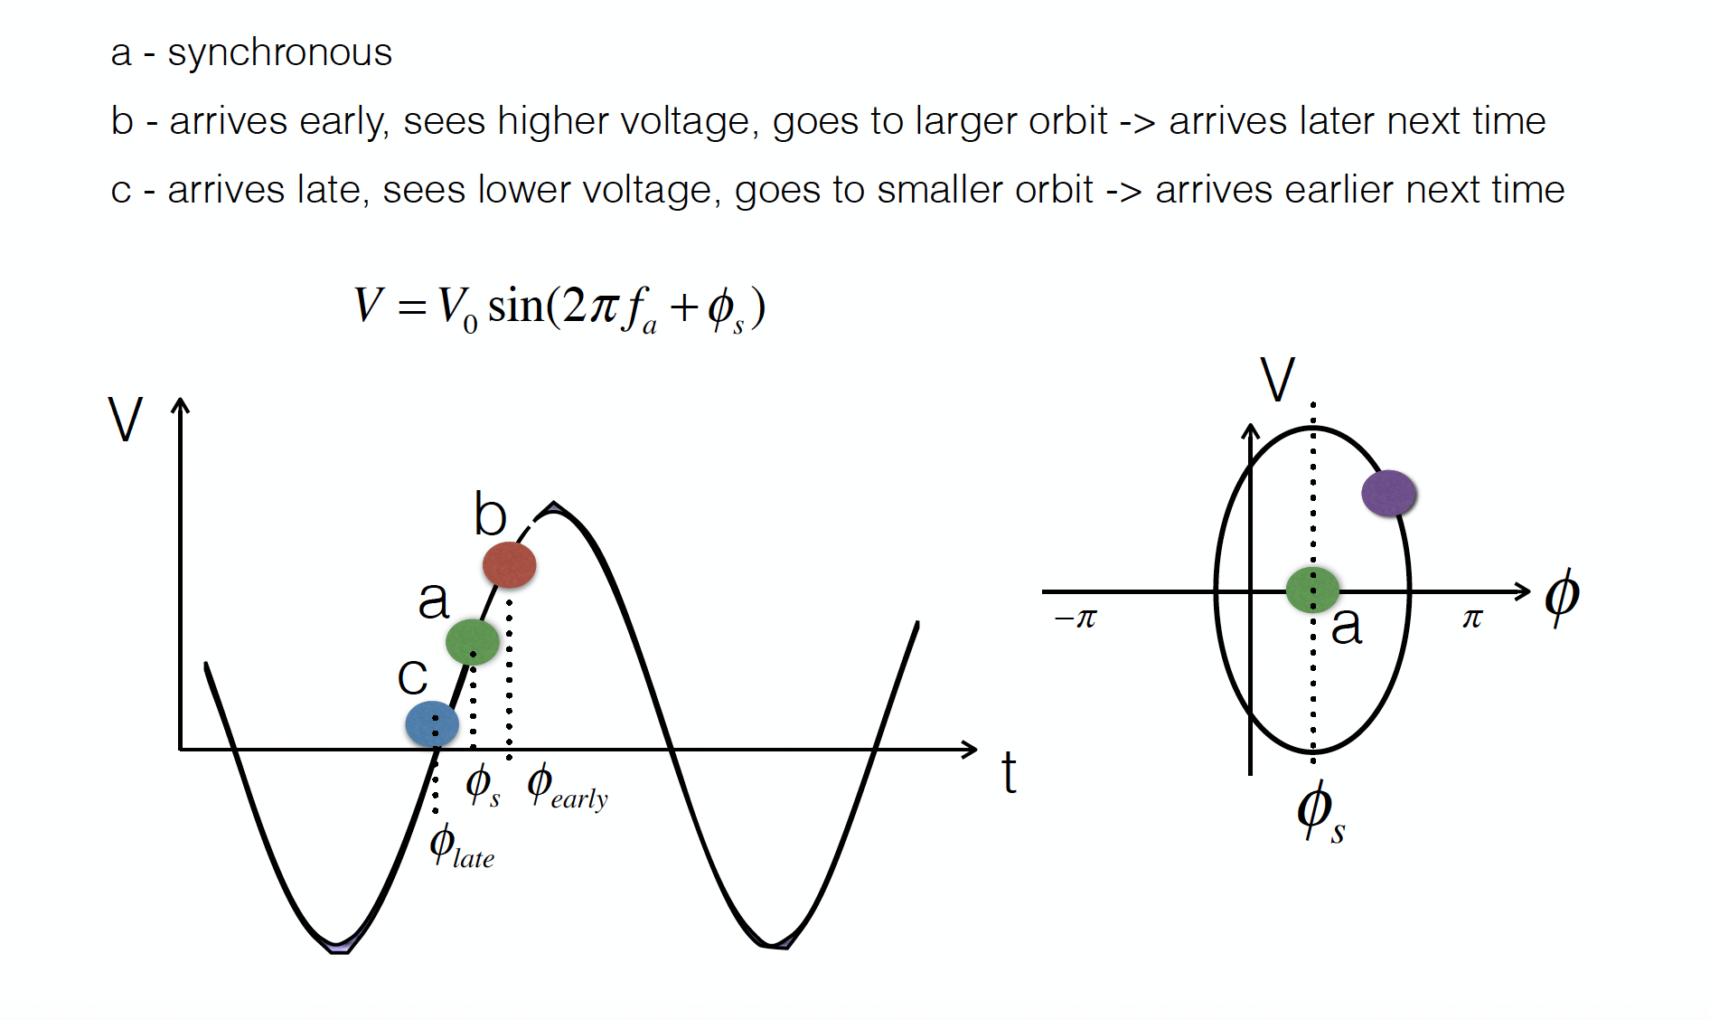
Synchtroton – Phase Stability

Slide 30


Why Colliders?
v~c
v=0
=>
E_{B} = γ m₀ c²
P_{B} = γ m₀ v
Only a tiny fraction of energy converted into mass of new particles
(due to energy and momentum conservation)
v~c
v~c
E_{B} = γ m₀ c²
E_{B} = γ m₀ c²
Entire energy converted into the mass of new particles

Slide 31
De Broglie Wavelength
Momentum
Planck Constant
De Broglie
Wavelength
    De Broglie Wavelength
    Wave-particle duality;
    For higher E, probe shorter distances inside matter

Slide 32
Luminosity
Particle colliders designed to deliver two basic parameters to HEP user.
    Measure of collision rate per unit area.
    Event rate for given event probability (“cross-section”):
    For a Collider, instantaneous luminosity L is given by
    → Require intense beams, high bunch frequency and small beam sizes at IP.

Slide 33
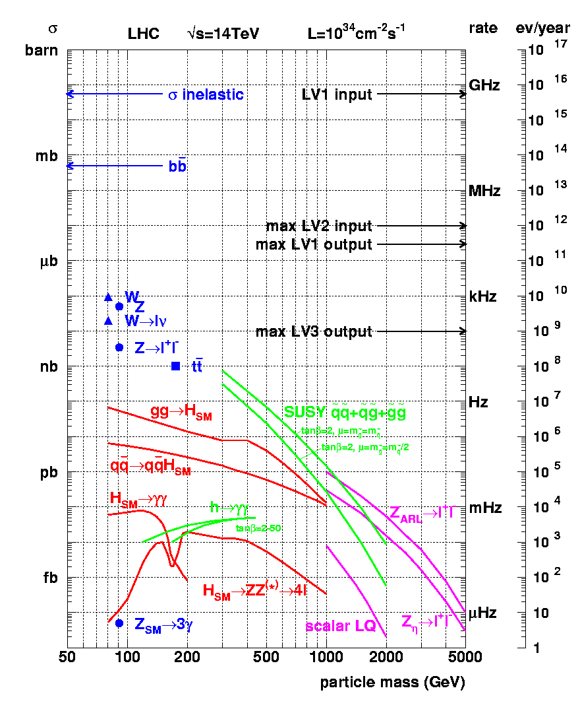
Cross-sections at the LHC
“Well known” processes. Don’t need to keep all of them …
New Physics!!
We want to keep!!

Slide 34
Collider Types
Hadron Colliders
  Desire high energy
    Only ~10% of beam energy available for hard collisions producing new particles
      Need O(10 TeV) Collider to probe 1 TeV mass scale.
      High-energy beam requires strong magnets to store and focus beam in reasonable-sized ring.
  Desire high luminosity
    Use proton-proton collisions.
      High bunch population and high bunch frequency.
    Anti-protons difficult to produce if beam is lost
      c.f. SPS Collider and Tevatron

Slide 35
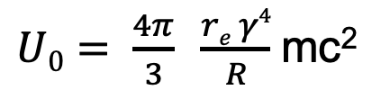

Collider Types
Lepton Colliders (e+e-)
  Synchrotron radiation is the most serious challenge
    Energy loss of a particle per turn
    Emitted power in circular machine is
      For collider with E_{CM} = 1 TeV in the LHC tunnel with a 1 mA beam, radiated power would be 2 GW
        Would need to replenish radiated power with RF
        Remove it from vacuum chamber
  Approach for high energies is Linear Collider.

Slide 36
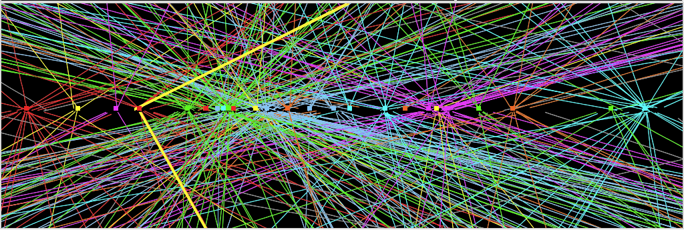
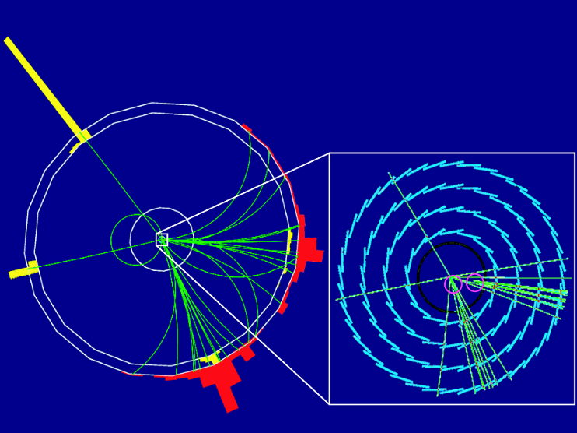
Collider Characteristics
Hadron collider at the frontier of physics
  Huge QCD background
  Not all nucleon energy available
  in collision
Lepton collider for precision physics
  Well defined initial energy for reaction
  Colliding point like particles
ATLAS Z → μμ event from 2012 data
with 25 reconstructed vertices
p
p
Simulation of HIGGS production e⁺e– → Z H Z → e⁺e–, H → bb
e+
e-

Slide 37
The Higgs is hiding in thousands
of trillions interactions…
Z→ μμ event from 2012 data with 25 reconstructed vertices
Z→ μμ

Slide 38
Circular versus Linear Collider
accelerating cavities
N
N
S
S
Circular Collider
many magnets, few cavities, stored beam
higher energy → stronger magnetic field
→ higher synchrotron radiation losses (E⁴/m⁴R)
source
main linac
Linear Collider
few magnets, many cavities, single pass beam
higher energy → higher accelerating gradient
higher luminosity → higher beam power (high bunch repetition)

Slide 39

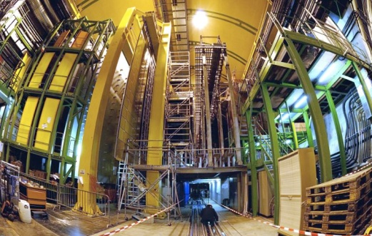


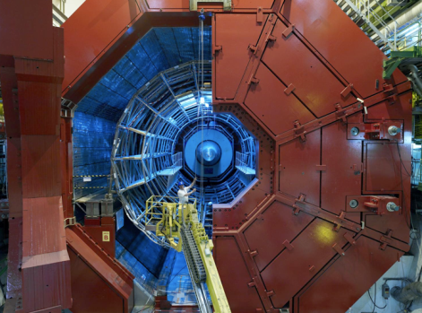

A New Era in Fundamental Science
LHCb
CMS
ATLAS
Exploration of a new energy frontier
in p-p and Pb-Pb collisions
ALICE
LHC ring:
27 km circumference
Notes:
39

Slide 40

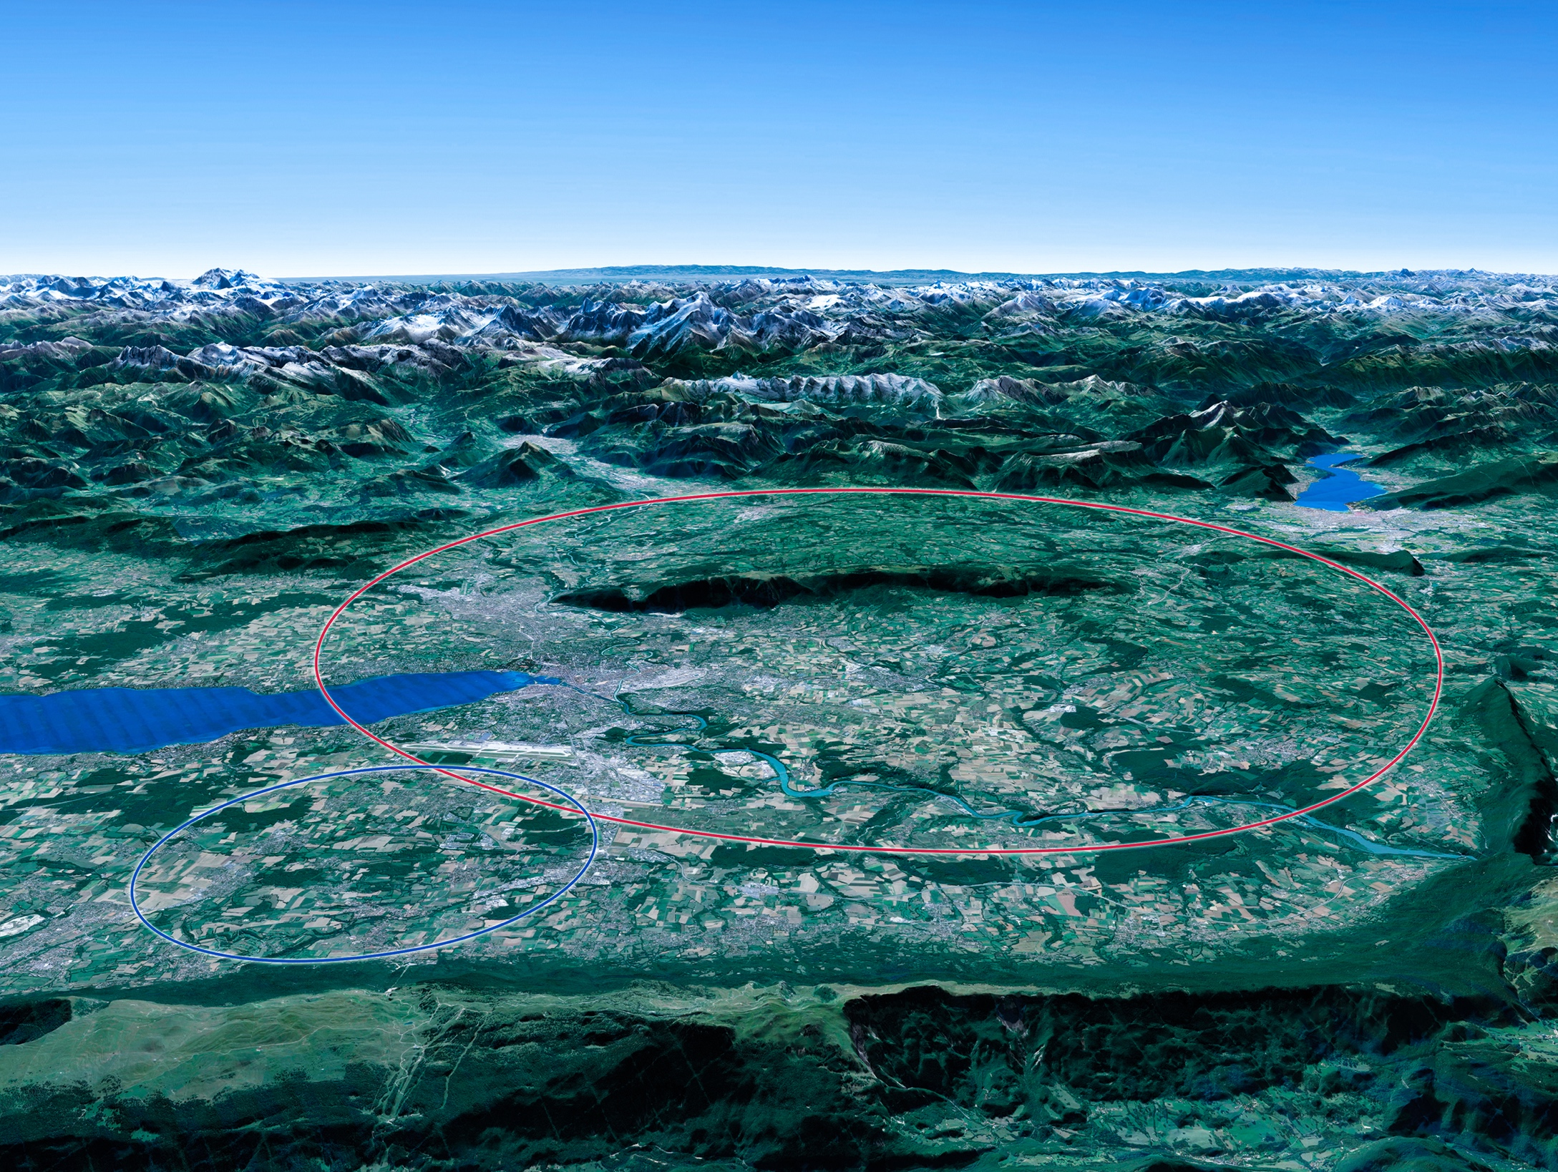

Scientific priorities for the future
Implementation of the recommendations
of the 2020 Update of the European Strategy
for Particle Physics:
• Fully exploit the LHC and the HL-LHC.
• Build a Higgs factory to further understand this unique particle.
• Investigate the technical and financial feasibility of a future energy-frontier 100 km collider at CERN.
• Ramp up relevant R&D.
• Continue supporting other projects around
the world.
LHC

Slide 41
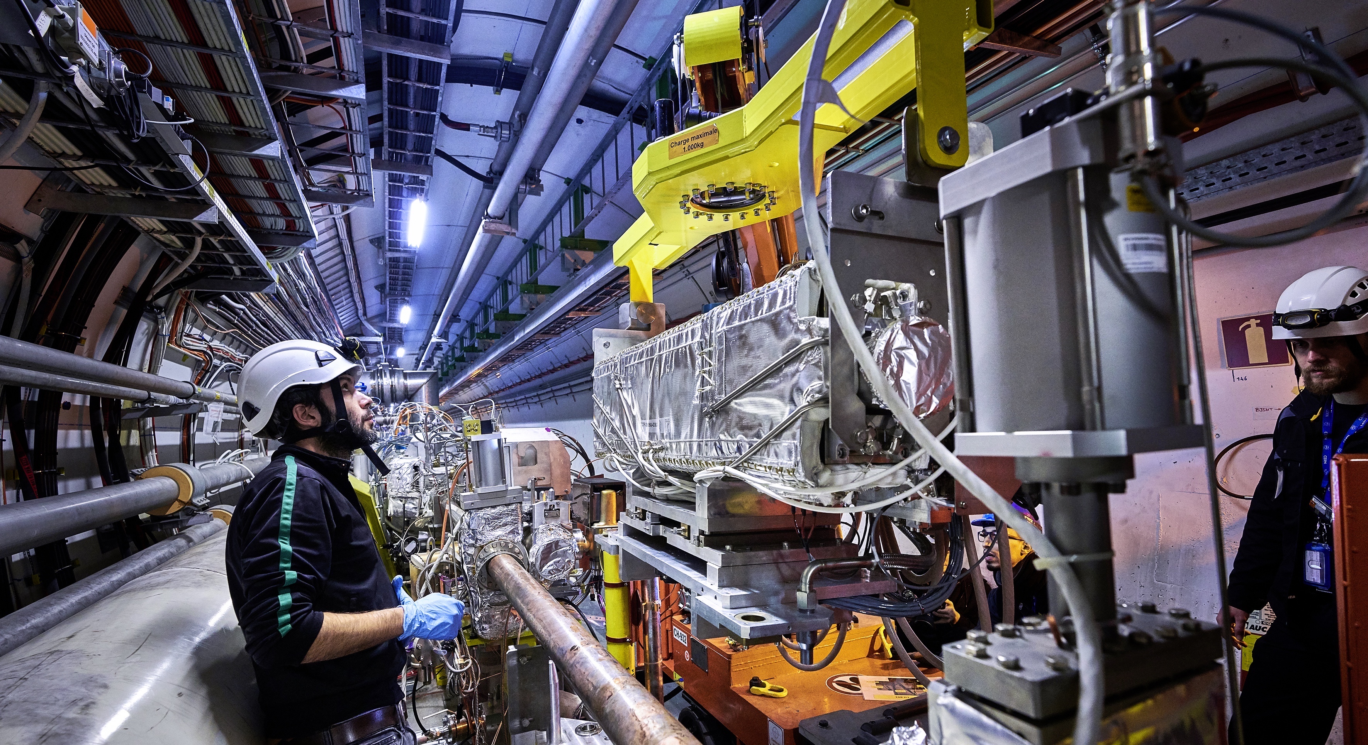
Upgrade to the
High-Luminosity LHC is under way
The HL-LHC will use new technologies to provide
10 times more collisions
than the LHC.
It will give access to rare phenomena, greater precision and discovery potential.
It will start operating in 2029, and run until approx. 2040.

Slide 42

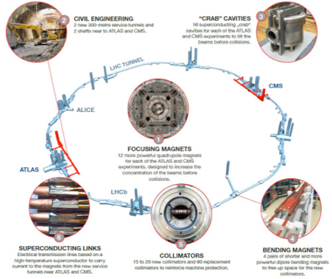
High-Luminosity LHC (HL-LHC)
New quadrupole magnets near the interaction points
New 11 Tesla short dipole magnets
Collimation upgrade
Crab Cavities
Accelerator safety upgrade
Major interventions on 1.2 km of the LHC
New quadrupole magnets near the interaction points
New 11 Tesla short dipole magnets
Collimation upgrade
Crab Cavities
Accelerator safety upgrade
Major interventions on 1.2 km of the LHC
New quadrupole magnets near the interaction points
New 11 Tesla short dipole magnets
Collimation upgrade
Crab Cavities
Accelerator safety upgrade
Major interventions on 1.2 km of the LHC

Slide 43
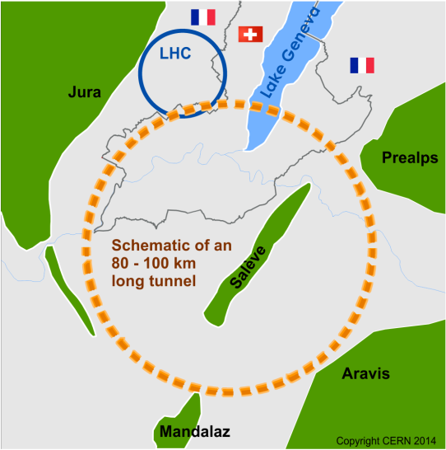
Future Circular Collider Study (FCC)
Forming an international collaboration to study:
pp-collider (FCC-hh) → defining infrastructure requirements
e⁺e⁻ collider (FCC-ee) as potential intermediate step
p-e (FCC-he) option
80-100 km infrastructure in Geneva area
~16 T ⇒ 100 TeV pp in 100 km
~20 T ⇒ 100 TeV pp in 80 km

Slide 44

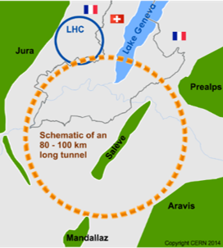
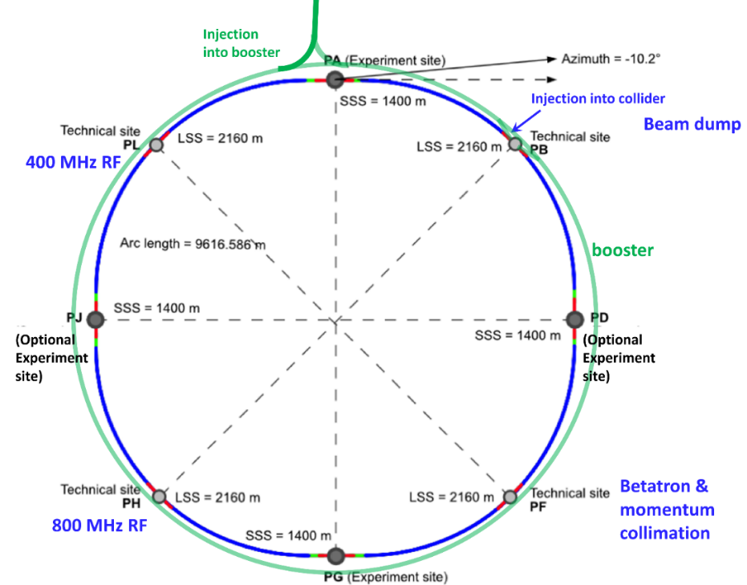


The FCC Integrated Programme
Inspired by Successful LEP – LHC Programmes at CERN
Comprehensive long-term programme maximising physics opportunities
Stage 1: FCC-ee (Z, W, H, $\text{t}\overline{\text{t}}$) as Higgs factory, electroweak & top factory at highest luminosities
Stage 2: FCC-hh (~100 TeV) as natural continuation at energy frontier, with ion and eh options
Complementary physics
Common civil engineering and technical infrastructures, building on and reusing CERN’s existing infrastructure
FCC integrated project allows seamless continuation of HEP after completion of the HL-LHC programme
FCC-ee
FCC-hh
2020 - 2040
2045 - 2060
2070 - 2090++

Slide 45
Stage 1: Updated Parameters
K. Oide, D. Shatilov,
Parameter [4 IPs, 91.2 km,T_{rev}=0.3 ms] | Z | WW | H (ZH) | ttbar
beam energy [GeV] | 45 | 80 | 120 | 182.5
beam current [mA] | 1280 | 135 | 26.7 | 5.0
number bunches/beam | 10000 | 880 | 248 | 36
bunch intensity [10¹¹] | 2.43 | 2.91 | 2.04 | 2.64
SR energy loss / turn [GeV] | 0.0391 | 0.37 | 1.869 | 10.0
total RF voltage 400/800 MHz [GV] | 0.120/0 | 1.0/0 | 2.08/0 | 4.0/7.25
long. damping time [turns] | 1170 | 216 | 64.5 | 18.5
horizontal beta* [m] | 0.1 | 0.2 | 0.3 | 1
vertical beta* [mm] | 0.8 | 1 | 1 | 1.6
horizontal geometric emittance [nm] | 0.71 | 2.17 | 0.64 | 1.49
vertical geom. emittance [pm] | 1.42 | 4.34 | 1.29 | 2.98
horizontal rms IP spot size [μm] | 8 | 21 | 14 | 39
vertical rms IP spot size [nm] | 34 | 66 | 36 | 69
beam-beam parameter ξ_{x} / ξ_{y} | 0.004/ .159 | 0.011/0.111 | 0.0187/0.129 | 0.096/0.138
rms bunch length with SR / BS [mm] | 4.38 / 14.5 | 3.55 / 8.01 | 3.34 / 6.0 | 2.02 / 2.95
luminosity per IP [10³⁴ cm⁻²s⁻¹] | 182 | 19.4 | 7.3 | 1.33
total integrated luminosity / year [ab⁻¹/yr] | 87 | 9.3 | 3.5 | 0.65
beam lifetime rad Bhabha + BS [min] | 19 | 18 | 6 | 9
preliminary – example parameters
for present layout & with 4 IPs

Slide 46
Stage 2: FCC-hh (pp) Collider Parameters
parameter | FCC-hh |  | HL-LHC | LHC
collision energy cms [TeV] | 100 |  | 14 | 14
dipole field [T] | ~17 (~16 comb.function) |  | 8.33 | 8.33
circumference [km] | 91.2 |  | 26.7 | 26.7
beam current [A] | 0.5 |  | 1.1 | 0.58
bunch intensity [10¹¹] | 1 | 1 | 2.2 | 1.15
bunch spacing [ns] | 25 | 25 | 25 | 25
synchr. rad. power / ring [kW] | 2700 |  | 7.3 | 3.6
SR power / length [W/m/ap.] | 32.1 |  | 0.33 | 0.17
long. emit. damping time [h] | 0.45 |  | 12.9 | 12.9
beta* [m] | 1.1 | 0.3 | 0.15 (min.) | 0.55
normalized emittance [μm] | 2.2 |  | 2.5 | 3.75
peak luminosity [10³⁴ cm⁻²s⁻¹] | 5 | 30 | 5 (lev.) | 1
events/bunch crossing | 170 | 1000 | 132 | 27
stored energy/beam [GJ] | 7.8 |  | 0.7 | 0.36

Slide 47


Timeline of the FCC Integrated Programme
Technical
schedule
2-4 experiments
20-30
Feasibility Study: 2021-2025
If project approved before end of
decade → construction can start
beginning 2030s
FCC-ee operation ~2045-2060
FCC-hh operation 2070-2090++
F. Gianotti

Slide 48


Linear Colliders
CLIC
Linear e⁺e⁻ colliders
Luminosities: few 10³⁴ cm⁻²s⁻¹
ILC
2-beam acceleration scheme
at room temperature
Gradient 100 MV/m
√s up to 3 TeV
Physics + Detector studies
for 350 GeV - 3 TeV
Superconducting RF cavities (like XFEL)
Gradient 32 MV/m
√s ≤ 500 GeV (1 TeV upgrade option)
Focus on ≤ 500 GeV, physics studies also for 1 TeV

Slide 49

The International Linear Collider (ILC)

Slide 50


CLIC Implementation
⬅ Possible lay-out near CERN
⬇ CLIC parameters
Note: the design is currently being re-optmised, e.g. to include 350 GeV as the first stage

Slide 51

Physics with Muon Beams
  Muon Beams and the Neutrino Sector
    Decay kinematics well known
    ν_{e} → ν_{µ} oscillations give easily detectable wrong-sign µ
  Muon Beams and the Energy Frontier
    Point particle makes full beam energy available for particle production.
      Couples strongly to Higgs sector
    Muon Collider has almost no synchrotron radiation
      Narrow energy spread
      Fits on existing laboratory sites

Slide 52
Muon Beam Challenges
Muons created as tertiary beam (p → π → µ)
  Low production rate
    Need target that can tolerate multi-MW beam
  Large energy spread and transverse phase space
    Need solenoidal focusing for the low-energy portions of the facility
      Solenoids focus in both planes simultaneously,
    Need ionisation cooling, high-acceptance acceleration system & decay ring.
Muons have short lifetime (2.2 µs at rest)
  Mean distance travelled in the lab frame from production to decay
    L = (p/mc) c tau with momentum p, mass m, lifetime at rest tau
  Puts premium on rapid beam manipulations
      High-gradient RF cavities (in magnetic field)
Decay electrons give backgrounds in Collider detectors and instrumentation & heat load to magnets

Slide 53

Muon Accelerator Synergies

Slide 54

Plasma Accelerators
e.g. AWAKE at CERN
Demonstration experiment to verify novel
technique of p-driven plasma
wakefield acceleration
Plasma
accelerators:
Transform transverse fields into longitudinal fields.
Significantly higher accelereating gradients than conventional RF.
Laser driven
e- driven
p driven
Dielectric wakefields

Slide 55
Bibliography
Unifying Physics of Accelerators, Lasers and Plasma, Andrei Seryi, CRC Press, 2015
The Physics of Particle Accelerators – An Introduction, Klaus Wille, OUP, 2000
An Introduction to Particle Accelerators, Edmund Wilson, OUP, 2001
Engines of Discovery, Andrew Sessler & Edmund Wilson, World Scientific, 2006
Engines of Discovery Revised & Expanded Edition, Andrew Sessler & Edmund Wilson, World Scientific, 2014

