Slide 1


Updates HOM power studies
corrected
Preliminary!!!
7th Meeting of Task 6.1 MuCol Design Study
11/9/2023
F. Batsch, I. Karpov, H. Damerau, A. Grudiev …

Slide 2
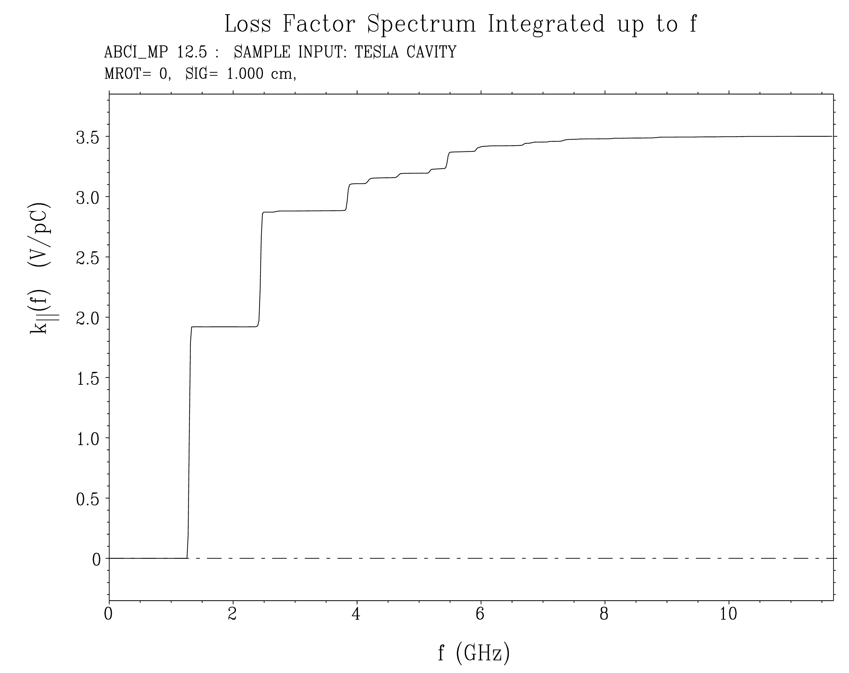
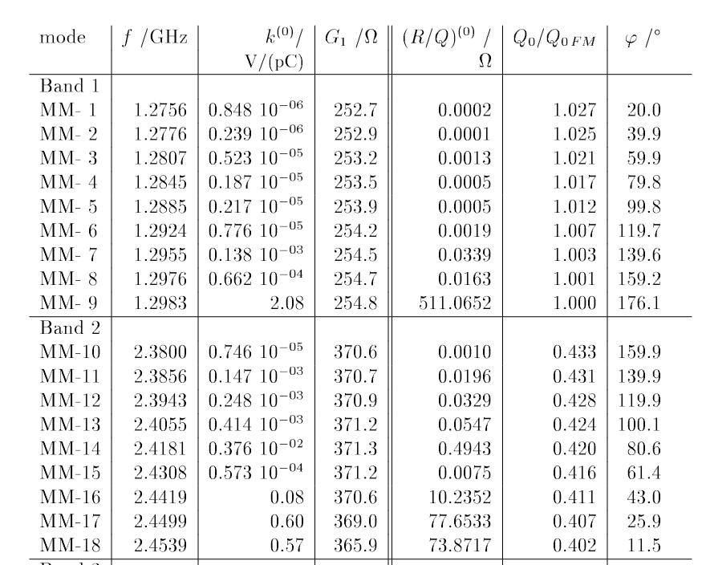

Summary (1)
K. Bane formulism not really valid with the bunch length of σ_{z} = 5 – 13 mm for simulations with intensity effects
Instead, use resonator model instead and calculate the induced voltage for each mode:
Extensive list of many HOMs in R. Wanzenberg’s note, 180 pages!
TM012
HOMs 1.5 V/pC
First two “strong” monopole HOM’s already contribute with 4.7 kW
fundamental mode, 2 V/pC

Slide 3
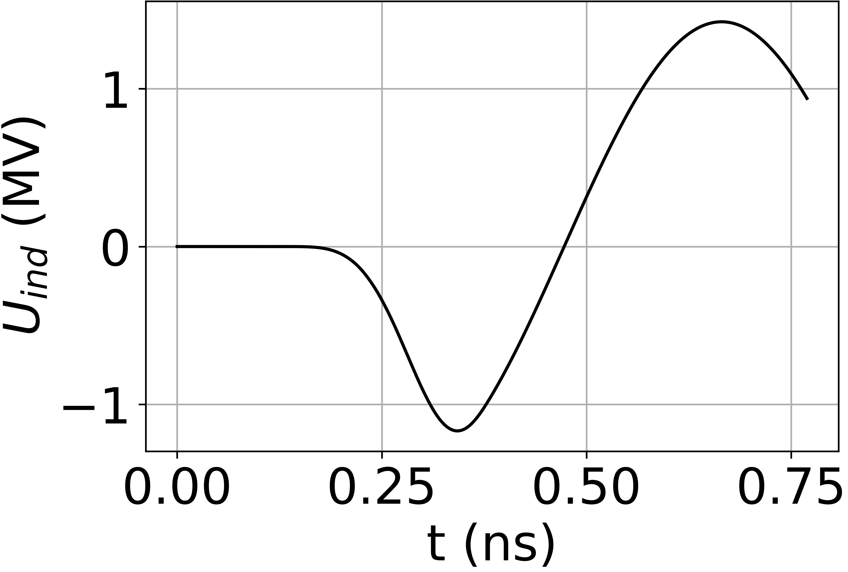
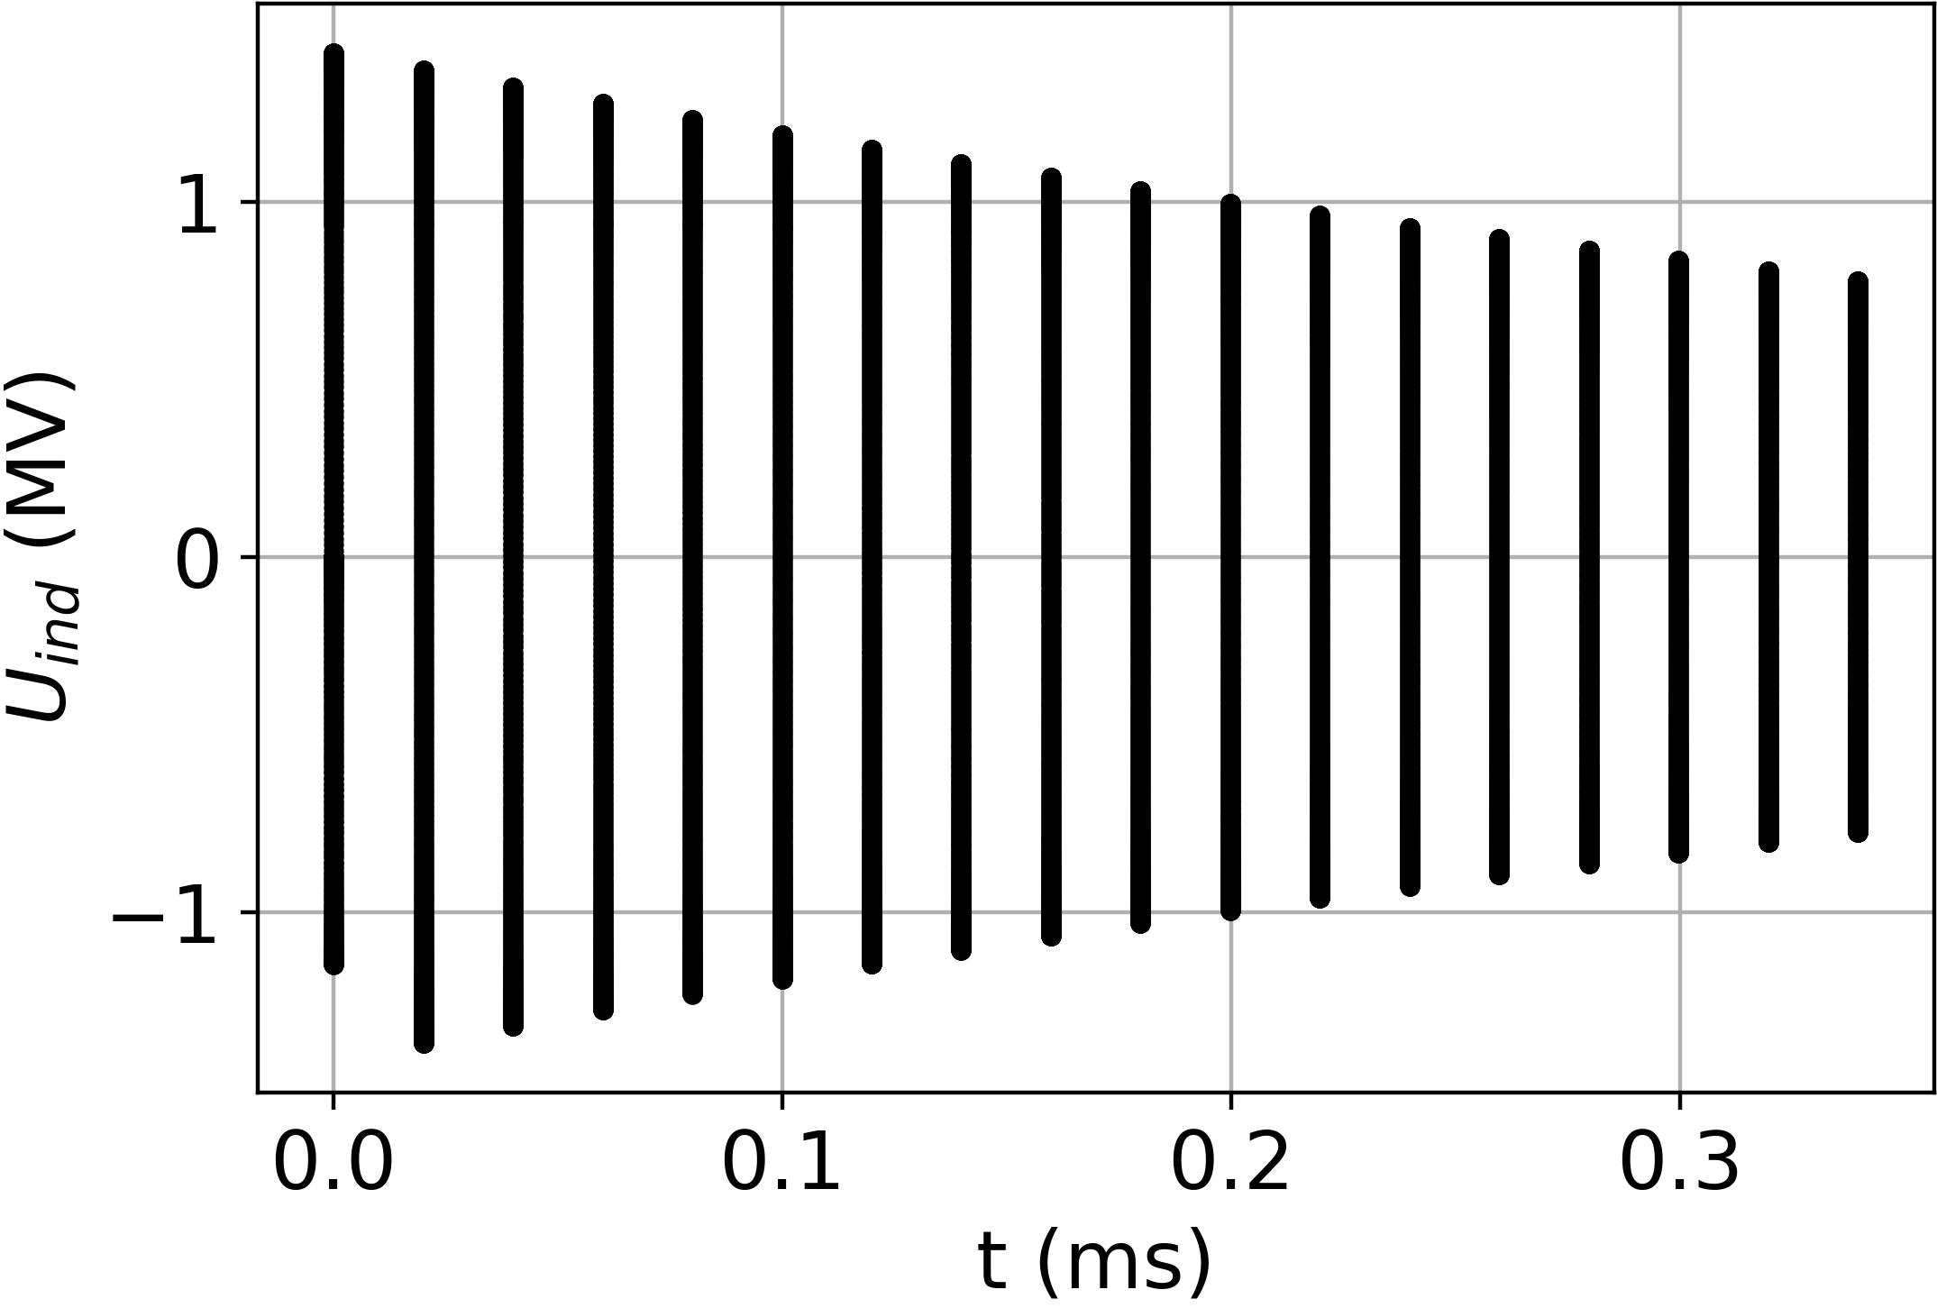
Summary (2)
Multi-turn wakefields calculated not for all buckets, but only those of interest:
Multi-turn wakefields implemented in BlonD: Calculates induced voltage of that turn plus the multi-turn fields of the previous turn
Initial bench mark tests promising, final bench marking with old code on cluster in progress
For RCS 1, Q_{L} = 2.2e6

Slide 4
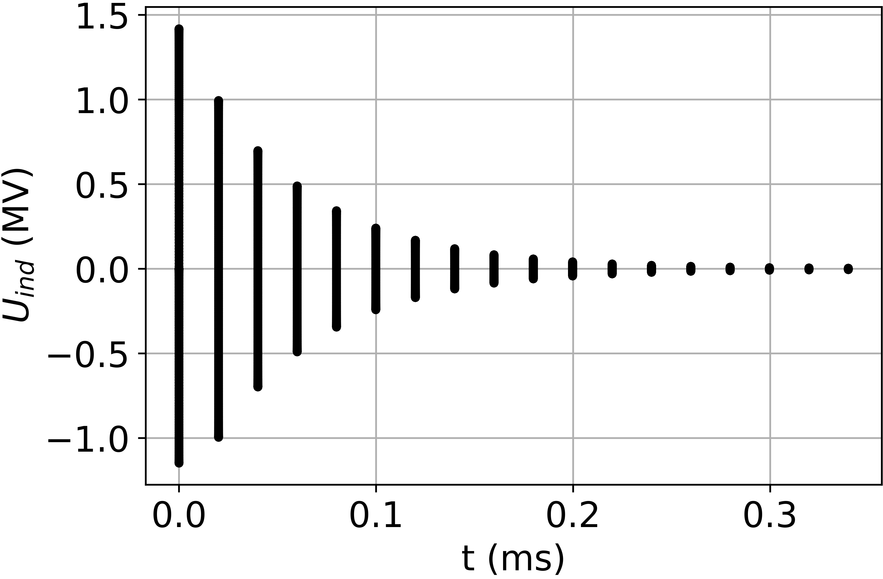
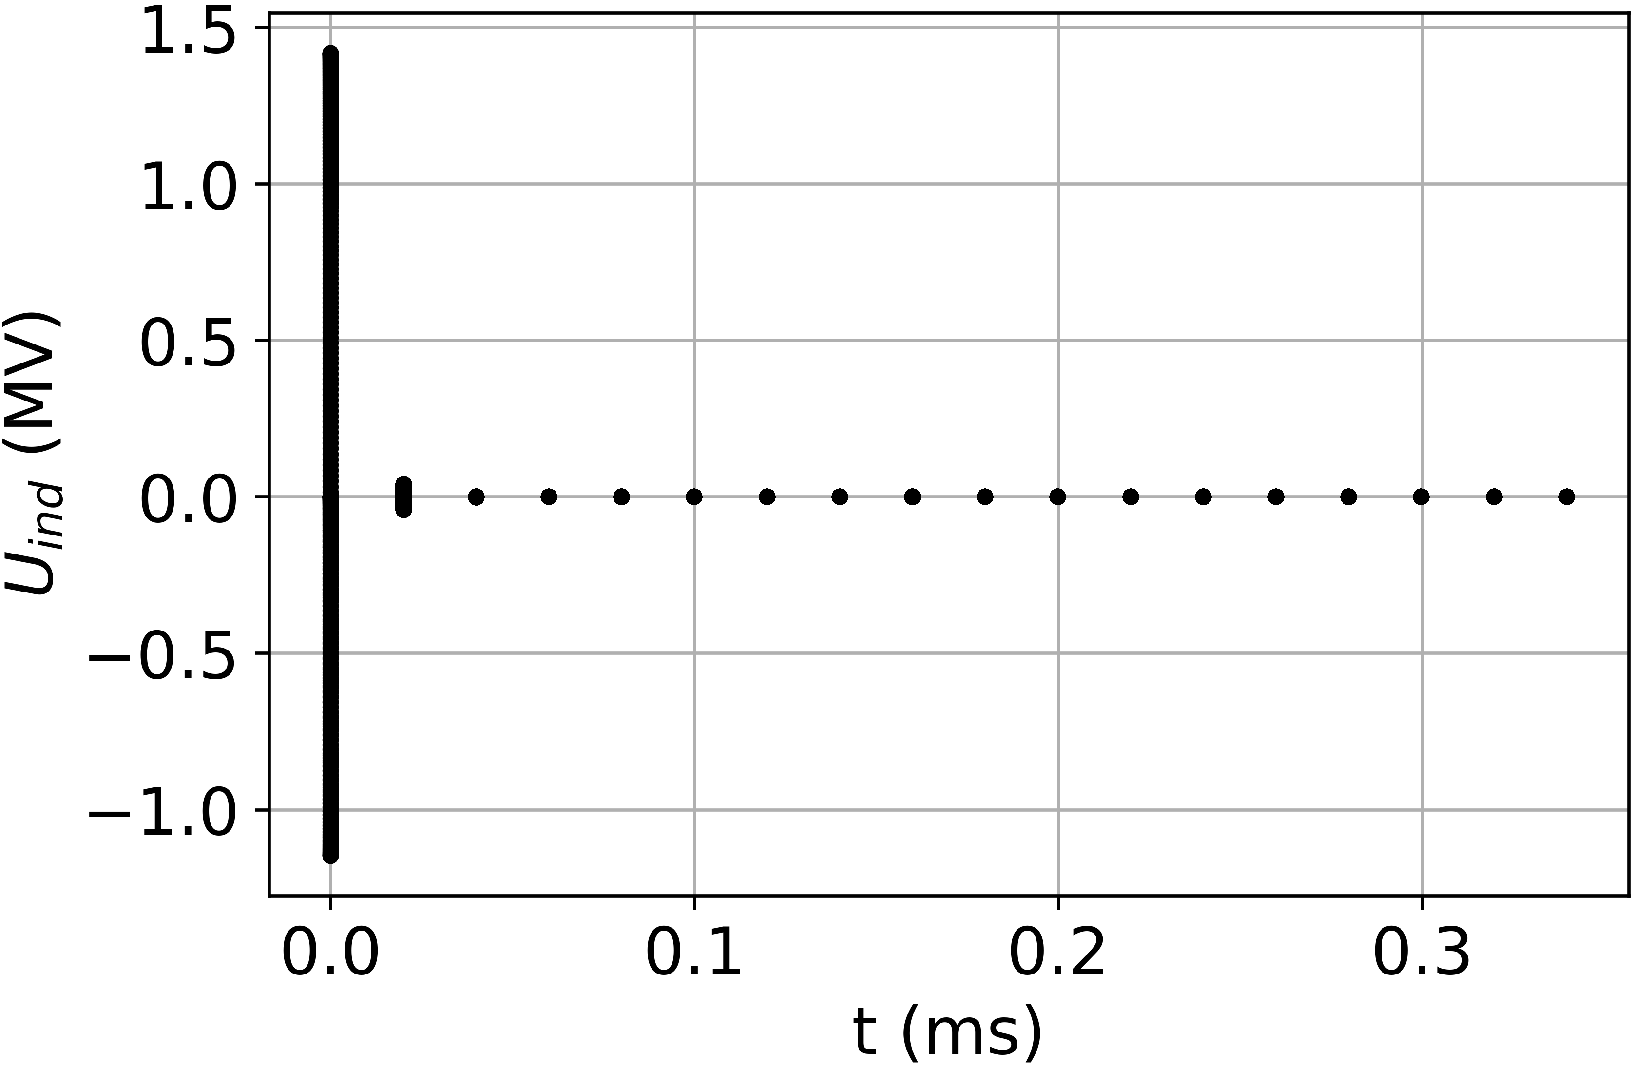
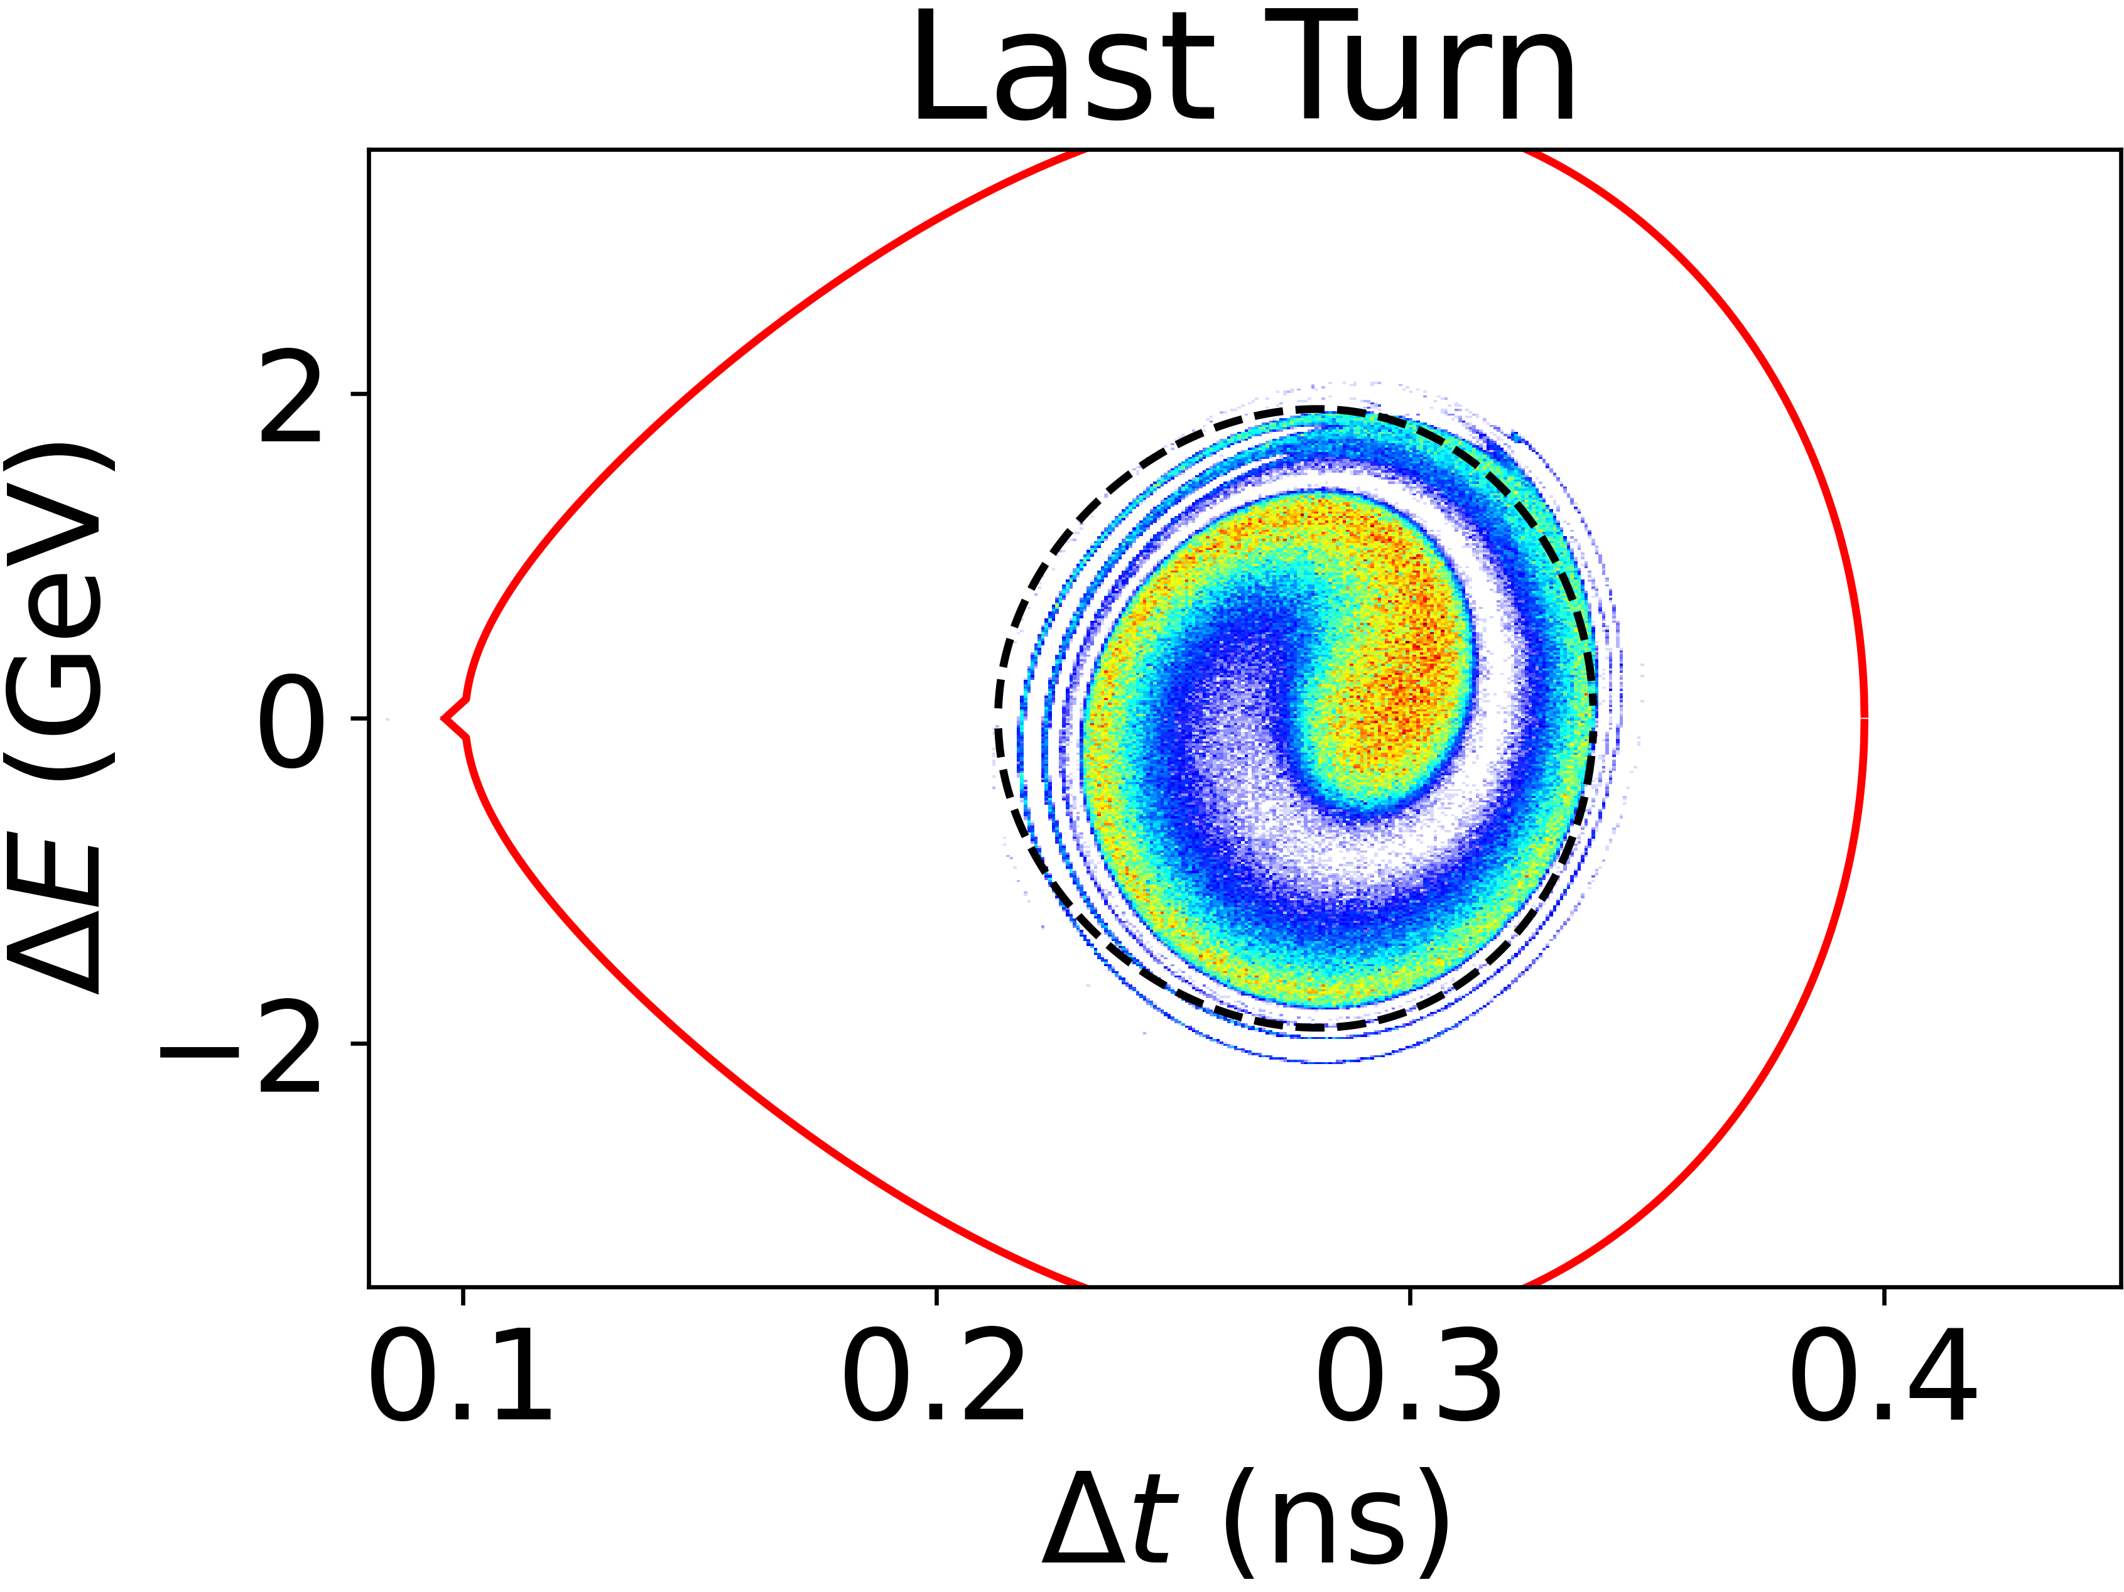
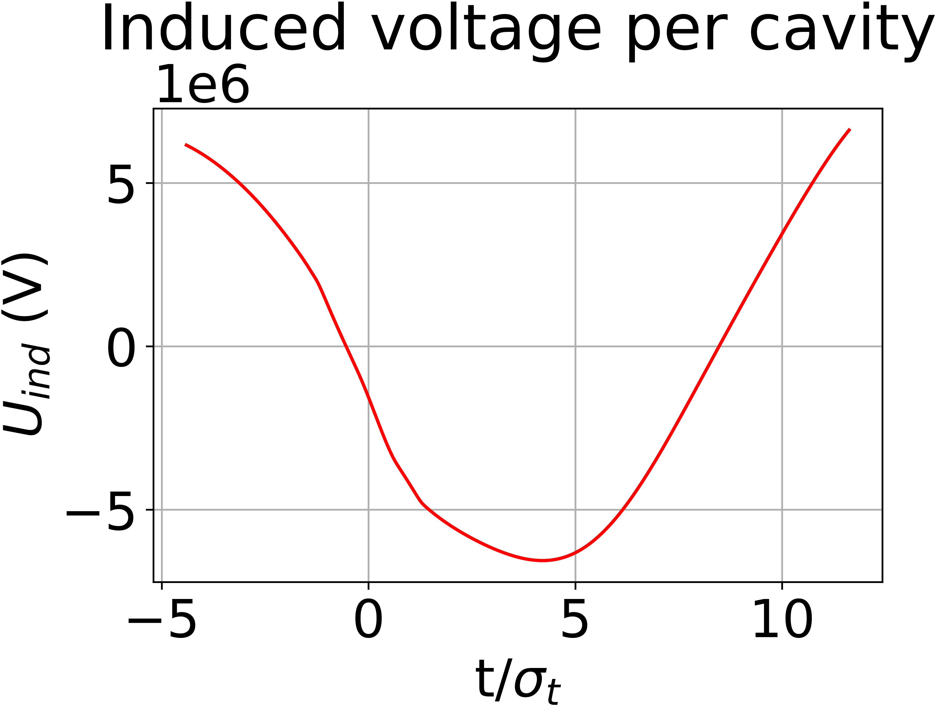
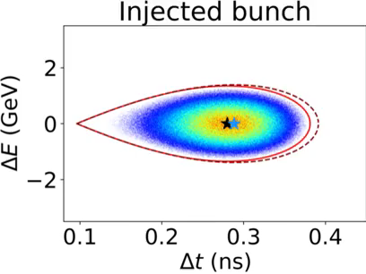
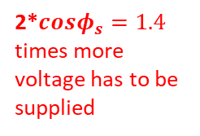
Summary (3)
Multi-turn wakefields calculated for different Q_{L} as test:
And in simulations
For RCS 1, Q_{L} = 2.2e6
For 0.1 Q_{L}
For 0.01 Q_{L}
For RCS 1, Q_{L} = 2.0e6
2*$cosφ_{s}=1.4$ times more voltage has to be supplied

Slide 5

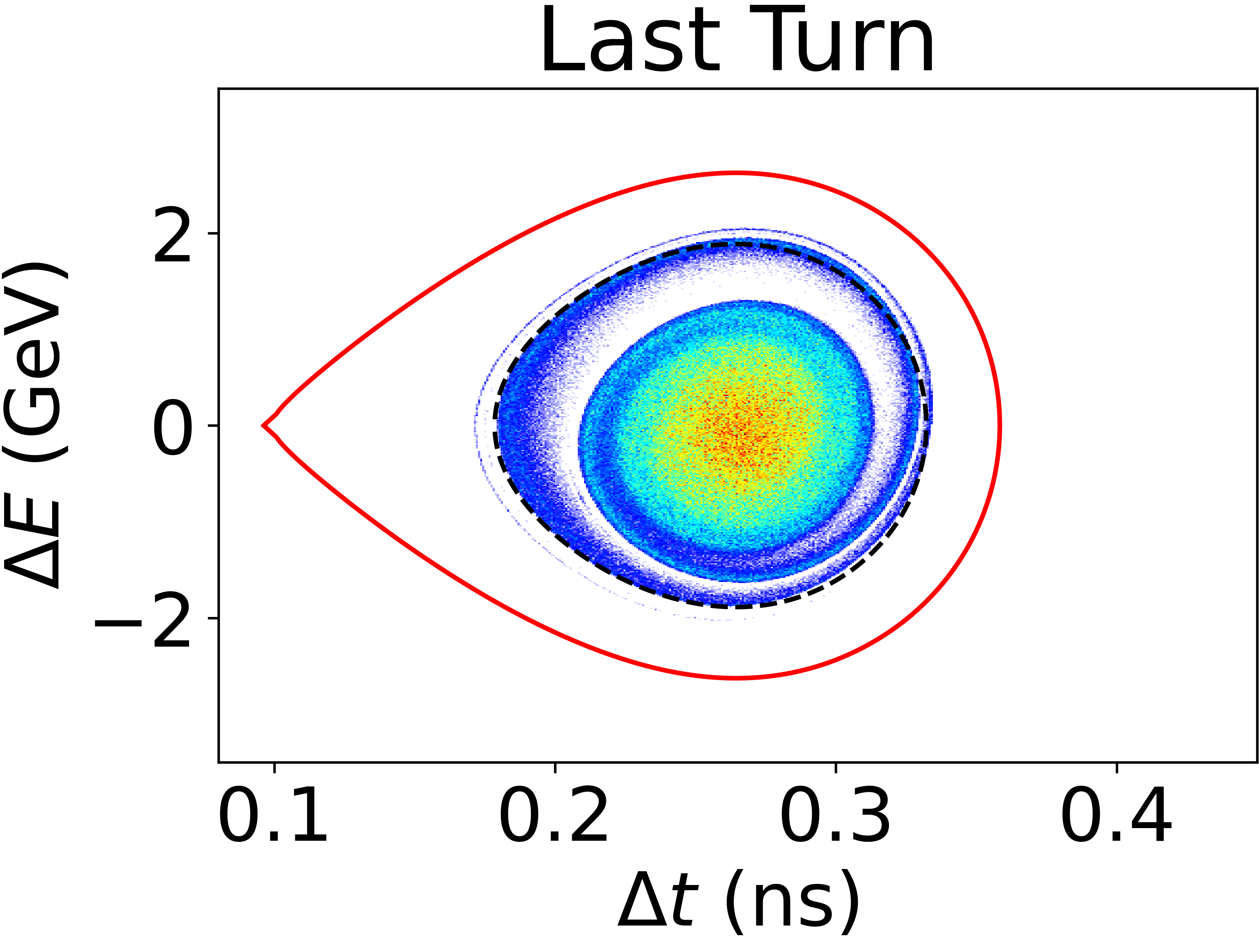
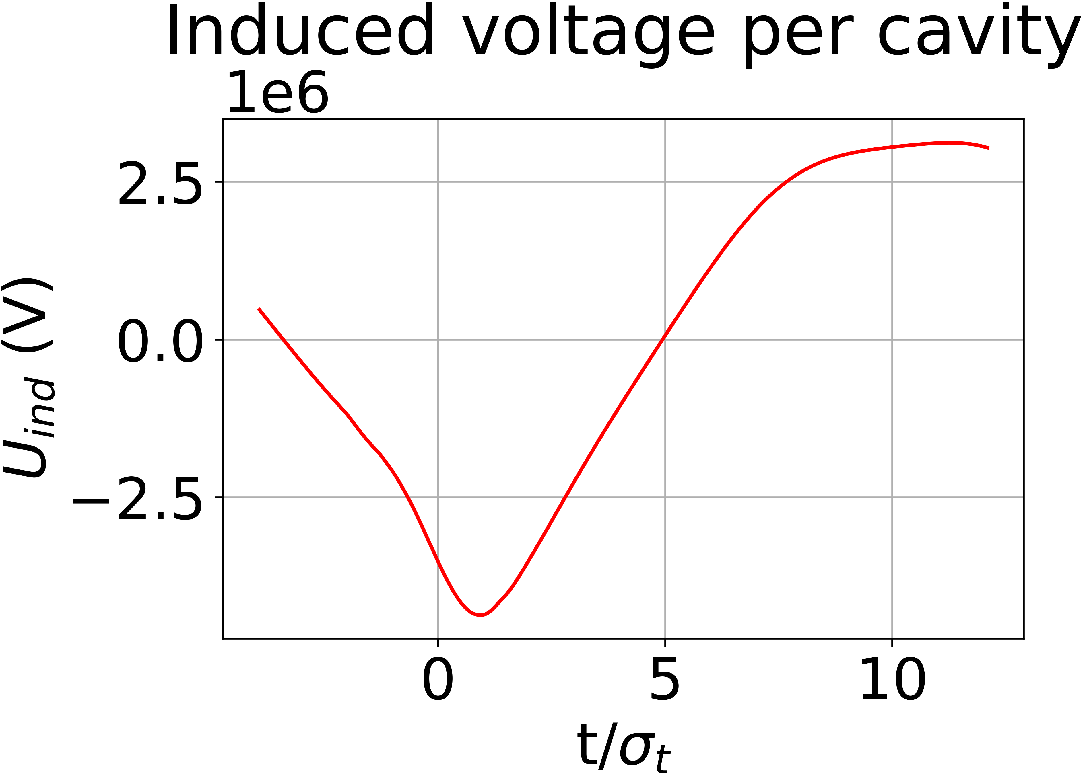
Summary (3)
Multi-turn wakefields calculated for different Q_{L} as test:
And in simulations
For RCS 1, Q_{L} = 2.2e6
For 0.1 Q_{L}
For 0.01 Q_{L}
For 0.1 Q_{L} = 2.2e5

Slide 6
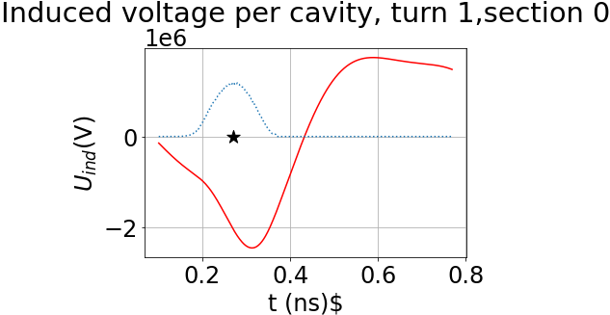
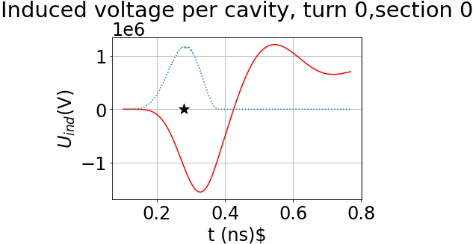
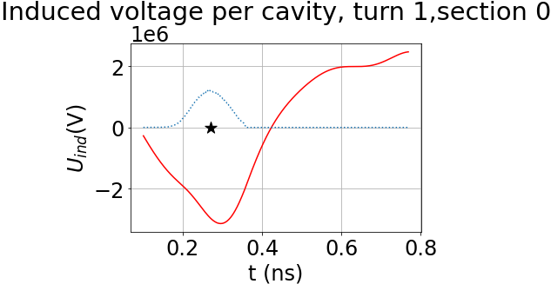
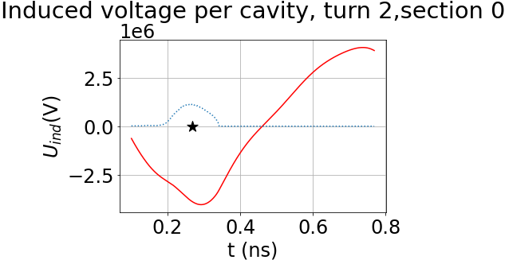
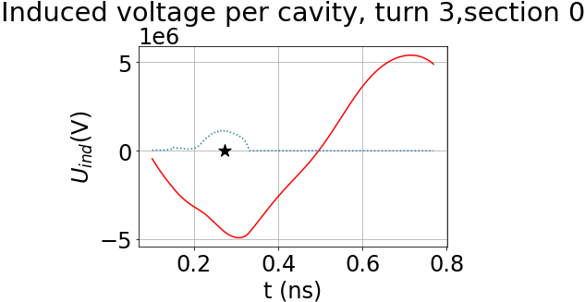
Summary (4)
Induced voltages per turn:

Slide 7
Summary summary
Implementation of multi-turn effects and counter-rotating bunches foreseen though resonator models per mode
Multi-turn wakefields implemented, but not 100% benchmarked
Effect of those scale with Q_{L}
More voltage, ca. 1.4 times more, has to be supplied to compensate the beam loading
→ Part of my HB2023 contribution “Intensity effects in a Chain of Muon RCS”
Preliminary!!!
Definition of ε_{L} unclear

Slide 8


