Slide 1
Computer graphics algorithms and techniques for Monte Carlo Simulation
Stewart T. Boogert
University of Manchester
Laurie Nevay
CERN

Slide 2
Aims
Enable complex geometric description and simulation with even less people resources than very modest HEP experiments
Improve transfer of geometry between commonly used codes and CAD
Promote maintainability and reuse of geometry
Reduce time between specifying task and physics results

Slide 3
Journey up to this point
Involvement in Geant4 started with trying to understand accelerator backgrounds, machine detector interface or dense beamlines
Accelerator and Medical physics requires Monte Carlo simulation
  Accelerators (Geant4, FLUKA, MCNP etc)
  Medical (Geant4)
Group developed multiple codes
  Beam delivery simulation (BDSIM)
  Pyg4ometry
  VTK visualization in Geant4
  CGAL Booleans for Geant4

Slide 4

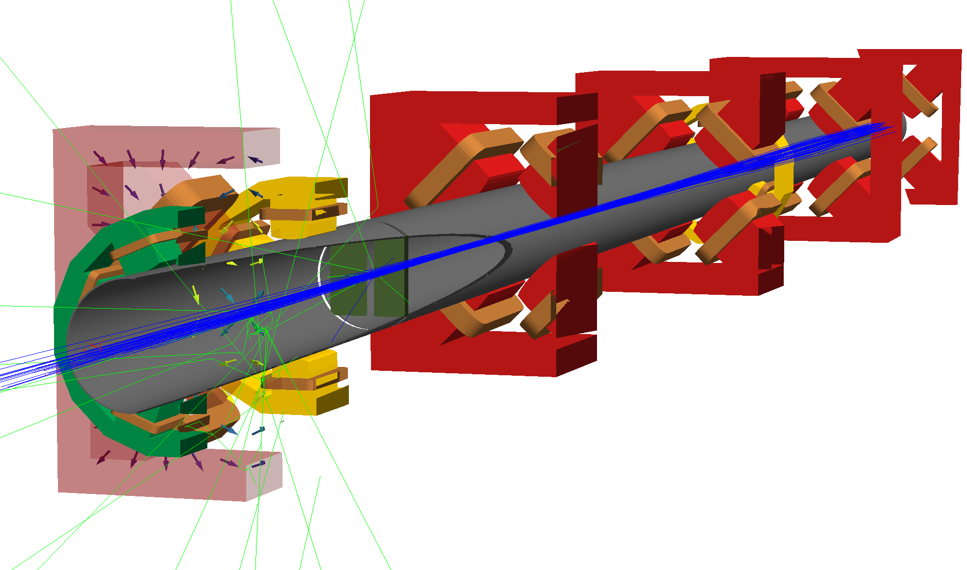
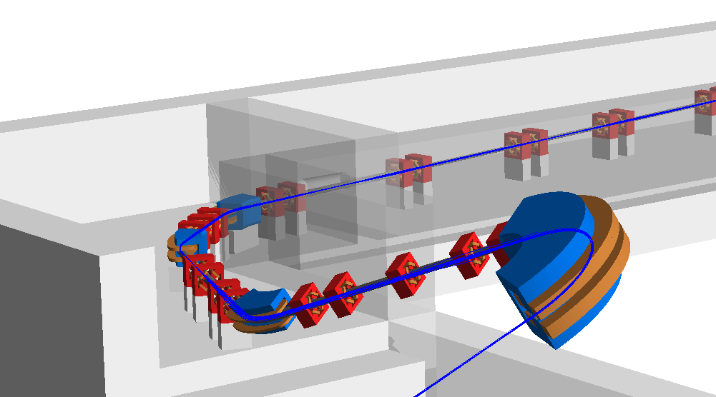
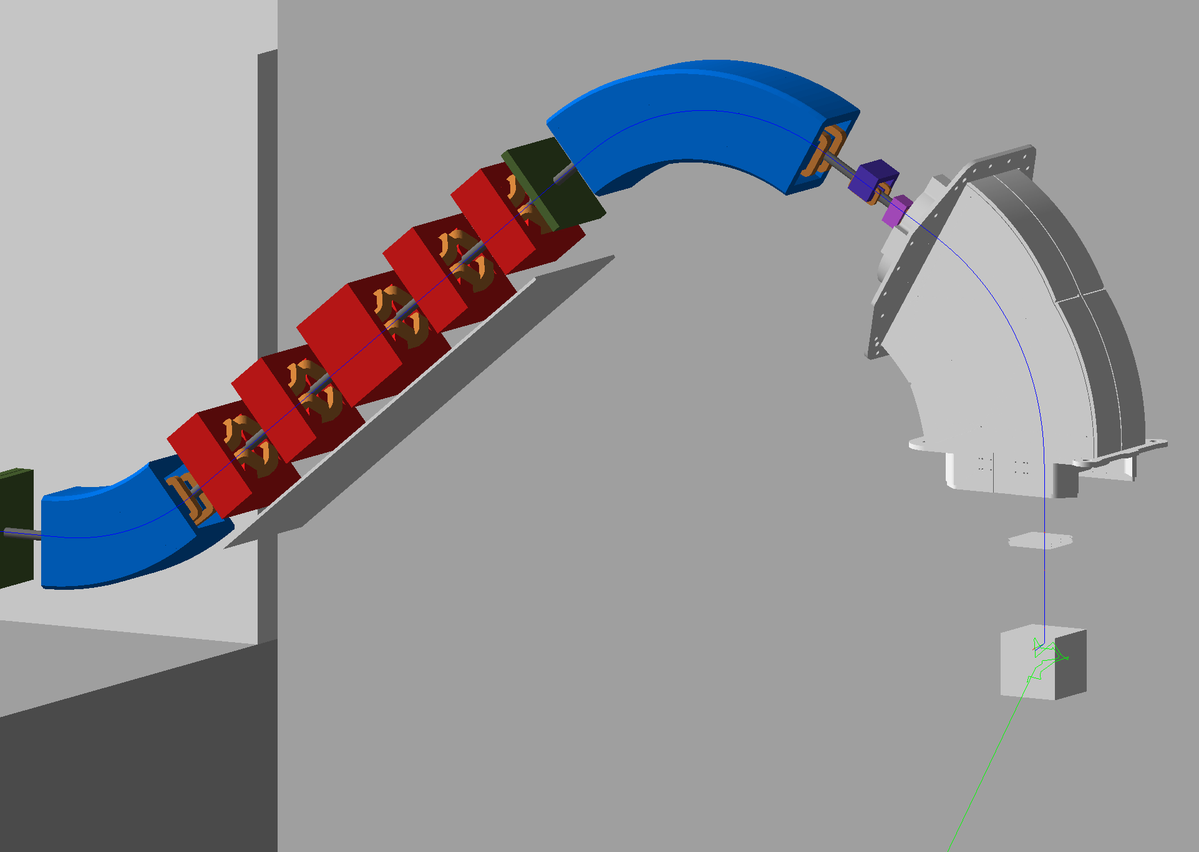
Beam delivery simulation
Geant4 based application to simulate beam lines
  Fast accelerator tracking in beam pipe
  Full physics outside
  Proton therapy systems, CERN beamline, EU-XFEL, PSI beamlines, FPF, FASER, HIKE/Shadows
  Design for ion radiobiology facility
http://www.pp.rhul.ac.uk/bdsim/manual/

Slide 5
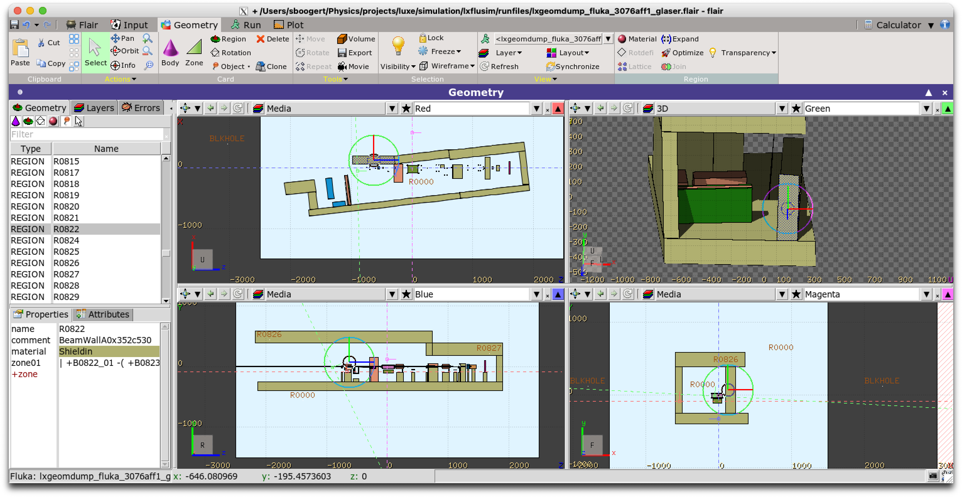
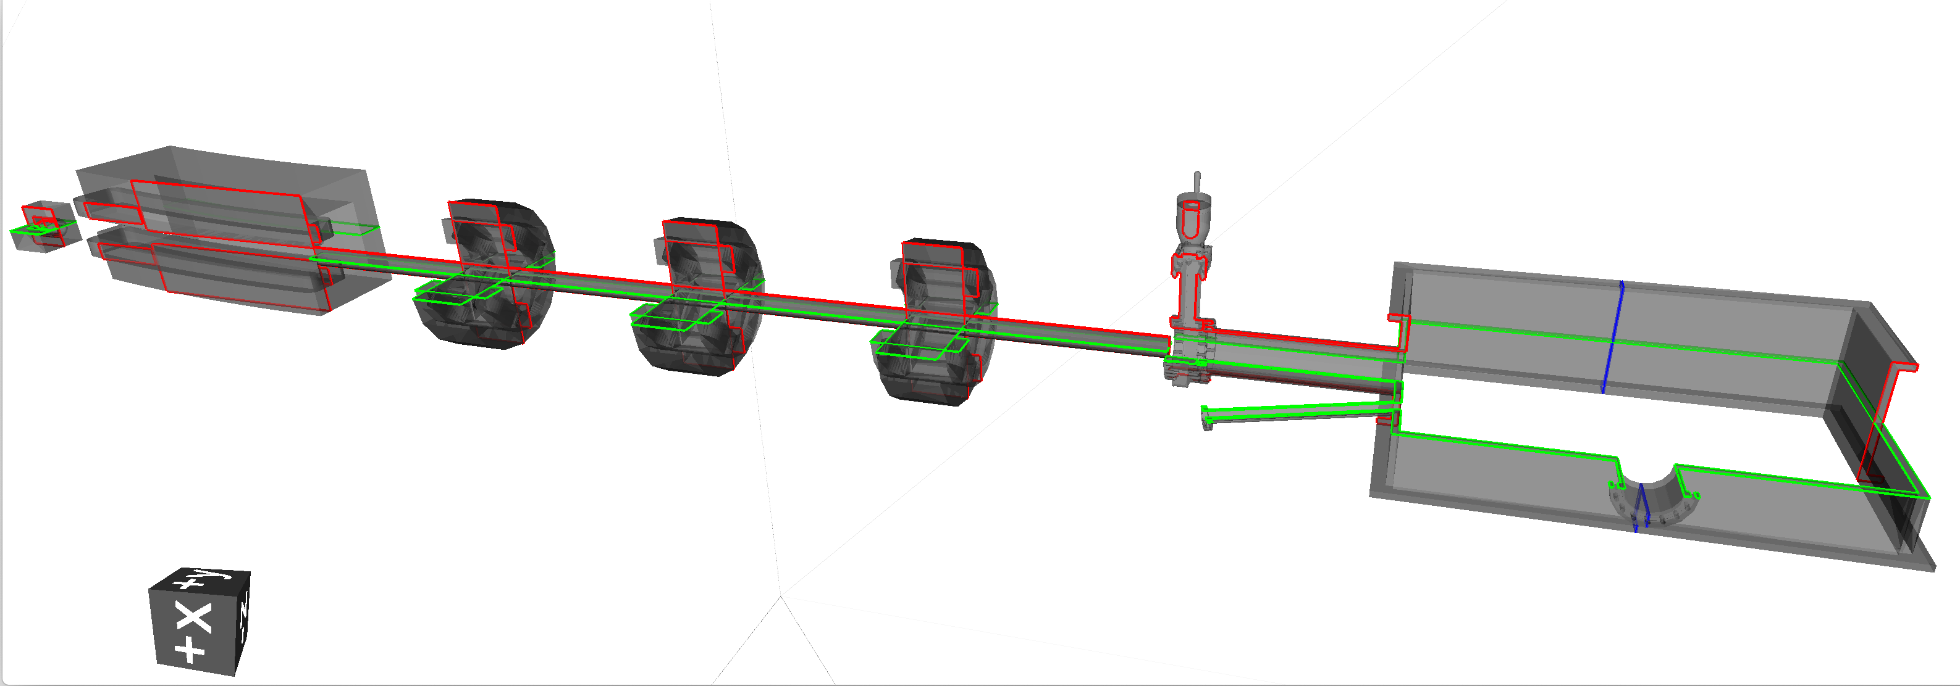
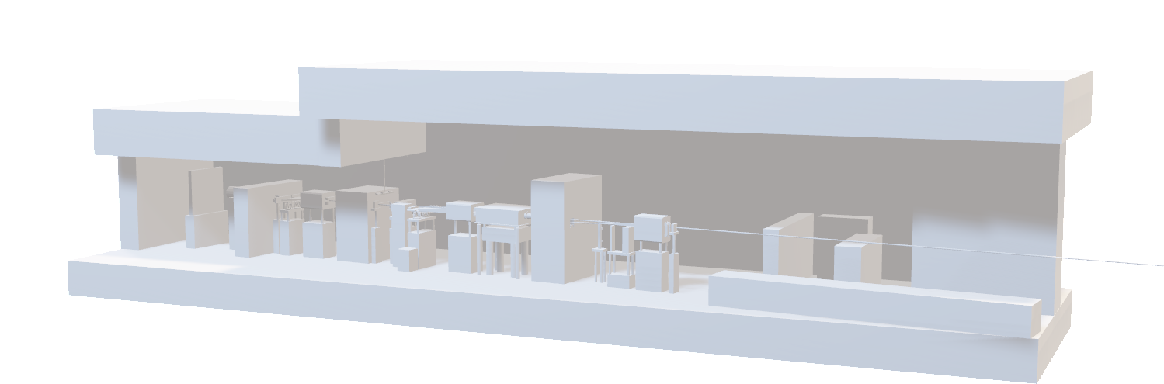
Pyg4ometry
Python library to manipulate and convert geometry
Basically
  Pythonic API to G4 geometry
  Ability to read/write gdml/inp/step
  Geometry manipulation via CGAL
  Visualisation in VTK
Not a replacement for DD4Hep/GDML
Expt users : Legend/Moller
CAD/STEP
GDML from
BDSIM
STL from vacuum
company
Python Geant4
Fluka
Faraday cup
https://github.com/g4edge/pyg4ometry

Slide 6
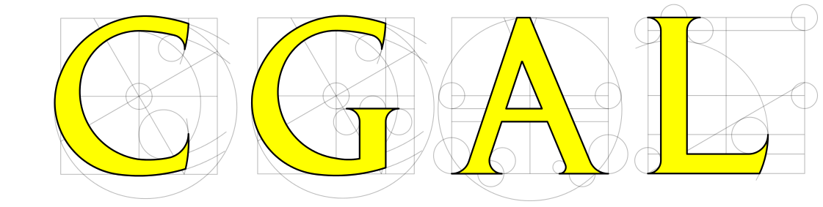
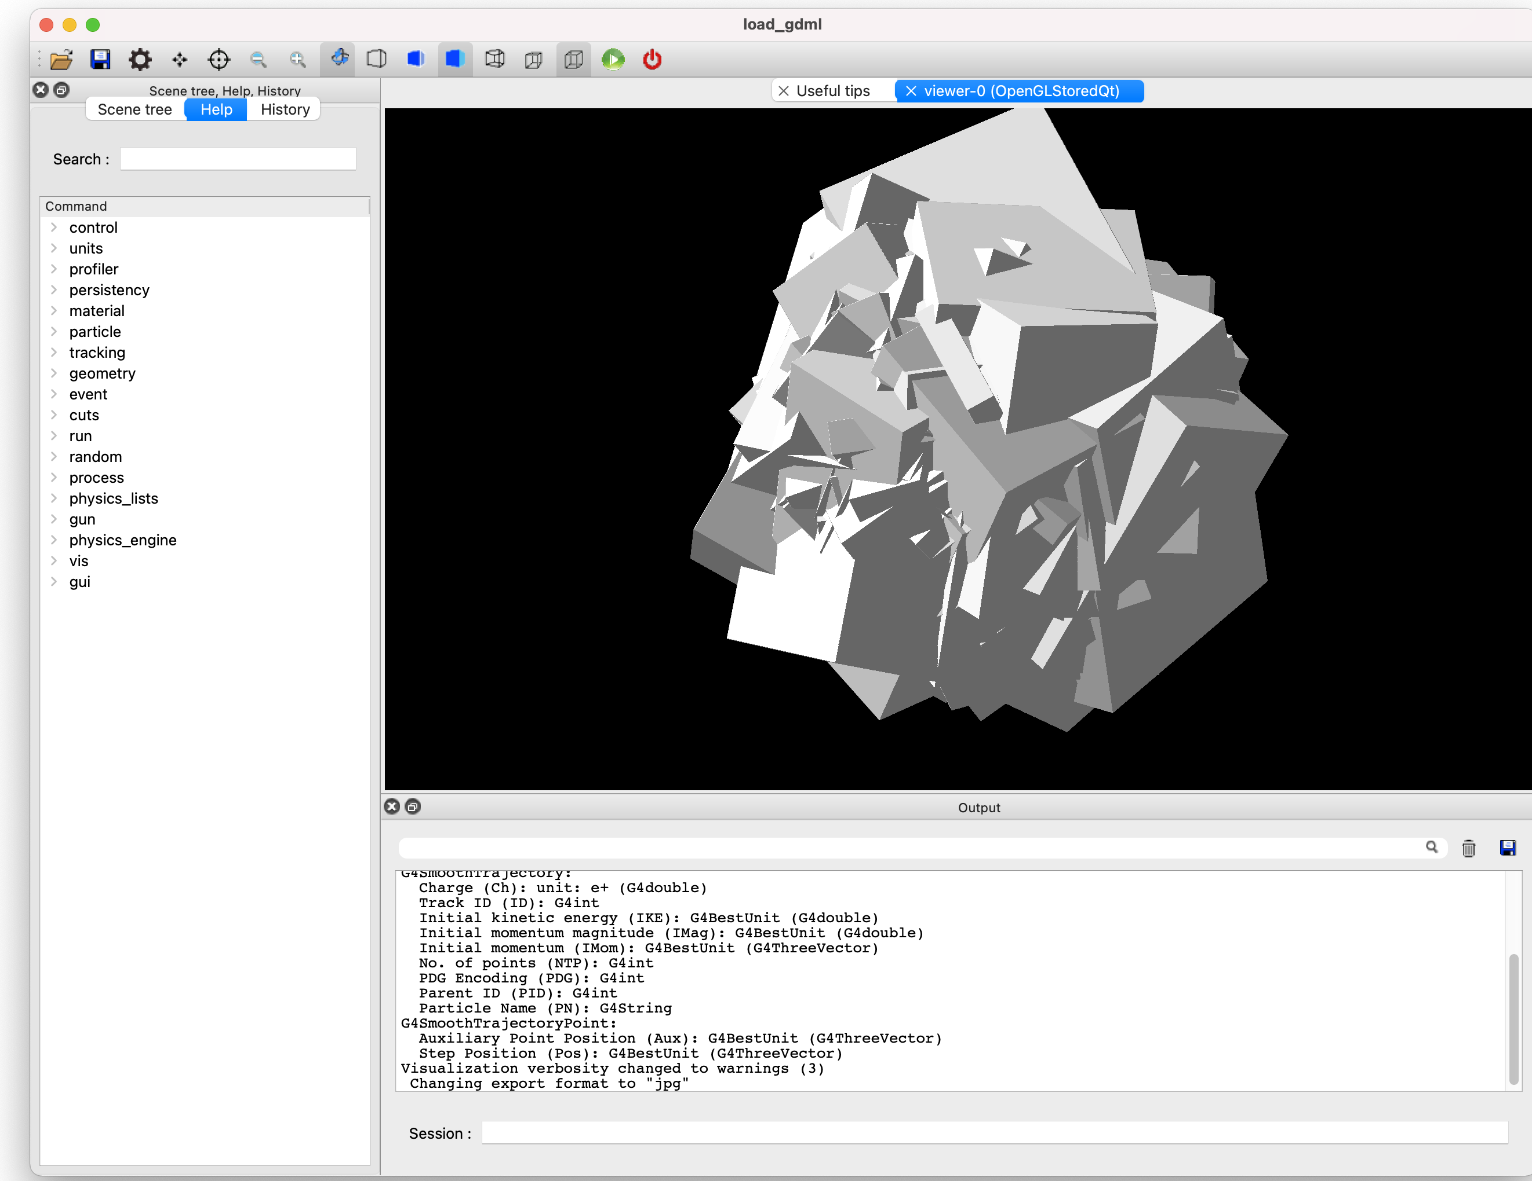
CGAL Boolean processing in Geant4
Geant4 default Boolean operations are not robust
Recent release of Geant4 to allow replacement Boolean processor
CGAL license does not allow distribution with Geant4
https://github.com/g4edge/g4cgal
Notes:
Computational Geometry Algorithms library

Slide 7

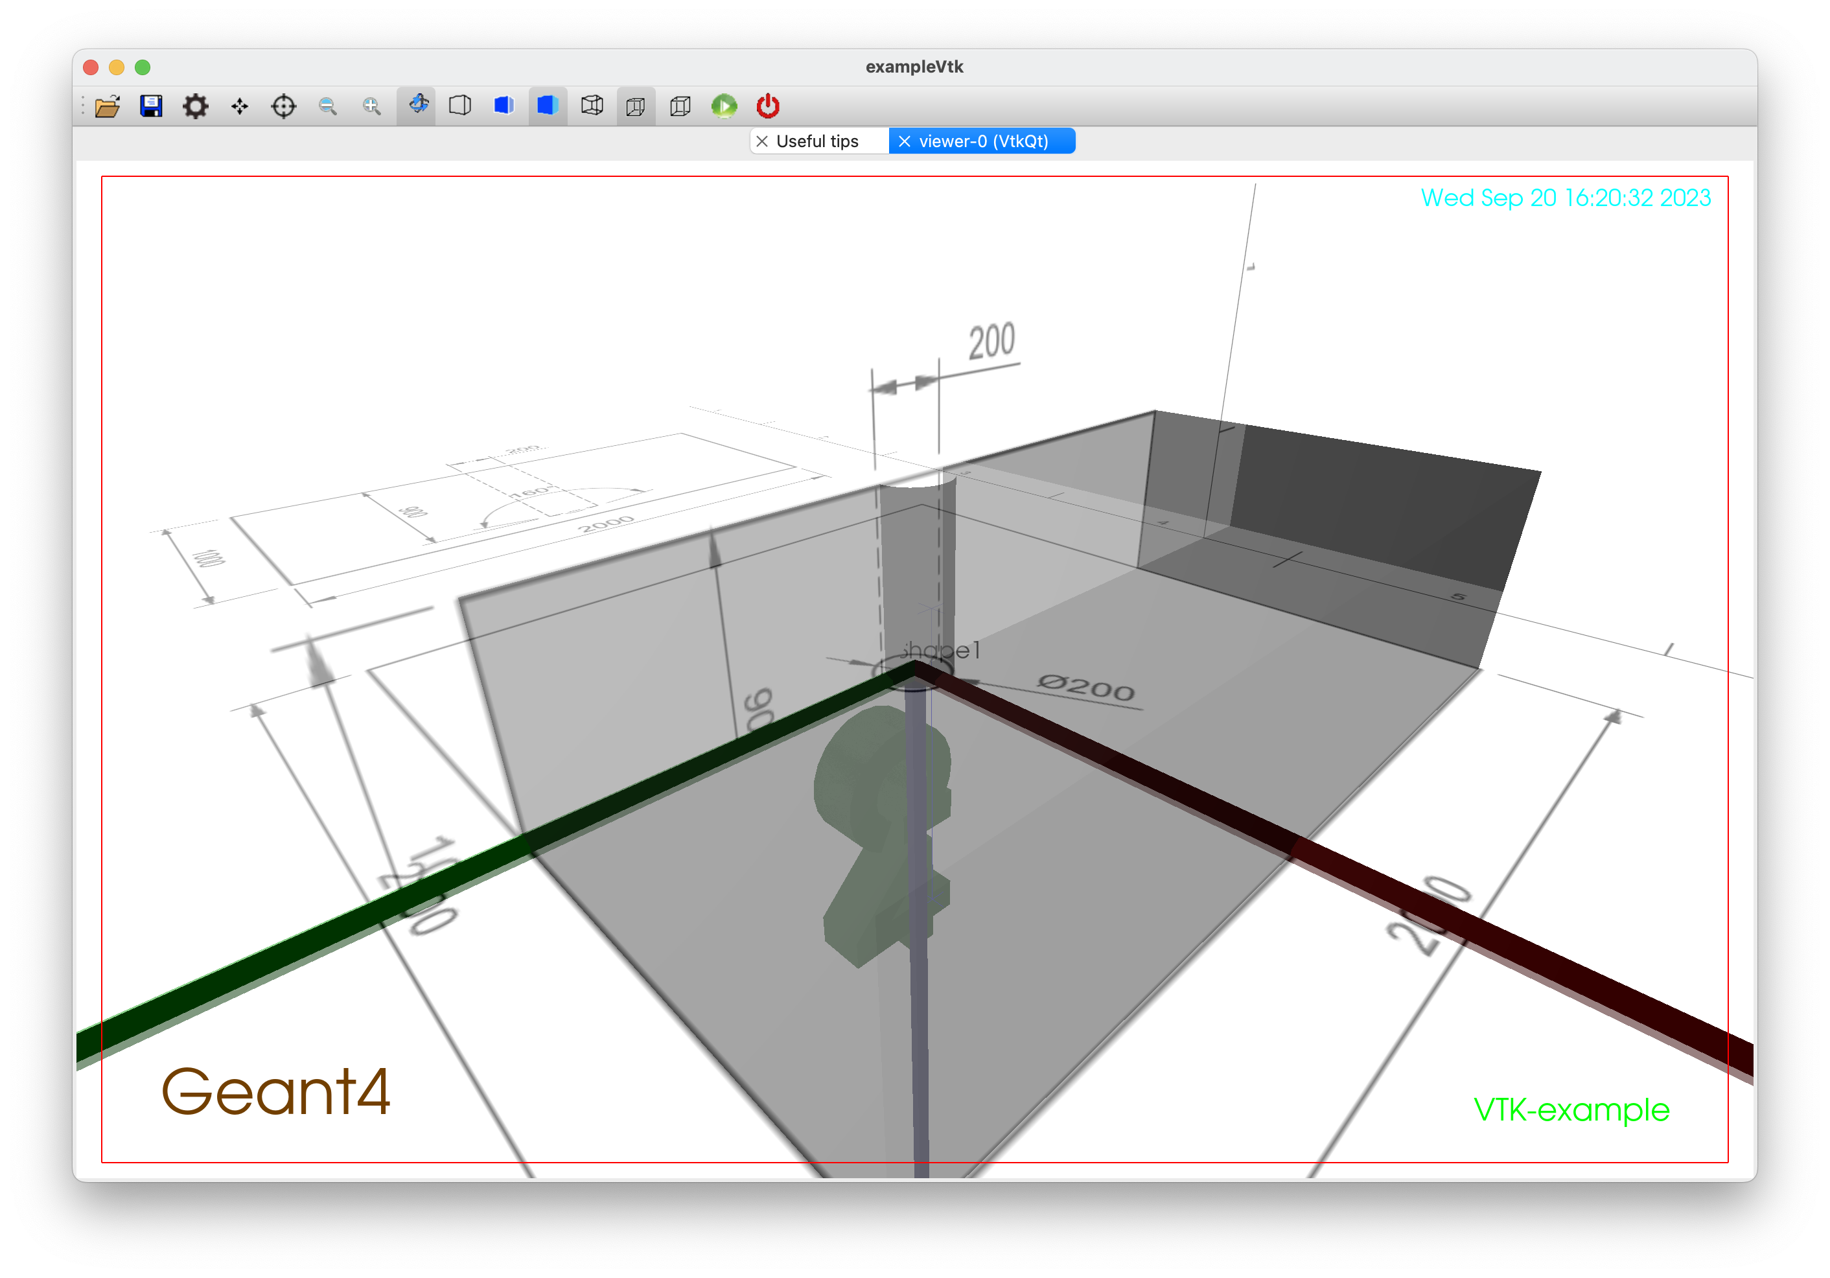
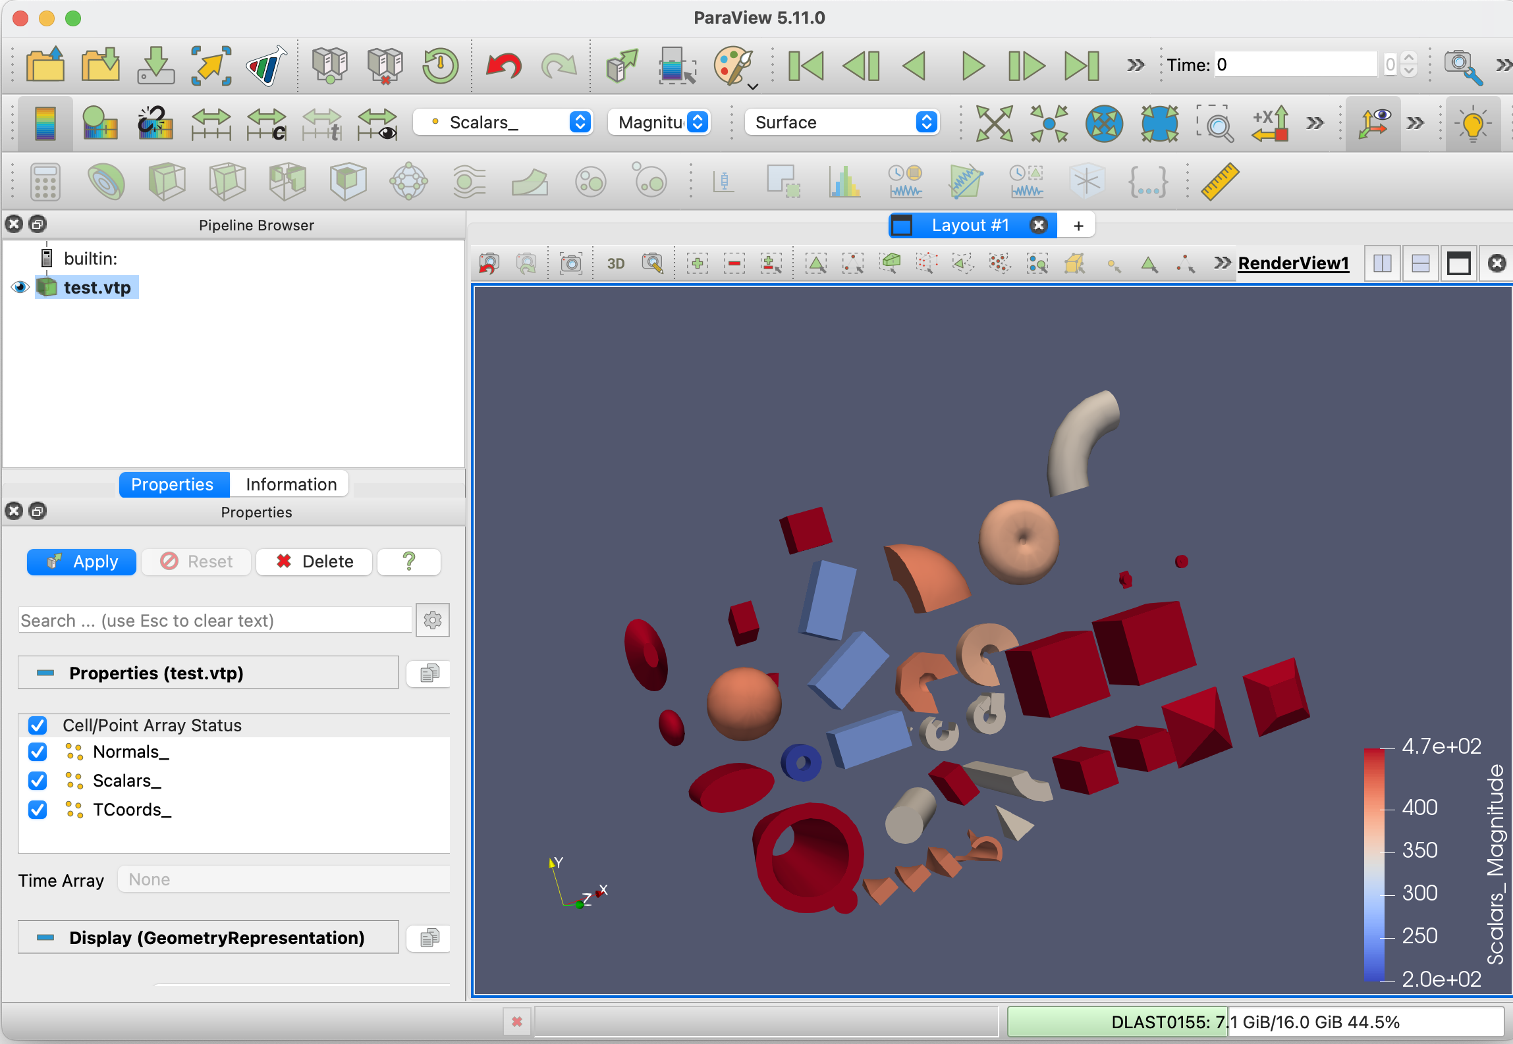
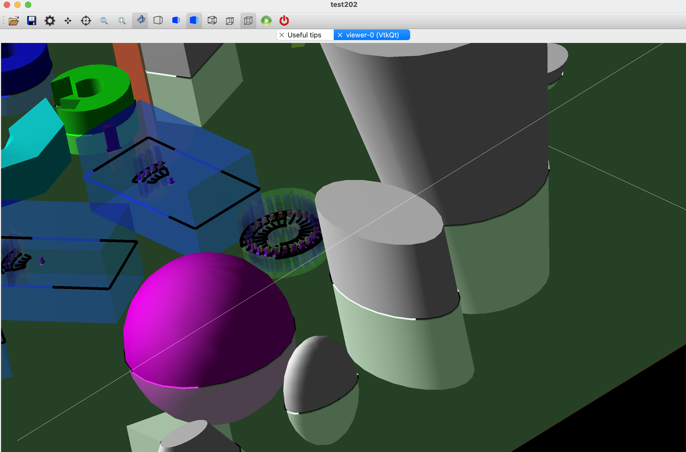
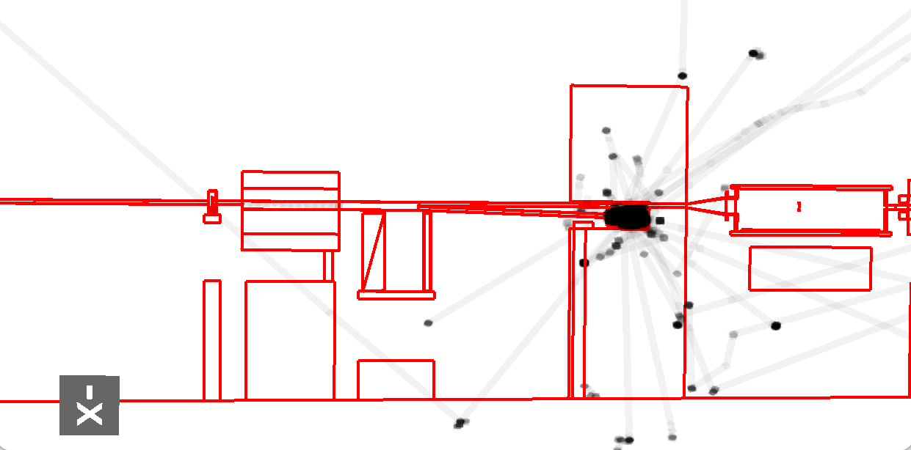
VTK visualisation driver for Geant4
The largest accelerator models could not be visualised using standard tools of geant4
  Developed pipelined VTK render for Geant4
  Good performance
  Well developed for next G4 release

Slide 8
Techniques in modern computer graphics
Accelerator (CAD, FLUKA)
  Half space decomposition of solids
  Loading of FLUKA/MCNP/PHITS geometry into Geant4
  Many non-Geant4 codes use a form of Constructive solid geometry (CSG) based on finite and infinite half spaces
  Need better half space geometry and tracking
Medical
  Phantoms are complex geometries not well described by standard solids
  Cubical voxel geometries generated by imaging systems also have limitations
    How to deform geometry?
  Reference phantoms are mesh based e.g ICRP145
  Need better mesh geometry tracking

Slide 9
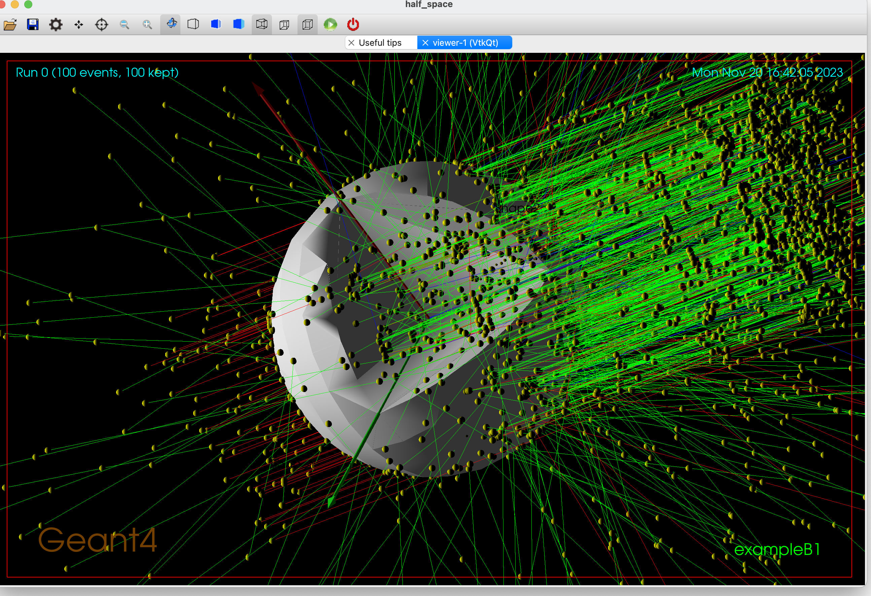
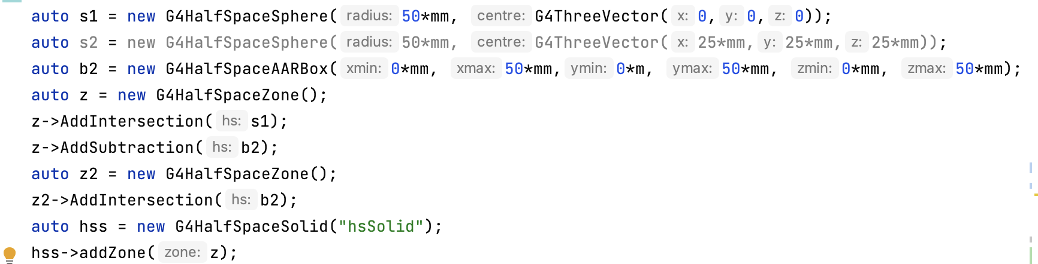
Prototype half space tracker being developed for Geant4
Half spaces are typically quadrics (2d quadratic surfaces)
  e.g. ellipsoid, hyperbolic cylinder etc.
  No fundamental reason why higher orders cannot be included (apart from computational speed and accuracy)
Relax requirement that geometry has to be in disjunctive normal form (DNF) i.e. union of convex solids
Signed distance fields (SDFs) perform all of the Boolean logic
  Helpful for distance to inside calculations
  Difficult/annoying to construct for some quadrics (requires 3rd/4th order polynomial roots)
  Use to determine if intersection is valid

Slide 10
Half space tracker possibilities
Bounded volume hierarchies to speed up
  Compare performance with DNF H–rep and one with a richer Boolean structure
Loaders (Antlr) for common formats to improve inter-operation
  MCNP, FLUKA, PHITs…
CAD conversion to H-rep is a relatively solved problem
  Still an issue with NURBS or other cubical splines
  Should there be a review of why we avoid these surfaces, i.e iterative solutions?

Slide 11
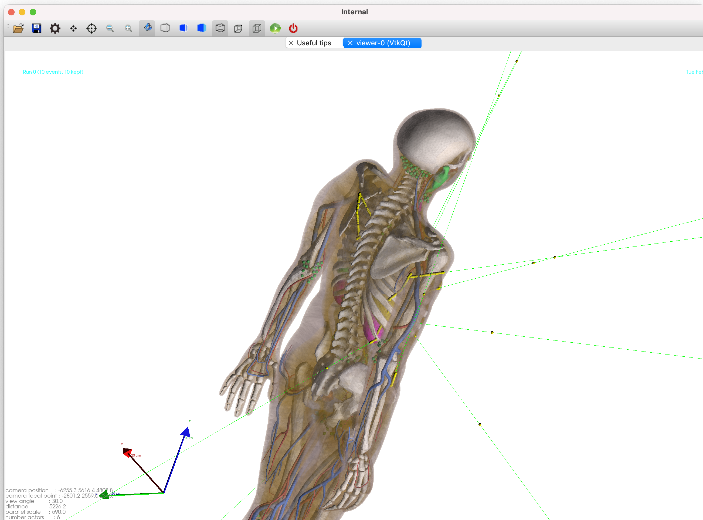
Medical phantoms
ICRP145 in geant4 rendered using VTK
  Typically, due to voxelization, users tetrahedralise the surface mesh
  Large files, difficult to manipulate
  Impossible to deform
Applications in personalised health care
Notes:
International Comission on Radiological Protection

Slide 12
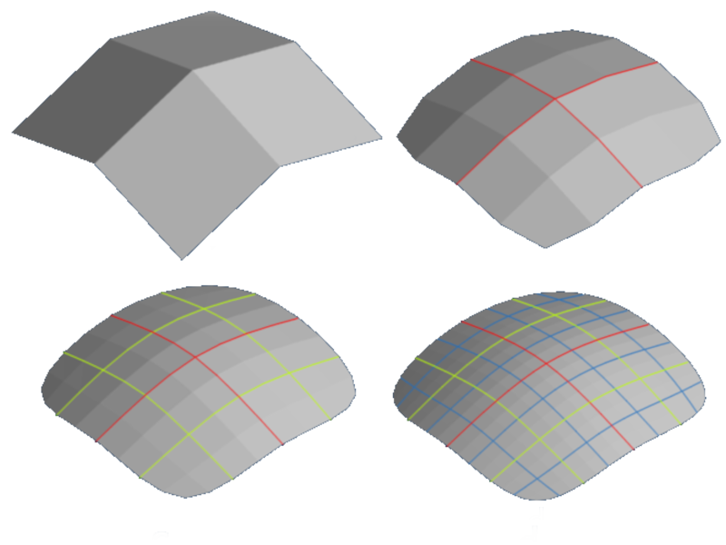
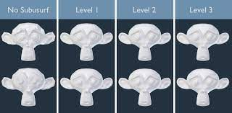
Subdivision meshes
Modelling in games/VFX typically do not use assets at full polygon count
  Algorithmic subdivision of geometry and if fine detail is required geometry shading
  Significantly easier to deform
  Lower memory for phantom models
Use of something like OpenSubdiv
Quad dominated meshes
Investigate subdivision during tracking and caching geometry

Slide 13
CGAL algorithms in Geant4
Boolean processing in Geant4 is a good start
Other algorithms
  Tetrahedralisation
  Mesh repair
  Decomposition
  Point cloud reconstruction
Same 3D geometry linked between Geant4-multiphysics simulations
Ultimately should direct use of triangular meshes be used to fully enable complex geometry
  BVHs a la Embree
  Or DagMC
  Need to fully explore for G4TesselatedSolid

Slide 14
Other algorithms
Differentiable rendering (e.g. Mitsuba3)
Is there an equivalent of level of detail (LoD) for MC
  Sources distant from a detector
Switch geometry description during simulation?
Wide range of variance reduction techniques in photon rendering

Slide 15
Programme of work
Complete H-rep tracker
  Data loaders for PHITS/MCNP etc
  Benchmark
Develop CAD H-rep converter
  Examples already existing from neutronics/nuclear community
Prototype subdivision tracker
  Embree based example started for tessellated solids
Direct mesh tracking
  Binary space partitioning trees
  Bound volume hierarchies
Direct SDF tracking
  Allows a different form of modelling
  Sphere tracing is not efficient for MC workflows
Develop CGAL workflow within Geant4
  Tetrahedralisation
  Mesh repair
  Mesh simplification (for simulation optimization)
https://github.com/g4edge/g4cgal

Slide 16
Summary (my opinion)
Ok, ok so not quite HEP, not even HEP adjacent
Rich programe of possible work around half space representations, subdivision meshes, direct mesh tracking, SDFs and differentiable MC
Small accelerator group attacking these problems as need arises and with available capacity
Need a rich set of tools in this area to better allow us as a simulation community to track computer graphics developments
  Formats (GLTF, USD)
  Simulation framework (e.g. Geant4) with CGAL, Embree, OpenSubdiv, OpenVDB, Mitsuba3 integrated

