Slide 1


WP1.1 Intelligent Data Management
Timothy Noble
22 Nov 2023
Notes:
The abstract pattern can be removed or repositioned if required. Be careful to ‘Send to Back’ so that it does not obscure any important information.

Slide 2
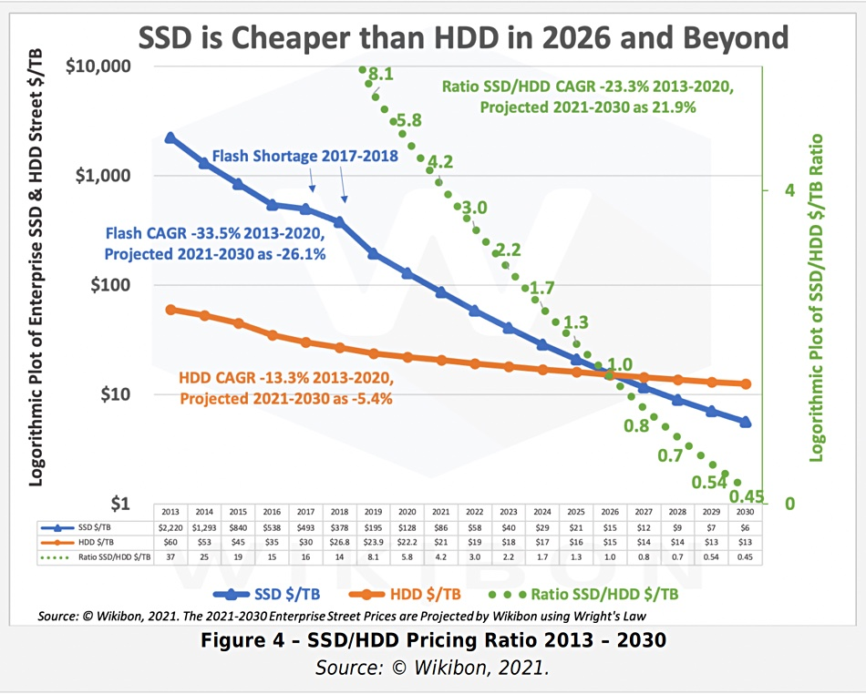
Work package 1 Vison
To optimise the use of the diverse Digital Infrastructure available to HEP experiments in the UK
HEP experiments record and produce more than 100 PByte of data every year, and is expected to increase to more than 1 EByte/year in the next five three years
  Storage is evolving, and much like compute resources, we need to adapt storage to a more heterogeneous environment
  Individual transfers need to be completed faster, and not just horizontally scale storage
The data-lake will be based on the Rucio data management tool

Slide 3
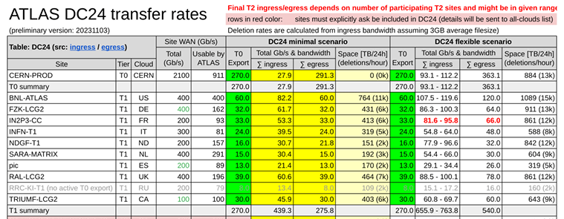
Data Challenge 2024 - DC24
A challenge to participating sites to ensure sites are on track to being able to accept HL-LHC data rates.
ATLAS and CMS RAW data from CERN to T1 to be ~800 Gbps per experiment, with an additional 200 Gbps for other data types
ATLAS DC24 data rates
Very high data rates and this is only a fraction of the HL-LHC data rate.
Investigating QoS, especially for SSD endpoints could be critical to ensure data rates into sites, as well as I/O for jobs

Slide 4
Work package 1.1
Intelligent Data Management
Set up a UK data-lake prototype.
  This will build on the DOMA prototype, with the intention that there will be one data lake per region/country.
Setting up the Data-lake in the first instance consists of 3 steps
  Configure core sites - current 10 RSEs configured in the UK
  Configure additional – different storage sites
  Generate metrics for comparison
Implement QoS information in Rucio
  Reliability of storage
  High performance storage

Slide 5
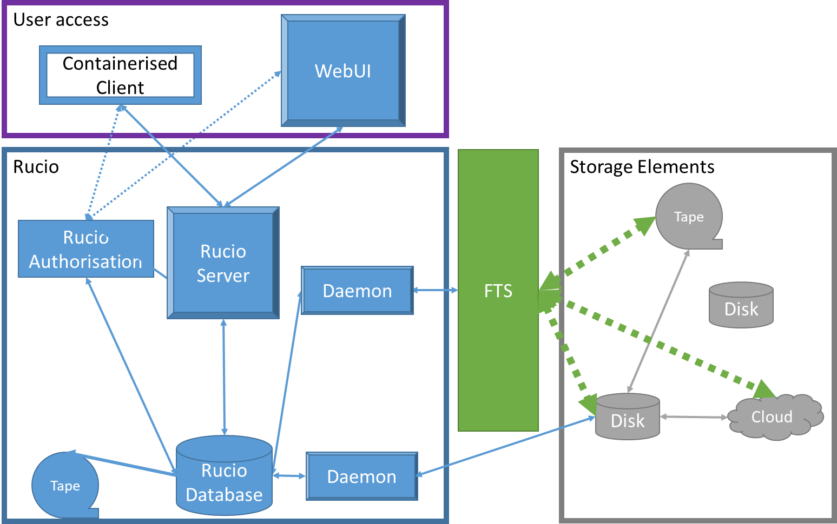
Rucio
Distributed data management tool
Used by several large experiments
  Handles Petabytes of data and Exabytes of data movement
  Treats different storage types with various behaviours
Adds a layer of abstraction between user and storage endpoints
Distributed components work together to orchestrate data movement as required
Image © STFC John Dawson
Notes:
PLEASE DELETE/REPLACE PHOTO CREDIT IF CHANGING THE IMAGE.

Slide 6
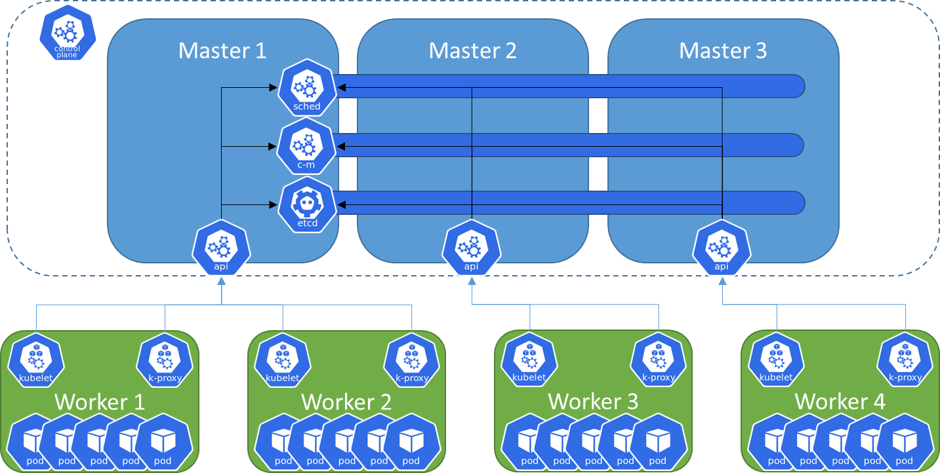
Kubernetes
Container orchestration system for automating scaling and management
Deployments environments described in easy-to-read and write YAML files
Containers are self contained units of software, that allow the software to be deployed anywhere
K8S orchestrates not just container deployment but networking, persistent storage, security, secret management

Slide 7
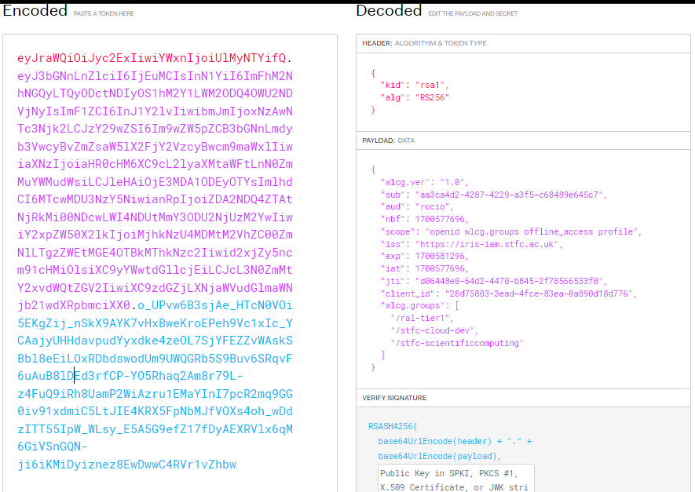
Tokens
WLCG is aiming for a transparent replacement of user X509 certificates + VOMS with tokens
CMS looking to use tokens for DC24 tests
With X509 becoming the optional / non-favoured authentication method for users in March 2024
Token authentication uses your institutional information to act as a assurance, then depending on the groups you are part of, give you authentication to perform specific actions
WLCG Token Transition Timeline working doc

Slide 8
Challenges for WP1.1
Deploying a Rucio instance that is flexible but robust for development and testing
Token authentication for data management – extending to the Analysis Facility
Maximising the SSD storage endpoints
Prioritising the data movement depending on job priority

Slide 9

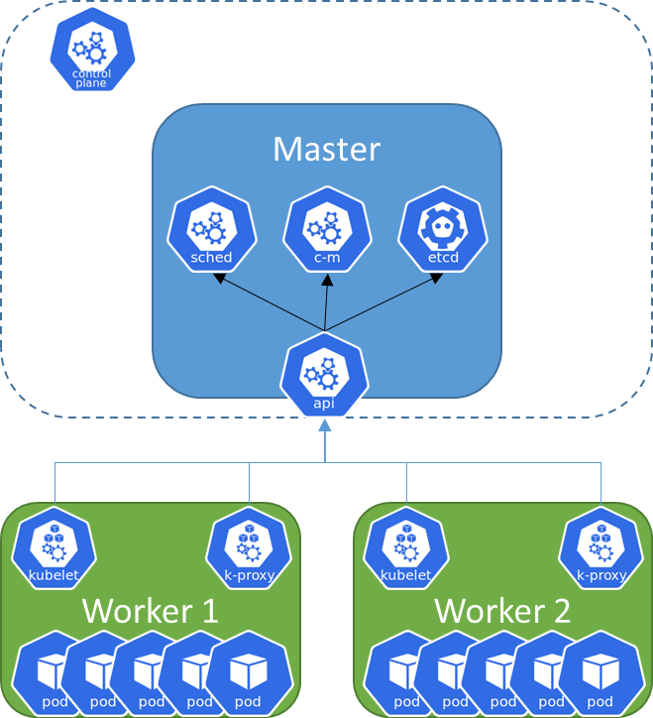

Kubernetes work
Rancher Container
Evolution of Kubernetes cluster from a simple deployment to something that is production ready
Deployment and iteration on K8S cluster deployment to make the cluster more reliable
Development of a production-ready K8S cluster, with Highly Available Master nodes
Move from a container used to create a cluster to a self-monitoring cluster using RKE2
Next step utilising the RAL Cloud K8S training to improve to a Cluster to integrate with OpenStack, and spin up and down Prod and Dev clusters

Slide 10
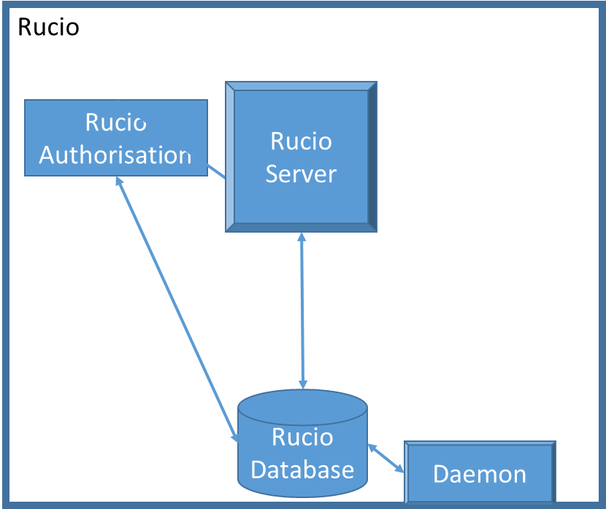
Kubernetes Deployment
GitLab Repo
ArgoCD
Rucio support shifted to K8S as the preferred way
Rucio is now deployed on the K8S cluster
Described in a GitHub Repository for a single source of truth and CI/CD integration to allow for development and deployment testing
Allowed for jump in versions to 1.29LTS bringing many features to Multi-VO Rucio
Working on upgrade to 32LTS (versioning format change, not a huge jump, the next LTS version)

Slide 11
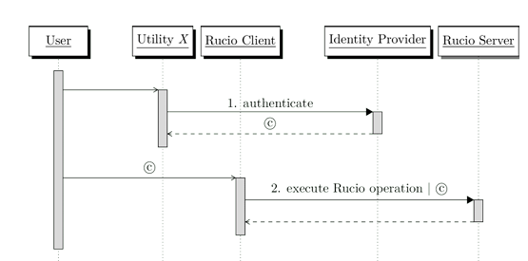
Token Authentication into Rucio
Tokens are coming, are we ready?
Token transition March 2024
Authentication with tokens to Rucio
Integrated into Rucio at RAL
  To be used for Functional tests as sites become token enabled
Token Concerns:
  specificity vs. rate of request
  Length of token life for FTS jobs
  Complexity of flows

Slide 12
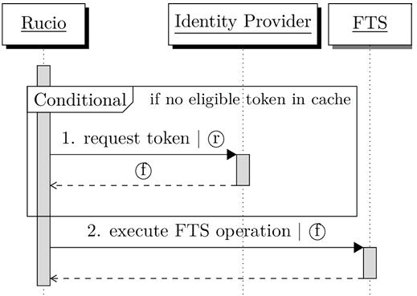
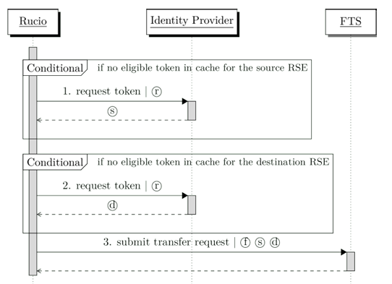
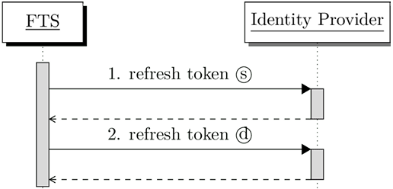
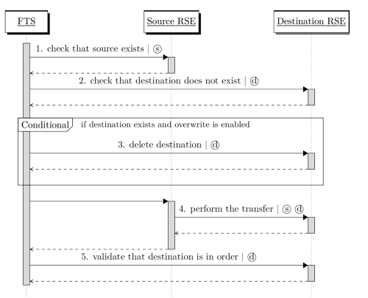
Token Authentication into Rucio
1.
2.
Rucio performing Third Party Copy using Tokens becomes quite a complicated workflow
Ensure authentication to use FTS
Obtain tokens to the source and destination storage endpoints
FTS maintaining tokens via refresh tokens
FTS running the actual Transfer
3.
4.

Slide 13
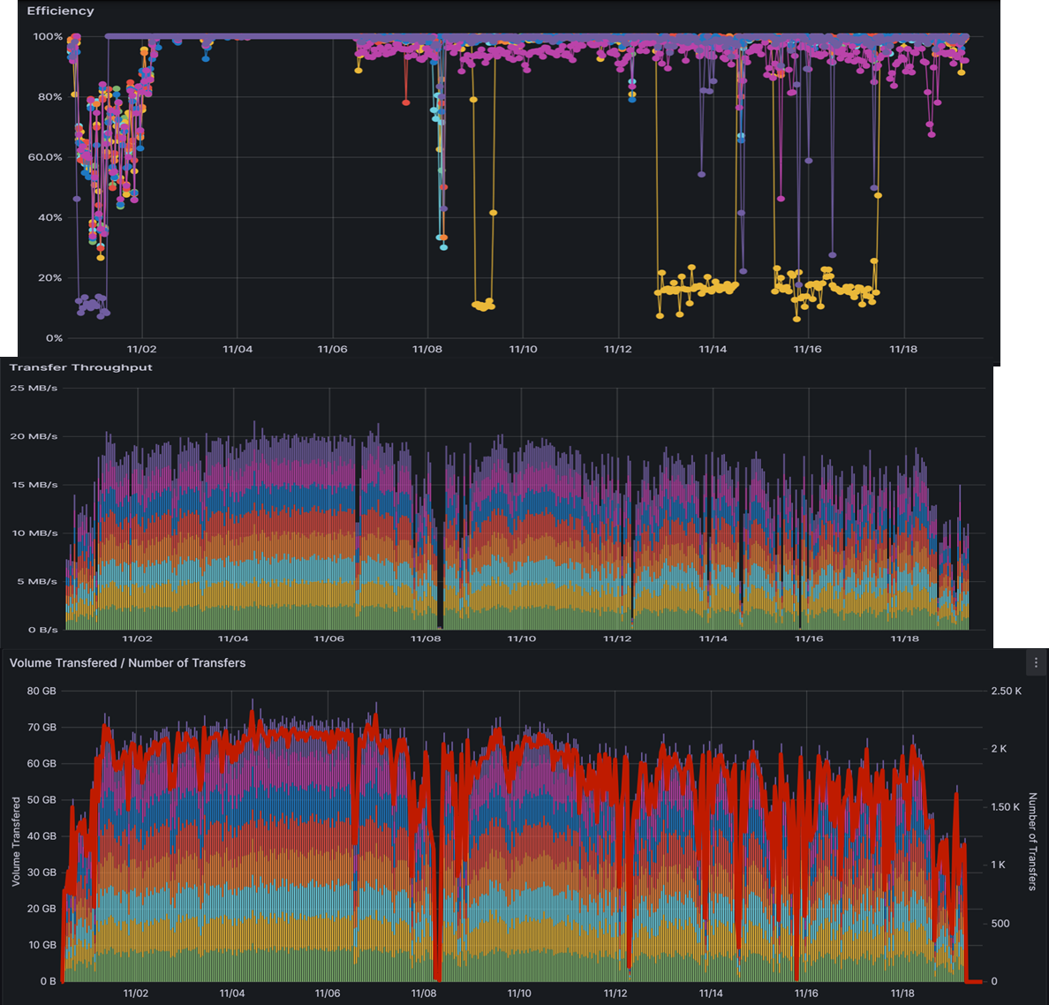
Monitoring of Functional Tests
Functional tests across the UK data lake setup now using Rucio components (Automatix and Transmogrifier)
Movement of around 60-70 GB an hour in tests, using 32MB files
  Simulating LSST data flow
Scalable functional testing tools to enable higher data rates and variable data sizes

Slide 14
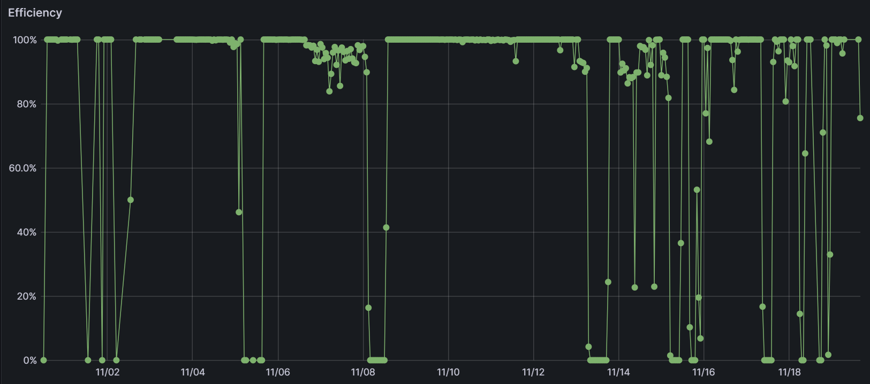
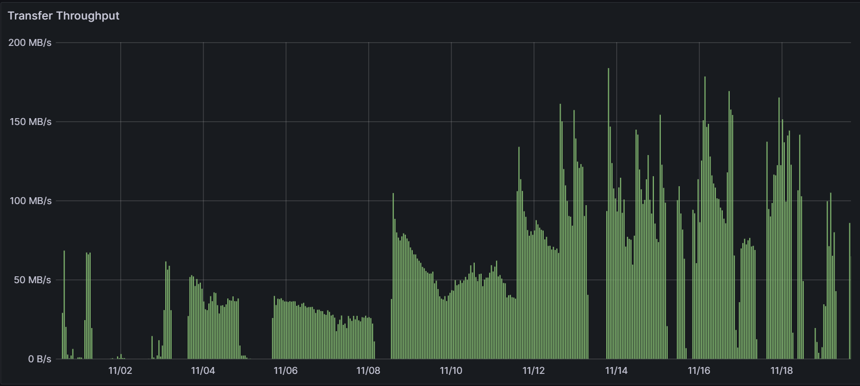
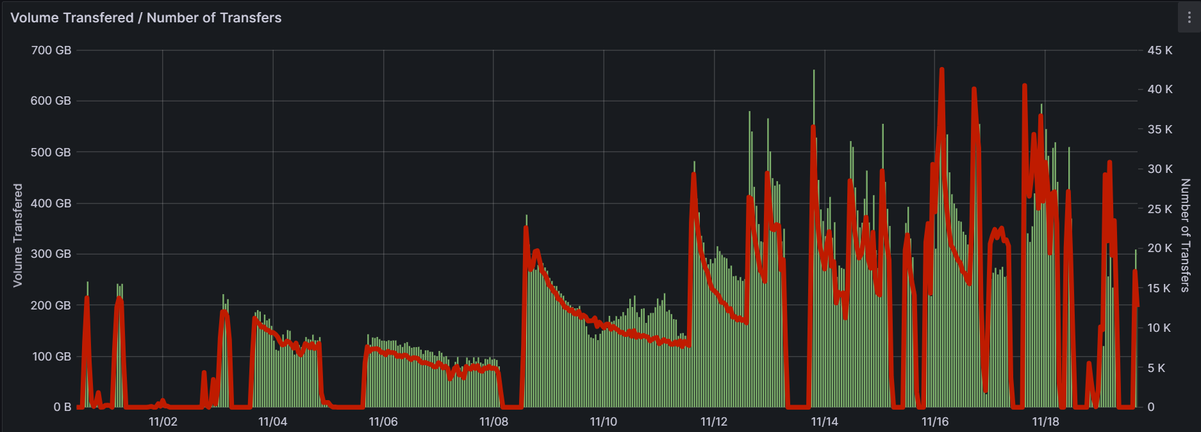
Monitoring of Functional Tests
LSST data movement from the US to UK
Movement of 80TB of data from LSST, peaks and trails off an interesting behaviour from many small files
Many connections (280-480 active connections recorded in FTS)

Slide 15
WP5 Analysis Facility
Rucio is capable of integrating directly with the analysis facility JupyterHub
Work from REANA, Rucio can be integrated with JupyterHub
Allows more flexibility for users
Currently uses X509 and VOMS proxies for authentication
  But from the documentation should be easy to swap to tokens

Slide 16
Plan for extension to project
SSD pools and testing at sites
  Setting one up at RAL
  Lancaster has stated they are also going to set one up
Development work on Rucio QoS to include and prioritise SSDs
  more than just the tagging possible right now
Work with LSST to develop better monitoring that will also benefit and give more information on the Rucio instance and data movement to better optimise the data movement

