Slide 1
X-Box Update
20.09.2023

Slide 2
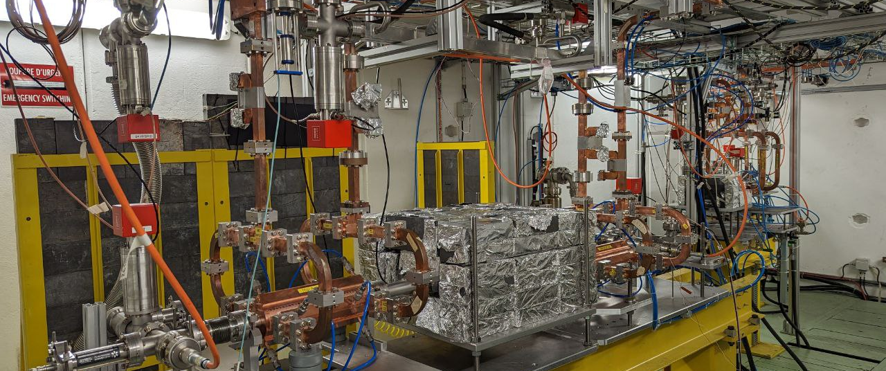
X-Box 2: TD31 N3 N4

Slide 3
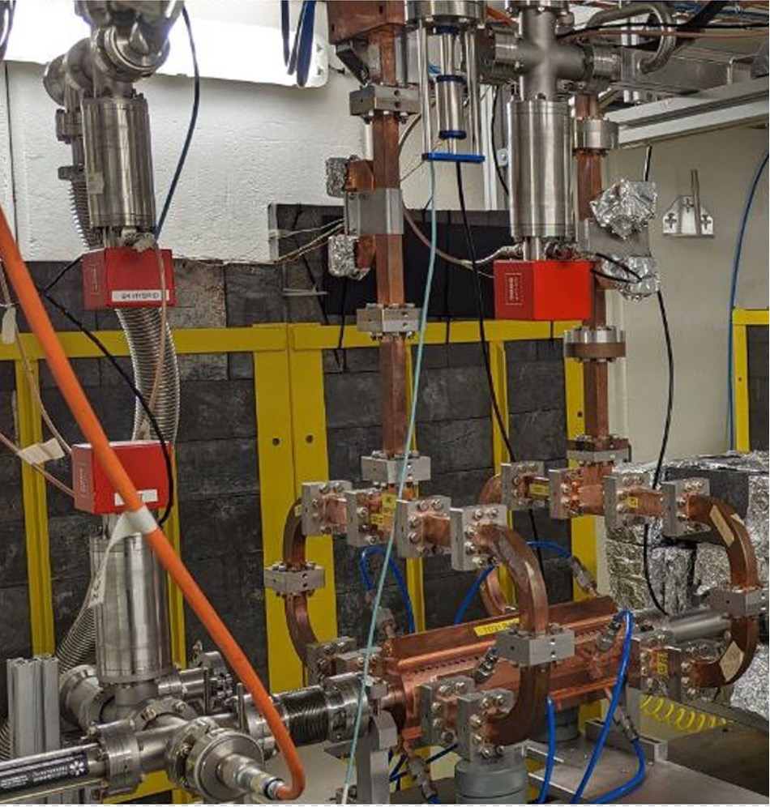
X-Box 2 TD31 N3 N4- Structure B
Restarted 22.08.2023
100% power going to Structure B
Calibration lines B – checked
Currently: 25MW
New electrical installation is ready

Slide 4
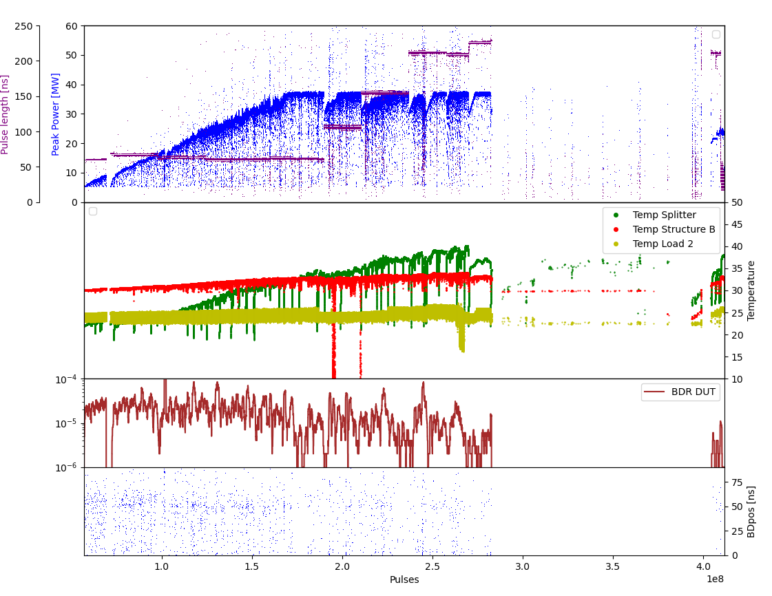
X-Box 2 TD31 N3 N: Peak power

Slide 5
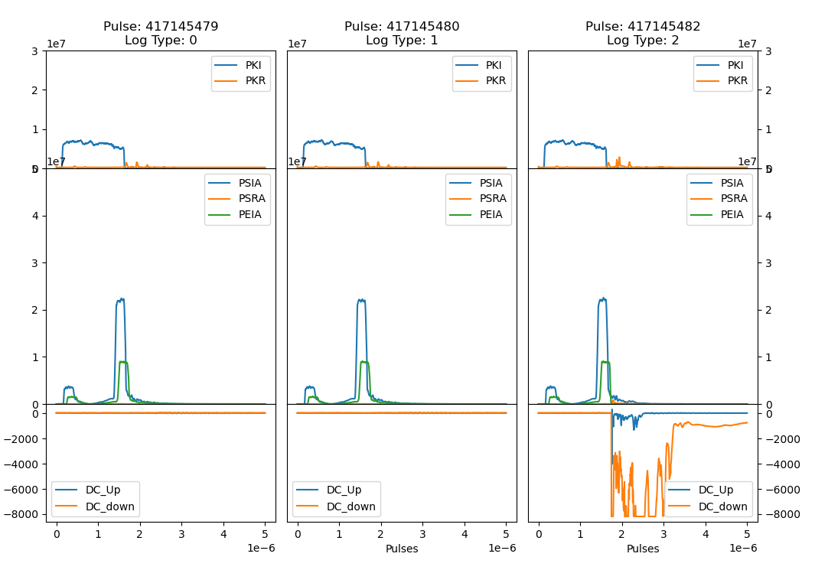
X-Box 2 TD31 N3 N

Slide 6
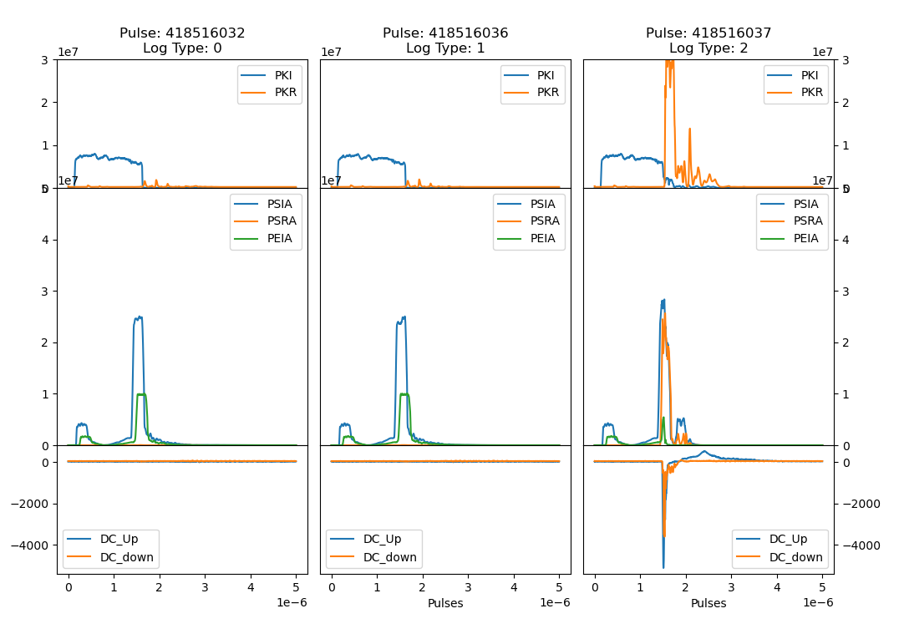
X-Box 2 TD31 N3 N

Slide 7
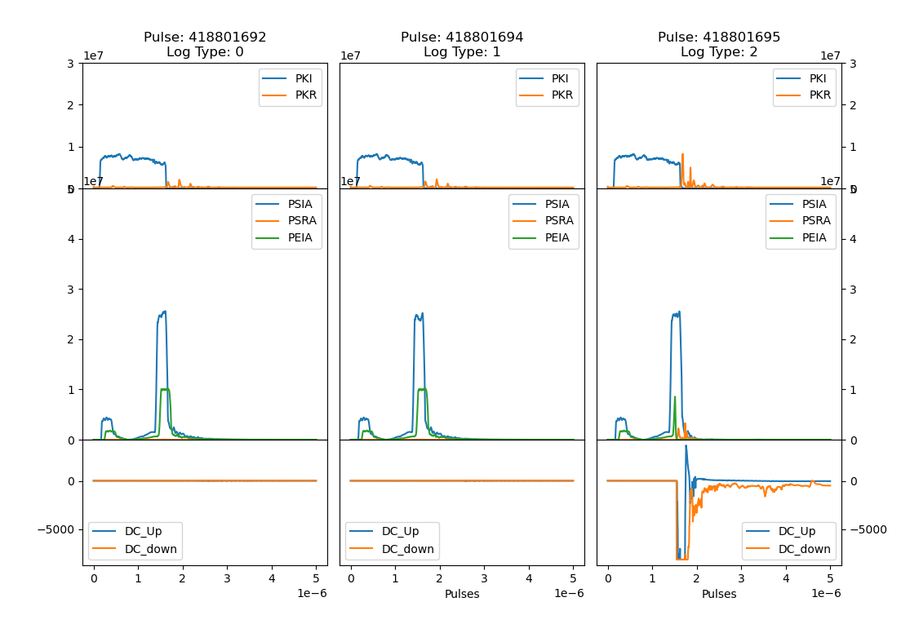
X-Box 2 TD31 N3 N

Slide 8
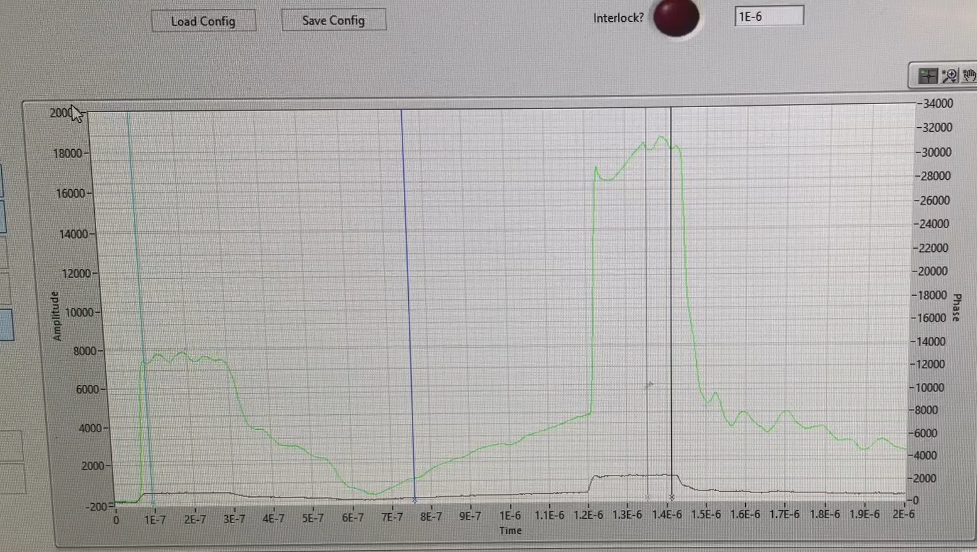
X-Box 2 TD31 N3 N
Weird behaviour >26 MW
  Structure B / Phase shifter / Power splitter / Pulse compressor
  PXI / ADC

Slide 9
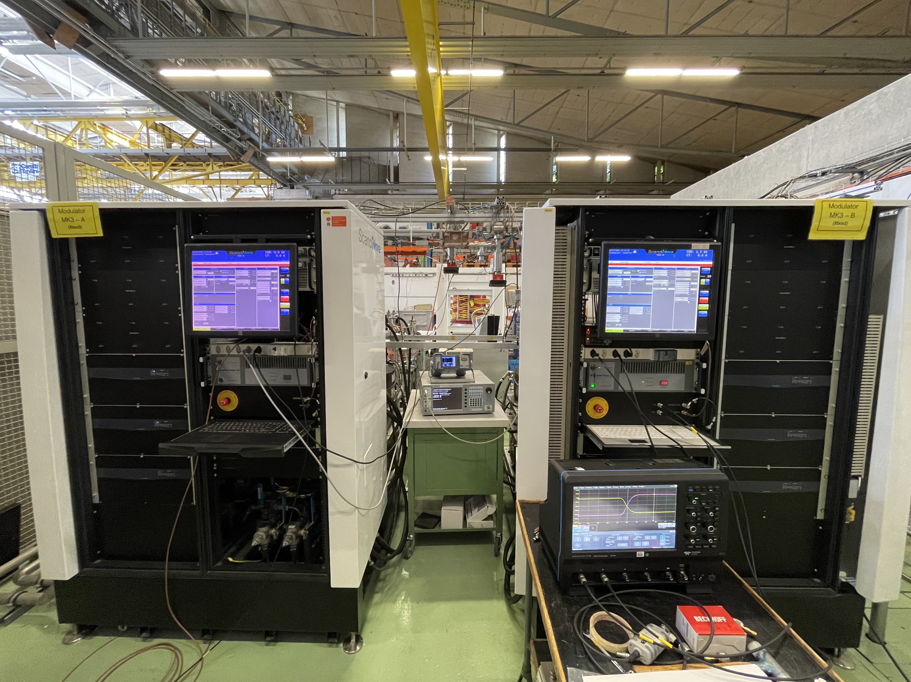
X-Box 3: High Efficiency Tubes Characterisation
Calibrated setup – problems with VNA -> recalibrated using VNA with coaxial type N ports
Measured curves of first TUBE (mod A)
Now – no tension in fillament (under investigation)

Slide 10
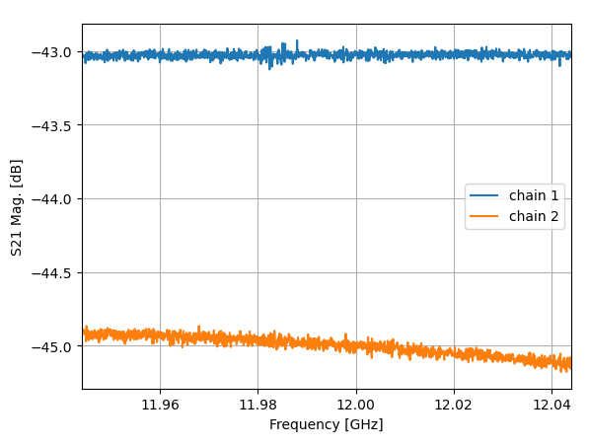
High Efficiency Klystron ER37117 TUBE1
Measurement setup
Klystron
RF Gen
SSA
HP DC
Load
DC
Attenuation
Isolation + Transition + Attenuation
Power Meter 1 - PKI
Power Meter 2 - PKI

Slide 11
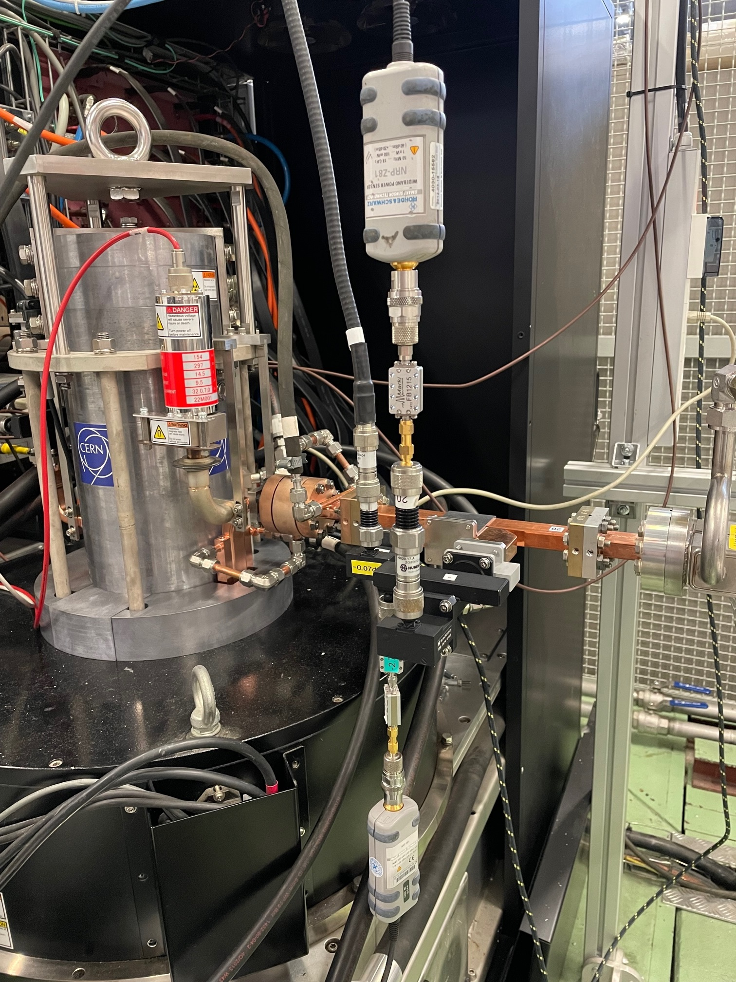
High Efficiency Klystron ER37117 TUBE1
Measurement setup
Klystron
RF Gen
SSA
HP DC
Load
DC
Attenuation
Isolation + Transition + Attenuation
PKI to Power Meter 1
Power Meter 1 - PKI
HP DC
Power Meter 2 - PKI
Chain | Att(dB)@11.994GHz
PKI, chain 1 | 43.04
PKI, chain 2 | 45.0
KLYIN | 49.68
PKI to Power Meter 2

Slide 12
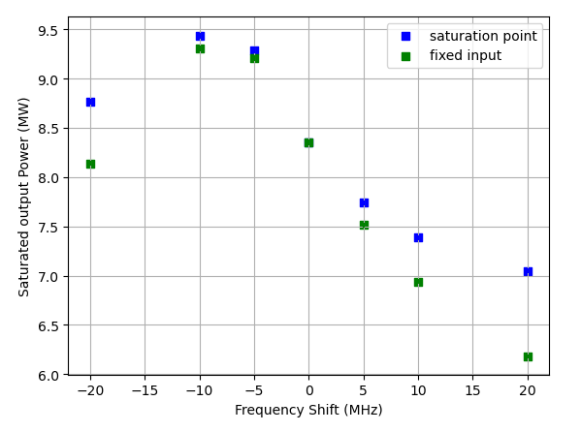
High Efficiency Klystron ER37117 TUBE1
Frequency behaviour

Slide 13
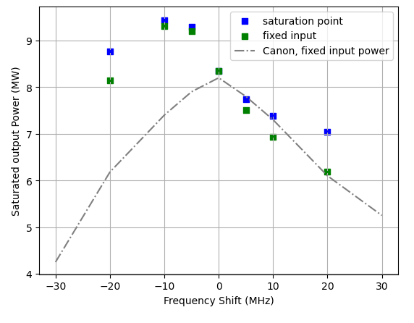
High Efficiency Klystron ER37117 TUBE1
Frequency behaviour

Slide 14
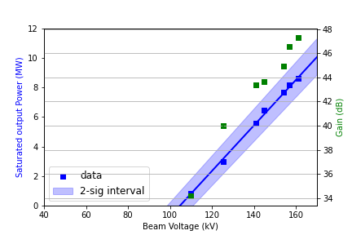
High Efficiency Klystron ER37117 TUBE1
Beam voltage dependency

Slide 15
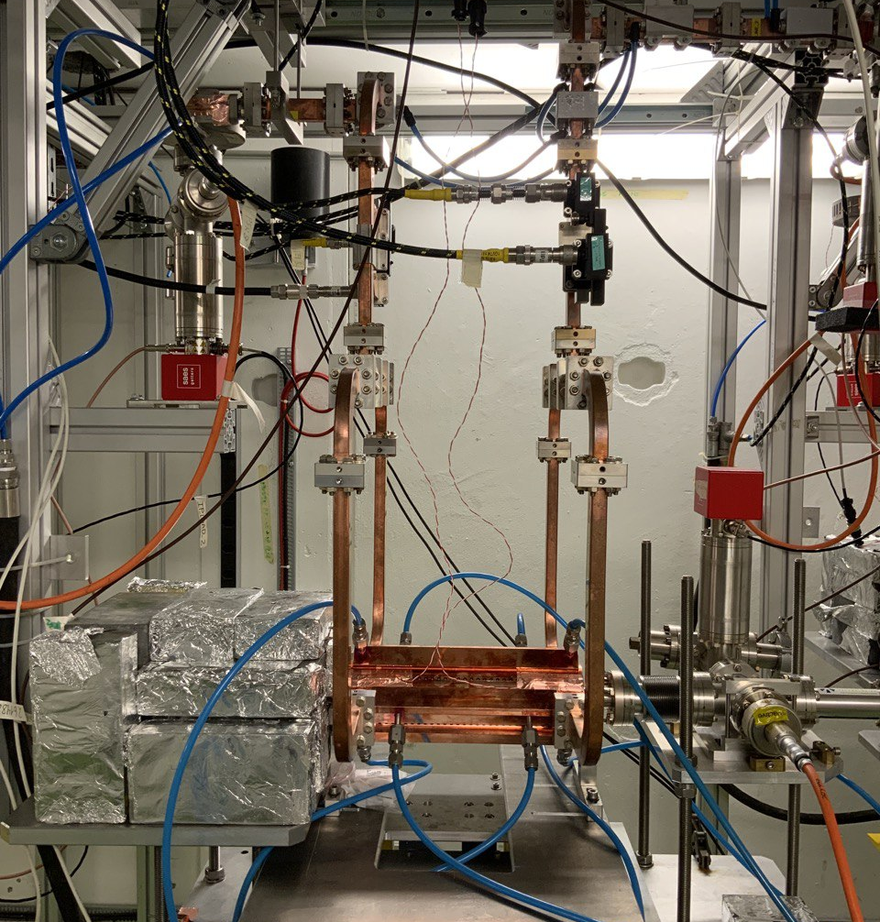
X-Box 3 Line 1: TD31 N1
Shut down

Slide 16
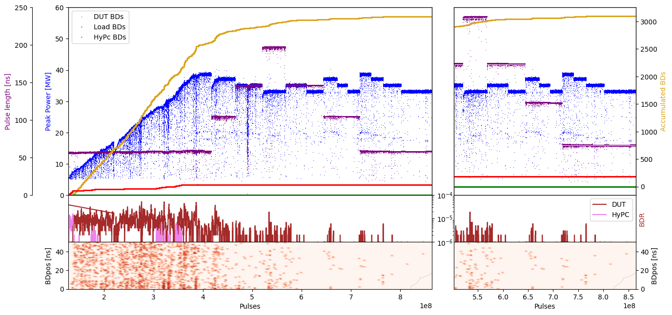
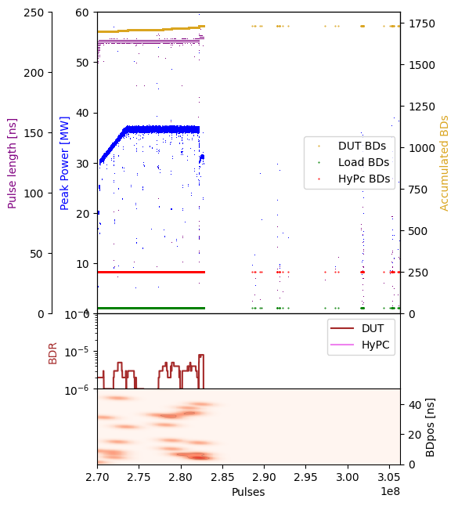
X-Box 3 Line 1: TD31 N1 – Peak Power

Slide 17
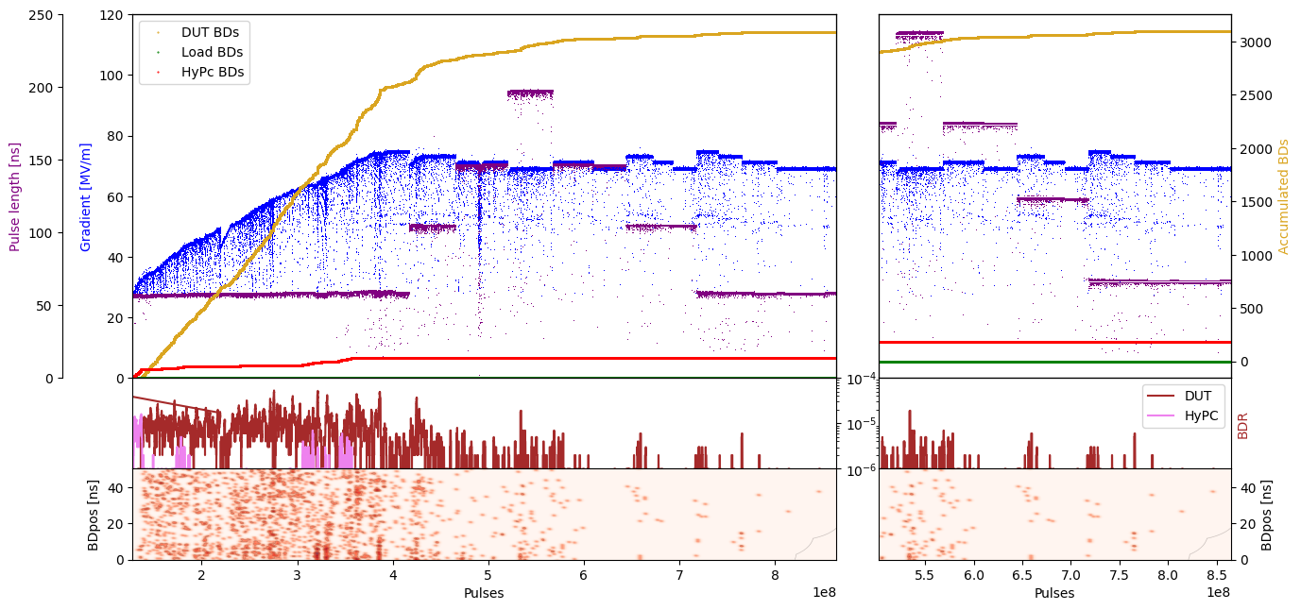
X-Box 3 Line 1: TD31 N1 – Gradient

Slide 18
X-Box 3 Line 2: TD31 N2
Shut down

Slide 19
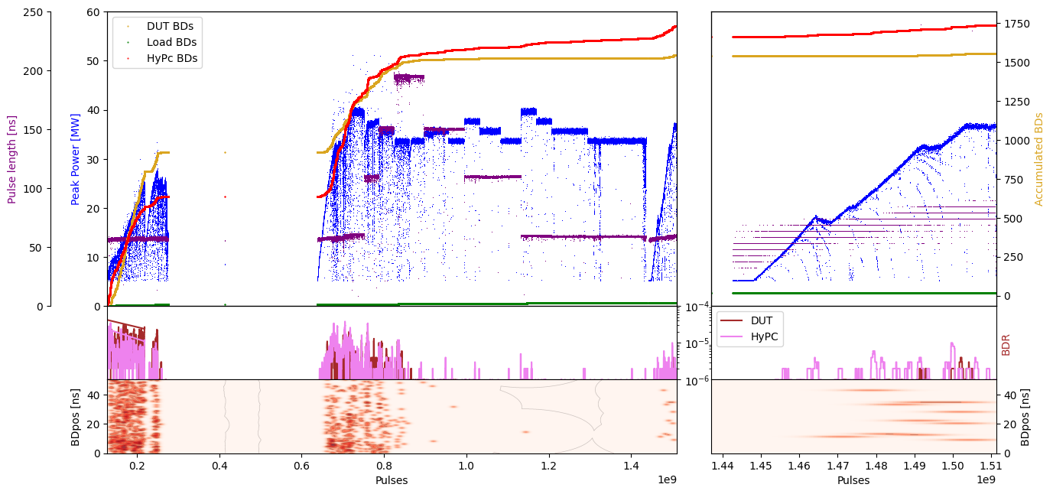
X-Box 3 Line 1: TD31 N2 – Peak Power

Slide 20
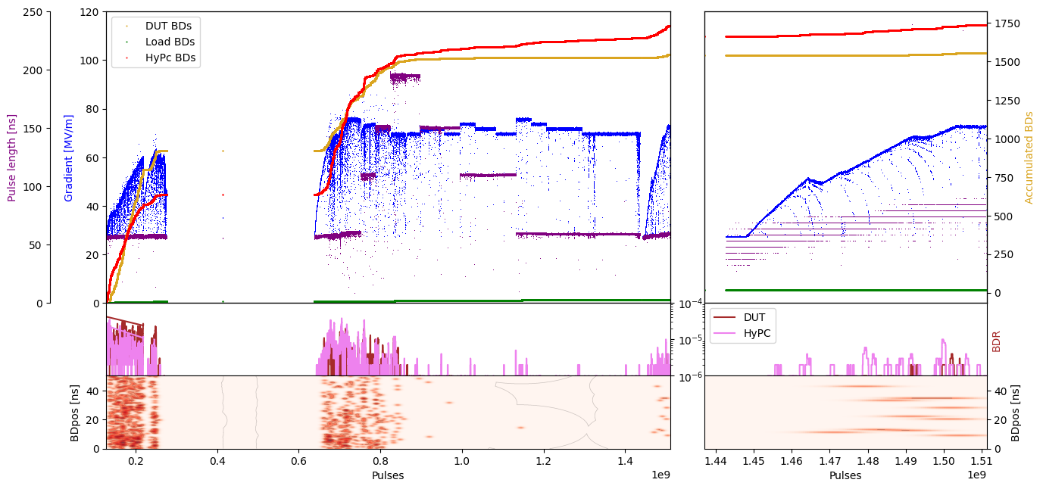
X-Box 3 Line 1: TD31 N2 – Gradient

