Slide 1
BIPXL MPSoC Readout
Gabriela Cabrera Castellano (SY-BI-XEI)

Slide 2
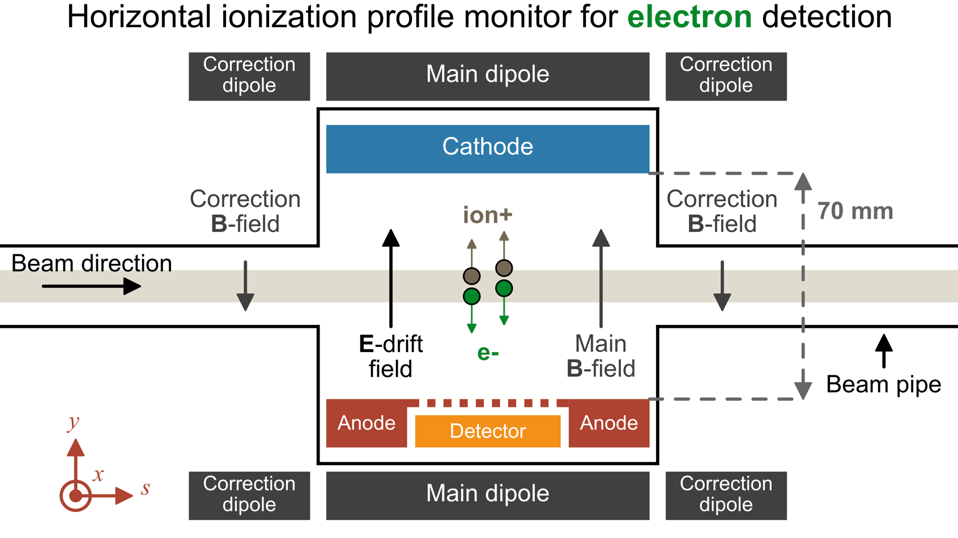
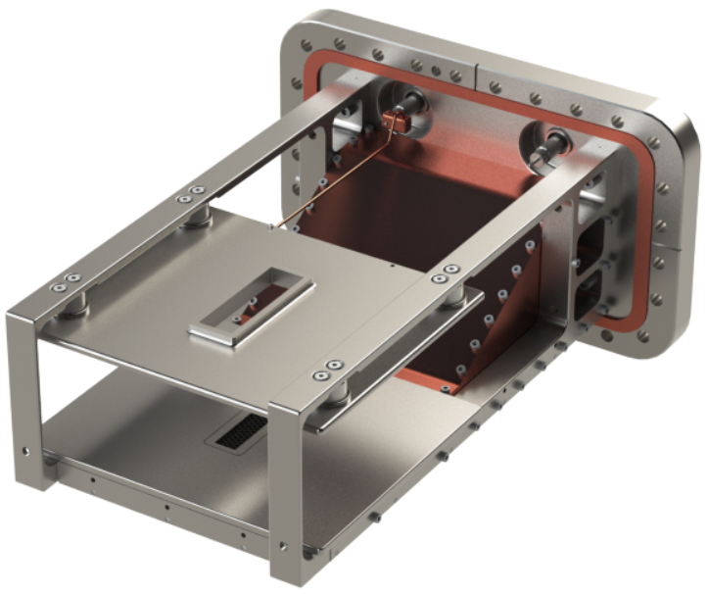
Beam Gas Ionisation, BGI
Non-invasive measurements of the beam profile:
    1. Beam ionizes rest gas particles in the beam pipe
    2. Transport ionization electrons with E-field and B-field
    3. Image ionization electrons with a detector
Based on Timepix3:
    Position (65k pixels with 55um pitch)
    ToA (1,56 ns of resolution)
    ToT (< 2KeV of energy resolution)
Two operational BGIs installed in PS since 2021

Slide 3
System requirements
4 TPX3 → 8 DataOut each one of 320 Mbps = 10,24 Gbps
Processing requirements:
  To publish all the data before the next cycle starts.
  Around 10k events per profile and about 1 profile per 2ms.
    60 bits per event
    Typical case: 2ms acq window every 10ms → 60 Mbps
Beam loss removal → offline.

Slide 4
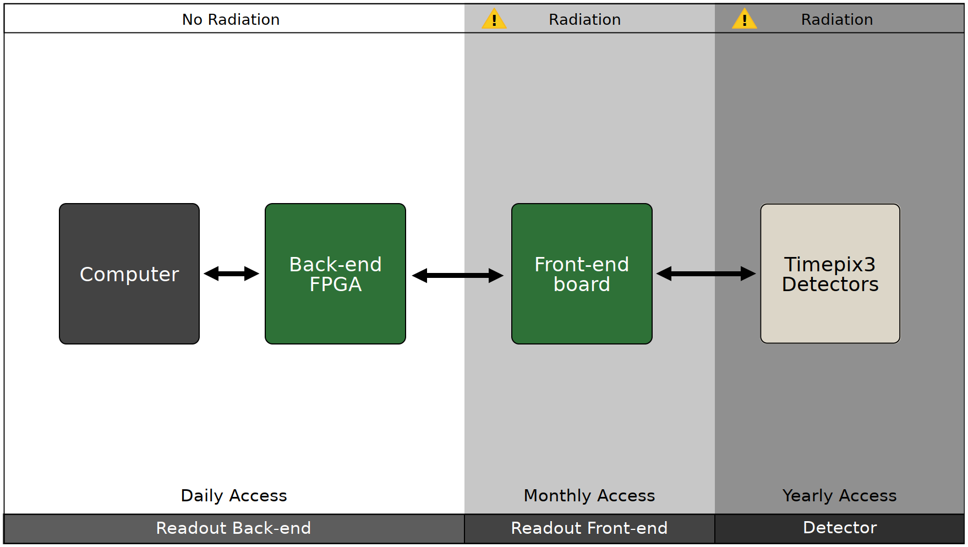
Readout overview
The readout consists of 3 parts: Back-end, Front-end and the detector(s).
Back-end:
  Until July 2022 → Virtex 7 FPGA VC707
    Limited profile processing capabilities just using FPGA.
  Back-end requirements:
    Generic platform for all the Timepix3 applications.
    Real-time processing of Timepix3 events.
      Bunch by bunch
    Simple debug, development and deployment.
    Long term availability.
    Support and expertise at CERN.
Zynq UltraScale+ MPSoC

Slide 5
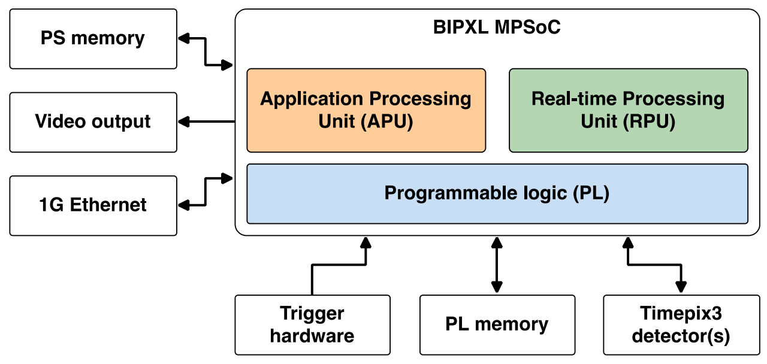
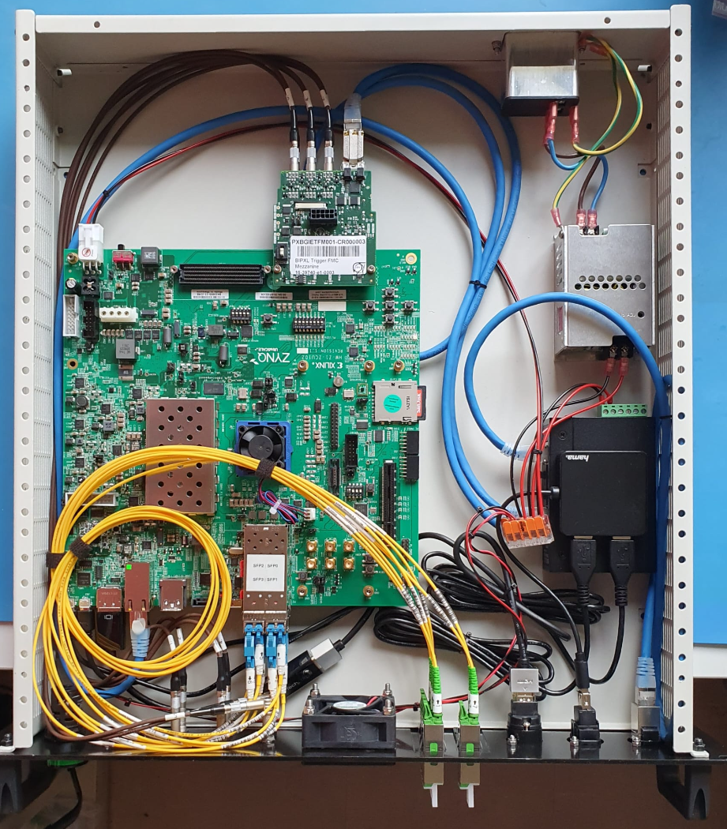
Zynq Ultrascale+ MPSoC Back-end
ZCU102 board
  HDMI/DP output
  1G ethernet (PS)
  4 SFP
  Trigger FMC mezzanine
APU runs Linux.
RPU cores will run in lock-step mode with FreeRTOS.
PL does the low-level assembly and transfer of bits and packets.

Slide 6
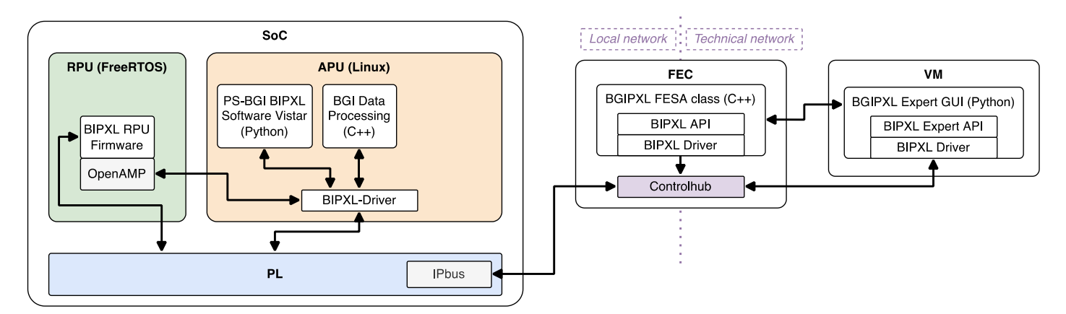
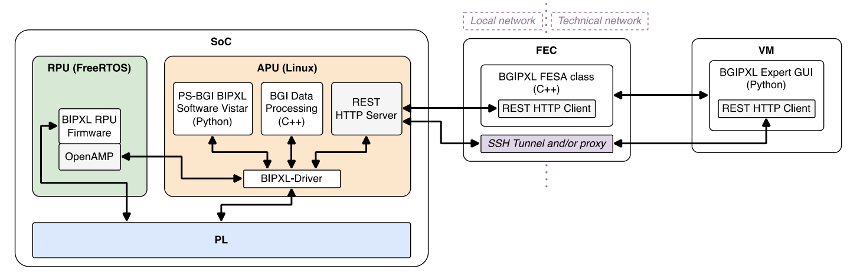
External view: REST
IPbus interface to external computers
REST HTTP interface to external computers

Slide 7
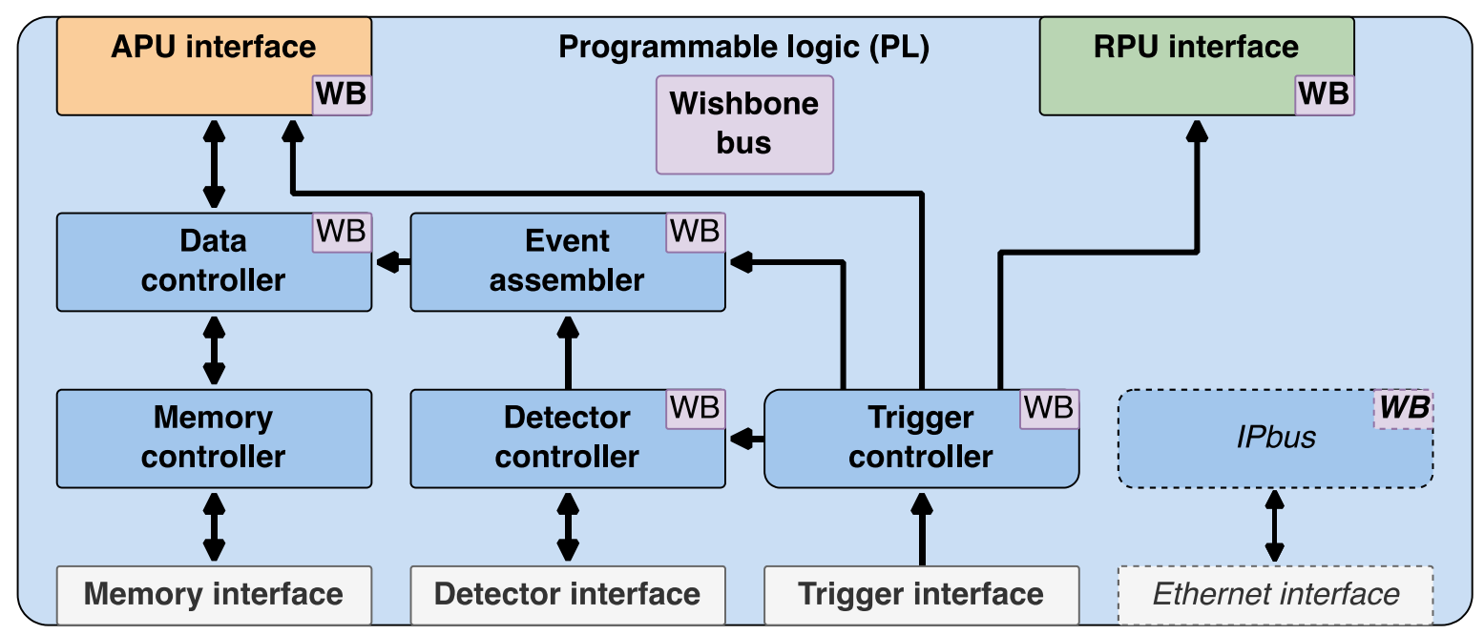
Internal view: PL Block
Low-level bit manipulation and data transfer:
Detector controller in charge of the synchronization
Event assembler packages the bytes with timing information.
Trigger controller: handles the generation of trigger signals and timestamps.
Data controller handles the events to/from DDR4.
Memory controller: DDR4 Xilinx IP block.
https://gitlab.cern.ch/be-bi-bgi/bipxl-readout/bipxl-gateware

Slide 8
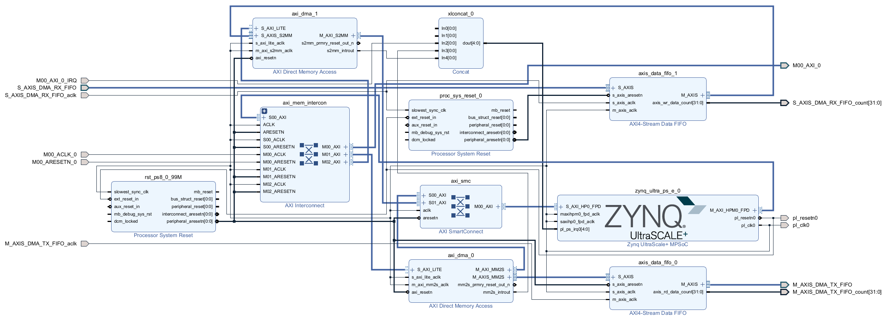
PL-APU Interface: DMA

Slide 9
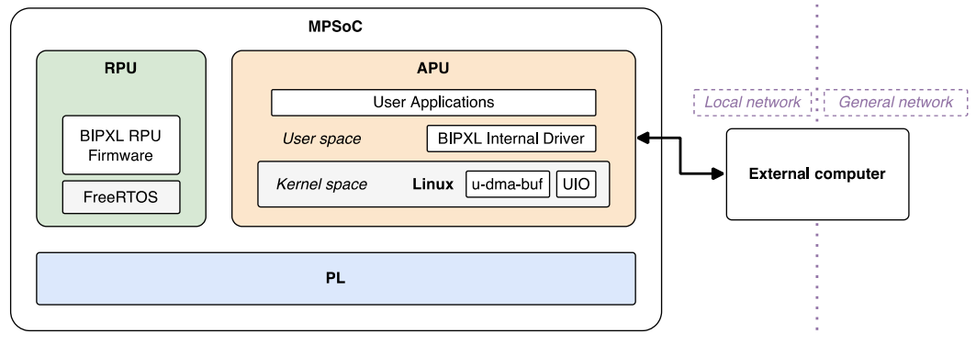
PL-APU Interface
Concepts:
  Kernel space
  User space
The following drivers are used:
  u-dma-buf: creates a buffer in kernel space and exposes the physical address to user space via a file (/dev/udmabuf<n>).
  UIO: userspace I/O associated with the DMA to transfer the data from/to the u-dma-buf.
The configuration of the UIO:
  Clear IRQs (MM2S_DMASR)
  Set config (MM2S_DMACR)
  Set address (MM2S_SA)
  Set length (MM2S_LENGTH)
Transfer starts automatically after length is set.

Slide 10
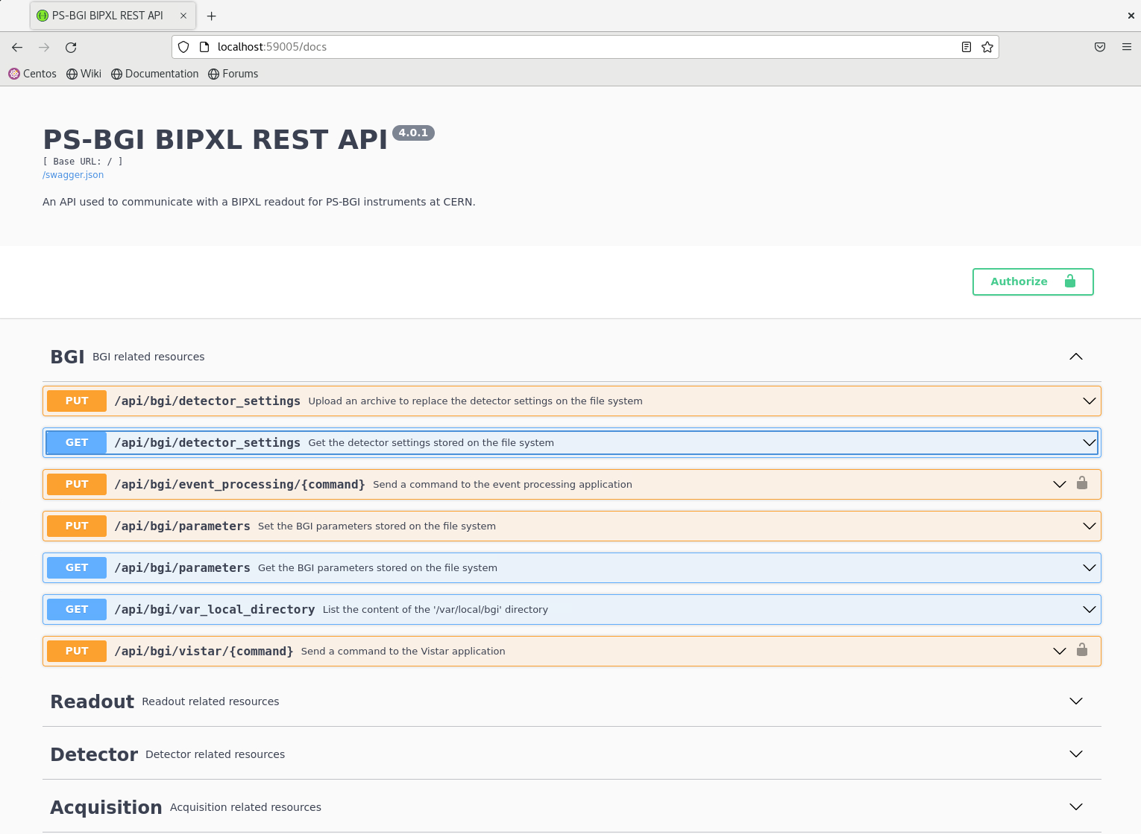
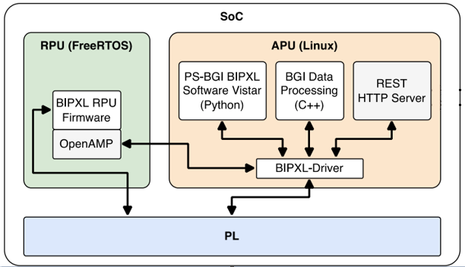
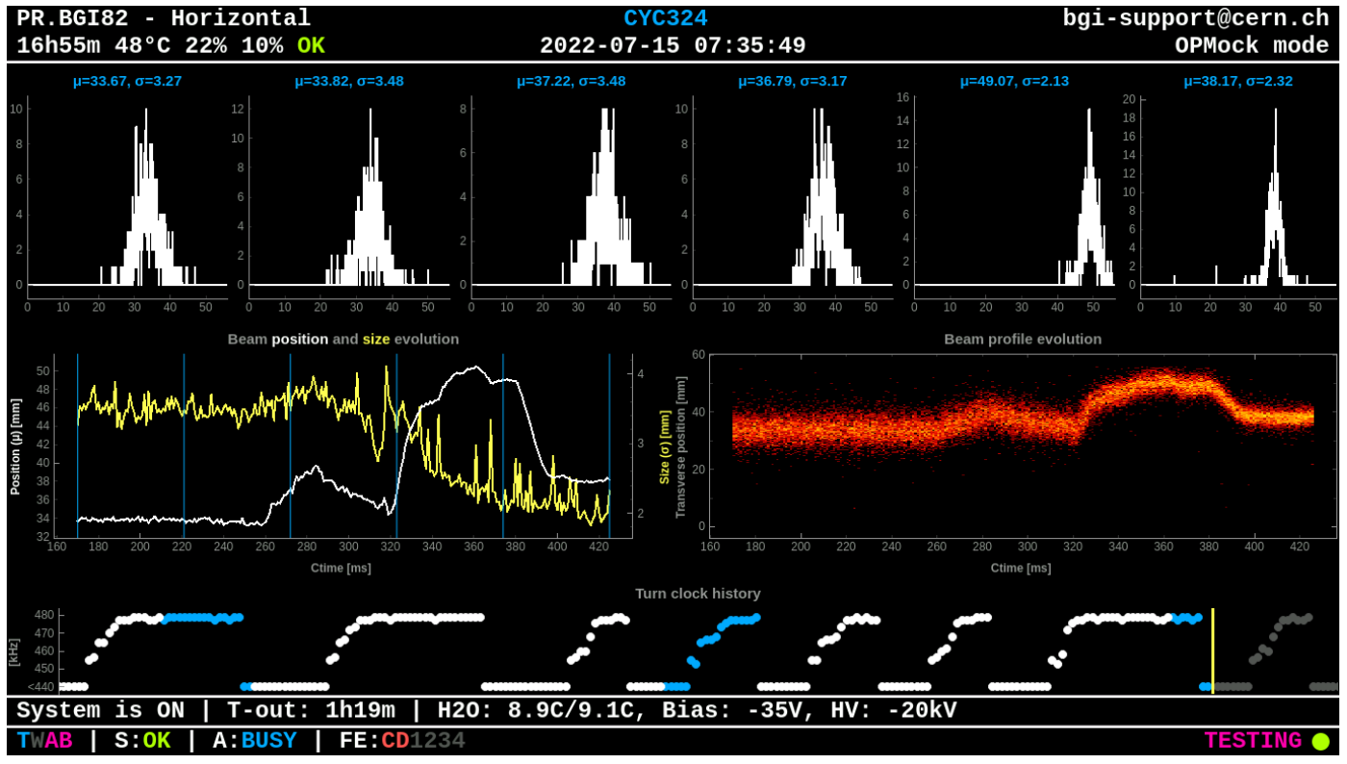
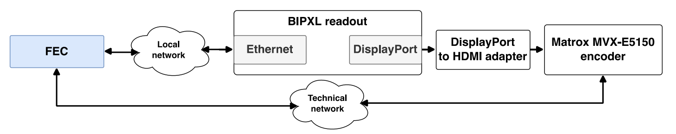
Internal view: User applications
BIPXL Internal Driver: abstraction between user applications above and the kernel drivers below.
REST HTTP Server: HTTP using Flask and Flask-RESTX frameworks.
BIPXL Event processing: beam profiles construction to be sent to the BGIPXL FESA class before the next user cycle.
BIPXL Software Vistar: live display of the instrument state and beam profile acquisition.
https://gitlab.cern.ch/be-bi-bgi/bipxl-readout/

Slide 11
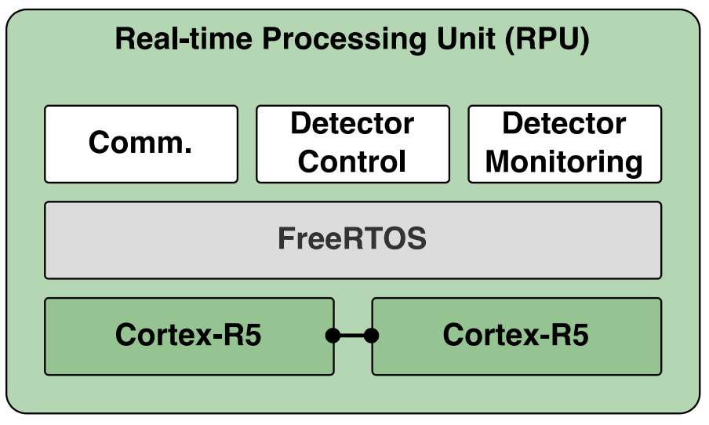
Internal view: RPU
Detector real-time critical tasks.
Lock-step mode using FreeRTOS.
Two main tasks:
  GBTx configuration and monitoring
  Detector control and monitoring:
    General config data
    Run startup sequence
    Temperature of the sensor
Interface to APU: OpenAMP library
https://gitlab.cern.ch/be-bi-bgi/bipxl-readout/bipxl-rpu-firmware

Slide 12
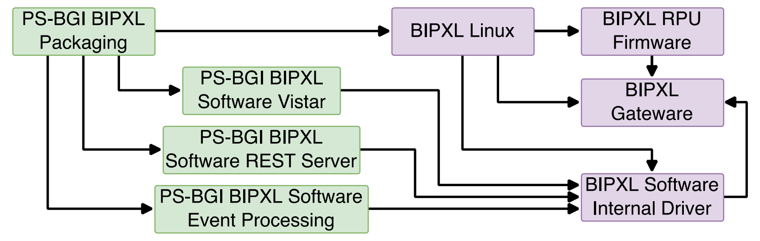
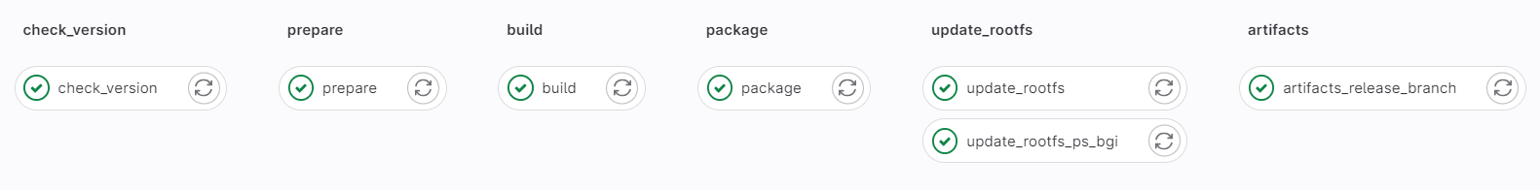
Packaging
Packaging repository:
  Scripts to push all the needed resources.
  Build Petalinux → Gitlab runner
  Xilinx tools (version 2021.2)
  Artifacts → SD Card
https://gitlab.cern.ch/be-bi-bgi/bipxl-readout/ps-bgi-bipxl-packaging

Slide 13
Future plans
Installation of SPS-BGI → YETS 2023
Instrument + readout development for LHC-BGI:
  TPX4:
    163.84 Gbps (16 Output x 10.24 Gbps)
    LpGBT: 2.56 Gbps in downlink and 5.12/10.24 Gbps in uplink.
SoM

Slide 15
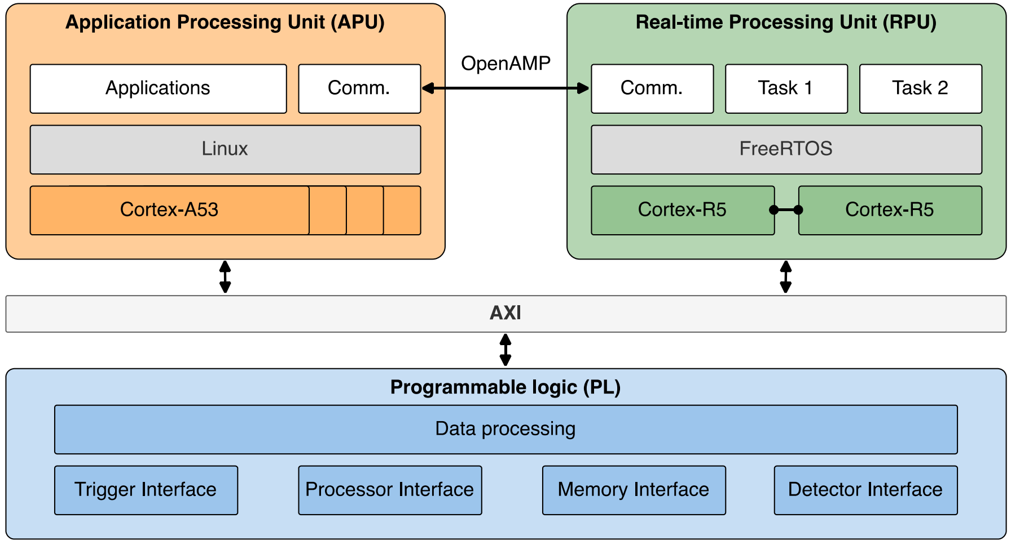
Internal view

Slide 16
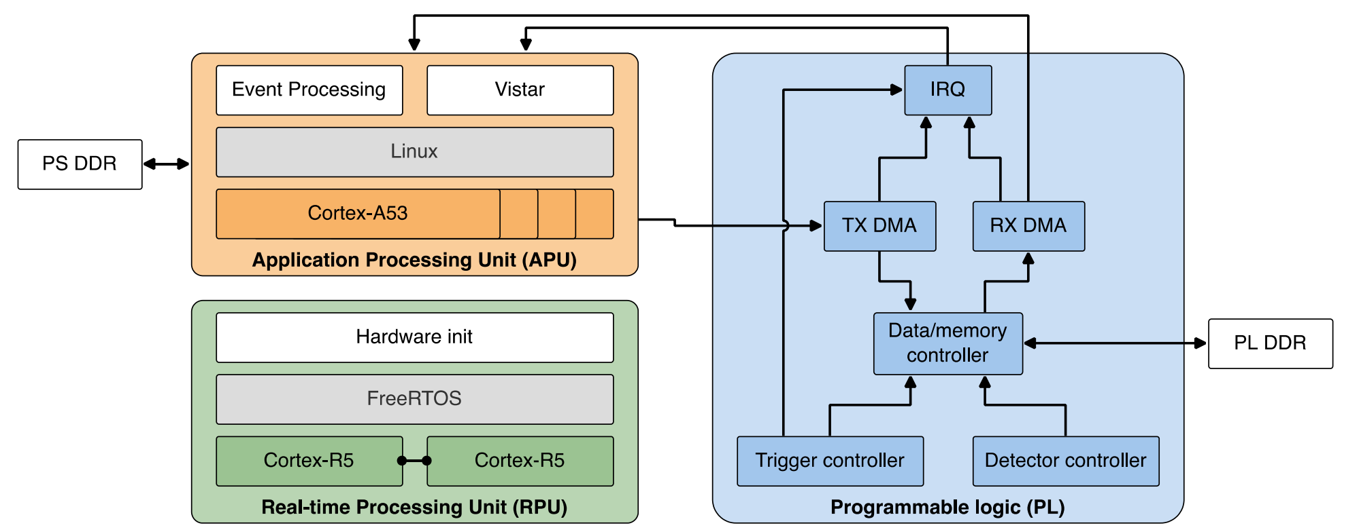
Internal view

