Slide 1
RFSoC for HL-LHC BPM BI Technical Board – 14/09/2023
E. Balci, M. Gonzales Berges, A. Boccardi, I. Degl’Innocenti, S. Jackson, M. Krupa

Slide 2
Outline
HL-LHC Beam Position Monitor upgrade: Introduction
System requirements
Future system architecture proposal
Prototype system architecture
Hardware platform ideas
Conclusion - Potential standardization in BI

Slide 3
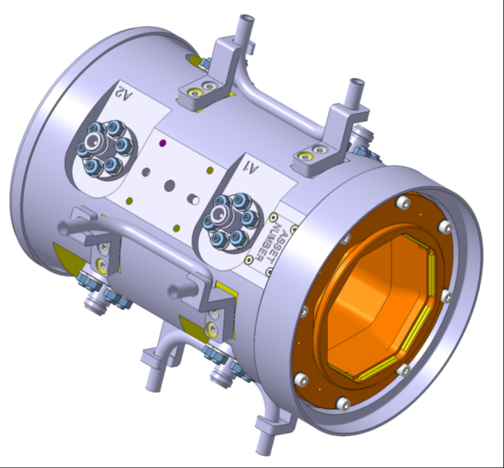
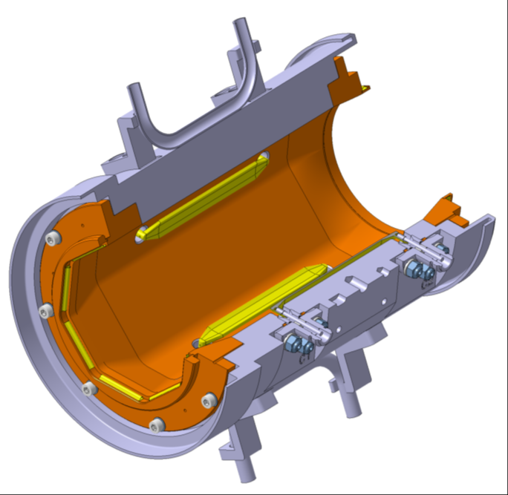
HL-LHC Beam Position Monitors Upgrade Introduction
Accurate Bunch-by-bunch position measurements
24 new monitors at IP 1 & 5
Two counter-rotating beams in a common vacuum chamber
Correction of the error induced by the counter-rotating beam
Integrated in the standard LHC BPM system
Signal processing requirements
Direct fast digitization: 8 ADCs (5 GSps) for 8 BPM outputs
Bunch-by-bunch electrode power computation (40 MHz)
8 channels real-time processing with mixing of all 8 input signals
Implementation of all acquisition modes of the existing LHC BPM system
Long-term stability: 8 DACs for generating calibration signal

Slide 4
Future System architecture proposal
AFE
RFSoC
NFS
PL
PS
Acquisition High-volume Data
Analog signals to hardware
(8 channels)
DACs
X 8
Signal synthesis
RPU (?)
Calibration application
Calibration data
APU (Linux)
FESA device
final processing
Control
NXCALS
Meta-data and others
Analog signals from BPM (8 electrodes)
ADCs
5Gsps
X 8
Signal Processing and
Acquisition logic
Status
Filters
DMA
DMA
PL DDR Memory
PS DDR Memory
Acquisition High-volume Data
System memory

Slide 5
Future System architecture proposal
Disclaimers:
This is work-in-progress!
We will follow any CERN or ATS guidelines if compatible with our requirements and timeline
Principles:
Processing in the PL and in the FESA device:
PL: data decimation to 40 MHz, beam-beam correction, averages according to acquisition modes
FESA: position calculation, rotation correction, linearization, etc.
Gateware and Linux image development uncoupled
Split between BP and SW inside the SoC, between PL and PS, with close collaboration
→ Prototype System exercise

Slide 6
Prototype System Architecture
AFE
RFSoC
PL
PS
FEC
NFS
High-Volume Data
Status
Control
APU
FESA device
Slow Control Application
Analog signals from BPM (8 electrodes)
ADCs
5Gsps
X 8
Signal Processing and
Acquisition Logic
Acquisition
Data Transfer
Application
NXCALS
Meta-Data
& Others
DMA
PS DDR Memory
Acquisition High-volume Data

Slide 7
Technical Choices
Communication Protocol
Technical choices are made with 2 important criteria at mind:
The technologies that the section/group possesses expertise in should be reused.
They will be replaced by a standard solution provided by CSS/CEM in the future.
Data to be transferred:
Status of the system, Acquisition Data, Acquisition Logic Control
Proposed Interfaces:
IpBus, OPC-UA, Zero-MQ
IpBus:
Made at CERN.
Used in previous projects of the group (Eg. LIU Wirescanners)
Section already has the know-how on it.
Fast and easy development with Ironman and uHal libraries.
Good for prototyping until a standard solution is provided
Operating System
PetaLinux has been chosen.
Hampus Sandberg's guide has been taken as a foundation and is customized to align with our needs.

Slide 8
Technical Choices
Transferring Data From SoC: TCP Socket
Suitable for transferring large amounts of data.
Customizable:
It is possible to append extra information on each packet.
Custom packets can be implemented for running programs like user applications.
PS
NFS
High-Volume Data
APU
FESA
IpBus
Slow Control Application
Storing Large Amounts of Data: HDF5 Files
Acquisition data is passed to FESA
FESA publishes a user defined window of the full dataset.
Entire acquisition is saved to NFS in HDF5 format.
HDF5 is used in other projects requiring storage of large data which doesn't fit to NXCALS
Standard HDF5 Analysis/Viewer Tool available in BI-SW
Acquisition Data Transfer
Application
NXCALS
TCP
Meta-Data
& Others

Slide 9
Division of Work
AFE
RFSoC
PL
PS
NFS
Acquisition High-Volume Data
RPU
FESA
Analog signals from BPM (8 electrodes)
Signal Processing and
Acquisition Logic
ADCs
5Gsps
X 8
APU
Slow Control Application
NXCALS
Meta-Data
& Others
Acquisition
Data Transfer
Application
Work distributed between BP and SW sections making the best use of the relevant competencies.
Collaboration from the early stage of the development enabled us to work efficiently.

Slide 10
Our Requests
FEC-like Support from CSS/CEM
Running FESA on SoC
OS distribution
EDGE drivers support
Timing integration
Disk-less boot
Lumens, Diamon, etc.
Notes:
I suppose this one should be merged to the conculisions

Slide 11
Hardware platform idea
Analogue front-end
System carrier
RFSoC System-on-Module
Power
Signal conditioning
I2C, SPI
UART
4 GB DDR
System Clocks
I2C, SPI
1 GbE
1 GbE connector
RFSoC
Voltage Reg
Calibration
8 RF input
ADCs
PS
>6 HP LVDS
128 MB QSPI Boot
BST Timing Circuitry
8 RF output
DACs
PL
>36 GPIO
Quantities: ~70 systems
IP1 and IP5 (24), AWAKE (20), IP2 and IP8 (12) + spares
More SoM → Finance Committee threshold
Ext. RF clock
RF PLLs
4 GB DDR
32 GB eMMC
GTYs
TCXO
FMC-HSPC
Memory
Plug & play pizza box approach
SoM still under consideration: CERN-made vs commercial (e.g., Avnet XRF8 SoM)
major long-term pros and cons for both approaches
procurement involved
Potential for standardization of System Carrier with MPSoC projects

Slide 12
Conclusions - Potential standardization in BI
Software:
FESA on SoC with FEC-like support at CERN level
Development tools: driver generation, disk-less boot, etc.
Gateware:
HDL cores sharing (e.g.: DMA)
Hardware:
SoM approach, system carrier
Timeline limitations
Prototype stage: procurement by 2025 for tests in 2026 (2 units)
Series production: procurement by 2027 for deployment in 2028
We must freeze our project by mid-2024

Slide 14
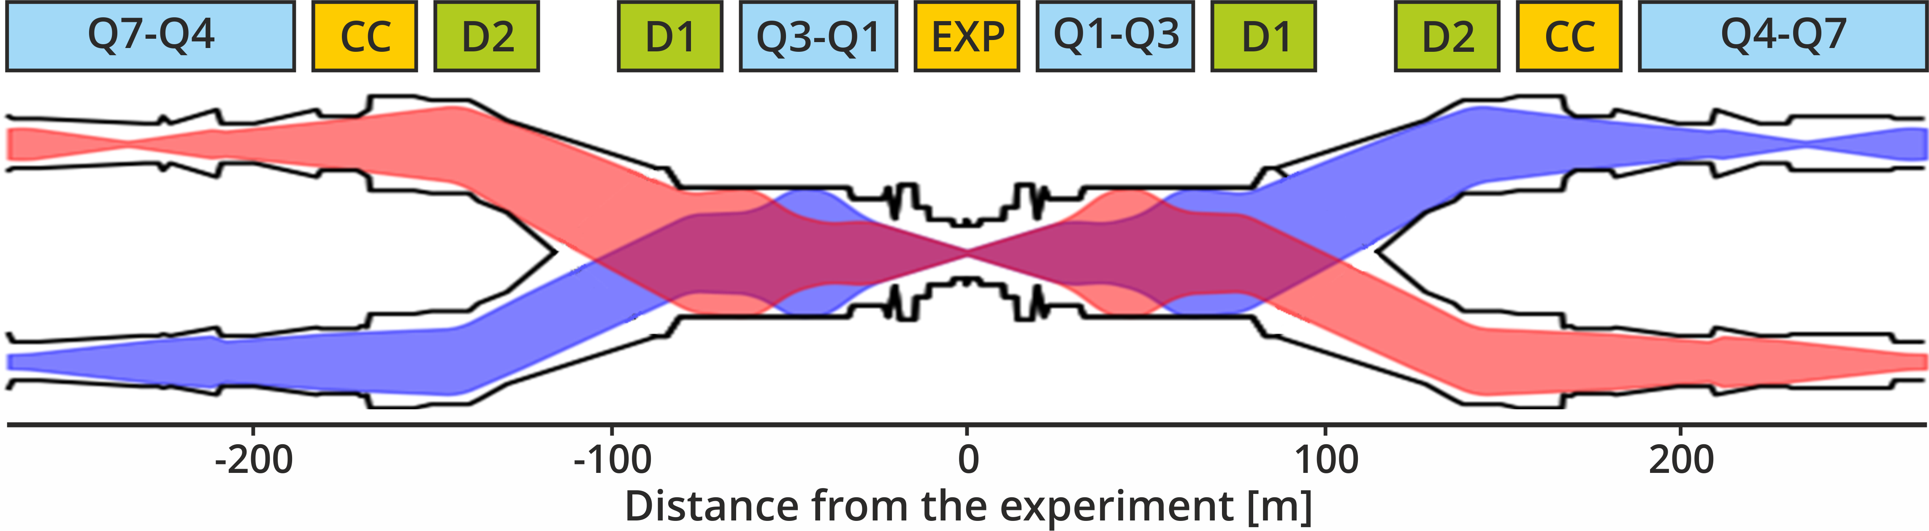
HL-LHC Beam Position Monitor Upgrade Introduction
24 new BPMs in the immediate vicinity of interaction regions 1 (ATLAS) and 5 (CMS), where the two beams coexist within a single pipe
Beam 1
Beam 2
Both counter-rotating beams in a common vacuum chamber

Slide 15
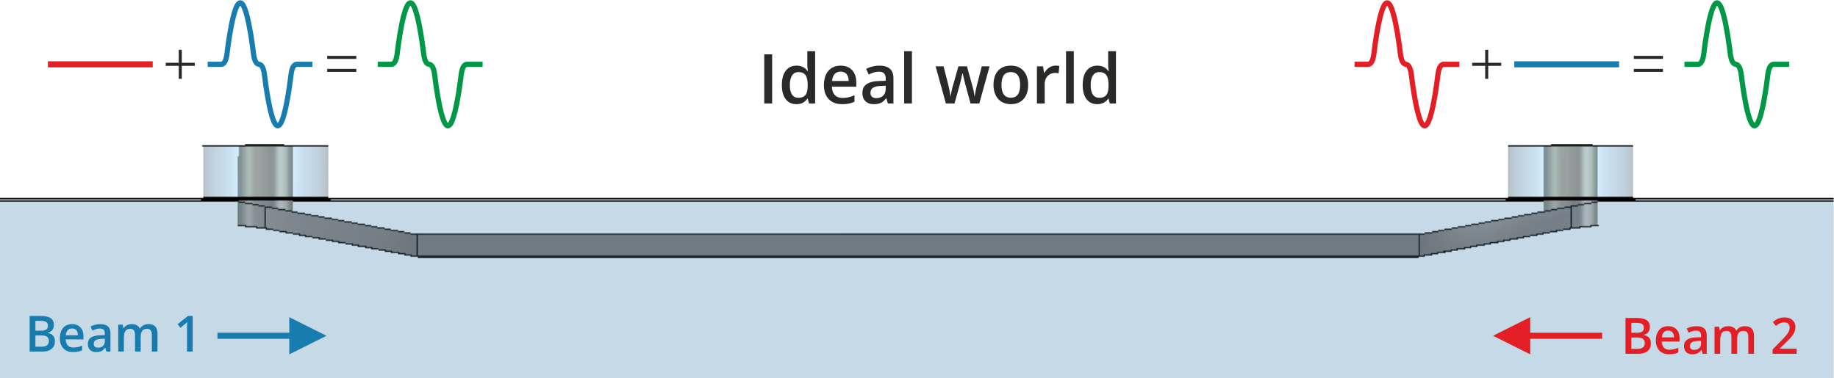
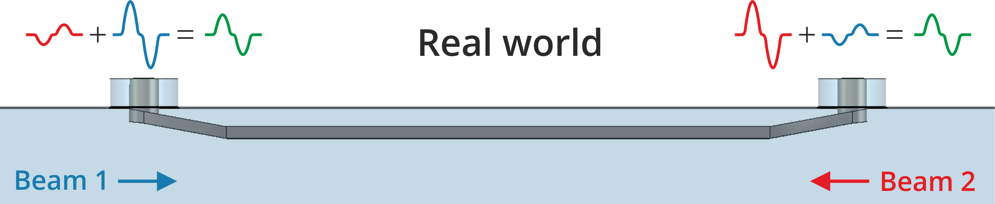
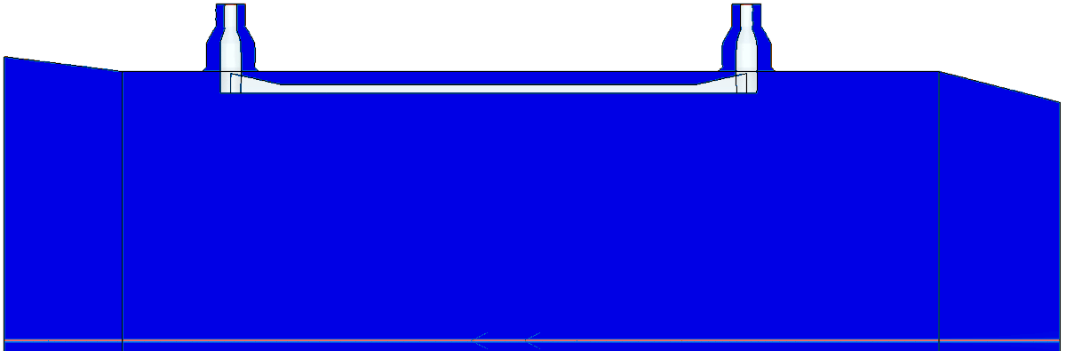
HL-LHC Beam Position Monitor Upgrade Introduction
Each BPM measures both counter-rotating beam and produces 8 wideband (DC-6 GHz) analogue pulse signals
CST model and simulation by Michal Krupa

Slide 16
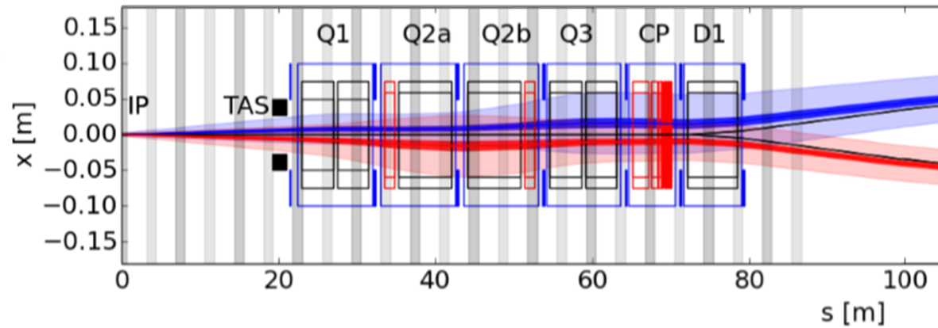
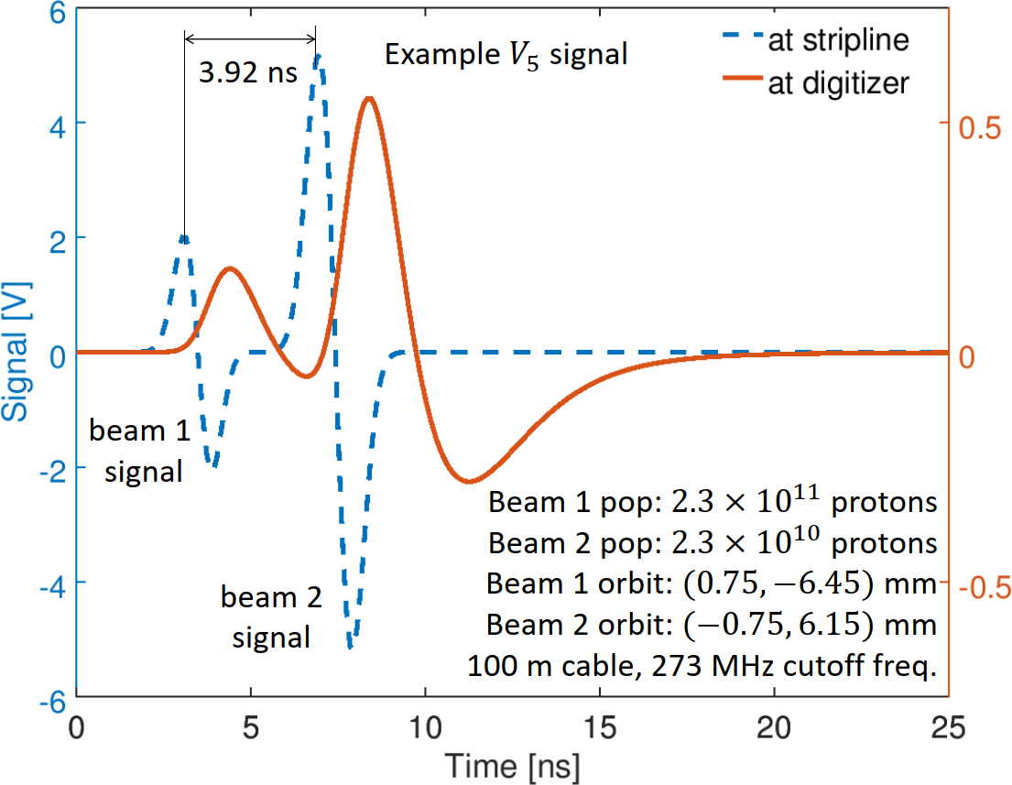
HL-LHC Beam Position Monitor Upgrade Introduction
The presence of the other beam affects the measurement when:
Short bunch crossing time
Intensity of other beam significantly higher
Counter-rotating beam
Beam we want to measure
BPM | s [m] | bxt [ns]
Q1 | 21.853 | 3.92
Q2A | 33.073 | 3.92
Q2B | 43.858 | 6.82
Q3 | 54.643 | 9.72
CP | 65.743 | 10.52
D1 | 73.697 | 7.36
bxt = bunch crossing time i.e. beam-beam delay
The distortion of the beam signals due to the presence of the other beam must be compensated for
Simulation by Doug Bett

Slide 17
System Requirements Signal Processing
Solution to minimize beam-beam effect and to achieve high resolution:
Minimalistic analogue conditioning and fast digitization: 8 ADCs (5 GSps) for 8 BPM outputs
Bunch-by-bunch electrode power computation (40 MHz)
Compensation of the counter-rotating beam distortion by application of power compensation algorithm: 8 channels real-time processing with mixing of all 8 input signals
LHC current system acquisition modes implementation
Continuous (global orbit, post-mortem, …)
On-demand (capture, FIFO,…)
Long-term stability: 8 DACs for generating calibration signal
Multi-channel fast digitization
High-performance digital signal processing
Radio-Frequency System on Chip

Slide 18
System Requirements Resources estimation
Resources | Required qty. | % RFSoC
ADCs | 8 | 100
DACs | 8 | 100
Internal memory | 30 Mb | 48
DSP | 172 | 4
LUT | 20521 | 5
FF | 50644 | 6
DDR | 768 Mb | 3
DDR WR peak BW | 22 Gbps | 24
Read-out BW | 54 Mbps | 10 (?)

Slide 19
Future System architecture proposal
AFE
RFSoC
FEC
NFS
PL
PS
Acquisition High-volume Data
Analog signals to hardware
(8 channels)
DACs
X 8
Signal synthesis
RPU (?)
FESA device
Calibration application
Calibration data
APU (Linux)
Slow-control application
Control
NXCALS
Meta-data and others
Analog signals from BPM (8 electrodes)
ADCs
5Gsps
X 8
Signal Processing and
Acquisition logic
Status
ETHERNET
Acquisition Data-transfer application
Filters
DMA
DMA
PL DDR Memory
PS DDR Memory
Acquisition High-volume Data
System memory

Slide 20
Topic | HL-LHC BPM
Accelerators | LHC
Current solution | New system. First acquisition prototype has custom TCP protocol on raw lwIP implementation.
SoC | Xilinx RFSoC
CPU architecture | aarch64
Linux | The SoC could run Linux if functional for the interface with the FEC.
Communication channel | SoC <-> FESA on FEC
Timing requirements | BST (or Whiterabbit in the future) on the SoC through dedicated mezzanine
Data streaming | Yes, if possible from SoC to FESA with <2ms latency Payload datarate: 32x64b@25Hz< 64 Kbps
GET/SET from FEC | Yes
GET/SET from SoC | No
Min. data per transfer | 32-bit numbers
Max. data per transfer | 4096x1024x8 array of 32-bit numbers (128 MB)
Guaranteed delivery | Yes, but not critical. There is no interlock, and the data feed the OFB, which handles lost packets/orbits.
Latency requirement | <2 ms for GET and SET or stream of 64 uint32 numbers
Data transfer rates | Worst case (capture), every 10s ≈ 12.8 MB/s
Special requirement on data types | No, only uint32 numbers and arrays foreseen
Expected prototype | Q4 2024
Expected installation | LS3

