Slide 1
SoC for LHC MIM
(Multi-Band Instability Monitor)
Tom Levens
14th September 2023

Slide 2
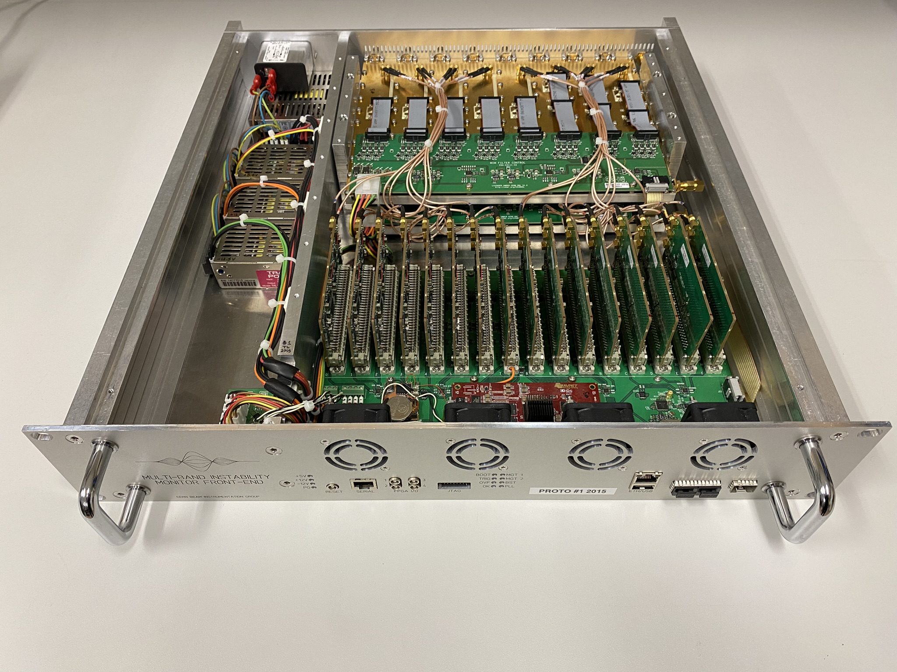
Multi-Band Instability Monitor
Prototype instability measurement system for the LHC
  Designed to be complimentary to the Head-Tail monitors
BPM delta signal is band-pass filtered by a RF filter bank at 8 harmonics of 400MHz
  400, 800, 1200 … 3200 MHz
Individual diode detector on each band (like BBQ)
Sampled in baseband by 24-bit ADC
  Sampling at 10x Frev (112.45kHz)
  16 x 112.45 kHz * 32-bits = ~8 MB/s
Implemented in stand alone 2U chassis with 2x filter banks (horizontal + vertical) – 16 ADCs

Slide 3
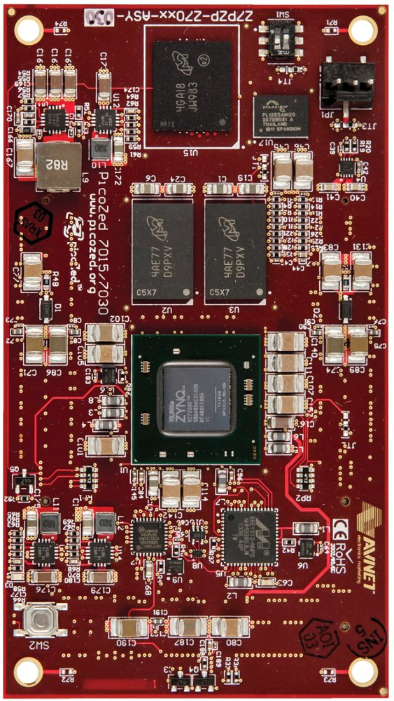
Multi-Band Instability Monitor – SoC
FPGA is a Zynq 7030
  “State of the art” in ~2014 ☺
Implemented with Avnet PicoZed SOM
  1GB DDR3
  128MB SPI flash + 4GB eMMC
  1Gb Ethernet + USB 2.0
  4 GTX, 135 PL I/O, 20 PS I/O
Custom backplane to hold SOM, 16 ADC cards, filter bank gain control via I²C
  EDA-03109 MIM 24BIT 4MSPS ADC
  EDA-03110 MIM FPGA Backplane
  EDA-03111 MIM Filter Control

Slide 4
SoC PL layout (simplified)
IRQ
ADC
SPI
ADC
Interface
(BRAM)
Cheby
MM
AXI
to
WB
Zynq PS
WB
WB
AXI
BST
Decoder
WB
BST
I²C
Board control
Filter bank 1
Filter bank 2
ADCs
I2C
MUX
I²C
GPIO

Slide 5
SoC PS
SoC PS is running Petalinux (2016)
Connected to the TN with Gb Ethernet
Control of WB part using UIO (Userspace I/O) generic drivers
Control of I²C devices using Linux’s built in drivers (hwmon, gpio, etc)
Control/diagnostics done with scripts executed via SSH connection to Zynq
    Not integrated into FESA
  Streaming raw ADC data to FESA with ZeroMQ pub/sub socket
    A “quick and dirty” solution
    But it works and was simple to implement
  Implementation of a “proper” communication protocol (control + acquisition) is waiting for a group standard to be decided…

Slide 6
SoC remote diagnostics
MIM front-ends are installed in UA43/UA47
  Not accessible when there is beam
  Aim to be able to debug remotely if required (like we have with VME)
PS serial console available remotely
  RS232 connector on front panel of MIM
  Connected to MOXA nPort RS232-Telnet bridge
  Allows control of the uboot shell
Remote power cycle available via GUDE power switch
Remote update available via net-boot ...
Could be useful to consider for other projects!

Slide 7
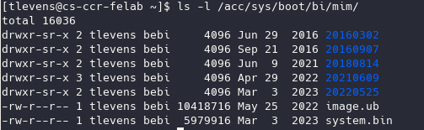
SoC net-boot
SoC is net-booted from cs-ccr-felab
On board SPI flash contains only a uboot image
uboot loads FPGA and Linux image using TFTP from cs-ccr-felab:
Very simple update procedure: copy new files to cs-ccr-felab and reboot!

Slide 8
BQMIM FESA
Small ZMQ “server” running on each MIM FE sends raw data on a ZMQ pub socket
BQMIM FESA class subscribes to these (in a CES) and publishes the data
  Publishes every 16k points (~7Hz)
CFB-UA43-BQMIMB1
(MIM)
TN (ZeroMQ)
CFC-SX4-BQ1
(Kontron)
TN (CMW)
TN (ZeroMQ)
CFB-UA47-BQMIMB2
(MIM)
FESA devices:
LHC.BQMIM.B1
LHC.BQMIM.B2

Slide 9
Links
FPGA:
  https://gitlab.cern.ch/bi/mim
FESA:
  https://sources.cern.ch/browse/FESA-rep/trunk/fesa-class/BQMIM

