Slide 1
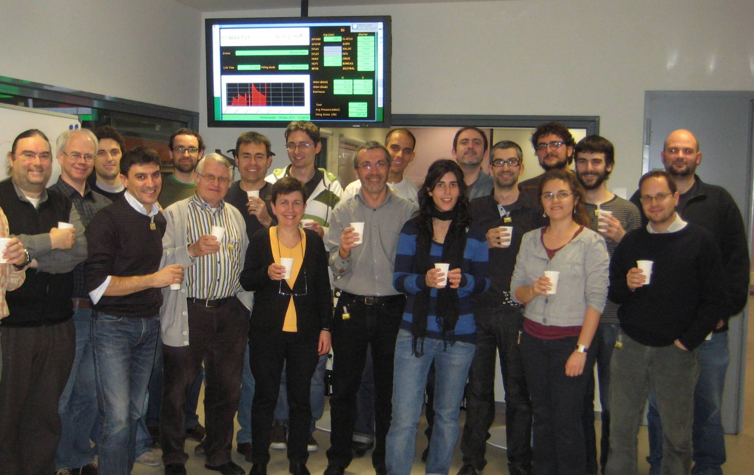
ALBA: COMMISSIONING STATUS
Marc Munoz
on behalf of ALBA Accelerator Division
Notes:
Bona tarda a tothom.
En primer lloc agrair al Museu, que no se si sabia que soc nascuda a Terrassa i que per tant em fa especial il.lusio se avui aqui, el que m’hagi donat l’oportunitat de venir a explicar-vos que és un sincrotró i en particular el sincrotró ALBA que s’està construint en aquests moments a Cerdanyola del Vallés.

Slide 2
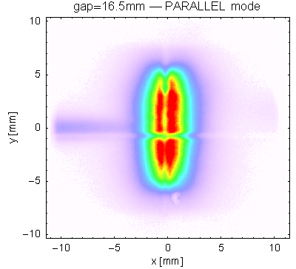

Slide 3
History of the project
1992-4: First plans for a light source in Spain. Creation of the LLS. Recruitment and training of the staff for the preparation of a conceptual design report for a light source.
1997: Finishing the conceptual design report
2002: Approval of the project by the Spanish- and the Catalonian Government. Site selected in the Valles area, close to Barcelona and to the Universitat Autonoma de Barcelona. CELLS created.
2003: Appointment of the General Director (Prof. Joan Bordas).
2003: Announcement of the positions for the heads of the 5 divisions.
2003-05: Users meeting and workshops to establish the scientific program. 7 beamlines approved.
2004-05: Redesign of the machine, Staff recruting
2005-08: Building.
2007-10: Mechanical installation.
2009: Booster commissioning
2010: SR commissioning

Slide 4
ALBA Accelerators
LINAC
100 Mev
BOOSTER
100 MeV – 3 GeV
STORAGE RING
3 GeV

Slide 5
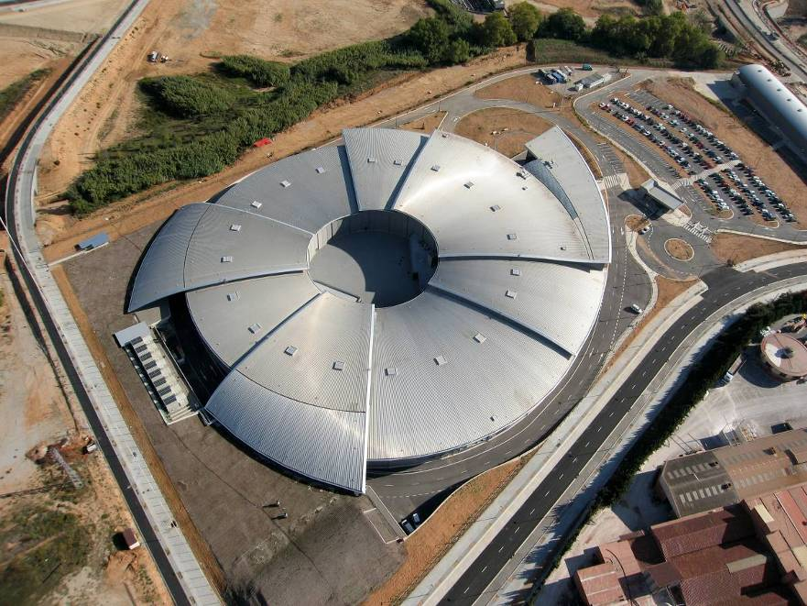
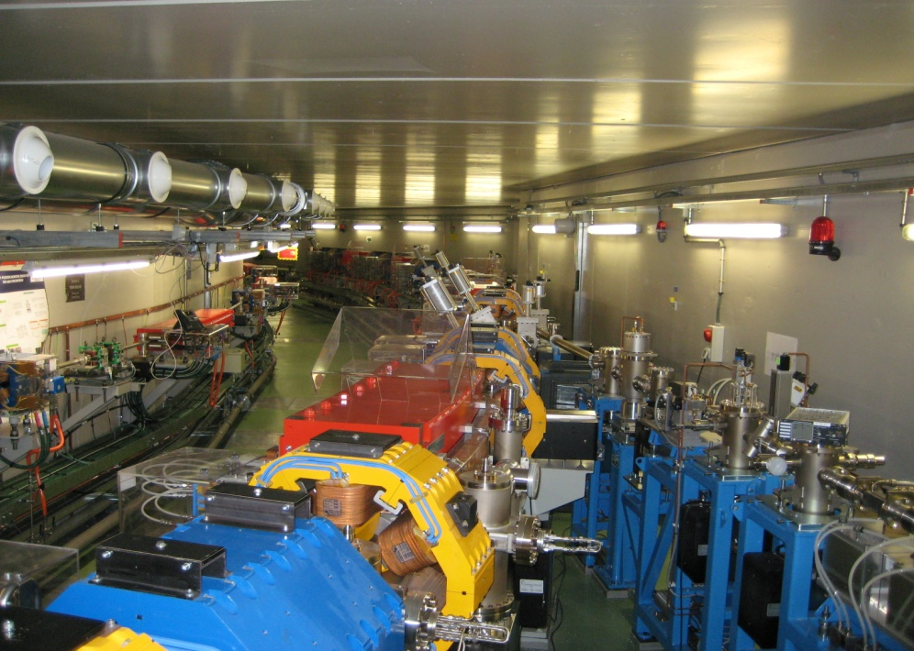
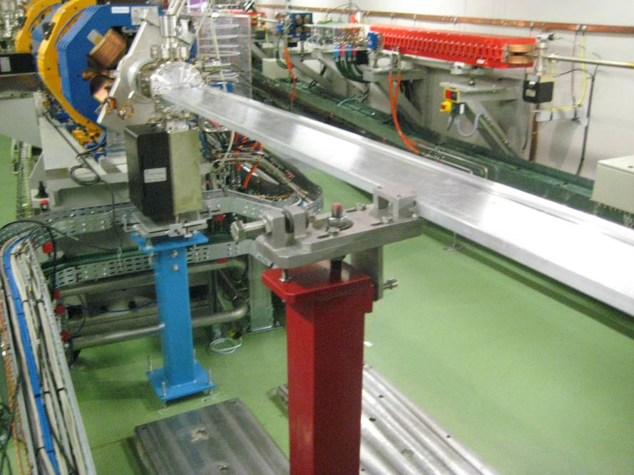
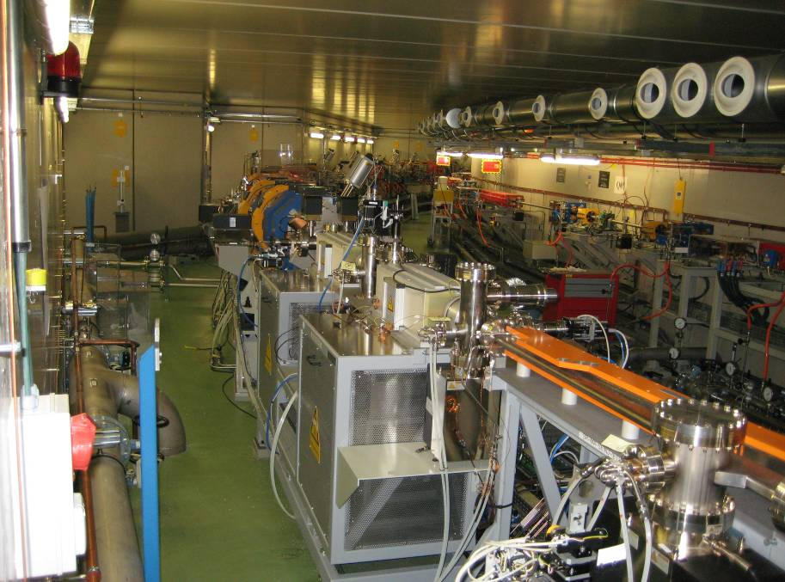

Slide 6
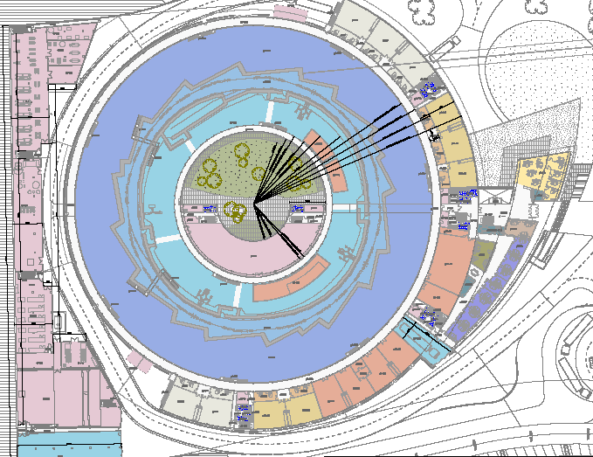
Cooling
Offices
Service tunnel
Diameter of storage ring = 85.6 m
Diameter of Exp.-Hall = 125 m
Electricity
Workshop
Laboratories

Slide 7
Fase 1 Beam Lines
FE29
EU71
BOREAS
FE34
3 GeV S.R.
FE01
FE24
EU62
CIRCE
100 MeV Linac
FE22
W80
CLAESS
Courtyard
FE04
SCW-31
MSPD
3 GeV Booster
Diagnostic FE
BM BL
FE09
BM
MISTRAL
ID BL
FE13
IVU-21
XALOC
FE11
IVU-21
NCD

Slide 8
Milestones for the Linac
1.) Installation of Linac: Febr. 2008 to may 2008
2.) First beam out of the Linac: July 2008
3.) Phase 1 Commissioning of Linac: October 2008
4.) Acceptance of Linac: October 2008
5.) Phase 2 Commissioning of Linac: October 2009
6.) Operation of Linac for booster commissioning: Dec. 2009 to Jan. 2010
7.) Reparation of Linac structure 1: April 2010
8.) Restart of Linac: May 2010
9.) Optimisation of Linac: June – July 2010
10.) Normal operation of Linac: since July 2010
Summary:
Some specifications of the Linac are much better as given by the specifications ( for example the emittance is by a factor 2 smaller). The Linac operation is very reliable for the different modes: long bunch, small bunch, single bunch, large charge (4 nC), small charge (0.5 nC), etc.

Slide 9
Booster synchrotron - Timeline
1.) Mechanical installation of booster: Jan. 2009 to March 2009
2.) Installation of RF-System : Febr. 2009
3.) Installation of secondary piping: July to Sept. 2009
4.) Cooling available: September 2009
5.) Personal safety system finished: November 2009
6.) Alignment of booster synchrotron : Nov. to Dec. 2009
7.) Control system finished: December 2009
8.) Pre-commissioning of booster components: Nov. to Dec.2009
9.) CSN- certificate for booster commissioning: December 2009
10.) First beam in the booster synchrotron : 21st December 2009
11.) Phase 1 of booster commissioning: 10th to 24th Jan. 2010
12.) Phase 2 of booster commissioning: July 2010
13.) Phase 3 of booster commissioning: Sept.- Octob. 2010
14.) Extraction of 3 GeV beam out of booster 28th October 2010
14.) Normal operation of booster synchrotron: since Nov. 2010
Summary: The booster synchrotron runs reliable. The behaviour of the booster
is pretty well understood. It is ready, working as an injector for the
storage ring, but we have to make some optimisation.

Slide 10
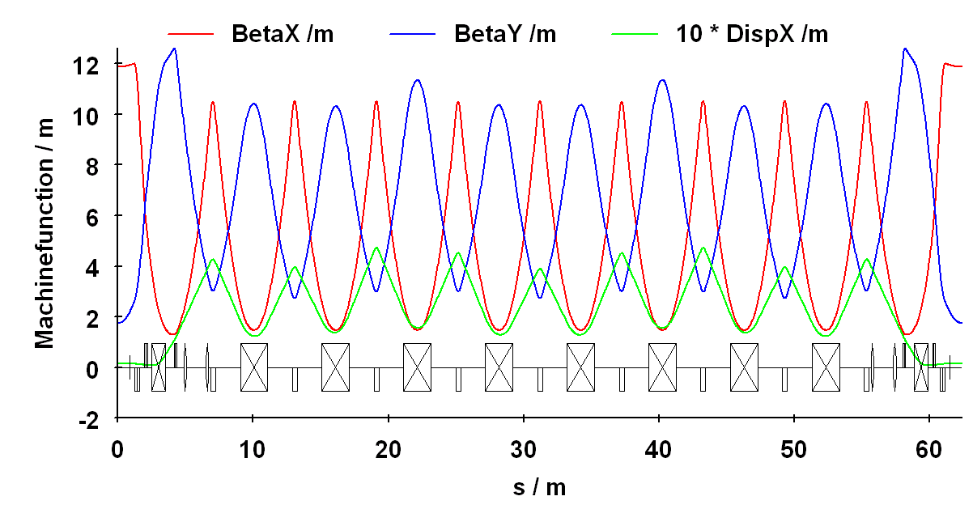
Lattice of Booster
QH01
QV01
QV02
SV
SH
short dipole
long dipole
QH02
Design working point: Q_{x} = 12.42, Q_{y} = 7.38
Notes:
10

Slide 11
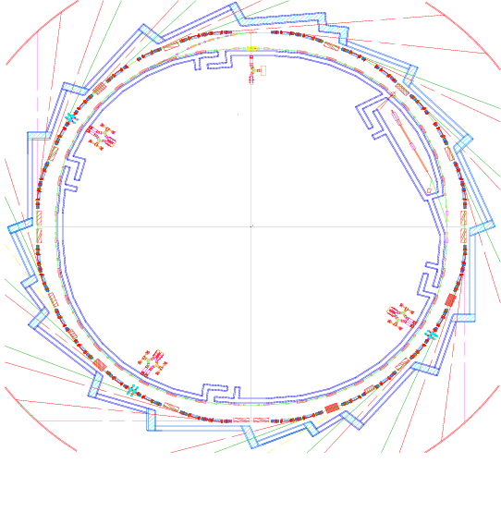
Layout Booster
3 GeV Booster
gradient dipoles with
built-in sextupole
circumference: 249.6 m
4 superperiods:
32 long dipoles 2 m
8 short dipoles 1 m
60 quads in 4 families
Emittance 10 nm·rad
RF frequency 500 MHz
Linac 110 MeV
Repetition rate 3 Hz
Multi bunch mode:
4 nC in 112 ns
Single bunch mode:
1 nC in 4 pulses (2ns)
BTS
LINAC
LTB
BOOSTER
STORAGE RING

Slide 12
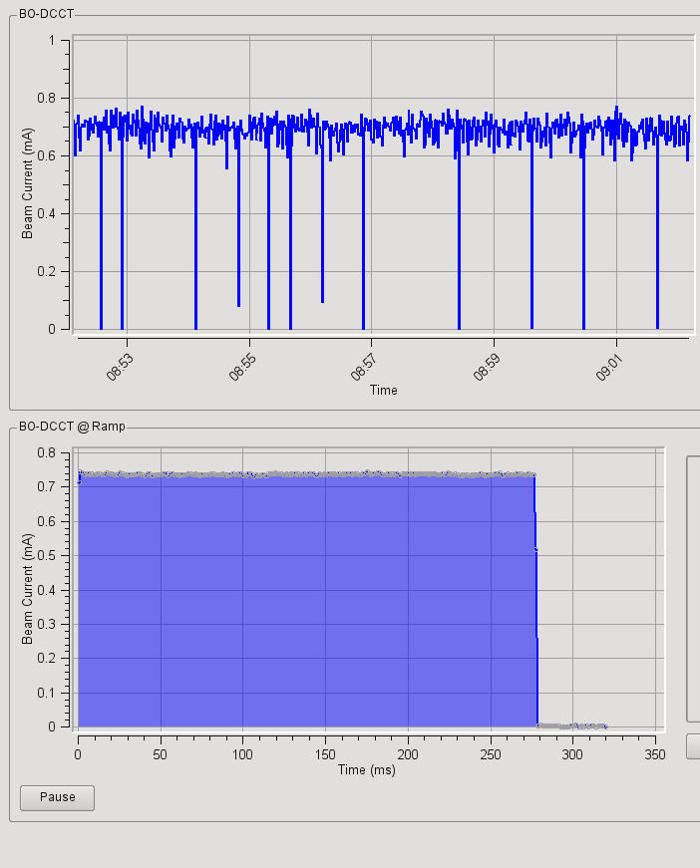
Summary of Booster
Bad shots
Injection (110 MeV)
3 GeV
200 MeV

Slide 13
Tunes and Quad-k-Values
model quad k-values along the ramping according to the calibrations
measured-model tunes comparison
the model of the booster optics in the ramping has a good agreement both at low and high energy, this is very useful to set the power supplies waveforms
Dieter Einfeld, Cells-ALBA 13th - SAC-Meeting, 31st – March 2011
Notes:
13
Modeling: tunes and K-values in ramp

Slide 14
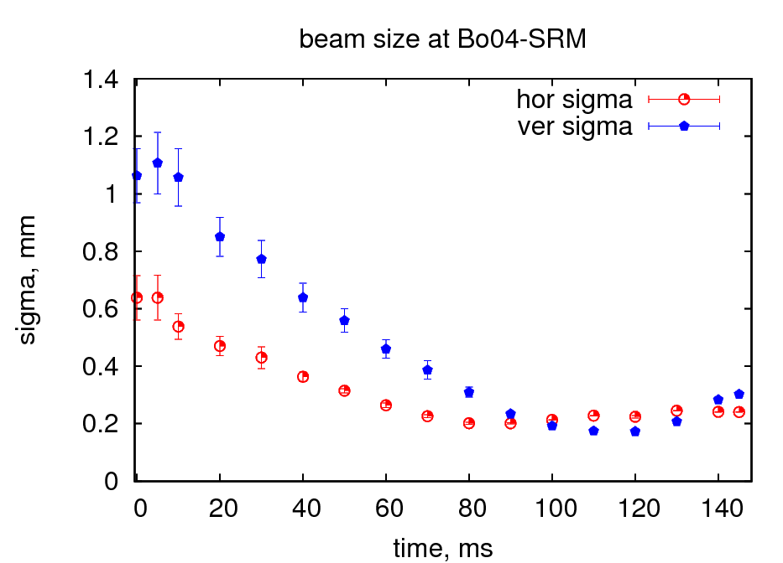
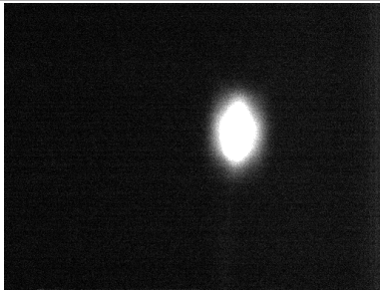
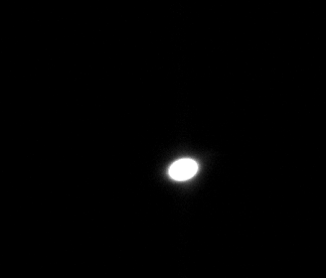
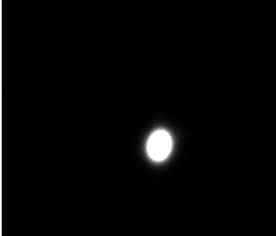
Booster Beam Sizes
t=0ms
σ(x) = 0.25, σ(y) = 0.3 (meas.)
σ(x) = 0.17, σ(y) = 0.09 (mod.)
t=120ms
t=145ms
E=110MeV
E=3GeV
Dieter Einfeld, Cells-ALBA 13th - SAC-Meeting, 31st – March 2011

Slide 15
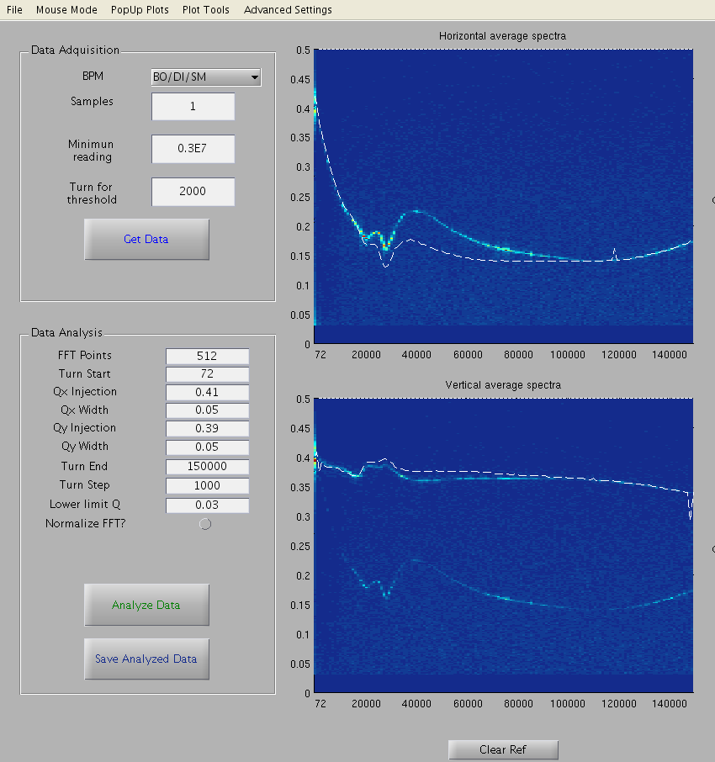
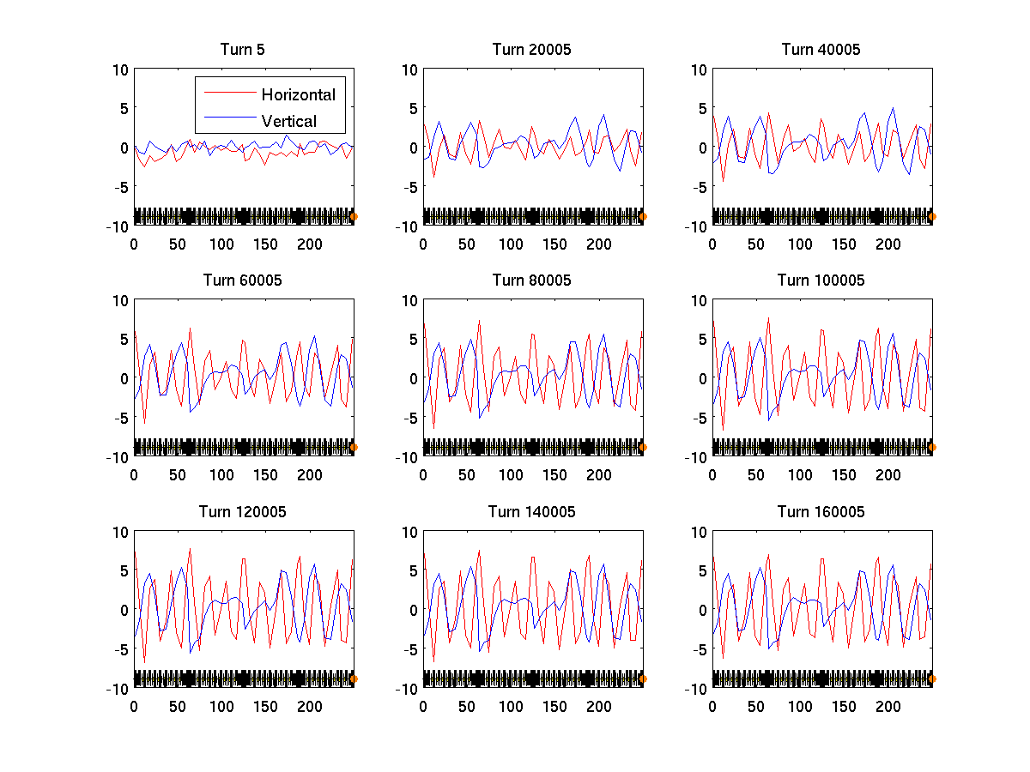
Results of BO in ramping mode
First beam to 3 GeV: injection on w.p. (12.42, 7.38)
Large drop of Qx at the start due to nonlinear magnet calibration
Vertical tune is flat: most of the vertical focusing is provided by the gradient bending
Orbit blow up, specially in the horizontal plane, ±8 mm
Notes:
Bona tarda a tothom.
En primer lloc agrair al Museu, que no se si sabia que soc nascuda a Terrassa i que per tant em fa especial il.lusio se avui aqui, el que m’hagi donat l’oportunitat de venir a explicar-vos que és un sincrotró i en particular el sincrotró ALBA que s’està construint en aquests moments a Cerdanyola del Vallés.

Slide 16
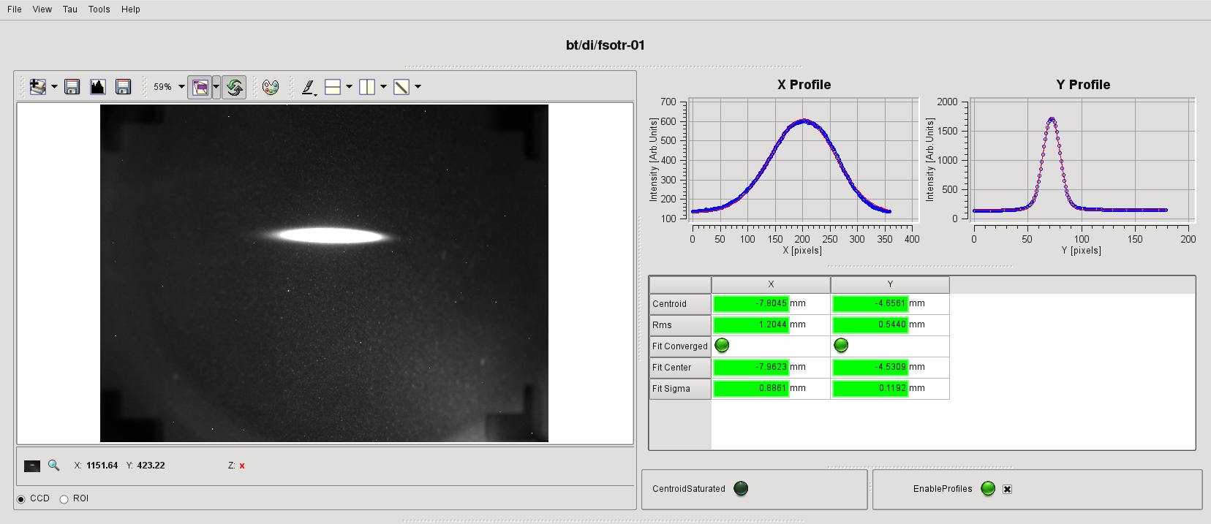
BTS – 1st Beam
σ(x) = 0.86 mm, σ(y) = 0.19 mm
ε(x) = 13 nmrad, ε(y) = 2,6 nmrad
Dieter Einfeld, Cells-ALBA 13th - SAC-Meeting, 31st – March 2011

Slide 17
Storage Ring Lattice
DBA expanded structure
16 cells
Only doublets to save space
Combined bending magnet with large gradient, 5.65 T/m

Slide 18
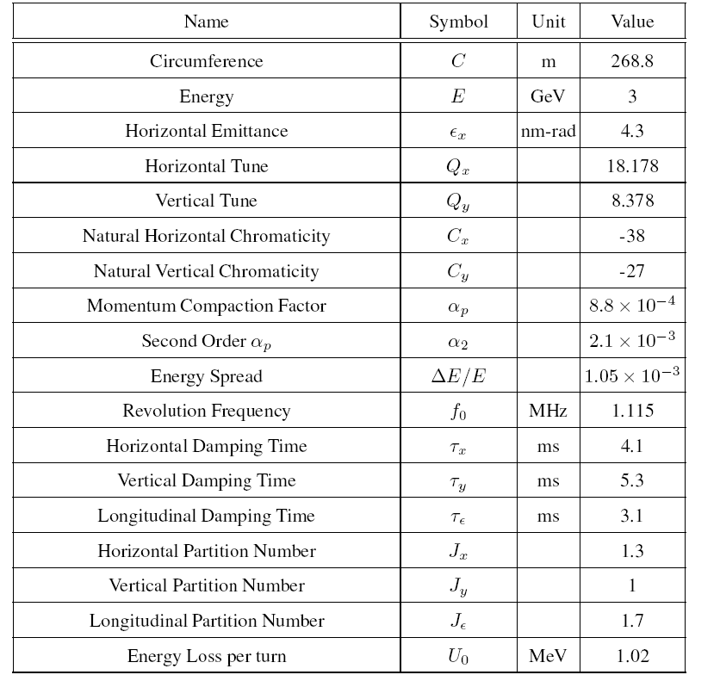
SR Summary
Parameters
Remarks:
  24 straight sections:
    4 x 8 m -> 3 free for ID
    12 x 4.3 m -> all free
    8 x 2.4 m -> RF, diagnostic
  38 % of the circumference for ss.

Slide 19
Light Output
Dieter Einfeld, Cells-ALBA 13th - SAC-Meeting, 31st – March 2011

Slide 20
Beam Sizes
σ_{x} = 132 μm
σ’_{x} = 46 μrad
σ_{y} = 7.5 μm
σ’_{y} = 5.8 μrad
σ_{x} = 270 μm
σ’_{x} = 20 μrad
σ_{y} = 16 μm
σ’_{y} = 2.7 μrad
σ_{x} = 310 μm
σ’_{x} = 22 μrad
σ_{y} = 15 μm
σ’_{y} = 2.9 μrad

Slide 21
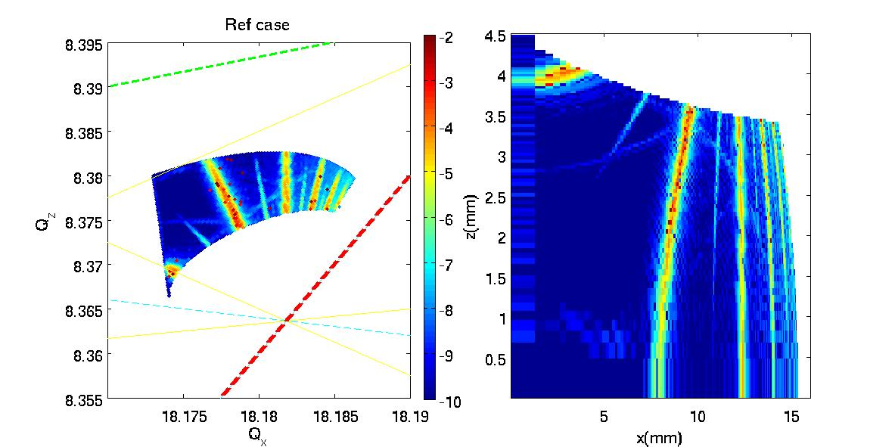
Frequency Map - Ideal

Slide 22
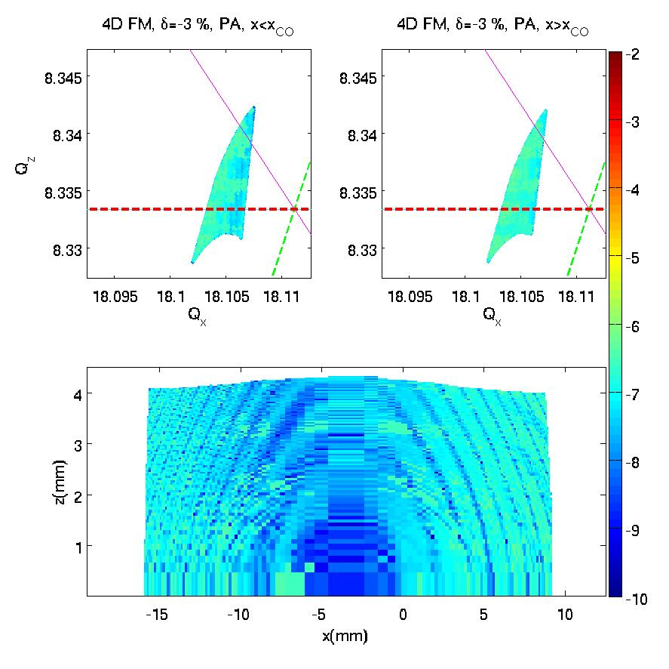
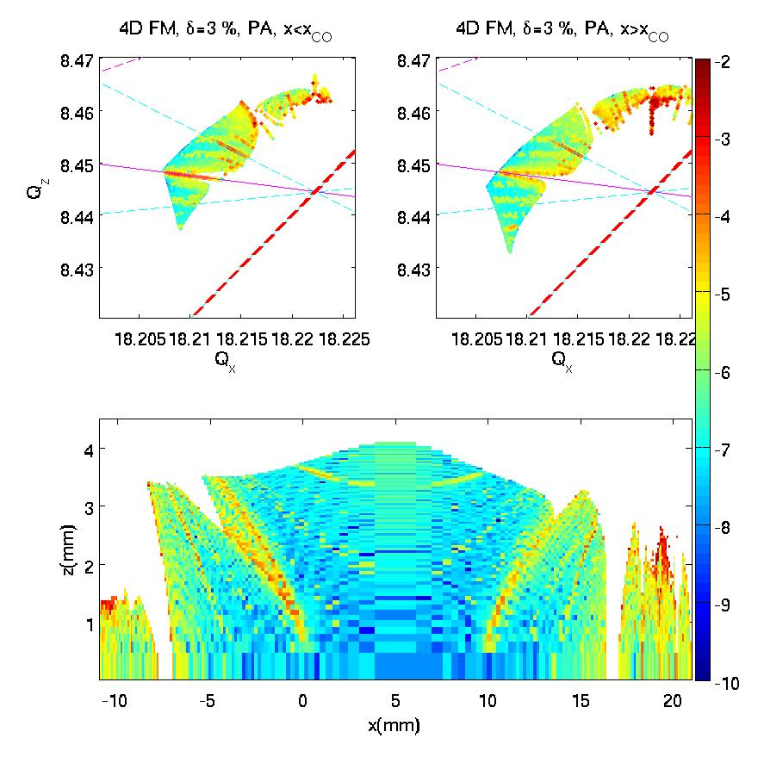

Slide 23
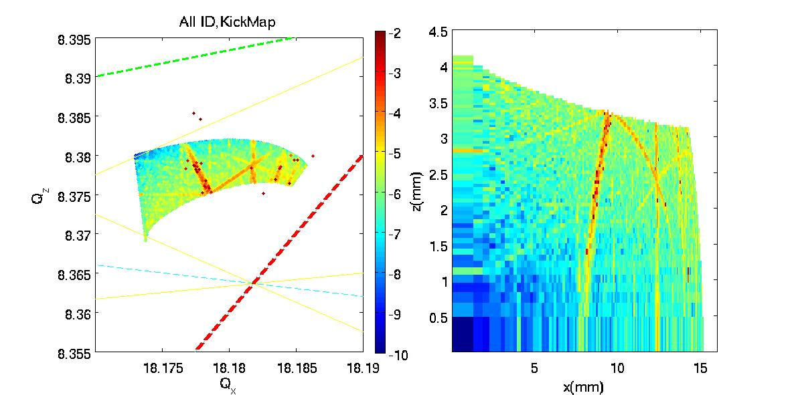
Frequency Map - IDs

Slide 24
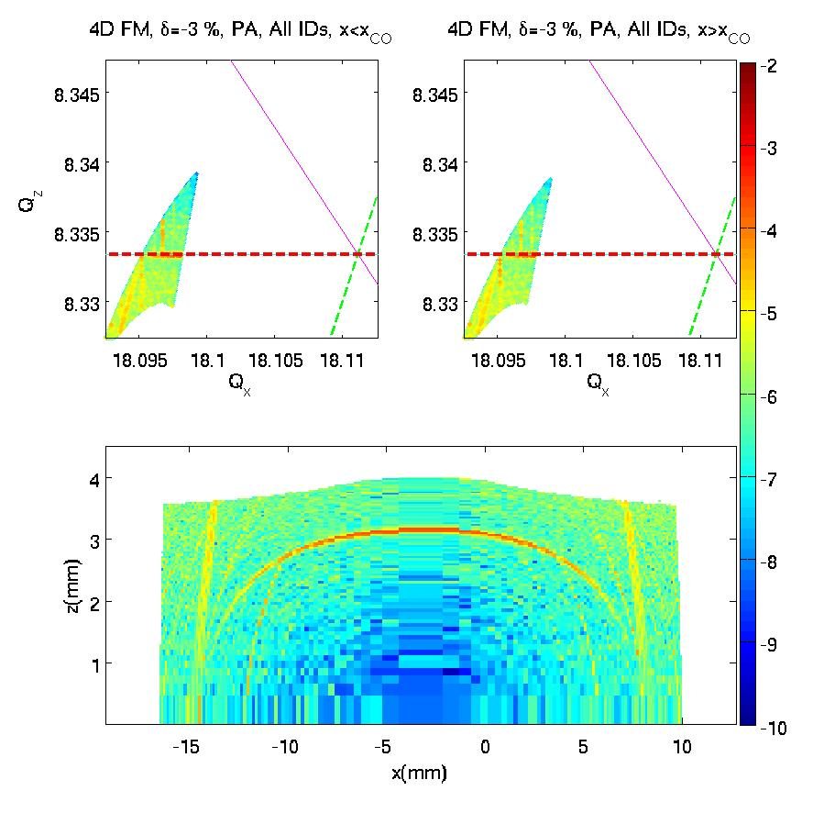
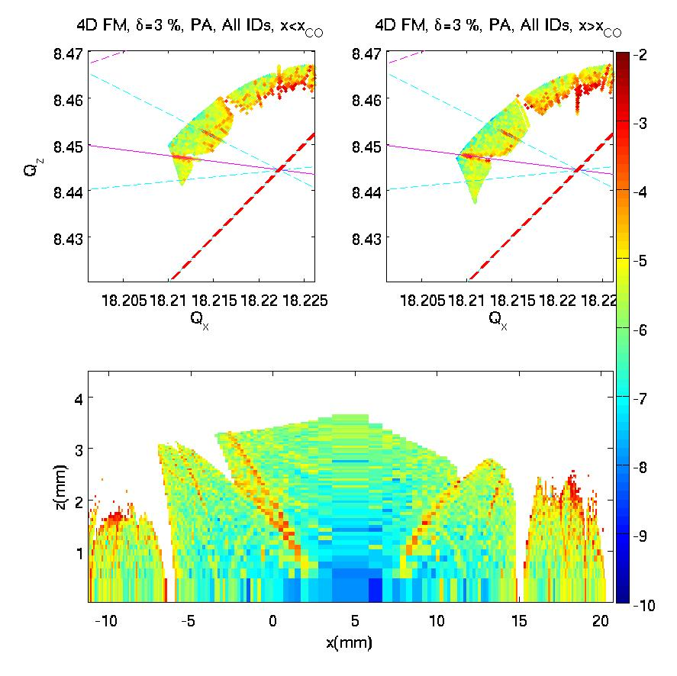

Slide 25
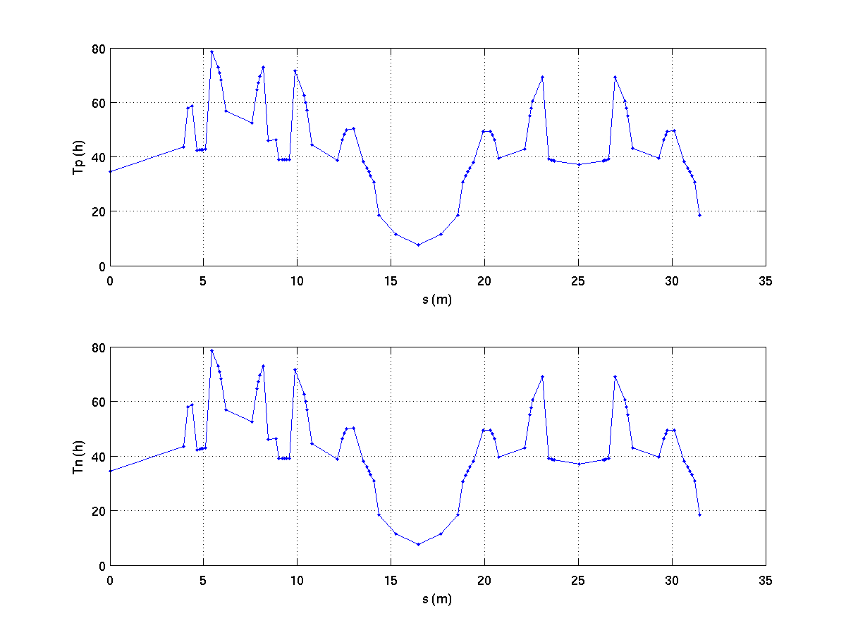
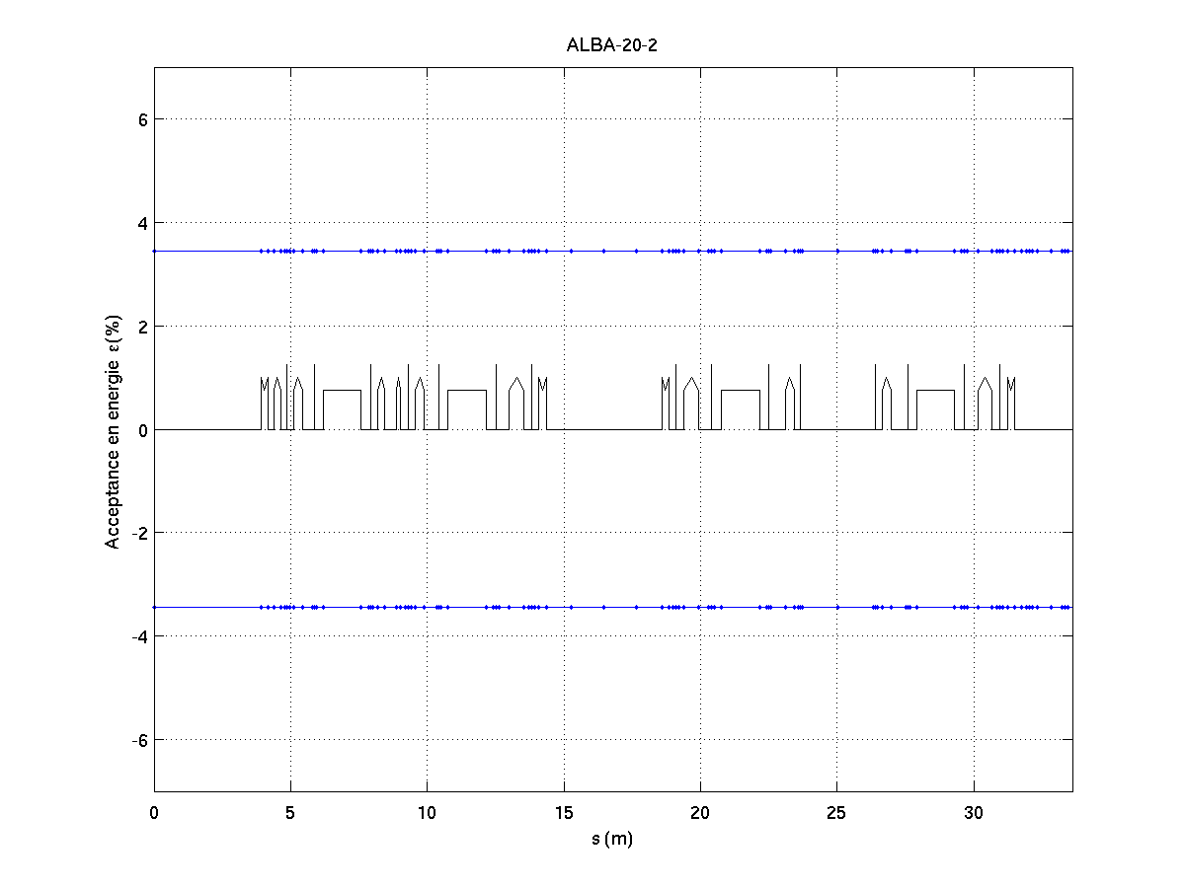
Lifetime
Touschek
  6D tracking with Tracy, introducing a 1% coupling and vacuum chamber
  For 400 mA:
  τ_{T} ~30.8 hours.
  Limited by the RF
Symmetric behavior of the energy acceptance for positive and negative dp. The limiting factor in both cases is the RF.

Slide 26
Beam lifetime at 400 mA, including 1% coupling and the default vacuum chamber. The inclusion of a 3rd harmonic cavity will increase it close to 25 h.
The effect of quantum lifetime in all three directions is negligible
Elastic scattering and bremsstrahlung lifetimes have been calculated for a residual N2 pressure of 1 nTorr
Elastic scattering | ≈ 78 h
Bremsstrahlung | ≈ 60 h
Touschek | ≈ 30 h
Total | 16 h

Slide 27
RF
RF Cavity (Dampy)
  f 499,654 MHz
  Q₀ 27000
  Rshunt 3.1 MΩ
  R/Q 115 Ω
  Cavity power 60 kW
  Beam power/cav 87 kW
  IPC power 147 kW
  Type of cavity nc (6 Cells/IPC)
  Total Voltage 3.6 MV (600 kV / cell)
  Total Power 960 kW (160 kW / cell)
Waveguide dampers
RF-coupling window
Tuner
Beam pipe
A SC third harmonic cavity is planned

Slide 28
RF II
RF cavity
Cavity Combiner
  2 Input Ports (80 kW each one)
  1 Output Port (150 kW)
  Insertion losses 0.3 dB
  Frequency stability 200 kHz
RF amplifiers (IOT)
  Inductive Output Tubes at 500 MHz
  Broadcasting standard
  80 kW output power
  3 MHz bandwidth at -1 dB
  50 Ohm impedance
IOT₁
IOT₂

Slide 29
Bending magnet
Combined function with a large gradient.
All the dipoles measured in house with good accuracy.
Arranged in the machine to ensure small effect due to the differences of gradient.
Correction coils avalible to compensate the errors if needed.
Magnetic field: 1.42 T
Bending angle: 11.25 deg.
Bending radius: 7.047 m
Gradient: 7 T/m
Gap: 36 mm
Current: 520 A
Field accuracy: <3*10⁻³
Grad. accuracy: <2*10⁻³

Slide 30
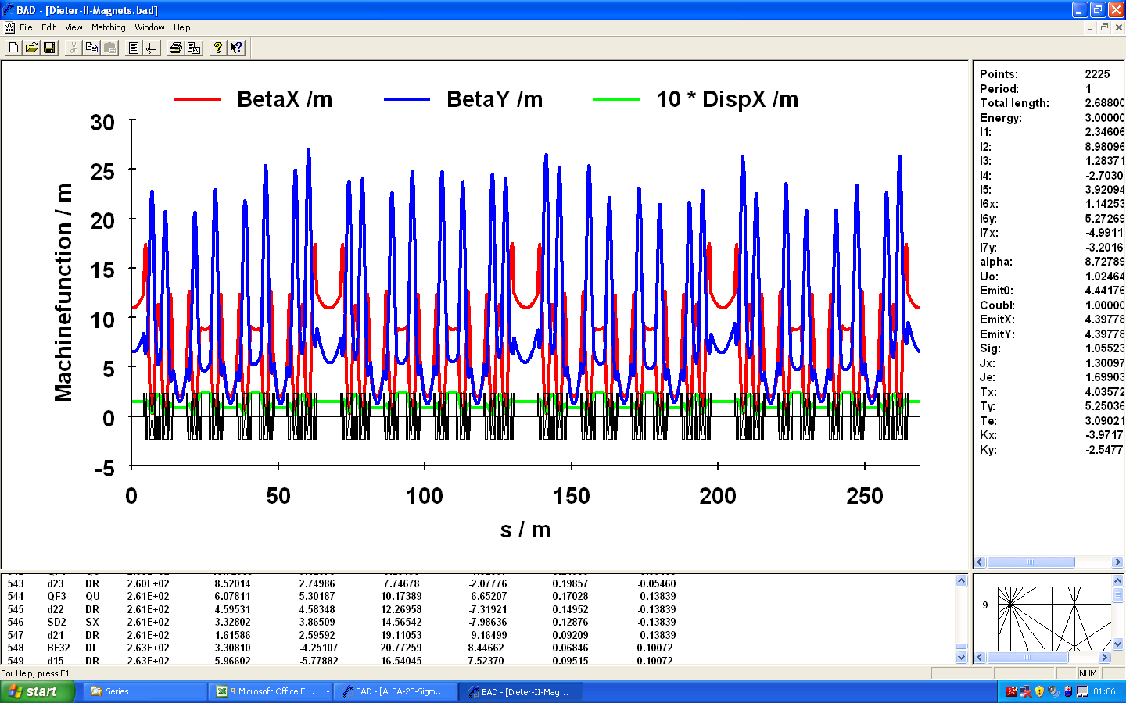
Bending
In the process to cross check this with LOCO

Slide 31
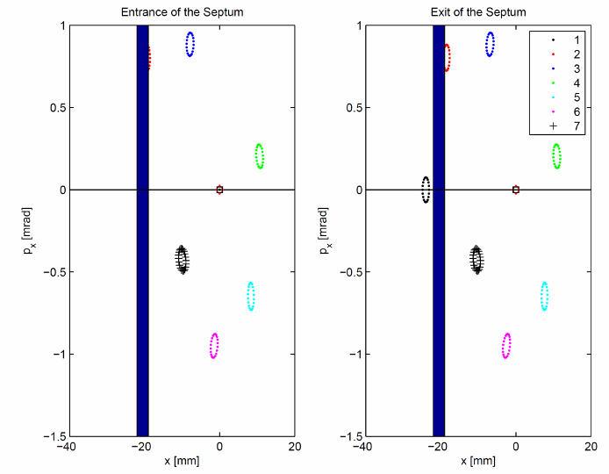
Injection scheme

Slide 32
Diagnostic
Component | Acronym | # units
Fluorescent Screen “In-air” | FS | 5
Fluorescent Screen Horizontal | FSH | 2
Beam Position Monitors – Libera Brilliance | BPM | 123
DC Current Transformer | DCCT | 1
Fast Current Transformer | FCT | 1
Annular Electrode | AE | 1
Stripline BPM | SBPM | 1
Scraper (Hor & Ver) | SCRH & SCRV | 1 & 1
Beam Loss Monitors | BLM | 128
X-Ray Pinhole Camera | Pinhole | 1
Visible Light Monitor | BL34 | 1

Slide 33
Results From SR commissioning

Slide 34
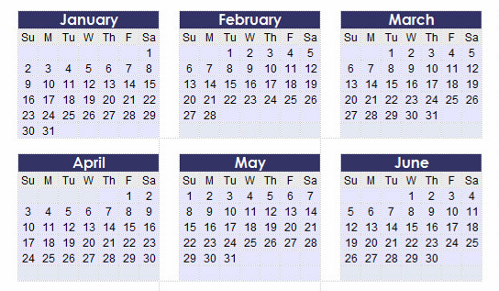
SR Commissioning
First try over one week-end: 4 shifts
2 intensive weeks: 2 shifts/day for 10 consecutive days
Normal commissioning: 9 shifts/week
Total commissioning phase I: 90 shifts (8 hours/shift)
2 shifts
1 shift

Slide 35
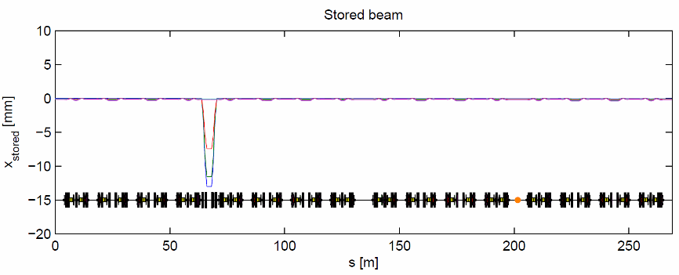
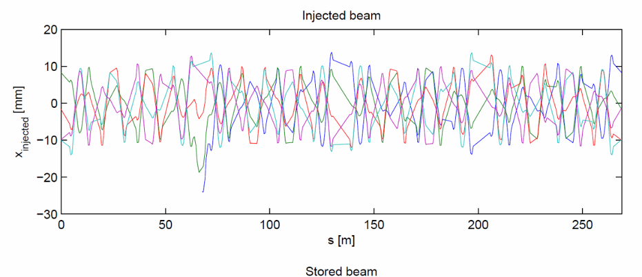
Injection
FSH1
FSH2
K1
K2
K3
K4
BTS
Septum

Slide 36
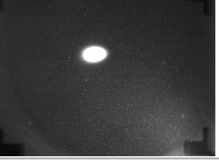
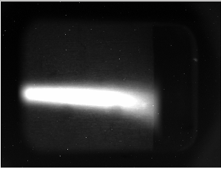
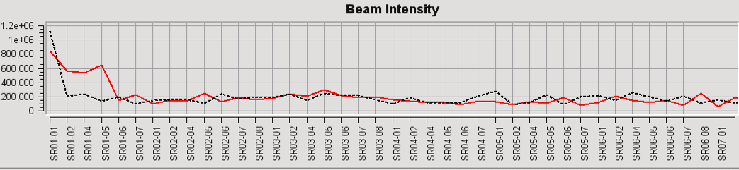
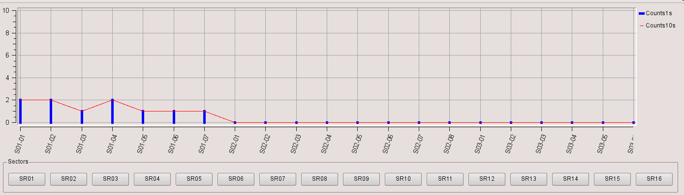
1st try at week-end (12-13 Feb)
Straigthforward extraction from the Booster
Problems to reach the end of the BT: Quad misaligned
(wrong reference fiducials)
Beam in SR only for one cell (2 bendings)
Stop because a problem with the BO extraction Kicker…

Slide 37
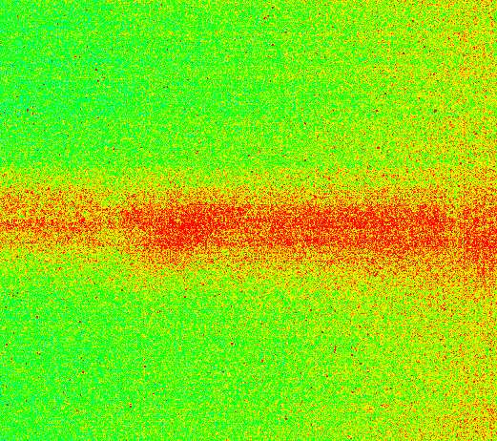
First 4 days … 8 – 12 March
9th March: Beam spot at 1st FS, at sector 2,
09h00 completely defocused horizontally.
All SR Quadrupoles with wrong polarity

Slide 38
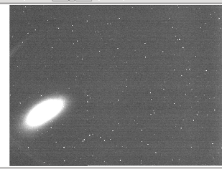
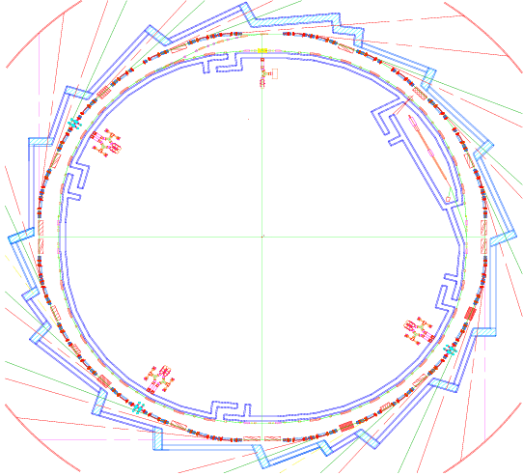
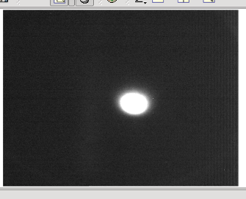
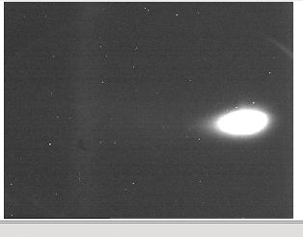
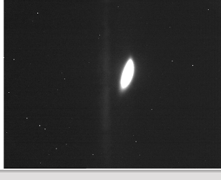
Recabling all quads
Recabling Quads:
Sectors 1&2
Quadrant 1
On axis injection
Quadrant 2
Quadrants 3&4
19h35: 1st turn !

Slide 39
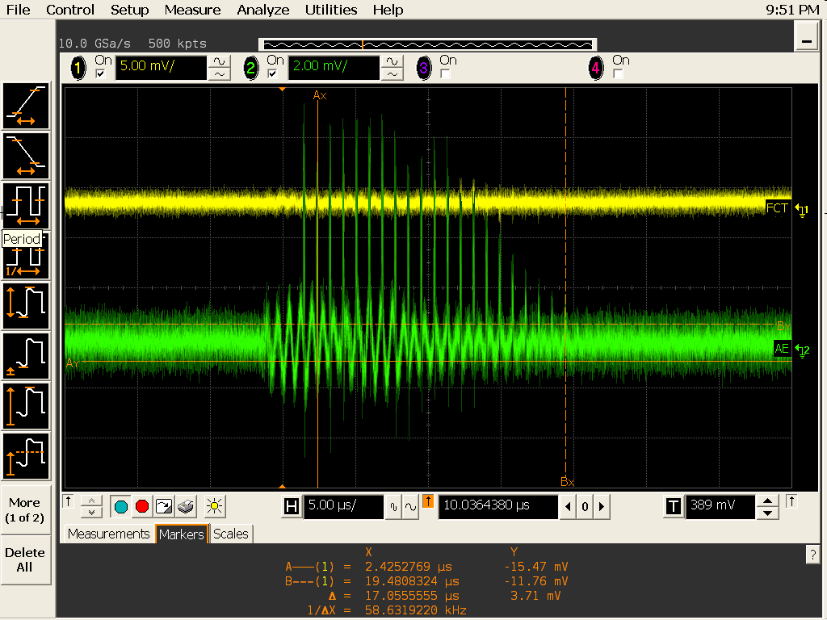
9th March 20 turns
Standard injection

Slide 40
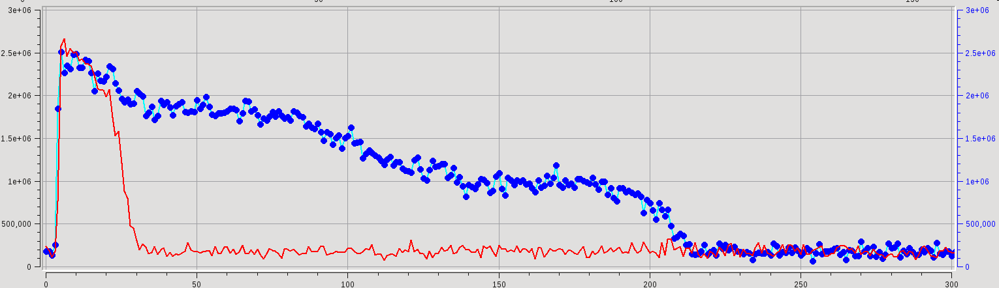
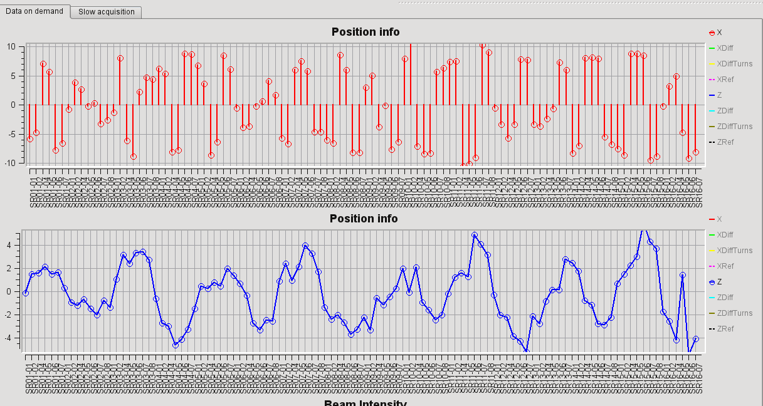
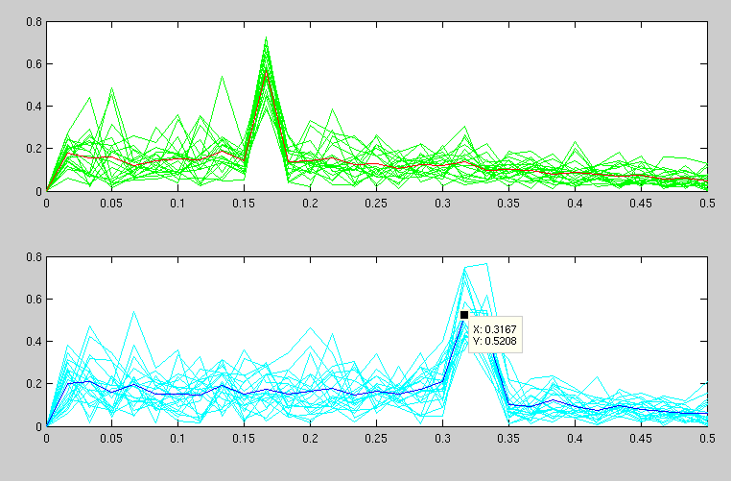
10-13 March: Objective, store beam
Switching ON RF
Adjusting injection angle
Adjusting tune
(0.17, 0.32)

Slide 41
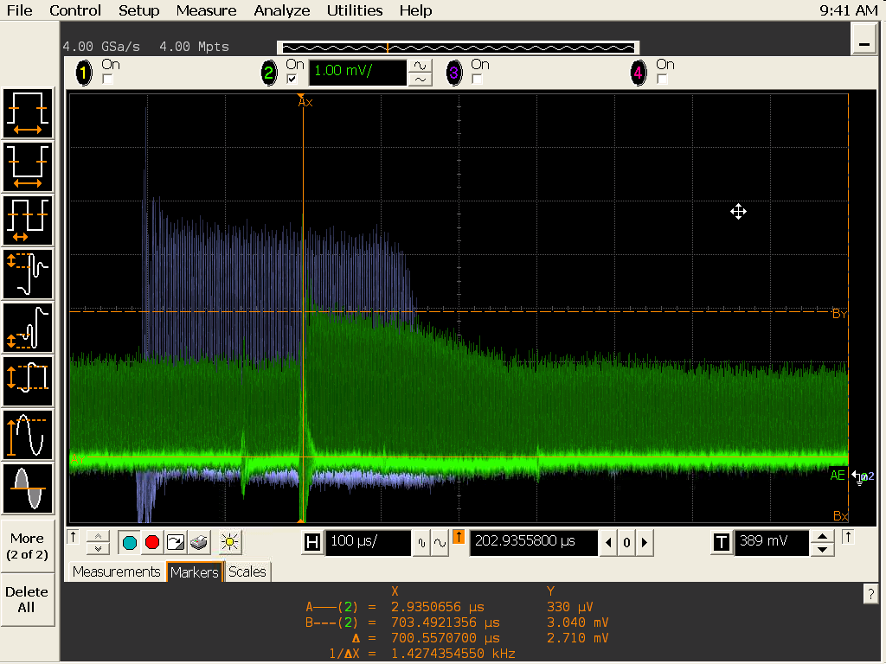
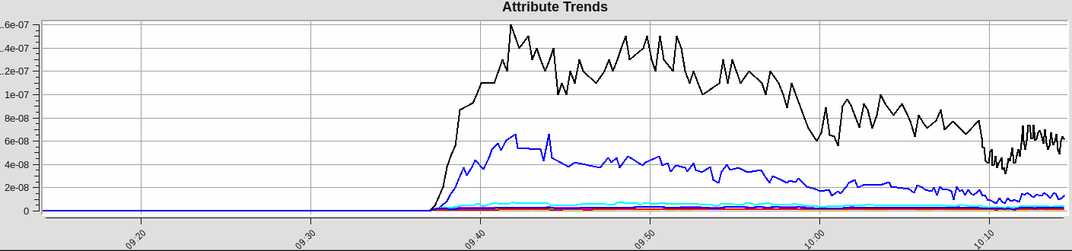
13th March, 9h38: 1 second stored beam
SR FCT
Vacuum

Slide 42
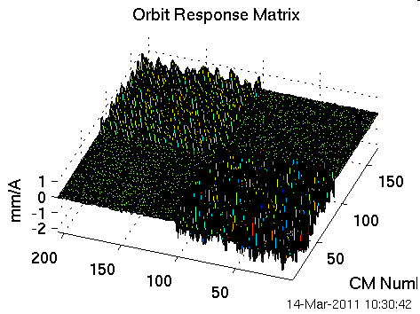
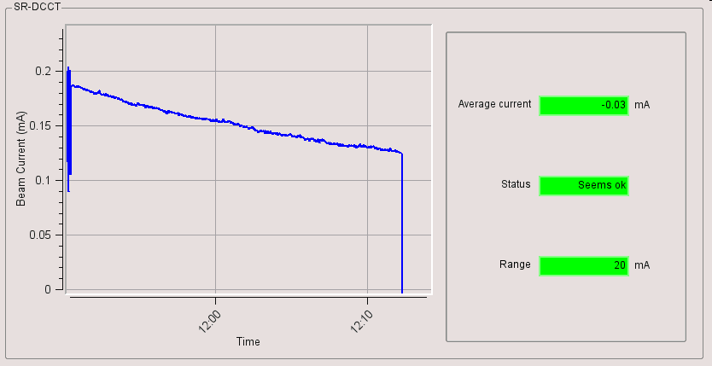
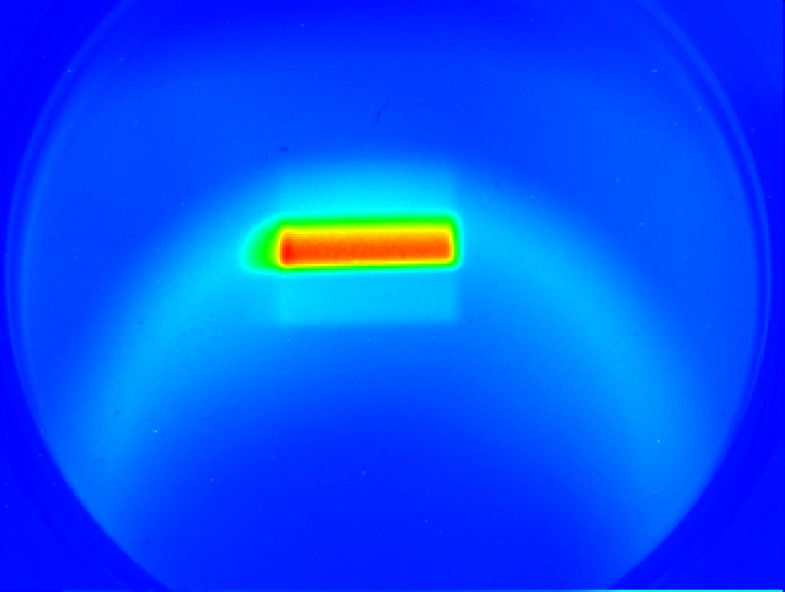


Firsts measurements
Lifetime
Synchrotron light
at pin hole camera
Dispersion
Qinteger= (18 , 8)

Slide 43





The road to accumulation
Turn by turn data
Orbit distortion
Surviving few turns together
with new injected beam
Lossing the lasts turns

Slide 44


1st Accumulation
1.5 mA stored
Acummulation
16 March, 8h50: Beam Acummulated
(9th day)
Current SR
Current Booster

Slide 45





16 March
1st synchrotron light
outside the tunnel

Slide 46



MAXIMUM CURRENT LIMITED TO 20 mA
UNTIL THE Machine Protection System IS OPERATIONAL
Synchrotron Light at Front End 9
FE09
and at the Pinhole camera:
Sigma X = 50 um
Sigma Y = 130 um
Pin hole

Slide 47







The road to 200 mA
Once the MPS was operational…
Now 170 mA reached.

Slide 48



Tune
Tune during the commissioning:
H
V

Slide 49

Chromaticity
Normally working with (+2 , +2).
Good agreement with the model

Slide 50
BBA
Horizontal offsets:
+1.0 mm to -1.1 mm
Vertical offsets
+0.9 mm to -1.1 mm

Slide 51

Orbit
Raw orbit without correctors
With offsets BBA included
RF frecuency adjusted
from 499.6540 MHz
to 499.6523 MHz
Horizontal orbit < 3mm
Vertical orbit < 2 mm
Good alignment

Slide 52

Horizontal
max.
2.5 mm
0.4 mm
sigma

Slide 53
Vertical
max.
1.5 mm
0.4 mm
sigma

Slide 54
Horizontal rms error
32 um
Vertical rms error
29 um
to reference orbit (BBA to center of quads)

Slide 55

Correctors

Slide 56


Orbit Correction: BPM stability
BPM0503
22 mA
Beam current
Vertical
30 um
55 um
Horizontal
45 min

Slide 57



Slide 58

SOFB Test

Slide 59

Day 1 Optics - Asymmetric
Two quadrupoles in sector 8 where swapped!

Slide 60


Measurements 17th March
Two quadrupoles S08
have the cables swapped

Slide 61


Correction of the quadrupoles
Measurements of June
After recabling and
applying LOCO correction

Slide 62

Beta functions
Beta beating < 5%
adjusting the tune to 0.23
including a -0.2% gradient error in the bendings

Slide 63

After the best correction

Slide 64
Dispersion
Model vs. Measurements: Very good agreement

Slide 65

ID effects
Effect of the MPW

Slide 66

Beam Size
And…
71 um 31 um
Pinhole camera
Quite ok with model:
Emittance = 4.5 nmrad
Coupling = 0.4 %
Emittance X = 4 to 6. nmrad
Emittance Y = 0.03 nmrad
Coupling = 0.5% to 2.5%

Slide 67

Vertical Dispersion
Direct result from the RF change measure
The vertical dispersion is still not well understood

Slide 68



After some LOCO analysis, we start to have some answers:

Slide 69

Coupling
Coupling between 0.5 and 2.5%.

Slide 70


Effect of Sextupoles

Slide 71

LOCO example
Data from 9 June, last day of commissioning

Slide 72

Betas reconstructed
Beta beat:
±5 % peak to peak in both planes

Slide 73

Gradients reconstructed

Slide 74

Measured Dispersion

Slide 75

Reconstructed Dispersion

Slide 76


Bunch Length
Streak camera, visible BL

Slide 77

Vacuum performance
Average pressure before injecting the first beam= 4.10⁻¹⁰ mbar
With the first stored beam in the machine (beam current = 0.1 mA), the average pressure increased to 2.10⁻⁸ mbar.
with accumulated beam dose of 4.5 A.h, 80 mA stored beam current, the average pressure of the SR is 3.10⁻⁹ mbar.

Slide 78


RGA scan before beam injection, typical UHV scan, H₂, water traces and CO.
RGA scan with the first beam stored. Increase in CO, CO₂ and CH₄.
Yellow= base pressure.
Cyan= First stored beam
Green= first stored 100 mA.

Slide 79


Effect of IDs
Three insertion devices have been installed and closed:
  EU62
  EU71
  MPW80
Without much influence in the machine:

Slide 80



Light from one ID
Screen @ 9.35m from source (middle of straight section)
Source → APPLEII undulator EU62
Stored current I=0.8mA
Minimum gap (15.5mm):
Horizontal mode (K=5.2)
Circular mode (K=3.0)
Vertical mode (K=3.7)

Slide 81
Lifetime
Problems with cavities, most of the time only 3 or 4 out of 6, with energy acceptance of ~1.5 %.
The values of the lifetime are compatibles with couplings of 1 to 2%, and our physical apertures
Increasing with time…

Slide 82

Apertures
Bumps and apertures scans performed.
No obstacle detected.
Physical aperture close to the theoretical one.

Slide 83


Vertical Instabilities
SCRV closed from 10mm to 0.25mm produces beam losses (~20mA) only in the last bunches of the train
Fast Ions (?)

Slide 84



Horizontal Instabilities
Horizontal beam size
Threshold ~ 24 mA
Current
Vertical beam size
87 um
72 um
31 um
31 um
(?)

Slide 85





Filling pattern(s)
Needs improvements ☺

Slide 86

How we reach 170 mA

Slide 87
Problems
RF problems
  LLRF deregulation, water leaks, vacuum leaks, trips ...
Vacuum problems
  Water configuration, chamber overheating, leaks …
Diagnostics problems
  Streak camera, Libera electronics, stack FS …
PS problems
  Wrong cabling, correctors and quadrupoles PS …
  PS from booster are delicate
Control system problems
  Applications froze, motors, CCD camera, cycling, MPS, PSS, timing …

Slide 88



RF problem
  Problems with the ceramics dome of the cavity’s pick up loops
Dampy 00 one leak during conditiong at the RF lab
Dampy 06 one leak after bake out at Alba
Dampy 04 one leak during conditioning at Alba
Dampy 03 two leaks due to sparks during conditioning at Alba and one during commissioning
No visible leak
Prototype of new pick-up loop:
(without ceramic dome)

Slide 89
In summary:
Water leak → S14B out of order
Vacuum leak → S10A out of order
LLRF deregulation → S10B out of order
Most of the commissioning have been done with only three cavities
1350 MV → q = 1.3

Slide 90


Vacuum problem
Synchrotron radiation hitting the vacuum chamber
Inside the chamber
After placing a thermocouple at the location:
With 20 mA we reached 80 degrees
We estimated the chamber heat up to few hundreds of degrees when injecting 100 mA.
Solved by adding a copper insert in the crotch absorber

Slide 91
Next steps
Installation IDs
Slow orbit feedback
Vacuum cleaning
Better control filling pattern
Fast orbit feedback
Multibunch feedback
Machine upgrades:
  3rd harmonic cavity
  Slicing
  New IDs
  Skew quads
Next commissionigng period Sept. 2011
Along 2012
????

Slide 92

THANK YOU

