Slide 1
Optics measurments of TOTEM
7 sigma runs (β*=3.5m) on 30/10/2010
Hubert Niewiadomski
Optics Measurements, Corrections and Modelling for High-Performance Storage Rings workshop (OMCM)
CERN, 20-23.06.2011

Slide 2
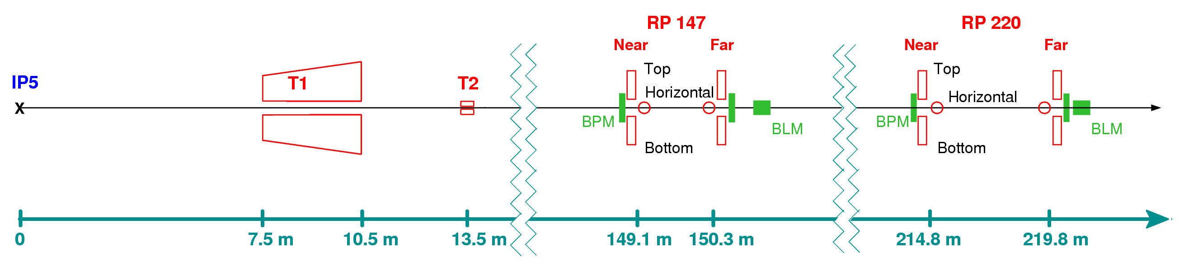
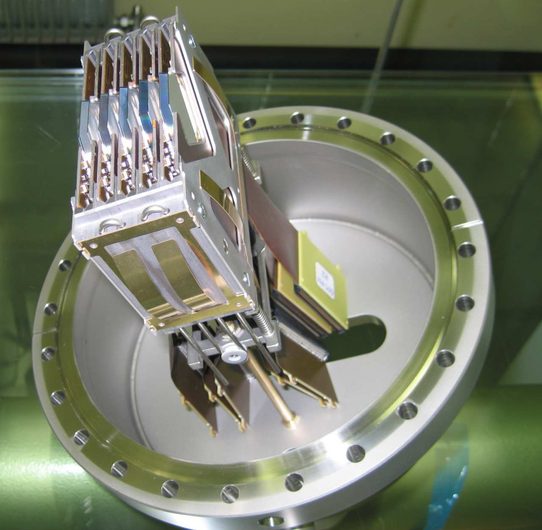
TOTEM Roman Pots in the LHC
Inelastic telescopes
3.1 ≤ |η| ≤ 4.7
5.3 ≤ |η| ≤ 6.5
Roman Pot detector
TOTEM Roman Pots
4 stations @ s≈±147 and s≈±220m
  6 Roman Pots per station
  (4 vertical + 2 horizontal)
A total of 24 Roman Pots

Slide 3
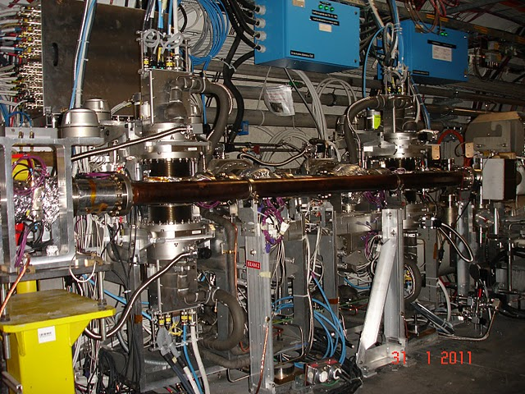
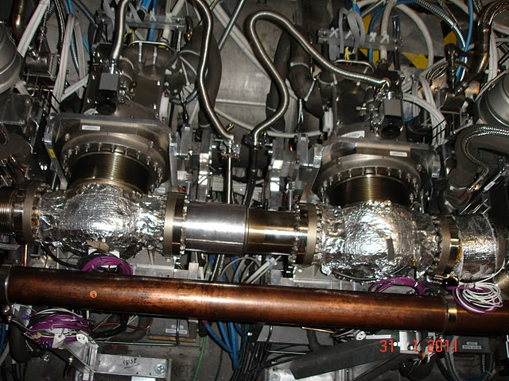
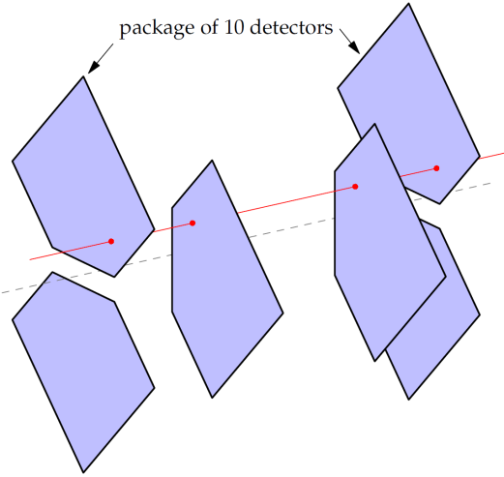
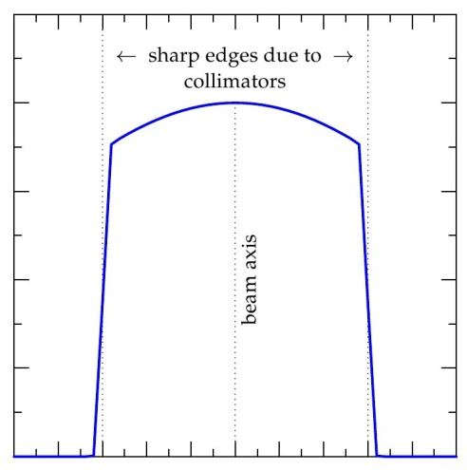
Roman Pot station outlook
Vertical Pot
Vertical Pot
High spatial resolution of track reconstruction
  σ(x)=σ(y)≈13μm
  σ(θ_{x})=σ(θ_{y})≈3.7μrad
Horizontal Pots
Horizontal Pot
Horizontal Pot
Vertical Pot
Vertical Pot
Precise detector alignment
Track based alignment: ∼5μm
Beam touching alignment: ∼20μm
Beam intensity
RP approach
(s=∼147m from IP5)
x, y

Slide 4
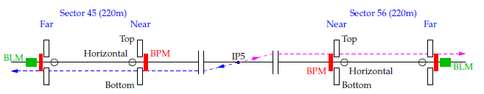
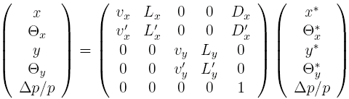
Elastic protons for optics diagnosis
7 sigma runs on 30/10/2010
Transport IP5→RP220
Measured
in Roman
Pots
Reconstructed
RP
IP5
Elastically scattered protons:
  Can be easily tagged
  Pair of collinear protons: Θ_{left}* = Θ_{right}* (within beam divergence)
  No momentum loss: (within beam momentum spread)
    Dispersion and tune change eliminated
β*=3.5m optics:
  Beam size @ IP5: 59μm, its impact eliminated by antisymmetric event topology
  @ s=220m : L_{x}≈0, L_{y}≈20m

Slide 5
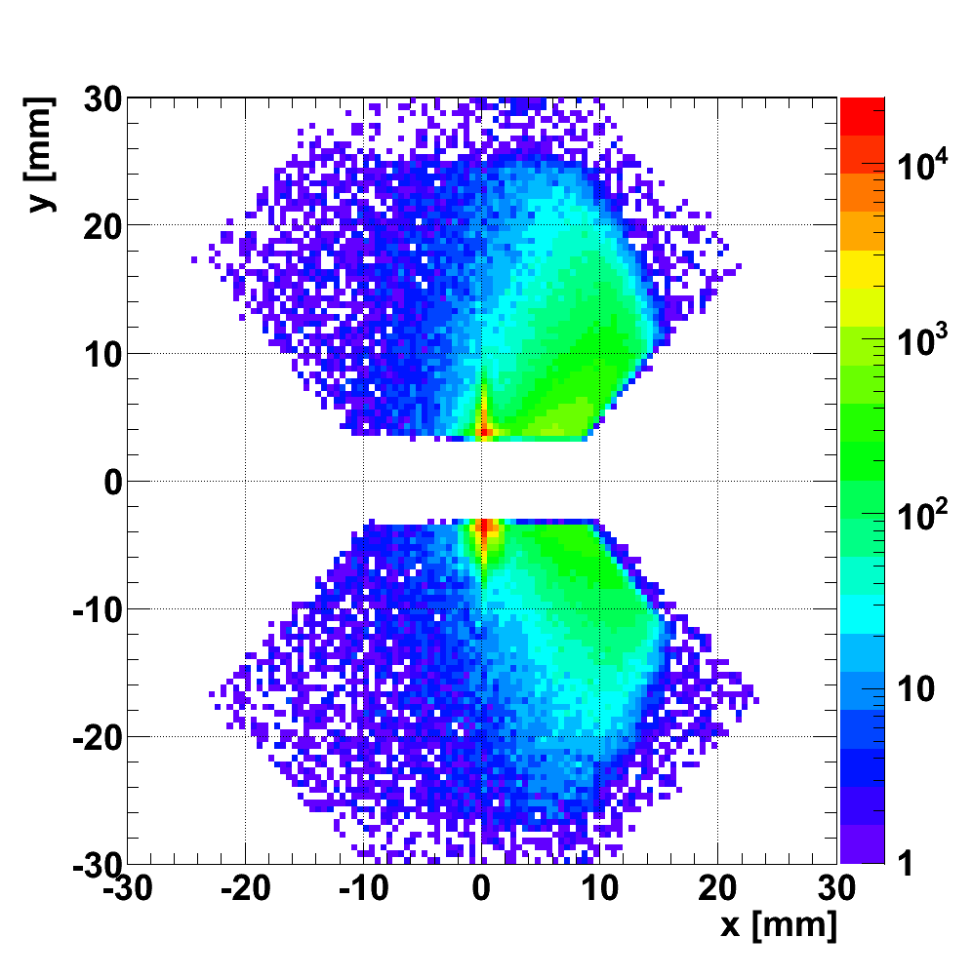
Proton tracks of a single diagonal
(left-right coincidences, RP @ 7σ, all tracks, no elastic selection)
Sector 56
t = -p² θ²
Elastically scattered protons
ξ = Δp/p
y = L_{y} Θ_{y}
x = L_{x} Θ_{x} + ξ D
L_{x} ~ 0
Sector 45
For details on elastic proton selection see backup slides

Slide 6
Elastic proton reconstruction
Elastic proton reconstruction:
Optics observed to be stable over a long time
But precise values of dL_{x}/ds and L_{y} @ RP locations needed!
  enough to have the values, sources of errors of less importance for TOTEM
  β-measurement based estimations give the error of 5–10%
Can we measure them with the proton tracks?
What are the sources of optics imperfections in the range of interest?
Arms averaged:
Per arm:
Finally:

Slide 7
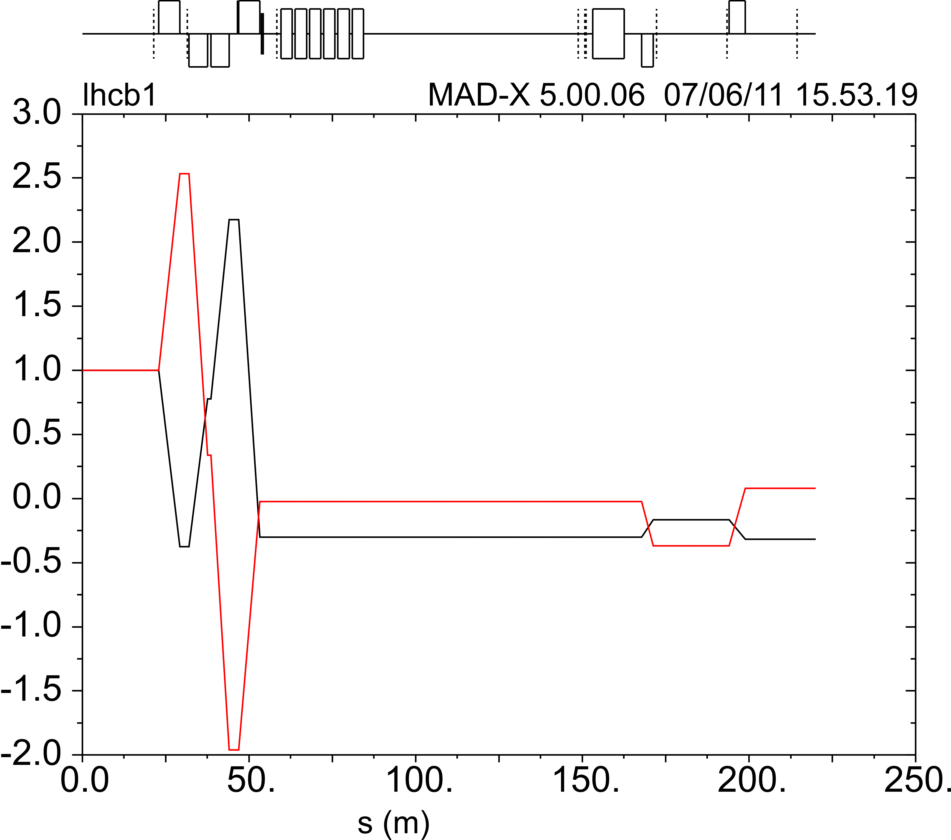
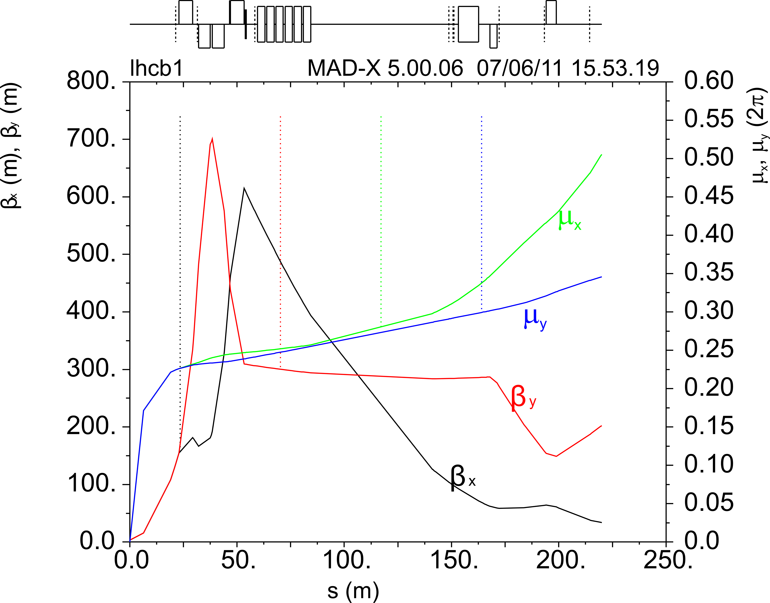
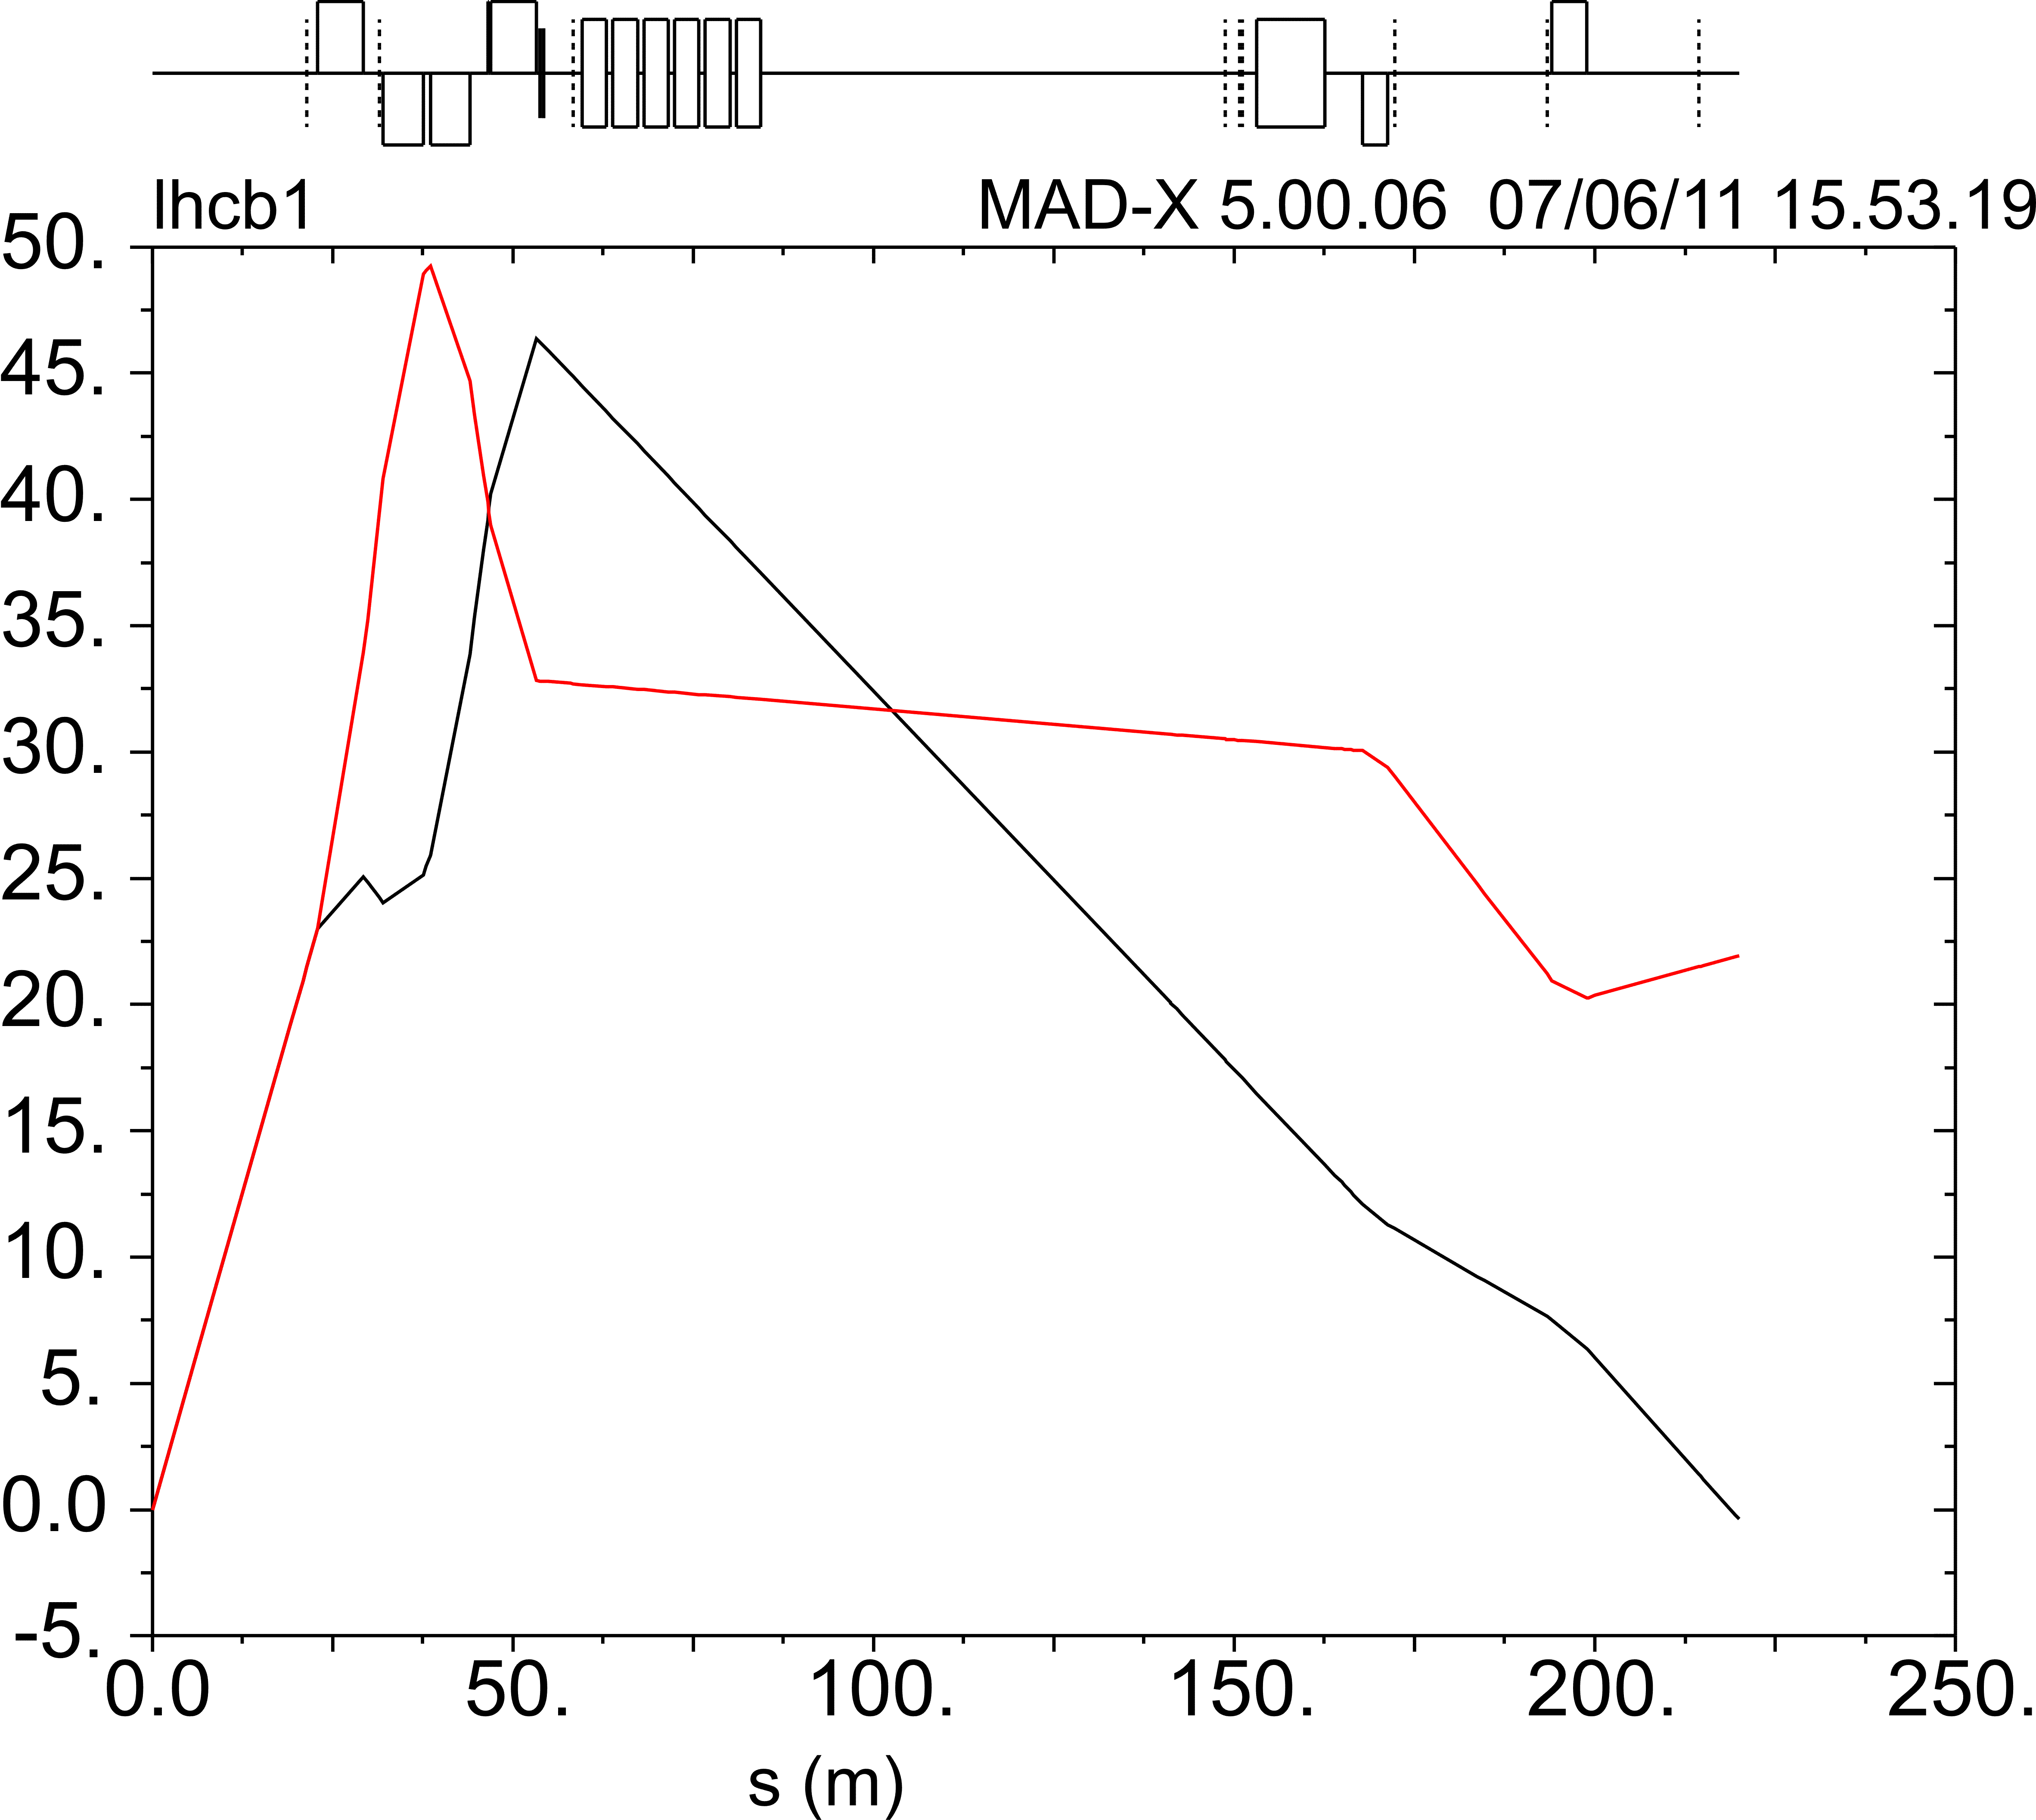
Optical functions
TRIPLET
MQY, MQML
RP220
dL_{y}/ds
transport matrix
dL_{x}/ds
transport matrix
Inner triplet determines
dL_{x}/ds and dL_{y}/ds for s=50..220m
L_{y}
L_{x}

Slide 8
Optics perturbation in IP5
k change by 0.1% (expected limit for the TF error)
Perturbed magnets BEAM 1 | BETX | BETY | MUX | MUY | v_{x} | v_{y} | L_{x} | L_{y} | dL_{x}/ds | dL_{y}/ds | s : L_{x}=0 | Δs : L_{x}=0 [m]
Nom. MADX solution (TIMBER Oct 30 2010) | 33.7m | 208m | 0.502 ⋅2π | 0.344 ⋅2π | 3.10 | 4.28 | -0.132m | 22.4m | -0.321 | 0.086 | 220m
MQXA.1R5 | 0.29% | 1.24% | 0.31% | -0.25% | 0.13% | -0.20% | 79.59% | 0.98% | -0.46% | 3.20% | -0.15% | -0.331
MQXB.A2R5 | -0.14% | -2.83% | -0.25% | 0.57% | -0.07% | 0.37% | -64.86% | -2.24% | 0.33% | -7.46% | 0.12% | 0.268
MQXB.B2R5 | -0.13% | -3.08% | -0.37% | 0.60% | -0.06% | 0.36% | -96.49% | -2.42% | 0.45% | -8.13% | 0.18% | 0.398
MQXA.3R5 | 0.33% | 1.91% | 1.00% | -0.34% | 0.08% | -0.18% | 259.35% | 1.45% | -1.14% | 4.95% | -0.49% | -1,086
MQY.4R5.B1 | 0.07% | -0.17% | -0.01% | 0.01% | 0.03% | -0.05% | -3.83% | -0.10% | -0.02% | -0.64% | 0.01% | 0.016
MQML.5R5.B1 | -0.12% | 0.09% | 0.01% | 0.00% | -0.06% | 0.04% | 2.80% | 0.05% | 0.05% | 0.54% | -0.01% | -0.011
t-reconstruction
Only inner triplet really important
MQY, MQML not really important
Roman Pot measurments can be used for optics matching

Slide 9
Optics determination
Measurements with Roman Pots:
Constrains between the 2 IP5 triplets
(2 sides of IP5)
Independent constraints per triplet
Strategy:
  Magnet settings from TIMBER/LSA
  MADX (PTC Twiss) optics model
  Insertion of the Roman Pots and data taking
  Elastically scattered protons selection
  Determination of optics constraints with RP proton tracks
  Matching of the optics (determination of the transport matrix)

Slide 10
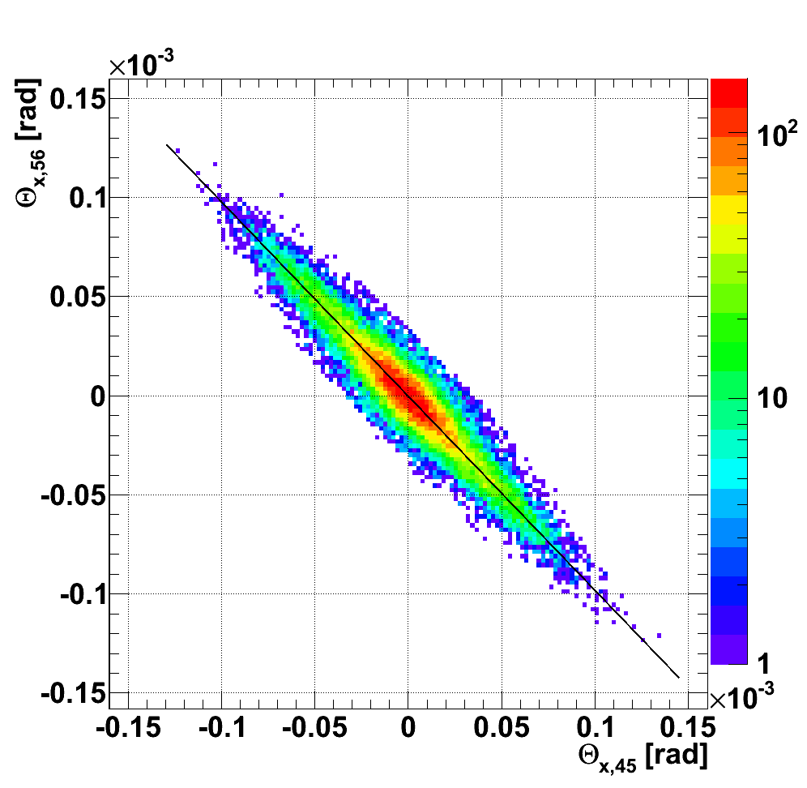
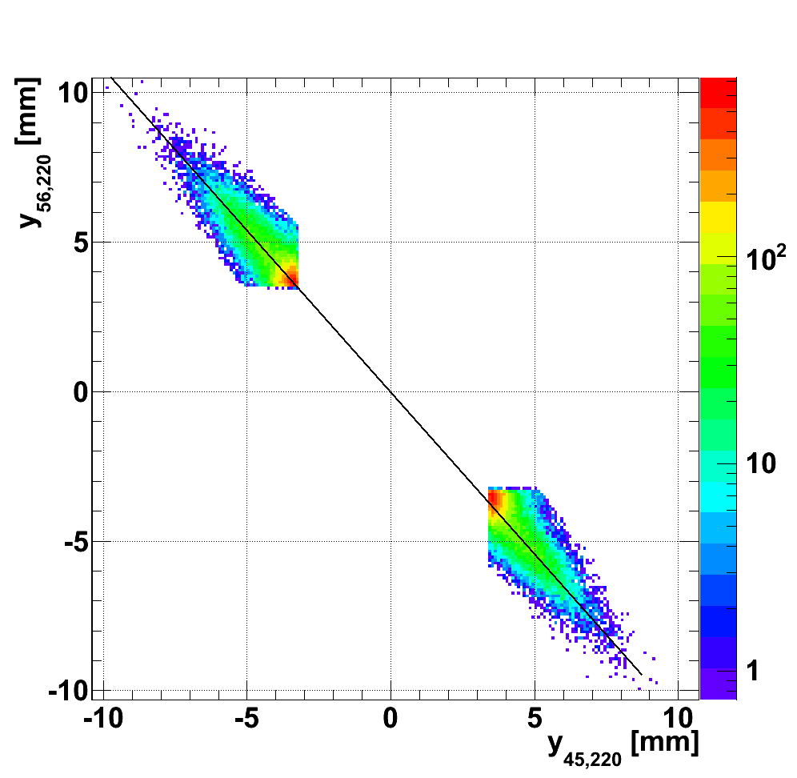
(dL_{x}/ds₄₅)/ (dL_{x}/ds₅₆) and L_{y,45}/L_{y,56} determination beam 1 & 2 together
–a=0.99
– a=1.09
Constraints for triplet strenghts matching

Slide 11
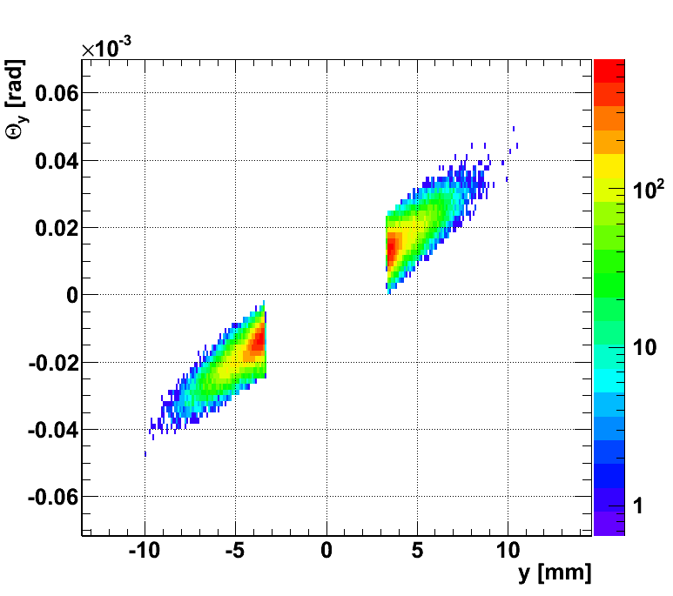
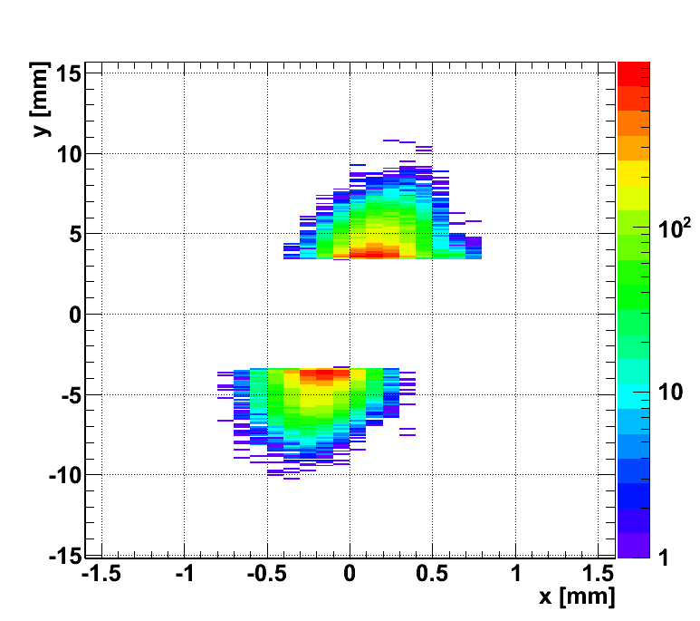
(dL_{y}/ds)/L_{y} and coupling determination beam 1 & beam 2 separately
(dLy/ds) / Ly near =3.92⋅10⁻³ m⁻¹
Nominally: 2.7⋅10⁻³ m⁻¹
re14/Ly far=36 mrad
Nominally: 0
Constraint for triplet strenghts matching
Constraint for triplet rotation matching

Slide 12
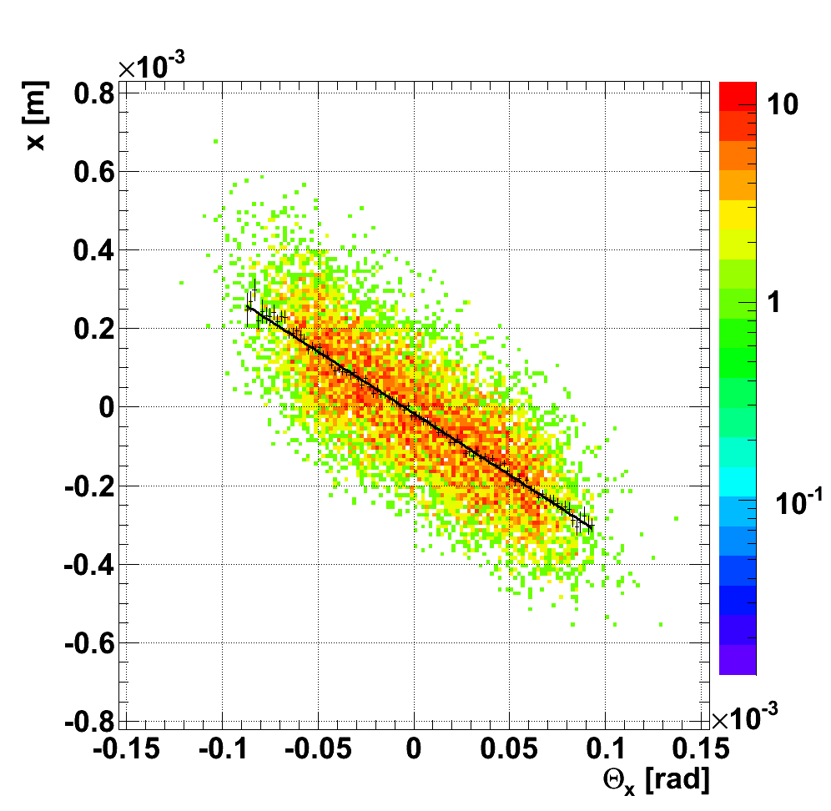
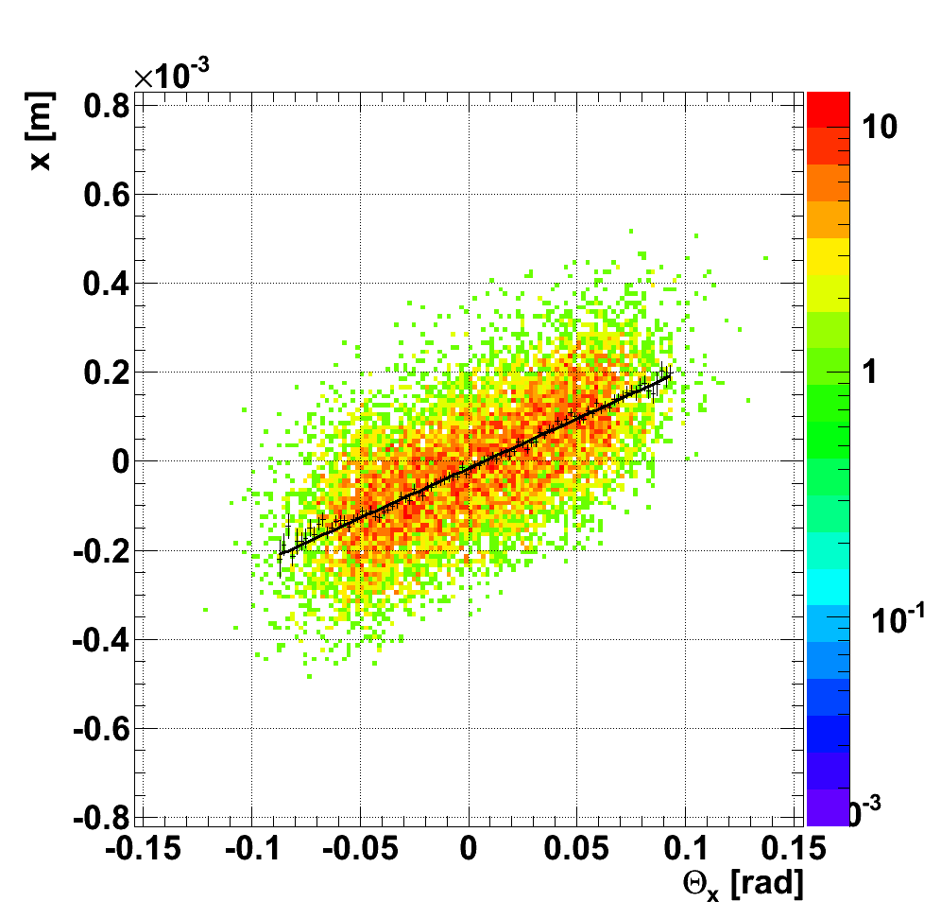
s: L_{x}(s)=0 determination beam 1 & beam 2 separately
45 near RP, s₁=214.46 m
45 far RP, s₂=220 m
a=-3.142m
a=2.229m
Interpolation: L_{x,45}(s) = 0 : s = 218 m (220m nominal)

Slide 13
Matched parameters
Influence of all magnet parameters in ±220m range analysed...
  ∼30 parameters per beam
  Magnet positions, rotations, k
  Beam momentum, displacement, crossing angle, harmonics...
Most significant parameters selected for matching
  6 strengths per beam (MQXA, MQXB, MQXB, MQXA, MQY, MQML)
  6 corresponding rotations about the beam
  Mean Δp/p per beam
  Total of 26 fitted parameters

Slide 14
Constraints
Measured elastic scattering kinematics constraints between arms (a total of 2):
  Ratio of L_{y56} / L_{y45} (0.5 % precision)
  Ratio of (dL_{x}/ds 56) / (dL_{x}/ds 45) (0.5 % precision)
Measured constraints of individual arms (a total of 8):
  (dL_{y}/ds)/L_{y} (0.5%)
  near unit coupling, far unit coupling (RP x-y rotation: 3%)
  s: L_{x}=0 (1 m)
LHC design constraints (a total of 26):
  Δk/k = 0.1%
  Δψ = 1mrad
  Δp/ p = 10⁻³
  TOTAL of 36 constraints

Slide 15
Matching solution
Full 4x4 transport matrix IP5→RP220 obtained per beam
Beam 1 | dL_{x}/ds | L_{y} [m] | rot [mrad]
RP215 | -0.311962 | 22.15 | 0.0432
RP220 | -0.311962 | 22.62 | 0.0396
Δ RP214 | -2.84% | +0.78%
Δ RP220 | -2.84% | +0.81%
Beam 2 | dL_{x}/ds | L_{y} [m] | rot [mrad]
RP215 | -0.314508 | 20.3883272 | 0.0400268
RP220 | -0.314508 | 20.6709463 | 0.0372828
Δ RP214 | -4.51% | +10.19%
Δ RP220 | -4.51% | +10.79%
Strong correlations between fitted parameters
PCA should ideally be applied
χ²/NDF = 25.8/(36-26)=2.6
(would be lower in correlations are elmininated)
Abs(Pulls) of constraints
Abs(Pulls) of fitted parameters

Slide 16
Complete solution
Beam 1
 | BETX | BETY | MUX | MUY
nominal | 3.37E+01 | 2.08E+02 | 5.13E-01 | 3.43E-01
obtained | 3.41E+01 | 2.10E+02 | 5.02E-01 | 3.44E-01
difference | 0.96% | 1.07% | 2.24% | -0.20%
s=220m
Obtained transport matrix
Obtained changes
-3.11E+00 | -9.18E-01 | 2.35E-02 | 8.89E-01 |  | 0.31% | 85.59% | 114.70% | 100.02%
3.11E-02 | -3.12E-01 | -2.23E-04 | -1.13E-02 |  | 0.38% | -2.84% | 115.46% | 96.83%
3.09E-02 | 1.40E+00 | -4.27E+00 | 2.26E+01 |  | 84.59% | 101.79% | -0.15% | 0.81%
4.49E-04 | 1.82E-02 | -6.08E-02 | 8.79E-02 |  | 84.88% | 100.53% | -0.28% | 2.13%
Beam 2
 | BETX | BETY | MUX | MUY
nominal | 3.40E+01 | 1.60E+02 | 4.90E-01 | 3.58E-01
obtained | 3.39E+01 | 1.81E+02 | 5.08E-01 | 3.47E-01
difference | -0.41% | 11.93% | 3.51% | -3.04%
s=220m
Obtained transport matrix
Obtained changes
-3.12E+00 | -5.39E-01 | 2.42E-02 | 6.87E-01 |  | 0.38% | 226.67% | 85.69% | 100.11%
3.33E-02 | -3.15E-01 | -2.33E-04 | -8.42E-03 |  | 0.70% | -4.51% | 84.17% | 104.35%
1.32E-02 | 1.07E+00 | -4.16E+00 | 2.07E+01 |  | 135.55% | 98.09% | -1.44% | 10.79%
2.05E-04 | 1.33E-02 | -5.90E-02 | 5.26E-02 |  | 132.41% | 99.80% | -1.23% | 54.60%

Slide 17
Error estimation
All the measurements provoke magnet corrections in the same direction
  Observed optics imperfections in x and y per beam provoke identical needs for strengths corrections
  Independent corrections of beam 1 and beam 2 lead to the observed ratios of (dL_{x}/ds₄₅)/ (dL_{x}/ds₅₆) and L_{y,45}/L_{y,56}
Which part of the triplet is precisely responsible? Difficult to say
  main source of systematic error of corrected optics
Optics error estimation
  Required corrections of up to 10% of the nominal optics values of Ly and dLx/ds
  Values of corrections of Ly and dL_{x}/ds change by up to 10% depending on the quadrupole of the triplet to which the error is attributed
  The error of the optics estimation is therefore ∼10%·10%=1%

Slide 18
MC error verification
(in progress)
Verification procedure
  Randomly perturbate the initial optics within magnet tolerances
  Measure optics parameters with RPs
  Match the optics
  Compare matched optics to the initial perturbated conditions
Obtained errors:

Slide 19
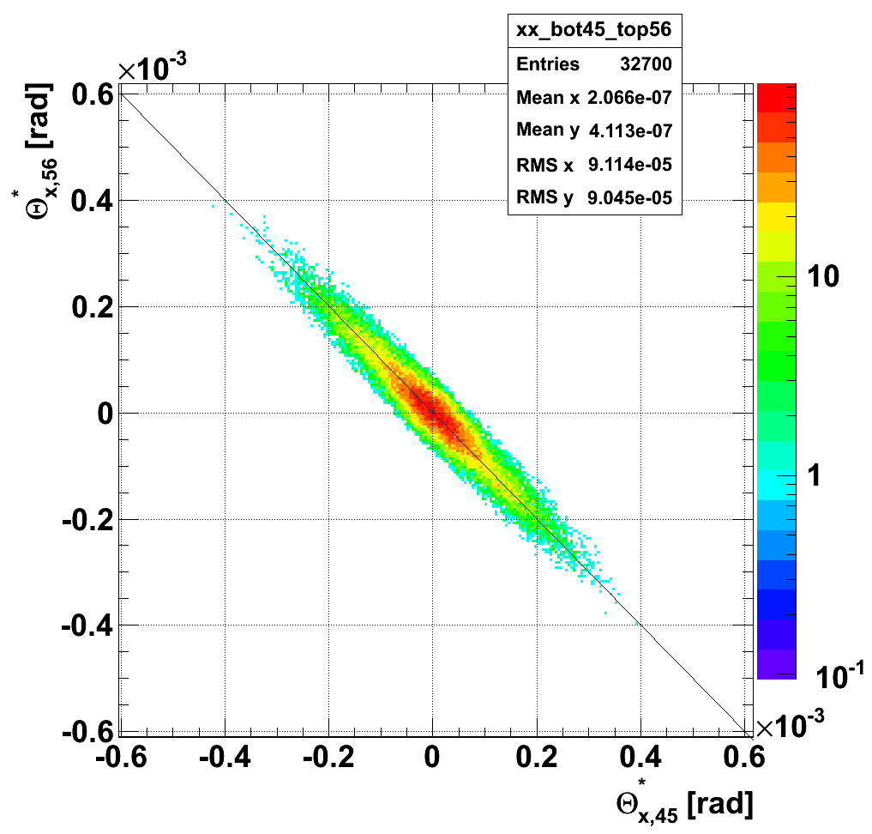
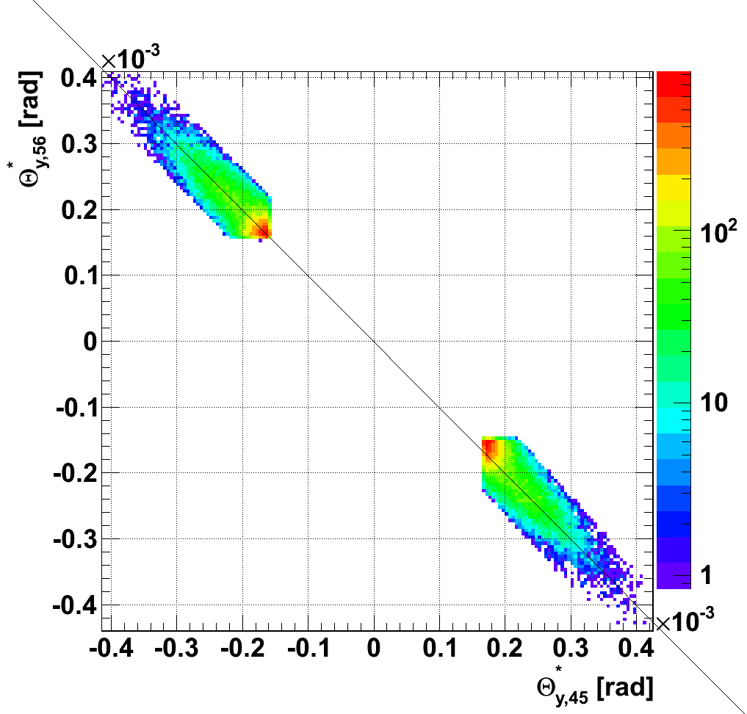
After matching, reconstructed protons
Arms and diagonals in perfect agreement!

Slide 20
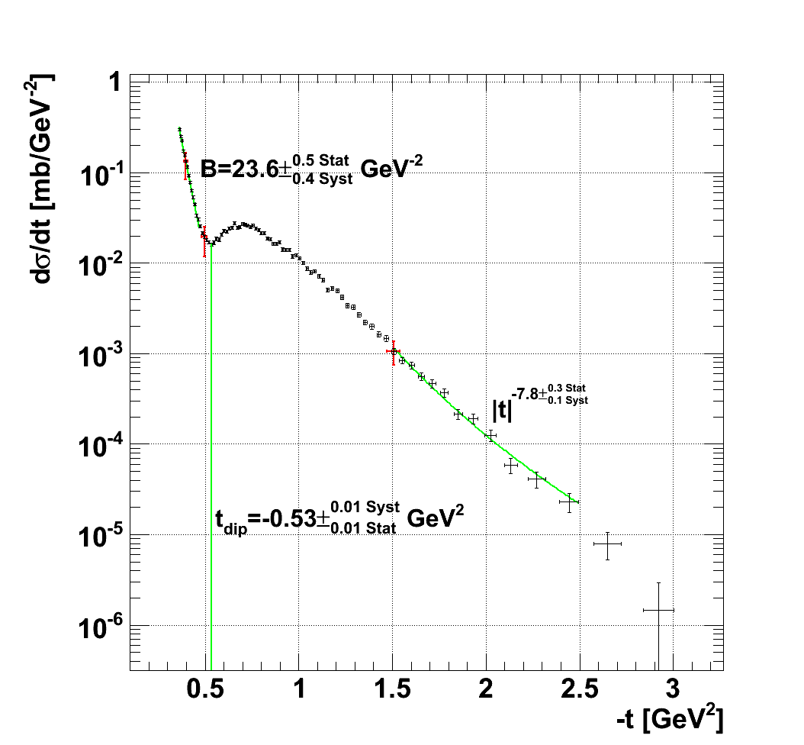
Final result: unfolded el. scat. distribution
| Systematic normalisation
uncertainty∼30%

Slide 21
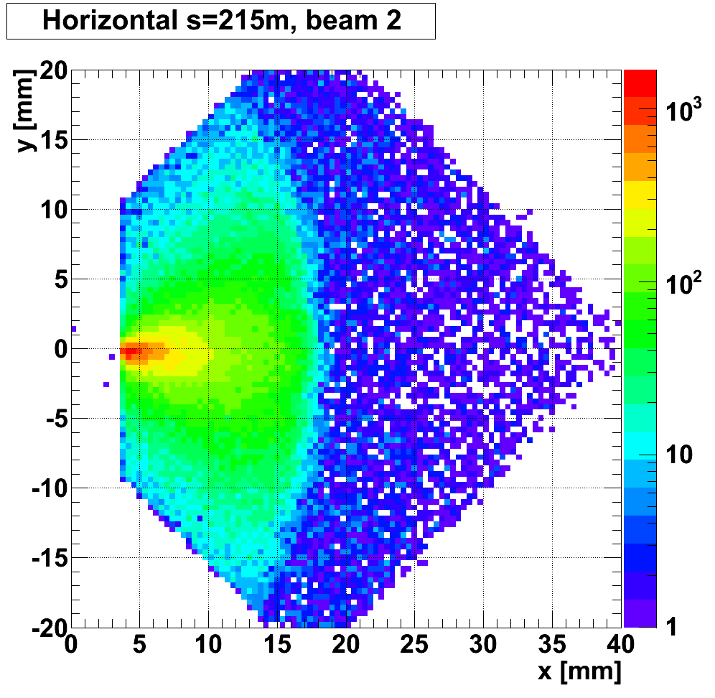
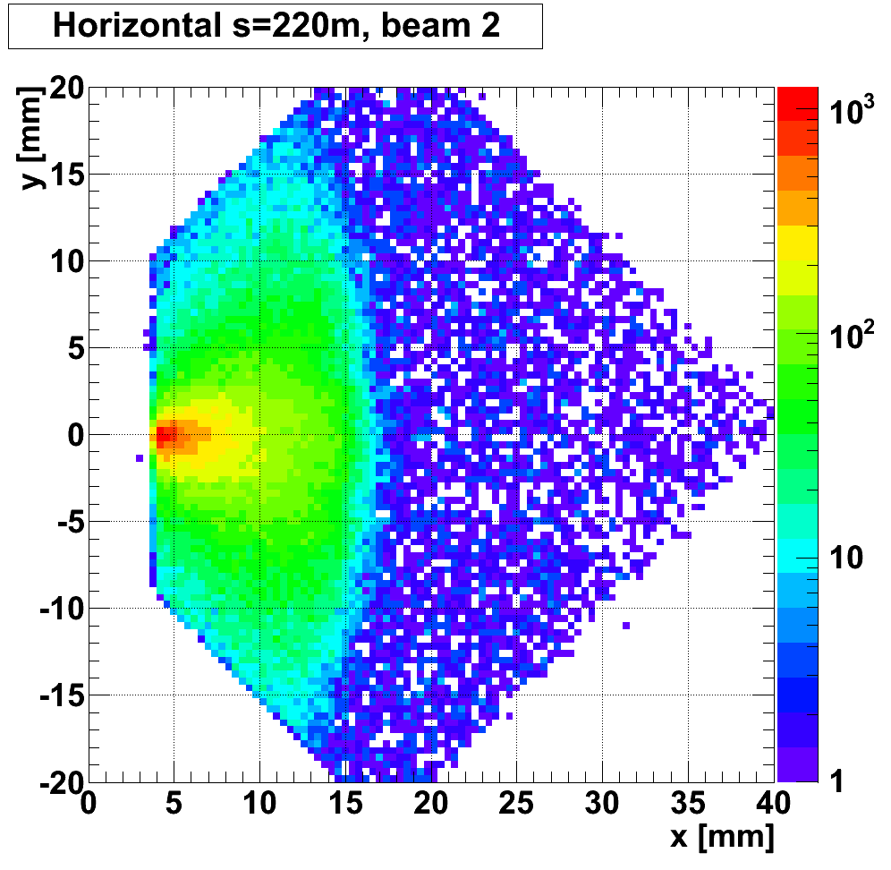
Further steps: inelastic protons, D_{y}
Inelastically scattered protons
Inelastically scattered protons

Slide 22
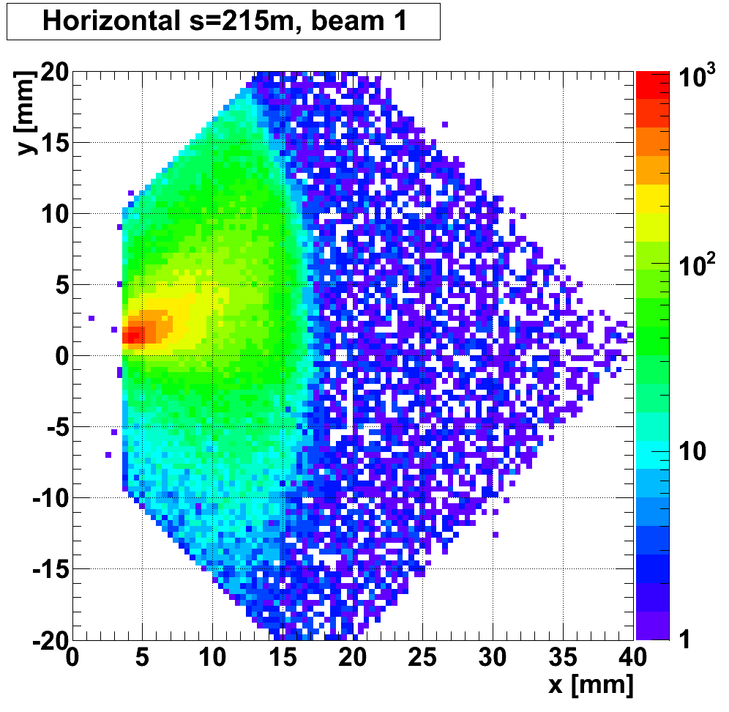
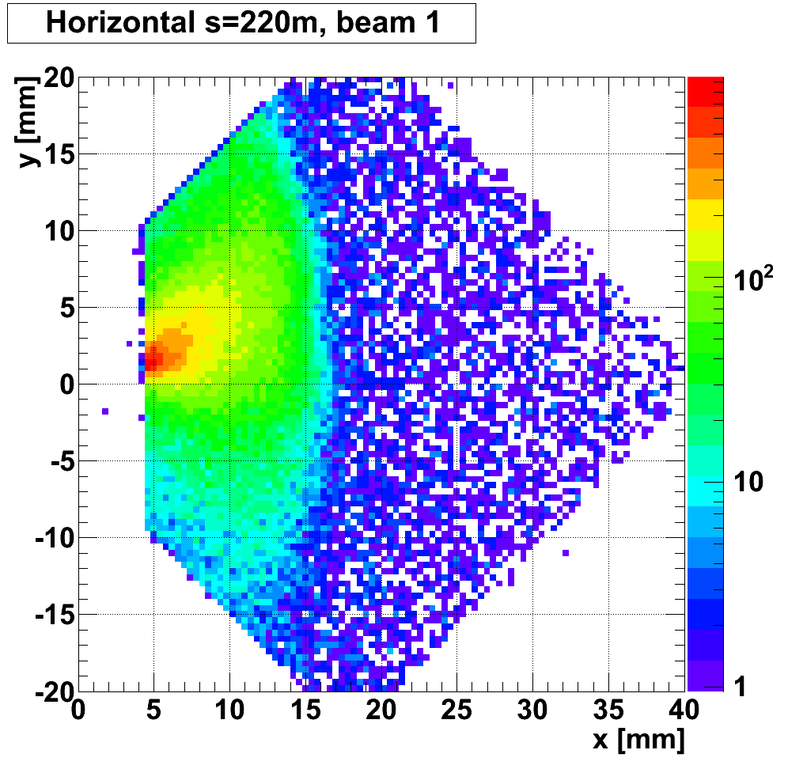
Further steps: inelastic protons, D_{y}
Inelastically scattered protons
Inelastically scattered protons

Slide 23
Further steps
Limiting machine apertures for large angle scattering (RPs at larger distances from the beam)
Analysis of the local dispersion and chromaticity for inelastic proton reconstruction (2010, 2011)
Analysis of optics for/from future 2011 TOTEM runs (β*=1.5m, 90m)
TOTEM would like to thank You for all your help
  Gabriel Mueller, Marek Strzelczyk, Massimo Giovannozzi, Helmut Burkhardt, Ralph Assmann, Rogelio Garcia, Ezio Todesco, Frank Schmidt, Carmen Alabau Pons, Stefano Redaelli, ... and many others
  Thank you!

Slide 24
Backup

Slide 25
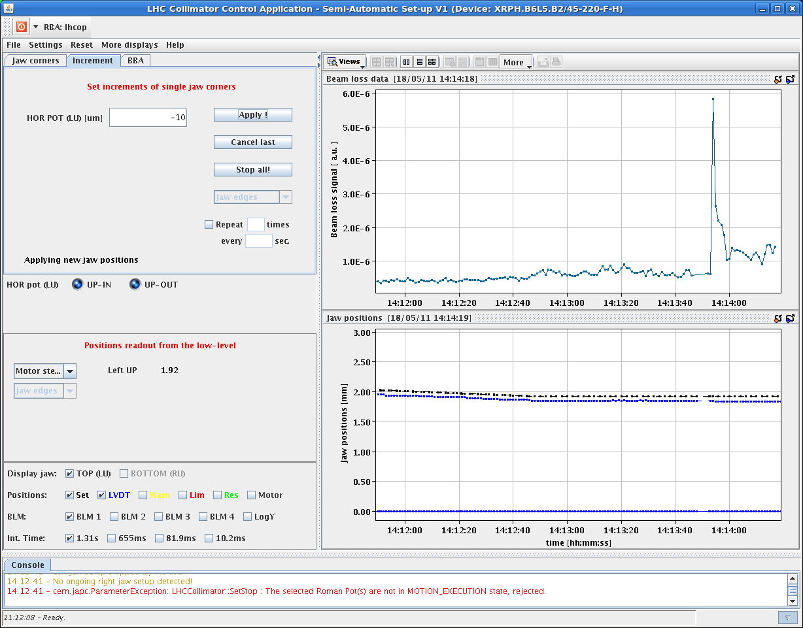
Beam based alignment of RPs @220m and data taking (T1,T2,RP220m) (18 May 2011)
Scraping exercise:
RP220 approached the low intensity beam in 10 μm steps
RP220 now ready for routine insertions in 2011
Beam intensity
RP approach
Beam Loss Data
x, y
Data taking with RPs @ 220 close to the beams
- vertical RPs @ 5σ = 2.2 mm
- horizontal RPs @ 7σ = 1 mm
- low pile-up
Vert Pot Position (mm)
Alignment of RP147 planned in August

Slide 26
Elastic pp scattering t-range: 0.36 – 3 GeV²

Slide 27
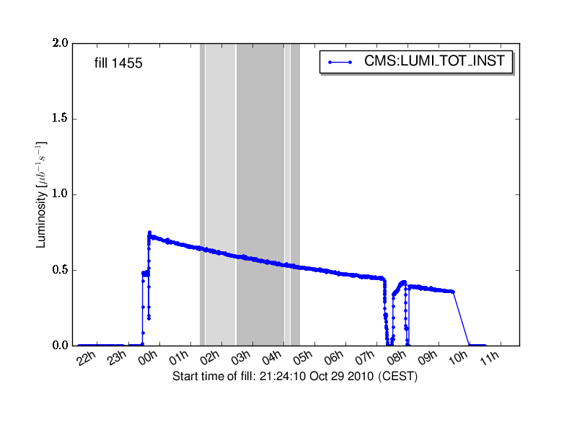
Elastic pp scattering
Several runs were taken during 2010
with different distances of the Roman pots to the beam center
The 7 σ runs were analyzed
The 18 σ runs with a total luminosity of ∼5.8 pb⁻¹ will follow
Luminosity
RP dist.
Integrated luminosity
25 σ | 1.5 nb⁻¹
20 σ | 185 nb⁻¹
18 σ | 5800 nb⁻¹
7 σ | 9.5 nb⁻¹
Analysed data files
important for large t

Slide 28
Proton reconstruction
Both angle projections reconstructed: Θ_{x}* and Θ_{y}*
  Θ_{x}* from Θ_{x} @ RP220 (through dL_{x}/ds) Θ_{x} = dL_{x}/ds Θ_{x}*
  Θ_{y}* from y @ RP220 (through L_{y}) y = L_{y} Θ_{y}*
→ Excellent optics understanding
  Magnet currents measured
  Measurements of optics parameters with elastic scatt.
    Θ_{left}* = Θ_{right}* (proton pair collinearity)
    Proton position ↔ angle correlations
    L_{x}=0 determination, coupling corrections
→ Fine alignment
  Alignment between pots with overlapping tracks (∼1μm)
  Alignment with respect to the beam – scraping exercise (∼20μm)
  Mechanical constraints between top and bottom pots (∼10μm)
Track based alignment

Slide 29
Cuts and data reduction
Topology
  near and far units
  diagonals
Low |ξ| selection (3σ)
  |x_{RP,45}|<3σ_{x} @ L_{x,45}=0
  |x_{RP,56}|<3σ_{x} @ L_{x,56}=0
  corr. y_{RP216,45} ↔ y_{RP220,45}
  corr. y_{RP216,56} ↔ y_{RP220,56}
Elastic collinearity (3σ)
  θ_{x,45}* ↔ θ_{x,56}*
  θ_{y,45}* ↔ θ_{y,56}*
Intergrated luminosity : 6.2 nbarn⁻¹
Total triggers | 5.28M
Reconstructed tracks & elastic topology | 293k
Low |ξ| selection | 70.2k
Collinearity cuts | 66.0k
showers
  Diagonals analysed independently

Slide 30
Proton tracks of a single diagonal
(left-right coincidences)
Sector 56
t = -p² θ²
ξ = Δp/p
y = L_{y} Θ_{y}
x = L_{x} Θ_{x} + ξ D
L_{x} ~ 0
Sector 45

Slide 31
Cuts and data reduction
Topology
  near and far units
  diagonals
Low |ξ| selection (3σ)
  |x_{RP,45}|<3σ_{x} @ L_{x,45}=0
  |x_{RP,56}|<3σ_{x} @ L_{x,56}=0
  corr. y_{RP216,45} ↔ y_{RP220,45}
  corr. y_{RP216,56} ↔ y_{RP220,56}
Elastic collinearity (3σ)
  θ_{x,45}* ↔ θ_{x,56}*
  θ_{y,45}* ↔ θ_{y,56}*
Intergrated luminosity : 6.2 nbarn⁻¹
Total triggers | 5.28M
Reconstructed tracks & elastic topology | 293k
Low |ξ| selection | 70.2k
Collinearity cuts | 66.0k
showers

Slide 32
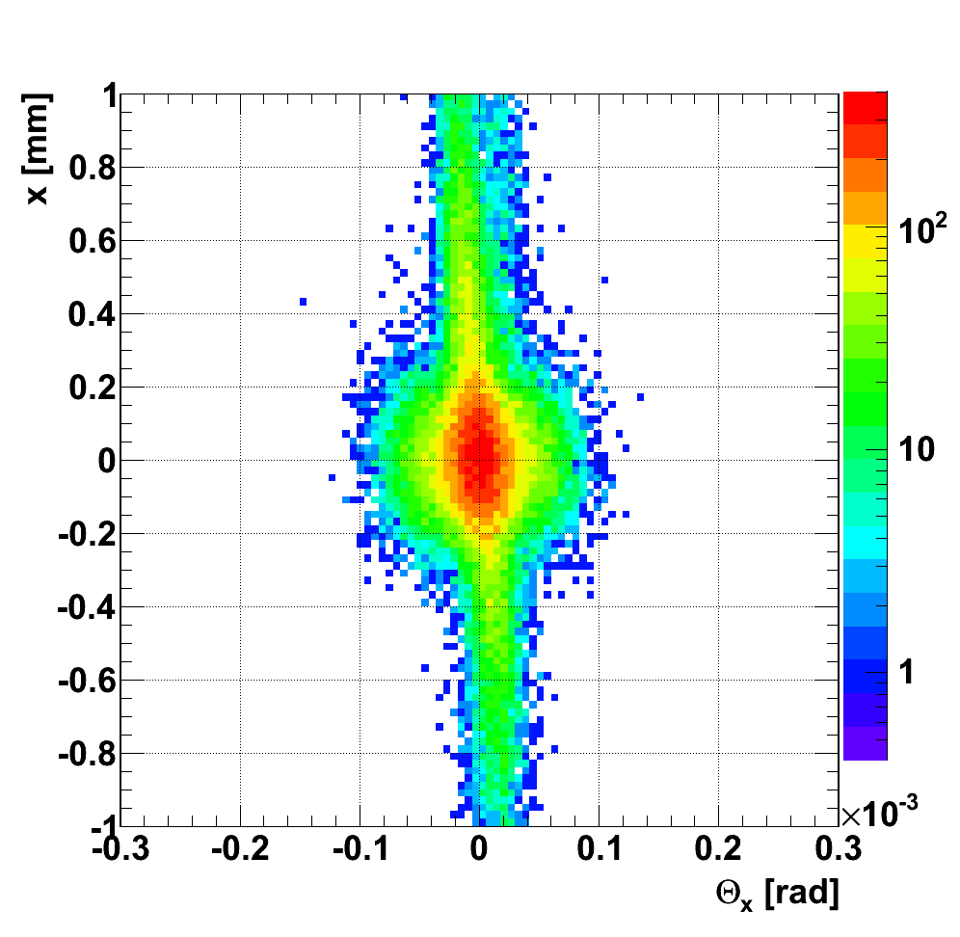
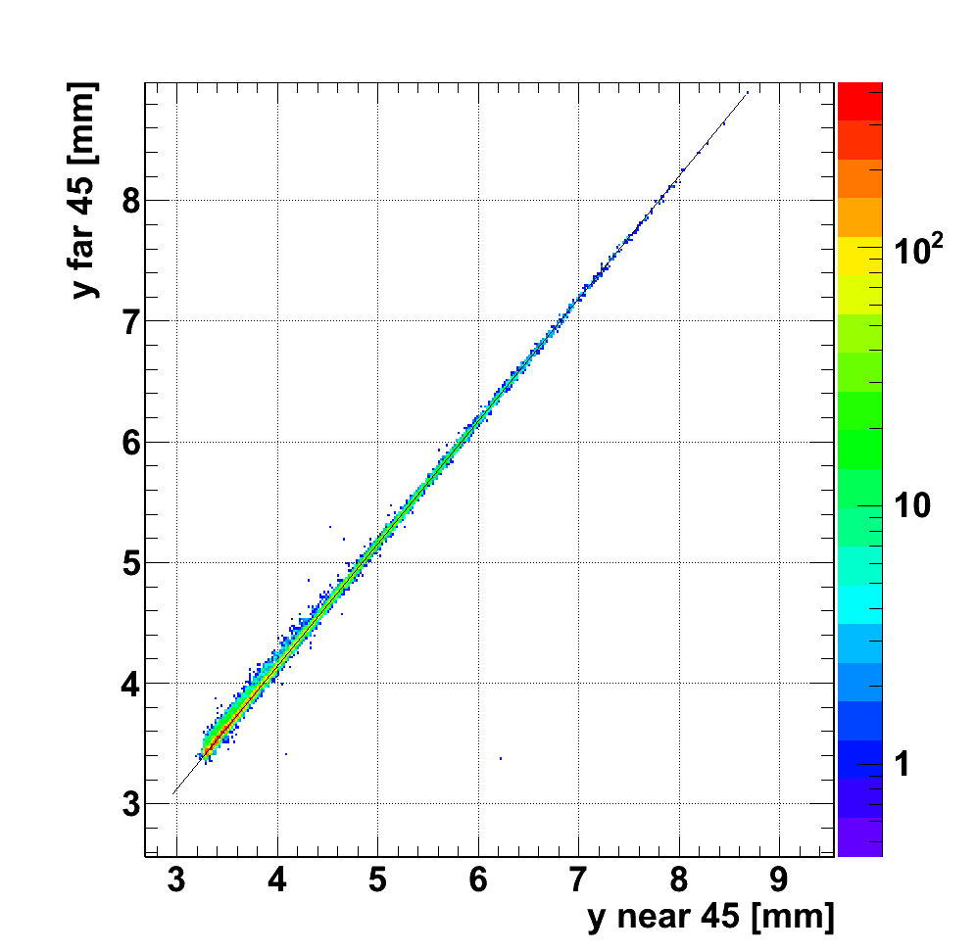
Low ξ = Δp/p cuts
|x| < 3σ_{x} @ L_{x} = 0
y_{RP near,45} ↔ y_{RP far,45}
_{(dLy/ds≈0)}

Slide 33
Cuts and data reduction
Topology
  near and far units
  diagonals
Low |ξ| selection (3σ)
  |x_{RP,45}|<3σ_{x} @ L_{x,45}=0
  |x_{RP,56}|<3σ_{x} @ L_{x,56}=0
  corr. y_{RP216,45} ↔ y_{RP220,45}
  corr. y_{RP216,56} ↔ y_{RP220,56}
Elastic collinearity (3σ)
  θ_{x,45}* ↔ θ_{x,56}*
  θ_{y,45}* ↔ θ_{y,56}*
Intergrated luminosity : 6.2 nbarn⁻¹
Total triggers | 5.28M
Reconstructed tracks & elastic topology | 293k
Low |ξ| selection | 70.2k
Collinearity cuts | 66.0k
showers

Slide 34
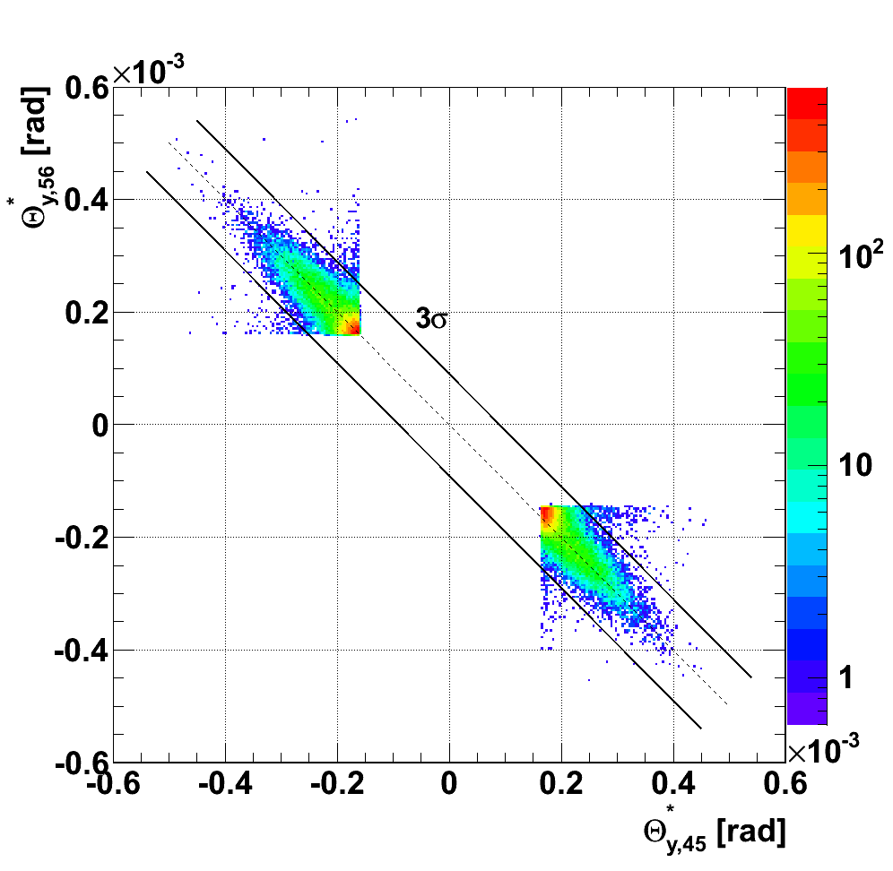
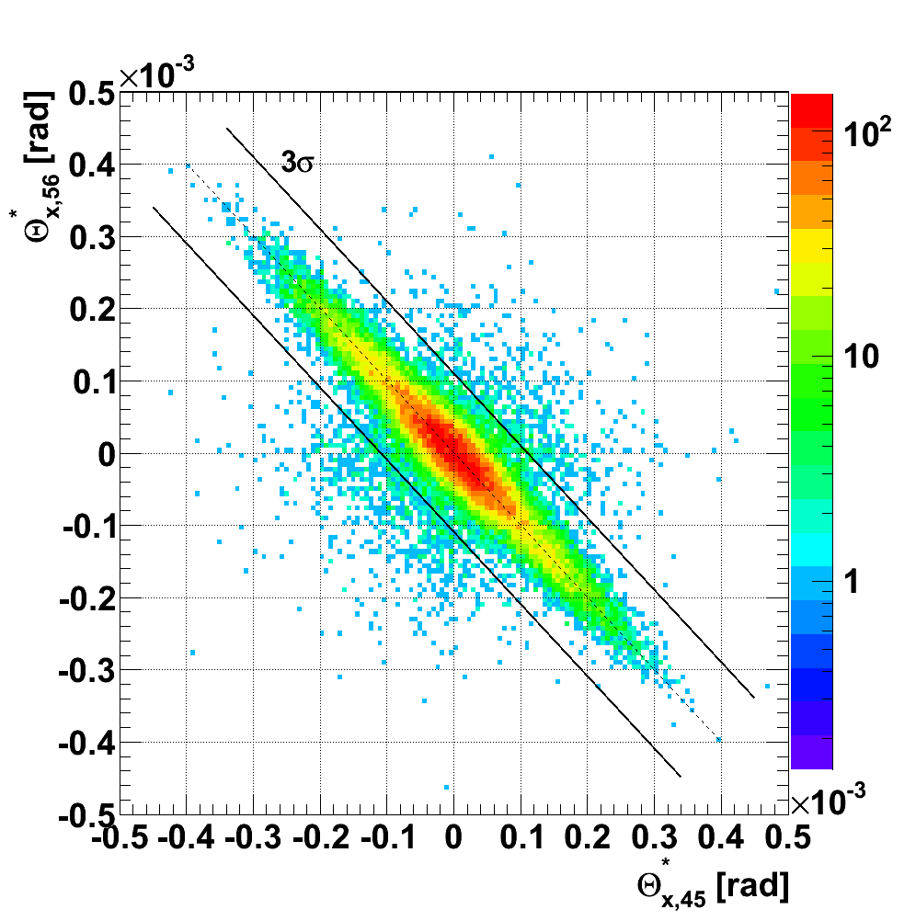
Elastic collinearity cuts
background
signal
background
signal
Data outside the 3σ cuts used for background estimation

Slide 35
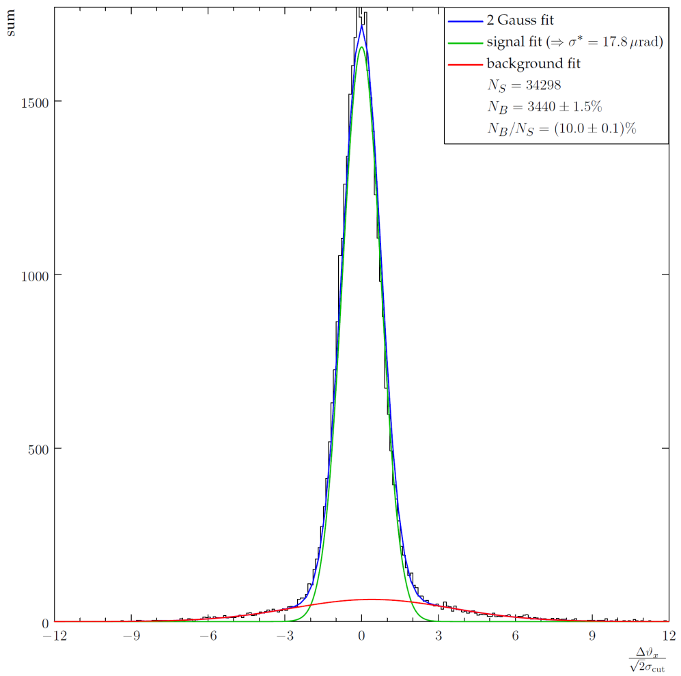
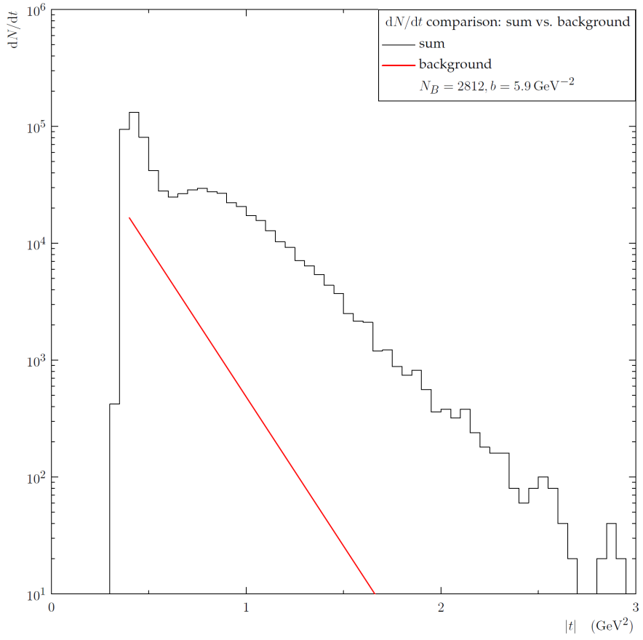
Background and resolution determination
–– signal
–– background
–– combined
B/S = (8±1)%
σ*=17.8μrad
(beam divergence)
Data
Combined background (t)
Δθ_{x}/sqrt(2)
-t [GeV²]
Signal to background normalisation
Signal vs. background (t)
(also as a function of Δθ_{y})
σ* → t-reconstruction resolution:
|t|=0.4GeV²: B/S = (11±2)%
|t|=0.5GeV²: B/S = (19±3)%
|t|=1.5GeV²: B/S = (0.8±0.3)%

Slide 36
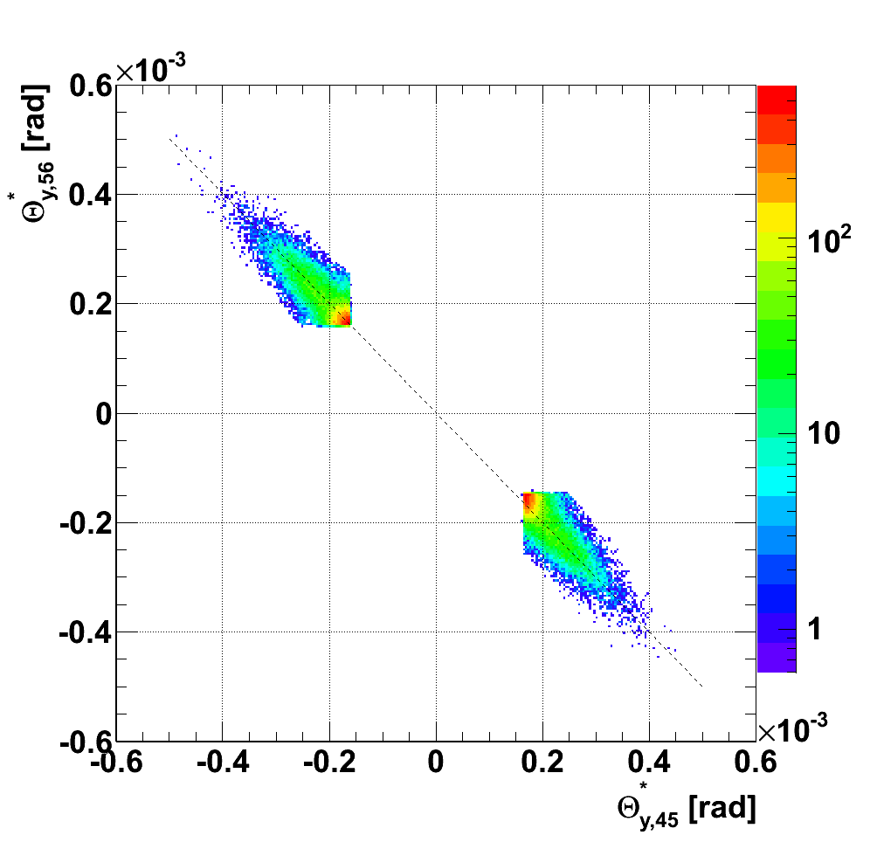
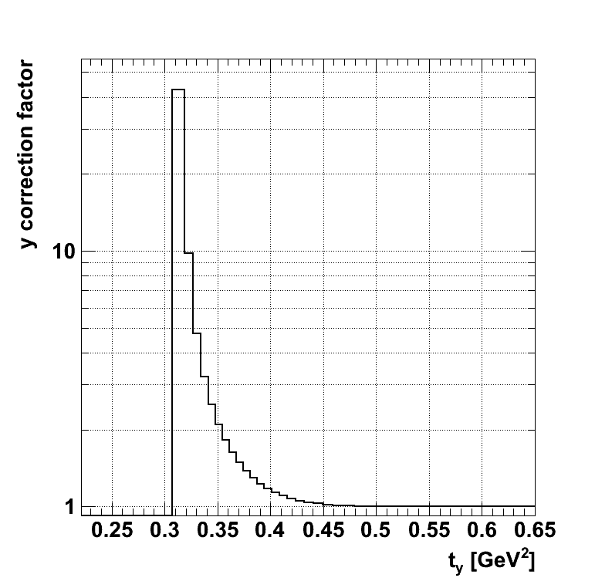
t_{y}-acceptance corrections
|t_{y}| (diagonal 1)
|t|<0.36GeV² removed
Beam divergence
|t_{y}| (diagonal 2)
Missing acceptance in θ_{y}*
Correction error (t_{y}):
0.31 GeV² : 30%
0.33 GeV² : 11%
0.35 GeV² : 2%
0.4 GeV² : 0.8%
0.5 GeV² : 0.1%

Slide 37
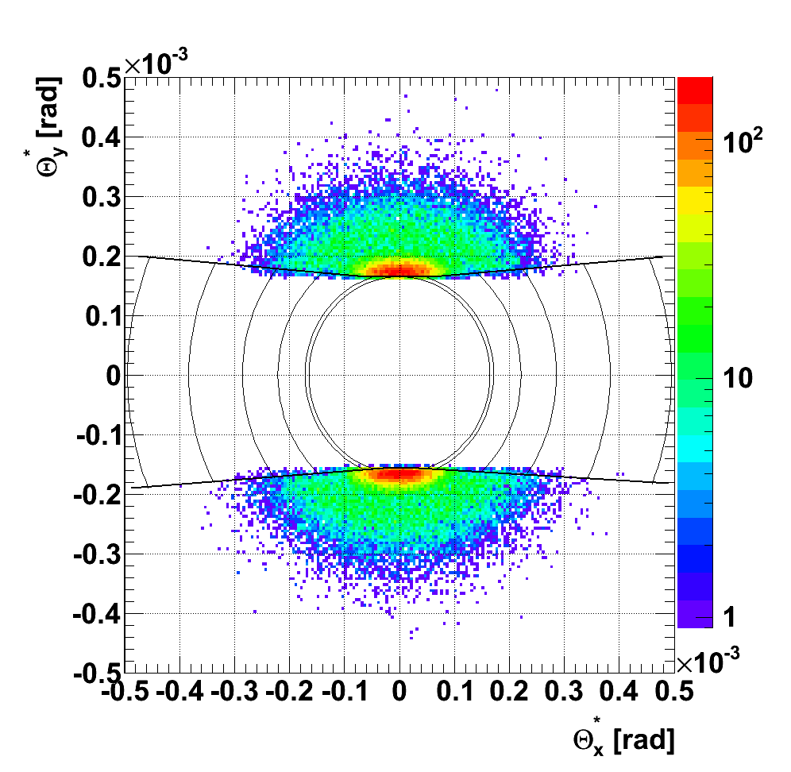
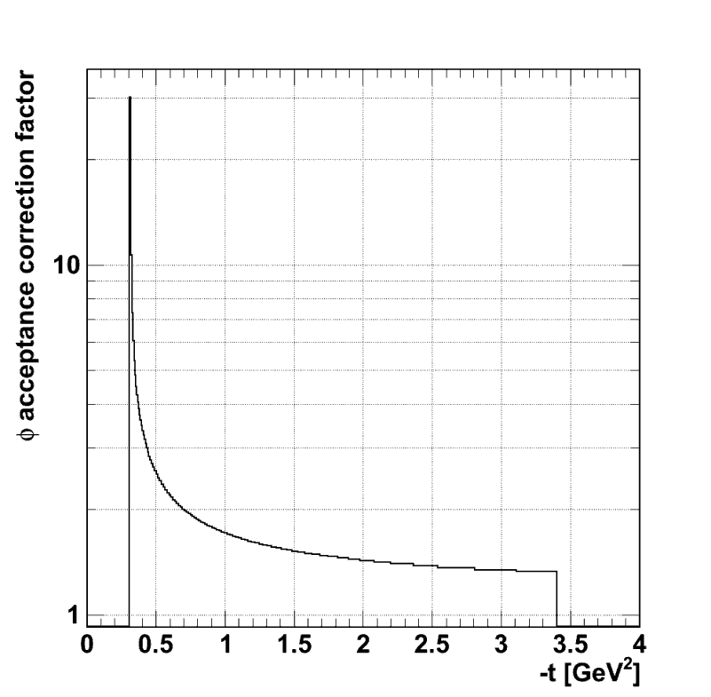
ϕ-acceptance correction
Total ϕ-acceptance correction
No. | t [GeV²] | Θ* [rad] | Accepted ϕ (2 diag.) [°] | ϕ accept. correct. factor
1 | 0.33 | 1.65E-04 | 38.6 | 9.3±4.7%
2 | 0.36 | 1.71E-04 | 76.4 | 4.7±1.8%
3 | 0.60 | 2.21E-04 | 162.5 | 2.2±0.3%
4 | 1.00 | 2.86E-04 | 209.8 | 1.7±0.1%
5 | 1.80 | 3.83E-04 | 246.3 | 1.5
6 | 3.00 | 4.95E-04 | 269.0 | 1.3
Accepted ϕ(t)
Diagonal 1
1 2 3 4 5 6
ϕ
Θ*
|t|<0.36GeV² removed
Diagonal 2
Accepted ϕ(t)
Critical at low t-acceptance limit

Slide 38
Final unfolded distribution
| Systematic normalisation
uncertainty∼30%

