Slide 1
FAIR synchrotrons and optics challenges
G. Franchetti
GSI
22/06/2011

Slide 2
SIS18
SIS100
SIS300
Future Challenges

Slide 3
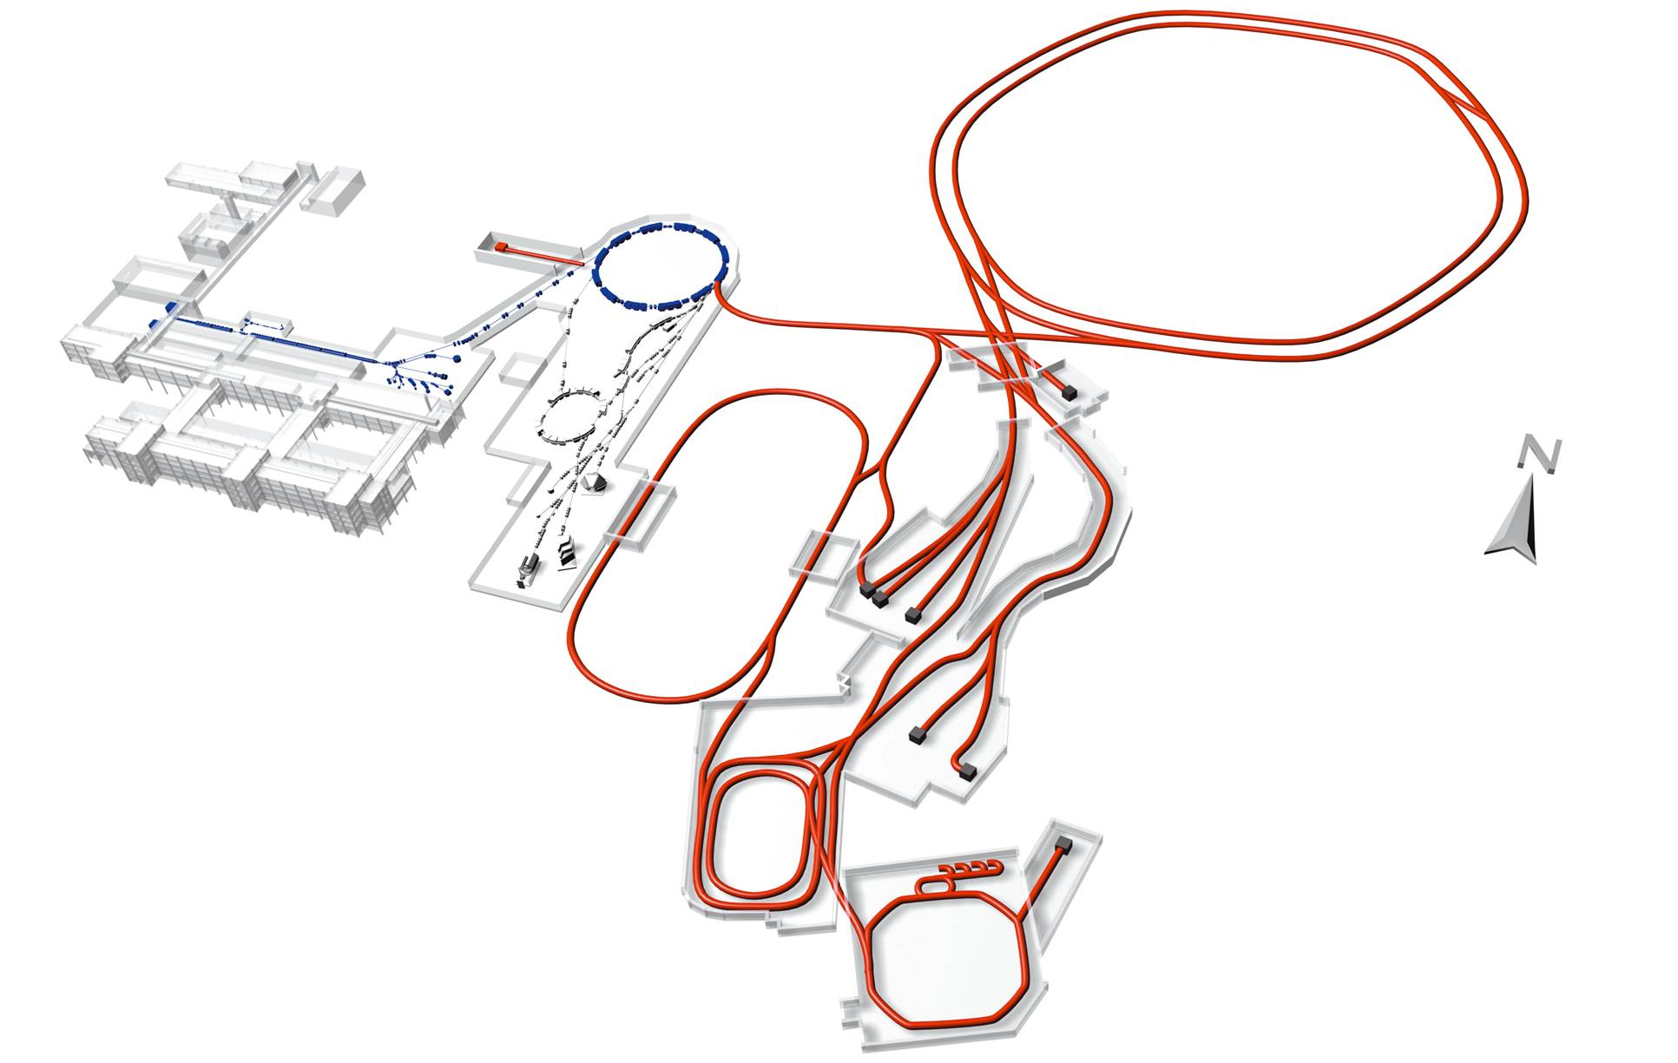
Facility for Antiproton and Ion Research
Existing facility: provides ion-beam source and injector for FAIR
Accelerator Components & Key Characteristics
Ring/Device Beam Energy Intensity
SIS100 (100Tm) protons 30 GeV 4x10¹³
²³⁸U 1 GeV/u 5x10¹¹
(intensity factor 100 over present)
SIS300 (300Tm) ⁴⁰Ar 45 GeV/u 2x10⁹
²³⁸U 34 GeV/u 2x10¹⁰
CR/RESR/NESR ion and antiproton storage and
experiment rings
HESR antiprotons 14 GeV ~10¹¹
Super-FRS rare isotope beams 1 GeV/u <10⁹
Existing Facility
Future Facility
New future facility: provides ion and anti-matter
beams of highest intensities and up to high energies

Slide 4
SIS100 injection plateau scenario
50 Tm
1000 MeV/u
SIS100
5 x 10¹¹ U²⁸⁺
18 Tm
200 MeV/u
SIS18
11.4 MeV/u
1
sec
First bunch @ 200 MeV/u
Nominal N_{ions} = 6.25 x 10¹⁰/bunch
Beam1: ε_{x/y} = 35/15 mm-mrad (2σ) ΔQ_{x/y}= -0.21/-033
Turns = 1.57 x 10⁵ (1 sec.)
Problem of control of beam loss for the bunched beams in SIS100 during 1 second

Slide 5
SIS18

Slide 6
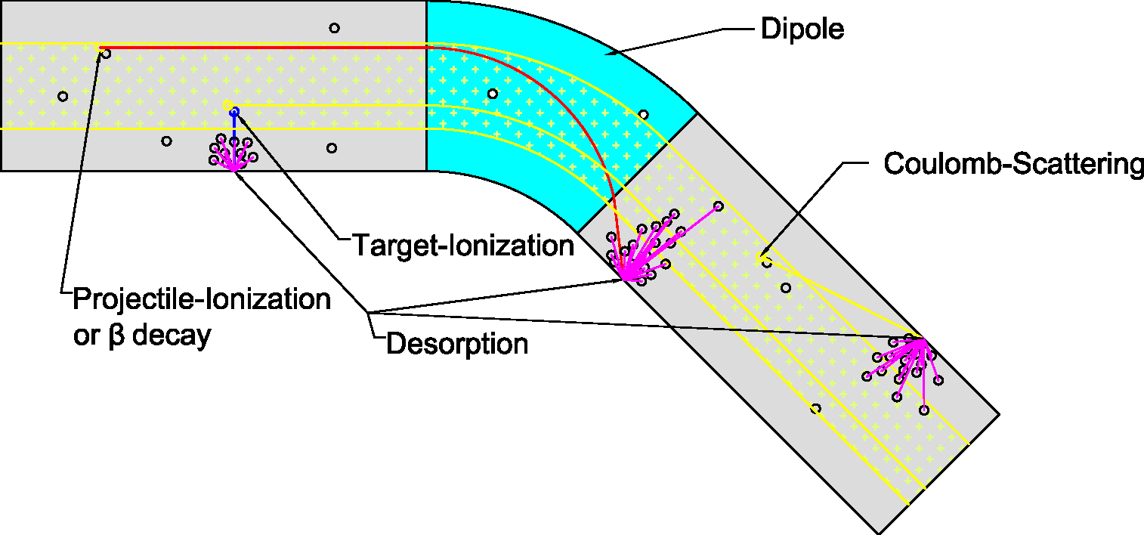
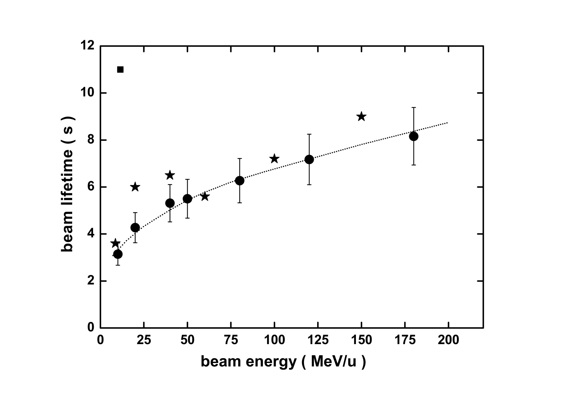
Beam loss in SIS-18:
U²⁸⁺ lifetime and residual gas pressure
Electron stripping:
High intensities
(Lifetime)⁻¹:
Born approximation:
Measured U²⁸⁺ life time for low intensities
2010
Desorption coefficient (n≈2):
G. Weber et al., PRAST-AB (2009)
H. Kollmus et al.,
J. Vac. Sci. (2009)
Stopping power:
Dynamic pressure:
Challenge: Control of dynamic pressure.
Lifetime increase (factor 3) due to NEG coating
Slide by O. Boine-Frankenheim

Slide 7
SIS18: Optics Change During Ramp
Triplet optic at injection:
Optimization of hor. acceptance
Evolution of
quadrupole
strengths
during ramp
1F
2D
3T
Slide from D. Ondreka
Dublet optic at extraction:
Large β_{x} for extraction devices
Main challenge:
  Optics dependent correction
  of closed orbit and tune
Work in progress:
  Software feed forward
  => LSA Collaboration with CERN
  Real time feed back
  => BI Collaboration with Univ. Dortmund
1F
2D
3T

Slide 8
SIS100

Slide 9
‘Beam loss budget’ in SIS-100
Beam loss induced effects in the vacuum chamber or accelerator components:
activation: loss of ‘hands-on-maintenance’
-> important only for localized losses e.g. during slow extraction
ion induced damage: persistent change of material properties
-> energetic heavy ions can cause higher damage than protons
ion induced desorption: increase of the vacuum pressure
-> distributed combined collimation/pumping system for ‘stripping’
losses in SIS-100
We presently expect that max. 5-10 % percent beam loss can be tolerated.

Slide 10
Multiple resonance crossing in bunched beams induced by space charge
Pipe
x
Slow halo
formation
If halo is too large
slow beam loss
take place
z
z
Bare tune
Lattice error or
Space Charge Structure
Resonance
Periodic crossing
of a resonance

Slide 11
SIS100 Modeling
Linear Lattice
All insertions (i.e. each element sizes + all septums, NO Collimators)
Each magnet has nonlinear field modeled via 3 localized nonlinear kicks of the systematic errors
Displacement of quadrupoles is modeled by insertion of a dipolar kick in center of quadrupole
Inclusion of all magnet correctors: steerers and sextupole for chromatic correction and resonance corrector sextupoles (in addition with quadrupoles and octupoles)
Magnet design: CSLD Pavel Akishin, Anna Mierau, Pierre Schnizer, Egbert Fischer 3. June 2010
Magnet multipoles: V.Kapin, P. Schnizer, A. Mierau
Kapin, V.; Franchetti, G. ACC-note-2010-004
Lattice: J. Stadlmann, A. Parfenova, S.Sorge

Slide 12
Resonances excited by the
“standard seed”
Resonances crossing the
space charge tune-spread
2 Qy = 37
Qx + 2 Qy = 56
3 Qx = 56
2 Qx + 2 Qy = 75
4 Qx = 75
Nonlinearity: Yes
Space charge: No
Chromaticity: No
Dispersion: No
COD: No
RF: No

Slide 13
Beam loss versus beam intensity
First bunch
Nonlinearity: Yes
Space charge: Yes
Chromaticity: Yes
Dispersion: Yes
COD: Yes
RF: Yes
Finding: Beam intensity is relevant for beam survival

Slide 14
The 3rd order resonance was responsible of the periodic resonance crossing
3Qx = 56
Qx + 2 Qy = 56
Proof obtained by
Compensating the resonance
Qx + 2 Qy = 56
without exciting the resonance
3 Qx = 56
Nonlinearity: Yes
Space charge: No
Chromaticity: No
Dispersion: No
COD: No
RF: No

Slide 15
Compensating the relevant resonance mitigates beam loss
Compensated
Un-Compensated
Standard seed
First bunch
First bunch
intensity 5E11
contained within 5%
intensity 5E11
This is a control that the same beam loss of the previous lattice is retrieved
error bar
error bar
error bar
Nonlinearity: Yes
Space charge: Yes
Chromaticity: Yes
Dispersion: Yes
COD: Yes
RF: Yes
Nonlinearity: Yes
Space charge: Yes
Chromaticity: Yes
Dispersion: Yes
COD: Yes
RF: Yes
error bar

Slide 16
SIS100 acceleration
50 Tm
1000 MeV/u
SIS100
5 x 10¹¹ U²⁸⁺
18 Tm
200 MeV/u
SIS18
11.4 MeV/u
1
sec
Bucket of storage
First bunch @ 200 MeV/u
Nominal N_{ions} = 6.25 x 10¹⁰/bunch
Beam1: ε_{x/y} = 35/15 mm-mrad (2σ) ΔQ_{x/y}= -0.21/-033
Turns = 1.57 x 10⁵ (1 sec.)
Acceleration

Slide 17
Change of RF bucket
1) The bunch length is kept constant
2) The longitudinal emittance
is preserved
5 x 10¹¹ U²⁸⁺
Bf
Nsy
233
50 Tm
0.2
Synchrotron frequency changes
Bunching factor changes
4 T/s
0.333
18 Tm
84
peak tuneshift increases of ~60%
1
sec
Storage
Acceleration

Slide 18
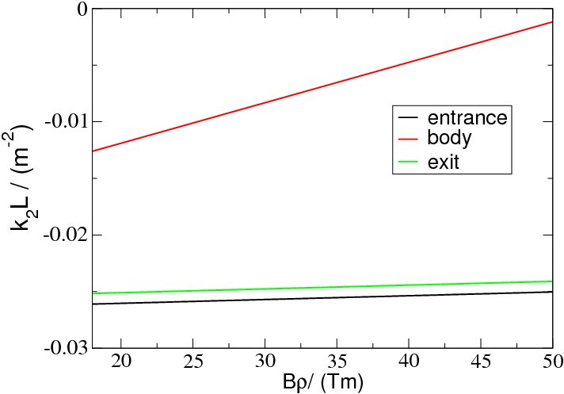
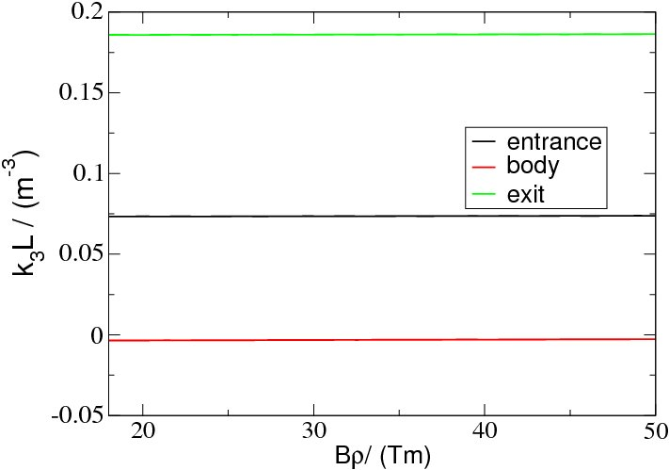
Magnet modeling during acceleration
Sextupolar
component
(without eddy current)
Octupolar
component
(without eddy current)
S.Sorge

Slide 19
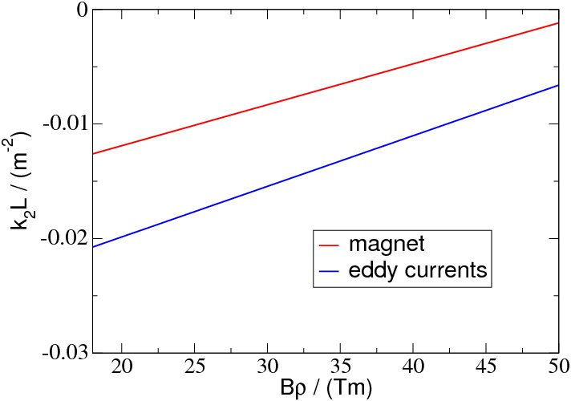
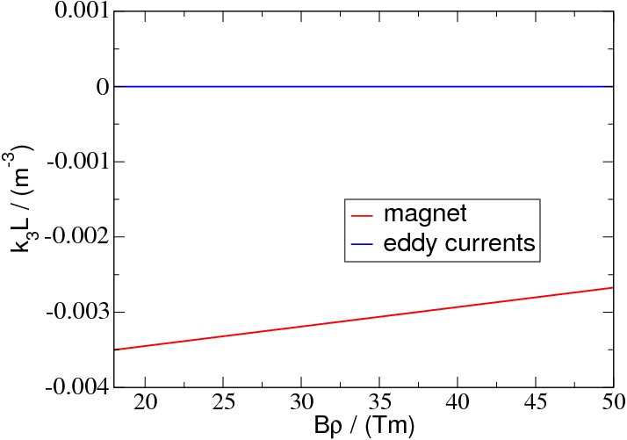
Effect of the eddy current
Sextupolar component
and eddy current
Octupolar component
and eddy current
Damp relatively fast
Created at the beginning of the acceleration ramp of 4 T/s enhances the
systematic sextupolar strength
S.Sorge

Slide 20
The beam dynamic issues
Increase of energy damps beam
size and space charge
periodic resonances crossing
pushes beam out
Relevance of resonances
varies during the ramp
Very complex process

Slide 21
Preliminary investigation
We keep conservative:
Keep the error seed of the storage also during the ramp
Closed orbit distortion remains during ramp
of the order of storage
Do not compensate any resonance
We study the higher intensity case I = 5x10¹¹ ions

Slide 22
Beam survival without including eddy current
apparent dynamical crossing
of two resonances
emittances: 35x15
dp/p: yes
Intensity: 5E11
Resonance: uncompensated
Ramp: 18Tm → 50Tm
random seed → yes
eddy current → no
bucket → Ramp

Slide 23
Beam survival including eddy current
emittances: 35x15
dp/p: yes
Intensity: 5E11
Resonance: uncompensated
Ramp: 18Tm → 50Tm
random seed → yes
eddy current → yes
bucket → Ramp

Slide 24
SIS300

Slide 25
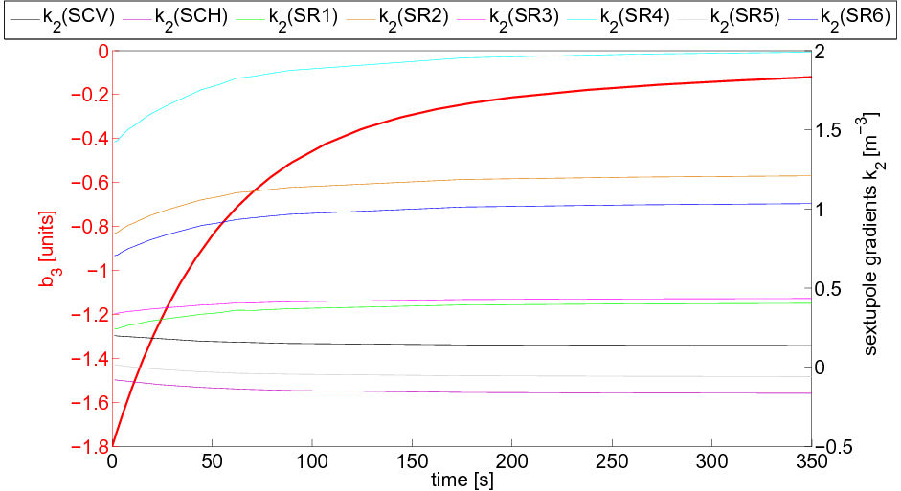
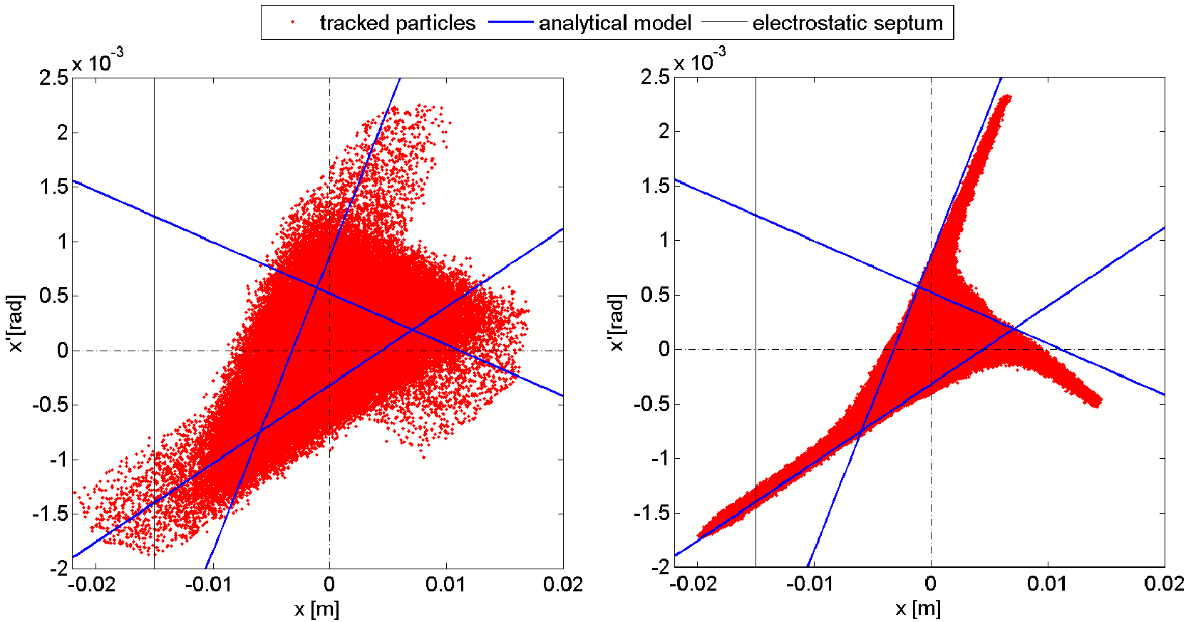
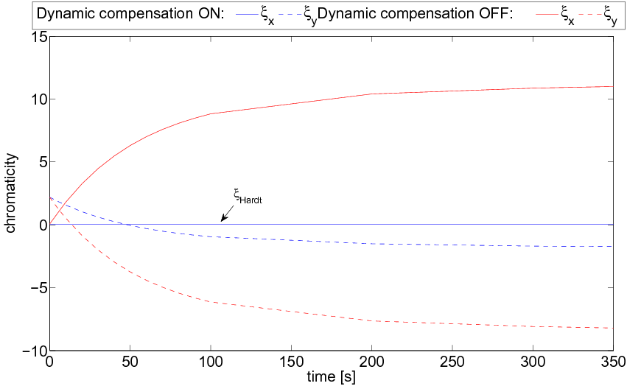
SIS300 slow extraction issues
This synchrotron has superconducting magnets
and is a fast ramping machine
64Tm
slow resonant extraction with
superconducting cos(θ) magnets
(1st time worldwide)
time
varying
b3
“Design and Optimization of the Lattice of the Superconducting Synchrotron SIS300 for Slow Extraction”
Angela Saa Hernandez PhD Thesis (to be published)
A. Saa Hernandez et al. “Slow extraction from the superconducting synchrotron SIS300 at FAIR: Lattice optimization and simulations of beam dynamics”. Proceedings of IPAC 2010, Kyoto.

Slide 26
Getting Prepared…

Slide 27
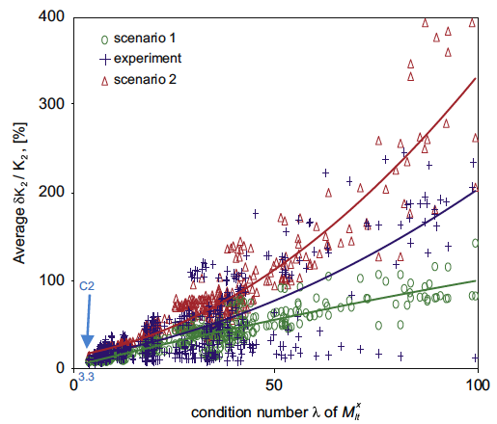
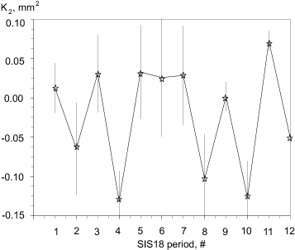
Reconstruction of nonlinear errors
At GSI we have developed the NTRM approach which is used for modeling SIS18 (A.Parfenova)
Applicability
of the method
Full reconstruction of
sextupolar error in SIS18
Proof of principle
for sextupoles +
general theory
A. Parfenova and G. Franchetti
Nucl. Instr. and Meth. A 646, (2011), 7-11.
(A. Parfenova. This workshop)
Resonance compensation of relevant resonance in SIS18 and benchmarking
of the effectiveness of the compensation for high intensity beams

Slide 28
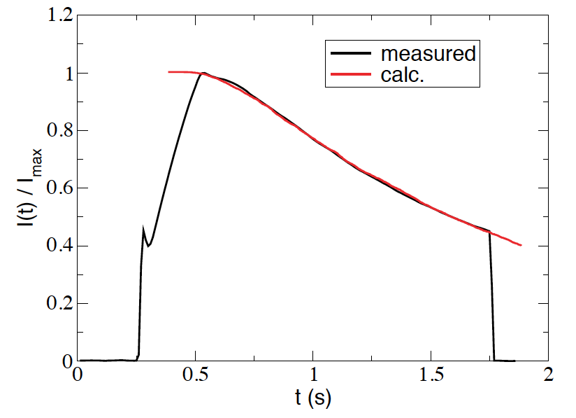
Linear and nonlinear machine apertures
After reconstructing the nonlinear component a check of acceptance and
dynamic aperture is an important verification
See seminar of S.Sorge, Thursday 23rd
principle → a small beam is excited by
noise and the curve of beam loss provides
information on the machine acceptance
Future challenge
extension of the method to
approach a measurement of
the dynamics aperture
S. Sorge, G. Franchetti, A. Parfenova
Phys. Rev. ST Accel. Beams 14, 052802 (2011)

Slide 29
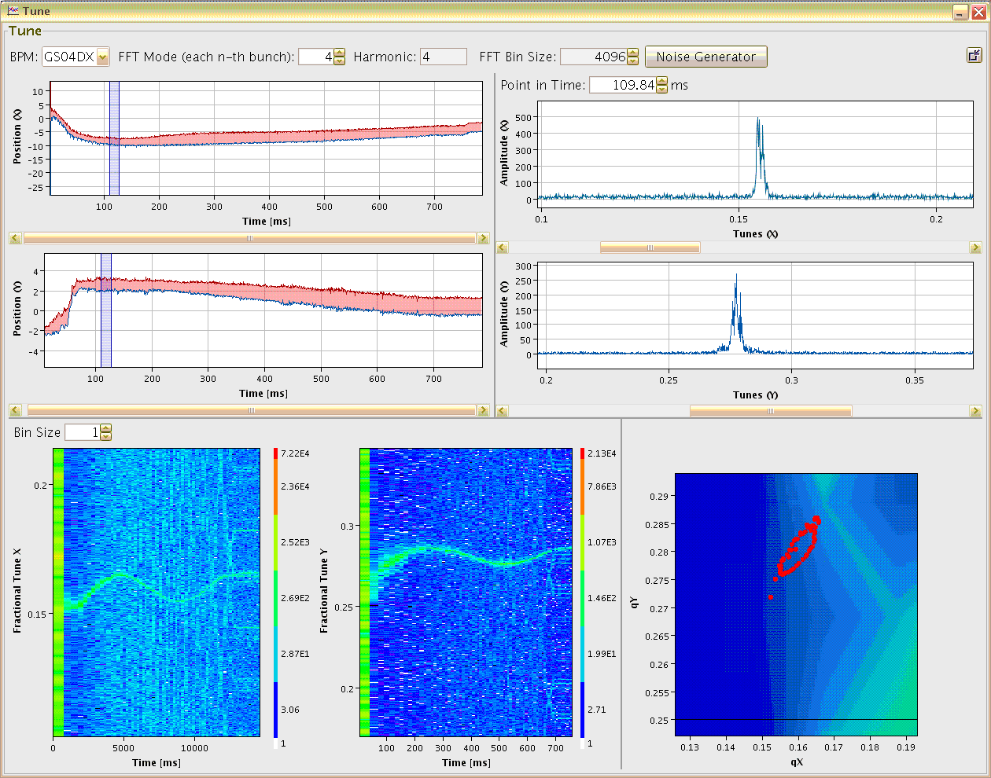
Tune measurement/control
Maximum Position Variation
Tune at fixed time
5 mm
horizontal
horizontal
Development of
noise based technique
for measuring tune
during the acceleration
ramp
2 mm
vertical
vertical
Tune versus time
Working Diagram
horizontal
vertical
Rahul Singh
+
diagnostic group
ΔQ_{x} ≈ 0.015
ΔQ_{y} ≈ 0.02
Beam parameter: Ar¹⁸⁺ acc. 11 → 300 MeV/u within 0.7 s

Slide 30
Future challenges / Outlook
Beam dynamics affected by space charge makes the
sensitivity to beam to optics more important (how much?)
Beam optics control and resonance compensation is essential
for the high intensity scenarios
Inventory of measured magnetic components of each elements
before assembly
Development of beam-based methods for measuring the machine optics
and effective nonlinear components
Studies on resonance compensation in presence of space charge
Control of beam optics during acceleration:
Do we need to compensate some specific resonance? when?
We should get prepared to the challenge to measure and to model the machine properties

