Slide 1
High Intensity Challenges
by Mike Plum
Ring Area Manager
Spallation Neutron Source
Workshop on Optics Measurements, Corrections, and Modeling at High Performance Storage Rings, CERN,
June 20-22, 2011

Slide 2
High intensity challenges
This presentation will focus on two high intensity (and high power) rings:
The SNS storage ring and the JPARC rapid cycling synchrotron.
Previous generation machines (PSR and ISIS) will also be compared.
All four are examples of neutron spallation sources.
Overview of SNS and J-PARC
Some high intensity challenges
Suggestions for future development

Slide 3
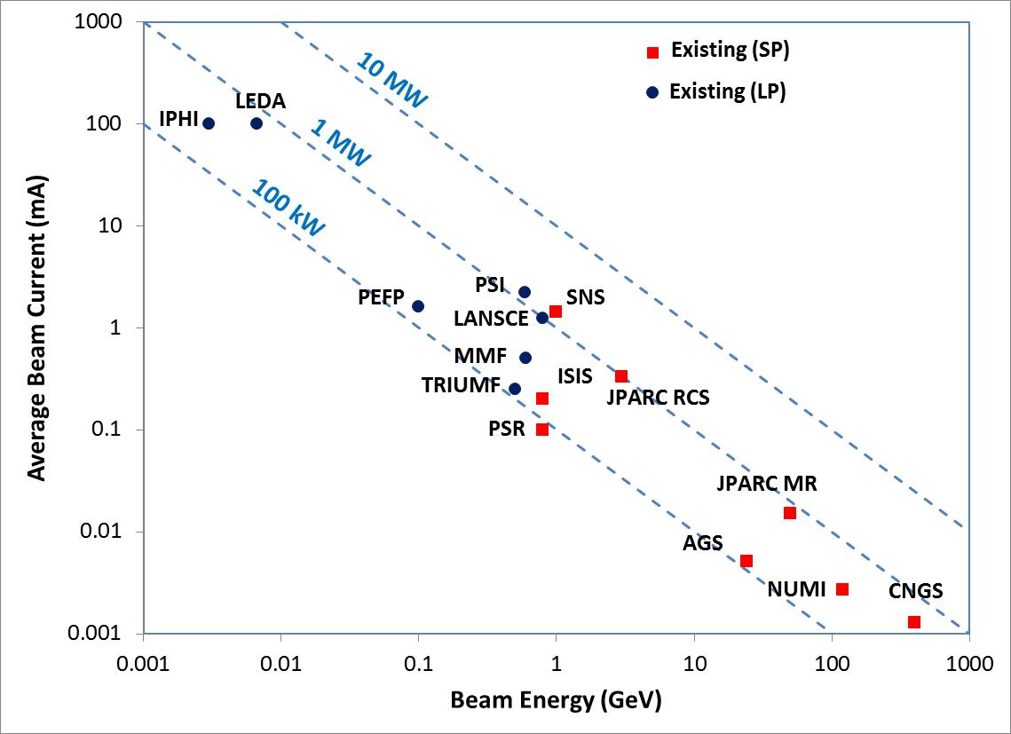
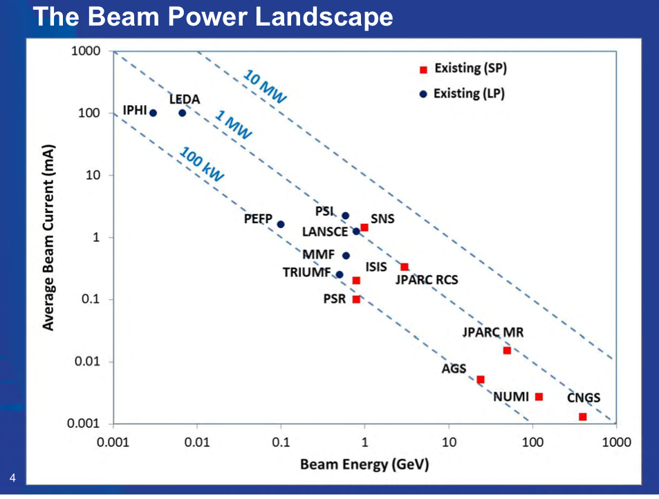
High intensity landscape
Courtesy S. Henderson

Slide 4
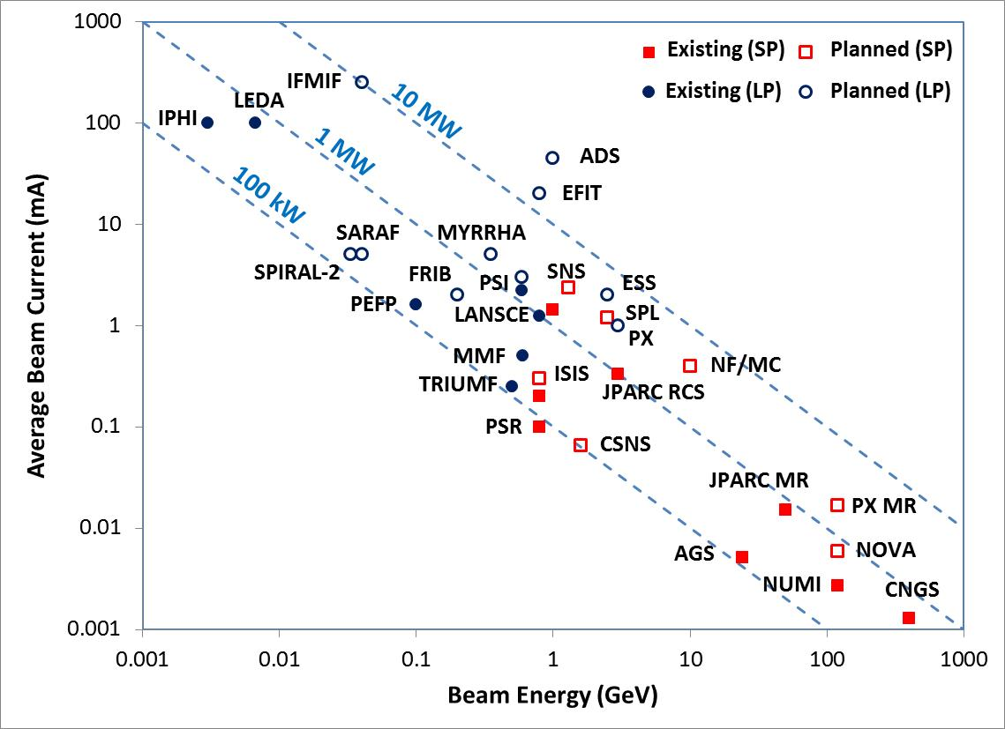
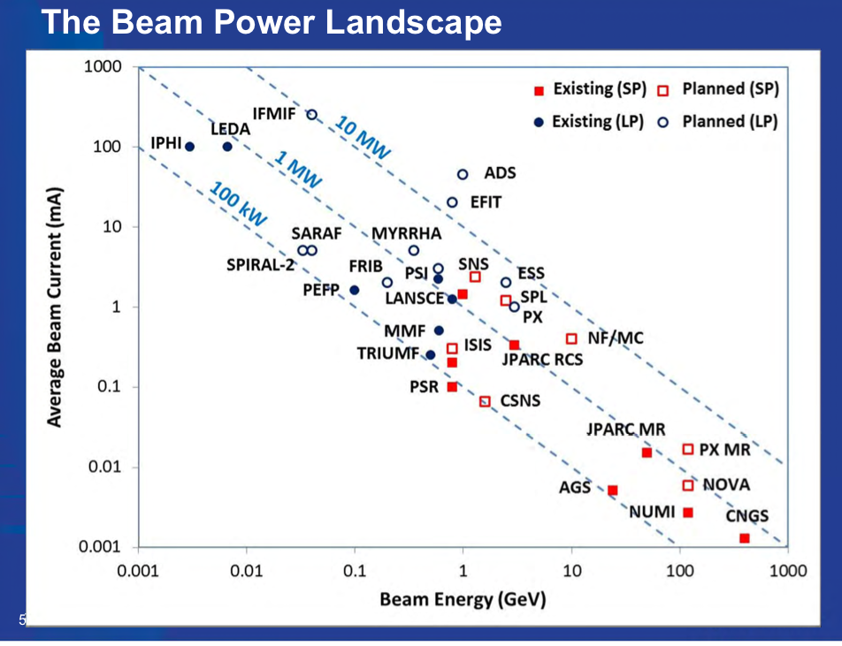
High intensity landscape incl. future
Courtesy S. Henderson

Slide 5
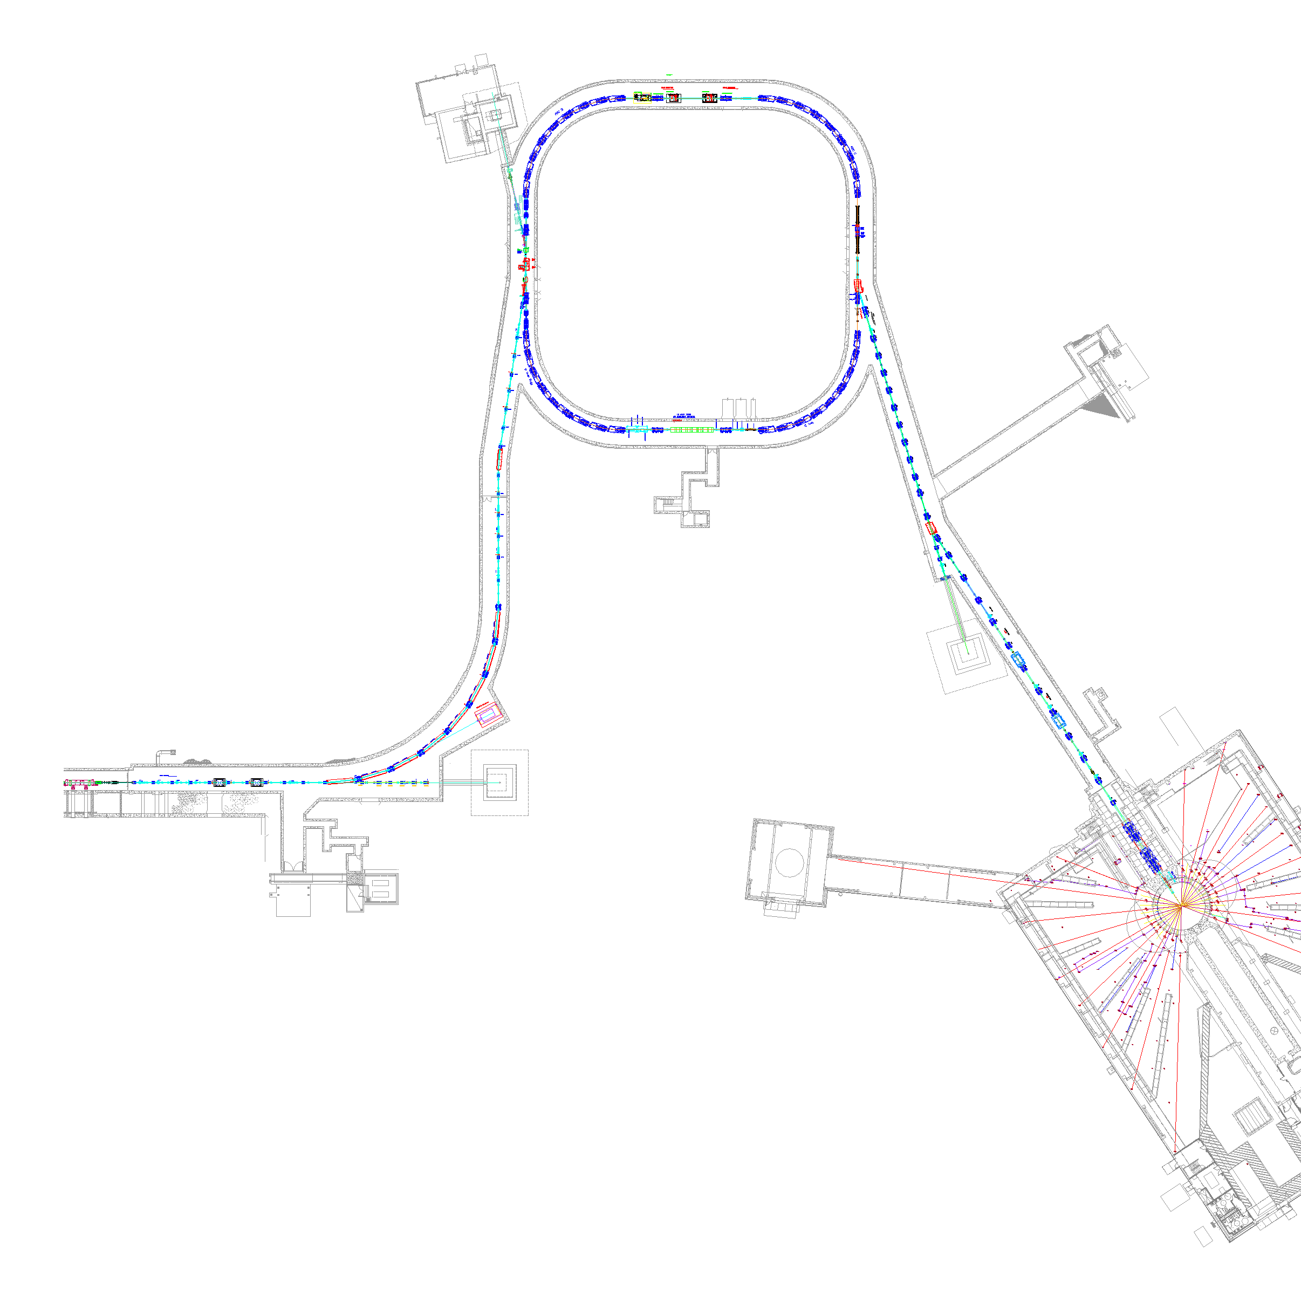


SNS Accelerator Complex
Accumulator Ring
1 GeV LINAC
Accumulator Ring: Compress 1 msec long pulse to 700 nsec
Collimators
Front-End:
Produce a 1-msec long, chopped,
H⁻ beam
Extraction
Injection
RF
1000 MeV
RTBT
2.5 MeV
HEBT
Front-End
LINAC
Liquid Hg Target
Chopper system makes gaps
945 ns
mini-pulse
Current
Current
1 ms macropulse
1ms

Slide 6
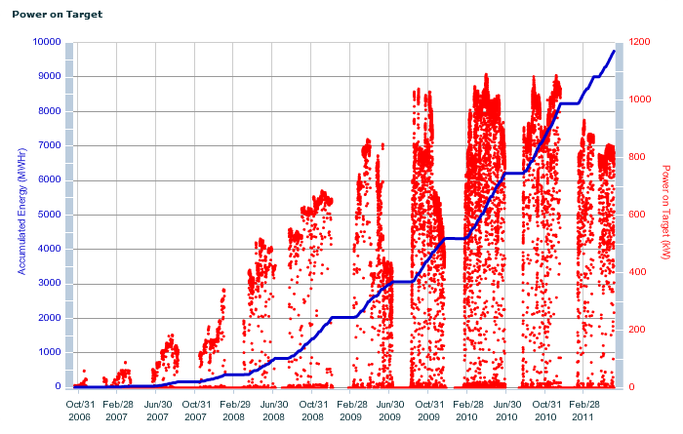
SNS power ramp up to date
1.08 MW
Power reduced to save money
October 2006 to present
Full design power is 1.4 MW

Slide 7

J-PARC Accelerator Complex
Linac 181 MeV (400MeV)
3 GeV Synchrotron
(25 Hz, 1MW)
50 GeV Synchrotron
(0.75 MW)

Slide 8
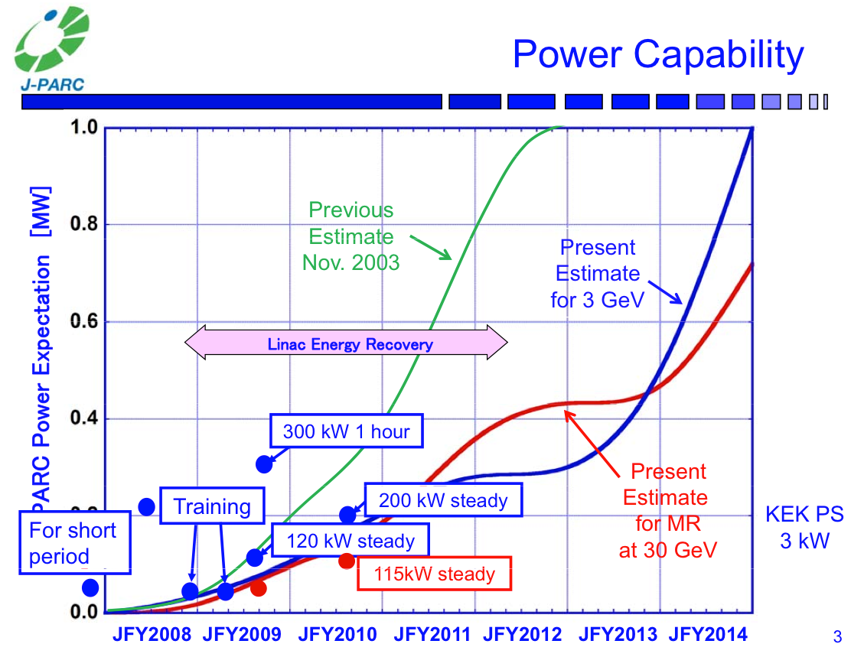
from S. Nagamiya, Jan. 2011

Slide 9
Some high intensity challenges
Beam loss
Charge exchange injection
Simulations
Collective effects
Theory vs. practice
Beam instrumentation

Slide 10
Beam loss
Rule of thumb: limit beam loss to <1 W/m for hands-on maintenance
  At high intensity machines such as SNS and J-PARC, this means a fractional loss of <1x10⁻⁶ per meter
Most beam loss comes from beam halo and beam scattering from stripper foils
  This drives the requirement for large apertures (30 cm maximum diameter in the SNS ring, and 41 cm in the JPARC RCS), which leads to other issues…
  Collimation is also an integral part of today’s high intensity machines (e.g. SNS, J-PARC, CSNS) to control beam halo and beam loss. SNS ring has first (?) two-stage collimation system.
  Stripper foils are as small and as thin as possible

Slide 11
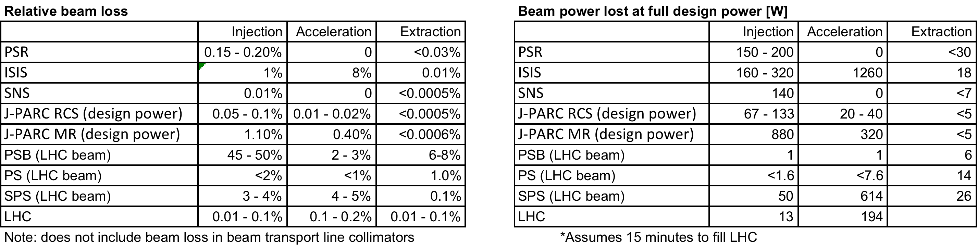
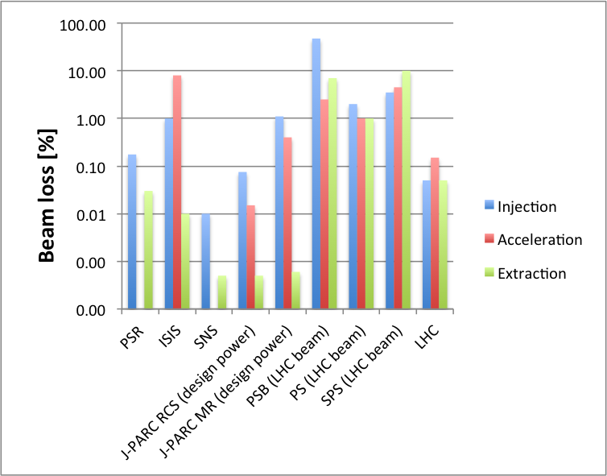
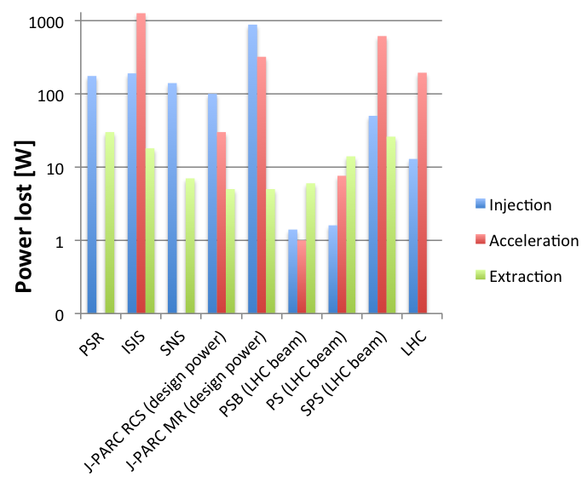
Beam loss at various machines

Slide 12
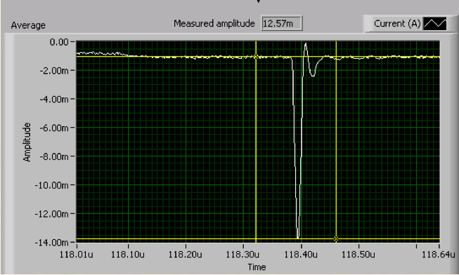
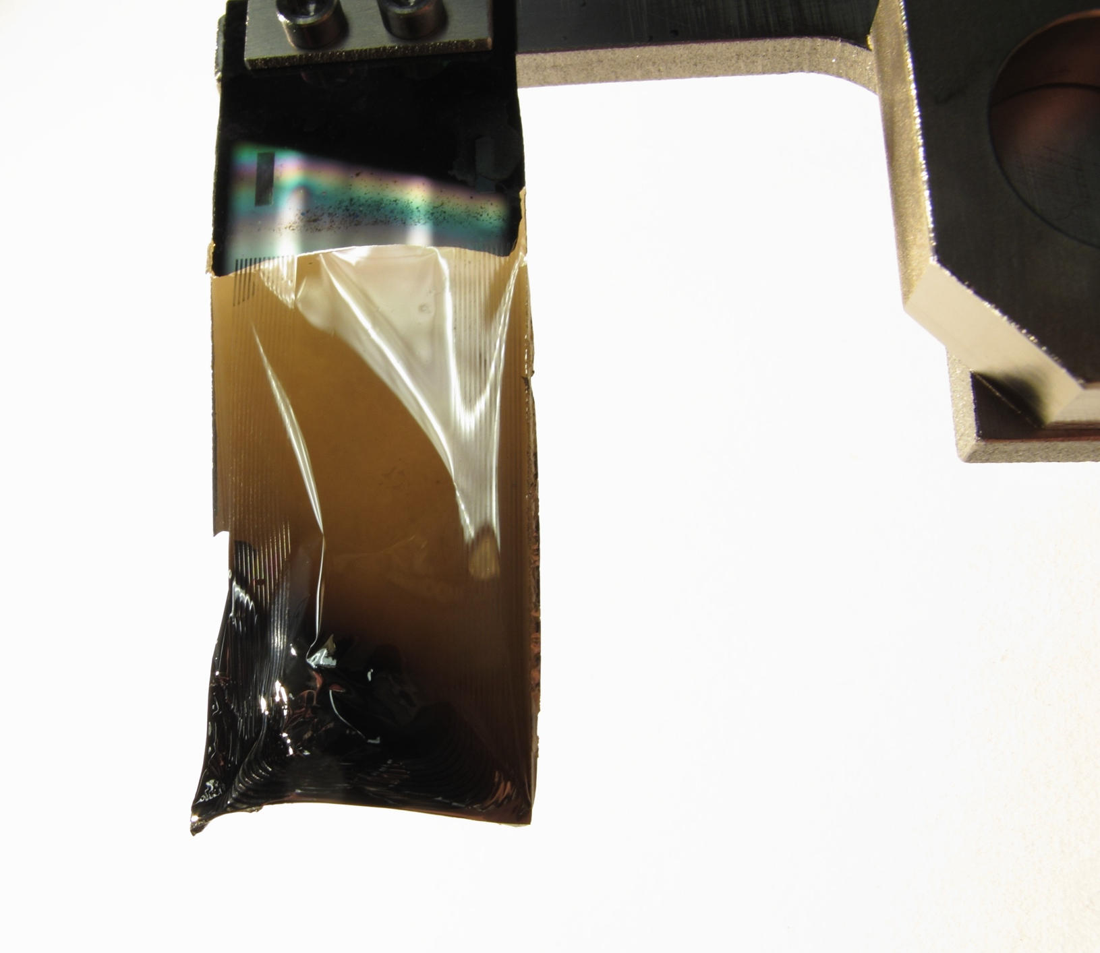
Charge exchange injection
Charge exchange injection is required for low-loss multi-turn injection
  And also to utilize phase space painting to control space charge and collective effects
Best way to do this today is with stripper foils
  But foil technology is close to its beam power limit due to short lifetimes caused by intense beam heating
  Laser stripping is the up and
  coming alternative technology
Blackened, twisted foil from SNS, used for 1 MW production
90% stripping of ~870 MeV H⁻ beam. (Danilov, PAC07)

Slide 13
Charge exchange injection today
Best foils today are HBC and AC-DC foils used at J-PARC and nanocrystalline diamond foils used at SNS
Laser stripping has been demonstrated in just one series of experiments, at SNS, and only for ~10 ns
High intensity challenge: Advance the technology for laser stripping to make it practical for the next generation of high intensity machines
  Laser stripping will eliminate the beam loss caused by foil scattering (which accounts for the majority of the beam loss in high intensity machines) and avoid the thermal foil problems
  SNS and Project X (FNAL) are collaborating toward this goal
  A experiment to demonstrate 1 – 10 μs stripping is in progress at SNS, but results are not expected for a few more years. (For SNS, need 1000 μs @ 60 Hz.)

Slide 14
Simulations
Simulations are needed to design our accelerators and storage rings
  In general they are better than ever
  However, they cannot accurately simulate beam loss at the <1x10⁻⁶ level
  They rarely include important effects such as magnetic field overlap caused by large aperture / poor-aspect-ratio magnets in close proximity
  An accurate simulation requires an accurate input 6D phase space beam distribution, but this is not known well enough and is difficult (impractical?) to measure
High intensity challenge: improve simulations to accurately predict beam loss at the <1x10⁻⁶ level

Slide 15
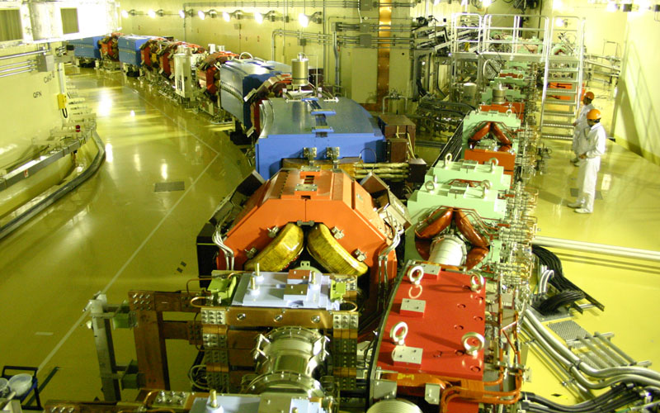
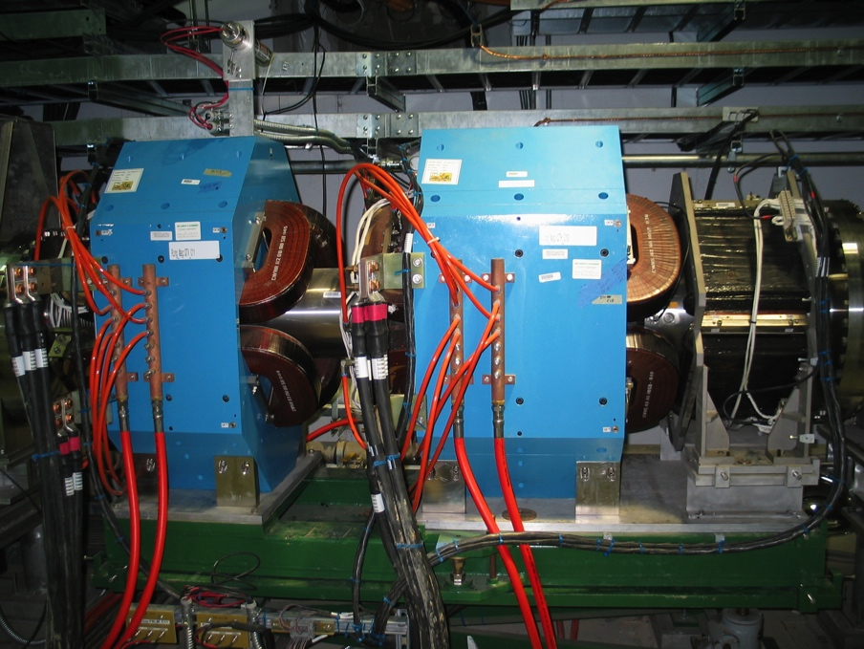
Consequences of large apertures
High intensity machines need large beam apertures to reduce the beam loss
  This often produces problems with fringe fields and magnetic field overlap caused by large aperture / poor-aspect-ratio magnets in close proximity, and these effects are rarely included in simulations
J-PARC injection section
SNS straight section

Slide 16
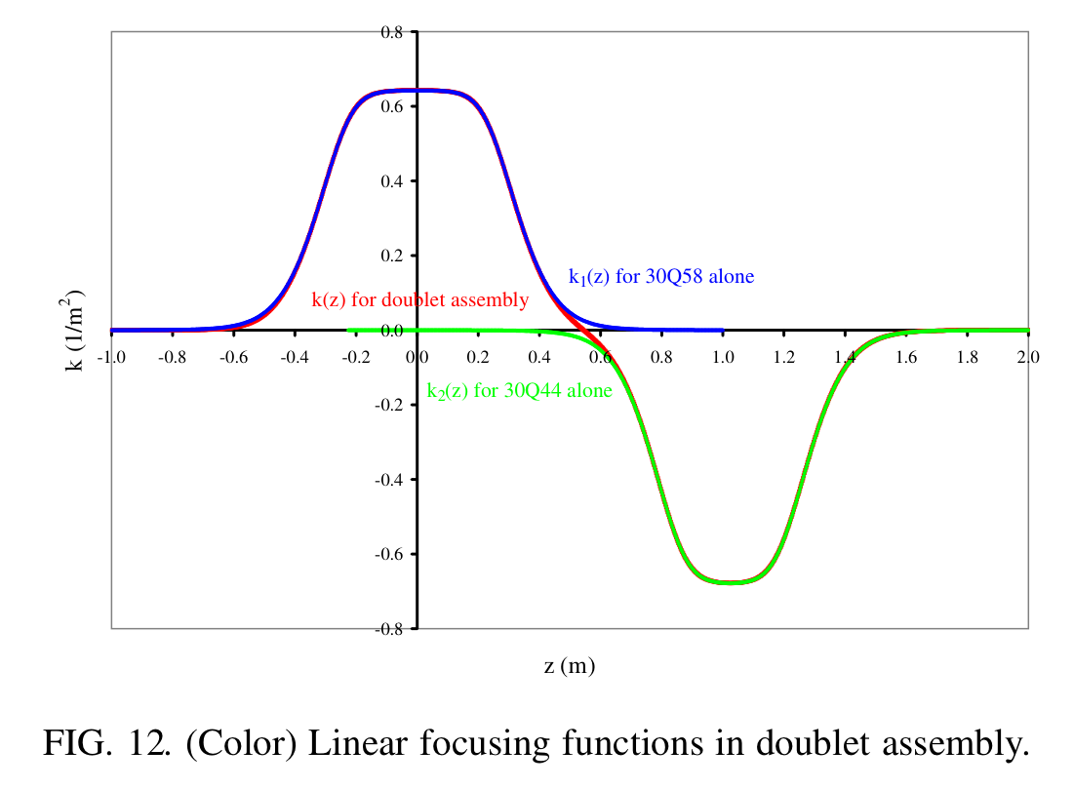
Effect of magnetic field overlap in the SNS quad doublets
Example focusing perturbation caused by magnetic field overlap
Focal length changes: Δf_{x} = -4.3%, Δf_{y} = -6.4%
From J.G. Wang, PRSTAB 9, 122401 (2006)

Slide 17
Collective effects
Space charge effects such as tune spread seem to be well enough understood for today’s high intensity rings
Some beam instabilities are well enough understood, and some are not
  Example of good understanding: Impedance-driven instability at SNS due to extraction kickers is accurately modeled by ORBIT simulation
  Examples of poor understanding: e-p instability threshold and behavior at both SNS and J-PARC
High intensity challenge: improve our understanding of the e-p beam instability

Slide 18
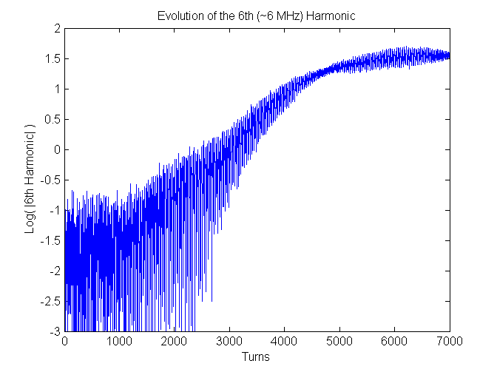
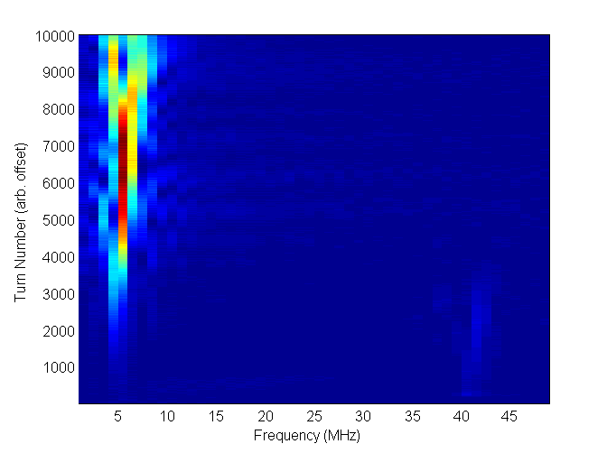
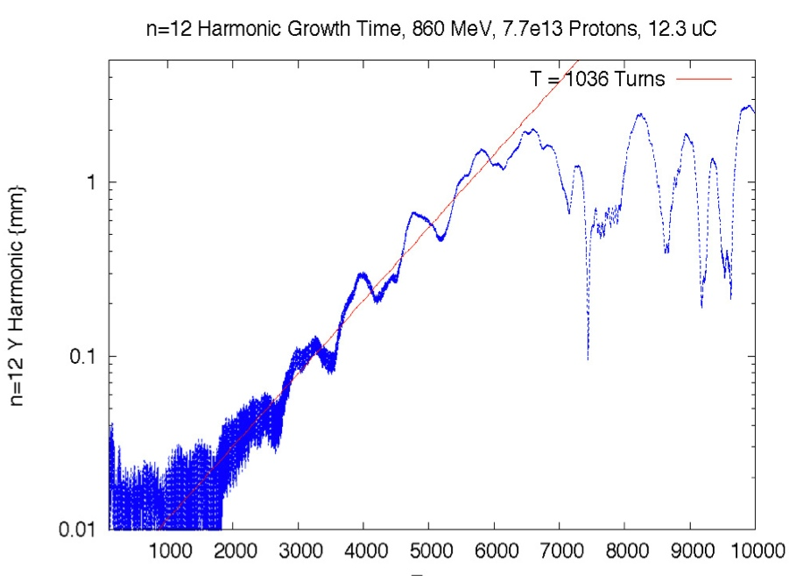
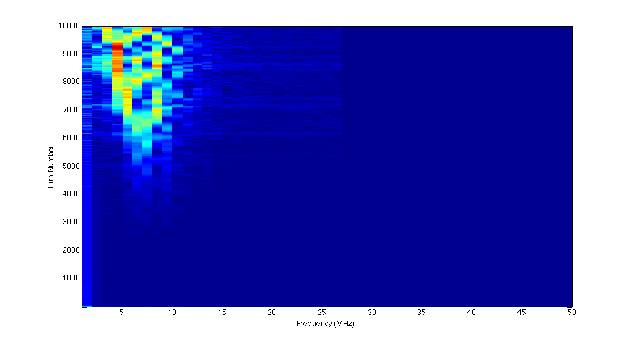
Extraction Kicker Instability Benchmark
ORBIT’s transverse impedance model was successfully used to model the extraction kicker instability. The rise time and the threshold are accurately predicted.
Measured
Rise time:
τ = 1036 turns
Simulated
τ = 1036 turns
Courtesy J. Holmes

Slide 19
e-p instability
SNS, J-PARC, ISIS, and PSR have mostly avoided the e-p instability – it does not interfere much with normal operations
  PSR needs a slightly higher buncher voltage to control it
  At SNS it is easily controlled with the second harmonic RF buncher voltage
  It’s not seen at the J-PARC RCS or ISIS
The e-p instability threshold and characteristics cannot be accurately predicted with today’s simulations
  At J-PARC MR the measured e-p oscillation frequency (15-60 MHz) is lower than expected (80 MHz)
  The characteristics of the e-p instability at SNS and PSR are very different, although they were expected to be very similar

Slide 20
e-p instability at PSR vs SNS
PSR
SNS
Threshold [uC]
Buncher voltage [kV]
At SNS, the e-p threshold does not change much with buncher voltage. It is more sensitive to the bunch shape (and thus the second harmonic buncher voltage).
This result was not predicted by either theory or the simulation codes
e-p instability
threshold vs. buncher voltage at the Los Alamos PSR
Courtesy R. Macek
Courtesy Z. Liu, PhD thesis

Slide 21
Theory vs practice
The low loss tune in practice sometimes does not correspond to the design set points and lattice functions
  SNS linac quads are ~50% below design values
  SNS ring RF buncher h=1 phases designed to be the same, but to get the best beam loss they must be separated by 15 - 75 deg
  J-PARC RCS design tune (6.68, 6.27) ⇒ current tune (6.45, 6.42) due to leakage fields from the extraction beam line magnets and edge focus effect of the injection bump magnets
  At least in transport lines, beam loss is due to the beam halo, and the magnet set points needed to to efficiently transport this halo can be different from the design and/or different from the settings needed to transport the core of the beam (e.g. SNS HEBT)

Slide 22
Theory vs practice (cont.)
SNS, J-PARC, and PSR all needed to modify their ring injection sections due to unanticipated problems
  SNS H⁰ and H⁻ waste beam transport issues due to unintended consequences of a design change in the injection chicane magnets
  J-PARC RCS high beam loss on the crotch between the ring and injection dump beam lines due to foil scattering
  PSR high beam loss caused by poor matching and injected beam emittance growth caused by two-step H⁻ to H⁰ to H⁺ injection process
Lesson learned: Particle-tracking simulations using 3-D magnetic fields from magnet simulations were an important tool to address the issues (SNS and J-PARC )
Lesson learned: For high intensity machines, it is important to have a flexible design that can accommodate a wide range of set points to achieve the empirically-determined low loss tune

Slide 23
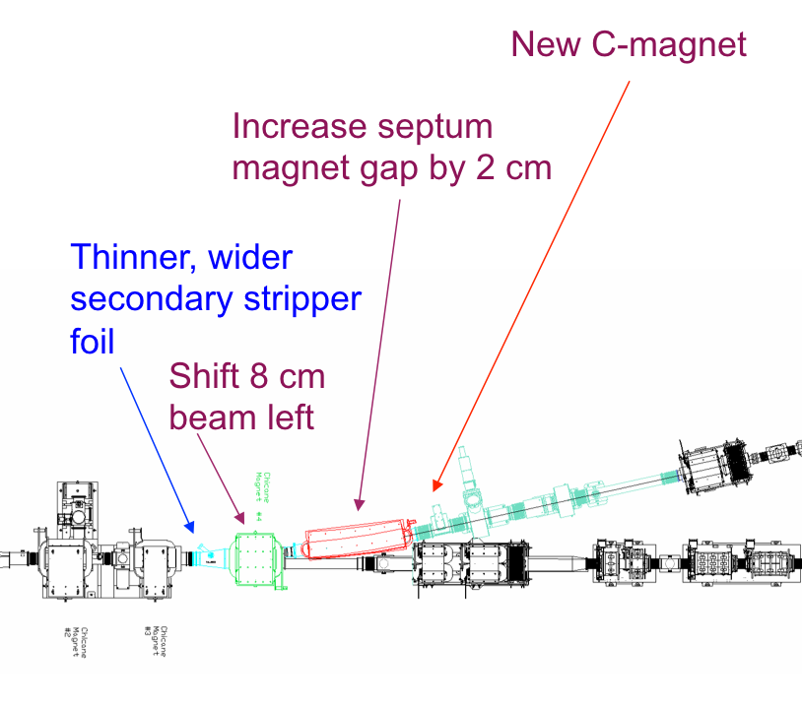
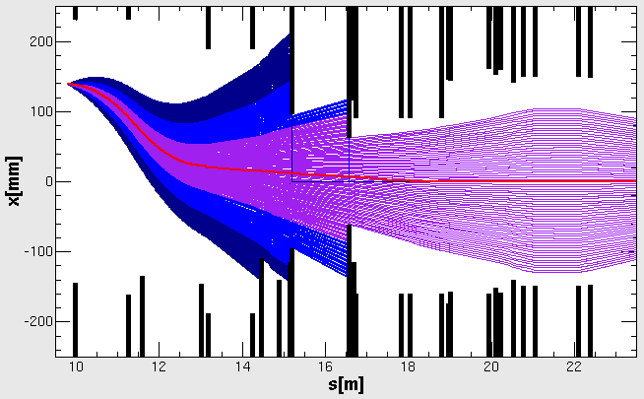
Example injection section modifications
A collimator is being added to the J-PARC RCS to protect the crotch in the H⁰ / ring beam line
Modifications to the SNS injection section
Beam loss due to scattered beam hitting crotch in beam pipe
30mrad
-30mrad
FOIL
QDL
Branch
BPM
PBH3
PBH4
QFM
Courtesy: H. Harada

Slide 24
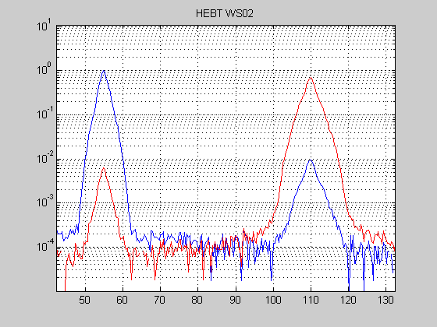
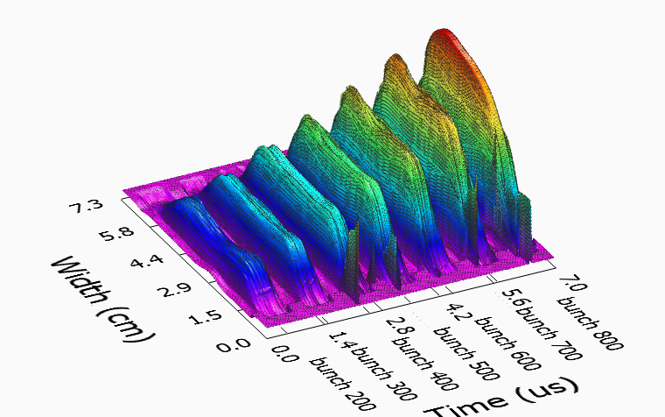
Profile measurements at SNS
Example wire scanner profile measurement in linac-to-ring transport line. Dynamic range is almost 10⁴.
Example non-intercepting electron-beam profile measurement in ring transport line. Dynamic range is 30 - 80.
Courtesy A. Aleksandrov
Courtesy W. Blokland
High intensity challenge: develop beam instrumentation that can measure beam distributions with wide dynamic range, ideally >10⁶, preferably non-intercepting

Slide 25
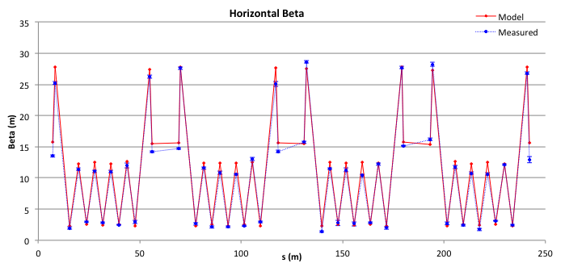
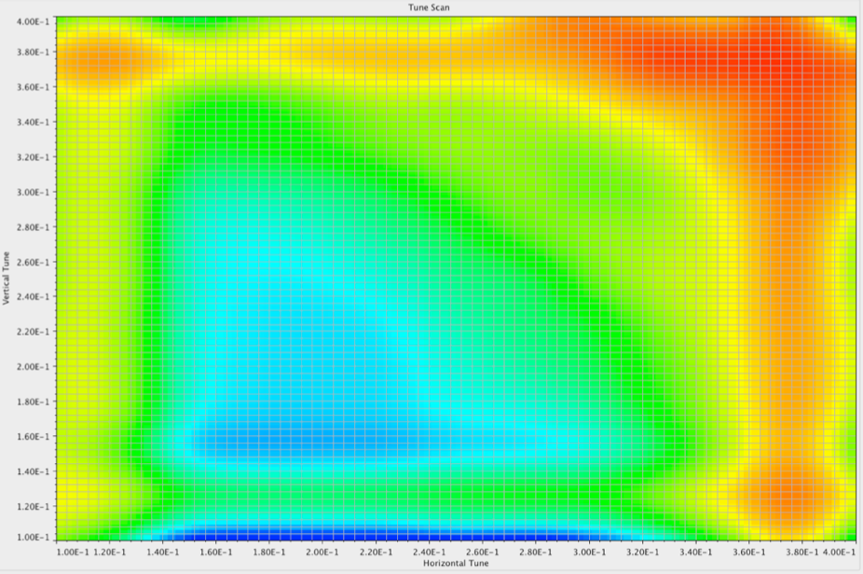
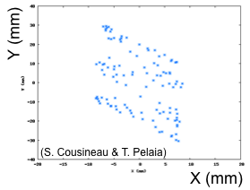
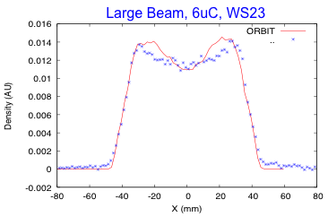
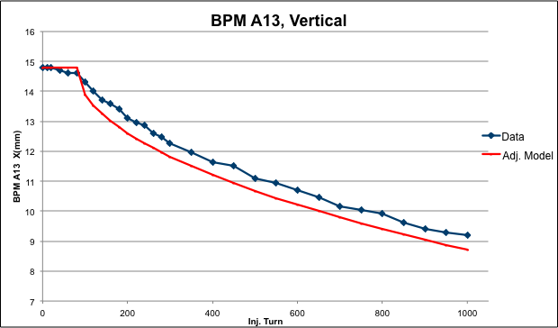
Basic optics measurements at SNS Ring
(S. Cousineau & T. Pelaia)
(M. Plum)
(T. Pelaia)
Betatron function measurement by varying
quad trims (also used MIA and ORM)
Transverse coupling in the Ring
Ring resonance map
(S. Cousineau)
(S. Cousineau)
Phase space painting
2-D beam distribution in extraction line using a BPM and single minipulse reconstruction
Simulation code benchmarking

Slide 26
Suggestions for future development
Improve simulations to accurately predict beam loss at the <1x10⁻⁶ level
Improve ability to predict and model the e-p beam instability characteristics, especially the threshold
Advance the technology for laser stripping to make it practical for the next generation of high intensity machines
Improve beam instrumentation:
  Measure beam halo, preferably non-intercepting, with
  dynamic range > 10⁶
  Measure input beam distributions (e.g from ion source or RFQ) with greater accuracy, with dynamic range > 10⁶, full 6D phase space

Slide 27
Acknowledgements
Thanks to H. Hotchi (J-PARC) and B. Goddard (CERN) for their input into this presentation

Slide 28
The SNS ring is an ideal environment for studying high intensity effects
PLEASE JOIN US!

Slide 29
Back up slides

