Slide 1
Building federated research communities
Christopher Whalen
International Centers of Excellence in Research
African Centers of Excellence in Bioinformatics and Data Intensive Science
whalen@researchdata.us

Slide 2
About the NIAID
International Program
Dual mission: Conduct research into human diseases, and respond to outbreaks when they occur
Partners with local scientists in disease-endemic countries to expand research capabilities/training of greatest relevance to the local population
Develops laboratory, clinical field site, and information technology infrastructure through long-term collaborations
Collaborative research programs underway at multiple national and international sites
Operate Research Infrastructure for the International Centers for Excellence in Research
Notes:
The NIAID is unique in that it has a dual mission. Not only does it have this research mission to conduct basic and applied research into human disease, but also part of what it does is pandemic response. Its job is to respond to outbreaks when and where they occur. To accomplish this mission, the NIAID partners with local scientists in disease-endemic countries to expand research capabilities/training of greatest relevance to the local population. This partnership includes developing laboratory, clinical field site, and information technology infrastructure through these long-term collaborations. The NIAID currently has 90 virtual research organizations with over 4500 scientists and staff at 100 institutions, including 25 active national and international clinical research studies.

Slide 3
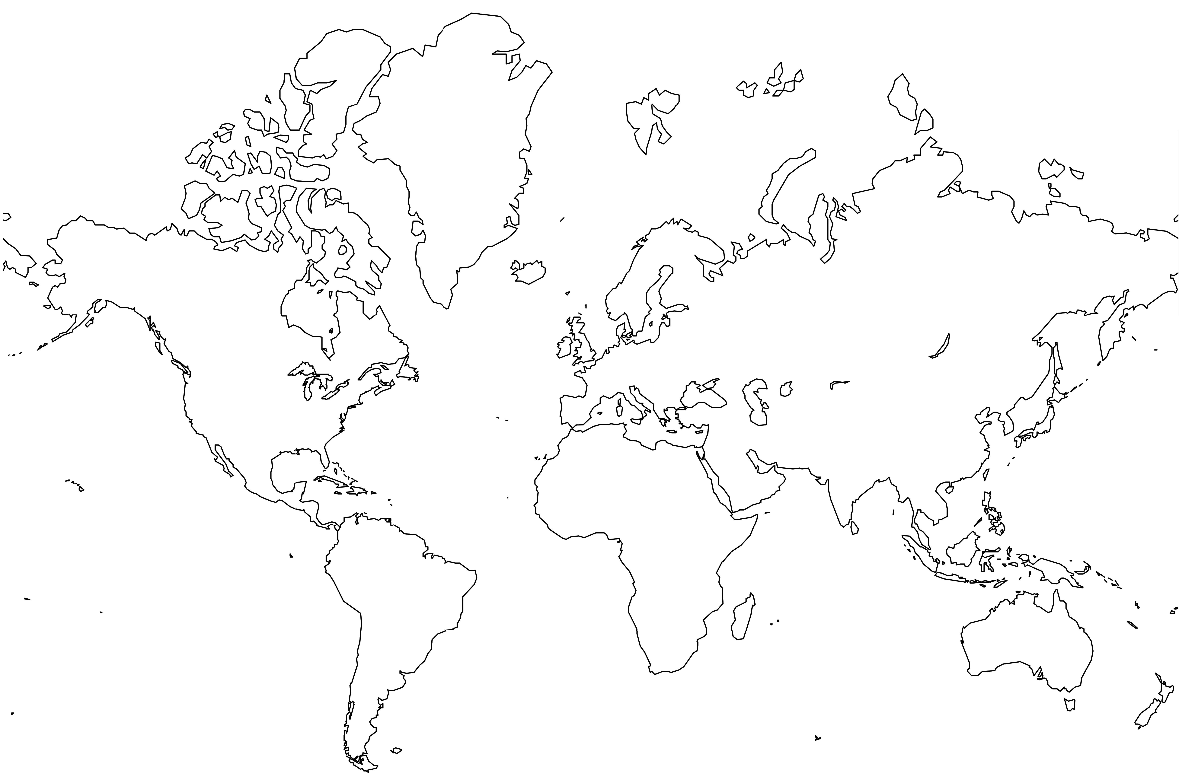
NIAID - BETHESDA
NIAID – Chennai, India
NIAID - MALI
NIAID – Phnom Penh, Cambodia
NIAID - UGANDA

Slide 4
International Centers of Excellence in Research - ICERs
Collaborative centers with a host institution
NIH Grants have no indirect funding
Cyberinfrastructure can’t be built or maintained with direct grant funding
~2000 researchers and supporting staff

Slide 5
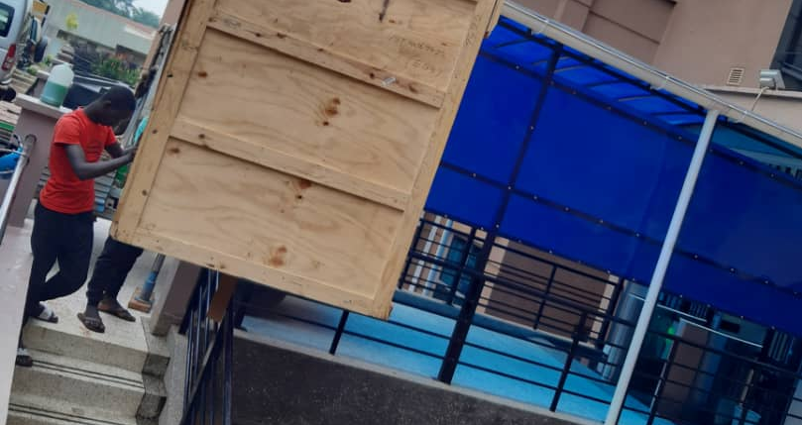
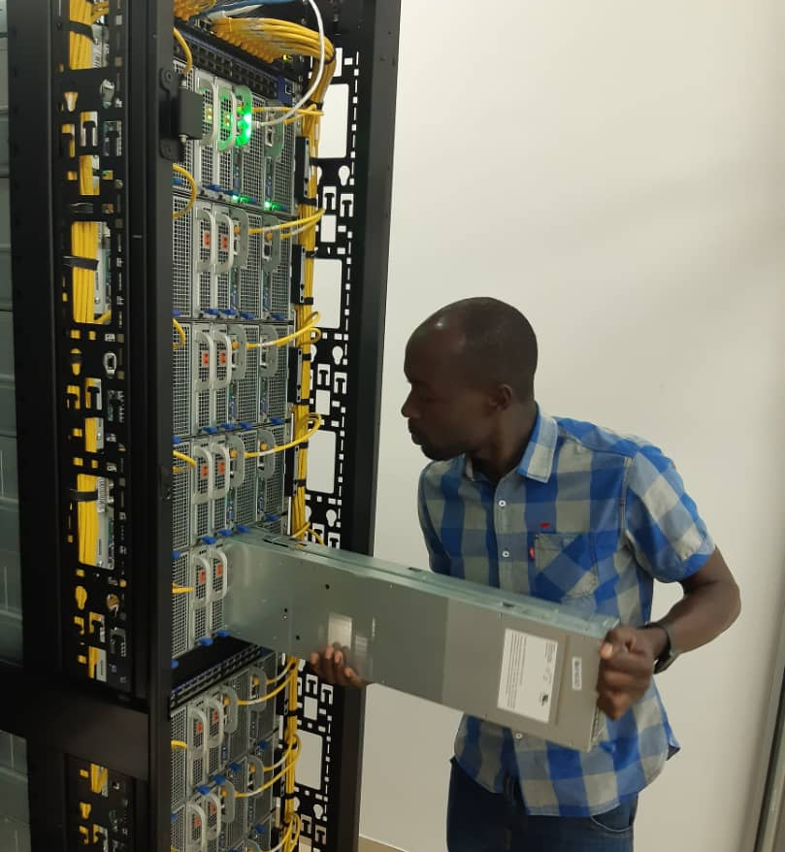
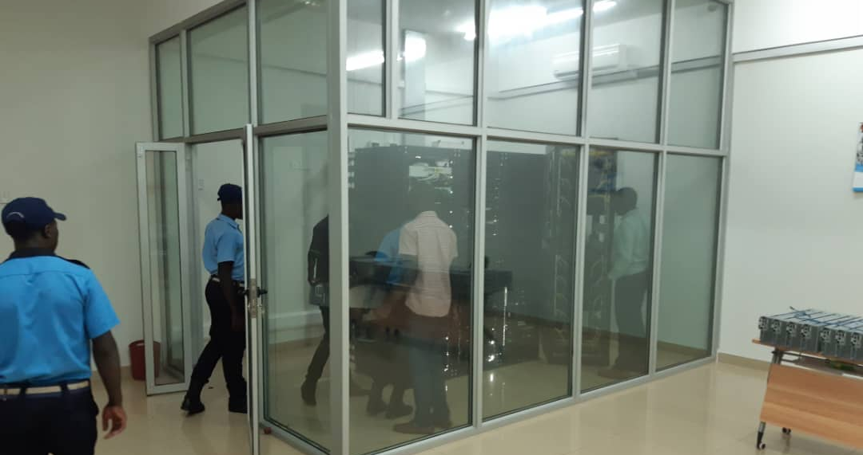
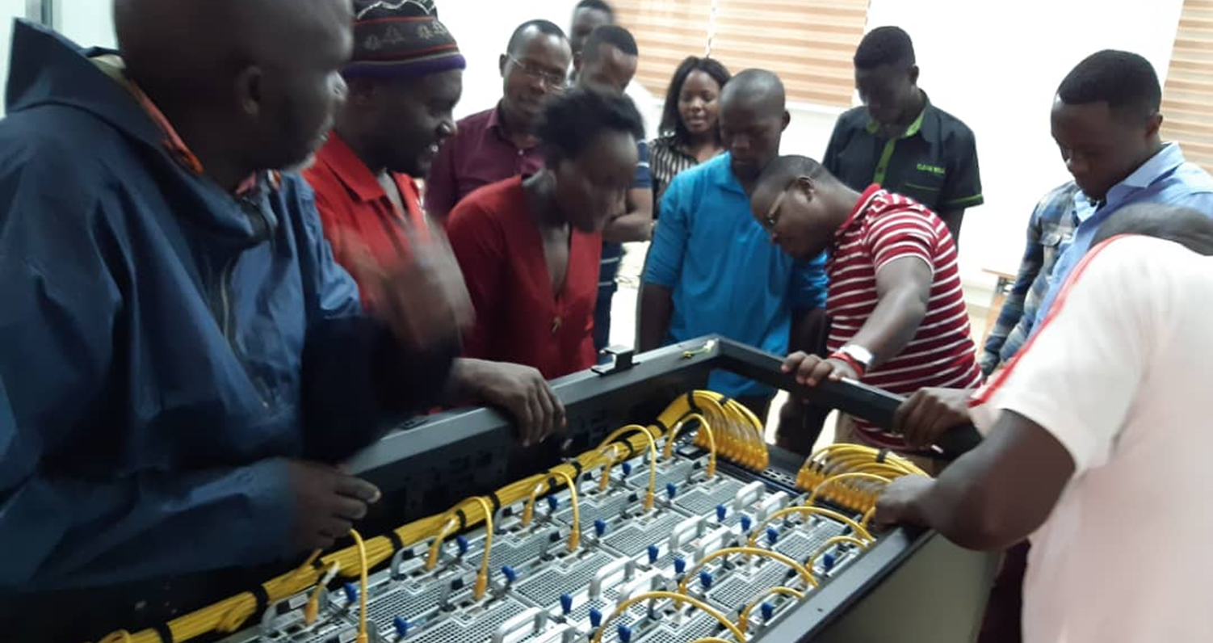
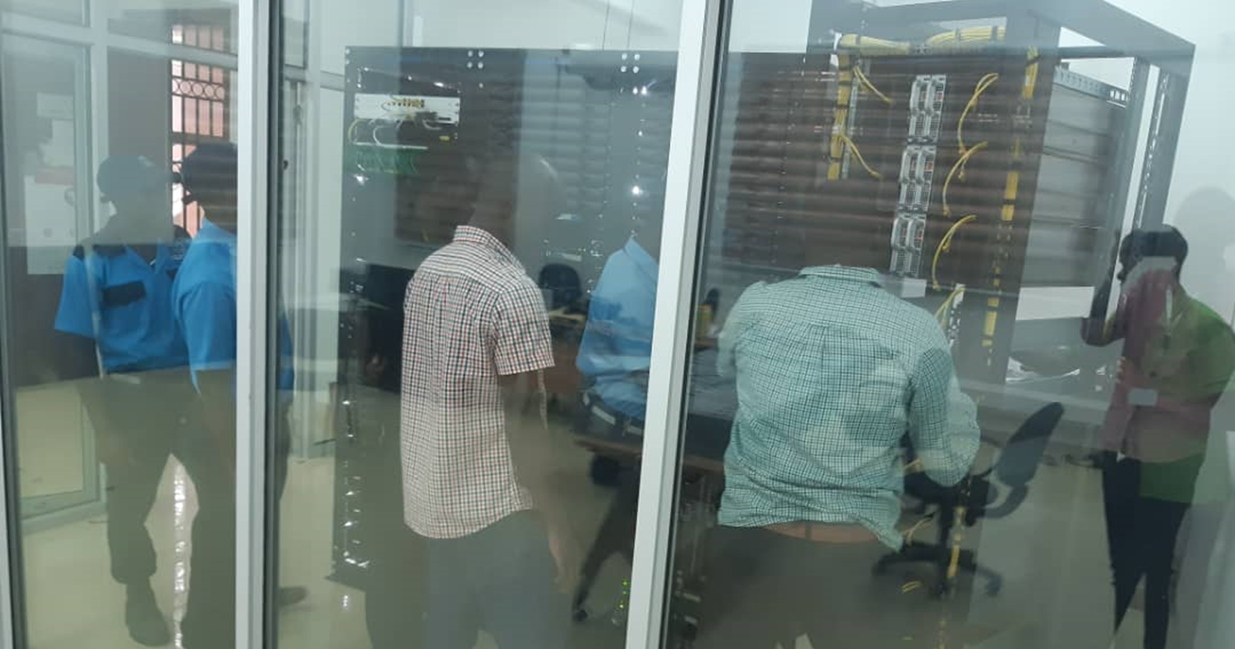
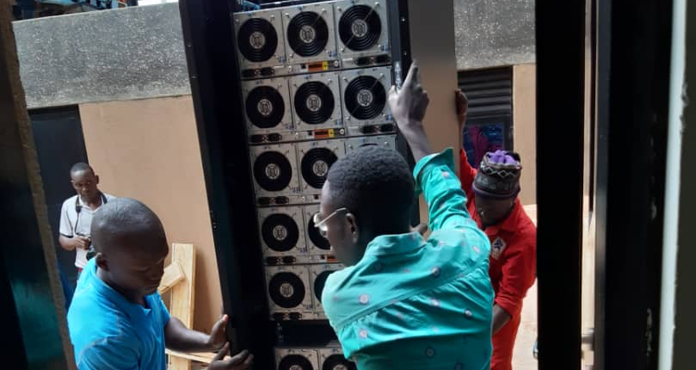
ACE-Uganda Compute Core
Notes:
320 Cores in 40 nodes from Stampede cluster – was used in the LIGO discovery of gravitational waves, study of mantle convection, and simulations of P53 protein; delivered over 3 billion core hours and had 10,000s users
Was most powerful and significant systems in the NSF XSEDE ecosystem
Power issues!

Slide 6
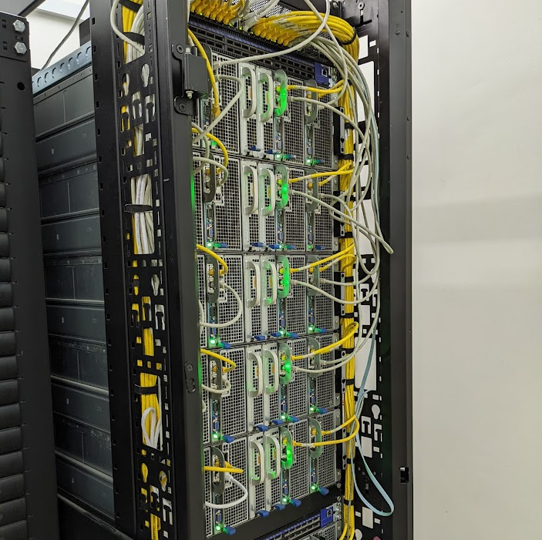
One Rack of Stampede Servers from the TACC
Retired to Sunny Uganda from Austin, Texas
40 8-core Xeon E5-2680 servers per rack
~12 kilowatts of power
~40,000 BTUs per hour

Slide 7
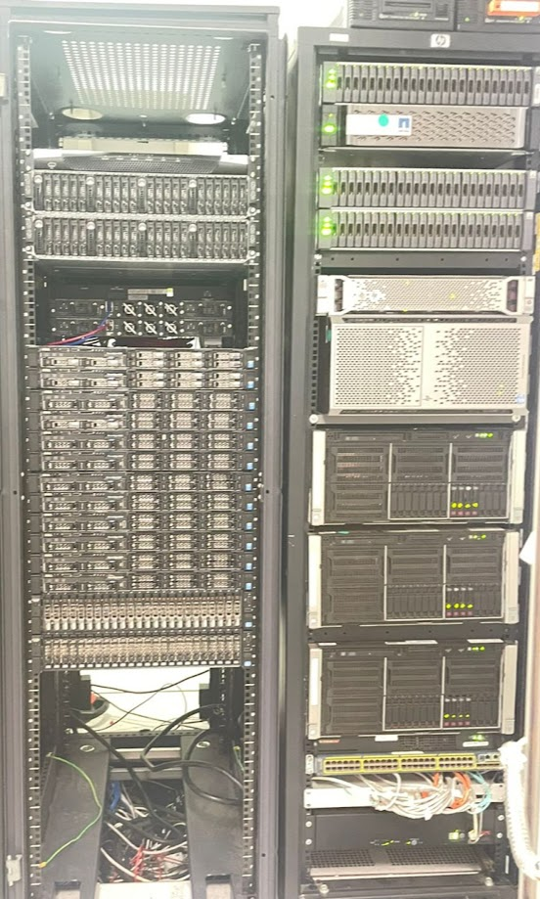
ACE Mali Cluster
Combination of Proxmox for virtual machines and HPC for analysis
20 Server Nodes
HPC - 696 total cores - 2028 GB RAM total
Synology Storage Array - 150 TB
Vmware platform: elwazi Gen3 platform funded by the NIH Data Science in Africa grants

Slide 8

Collaboration
Are you sharing data with a dog or a scientist?

Slide 9
All ICERs -
Built authentication infrastructure
Established identity assurance
Multi-factor authentication
Providing those to the federations
Encouraged building of Federation in Uganda
Encouraged building eduroam at the centers
Encouraged use of the R&S Profile in India

Slide 10
Objective of the NDCP (NIAID VRO)
Researchers need access to research protocol documentation, clinical information systems, outbreak monitoring tools, and more.
External user accounts were extremely difficult to support, particularly in an international operational context (e.g., identity proofing, password resets).
Key insights: Transition to campus identities, where local IT resources are already in place to handle credentialing and authenticator support. Decorate campus IDs with authorization data for use by multiple scientific applications.
Notes:
The primary objective is to give scientists and clinicians access to all the different tools they use to conduct disease research. Workflow automation, document management, data transport, metadata-driven EDC, clinical and translational research databases, specimen management, outbreak monitoring, and cloud computing resources. There's a lot that goes into disease research and outbreak response! Of key importance is not just the outbreak monitoring tools but also our researchers' ability to monitor trials for serious adverse events because a very important part of our job is to protect the human participants of our research studies.
Previously, our customer had external user accounts mixed into their existing directory service, and this was very difficult to support because all of these external user accounts were not just remote. They were overseas. And support in that context is very difficult especially around basic stuff like identity proofing and password resets. So the key insight we had was to transition to campus identities. Local IT resources were already there. Someone was already there to get folks credentialed, get authenticators up and supports. So use those instead of duplicating the effort.

Slide 11
Recent Accomplishments
Dynamic MFA
Implemented RAF 1.0 identity proofing at NIAID ICERs in Uganda, Mali
Assisted RAF 2.0 development—international ID proofing framework
https://refeds.org/assurance
Expanded collaborative research services—
  Study data visualization (Tableau)
  Specimen management (FreezerPro, Freezerworks)
  Environmental monitoring (DicksonOne)
  ORCID iD integration
Notes:
Dynamic MFA—Dynamically determine whether to implement step-up MFA on a per-identity basis using free/libre/open source software
RAF 1.0 at Mali and Uganda—able to use existing identity proofing process to identity user community's accounts into three levels of identity proofing (IAP Low, Medium, or High), and implemented step-up identity proofing procedures for users needing higher IAPs in order to prep for NIH eventuality of requiring RAF IAPs.
RAF 2.0—Our team participated in the RAF 2.0 working group in order to provide single set of criteria defining the IAPs low, moderate, and high; avoid need for the CSP to refer to one of several external standards; Reduce ambiguity for RPs’ understanding of what each IAP claim actually means. RAF 2.0 is now published and available.

Slide 12
Challenges
Provision scientists quickly as part of pandemic response.
Handle variations in campus IAM standards and practices.
Enroll users in MFA when not supported by campus IT.
Integrate systems from a wide variety of vendors.
Building Trust at the top of the organization
    Mapping international standards to the local regulations and bureaucracy
Notes:
We continue to work around variations in how campus identity and access management systems operate or service providers process authentication and authorization data. They are all different. Sometimes the variations are slight, sometimes they're significant, but everyone implements identity federation standards differently, and we had to work around those variations. A concrete example of a challenge like that is not everybody implements multi-factor authentication today, or if they do, they don't signal it correctly. We developed a way to dynamically decide whether we would use the MFA signal from the campus IAM system or enroll users in our own MFA. Another example is that web applications rarely, if ever, implement user provisioning standards like SCIM or group/role data claims like eduMember. Today, we provision access manually for many applications, which impacts research collaboration scalability as additional services and new studies come online.
It's really hard for IdP or SP operators who wish to interoperate with the global R&E community to know when they got it right. Current good federation practice involves an overwhelming variety of expectations, standards, entity categories, frameworks, profiles, and more. There exists no single, comprehensive resource for operational guidance and integration testing. What documentation or test resources exist are difficult to find even for experienced IAM professionals, are typically restricted to federation members, and are focused almost exclusively on IdPs. And while the decentralized nature of R&E federation allows it to scale far beyond current commercial offerings, that same decentralization makes enacting meaningful change to IdP, SP, or federation operations seemingly impossible.

Slide 13
Next Steps
Rebranding after pilot
Begin accepting subject ID/pairwise ID and RAF 2.0 IAP High
Migrate select SPs from SAML to OIDC
Develop automated validation for the NDCP and integrated research applications
Install and operate open-on demand for HPC at the centers in Mali and Uganda
Notes:
Subject ID makes stronger uniqueness and non-reassignment claims than eduPerson Principal Name.
Pairwise ID has more consistent matching rules than eduPerson Targeted ID.

Slide 14
Building the community requires constant investment
RAF Working Group
Baseline Expectations 1 & 2
CTAB
TAC
FIM4R

Slide 15





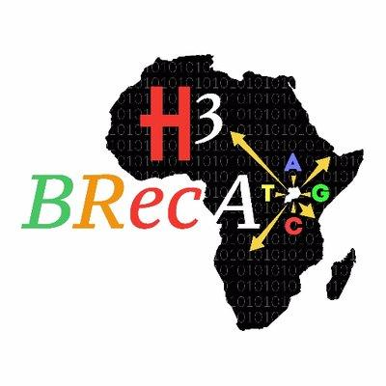























Acknowledgements
Makerere University

