Slide 1


SRF beyond Niobium: Thinner is better
How multilayer might break through the barrier
Marc Wenskat - on behalf of the SRF R&D Team

Slide 2

Let’s look beyond Niobium?

Slide 3
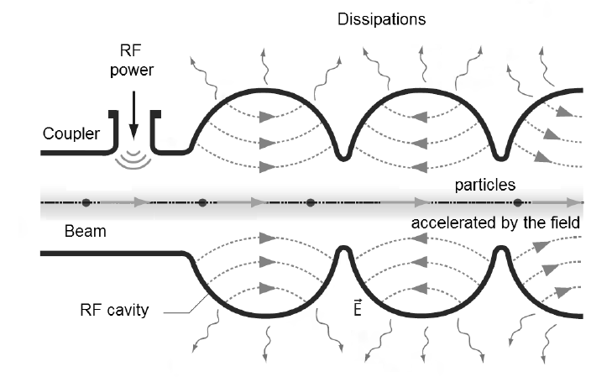
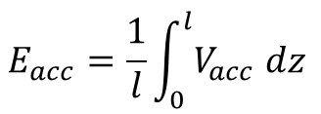

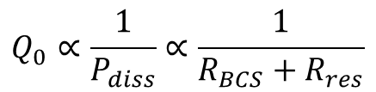
Leave no one behind
$$E_{acc}=\frac{1}{l}\int_{0}^{l}{V_{acc} dz}$$
$$Q_{0}∝\frac{1}{P_{diss}}∝\frac{1}{R_{BCS}+R_{res}}$$
Quality factor Q₀ as figure of merit for the loss
Non-vanishing RF resistance
R_{BCS} ~ 8 nΩ at 2K and 1.3 GHz, Nb
R_{res} ~ 4-6 nΩ
→ Q_{0,max} ~ 1 x 10¹¹
critical magnetic field H_{c,1}: 180 mT → phase transition
→ E_{acc,max} = 42 MV/m

Slide 4
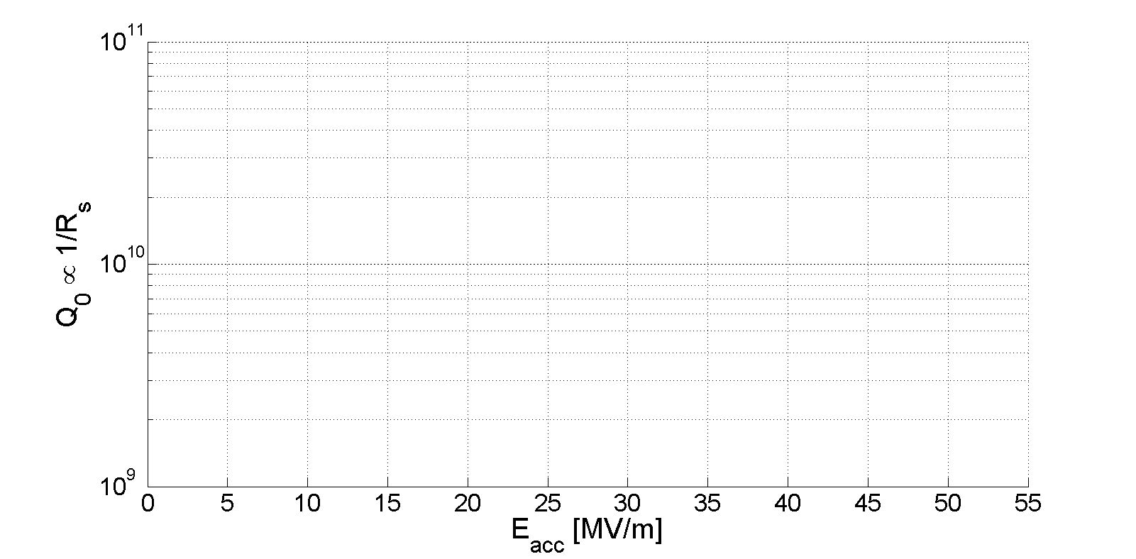
The real world
Theory
Standard Cavity
Doped Cavity
Infused Cavity
Mid-T Bake
SIS Coating
?
LCLS-II CW
EXFEL Spec
Q₀ and E_{acc} (seperately) approach the thermodynamic limit of Nb
→ We need to look beyond
@2K
[Reschke et al., Phys. Rev. Accel. Beams, 20, 042004 (2017)]
[Grassellino et al., SUST, 26, 102001 (2013) ]
[Grassellino et al., SUST, 30, 094004 (2017) ]
[Posen et al., Phys. Rev. Applied 13, 014024]
[Gurevich, APL, 88, 012511 (2006)]
Curves are exemplary representations
Cavities limited by quench

Slide 5
Why thinner should be better?

Slide 6
Why thin and not thick?
Take a cavity and coat it with a “higher” T_{c} superconductor
- Fewer rf losses & higher Q₀ compared to Nb at 2K since R_{BCS} ~ exp(-T_{c})
How do we increase E_{acc}?
Such superconductors usually have a lower H_{c,1} compared to Nb (although H_{sh} is higher)
H_{c,1}
H_{sh}
H / mT

Slide 7

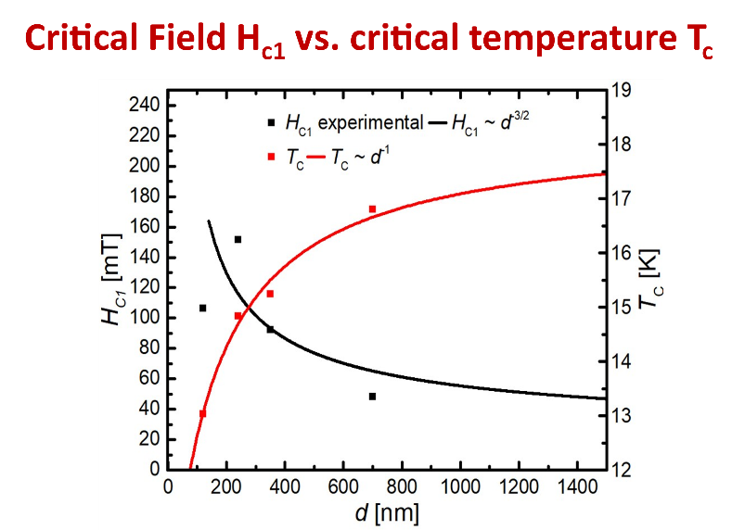
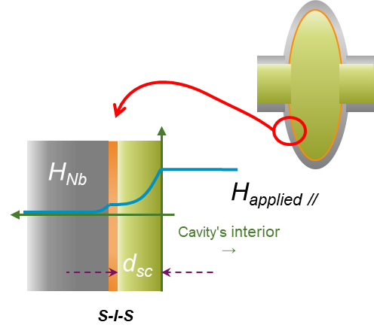
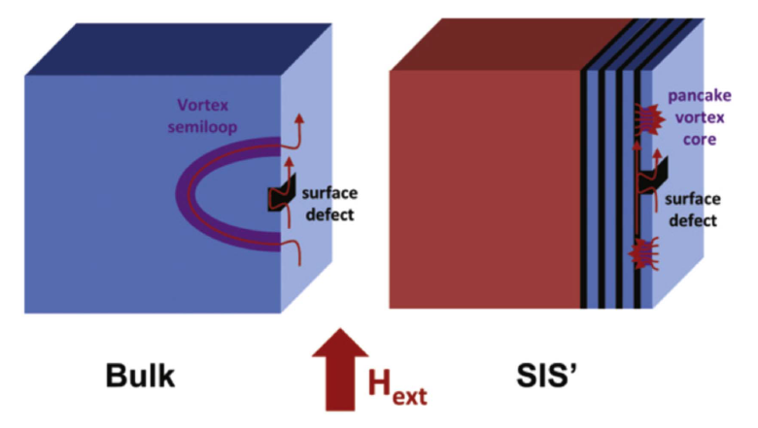
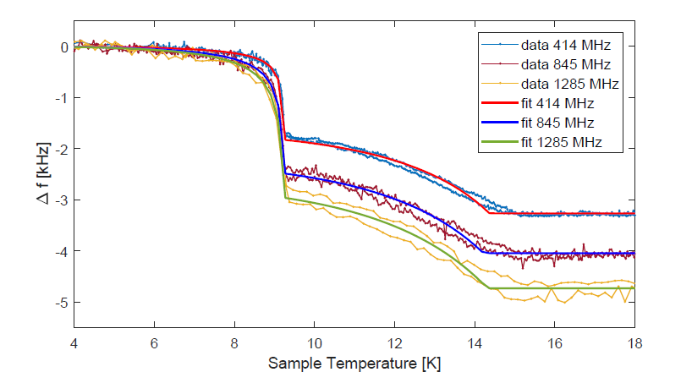
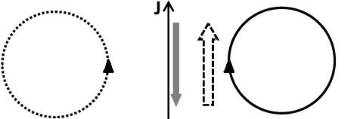
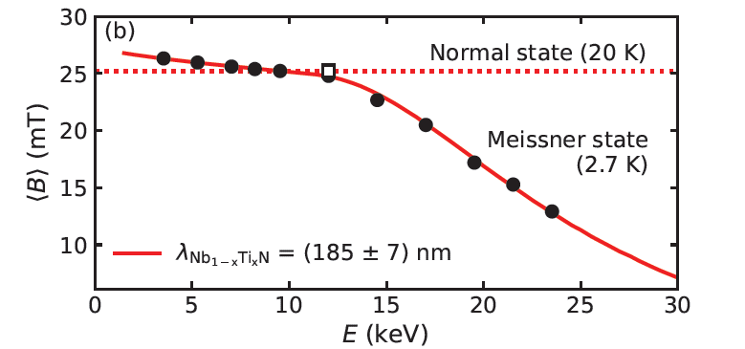
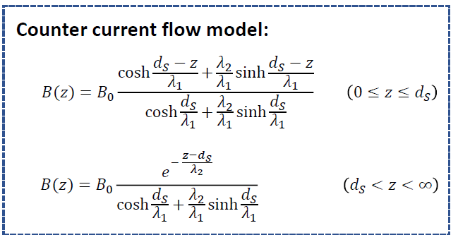

Taka finished what Alex started
Energetically suppressed vortices in thin films cause enhancement of “field of first flux entry” a.k.a. H_{c1}
Alex’ idea: Coat a cavity with a thin superconducting film with insulating layer, acting as vortex barrier
Controversy around effectiveness
Taka’s new argument: Bean-Livingston Barrier increase through “counter current”
$$µ_{0}H_{c1}= \frac{2ϕ_{0}}{πd^{2}}ln\frac{d}{ξ}$$
[G. Stejic et al., PRB 49.2 (1994)]
Co-Autor: Gurevich
[A. Gurevich, APL 88 (2006)]
[D. Liarte, SUST 30 (2017) 033002]
[T. Kubo, SUST 30 (2017)]
[N. Schäfer et al., J. Appl. Phys. 128, 133902 (2020)]
[Keckert, S. PhD Thesis, Siegen 2019]
[Asaduzzaman, arXiv: 2304.09360]
H_{c,1} of Nb₃Sn is 50mT

Slide 8
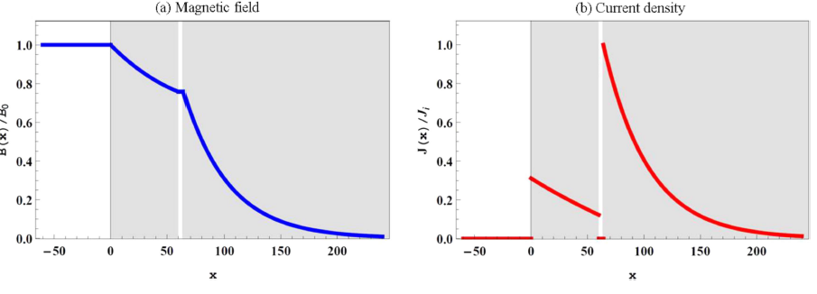
Summarizing the theory
Top superconductor should see majority of rf field → this way Q₀ improves most
Field should not decay completely in the top layer → layer should be thinner as λ_{L,Top}
Insulating layer creates more interfaces, prevents flux avalanches / free movement, pancake vortices
Taken from [T. Kubo, SUST 30 (2017)]
λ_{L}=185nm
λ_{L}=40nm

Slide 9
How to maximize the field enhancement?
[T. Kubo, SUST 30 (2017)]
Depends on H_{c,1} and λ_{L} of both SC and “defectiveness” η
  Assume NbTiN – I – Nb
    H_{c,1} Nb 180 mT
    H_{c,1} NbTiN 213 mT
    For η = 1
  Isolator 15nm, NbTiN 100nm
  → H_{ffp} = 270mT oder 63 MV/m
    For η = 0.7
  Isolator 10nm, NbTiN 60nm,
  → H_{ffp} = 224mT oder 52 MV/m

Slide 10
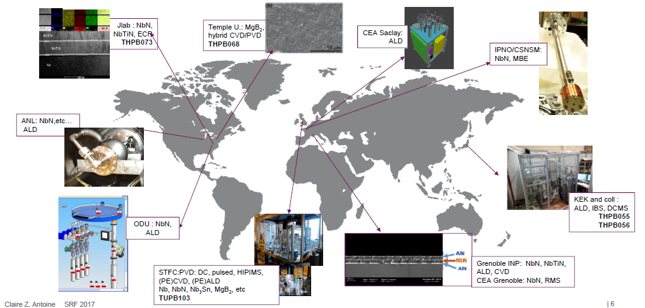
Who is coating SIS?
Surely I‘m missing someone!
Anne-Marie Valente-Feliciano
Method of choice: HiPIMS
First steps @ TJNAF 2011 (flat samples)
Thomas Proslier
Method of choice: ALD
First steps @ ANL 2009 (coated cavity w. Al₂O₃)
SIS-Network is now larger
INFN / HZB / CNRS / USI / UKRI / UVic / STFC / RTU / IEE / U Lancaster … + Theory

Slide 11
What are we doing?
(since 2019)

Slide 12
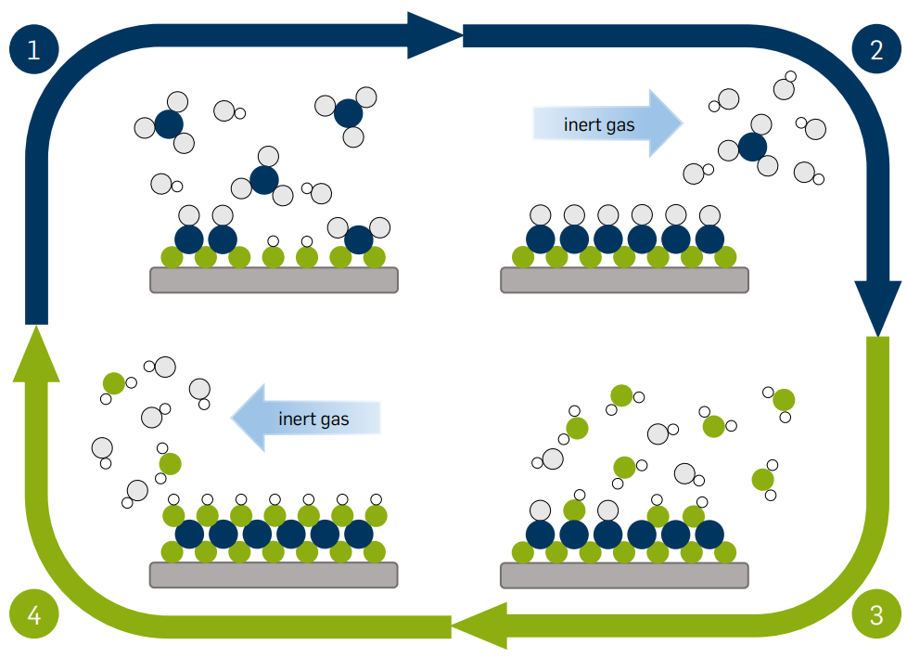
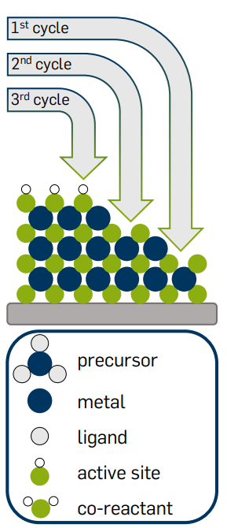
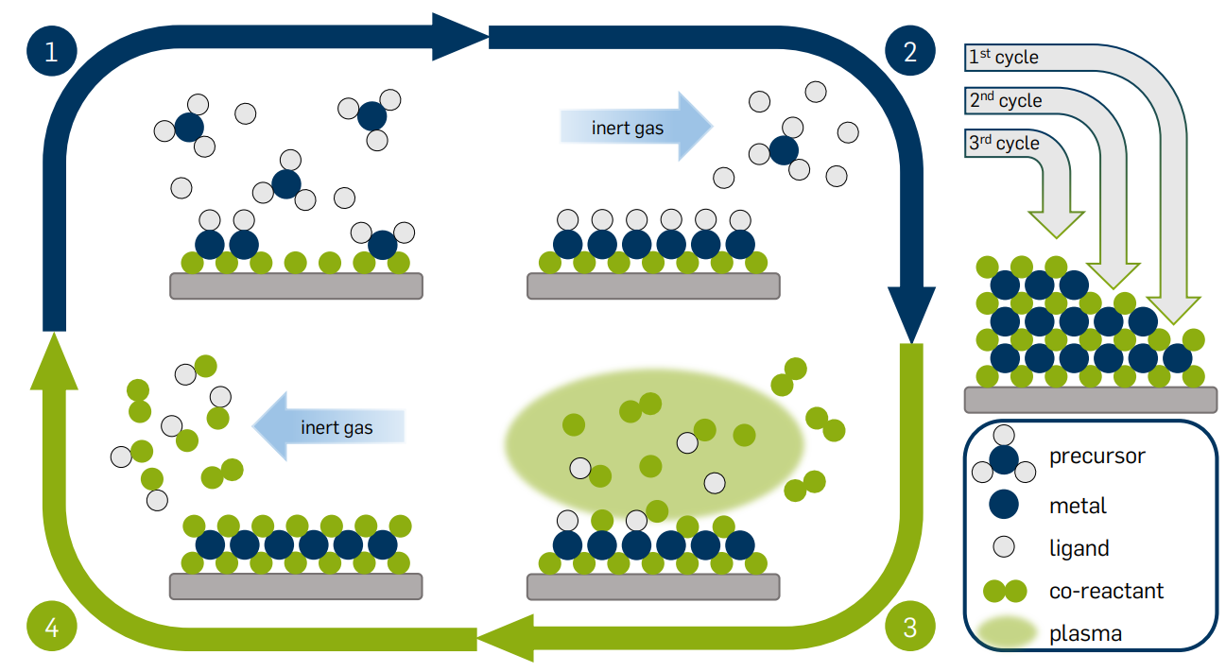
Method of choice: Atomic Layer Deposition
Material candidates for SIS
S: NbN, NbTiN
I: AlN, Al₂O₃
Deposition choice at UHH: Thermal ALD/PEALD
Thermal ALD
PEALD
Taken from: L. Mai, (2020), DOI:10.13154/294-7658.

Slide 13
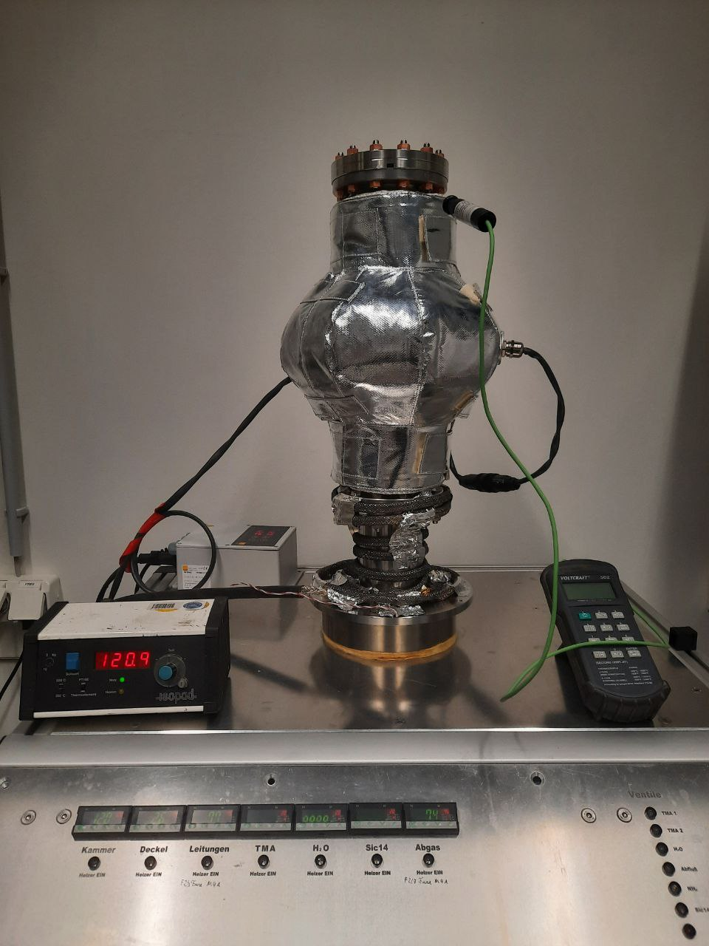
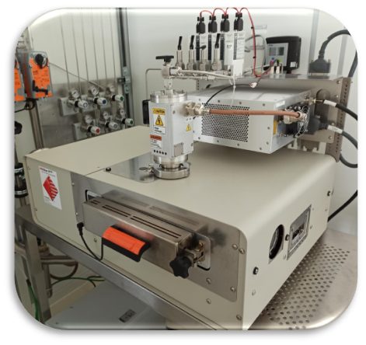
SIS multilayers (PE)-ALD investigation at UHH
Thermal ALD: Al₂O₃
PEALD: AlN, NbTiN, NbN
Thermal ALD: Al₂O₃
Capability for coating
single-cell cavities
Capability for coating
planar samples
Capability for coating
single-cell cavities

Slide 14
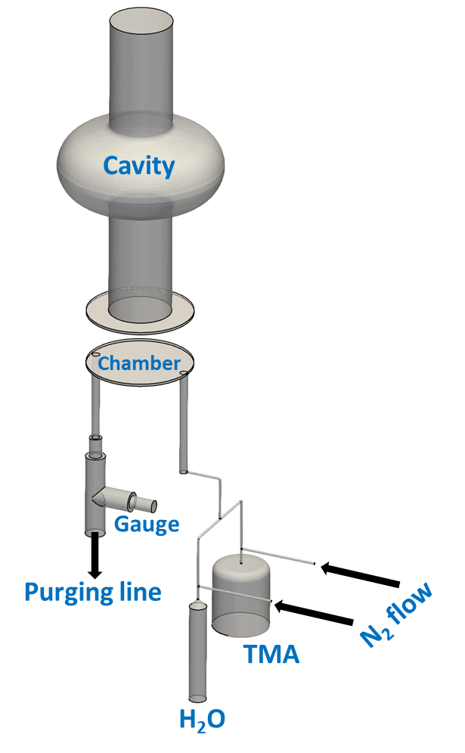
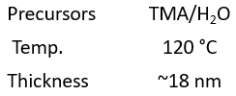
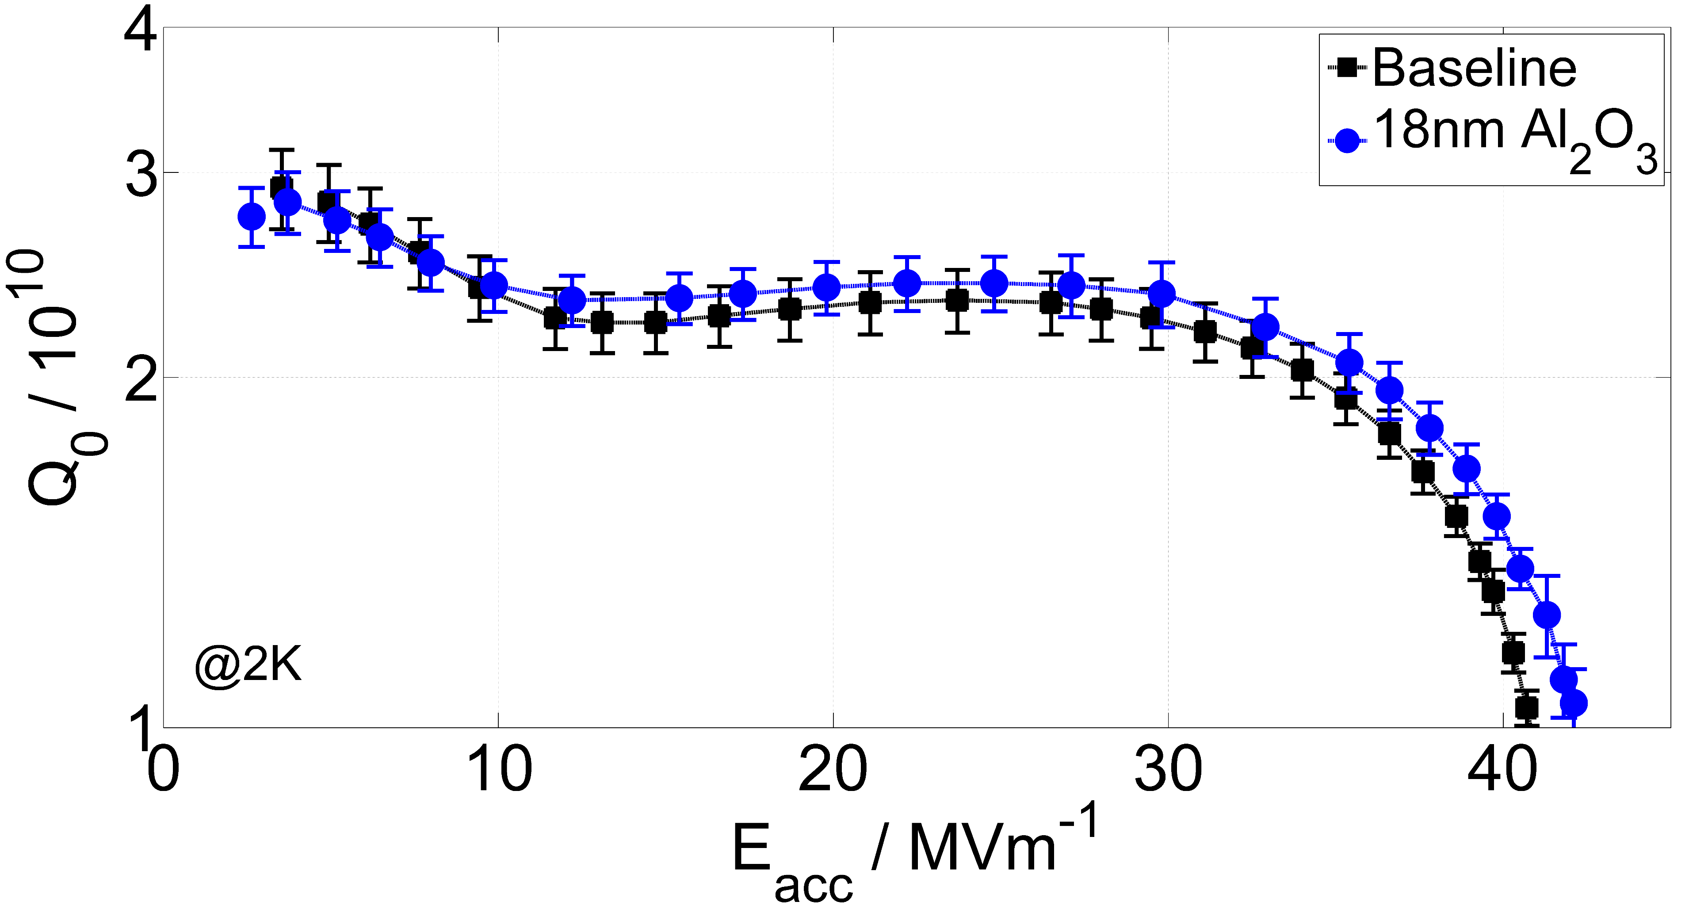
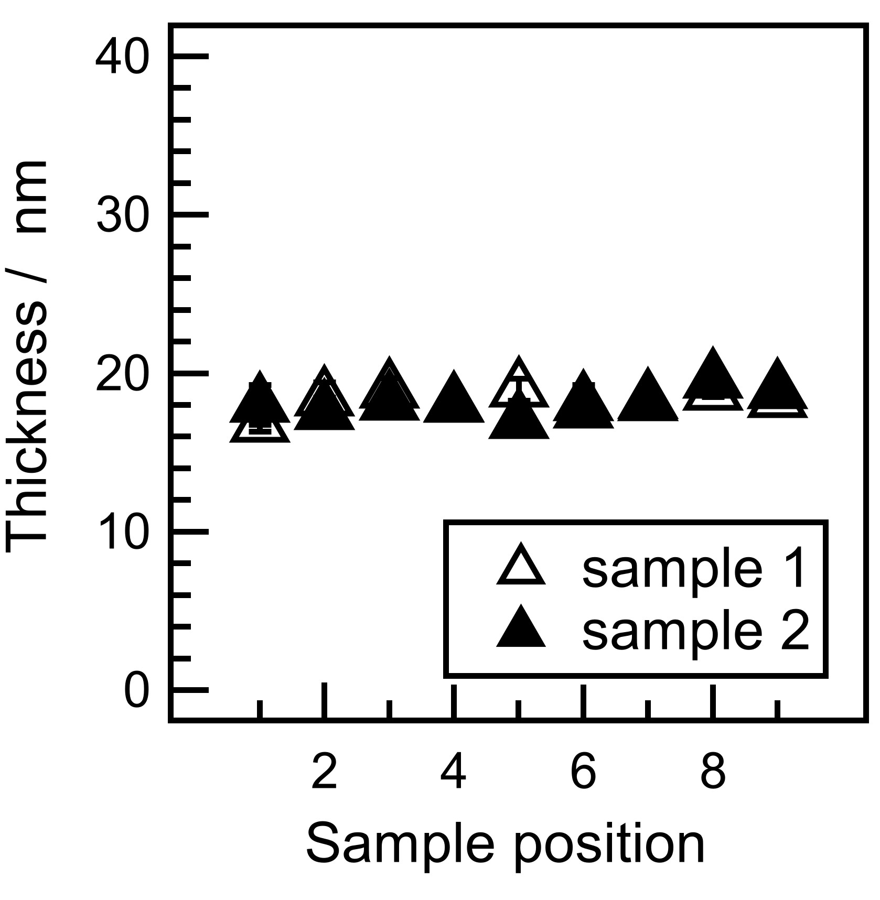
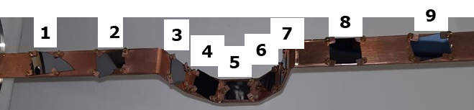
Successful Al₂O₃ coating of high-gradient cavities by thermal ALD
[M. Wenskat et al., 2023 SUST 36 01501]
Thermal ALD setup
Process optimization
Cavity performance
Successfully coated three cavities so far
„Oxide-layer manipulation“ studies as spin-off

Slide 15
SIS multilayers (PE)-ALD investigation at UHH
PEALD: AlN, NbTiN, NbN
Thermal ALD: Al₂O₃
PEALD: AlN, NbTiN, NbN
Capability for coating
planar samples
Capability for coating
single-cell cavities
Capability for coating
planar samples

Slide 16
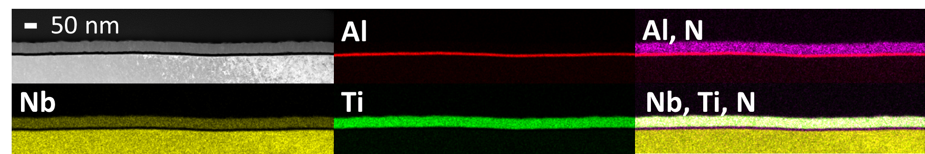
Tailored AlN-NbTiN multilayers on Nb and Si
[I. González Díaz-Palacio et al., Journal of Applied Physics 134(3), 035301 (2023)]
DEPOSITION PARAMETERS
Temperature: 250 °C
Plasma power: 300 W
Base pressure: 1E-1 mbar
Developed recipe leads to a T_{c} of 15.4 K on coated samples

Slide 17
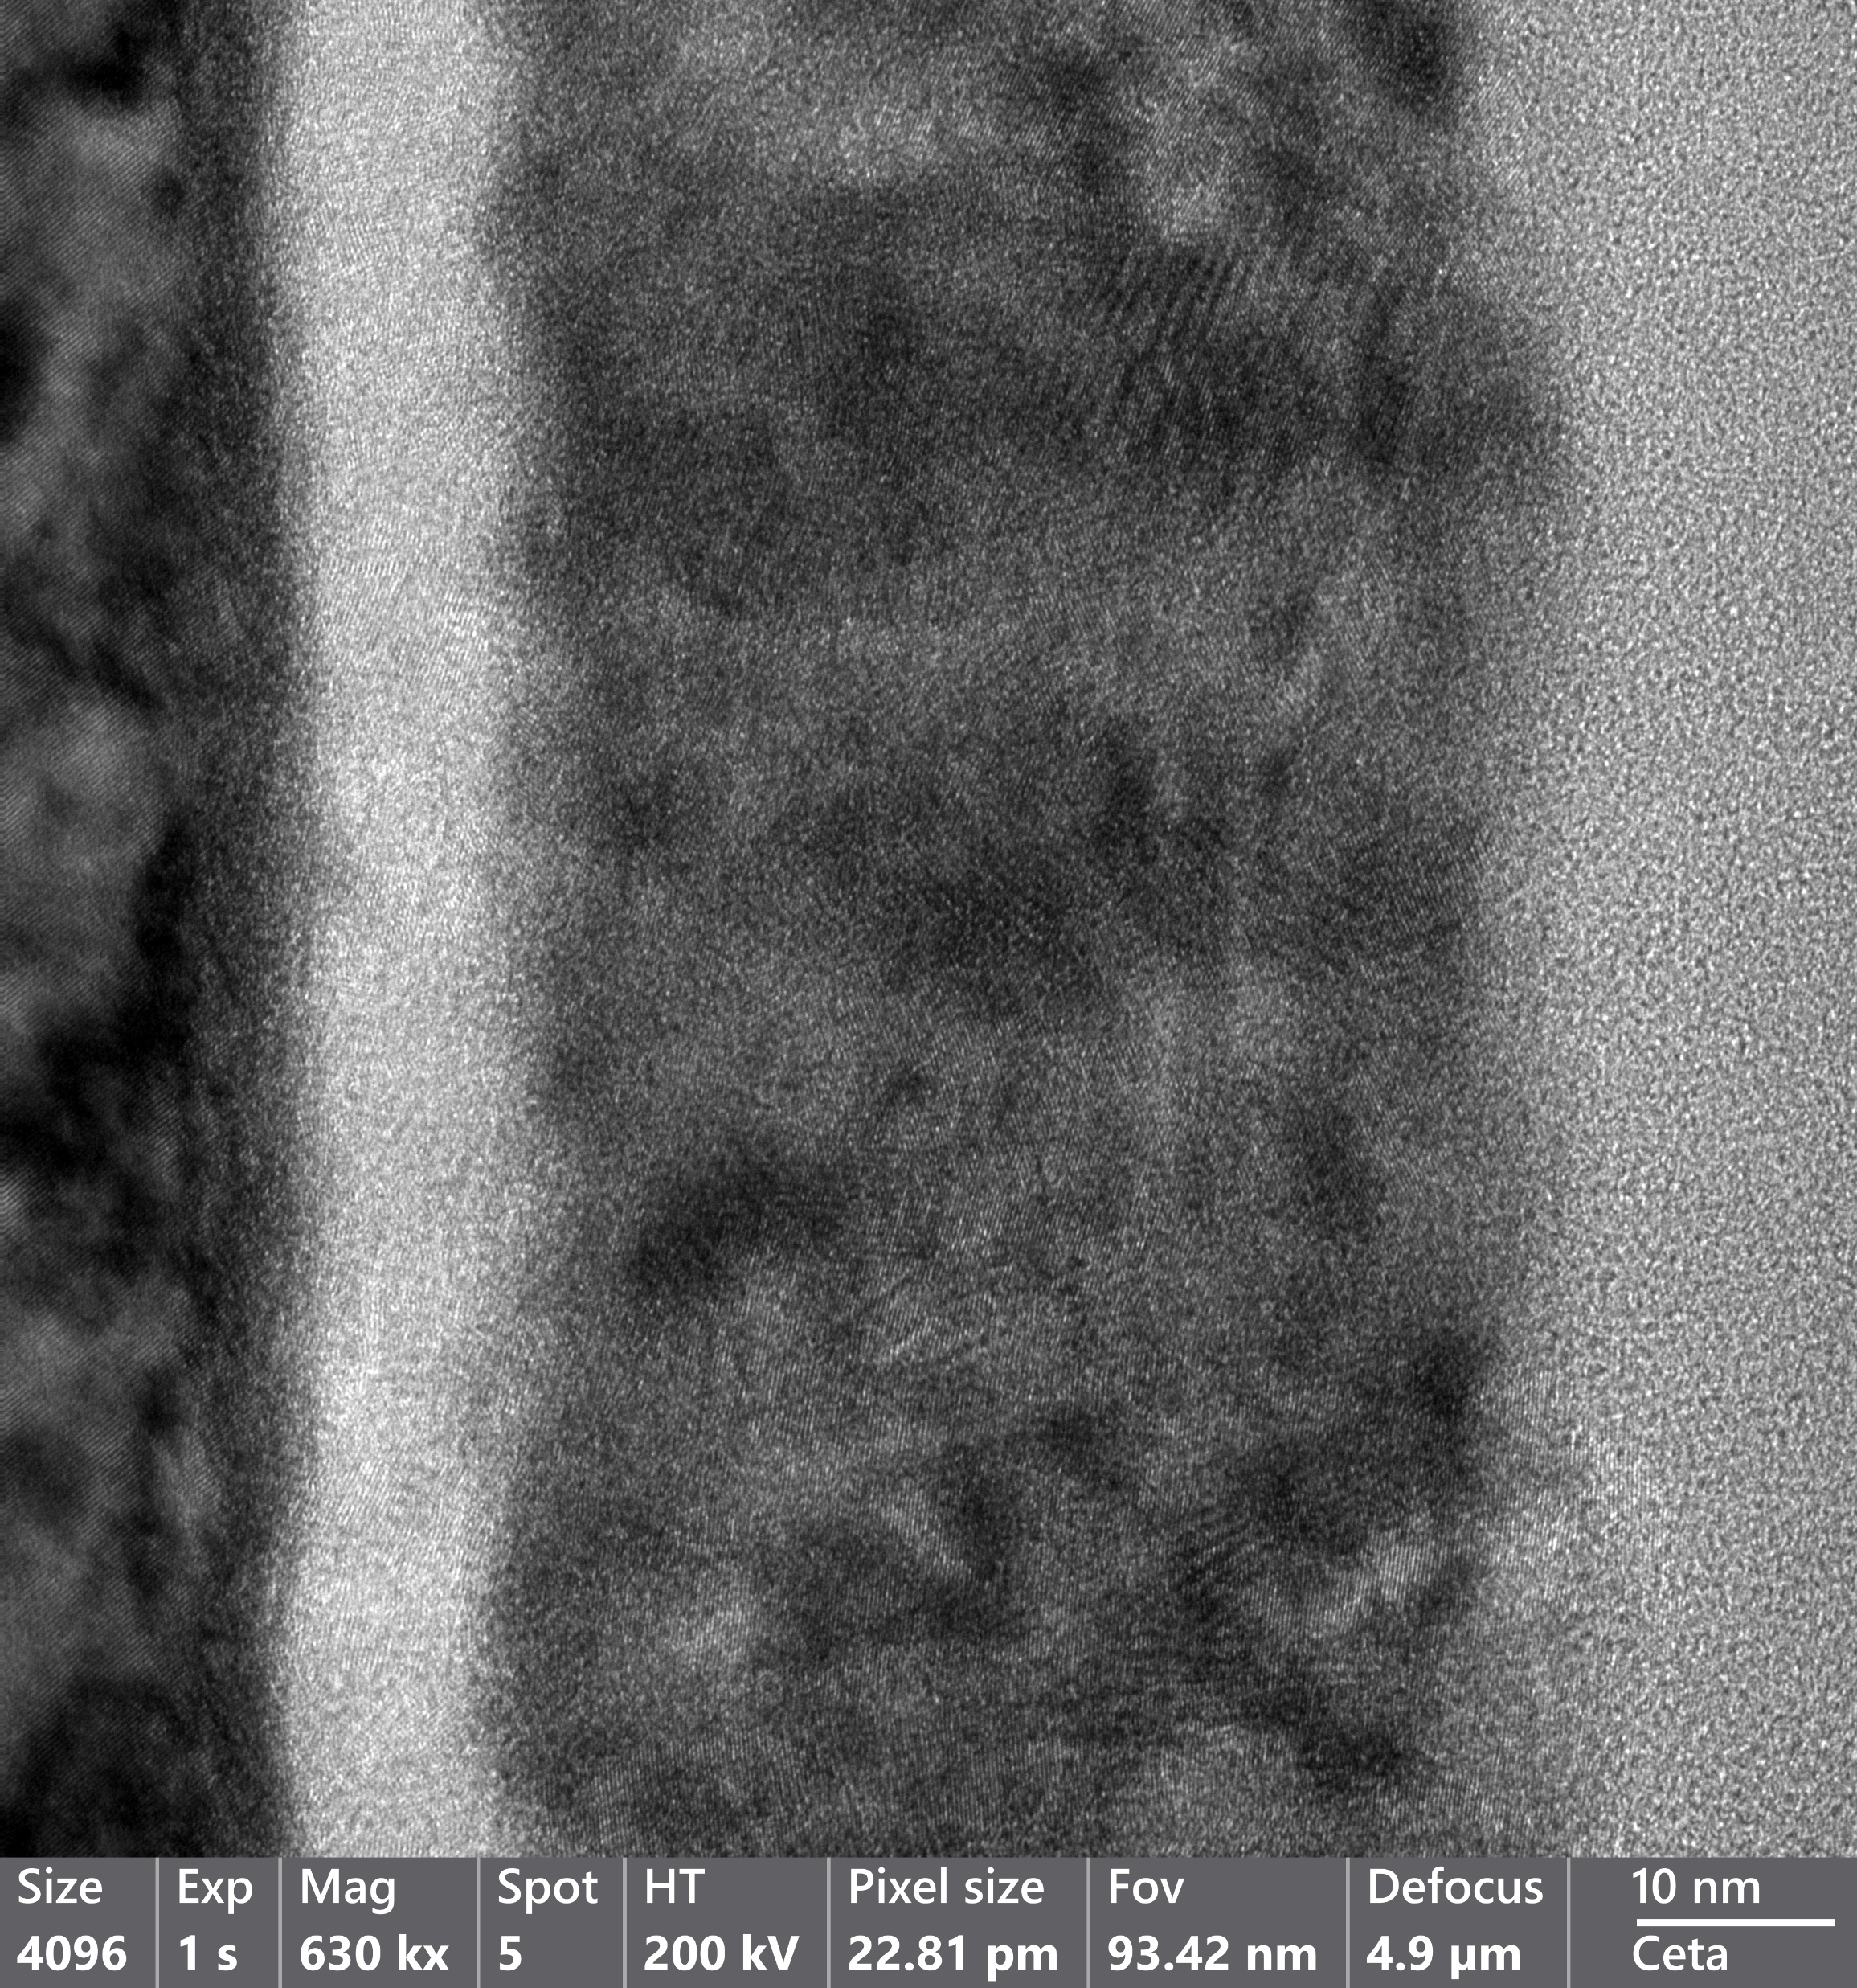
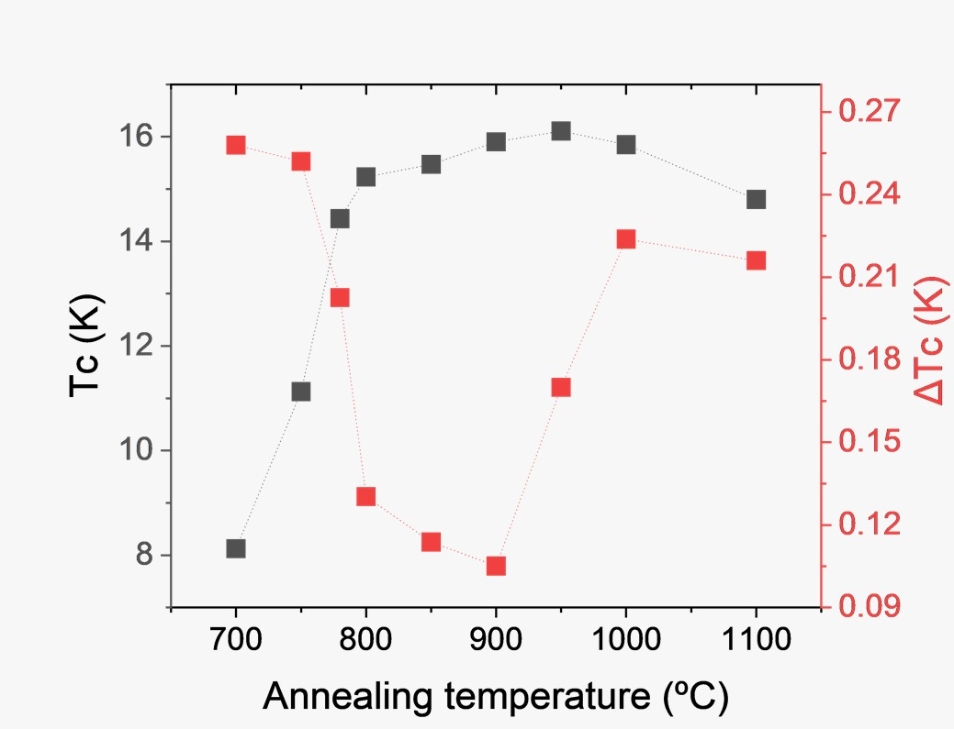
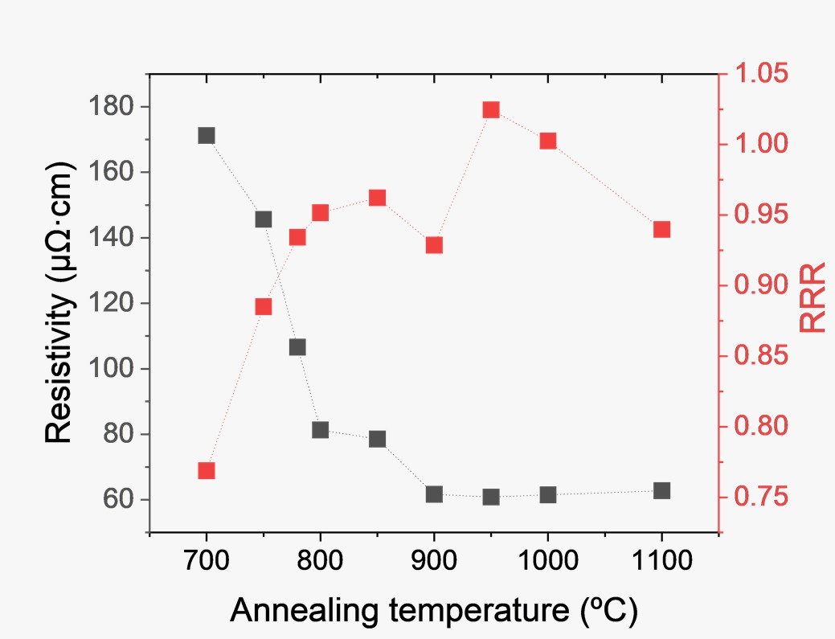
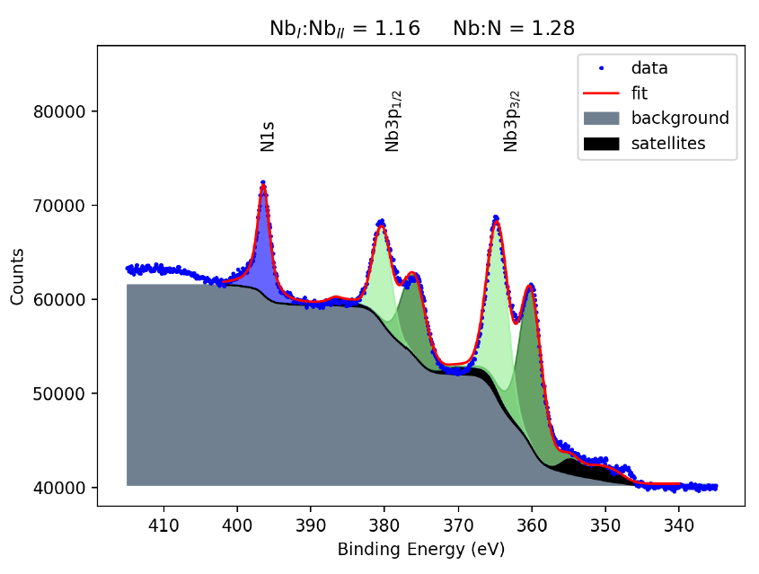
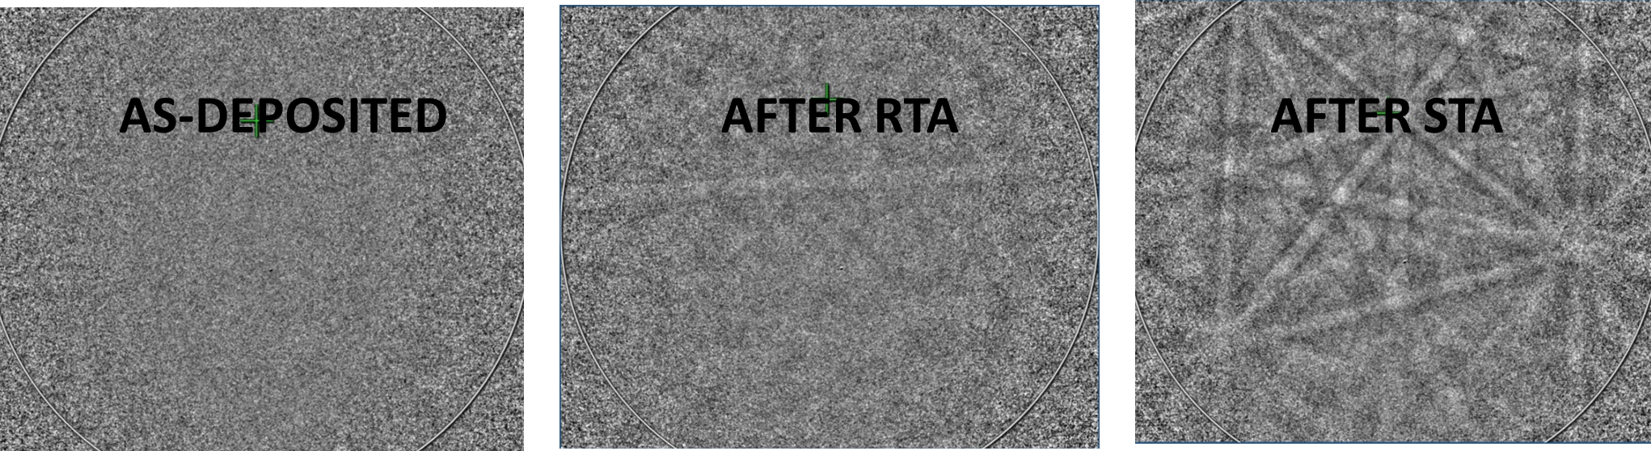
Annealing the layer improves T_{c} – but why?
10 nm
Identified optimal temperature on Si
Crystallinity improves – nanocrystalline / polymorphous at the beginning
XPS studies show significant changes during annealing
Current hypothesis: pollution by metallo-organic precursor is reduced
  Fits to literature results in better vacuum
  Fits to KEK studies
TEM

Slide 18
H_{c1} measurements
VSM measurements
  Filmthickness identical 75nm – on Si
  Magnetic dipolemoment m as function of B and T
H_{c1} of Bulk NbTiN on the order of 30mT (depends on stochiometry)
Significant increase of H_{c1} observed
Consistent with publications from ODU
  75nm NbTiN auf Nb
  DC „punchthrough“ measurement H ≈ 250mT
Best explanation: pancake effect since NbTiN on Si
[I. H. Senevirathne, SUSPB025, SRF2023]

Slide 19

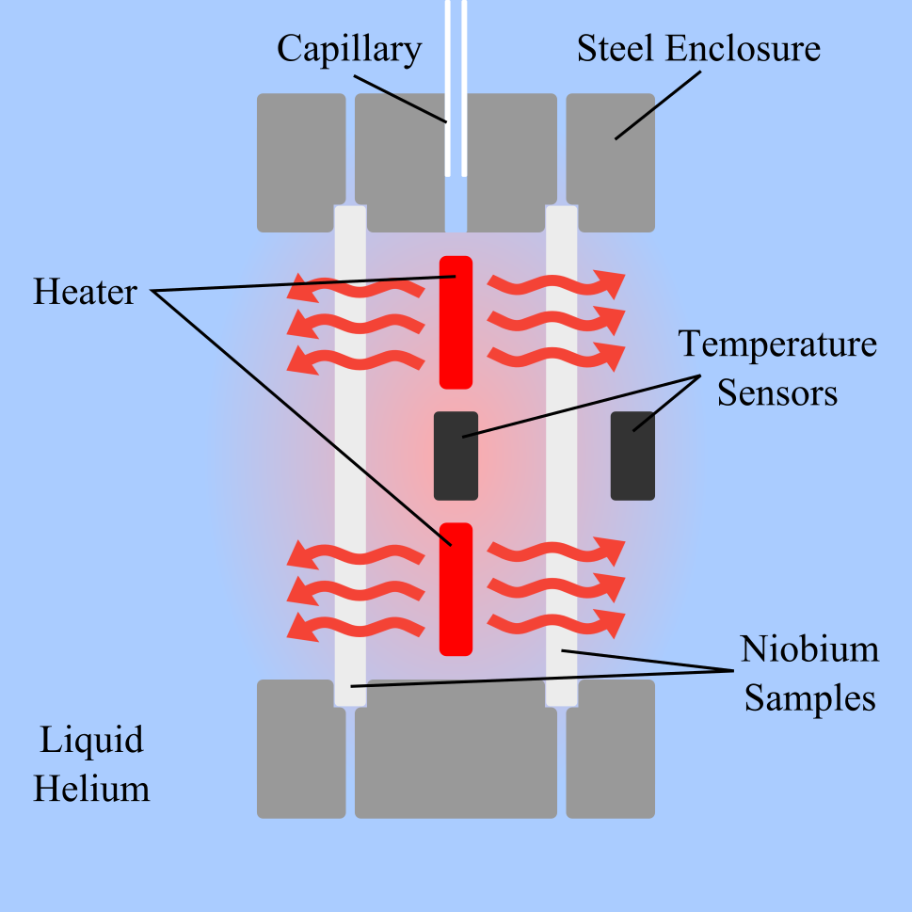
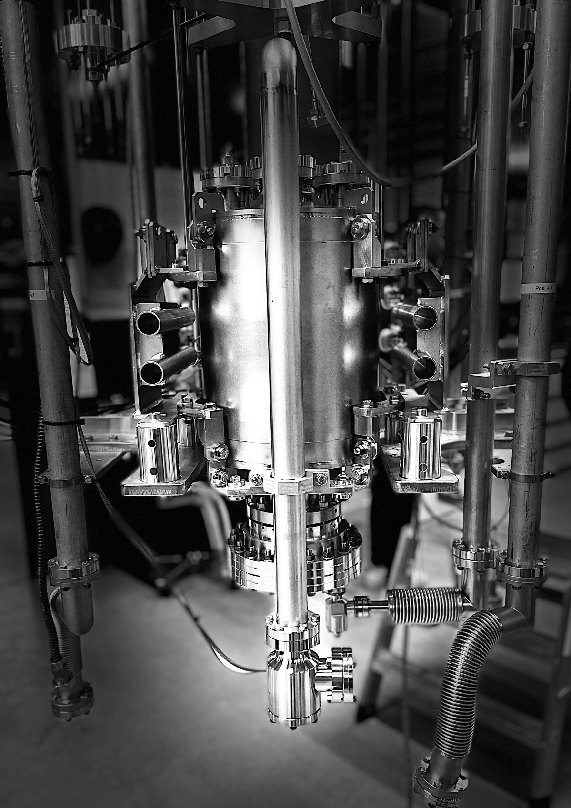
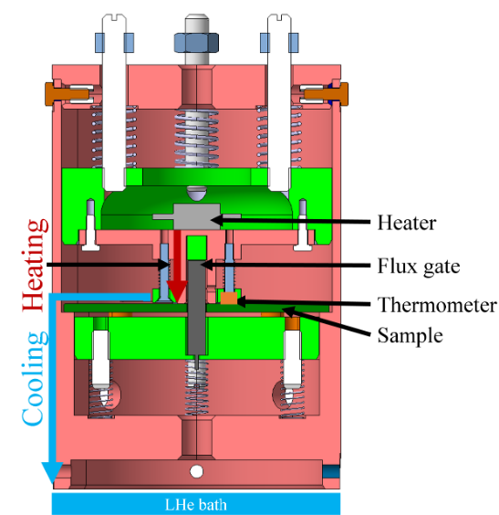
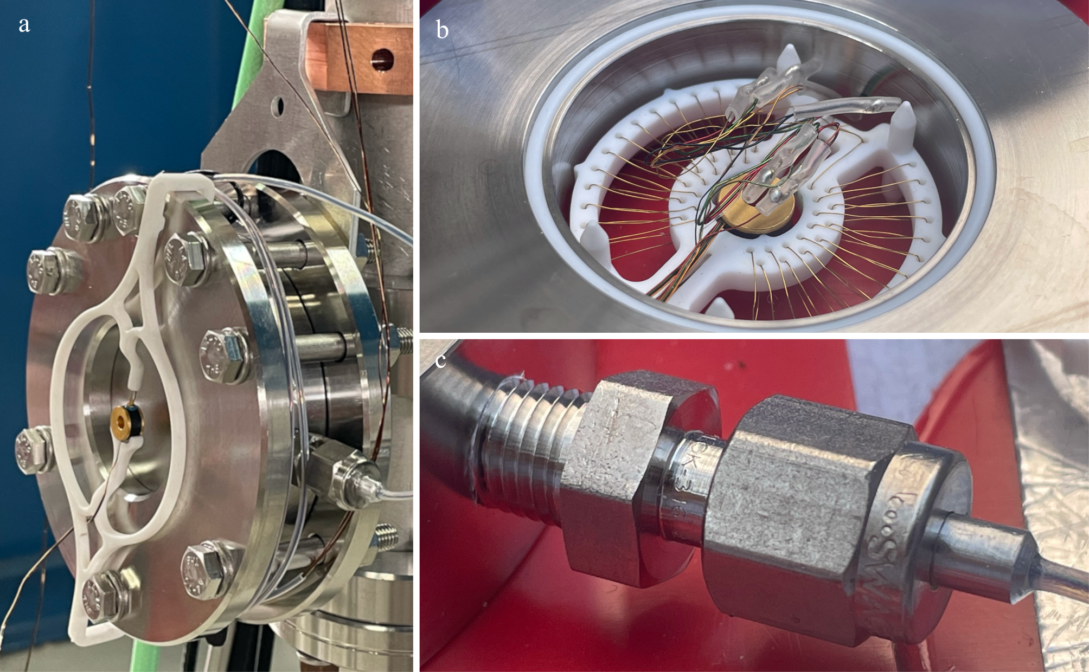
Related ongoing studies
Thermal conductivity studies at UHH/DESY
Commissioning of the UHH Quadrupole Resonator (QPR) at DESY
Flux expulsion studies at
CERN
forming a hollow cavity

Slide 20
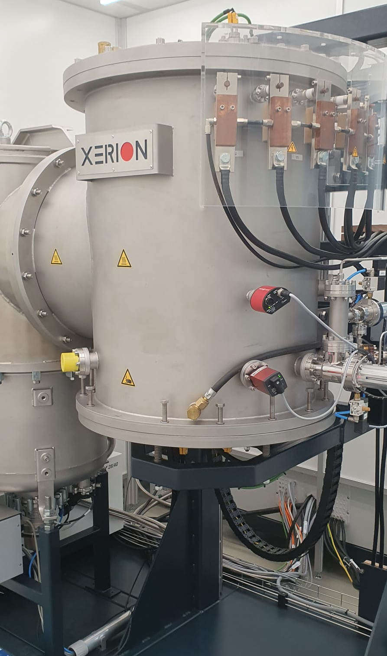
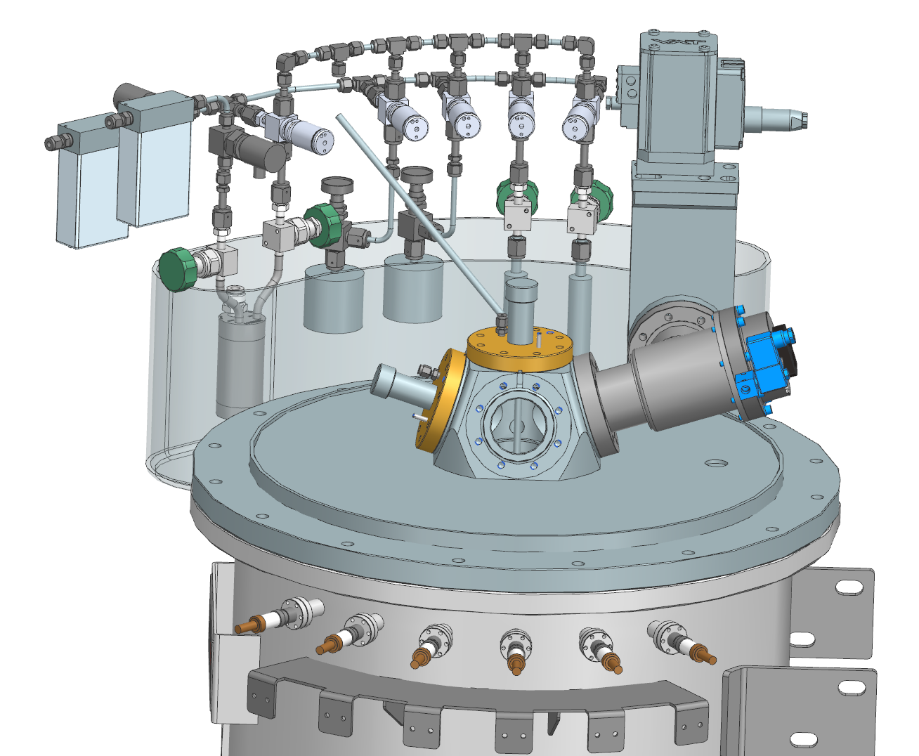
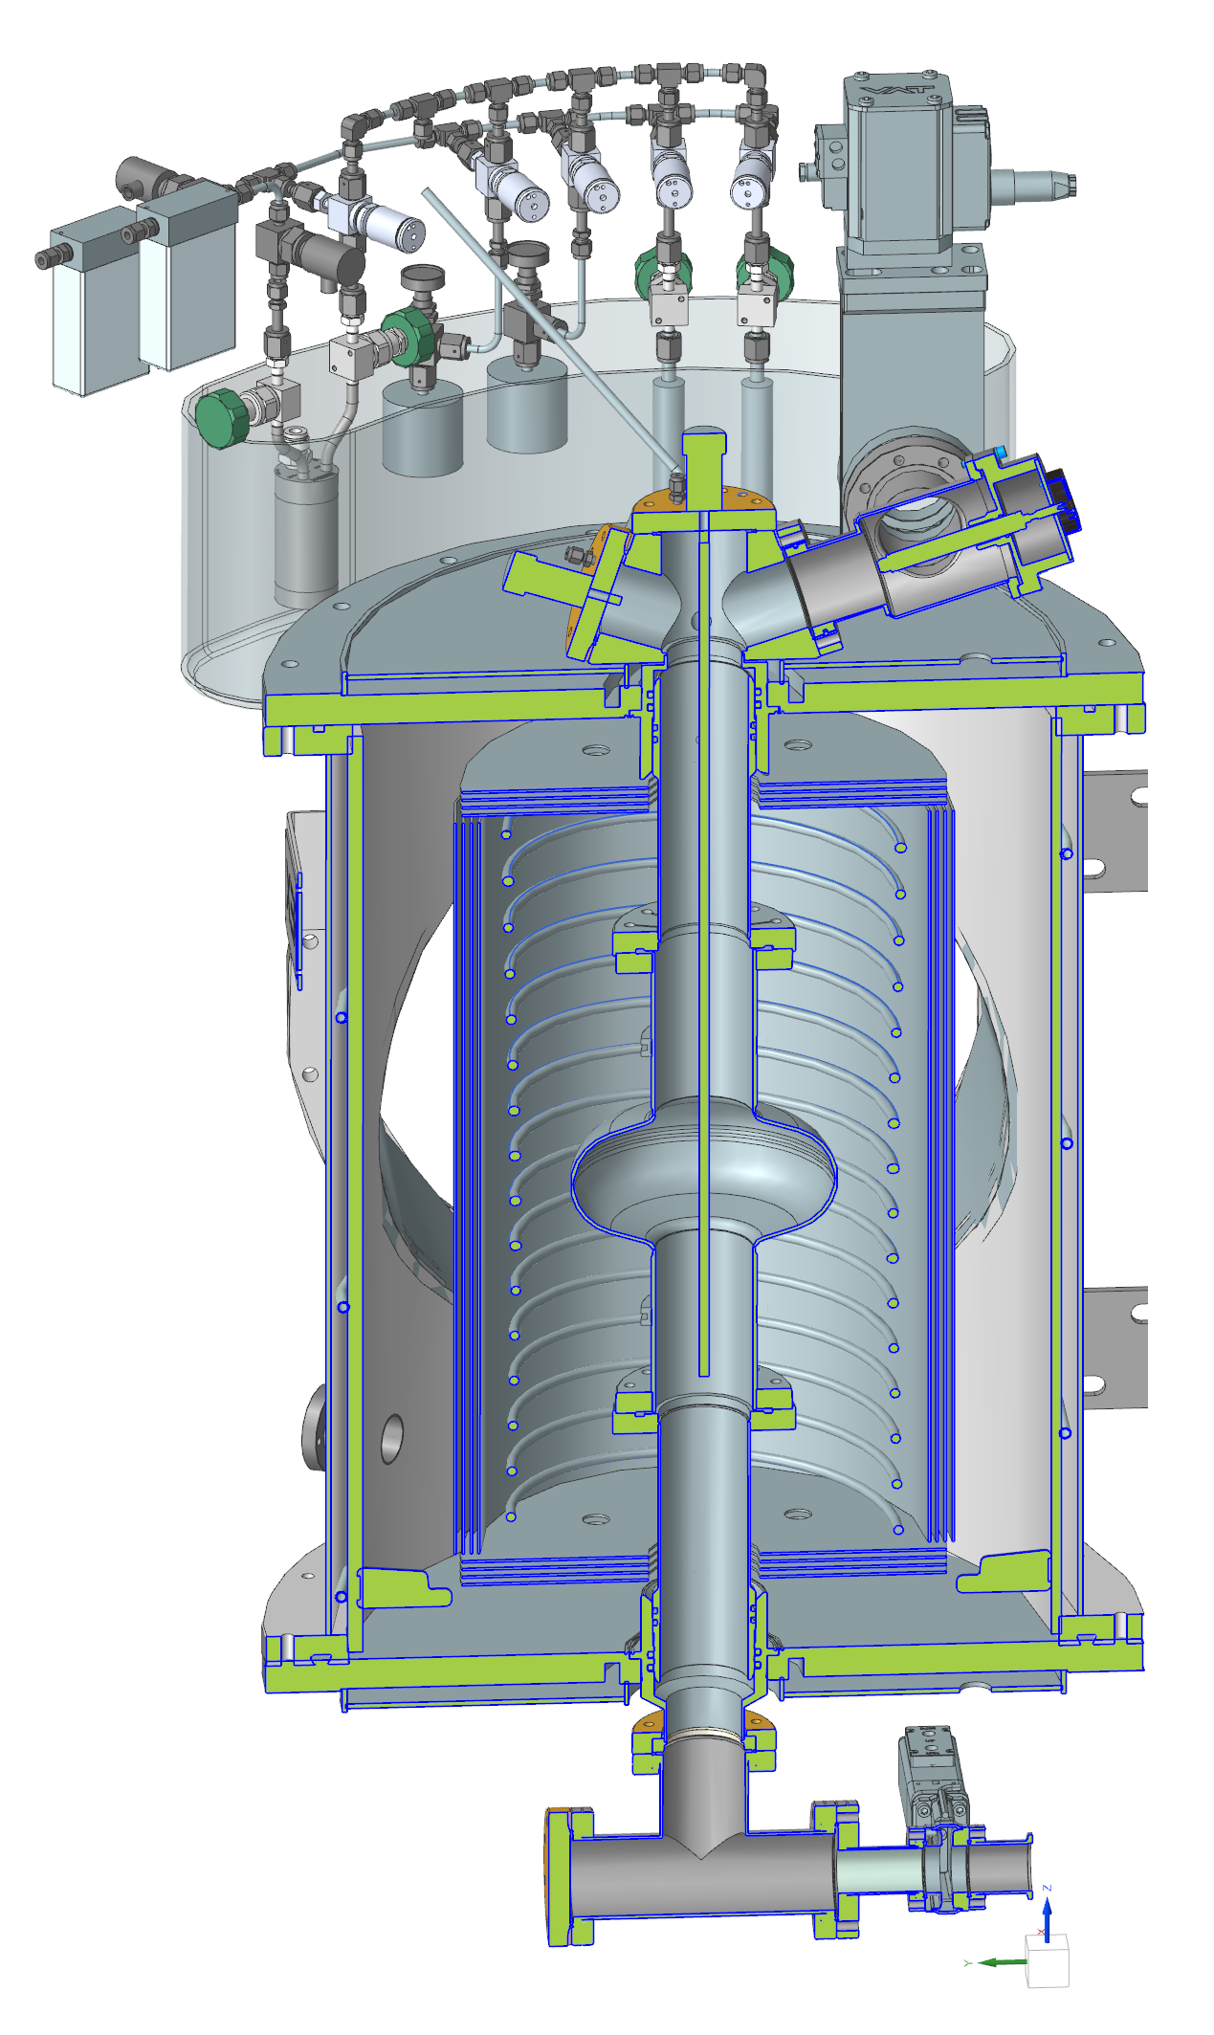
PEALD AlN-NbTiN cavity coating
EXTEND SINGLE-CELL FURNACE TO PEALD-SINGLE-CELL COATING SYSTEM
Upgraded system
High versatility in one system:
PEALD and thermal ALD
Capable depositing:
  NbTiN / NbN
  AlN
  Al₂O₃
In-situ annealing
  dissolve oxide layers before coating
  after coating
Status:
Design
Fabrication ongoing
Commissioning

Slide 21
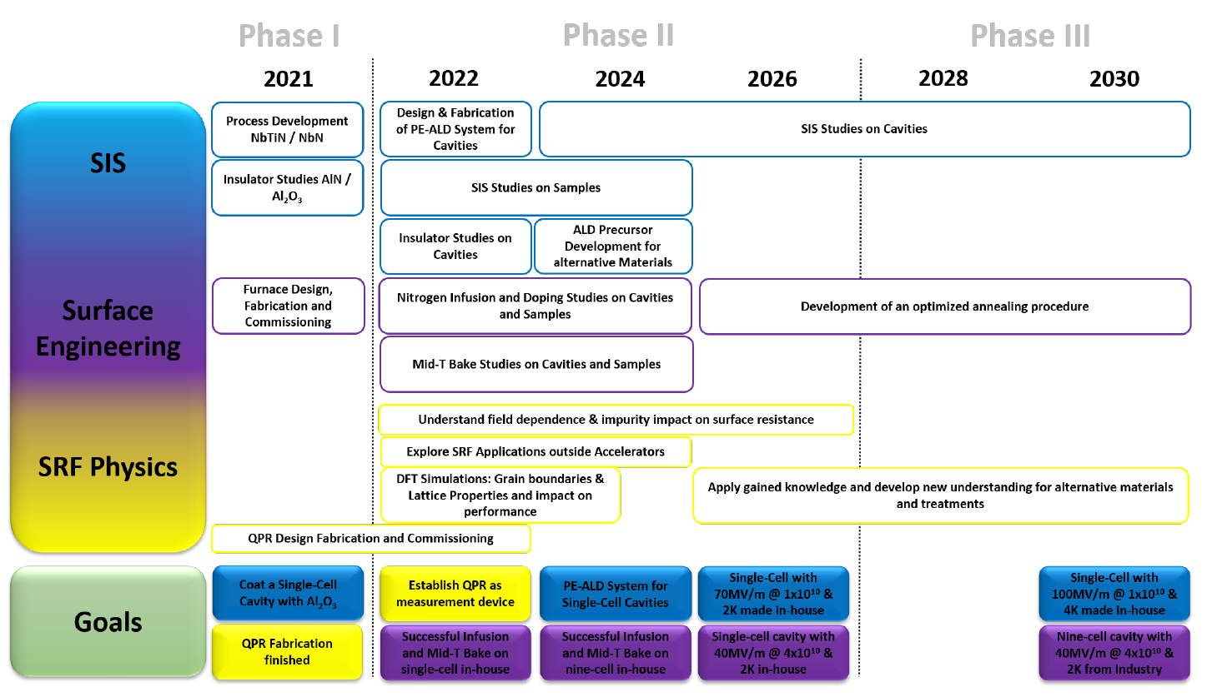
SRF R&D Roadmap of UHH
Now-ish

Slide 22
Summary
We have to start looking for alternatives beyond Nb…
… and SIS is one (awesome and fun) candidate
SIS / thin film community already large and keeps growing
UHH pushes deep into the topic and tries to catch up fast…
…already at eye-level on some points

Slide 23

Thank you
Thanks to
Robert Blick (UHH), Frederic Braun (U. Wuppertal), Maik Butterling (HZDR), Jakub Cizek (U Prague), Getnet Deyu (UHH), Alexey Ermakov (DESY), Jürgen Eschke (DESY), Erik Hirschmann (HZDR), Wolfgang Hillert (UHH), Arno Jeromin (DESY), Thomas Keller (UHH), Nicolay Krupka (DESY), Anton Lorf (UHH), Kay Jensch (DESY), Thomas Keller (DESY), Oskar Liedke (HZDR), Lutz Lilje (DESY), Dirk Lützenkirchen-Hecht (U. Wuppertal), Cornelius Martens (UHH), Giso Marquardt (DESY), Trupen Parik (DESY), Lea Preece (UHH), Detlef Reschke (DESY), Cem Saribal (UHH), Nils Schäfer (TUDA), Lea Steder (DESY), Andreas Stierle (DESY), Vedran Vonk (DESY), Birte van der Horst (DESY), Andreas Wagner (HZDR), Nick Walker (DESY), Hans Weise (DESY), Mateusz Wiencek (DESY), Artem Zaidman (UHH), Robert Zierold (UHH) and many more
Questions?

Slide 24
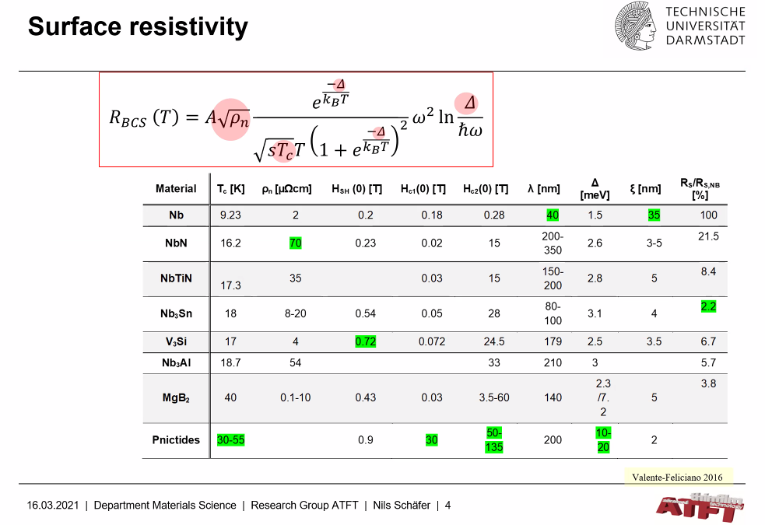

Slide 25
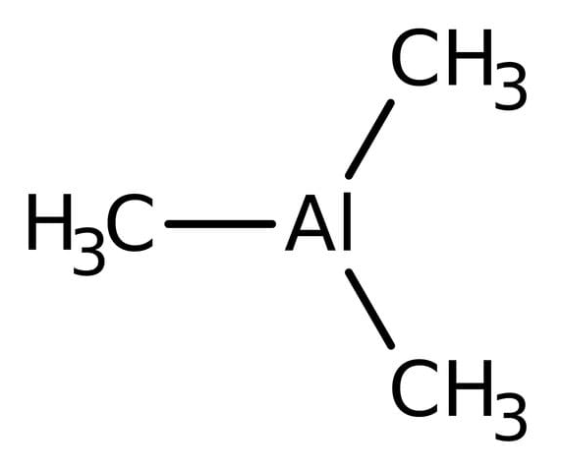
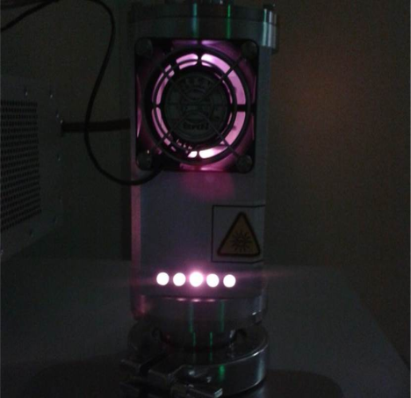
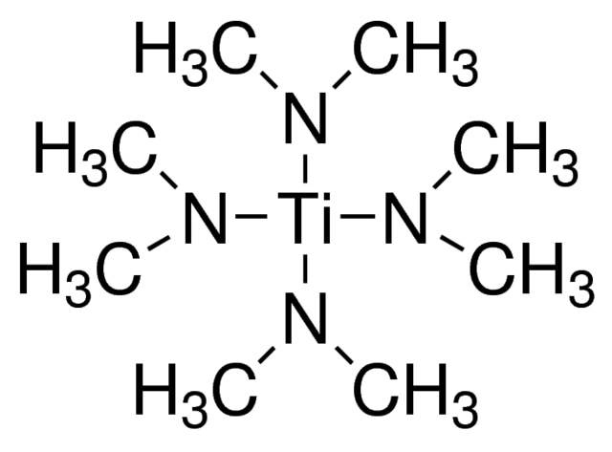
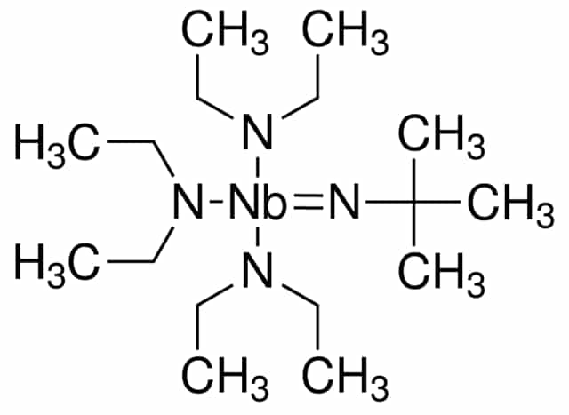
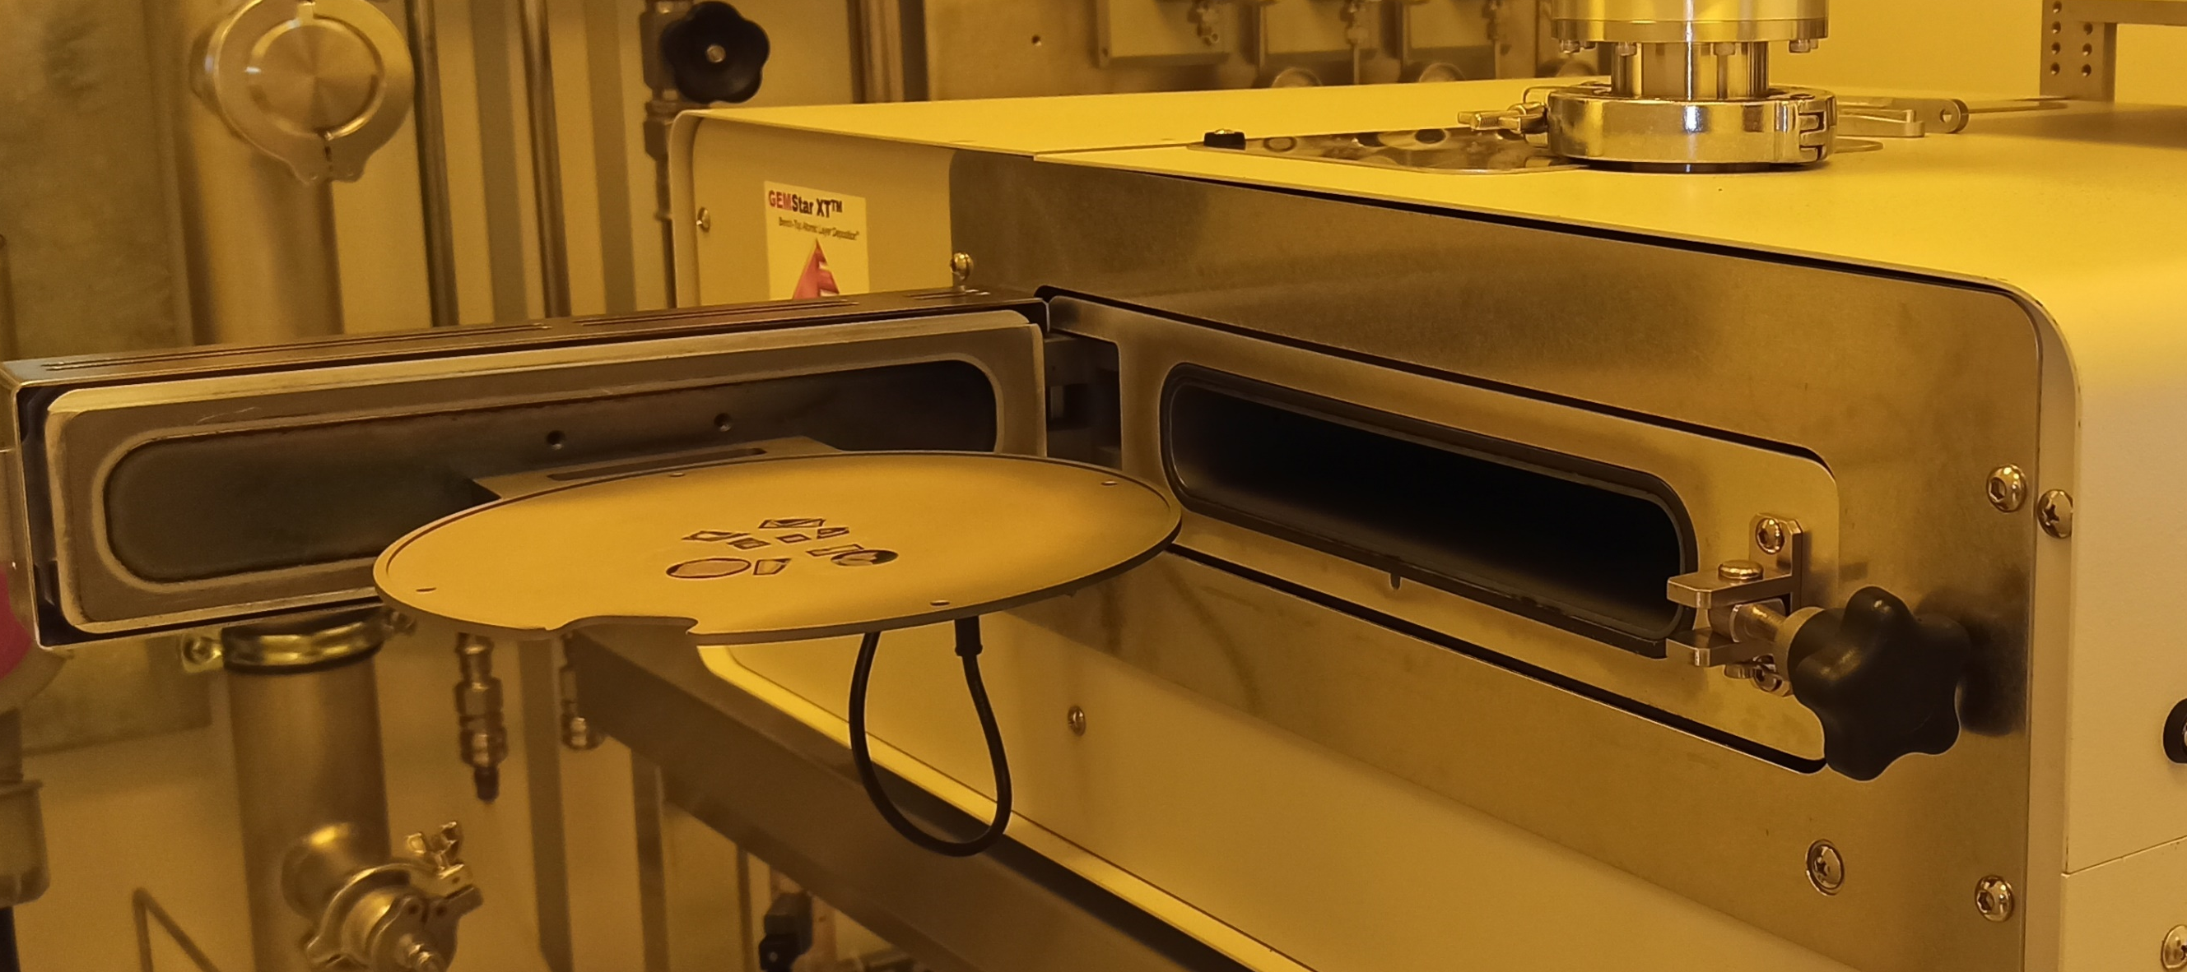
How we grow AlN-NbTiN multilayers by PEALD
DEPOSITION PARAMETERS
Temperature: 250 °C
Plasma power: 300 W
Base pressure: 1E-1 mbar
Precursors: Al, Ti, and Nb
TMA: Trimethylaluminum
AlN
H₂/N₂ PLASMA
Plasma reactive species
TDMAT: tetrakis(dimethylamino)titanium(IV)
TiN
Nb_{x}Ti_{1-x}N
GEMStar XT-P from Arradiance
TBTDEN: (t-Butylimido)tris(diethylamino)niobium(V)
NbN
SRF2023, Isabel González Díaz-Palacio, UHH
ALD cavity coating PEALD SIS studies Thermal conductivity
SIS motivation ALD principle ALD coating cavities PEALD SIS studies Outlook
8

Slide 26
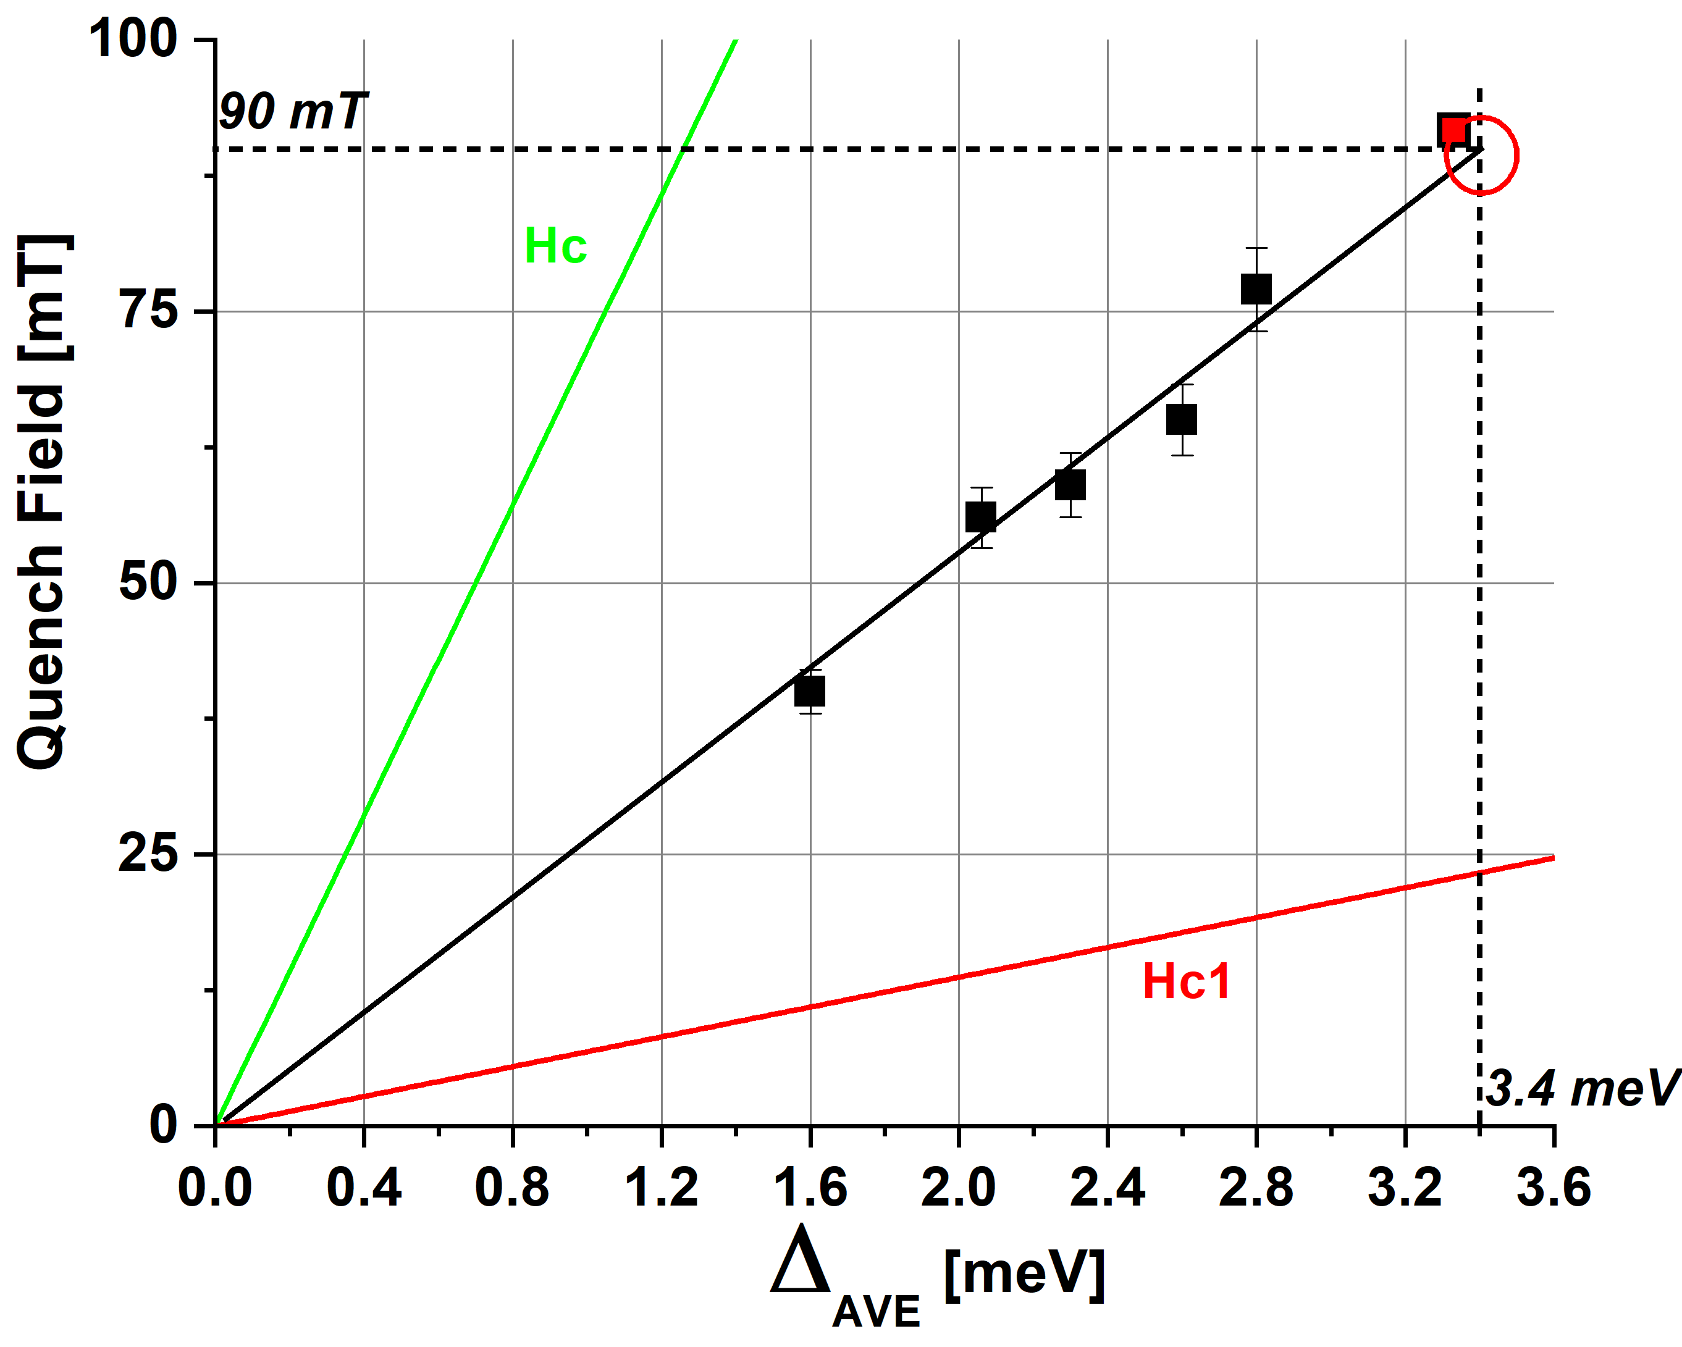

Nb₃Sn/Nb (Cornell - FNAL) – PCT
Quench field vs Average Gap
World Record FNAL Nb₃Sn Cavity mit 22 MV/m ≈ 93mT
$$H_{C}=\sqrt{\frac{N_{0}}{μ_{0}}}. Δ.e$$
$H_{c,exp}=26 ±2.5 Δ [\frac{mT}{meV}]$
Bulk Δ for Nb₃Sn is 3.4 to 3.5 meV
Max expected quench field is ~ 91 mT ≈ 21 MV/m
$$H_{C1}=\frac{1}{\sqrt{2}κ}\left(Ln\left[κ\right]+0.08\right) H_{C}$$
Comment: Could be a property of the specific coating procedure!

