Slide 1

Accelerating Computer-Enabled Discovery (ACED)
1

Slide 2
A New Vision for Scientific Discovery?
Science → Compute:
  Scientific exploration driving new computing innovation
  E.g. data science, modeling, simulation, analysis, reasoning, and prediction
Compute → Science:
  Computing technologies already accelerating new scientific advances
  E.g. AlphaFold2, Sgr A* black hole, Human Genome Project, Kepler conjecture
Can we harness the full power of computing to fundamentally revolutionize the scientific method, across all fields of science and engineering?

Slide 3
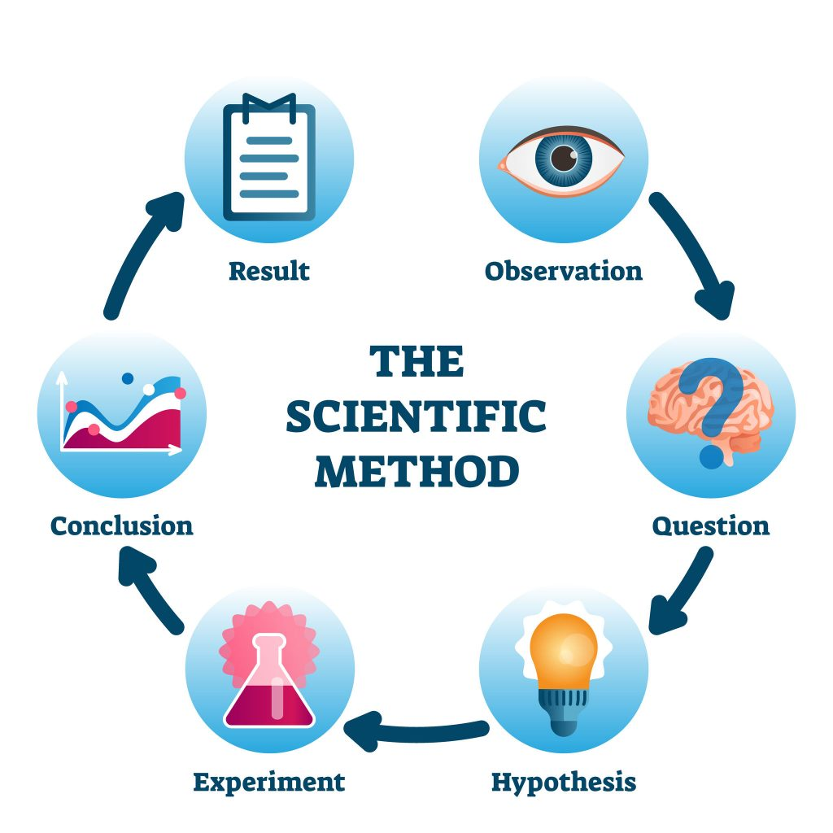
Data Driven Scientific Workflows/Methods
Data Curation
Hypothesis Generation
Artificial Intelligence
Smart Sensors
Visualization
Wireless Technologies
Computational modeling
Cloud
Infrastructure
High Precision Simulation
Robotics
Verification & Validation
Autonomous
Systems
Rigorous Reasoning
Security
Reproducibility

Slide 4
Synergies with existing programs
Many NSF programs that focus on similar topics
  Core programs, HDR, CDS&E, AI Institutes, Tripods, etc
Can we leverage and build on these programs?
  Identify promising cross-cutting technology areas with the potential to benefit from interaction multiple science and engineering disciplines, and with the potential to benefit multiple disciplines
  Identify new collaborative research directions in experimental, computational, and data-enabled science to accelerate scientific discovery
  Explore when and why certain computing techniques work well in some contexts & not others
  Continue to build and grow an interdisciplinary community

Slide 5
ACED Workshops Goals
Organize a series of workshops to identify
  New and promising research directions and priorities that have potential to accelerate scientific discovery across multiple scientific domains
  Cyberinfrastructure needed to enable this research
  Translational and partnership opportunities
  Cross-cutting issues across the five workshop themes

Slide 6
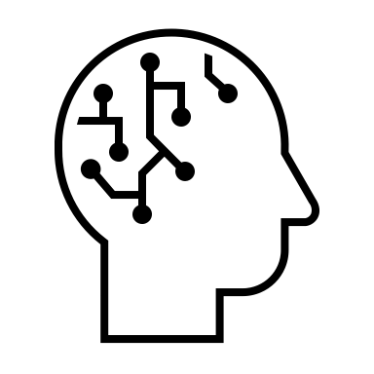




Workshop topics/themes
Data, AI and Machine Learning
Chemistry
Envrionmental Science
Materials Science
Genomics
Computer Systems
Mathematics
Your Science Here!
Digital Twins
Smart Sensing and Analytics
…
Rigorous & Reproducible Reasoning
Programmable/Self-Driving Labs

Slide 7
Workshops
Meta-Workshop on AI to Accelerate Science and Engineering Discovery
  Organizers: Shih-Chieh Hsu, Aidong Zhang
  Virtual (Tentative dates are October 2-3, 2023)
  This meta-workshop will bring together leaders of specific domains in data science, AI and ML. Majority of attendees will be core organizers from recent workshops and meetings around the heart of data-intensive discoveries. They will include the most important findings from their events, bring them to this meta-workshop, and collaborate with other participants to generate new insights.
Workshop on Crosscutting Research Needs for Digital Twins
  Organizers: Karen Willcox, Omar Ghattas, Kenichi Soga
  In person on Oct 11-12th, Cowan campus in Santa Fe Institute, New Mexico
  The workshop aims to identify research gaps in digital twin technologies that are common across application domains and that may benefit from crosscutting interdisciplinary research efforts. The workshop will focus on four methodological themes: models; data; decisions; and verification, validation & uncertainty, quantification, and numerous diverse application domains.

Slide 8
Workshops
Workshop on Convergence of Smart Sensing Systems, Applications, Analytic & Decision Making
  Organizers: Mingyi Hong, Alison Gray, Cherie Kagan, Qi Li, Joshua Smith, Peng Wei
  In person on Nov 16-17th at NSF, Alexandria, VA
  This workshop will bring together stakeholders with domain expertise in sensing systems together with experts on signal processing, optimization, machine learning, and control theory to address a number of present and future challenges in smart sensing and analytics.
  Workshop on Rigorous and Reproducible Scientific Reasoning
    Organizers: Sriram Sankaranarayanan, Chris Myers, Rajagopalan Balaji
    In person in third week of Oct at University of Colorado, Boulder, Colorado
  This workshop will explore rigorous and reproducible approaches to increase confidence in the outcomes of data driven scientific workflows/processes. The focus will be on development and use of rigorous methods to ensure correctness, reliability, robustness, reproducibility, safety, security, and efficient resource usage.

Slide 9
Workshops
Workshop on Automated, Programmable and Self-driving Laboratories
  Organizers: Nadya Peek, Thomas Kurfess, and Ian Foster
  In person (east coast, and date to be decided)
  this workshop will convene experts in laboratory automation, data-driven methods, robotics, manufacturing, and human-machine interaction to identify the major challenges facing self-driving and automated experimental laboratories that can dramatically shorten the time between iterations of experiments or make it possible to conduct experiments that would be too dangerous for human technicians.

Slide 10
Topics for Discussion
How can we identify cross-cutting themes across the five workshops?
How do we ensure and leverage a diverse pool of participants and ideas?
What is the current status and ideal end state, and what is achievable in 1, 5, and 10 years?
What can be accomplished given current funding mechanisms vs. of a scope and scale that would require other funding mechanisms or avenues?
What is the potential for partnerships? Industry? Cross USG? Consortia?
What is the potential for international collaboration and cross-fertilization?

