Slide 1
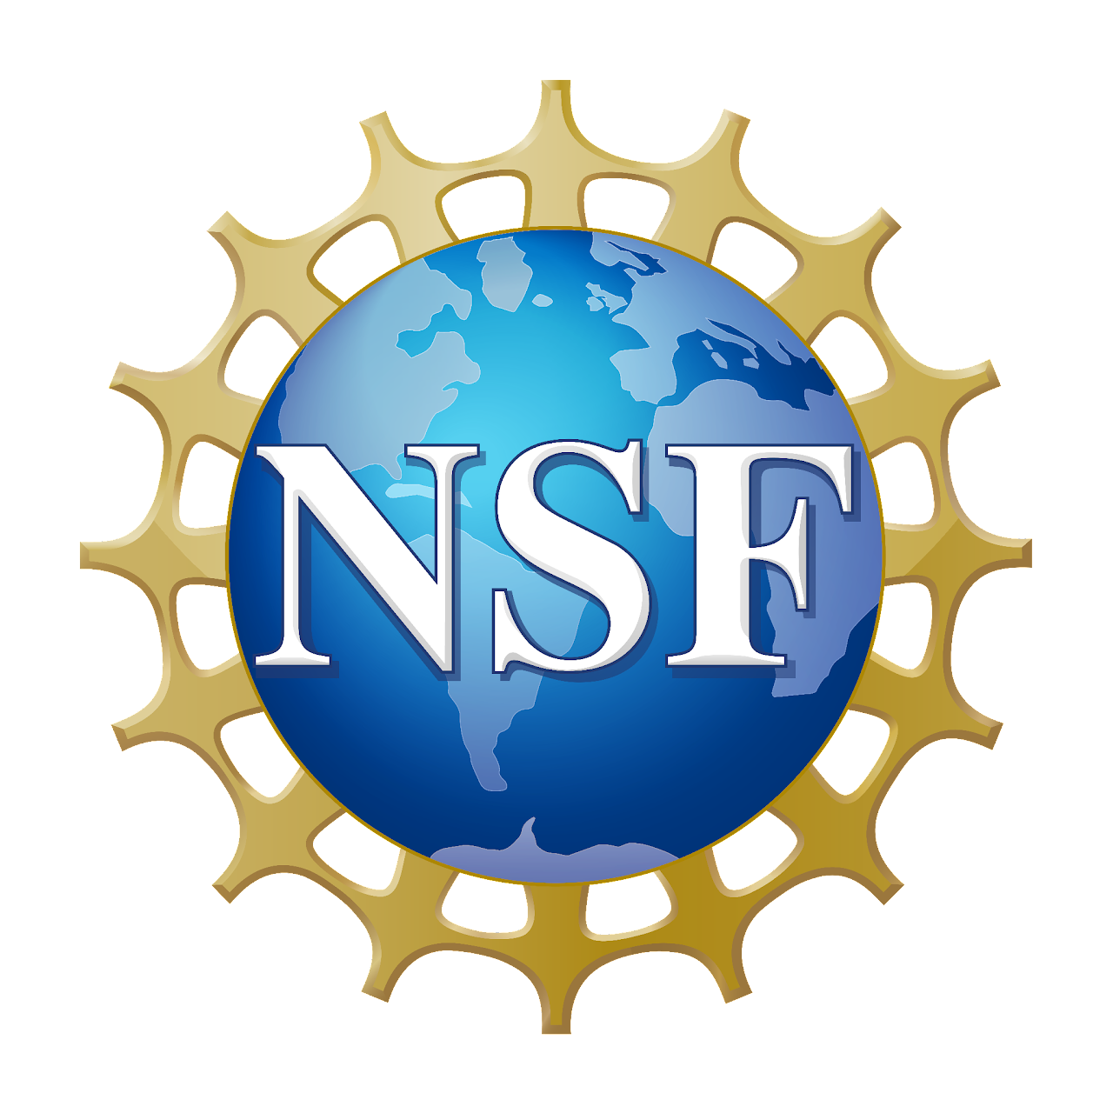
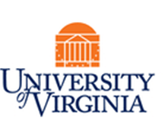
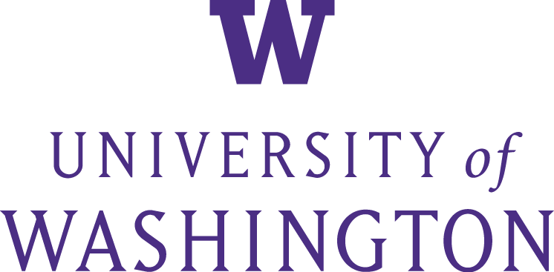
NSF Funded Workshop on AI to Accelerate Science and Engineering Discover
Supported by NSF Award #2337647
October 2 and 3, 2023
Virtual Event
Introduction and Overview
Shih-Chieh Hsu (UW) and Aidong Zhang (UVA)
Workshop Organizers
Visit the workshop page for logistics and details:
https://indico.cern.ch/event/1325897/
Notes/Slides/Recordings via Google Drive:
https://drive.google.com/drive/folders/1fBPcT2X5ulGV6vUgz60Ske5uA0HHTwBj?usp=drive_link
Workshop sessions are accessible via Zoom: https://virginia.zoom.us/j/98799084466?pwd=QWVqb0E0dnNEOTBYQ1dnN3NpbVErdz09
Instant communication via SLACK:
https://nsf-ai2ased.slack.com

Slide 2
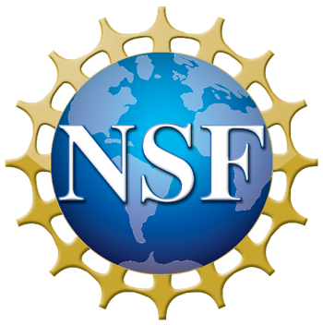
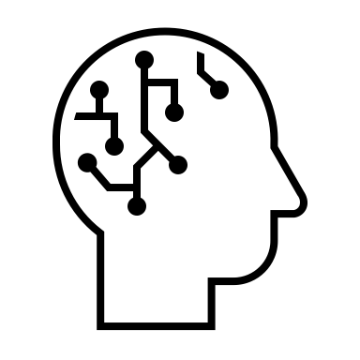




Accelerating Computer-Enabled Discovery (ACED)
Engaging the Community through 5 Workshops:
Data, AI and Machine Learning
Digital Twins
Smart Sensing and Analytics
Mathematics
Computer Systems
Your Science Here!
Genomics
Chemistry
Environmental Science
Materials Science
…
Rigorous & Reproducible Reasoning
Programmable/Self-Driving Labs
2
Notes:
Can we harness the full power of computing to fundamentally revolutionize the scientific method, across all fields of science and engineering?

Slide 3
Accelerating Computer-Enabled Discovery (ACED)
Data, AI and Machine Learning
Digital Twins
Smart Sensing and Analytics
Rigorous & Reproducible Reasoning
Programmable/Self-Driving Labs
Organizers: Shih-Chieh Hsu, Aidong Zhang
Virtual
Tentative: October 2-3, 2023
Meta-workshop bringing together leaders of specific domains in data science, AI and ML. Majority of attendees will be core organizers from recent workshops and meetings around the heart of data-intensive discoveries. They will include the most important findings from their events, bring them to this meta-workshop, and collaborate with other participants to generate new insights.
Organizers: Karen Willcox, Omar Ghattas, Kenichi Soga
In person: Santa Fe Institute’s Cowan campus, Santa Fe, NM
Oct 11-12, 2023
The workshop aims to identify research gaps in digital twin technologies that are common across application domains and that may benefit from crosscutting interdisciplinary research efforts. The workshop will focus on four methodological themes: models; data; decisions; and verification, validation, and uncertainty quantification, across diverse application domains.
Organizers: Mingyi Hong, Alison Gray, Cherie Kagan, Qi Li, Joshua Smith, Peng Wei
In person: NSF in Alexandria, VA
Dec 7-8, 2023
This workshop will bring together stakeholders with domain expertise in sensing systems together with experts on signal processing, optimization, machine learning, and control theory to address a number of present and future challenges in smart sensing and analytics.
Organizers: Sriram Sankaranarayanan, Chris Myers, Rajagopalan Balaji
In person: University of Colorado, Boulder, Colorado
Nov 13-14
This workshop will explore rigorous and reproducible approaches to increase confidence in the outcomes of data driven scientific workflows/processes. The focus will be on development and use of rigorous methods to ensure correctness, reliability, robustness, reproducibility, safety, security, and efficient resource usage.
Organizers: Nadya Peek, Thomas Kurfess, and Ian Foster
In person: East coast
Nov 14-15,2023
This workshop will convene experts in laboratory automation, data-driven methods, robotics, manufacturing, and human-machine interaction to identify the major challenges facing self-driving and automated experimental laboratories that can dramatically shorten the time between iterations of experiments or make it possible to conduct experiments that would be too dangerous for human technicians.
TBD
https://santafe.edu/events/crosscutting-research-needs-digital-twins
TBD
TBD
TBD
Notes:
Digital Twins – Oct 11 and 12
Smart Sensing - Dec 7 and 8
Self-Driving - Nov 14 and 15
Scientific Reasoning - Nov 13 and 14

Slide 4
AI to Accelerate Science and Engineering Discover
Foundational research in data science, artificial intelligence (AI) and machine learning (ML) have drawn incredible interest in application to a wide range of data driven approaches to scientific and engineering discovery.
  AlphaFold
  AlphaMissense
  Large Language Models (LLMs)
              ChatGPT, cancerGTP, bioGPT, ,,,

Slide 5
Meta-workshop Motivation
Many workshops and meetings were held by the U.S. National Science Foundation (NSF) and other organizations to discuss cutting-edge breakthroughs and emerging trends.
The majority of events are structured for a particular scientific field in silos.
A paradigm-shifting scientific revolution might be made possible by integrating important discoveries from these incidents and developing fresh, cogent insights.
Notes:
While ML is Increasingly being considered as an alternative to the traditional scientific discovery paradigm based on domain theories, black box methods have shown disappointing results in scientific domains!

Slide 6
Workshop Objective
This meta-workshop on AI to Accelerate Science and Engineering Discovery provides NSF with information on the state of complementary research in data analytics, AI, machine learning as well as science and engineering domains.
The subjects of interest include identifying specific subject areas with high potential for data-driven approaches to discovery, appropriate community size and AI methods widely incorporated to assist the development, and synergies between AI/ML and domain applications.
Notes:
While ML is Increasingly being considered as an alternative to the traditional scientific discovery paradigm based on domain theories, black box methods have shown disappointing results in scientific domains!

Slide 7
Workshop Participants
Meta-workshop bringing together leaders of specific domains in data science, AI and ML, and science and engineering.
Majority of attendees are core organizers from recent workshops and meetings around the heart of data-intensive discoveries.
The participants include the most important findings from their events, bring them to this meta-workshop, and collaborate with other participants to generate new insights.
Notes:
While ML is Increasingly being considered as an alternative to the traditional scientific discovery paradigm based on domain theories, black box methods have shown disappointing results in scientific domains!

Slide 8
Breakout session I - AI for data-driven discovery
What are the priority research directions for AI to enable data-driven discovery?
What are the key limitations of state-of-the-art AI in the context of scientific and engineering problems?
What AI insights from one scientific discipline would you expect to generalize to others?
What can AI do to advance other scientific and engineering areas?
How can education and community outreach about data science, AI and ML speed up this process?

Slide 9
Breakout session II and III - Sci/Eng for data-driven discovery
What areas of science and engineering have been transformed by AI?
What are the key gaps in current scientific methods that can be filled by AI?
What are the priority research directions of data-driven discovery in science and engineering that data analytics, AI, and ML can enable or accelerate?
What are examples of research that could be used as concrete exemplars of the kind of work we’d like to see more of? In particular, we’re trying to build a community that is diverse and examples can be really helpful when communicating across communities.
How can education and community outreach about data science, AI and ML speed up this process?

Slide 10
Panel session discussions
Topic (5mins): What are the priority research directions for AI to enable data-driven discovery?
Q1. What AI insights from one scientific discipline would you expect to generalize to others?
Q2. What can the federal government/industry/researchers do to catalyze computational-enabled data-driven discovery?
Q3. How can AI education and community outreach accelerate this process?

Slide 11
Lightening Talks
Three Breakout Discussion and Report Back
Lead and scribes

