Slide 1
AI + Computation: Use inspired challenges from Manufacturing and Design
Baskar Ganapathysubramanian
Iowa State University

Slide 2
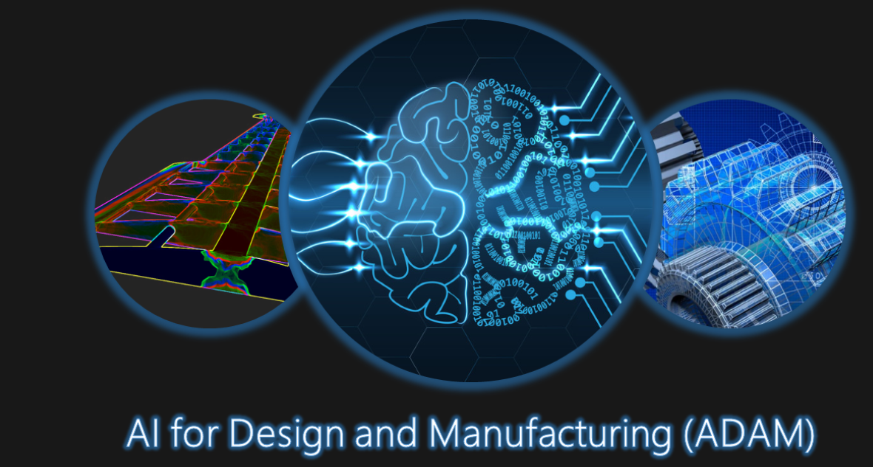
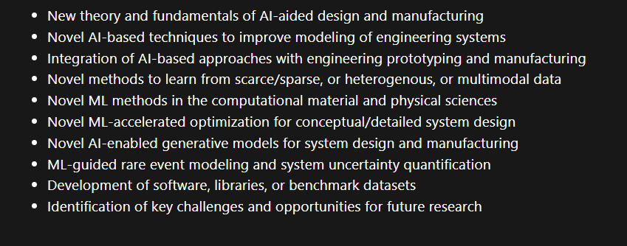
AAAI 2022
Organizers:
Aarti Singh (CMU), Baskar G (ISU), Chinmay Hegde (NYU), Mark Fuge (Maryland), Olga Wodo (SUNY, Buffalo), Payel Das (IBM), Soumalya Sarkar (Raytheon), Aditya Balu (ISU), Adarsh Krishnamurthy (ISU)
25 papers, along with 5 invited talks
https://adam-aaai2022.github.io/

Slide 3
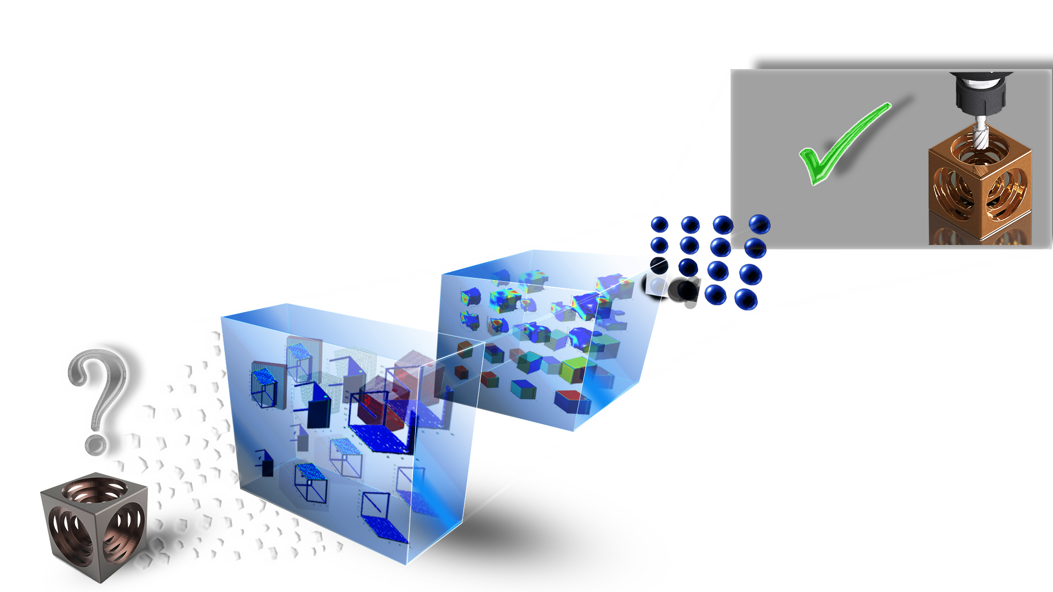
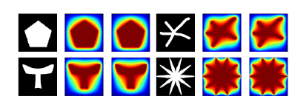
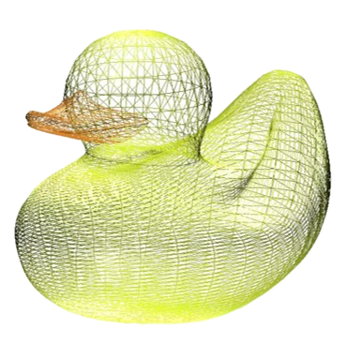
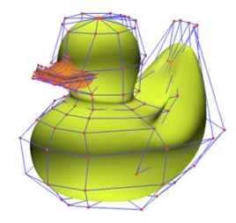
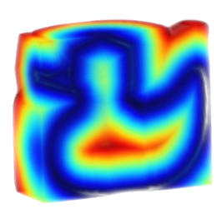
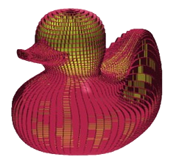
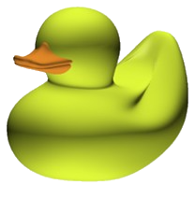
Thematic challenges
Constrained generation of (3D) objects
Incorporating design intent
PDE constraints: Fast surrogates
Non-differentiable features
(lack of usable) large data sets
Scale up to high-res 3D
Triangular tessellation
Non-uniform rational B-splines (NURBS)
Voxel
CAD model
Distance fields

Slide 4
Thematic challenges
AI in the loop
Digital twins of physical equipment
Multimodal assimilation and reconstruction
Navigating process-structure-property-performance landscapes: 3D high-res simulators
Cyberinfrastructure
Real time process/manufacturing monitoring
Autonomous exploration and experimentation

Slide 5
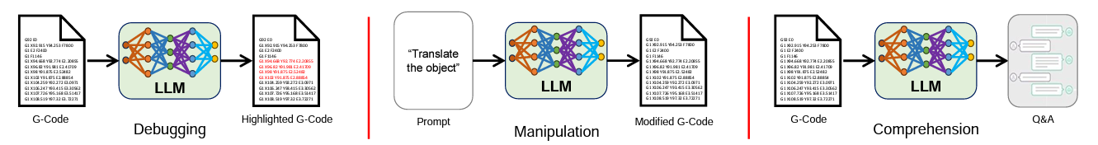
Thematic challenges
Democratization
LLMs for manufacturing/prototyping
Cybersecurity issues?
Uncertainty quantification

