Slide 1

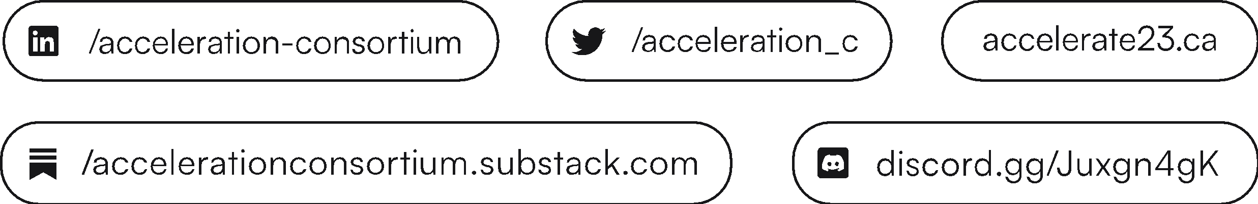
Accelerate Conference 2023

Slide 2

About the Acceleration Consortium
Based at the University of Toronto, the Acceleration Consortium (AC) is a global community of academia, non-profit, industry, and government accelerating discovery
We design and build self-driving labs—which combine AI, automation, and advanced computing—to accelerate the discovery of new materials and molecules

Slide 3

$200-million news
In March 2023, the AC was awarded $200 million
from the Canada First Research Excellence Fund (CFREF)
It is the largest research grant ever awarded to a Canadian university!

Slide 4
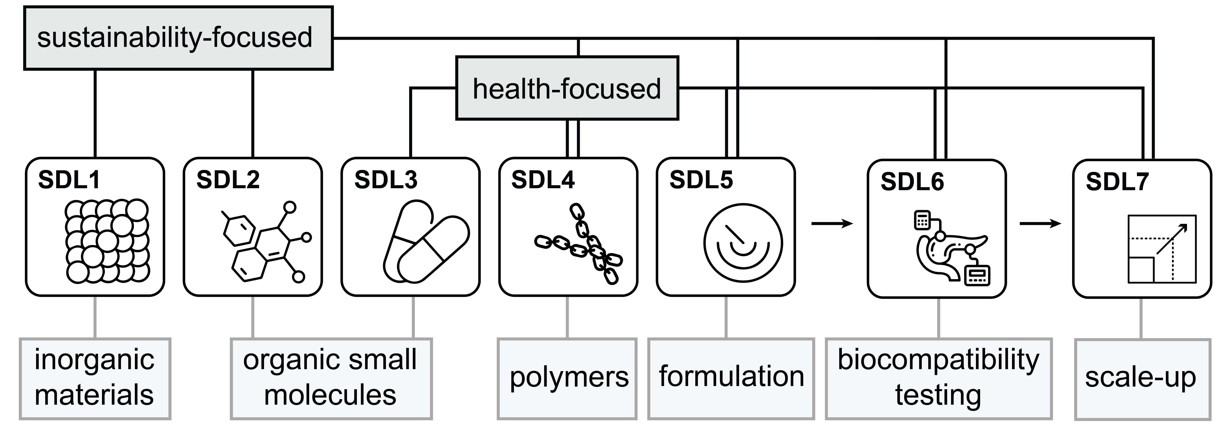
AC’s self-driving labs (SDL1 – SDL7)
AI & Automation Lab
Social Sciences Lab

Slide 5
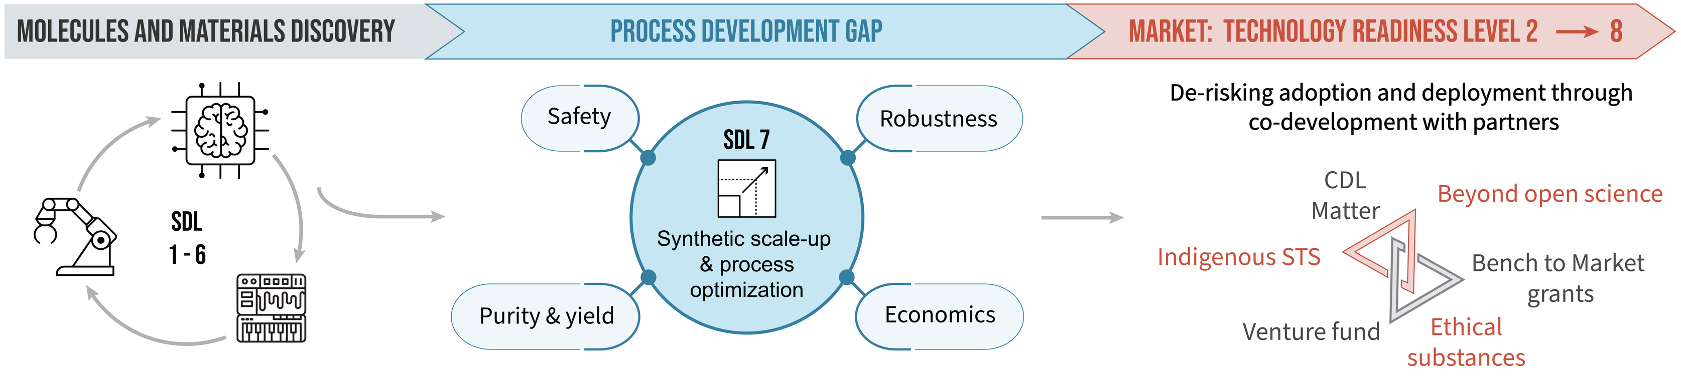
Innovation strategy
Professionals AND TRAINEES
Staff
Scientists
30
Software
Engineers
5
Product
Managers
3
Business Development Team
3
Staff Scholars
4
TRAINEES

Slide 6

Accelerate conference
History
Format
Future
Inaugural conference
Toronto, Aug 2022
Most recent
Toronto, Aug 2023
Talks, Posters, Industry workshops, Training workshops, Panels
3 tracks
Tools
Materials
Ecosystem
Going global
Vancouver
Boston
Madrid
Liverpool
…
and back to
Toronto

Slide 7
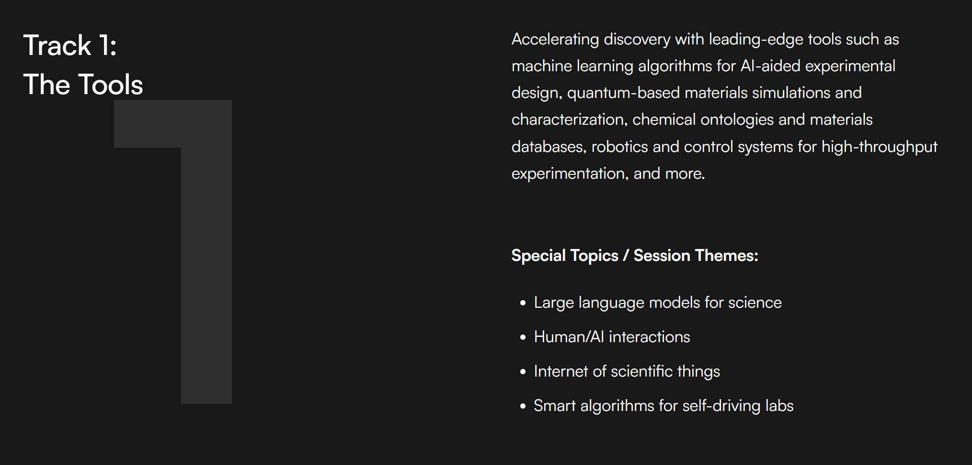
Three conference tracks: Track 1

Slide 8
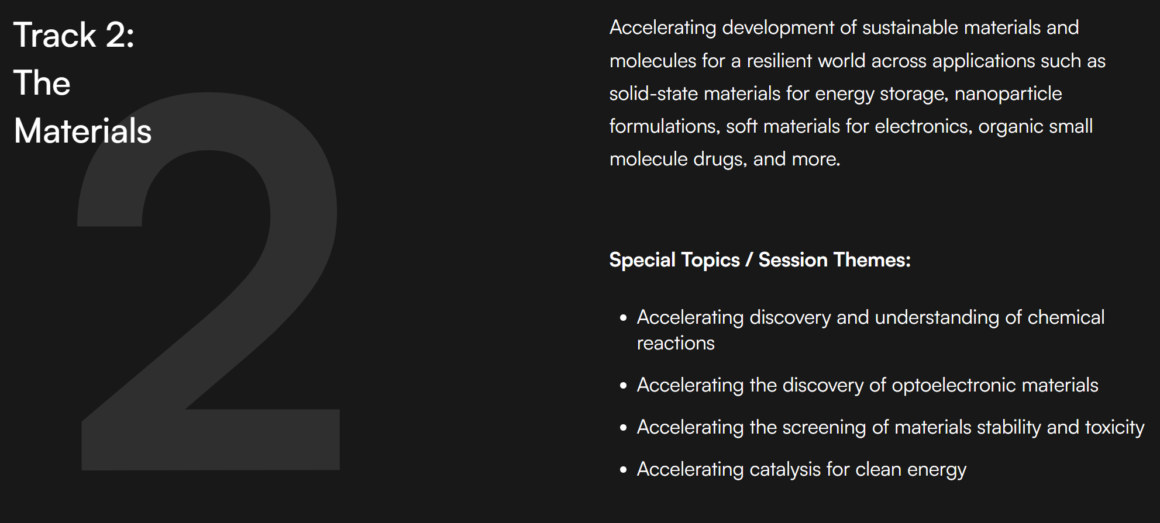
Three conference tracks: Track 2

Slide 9
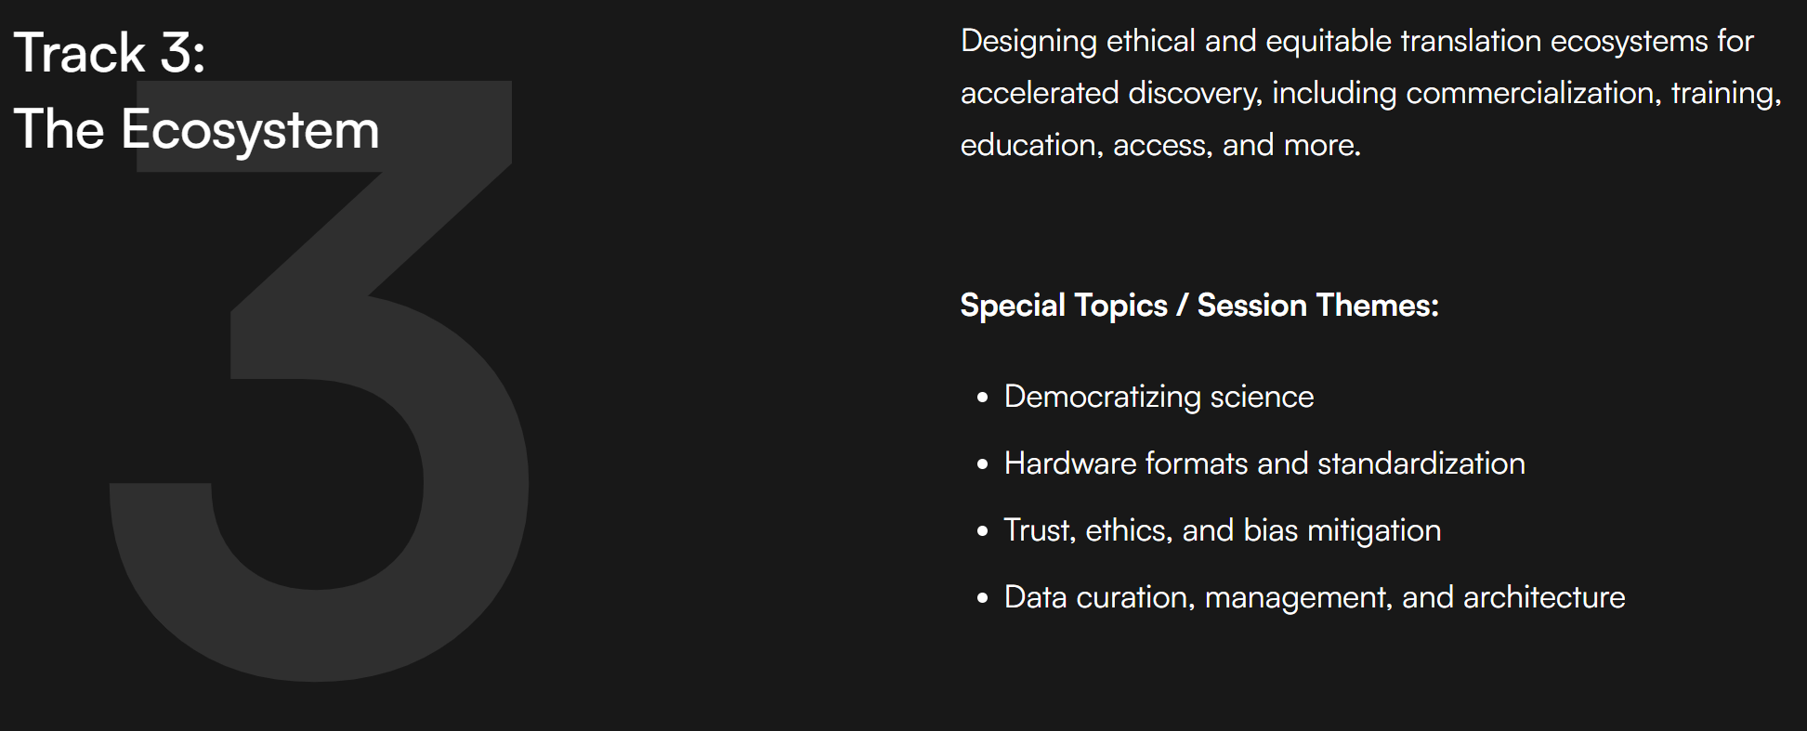
Three conference tracks: Track 3

Slide 10



In 2023 the conference welcomed:
350+
attendees
170+ community/industry
16+
countries
Including:
150+ students, postdocs, trainees
125+ academia/govt
20+ startups
  60+ talks
  90+ posters
  9 workshops
Including:
Apple, BASF, Chemix, Covestro, Dow, Estee Lauder, EMD, Meta, IBM, Microsoft, Intel, Thermofisher, L’Oreal, Lewis and Clark, Lubrizol, Mesosil, Micron, Nokia, Genentech, Roche, P&G, PVD Products, Solvay, Svante, Heritage Group, TRI, Unchained labs, Unilever, Sekisui, vsparticle
Including:
Canada, USA, Switzerland, Denmark, Australia, Germany, Singapore, UK, Spain, Mexico, India, Sweden, Israel, Finland, South Korea, Austria

Slide 11
Thank you

