Slide 1



NSF Funded Workshop on AI-Enabled Scientific Revolution
Supported by NSF Award #2309660
March 8 and 9, 2023
Location: NSF Headquarters
2415 Eisenhower Avenue
Alexandria, Virginia 22314
Introduction and Overview
Vipin Kumar (UMN) and Aidong Zhang (UVA)
Workshop Organizers
Visit the workshop page for details and report:
https://sites.google.com/umn.edu/nsfaiworkshop2023/home

Slide 2


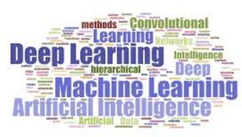
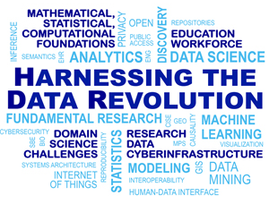
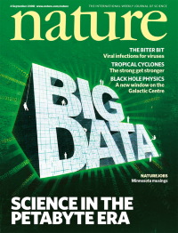
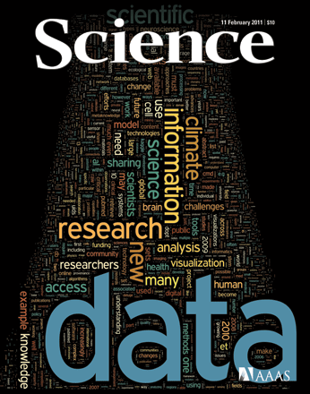
AI for Scientific Discovery
Advances in ML and high-end computing fed by big data have revolutionized all aspects of our lives
High Performance Computing
Big Data
Machine Learning
Big data and ML are Increasingly being considered as an alternative to the traditional scientific discovery paradigm based on domain theories

Slide 3
Workshop Motivation
AI is poised to disrupt science
  It can unlock new approaches that enable scientific advances with far-reaching societal consequences.
Current AI methods are not suited for many science applications
  Many of the most successful AI methodologies have been driven by big, labeled data sets in the context of vision and language translations, whose nature is quite different than many areas of science.
There is a tremendous opportunity for
  Advancing frontiers of AI that are driven by the unique needs of scientific problems, and
  Taking advances made in the context of specific scientific domains to many other domains.
.
Notes:
While ML is Increasingly being considered as an alternative to the traditional scientific discovery paradigm based on domain theories, black box methods have shown disappointing results in scientific domains!

Slide 4
Workshop Objective
Develop a vision and strategy for catalyzing next-generation AI-enabled science that will
  drive scientific inquiry,
  suggest novel experiments,
  elucidate new theories,
  revolutionize the traditional discovery process across multiple scientific disciplines.
Notes:
While ML is Increasingly being considered as an alternative to the traditional scientific discovery paradigm based on domain theories, black box methods have shown disappointing results in scientific domains!

Slide 5
Workshop Participants
Twenty eight participants are leading researchers who
  Cover all aspects of AI (e.g., ML, planning, decision making, optimization, knowledge-representation, computer vision, language translation)
  Cover numerous scientific disciplines (e.g., health care/medicine, genomics, material science, ecology, hydrology, high-energy physics, climate, remote sensing)
  Have extensive track record of interdisciplinary collaborations.
  Come from academia, industry, research labs, NGOs
Notes:
While ML is Increasingly being considered as an alternative to the traditional scientific discovery paradigm based on domain theories, black box methods have shown disappointing results in scientific domains!

Slide 6
Highlights from Position Papers
AI is poised to disrupt Science
  Unique capabilities to learn from large observational data sets
  Not hindered by incomplete scientific understanding
Many areas of Science can be transformed by AI
  Substantially improved predictive modeling of complex bio-physical/social systems
  Hypothesis generation
  Scientific workflows - operationalizing science
  Data collection (what to collect)
Barriers faced by existing AI in the context of scientific problems:
  Lack of large-scale labeled data sets
  Generalizability to unseen scenarios
  Inability to model multi-scale phenomena, and handle data at multiple resolution/modality
  Inability to reason and quantify uncertainty
  Lack of trust
Notes:
While ML is Increasingly being considered as an alternative to the traditional scientific discovery paradigm based on domain theories, black box methods have shown disappointing results in scientific domains!

Slide 7
Highlights from Position Papers (cont.)
What topics in AI can have the most impact on science?
  Incorporating scientific knowledge and reasoning in all aspects of AI
    Predictive Modeling
    Generative Modeling
    Self-supervision framework
    Uncertainty quantification
  Interpretable/explainable models
  Extract/utilize structured knowledge from unstructured data
What AI methods are relatively unexplored in scientific disciplines?
  Reinforcement learning
  Symbolic AI (may help with reasoning about scientific processes)
  Large foundation models
Notes:
While ML is Increasingly being considered as an alternative to the traditional scientific discovery paradigm based on domain theories, black box methods have shown disappointing results in scientific domains!

Slide 8
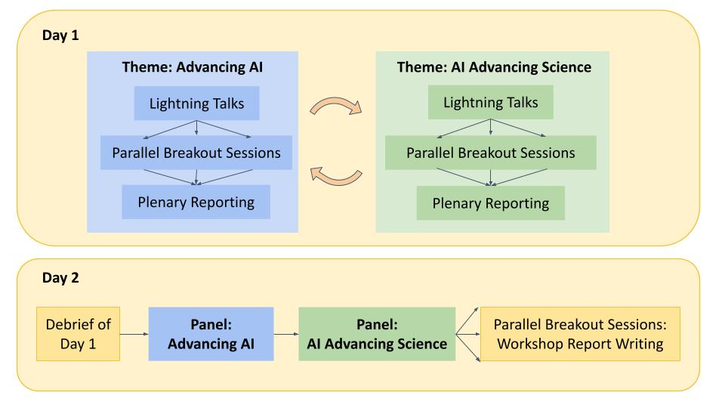
Workshop Structure

Slide 9
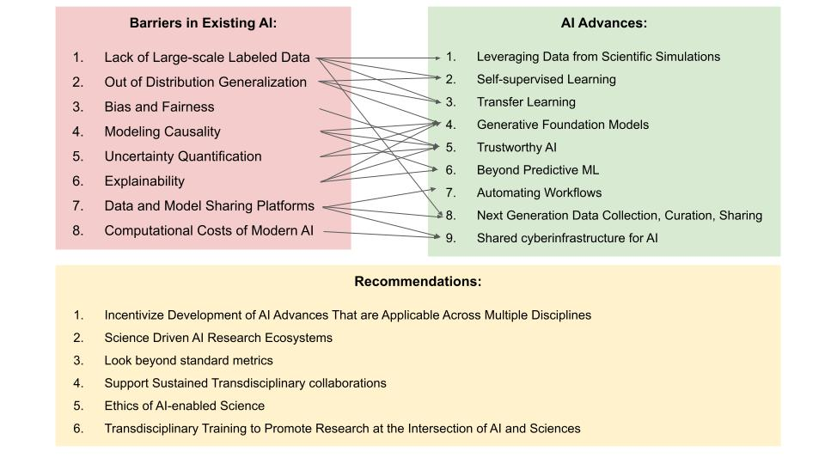

Slide 10
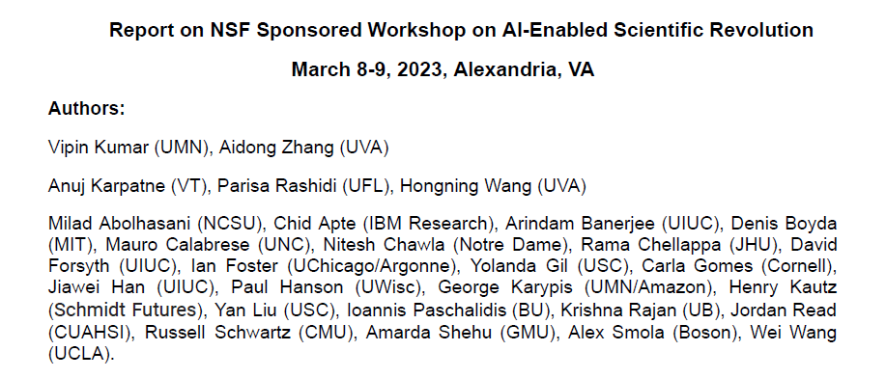
Report available at workshop webpage:
https://sites.google.com/umn.edu/nsfaiworkshop2023/home

