Slide 1


Unified Knowledge Representation for Science
Wei Wang
University of California, Los Angeles
weiwang@cs.ucla.edu

Slide 2

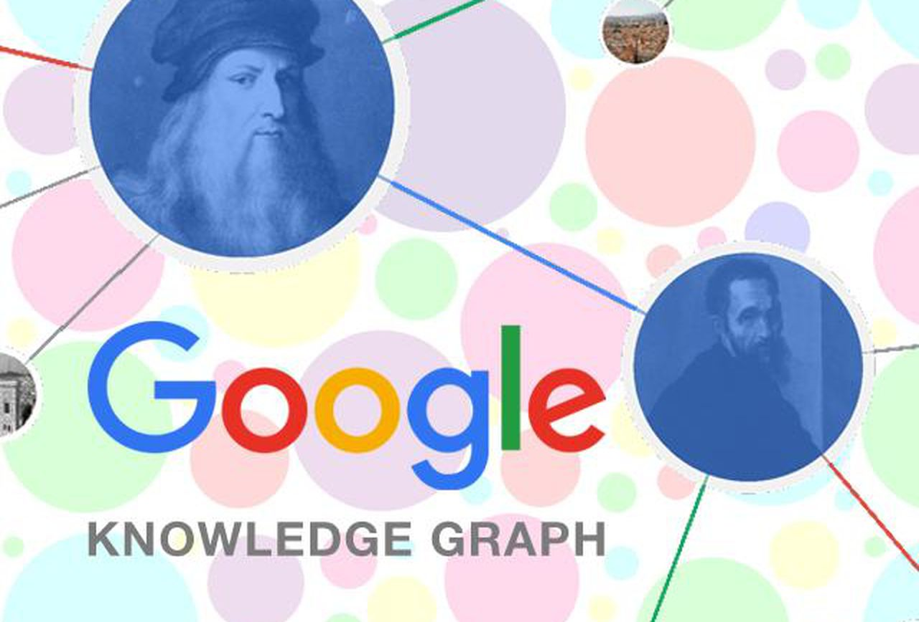


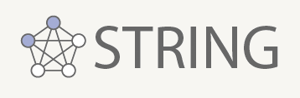
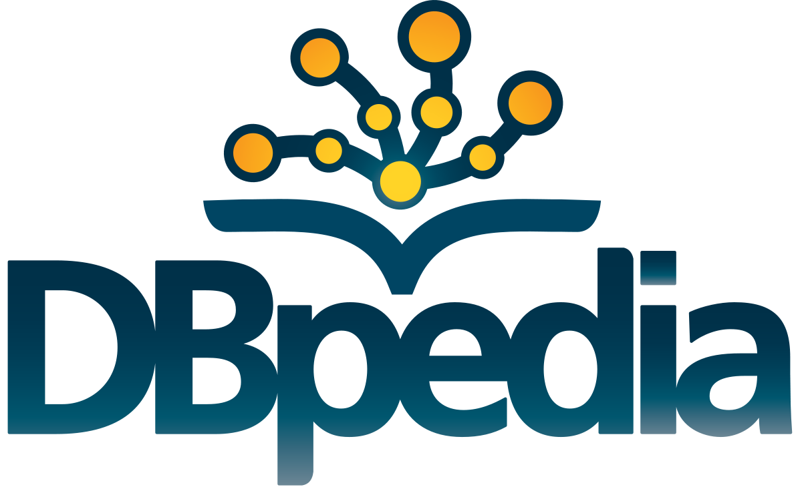










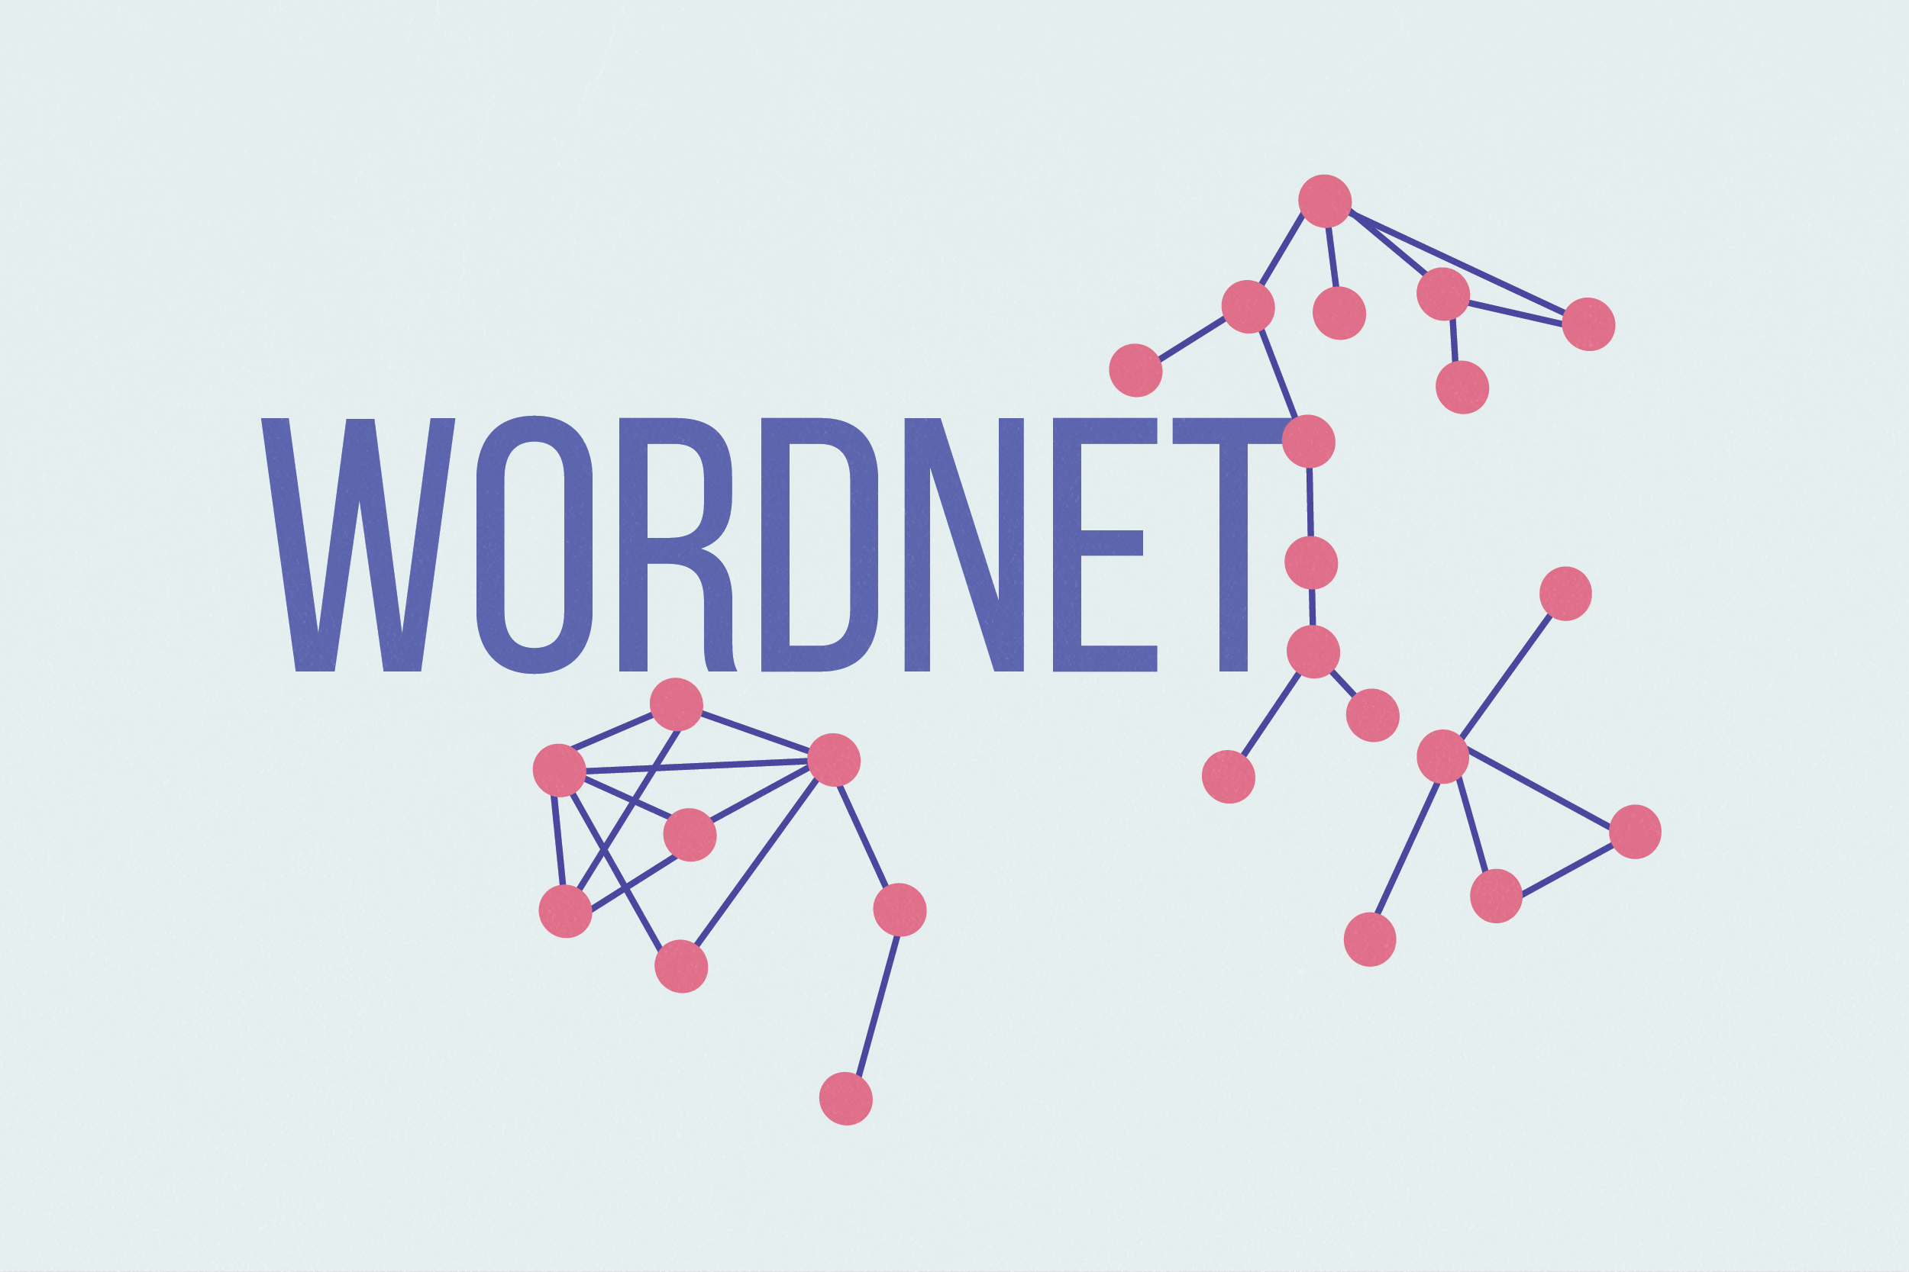

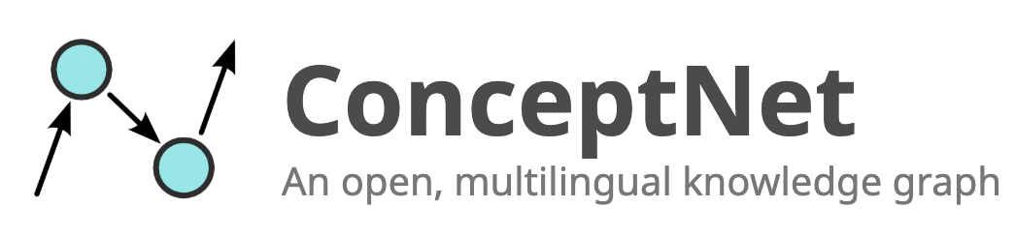
Knowledge Model
General-purpose KGs
Bio & Medical KGs
Product Graphs & E-commerce
Common-sense KGs & NLP

Slide 3
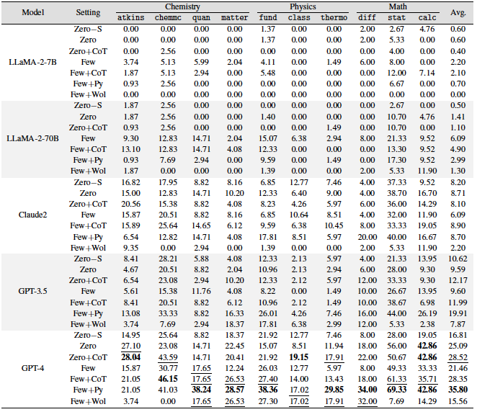
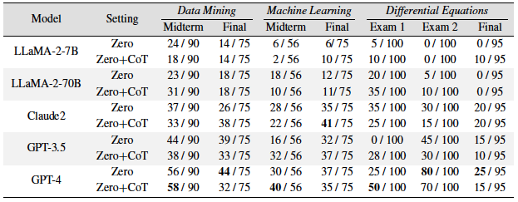
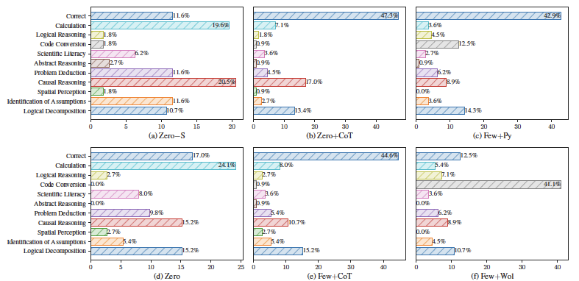
Large Language Models

Slide 4
Unique Challenges
Complexity and Multimodal Data: Scientific knowledge often involves complex, multimodal data, including textual publications, structured databases, experimental results, images, and more. Integrating and representing this diverse data effectively is a challenge.
Dynamic Nature: Scientific knowledge is constantly evolving. New discoveries, revisions of existing theories, and updates to databases are frequent. Representations must be adaptable and capable of handling dynamic changes.
Interdisciplinary Nature: Many scientific problems are inherently interdisciplinary. Knowledge representation systems must bridge gaps between different scientific disciplines and capture the relationships between them.
Uncertainty and Variability: Scientific data often contains inherent uncertainty and variability. Representations must be able to handle probabilistic and fuzzy information to reflect the uncertainty in scientific findings.
Semantic Heterogeneity: Different scientific communities may use different terminologies or taxonomies to describe similar concepts. Effective knowledge representation must address semantic heterogeneity and provide means for cross-disciplinary mapping.

Slide 5
Unique Challenges
Incorporating Expert Knowledge: Scientific expertise is crucial. Knowledge representation systems should facilitate the incorporation of domain-specific expert knowledge to enhance their accuracy and utility.
Interoperability: Scientific knowledge representation systems must be interoperable with existing databases, ontologies, and standards to ensure compatibility and facilitate data sharing and integration.
Validation and Reproducibility: In scientific research, the validity and reproducibility of knowledge are paramount. Representations should support the validation of results and enable reproducible experiments.
Interpretability: Representations should facilitate the interpretability of complex scientific knowledge to aid researchers in understanding and making informed decisions.
Ethical Considerations: Ethical considerations such as data privacy, responsible AI, and ethical research conduct are increasingly important in scientific knowledge representation.

Slide 6
Graphs as a unified representation
signs & symptoms from the EHR
quantitative imaging features
proteins and transcriptomic biomarkers
genomic biomarkers

Slide 7




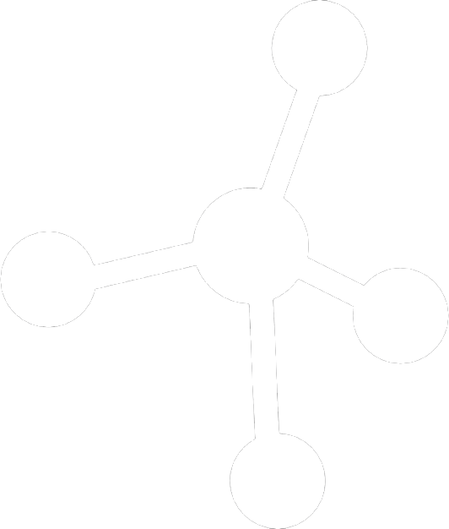
Graphs as a unified representation
Current methods on knowledge graphs
Representation learning on a single knowledgebase
Focusing on entities and binary relations
Not easily updatable
Computational challenges
Deep but fragmented
Different knowledge bases are designed and maintained separately, lacking interoperability
signs & symptoms
imaging
New scalable methods for knowledge integration
Many knowledgebases in some domain
Multi-modality
protein
gene

Slide 8
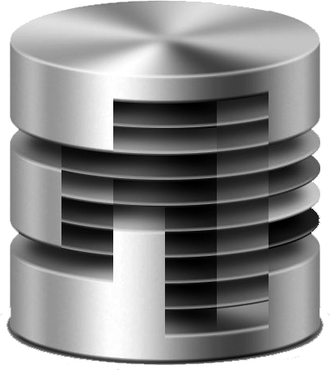
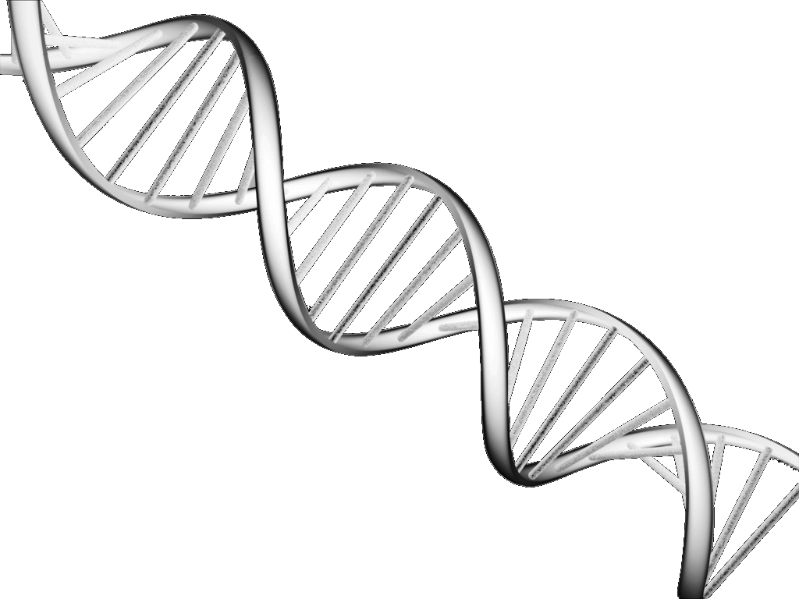


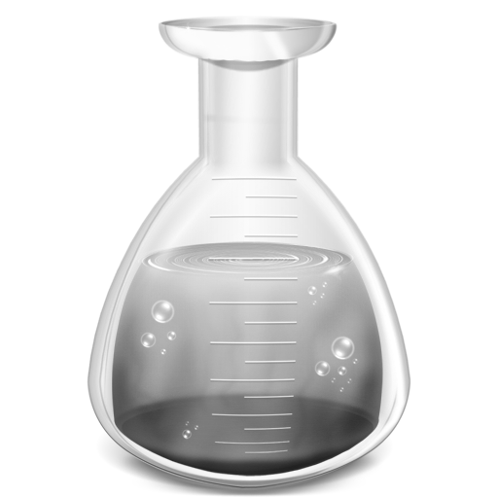

Optimizing AI Performance through Knowledge Integration
knowledge
bases
outcome
data
analytic
models
adding constraints to
limit search space and ensure consistency with prior knowledge …
Neural networks | Reinforcement learning | Generative models | …

Slide 9
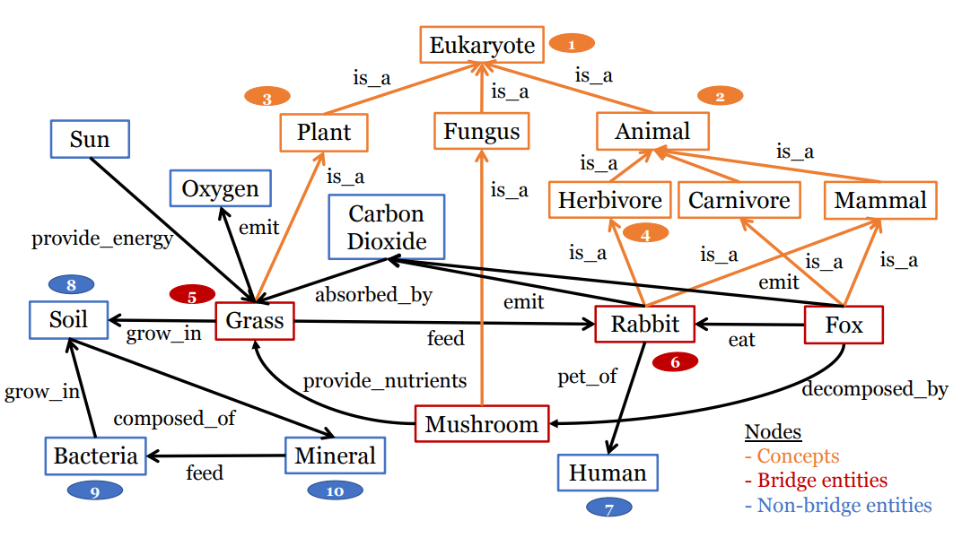
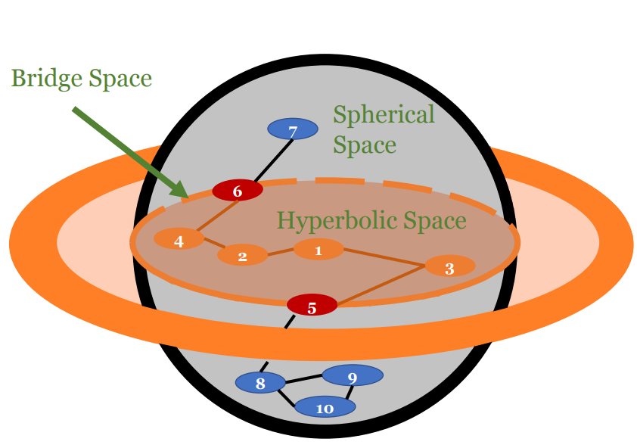
Multi-view Representation Learning - DGS

Slide 10
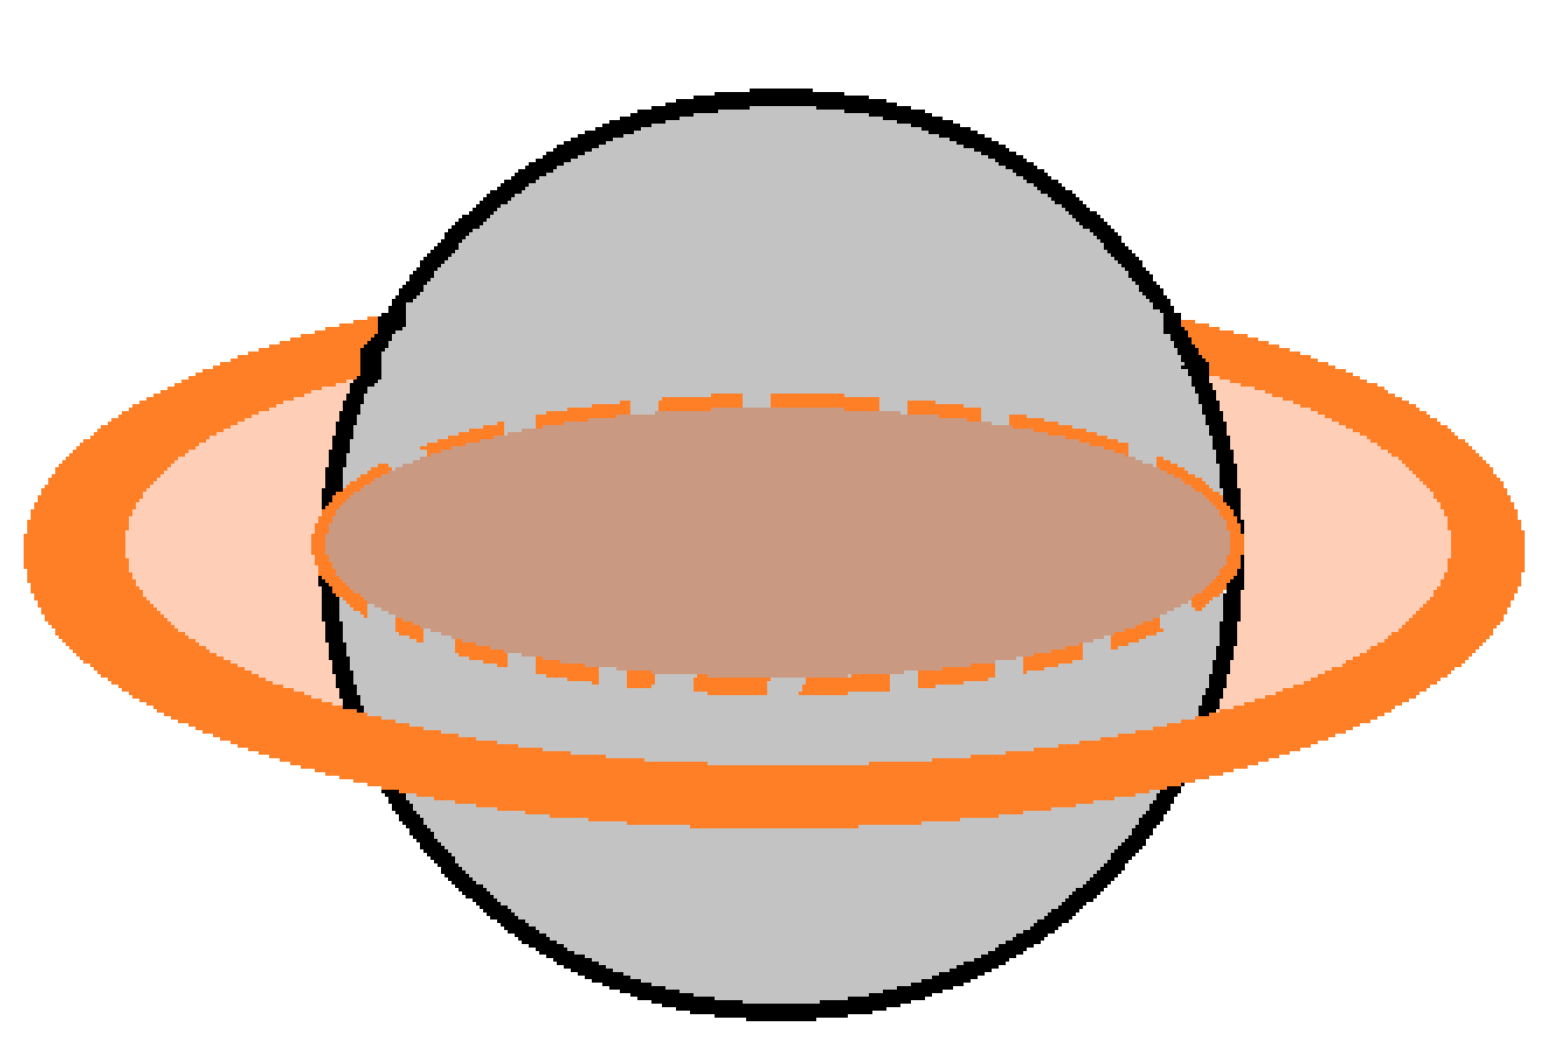










Multi-view Representation Learning - DGS
Bridge Space
5
7
Spherical Space
Instance $θ_{r_{k}}^{B}$
6
6
7
Ontology $θ_{r_{k}}^{B}$
Hyperbolic Space
4
2
1
1
3
$θ_{r_{k}}^{H}$
2
8
4
3
5
9
10
8
$θ_{r_{k}}^{S}$
9
10
Sub-sampling
bridge entities
concepts
7
$$𝔹^{d}, K^{B}>0$$
$$ℍ^{d}, K^{H}<0$$
entities
7
6
$$𝕊^{d},K^{S}>0$$
6
6
5
4
4
2
1
3
3
5
8
9
5
10
8
Perform spherical update of entities: $R_{I}$
Alternatively perform spherical and hyperbolic updates of bridge nodes: $R_{I}∪R_{IO}$
Perform hyperbolic update of concepts: $R_{O}∪R_{IO}$
Updates
7
6
4
6
4
6
$$…$$
$$…$$
$$…$$
8
9
8
5
1
2
Notes:
Updates are performed s.t. there is bi-directional influence from the bridge nodes to other entities and concepts

Slide 11
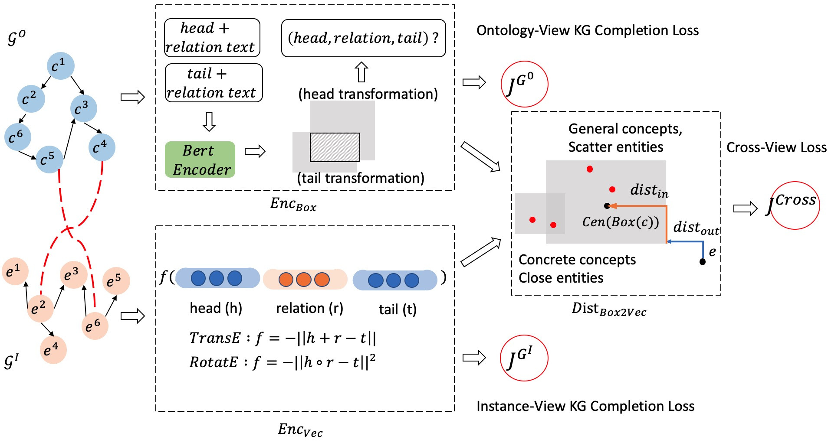
Multi-view Representation Learning – Concept2Box
Notes:
Here's the overall framework of concept2box
In total we have three loss that are trained jointly.
The KG completion loss for concept KG, which is modeled using box embedding.
The KG completion loss for product KG, which is modeled using existing vector KG embedding method
The cross KG loss , or the concept linking loss, which is based on the distance from a vector to a box.

Slide 12
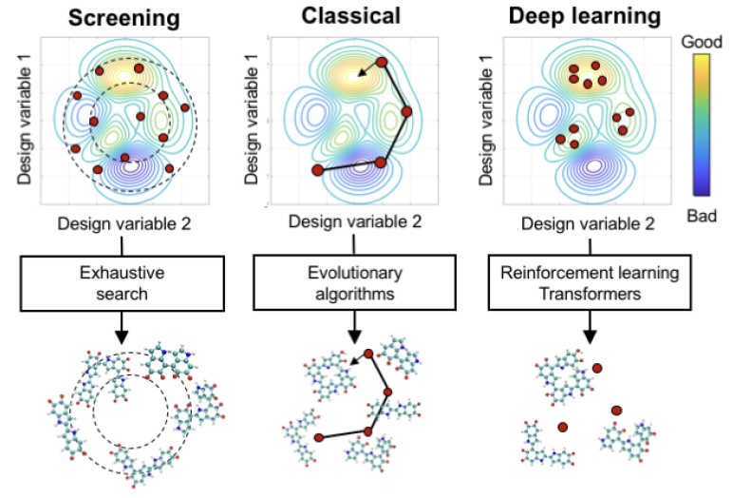
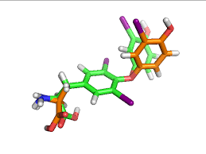
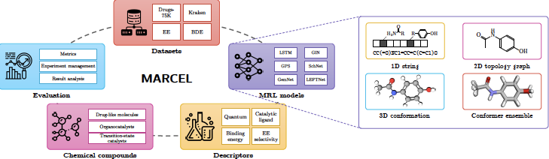
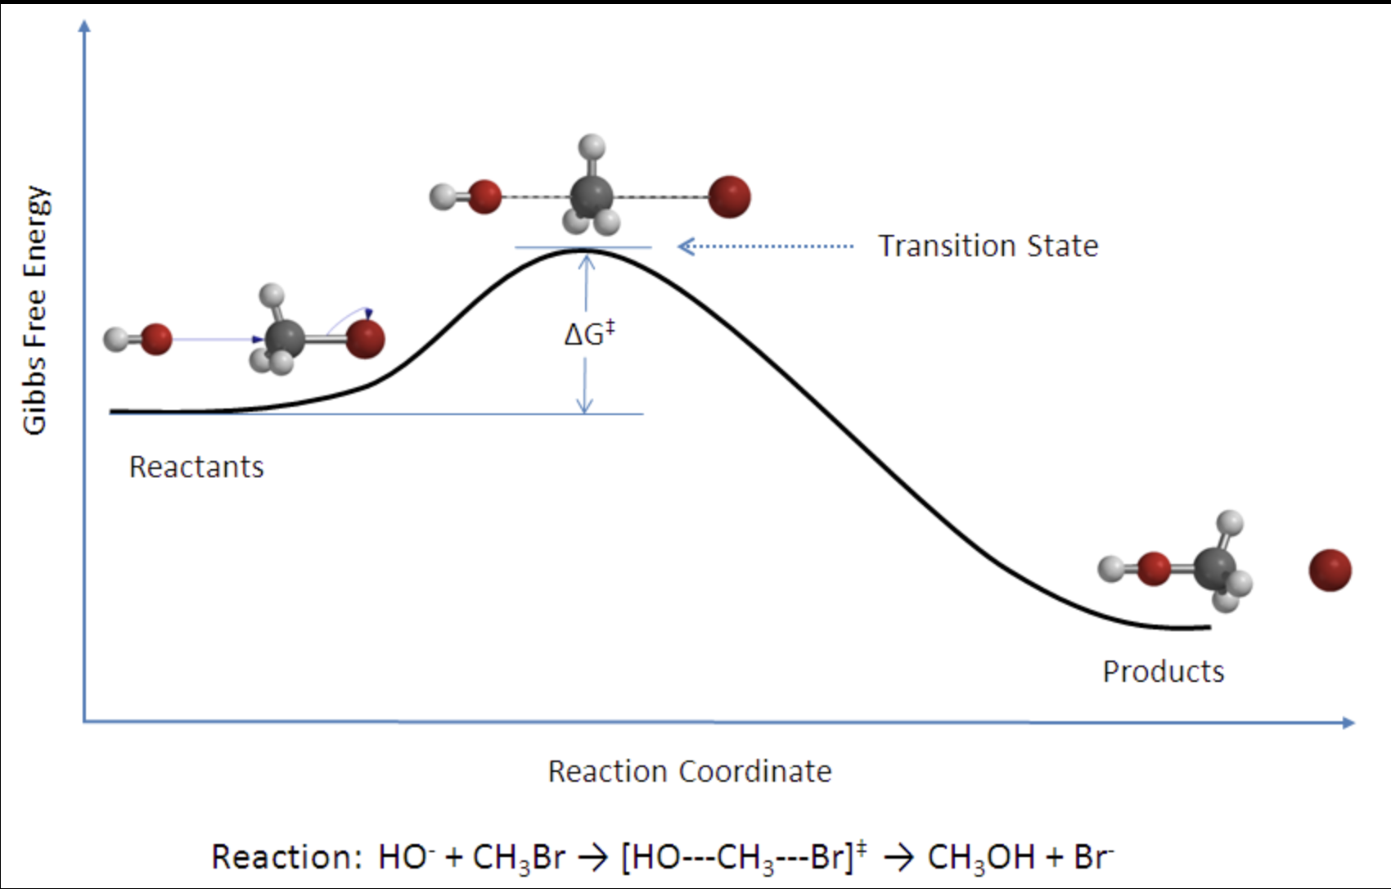
Molecular conformer ensembles

Slide 13
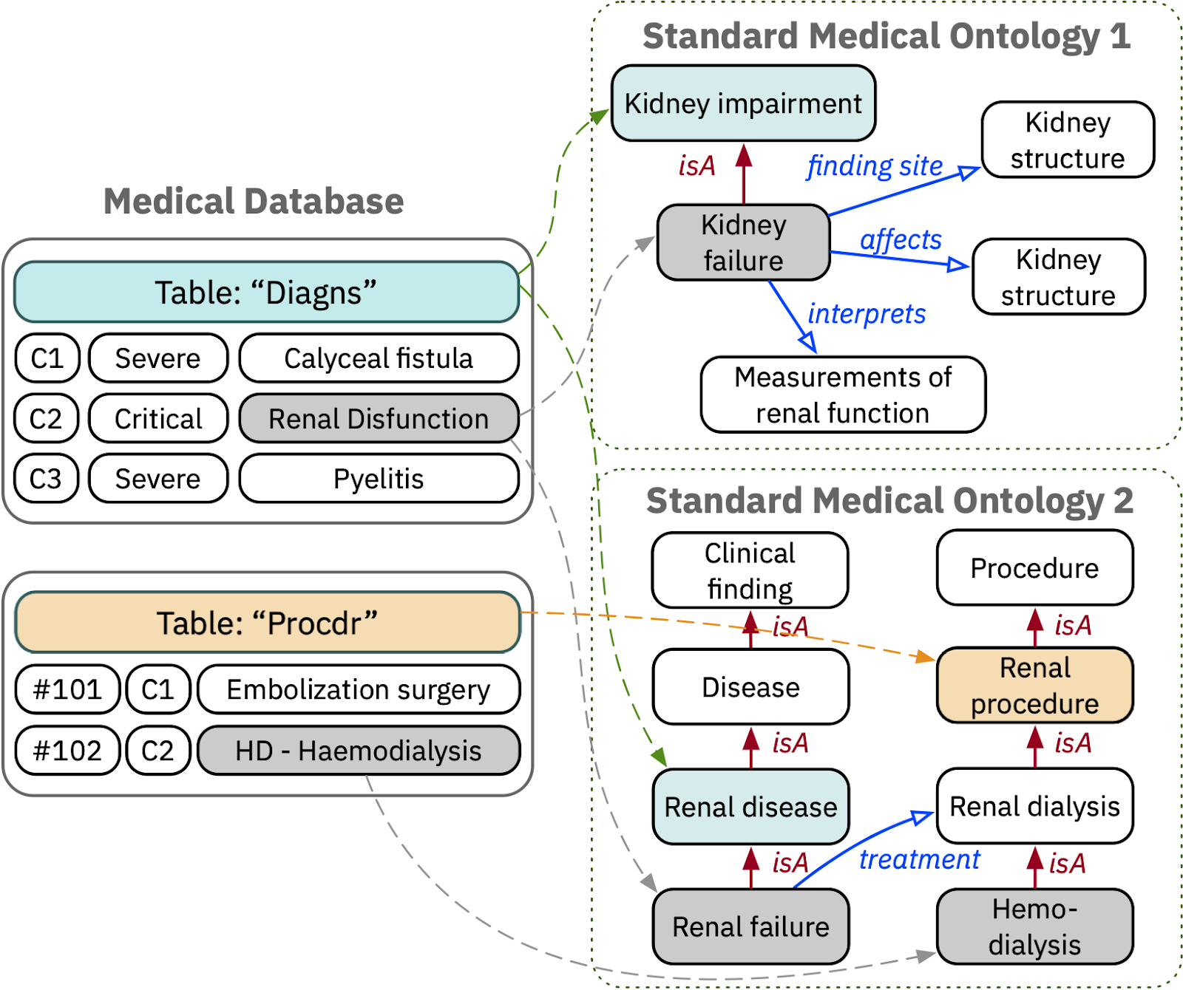
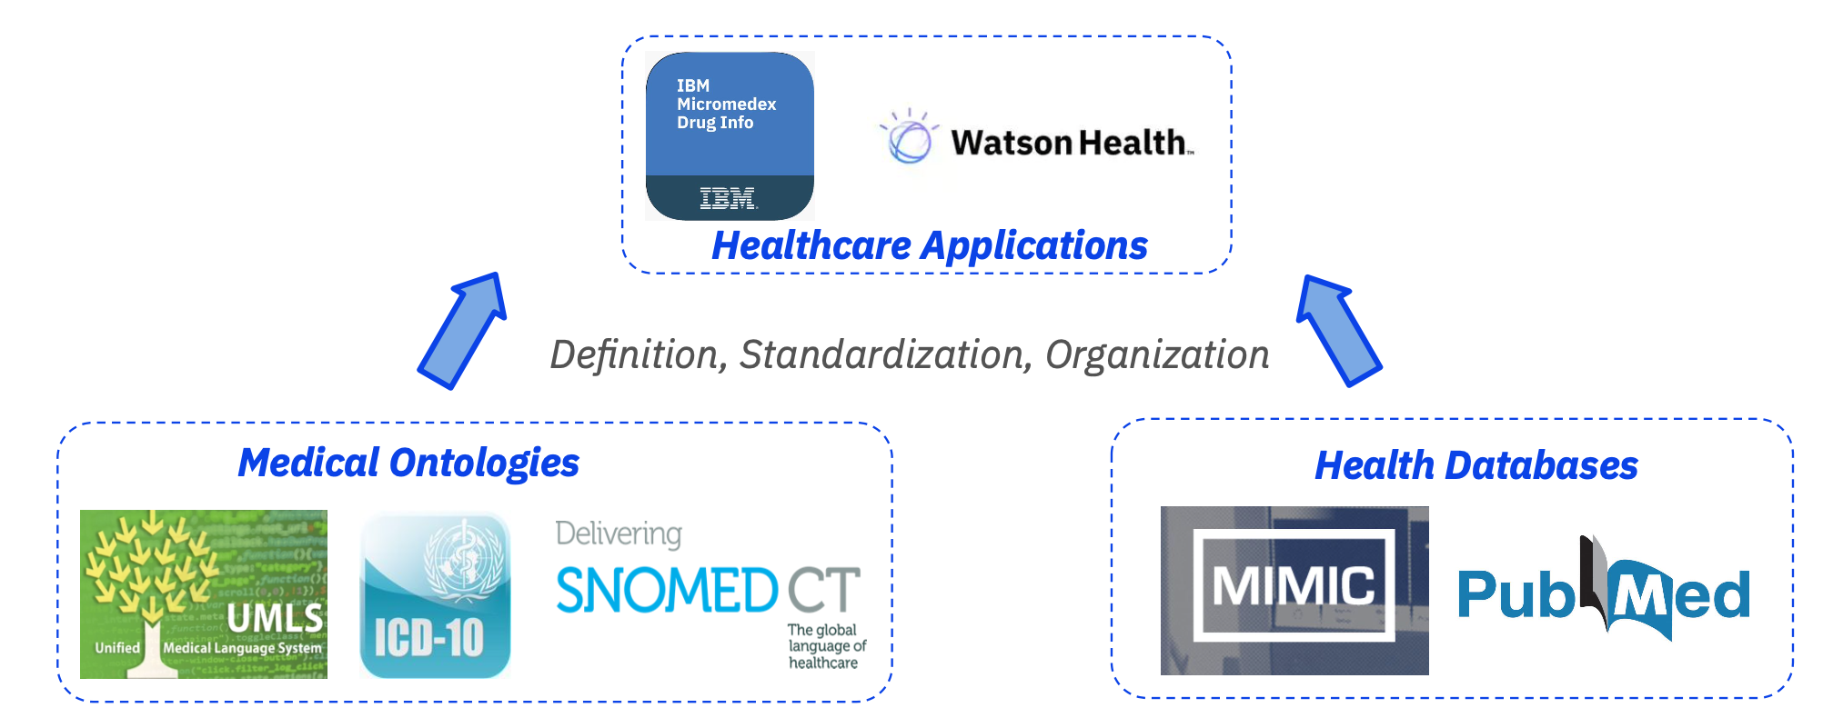
MEDTO: Hybrid-GNN Data-Ontology Matching

Slide 14
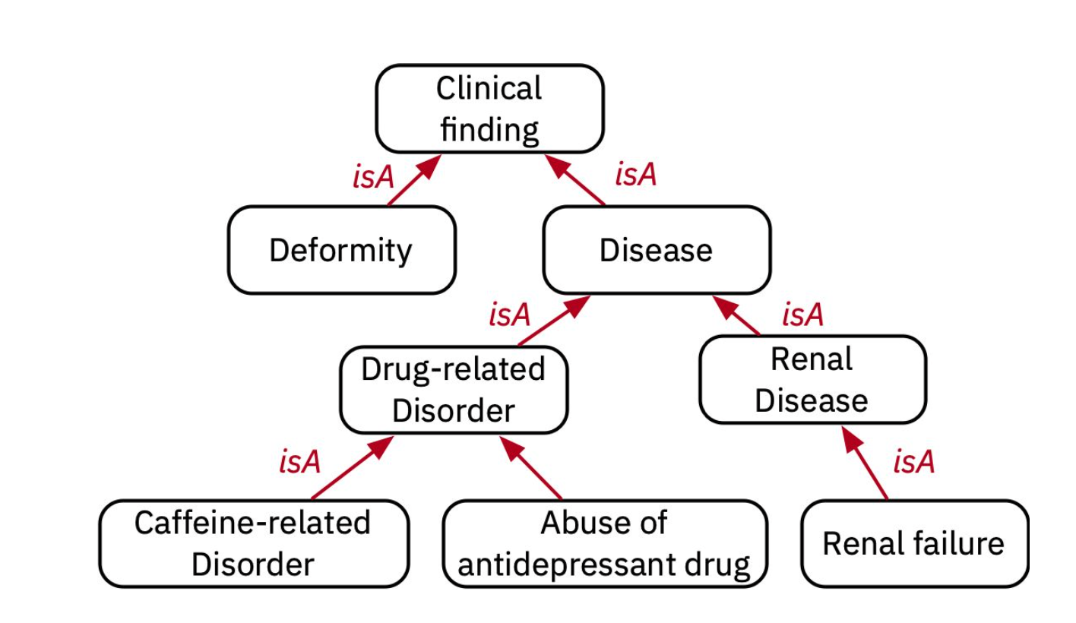
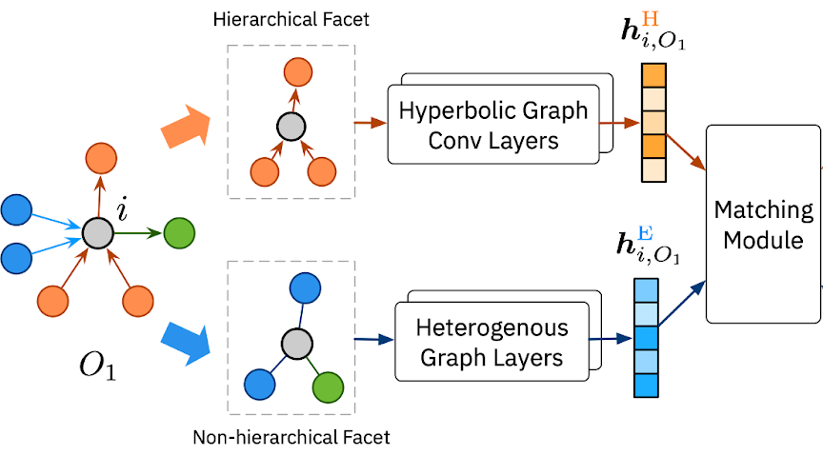
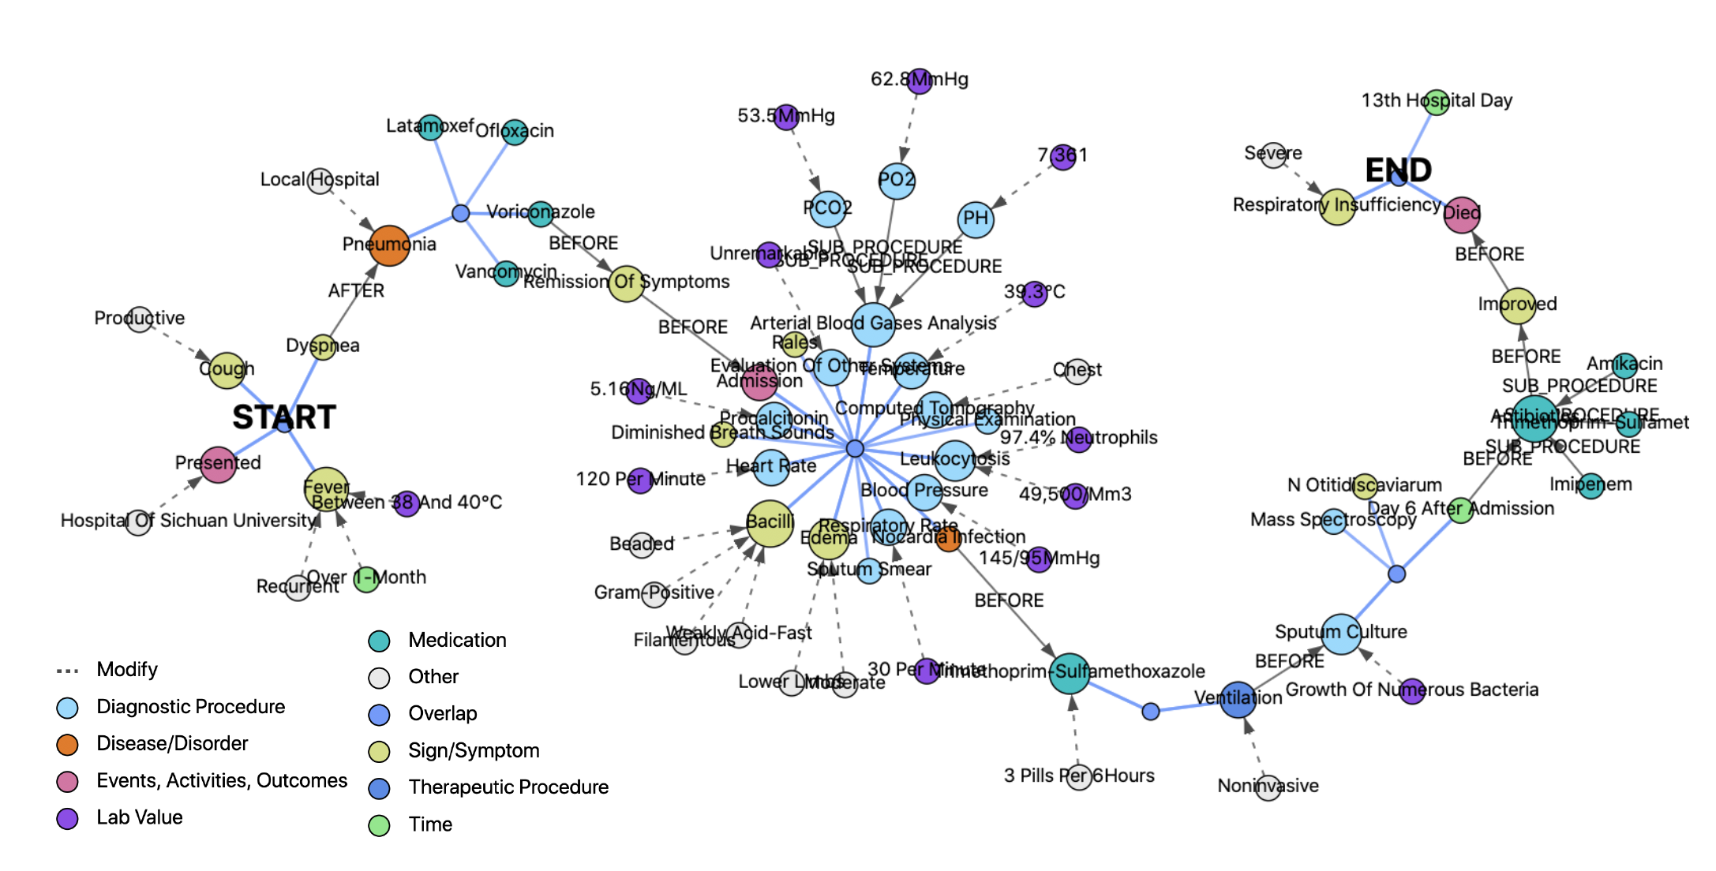
MEDTO: Hybrid-GNN Data-Ontology Matching

Slide 15
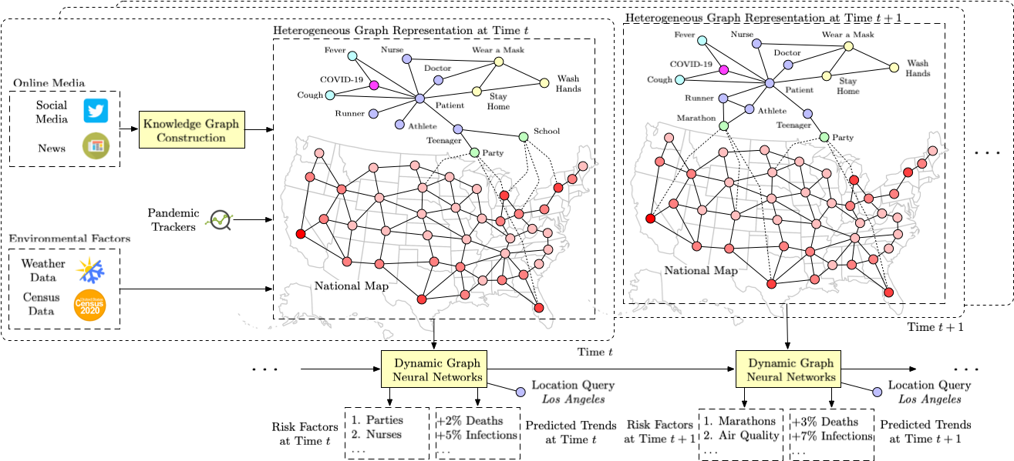
Pandemic monitoring and forecast

Slide 16
Conclusion remarks
Enabling Scientific Breakthroughs: Knowledge representation plays a pivotal role in accelerating scientific breakthroughs by organizing, integrating, and making sense of vast and complex scientific data.
Dynamic and Adaptive: In the ever-evolving landscape of science, adaptable knowledge representation systems facilitate the seamless integration of new discoveries and revisions to existing knowledge.
Human-centered AI: Engaging domain experts remains crucial in the development and refinement of knowledge representation systems, ensuring their relevance and accuracy.
Ethical and Responsible Research: They incorporate ethical considerations into the scientific process, ensuring responsible research conduct, data privacy, and transparency.

Slide 17








Thank you!
weiwang@cs.ucla.edu

