Slide 1
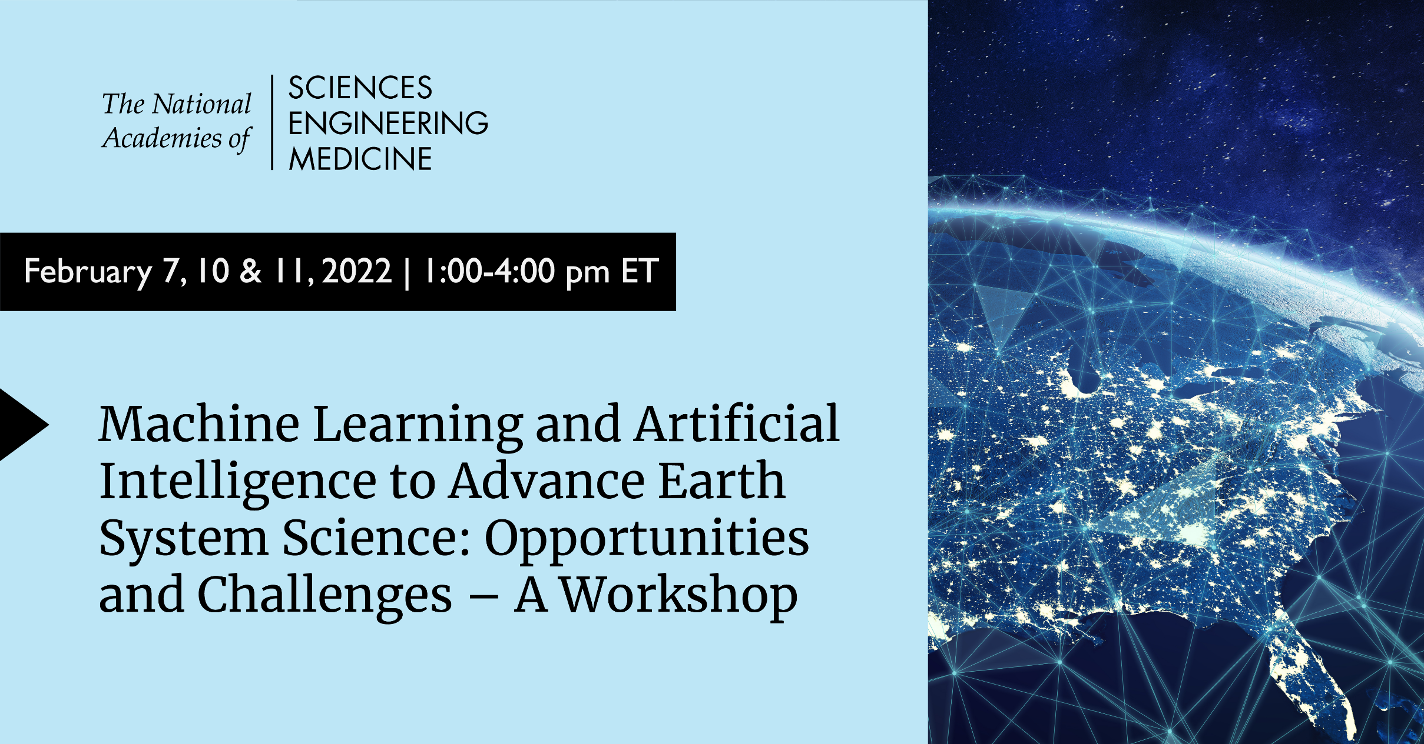

Slide 2
Machine Learning and Artificial Intelligence to Advance Earth System Science:
Opportunities and Challenges - A Workshop
Workshop Background
Every few years the Board on Atmospheric Sciences and Climate (BASC) organizes a workshop on a self-selected topic to explore an issue in some depth and leave a record of those discussions.
This workshop is a collaboration between BASC and the Board on Mathematical Sciences and Analytics, Computer Science and Telecommunications Board, Board on Earth Sciences and Resources, and Ocean Studies Board.
Workshop funded under Board core support from NASA, NOAA, and NSF.
Specific topics addressed include:
  Review current applications of ML/AI to Earth system science.
  Survey emerging ML/AI technologies and approaches that could be useful for Earth system science.
  Consider challenges and risks of using ML/AI for Earth system science and discuss ways to mitigate these risks.
  Identify future opportunities to accelerate progress.

Slide 3
Machine Learning and Artificial Intelligence to Advance Earth System Science:
Opportunities and Challenges - A Workshop
Workshop Planning Committee
Dr. L. Ruby Leung (NAE), Chair, Pacific Northwest National Laboratory
Dr. Ann Bostrom, University of Washington
Dr. Patrick Heimbach, University of Texas at Austin
Dr. Amy McGovern, University of Oklahoma
Dr. Diego Melgar, University of Oregon
Dr. Aarti Singh, Carnegie Mellon University
Dr. Laure Zanna, New York University

Slide 4
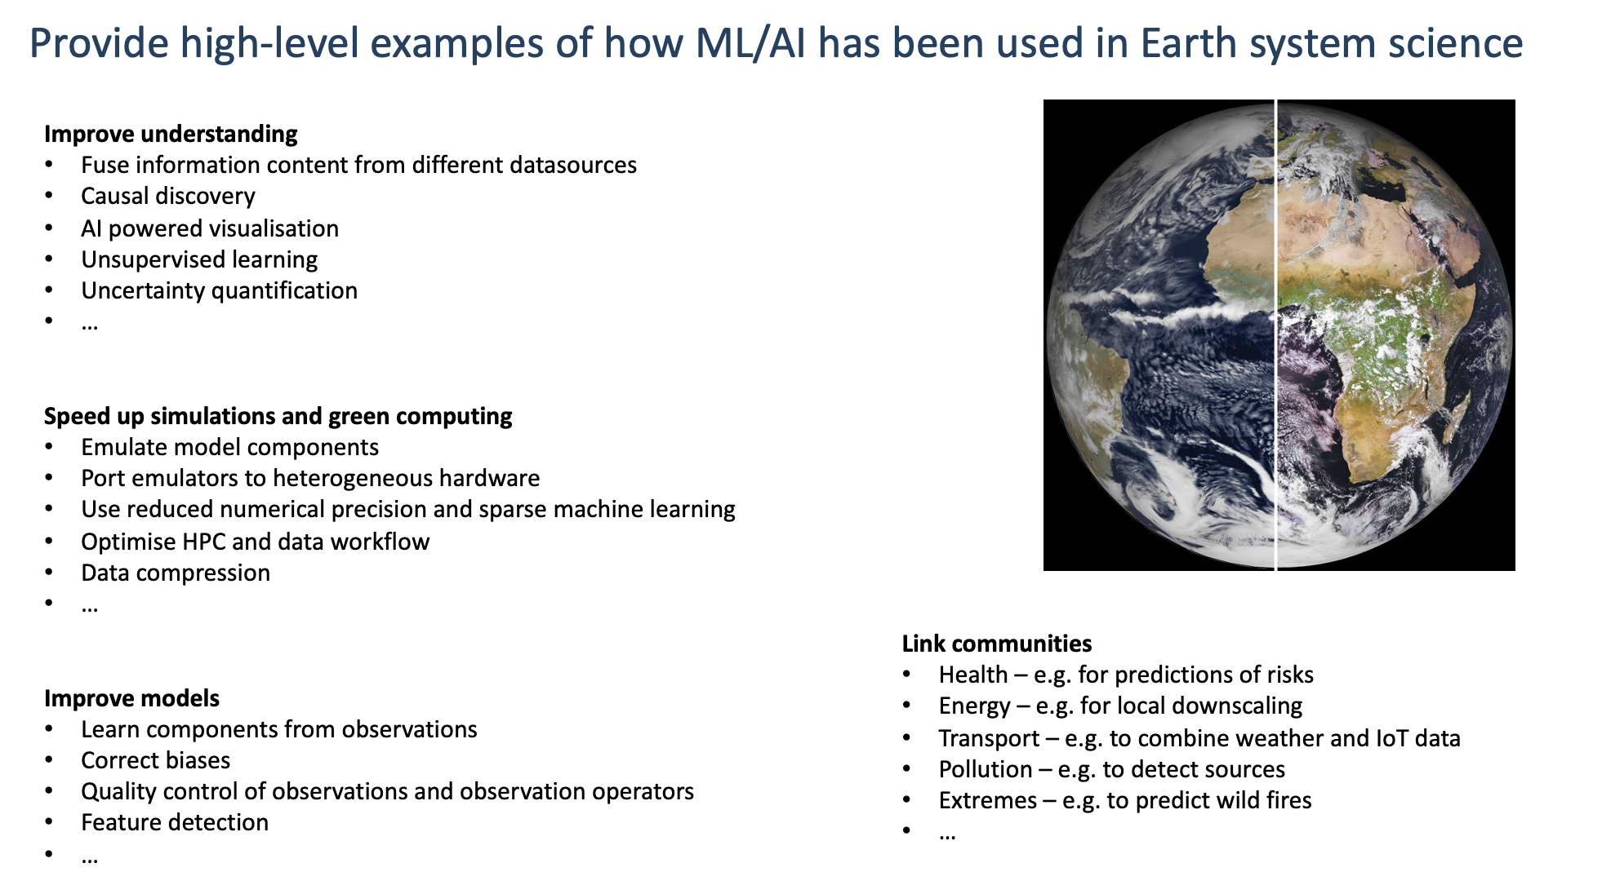
(Peter Dueben, ECMWF)

Slide 5


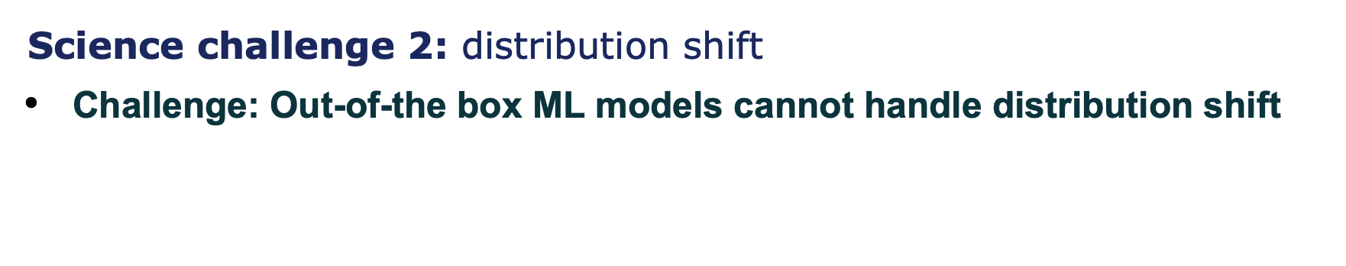


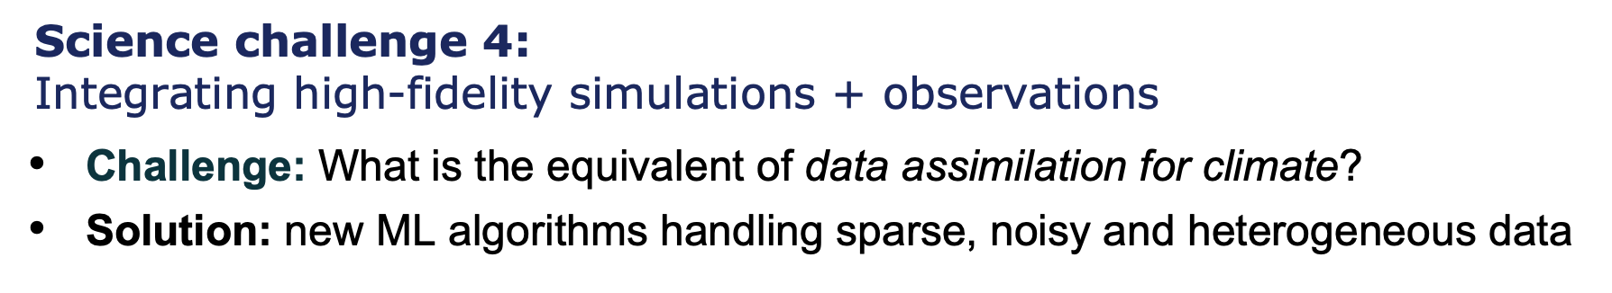
(Pierre Gentine, Columbia University)

Slide 6
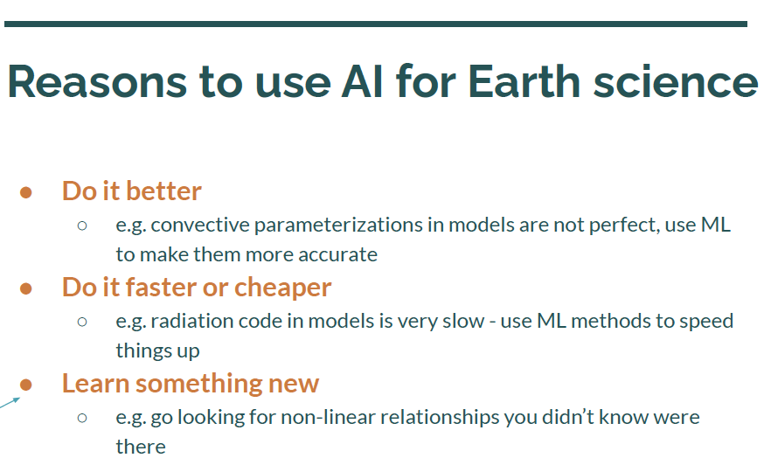
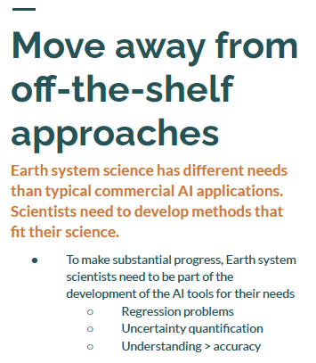
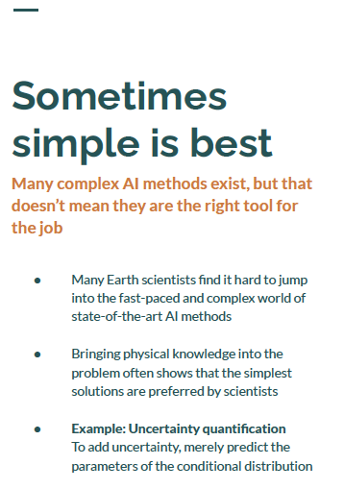
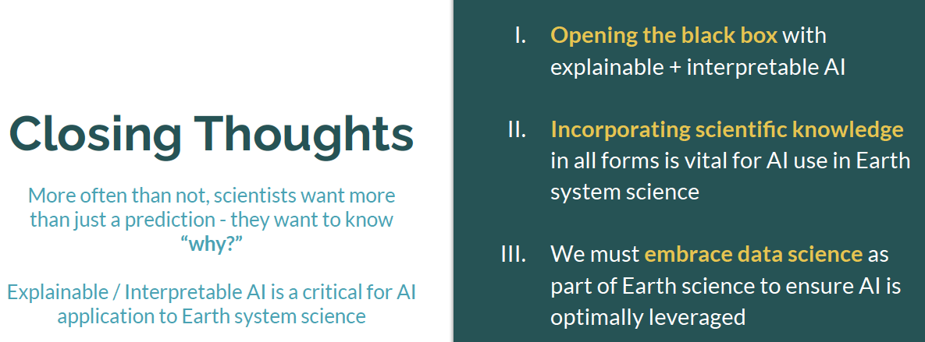
(Elizabeth Barnes, Colorado State University)

Slide 7
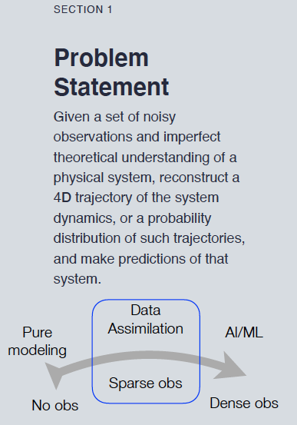
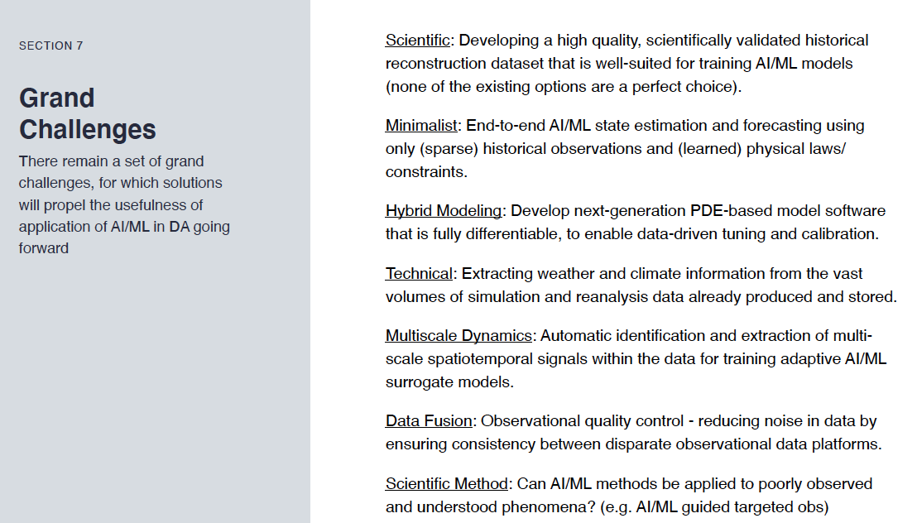
(Steve Penny, Sofar Ocean)

Slide 8
Emerging Opportunities from Social and Human Engineered Systems
Auroop Ganguly (Northeastern University and PNNL): ML/AI in combination with science, engineering, social science theory, and policy frameworks can tackle the challenging complexities at the intersection of coupled natural, human-engineered, and social systems.
Abigail Snyder (PNNL): use of ML/AI tools for computationally efficient coupling of human and Earth systems, representing systems for which researchers lack hypotheses in the structure of input-output relationships, and using unsupervised learning on large ensembles of model results for knowledge discovery.
David Rolnick (McGill University): AI tools can be valuable in motivating fundamental innovations in AI, creating valuable use cases for hybrid physical models, transfer learning, interpretable and causal ML, and uncertainty quantification. However, AI may provide incorrect information if the question has not been framed properly.
Jennifer Hayes (UC Berkeley): described a vision for creating an integrated ML climate platform that includes not only physical laws and technical solutions but also behavioral changes, economic constraints, and geopolitical factors.

Slide 9
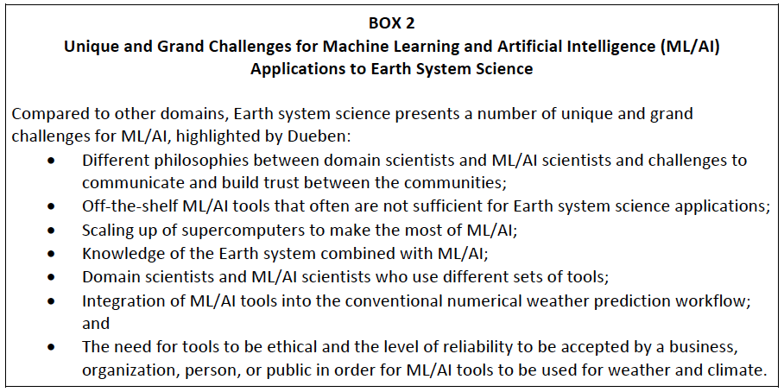
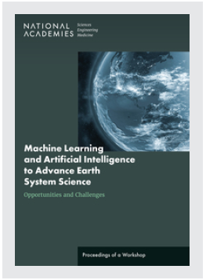
Workshop proceedings: https://doi.org/10.17226/26566

Slide 10
Machine Learning and Artificial Intelligence to Advance Earth System Science:
Opportunities and Challenges - A Workshop
Agenda
DAY 1 (February 7)
Welcome
Session 1: Overview of State of the Art Use of ML/AI for Earth System Science
Session 2: Emerging Approaches for Using and Interpreting ML/AI
Session 3: Emerging Opportunities from Social and Human Engineered Systems
Wrap-up
DAY 2 (February 10)
Welcome
Recap of Day 1
Session 1: Responsible and Ethical Use and JEDI Issues
Session 2: Workforce Development Capacity and Skill Sets
Session 3: Challenges and Opportunities for Earth Science Technology and Data
Wrap-up
DAY 3 (February 11)
Welcome
Recap of Day 2
Session 1: Using ML/AI for Data-Driven Decision Making
Session 2: Novel Funding Mechanisms, Partnerships, and Knowledge Transfer Between Academies, Industry, Nonprofits and Government
Summary of Day 3
Closing Remarks
Notes:
Will highlight for each day

