Slide 1

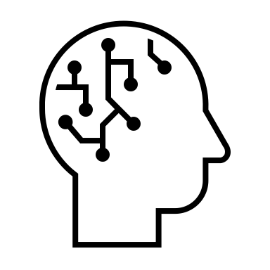




Accelerating Computer-Enabled Discovery (ACED)
Engaging the Community through 5 Workshops:
Data, AI and Machine Learning
Chemistry
Environmental Science
Materials Science
Genomics
Computer Systems
Mathematics
Your Science Here!
Digital Twins
Smart Sensing and Analytics
…
Rigorous & Reproducible Reasoning
Programmable/Self-Driving Labs
1
Notes:
Can we harness the full power of computing to fundamentally revolutionize the scientific method, across all fields of science and engineering?

Slide 2
Accelerating Computer-Enabled Discovery (ACED)
Data, AI and Machine Learning
Digital Twins
Smart Sensing and Analytics
Rigorous & Reproducible Reasoning
Programmable/Self-Driving Labs
Organizers: Shih-Chieh Hsu, Aidong Zhang
Virtual
Tentative: October 2-3, 2023
Meta-workshop bringing together leaders of specific domains in data science, AI and ML. Majority of attendees will be core organizers from recent workshops and meetings around the heart of data-intensive discoveries. They will include the most important findings from their events, bring them to this meta-workshop, and collaborate with other participants to generate new insights.
Organizers: Karen Willcox, Omar Ghattas, Kenichi Soga
In person: Santa Fe Institute’s Cowan campus, Santa Fe, NM
Oct 11-12, 2023
The workshop aims to identify research gaps in digital twin technologies that are common across application domains and that may benefit from crosscutting interdisciplinary research efforts. The workshop will focus on four methodological themes: models; data; decisions; and verification, validation, and uncertainty quantification, across diverse application domains.
Organizers: Mingyi Hong, Alison Gray, Cherie Kagan, Qi Li, Joshua Smith, Peng Wei
In person: NSF in Alexandria, VA
Dec 7-8, 2023
This workshop will bring together stakeholders with domain expertise in sensing systems together with experts on signal processing, optimization, machine learning, and control theory to address a number of present and future challenges in smart sensing and analytics.
Organizers: Sriram Sankaranarayanan, Chris Myers, Rajagopalan Balaji
In person: University of Colorado, Boulder, Colorado
Nov 13-14
This workshop will explore rigorous and reproducible approaches to increase confidence in the outcomes of data driven scientific workflows/processes. The focus will be on development and use of rigorous methods to ensure correctness, reliability, robustness, reproducibility, safety, security, and efficient resource usage.
Organizers: Nadya Peek, Thomas Kurfess, and Ian Foster
In person: East coast
Nov 14-15,2023
This workshop will convene experts in laboratory automation, data-driven methods, robotics, manufacturing, and human-machine interaction to identify the major challenges facing self-driving and automated experimental laboratories that can dramatically shorten the time between iterations of experiments or make it possible to conduct experiments that would be too dangerous for human technicians.
TBD
https://santafe.edu/events/crosscutting-research-needs-digital-twins
TBD
TBD
TBD
Notes:
Digital Twins – Oct 11 and 12
Smart Sensing - Dec 7 and 8
Self-Driving - Nov 14 and 15
Scientific Reasoning - Nov 13 and 14

