Slide 1
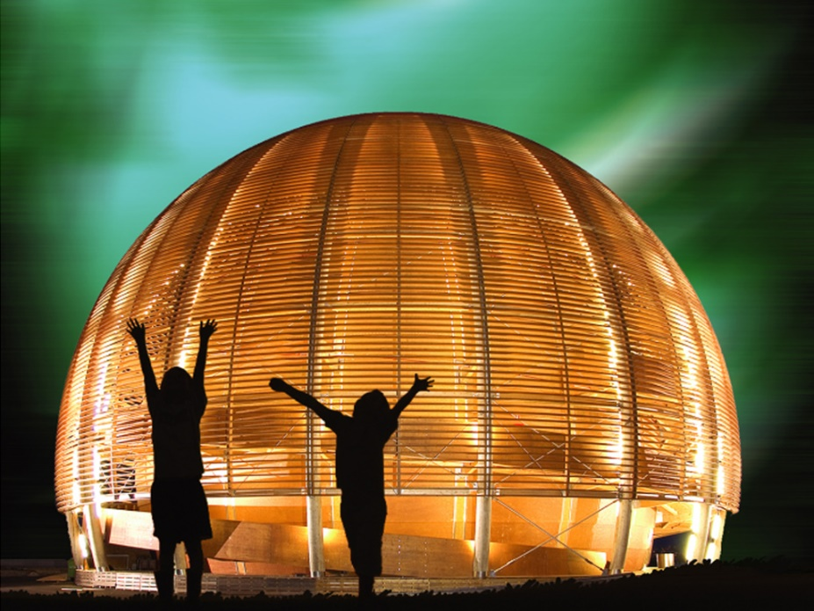



Slide 2
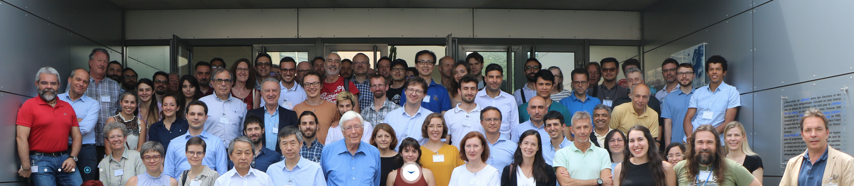
Impressive progress
ESPP: “an international design study for a muon collider - to determine whether investment in a demonstrator and a conceptual design report is justified from the scientific perspective”
CERN’s 2020 MTP – resources allocated to host an International Muon Collider study at CERN – an opportunity well exploited by Daniel et al leading to a thriving IMCC
Accelerator R&D Roadmap document delivered to Council at end of 2021 - included an international effort by representatives of the Muon community “Bright muons beams and Muon Colliders”
MuCol successful application to Horizon INFRADEV last year - Development of novel technologies for the Muon Collider

Slide 3


Slide 4
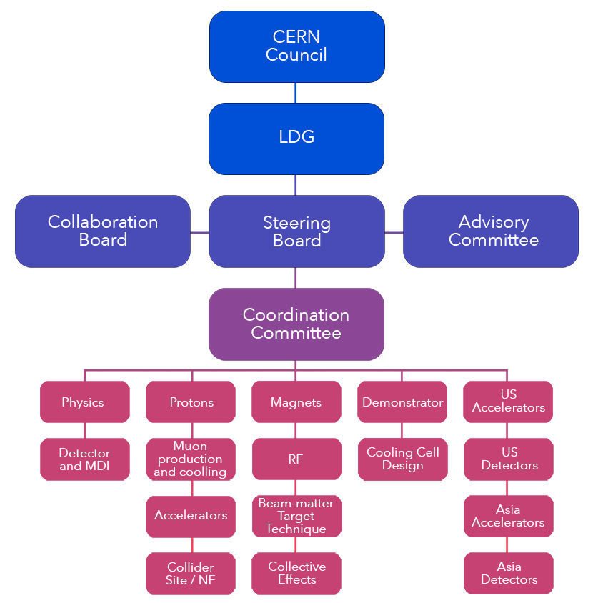
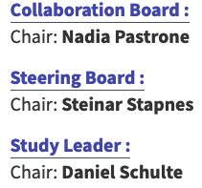
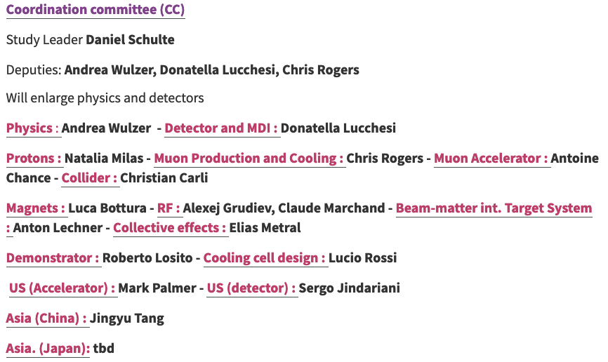

Slide 5
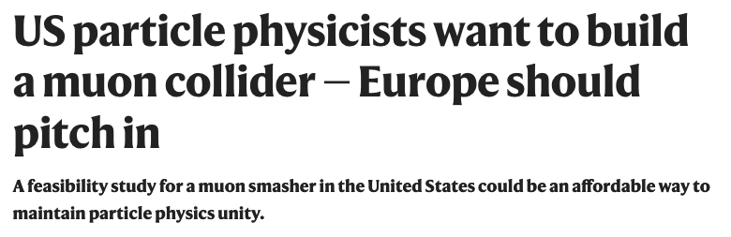

Slide 6
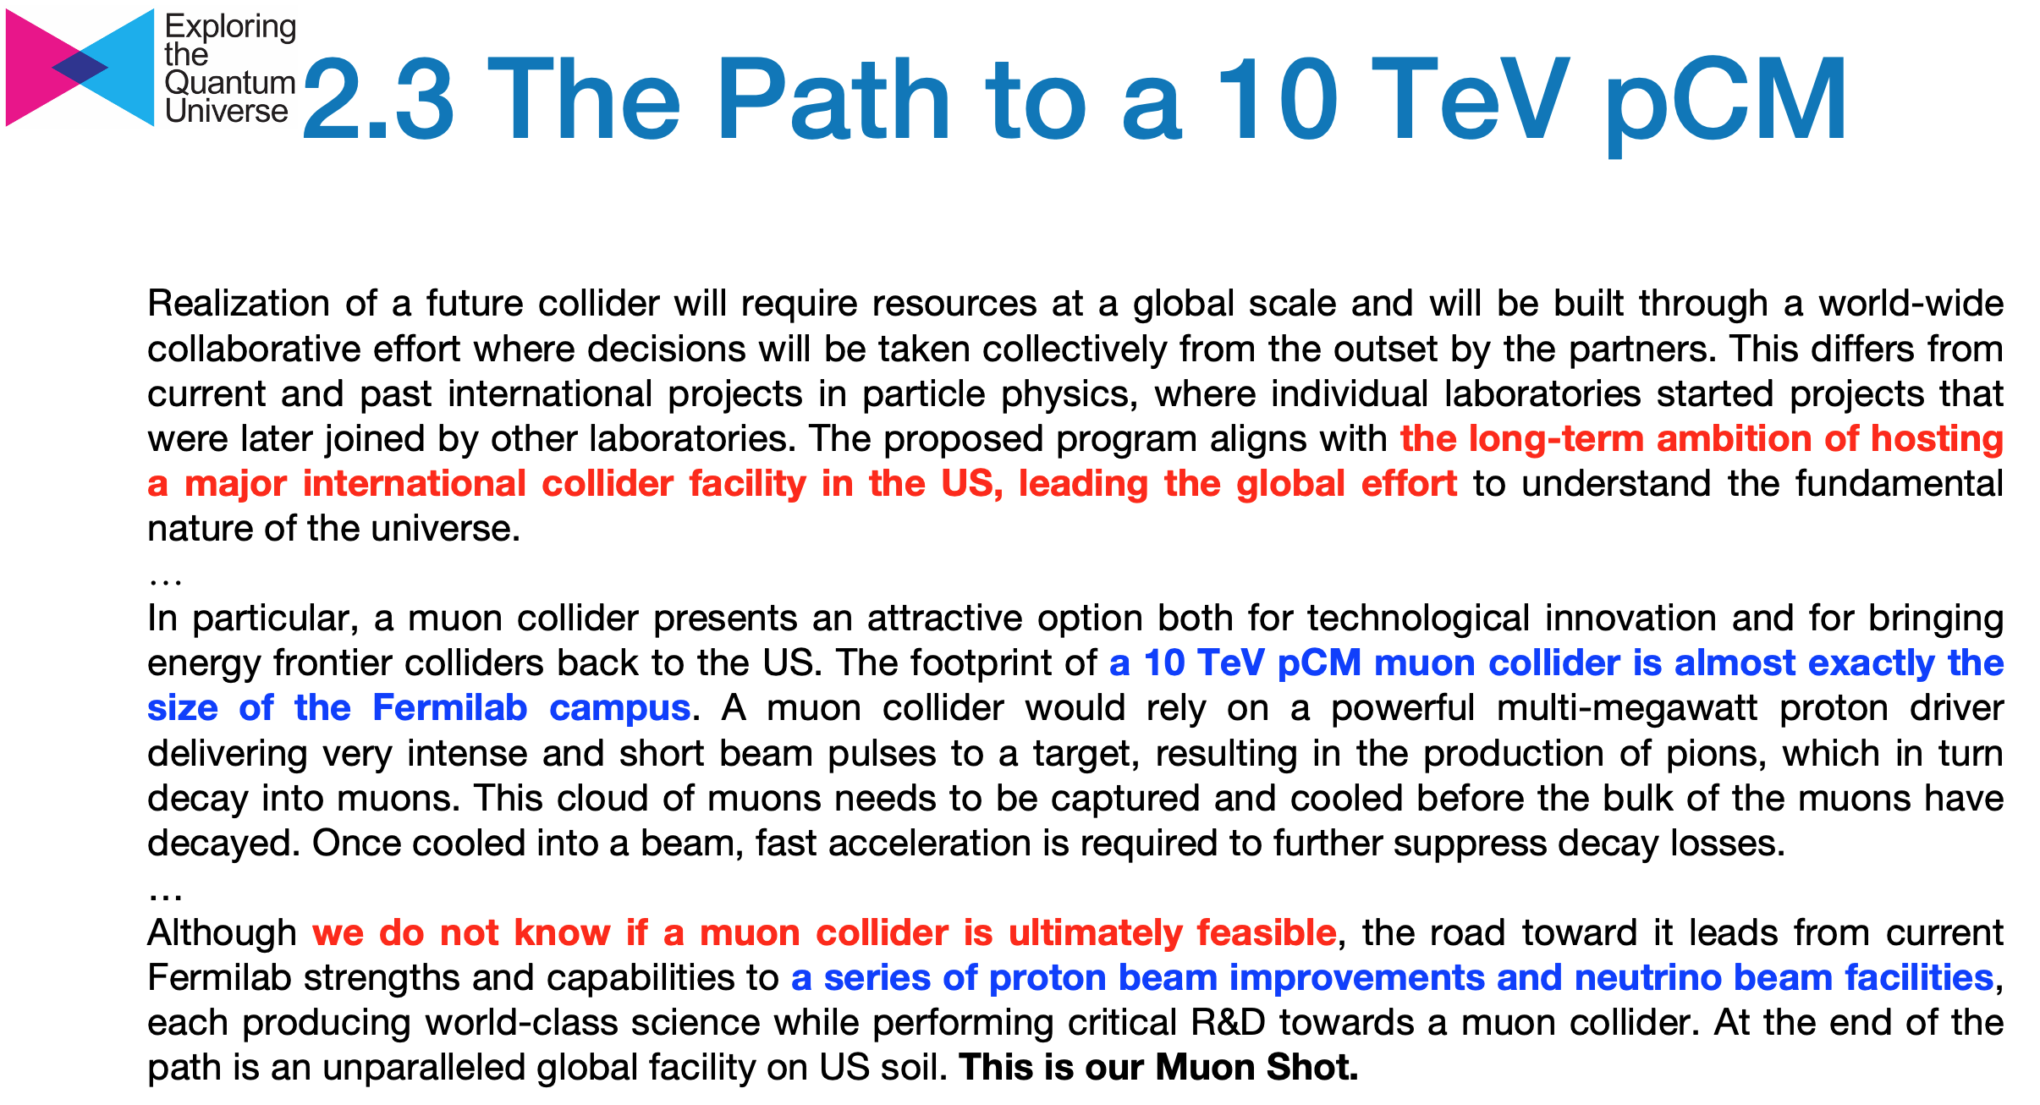

Slide 7


Slide 8
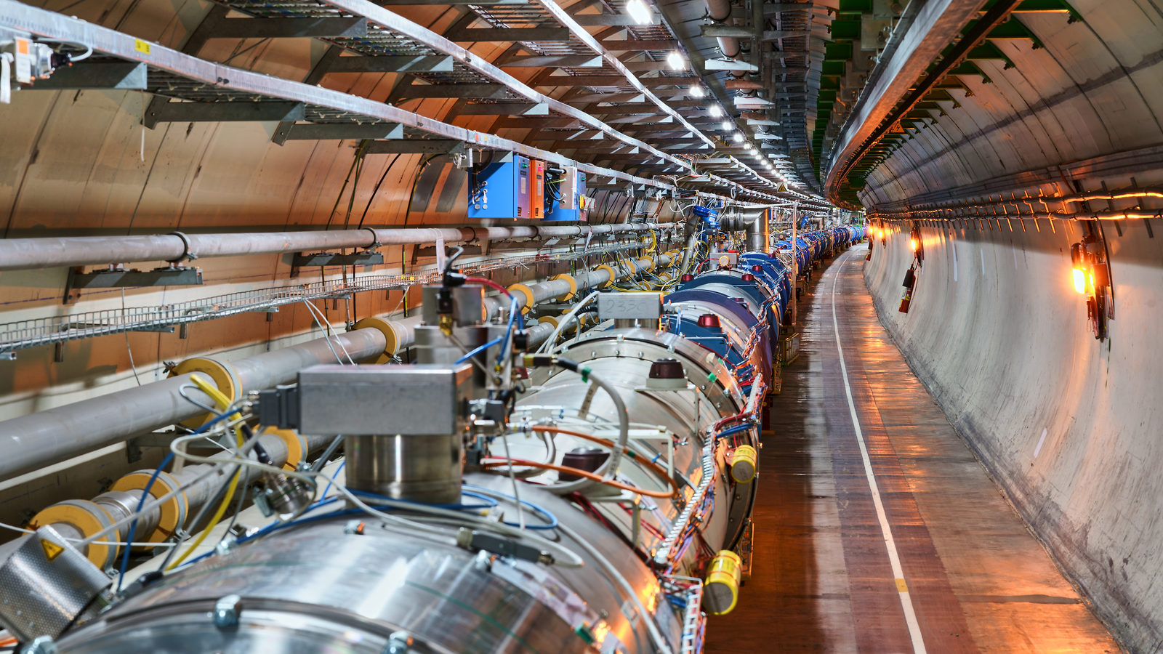
CERN Plans

Slide 9
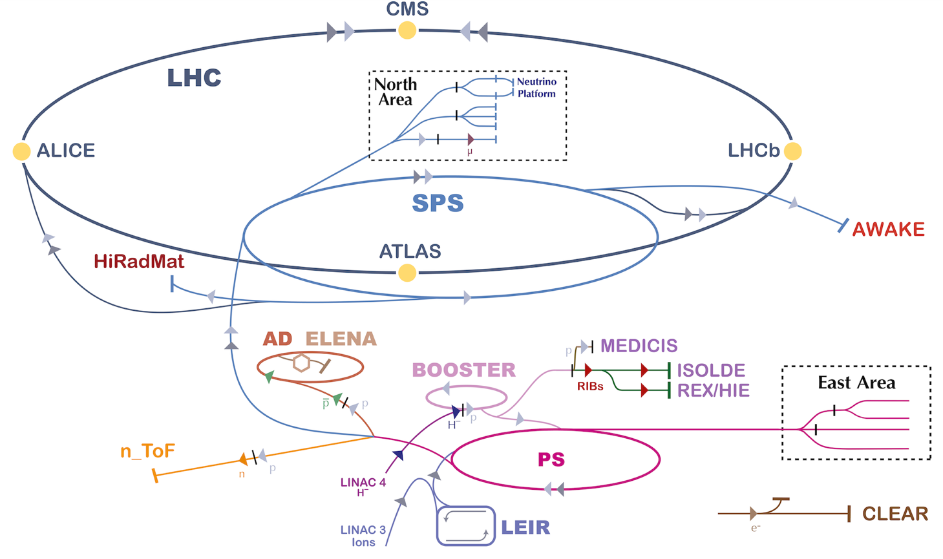
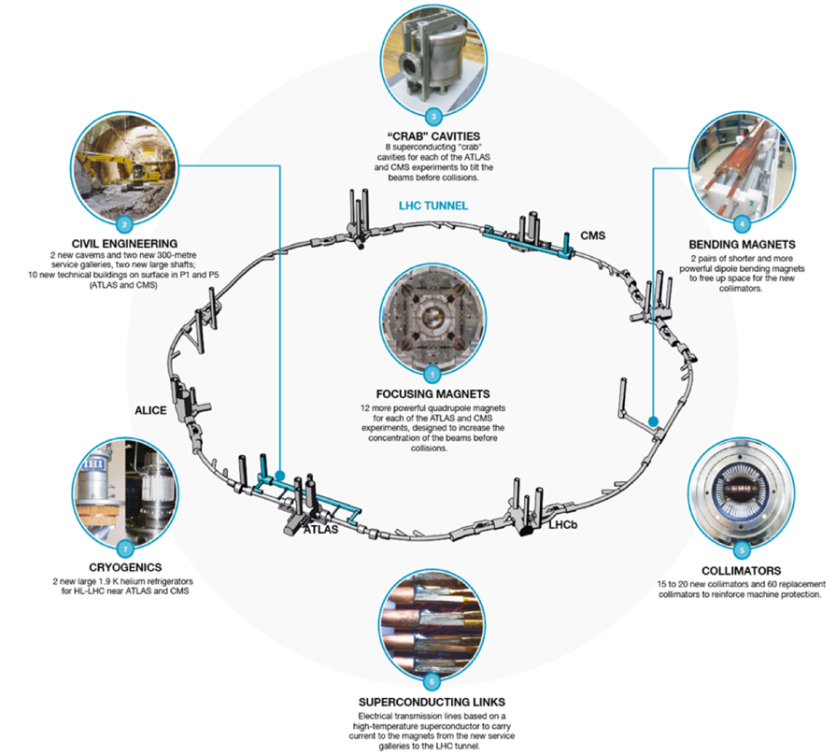
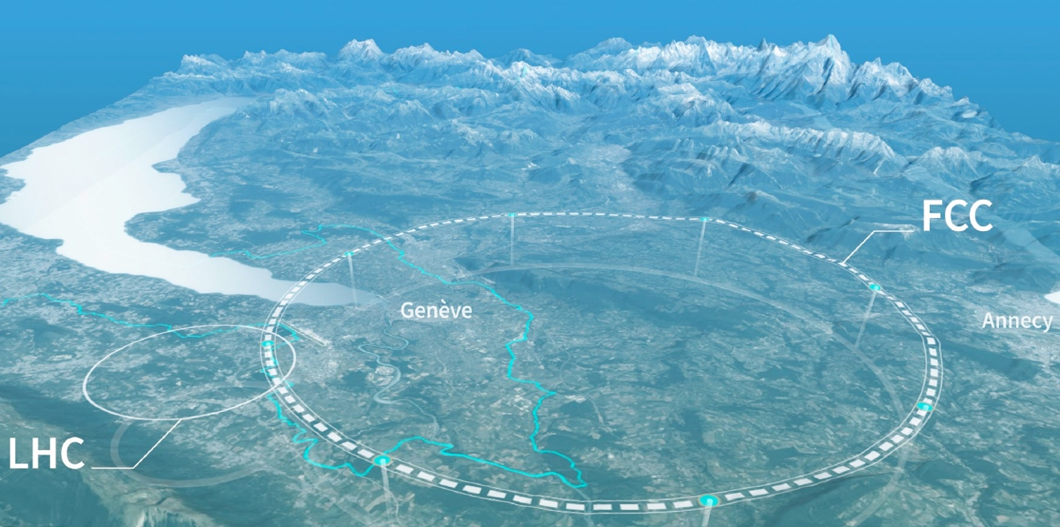
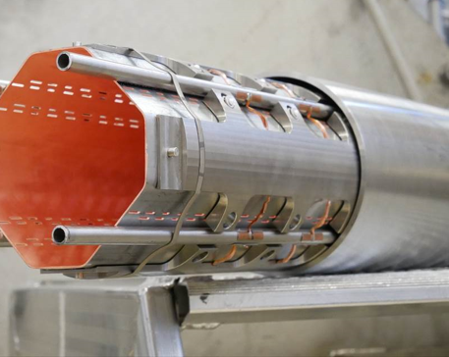
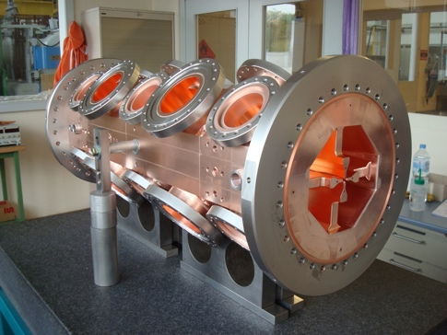
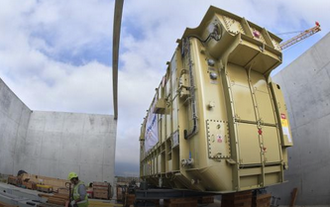
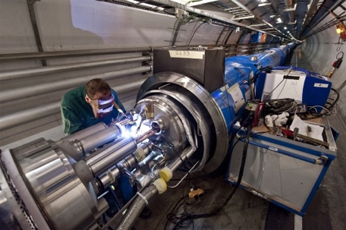
HL-LHC
Future Options
Technology/Engineering/R&D

Slide 10
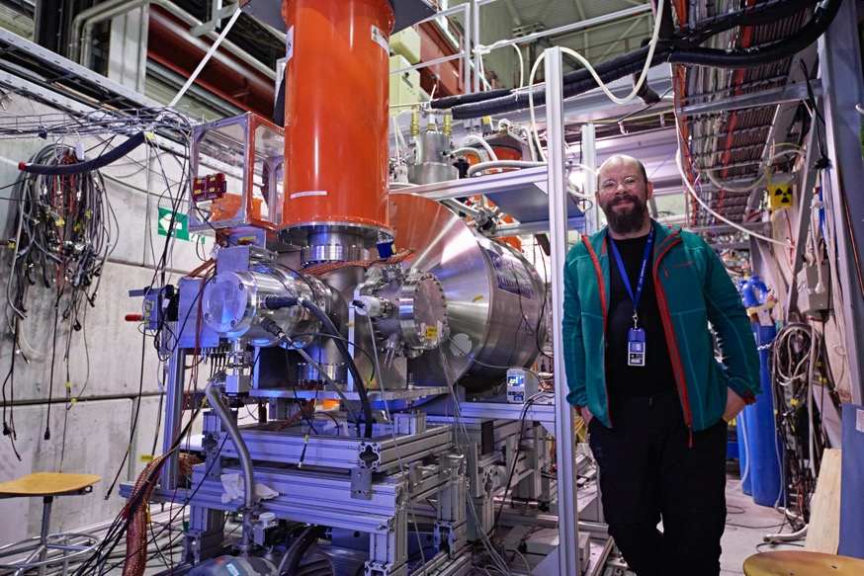
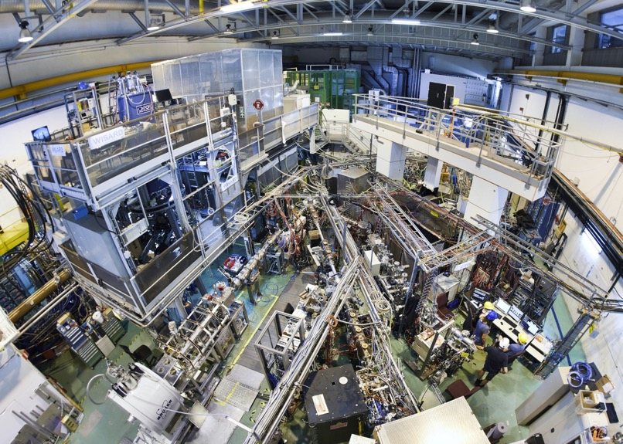
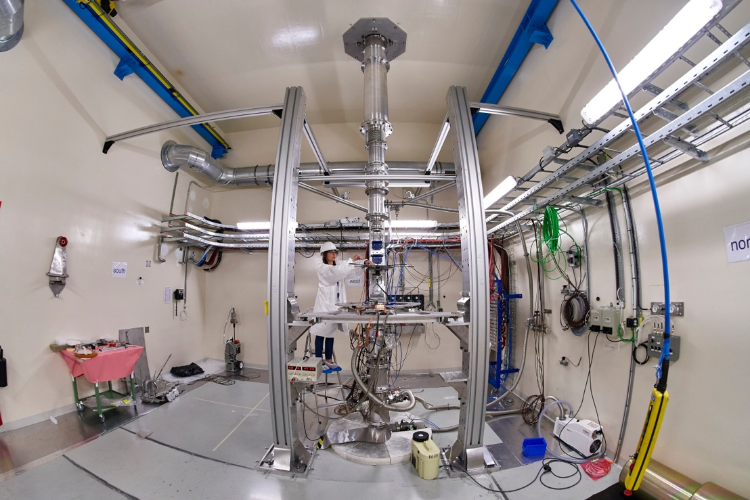
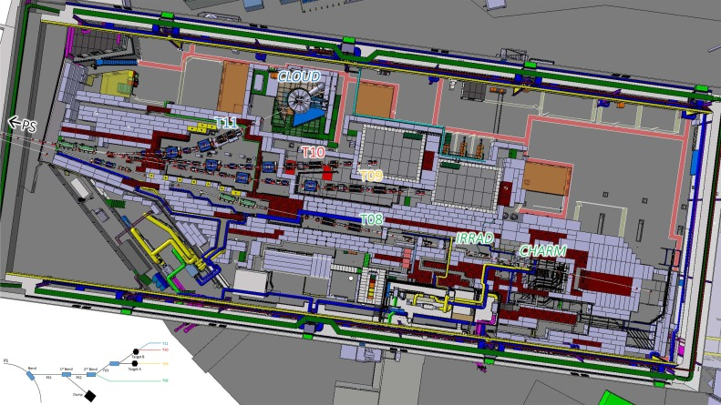
AD-ELENA
ISOLDE
n_TOF
East Area
Notes:
Diverse Physics programme

Slide 11
AD, n_TOF, ISOLDE, North Area, East Area
Unique facilities worldwide
  High satisfaction across the physics user community
Significant physics return from previous consolidation and improvement investments
  Machine understanding, control and automation efforts must persist to safeguard the investment
Anticipate further investment aimed at bolstering the facility’s long-term sustainability with a target operational horizon extending to 2042 (and possibly beyond)
Extending the facility physics reach is possible, depending on the physics cases that will emerge in the forthcoming years
Facilities still have a bright future and their place in the future of the CERN accelerator complex (i.e. FCC era)
Notes:
Some other informations:
- Today, well physics community is well set for next 10 years. Modification for following 10 years will likely require some discovery/new ideas coming up in the next 10 years.
- Cost of building the facility in ~2000 was estimated to be about 8 MCHF according to https://cds.cern.ch/record/507788. Back then, the cost of building AD from scratch (at CERN) was considered to be 100 MCHF.
- The cost of building AD facility on a green field is estimated to be of the order of 1BCHF, dominated by the cost of building the proton facility.
- The average running cost of the AD facility are estimated to be:
- - Operational Staff Workforce: ~16 FTE/year mainly coming from BE & SY
- - Additional AD Consolidation Staff Resources: ~3 FTE/year
- - Operational Graduate Workforce: ~2 FTE/year
- - Operational budget: ~0.5 MCHF/year, ~2 MCHF/year for LHe, ~1 MCHF/year for electricity
- - Building ELENA costed about 25 MCHF in material budget
- - Typical AD consolidation budget can be estimated in ~2 MCHF/year (25 MCHF AD-CONS budget spread in about 15 years)
- Some experiments have some specific needs:
- - BASE is limited by electromagnetic noise of the AD-HALL (hence STEP…)
- - Some (most) experiments run also during YETS and Shutdowns! They don’t necessarily need pbars all the time…
- - Funding from european institues to run mid-size experiments with long time is typically very small (succsefull experiments manage to get US fundings, which can be more generous for covering infrastructure expenses)
- - Some experiments would benefit from having a local staff/fellow/… and to have easier access to CERN funding for infrastructure and space.

Slide 12
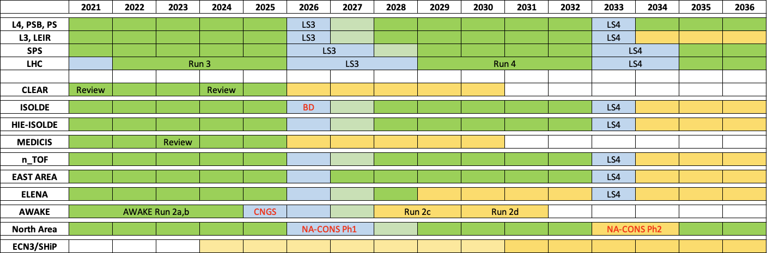
Complex out to 2036

Slide 13
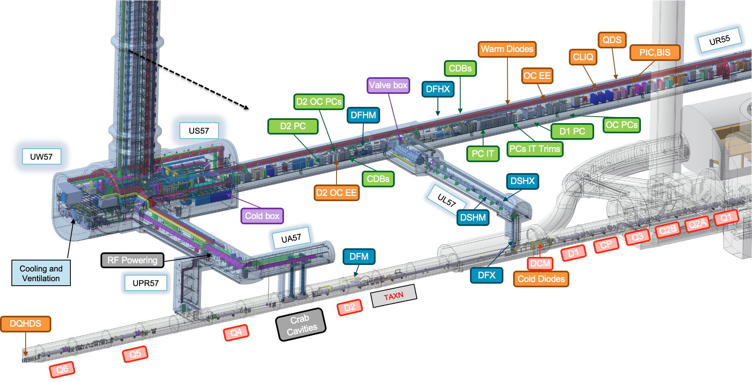
HL-LHC

Slide 14
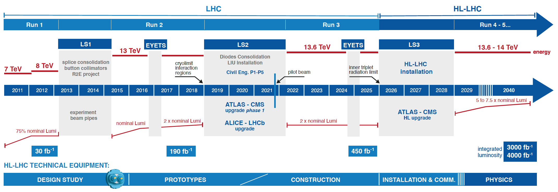
HL-LHC timeline
Foreseen end of operations - 2041

Slide 15
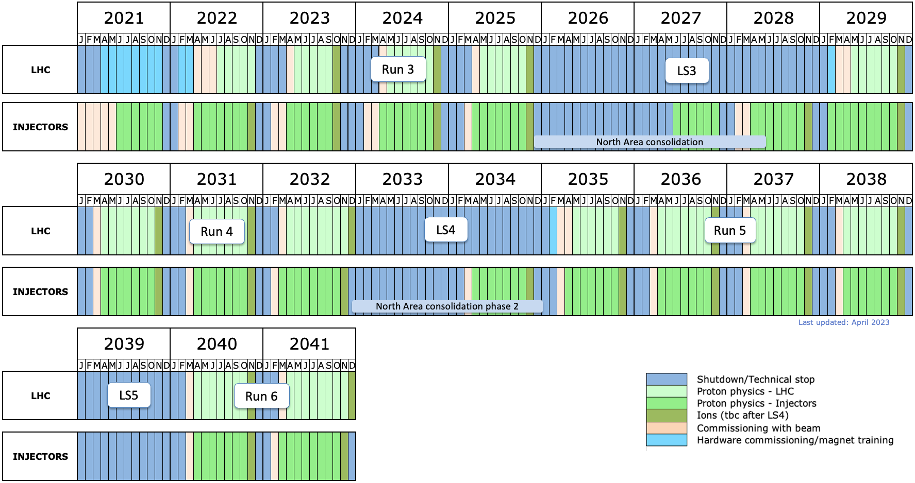
HL-LHC era - indicative timeline
LS3: HL-LHC installation
LHCb-II, ALICE3 upgrades (tbc)

Slide 16
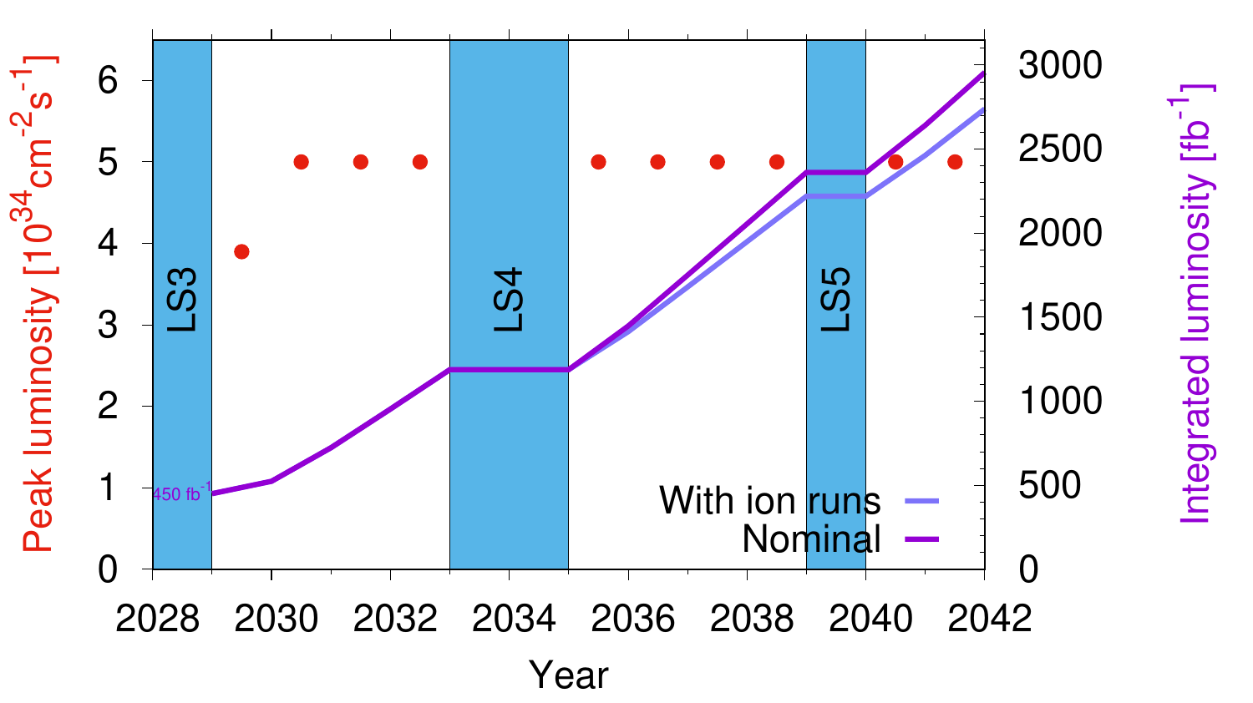
HL-LHC - rich and diverse physics programme
Headline deliverable is 3 ab⁻¹ p-p but the physics programme promises to be impressively diverse…
Ions (ALICE 3 proposed for LS4)
b-physics (LHCb upgrade proposed for LS4)
Forward physics (Precision Proton Spectrometer II (PPS II) recently approved for HL-LHC era)
Neutrinos (SND, FASERnu, Forward Physics Facility (FPF))
Long Lived Particles (GPDs, FASER, MoEDAL, milliQan, FPF, CODEX-b, MATHUSLA, ANIBUS,)
Fixed target (SMOG-2, Crystal Fixed Target)

Slide 17
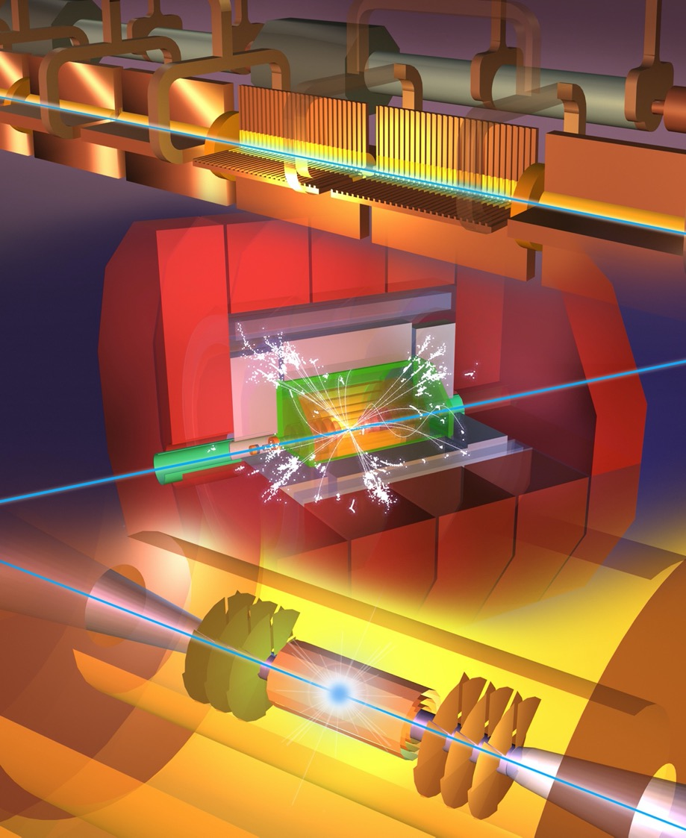
Future Collider Options
Within specified timeframe - start ops. ~2045
FCC-ee
CLIC-380
(ILC-250, LEP3, LHeC, HE-LHC)
Outside specified timeframe
FCC-hh (natural follow-on to FCC-ee)
Muon Collider
Options possibly in timeframe, not at CERN: ILC, CEPC, C³

Slide 18




LEGEND
CERN ExistingLHC
LHC
FCC
Muon Collider
CLIC
FCC
CLIC
Muon Collider ring
Muon Acceleration ring

Slide 19
Future Colliders - in brief…
Future collider study | Status
FCC feasibility study (FS) | Excellent progress – FS delivery foreseen March 2025 Serious mid–term review completed, closeout Feb. 2024
Linear collider - ILC | Mature design, slow progress in moving to pre-lab phase in Japan Targeted R&D phase as a bridge - ILC Technology Network launched
Linear collider - CLIC | Mature design, X-band, luminosity optimization, sustainability Project Readiness Report as a step toward a TDR for next ESPPU
Muon collider | International Study established, collaboration up and running, successful INFRA-DEV bid, lots of interest…!

Slide 20

FCC Feasibility Study 2021-2025: main objectives
Ring Placement
Host States engagement & processes
Collider(s) Design
Operation Model
Cost Estimate
Funding Model
Physics Case
Medium Term Review well received…

Slide 21

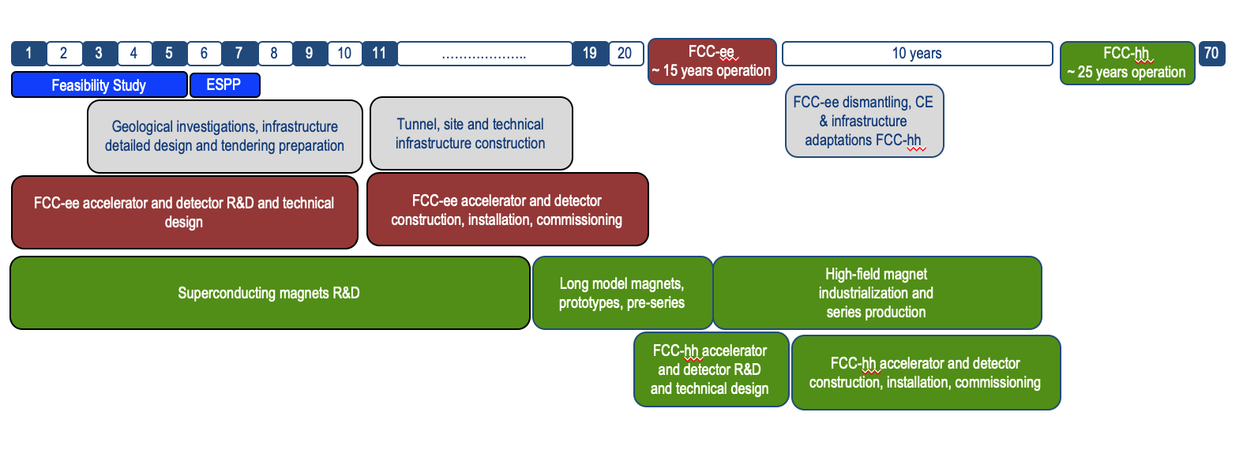
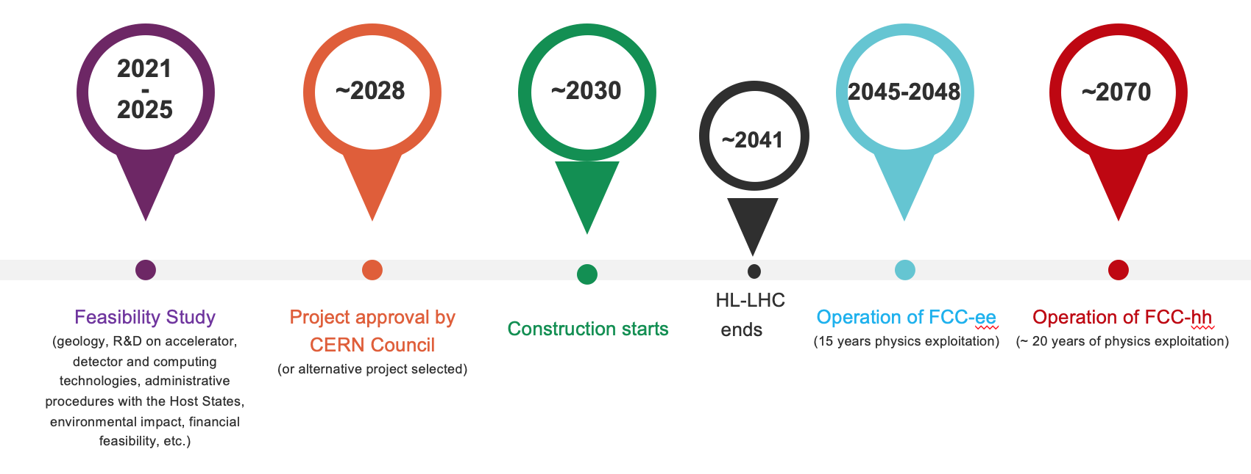
FCC integrated program - timeline
Note: FCC Conceptual Design Study
started in 2014 leading to CDR
end 2018.
FCC Feasibility Study started
in 2021, to be completed in 2025.
Realistic schedule takes into account:
CERN Council approval timeline
past experience in building colliders at CERN
that HL-LHC will run until ~ 2041
Presently investigating possibilities to shorten
project duration and advance FCC-ee start date
2033
2048
2073

Slide 22


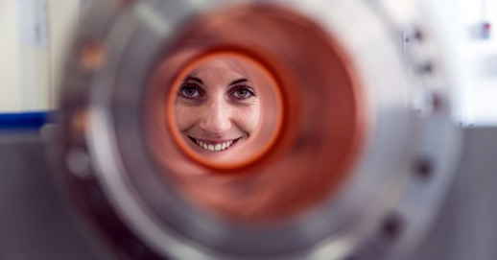
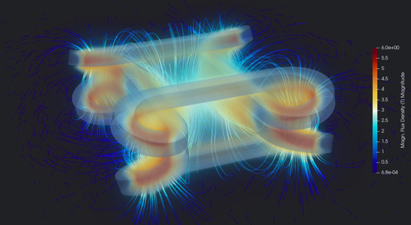
Accelerator R&D
Accelerator Technologies and R&D
RF technologies R&D (SRF, X-band)
High-field superconducting accelerator magnets R&D
Proton-driven plasma wakefield acceleration (AWAKE)
CERN Linear Electron Accelerator for Research (CLEAR)
Other targeted accelerator R&D (Vacuum, Materials…)
Detector R&D Roadmap also in place

Slide 23
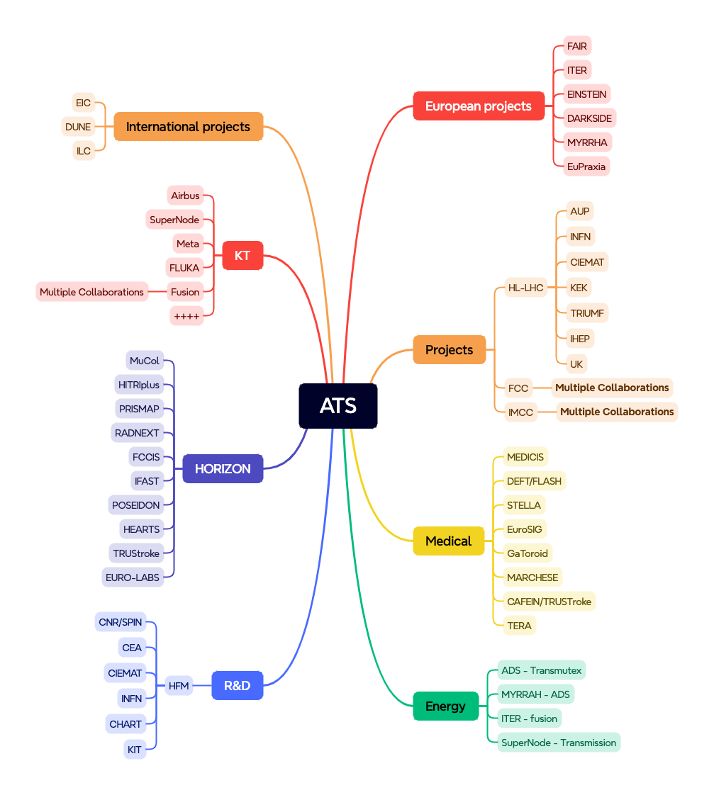
International Collaboration

Slide 24
CERN Plans - Summary
Full, safe, exploitation of the remarkable potential of the complex – longevity & possible facility upgrades. Backed by our technology and engineering base and support facilities.
HL-LHC as our flagship out to end 2041
Complementary scientific diversity programme exploiting complex and facilities
In the longer term, the preferred direction for a future collider at CERN is the FCC: feasibility study to be delivered end 2025. Alternatives pursued as plan B (CLIC, Muon Collider) plus agreed support to ILC
Execution of a European Accelerator R&D Roadmap (HFM, RF, MC, PWA, (ERL))
CERN as a Research Infrastructure. European integration via diverse Horizon projects. Leverage position as nexus of an impressive collaborative ecosystem.
Sustainability and Societal impact, Outreach and Education as part of our mission

