Slide 1





Muon Collider
D. Schulte
On behalf of the International Muon Collider Collaboration
Funded by the European Union (EU). Views and opinions expressed are however those of the author(s) only and do not necessarily reflect those of the EU or European Research Executive Agency (REA). Neither the EU nor the REA can be held responsible for them.
CERN, March 2024

Slide 2
Muon Collider Community
CERN-hosted collaboration
EU Design Study helped to kick-start collaboration
(since March 2023, EU+Switzerland+UK and partners)
EU support also helps with funding in institutes
O(70) partners, 60+ already signed MoC
Increase resources of partners with other funding requests:
Submit to HORIZON-INFRA-2024-TECH
  Focus on magnet technologies
National funding agencies
Looking for new partners
In particular US
But also other regions

Slide 3
MoC and Design Study Partners
UK | RAL
 | UK Research and Innovation
 | University of Lancaster
 | University of Southampton
 | University of Strathclyde
 | University of Sussex
 | Imperial College London
 | Royal Holloway
 | University of Huddersfield
 | University of Oxford
 | University of Warwick
 | University of Durham
US | Iowa State University
 | Wisconsin-Madison
 | Pittsburg University
 | Old Dominion
 | BNL
 | Florida State University
 | RICE University
 | Tennessee University
IT | INFN
 | INFN, Univ., Polit. Torino
 | INFN, Univ. Milano
 | INFN, Univ. Padova
 | INFN, Univ. Pavia
 | INFN, Univ. Bologna
 | INFN Trieste
 | INFN, Univ. Bari
 | INFN, Univ. Roma 1
 | ENEA
 | INFN Frascati
 | INFN, Univ. Ferrara
 | INFN, Univ. Roma 3
 | INFN Legnaro
 | INFN, Univ. Milano Bicocca
 | INFN Genova
 | INFN Laboratori del Sud
 | INFN Napoli
Mal | Univ. of Malta
IEIO | CERN
FR | CEA-IRFU
 | CNRS-LNCMI
DE | DESY
 | Technical University of Darmstadt
 | University of Rostock
 | KIT
SE | ESS
 | University of Uppsala
PT | LIP
NL | University of Twente
FI | Tampere University
LAT | Riga Technical Univers.
CH | PSI
 | University of Geneva
 | EPFL
EST | Tartu University
BE | Univ. Louvain
China | Sun Yat-sen University
 | IHEP
 | Peking University
AU | HEPHY
 | TU Wien
ES | I3M
 | CIEMAT
 | ICMAB
KO | KEU
 | Yonsei University
India | CHEP
US | FNAL
 | LBL
 | JLAB
 | Chicago
3

Slide 4

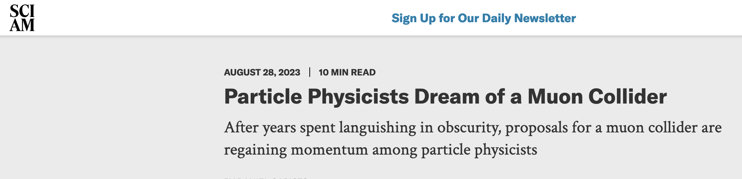
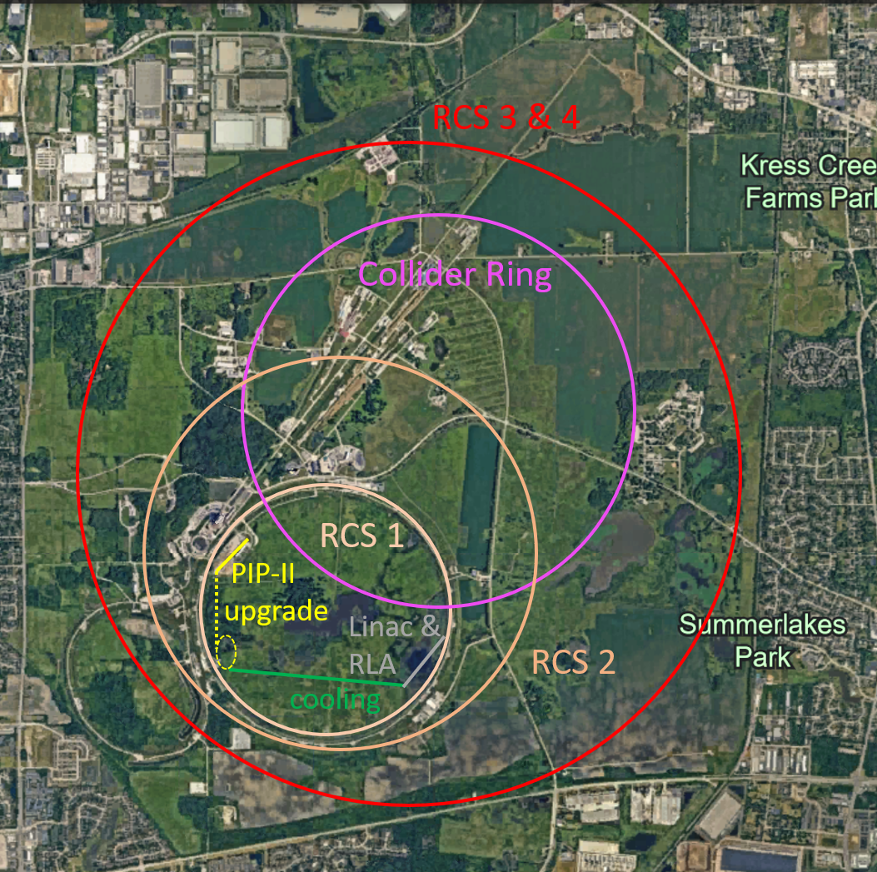
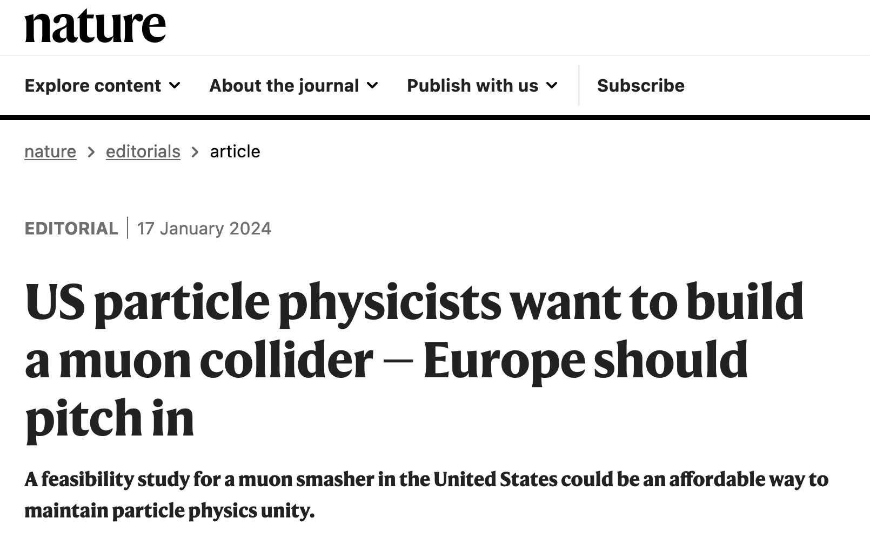
US P5: The Muon Shot
Particle Physics Project Prioritisation Panel (P5) endorses muon collider R&D: ”This is our muon shot”
Recommend joining the IMCC
Consider FNAL as a host candidate
We welcome the US community
Already participation, also in leadership
Will increase and reorganise in 2024
Ambition of US to host collider is excellent news
4

Slide 5
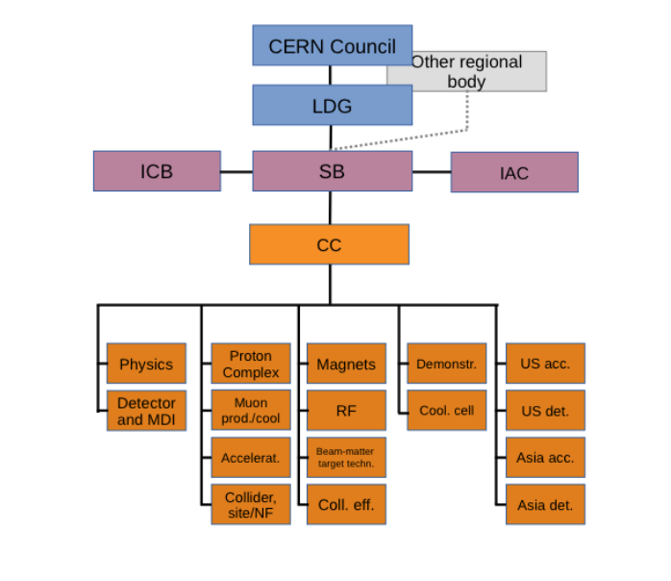
Global Integration
Some US experts already in leading positions (e.g. CC)
Several Universities signed/are in the process
US integration is important goal this year (and maybe somewhat longer)
R&D programme
Leadership
Staging strategy
Timelines
Site
…
Formal US funding only available from 2026 onwards
Hope flexibility in using budgets can be employed
China | Sun Yat-sen University
 | IHEP
 | Peking University
KO | KEU
 | Yonsei University
India | CHEP
US | Iowa State University
 | Wisconsin-Madison
 | Pittsburg University
 | Old Dominion
 | Florida State University
 | RICE University
 | Tennessee University
 | University of Chicago
Should not forget other regions:
E.g. Hokkaido Workshop on Particle Physics at Crossroads
(https://conference-indico.kek.jp/event/248/overview)
Slanted: asked for MoC, but did not (yet) sign
5

Slide 6
Evolution of Mindset
Actually an important change toward the end of the Interim Report preparation
In European Accelerator Roadmap main goal has been to be back into the field
Focus on justifying our existence
Focus on the ESPPU allowing us to continue
Several developments since
With the progress of work are gaining confidence that collider can keep its promises
Are becoming a global effort
  US expresses strong interest in the collider
  Also interest in Asia, might well increase
  Are becoming less dependent on decisions in Europe
So we need to focus on the longer term and prepare the R&D programme
Will focus on the future, not the achievements in this talk

Slide 7
Parameters
First Parameter Report submitted in October 2023
The first parameter document has been important progress
The teams took ownership of their parameters
Now need to consolidate and update the parameters
Feel that we are in a position to start making trade-offs
Cannot not at this moment make the final parameter set
But consider different options
Prepare what to do if not all parameters can be reached by 2026
  For linear colliders much more effort has been required to sort out lattice design challenges
Need a parameter working group and some task forces to explore the different trade-offs

Slide 8
Interim Report
To show the progress, manage the expectations and jsutify that we need more resources
Executive Summary
Overview of Collaboration Goals and R&D programme
Physics Potential
Physics, Detector and Accelerator Interface
Detector
Accelerator design
Accelerator technologies
Synergies
R&D programme development
Implementation Considerations
Many thanks for the excellent work
Documents the really good progress
Helps define the future
Final editing required to take into account IAC

Slide 9
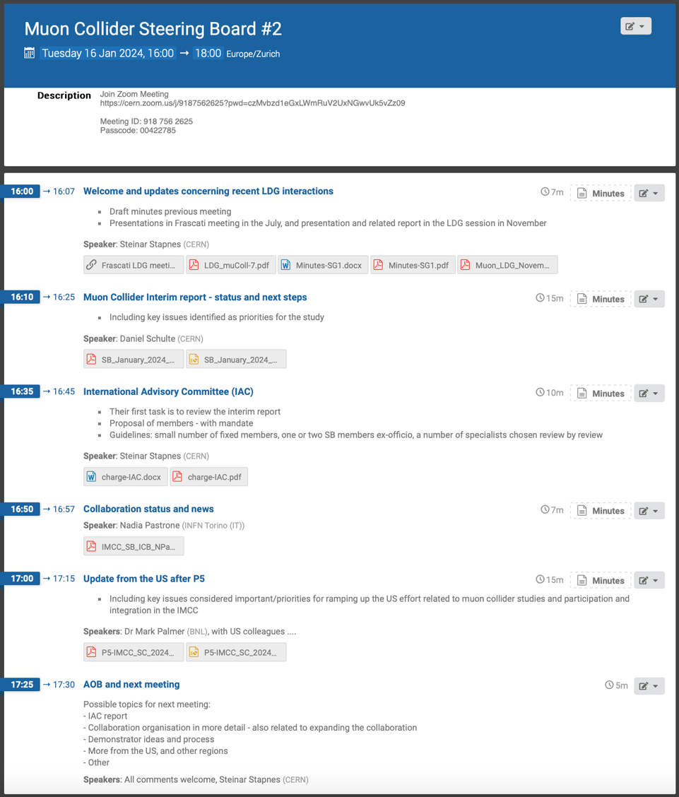
Steering Board
Will tune membership for diversity and strengthening physics and detector, continue to work with invited members from the US and Asia
SB wants to focus on:
Project development strategies (1-5 year timeframe, e.g. demonstrators, synergies, …)
Interfaces to various bodies and processes (roadmaps, funding opportunities and parallel projects (e.g. magnet development))
International collaboration development – remain open and inclusive, while operative
Links to the ECFA detector roadmap process – ongoing
US planning related to the P5 process
Will propose International Advisory Committee
  First goal: review interim report early 2024
Collaboration Organisation

Slide 10
International Advisory Committee
IAC regular members:
Ursula Bassler (IN2P3, interim Chair)
Mauro Mezzetto (INFN)
Hongwei Zhao (Inst. of Modern Physics, IMP)
Akira Yamamoto (KEK)
Maurizio Vretenar (CERN)
Stewart Boogert (Cockcroft)
Sarah Demers (Yale)
Giorgio Apollinari (FNAL)
Experts for this review
Marica Biagini (INFN)
Luis Tabarez (CIEMAT)
Giovanni Bisoffi (INFN)
Jenny List (DESY)
Halina Abramowicz (Tel Aviv)
Lyn Evans (CERN)
The IAC reviewed the Interim Report and prepared an excellent report on their findings
Many thanks for this important effort
Report will not be public to get best feedback
The report contains
High-level comments
Detailed comments on actual text
Need to go through it and
implement now what we can be implemented now
Implement in the next report what requires more work

Slide 11
IAC General Comments
“[..]
The IAC would like to commend the collaboration for the tremendous conceptual progress made, in particular in the area of accelerator design and technology development. The committee encourages the collaboration strongly to complete the lattice design, to work out a resource loaded roadmap for the necessary demonstrators and to define more clearly the possible staging strategies and their implications.
[..]“
IAC agrees that resources are lacking, suggest to add some more quantitative statements and emphasize as opportunities for new collaborators
Maybe we will turn “missing resources” with “research opportunities”
IAC encourages to further strengthen use of synergy.
“The IAC encourages in particular stronger use of the synergies and complementarities with ee- and hh-collider studies in the domain of the physics preparation and detector design.”
Some further improvement of the report is possible
Overview of the collider, some more quantitative statements, details on physics simulations

Slide 12
Physics and Detector Questions
Further development of physics case
Quantitative statements
Clear split of results into classes of detail, e.g. maybe the following
  DELPHES or equivalent
  …
  With full detector simulation including background
Benchmark points are critical to link the different levels
  Really important to maximise our effectiveness
Exploration of complementarity
Higgs factory and muon collider
High-energy hadron collider and muon collider
We need to understand this to judge different scenarios
Further development of detector design
Quantitative assessment of the performance, including background
  e.g. jet resolutions, tagging efficiencies

Slide 13
Physics and Detector Questions
Development of synergy case
For the demonstrator (e.g. NuStorm, Mu2e, …)
And the actual collider (e.g. neutrinos from the experimental insertions, …)
Different detector concepts
We can have two different detectors at the collider
Important to explore different approaches in some detail
Include future technologies, including software, e.g. machine learning
Link to the technology development
What is in the currently funded detector R&D technology?
Is in time for our detector?
Do we need further performance improvements?

Slide 14
Accelerator Questions
Continue to develop the machine design and the technologies
Continue and further improve existing studies
  Still much work left
Increase level of integration (e.g. parameters)
  Trade-off collider ring magnet field vs aperture vs cost vs luminosity
  Define sequence of pulsed synchrotrons
  Common optimization of RF and fast-ramping magnet in pulsed synchrotrons
  Try to find resources to complete the lattice sequence
  …
Include development of
R&D plan
Implementation scenarios, staging and timelines
Site choices

Slide 15
Implementation Considerations
Reviewing timeline (still evolving)
Uncertainties from physics case (e.g. HL-LHC), society development, budget profile etc.
Can concept be mature for decision before 2040 and start operation before 2050?
Identifying shortest possible “technically limited” timeline
Accept performance compromises that are required on this timescale
Tentatively identified main technologies that might limit the timeline
Muon cooling technologies and integration
Magnet technology
Detector technologies
Needs to be reviewed
To be reviewed by 2026
Expect that other technologies can be accelerated if funding is increased appropriately
  But they are equally important now to support that the muon collider can be done and can perform

Slide 16
Roadmap
Initial tentative findings (to be reviewed now):
Expect detector and muon production and cooling can meet the required timeline
Magnets are main limitation:
Consensus of magnet experts (review panel):
Anticipated mature magnet technology in O(15 years):
  HTS solenoids in muon production target, 6D cooling and final cooling
    HTS tape can be applied more easily in solenoids
    Strong synergy with society, e.g. fusion reactors
  Nb₃Sn 11 T magnets for collider ring (or HTS if available): 150mm aperture, 4K
  This corresponds to 3 TeV design
Still under discussion:
  Timescale for HTS/hybrid collider ring magnets

Slide 17
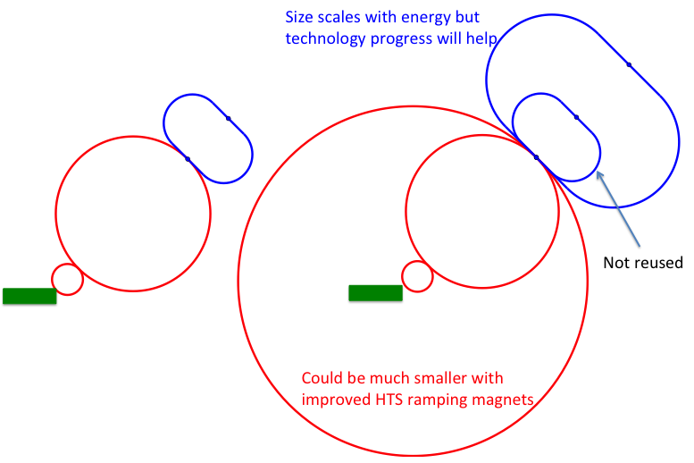
Staging Approaches
Assumptions:
In O(15 years):
  HTS technology available for solenoids
  Nb₃Sn available for collider ring
In O(25 years):
  HTS available for collider ring
Scenario 1: Energy staging
Start at lower energy (e.g. 3 TeV)
Build additional accelerator and collider ring later
Requires less budget for first stage
3 TeV design takes lower performance into account
Scenario 2: Luminosity staging
Start at with full energy, but less performant collider ring magnets
Main sources of luminosity loss are collider arcs and interaction region
  Can recover interaction region later (as in HL-LHC)
  But need full budget right away
  Some luminosity loss remains (O(1.5))
  More power for the collider ring required (lower magnet temperature)

Slide 18
Initial Staged Target Parameters
Parameter | Unit | 3 TeV | 10 TeV |  | 10 TeV | 10 TeV
L | 10³⁴ cm⁻²s⁻¹ | 1.8 | 20 |  | 6? | 13
N | 10¹² | 2.2 | 1.8 |  | 1.8 | 1.8
f_{r} | Hz | 5 | 5 |  | 5 | 5
P_{beam} | MW | 5.3 | 14.4 |  | 14.4 | 14.4
C | km | 4.5 | 10 |  | 15 | 15
<B> | T | 7 | 10.5 |  | 10.5 | 7
ε_{L} | MeV m | 7.5 | 7.5 |  | 7.5 | 7.5
σ_{E} / E | % | 0.1 | 0.1 |  | 0.05? | 0.1
σ_{z} | mm | 5 | 1.5 |  | 3? | 1.5
β | mm | 5 | 1.5 |  | 3? | 1.5
ε | μm | 25 | 25 |  | 25 | 25
σ_{x,y} | μm | 3.0 | 0.9 |  | 1.3 | 0.9
Target integrated luminosities
Need to spell out scenarios
Need to integrate potential performance limitations for technical risk, cost, power, …
Example as discussion basis
numbers will change
18

Slide 19
Other Parameter Considerations
The tentative target parameters are at this moment not yet fully supported by beam physics and technology studies
This is normal, this is why they are target parameters
Ongoing work is providing progress on the performances
Trade-offs for cost and power need to be considered
E.g. cost of collider ring magnets and field level are linked
Have to find a way to refine the targets when required and to present a current status view where the targets are maintained but have not yet been fully reached
Need to consider more time development in our design
E.g. assume the same muon production and cooling complex in the stages, but could upgrade the final cooling and maybe other parts

Slide 20
CDR Phase, R&D and Demonstrator Facility
Broad R&D programme can be distributed world-wide
Models and prototypes
  Magnets, Target, RF systems, Absorbers, …
CDR development
Integrated tests, also with beam
Cooling demonstrator is a key facility
Important timeline limitation
Could be used to house physics facility

Slide 21
Demonstrator Considerations
It is good to have more than one site option
At least one is required
For cost reasons try to find existing proton facility
Candidate sites CERN, FNAL, potentially others (ESS, JPARC, … )
Will have a workshop at FNAL to discuss demonstrator and potential sites
Date to be defined
Will try to develop a common, global demonstrator design
With variations only where required because of site limitations
Prototype development before the demonstrator can be distributed globally
E.g. RF test stand
Muon cooling module
Production of components can be distributed globally

Slide 22
Collider Site Studies
Candidate sites CERN, FNAL, would like to encourage other proposals (ESS, JPARC, … )
It is good to have more than one site option
  At least one is required
  Converging to one site too early is bad for the field
Some site considerations are important
Neutrino flux mitigation
Specific site requirements
  E.g. FNAL wants the largest accelerator ring to fit on the FNAL site
Other site considerations can be beneficial
Existing infrastructure
  However, can demand time consuming detailed studies
Help to guide site development, e.g. future proton complex
Aim to keep study as common as possible
Commonly work on collider configurations that suit different requirements
Focus only on high-level considerations on infrastructure reuse

Slide 23
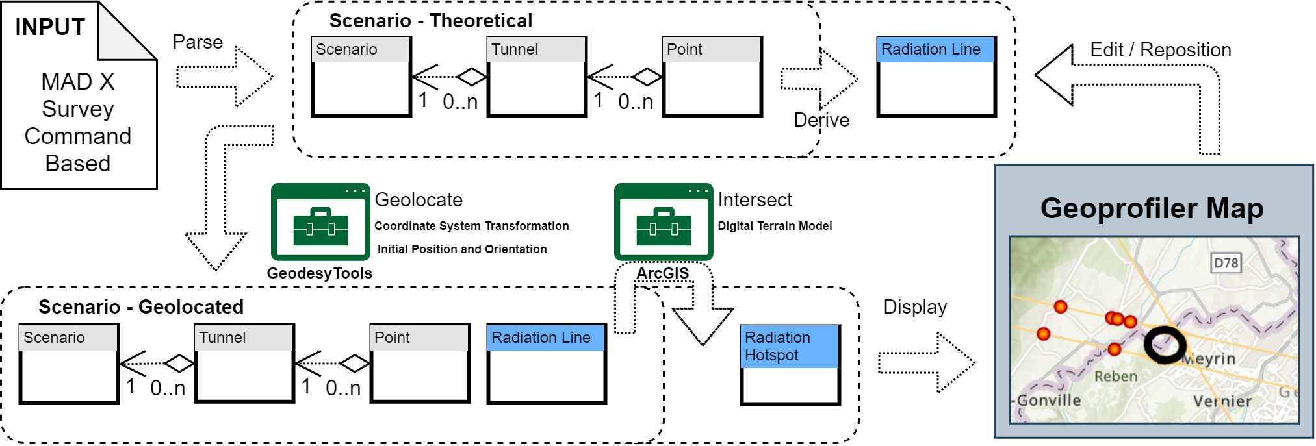
CERN Site Studies
Neutrino flux from experimental insertions is most important concern
Potential site next to CERN identified
Mitigates neutrino flux
  Points toward mediterranean and uninhabited area in Jura
Detailed studies required
280 m deep
Slope but seems acceptable
Other options to be explored
Other neutrino flux sources need some study

Slide 24
FNAL Collider Site Status
Requirement that accelerator rings fit on FNAL site
Last accelerator ring needs to be smaller than in current baseline
Solution is to have two accelerator stages in the last tunnel
Reminder: mix superconducting and fast-ramping normal-conducting magnets in the accelerator ring
Adding more superconducting magnets in the second ring in the same tunnel increases injection and extraction energy
Potentially can use the CERN geo-profiling tool also for the US if database can be secured

Slide 25
Costing Effort
Starting cost estimate
Develop PBS for the whole project, considering PBS for FCC and CLIC
But are very limited in resources, compared to other efforts
PBS will allow to
Identify where information is available
Understand uncertainty of estimate
Planned work
Some bottom-up estimates for key unique components
  E.g. fast-ramping magnets and power converter
Generic and scaled estimates for other components
  Where possible with the relevant groups but do not have a dedicated budget for the group personnel
Carlo Rossi (CERN) will lead the effort

Slide 26
MuCol
The MuCol effort is fully integrated in IMCC
Will not report much, since we need to focus on the next steps
MuCol has really enabled many European partners to contribute
Provided our deliverables
Data management plan
Preliminary ESPPU Report 1
And milestones
Web site available
Kick-off meeting
Tentative parameters
First annual meeting
Training on detector design and physics performance tools
Workshop on MDI and IR design

Slide 27

Proposal: EuMAHTS
Luca Botture et al.
Submitted to INFRA-2024-TECH-01-01
Short name | Country | Status
CERN | IERO | B
EMFL | Belgium | B
TAU | Finland | B
CEA | France | B
ESRF | France | B
EUXFEL | Germany | B
GSI | Germany | B
KIT | Germany | B
INFN | Italy | B
UMIL | Italy | B
UTWENTE | Netherlands | B
IFJ-PAN | Poland | B
PK | Poland | B
CIEMAT | Spain | B
CSIC | Spain | B
PSI | Switzerland | A
TERA-CARE | Switzerland | A
UNIGE | Switzerland | A
CNRS | France | A
HZDR | Germany | A
RU-NWO | Netherlands | A
Focus on HTS development
O(10 Meur) request
WP9 – Test Infrastructures
(G. Willering, E. Beneduce)
WP6 – 40T-class all-HTS solenoid
(B. Bordini, P. Vedrine)
WP5 – Materials and Technologies
(D. Bocjan, A. Bersani)
WP2 – Strategic Roadmap
(A. Ballarino, L. Rossi)
WP1 - Coordination and Communication
(L. Bottura, P. Vedrine)
WP4 – HTS Magnets Applications Studies
(P. Vedrine, M. Statera)
WP3 – Industry Co-innovation
(J.M. Perez, S. Leray)
WP7 – 10T/10MJ-class all-HTS solenoid
(S. Sorti, C. Santini)
WP8 – K=2 all-HTS undulator
(S. Casalbuoni, M. Calvi)
Strategy and context
Material and technology
Three core components (6 MEUR)
40 T solenoid, 50 mm bore
10 T/10 MJ/300 mm solenoid
HTS undulator
Test infrastructure

Slide 28
Publications
Defined the rules for the publications
Accepted by the ICB and GB
The rules are inclusive
Anyone who contributed can be author of the IMCC publications
But you have to register, due to some data protection laws
Using it for the Interim Report
The newly established PSC started to work
User friendly publication guidelines should appear online soon
Including templates etc.
Please send talks and papers to them before publications
Identified past publications that are from the collaboration
Added 68 publications on CDS with the muon collider tag
https://cds.cern.ch/collection/Muon%20Collider%20study?ln=en

Slide 29
Synergies and Outreach
Training of young people
Novel concept is particularly challenging and motivating for them
Technologies
Need HTS, in particular solenoids
Fusion reactors
Power generators
Nuclear Magnetic Resonance (NMR)
Magnetic Resonance Imaging (MRI)
Magnets for other uses (neutron spectroscopy, detector solenoids, hadron collider magnets)
Target is synergetic with neutron spallation sources, in particular liquid metal target
High-efficiency power sources
RF in magnetic field can be relevant for some fusion reactors
High-power proton facility
Facilities such as NuStorm, mu2e, COMET, highly polarized low-energy muon beams
(Need to add: detector technologies, AI, physics)
29

Slide 30
Conclusion
Collaboration is increasing
More requests to EC and other funding agencies
The US partners will join
Hope to also grow in Asia
Feel that there is important synergy with other facilities and technologies
Work is progressing but is still budget limited
Continue to secure more resources
Similar to MuCol, which is an active part of the IMCC
Need now to move more focus to the R&D programme
http://muoncollider.web.cern.ch To join contact muon.collider.secretariat@cern.ch
30

Slide 31
Reserve

Slide 32
Risks
Risk | Potential cause | Mitigation
Reduced N₀ | Less charge from target | Alternative target Increase f_{r}
 | Larger loss in cooling | Increase target charge
 | Larger loss in acceleration | Increase target charge
Larger transverse IP emittance | Larger emittance from cooling | Cooling lattice design Larger charge
 | Larger emittance increase | Beam-based tuning Larger charge
Larger longitudinal IP emittance | Larger emittance from cooling | Cooling lattice design Larger charge
 | Larger emittance increase | Beam-based tuning Larger charge
32

