Slide 1

Outcome of P5 Process
IMCC and MuCol Annual Meeting 2024
CERN, 12/03/2024
Amalia Ballarino

Slide 2

P5
The Particle Physics Project Prioritization Panel (P5) is tasked with evaluating and prioritizing projects and program initiatives for particle physics in the USA
Since 2003 P5 has been guiding the future direction of the field and funding priorities in the United States
The P5 process culminates with a Report that proposes a prioritized project and program agenda under a couple of different funding scenarios, to be pursued over 10 years
The next to last P5 process provided its long-range strategy in 2014, for FY 2014-2023
The last P5 strategic report for FY 2024-2033 was released on December 7, 2023, during the HEPAP meeting in Washington DC. The report will serve as a roadmap for U.S. investments in the particle physics field for a prioritized, time-ordered, and globally aware program
Notes:
ten-year strategic plan for high energy physics in the U.S.

Slide 3
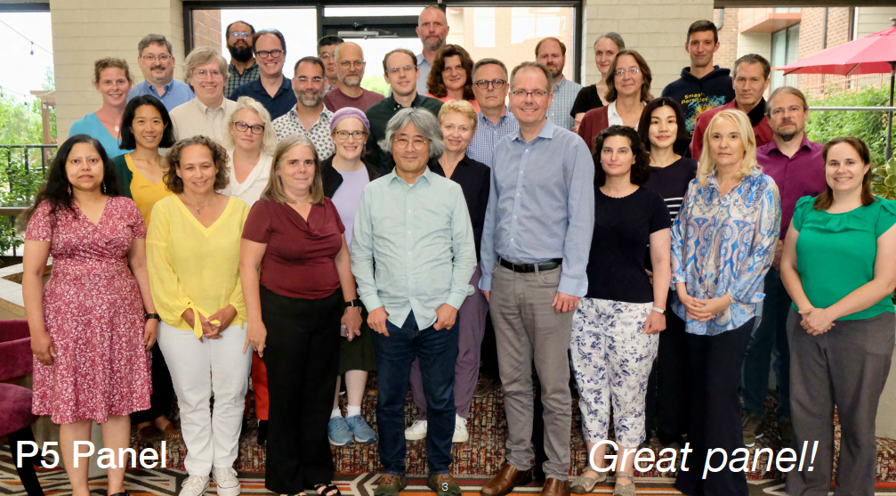

Slide 4
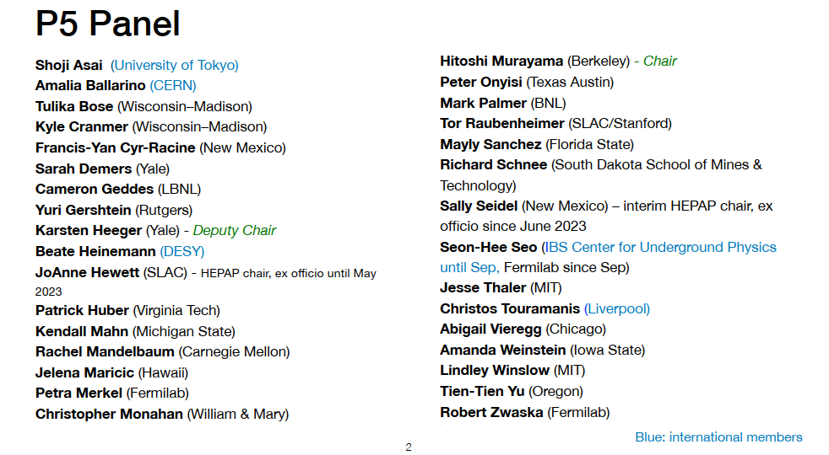
4
Notes:
Shoji Asai: DG of KEK for three years, beginning on April 1, 2024. Beate: Director in charge of Particle Physics at DESY. Johanne: director of Brookhaven laboratory

Slide 5

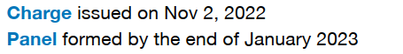
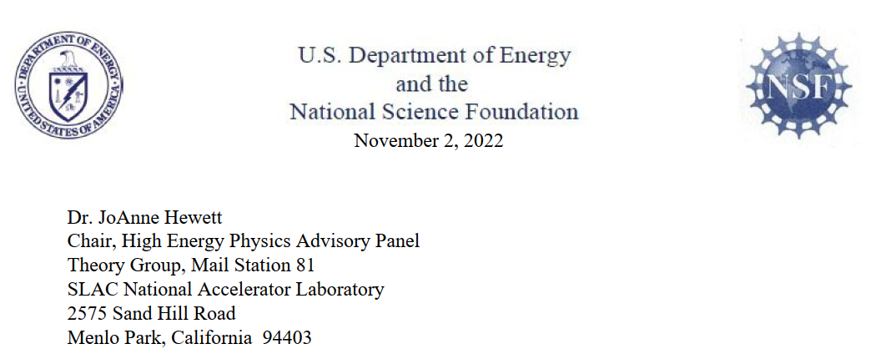
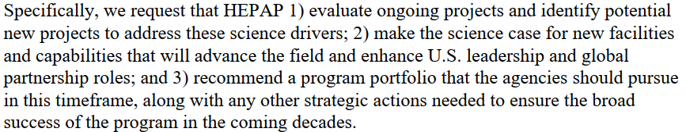
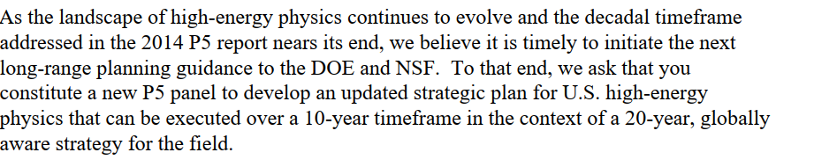
P5 Timeline and Charge
The P5 charge was issued by DOE (Department of Energy) and NSF (National Science Foundation) to HEPAP (High Energy Physics Advisory Panel)
`
`
`
`
`
`
`
`
`
`

Slide 6

P5 Timeline and Process
Multi-step process that gathers broad input from all members of the community: Snowmass precedes P5 (last: 2021-2022) and is a Community Planning Exercise
4 Town Hall Meetings in USA from February to May
4 Closed in person Meetings in the USA from May to August
Weekly video meetings from August to December

Slide 7
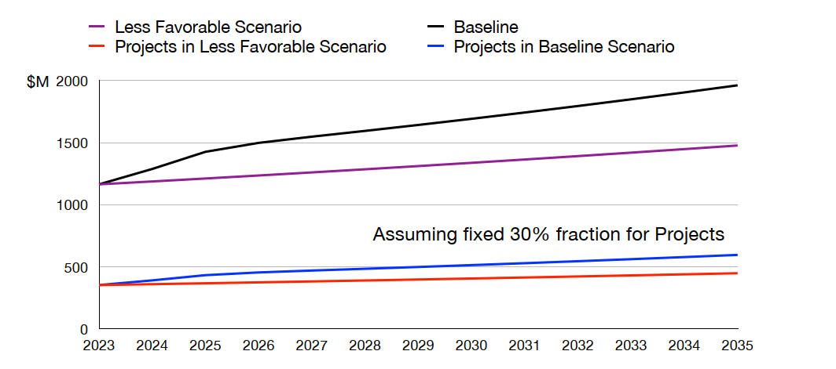
Budget Scenario

Slide 8
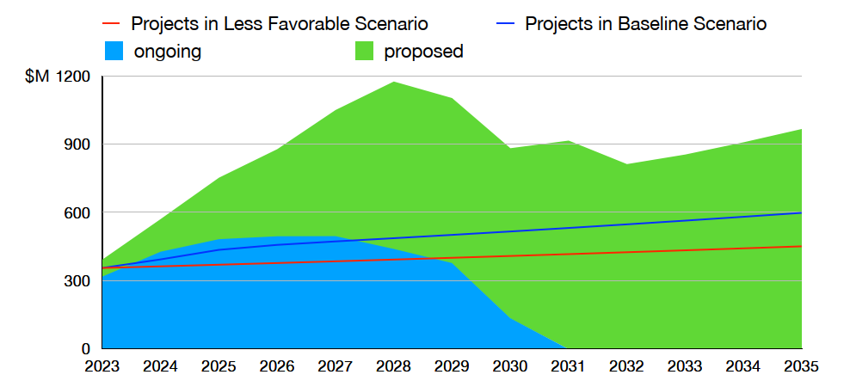
Budget Scenario and Projects
Proposed efforts far exceeded the budget scenarios

Slide 9
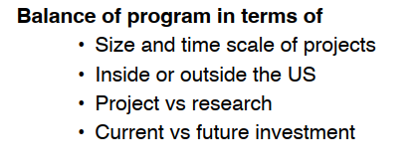
Prioritization Principles
In the process of prioritization, we considered scientific opportunities, budgetary realism, and a balanced portfolio as major decision drivers
Large projects (>$250M)
• Paradigm-changing discovery potential
• World-leading
• Unique in the world
Medium projects ($50–250M)
• Excellent discovery potential or development of major tools
• World-class
• Competitive
Small projects (<$50M)
• Discovery potential, well-defined measurements, or outstanding technology development
• World-class
• Excellent training grounds

Slide 10
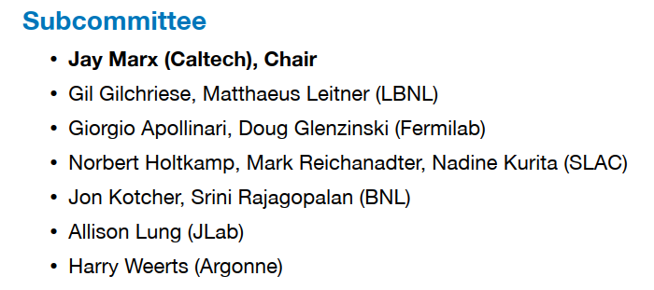
Subcommittee on Costs/Risks/Schedule
For prioritization of projects within budget scenarios, it is critical to understand maturity of project cost estimates as well as risks and schedule
Concerns about potential cost growth
Sub-committee on Costs, Risks & Schedule, chaired by Jay Marx

Slide 11
Since the 2014 P5
Since the 2014 Particle Physics Project Prioritization Panel (P5) report, the US the US has made significant investments in expanding its capabilities for groundbreaking discoveries in accelerators and deep underground laboratories:
Contribution to the High-Luminosity Large Hadron Collider (HL-LHC) upgrade;
On going construction of the Deep Underground Neutrino Experiment (DUNE) and the Long Baseline Neutrino Facility (LBNF);
Commissioning of the world’s largest digital camera for the Legacy Survey of Space and Time (LSST) and almost completion of Vera C. Rubin Observatory;
Mid-scale projects, e.g. Dark Energy Spectroscopic Instrument (DESI) and the short baseline neutrino (SBN) experiments, Muon g-2 experiment

Slide 12

Three science themes and six science drivers

Slide 13
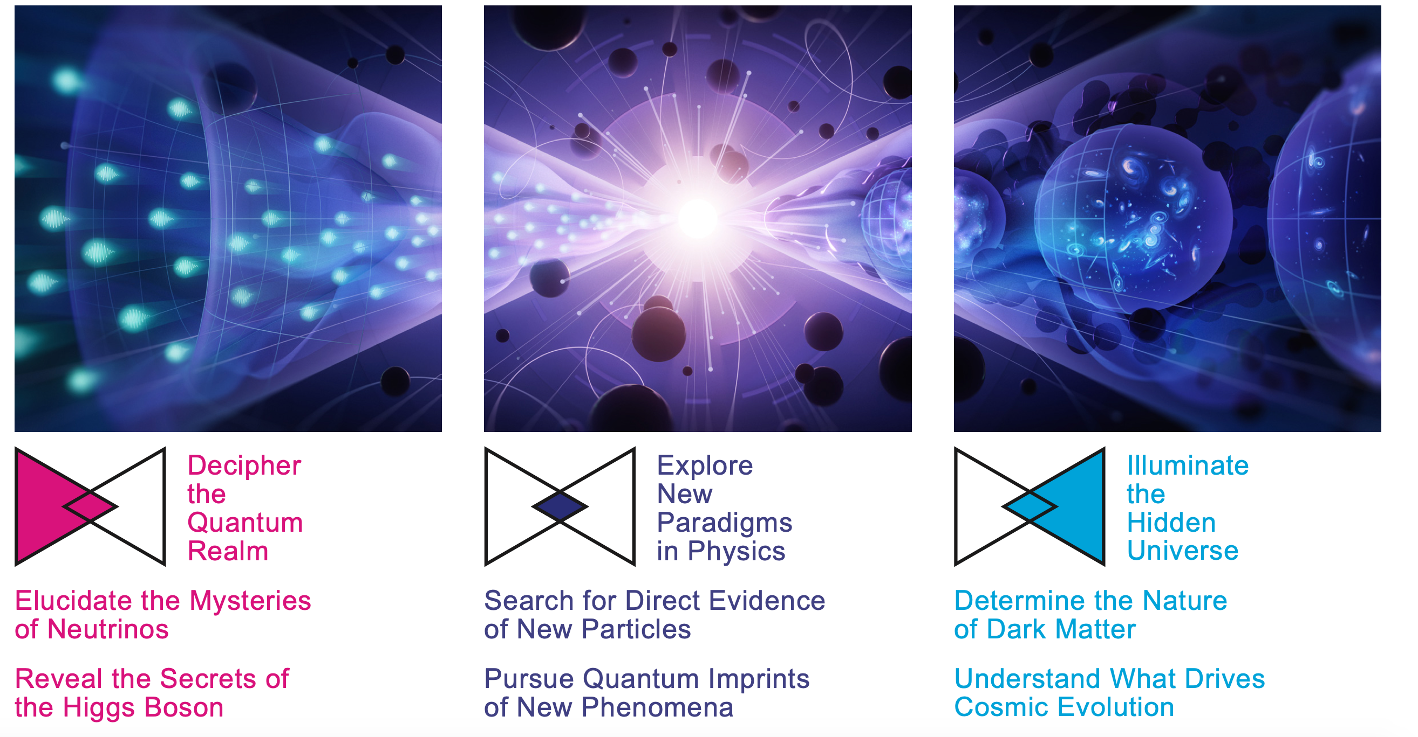

Slide 14
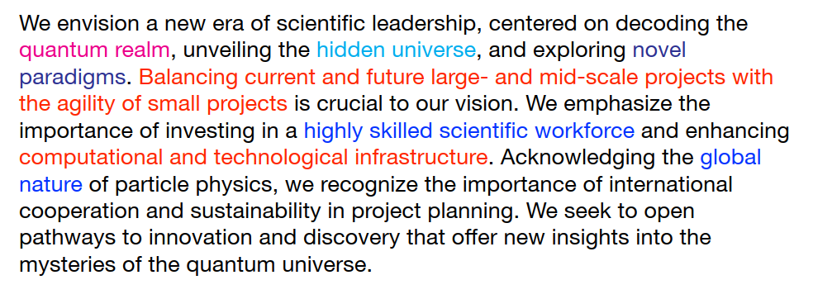
Overview and Vision

Slide 15


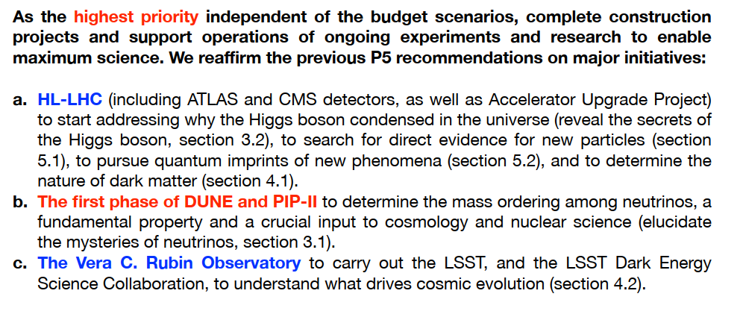
Recommendation 1

Slide 16
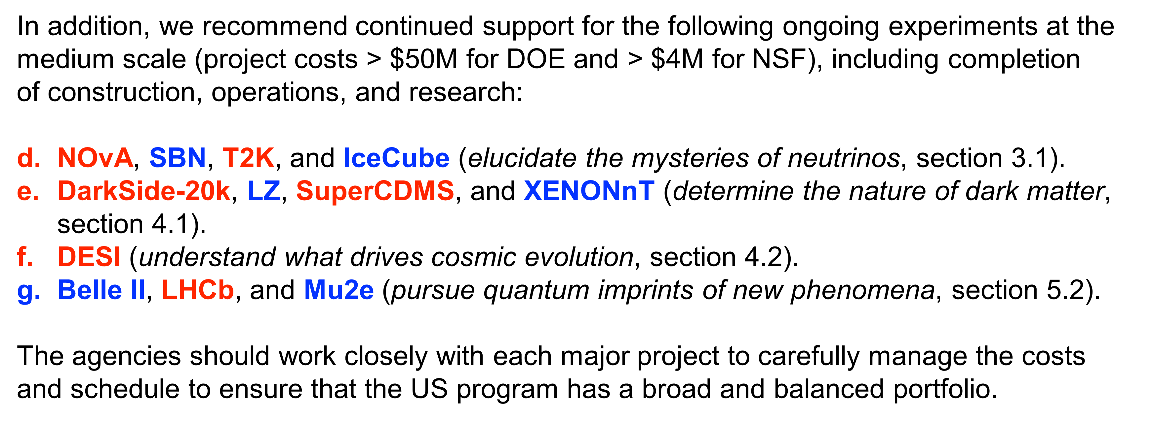
Recommendation 1

Slide 17
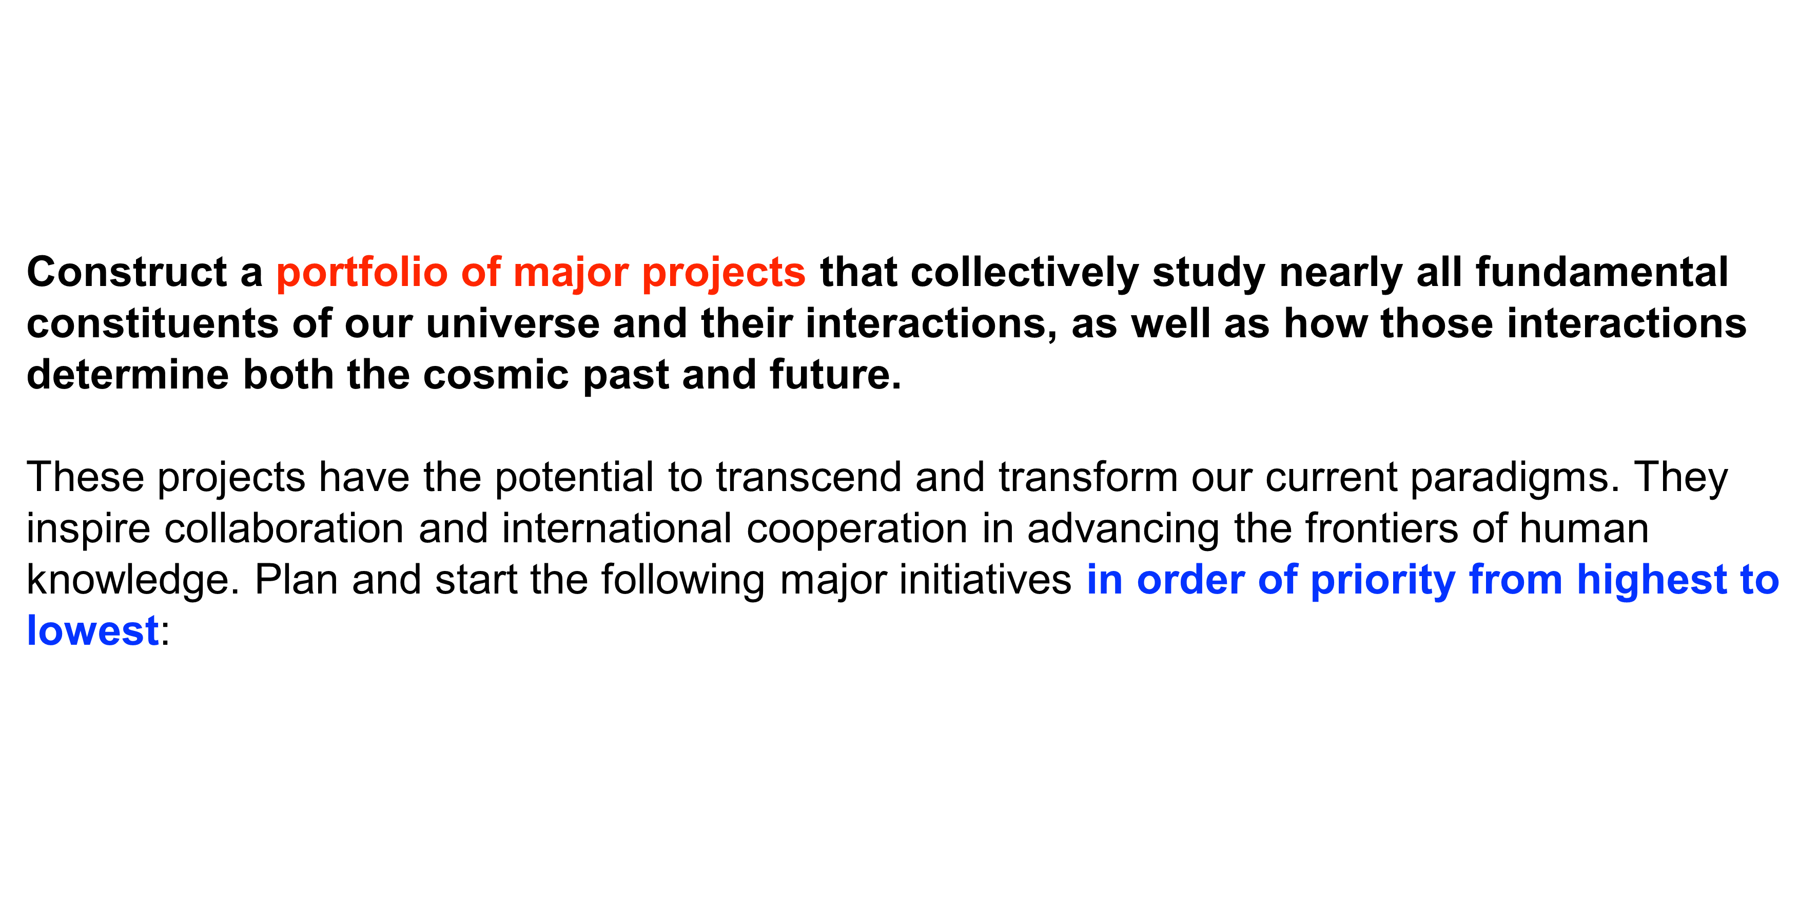
Recommendation 2

Slide 18

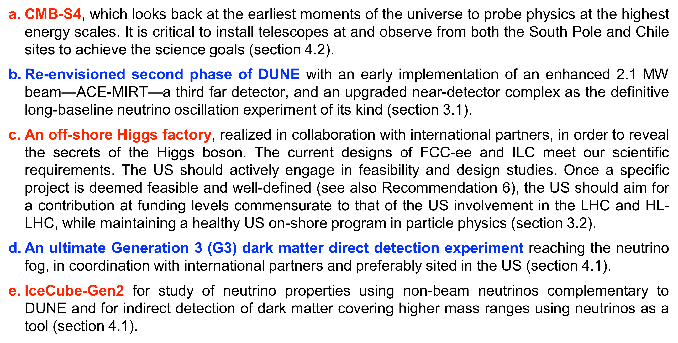
Recommendation 2

Slide 19
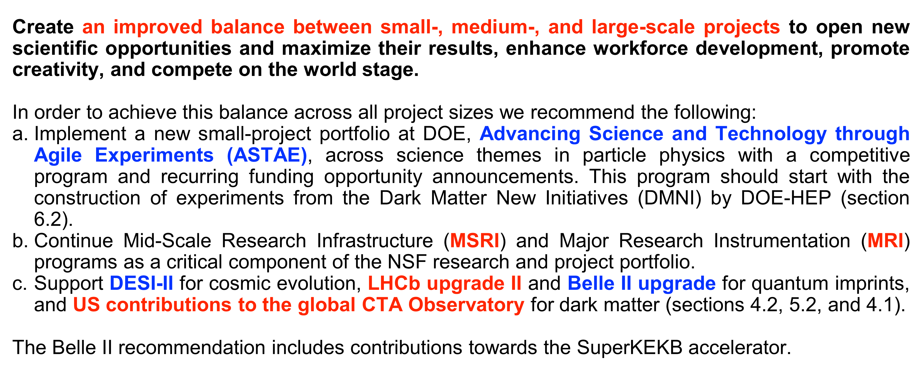
Recommendation 3

Slide 20
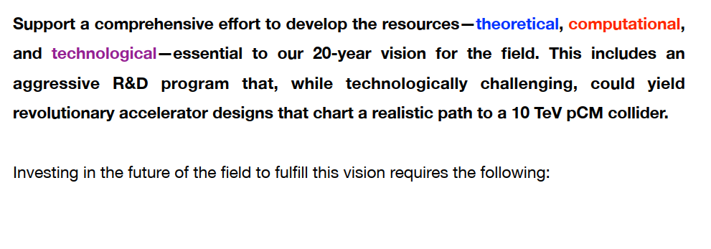
Recommendation 4

Slide 21

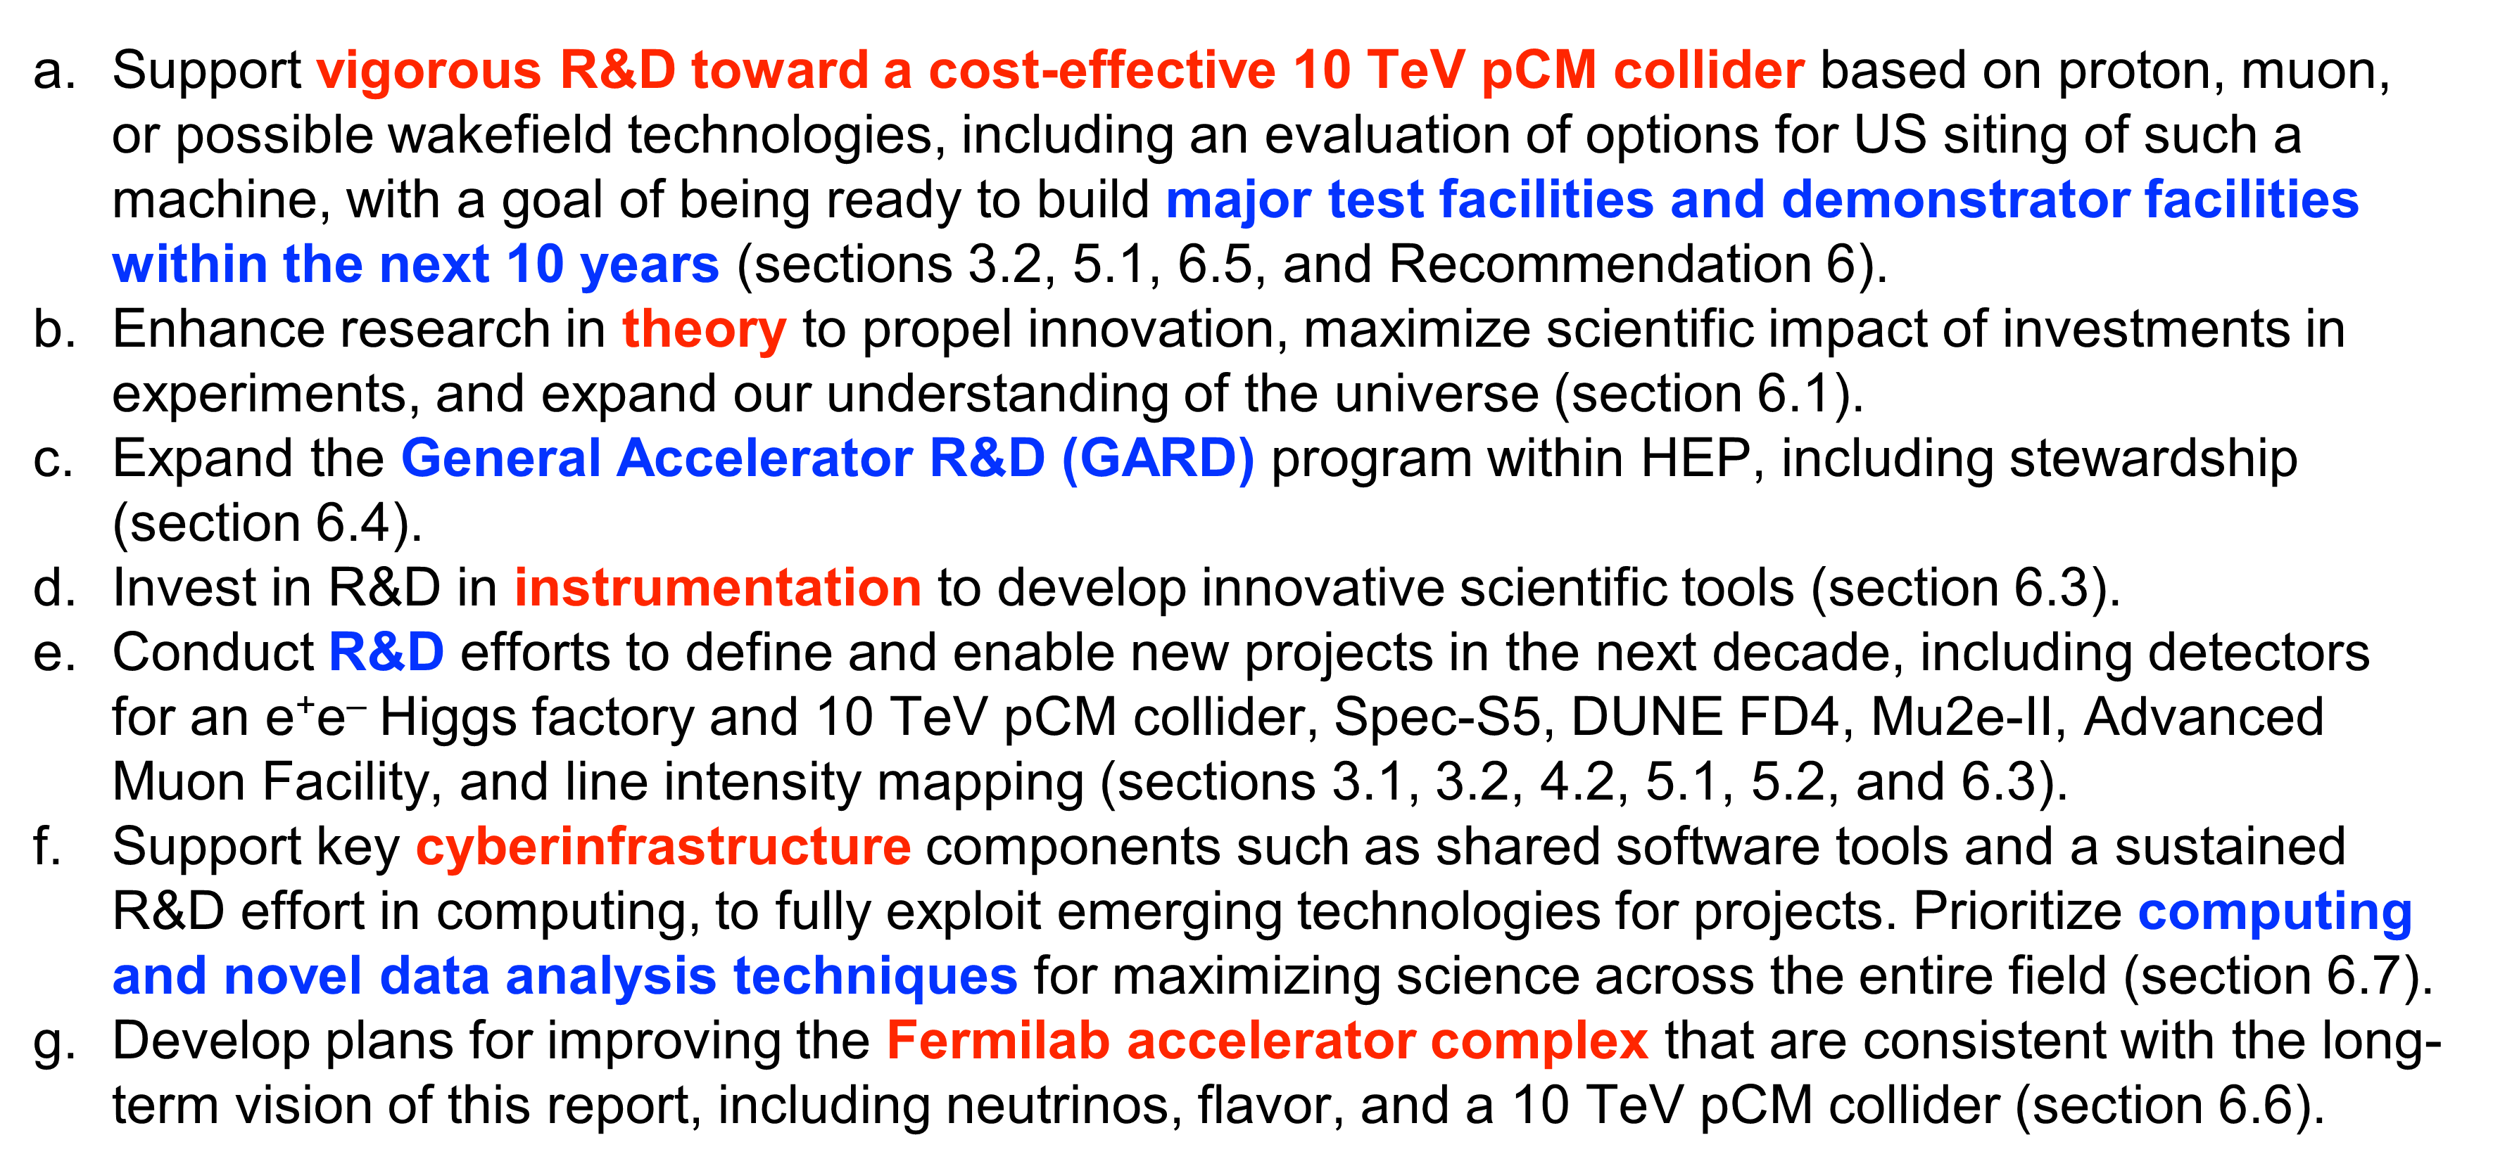
Recommendation 4

Slide 22
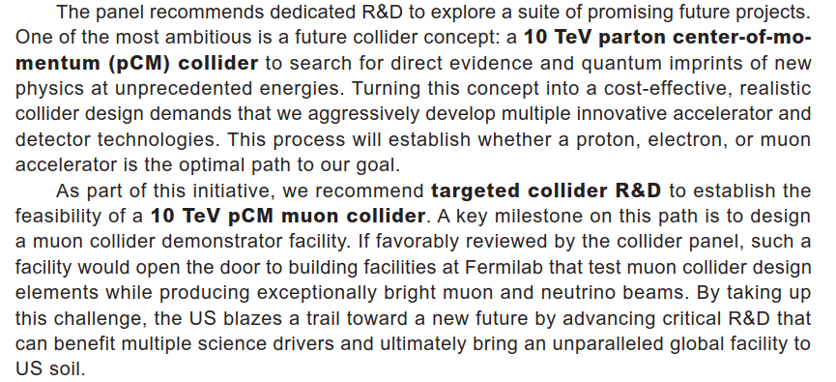
Muon Collider

Slide 23
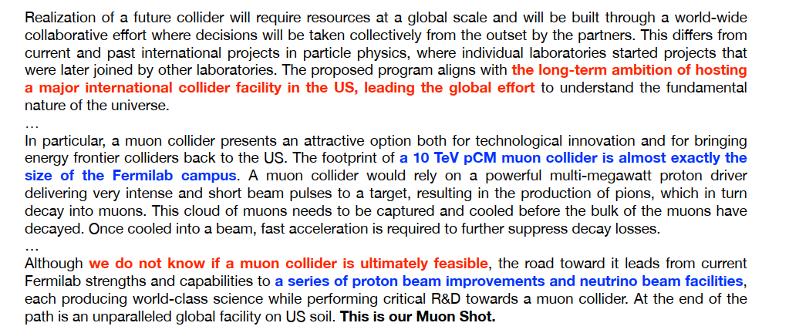
The Path to a 10 TeV pCM

Slide 24
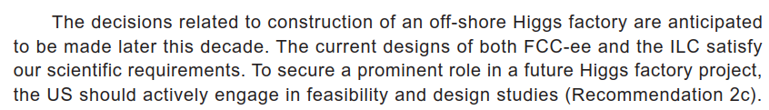
Collider R&D (1/2)

Slide 25
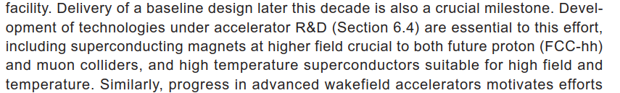
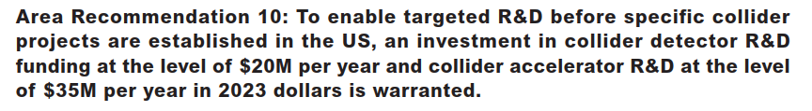
Collider R&D (2/2)

Slide 26
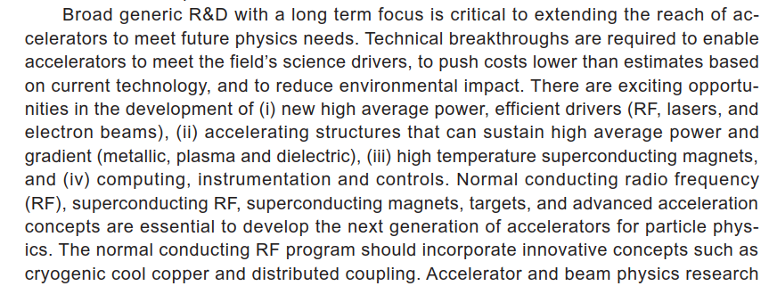

Recommendation 4
A 10 TeV pCM Collider
GARD Program

Slide 27
Recommendation 4

Slide 28
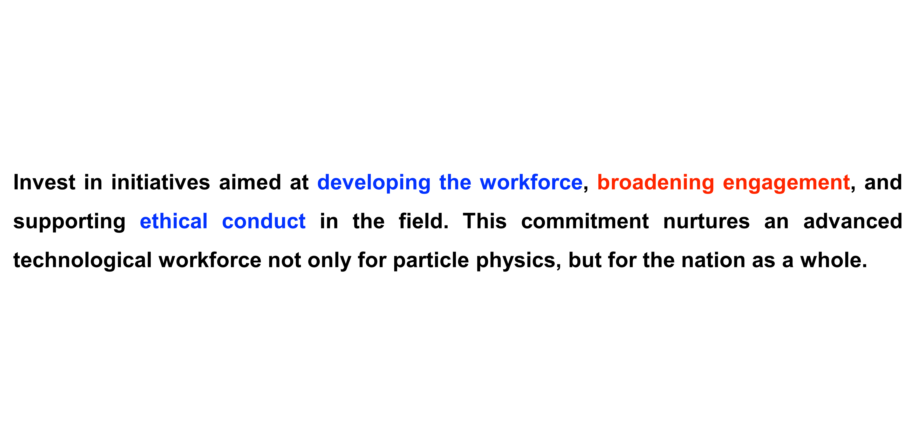
Recommendation 5

Slide 29
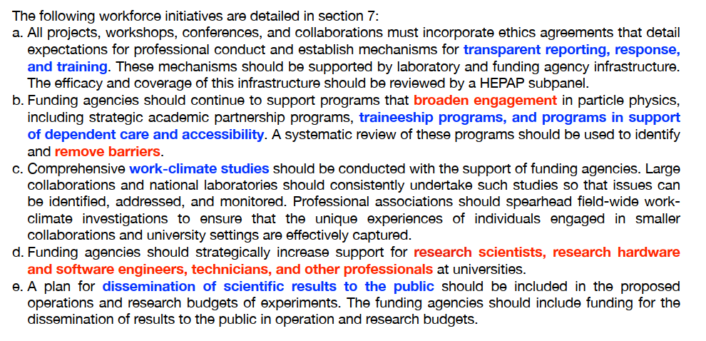
Recommendation 5

Slide 30
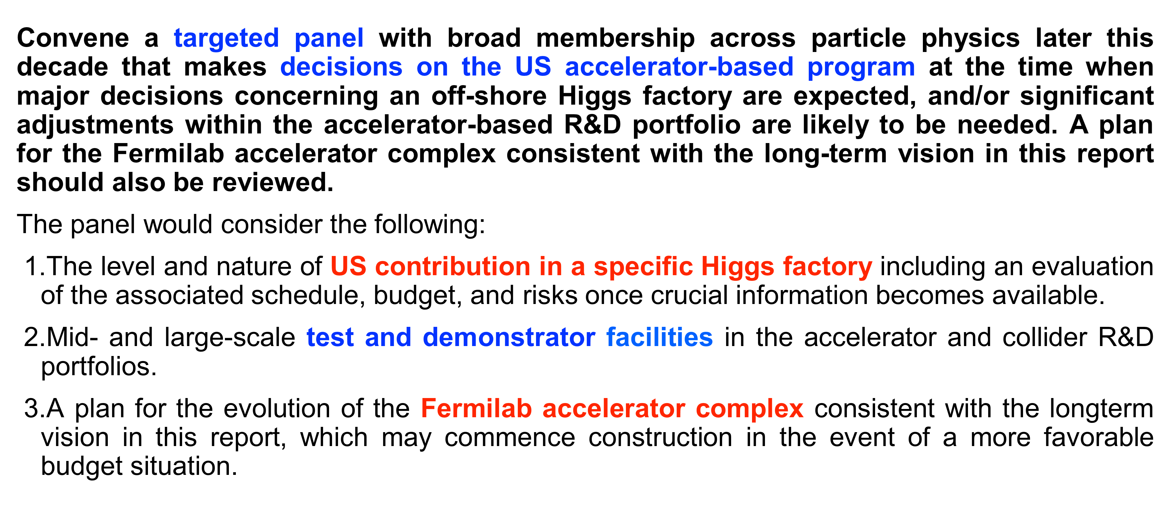

Recommendation 6

Slide 31
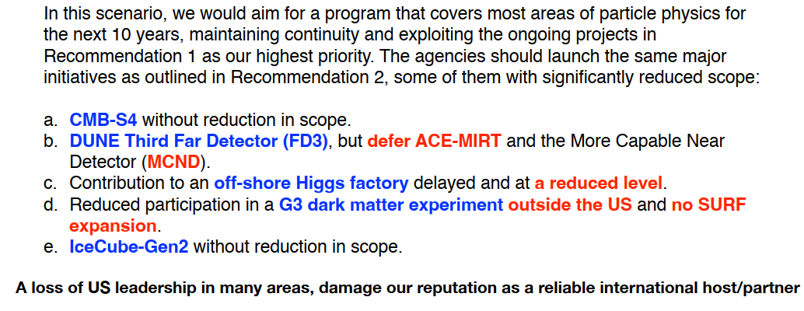
Less Favorable Budget Scenario

Slide 32


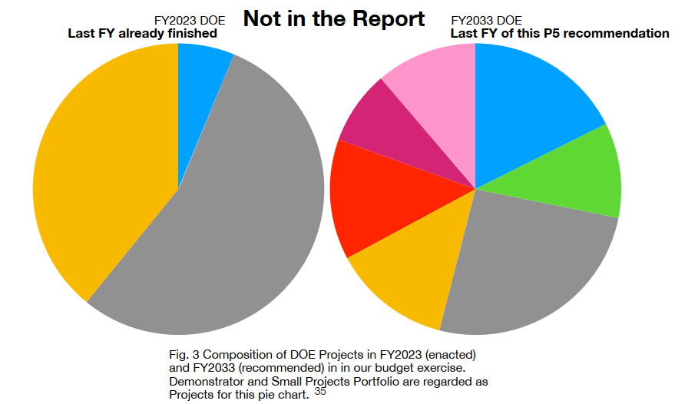

Slide 33
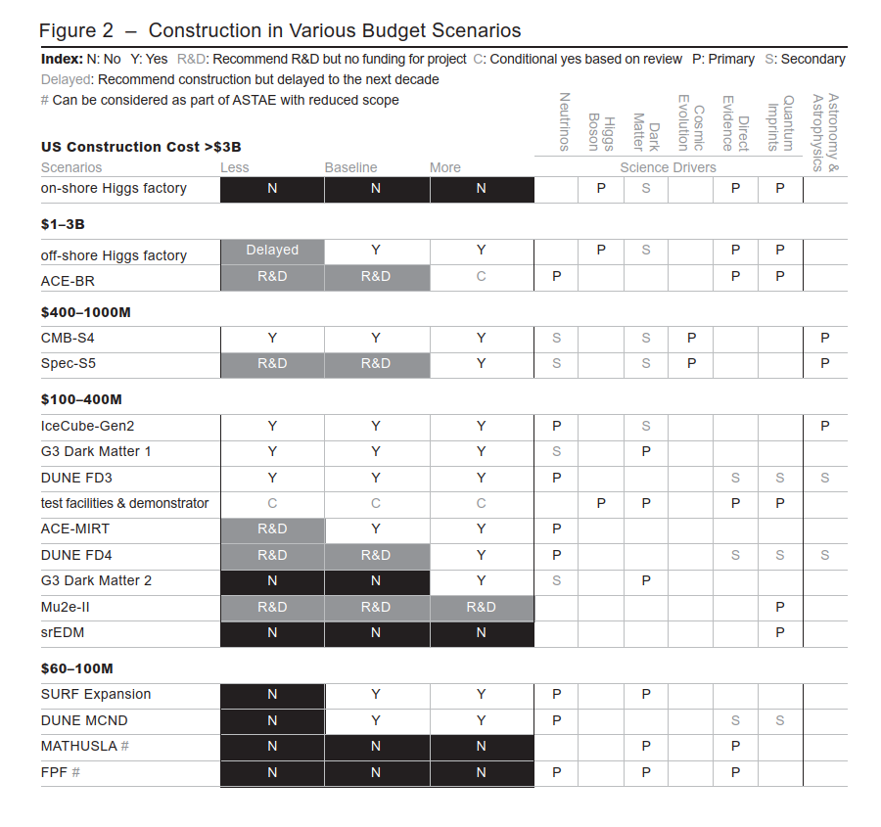
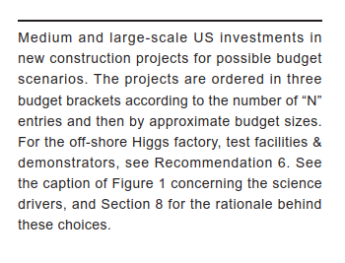

Slide 34
Thanks for your attention !

Slide 35
Additional slides

Slide 36
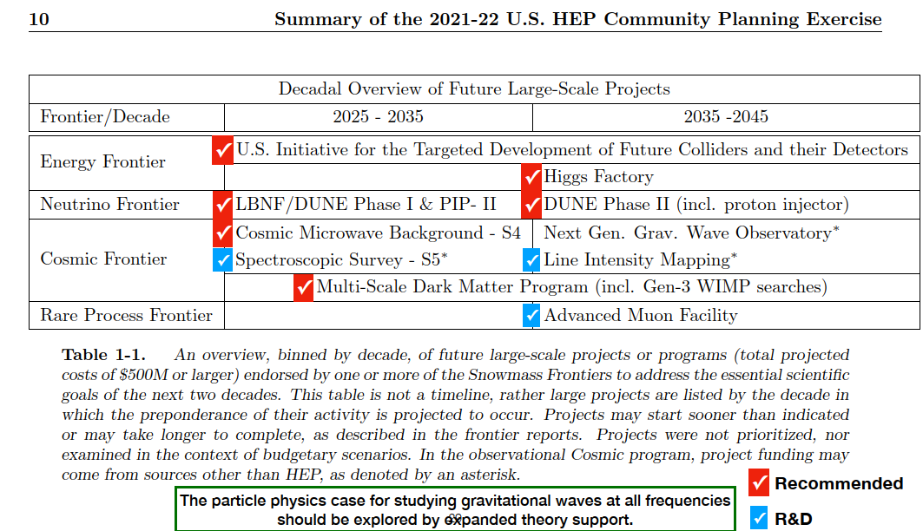

Slide 37
