Slide 1





Timeline
D. Schulte
On behalf of the International Muon Collider Collaboration
IMCC Annual Meeting, March 2024
This project has received funding from the European Union’s Research and Innovation programme under GAs No 101094300 and No 101004730.

Slide 2
Timeline Considerations
Start developing timeline (still evolving)
Uncertainties from physics case (e.g. HL-LHC), society development, budget profile etc.
Can concept be mature for decision before 2040 and start operation before 2050?
Identifying shortest possible “technically limited” timeline
Accept performance compromises that are required on this timescale
Tentatively identified main technologies that might limit the timeline
Muon cooling technologies and integration
Magnet technology
Detector technologies
Needs to be reviewed
To be reviewed by 2026
Expect that other technologies can be accelerated if funding is increased appropriately
  But they are equally important now to support that the muon collider can be done and can perform

Slide 3
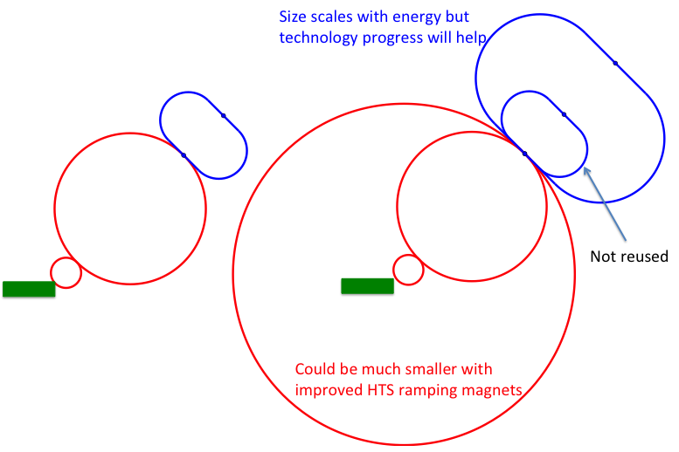
Staging Strategy
Assumptions:
In O(15 years):
  HTS technology available for solenoids
  Nb₃Sn available for collider ring
In O(25 years):
  HTS available for collider ring
Scenario 1: Energy staging
Start at lower energy (e.g. 3 TeV)
Build additional accelerator and collider ring later
Requires less budget for first stage
3 TeV design takes lower performance into account
Scenario 2: Luminosity staging
Start at full energy, but less performant collider ring magnets
Main sources of luminosity loss are collider arcs and interaction region
  Can recover interaction region later (as in HL-LHC)
  But need full budget right away
  Some luminosity loss remains (O(1.5))
  More power for the collider ring required (lower magnet temperature)
3

Slide 4
Initial Staged Target Parameters
Parameter | Unit | 3 TeV | 10 TeV |  | 10 TeV | 10 TeV
L | 10³⁴ cm⁻²s⁻¹ | 1.8 | 20 |  | 6? | 13
N | 10¹² | 2.2 | 1.8 |  | 1.8 | 1.8
f_{r} | Hz | 5 | 5 |  | 5 | 5
P_{beam} | MW | 5.3 | 14.4 |  | 14.4 | 14.4
C | km | 4.5 | 10 |  | 15 | 15
<B> | T | 7 | 10.5 |  | 7 | 7
ε_{L} | MeV m | 7.5 | 7.5 |  | 7.5 | 7.5
σ_{E} / E | % | 0.1 | 0.1 |  | 0.05? | 0.1
σ_{z} | mm | 5 | 1.5 |  | 3? | 1.5
β | mm | 5 | 1.5 |  | 3? | 1.5
ε | μm | 25 | 25 |  | 25 | 25
σ_{x,y} | μm | 3.0 | 0.9 |  | 1.3 | 0.9
Target integrated luminosities
Need to spell out scenarios
Need to integrate potential performance limitations for technical risk, cost, power, …
Example as discussion basis
numbers will change
4

Slide 5
Example Timeline
Fast-track 10 TeV Collider
Continued exploitation of demonstrator for technology development
Flexible range
Maybe also matche US
Decision
5

Slide 6
Demonstrator Considerations
Chr. Rogers, R. Losito et al.
6

Slide 7
Muon Cooling Tests
2035
2036
RF Test Stand
Muon cooling cell test facility
Muon cooling cell test with beam
Final cooling
7

Slide 8
Target
8

Slide 9
Detector
D. Lucchesi, S. Jindariani, N. Pastrone et al.
9

Slide 10
Magnets: Muon Beam Production
L. Bottura, M. Statera, F. Boattini, S. Mariotto, B. Caiffi, S. Fabbri et al.
Not all technology is ready
But are confident
Large number requires important effort
Many different cell require several integration teams
10

Slide 11
Magnets: Muon Beam Acceleration
Mature technology
Large number requires important effort in production
Power converter technology known but test required
11

Slide 12
Magnets: Collider Ring
LTS can be based on HL-LHC experience
Development required but foreseen inn HFM and US-MDP
HTS requires development
Not mature in 15 years
12

Slide 13
Magnets
A plan is a living entity, it is made to be changed
A plan is a tool to facilitate our work
A plan is a powerful instrument to set work objectives and priorities
To work well, a plan needs to be shared and integrated
13

Slide 14
Way Forward
Consolidate timeline this year
Might need to provide strategy input early 2025
Need to discuss the timelines with experts
Are the assumed durations realistic?
Is the interplay of different parts OK?
Are we missing something?
What is needed for decision making?
What are regional requirements?
Understand the needs of the US
How should the longer timelines look like?
  Tried to anticipate some in the tentative timeline
When is a Reference Design Report (or similar) needed?
When is a costed R&D programme required?
Similar considerations for other regions
Many thanks to the people that help in the initial discussions:
Steinar Stapnes, Roberto Losito, Chris Rogers, Andrea Wulzer, Donatella Lucchesi, Nadia Pastrone
Luca Bottura, Lucio Rossi, Alexej Grudiev, Rob van Welderen, Christian Carli, Anton Lechner, …
Mark Palmer, Sergo Jindariani, Diktys Stratakis, Sridhara Rao Dasu, Stephen Gourlay, Vladimir Shiltsev
Dave Nebold
14

