Slide 1
Muon Collider Magnets
Where are we ?
L. Bottura, M. Statera, F. Boattini, S. Mariotto, B. Caiffi, S. Fabbri and the mmWG
IMCC Annual Meeting, 15 March 2024

Slide 2
March 2024 - What did we do ?
Muon beam production
  Revision of target solenoid to accommodate larger shielding and simplify powering
  First screening of magnet challenges for the new 6D cooling channel optics
  Much advance in final cooling solenoids, moving from conceptual to engineering activities
Muon beam acceleration
  New design tools for system optimization: magnets, power conversion, energy storage
  Advanced in the concept of a racetrack SC magnet with rectangular aperture
  Exploring SC pulsed magnets alternative
Collider (see the presentation by D. Novelli)
  Completed the A-B plots for dipoles and quadrupoles
  Started the analysis of combined function magnets

Slide 3
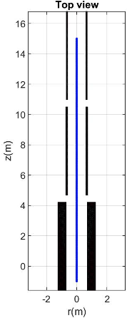
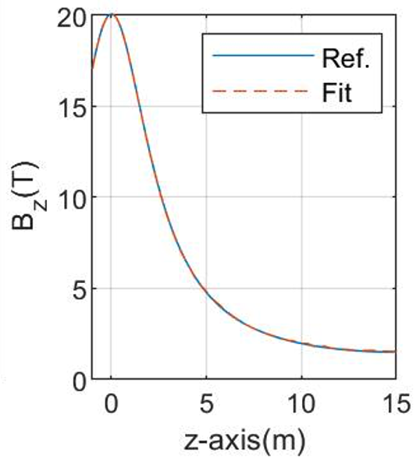
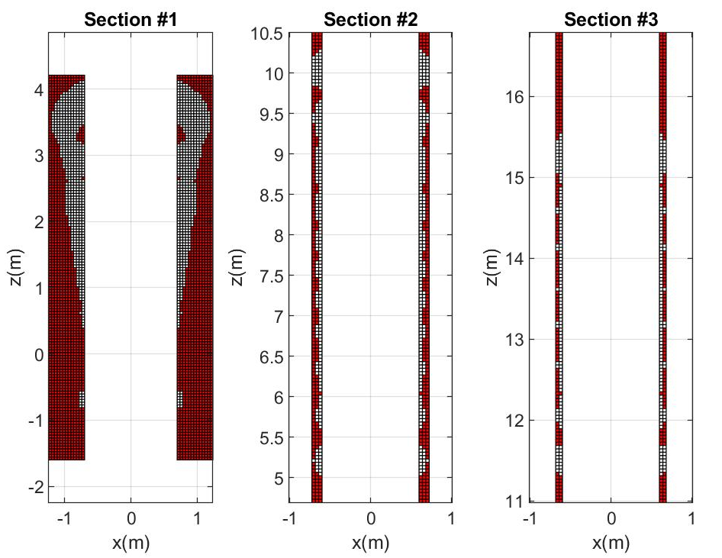
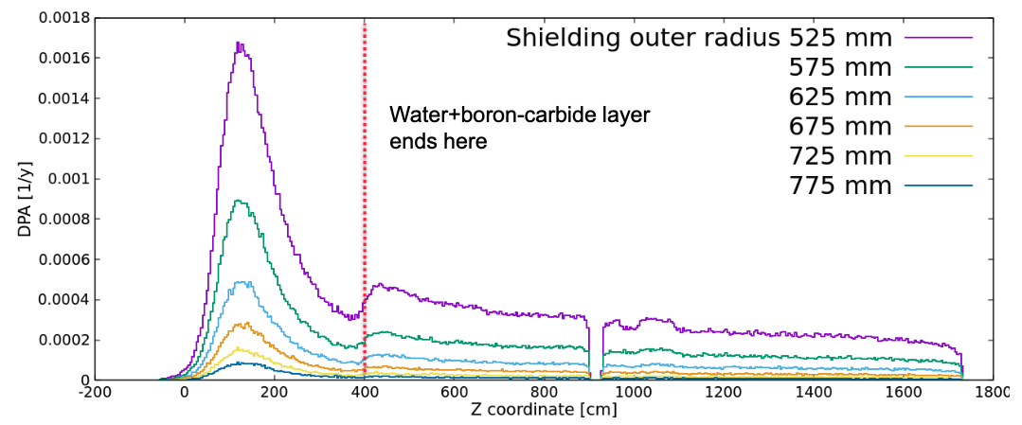
Muon beam production
A. Portone, et al.
Identical current in all coils
J. Mikolaj, et al.
Understand HTS radiation effects !!!

Slide 4
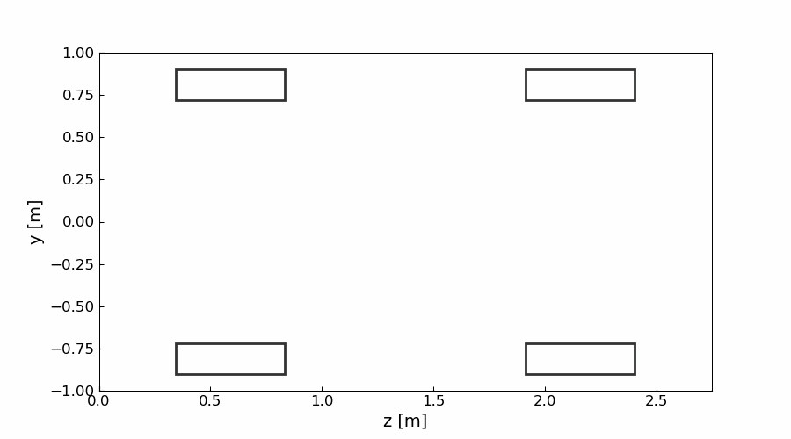
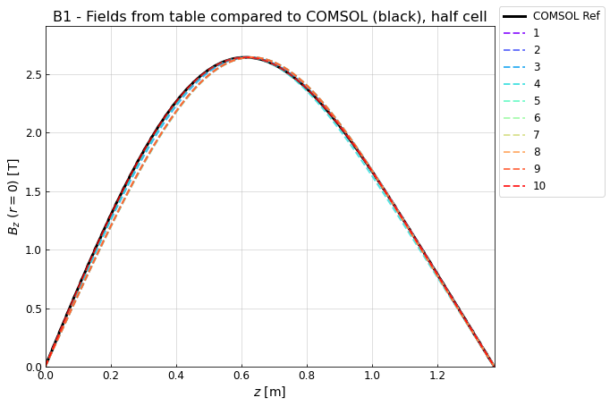
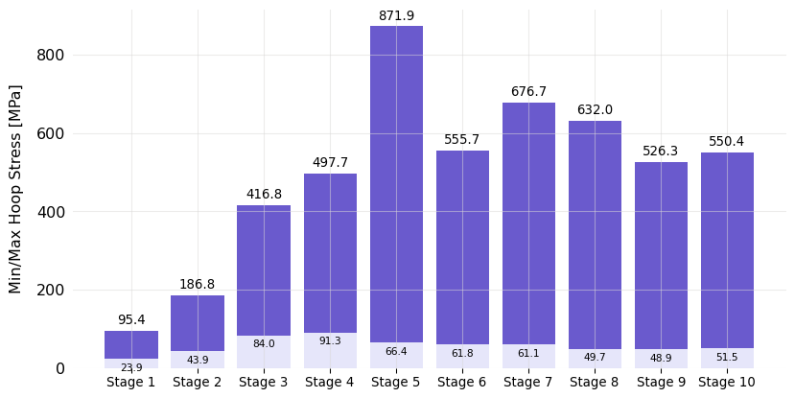
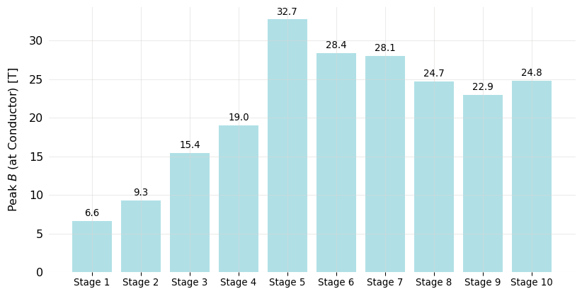
6D cooling solenoids
S. Fabbri
Integrate engineering limits in the beam optics !!!

Slide 5

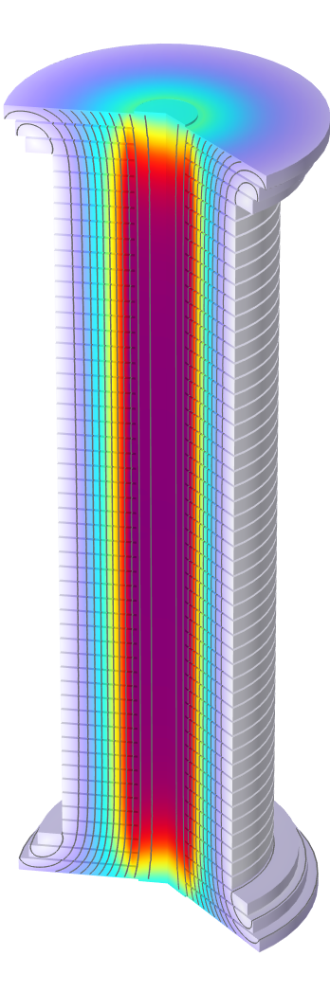
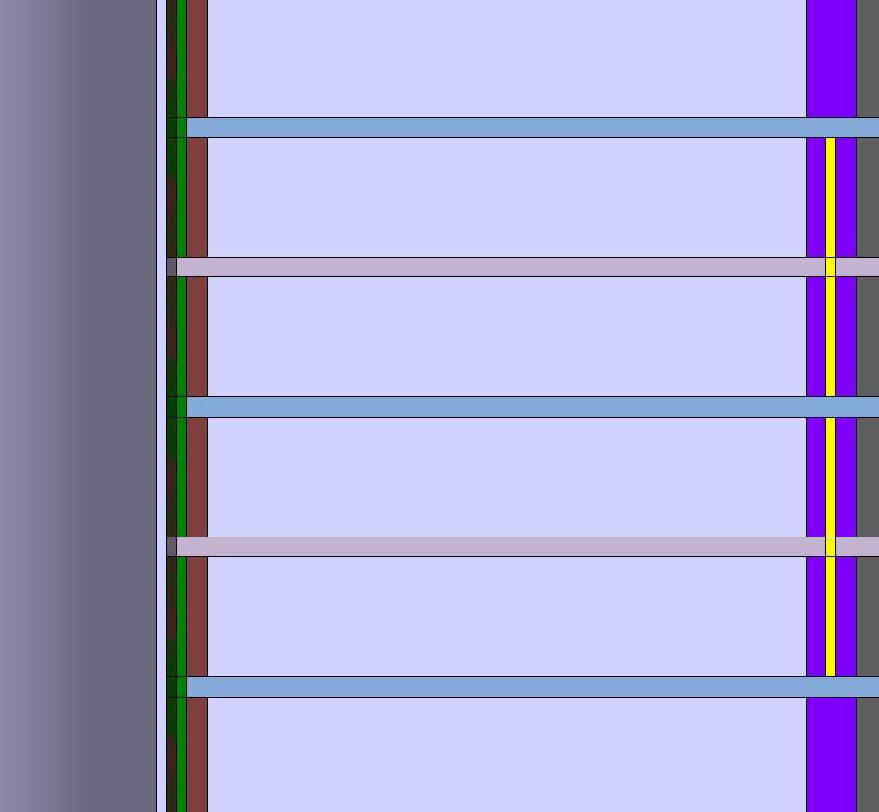
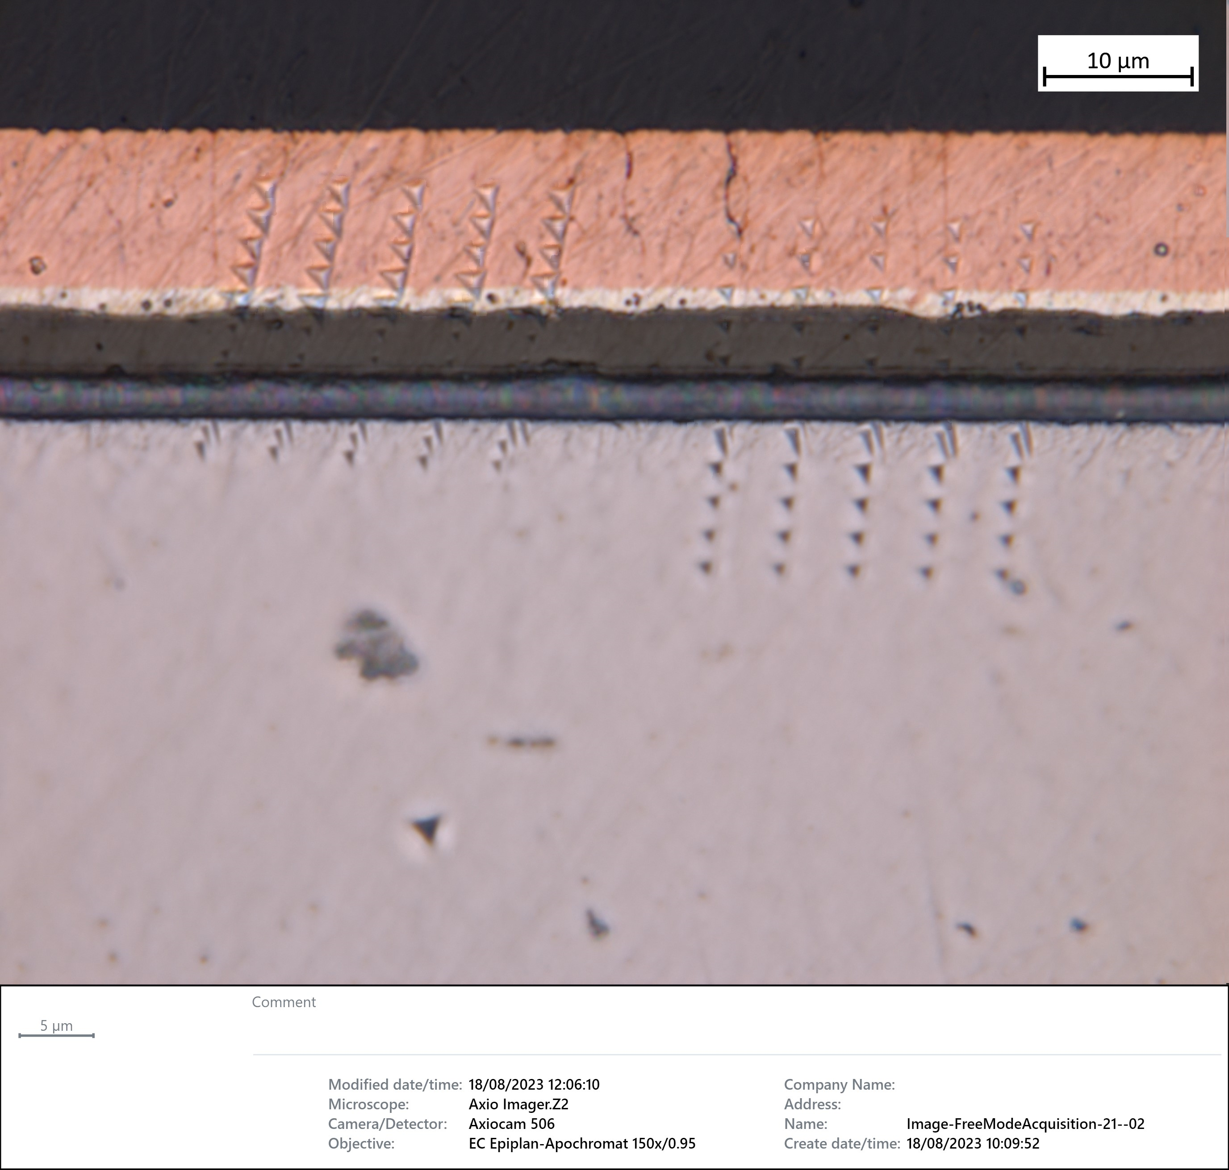
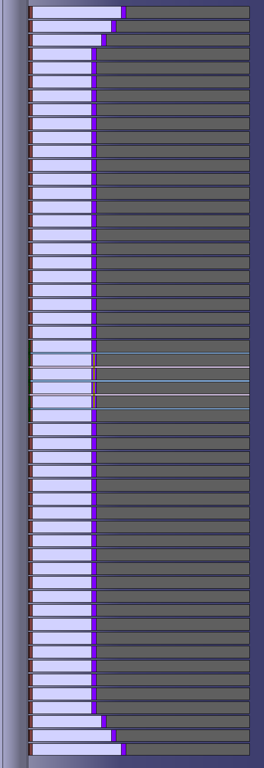
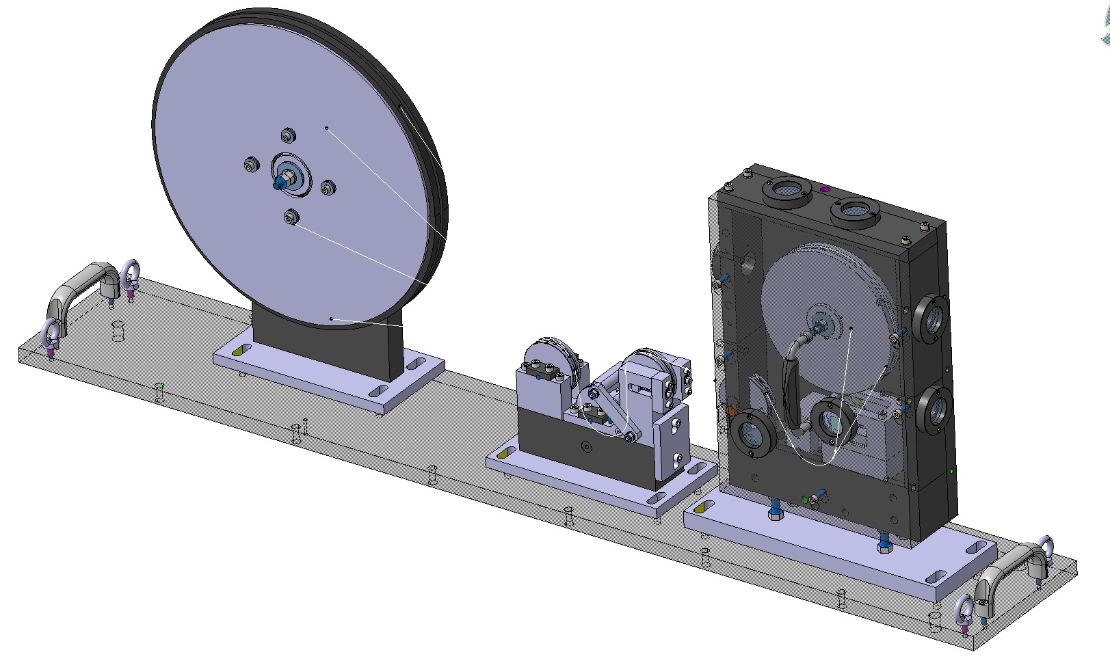
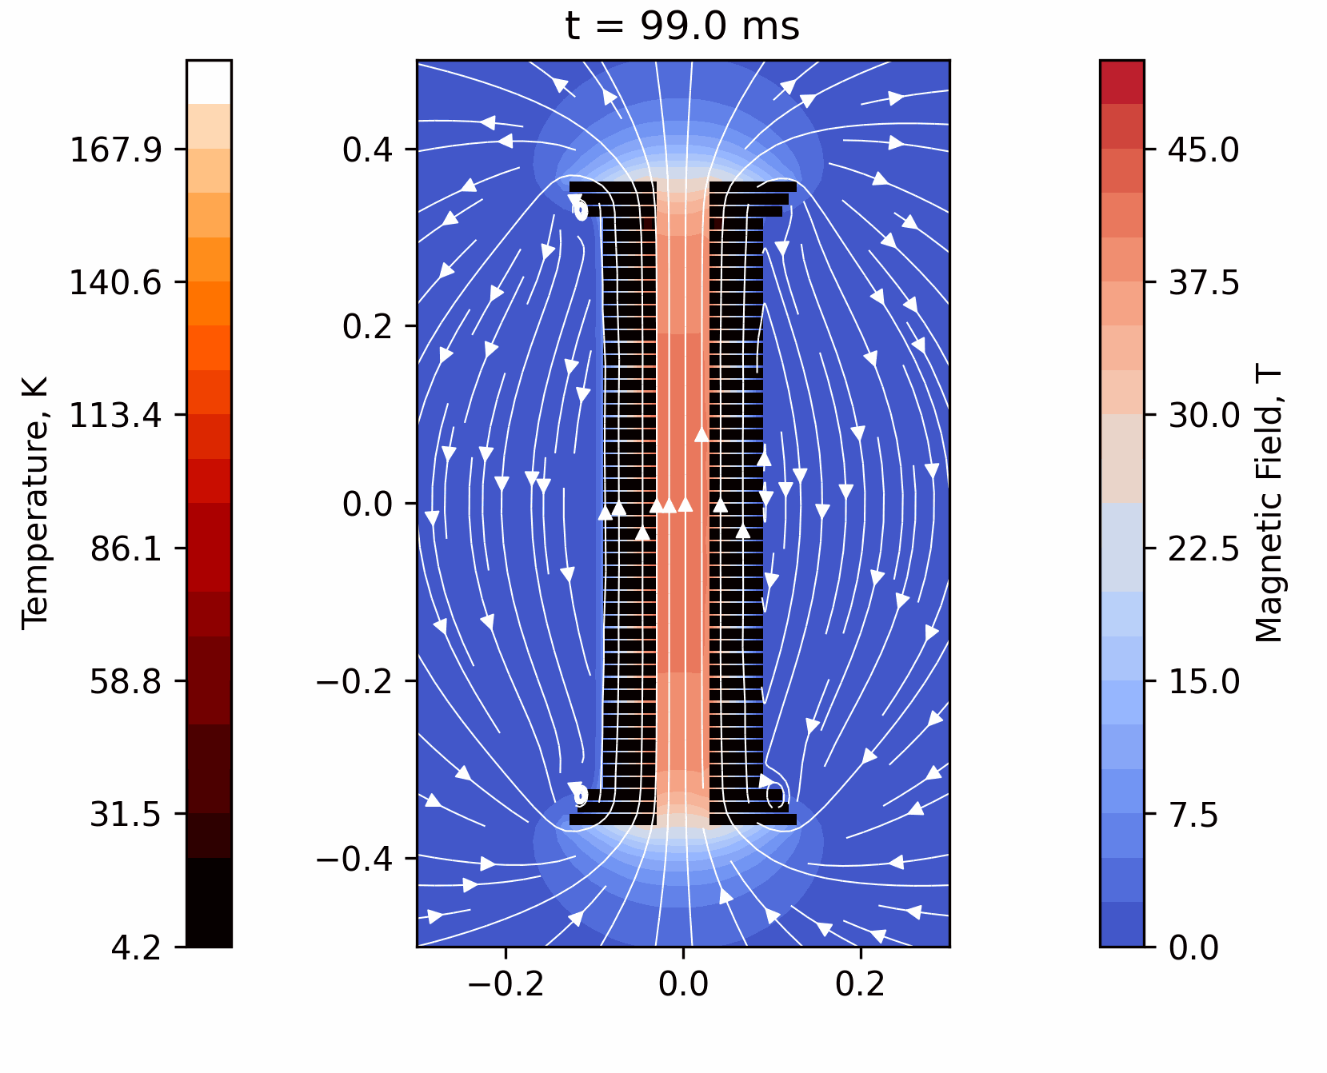
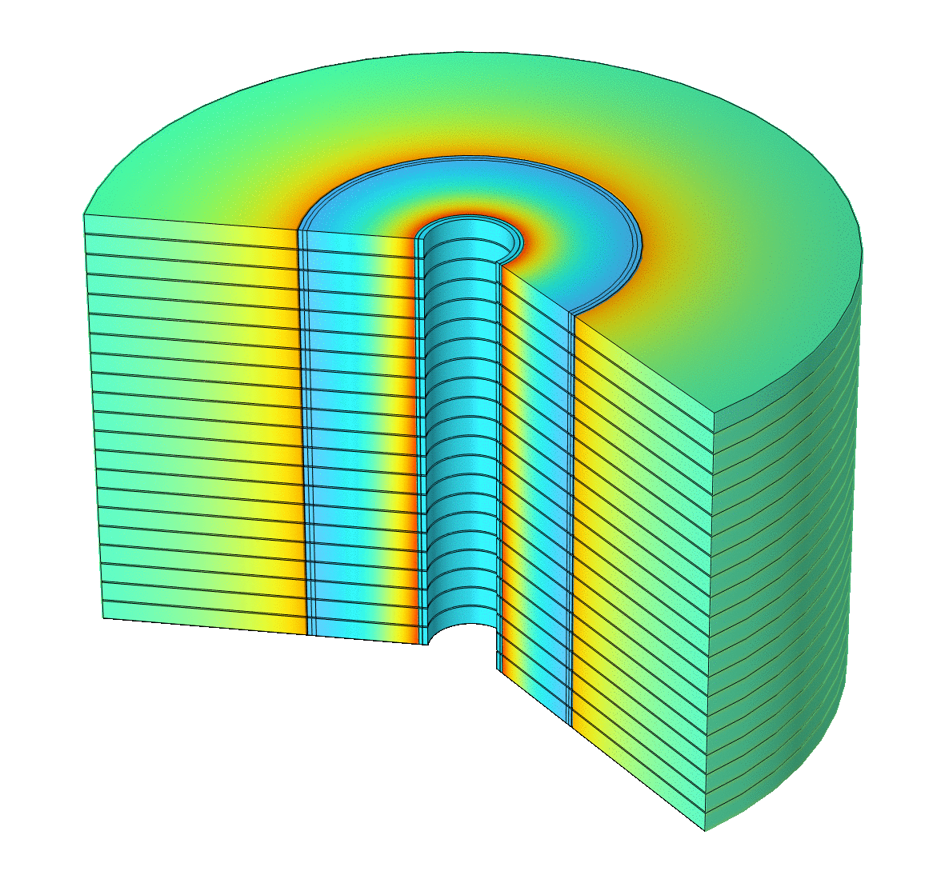
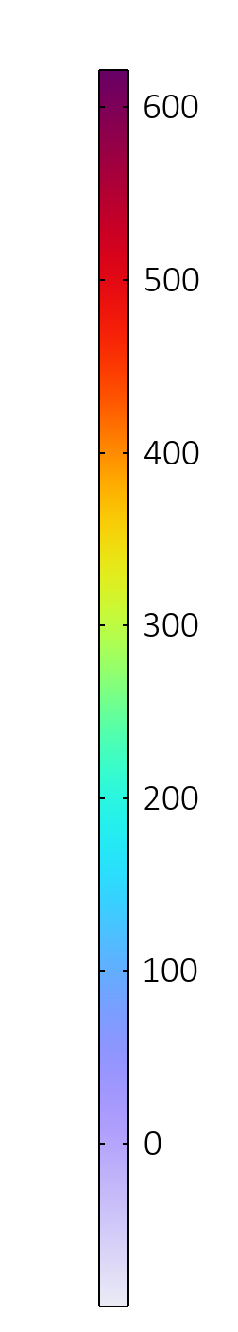
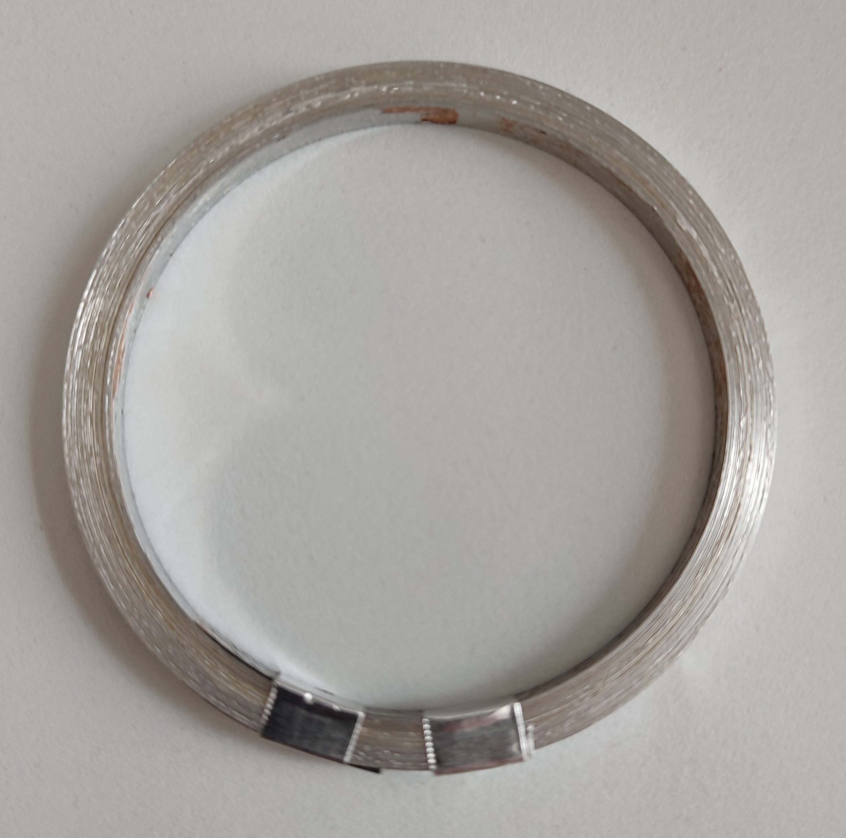
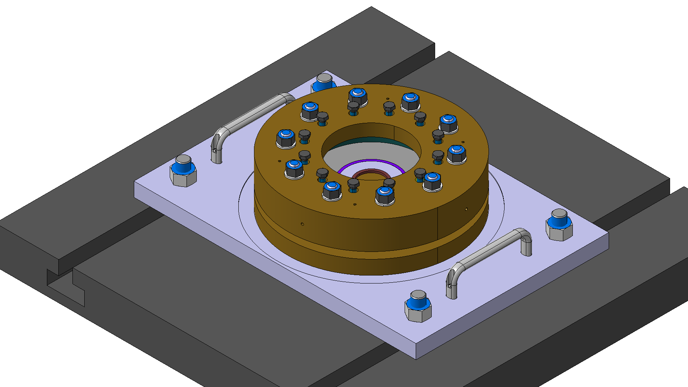
Final cooling solenoid
B. Bordini, et al.
Engineering Design
Material testing
Advanced analysis methods
Tools and tests

Slide 6
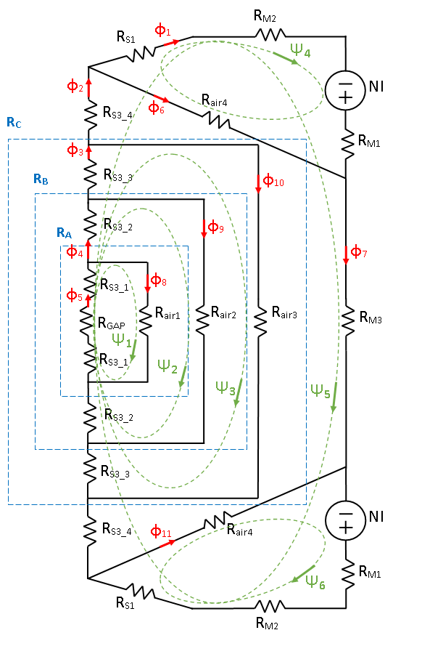
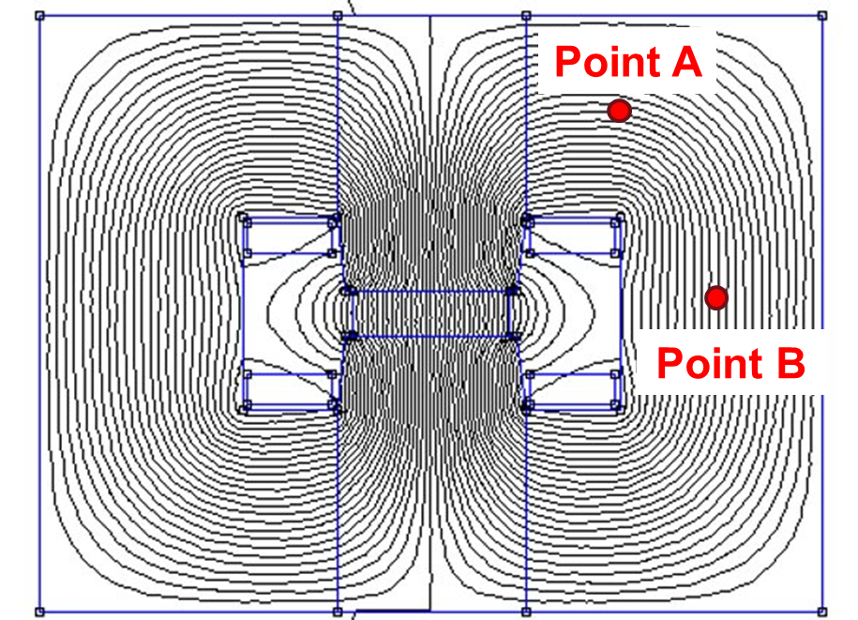
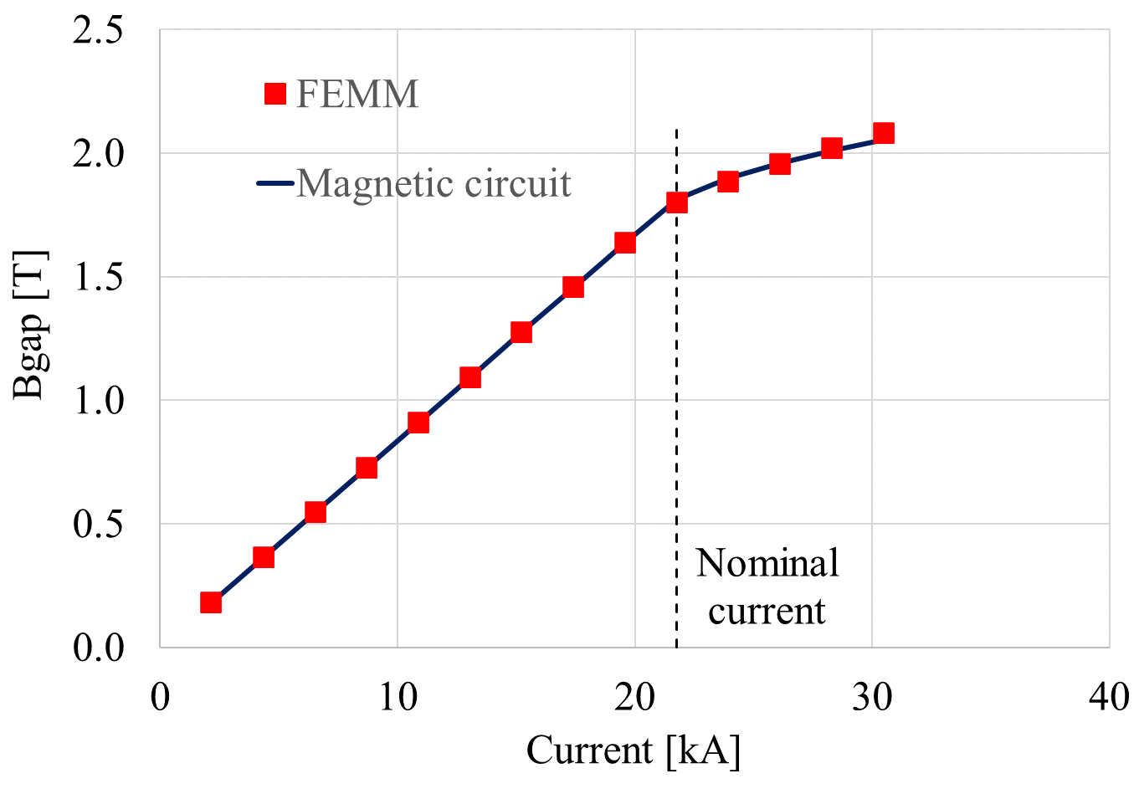
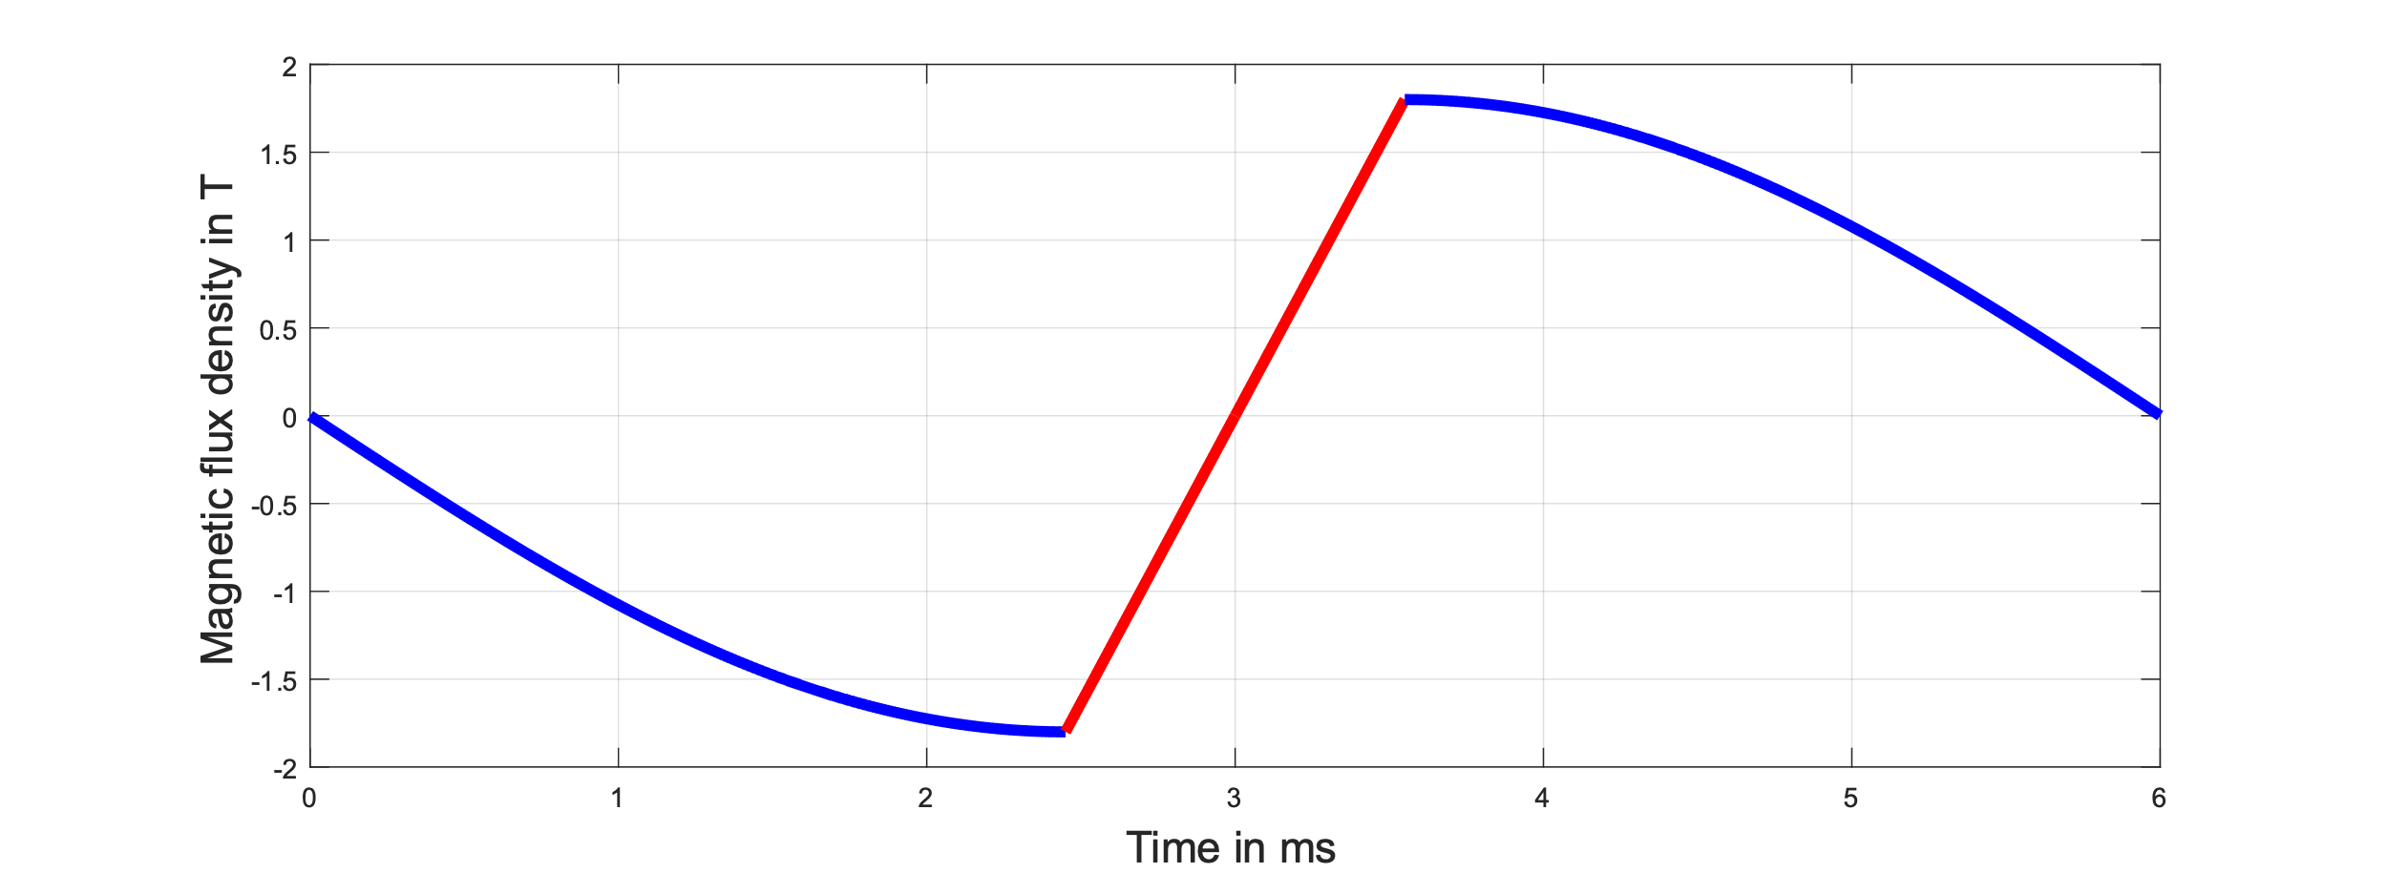
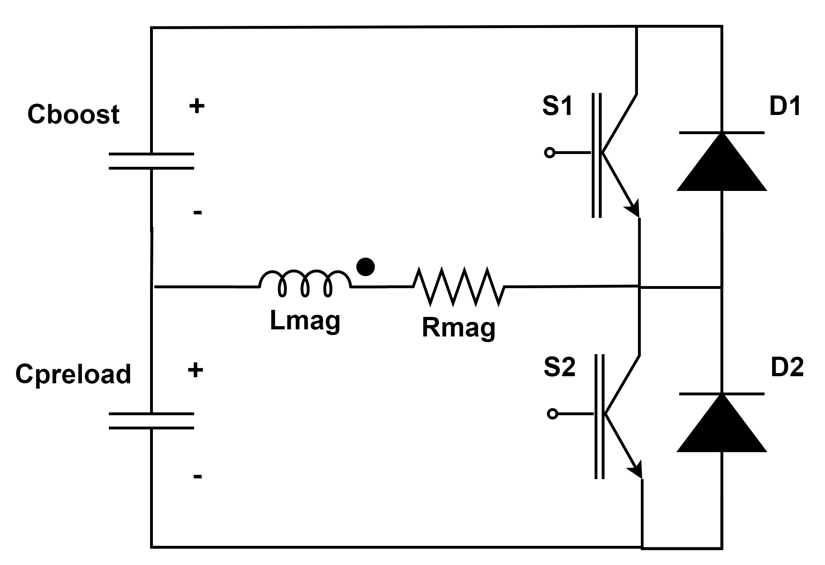
RCS
M. Breschi et al.
Ingenuity has great potential for big pay-back !!!
M. Gast, et al.
Bref
Preload
Boost
T_{pulse}
Preload

Slide 7
We have a plan
DRAFT

Slide 8


Major milestones for magnets
20T/20K solenoid model coil for the target
3 TeV full-length prototypes
Split Solenoids for RFMFTF
NI UHF solenoid
10 TeV full-length prototypes
0
5
10
15
20
HCS SC dipole prototypes
RCS string test
10 TeV HTS short models
6D cooling cell magnets
Fast pulsed NC dipole for RCS

Slide 9
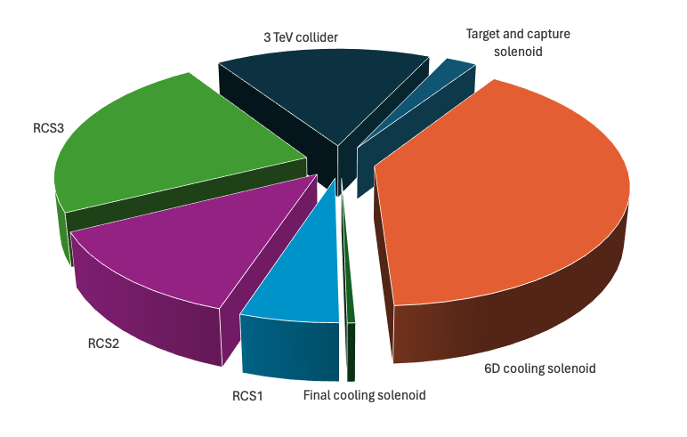
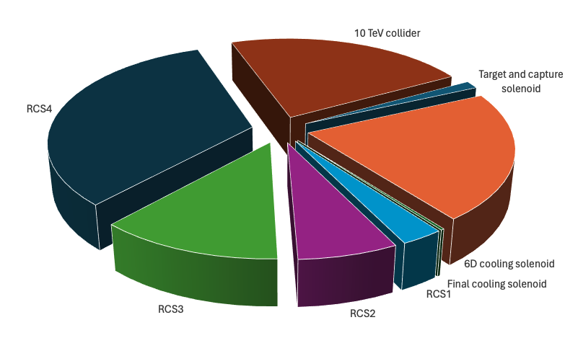
We have a cost estimate
3 TeV
Share in percentage of total cost for the magnet and powering systems
10 TeV
Share in percentage of total cost for the magnet and powering systems
The 6D cooling and accelerator (RCS) are the largest cost positions
RCS4 is the largest single cost item in the 10 TeV collider option
Target and capture (largest stored energy single magnet in the system) and final cooling (largest nominal field) only represent a few % of the total cost

Slide 10
Feedback and other considerations on the plan
Consider the IR quadrupoles of the collider as a separate and crucial item (luminosity) (OK)
Include different scenarios based on “aggressive” (baseline) and “conservative” (backup) technology (evaluate TRL and risk)
Include considerations on staging based on energy and/or luminosity (this may open very interesting possibilities for fast-tracking)
Work on the “expensive” parts of the collider (OK)
  6D cooling channel
  Rapid/Hybrid Cycled Synchrotrons (RCS4)

Slide 11
Final words
Grateful thanks to the participants to the working group and especially our students and fellows who are driving the study with their enthusiasm and hard work
And there are more opportunities to come, recognizing that the magnet and power system technology development for the Muon Collider has measurable positive impact on other science and society (maybe worth formalizing this in view of the upcoming strategy process)

