Slide 1
Performance Limits of
Dipole and Quadrupole for a Muon Collider Ring
D. Novelli^{1,2}, L. Alfonso ², A. Bersani², L. Bottura⁵, B. Caiffi²,
S. Farinon², F. Mariani¹, S. Mariotto³ , A. Pampaloni ², T. Salmi⁴
¹Sapienza University of Rome , ²INFN – Genoa , ³INFN and University of Milan, ⁴Tampere University , ⁵CERN

Slide 2
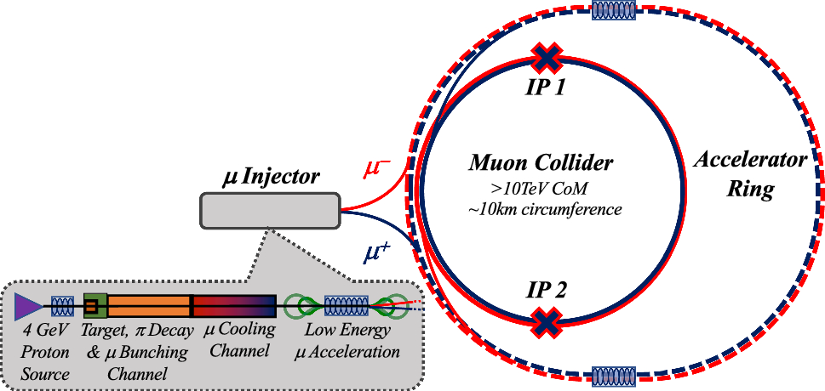
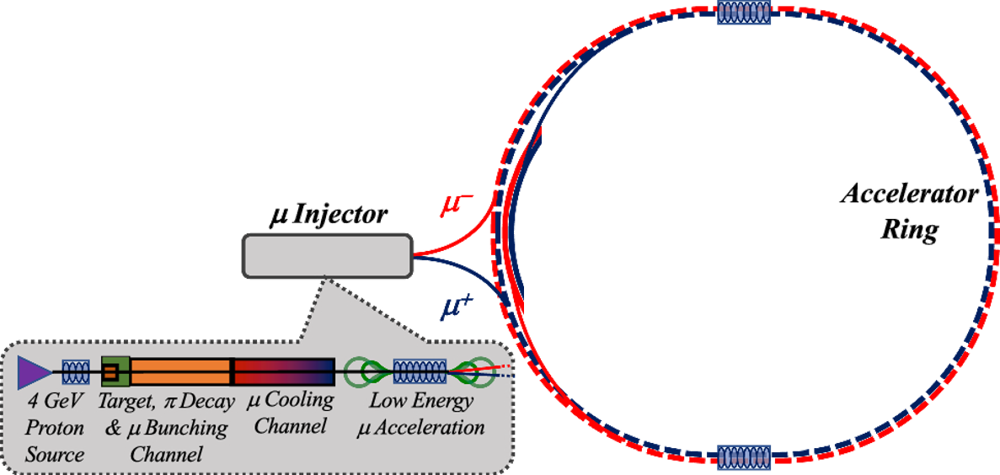
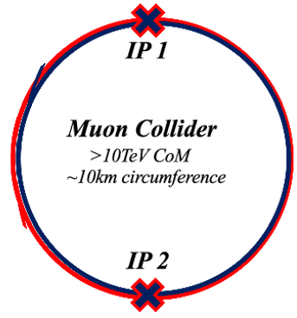
Overview
Main stages of a muon collider complex
Magnets:
Dipoles
Quadrupoles
Sextupoles
Purpose:
Evaluate realistic performance targets for the collider magnets, in close collaboration with studies of beam physics, cryogenics, and energy storage.
Produce a credible and affordable design study (contain costs, energy efficiency, sustainable operation).
Task 7.4

Slide 3
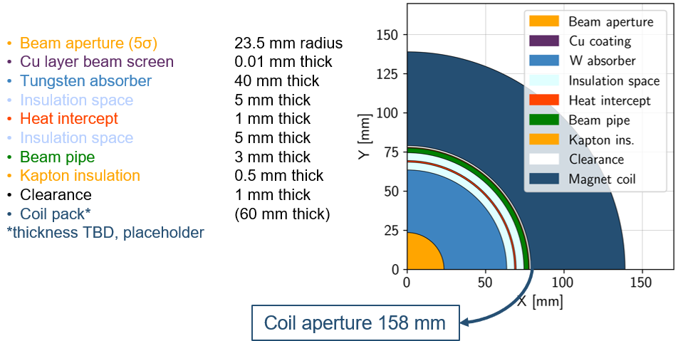

Collider Magnets Requirements
Assuming 10 TeV machine and coil at 4.5 K
3 TeV collider (5 km ring):
Close to state of the art
$∼$11T/150mm (Nb₃Sn)
600 magnets, 5 m length
Operating temperature: 4.5 K
10+ TeV collider (10 km ring):
HTS magnets, R&D is required
$∼$15T/150mm (ReBCO, hybrid)
1200 magnets, 5 m length
Operating temperature: 4.5…20 K
Courtesy of Patricia Borges de Sousa
https://indico.cern.ch/event/1250075/contributions/5357594/
with HTS @20K the absorber can be thinner
High field dipoles to minimize collider ring size and maximize luminosity.
Beam loss protection
High-energy electrons and positrons arising from muon decay and striking the collider ring magnets can cause radiation damage and unwanted heat load.
Shielding
Large aperture
Courtesy of A. Lechner

Slide 4
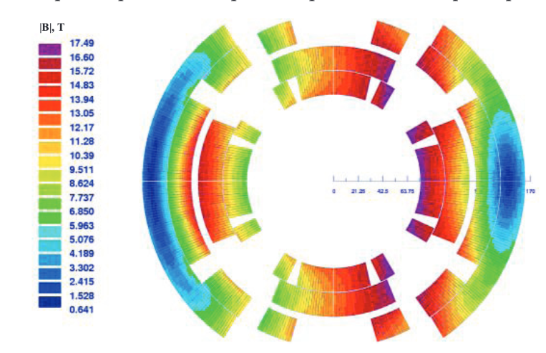
Collider Magnets Requirements
3 TeV collider (5 km ring):
Close to state of the art
$∼$11T/150mm (Nb₃Sn)
600 magnets, 5 m length
Operating temperature: 4.5 K
10+ TeV collider (10 km ring):
HTS magnets, R&D is required
$∼$15T/150mm (ReBCO, hybrid)
1200 magnets, 5 m length
Operating temperature: 4.5…20 K
Arc:
Combined function magnets: B1, B1+B2 and B1+B3
B ≈ 8…16 T; G ≈ 320 T/m; G’ ≈ 7100 T/m²
Aperture ≈ 160 mm
Final focus:
Combined function magnets: B1, B2, B1+B2, B1+B3
B ≈ 4…16 T; G ≈ 100…300 T/m; G’ ≈ 12000 T/m²
Aperture ≈ 150…330 mm
Difficult to define
a single magnet
specification
High field dipoles to minimize collider ring size and maximize luminosity.
Beam loss protection
High-energy electrons and positrons arising from muon decay and striking the collider ring magnets can cause radiation damage and unwanted heat load.
Shielding
Large aperture
V.V. Kashikhin et al.

Slide 5
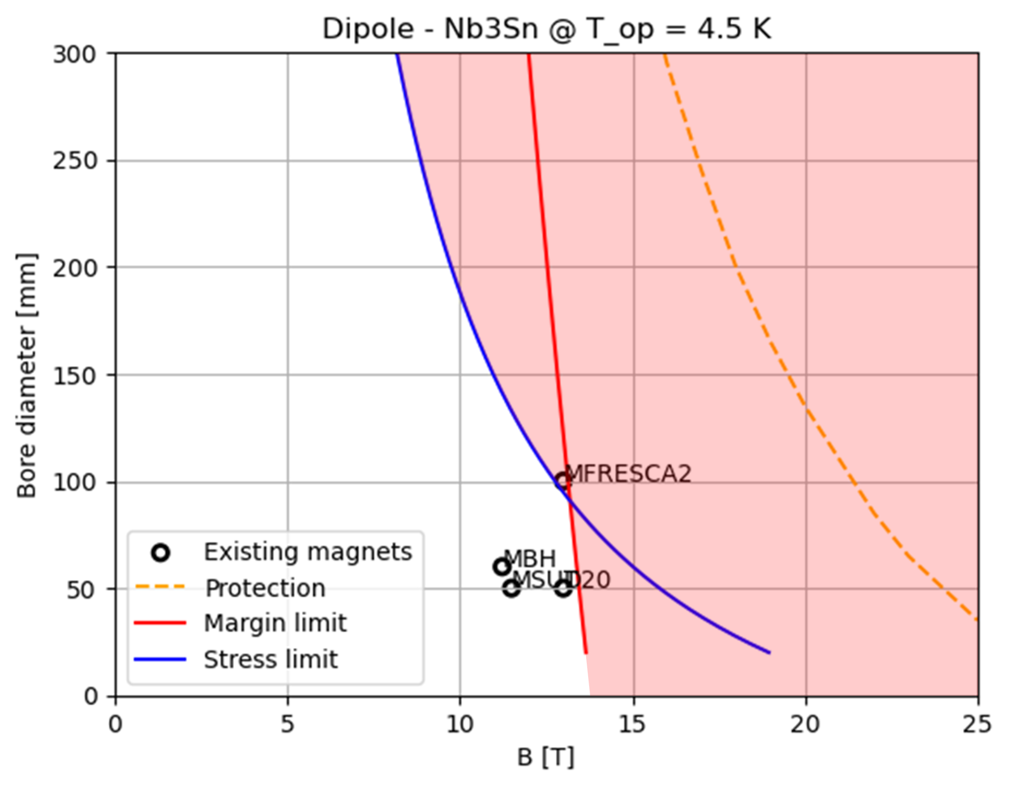
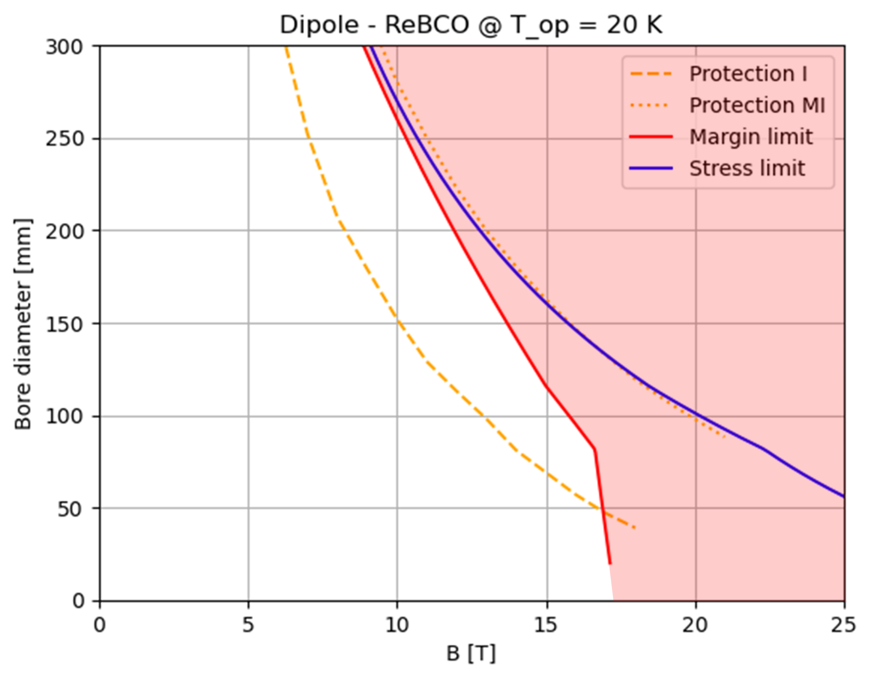
Introduction to A-B plots
Need for high fields in large apertures
We perform plots that can show the allowed area between aperture diameter (A) and bore field (B).
We consider Nb₃Sn for the 3 TeV machine and HTS (ReBCO) for the 10 TeV collider.
Innovative approach, useful for interfacing the needs of beam dynamics with the technological limits (of today and the near future) related to superconducting magnets.
Immediate feedback capable of analyzing many possible configurations in a single plot

Slide 6
Introduction to A-B plots
Need for high fields in large apertures
We perform plots that can show the allowed area between aperture diameter (A) and bore field (B).
We consider Nb₃Sn for the 3 TeV machine and HTS (ReBCO) for the 10 TeV collider.
Limit curves are introduced by mechanical challenges (stress limit), critical current density (margin limit) and stored magnetic energy (quench protection), depending on the superconducting material.

Slide 7
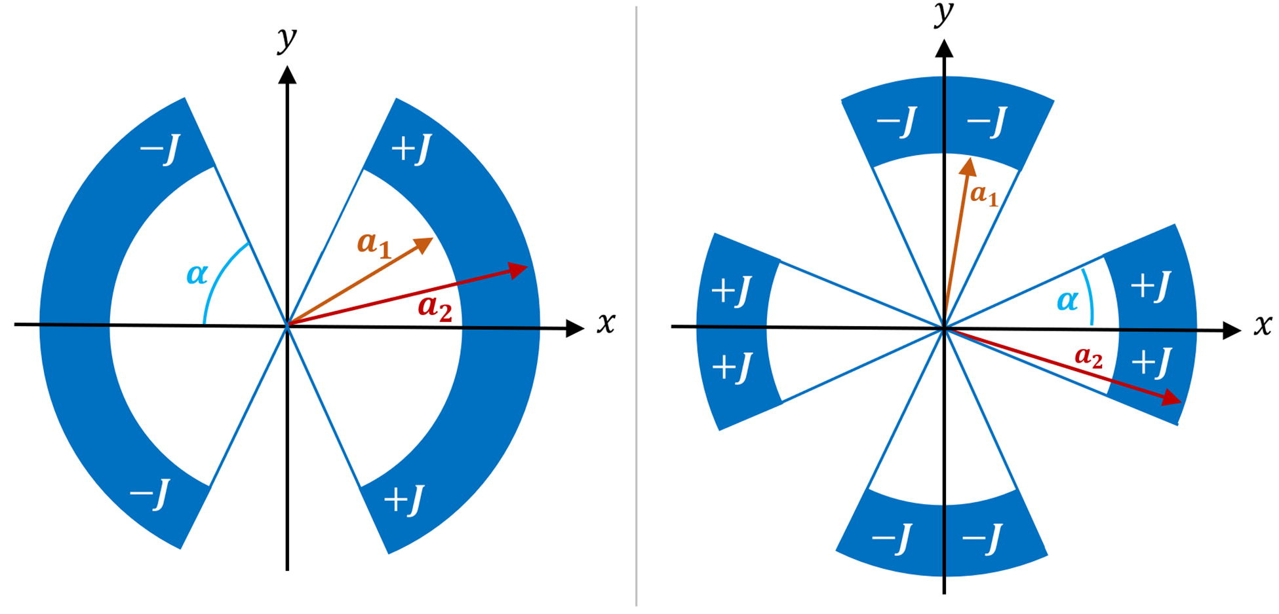



Method and Assumptions
A Python code is used to implement the analytic formulas for the cos-theta magnets in sector coil approximation.
($α$ is 60° for the dipole and 30° for the quadrupole)
Dipole
Quadrupole
$$B\left(w,J\right)=\frac{2μ_{0}J(a_{2}−a_{1})sinα}{π}$$
$$G\left(w,J\right)=\frac{2μ_{0}J}{π}\ln\left(\frac{a_{2}}{a_{1}}\right)sin⁡(2α)$$
($w=coil width )$

Slide 8
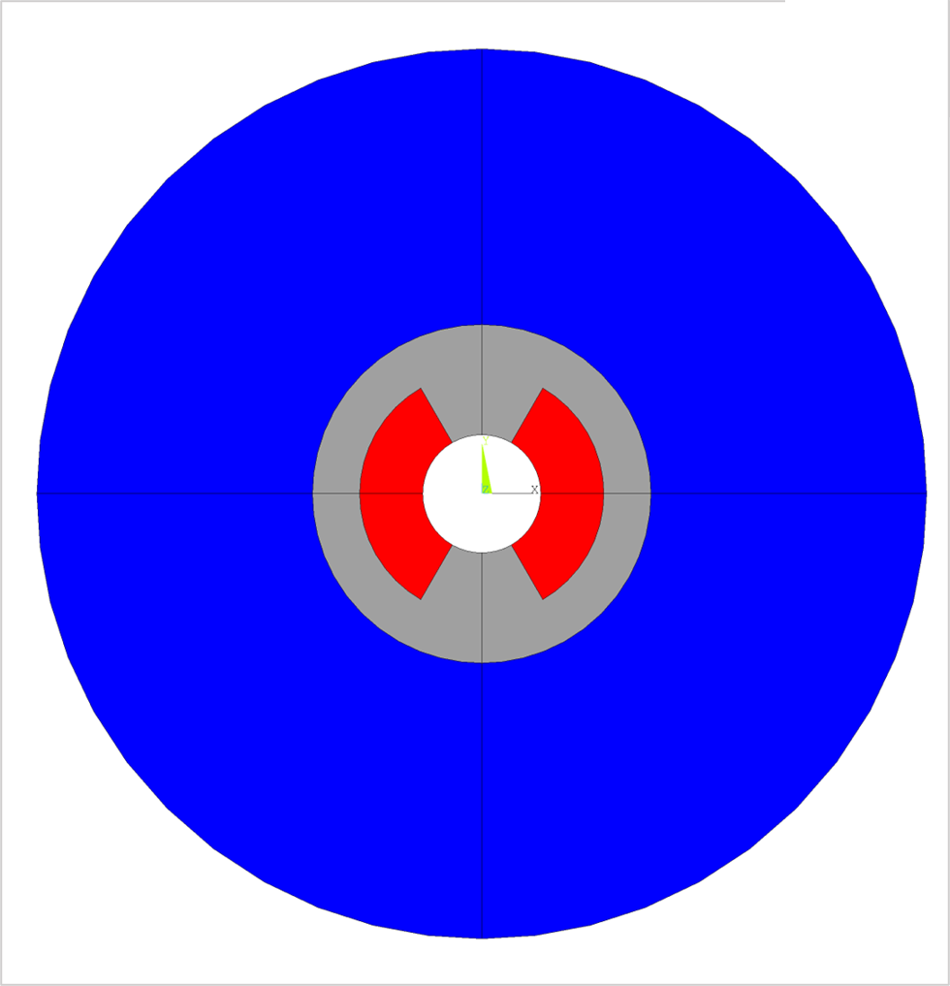
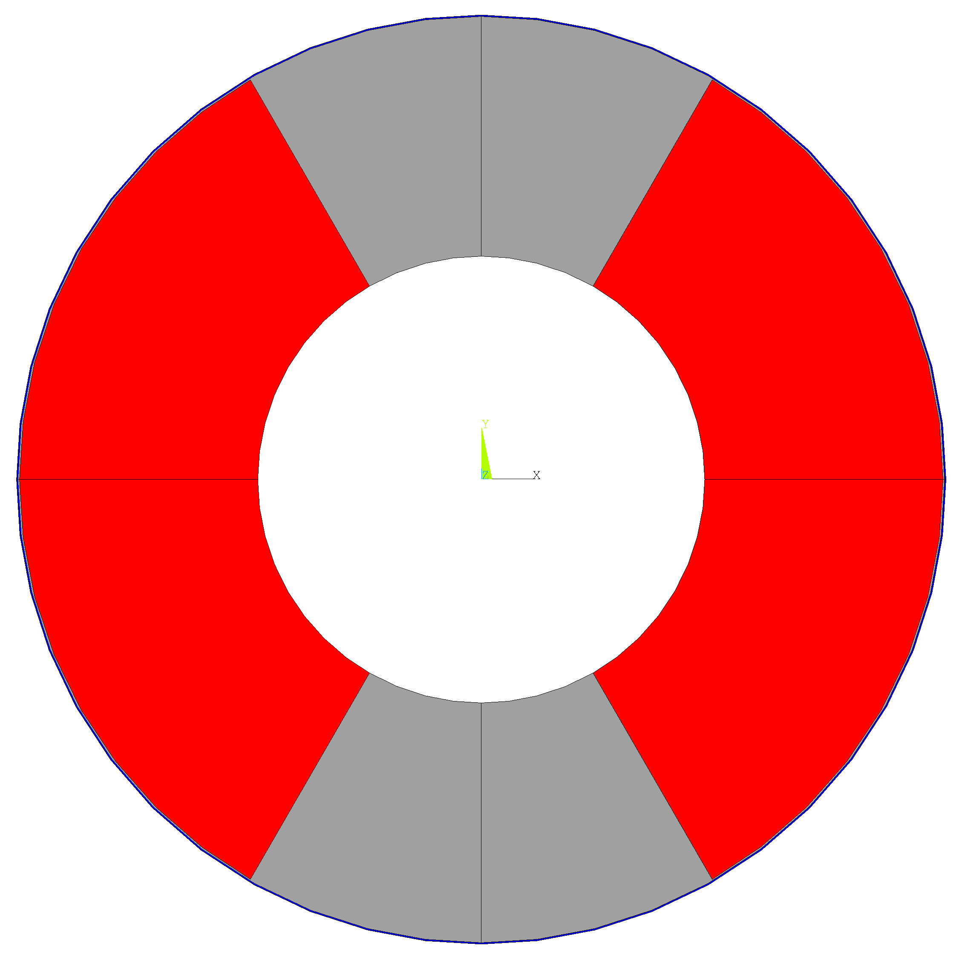
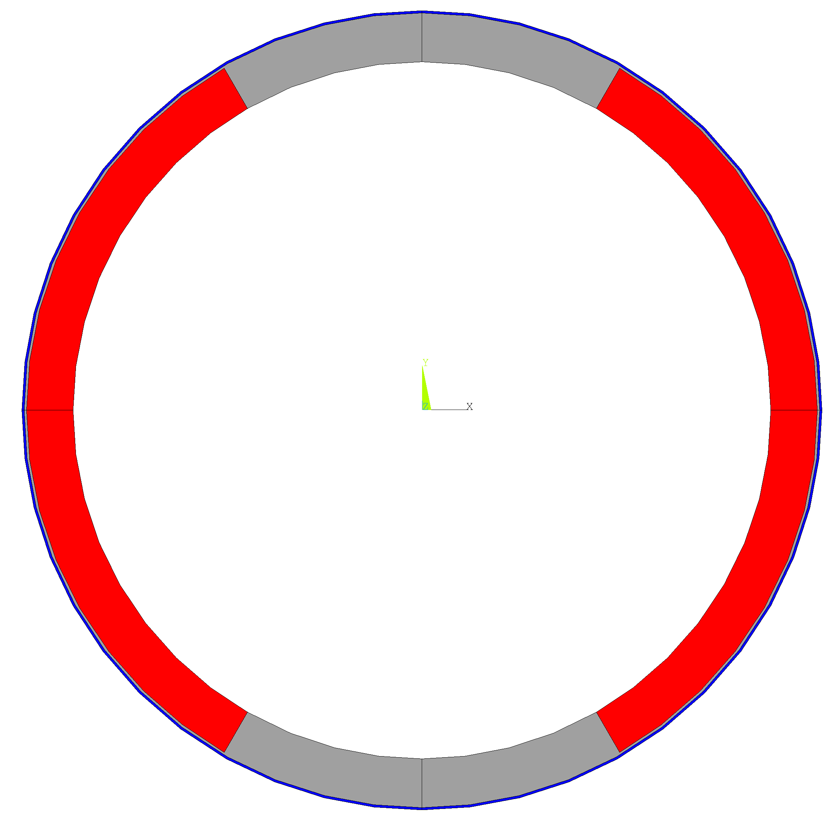
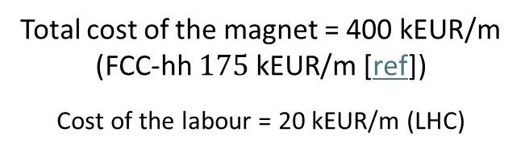
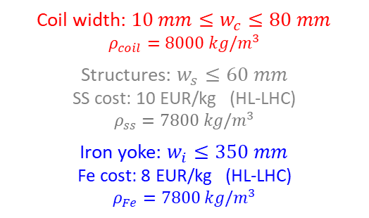
Method and Assumptions
A Python code is used to implement the analytic formulas for the cos-theta magnets in sector coil approximation.
Cost model: by setting an upper limit to the cost of the magnet, the maximum coil width can be calculated for each aperture, taking into account the other components.
Example diagram with bore aperture set at 150 mm.
Total cost of the magnet = 400 kEUR/m (FCC-hh $175 \text{k}\text{EUR}\text{/}\text{m}$ [ref])
Cost of the labour = 20 kEUR/m (LHC)
Aperture
150 mm
Aperture
150 mm
Materials | SC cost [EUR/kg] | Aspirational SC cost [EUR/kg]
Nb₃Sn | 2000 | 700 (FCC target)*
ReBCO | 8000 | 2500 (realistic projection)**
Coil width: $10 mm≤w_{c}≤80 mm$
$$ρ_{coil}=8000 kg/m^{3}$$
Structures: $w_{s}≤60 mm$
SS cost: 10 EUR/kg (HL-LHC)
$ρ_{ss}=7800 kg/m^{3}$
Iron yoke: $w_{i}≤350 mm$
Fe cost: 8 EUR/kg (HL-LHC)
$$ρ_{Fe}=7800 kg/m^{3}$$
Aperture
150 mm
* 7€/kAm, FCC target 5€/kAm
  ** 50 €/kAm: 1/3 of today prize (150€/kAm)
  Also based on projection of ref
  A. Molodyk and C. Larbalestier, Science, 2023
Bore
Coil
Structures
Iron
The maximum total cost of the magnet is the same for both materials.

Slide 9
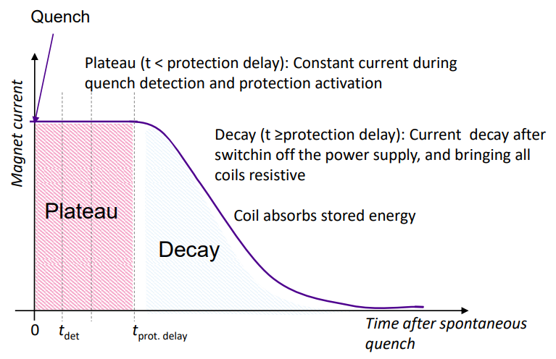
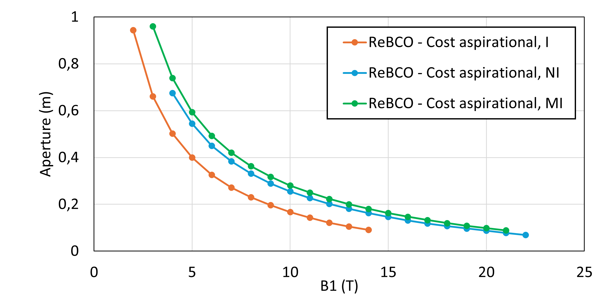
Method and Assumptions
A Python code is used to implement the analytic formulas for the cos-theta magnets in sector coil approximation.
Cost model: by setting an upper limit to the cost of the magnet, the maximum coil width can be calculated for each aperture, taking into account the other components.
The protection scheme consists in QH (or CLIQ) for classical insulated coils, limiting the hotspot temperature and the stored energy in the coils.
For the ReBCO, high cost requires small coil and very high current density → Protection will be a limiting factor
  Need to devise alternative protection schemes!
    → Non-Insulated and Metal-Insulated coils
40 ms protection delay
Materials | Hotspot T [K]
Nb₃Sn | 350
ReBCO | 200
Courtesy of Tiina Salmi https://indico.cern.ch/event/1240045/

Slide 10
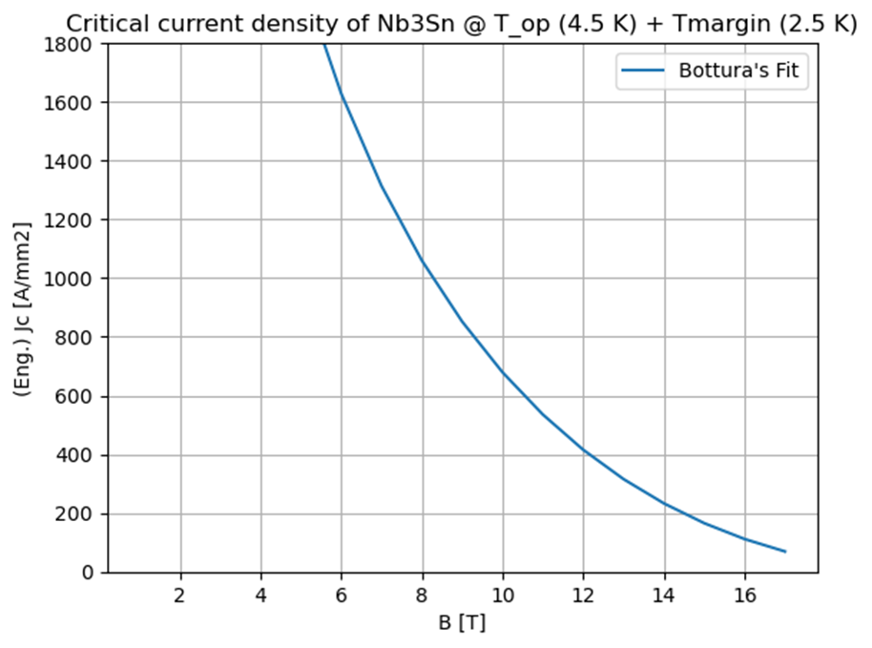
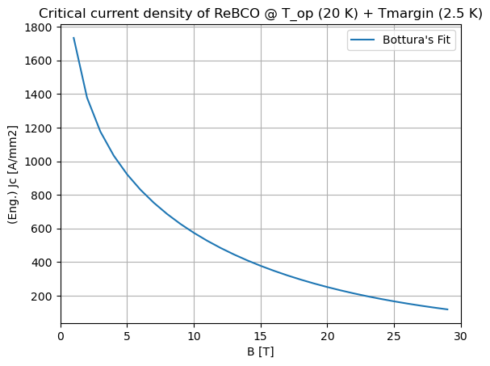
Method and Assumptions
A Python code is used to implement the analytic formulas for the cos-theta magnets in sector coil approximation.
Cost model: by setting an upper limit to the cost of the magnet, the maximum coil width can be calculated for each aperture, taking into account the other components.
The protection scheme consists in QH (or CLIQ) for classical insulated coils, limiting the hotspot temperature and the stored energy in the coils.
The margin limit is the limit due to the SC material itself, starting from the Bottura’s fit for the critical current density.
Materials | Operating T [K] | T margin [K]
Nb₃Sn | 4.5 | 2.5 (HL-LHC)
ReBCO | 20 | 2.5
J_{c} refers to:
Nb₃Sn: FCC cable target performance
ReBCO: Fujikura FESC-AP tape

Slide 11
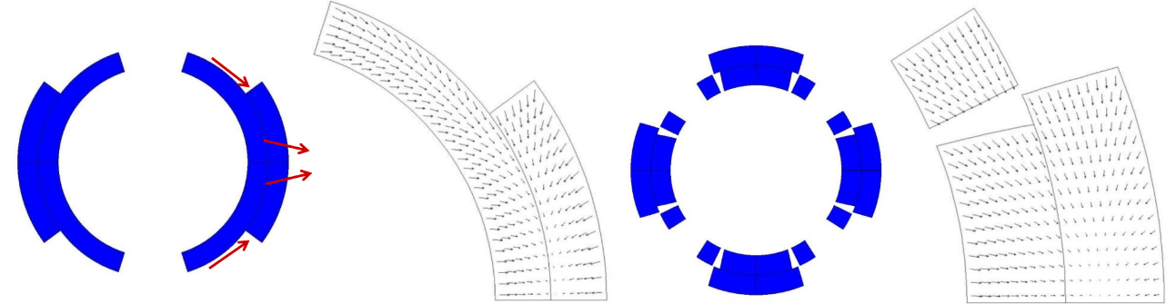
Method and Assumptions
A Python code is used to implement the analytic formulas for the cos-theta magnets in sector coil approximation.
Cost model: by setting an upper limit to the cost of the magnet, the maximum coil width can be calculated for each aperture, taking into account the other components.
The protection scheme consists in QH (or CLIQ) for classical insulated coils, limiting the hotspot temperature and the stored energy in the coils.
The margin limit is the limit due to the SC material itself, starting from the Bottura’s fit for the critical current density.
The stress limit considers the maximum mechanical stress we can have on the coils, starting from the analytical formula for the midplane pressure of cos-theta magnet in sector coil approx. (Reference: https://doi.org/10.15161/oar.it/143359 )
Materials | Peak Stress [MPa]
Nb₃Sn | 150
ReBCO | 400
LARP TQ
(P. Ferracin)
Currently, only stresses generated by Lorentz forces are considered.
Tevatron dipole
(P. Ferracin)

Slide 12

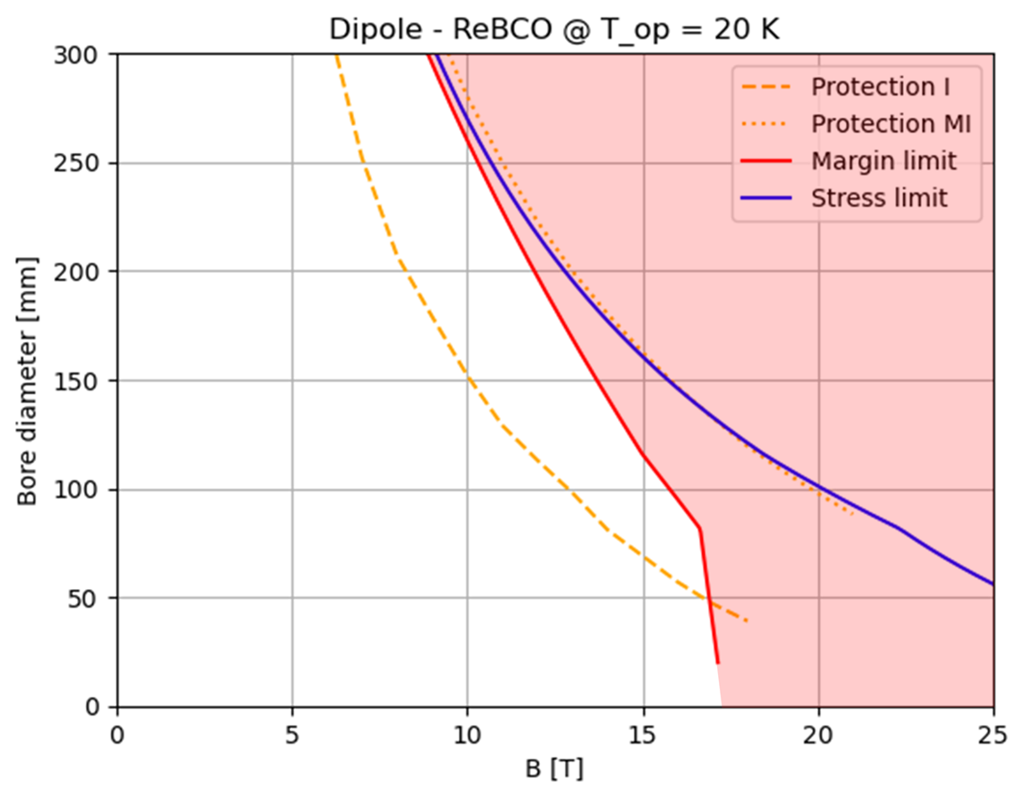
Dipole A-B Plots
Design
target
Design
target
Nb₃Sn falls short of required performance because of operating margin and peak stress (at affordable cost !)
HTS falls short of required performance with classical insulated coils. Assuming MI or NI magnets, the protection limit becomes comparable with the other limits.

Slide 13
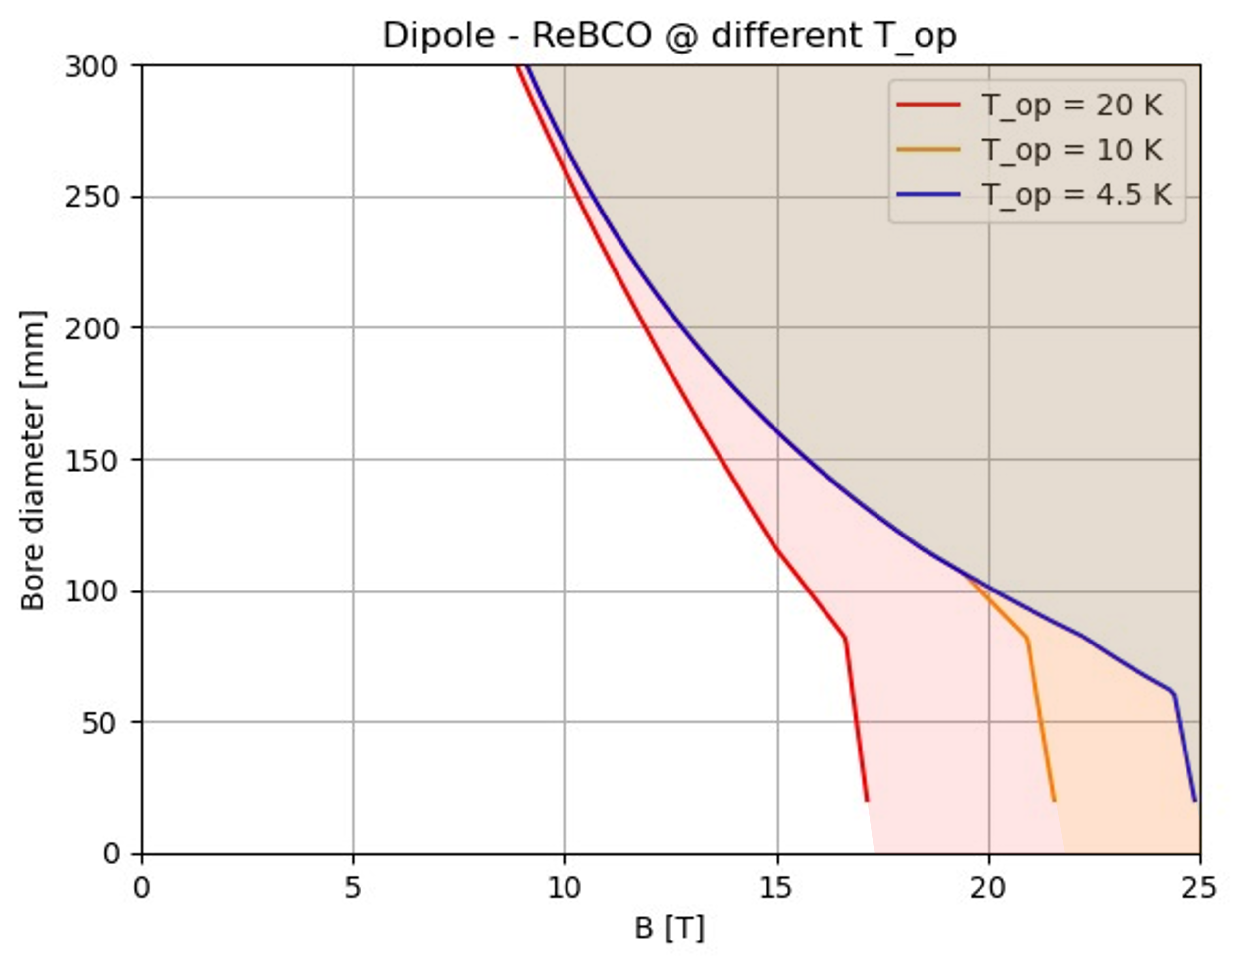
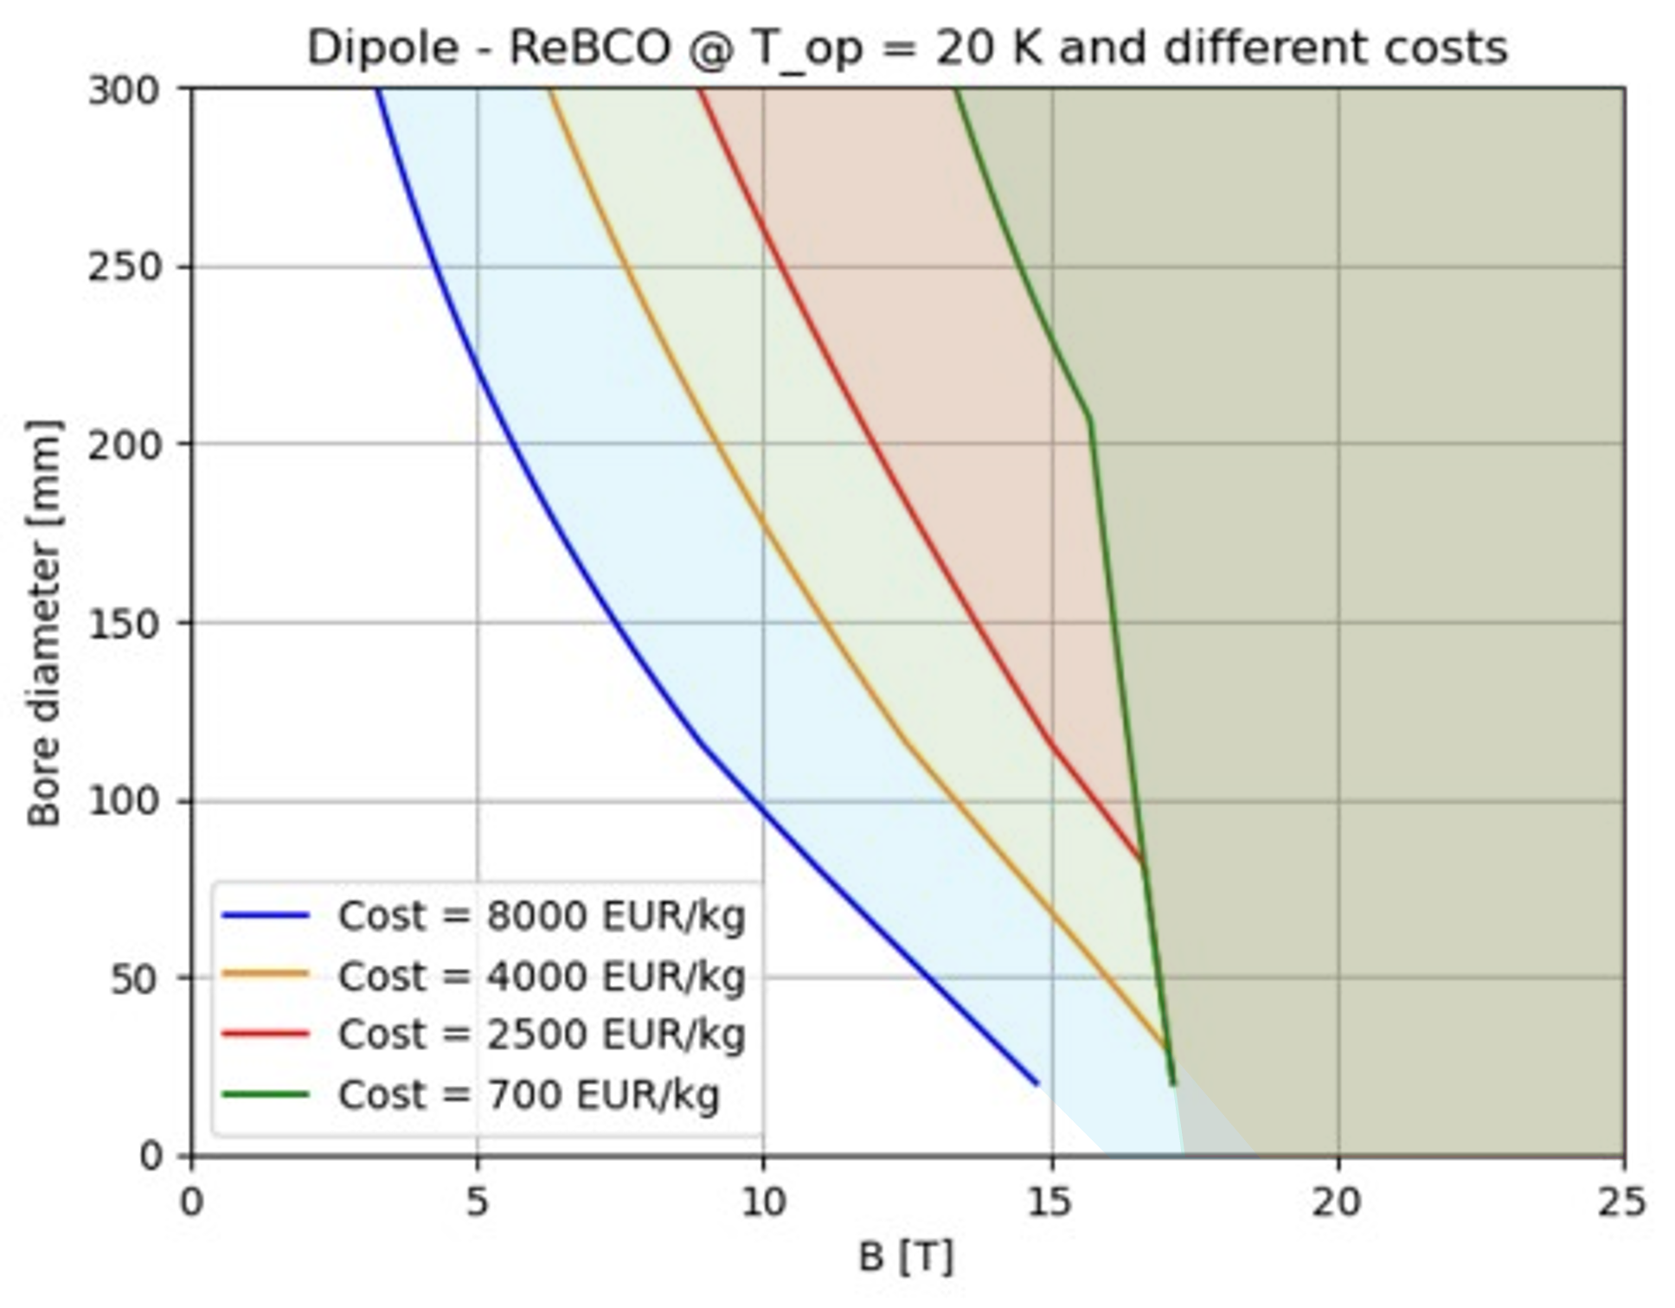

HTS dipole A-B Plots
Cost
reduction
Design
target
Design
target
$T_{op}$reduction
A reduction of operating temperature will result in wider design A-B range
The curves shown in the plots are the limit curves,
i.e., for each aperture value the strictest limit is taken, excluding the limit for insulated magnets.
A reduction of HTS cost will result in wider design A-B range

Slide 14
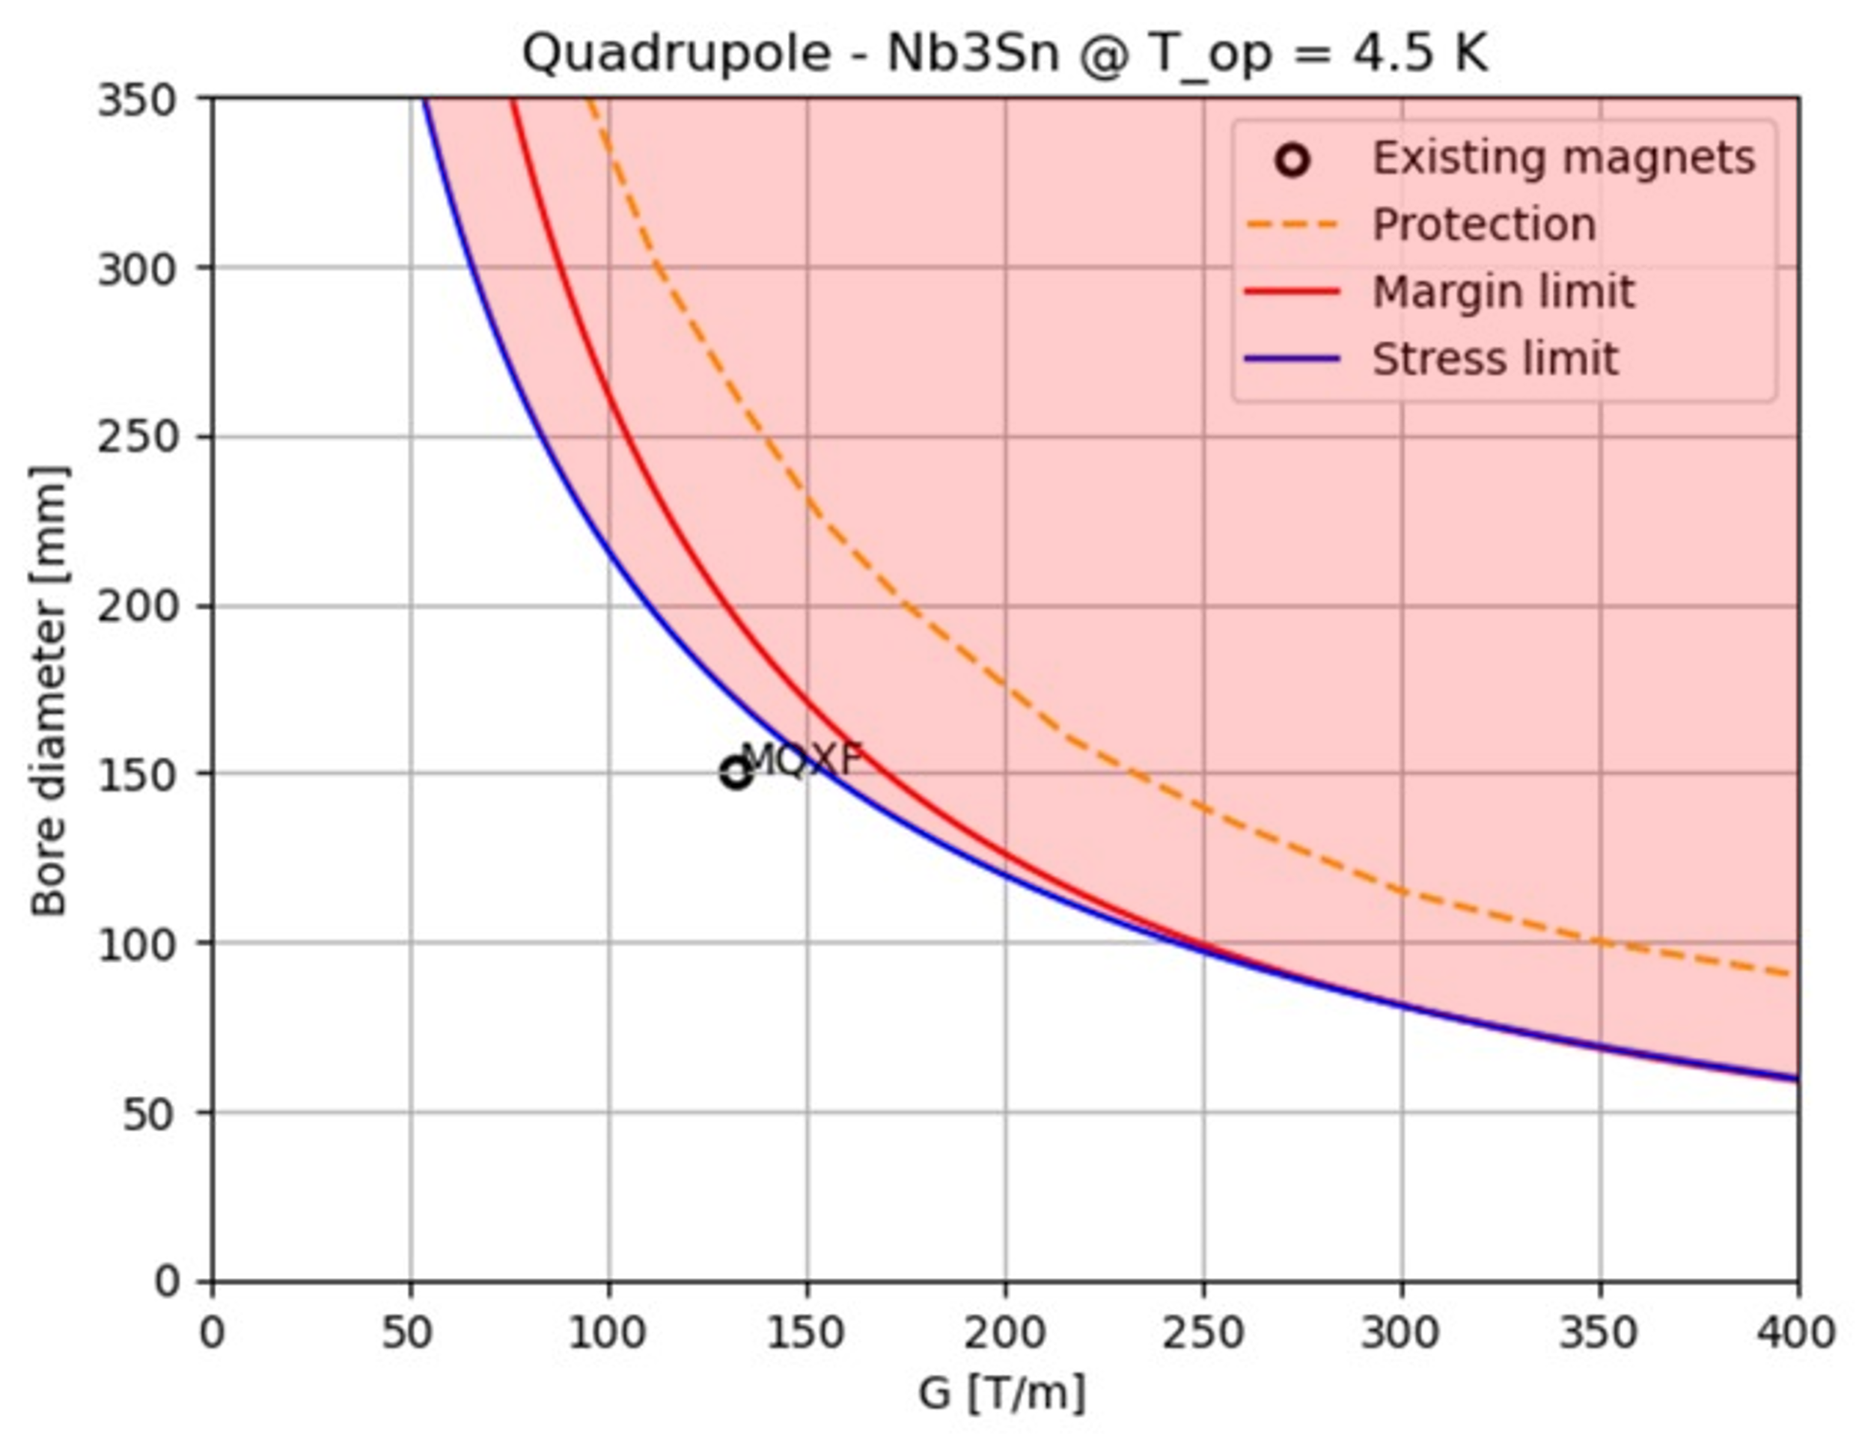
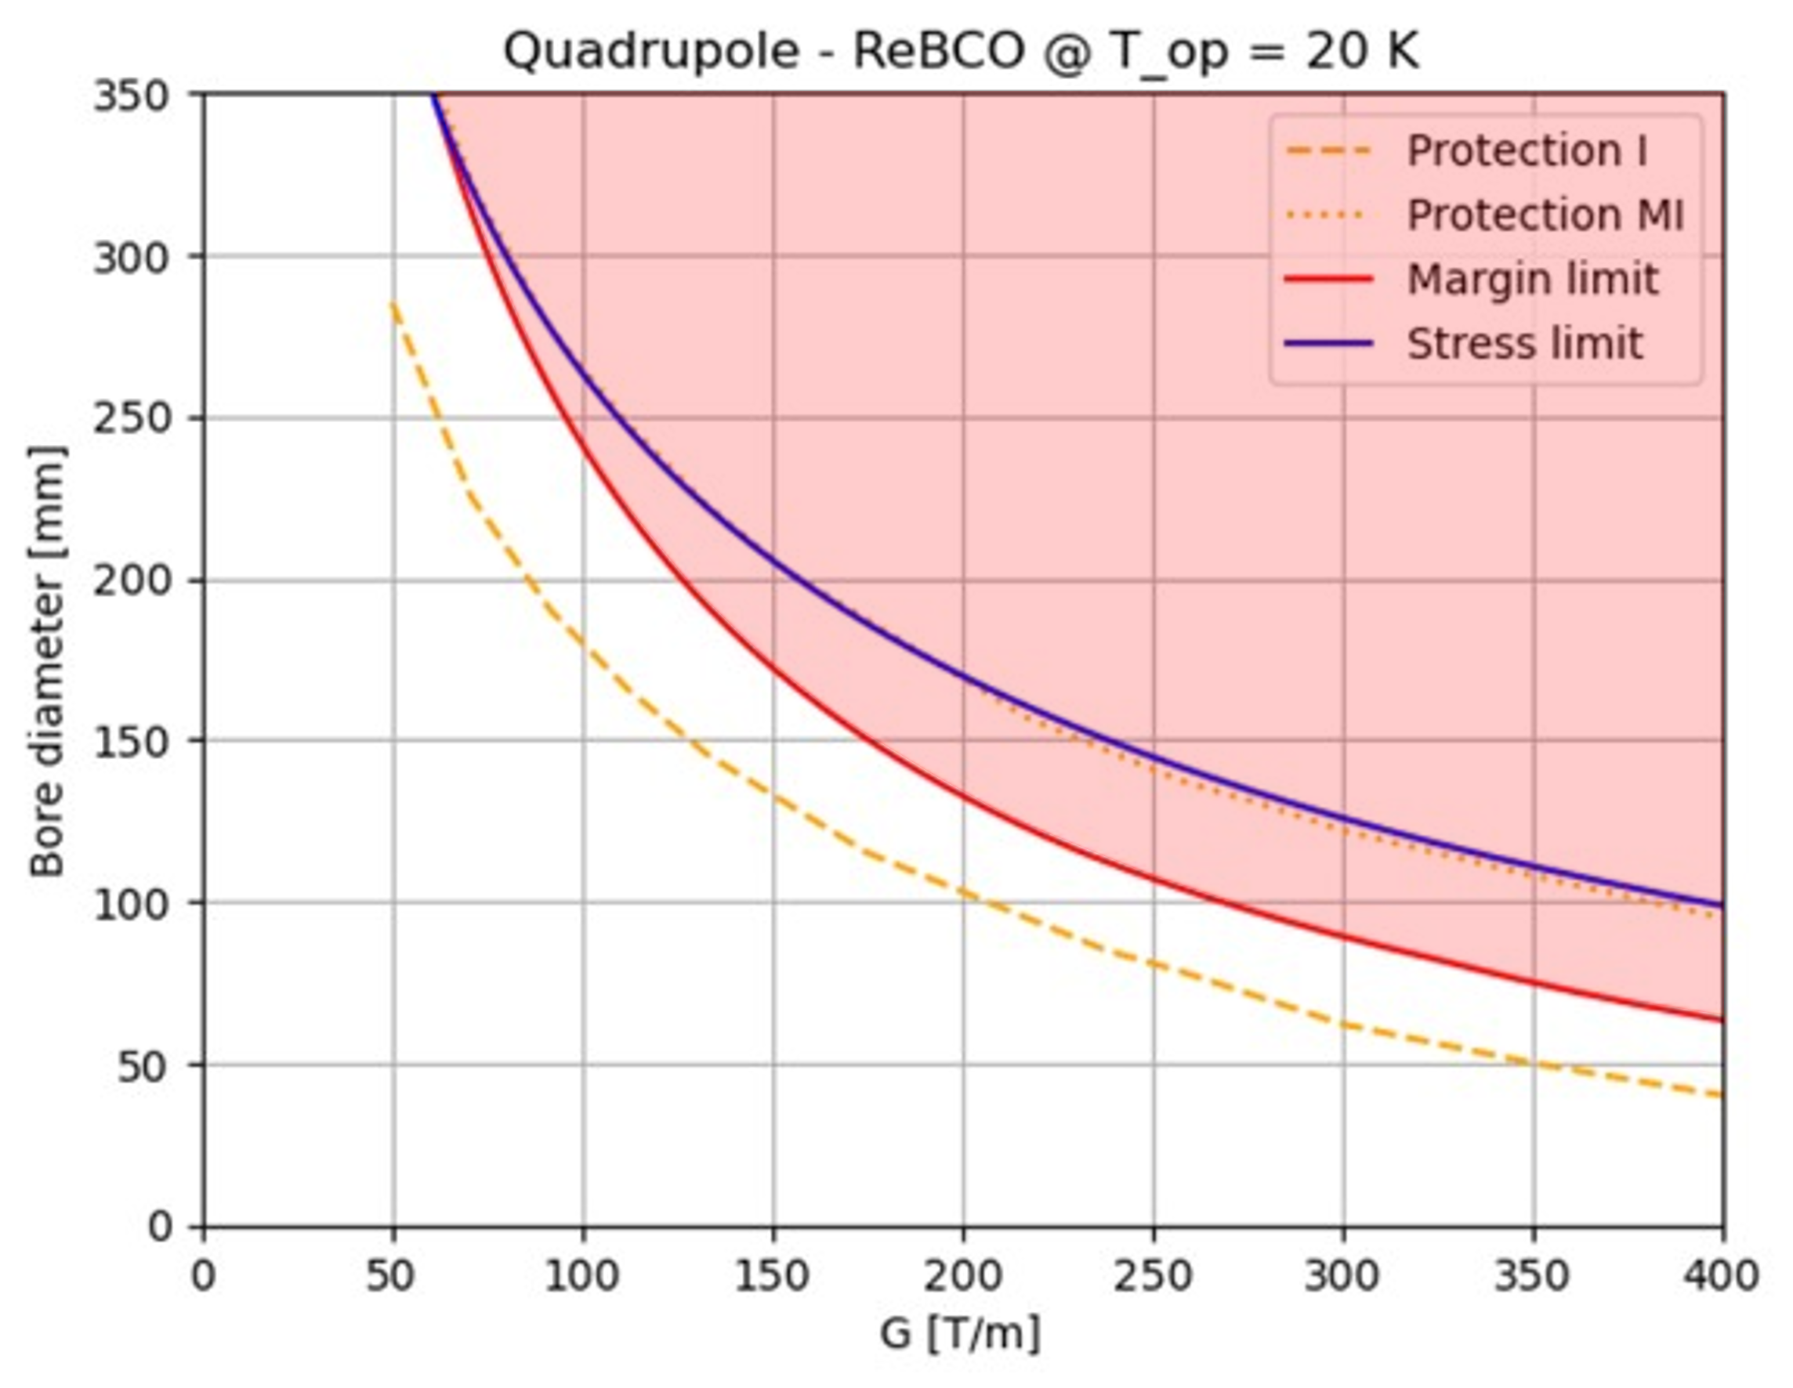
Quadrupole A-B Plots
Nb₃Sn is limited by peak stress and operating margin
HTS is mainly limited by cost production and protection. Working @20K the margin curve is also a limiting factor.

Slide 15
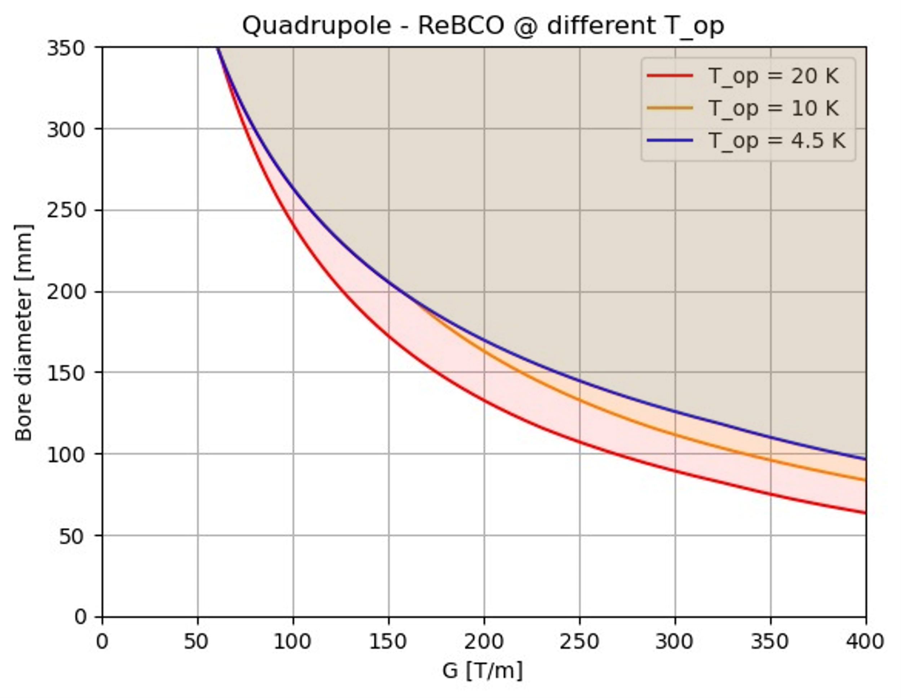
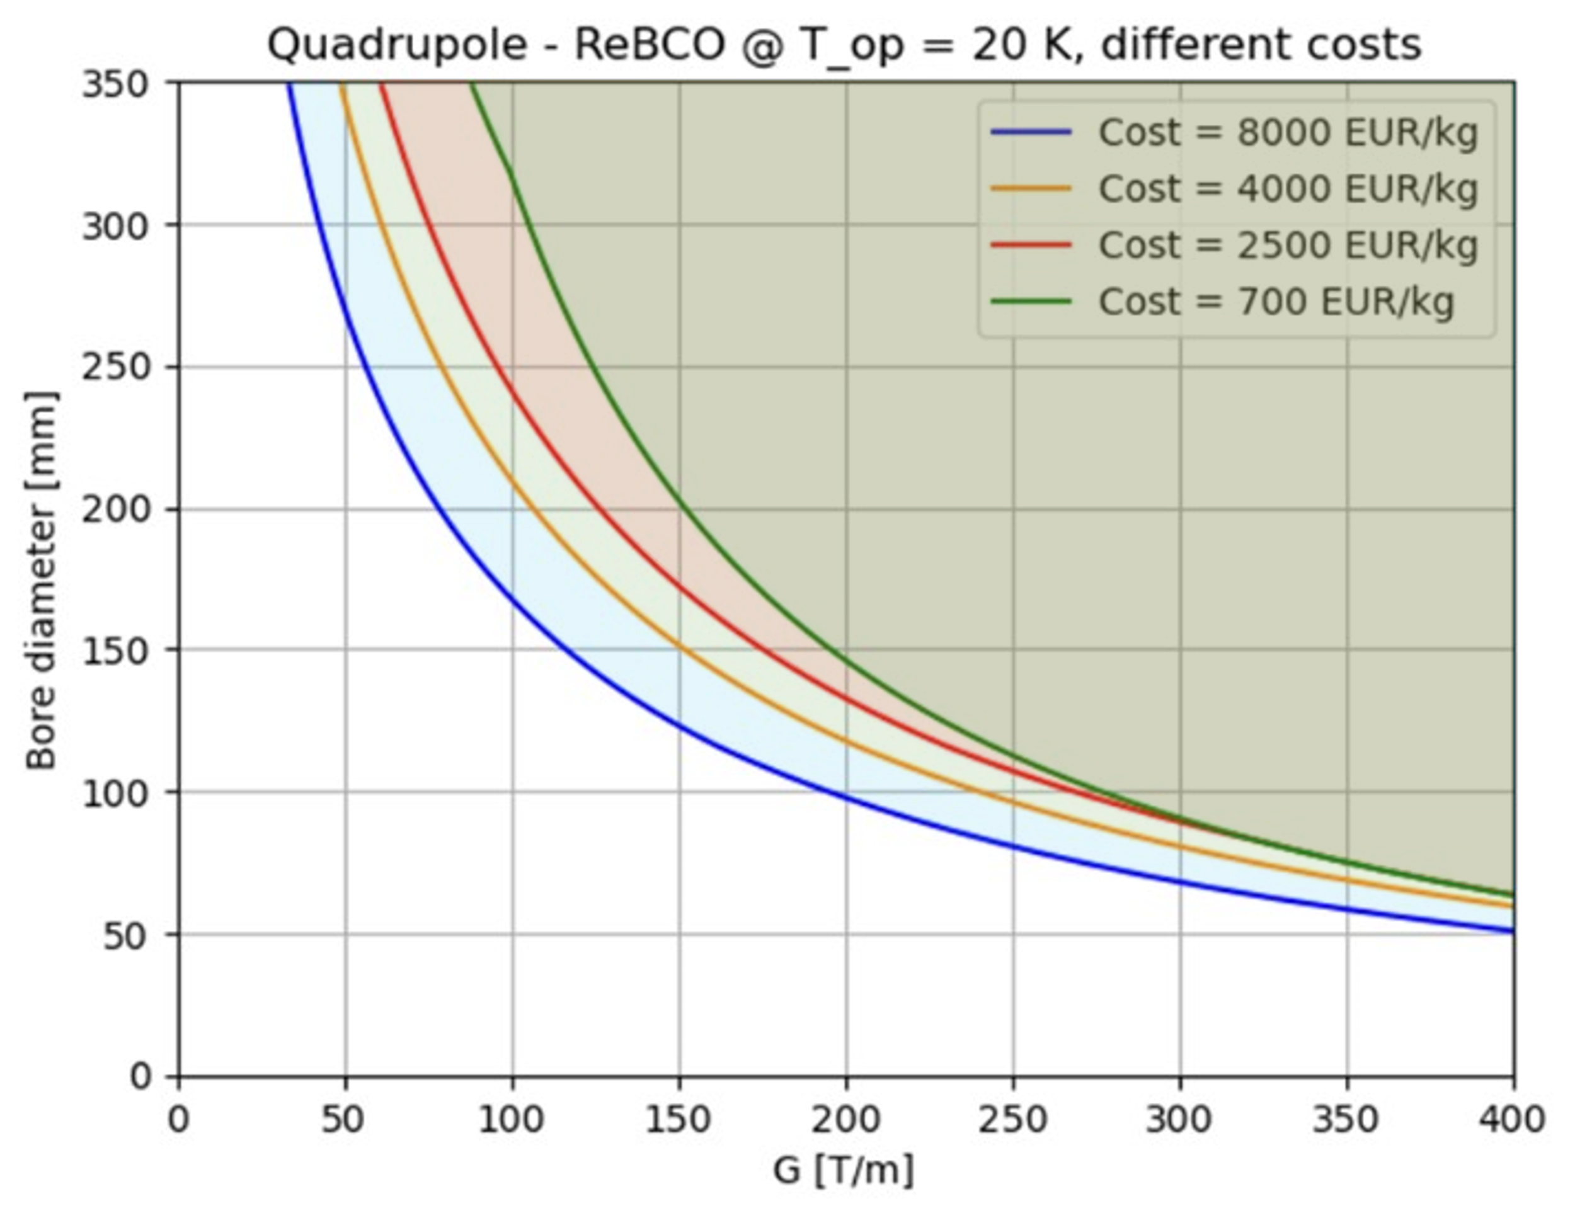

HTS quadrupole A-B Plots
Cost
reduction
$T_{op}$reduction
A reduction of operating temperature will result in wider design A-B range
A reduction of HTS cost will result in wider design A-B range
The curves shown in the plots are the limit curves,
i.e., for each aperture value the strictest limit is taken, excluding the limit for insulated magnets.

Slide 16
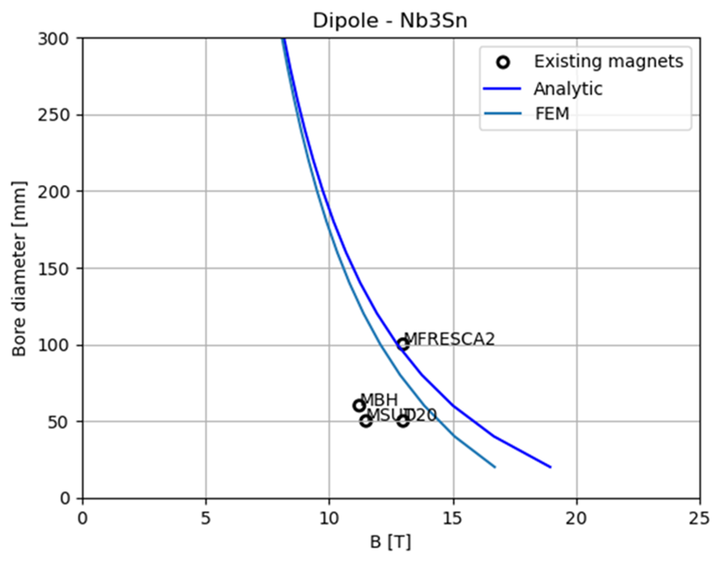
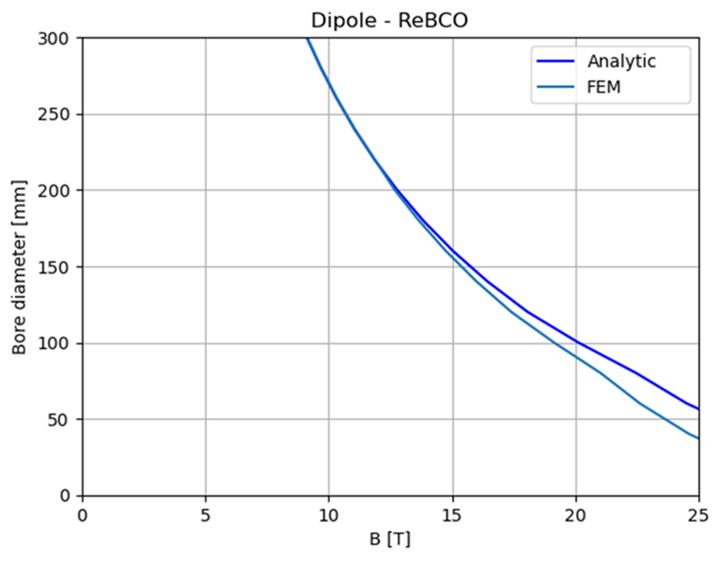
FEM Crosscheck for Stress Curves
We implemented a FEM model for a sector dipole in ANSYS.
We implemented a Python code able to work with Ansys software
to run FEM simulations with the same inputs as the analytical study.
In the comparison, the FEM curves are always more restricting than the analytical ones
since they take the maximum pressure on the midplane instead of an average over the coil width.

Slide 17
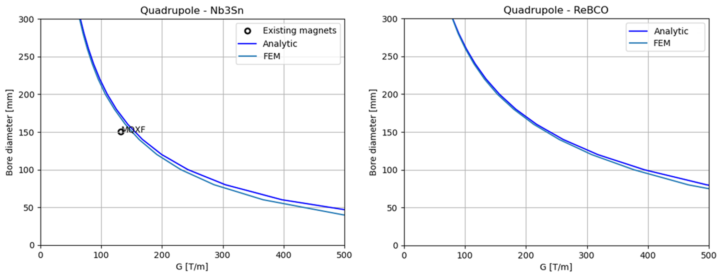
FEM Crosscheck for Stress Curves
We implemented a FEM model for a sector quadrupole in ANSYS.
We implemented a Python code able to work with Ansys software
to run FEM simulations with the same inputs as the analytical study.
In the comparison, the FEM curves are always more restricting than the analytical ones
since they take the maximum pressure on the midplane instead of an average over the coil width.

Slide 18
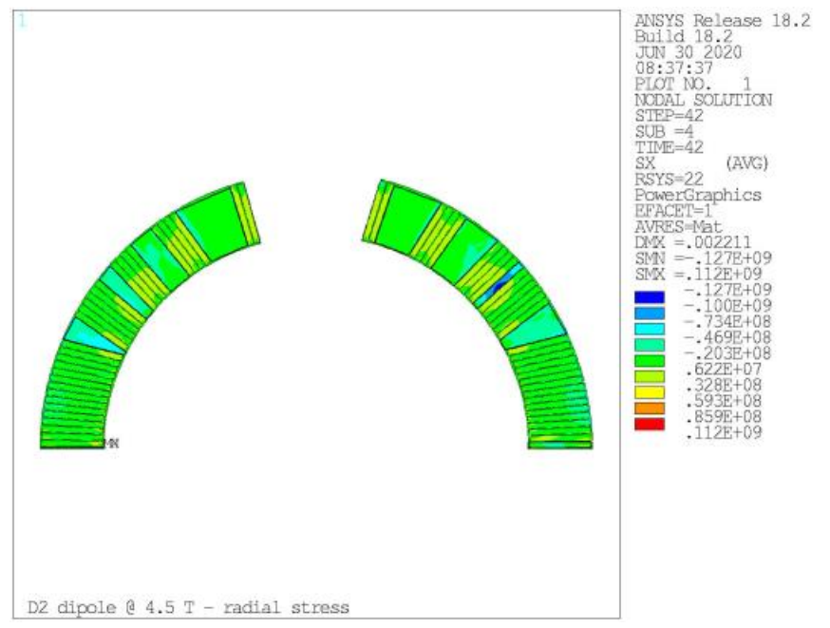
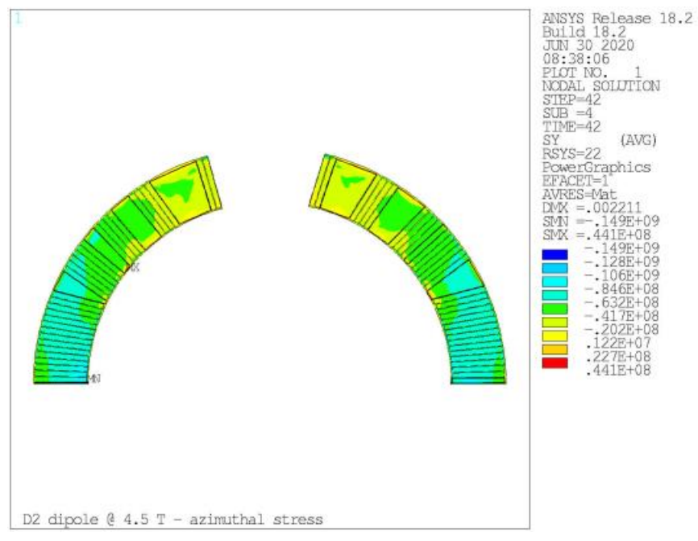
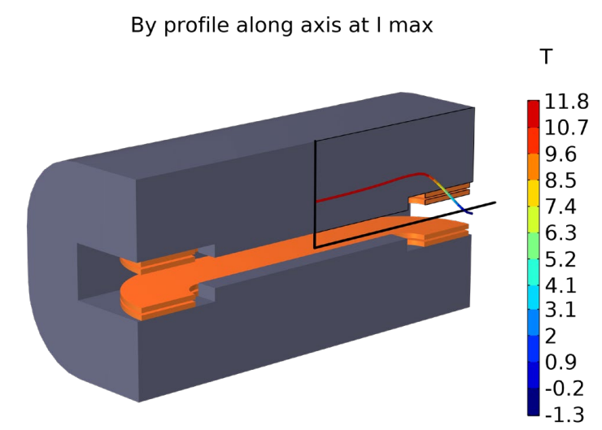
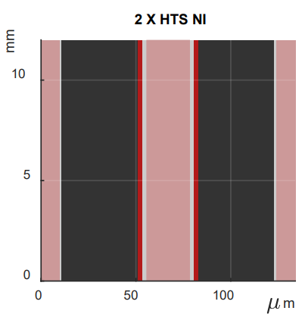

A-B Plots Outline
We have defined the maximum working space designing for material at transport, mechanical and quench protection limits:
minimum operating margin (likely OK)
maximum allowable stress
(in one direction, likely to get worse
when considering the 3D coil winding)
best protection scenario
(based on promising NI technology,
but still to be validated)
A design point in the allowed space is likely possible,
but we will need to take engineering margins for a credible operating machine.
D2 dipole
(S. Farinon et. al.)
Radial stress
Azimuthal stress
PNRR-IRIS dipole
(L. Balconi, L. Rossi, S. Sorti, M. Statera)

Slide 19
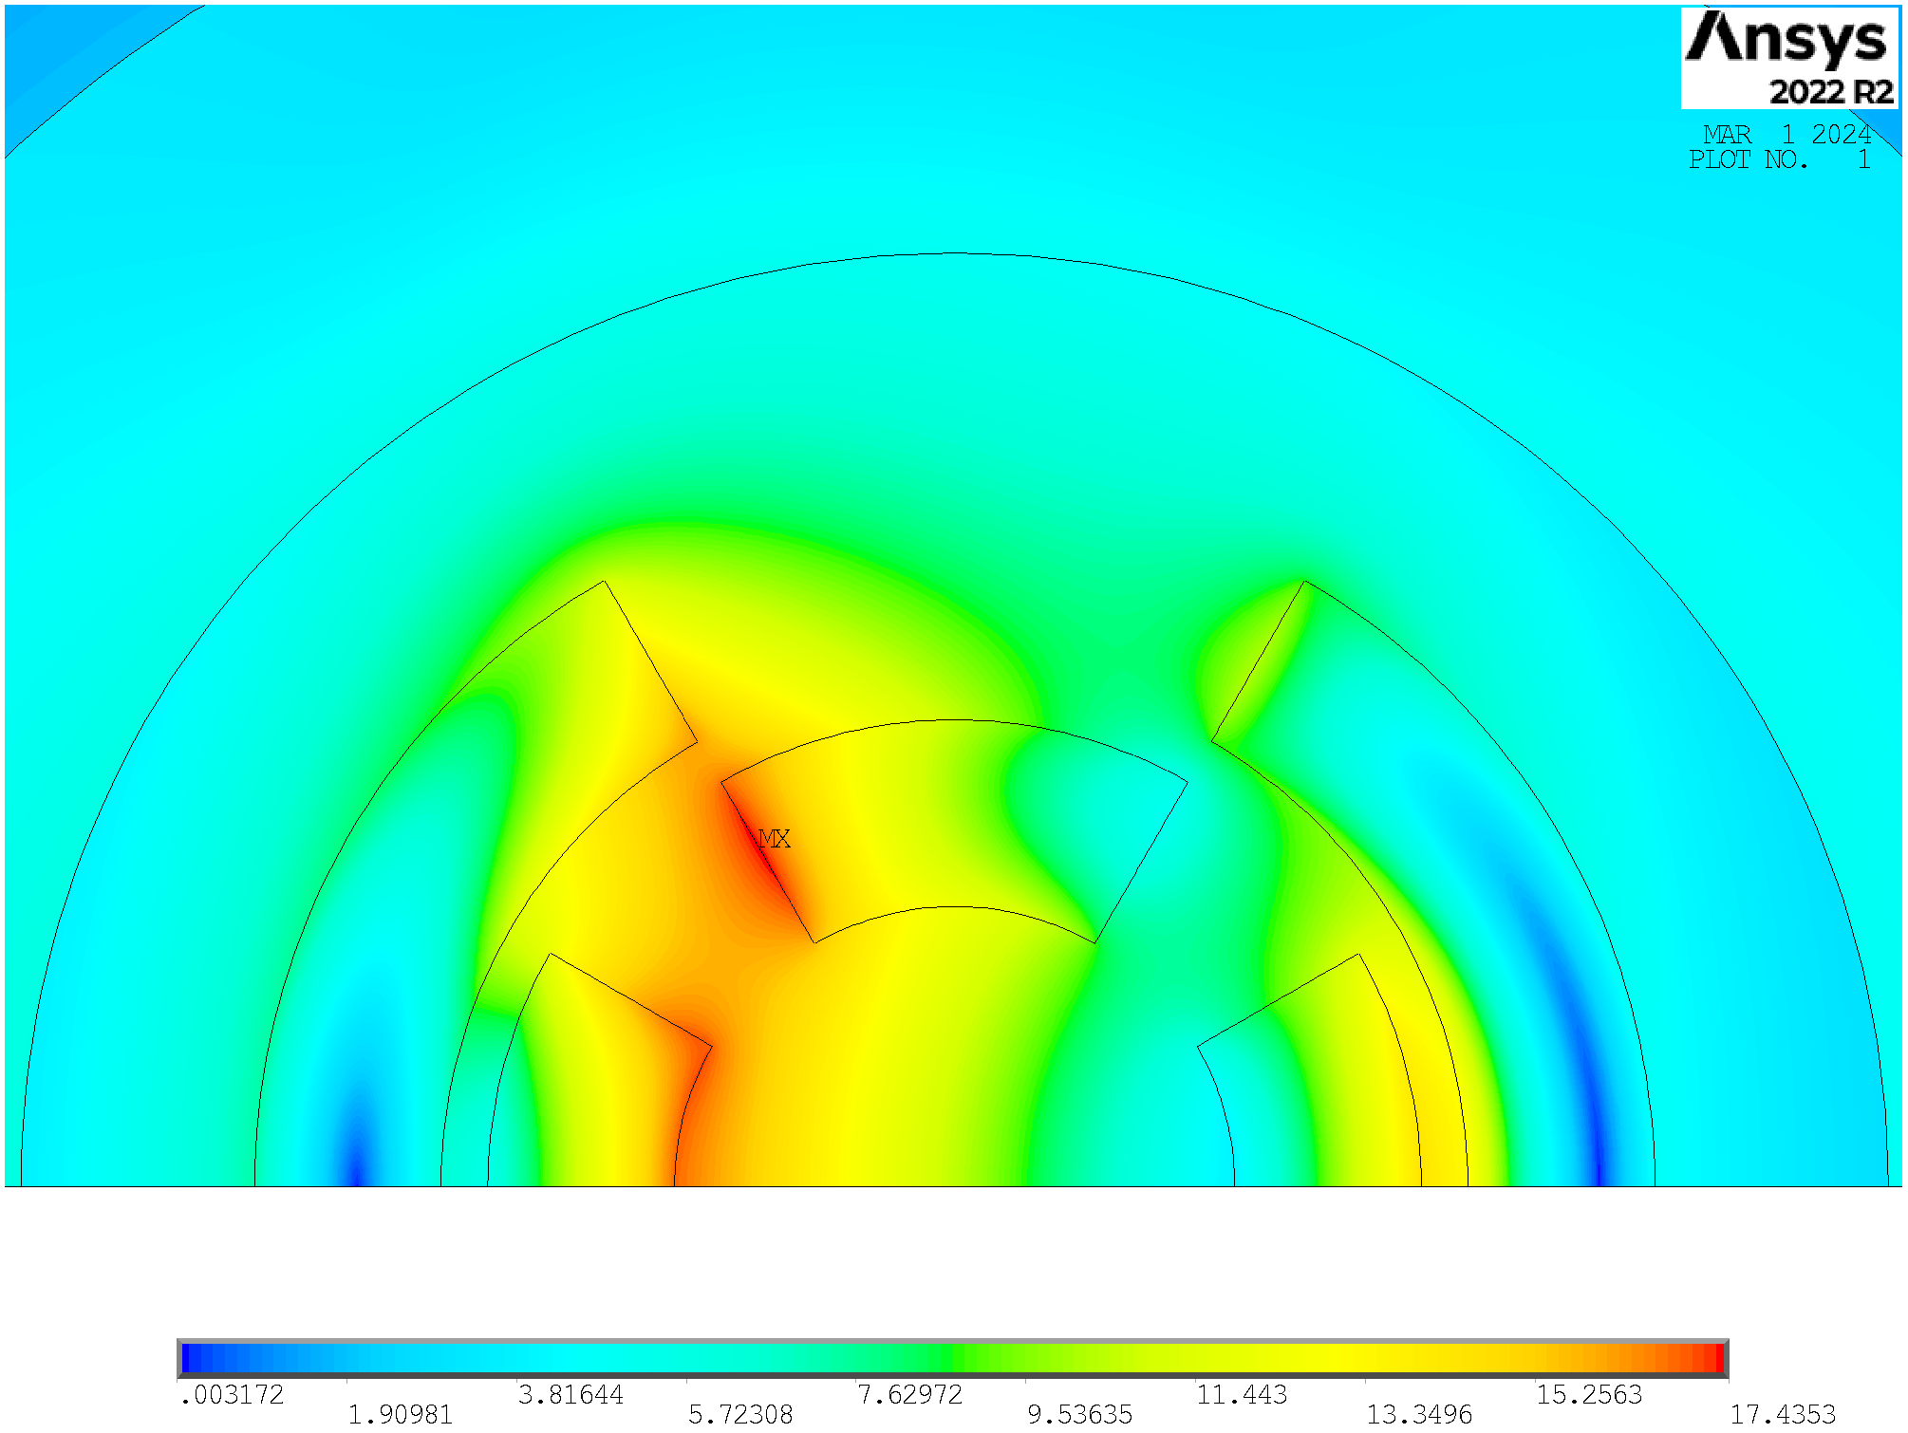
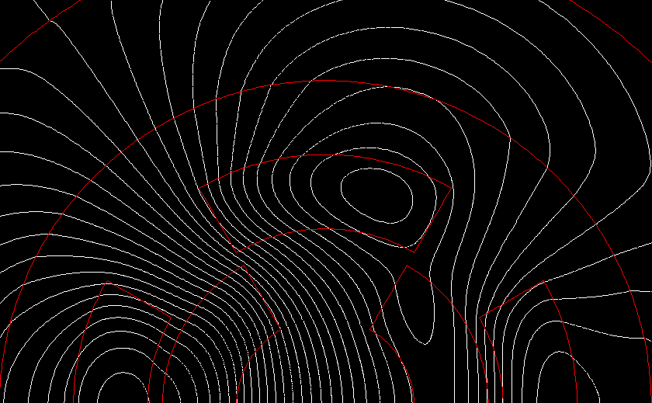
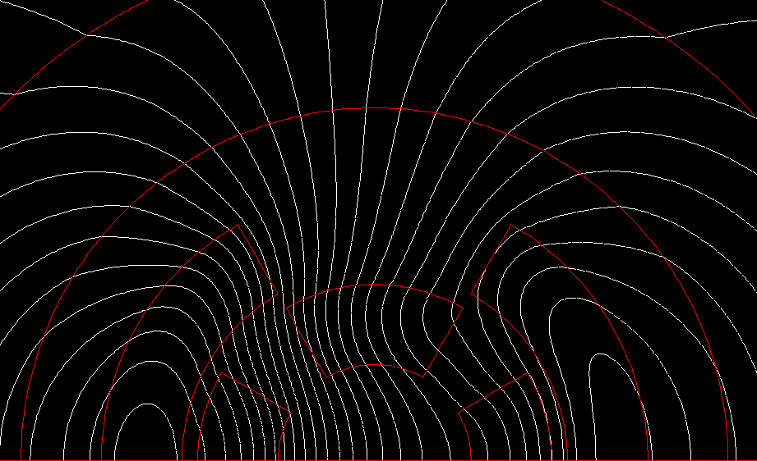
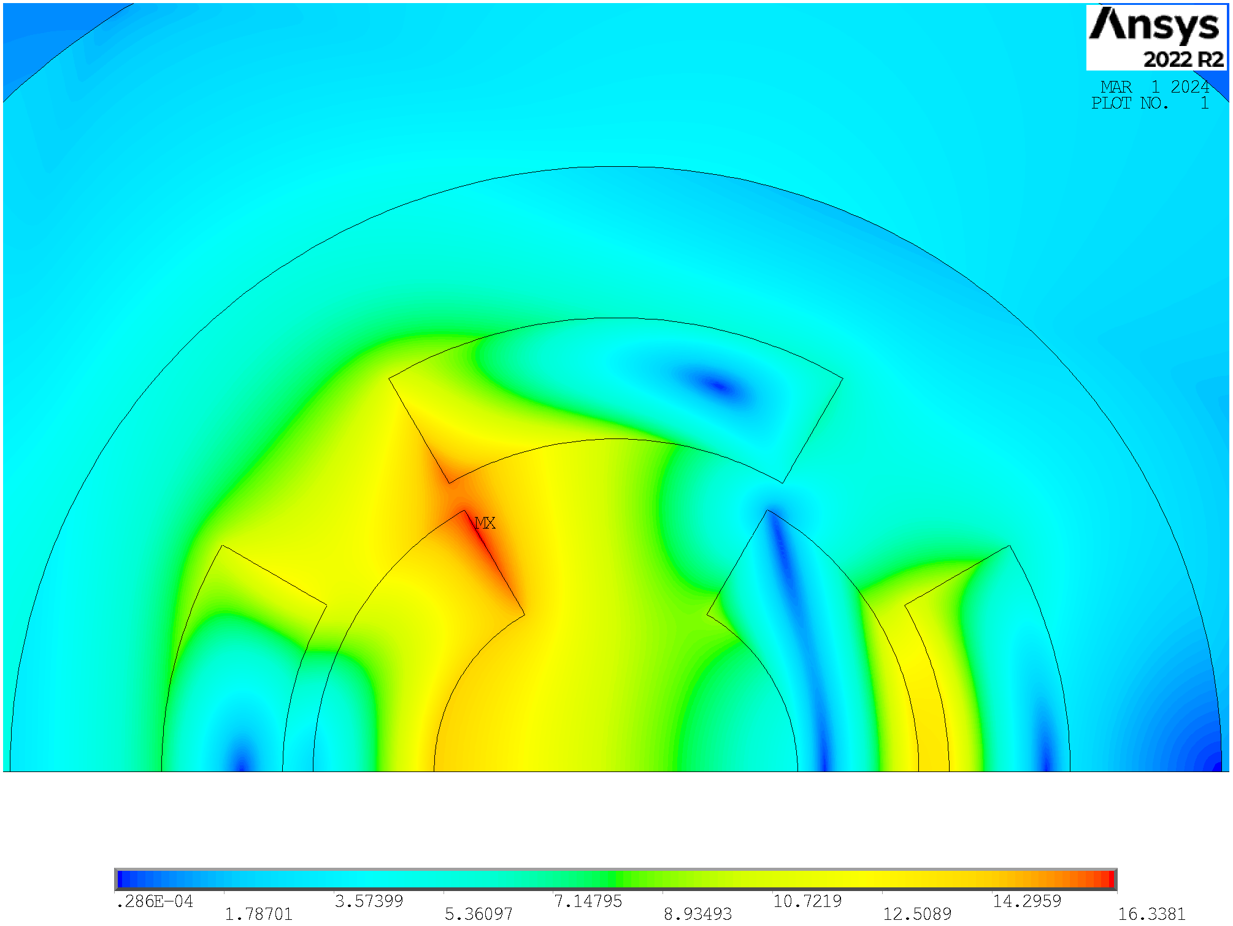
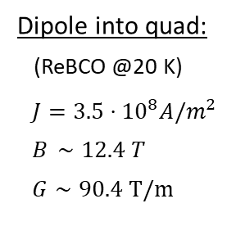
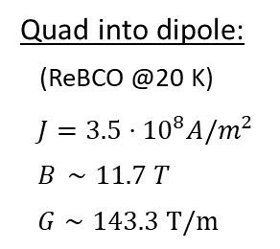
Combined Function Magnet
Final focus:
Combined function magnets: B1, B2, B1+B2 , B1+B3
B ≈ 4…16 T; G ≈ 100…300 T/m; G’ ≈ 12000 T/m²
Aperture ≈ 120…300 mm
Arc:
Combined function magnets: B1, B1+B2 and B1+B3
B ≈ 8…16 T; G ≈ 320 T/m; G’ ≈ 7100 T/m²
Aperture ≈ 160 mm
Quad into dipole:
(ReBCO @20 K)
$J=3.5⋅{10}^{8}A/m^{2}$
$B_{ }∼11.7 T$
$G∼143.3 T/m$
Dipole into quad:
(ReBCO @20 K)
$J=3.5⋅{10}^{8}A/m^{2}$
$B_{ }∼12.4 T$
$G∼90.4 T/m$
Most efficient
configuration
This work has just started and is still in progress. The configurations are not optimized.

Slide 20
Conclusions
The allowed magnet aperture (A) - magnetic field (B) phase spaces are provided and discussed, representing the starting point to define possible beam optics which are also acceptable from a technological point of view.
Our goal: make magnets! Our R&D must be magnet-oriented!
We want to achieve the desired magnetic field and gradient but keeping the stress acceptable and the protection feasible!
How we deal with stress?
  Which concept (block, cos-theta)?
  Which mechanical structure (bladder & key,
  collaring, stress management)?
  Which cable (Roebel, CORC, tape)?
How we protect the magnet?
  Insulated, not insulated, metal insulated?
  At which T_{op}?
DEMOSTRATORS CONSTRUCTION AND TEST of paramount importance to validate design choices!
R&D on the cable
  Improve reproducibility and uniformity in batch length beyond 1 km
  Optimization of industrial HTS tape mechanical and thermal properties
  Improvement of robustness and reproducibility of cable concept (CORC, ROEBEL)
  Development of novel technique of control of the inter-turn resistance
If we work at 20/30K, can we use indirect cooling or forced gas cooling solutions?

Slide 21
Thank you for your attention

