Slide 1

Report from MuCol Governing Board
Gianluigi Arduini, Mike Lamont
Acknowledgements Roberto Losito, Kristiane Bernhard-Novotny, EJ Bahng

Slide 2


Slide 3
News
Consortium:
    29 out of 32 Institutes signed
    2 informed us they cannot sign (BNL and UNIBO)
    1 still pending (RHUL)
Table of hirings kept up to date by Muon Collider Secretariat – presented
EU project Officer changed: it is now Sotirios KAKARANTZAS

Slide 4
Deliverables recalled
New deliverable enforced by EU:
Communication and Dissemination plan, due by 31 March 2024

Slide 5
Milestones recalled

Slide 6
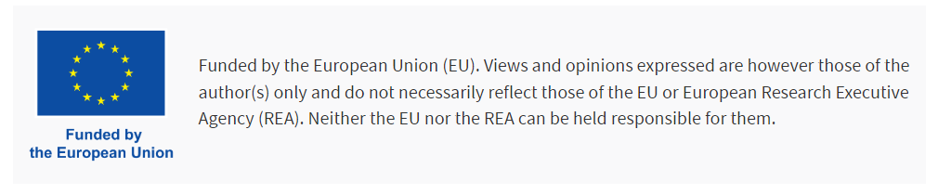
Publications
The guidelines for acknowledgement of the EU funding are available on the MuCol website:
  https://mucol.web.cern.ch/guidelines
Please note the Grant Agreement Number is not necessary, while the sentence below is mandatory:
Elias Metral is keeping a list of all papers and presentations that have an explicit acknowledgement (even if not perfect…).
Any paper signed by those hired with MuCol funds has to show the acknowledgment (funded can be replaced by “co-funded” if the funding is only partial…

Slide 7
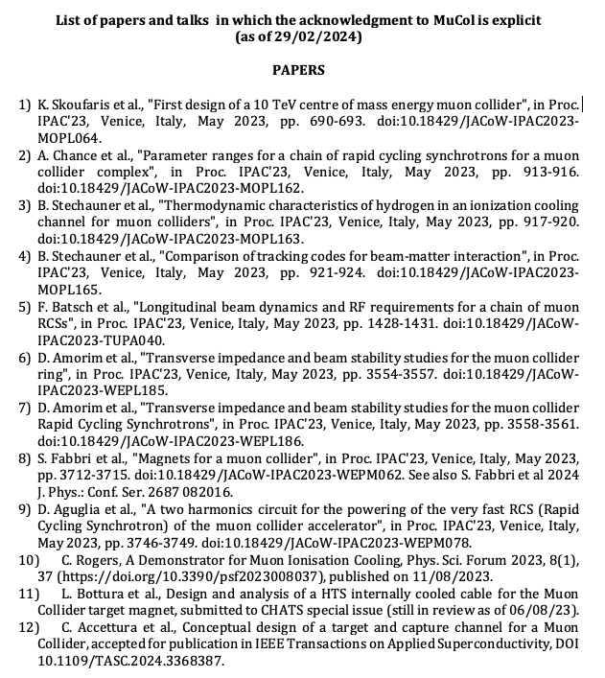

Slide 8
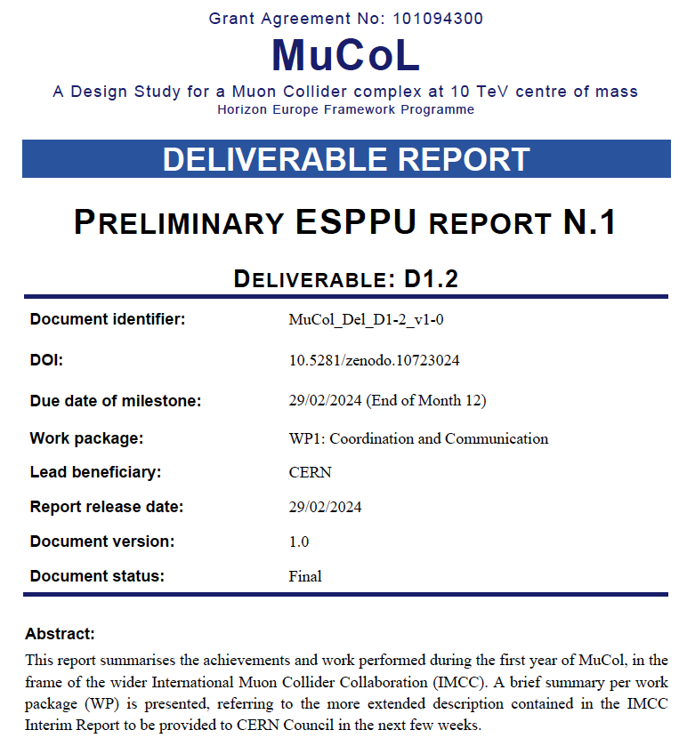
Technical achievements
120 pages
Described in the “ESPPU Preliminary Report no 1 (D1.2)
Many of the results presented this week have been produced with the participation of MuCol resources (either from EU or matching…)
This report summarises the achievements and work performed during the first year of MuCol, in the frame of the wider International Muon Collider Collaboration (IMCC). A brief summary per work package (WP) is presented, referring to the more extended description contained in the IMCC Interim Report to be provided to CERN Council in the next few weeks.
WP highlights presented to GB

Slide 9
Dissemination and Exploitation plan
Requests by EU officer
Planned measures to maximise the impact of project results
Target groups (e.g. scientific community, end users, financial actors, general public) and proposed channels
Communication measures for promoting the project and its findings throughout the full lifespan of the project
A comprehensive and feasible strategy for the management of intellectual property and convincing justification that exploitation is still in the Union’s interest, if it is expected primarily on non-associated third countries
Kristiane Bernhard-Novotny

Slide 10

Analysis
Target Groups
Assumed knowledge about MC initiative and physics
Values, Knowledge and Messages depending on target group
Content & goals
Available channels & measures
Particle physics community
Financial actors
General public
Decision-makers

Slide 11
Decision makers & financial actors
Values | Communication goal | Messages
- Influence on the global scientific agenda - Economic and social return on investment -Scientific excellence - Sustainability, energy efficiency, and other resource efficiency | - Investing in STEM skills, technological and industrial development for your region or country - Your region/country is part of world-class research, whose cutting-edge technologies have transformed society and hold potential to help address current global challenges | - Through funding, EU’s vision plays vital role in the global context - Supporting MuCol Design study creates new EU-driven projects - Funding this project might attract other large-scale research infrastructures
Decision-makers
Financial actors
Kristiane Bernhard-Novotny

Slide 12
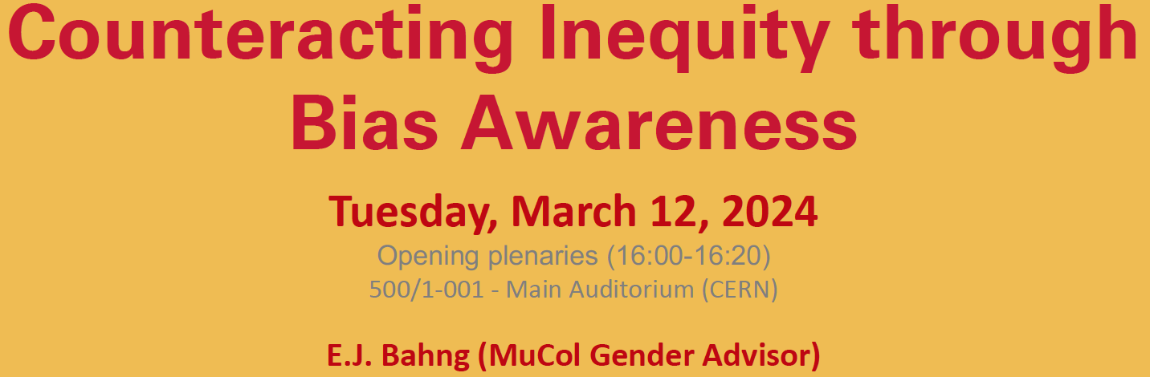
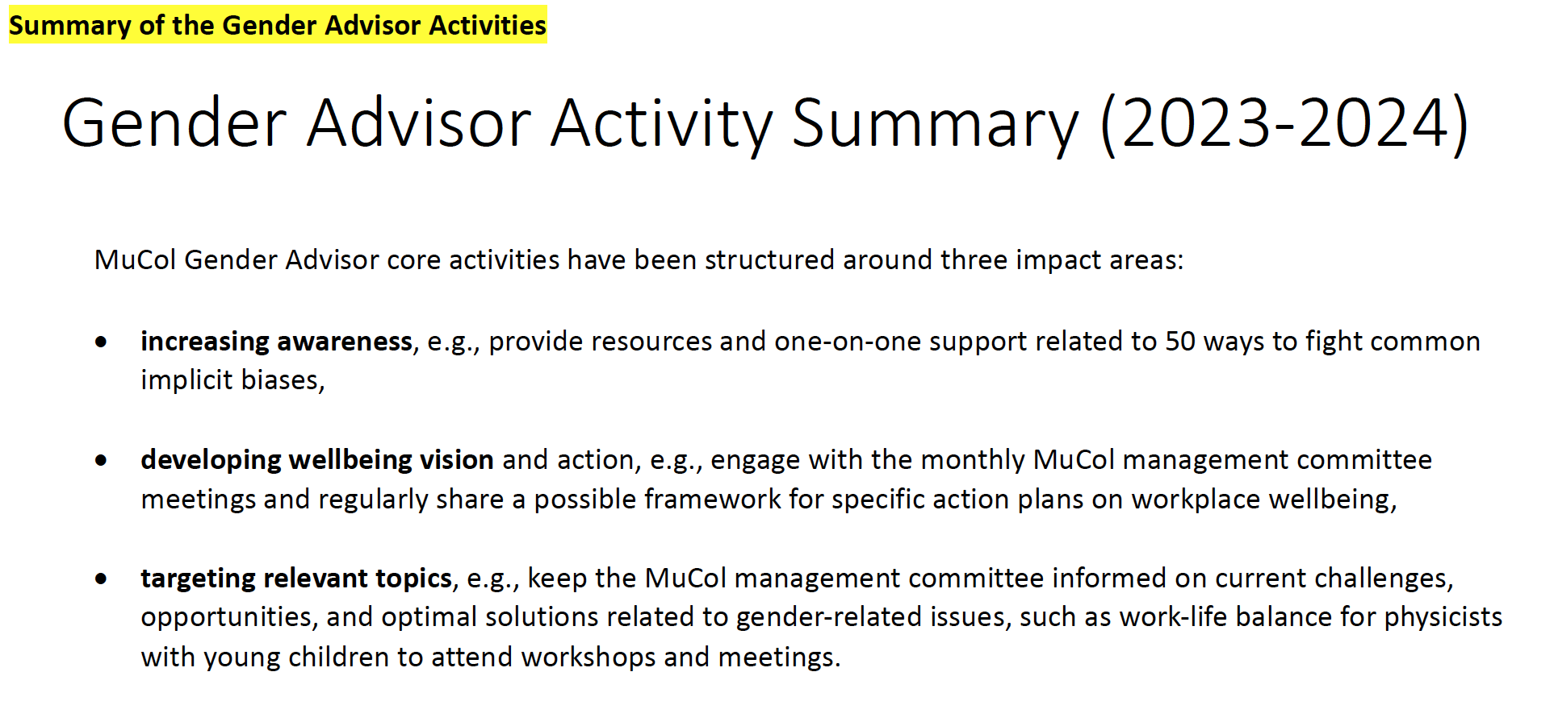
Report on Gender and Equality matters
E.J. Bahng

Slide 13


Slide 14
